Slide 1
Current status of data acquisition electronics at the FLNP, JINR, Dubna
Elena Litvinenko,
Feodosiy Levchanovsky, Valentin Prikhodko, Sergey Kulikov, Valeriy Zhuravlev
FLNP JINR Dubna
litvin@nf.jinr.ru

Slide 2
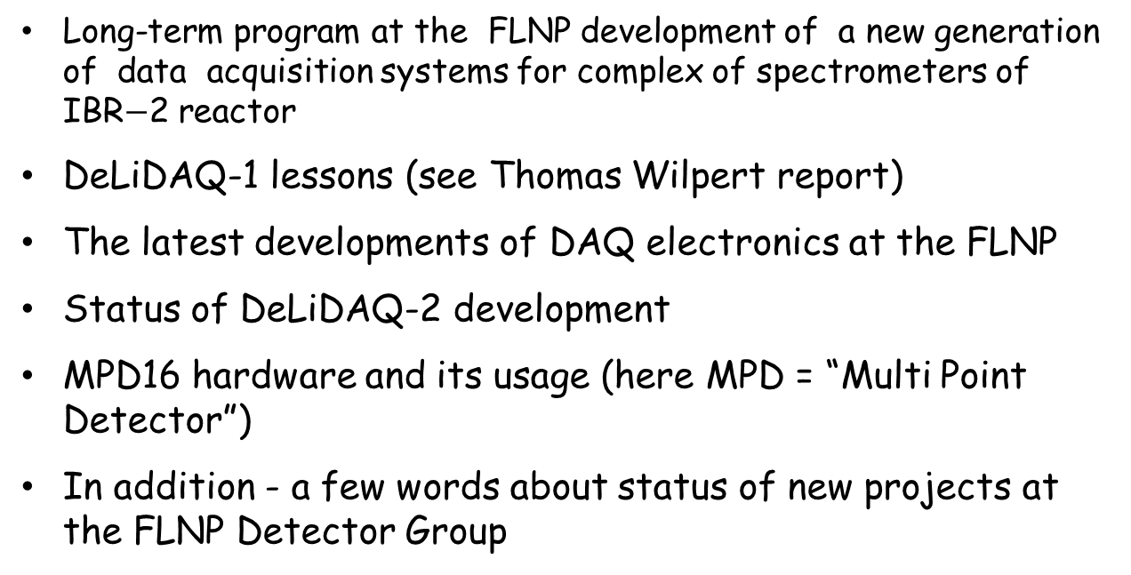
Outlook
Long-term program at the FLNP development of a new generation of data acquisition systems for complex of spectrometers of IBR$−$2 reactor
DeLiDAQ-1 lessons (see Thomas Wilpert report)
The latest developments of DAQ electronics at the FLNP
Status of DeLiDAQ-2 development
MPD16 hardware and its usage (here MPD = “Multi Point Detector”)
In addition - a few words about status of new projects at the FLNP Detector Group

Slide 3
Long-term program at the FLNP
JINR Topical Plan. Theme 04-4-1075-2009/2011->2014
Novel Development and Creation of Equipment for the IBR-2M Spectrometer Complex
S.A. Kulikov, V.I. Prikhodko
Research, development, manufacturing of prototypes and working models of perspective neutron detectors.
Development and creation of new generation of data acquisition and experiment control systems for the IBR-2 spectrometer complex.
Development of new sample environment systems including cryostats and cryomagnetic systems and beam forming systems for the IBR-2 spectrometer complex.

Slide 4
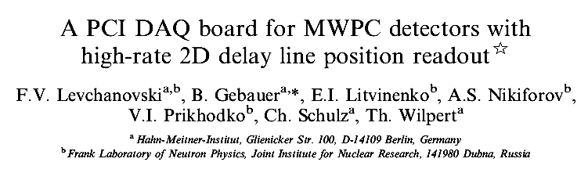

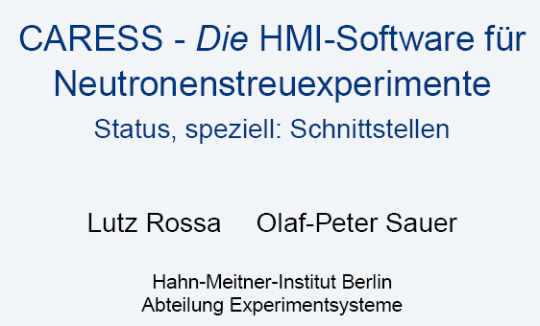

DeLiDAQ-1 (since 2001)
http://wwwinfo.jinr.ru/~elitvin/DeLiDAQ/
Project, design and implementation:
  B.Gebauer, K.Shultz, Т.Wilpert,
  V.I.Prikhodko, F.V.Levchanovsky, A.S.Nikiforov, E.I.Litvinenko
The first users at the FLNP:
  A.A.Bogdzel, A.M.Balagurov, T.L.Enik, V.Proglyado, V.G.Simkin, V.N.Shvetzov, A.Churakov
Interface with CARESS (HZB, Berlin):
  L.Rossa, O.-P.Sauer, T.Wilpert,
  E.I.Litvinenko
Interface with SONIX+ (FLNP JINR):
  A.S.Kirilov, S.M.Murashkevich,
  E.I.Litvinenko,V.I.Prikhodko

Slide 5
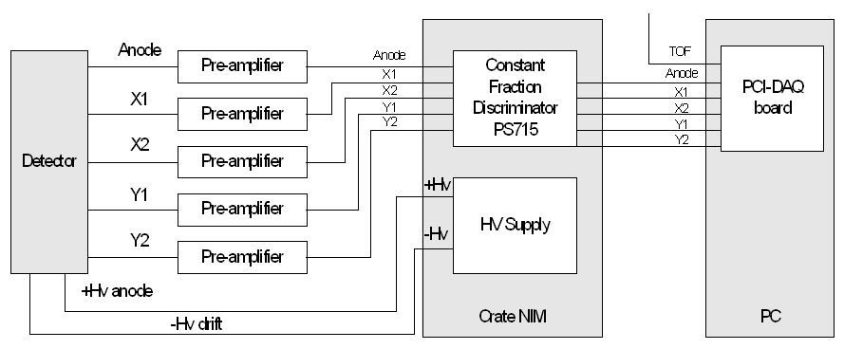
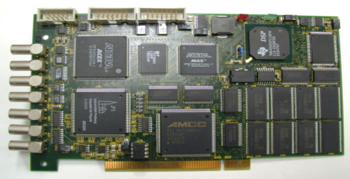

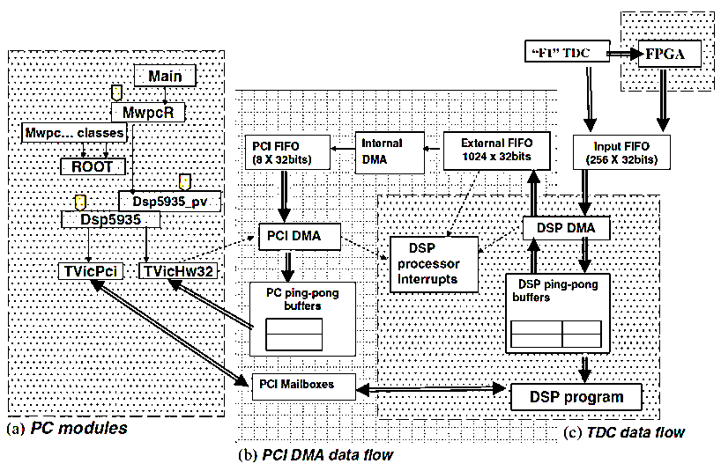
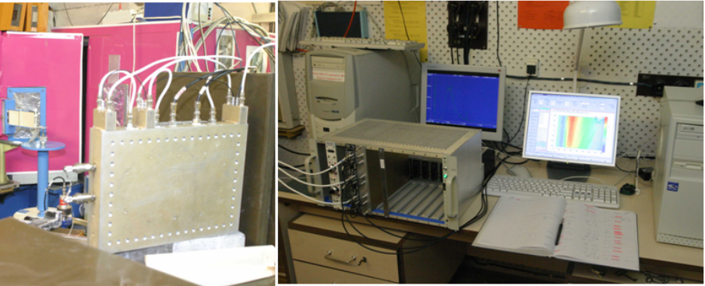
DeLiDAQ-1 systems at the FLNP
Detector => Preamplifiers => Discriminator => DeLiDAQ-1 <=> PCI <=> PC software
PC

Slide 6
Prerequisites for transfer from DeLiDAQ-1 to DeLiDAQ-2
What is bad?
1. The PCI interface of the board is out of date for a new PC generation;
2. DSP has only one external data bus to process and transfer detector data:
TDC to DSP, DSP to memory and memory to DSP, DSP to PCI bus;
3. Low speed data transfer ability of TDC F1;
4. In spite of FPGA event filtering procedure, the DSP data processing rate is too small.
What tasks have been decided during design of a new DAQ-board?
• two parts – one base board (NIM) and two data communication boards (PC interface), realized as daughter boards;
• USB2.0 - a possibility to connect DAQ-system to any PC’s, including Note-Books (important);
• No DSP, all data processing tasks are performing by FPGA;
• Fiber link connection between computer USB port and DAQ-board for increasing distance and abolishing EMI problem;
• A new simpler (no built-in seek event function) but an order faster TDC GPX (I-mode);
• Four times larger hist. memory – 1Gbyte (256MW x 32bits);
• Improved test generator can issue any pattern of simulating events including overlapped ones;
• Possibility to work in synchrotron radiation experiments (tested in FPGA 2Mevents/sec);
• Low jitter system clock on the base board - 40MHz, 5ppm;
• 2 inputs for monitor detectors, “GATE” and “KICK” pulse inputs.

Slide 7
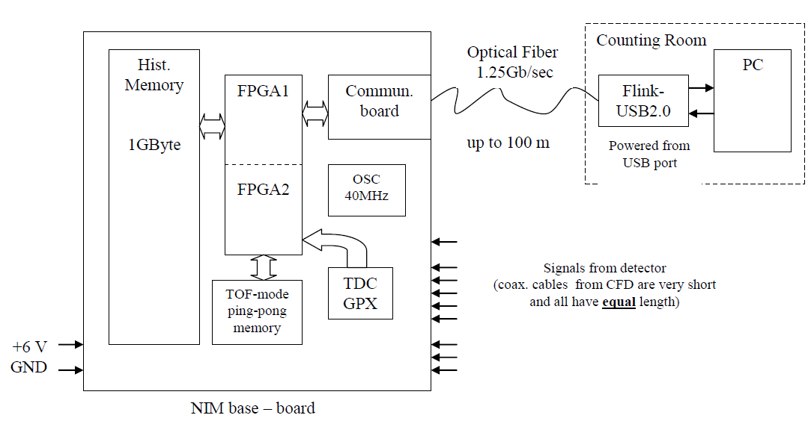
DeLiDAQ-2 architecture

Slide 8
Specially developed communication protocol
Serial Communication Protocol:
• Lighten like SFPDP VITA 17.1 protocol (used protocol approach only);
• Bi-directional links;
• Four types of frames supported (RD/WR/FILL memory, RD/WR registers, ACK/NACK/BUSY, idle);
• Dataflow control in both directions (receiving FIFO is full);
• Very low latency;
• Packet size – 512 bytes (natural USB2.0 packet size);
• Powerful 32-bit CRC code data protection (like Ethernet one);
• Repeat previous packet if transmit error (loop back NACK frame);
• Transparent or invisible to user, absent any software.
• Frame structure: packet type or Start_of_Frame, Data Packet, CRC code (SoF = 16 bit, CRC = 32 bit);

Slide 9
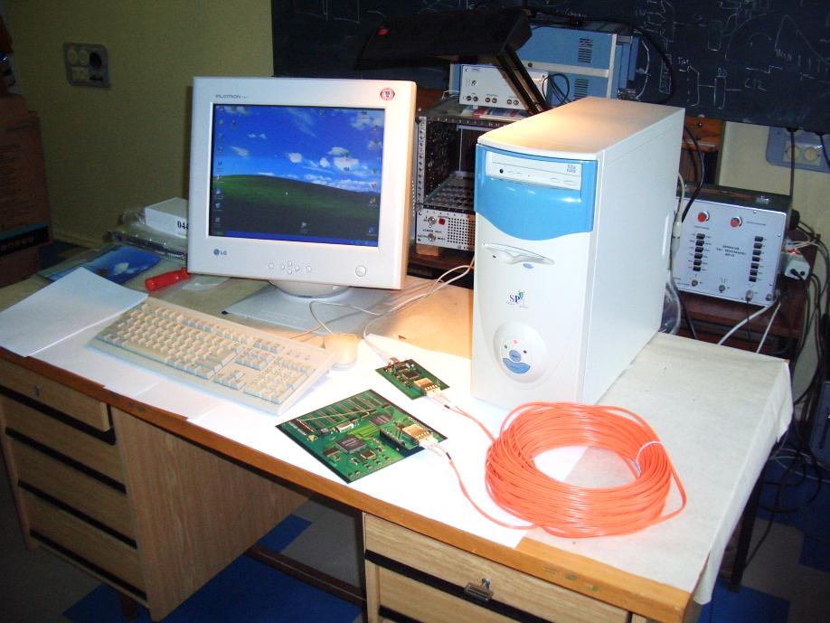
DeLiDAQ-2: recent design and look
FPGA
EP1C6Q240C6
Hist.
Memory
1GByte
From MWPC
Anode
NIM-TTL
TDC-GPX
Data
X1
X2
WR
Y1
RD
WE
RAS
CAS
Y2
TOF
Gate
Parallel2Serial
Serial2Parallel
Fiber Link
1.25Gb/s
Optical
Converter
Daughter Board

Slide 10
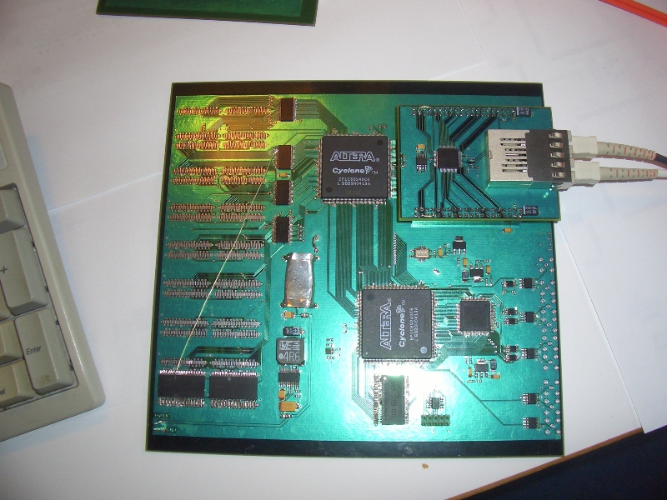
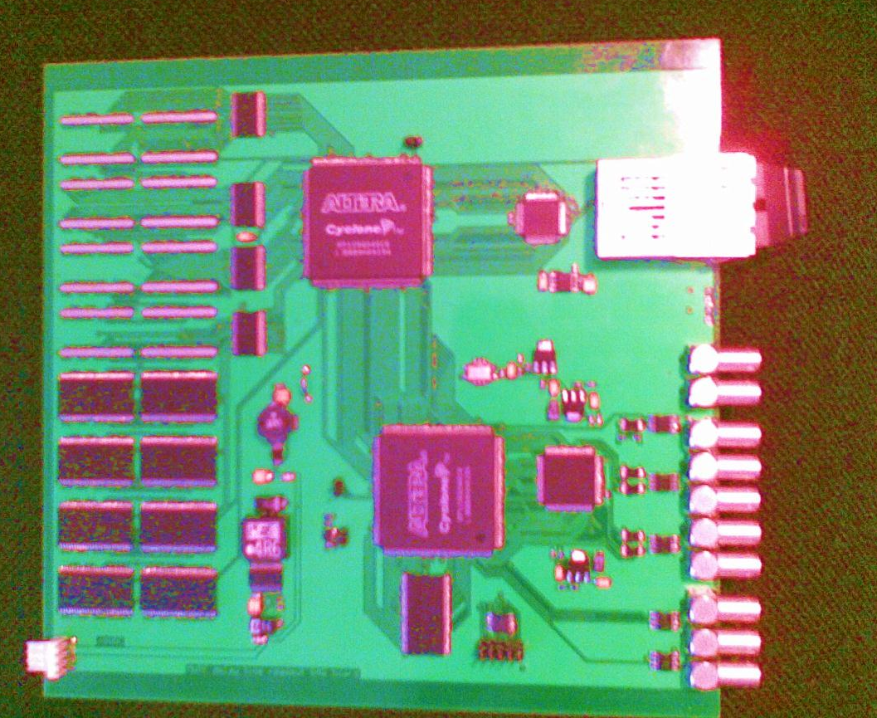
Before and now…

Slide 11
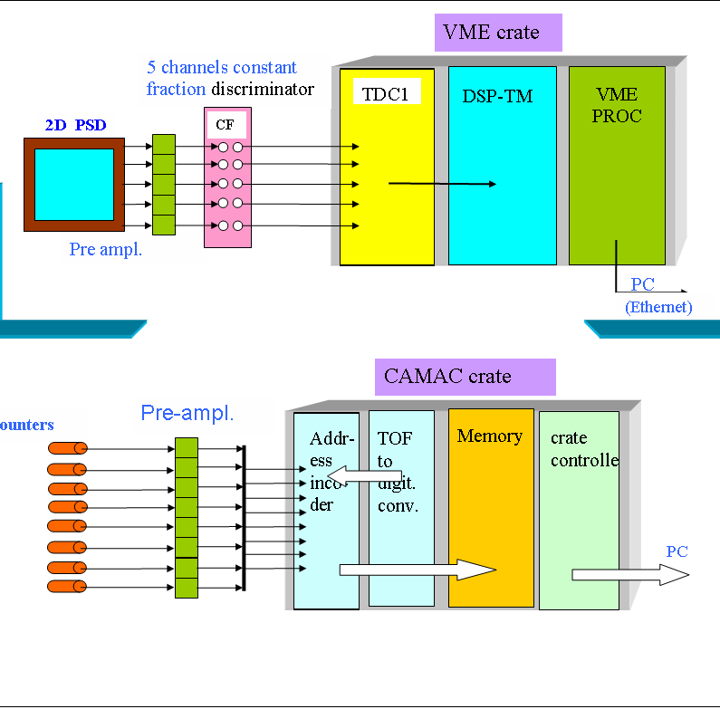
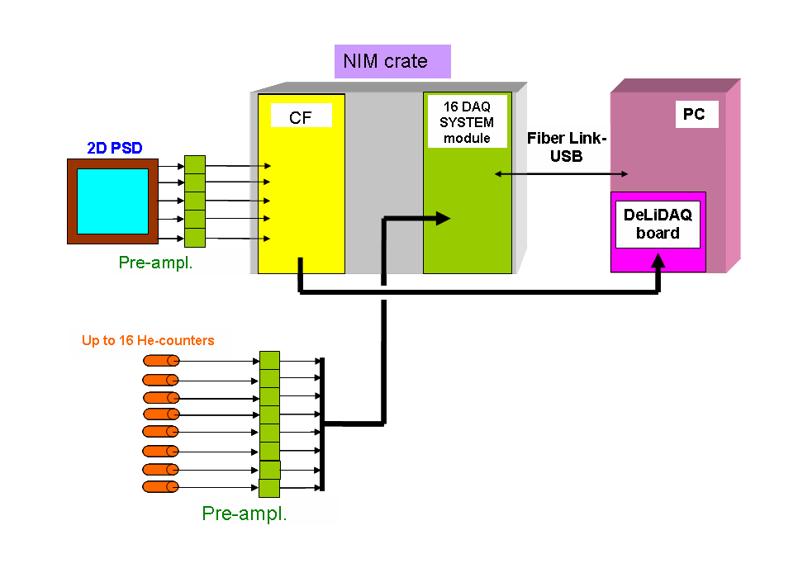
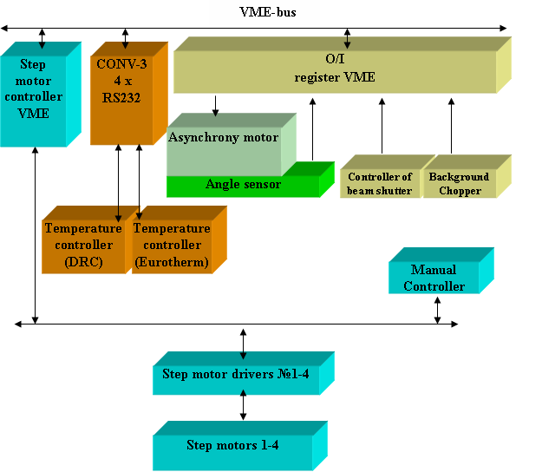
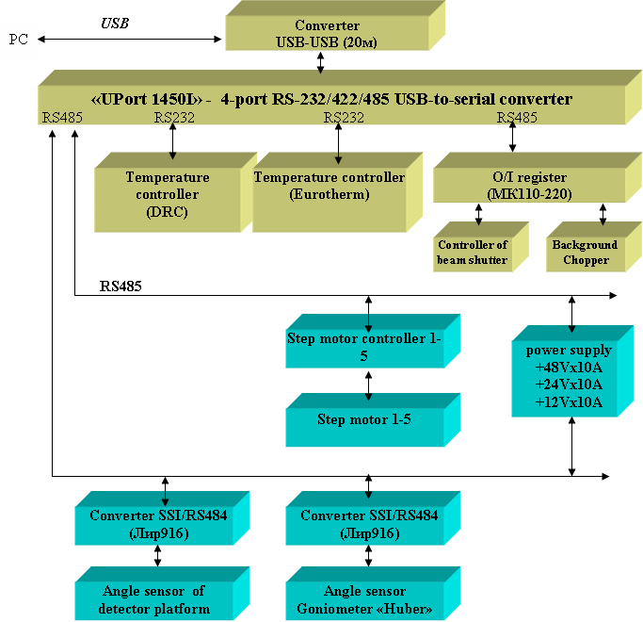
Modernization of electronics at FLNP – change-over to direct control from PC and unification

Slide 12
Prerequisites for the establishment of the project MPD16 at the FLNP
Descriptors of event started become bigger than the address field of the memory for histogram
Integral accumulation leads to impossibility to study the reasons of different artifacts at the spectrometers (happened at HRFD and Epsilon)
Performance of personal computer and disk storage capacity began to be adequate to the task of the list mode data accumulation
Requirements
Realization
To provide DAQ for different types of neutron spectrometers at IBR-2M
Number of detector elements <= 256
Mean count rate: 10 ⁴ events*detector elements/seconds
Time accuracy >= 32 nsec
Registration in absolute experimental time
>= 10⁶ seconds
Yes
<= 240 (246)
Frequency 62.5 MHz
16 nsec
4.5 * 10⁶ seconds

Slide 13
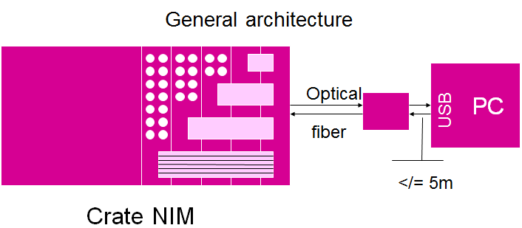
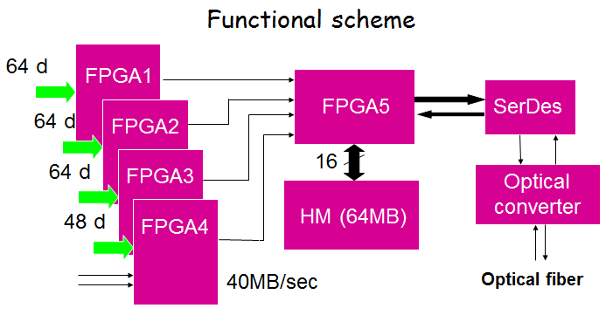
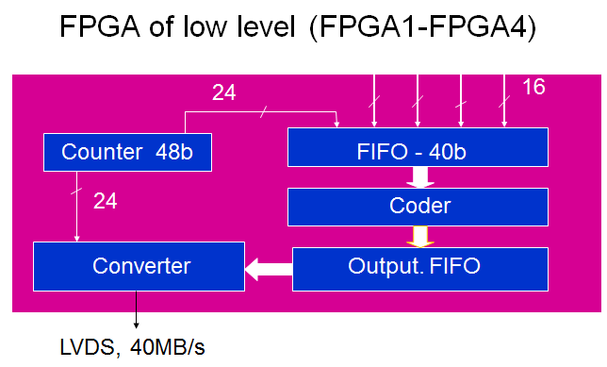
MPD16 architecture

Slide 14
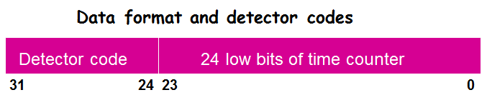
MPD16 features
Mask register at the entrances of the detector elements
Histogram memory 64 Mb for visualization, on-line control, or accumulation in low resolution mode
Individual time bin width for each detector element (if data are accumulated into histogram memory)
Test generator exists
USB2.0 interface (480 Mb/sec). Later will be USB3.0 (5.6 Gb/sec)
Optical fiber up to 100 m between DAQ board and USB adapter
Overall performance 8Mevents/sec or 30Kevents/sec per detector element (if 240 detectors are used)

Slide 15
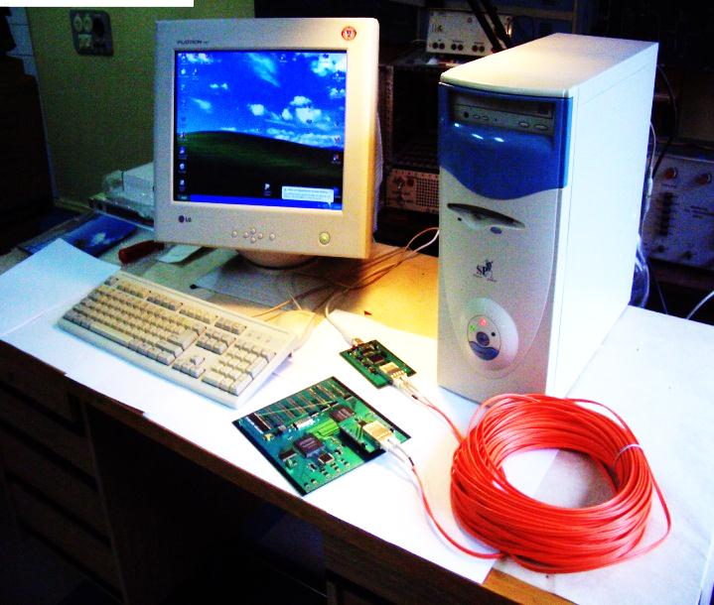
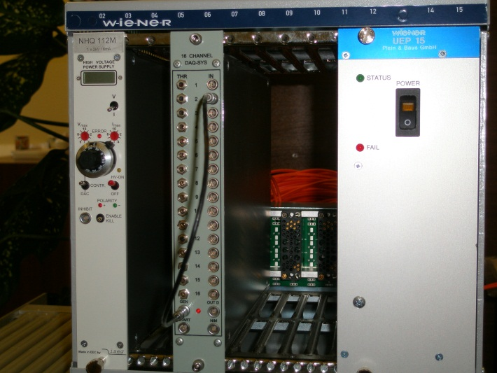
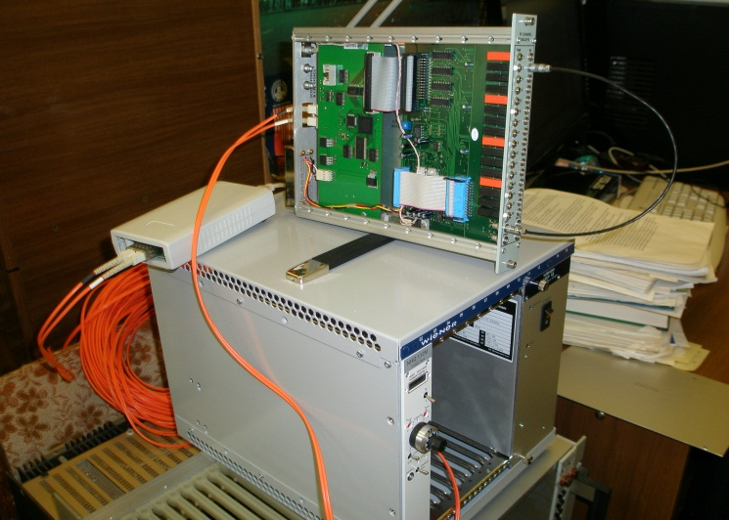
Testing of the communication protocol
The De-Li-DAQ2 block. Data transmission between DAQ and USB via a serial fiber-optic line
Electronic blocks MPD16. Data transmission between DAQ and USB via a serial fiber-optic line

Slide 16
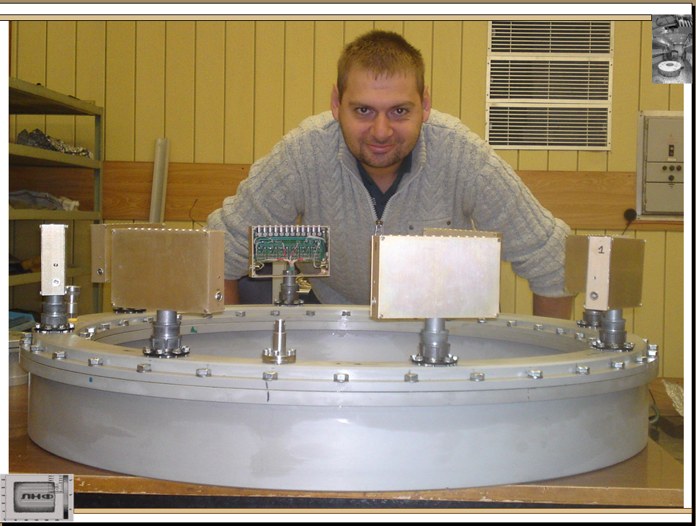
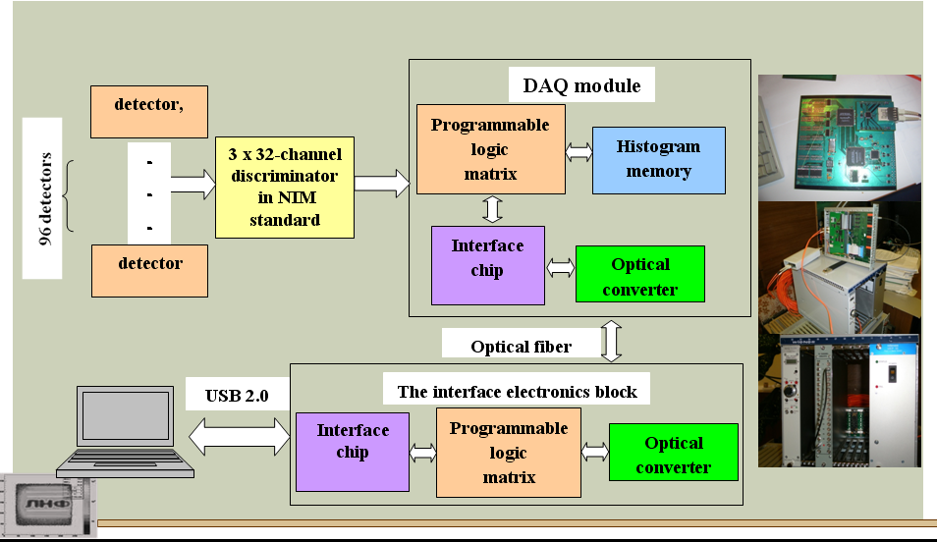
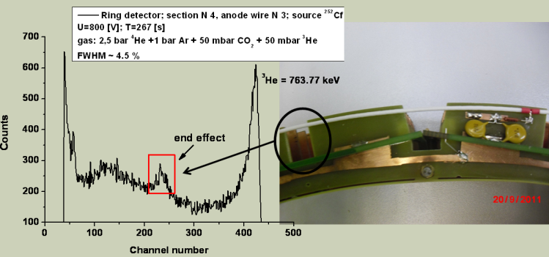
The use of electronics MPD-16 in the FLNP:
Multi-section ring detector project
“Multisection ring detector of thermal neutrons for diffraction studies on microsamples in axial geometry”
V.M. Milkov, Ts. Ts. Panteleev, A. A. Bogdzel, A.V. Belushkin, S.A. Kulikov, V.V.Zhuravlev, V.I.Prikhodko, F. V. Levtchanovski

Slide 17
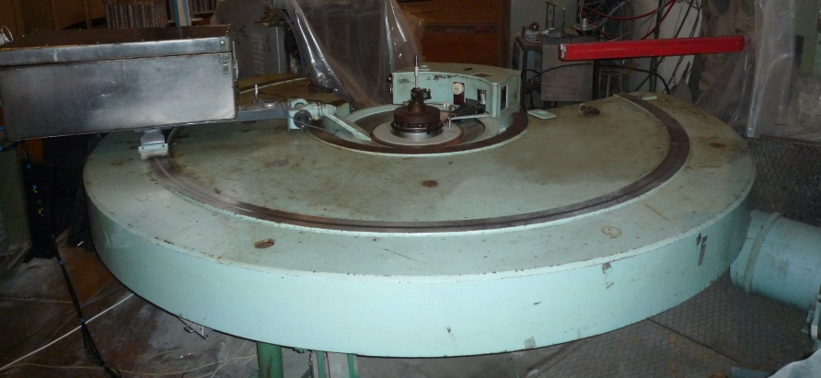
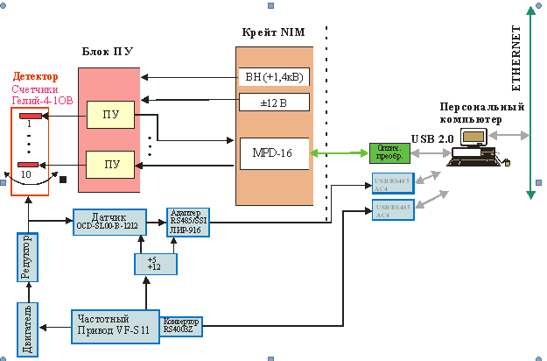
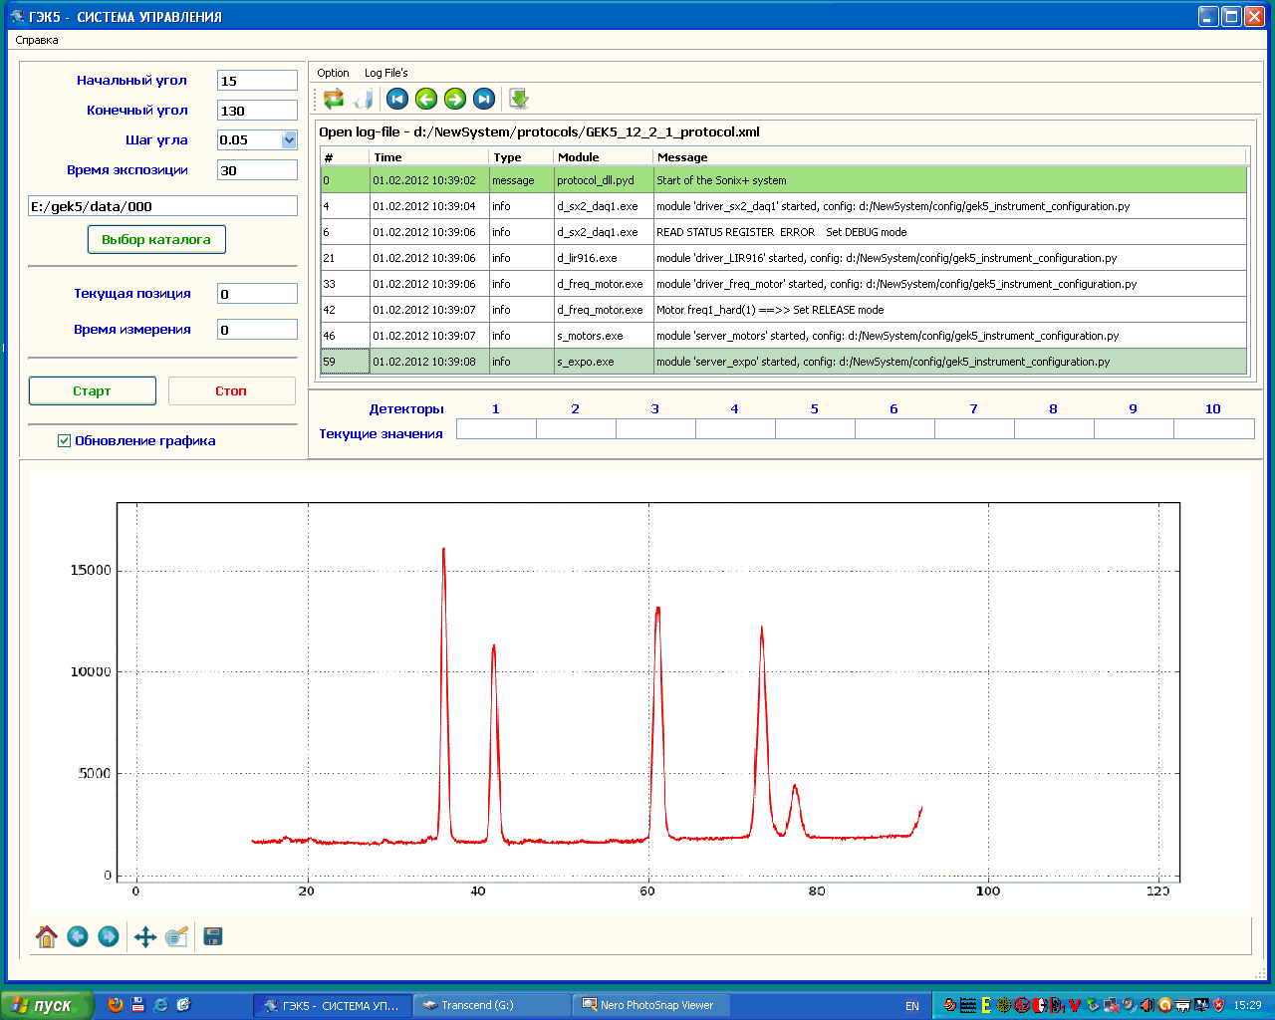
The use of MPD-16 in the Karpov Institute (Obninsk): Experiment automation system for a neutron powder diffractometer
A.A.Bogdzel, S.Veleshki, A.I.Zhuravlev, V.V.Zhuravlev, F.V.Levchanovskiy, A.S.Kirilov, M.V.Mikhin, T.B.Petukhova, S.M.Murashkevich, V.I.Prikhodko, A.P.Sirotin, A.I.Kalyukanov, L.E.Fykin

Slide 18
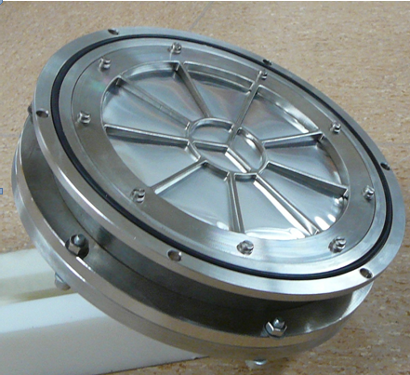
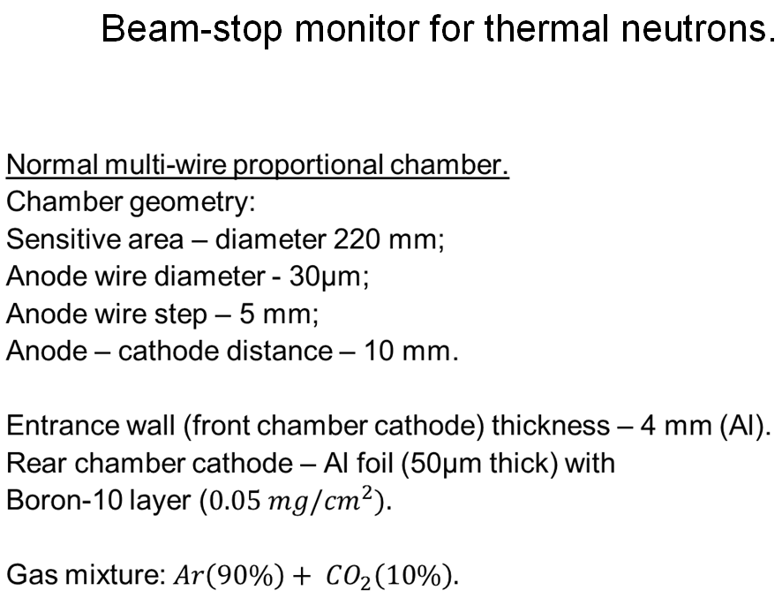
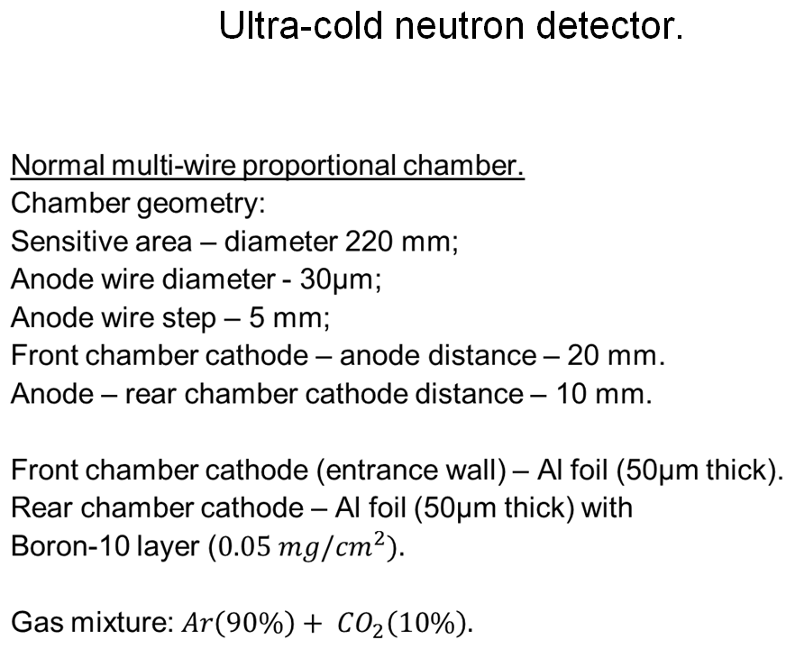
Detector group developments:
Boron-10 thin film detectors
“Boron-10 thin film multi-wire gas detectors for thermal and ultra-cold neutrons”
A. Bogdzel, T. Enik, V. Kruglov

