Slide 1
Welcome to GridKa School 2016
Hannes Hartenstein
Notes:
Good afternoon! With best wishes from the KIT presidential board and my colleagues in the board of directors of the Steinbuch Centre for Computing (in short SCC) I‘ like to welcome you to Karlsruhe and the KIT.
My name is Hannes Hartenstein and I‘m director of the SCC, which is operating GridKa, the German Tier-1 data and computing centre for the LHC data and which gave name to the 14th edition of this years GridKa School.
In the following I would like to give you a very brief overview about KIT and the activities of our institute, the Steinbuch Centre for Computing.

Slide 2
Karlsruhe Institute of Technology
RESEARCH – TEACHING – INNOVATION

Slide 3



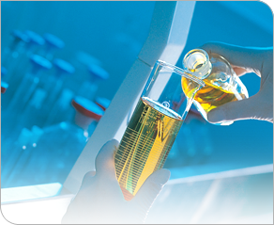


Karlsruhe Institute of Technology (KIT)
One legal entity
The mission
The Research University in the Helmholtz Association
Three core tasks
Research
Higher Education
Innovation

Slide 4
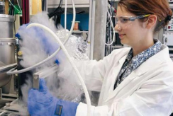
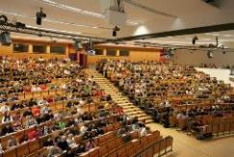
KIT – Selected Facts and Figures
25.196 Students
9.315 Employees
5.859 Education and research
355 Professors
999 Foreign guest scientists
3.456 Infrastructure and services
471 Trainees
Research
Higher Education
Status of March 2016
Innovation

Slide 5

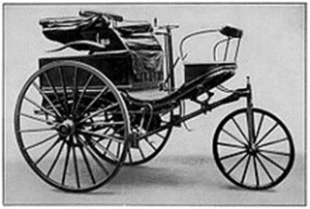
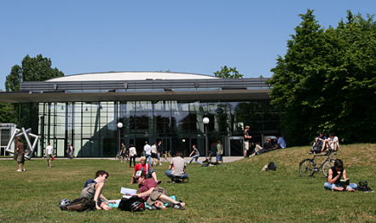
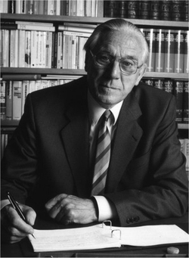
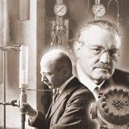
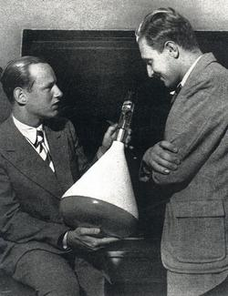
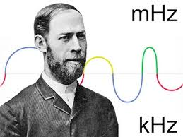

KIT – Tradition and Vision
The first E-Mail
received in Germany
Carl Benz
The first Faculty of Informatics in Germany
Karl Steinbuch
Fritz Haber
One of the largest energy research centers in Europe
Heinrich Hertz
Ferdinand Braun

Slide 6
Introduction to the
Steinbuch Centre for Computing (SCC)

Slide 7

Steinbuch Centre for Computing
Which demands do we satisfy?
Computational Science & Engineering (CSE)
Data-Intensive Science (DIS)
For users in KIT, BaWü, Germany and international
Who are we?
Institute in KIT with
service tasks
What do we do?
Research, education and innovation in Supercomputing, Big Data and secure IT-federations
Operation of large scale research facilities
Operation of basic IT services
“Services for Science – Science for Services”

Slide 8
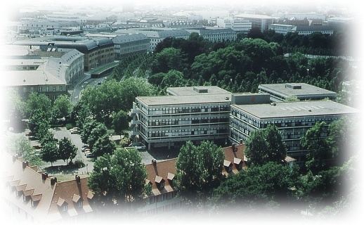
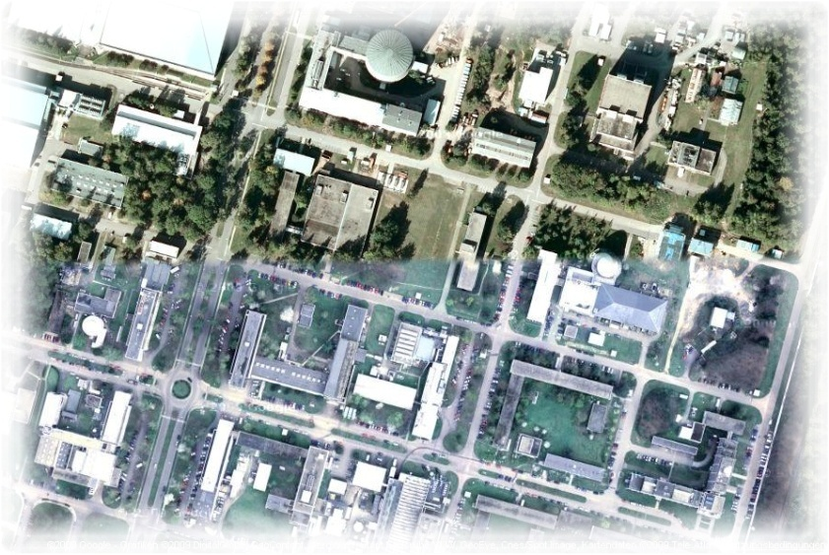

SCC IT-Services
Campus-wide IT-services for > 25.000 students and > 10.000 employees
Networks: 1700 switches/router,
1000 WLAN APs
Server virtualisation: 800 virtual servers
HW server: ca. 400 servers in 80 racks
Backup/archive: 3000 Clients, 6 Libraries, 30000 Slots
E-Mail: 45.000 mail boxes, 450.000 incoming mails/d, 200.000 outgoing mails/d
Databases: ca. 1250 MS-SQL/Oracle DB
Web: 600.000 web pages, 500 virt. web servers
Computer rooms: 400 PCs, 250 courses
Portal for students/e-learning: 8.000 users/d, 26.000 users/a, 8.300 active courses

Slide 9
Cybersecurity and integration/federation:
R&I
Teaching
Basic services
Services (examples)
…
SDIL
bwUni-
Cluster
ILIAS
Campus
(ASERV)
Web
Mail
Storage
…
Innovation projects: KIM-IDM, bwIDM, bwITSec, AARC
Research projects: CollabFuL, KASTEL
Operation and
Research and Innovation
Identity & Access
Management (IAM)
Systems- and Network Security
Computer Incident Response Team (CERT)
membership / guidance
requirements / guidelines
State of Baden-Württemberg
HGF/National/
International
KIT
Policy

Slide 10
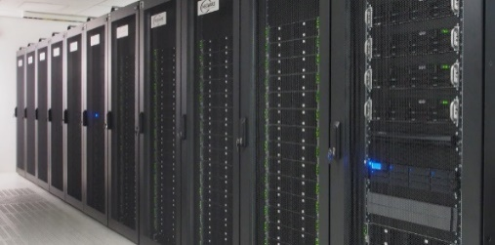
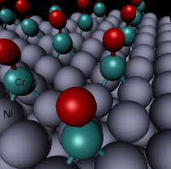


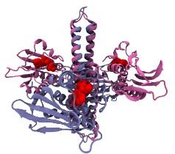




Enabling Computational Science & Engineering (CSE)
Operation of HPC systems
  ForHLR: Tier-2 system in Germany
  phase-1 (11.000 core) + phase-2 (> 23.000 cores)
  total peak performance > 1,4 PetaFlop/s
  peer-review access for users in BaWü und D
  bwUniCluster: Tier-3 system in the state BaWü
  HPC capacity system with 8.500 cores
  shareholder ownership with all 9 state universities
Joint R&D&I with scientific communities
  Application optimisation, scaling, model enhancements
  Simulation Labs in HGF Programm SBD
HYIG „Multiscale Biomolecular Simulation“
Innovation drivers for SMEs
Architect for HPC environment in BaWü

Slide 11
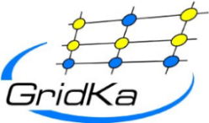



















Enabling Data-Intensive Science
(DIS)
Operation of GridKa
  German Tier-1 in WLCG for an
  international community
Operation of the Large-Scale Data Facility
  Multi-disciplinary data centre for climate research,
  systems biology, energy research, etc. in BaWü
Joint R&D&I with scientific communities
  Generic data management research
  Data Life Cycle Labs in Helmholtz Programm SBD
Innovation driver for SMEs,
big industry und start-ups
Active role in national and international projects & initiatives

Slide 12

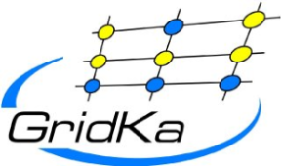
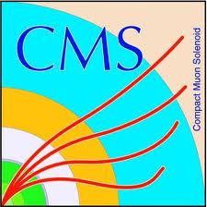


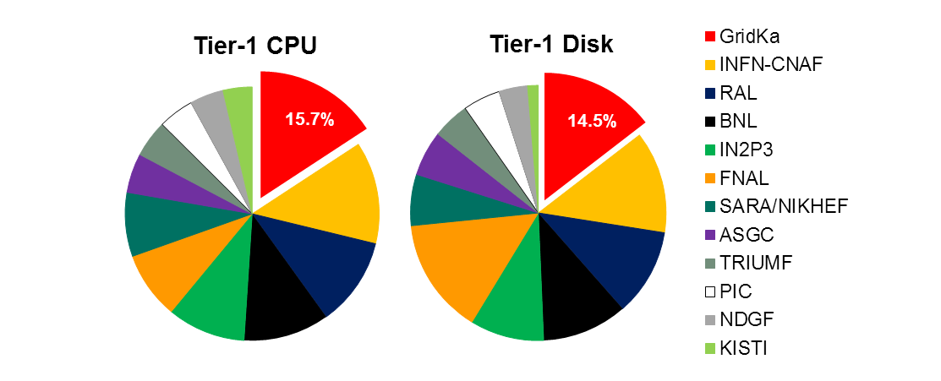
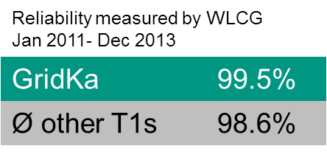

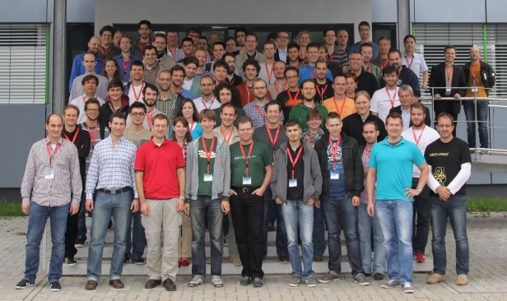

GridKa
German Tier-1 Center in WLCG
  Supports all LHC experiments + Belle II +
  several small communities
Resources
  Computing: ~ 11.000 physical cores
  Disk: 16 PB (netto)
  Tape: 20 PB (used)
  100 Gbit/s network connectivity to LHCOPN, LHCONE
14% of LHC data permanently stored at GridKa
Among the largest and best performing T1s
Annual international GridKa School
  > 1400 participants in 13 years!
  2015: ~100 participants / 15 countries
Global Grid User Support (GGUS) for WLCG
  If there is no ticket in GGUS,
  it is a not problem.

Slide 13
