Slide 1
ROOT as a
Service for Web-based Data Analysis,
SWAN
https://swan.web.cern.ch
L. Moneta, X. Valls – CERN EP-SFT
The SWAN team
E. Tejedor, D. Piparo, P. Mato – CERN EP-SFT
L. Mascetti, J. Moscicki, M. Lamanna – CERN IT-ST
GridKa School 2016
August 29 – September 2, 2016 Karlsruhe

Slide 2
Our Objective
A service for analysing data in the Cloud only with a web browser, using the CERN software suite and relying on existing CERN services in production
Promote CERN software suite and services, propose widely adopted analysis ecosystems.
https://swan.web.cern.ch
The SWAN Team: P. Mato, D. Piparo, E. Tejedor – EP-SFT / M. Lamanna, L. Mascetti, J. Moscicki – IT-ST

Slide 3
This Talk
Prelude: the Notebook
Innovation based on existing CERN services
Examples and Demo
Future plans
We will have a tutorial tomorrow afternoon

Slide 4
Prelude:
The “Notebook”

Slide 5
The Notebook
A web-based interactive computing interface and platform that combines code, equations, text and visualisations.
In a nutshell: an “interactive shell opened within the browser”
Many supported languages: Python, Haskell, Julia, R … One generally speaks about a “kernel” for a specific language
No excuses possible when it comes to describe all steps in an analysis!
http://www.jupyter.org
Also called:
“Jupyter Notebook” or “IPython Notebook”

Slide 6
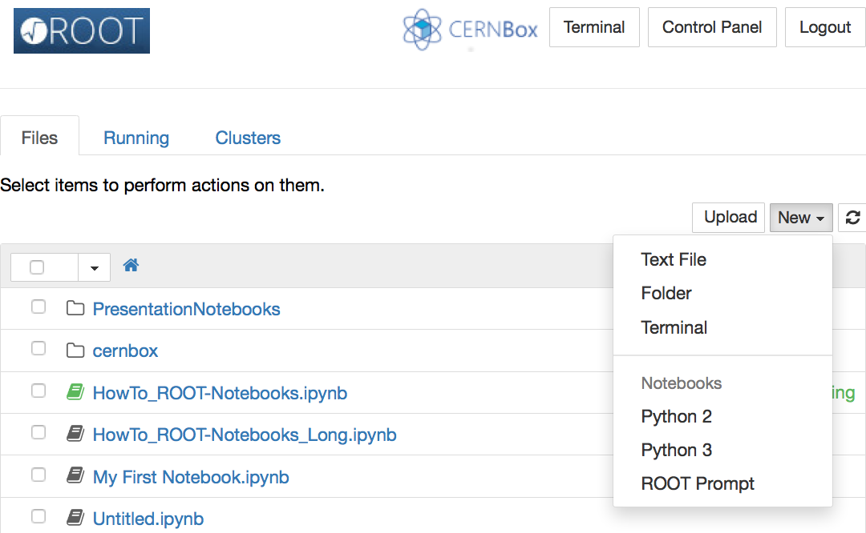
http://
In a browser
A Choice of Kernels
Kernels are processes that run interactive code in a particular programming language and return output to the user. Kernels also respond to tab completion and introspection requests.

Slide 7
http://
Text and Formulas

Slide 8
http://
Code

Slide 9
http://
This is a notebook in Python
Code

Slide 10
http://
Code

Slide 11
http://
We can invoke commands in the shell…
Shell Commands

Slide 12
http://
… And capture their output
Shell Commands

Slide 13
http://

Slide 14
http://
http://
Images

Slide 15
http://
In a browser
Text and Formulas
Code
Shell Commands
http://
Images

Slide 16
ROOT Integration With Notebooks
Full integration of ROOT with Jupyter Notebooks
“import ROOT”: only action required to activate all goodies!
A C++ Kernel
Inlining of plots as images or JavaScript interactive graphics
Magics to JIT or compile C++ code for acceleration
Immediately usable in Python!
Tab completion for name and methods of classes known to ROOT
Capturing of output from C++ libraries
“Like before, but better”

Slide 17
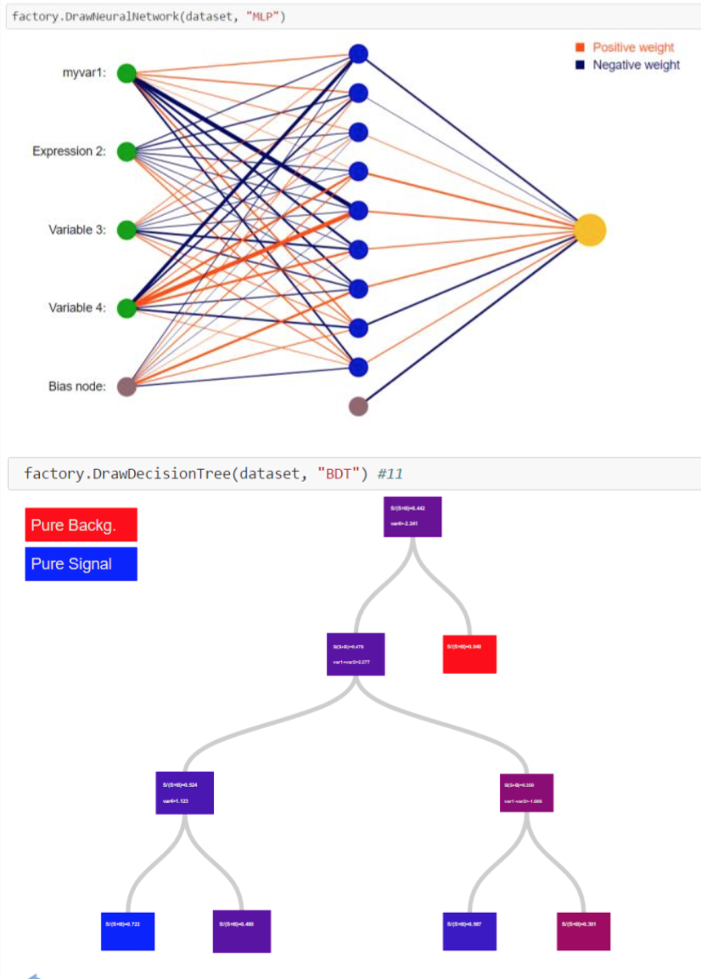
ROOT – TMVA Integration
Full integration of ROOT Machine Learning package (TMVA) with Jupyter Notebooks
Enhanced JSROOT plots
Interactive training
neural network and decision tree visualization
Work produced by GSoC students
Will be available in next ROOT release

Slide 18
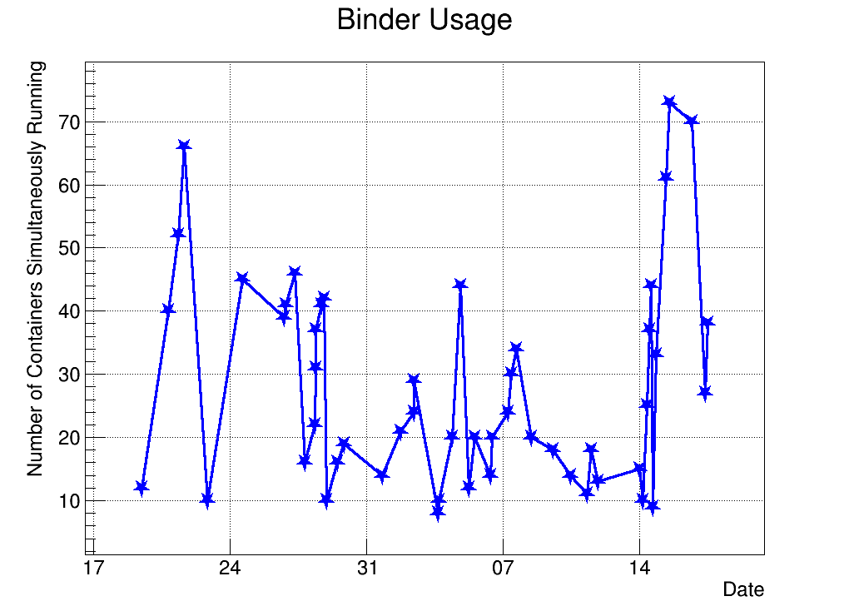
ROOT Binder
Notebook based ROOT online demo
Linked from ROOT website front-page
Anonymous access, no persistent storage
ROOT Demo available on Binder
http://rootbinder.web.cern.ch
2k visits/month since December 2015!
Dec 2015
Jan 2016
View, Create and Run
ROOTbooks!

Slide 19
Try it Out: Local Server
Follow some simple instructions at:
https://root.cern.ch/how/how-create-rootbook
(basically build ROOT) and…
$ root --notebook
This command:
Starts a local notebook server
Connects to it via the browser
Provides a ROOT C++ kernel and the rest of ROOTbook goodies

Slide 20
A Distributed Service Building on top of CERN Services Portfolio

Slide 21
Data Analysis as a Service
Platform independent: only with a web browser
Analyse data via the Notebook web interface
No need to install and configure software
Calculations, input and results “in the cloud”
Allow easy sharing of scientific results: plots, data, code
Storage is crucial, both mass and synchronised
Simplify teaching of data processing and programming
ROOT Summer Student course, ML and statistics trainings
Ease reproducibility of results and documentation
C++, Python and other languages or analysis “ecosystems”
Also interface to widely adopted scientific libraries

Slide 22
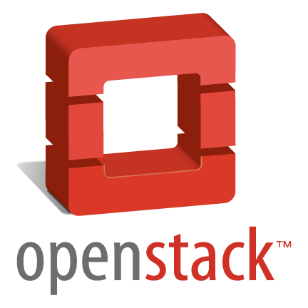
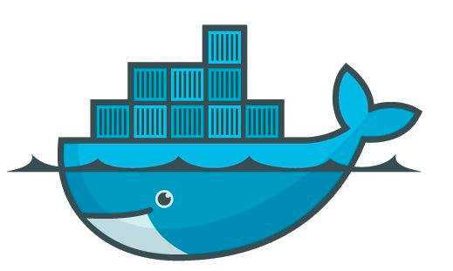
SWAN in the CERN Ecosystem
SWAN relies on the CERN ecosystem:
Authentication with CERN credentials
Machines in the Openstack cloud
Software distribution: CVMFS
Storage access: EOS, CERNBox
User and experiments data available
External but mainstream technologies
Jupyterhub
Docker
A coherent view at CERN
The “home directory” in SWAN
Both have large user bases and an active community behind

Slide 23
Storage Technologies
EOS
Disk-based low latency storage infrastructure for physics users. Main target: physics data analysis. Storage backend for CERNBox.
CVMFS
HTTP based network FS, optimized to deliver experiment software Files aggressively cached and downloaded on demand. Read-only.

Slide 24
JupyterHub
Server application - manages login of users and redirection to notebook
Existing solution
Allows encapsulation: spawn Docker container at logon

Slide 25
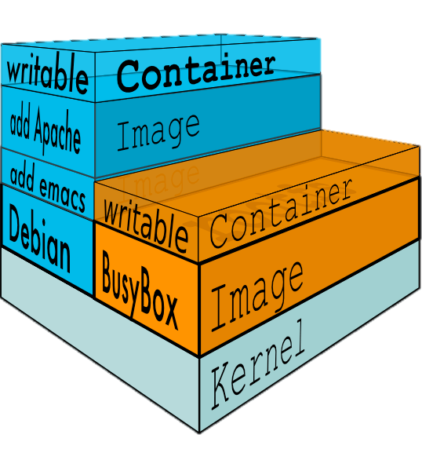
Docker
A “Light-weight virtual machine”
Complete isolation of users: many linux systems sharing the same kernel
Works on OSx and Windows too
Need VM in the background to run the Kernel!
Openstack support
Transparent to the SWAN users!

Slide 26
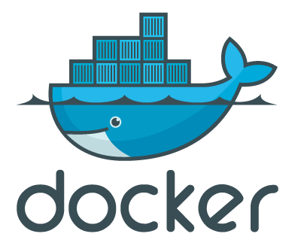
Software Environment
Strategy to configure the software environment:
Docker: single thin image, not managed by the user!
CVMFS: configurable environment via “views”
CERNBox: custom user environment
Externals/LCG Releases
Experiment software
C
User software

Slide 27
The Architecture
CERN Auth
CERN Cloud
Web Portal
Notebook
Container
Container Scheduler
EOS
(Data)
C
C
C
C
CVMFS
(Software)
C
C
C
C
CERNBox
(User Files)

Slide 28
Potential Daily Usage
Launch jobs on the batch farm
Access notebook running in a container
Inspect produced data via CERNBox/EOS from the notebook
Create plots and output data
Share, access plots (and output data!) on the web with CERNBox web interface
Security guaranteed by the usual CERN standards
Added value: remote users cannot open graphical connections to CERN (latency): Problem automatically solved in the workflow described above!
e.g.

Slide 29
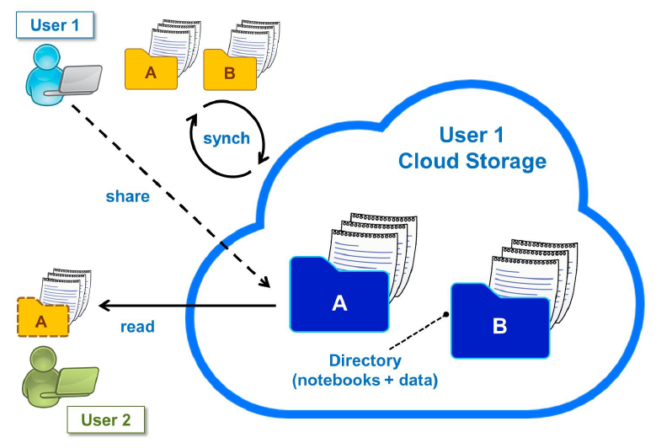
A Cloud Based Analysis Model

Slide 30
Examples and Demo

Slide 31
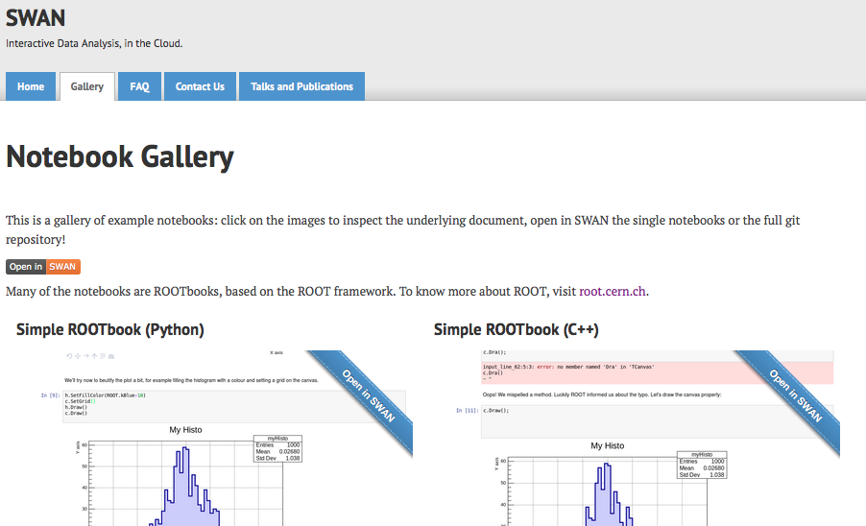
Open a single notebook or a GIT repository in SWAN: one click away!

Slide 32
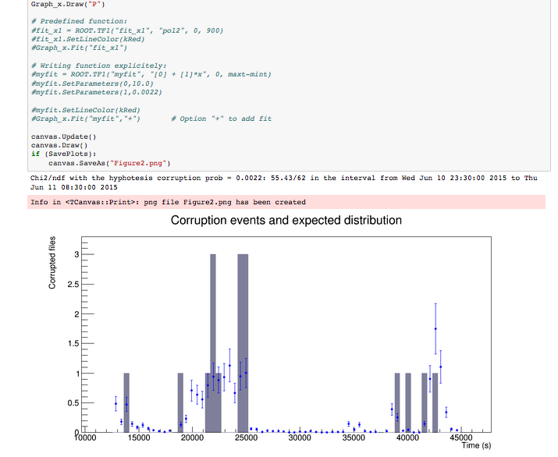
G. Lo Presti, M. Lamanna
“Castor data corruption incident”
Describe incident, data source, analysis and results in a single document

Slide 33
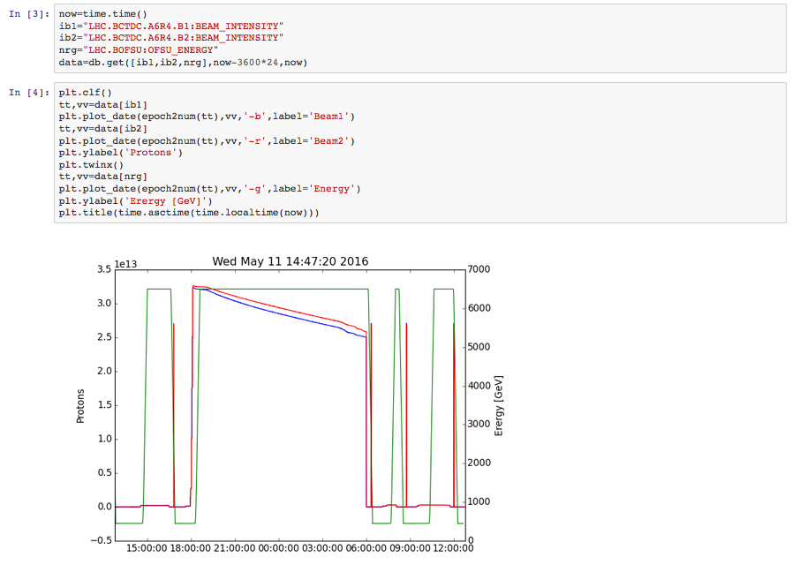
R. De Maria, BE-ABP-HSS
https://github.com/rdemaria/pytimber/blob/master/examples/LHC%20Page1.ipynb
Read measurements coming from pick-ups in a database
Plot time series
Needs also SciPy and to share the notebooks with his colleagues

Slide 34
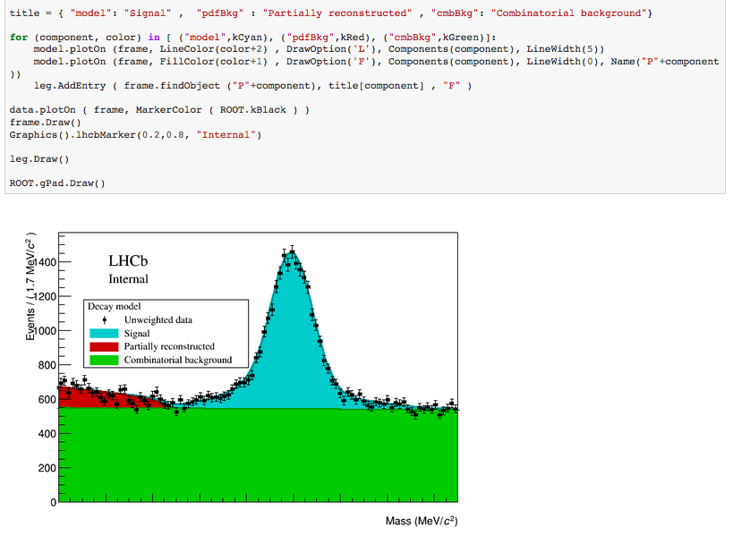
Results coming from real data!(published now)
L. Anderlini
Rare B meson decay in LHCb
Read data from EOS
Setup complex fit
Document and inspect results

Slide 35
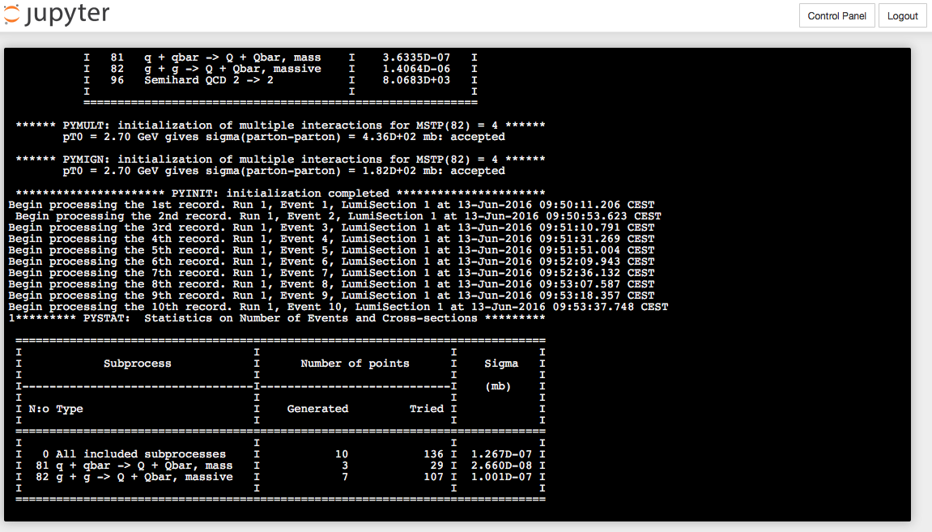
CMSSW
Gen-Sim
Running in a container
Writing directly on EOS
Steered from a web browser

Slide 36
SWAN Now
Pilot service released beginning of June
available at http://swan.cern.ch
All the main components are already there
EOS, CERNBox: Mass & Synchronised Cloud storage
ROOT integrated with Jupyter, Python analysis ecosystem, R
CVMFS to distribute software
In beta testing phase: ~200 users, growing
If interested, please send us an e-mail to:
swan-talk@cern.ch
Your feedback is very much welcome!!

Slide 37
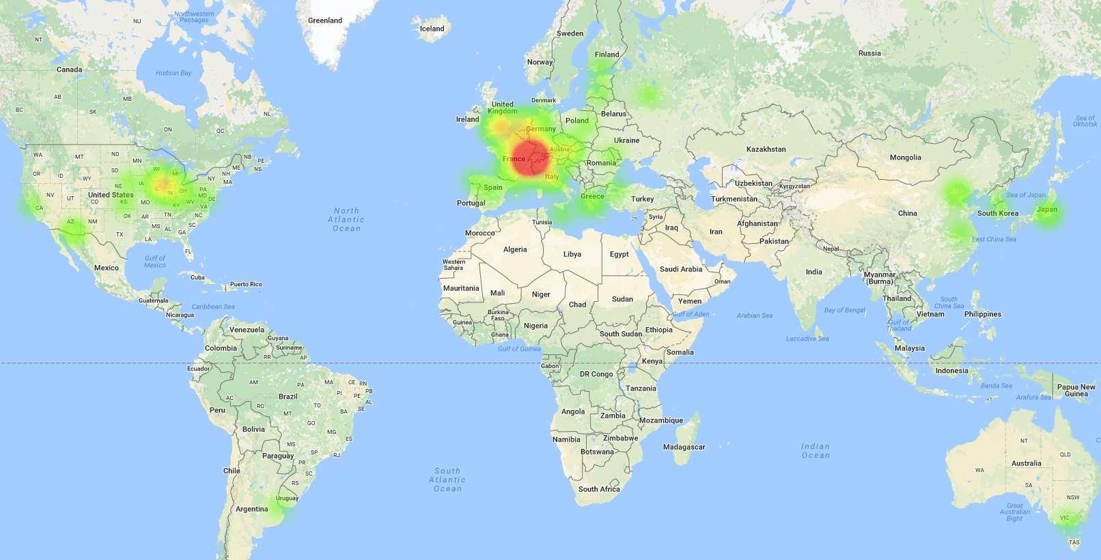
SWAN Now (II)
Since a month, accessible also from outside CERN

Slide 38
Future Plans
Continue to incorporate user feedback
Improve experience with storage: response time, sharing
Exploit external resources
Spark clusters, batch, Grid rsources
Approach more and more analysis community
Started by providing support for machine learning use cases

Slide 39
Summary
Prototype service for Web based analysis available
ROOT integrated with Jupyter
CVMFS for software distribution
EOS mass storage + CERNBox synchronisation
Try on https://swan.web.cern.ch
Open for users with CERN accounts, but need to register first.
Send mail to swan-admins@cern.ch to register.

Slide 40
Swan Tutorial
Swan and ROOT Notebooks hands-on tutorial tomorrow at 13:00 (Room 163)
People intended to participate and having CERN accounts are invited to register by sending an email to swan-admins@cern.ch
Other accounts will be available for non-CERN users

Slide 41
Backup Slides

Slide 42
What are the Others Doing?
Free Jupyterhub deployments on the web: for instance tmpnb, Binder
Only temporary resources, e.g. no persistent storage
Some commercial providers of cloud based analysis models:
Sage Math Cloud
Microsoft Machine Learning Cloud
Google Cloud Datalab
Wolfram Mathematica Online
Wakari
Octave Online
Must be sure of the added value

Slide 43
Interface to Job Submission Tools
Large volume of data – complex analysis: need to use many cores
Single node: TProcPool, IPython Parallel, etherogeneous/multithreaded code
Many nodes: Batch/Grid jobs
Several production grade, Python based job submission tools available:
Ganga, GridControl, Panda, Crab, …
Opportunity: Steer job submission to WLCG or local batch resources from the notebook.
CERN Batch Service being considered in the full picture!

Slide 44
R&D: Offloading Calculations
C
Spark Master
User Notebook
Spark
Cluster
Python
Python
Python
Spark Worker

