Slide 1
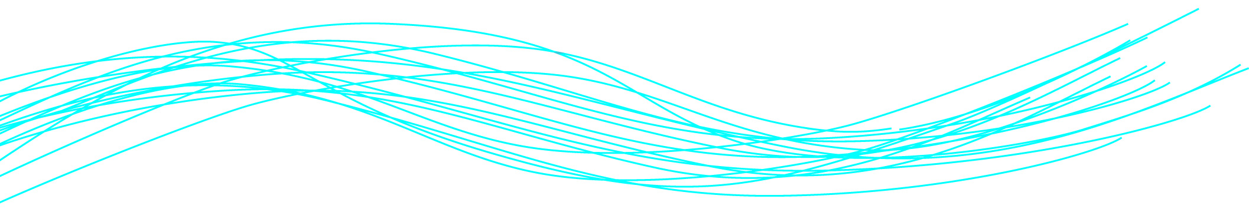
Data Science
Past, Present and Future
Professor John Wood
Secretary-General ACU
Former Chair, European Research Area Board
Co-chair Global Research Data Alliance
29/08/2016
Notes:
1

Slide 2
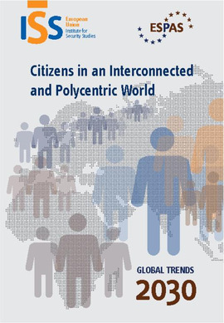

Slide 3
There are three main global trends emerging today that will shape the world in 2030:
‘
the empowerment of individuals, which contributes to a sense of belonging to a single human community
greater stress on sustainable development against a backdrop of greater resource scarcity and persistent poverty, compounded by the consequences of climate change:
and the emergence of a more polycentric world characterised by a shift of power away from states and growing governance gaps as the mechanisms for inter-state relations fail to respond adequately to global public demands.’
ESPAS Report: 2012 “Global Trends 2030”

Slide 4
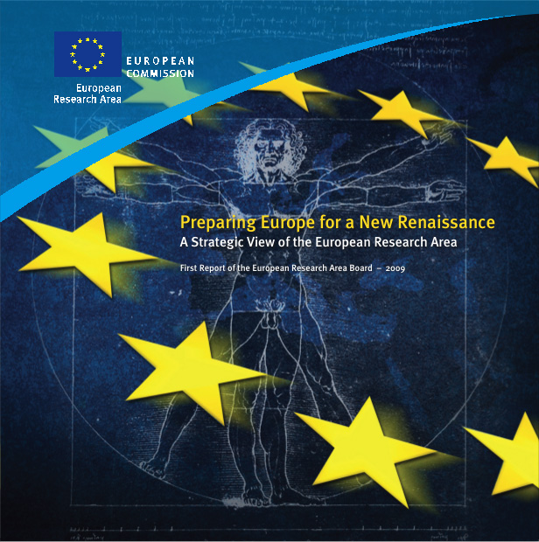
ERA 2030: ERAB’s STRATEGIC VIEW
October 2009

Slide 5
Commissioner Janez Potocnik
... holistic thinking and approach epitomized
the first ‘Renaissance’, where scholars and artists
moved relatively freely around Europe among the
centres of learning and culture. While this privilege
was the domain of a few at that time, it should be
our ambition, in the new ‘Renaissance’, that this
should be the expectation of all citizens, especially
in the field of research and innovation.

Slide 6
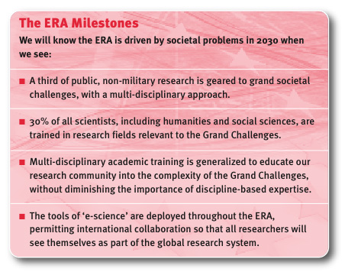
An ERA driven by societal needs to address the ‘Grand Challenges’

Slide 7
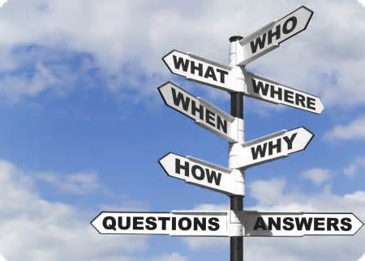
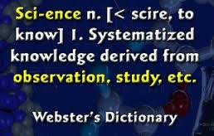
All change but back to the past
Open Science/Science 2.0
A systemic change in the modus operandi of science and research
Affecting the whole research and innovation cycle and its stakeholders

Slide 8
Science 2.0 or Open Science
Current model of research | Emerging model of Science 2.0
Research done privately; then submitted to journals; then peer-reviewed by gatekeepers in major journals; published | Research data shared during discovery stages; ideas shared; scientists collaborate; then findings are disseminated online
Scientific literature behind paywalls online | Scientific discoveries free online
Credit established by name attached to journal article. | How is credit established for contributors?
Data is private until publication | Data is shared before publication
Papers generally protected by copyright | Many different licenses possible: copyright, public domain, Creative Commons 3.0, etc.
Reviewers paid by journals via subscriptions, fees. | Who will pay the reviewers? How will they be paid?
Journal article summaries available online after publication | Share methods, data, findings via blogs, social networking sites wikis, computer sites wikis, computer networks, Internet, video journals Wikipedia: www. 28/12/2013

Slide 9
Benefits of Science 2.0 | Drawbacks of Science 2.0
more productive^{[7]} | difficulty getting credit for discoveries^{[3]}
more collaborative^{[5]} | difficulty getting paid
more collegial working environment^{[7]} | How is credit established for contributors?
freer, less expensive^{[8]} | risk others will copy preliminary work to get credit, patents, money^{[3]}
faster development^{[5]} | how will reviewers and editors get paid?^{[8]}
wider access^{[8]} | it is not clear how Science 2.0 will work^{[1]}
diverse applications: homeland security, medical care, environment etc^{[9]} | needs infrastructure^{[8]}
easier
lets other scientists see results instantly and comment *WWW: Wickipedia as of 28/12/2012

Slide 10
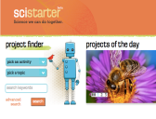







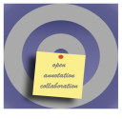




It's real!
An emerging ecosystem of services and standards
Sci-starter.com
Figshare.com
Data-intensive
Citizens science
Open code
Runmycode.org
Myexperiment.org
Open workflows
Pre-print
ArXiv
Analysis
Publication
Review
Conceptualisation
Data gathering
Open data
Roar.eprints.org
Open access
Datadryad.org
Open annotation
Impact Story
Alternative Reputation systems
Openannotation.org
Scientific blogs
Altmetric.com
Collaborative bibliographies
Researchgate.com
Academia.edu
Mendeley.com

Slide 11
From Open Science to Open Innovation
  Basic science is still a seed for major ideas in the field of innovation
  The important public research network could be better integrated in the overall innovation picture, establishing a closer relation to the industrial R&D&I needs
  Science works if it is open. Knowledge transfer could become more effective if it was open → Co-innovation
  Co-innovating partners will identify common synergies and subsequently co-develop and co-implement projects leading to mutual benefits

Slide 12
From Open Science to Open Innovation
Frontier science needs to be open because it needs to engage the best minds in a transparent manner, where ever and whoever they are
Open Science is not interested in “Incremental” advancement
Open Science is not challenged by the seemingly “Impossible”, either
Instead, Open Science is driven by the “Unthinkable”
The challenge thus is to capture and exploit the innovation opportunities generated by the push for the Unthinkable

Slide 13
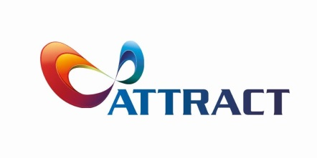
Why now?
Open Science, Science 2.0, Open Research
Open Innovation, Innovation 4.0
Driven by the e-revolution where information is no longer defined by place, person or national boundaries
How will it change the way research is done?
What will be the new business models?
The largest impact will be in the speed of innovation exploitation

Slide 14
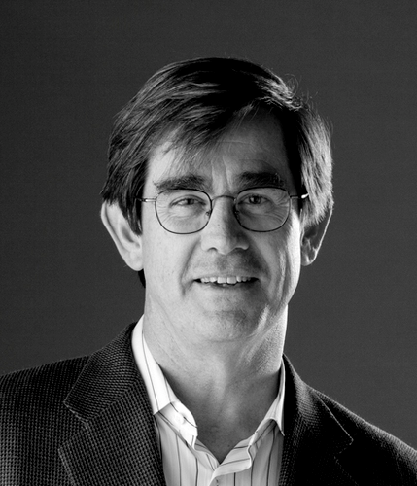
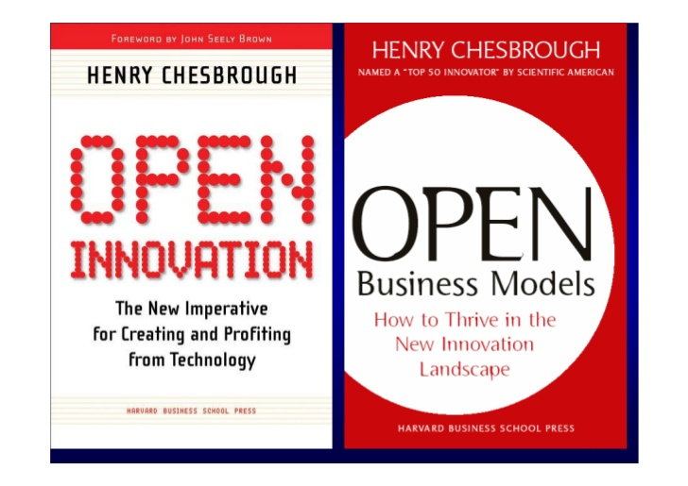
The Guru behind this movement

Slide 15
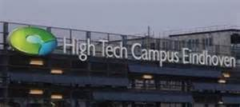
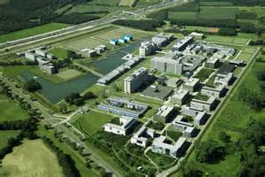
Philips Eindhoven Innovation Campus

Slide 16
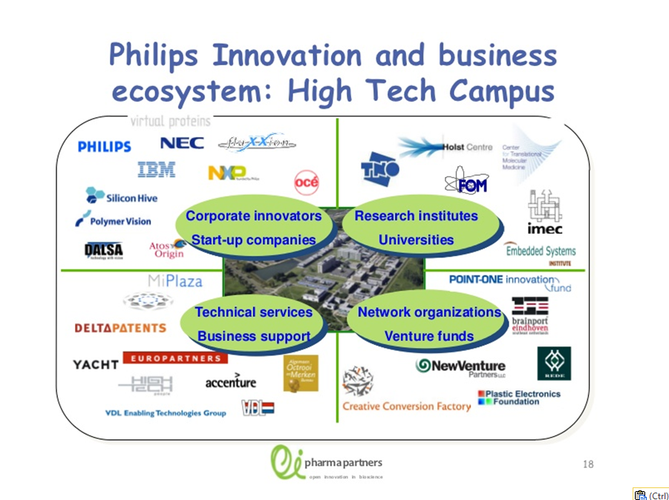
Philips’ Eindhoven Campus

Slide 17
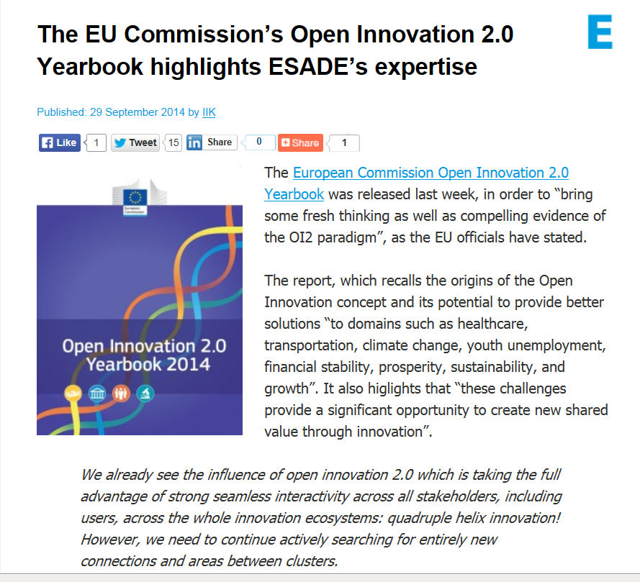

Slide 18
From the 2014 Yearbook
Open Innovation 2.0
Open Innovation 2.0 (OI2) is a new paradigm based on a Quadruple Helix Model where government, industry, academia and civil participants work together to co-create the future and drive structural changes far beyond the scope of what any one organization or person could do alone. This model encompasses also user-oriented innovation models to take full advantage of ideas' cross-fertilisation leading to experimentation and prototyping in real world setting.
We talk about principles of integrated collaboration, co-created shared value, cultivated innovation ecosystems, unleashed exponential technologies, and extraordinarily rapid adoption. We believe that innovation can be a discipline practiced by many, rather than an art mastered by few.
There is much that needs to be done to properly establish OI2 in Europe. This is why policy makers must make serious efforts to strengthen the framework supporting open
innovation approaches.

Slide 19
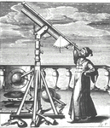
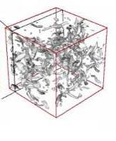
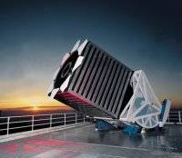

e-Science and the Fourth Paradigm
Thousand years ago – Experimental Science
  Description of natural phenomena
Last few hundred years – Theoretical Science
  Newton’s Laws, Maxwell’s Equations…
Last few decades – Computational Science - Simulation of complex phenomena
Today – Data-Intensive Science
  Scientists overwhelmed with data sets
  from many different sources
    Data captured by instruments
    Data generated by simulations
    Data generated by sensor networks
  e-Science is the set of tools and technologies
  to support data federation and collaboration
    For analysis and data mining
    For data visualization and exploration
    For scholarly communication and dissemination
(With thanks to Jim Gray)

Slide 20
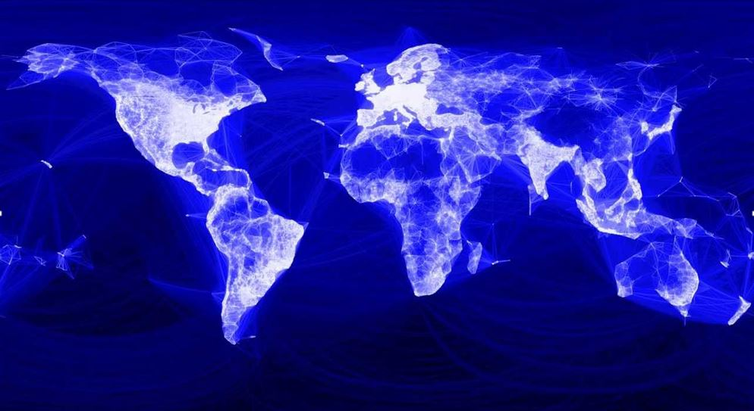
Connecting the world
by light

Slide 21
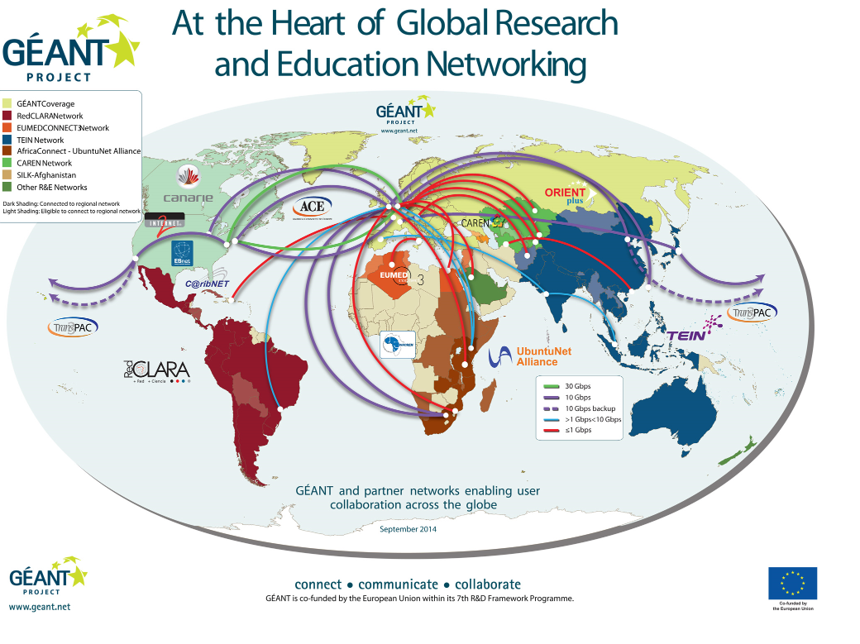

Slide 22
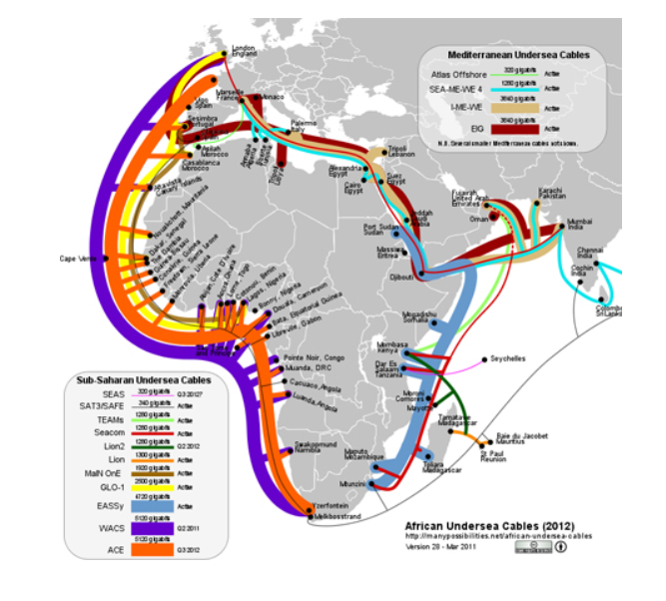
West Coast Connectivity

Slide 23
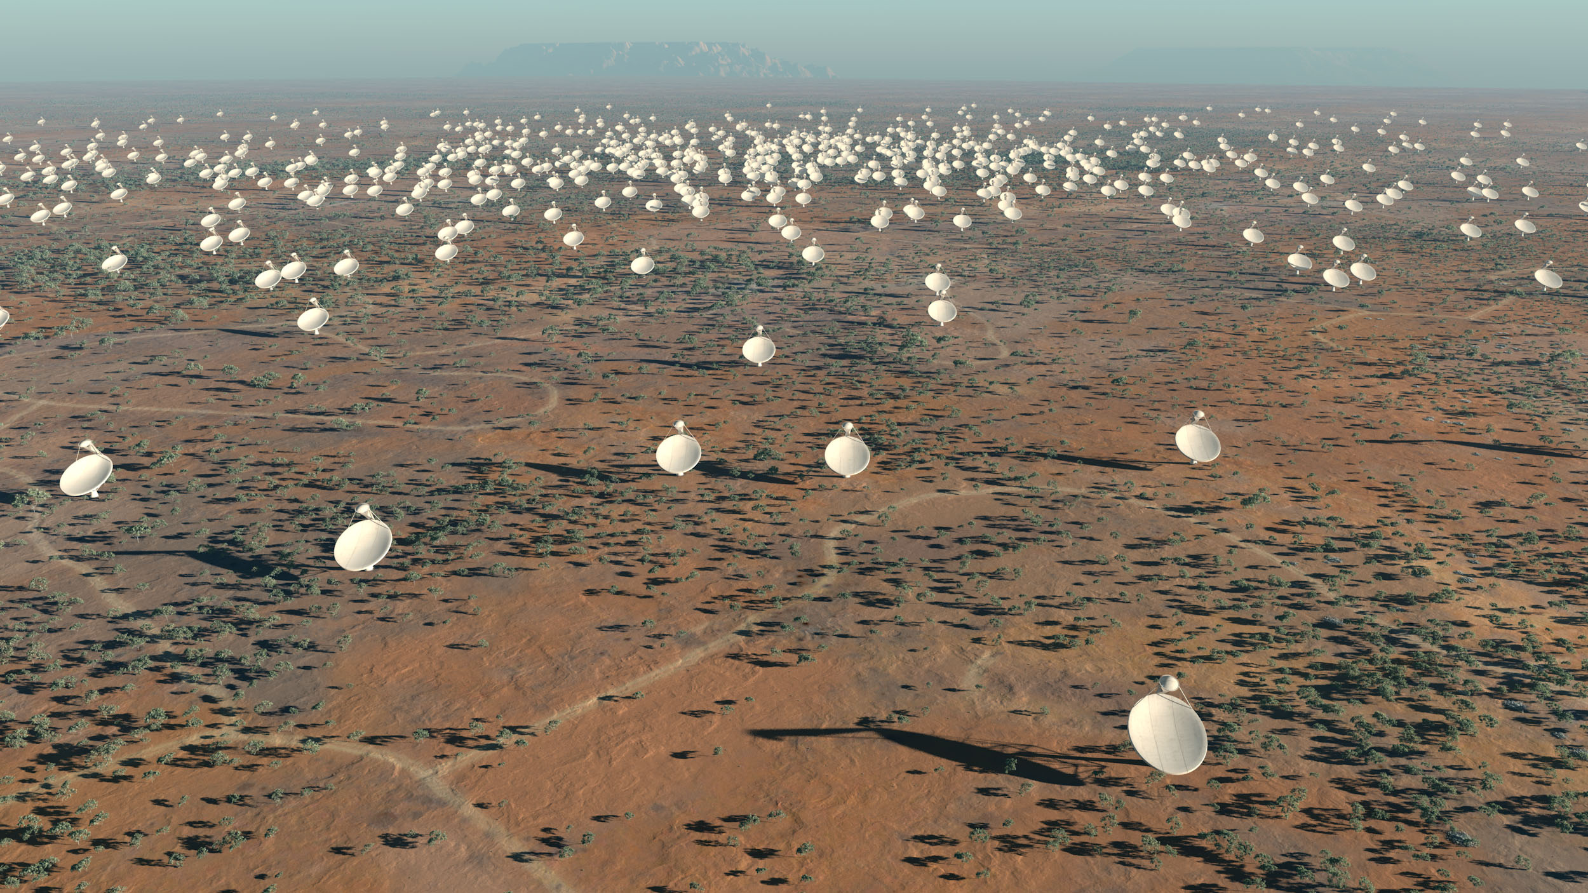
SKA
One quarter of Commonwealth Countries involved

Slide 24
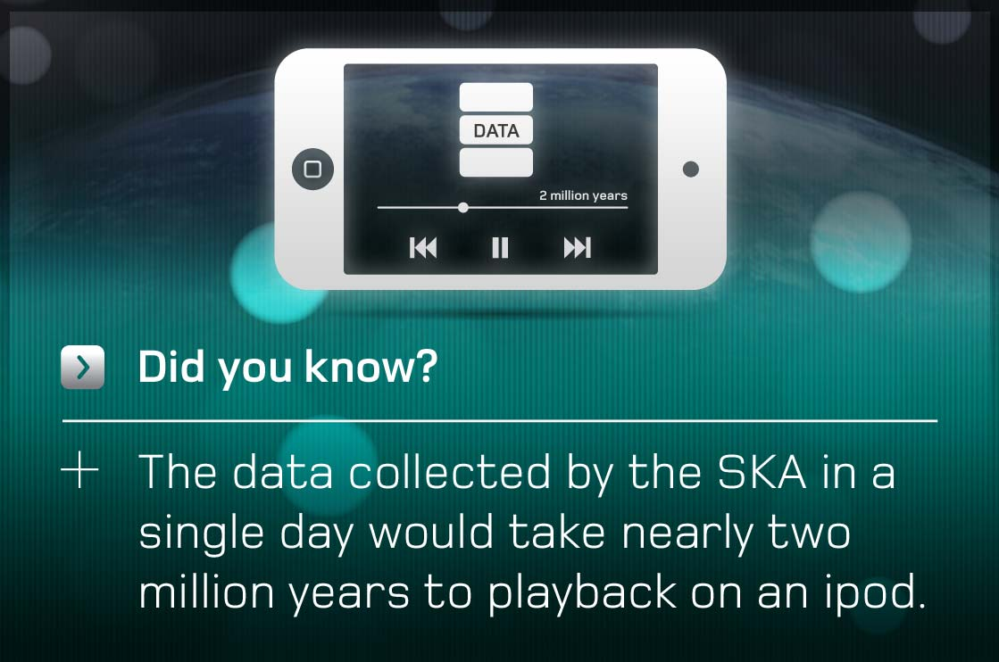
SKA impact

Slide 25
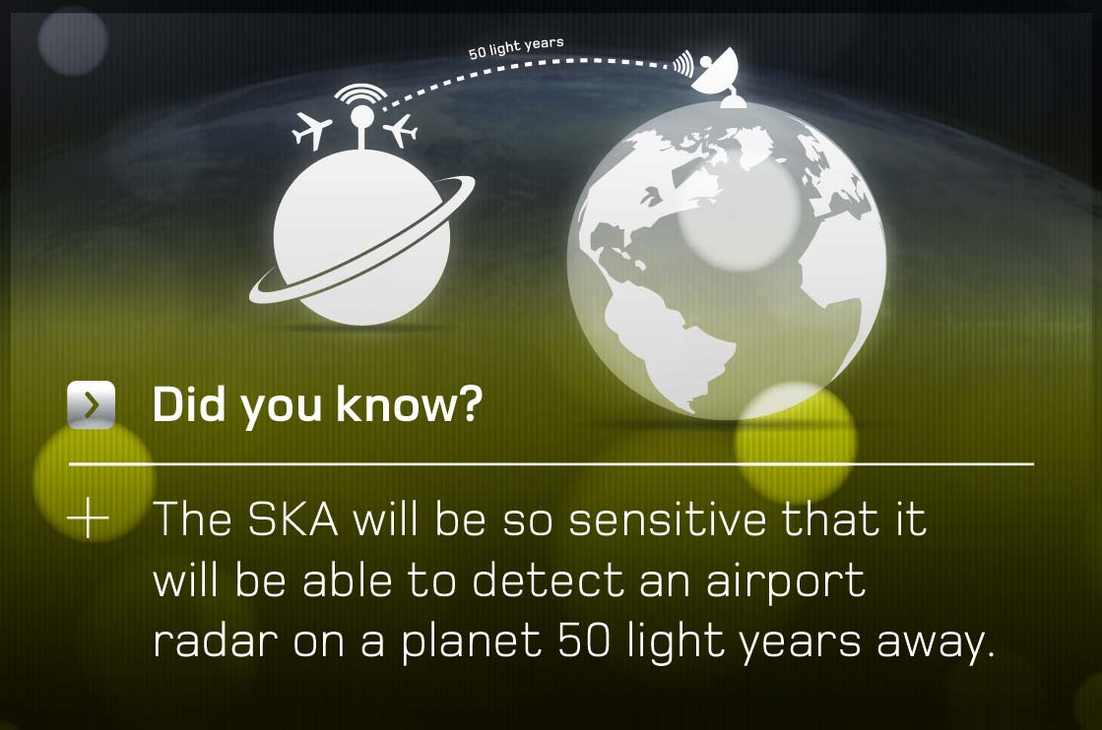

Slide 26
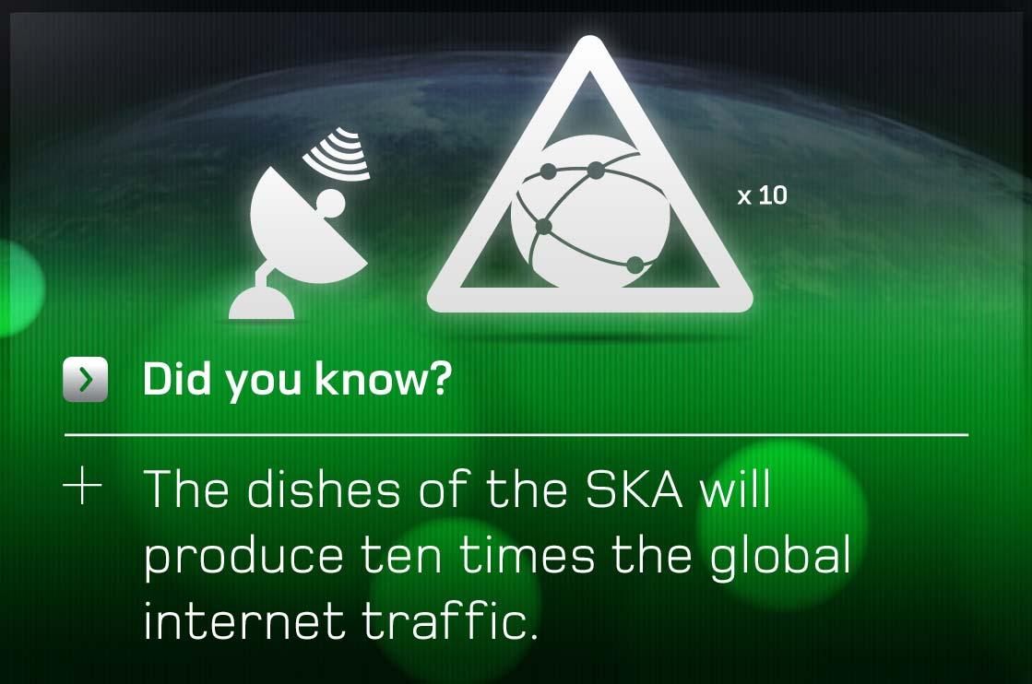

Slide 27
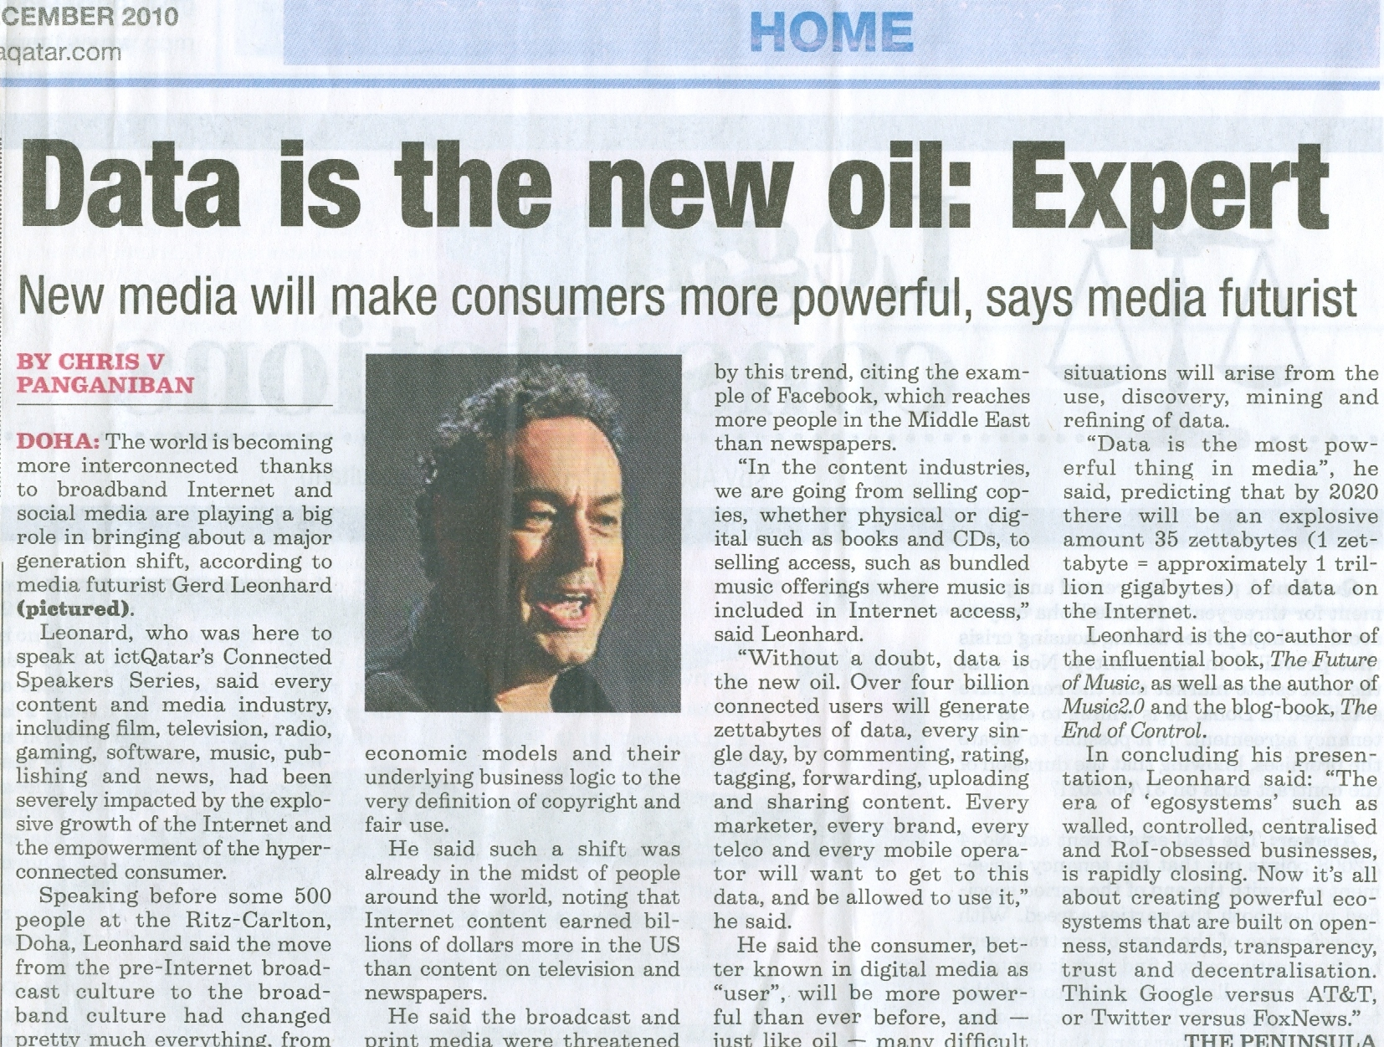

Slide 28
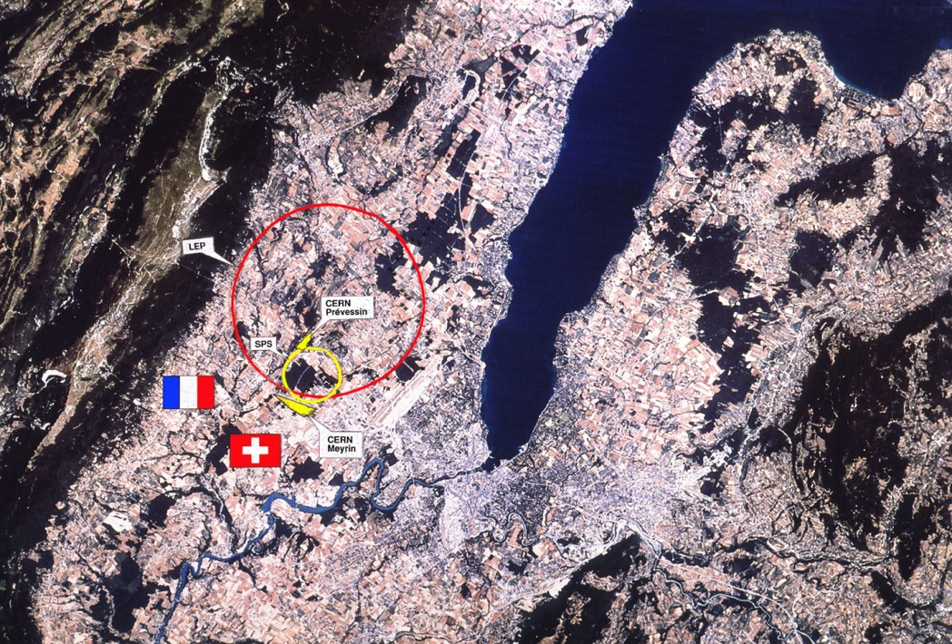
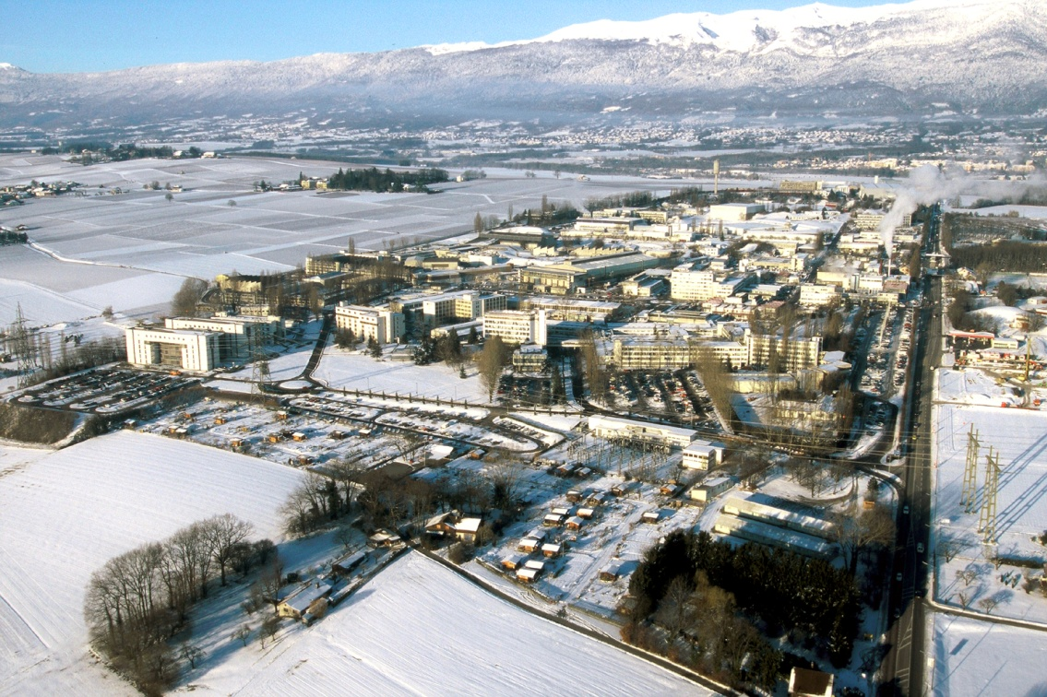
“Conseil Européen pour la Recherche Nucléaire”
“European Organisation for Particle Physics”
Basic Research Laboratory
World’s largest particle physics centre
Founded in 1954
www.cern.ch
CERN
Located on top of the French-Swiss
border in Geneva (Switzerland)
2600 Staff members and Fellows
plus 6800 visitors on-site
1100 MCHF (730 million Euro)
Annual Budget
Bernd Panzer-Steindel, CERN
2/17/2010
28
Notes:
28

Slide 29
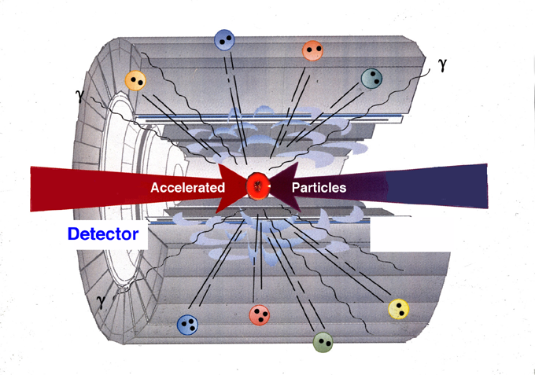
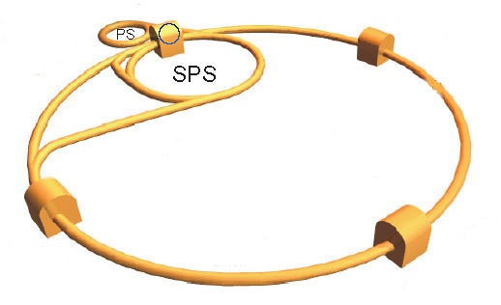
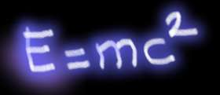
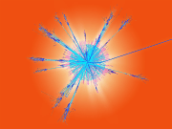
Particle Accelerator
The most powerful microscope in the world
‘snapshot of nature’
Creating conditions similar
to the Big Bang
one snapshot == one event == 1.5 MByte
Bernd Panzer-Steindel, CERN
2/17/2010
29
Notes:
29

Slide 30
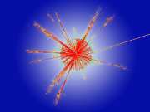
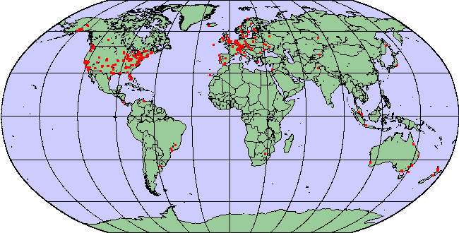
RAW data
Data and Bookkeeping
RAW data copies
10 PB RAW data per year
+ derived data, extracted physics
data sets, filtered data sets, artificial
data sets (Monte-Carlo), multiple versions,
Multiple copies
20 PB of data at CERN per year
50 PB of data in addition transferred and stored
world-wide per year
Sub-samples
Enhanced copies
Enhanced copies
Data copies → safety and access/performance
2/17/2010
Bernd Panzer-Steindel, CERN
30
Notes:
30

Slide 31
Big issues facing Universities and Public at Large
Open Access to both publications and data “all publicly funded research must be publicly available
Who is providing the data, can it be trusted?
How do I know the provenance – has it been corrupted?
Is it accessible, what type of metadata is there?
Personal and persistent identifiers, a loss of personal freedom or a passport to participate?
IPR and legal position
Personal health data – how can this be handled?
How to teach and research in this global environment?

Slide 32
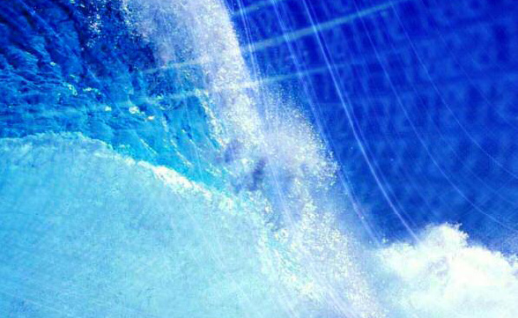
Riding the wave
How Europe can gain from the rising tide of scientific data a vision for 2030
>

Slide 33

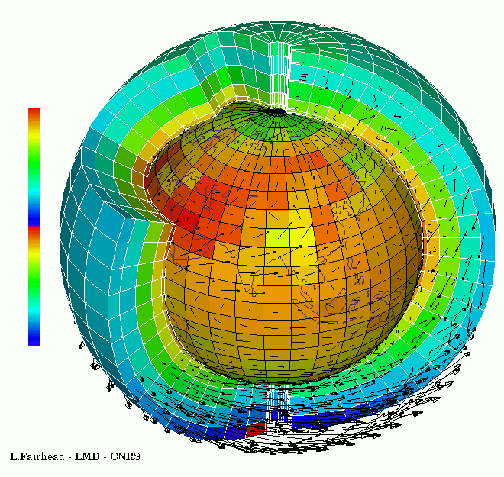

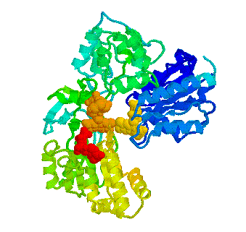
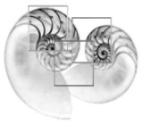
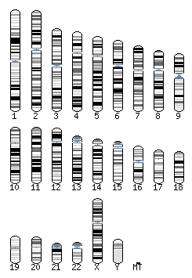


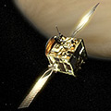
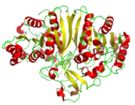
Global collaboratories
They can engage in whole new forms of scientific inquiry and treat information at a scale we are only beginning to see.
… and help us solving today’s Grand Challenges such as climate change and energy supply.

Slide 34

Vision 2030
“Our vision is a scientific e-Infrastructure that supports seamless access, use, re-use and trust of data. In a sense, the physical and technical infrastructure becomes invisible and the data themselves become the infrastructure – a valuable asset, on which science, technology, the economy and society can advance.”
  High-Level Group on Scientific Data
  “Riding the Wave: how Europe can gain from the raising tide of scientific data”

Slide 35
The Centrality of International Research Infrastructures for Innovation

Slide 37
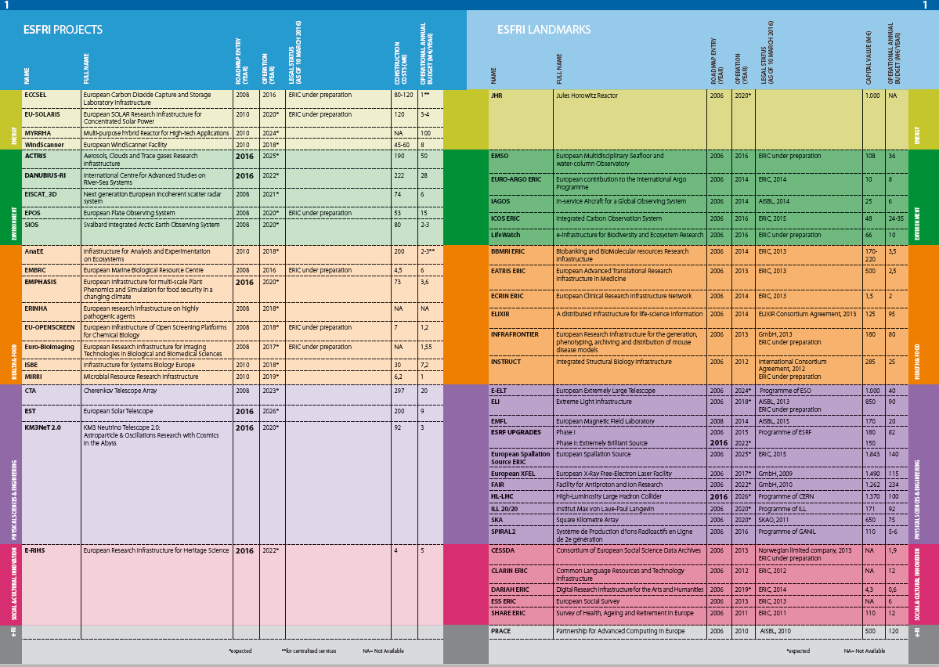

Slide 38
ECCSEL European Carbon Dioxide Capture and Storage Laboratory Infrastructure

Slide 39
DANUBIUS-RI International Centre for Advanced Studies on River-Sea Systems
Mission and Vision
Our Mission is for DANUBIUS-RI to provide a world-leading research infrastructure that will enable excellent interdisciplinary research in river-sea systems that will have high social and economic impact.
Our Vision is for DANUBIUS-RI to be recognised as the European centre for excellent interdisciplinary research and innovation on river-sea systems globally.

Slide 41
E-RIHS European Research Infrastructure for Heritage Science

Slide 43



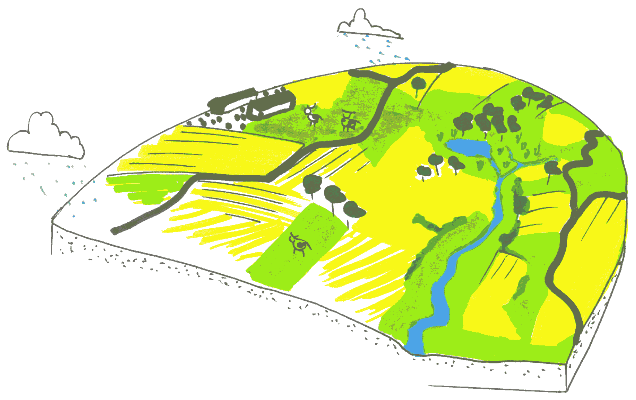

Combine and analyse data from a variety of distributedinstruments/observations

Slide 44
Virtual Lab
Virtual Lab
Virtual Lab
Virtual Lab
Personalized web-environments
for scientific cooperation
Composition
Make your own selection from
(data, algorithms) resources
e-Infrastructure
Integrated access to resources
External data, computation
and other functionalities
Resources

Slide 45
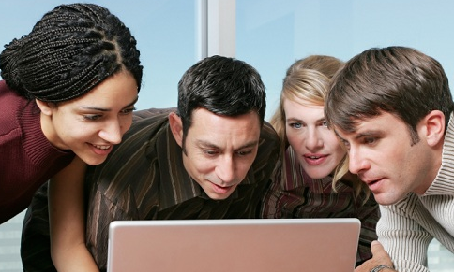
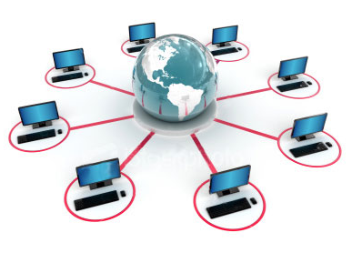
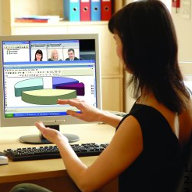
Cooperation in “virtual” labs
Find and integrate data
Select algorithms and compose workflows
Remote (high performance) computing
Visualize outcomes
Experimentation in silica

Slide 46
ELIXIR
ELIXIR A distributed infrastructure for life-science information
Description
The distributed infrastructure for life-science information (ELIXIR) is a unique initiative that consolidates Europe’s national centres, services, and core bioinformatics resources into a single, coordinated infrastructure. By coordinating
these resources, ELIXIR supports the data-related needs of Europe’s 500.000 life-scientists and helps address the Grand Challenges across life sciences from marine research via plants and agriculture to health research and medical sciences.

Slide 47
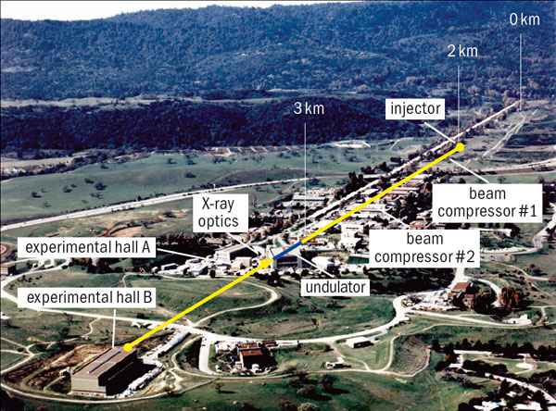

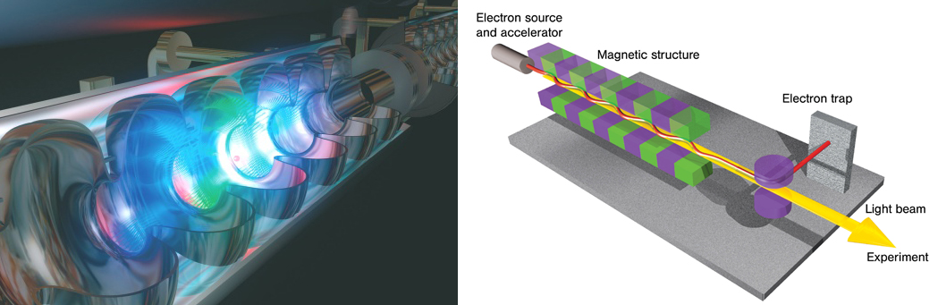
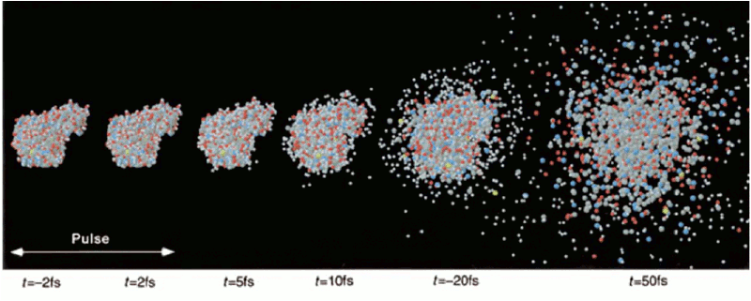

Slide 48
European X-ray Free Electron Laser

Slide 49
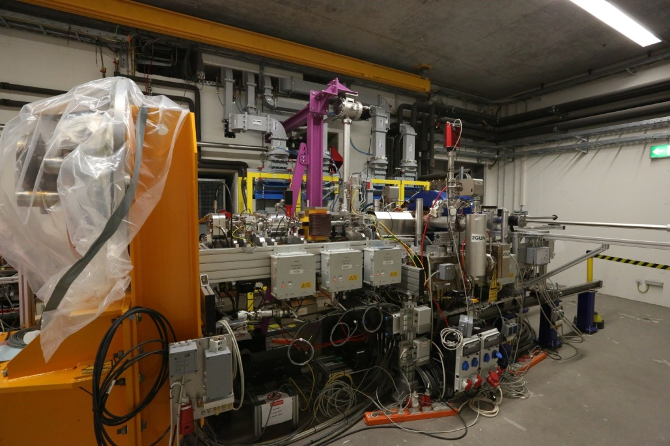




Slide 50
Operating all six instruments will, according to current estimates, produce 10 million gigabytes (10 petabytes) of data per year, increasing to over 50 million gigabytes per year as a result of improved detector resolution. Storing 50 million gigabytes of data would require 10 million DVDs, which, if stacked on top of one another, would be 12 kilometres high. In comparison, the four experiments at the Large Hadron Collider produce about 13 million gigabytes per year.
The extremely large data volumes generated at X-ray free-electron lasers require a new way of thinking about how data is managed and analysed. At conventional X-ray labs, scientists are able to bring their own hard disk drives, copy their data onto the drives, and then do their analyses at home. In the case of the European XFEL, the sheer amount of data will not make this approach possible any longer.

Slide 52
CLARIN ERIC Common Language Resources and Technology Infrastructure
Description
The Common Language Resources and Technology Infrastructure (CLARIN) provides easy and sustainable access for scholars in the humanities and social sciences to digital language data − in written, spoken or multimodal form − and advanced tools to discover, explore, exploit, annotate, analyse or combine them, independent of their location. To this end CLARIN is building a networked federation of language data repositories, service centres and centres of expertise, with single sign-on access for all members of the academic community in all participating countries. Tools and data from different centres are interoperable, so that data collections can be combined and tools from different sources can be chained to perform complex operations to support researchers in their work. CLARIN integrates existing data and
service centres, without major capital investments.

Slide 53
CESSDA
Consortium of European Social Science
Data Archives
Description
The Consortium of European Social Science Data Archives (CESSDA) provides large scale, integrated and sustainable data services to the social sciences (and beyond) by supporting high-quality, national and international research and cooperation. It brings together social science data archives across Europe, with the aim of facilitating social, economic and political research and by doing so allows researchers to gain a better understanding of the challenges facing society today and to help solve them. Presently 14 countries are members of the Consortium and one country is a formal observer. Additionally social science data archives from nine other European countries are cooperating, taking part in some way or aiming at membership.

Slide 54
Vision 2030
(6) The public has access and can make creative use of the huge amount of data available; it can also contribute to the data store and enrich it. All can be adequately educated and prepared to benefit from this abundance of information.
  Embed data science in all training and academic qualifications.
  Integrate into gaming and social networks
  IMPACT IF ACHIEVED
  Citizens get a better awareness of and confidence in sciences, and can play an active role in evidence based decision making and can question statements made in the media.

Slide 55
The Problem for the e-Scientist Student
Experiments &
Instruments
facts
facts
?
questions
Other Archives
facts
answers
Literature
facts
Simulations
Data ingest
Managing petabytes+
Common schema(s)
How to organize?
How to re-organize?
How to coexist & cooperate with other scientists and researchers?
Data query and visualization tools
Support/training
Performance
  Execute queries in a minute
  Batch (big) query scheduling
Notes:
55

Slide 56
Source: High-level Group on Scientific Data
Climatology
Biology
Astronomy
Chemistry
Aggregated Data Sets
(Temporary or Permanent)
History
Other Data
Demography
Scientific Data
(Discipline Specific)
Workflows
Researcher 2
Aggregation Path
Researcher 1
Scientific World
API
Data Discovery & Navigation
Workflows Generation
Community Support Services
Data Services
Computing Infrastructure
Persistent Storage Capacity
Integrity
Authentication & Security
Non Scientific World

Slide 57
European Commissioner Nellie Kroes
Smarter Data for Europe
How ‘Big Data’ can increase opportunities for the economy, society and science
May 23 2013 Venue: British Residence, Brussels
“The development of ‘Big Data’ applications and e-infrastructure can stimulate a new wave of economic and social progress – but it needs leadership from both public and private sector. What are the opportunities, obstacles and solutions to making public and private data work harder for us all, in healthcare, energy and other domains?”

Slide 58


http://www.independent.co.uk/life-style/gadgets-and-tech/g8-open-data-charter-will-increase-transparency-and-fuel-innovation-8665696.html
Notes:
EO data = Meteorological/weather, agriculture, forestry, fishing, and hunting
Geospatial = Topography, postcodes, national maps, local maps

Slide 59

G8 Open Data Charter
Open Data by Default
Quality and Quantity
Useable by All
Releasing Data for Improved Governance
Releasing Data for Innovation

Slide 60

Tools to Support the Entire Data Life Cycle
Data
Acquisition & modelling
Collaboration and visualisation
Analysis & data mining
Dissemination & sharing
Archiving and preserving
fourthparadigm.org
Notes:
Tagging to hide QA as part of publication and sign-off prior to dissemination

Slide 61

New Skills Needed
Slide courtesy of Jian Qin

Slide 62



What is a Data Scientist?
Data Engineer | People who are expert at Operating at low levels close to the data, write code that manipulates They may have some machine learning background. Large companies may have teams of them in-house or they may look to third party specialists to do the work.
Data Analyst | People who explore data through statistical and analytical methods They may know programming; May be an spreadsheet wizard. Either way, they can build models based on low-level data. They eat and drink numbers; They know which questions to ask of the data. Every company will have lots of these.
Data Steward | People who think to managing, curating, and preserving data. They are information specialists, archivists, librarians and compliance officers. This is an important role: if data has value, you want someone to manage it, make it discoverable, look after it and make sure it remains usable.
What is a data scientist? Microsoft UK Enterprise Insights Blog, Kenji Takeda
http://blogs.msdn.com/b/microsoftenterpriseinsight/archive/2013/01/31/what-is-a-data-scientist.aspx

Slide 63
The Data Harvest Report
How sharing research data can yield knowledge, jobs and growth
A RDA Europe Report

Slide 64
Data driven …
“It’s pretty clear that in the 21st Century, data drives everything, from the health sciences to climate change. But there’s only so far you can go in solving problems using your own data and your own team. Today, you need to reach across boundaries.” Fran Berman, RDA US Chair

Slide 65
The benefits of open data
The Citizen: All people will benefit from the products and services that are developed around open data and sharing – directly or indirectly.
The Entrepreneur: Open data is a source of inspiration for entrepreneurs and provides the raw material for new products and services.
The Scientist: Freely exchanging data will transform the nature of what it means to be researchers.

Slide 66
The benefits of acting now!
Benefit 1: Creating jobs, spurring growth
It seems obvious: Data have more value shared and used, than hidden and unused.
Benefit 2: Boosting research productivity and creativity
Sharing and re-using data change the way science is done, and who does it; that has unexpected consequences
Benefit 3: Helping people, engaging citizens
Citizens not only gain greater insight into what is being done in their name, but they can also look at the data themselves and suggest policy improvements.

Slide 67


Are there costs?
It’s hard to prove a negative; but most researchers and economists believe there is a cost of not sharing.

Slide 68
Research Data Alliance

Slide 69

The Research Data Alliance
Global community-driven organization
launched in March 2013 to accelerate
data-driven innovation
Focus is on building the social, organizational and technical infrastructure to
  reduce barriers to data sharing and exchange
  accelerate the development of coordinated global data infrastructure
CREATE → ADOPT → USE: RDA Working Groups operate for 12-18 months to build and use targeted pieces of data infrastructure
Over 60 groups formed since the start. Growing rapidly

Slide 70


Integrating Data Across Cultures,
Scales, Technologies Requires Infrastructure
Common metadata standards
Interoperability / integration framework
Data access and preservation policy and practice
Harmonized standards
Common economic model for sustaining data
Digital object identifiers
Tools for data discoverability
Etc. …
Harmonized standards
Policy and Practice

Slide 71


Type | Members (Nov 2015)
Press & Media | 21
Policy/Funding Agency | 50
Large Enterprise | 77
IT Consultancy/Development | 112
Small and Medium Enterprise | 202
Other | 191
Government/Public Services | 533
Academia/Research | 2265
TOTAL | 3451
Who is RDA?
3451
from 110 countries
Total RDA Community Members: 3451
https://rd-alliance.org/about.html

Slide 72







































Organisational & Affiliate Members
RDA Organisational Members
RDA Affiliate Members
https://rd-alliance.org/organisation/rda-organisation-affiliate-members.html
Notes:
Guiding Principles:
Openness
Consensus
Balance
Harmonization
Community-driven
Non-profit and technology-neutral

Slide 73

RDA Council and Funders 2014

Slide 74

RDA Council May 2016

Slide 75
RDA Interest (IG) and
Working Groups (WG) by Focus 1
Domain Science - focused
Toxicogenomics
Interoperability IG
Structural Biology IG
Biodiversity Data
Integration IG
Agricultural Data
Interoperability IG
Wheat Data Interoperability WG
Digital Practices in History and Ethnography IG
Geospatial IG
Marine Data Harmonization IG
Metabolomics IG
RDA/CODATA Materials Data Infrastructure and Interoperability IG
Research Data Needs of the Photon and Neutron Science Community IG
Defining Urban Data Exchange for Science IG
The BioSharing Registry: Connecting data policies, standards and databases in the life sciences WG
Urban Quality of Life Indicators IG
Community Needs - focused
Community Capability Model IG
Engagement IG
RDA/CODATA Summer Schools in Data Science and Cloud Computing in the Developing World IG
Development of Cloud Computing Capacity and Education in Developing World Research IG
Data for Development IG
Education and Training on handling of research data IG

Slide 76
RDA focuses on Impact and Implementation
RDA Interest Groups are specific communities mapping out infrastructure that will enable data sharing and exchange, with concrete pieces of infrastructure then proposed as Working Groups
RDA Working Groups are “Tiger Teams” focusing on short-term deliverables:
Focused pieces of adopted code, policy, infrastructure, standards, or best practices that enable data to be shared and exchanged
“Harvestable” efforts for which 12-18 months of work can eliminate a roadblock for a substantial community
Efforts that have substantive applicability to “chunks” of the data community, but may not apply to everyone
Efforts for which working scientists and researchers can start today while more long-term or far-reaching solutions are appropriately discussed in other venues

Slide 77
ELIXIR Bridging Force IG Case Statement
Life sciences are becoming increasingly more data intensive, especially resulting from the huge improvements in large-scale gene sequencing and other “omics” techniques. There is need for large-scale sustainable data storage methods allowing secure and easy access to these highly complex data.
Simultaneously, since life science research projects increasingly depend on more than one type of measurement, there is a wide–felt need for integrating data of different types. Very similar issues and similar data sets come up in the different sectors of life sciences, such as health, agriculture, bio-industry and marine life, calling also for interoperability between these sectors.

Slide 78
Agriculture Data Interest Group
The Agricultural Data Interest Group is a domain oriented interest group to work on all issues related to data important for the development of global agriculture. The interest group aims to represent all stakeholders producing, managing, aggregating, sharing and consuming data for agricultural research and innovation. Efforts will be made to get an active representation of the major international institutions, which work on agricultural research and innovation. It will take stock of existing problems and experiences and will pave the way for a number of domain specific working groups to make precise proposals for solution in specific area. This interest group will help to promote good practices in our research domain : data sharing policies, data management plan, data interoperability.
The Agricultural Data Interest Group has a specific interest in data interoperability. This refers not only to exchange of data of the same type, but also to data of a different types, which refers to the same object. In this context the interest group is planning a first working group on "wheat data interoperability" in close collaboration with the "Global Wheat Initiative".

Slide 79

Wheat Data Group
The Wheat Data Interoperability Working Group aims to provide a common framework for describing, representing linking and publishing Wheat data with respect to open standards.Such a framework will promote and sustain Wheat data sharing, reusability and operability. Specifying the Wheat linked data framework will come with many questions: which (minimal) metadata to describe which type of data? Which vocabularies/ontologies/formats? Which good practices? Mainly based on the the needs of the Wheat initiatiative Information System (WheatIS) in terms of functionalities and data types, the working group will identify relevant use cases in order to produce a “cookbook” on how to produce “wheat data” that are easily shareable, reusable and interoperable.

Slide 80
A recent communication
Groups audience:
Wheat Data Interoperability WG
Hello,
We are pleased to announce the public availability of the INRA Small Grain
Cereals Network Phenotypic Trials dataset.
Those includes observations (agronomic, quality, disease, phenology, ) on
11 locations and 15 years for more than 1700 bread wheat
germplasms/genotypes.
It is available for consultation and download at the following URL :
https://urgi.versailles.inra.fr/ephesis/ephesis/viewer.do#dataResults/tr...
etIds=5,6,7
Thanks to François-Xavier Oury, Arnaud Gauffreteau and Gilles Charmet.
Feel free to forward this email.
Best regards
The URGI Information System Team
INRA

Slide 81
Commissioner Oettinger
“We are in the middle of a true revolution — the fourth industrial revolution. It will change our industries, it will change our economy. And it will have a profound impact on our lives.
At the third industrial revolution, sometimes referred to as 'the digital revolution', information held on paper turned digital. Data was no longer handled on cardboard files stored in large filing cabinets. IT systems were created for customer relation management, for warehouse management, for accounting. Assembly lines were automated.
But all of this happened separately. Different vendors of software or hardware supplied different solutions, not always compatible. This resulted in a situation where many different IT systems, still in use today, do not talk to one another.
We are now in the midst of the next digital revolution which is precisely based on interconnection and communication: Any object, any machine, are now starting to be equipped with sensors in this "internet of things" - sensors able to communicate and to feed in real time into processes.

Slide 82
Industry 4.0 or Open Innovation
The potential of the 'internet of things' becomes obvious when looking at the sheer figures: The US technology consultancy Gartner forecasts that 4.9 billion connected things will be in use in 2015, a number that will reach 25 billion by 2020. The number of connected objects will thus multiply by 5 in just five years!
In this interconnected digital world, particularly data analytics become the key technologies to be mastered. Data analytics can be used for predictive maintenance, to understand customer feedback, to simulate processes and many other things.
This is at the heart of the revolution of what some call 'industry 4.0'. Industry is a key pillar of the European economy – the EU manufacturing sector accounts for 2 million companies and 33 million jobs. Our challenge is to ensure that all industrial sectors make the best use of new technologies and manage their transition towards higher value digitised products and processes.

Slide 83

Challenge based innovation

Slide 84

IdeaSquare

Slide 85

From open science to open innovation
The ATTRACT Initiative – to get Europe back to work

Slide 86
Looking to the future
Yet, much more needs to be done:
First, we need to facilitate access to digital computing infrastructures: for industry, especially for SMEs, and for research centres.
Second, we need to ensure access to good quality data.
Third, to have regulatory approaches supporting the emerging data economy.
Fourth, we need a skilled workforce able to contribute to and benefit from the digital transformation.
Finally, we need to catalyse and manage the transformation process

