Slide 1

Technologies to build hybrid clouds on public-private infrastructures
GridKa Summer School @ KIT , 30 August 2016
Jurry de la Mar, T-Systems

Slide 2
Why do we need a European Open Science Cloud?
Notes:
Science is becoming digital in all fields. The amount of data being taken by scientific instruments is growing rapidly and consequently so are the computing resources needed to store, process and share that data. Let me show you just 2 examples.

Slide 3
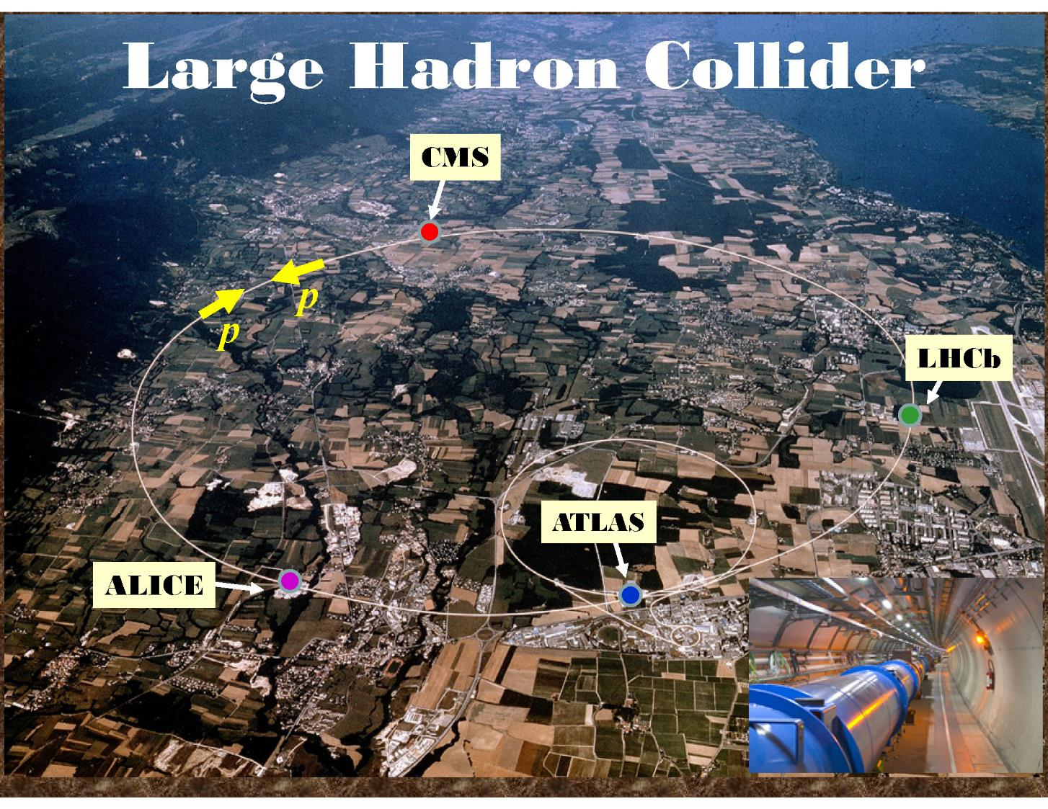
LHC computing resources in 2014
3.4 billion CPU hours
100 PetaBytes storage
Notes:
First beam splashes at the LHC
After a two-year shutdown, the first beams of Run 2 circulated in the LHC earlier this month (April 2015). The LHC operators performed dedicated runs to allow some of the experiments to record their first signals coming from particles splashed out when the circulating beams hit the collimators. and CMS recorded their first splash events of Run 2 :
https://cds.cern.ch/journal/CERNBulletin/2015/17/News%20Articles/2007716?ln=en
The computing resources consumed in 2014 concern the reprocessing of data taken during the first run (which stopped in 2013) and simulation activities. The second run of the LHC that is now starting will require even more resources than run 1.

Slide 4
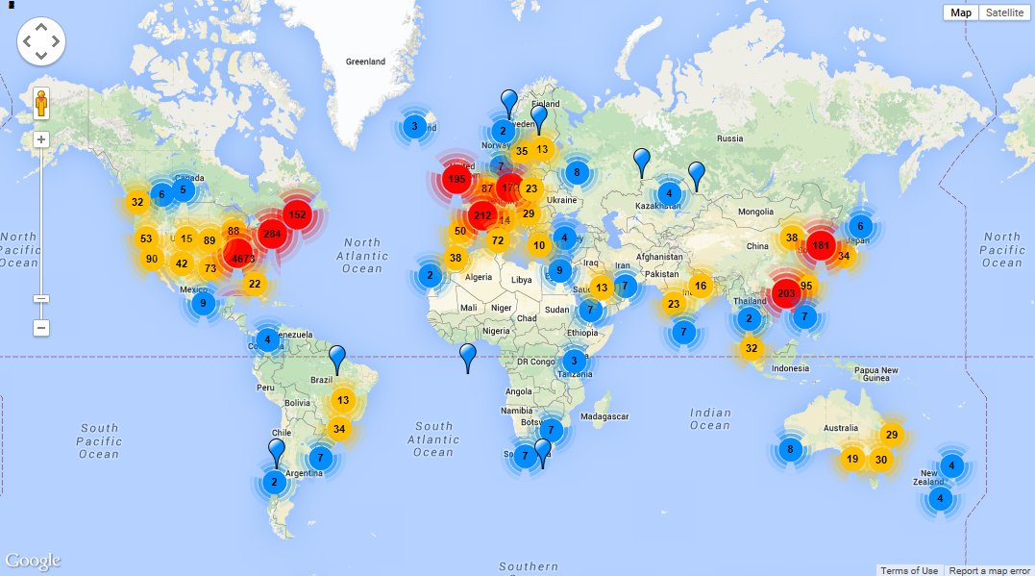


Next Generation Genomics: World Map of High-throughput Sequencers
Managed by EMBL-EBI:
55 PetaBytes of data
55,000 CPU cores
Doubling every 18 months
http://omicsmaps.com/
Notes:
EMBL-EBI provides public and managed access to dataset and associated analysis services for the global life sciences community based on an IT infrastructure totalling 55 PetaBytes and 50,000 processing cores. Many of these datasets are doubling every 12 months and so EMBL-EBI estimates that by 2020 the datasets and services will expand to such a scale that they will require an infrastructure approaching 2 Exabytes and 250,000 cores.
The EGA provides a service for the permanent archiving and distribution of personally identifiable genetic and phenotypic data resulting from biomedical research projects. Data at EGA was collected from individuals whose consent agreements authorise data release only for specific research use to bona fide researchers. Strict protocols govern how information is managed, stored and distributed by the EGA project.
Otogenetics Corporation is the centre in the USA with such a high number of machines (4500).

Slide 5
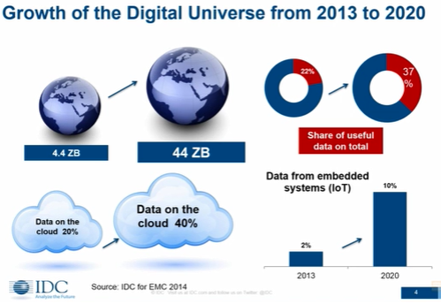
Notes:
IDC research indicates that the amount of data to be dealt with across all sectors (all digital content) will increase 10 times in volume between 2013 and 2012. The fraction of that data available via the cloud will double. A zettabyte is 1000 exabytes which is 1000 petabytes which is 1000 terabytes.

Slide 6
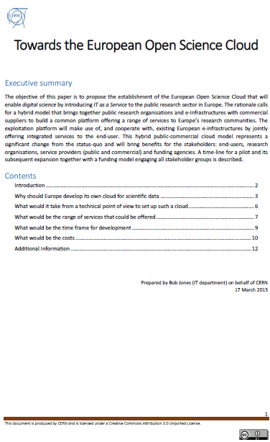
What is the European
Open Science Cloud?
Hybrid – link public research organisations, e-Infrastructures & commercial cloud services
  Use GEANT network to link Research Infrastructures, repositories (EUDAT, OpenAIRE), EGI, PRACE etc. to commodity commercial cloud services (multiple providers)
  Relevance for all communities facing societal challenges explained in EIROforum publication *
Trust - Researchers keep control of the cloud and their data
  Guarantee a copy of all the data is kept on public resources
  Ensure long-term preservation of the data
  Insulate users from changes of service supplier and technology
Economy - Must be cheaper than the ‘build our own’ approach
  Avoid separate ‘silos’ for each Research Infrastructure/Community
  Profit from the economies of scale in commercial data centres
* http://dx.doi.org/10.5281/zenodo.34264
http://dx.doi.org/10.5281/zenodo.16140
Notes:
So clearly there is a need to have a platform on which this data can be managed.
Sharing of data is necessary, increasing and must be encouraged by the platform but it has to respect the cultures and investments made by the research communities.
Researchers have fears, some of them irrational, about using commercial cloud services.
But telling someone who is afraid of flying that their fear is irrational does not mean they will get on the plane.
We have to make them feel secure. Here the hybrid cloud model can help by ensuring that a copy of their precious data is kept safe on publicly managed resources.
Economy – the price comparison must take into account all costs, not just the purchase price of h/w.

Slide 7
















































The European cloud public-private partnership
Strategic Plan
Establish multi-tenant, multi-provider cloud infrastructure
Identify and adopt policies for trust, security and privacy
Create governance structure
Define funding schemes
To support the computing capacity needs for the ATLAS experiment
Setting up a new service to simplify analysis of large genomes, for a deeper insight into evolution and biodiversity
To create an Earth Observation platform, focusing on earthquake and volcano research
To improve the speed and quality of research for finding surrogate biomarkers based on brain images
Additional Users:
Suppliers
Adopters
March 2016

Slide 8
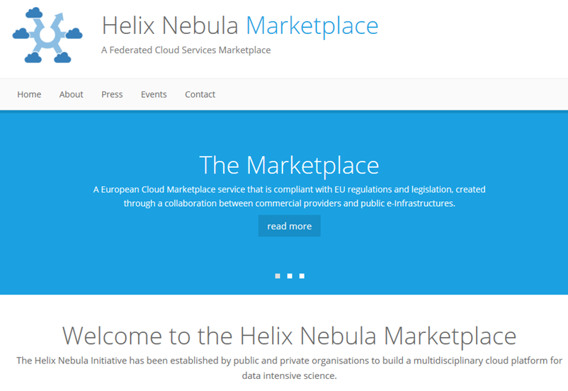
HNX Platform
Branded-product
# 1: HNX
EC2 Bridge
IaaS
Broker
Atos
CloudSigma
Interoute
T-Systems
EGI
FedCloud
GÉANT / Internet
Notes:
Together a sub-set of the suppliers have developed a first product called HNX which implements the hybrid model and has been used for application deployments.

Slide 9
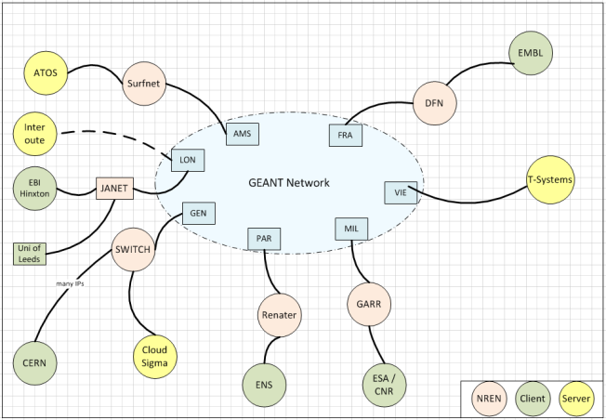
Building the hybrid cloud
Connecting commercial cloud providers to GÉANT/NRENs
GEANT Association offering free IP connectivity in GÉANT for research traffic during the pilot phase
NRENs have different commercial agreements (usually they apply a fee)
Currently T-Systems connects through DFN in Germany
Notes:
A key point is to make use of the GEANT high performance network. GEANT and the NRENs have enabled the connection of commercial cloud service providers so that data and applications from the research organisations can be transferred and processed without the users paying additional ingress and egress costs that are typical of standard commercial cloud service charges.

Slide 10
What are the remaining gaps?
Key challenges identified in the EC Paper
“Advances in Cloud”
http://cordis.europa.eu/fp7/ict/ssai/docs/future-cc-2may-finalreport-experts.pdf
  Interoperation across clouds
  multi-tenancy at large scale
  seamless elasticity in a hybrid cloud
  data management
The science community identified a key opportunity for Europe!

Slide 11
How to address them?
H2020 project INDIGO-Datacloud
www.indigo-datacloud.eu
(Apr 2015 – Sep 2018, Grant Agreement RIA 653549)
26 European Partners in 11 countries, 11.1M€
Develop an open-source cloud for science
Focus on use cases presented by scientific communities
Design a global architecture making use of lightweight containers and microservices
Provide general solutions through public open-source software releases
8-8-16: MidnightBlue released

Slide 12

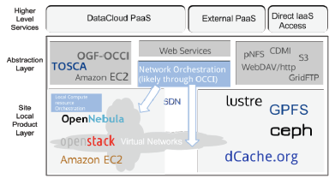
High-Level view of the interaction between IaaS and PaaS layer

Slide 13
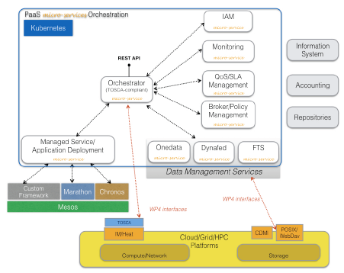
Key components of the PaaS and their high-level interrelations

Slide 14
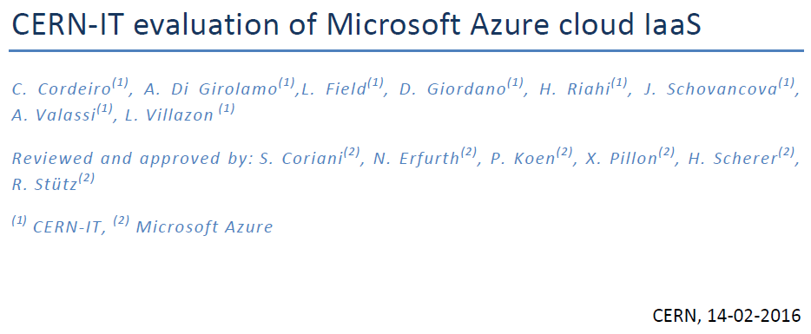
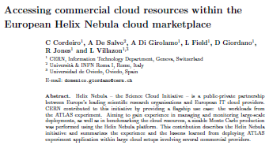
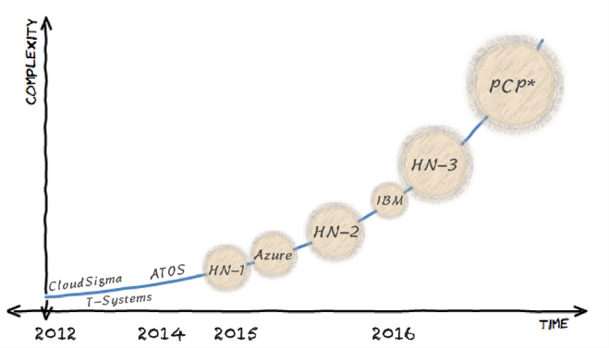






CERN Approach
Series of short procurement projects of increasing size and complexity
Open Telekom Cloud

Slide 15
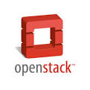
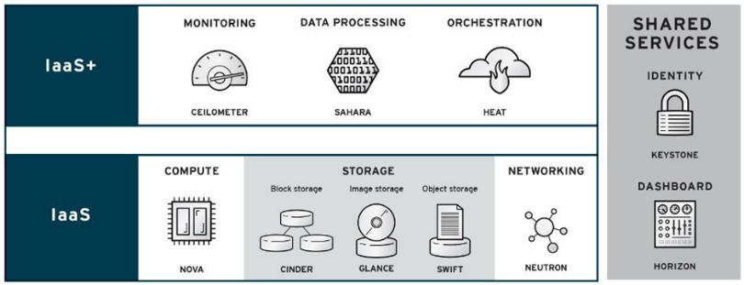
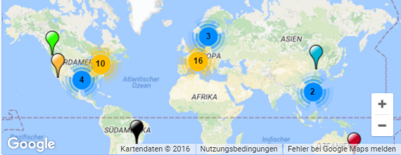
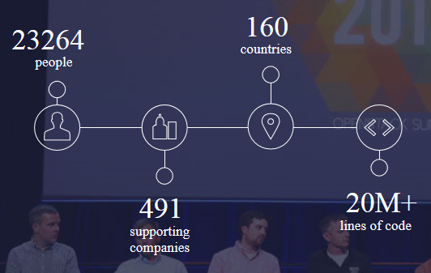
Creating a momentum through
Open Standards
OpenStack based Public cloud services providers
The OpenStack community
Notes:
It is important to ensure that such a platform remains open and allows all parties to participate. Standards are maturing and so are the underlying open source technologies with massive uptake in the academic, research and commercial domains. This means that there is a channel for ensuring the innovation spreads rapidly with clear IP rules. It also means that funding agencies, both national and European, can fund innovation with the assurance that there are functioning business models that will ensure the long-term support, maintenance and exploitation.
By ‘public cloud service providers’ we mean companies selling cloud services on an open market.
OpenStack is the linux of the cloud world.

Slide 16

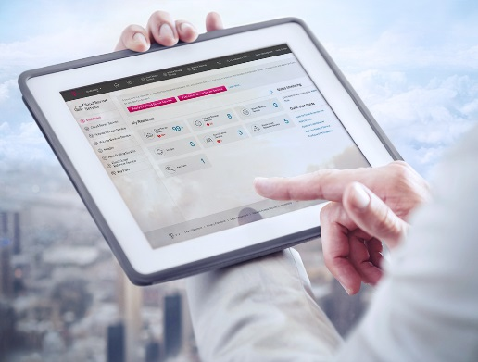



Open telekom cloud
Simple
  Easy to use Public IaaS
  On boarding
  OpenStack
Secure and compliant
Data privacy according to German legislation
Enterprise grade
Affordable
Best market prices
CapEx to OpEx für IT infrastructures
German IaaS alternative by huge player

Slide 17

Open Telekom Cloud
Service Catalogue (Release 1.01)
compute
Cloud Server Service
Auto
Scaling Service
Cloud Image
Service
Relational Database Service (MySQL)
Container Service (Docker)
Storage
Cloud Storage Service
Volume Storage Service
Volume Backup Service
network
Virtual Private Cloud Service
Elastic Load Balancer Service
Elastic
IP Service
security
Anti-DDoS Service
Management
Cloud Monitor Service
Identification & Authentication Service

Slide 18
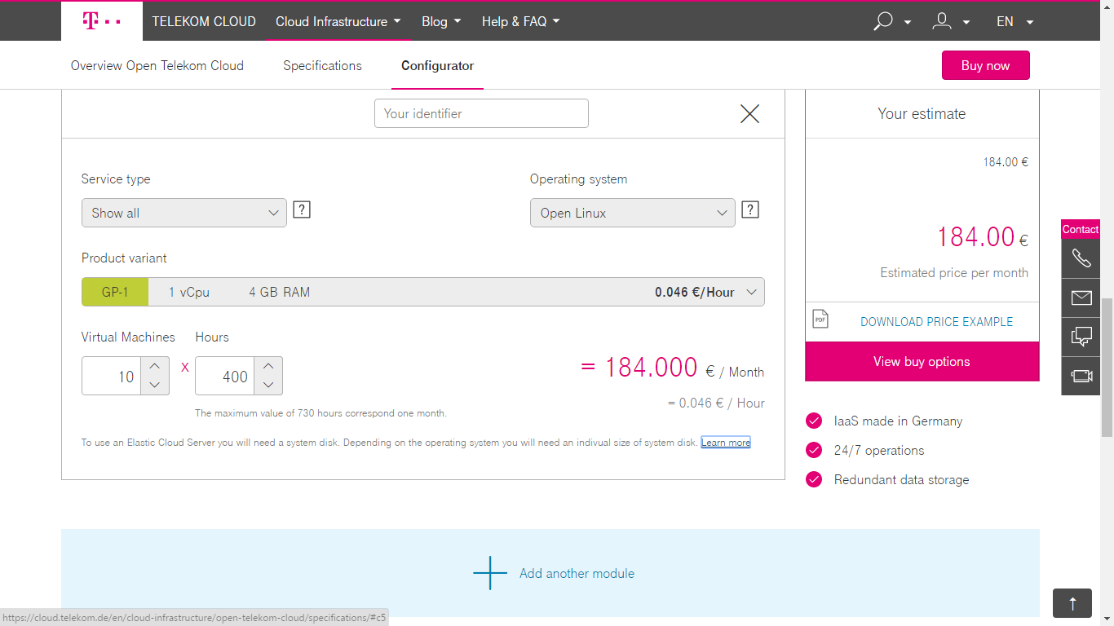
Open Telekom Cloud
configurator

Slide 19
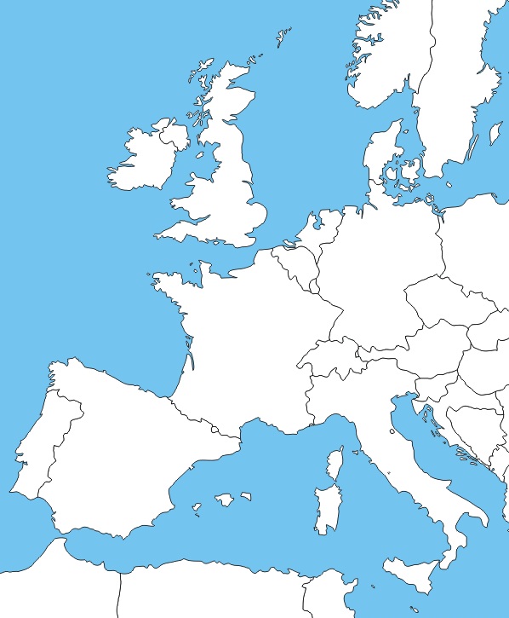









HNSciCloud Joint Pre-Commercial Procurement
The group of buyers have committed
>1.6M€ of funds
Manpower
Use-Cases with applications & data
In-house IT resources
To procure innovative cloud services integrated into a hybrid cloud model:
Commercial cloud services
European e-Infrastructures
Service will be made available to end-users from many research communities including BBMI, DARIAH, ELIXIR, EISCAT_3D, EPOS, INSTRUCT, LifeWatch, LHC, etc.
Co-funded via H2020 (Jan’16-Jun’18)
Grant Agreement 687614
Notes:
Research organisations from 7 countries have proposed to work together to develop a cross-border joint procurement of innovative cloud services. This is an important change: never before have research organisations across Europe pooled their funds and resources to procure cloud services to support their scientific programmes.
eduGAIN federated identity mgmt. should include commercial identity providers taking into account multiple levels of assurance.

Slide 20
Closing remarks
Cloud computing offers a flexible, cost effective model for IT resource provisioning
A hybrid cloud model leverages the investments made in both the public and private sectors while ensuring trust and continuity
Changes to the procurement process in the public research sector are necessary to benefit from a dynamic Digital Single Market
Mature open source technologies exist but integration, and adherence to standards requires careful attention
A European Open Science Cloud will promote public-private innovation to satisfy the needs of the research communities and increase the global competitiveness of Europe’s cloud service suppliers

Slide 21
We very much welcome any user feedback!
IF you consider joining the current cloud orchestration survey please contact:
K.Schleuning@telekom.de jurry.delamar@t-systems.com
Thank you for your attention!

