Slide 2
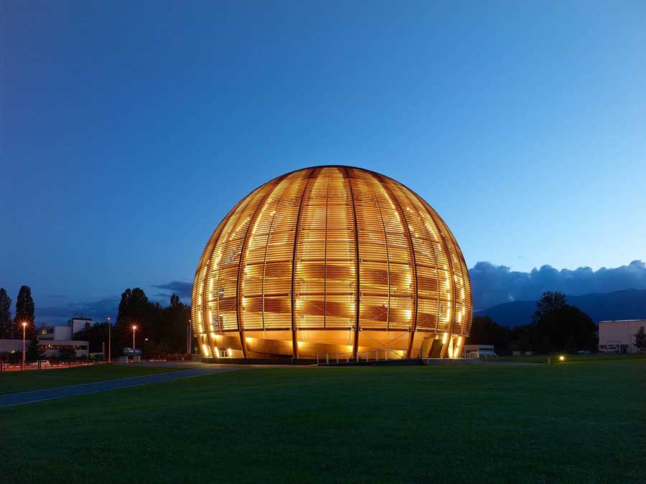
GridKA School 2016
OpenStack @ CERN
Jose Castro Leon
CERN Cloud Infrastructure
Notes:
Hi everyone,
My name is Jose Castro Leon. I am working at CERN on the Cloud Infrastructure Team
This is how to build an openstack cloud, in particular how we build the CERN Cloud

Slide 3
CERN
  World’s largest particle physics laboratory
  Founded in 1954
  Located at Franco-Swiss border near Geneva
  22 member states
  ~2’500 staff members
  >12’000 users

Slide 4
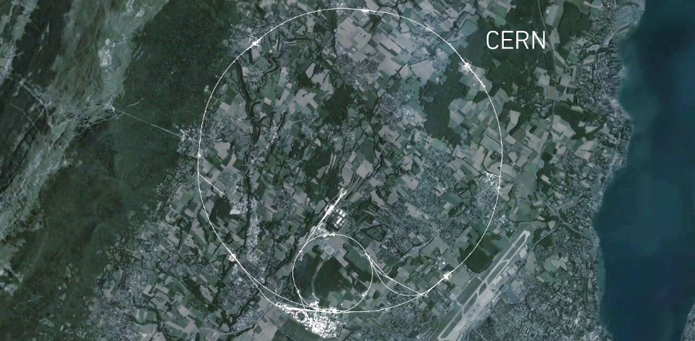
Largest Machine on Earth
CMS
ALICE
ATLAS
LHCb
27 Km circumference, 100m underground
Notes:
This is a map of the complex of main accelerators of CERN.
The dotted line is the French-Swiss border.
The 2 main CERN sites are Meyrin and Prévessin (as big, but not as built nor populated)
The PS is the tiny 600m ring on the Meyrin site, the SPS goes accross the border and the LHC takes all the space between Geneva airport and the Jura (dark green on the left).
The 4 red dots represent where the 4 detectors are located.

Slide 5
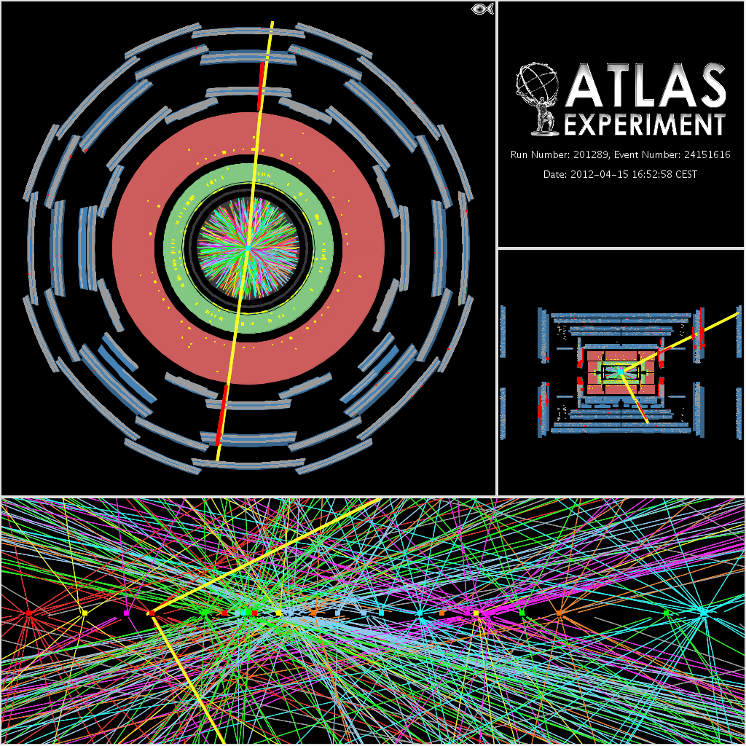
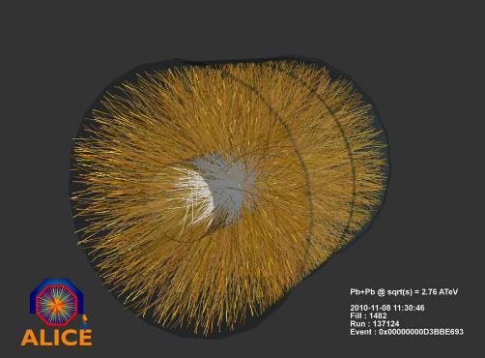
COLLISIONS
Collisions Produce 1PB/s
Notes:
The detectors produce about 1PB/s, this is filtered down to 10s of GB/s using farms close to the detectors and then sent to the computer centre.

Slide 6
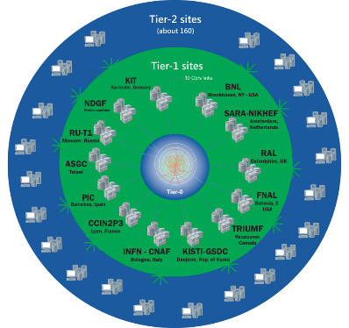
Worldwide LHC Computing Grid
TIER-0 (CERN):
data recording, reconstruction and distribution
nearly 170 sites,
40 countries
~350’000 cores
TIER-1:
permanent storage,
re-processing,
analysis
500 PB of storage
> 2 million jobs/day
TIER-2:
Simulation,
end-user analysis
10-100 Gb links

Slide 7
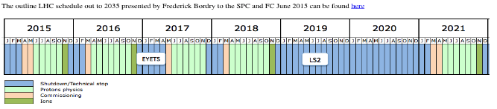
Compute Growth Outlook
Compute: Growth > x50
Moore’s law only x16
What we can afford
… and 400PB/year by 2023
Notes:
EYETS – extended year technical stop

Slide 8
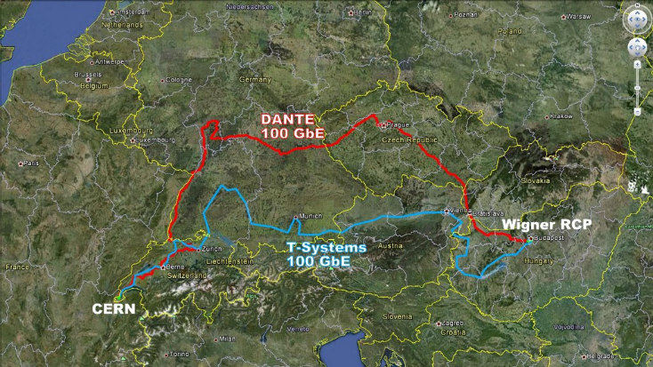
Expanded Facilities in Hungary
Notes:
An additional data centre gave us the total capacity… we ran a competive procurement and selected Budapest for a 2nd 3MW datacentre according to CERN’s purchasing rules.
Given public procurement, we can only procure on a 1-2 times/year in bulk.

Slide 9
Notes:
We came up with a number of guiding principles…
We took an approach that CERN was not special. Culturally, for a research organisation this is a big challenge. Many continue to feel that our requirements would be best met by starting again from scratch but with the modern requirements.
In the past, we had extensive written procedures for sysadmins to execute with lots of small tools to run, These were error prone and often the guys did not read the latest ones before they performed the operation. We needed to find ways to scale the productivity the team to match the additional servers.
One of the highest people cost items was the tooling. We had previously been constructing requirements lists, with detailed must-have needs for acceptance. Instead, we asked ourselves how come the other big centres could run using these open source tools yet we had special requirements. Often, the root cause was that we did not understand the best approach to use the tools rather than that we were special.
The maintenance of our tools was high. The skills and experienced staff were taking up more and more of their time with the custom code so we took an approach of deploy rather than develop.
This meant finding the open source tools that made sense for us, trying them out. Where we found something that was missing, we challenged it again and again. Finally, we would develop in collaboration with the community generalised solutikons for the problems that can eb maintained by the community afterwards. Long term forking is not sustainable.

Slide 10
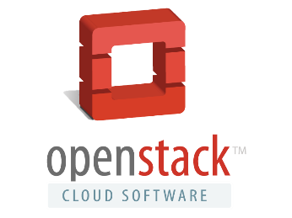










CERN Tool Chain

Slide 11
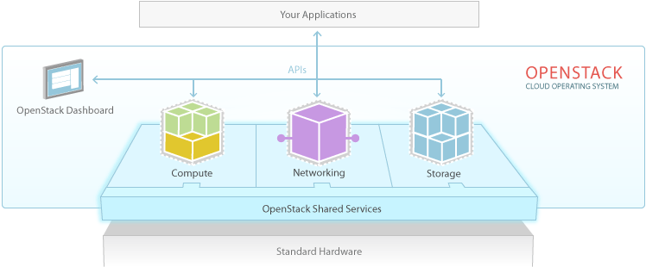
OpenStack
Notes:
Here is the basic architecture of Openstack. In these we can see the several services like compute, networking or storage offering their APIs to the users to consume resources. There is also the dashboard that allows the users to interact with the APIs through a website. On the bottom part there is a set of services that they are not offering resources but they are needed for the cloud, like authentication/authorization, databases, message brokers…

Slide 12
Not Just The Software
Upstream OpenStack on its own does not give you a cloud service
e.g.
200 people arrive and leave CERN / month
User skill levels vary widely
Application range from server consolidation, dev/test to production compute
Metering and chargeback
Autoscaling
Monitoring and alerting
Remediation
Cloud is a service!
High availability
Config management
Resource Lifecycle
Log processing
Infra
onboarding
Capacity planning
Metrics
OpenStack APIs
Network design
CI
Upgrades
Cloud monitoring
Builds
Net/info
sec
SLA
Alerting
Incident resolution
Customer support
User experience
Subbu Allamaraju @ eBay

Slide 13
CERN OpenStack Project
July 2013
CERN OpenStack
Production Service
February 2014
CERN OpenStack
Havana Release
October 2014
CERN OpenStack
Icehouse Release
March2015
CERN OpenStack
Juno Release
September 2015
CERN OpenStack
Kilo Release
August 2016
CERN OpenStack
Liberty Release
5 April 2012
27 September 2012
4 April 2013
17 October 2013
17 April 2014
16 October 2014
30 April 2015
15 October 2015
15 April 2016
ESSEX
Nova (*)
Swift
Glance (*)
Horizon (*)
Keystone (*)
FOLSOM
Nova (*)
Swift
Glance (*)
Horizon (*)
Keystone (*)
Quantum
Cinder
GRIZZLY
Nova
Swift
Glance
Horizon
Keystone
Quantum
Cinder
Ceilometer (*)
HAVANA
Nova
Swift
Glance
Horizon
Keystone
Neutron
Cinder
Ceilometer (*)
Heat
ICEHOUSE
Nova
Swift
Glance
Horizon
Keystone
Neutron
Cinder
Ceilometer
Heat
Ironic
Trove
JUNO
Nova
Swift
Glance
Horizon
Keystone
Neutron
Cinder
Ceilometer
Heat (*)
Rally (*)
KILO
Nova
Swift
Glance
Horizon
Keystone
Neutron
Cinder
Ceilometer
Heat
Rally
Manila
LIBERTY
Nova
Swift
Glance
Horizon
Keystone
Neutron (*)
Cinder
Ceilometer
Heat
Rally
Magnum (*)
Barbican (*)
Ironic
MITAKA
Nova
Swift
Glance
Horizon
Keystone
Neutron
Cinder
Ceilometer
Heat
Rally
Magnum (*)
Barbican (*)
Manila
Ironic
(*) Pilot
Notes:
We are gradually expanding the functionality of the CERN cloud through the releases.
We experiment with some new technology, some make it to production in a release or so, others such as Ironic, we have a look at and then come back a year or so later
The service catalog functions allow us to easily expose selected function to early users

Slide 14
OpenStack@CERN Status
In production:
4 clouds
>200K cores
>8,000 hypervisors
~60,000 additional cores being installed in Q2 2016
90% of CERN’s compute resources are now delivered on top of OpenStack
Notes:
Already 4 independent clouds – federation is now being studied
Currently around 160,000 cores in the largest IT instance
3 other OpenStack Clouds run by the experiment teams
Around 70% is compute dedicated cores, 20% production services and 10% test and dev

Slide 15
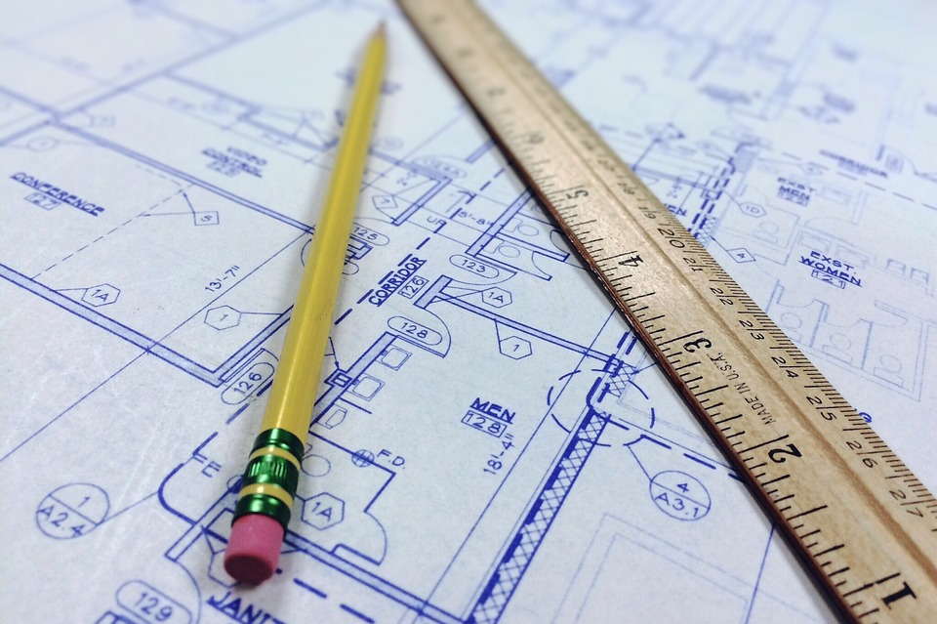
Architecture
Notes:
How we arrive to this architecture. As I said before we were launching preproduction services and gaining operational experience with them.
Along with each service we did some changes in the architecture in each cycle while adding new features

Slide 16



1st Architecture
Compute
Nova Compute
API Node
Keystone
Glance
Horizon
Nova API
Compute
Nova Compute
Notes:
This is the first architecture we used in our first pre production instance in 2012. It is pretty much similar to the one we get after packstack finishes. But at that time we did not have packstack.
So in this one we have one controller with all services in it. We also have the queue and the database. For the compute nodes in this release we only had KVM as the Hyper-V driver was not quite stable yet.

Slide 17

2nd Architecture
Compute
Nova Compute
API Node
Keystone
Glance
Horizon
Nova API
Compute
Nova Compute
Notes:
This was our second architecture of the service. We started to add more high availability on the service itself. We put several controllers with a shared queue and database. We added a load balancer frontend to minimize user impact when doing maintenance/upgrades and we add windows hypervisors.
So this architecture was a bit more mature than the other but it has also some inconveniences.

Slide 18
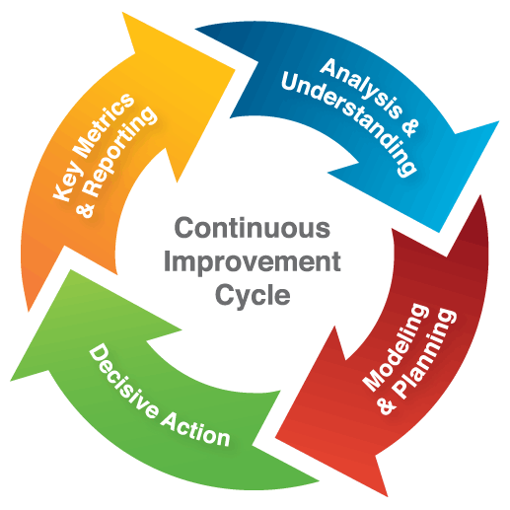
… and it continues
Notes:
So we iterate it over an over improving the availability and reliability of the system

Slide 19

N^{th} Architecture
Notes:
And right know we are in our last version.
Right now we splitted all services maintainting the API as the stable connection between them. That’s because all services have a different requirements and architecture.
This approach is quite flexible as it allows us to modify the layout of an specific service without affecting others. It allowed us to make updates much more easily.
Our approach for updates was always to create a dependency graph and update the services following this order. This distributed architecture allows us to unlink this dependency graph and upgrade each service when ready.
But this approach is not perfect, the compute nodes (hypervisors) are shared between services (Ceilometer, Nova) we still need to check for compatibility between versions between this two services.
The community is working since the last two releases to improve the upgrade procedures to minimize impact on the users.

Slide 20


Compute Service
Nova Cell
Compute
Compute
Compute
Compute
Compute
Compute
Nova API
Nova API
Nova API
Nova Cell
Compute
Compute
Compute
Compute
Compute
Compute
Notes:
This is for example the architecture of the compute service. It is hierarchical. We split the compute servers in different batches (cells). All of them are independent and have their own queue and database.
All of this cells are aggregated into the api level. Each cell is capable to handle up to 1000 hypervisors. Currently we have 20 between different computer centres and this allows us to scale transparently between them.
Because we offer only one API for the compute resources at CERN.
For the api nodes, we preferred to have physical machines up to a certain level. In case of a disaster recovery scenario we have just the enough resources to make the cloud available, and we use the virtual ones to scale it up.

Slide 21


Identity Service
Keystone.cern.ch
Identity
Identity
Identity
Identity
Notes:
This is how it looks like the identity architecture. The identity service is integrated with AD, we use CERN accounts for the cloud service. This service has different requirements as the compute one.
This service needs to support different authentication methods (kerberos, x509 and SSO) from the end-user and from the cell monitoring. For this reason we inspect the request method of the client and redirect to the proper backend at the load balancer level.
With this architecture we offer seamless transition between versions of the identity service for compatibility reasons. We also offload some of the cell monitoring load from the identity service onto a different set this load can be up to 90% load of the identity service.

Slide 22
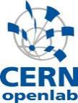
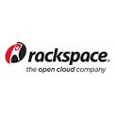
Onwards Federated Clouds
Public Cloud such
as Rackspace or IBM
Many Others
on Their Way
NecTAR
Australia
Brookhaven
National Labs
ALICE Trigger
9K cores
CERN Private Cloud
160K cores
INFN
Italy
ATLAS Trigger
28K cores
CMS Trigger
13K cores
Available in standard OpenStack since Kilo
Notes:
The trigger farms are those servers nearest the accelerator which are not needed while the accelerator is shut down till 2015
Public clouds are interesting for burst load (such as coming up to a conference) or when price drops such as spot market
Private clouds allow universities and other research labs to collaborate in processing the LHC data
This is now in production for EU projects to allow rapid access to resources without registration

Slide 23

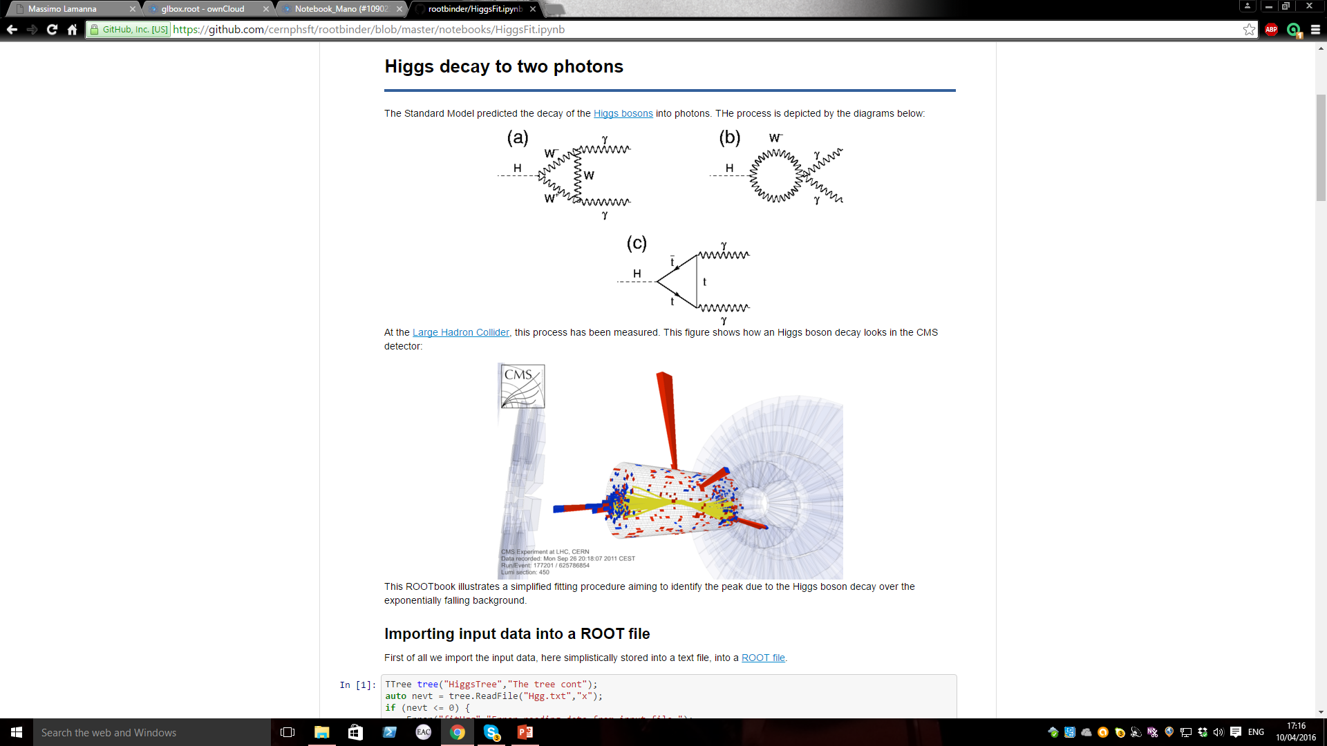
Containers on Clouds
For the user
Interactive
Dynamic
Choice
For IT
Timely!
Secure
Managed
Integrated
CERN now runs Magnum on the production cloud
Notes:
Users want an interactive environment for physics analysis… open the web browser, write your paper and analysis including the data into a notebook and run. Provide that notebook to the citizen scientists as part of your outreach work
Some may want Kubernetes, others Docker Swarm, not a single solution....
Make the request to central IT department and wait ......
Managed means:
Project structure
Shared free resource pool
Authorisation / Identity
Audit
Resource lifecycle
Familiar end user interface

Slide 24

Operational Experiences
Upgrades
Maintenance procedures
User support and documentation
Monitoring and automation
Resource lifecycle management
Notes:
During last two years that we are been running the cloud we gained a lot of experience. In upgrades for example, we have been doing in-place upgrades since grizzly release.
These upgrades means that the machines continue to run during the intervention. We have minimized the user impact to the API access level. Some of the services we managed to get live-upgrades.
More and more of the components allow us to do live upgrades.
We also automate most of the maintenance using rundeck. Some tedious operation like when you need to evacuate a node due to a hardware failure, is fully automated using rundeck.
We also write documentation and best practices guides for our user community that explains better how they can use our cloud.

Slide 25
CERN Integration
Datacenter network
  Flat network
  Specific restrictions to allow traffic
  Register instance before boot up
Kerberos and domain join
Notes:
Some of the extra code that we wrote was to integrate it on the datacenter network. At CERN every single instance needs to be registered before trying to access to the network. We have a highly restricted flat network environment with specific restrictions to allow traffic.
An instance can only have network on a specific rack of the computer centre. On every machine creation, we are registering it on the Network DB service and checking if it can receive an IP address/name before booting it up. Also we check that the machine can access the CERN domain, so we create a computer account on the domain before booting it up. This allows us to deploy machines joined into the CERN domain.

Slide 26


Challenges
Scale out
Consolidate
  Enhance
  Investigate
Notes:
Scale out
Another ~100K cores end 2016
Further significant retirements and migrations
Consolidate
EC2 API project
Nova network to Neutron
Enhance
Kubernetes,Mesos,Swarm containers for all
Bare metal (Ironic) and Workflow (Mistral) to pilot
Accounting / Fleet Management
Investigate further capacity options
Public clouds

Slide 27

Thank you
github.com/cernops
openstack-in-production.blogspot.ch
jose.castro.leon@cern.ch
@josecastroleon
IRC: josecastroleon

Slide 29
Backup Slides

Slide 30
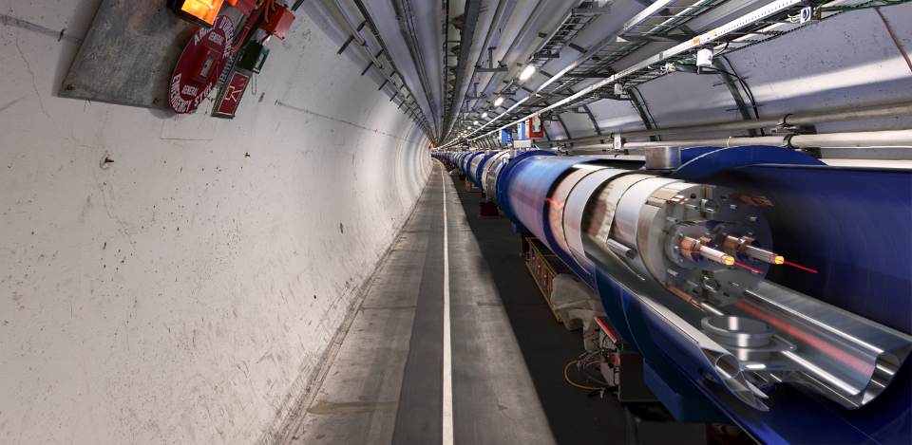
Most Powerful Magnets
9,600 superconducting magnets direct the beam
Notes:
The LHC is built underground, mainly for financial reasons (would have cost too much to buy all the land and would have been impractical anyway).
It also provide natural shielding of radiations for the population but also shielding from cosmic rays to the 4 detectors.
The LHC is mainly hosted in a 3m diameter tunnel containing mostly superconducting magnets and some accelerating devices.
You can see on the picture that the 2 counter-rotating beams are hosted in different pipes, making collisions impossible there.

Slide 31
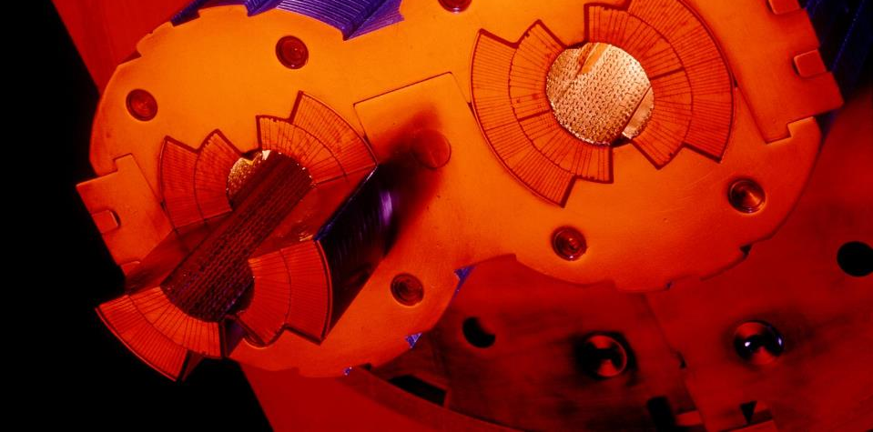
Highest Vacuum
Pressure is 10 times less than on the moon
Notes:
These 2 pipes need to be as empty as possible (otherwise protons would hit air molecules all the time).
Thanks to turbo-molecular pumps and other technologies, we reach a vacuum of 10^-13 atmosphere in the centre of the pipes: this is 10 times emptiers than on the surface of the Moon or as empty as in the solar system.
The magnetic field which curves the beam, is provided by the coils surrounding the pipes. As each beam holds as much energy as in a high-speed train, the magnets must deliver a tremendous magnetic field of 9 T (tesla). This equates to 200’000 times the magnetic field of Earth (ca 45 micro tesla)
For that, each of the small electric cable you see around the vacuum pipes (1mm by 10mm section) a current of 11’000 amperes (in comparison in your home there is a current of about 20 amperes in the wires).

Slide 32
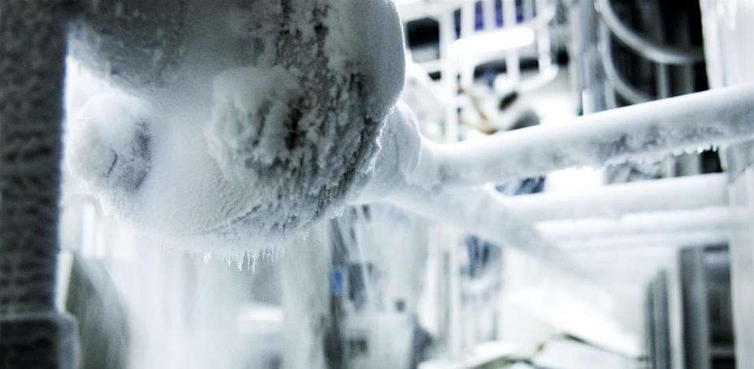
Coldest Temperature
120 tonnes of liquid helium for cooling to -271°C
Notes:
That’s why we need to cool down the cables to the lowest temperature possible.
We have to reach -271°C (or 1.9° kelvin, which is 1.9° above the absolute zero).
At that temperature, the cables made of Niobium Titanium (NbTi) are «superconducting», it means they don’t heat up anymore as they have no electric resistance.
LHC is colder than the vast majority of the Universe whose average temperature is 2.725° kelvin
This is possible thanks to cryogenic facilities using 120 tonnes or 700’000 litres of Helium!

Slide 33
30M USD/year Electricity Bill
Up to 200MW at peak utilisation
Notes:
Maintenance is generally done during the winter months due to the electricity price increases.
Unfortunately, being in the countryside, there are occasional problems such as the one a month ago where a pine marten caused a short circuit in the 66KV transformer and the LHC was down for a week while repairs were done.

Slide 34
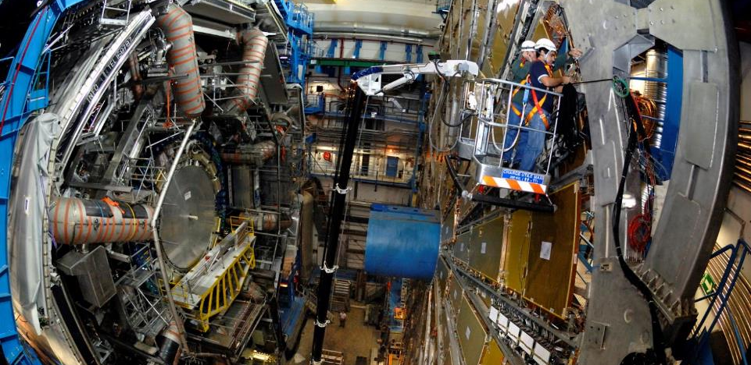
ATLAS Experiment
Notes:
Here is a real picture of ATLAS.
Noticed the man at the bottom?
ATLAS is a multi-purpose experiment looking for the Higgs Boson (which it has found in 2012), dark matter candidates etc.
It gathers 3000 physicists from 174 universities and institutes in 38 countries.
This is also the experiment with the largest Israeli involvement from Tel Aviv, Technion and Weismann instistutes along with a role as a computing hub for analysis.

Slide 35
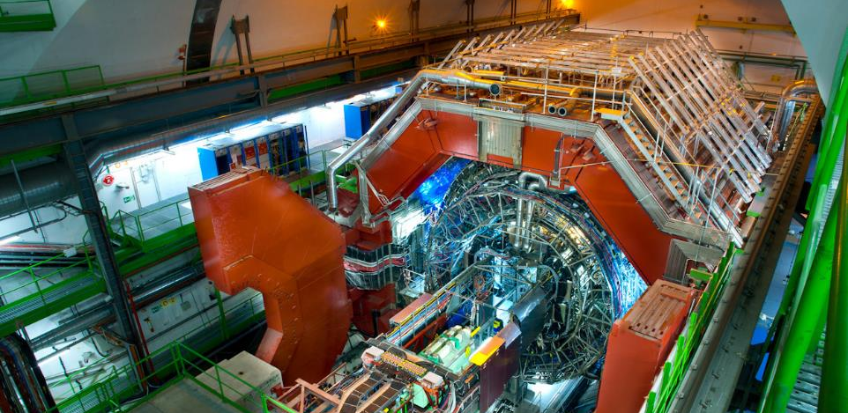
ALICE Experiment
Notes:
Here is a ALICE.
This experiment looks more particularly at the creation of the «Quark Gluon Plasma» state of matter which existed moments after the Big Bang.
For that it wait for the beams of Lead Nuclei which occur about 10% of the beamtime of the LHC.
It gathers 1500 physicists from 154 universities and institutes in 37 countries.

Slide 36
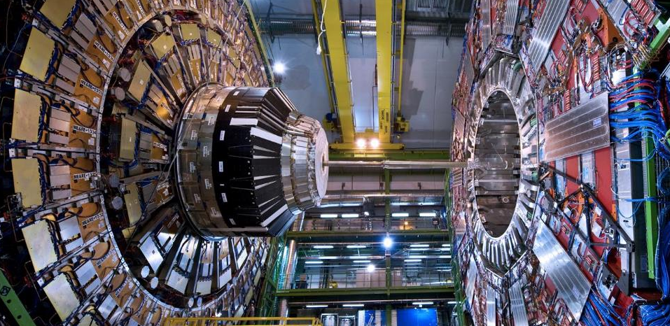
CMS Experiment
Notes:
Here is a CMS.
Like ATLAS, this is another multi-purpose experiment. It also discovered the Higgs Boson in 2012.
The C in CMS stands for Compact. Even though it does not look compact to most of you, this experiment is half the size of ATLAS but twice as heavy: 2 times the Eiffel Tower (14’000 tonnes)!
It gathers 2600 physicists from 182 universities and institutes in 42 countries.

Slide 37
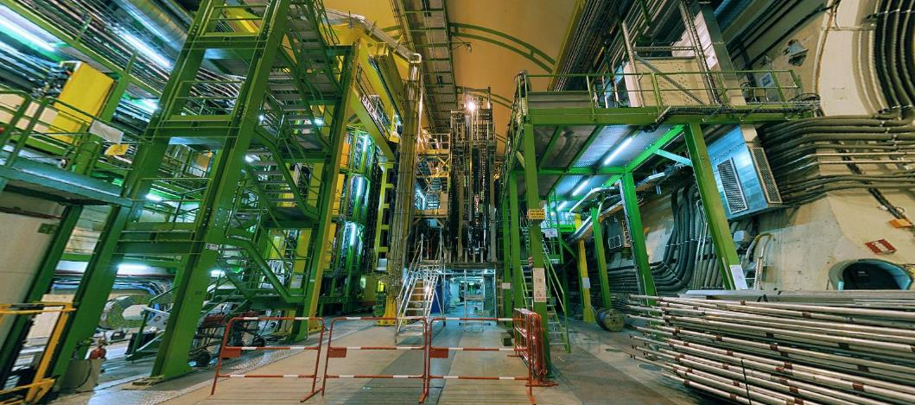
LHCb Experiment
Notes:
And the final experiment on the LHC is LHCb. Is is name after the «b» quark which it studies.
In fact LHCb studies the behaviour difference between the b quark and the anti-b quark.
It tries to find difference in the symmetry which may account for the lack of antimatter in the Universe.
It gathers 800 physicists from 69 universities and institutes in 17 countries.

Slide 38

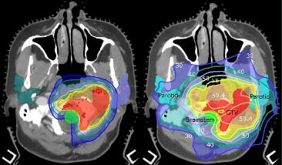
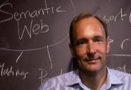
Innovations
Notes:
Magnets in MRI machines, Touch screens, Solar panels vacuums to reduce loss, Hadron therapy to use proton beams for cancer treatment and the world wide web..

Slide 39

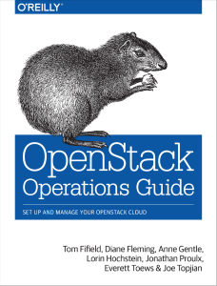
O’Reilly Consideration
Notes:
So how did we choose our tools ? There were the technical requirements are a significant factor but there is also the need to look at the community ecosystem.
Open source on its own is not enough.. Our fragile legacy tools were open source but were lacking a community. Typical example of this is the O’Reilly books.. Once the O’Reilly book is out, the tool is worth a good look.
Furthermore, it greatly helps to train new staff… you can buy them a copy and let them work it through to learn rather than needing to be guru mentored.

Slide 40
Job Trends Consideration
From Indeed.com
Notes:
CERN staff are generally on short term contracts, 2-5 years and come from all over the member states.
Attracting talent is important but also returning value to the funding member states is key.
They come to CERN, often out of university or their 1st jobs. We look for potential rather than specific skills in the current tools.
After a time at CERN, they leave with expert skills and experience in our tools which is a great help for finding future job opportunities and ensuring motivation to the end of their contracts.

Slide 41
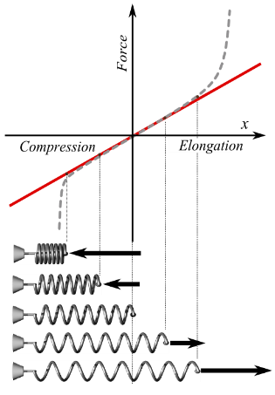
Cultural Change Impact
Move to Agile technologies brings great benefits
  Reduced deployment time
  Continuous integration validation
  Flexibility
Don’t forget Hooke’s Law (adapted)
  Under load, an organisation can extend proportional to external force
  Too much load leads to permanent deformation
Ensure the tail is moving fast as well as the head
  Application support
  Cultural challenges
  Process change
Notes:
Even in a research oriented environment like CERN, we’ve found tensions between the needs of different services. Hostnames, software version pinning, automatic updates at weekends, ... There are no easy answers especially in an organisation with a culture of academic freedom.

Slide 42
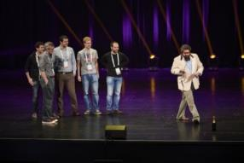
Communities Encourage Change
Open source collaboration sets model for in-house teams
External recognition by the community is highly rewarding for contributors
Reviews and being reviewed is a constant learning experience
Operator sharing is much more than just OpenStack
Keystone 2013
Paris 2014
Notes:
The cultural change can be greatly helping by interacting with the community.
Deploying the tools and not changing the processes does not make the change, seeing how a tool is used such as the openstack infrastructure team shows how continuous integration can work
Equally, working groups such as the operator meetups to share experiences, the large deployment team where clouds such as Walmart, eBay, Rackspace, goDaddy get together … typical example was where Yahoo! Described their unique network architecture, and we found that 80% of the large deployments had the same unique architecture and Neutron now supports the model.
Hypervisor tuning, we want the minimum virtualisation overhead… so does the Telekom industry so we use their optimisations for NFC to run efficient simulations
There are many ways to contribute ... It is not just limited to python code. Good sysadmins can help with packaging and configuration modules. Helping out on test days in your environment, There is now a vibrant set of user working groups, the docs always need more help and simply blogging about the problem you solved today is very useful.

Slide 43
Deployment Models
Skills
Culture
Need for Speed
Risk Appetite
Notes:
First question to ask is a cloud the right model ? Lots of good documents on that with the analysts so I won’t add more
Second question, is OpenStack the right solution to consider ?
Choose the distribution model which works for you
Run it yourself off trunk
Use a distro – we chose RDO
Private cloud as a service
Appliance
Selection based on skills, vendor relationships, need for flexibility

Slide 44
Keeping Up with Releases
Notes:
The forth road bridge painting process is a phrase used in the UK to describe a process which never completes… you restart it once completed.
The approach used at CERN is to try and upgrade within the next release window... We upgrade to Liberty before Mitaka is out.
There may be better ways but this is just about working for us at the moment with RDO help. Others choose more frequent updates. Others end up in a frozen zone on a fixed version.
Watch out for deprecation of features... Features come and go, it is important to interact with the community if an important feature is being reworked and adapt the service for your users. EC2 API, Nova networking, …

Slide 45
Users and Technology
Notes:
Lots of great projects with interesting technology
Are they useful for my end users ?
Are they mature and usable
Packaging
Configuration management
Documentation
We trial with summer students (10 weeks over the summer) and then review
Is it deployable ?
Is there potential user interest ?
Is it sustainable ?

Slide 46
When it’s not on the menu?
You want an m1.xxxlarge with SSDs ?
Notes:
As a private cloud provider, how do you handle requests which are not on the service level agreement ?
The massive VM
The GPU
The small SME application

Slide 47
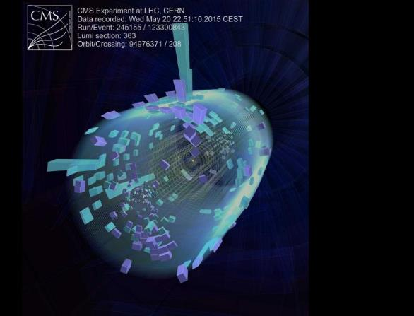
Thanks to all of you for contributing!
Technical details at http://openstack-in-production.blogspot.fr
Thanks to the CERN IT team and Francois Briard from CERN communications

Slide 48
Some history of scale…
Date | Collaboration sizes | Data volume, archive technology
Late 1950’s | 2-3 | Kilobits, notebooks
1960’s | 10-15 | kB, punchcards
1970’s | ~35 | MB, tape
1980’s | ~100 | GB, tape, disk
1990’s | ~750 | TB, tape, disk
2010’s | ~3000 | PB, tape, disk
For comparison:
1990’s: Total LEP data set ~few TB
Would fit on 1 tape today
Today: 1 year of LHC data ~27 PB

Slide 49
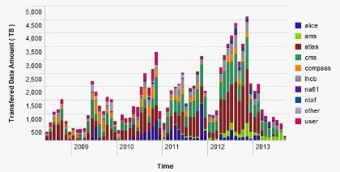
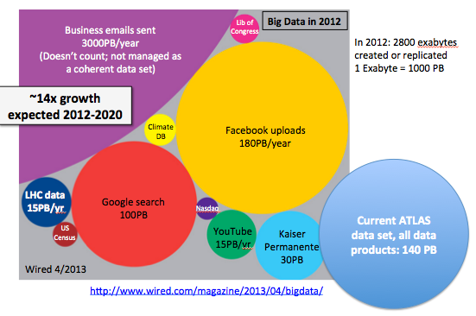
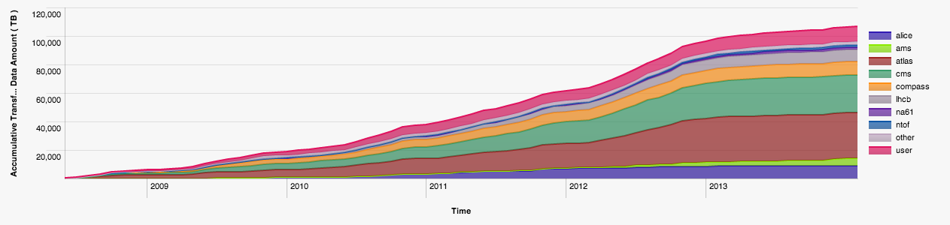
CERN New data
27 PB
23 PB
15 PB
CERN Archive
>100 PB

Slide 50


Slide 51
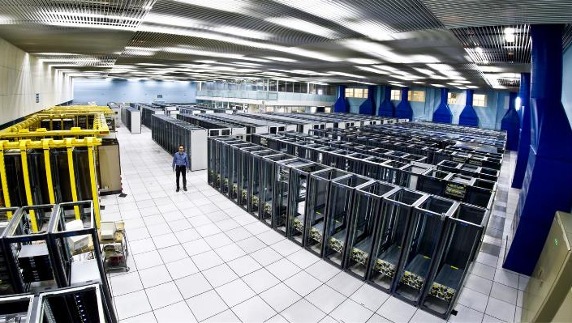
THE CERN MEYRIN
DATA CENTRE
http://goo.gl/maps/K5SoG
Notes:
Recording and analysing the data takes a lot of computing power.
The CERN computer centre was built in the 1970s for mainframes and crays. Now running at 3.5MW of power, it houses 11,000 servers but is at the limit of cooling and electrical power. It is also a tourist attraction with over 80,000 visitors last year!
As you can see, racks are only partially empty in view of the limits on cooling.

Slide 52
Public Procurement Cycle
Step | Time (Days) | Elapsed (Days)
User expresses requirement |  | 0
Market Survey prepared | 15 | 15
Market Survey for possible vendors | 30 | 45
Specifications prepared | 15 | 60
Vendor responses | 30 | 90
Test systems evaluated | 30 | 120
Offers adjudicated | 10 | 130
Finance committee | 30 | 160
Hardware delivered | 90 | 250
Burn in and acceptance | 30 days typical with 380 worst case | 280
Total |  | 280+ Days
Notes:
However, CERN is a publically funded body with strict purchasing rules to make sure that the contributions from our contributing countries are also provided back to the member states, our hardware purchases should be distributed to each of the countries in ratio of their contributions.,
So, we have a public procurement cycle that takes 280 days in the best case… we define the specifications 6 months before we actually have the h/w available and that is in the best case. Worst case, we find issues when the servers are delivered. We’ve had cases such as swapping out 7,000 disk drives where you stop tracking by the drive but measure it by the pallet of disks.
With these constraints, we needed to find an approach that allows us to be flexible for the physicists while still being compliant with the rules.

Slide 53
Good News, Bad News
Additional data centre in Budapest now online
Increasing use of facilities as data rates increase
But…
Staff numbers are fixed, no more people
Materials budget decreasing, no more money
Legacy tools are high maintenance and brittle
User expectations are for fast self-service
Notes:
With the new data centre in Budapast, we could now look at address the upcoming data increases but there were a number of constraints.
In the current economic climate, CERN cannot be asking for additional staff to run the computer systems.
At the same time, the budget for hardware is also under restrictions. The prices are coming down gradually so we can get more for the same but we need to find ways to maximise the efficicency of the hardware.
Our tools for management were written in 2000s, consist of 100,000 of lines of perl over 10 years, often by students, and in need of maintenance. Changes such as IPv6 or new operating systems would require major effort just to keep up.
Finally, the users are expected a more responsive central IT service… their expectations are set by the services they use at home, you don’t have to fill out a ticket to get a dropbox account so why should you need to at work ?

Slide 54
Innovation Dilemma
How can we avoid the sustainability trap ?
  Define requirements
  No solution available that meets those requirements
  Develop our own new solution
  Accumulate technical debt
How can we learn from others and share ?
  Find compatible open source communities
  Contribute back where there is missing functionality
  Stay mainstream
Are CERN computing needs really special ?
Notes:
We came up with a number of guiding principles…
We took an approach that CERN was not special. Culturally, for a research organisation this is a big challenge. Many continue to feel that our requirements would be best met by starting again from scratch but with the modern requirements.
In the past, we had extensive written procedures for sysadmins to execute with lots of small tools to run, These were error prone and often the guys did not read the latest ones before they performed the operation. We needed to find ways to scale the productivity the team to match the additional servers.
One of the highest people cost items was the tooling. We had previously been constructing requirements lists, with detailed must-have needs for acceptance. Instead, we asked ourselves how come the other big centres could run using these open source tools yet we had special requirements. Often, the root cause was that we did not understand the best approach to use the tools rather than that we were special.
The maintenance of our tools was high. The skills and experienced staff were taking up more and more of their time with the custom code so we took an approach of deploy rather than develop.
This meant finding the open source tools that made sense for us, trying them out. Where we found something that was missing, we challenged it again and again. Finally, we would develop in collaboration with the community generalised solutikons for the problems that can eb maintained by the community afterwards. Long term forking is not sustainable.

Slide 55
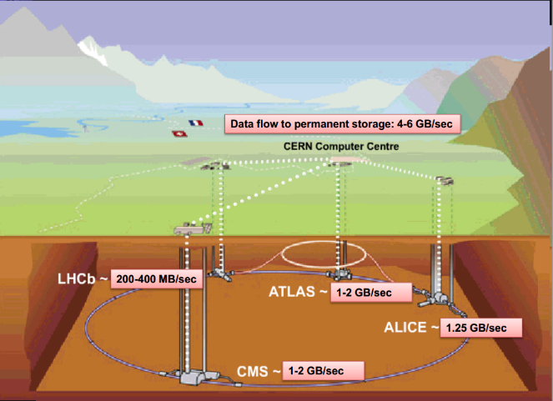

Slide 56
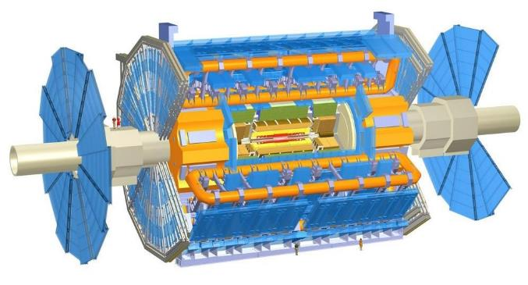
The largest detectors
Notes:
Now that we have accelerated the particles, let’s collide them!
This is possible only in the 4 points where we cross-over the beams.
The collision point is tinier than a needle head.
Here is the ATLAS detector, the largest of the 4 LHC detectors. Look at the small persons next to it.
It is 50 long, 25m diameter and weights 7’000 tonnes, the same as the Eiffel Tower.
The collision of protons will create new particles in all directions. That’s why the detector often have this cylindrical shape.

Slide 57
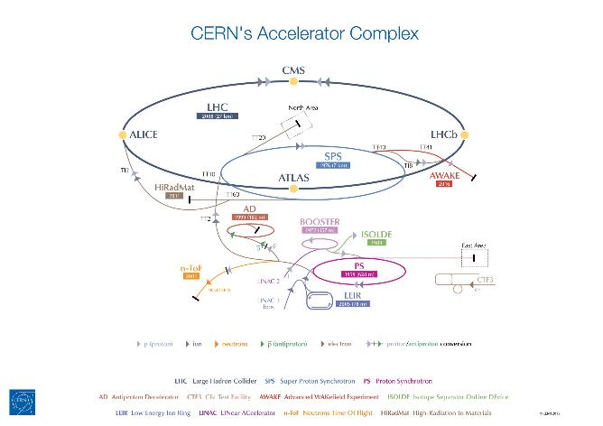

Slide 58

























Strategic Plan
Establish multi-tenant, multi-provider cloud infrastructure
Identify and adopt policies for trust, security and privacy
Create governance structure
Define funding schemes
To support the computing capacity needs for the ATLAS experiment
Setting up a new service to simplify analysis of large genomes, for a deeper insight into evolution and biodiversity
To create an Earth Observation platform, focusing on earthquake and volcano research
To improve the speed and quality of research for finding surrogate biomarkers based on brain images
Additional Users:
Suppliers
Adopters

Slide 59
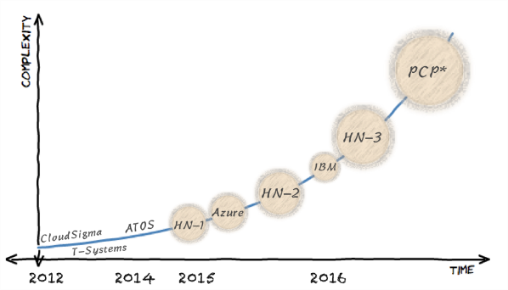

Investigations
Support CERN’s scientific computing programme
    HN - Helix Nebula
    Partnership between research organization and European commercial cloud providers
* EC co-funded joint Pre-Commercial Procurement (PCP) project: https://indico.cern.ch/event/319753
** Other work has been conducted outside CERN, such as the Amazon Pilot project at BNL for ATLAS

Slide 60
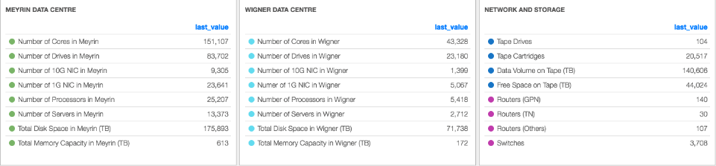
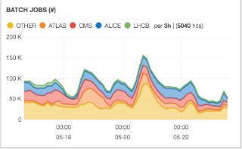
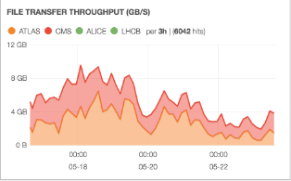
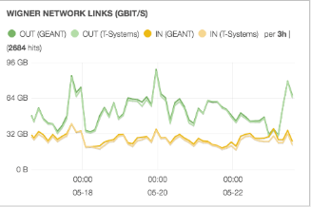
Tier 0

Slide 61
Run 2 has only just started
Hint of an excess with diphoton mass of 750 GeV
  Seen by ATLAS and CMS – coincidence or a new signal?
Notes:
Two experiments are showing something “strange”
300 theory papers already being written
Interesting but can also be a statistical fluctuation

Slide 62
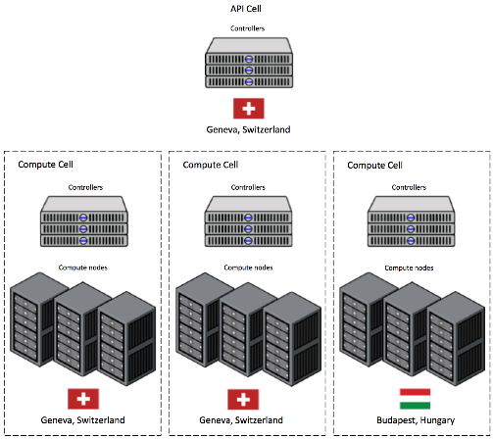
Nova Cells
Top level cell
  Runs API service
  Top cell scheduler
Child cells run
  Compute nodes
  Nova network
  Scheduler
  Conductor
Version 2 coming
  Default for all

