Slide 1
Heraeus Workshop Mai 2013
Annual Meeting and Workshop
Detector technology and systems platform
KIT Karlsruhe
November 19th – November 21th
Radiation Physics, HZDR
Fine Fiedler

Slide 2
The idea
May 2012 …approached with the request if a dedicated workshop would make sense; the Heraeus foundation would host it
July 2012 Marc Weber organized a team to plan and organize such a workshop

Slide 3
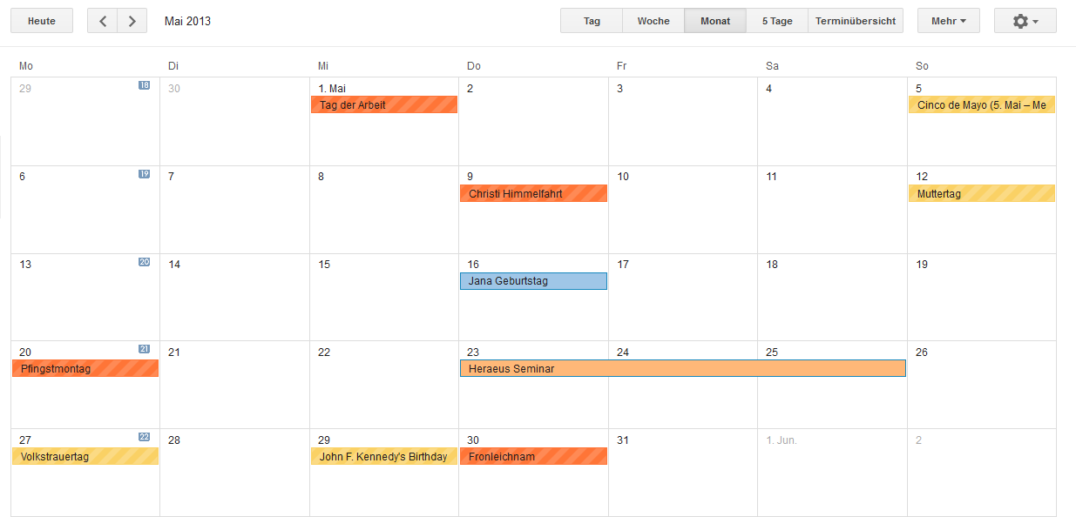
The idea
May 2012 DPG approached with the request if a dedicated workshop would make sense; the Heraeus foundation would host it
July 2012 Marc Weber organized a team to plan and organize such a workshop
Time slot: Thursday, May 23rd 2013 to Saturday, May 25th 2013

Slide 4
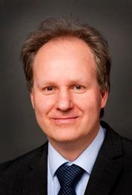
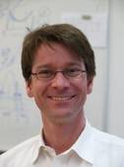
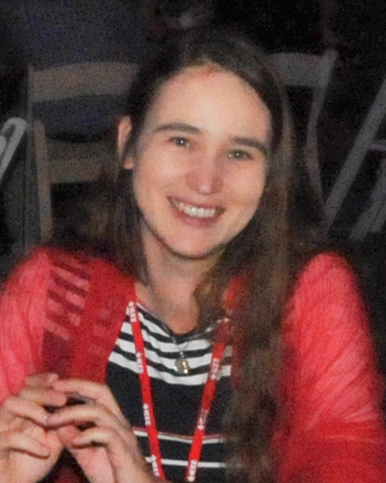
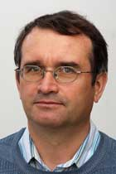
Scientific committee
Prof. Dr. Marc Weber
KIT Karlsruhe
Head of Institute for Data Processing and Electronics
Nuclear Physics @ LBNL, Rutherford Appleton Laboratory, STFC …
Prof. James L. Ritman
FZ Jülich
Director at the Nuclear Physics Institute
Nuclear Physics @ SUNY, Gießen, …
PANDA collaboration
Dr. Fine Fiedler
HZDR
Head of Radiation Physics division
In-vivo dosimetry,
Ion beam therapy
Dr. Hans-Günther Moser
MPI München
Head of the Semiconductor Lab
Nuclear physics @ CERN, …
ATLAS silicon tracker

Slide 5
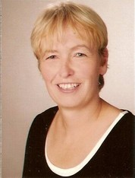
Scientific committee
Prof. Dr. Marc Weber
KIT Karlsruhe
Head of Institute for Data Processing and Electronics
Nuclear Physics @ LBNL, Rutherford Appleton Laboratory, STFC …
Prof. James L. Ritman
FZ Jülich
Director at the Nuclear Physics Institute
Nuclear Physics @ SUNY, Gießen, …
PANDA collaboration
Dr. Fine Fiedler
HZDR
Head of Radiation Physics division
In-vivo dosimetry,
Ion beam therapy
Dr. Hans-Günther Moser
MPI München
Head of the Semiconductor Lab
Nuclear physics @ CERN, …
ATLAS silicon tracker
Dipl.-Betriebswirtin Christiane Buchwald
Head of Administration

Slide 6
The Heraeus Foundation
The Wilhelm and Else Heraeus Foundation is a private institution which supports scientific research and education with emphasis on physics. It was established in 1963 by Dr. Wilhelm Heinrich Heraeus (1900 – 1985) and his wife Else Heraeus (1903 – 1987).
Since the mid-seventies of the last century the Foundation has been cooperating closely with the German Physical Society (DPG). The Wilhelm und Else Heraeus-Stiftung is Germany’s most important private institution funding physics.
Flyer, http://www.we-heraeus-stiftung.de/

Slide 7
The Heraeus Foundation – Heraeus Seminar
Organizing scientific seminars is the pre-eminent activity of the WE Heraeus Foundation
These workshop-type meetings are designed to allow for scientific exchange within a rather informal framework
They cover cutting-edge research in both physics and neighboring fields. Proposals are reviewed by a Scientific Advisory Board
Most of the seminars take place at the Physikzentrum Bad Honnef (near Bonn)
Since 1975 about 500 WE Heraeus Seminars have been carried out with ca. 30.000 participants, approximately one third thereof coming from abroad
Funding includes both organizational work and financial support
Flyer, http://www.we-heraeus-stiftung.de/

Slide 8
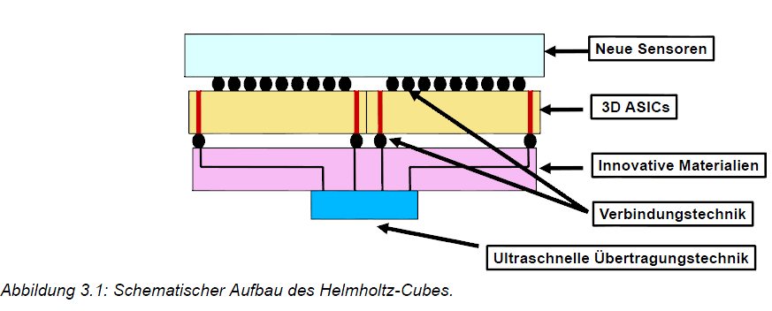
The topic
DTSP Antrag

Slide 9
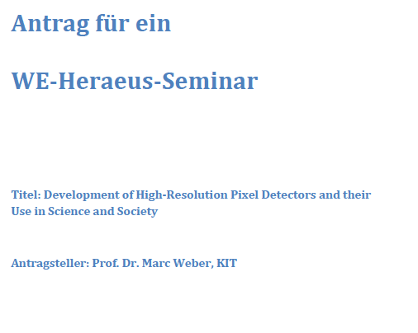
The topic
Development of High-Resolution Pixel Detectors and their Use in Science and Society

Slide 10
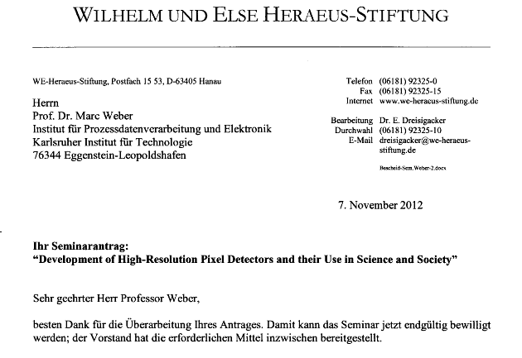
The topic
Development of High-Resolution Pixel Detectors and their Use in Science and Society
532. Wilhelm und Else Heraeus Seminar

Slide 11
Heraeus Seminar
Development of High-Resolution Pixel Detectors and their Use in Science and Society
Photon counting pixel detectors have been developed in particle physics. They are increasingly used as imaging techniques in various areas such as materials science, astronomy and (bio) medicine. A wide audience these sensors reach in the consumer electronics and automotive.
Particle detectors …
For applications … XFEL … AGIPD, LPD and DSSC
CCDs are used as sensors in astronomy and remote sensing...
Another important development … hybrid detector "Medipix" …
CCDs provide a more widespread use in … automotive industry….
At the Helmholtz portfolio program "Detector Technology and Systems Platform" is in several work packages to some aspects of this issue worked. So one of the goals is defined as the development of a three-dimensional compact sensor with integrated readout. In the preparation of this joint research project there is need for (and the gain by) the exchange between the groups.

Slide 12
Heraeus Seminar - Objectives
Development of High-Resolution Pixel Detectors and their Use in Science and Society
Identification of emerging trends and issues in the area pixel detector and the initiation of new scientific collaborations
Detector portfolios should be strengthened in the area of high-performance pixel detector and new, complementary partner should be identified
Participation of universities and junior scientists is highly welcome
Bring the latest findings in the field of pixel detectors into teaching
Cooperation with the foreign partners - maintain and develop
Identify new applications for high-resolution pixel sensors and initiate contacts with the industry
The workshop is not only to researchers in the field structure of matter, but also to other interdisciplinary research areas such as health, energy, key technologies and aeronautics, space and astronomy.

Slide 13
Heraeus Seminar
Development of High-Resolution Pixel Detectors and their Use in Science and Society
Program: 18 talks á 30 mins, 15 mins discussion after each talk
1 poster session
Speaker: Experienced and leading in their field
Auditorium: Non-university institutions like Helmholtz centers, Max Planck Institutes, etc. Universities Foreign laboratories Industry representatives, SME

Slide 14
Heraeus Seminar - Agenda
Development of High-Resolution Pixel Detectors and their Use in Science and Society
CMOS Pixel Sensors – Experimental Trends Marc Winter, IPHC Strasbourg
CMOS Image Sensor: From Science to Industry and back Renato Turchetta, STFC
CMOS Monolithic Active Pixel Sensors for CBM/FAIR Michael Deveaux, Uni Frankfurt
Trends in CMOS Imaging Sensors Soek-Hee Hwang, Samsung
DEPFETs for BELLE II Jelena Ninkovic, MPI Munich
Digital Single Photon Detector Development at Philips Thomas Frach, Carsten Degenhardt
Silicon Photomultipliers Paola Avella, MPI HLL
Technology for High Z Direct Converting Detectors Michael Fiederle, FMF
The Development of CVF-Diamond Detectors… Elèni Berdermann, GSI
Monolithic Active Pixel Matrix with Binary Counters in an SOI Process Greg Deptuch, Fermi Lab
X-Ray Detector Development at LBNL Peter Denes, LBNL
Edgeless Detector Tiles, using 3D-Integration Heinz Graafsma, DESY Hamburg
3D Integration of Pixel Detectors Valerio Re, INFN Pavia
Pixel detector development for the PANDA MVD Daniela Calvo, INFN
Specialty imager developments at imec Piet de Moor, imec
High-Resolution Spiral CT at very Low Dose: Concept and Feasibility NN
The Timepix detector for ion beam radiotherapy applications Maria Martisikova, DKFZ HD

Slide 15
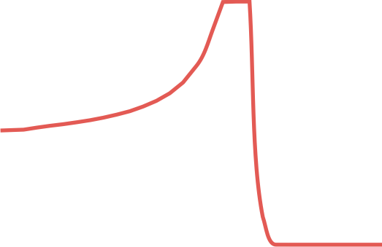
Heraeus Seminar
Development of High-Resolution Pixel Detectors and their Use in Science and Society
May 23rd to May 25th 2013
Looking forward to interesting and various talks on cutting edge technology
Looking forward to fruitful discussion and learning
More information and invitation to the seminar will follow soon
Thank you

