Slide 1
`Cross disciplinary applications`
Annual Meeting and Workshop
Detector technology and systems platform
KIT Karlsruhe
November 19th – November 21th
Radiation Physics, HZDR
Fine Fiedler

Slide 2
DTSP – Detektor Technology and Systems Platform
Ultrafast data
transfer and
reconstruction
Intelligent programmable
hardware
Near detector
optical signal
transmission
Fastest data
processing with
highly parallel
architectures
Technologies for
assembling highly
integrated detectors
3D ASICs
Mixed-signal ASICs
3D / high-Z sensors
Packaging and interconnection technologies
Innovative detector structure materials
Detector types
Fast photon and
X-ray detectors
Diamond detectors
Detectors for
thermal neutrons
Compact gas detectors
Cross disciplinary application

Slide 3
Cross disciplinary application
This topic will look for specific application fields outside “Matter”
Visibility of the technological competencies
Search for interdisciplinary cross-program opportunities
Particularly promising application, examples:
Dose monitoring for ion therapy
Reduced radiation exposure for Computed Tomography
Ultra-sound Computed Tomography
Non-destructive material analysis with positron life time spectroscopy
Homeland security

Slide 4
Cross disciplinary application
This topic will look for specific application fields outside “Matter”
Visibility of the technological competencies
Search for interdisciplinary cross-program opportunities
Particularly promising application, examples:
Dose monitoring for ion therapy
Reduced radiation exposure for Computed Tomography
Ultra-sound Computed Tomography
Non-destructive material analysis with positron life time spectroscopy
Homeland security
Prototypic application for DTSP could be:
Compton camera:
Coherent development and combination of various sub-domains for an application with common benefit
All sub-domains are technological challenging
No real cutting edge detector development, however
Novelty: Systemic solution-focused development, all components need special and highly skilled support

Slide 5
Cross disciplinary application – Dose monitoring for ion therapy
New group leader started Nov 1st
In-vivo dosimetry
Treatment planning
Clinical application
Data evaluation
In-room PET
In-vivo dosimetry
Research group dedicated to
Detectors and DAQ
Hardware for Clinical system
Nuclear physics
IKTP
Laser radiooncology
In-vivo dosimetry
Physics
In-beam PET
Tomographic reconstruction
Motion compensation
Research infrastructure
Detector laboratory
Dept. of Research Technology
Laser proton acceleration

Slide 6
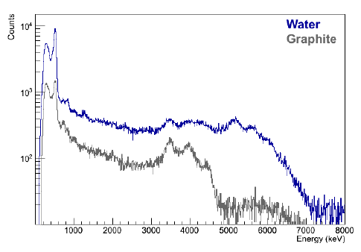
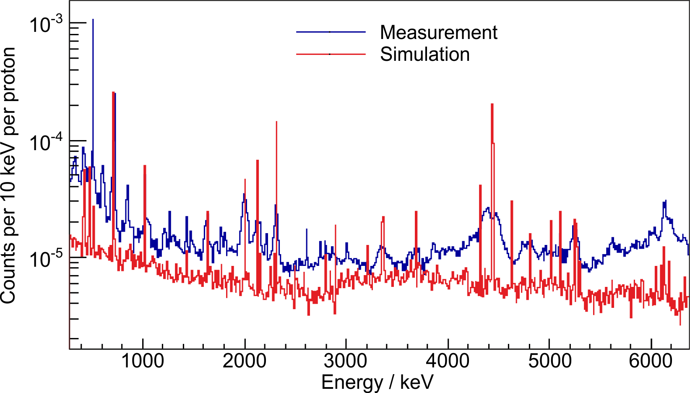
Cross disciplinary application – Dose monitoring for ion therapy
Some successful experiments at KVI and ELBE
Systemic expertise, handling of innovative scintilators and measurement of relevant quantities
August 2012
June 2012
PRELIMINARY
γ-ray spectrum @ 55 MeV p beam
Ce:GAGG scintillator on a Hamamatsu MPPC
γ-ray spectrum @ 55 MeV p beam
HPGE Detector (KVI), 0.3-8 MeV: 0.015 γ p⁻¹
S. Brandenburg, P. Dendooven, F. Fiedler, F. Hueso-Gonzales, C. Golnik, H. Kiewiet, A. Müller, D. Oxley

Slide 7
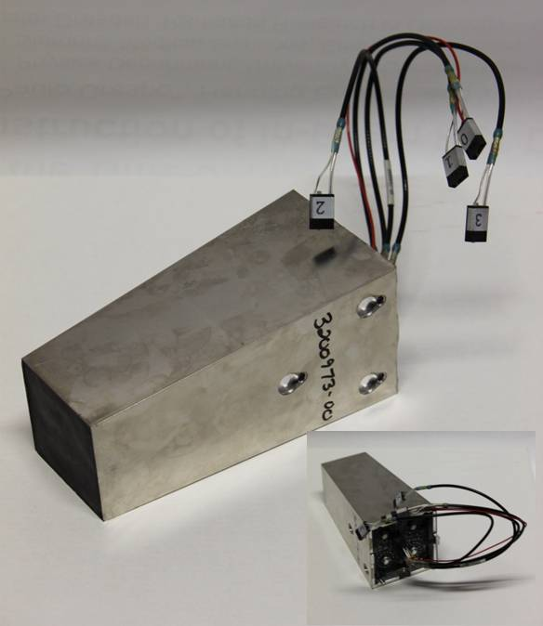
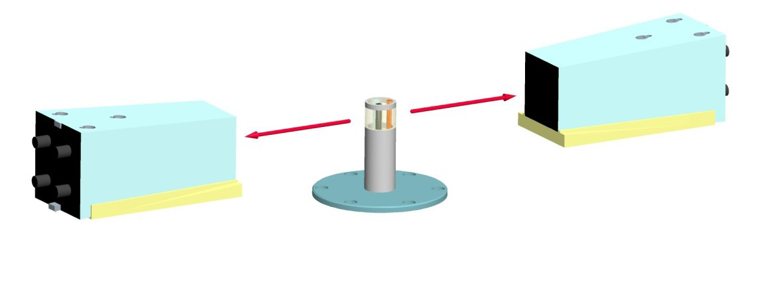
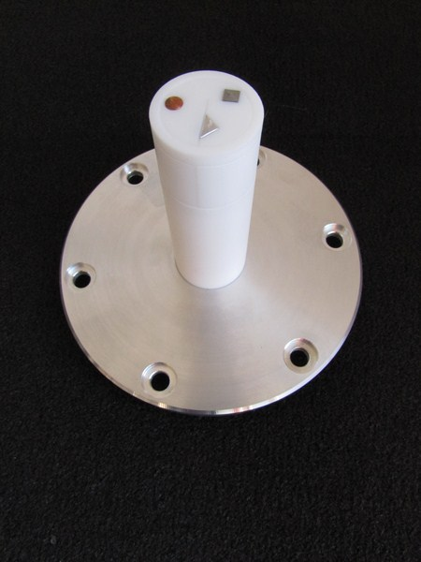
Cross disciplinary application –
Non-destructive material analysis with positron life time spectroscopy
Siemens’ LSO-based commercial 13x13 PET pixel detector
Bremsstrahlung beam, 26/13 MHz rep rate
511 keV
F. Fiedler, F. Fritz, M. Kempe, S. Schöne, A. Wagner

Slide 8
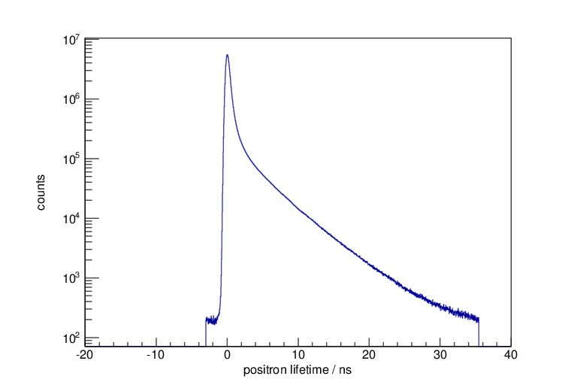
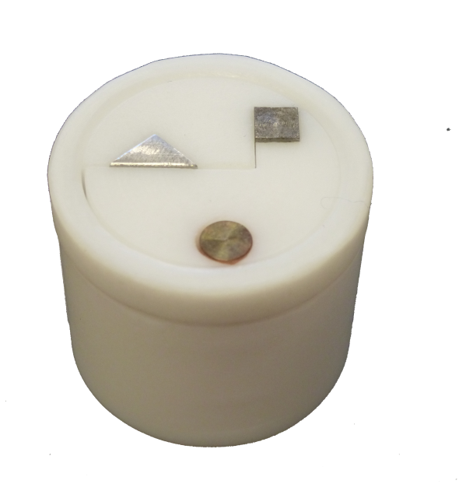
Cross disciplinary application –
Non-destructive material analysis with positron life time spectroscopy
Aluminium
Steel
Copper
short
long
all
prompt
Prompt / all
F. Fiedler, F. Fritz, M. Kempe, S. Schöne, A. Wagner

Slide 9
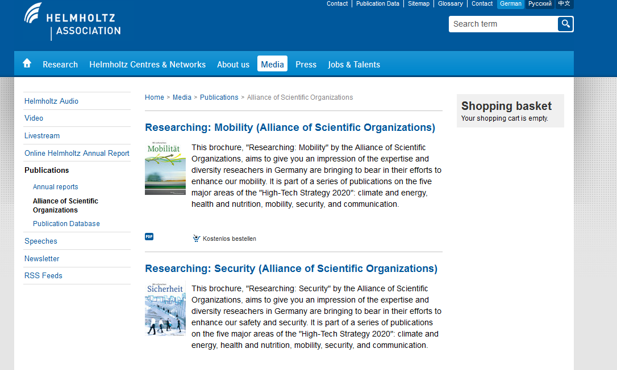
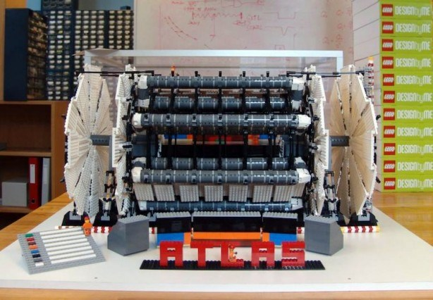
Cross disciplinary application
This topic will look for specific application fields outside
high energy physic, “Matter” , Helmholtz Association
Visibility of the technological competencies
Websites, …, leaflet for outreach and communication, Contribution to physical journals, Helmholtz publication, Job advertisements
Workshops HZDR – OncoRay with Ascenion for valorization
What else?

Slide 10
Cross disciplinary application – Workshop

Slide 11
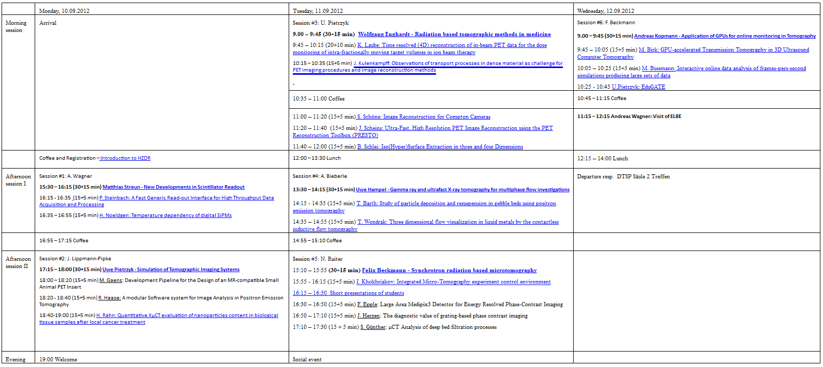
Cross disciplinary application – Workshop
Tomography, data processing and image reconstruction for medicine and engineering

Slide 12
Cross disciplinary application – Workshop
Tomography, data processing and image reconstruction for medicine and engineering
6 Sessions: Hardware, Simulation, Tomography – medicine and engineering, Reconstruction, GPU

Slide 13
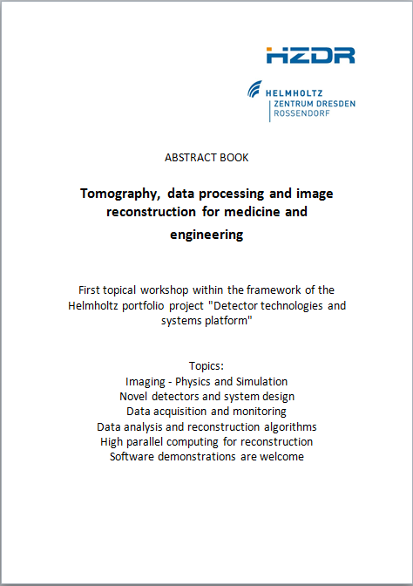
Cross disciplinary application – Workshop
Tomography, data processing and image reconstruction for medicine and engineering

Slide 14
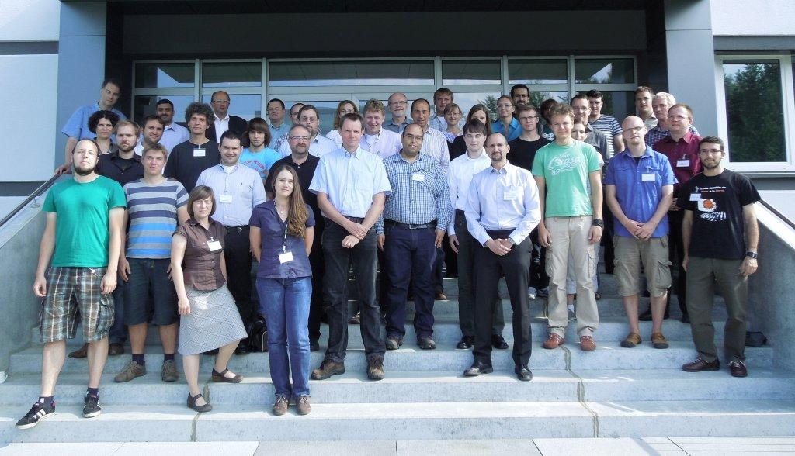
Cross disciplinary application – Workshop
Tomography, data processing and image reconstruction for medicine and engineering
Ascenion | 1
DESY | 1
FZJ | 7
GSI | 1
HZDR | 18
HZG | 5
KIT | 2
OncoRay | 5
TU Dresden | 5
TU München | 2 Σ 47

Slide 15
Cross disciplinary application – Workshop
Tomography, data processing and image reconstruction for medicine and engineering
6 Sessions: Hardware, Simulation, Tomography – medicine and engineering, Reconstruction, GPU
25 talks, 2 social events, 47 registrants, 1 Abstract book
Positive feedback like “I found interesting and helpful contacts I would have never met in my ‘normal’ community”

Slide 16
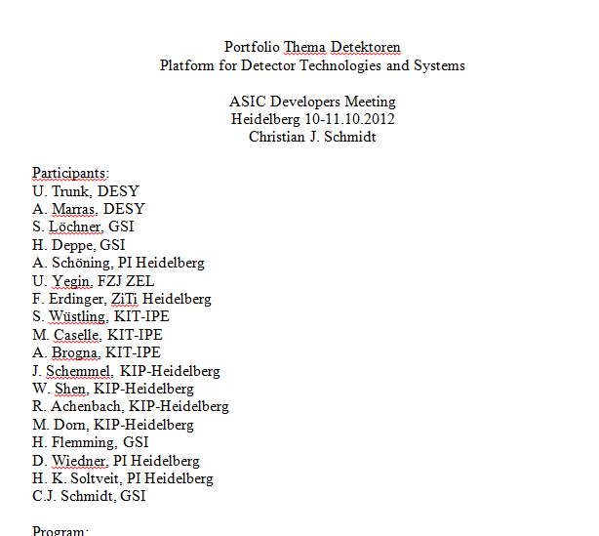
Cross disciplinary application – More Workshops
Tomography, data processing and image reconstruction for medicine and engineering

Slide 17
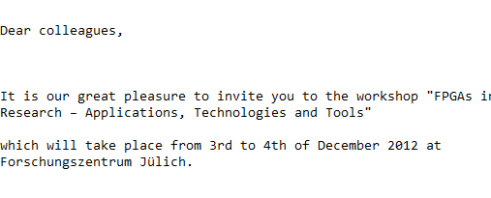
Cross disciplinary application – More Workshops
Tomography, data processing and image reconstruction for medicine and engineering

Slide 18
Cross disciplinary application – More Workshops
Tomography, data processing and image reconstruction for medicine and engineering
532. Wilhelm und Else Heraeus Seminar
May 2013

Slide 19
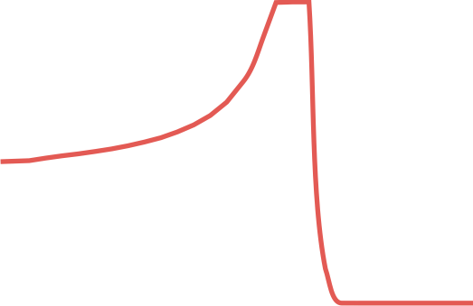
Cross disciplinary application
Thank you
To do:
Workshops
DTSP Leaflet?
…
Any suggestion and ideas are higly welcome

