Slide 1
FPGA Programming Methods - An Overview
Dr.-Ing. Diana Göhringer, Dipl.-Ing. Matthias Birk

Slide 2
Outline
Introduction and Motivation
Programming Methods for FPGAs
  Hardware Description Languages (HDLs)
  Model-based Design (Matlab / Simulink)
  High-Level-Synthesis Tools (HLS)
  IP-cores
  Summary
Dr.-Ing. Diana Göhringer
FPGA Programming Methods - An Overview

Slide 3
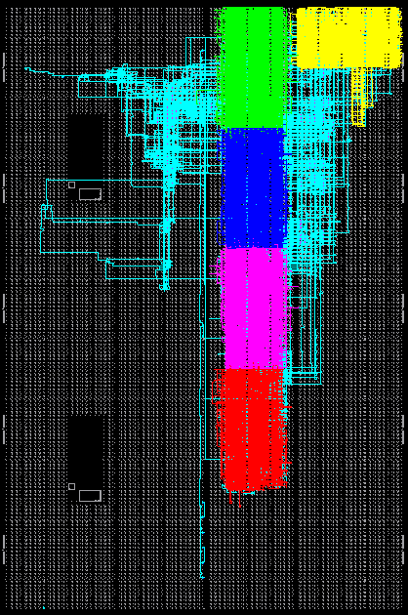
Motivation
Which is the best
methodology to program
my FPGA?
HDL
Model-based Design
HLS
IP-Library
FPGA
Dr.-Ing. Diana Göhringer
FPGA Programming Methods - An Overview

Slide 4
Outline
Introduction and Motivation
Programming Methods for FPGAs
  Hardware Description Languages (HDLs)
  Model-based Design (Matlab/Simulink, Labview)
  High-Level-Synthesis Tools (HLS)
  IP-cores
  Summary
Dr.-Ing. Diana Göhringer
FPGA Programming Methods - An Overview

Slide 5
Hardware Description Languages
Hardware Description Languages (HDLs)
  VHDL (Very High Speed Integrated Circuits Hardware Description Language)
    Since 1987 IEEE Standard
    Propagation: Mainly Europe
  Verilog
    Since 1995 IEEE Standard
    Propagation: Mainly USA
Dr.-Ing. Diana Göhringer
FPGA Programming Methods - An Overview

Slide 6
Hardware Description Languages
Design Flow: VHDL versus C, C++
VHDL
C++
Synthesis
and
Implementation
Compiler
.bit File
.exe File
Dr.-Ing. Diana Göhringer
FPGA Programming Methods - An Overview

Slide 7

Hardware Description Languages:
Comparison VHDL versus C, C++
C, C++
  Sequential Instructions
  Hierarchical
  Behavioral descriptions
  Object Oriented Programming (→ “Structural descriptions”)
VHDL
  Sequential Instructions
  Concurrent Instructions
  Hierarchical
  Behavioral descriptions
  Structural descriptions
Dr.-Ing. Diana Göhringer
FPGA Programming Methods - An Overview

Slide 8
Outline
Introduction and Motivation
Programming Methods for FPGAs
  Hardware Description Languages (HDLs)
  Model-based Design (Matlab/Simulink, Labview)
  High-Level-Synthesis Tools (HLS)
  IP-cores
  Summary
Dr.-Ing. Diana Göhringer
FPGA Programming Methods - An Overview

Slide 9

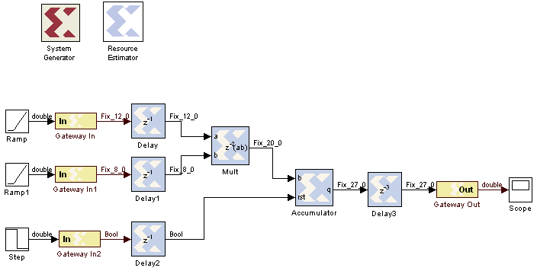
Model-based Design (Matlab/Simulink, Labview)
Matlab HDL-Coder (evaluated in 2008)
  Generates readable VHDL-Code
  Only supports the basic Simulink-Toolbox / basic Matlab commands
Xilinx SystemGenerator
  Own Code can be integrated as black box
  Cores generates with Vivado HLS can also be integrated
  Limited to the available toolboxes
  Generated Code is not readable
Dr.-Ing. Diana Göhringer
FPGA Programming Methods - An Overview

Slide 10

Model-based Design (Matlab/Simulink, Labview)
Xilinx AccelDSP (evaluated in 2008, no longer available)
  Most powerful of these 3 Tools
  Generates HDL-Code from Matlab
  Generates von Simulink blocks
  Very expensive
  Generated VHDL-Code not readable
  Limitations for the Matlab Code
Dr.-Ing. Diana Göhringer
FPGA Programming Methods - An Overview

Slide 11
Outline
Introduction and Motivation
Programming Methods for FPGAs
  Hardware Description Languages (HDLs)
  Model-based Design (Matlab/Simulink, Labview)
  High-Level-Synthesis Tools (HLS)
  IP-cores
  Summary
Dr.-Ing. Diana Göhringer
FPGA Programming Methods - An Overview

Slide 12
High-Level Synthesis Tools: Motivation
 | HDL | C, C++
Abstraction level | ☹ | ☺
Development time | ☹ | ☺
Error Correction | ☹ | ☺
Dr.-Ing. Diana Göhringer
FPGA Programming Methods - An Overview

Slide 13
High-Level Synthesis Tools: Overview
A variety of open-source and commercial tools exist
Very dynamic market: many changes and improvements in the past years
High-Level language (C, C++, SystemC) → VHDL, Verilog, Netlists
Examples for commercial tools:
  Xilinx Vivado HLS (former Xilinx AutoESL)
  Calypto Catapult C (former Mentor Graphics Catapult C)
  ImpulseC
Examples for open-source tools:
  ROCCC/ ROCCC 2.0
  Trident
  LegUp
Dr.-Ing. Diana Göhringer
FPGA Programming Methods - An Overview

Slide 14
Hints for HLS Programming
Restricted hardware resources:
  Select bitwidths of variables only as wide as necessary
  Store intermediate data only if necessary
  Don’t use dynamic allocations or unbound loops
Variety of different implementation strategies:
  Sequential implementation similar to C-Code is possible, but inefficient (Clock rate of the FPGA << Clock rate of a PC)
  Memory accesses, can be influenced using pragmas/directives
  Exploitation of Parallelism through:
    Loop-Unrolling (partial or complete)
    Pipelining
    Parallel implementation of independent functions
    Tradeoff: Hardware resources / power versus performance
Dr.-Ing. Diana Göhringer
FPGA Programming Methods - An Overview

Slide 15
High-Level Synthesis Tools
ImpulseC
  Generates hardly readable HDL Code
  Better results compared to the Model-based design tools (Compared in 2008/2009)
  Fast generation of IP-Cores, especially hardware accelerators for Xilinx processors (generates the interface for the bus system)
  Supports pipelining and loop-unrolling
  Supports Xilinx and Altera FPGAs
  Only supports a subset of C (no C++ or SystemC)
  needs to be extended with special Pragmas
  C-Code needs to be modified to achieve a good result, e.g.: usage of exact bitlenghts for variables
  Costs
  Mostly a bit behind the standard Xilinx tools and FPGAs, as it is a third party tool
Dr.-Ing. Diana Göhringer
FPGA Programming Methods - An Overview

Slide 16
High-Level Synthesis Tools
CatapultC (tested 2011)
  Supports C, C++
  Generates hardly readable HDL Code
  Fast generation of IP-Cores
  Supports pipelining and loop-unrolling
  C-code is annotated via a user-friendly GUI, e.g. no modifications in the C-code needed for unrolling/pipelining loops or for organizing the memory layout
  Supports Xilinx and Altera FPGA
  C-Code needs to be slightly modified to achieve a good result, e.g.: usage of exact bitlenghts for variables
  No support for System C so far
  Costs → More expensive than ImpulseC
Dr.-Ing. Diana Göhringer
FPGA Programming Methods - An Overview

Slide 17
High-Level Synthesis Tools
Vivado HLS (formerly AutoESL)
  Supports C, C++ and SystemC
  Generates hardly readable HDL Code
  Fast generation of IP-Cores (incl. interfaces for the processors (Xilinx EDK tool), and for integration as a black box into Xilinx SystemGenerator)
  Supports pipelining and loop-unrolling
  C-code is annotated via a user-friendly GUI, e.g. no modifications in the C-code needed for unrolling/pipelining loops or for organizing the memory layout
  Low costs, comes with the Xilinx System Edition Tool set
  C-Code needs to be slightly modified to achieve a good result, e.g.: usage of exact bitlenghts for variables
  Costs
Dr.-Ing. Diana Göhringer
FPGA Programming Methods - An Overview

Slide 18
High-Level Synthesis Tools:
Catapult C vs AutoESL vs IP-Core
Results from the bachelor thesis of Thomas Kleiner
 | AutoESL | Catapult C | IP-Core
Throughput | + |  | ++
Efficiency (Area) |  | + | ++
Open-source programs are currently no alternative to commercial tools
 | FIR | FFT | SAFT
AutoESL | + | - | ++
Catapult C | ++ | - | +
  Optimal algorithm parameters for HLS
    Linear memory accesses
    Constant loop iterations
Dr.-Ing. Diana Göhringer
FPGA Programming Methods - An Overview
Notes:
ML506

Slide 19
Outline
Introduction and Motivation
Programming Methods for FPGAs
  Hardware Description Languages (HDLs)
  Model-based Design (Matlab/Simulink, Labview)
  High-Level-Synthesis Tools (HLS)
  IP-cores
  Summary
Dr.-Ing. Diana Göhringer
FPGA Programming Methods - An Overview

Slide 20
IP-Cores
Optimized cores in terms of performance and area
Mostly only available as netlists / black box → no source code available
Costs
Dr.-Ing. Diana Göhringer
FPGA Programming Methods - An Overview

Slide 21
Outline
Introduction and Motivation
Programming Methods for FPGAs
  Hardware Description Languages (HDLs)
  Model-based Design (Matlab/Simulink, Labview)
  High-Level-Synthesis Tools (HLS)
  IP-cores
  Summary
Dr.-Ing. Diana Göhringer
FPGA Programming Methods - An Overview

Slide 22
Summary: FPGA Programming Methods
Programming Method | Pros | Cons
HDL: e.g. VHDL, Verilog, SystemVerilog | Very flexible | Hardware skills necessary High development time Error-prone
Model-based Design: e.g. Matlab/Simulink | High abstraction level Library with standard components Rapid Prototyping | High Costs Less flexible
HLS Tools: e.g. Xilinx Vivado HLS, Calypto CatapultC, Impulse C | High abstraction level Fast design space exploration Rapid Prototyping | Only for IP-cores, not for a complete FPGA-Design Quality of results (ressources, performance) strongly depends on the C-code Costs
IP-Cores | Optimized modules | High costs Source code often not available (only netlists)
Dr.-Ing. Diana Göhringer
FPGA Programming Methods - An Overview
Notes:
There is no single solution
Choice strongly depends on the application requirements and the knowledge of the programmer
A combination of

Slide 23
Summary: FPGA Programming Methods
There is no single solution!
Decision depends on
  Application requirements
  Background of the programmer
Trend towards higher abstraction levels visible
  E.g. Xilinx Vivado HLS, Altera OpenCL Support
  New and better tools every year
  Goal → to overcome the HDL programming hurdle for software / application programmers
Dr.-Ing. Diana Göhringer
FPGA Programming Methods - An Overview

Slide 24

Thank You!
Questions?
Dr.-Ing. Diana Göhringer
FPGA Programming Methods - An Overview

