Slide 1
High Level Synthesis
with Xilinx HLS
Eugen Krassin / PLC2 GmbH

Slide 2
Agenda
Functional Abstraction Level
High Level Synthesis HLS
Control & Datapath Extraction
Scheduling & Binding
Arbitrary Precision Data Types
Top Level I/O Ports
Loops
Arrays
Interfaces
Latency & Throughput
Optimizations
Examples
FIRMENPRÄSENTATION 2012

Slide 3
Functional Abstraction Level
Evolution of the Functional Abstraction Level
Transistor layout database : The focus of the layout abstraction layer is to respect
Design Rule Checks (DRC) which models the basic layout.
Netlist database (Schematic): The netlist is constructed with instances from a pre-built library. The focus of the netlist abstraction layer is to
define the Boolean functionality of the design with appropriate area, performance and power.
Register Transfer Level (RTL) : The focus of the RTL abstraction layer is to define a model for the hardware which is functionally correct.
Functional specification : Removes the need to the define register boundaries (and the specific logic required between them) to implement the desired algorithm. The focus of the designer is only on specifying the desired functionality.

Slide 4
Agenda
Functional Abstraction Level
High Level Synthesis HLS
Control & Datapath Extraction
Scheduling & Binding
Arbitrary Precision Data Types
Top Level I/O Ports
Loops
Arrays
Interfaces
Latency & Throughput
Optimizations
Examples
FIRMENPRÄSENTATION 2012

Slide 5
High Level Synthesis
Advantages of using HLS
C Language based specification: The significant benefits of acceleration in simulation time
by using a functional C language based specification and
the resultant earlier detection of design errors.
Creation of the RTL : High Level Synthesis shortens the previous manual RTL
creation process and avoids translation errors by
automating the creation of the RTL from the functional
specification.
Architecture optimization : High Level Synthesis automates the optimization of the
RTL architecture, allowing multiple architectures to
quickly and easily be evaluated before committing to an
optimum solution.

Slide 6
High Level Synthesis
Two types of synthesis during HLS
Algorithm Synthesis : takes the content of the functions, and synthesizes the functional
statements into RTL statements over a number of clock cycles.
Interface Synthesis : transforms the function arguments (or parameters) into RTL ports
with specific timing protocols, allowing the design to communicate
with other designs in the system.
Interface synthesis can be performed on global variables,
top-level function arguments and the return value of the
top-level function. Several types of interfaces available
(Wire & Register , One-way & two-way handshakes , Bus ,
FIFO & RAM )

Slide 7
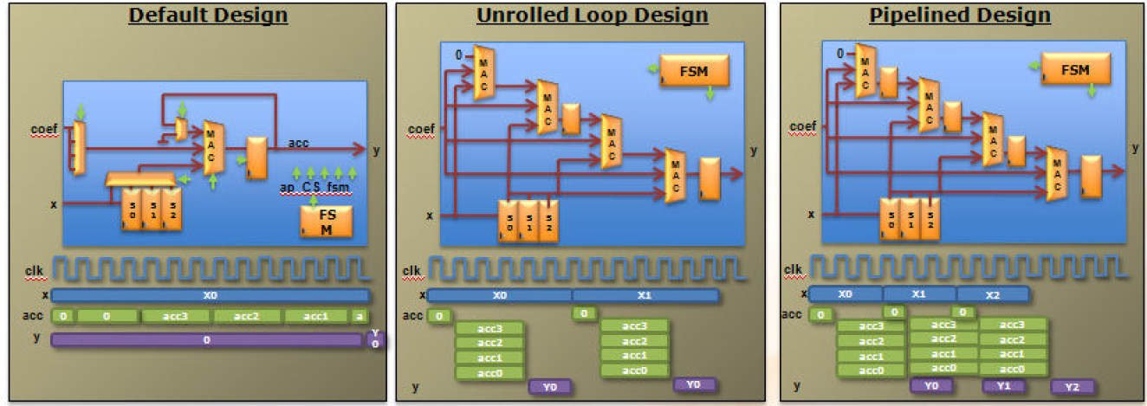
High Level Synthesis
Create the optimum Architecture
Extraction of
Control
Datapath
Scheduling
Binding

Slide 8
High Level Synthesis
HLS is executed in multiple steps
Interface synthesis : Impacts what is achievable in algorithm synthesis . The number of
available implementations and optimizations is large and the
combinations of how they impact each other is also very large.
Optimization : Control and Datapath Extraction
Scheduling & Binding
Arbitrary Precision Data Types
Throughput and Latency Optimizations

Slide 9
Agenda
Functional Abstraction Level
High Level Synthesis HLS
Control & Datapath Extraction
Scheduling & Binding
Arbitrary Precision Data Types
Top Level I/O Ports
Loops
Arrays
Interfaces
Latency & Throughput
Optimizations
Examples
FIRMENPRÄSENTATION 2012

Slide 10
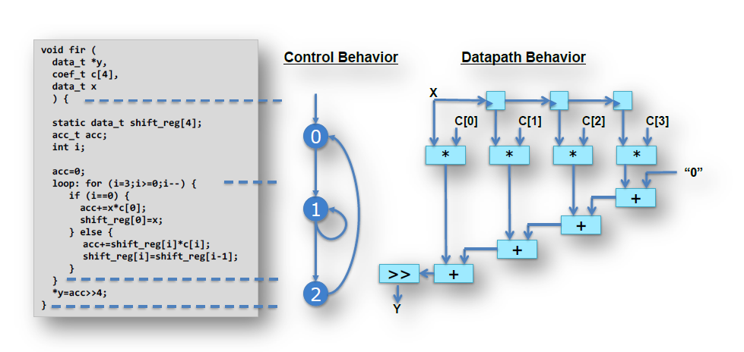
Control and Datapath Extraction

Slide 11
Control and Datapath Extraction
Analyze the code : The first thing which is performed during HLS is to extract the
control and datapath inferred by the code
Define the FSM : The control functionality is provided by the loops and conditional
branches in the code. The example before shows how the control
behavior can be extracted from the code. Each time the function
requires an entry or exit from a loop, it is equivalent to entering or
exiting a state in an RTL Finite State Machine (FSM).
Use user directives : All operations could take a single cycle (or state) to complete.
Timing delays and the clock frequency may require more cycles to
complete the operations. The control logic may be impacted by the
IO protocols inferred by interface synthesis resulting in more
complex and optimized state machine.

Slide 12
Agenda
Functional Abstraction Level
High Level Synthesis HLS
Control & Datapath Extraction
Scheduling & Binding
Arbitrary Precision Data Types
Top Level I/O Ports
Loops
Arrays
Interfaces
First Example
Latency & Throughput
Optimizations
FIRMENPRÄSENTATION 2012

Slide 13
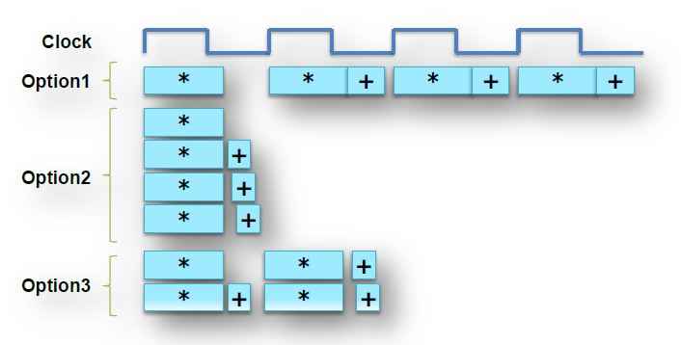
Scheduling & Binding
Scheduling and binding are the processes at the heart of high-level synthesis. The decisions made during scheduling are based on clock frequency, timing information, as well as area, latency and throughput directives.
Scheduling : Determines in which clock cycle an operation will occur
Binding : Determines which library cell is used for each operation
Option ADD MULT CLK
1 1 1 4
2 3 4 1
3 2 2 2

Slide 14
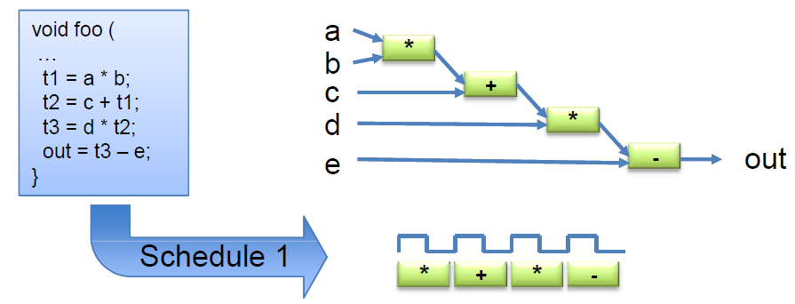
Scheduling … a closer look
The operations in the control flow are mapped into clock cycles
The technology selected and the directives defined impact the schedule
Faster technology or slower clock may allow more operations to occur in the same
clock cycle

Slide 15
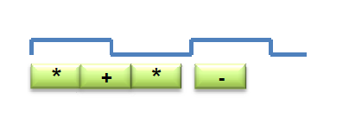
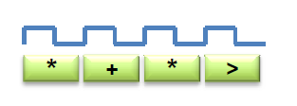
Binding … a closer look
Binding is where operations are mapped to hardware
Binding Decision: to share
Binding must use 2 multipliers, since boths are in the same cycle.
It can decide to use an adder and subtractor or one add/sub
Binding Decision: or not to share
Binding may decide to share the multipliers (each used in a different cycle.
Or it may decide the cost of sharing (muxing) would impact timing and it may decide not to share them

Slide 16
Agenda
Functional Abstraction Level
High Level Synthesis HLS
Control & Datapath Extraction
Scheduling & Binding
Arbitrary Precision Data Types
Top Level I/O Ports
Loops
Arrays
Interfaces
Latency & Throughput
Optimizations
Examples
FIRMENPRÄSENTATION 2012

Slide 17
Arbitrary Precision Data Types
Native C data types are on 8-bit boundaries (8, 16, 32, 64 bits). RTL operations (corresponding to hardware) support arbitrary widths.
HLS needs a mechanism to allow the specification of arbitrary precision bit-widths or the RTL design may use 32-bit multipliers when only 17-bit multipliers are required (not an issue to a C program, but a major issue in an RTL design).
AutoESL provides arbitrary precision integer and fixed-point data types

Slide 18
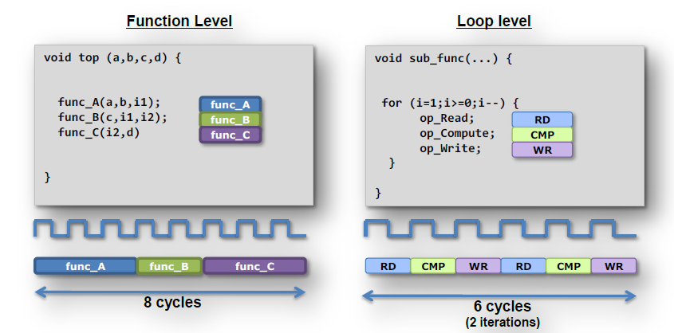
Optimizations
AutoESL can perform a number of optimizations on the design to produce high quality RTL satisfying the performance and area goals.
Pipelining is an optimization which allows one of the major performance advantages of hardware over software, concurrent or parallel operation, to be automatically implemented in the RTL design.
Before Pipelining

Slide 19
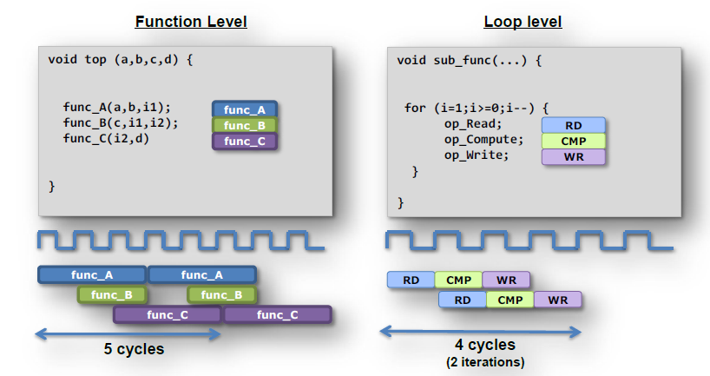
Optimizations
The sequential nature of the C language, or in other words its lack of concurrency, puts artificial dependencies on operations which must wait their turn for execution.
AutoESL provides the ability to automatically pipeline both functions and loops to ensure the RTL design does not suffer from such limitations.
After Pipelining

Slide 20
Agenda
Functional Abstraction Level
High Level Synthesis HLS
Control & Datapath Extraction
Scheduling & Binding
Arbitrary Precision Data Types
Top Level I/O Ports
Loops
Arrays
Interfaces
Latency & Throughput
Optimizations
Examples
FIRMENPRÄSENTATION 2012

Slide 21
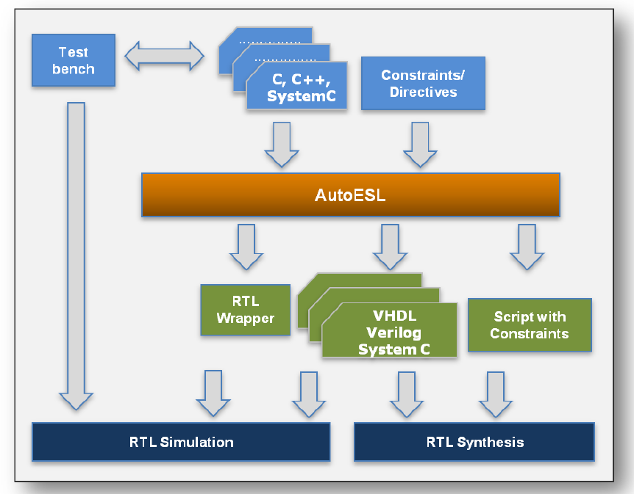
High Level Synthesis with autoESL
AutoESL accepts C-based design description and directives and constraints.
A technology library specifying the timing and area details of all supported Xilinx device is built-in.
AutoESL outputs RTL design files in Verilog, VHDL and SystemC.
Verification and implementation scripts, used to automated the RTL verification and RTL synthesis steps are also created.
AutoESL creates the scripts required to verify the generated RTL through co-simulation with the original test bench and a variety of RTL simulators. The following RTL simulators are supported: ModelSim, VCS and OSCI SystemC.

Slide 22
The Key Attributes of the C code
void fir (
data_t *y,
coef_t c[4],
data_t x)
{
static data_t shift_reg[4];
acc_t acc;
int i;
acc=0;
loop: for (i=3;i>=0;i--) {
if (i==0) { acc+=x*c[0];
shift_reg[0]=x;}
else { shift_reg[i]=shift_reg[i-1];
acc+=shift_reg[i] * c[i];}
}
*y=acc;
}
Functions: All code is made up of functions which represent the design hierarchy: the same in hardware
Types: All variables are of a defined type. The type can influence the area and performance
Top Level IO : The arguments of the top-level function determine the hardware RTL interface ports
Loops: Functions typically contain loops. How these are handled can have a major impact on area and performance.
Arrays: Arrays are used often in C code. They can influence the device IO and become performance bottlenecks.
Operators: Operators in the C code may require sharing to control area or specific hardware implementations to meet performance

Slide 23
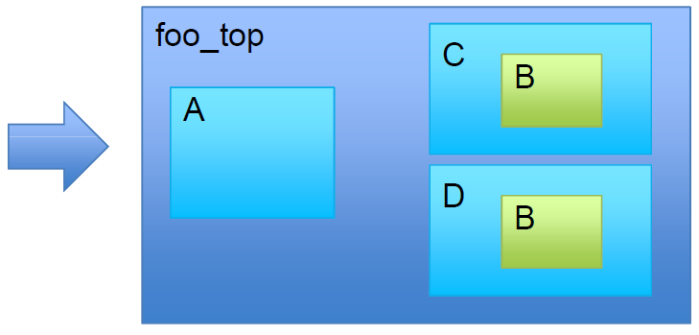
Functions and RTL Hierarchy
Each function is translated into an RTL block
By default, each function is implemented using a common instance
Functions may be inlined to dissolve their hierarchy. Small functions may be
automatically inlined
void A() { ..body A..}
void B() { ..body B..}
void C() { B(); }
void D() { B(); }
void foo_top() {
A(…);
C(…);
D(…)
}

Slide 24
Top Level IO Ports
Top level function arguments.
Top Level arguments become ports on the RTL designs. This can be implemented with a specific hardware protocol → Interface Synthesis
IO Protocols
Allow RTL blocks to automatically synchronize data exchange. Many types of protocols are available

Slide 25
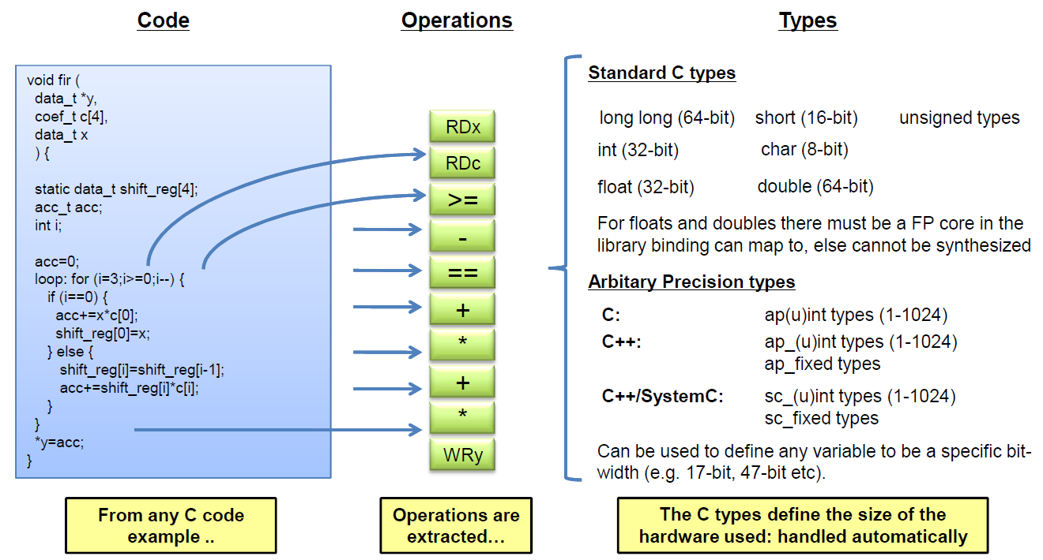
Types = Operator Bit-sizes

Slide 26
Agenda
Functional Abstraction Level
High Level Synthesis HLS
Control & Datapath Extraction
Scheduling & Binding
Arbitrary Precision Data Types
Top Level I/O Ports
Loops
Arrays
Interfaces
Latency & Throughput
Optimizations
Examples
FIRMENPRÄSENTATION 2012

Slide 27
Loops
By default, loops are rolled
Each C loop iteration Implemented in the same state
Each C loop iteration Implemented with same resources
Loops can be unrolled if their indices are statically determinable at
elaboration time.
Unrolled loops result in greater operator mobility. Let’s look at an
example

Slide 28
Data Dependencies: Good
Example of good mobility
The read on port X can occur anywhere from the start to iteration 4.
The only constraint on RDx is that it occur before the final multiplication
AutoESL has a lot of freedom with this operation, f.e. it waits until the read
is required, saving a register.
The final multiplication however is very constrained

Slide 29
Data Dependencies: Bad
Example of bad mobility
The final multiplication must occur before the read and final addition. It could
occur in the same cycle if timing allows.
Each iteration cannot start till the previous iteration completes. The final
multiplication (in iteration 4) must wait for earlier iterations to complete. The
structure of the code is forcing a particular schedule and there is little mobility
for most operations
Optimizations allow loops to be unrolled giving greater freedom

Slide 30
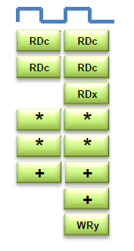
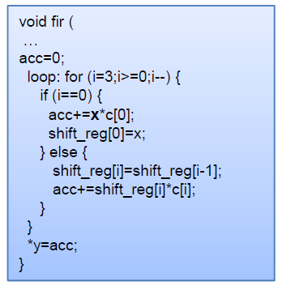
Schedule after Loop Optimization
With the loop unrolled (completely)
The dependency on loop iterations is gone
Operations can now occur in parallel if data
dependencies and if operator timing allows.
Design finished faster but uses more operators
(2 multipliers & 2 Adders).
Schedule Summary
All the logic associated with the loop counters and
index checking are now gone. Two multiplications can
occur at the same time. All 4 could, but it’s limited by the
number of input reads.
Why 2 reads on port C?
The default behavior for arrays now limits the schedule

Slide 31
Agenda
Functional Abstraction Level
High Level Synthesis HLS
Control & Datapath Extraction
Scheduling & Binding
Arbitrary Precision Data Types
Top Level I/O Ports
Loops
Arrays
Interfaces
Latency & Throughput
Optimizations
Examples
FIRMENPRÄSENTATION 2012

Slide 32
Arrays in HLS
An array in C code is implemented by a memory in the RTL
By default, arrays are implemented as RAMs, optionally a FIFO
The array can be targeted to any memory resource in the library
The ports (Address, CE active high, etc.) are defined by the library model.
Arrays can be merged with other arrays and reconfigured
To implement them in the same memory or one of different widths & sizes
Arrays can be partitioned into individual elements
Implemented as smaller RAMs or registers

Slide 33
Arrays as an IO Port
When the array is an argument of the top-level function
The array/RAM is considered to be “off-chip”
The type of memory resource specified for the array determines the top-level
IO ports: A dual-port RAM results in two sets of address & data ports
Default RAM resource
Two port if it provides better throughput, else single port
Always best to explicitly specify IO/external RAM resources

Slide 34
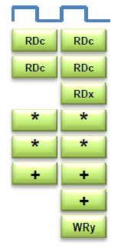
Schedule after Array Optimization
With the existing code & defaults
Port C is by default a dual port RAM
Allows 2 reads per clock cycles
Therefore limits the max number of
simultaneous reads and writes
With the C port partitioned into (4) separate ports
All reads and mults can occur in one cycle.
If the timing allows:
The additions can also occur in the same
cycle and the write can be performed in
the same cycle.
Optionally the port reads and writes could
be registered
loop: for (i=3;i>=0;i--) {
if (i==0) { acc+=x*c[0];
shift_reg[0]=x;}
Else
{shift_reg[i]=shift_reg[i-1];
acc+=shift_reg[i]*c[i];}
} *y=acc;

Slide 35
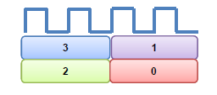
Operators
Operator sizes are defined by the type
The variable type defines the size of the operator
AutoESL will try to minimize the number of operators
By default AutoESL will seek to minimize area after
constraints are satisfied
User can set specific limits & targets for the resources used
Allocation can be controlled. This can be used to force
sharing e.g. limit the number of multipliers to 1 will force
AutoESL to share
Resources can be specified
The cores used to implement each operator can be
specified, e.g. Implement each multiplier using a 2 stage
pipelined core (hardware)

Slide 36
High Level Synthesis … a summary
1
Synthesize the initial design
Analyze to see what limits the performance and use directives to change the
default behaviors and remove bottlenecks
Analyze to see what limits the area
The types used define the size of operators. This can have an impact on what
operations can fit in a clock cycle
Use directives to shape the initial design to meet performance
2
3

Slide 37
Agenda
Functional Abstraction Level
High Level Synthesis HLS
Control & Datapath Extraction
Scheduling & Binding
Arbitrary Precision Data Types
Top Level I/O Ports
Loops
Arrays
Interfaces
Latency & Throughput
Optimizations
Examples
FIRMENPRÄSENTATION 2012

Slide 38
Block Level Protocol
Block level handshake signals are added to the design by default
These tell the design when to start operation (ap_start)
Indicate when the design has completed (ap_done) and is idle (ap_idle)
In a pipelined design, they also indicate when the design can accept new data
(ap_ready)

Slide 39
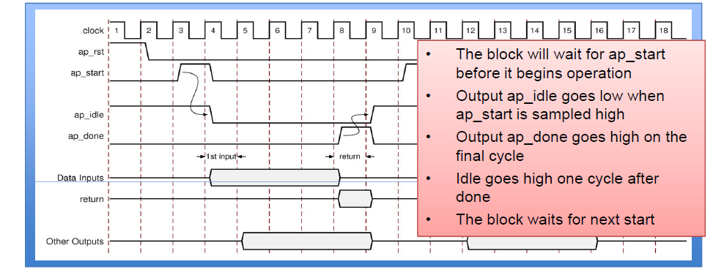
Timing Block Level Protocol
Input Data
Can be applied when ap_idle goes low
Output Data
Any function return is valid when ap_done is asserted high

Slide 40
Port Level Protocol
The block level output signal ap_done goes high to indicate the function return is valid
For other outputs, Port Level IO protocols can be added
Allowing upstream and downstream blocks to synchronize with the other data ports
The type of protocol depends on the type of C port
• Pass-by-value scalar
• Pass-by-reference pointers (& references in C++)
• Pass-by-reference arrays

Slide 41
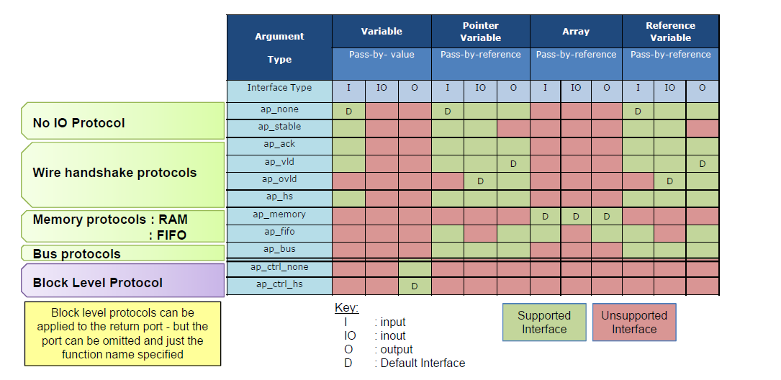
Interface Types
Multiple interface protocols are available
– Every combination of C argument and port protocol is not supported
– It may require a code modification to implement a specific IO protocol

Slide 42
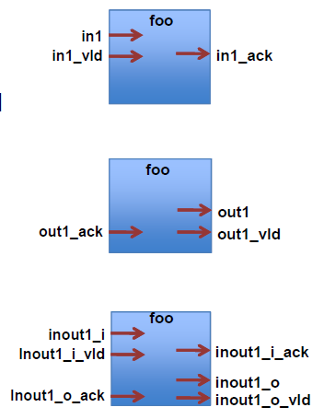
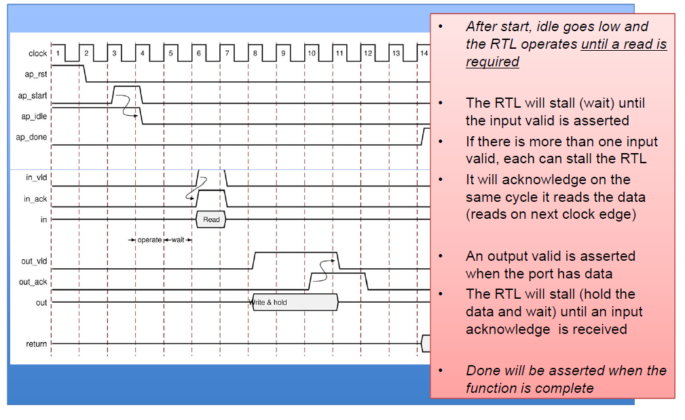
Wire Protocols

Slide 43
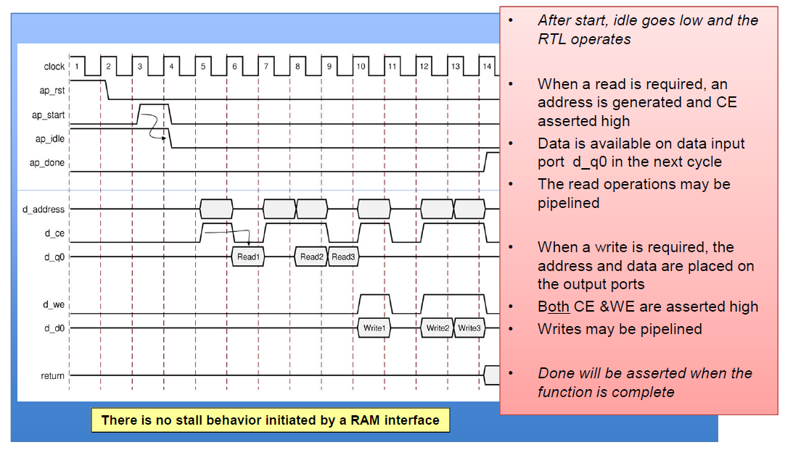
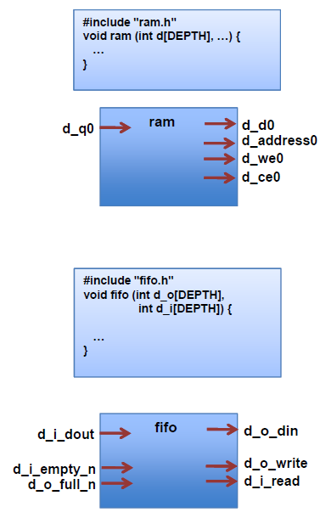
Memory Protocols

Slide 44
Agenda
Functional Abstraction Level
High Level Synthesis HLS
Control & Datapath Extraction
Scheduling & Binding
Arbitrary Precision Data Types
Top Level I/O Ports
Loops
Arrays
Interfaces
First Example
Latency & Throughput
Optimizations
FIRMENPRÄSENTATION 2012

Slide 45
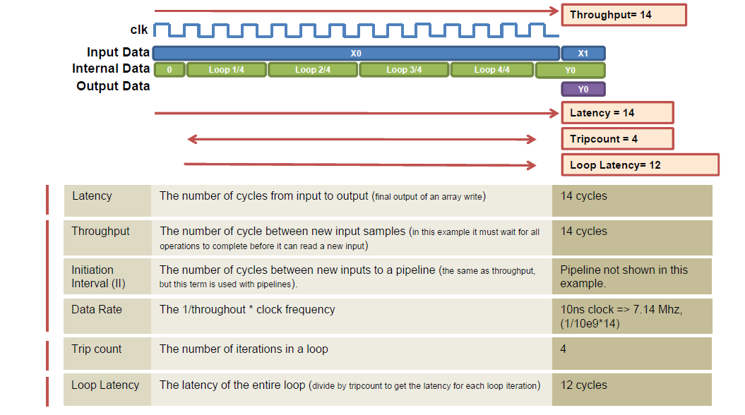
Terminology for measuring in Clock Cycles

Slide 46
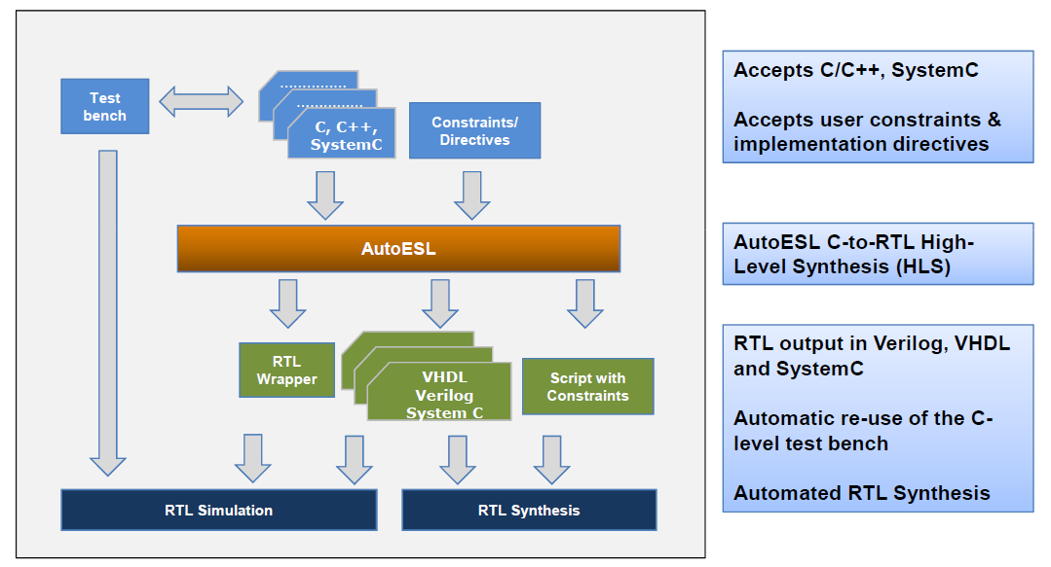
Running High Level Synthesis

Slide 47
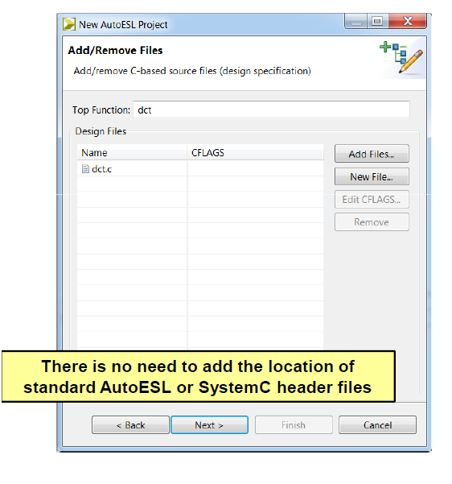
Add Design Source Files
Specify the top-level
This allows AutoESL to determine the top-level design for
synthesis, from the test bench & associated files
Not required for SystemC designs
2. Add Files..
Select the source code file(s)
The CTRL and SHIFT keys can be used to add multiple files
No need to include headers (.h) if they reside in the same
directory
3. Select File and Edit CFLAGS..
If required, specify C compile arguments using the “Edit
CFLAGS>”
Define macros: -DVERSION1
Location of any (header) files not in the same directory as
the source: -I../include. Same “–flags” as gcc/g++

Slide 48
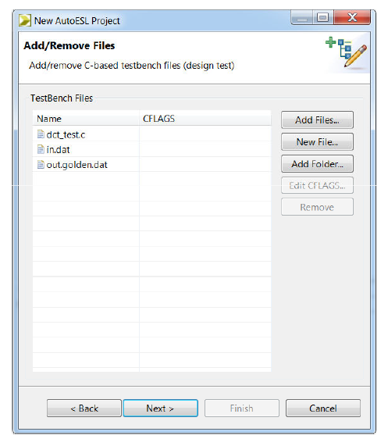
Specify Test Bench Files
1. Add the test bench
− AutoESL will re-use these to verify the RTL
2. Use “Add Files” to include the test bench
3. And all files referenced by the test bench
The RTL simulation will be executed in a different
directory (Ensures the original results are not over-
written)
AutoESL needs to also copy any files accessed
by the test bench
4. Add Folders
If the test bench uses relative paths like
“sub_directory/my_file.dat” you can add
“sub_directory” as a folder/directory
5. Use “Edit CFLAGS6”
– To add any C compile flags required for
compilation

Slide 49
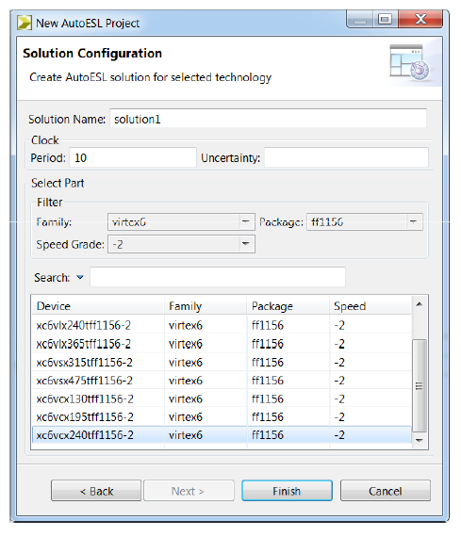
Select Clock & Technology
1. Provide a solution name
Default is solution1, then solution2 etc.
2. Specify the clock
The clock uncertainty is subtracted from the
clock to provide an “effective clock period”
Defaults to 12.5% of the clock period
AutoESL uses the “effective clock period” for Synthesis
Provides users defined margin for downstream RTL
synthesis, P&R
3. Select the technology
Technology libraries are built in
Select device, package and speed grade

Slide 50
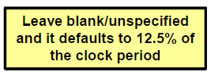
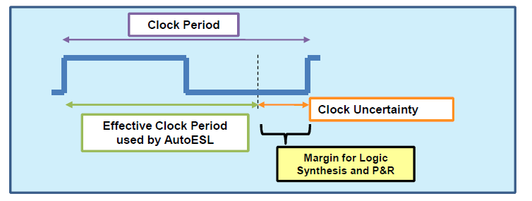
Clock Specification
Clock frequency must be specified
Only 1 clock can be specified for C/C++ functions
SystemC can define multiple clocks: one for each sc_cthread
Clock uncertainty can be specified
Subtracted from the clock period to give an effective clock period
The effective clock period is used for synthesis

Slide 51
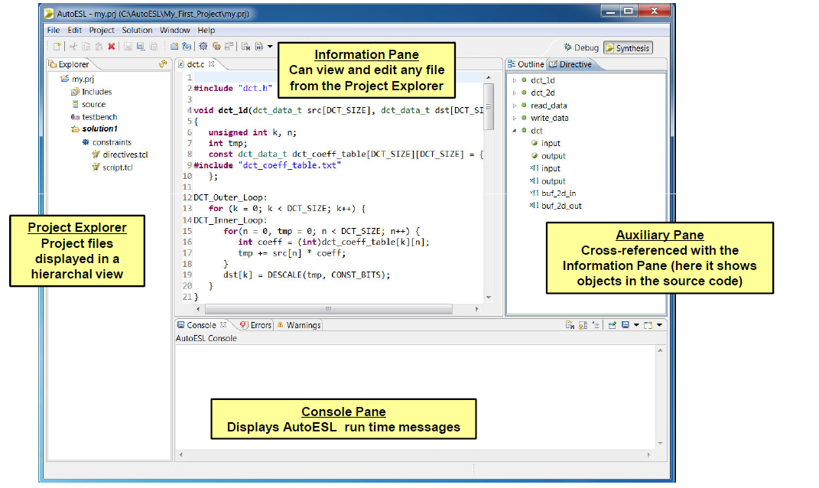
An AutoESL Project

Slide 52
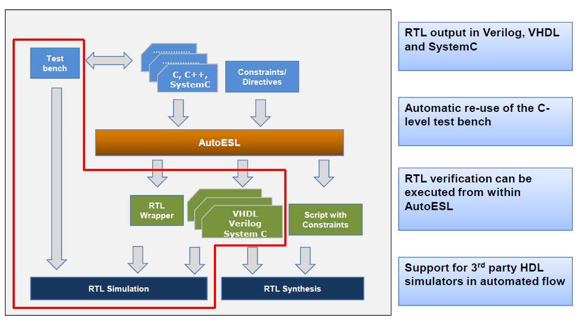
AutoESL: RTL Verification

Slide 53
RTL Verification: Under-the-Hood
RTL Simulation
AutoESL provides RTL verification
Creates the wrappers and adapters to re-use the C test bench
Prior to synthesis
Test bench
Top-level C function
After synthesis
Test bench
SystemC wrapper created by AutoESL
SystemC adapters created by AutoESL
RTL output from AutoESL
SystemC, Verilog or VHDL

Slide 54
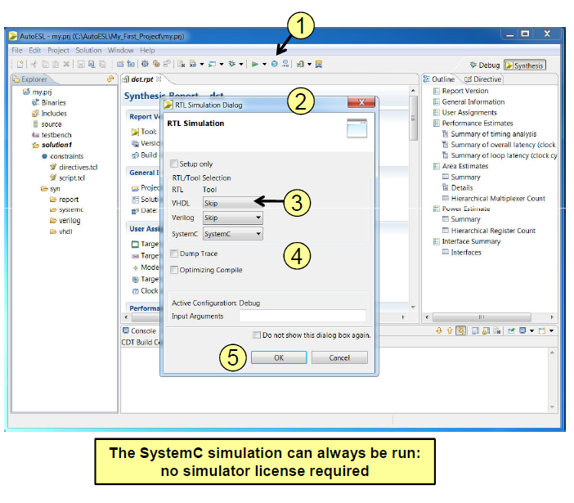
RTL Simulation
1. Start Simulation
2. Opens the dialog box
3. Select the RTL
SystemC does not require a 3rd party license
Verilog and VHDL require the appropriate
simulator
4. Options
Can output trace file (VCD format)
Optimize the C compilation & specify test
bench linker flags
5. OK will run the simulator
The “setup only” option will not execute the
simulation
Output files will be create in a “sim” directory

Slide 55
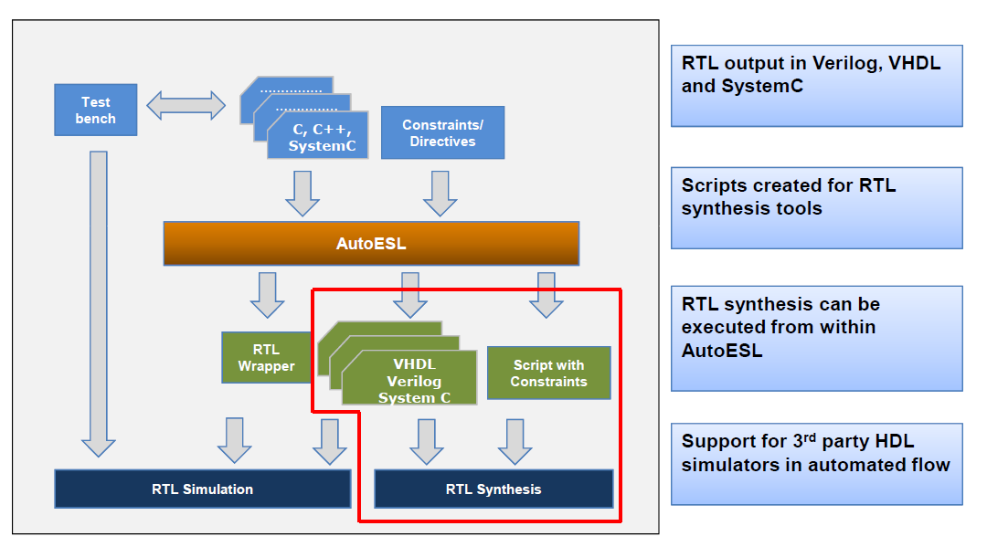
AutoESL: RTL Synthesis

Slide 56
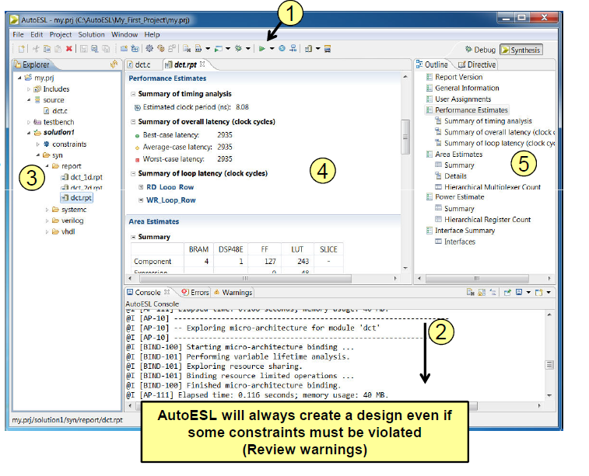
Synthesis
1. Execute Synthesis
2. Console
Will show run time information
Examine for failed constraints
3. A “syn” directory is created
Verilog, VHDL & SystemC RTL
Synthesis reports for all
non-inlined functions
4. Report opens automatically
When synthesis completes
5. Report is outlined in
the Auxiliary pane

Slide 57
RTL Synthesis Support
RTL Synthesis
Is supported using ISE or Synplify
Allows RTL synthesis to be run from within AutoESL
The path to the executable must be in your windows or linux search path. For ISE,
this is the path to xtclsh(.exe)
When AutoESL is embedded within ISE, this will be automated
The ISE license must also be specified with LM_LICENSE_FILE or XILINXD_LICENSE_FILE
The output files are written to <solution name>/impl/<HDL>

Slide 58
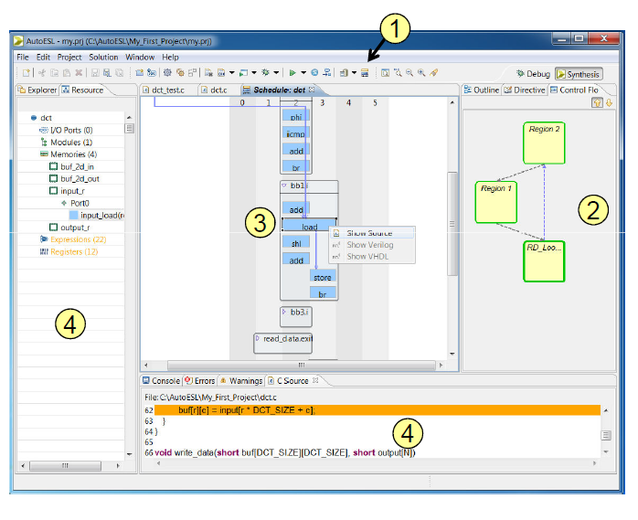
Design Viewer Analysis
1. Open Design Viewer
2. Control Flow Graph
Closest view to the code, shows the
code control hierarchy
3. Schedule Viewer
Shows how operations where
scheduled
4. Code maps
Select an object in the
schedule viewer (3) and right-click to
view in the code
5. Resource Viewer
Select an object in the schedule
viewer (3). The resource viewer
will show the hierarchy: Object Type
Instance and Operations mapped to
instance

Slide 59
Agenda
Functional Abstraction Level
High Level Synthesis HLS
Control & Datapath Extraction
Scheduling & Binding
Arbitrary Precision Data Types
Top Level I/O Ports
Loops
Arrays
Interfaces
Latency & Throughput
Optimizations
Examples
FIRMENPRÄSENTATION 2012

Slide 60
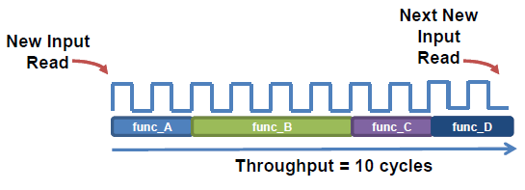
Review: Latency and Throughput
• Design Latency
– The latency of the design is the number of cycle it takes to output the result
• In this example the latency is 10 cycles
• Design Throughput
– The throughput of the design is the number of cycles between new inputs
• By default (no concurrency) this is the same as latency
• Next start/read is when this transaction ends

Slide 61
Latency and Throughput
• In the absence of any concurrency
– Latency is the same as throughput
• Pipelining for higher throughput
– AutoESL can pipeline functions and loops to improve throughput

Slide 62
AutoESL: Minimize Latency
• AutoESL will by default minimize latency
– Throughput is prioritized above latency (no throughput directive is specified here)
– In this example the functions are connected as shown below and function B takes longer than any other functions
AutoESL will schedule functions to start as soon as they can

Slide 63
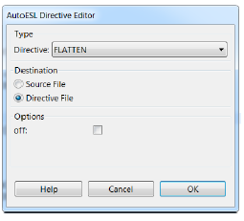
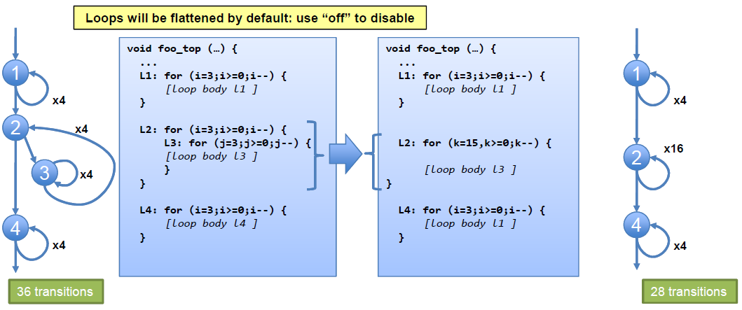
Loop Flattening
• AutoESL can automatically flatten nested loops
– A faster approach than manually changing the code
• Flattening should be specified on the inner most
loop
– It will be flattened into the loop above
– The “off” option can prevent loops in the hierarchy from
being flattened

Slide 64
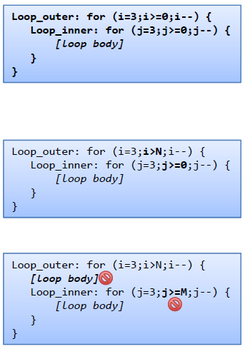
Perfect and Semi-Perfect Loops
• Only perfect and semi-perfect loops can be flattened
– The loop should be labeled or directives cannot be applied
• Perfect Loops
– Only the inner most loop has body (contents)
– There is no logic specified between the loop statements
– The loop bounds are constant
• Semi-perfect Loops
– Only the inner most loop has body (contents)
– There is no logic specified between the loop statements
– The outer most loop bound can be variable
• Other types
– Should be converted perfect or semi-perfect loops

Slide 65
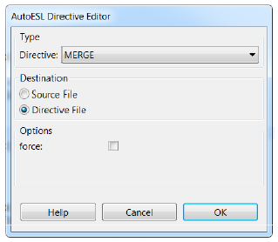
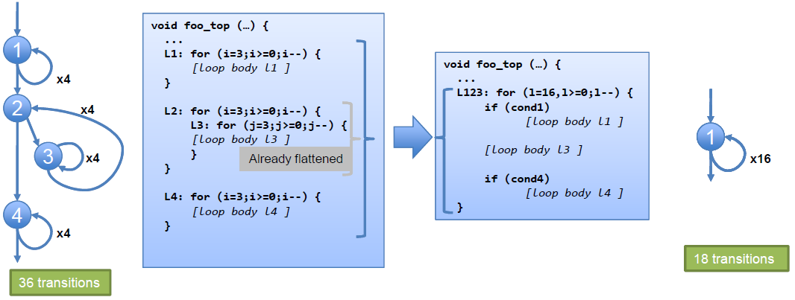
Loop Merging
AutoESL can automatically merge loops
– A faster approach than manually changing the code
– Allows for more efficient architecture explorations
– FIFO reads, which must occur in strict order, can
prevent loop merging
• Can be done with the “force” option : user takes
responsibility for correctness

Slide 66
Loop Merge Rules
• If loop bounds are all variables, they must have the same value
• If loops bounds are constants, the maximum constant value is used as
the bound of the merged loop
– As in the previous example where the maximum loop bounds become 16
(implied by L3 flattened into L2 before the merge)
• Loops with both variable bound and constant bound cannot be merged
• The code between loops to be merged cannot have side effects
– Multiple execution of this code should generate same results
• A=B is OK, A=B+1 is not
• Reads from a FIFO or FIFO interface must always be in sequence
– A FIFO read in one loop will not be a problem
– FIFO reads in multiple loops may become out of sequence
• This prevents loops being merged

Slide 67
Improving Throughput
Given a design with multiple functions
– The code and dataflow are as shown
AutoESL will schedule the design
It can also automatically optimize the dataflow for throughput

Slide 68
Dataflow Optimization
• Dataflow Optimization
– Can be used at the top-level function
– Allows blocks of code to operate concurrently
• The blocks can be functions or loops
• Dataflow allows loops to operate concurrently
– It places channels between the blocks to maintain the data rate
• For arrays the channels will include memory elements to buffer the samples
• For scalars the channel is a register with hand-shakes
• Dataflow optimization therefore has an area overhead
– Additional memory blocks are added to the design

Slide 69
Pipelining: Dataflow, Functions & Loops
• Dataflow Optimization
– Dataflow optimization is “coarse grain” pipelining at the function and loop
level
– Increases concurrency between functions and loops
– Only works on functions or loops at the top-level of the hierarchy
• Cannot be used in sub-functions
• Function & Loop Pipelining
– “Fine grain” pipelining at the level of the operators (*, +, >>, etc.)
– Allows the operations inside the function or loop to operate in parallel
– Unrolls all sub-loops inside the function or loop being pipelined
• Loops with variable bounds cannot be unrolled: This can prevent pipelining
• Unrolling loops increases the number of operations and can increase memory
and run time

Slide 70
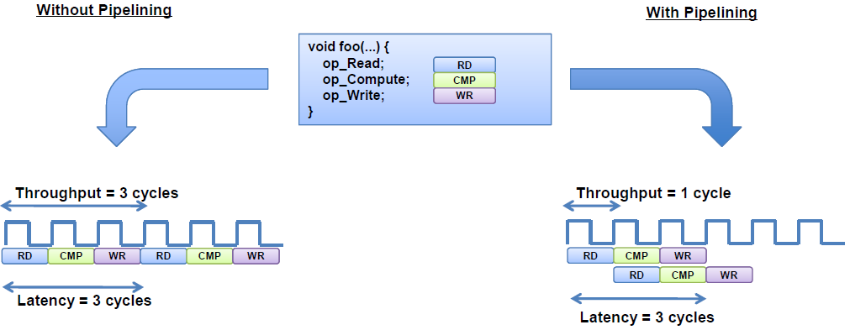
Function Pipelining
• There are 3 clock cycles before operation
RD can occur again
– Throughput = 3 cycles
• There are 3 cycles before the 1st output is written
– Latency = 3 cycles
• The latency is the same
• The throughput is better
• Less cycles, higher throughput

Slide 71
Arrays: Performance bottlenecks
• Arrays are intuitive and useful software constructs
– They allow the C algorithm to be easily captured and understood
• Array accesses can often be performance bottlenecks
– Arrays are targeted to a default RAM
• May not be the most ideal memory for performance
Cannot pipeline with a throughput of 1
• AutoESL allows arrays to be partitioned and reshaped
– Allows more optimal configuration of the array
– Provides better implementation of the memory resource

Slide 72
Review: Arrays in HLS
• An array in C code is implemented by a memory in the RTL
– By default, arrays are implemented as RAMs, optionally a FIFO
• The array can be targeted to any memory resource in the library
– The ports and sequential operation are defined by the library model
• All RAMs are listed in the AutoESL Library Guide

Slide 73
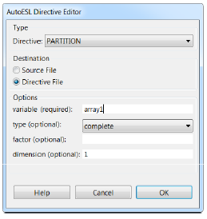
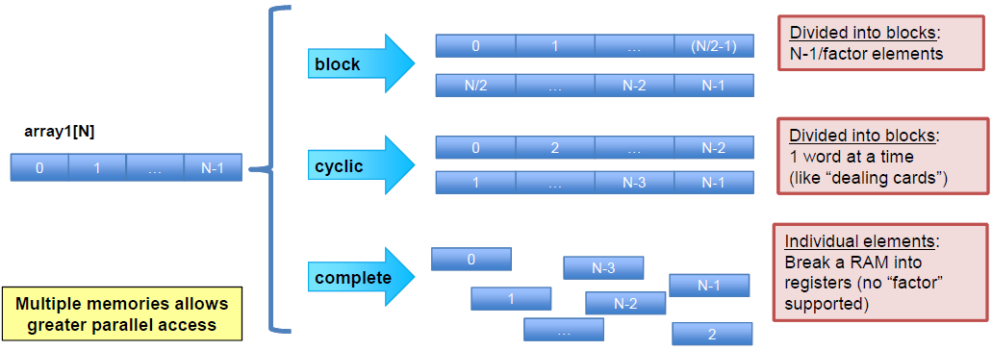
Array Partitioning
• Partitioning breaks an array into smaller elements
• If the factor is not an integer multiple the final array has
fewer elements
• Arrays can be split along any dimension
• If none is specified dimension zero is assumed
• Dimension zero means all dimensions

Slide 74
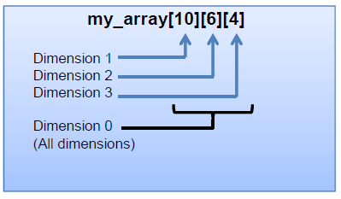
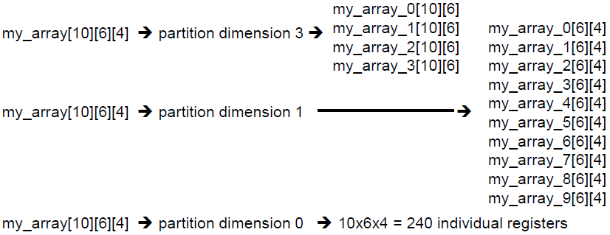
Array Dimensions
• The array options can be performed on dimensions of the array
Examples

Slide 75
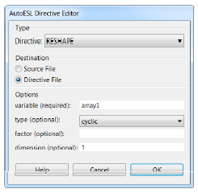
Array Reshaping
• Reshaping recombines partitioned arrays back into a single array
• Same options as array partition
• However, reshape automatically recombines the parts
back into a single element
• The “new” array has the same name
• Same name used for resource targeting

Slide 76
First Example
Example 1:
Simple calculation of an average value of N input samples:
Create the Source for the algorithm
Create the Source for the Test Bench
Create the autoESL project (sources may also be created inside autoESL)
Verify your C/C++ code by running the Test Bench
Run different optimization strategies for speed / area
Generate RTL and run the implementation
accu = 1/N ∑ a(K)
K=N
K=0

Slide 77
Overview and first Example
Create the Source for the algorithm
#include "accu.h"
#include "ap_int.h"
atype accu(atype a[N])
{btype y;
y = 0;
accumulate:for(int i = 0; i < N; i++) {y += a[i];}
return y/N ;
}
#ifndef __ACCU_H__
#define __ACCU_H__
#include <cmath>
#include "ap_int.h";
#define N 8
typedef ap_int<6> atype; // arbitrary precision
typedef ap_int<9> btype; // arbitrary precision
// Prototype of top level function for C-synthesis
atype accu(atype a[N]);
#endif // __MATRIXMUL_H__ not defined
accu = 1/N ∑ a(K)
K=N
K=0
Use arbitrary precision type for 6 bit wide inputs and 9 bit wide outputs

Slide 78
Overview and first Example
Create the Source for the Test Bench
#include <iostream>
#include "accu.h"
#include "ap_int.h"
using namespace std;
// Prototype of top level function for C-synthesis
atype accu(atype a[N]);
int main()
{ atype in_a[N] = {12,10,-12,23,4,5,10,-10};
atype hw_result, sw_result;
int y,i;
// Generate the expected result
y = 0;
sw_accumulate:for( i = 0; i < N; i++) {y += in_a[i];}
sw_result = y/N ;
// Run the real hardware **********************
hw_result = accu(in_a);
// print the expected Results *******************
cout << "Expected Results: " << sw_result << endl;
// print the hardware Results ******************
cout << "results from the Hardware Implementation: " << hw_result << endl;
// Display the Check results
if (sw_result == hw_result) return 0;
else return 1;
}

Slide 79
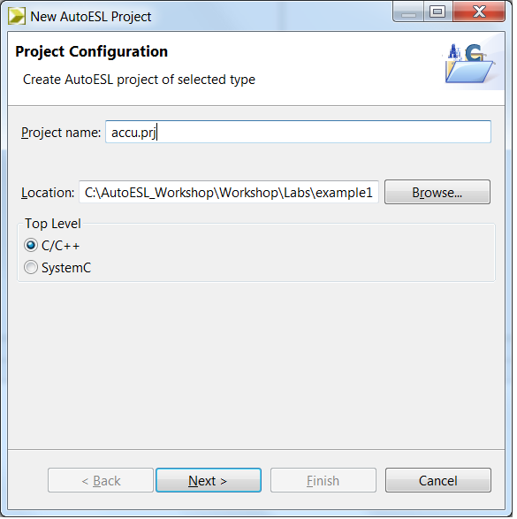
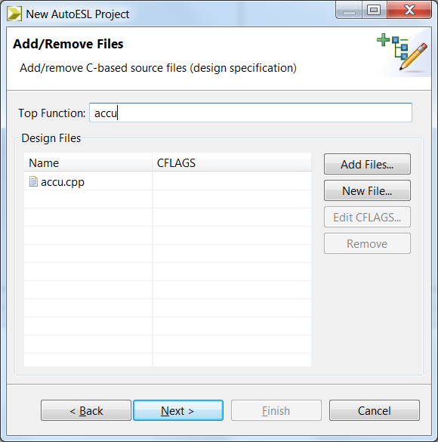
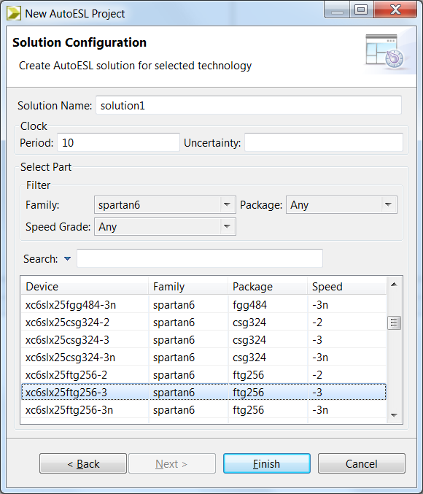
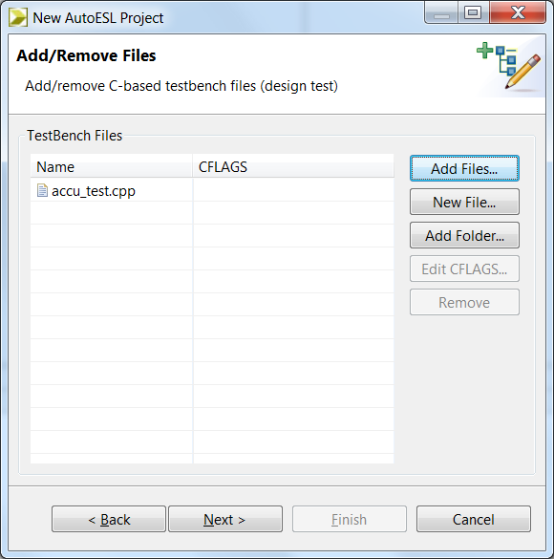
Overview and first Example
Create the AutoESL Project
Create new autoESL project “accu.prj” and Select C/C++
Add Files and define the top level function
Add Test bench File for C Level Verification.
Select the device
Start with Solution1
1
2
4
3

Slide 80
Overview and first Example
Verify your C/C++ code by running the Test Bench
Output from the Test Bench is shown here
Expected Results: 5
Results from the Hardware Implementation: 5

Slide 81
Solution 1
Clock Period: 10 ns
Loop: unrolled
Interface type: ap_none

Slide 82
Interface type ap_none (Solution 1)
AutoESL support different interface types. The interface type used for solution 1 is ap_none.
Signal timing diagram
More in the Interface section

Slide 83
PlanAhead Project (Solution 1)
1 . Import the RTL source and setup the project.
2. Define the RTL Test Bench.
3. Run the Simulation
4. Run the Synthesis

Slide 84
Setup a simple Test Bench (Solution 1)
ap_rst_process: process
begin
ap_rst <= '1';
wait for 2 * ap_clk_period;
ap_rst <= '0';
wait;
end process;
ap_start_process: process
begin
ap_start <= '0';
wait for 3 * ap_clk_period;
ap_start <= '1';
wait for ap_clk_period;
ap_start <= '0';
wait for 30 * ap_clk_period;
end process;
end behave;
signal ext_ram : ext_memory_type := ("001100","001010","110100","010111","000100","000101","001010","110110");
constant ap_clk_period: time := 10 ns;
begin
uut: accu port map ( ap_clk => ap_clk, ap_rst => ap_rst, ap_start => ap_start, ap_done => ap_done, ap_idle => ap_idle, a_V_address0 => a_V_address0,
a_V_ce0 => a_V_ce0, a_V_q0 => a_V_q0, ap_return => ap_return );
ext_ram_process: process(ap_clk)
begin
if rising_edge(ap_clk)
then if a_V_ce0 = '1'
then a_V_address0_reg <= a_V_address0;
end if;
end if;
end process;
a_V_q0 <= ext_ram(conv_integer(a_V_address0_reg));
ap_clk_process: process
begin
ap_clk <= '0';
wait for ap_clk_period / 2;
ap_clk <= '1';
wait for ap_clk_period / 2;
end process;
ap_rst
UUT
ram
ap_start
Return value
ap_clk

Slide 85
Run the ISIM (Solution 1)
Latency

Slide 86
Run the Synthesis (Solution 1)
Run RTL Design
Run Netlist Design

