Slide 1
FPGAs in Research - Applications, Technologies and Tools
FPGA Oriented HW/FW Development in FEA DESY
Frantisek Krivan – DESY FEA
Jülich, 04. 12. 2012

Slide 2
Evolution of FPGA Technology (XILINX)
Transceiver Speed up to 12.5Gb/s
Memory Interface up to 1866Mb/s
AXI4 integration to many IP
PCI Express Gen 2
ZYNQ: Processing System and
Programmable logic in single chip
GTX Transceiver Speed up to 6.5Gb/s
GTX Transceiver Speed up to 3.75Gb/s
PCI Express Gen 1
I/O Transfer Rate up to 622Mb/s
Memory support up to 333Mb/s
Spartan3
Virtex5
Kintex7/Zynq
PXI – Fast ADC Transient Recorder
µTCA - DAMC2
µTCA - HGF – AMC1

Slide 3
Starting efficiently with a Technology having limited resources ?
Concentrate on key challenges of new technology
10G
DDR3
PCIe Gen2
AMBA AXI4
Don’t make everything new
Build up on existing in-house know-how and experiences
Have users and applications for the development
One can learn much more if a development is really used
Share experience with other groups if possible
Additional resources
Try to be cost effective
Development of an improved version of the DAMC2 Board together with KIT –IPE (M. Balzer’s group)

Slide 4
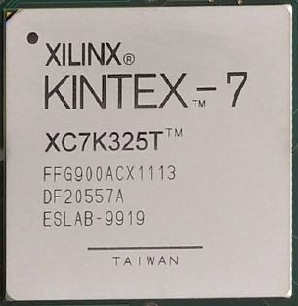
DAMC2 – Virtex-5
HGF-AMC1- Kintex - 7
Versatile board
Modular structure
Compatible with DAMC2
For high performance applications
XC7K325T-2FFG900C

Slide 5
Preliminary HGF-AMC1 – Block Diagram

Slide 6
HGF-AMC1 – Improvements and modifications
PCI Express, Gen 2,
DDR3 Memory, SODIMM
RTM Interface include 2 GTX channels
FMC Interface include 1 GTX channel
SFP+ Interface, 4 channels ( optionally direct 10G Ethernet )
GTX to backplane 4 channels
AMBA®AXI4 conforming interfaces
Power sequencing and monitoring of the Kintex 7
New BPI configuration interface

Slide 7
Outlook: ZYNQ based developments
from Xilinx documentation

Slide 8
Advantages of ZYNQ based Board
Commercial modules already on the market
Simplification of hardware development
Algorithms can be programmed in C/C++ under OS
Users can much easier maintain their DAQ Systems
Application Firmware and algorithms develop over time
Today typically a VHDL developer has to update firmware

Slide 9
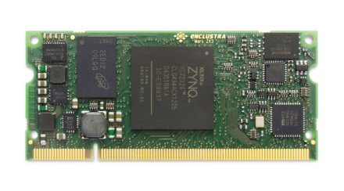
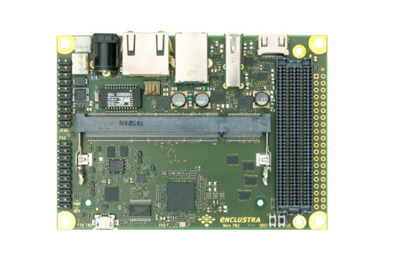
ZYNQ based example – Application of commercial modules
Simplification of HARDWARE development by splitting a design to 2 parts:
Commercial module:
Support most of the standard interfaces in processor system part
Support of the application design in programmable logic part
Carrier board:
Signals drivers, receivers/transmitters, termination and interfaces connector
Connect signals from commercial module to correspondent interfaces connector
Combination of the different commercial modules and carrier boards can supply broad spectrum of the customers / applications

Slide 10
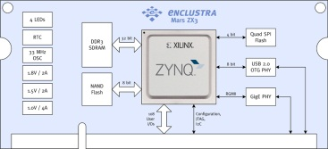
ZYNQ based example – Application of commercial modules
Simplification of the SOFT/FIRMWARE development by splitting a design to 2 parts:
Processor system (PS) - software:
Powerful processing unit
OS integration
Programming in high level languages
Broad spectrum of standard interfaces
Programmable logic (PL) - firmware:
Based on Artix-7/Kintex-7
System monitoring
Written in VHDL Framework
Significant advantage can be relatively independent software development for PS part and firmware development for PL part, including possibility to combine them from different designs

Slide 11
Thank You

