Slide 1
Development of a FPGA based DAQ for digital SiPM‘s using USB3.0
Holger Nöldgen
10. September 2012 | Holger Nöldgen

Slide 2
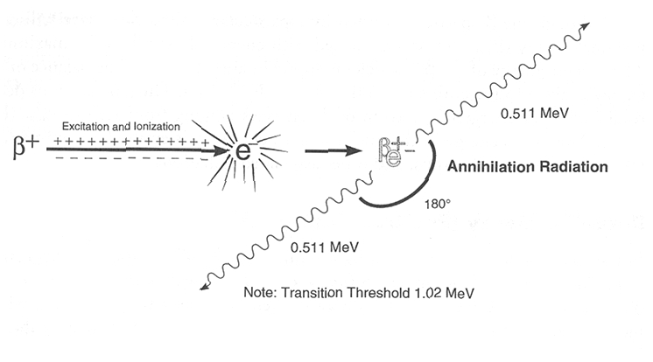
PET-Detectors
A Positron Emission Tomograph (PET) uses the positron decay of radionuclide tracers.
During the annihilation process of a positron two gammas of 511 keV are produced in an angle of 180°.

Slide 3
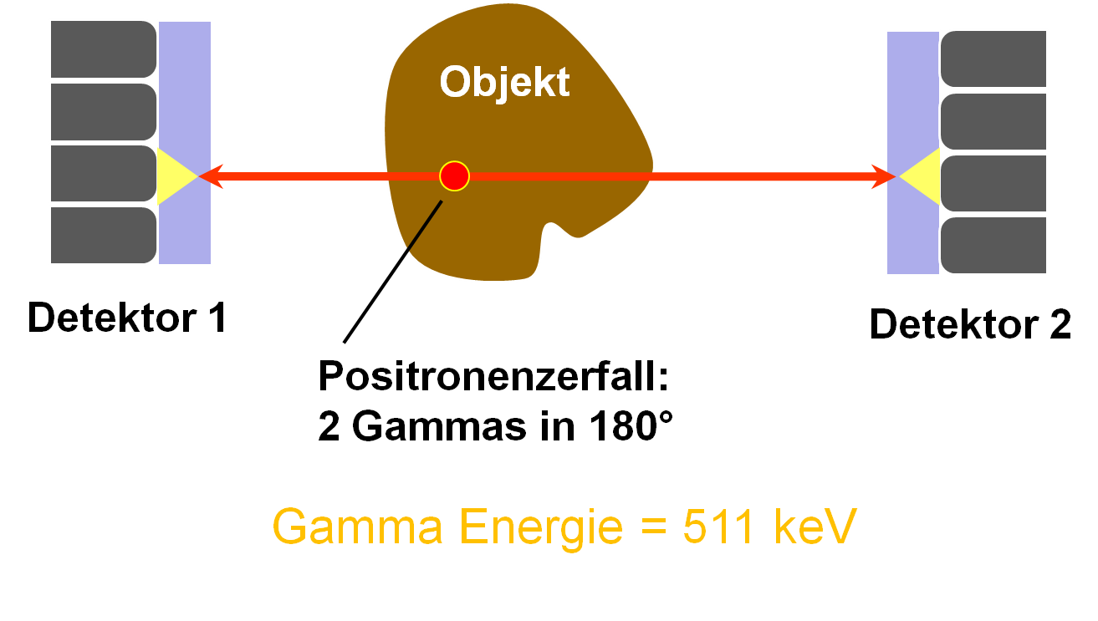
PET-Detectors
A PET detector consists of face-to-face placed scintillation detectors measuring coincident γ-particles.
The coincident signals give information about the line of response.
Three informations are required:
Timing information
Energy information
Position on detector (Pixelnumber)

Slide 4
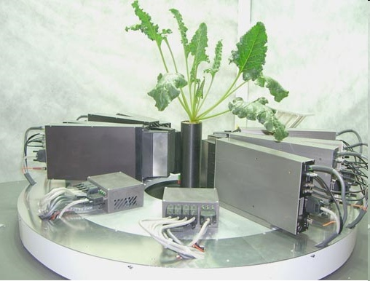
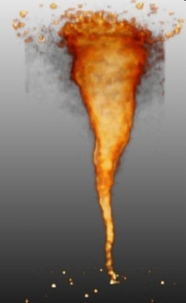
PET Detecor in Jülich (Plantis)
Solute transport in
plants (spica)
¹¹C-distri-bution in a sugar beet
Used as a high resolution detector for plant phenotyping, e.g
for carbon transport within plants using ¹¹CO₂ as a radioactive marker

Slide 5
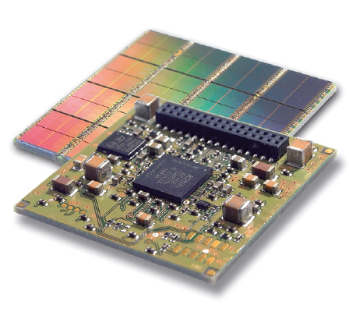
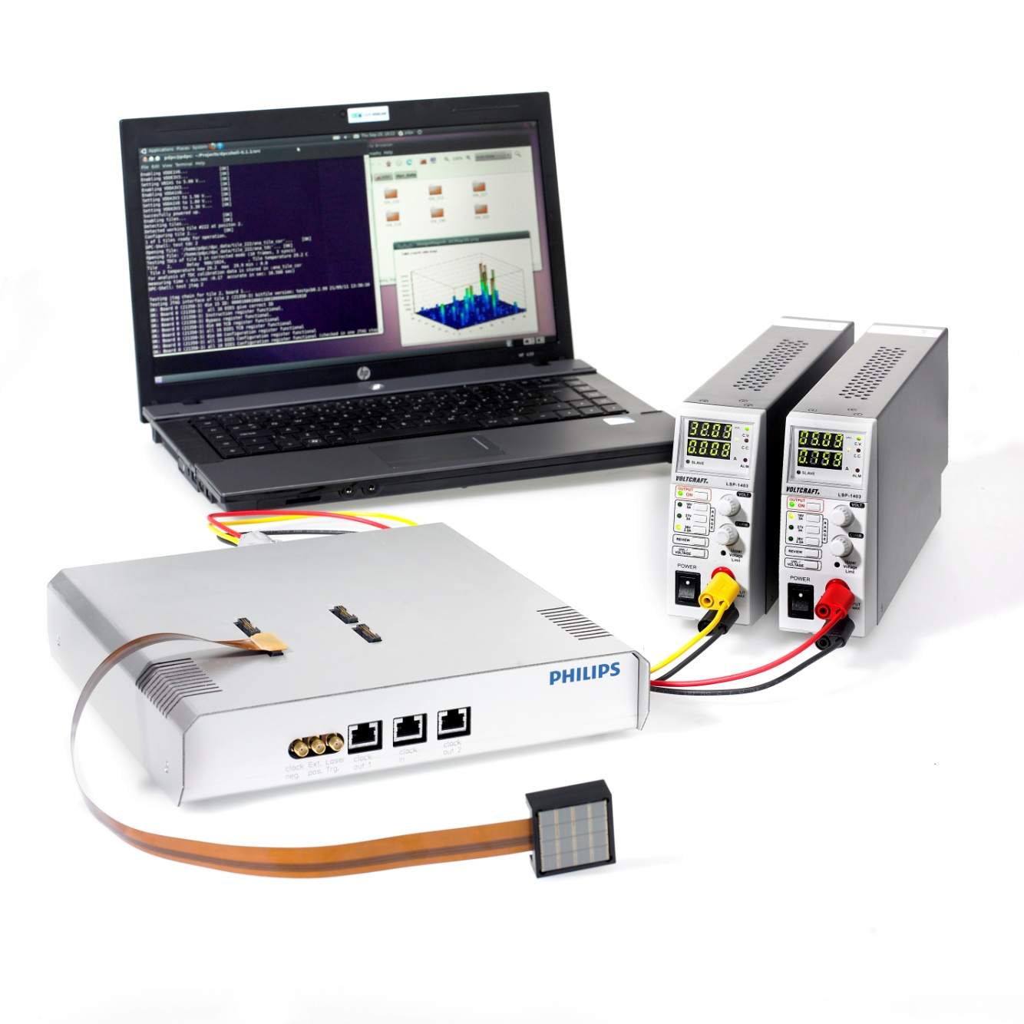
Philips Digital Silicon Photomultiplier
Digital Silicon Photomultiplier (dSiPM) are novel devices, allowing their users to implement them as a fully digital device for photon counting.
An evaluation kit for dSiPM (TEK) arrays has been installed at the Central Institute for Electronics of the Forschungszentrum Jülich.
Pictures courtesy of Philips Digital Photon Counting

Slide 6
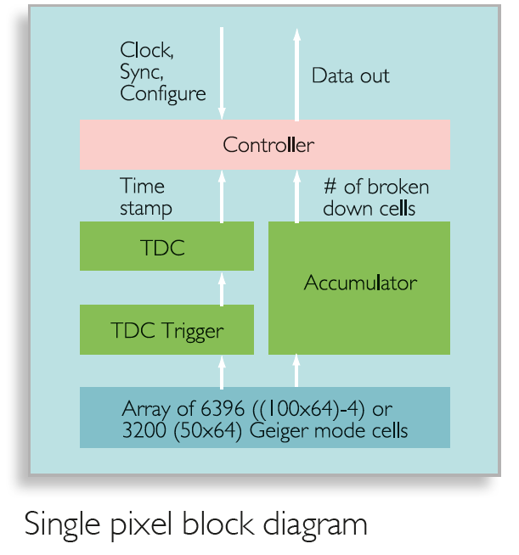
How dSiPM work
Analog SiPM: Analog amplifiers are used before the output gets digitized
Digital SiPM: No analog electronics needed, since each photon is counted by the cell electronics
Pictures courtesy of Philips Digital Photon Counting

Slide 7
dSiPM Read-Out Concept
A FPGA will play a central role within the readout chain
A seperate board will provide the proper voltages and logic levels for the tile
As a high speed data-link USB 3.0 will be implemented

Slide 8
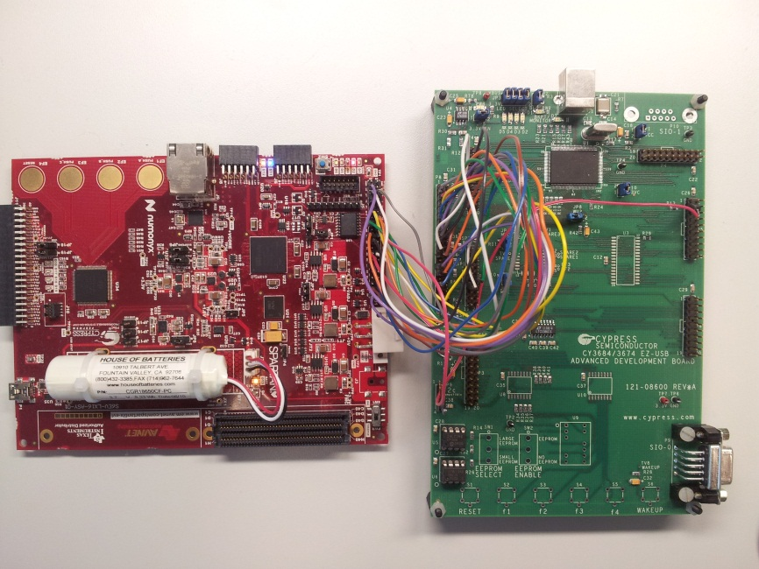
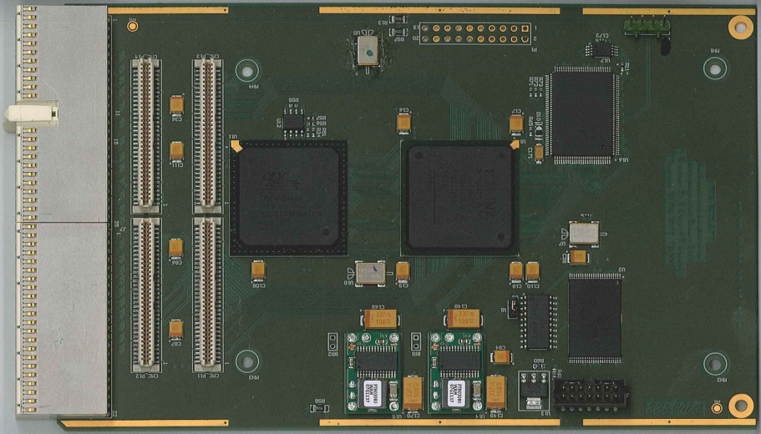
USB 2.0 Development @ ZEL in the past
Avnet Spartan6 LX16 Development Board connected to Cypress FX2 Development Board
cPCI CMC Carrier Board with Cypress USB 2.0 Link

Slide 9
Differences between USB 2.0 and USB 3.0
Feature | USB 2.0 (Cypress FX2) | USB 3.0 (Cypress FX3)
Data rate | Max. 480 Mbits/s (High Speed) | Max 5.0 Gbits/s (Super Speed)
Data interface | Half-duplex Two-wire differential signaling | Dual-simplex Four-wire differential signaling
Bus transaction protocol | Host directed Polled traffic flow | Host directed Asynchronous notifications
Interface to FPGA | GPIF with 8-Bit @ 48 MHz Slave FIFO Interface | GPIF II with 32-Bit @ 100 MHz Slave FIFO Interface
Cypress FX2 USB Controller has been used in the past.
→ Existing USB 2.0 delevopments can be adapted to USB 3.0

Slide 10
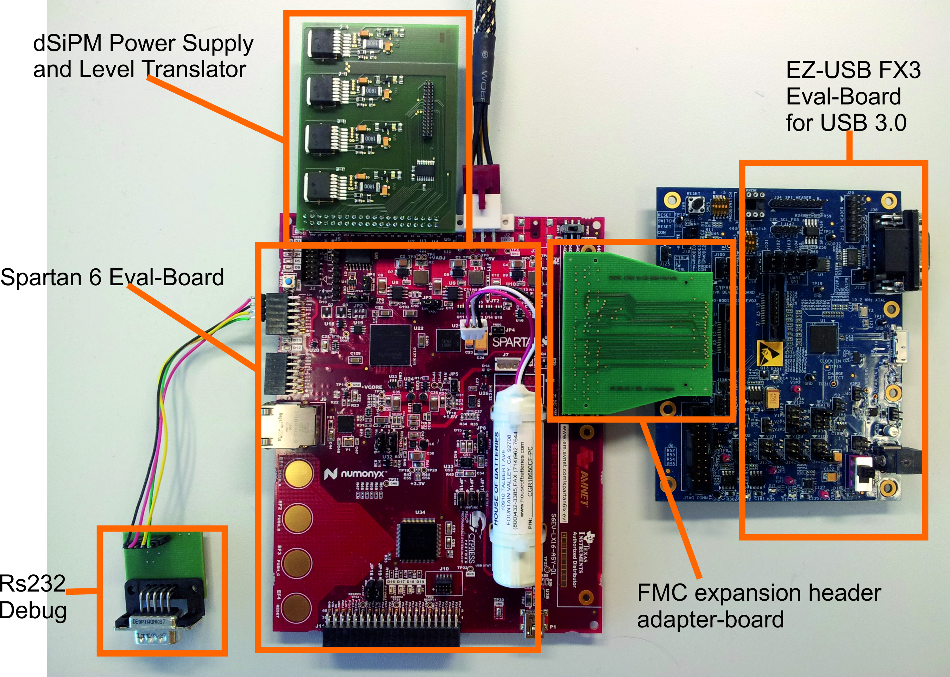
USB 3.0 Development @ ZEL now

Slide 11
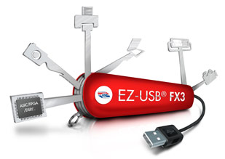
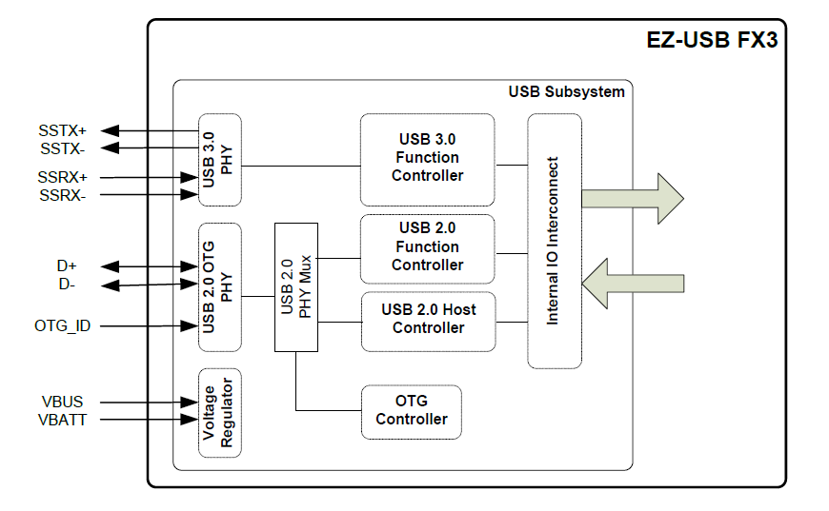
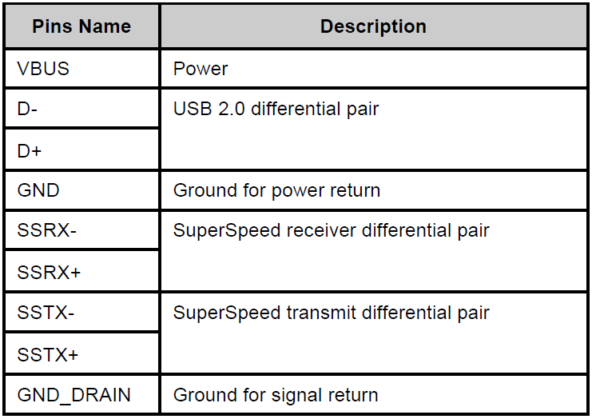
Cypress FX3 USB Controller [1]
[5]
[4]
FX3-Chip has internal USB phy
FPGA can be connected to a more simple parallel interface
USB 3.0 interface is backward
compatible to USB 2.0

Slide 12
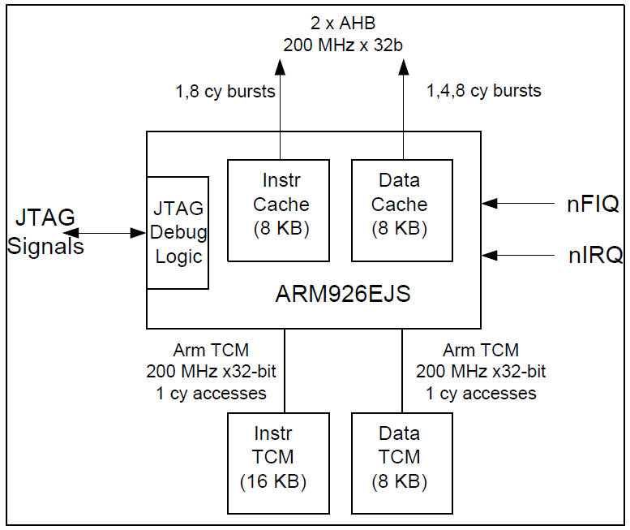
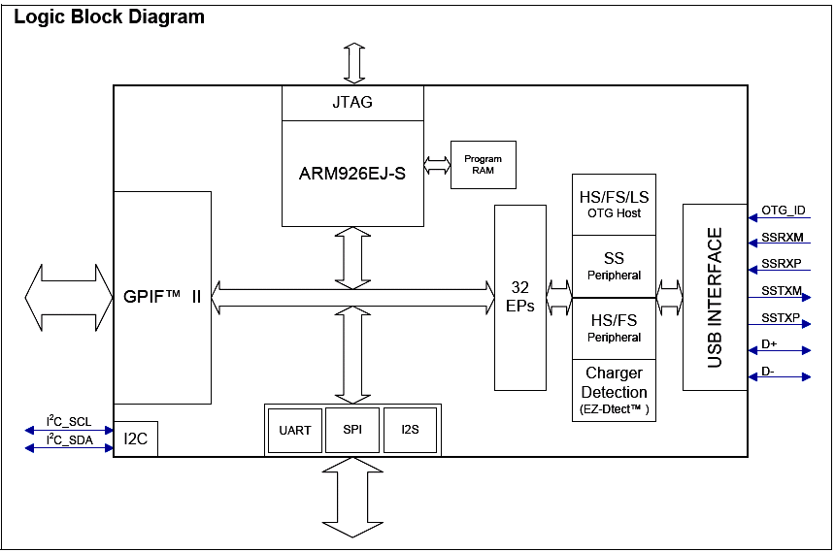
Cypress FX3 USB Controller [2]
[3]
FX3 has internal ARM926 CPU running at 200 MHz
[3]
Data transfer inbetween USB interface and GPIF II is set up by CPU code
After setup, data can be exchanged without CPU access (DMA channels)

Slide 13
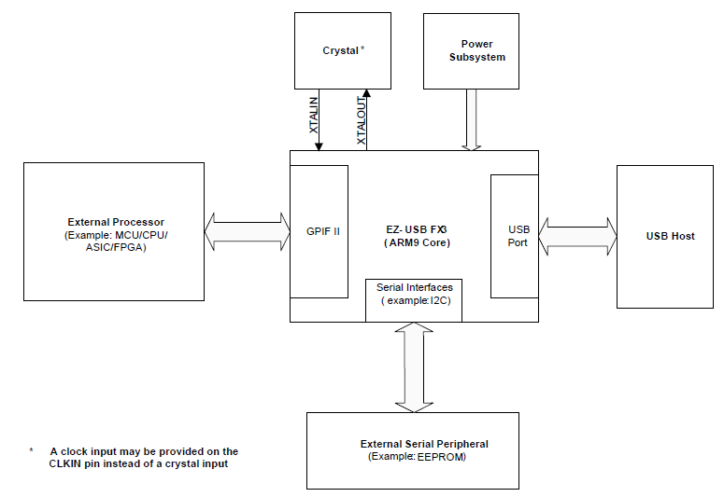
FX3 System Architecture
FX3 acts as a external coprocessor to provide a USB 3.0 to the FPGA
GPIF II is connected to FPGA I/Os
CPU code is stored on external I²C EEPROM
[2]

Slide 14
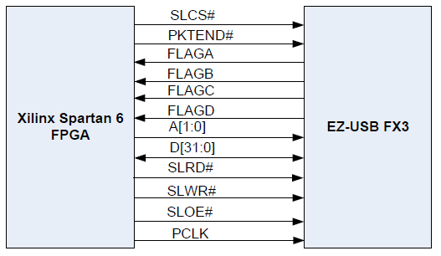
GPIF II Interface
[1]
Signal | Usage
D[31:0] | Data bus
A[1:0] | USB endpoint adress
PCLK | GPIF clock (100 MHz)
SLCS | Chip select
SLRD | Read from bus
SLWR | Write to bus
SLOE | Bus output enable
FLAGA-FLAGD | FIFO signals (full, empty)
PKTEND | Write short package
[1]
44 FPGA I/O pins needed

Slide 15
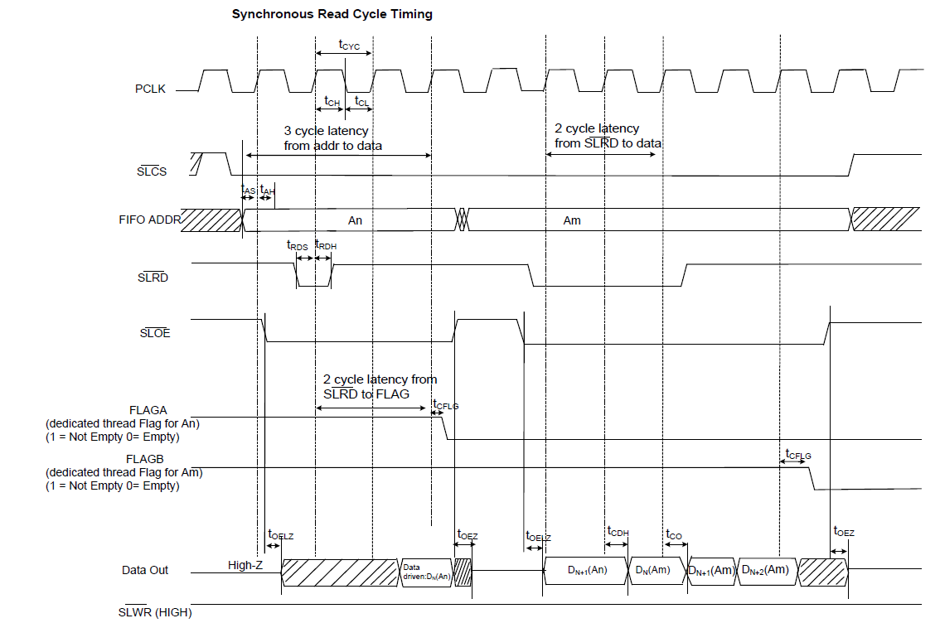
GPIF II Read Cycle
Data is clocked out from FIFO by PCLK
CS and ADDR adresses the endpoint buffer
RD is the FIFO read signal
OE enables the bus to be non tri-state and drive the output
FLAGs show status of FIFOs
Latencies !
[2]

Slide 16
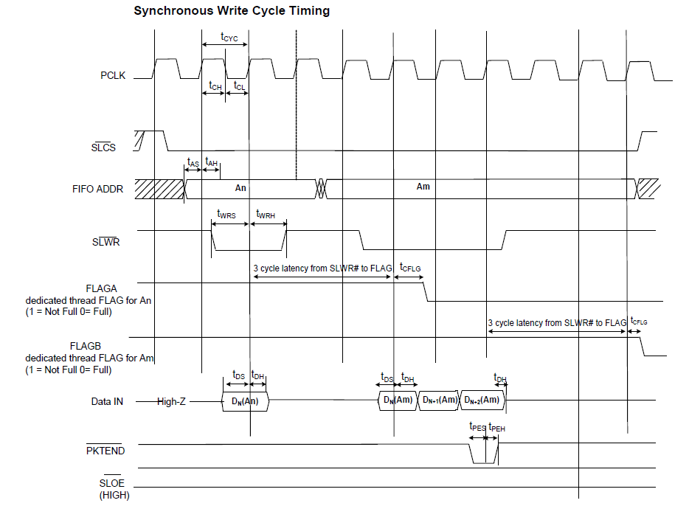
GPIF II Write Cycle
Data is clocked into FIFO by PCLK
CS and ADDR adresses the endpoint buffer
WR is the FIFO write signal
PKTEND indicates short pakate write (direct transfer to USB-Host)
OE disables the bus drive and forces bus to be an input
FLAGs show status of FIFOs
Latencies !
[2]

Slide 17
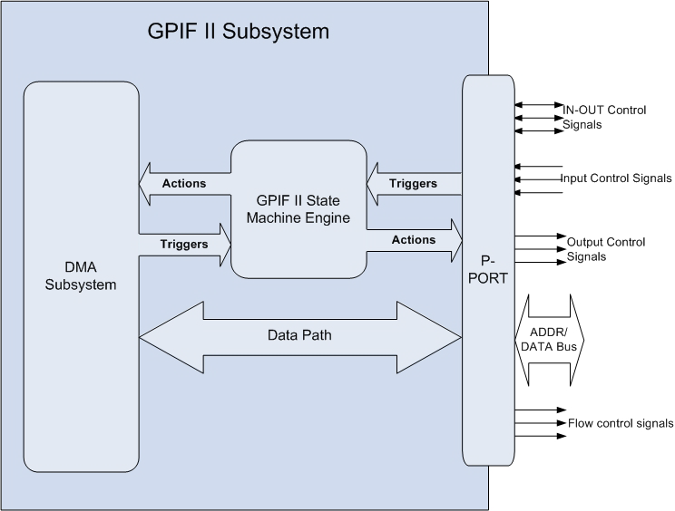
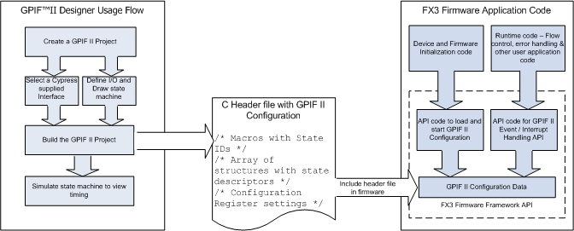
GPIF II Software Implementation
[6]
[6]
GPIF II: A user state machine which can be created by GPIF-Designer tool and implemented into FX3 firmware
GPIF II internally consist of Triggers and Actions

Slide 18
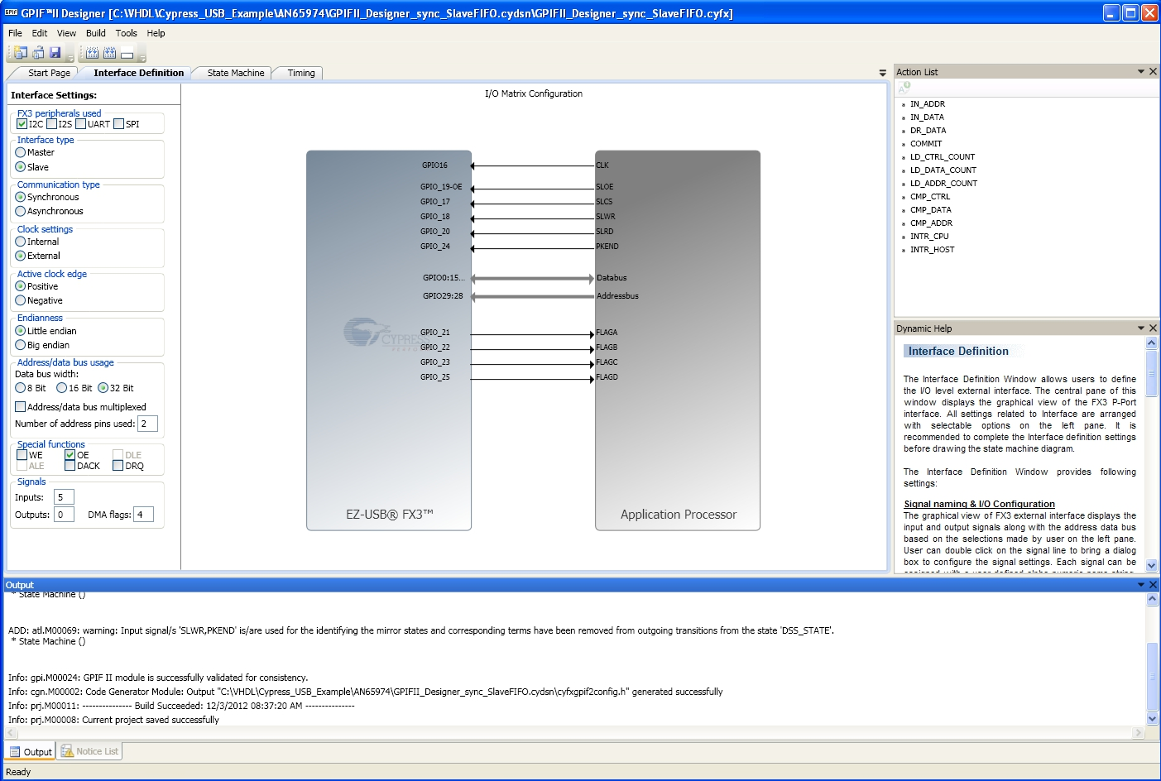
GPIF II Designer Interface Definition

Slide 19
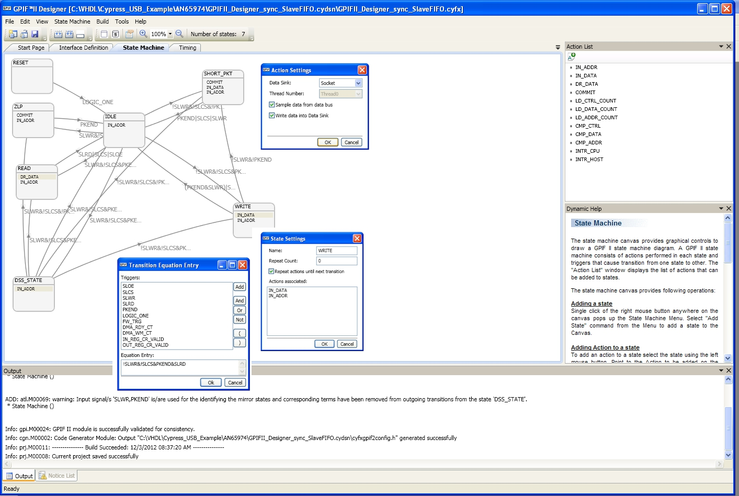
GPIF II Designer State Machine
After basic definition of user interface, each state can be examined and edited

Slide 20
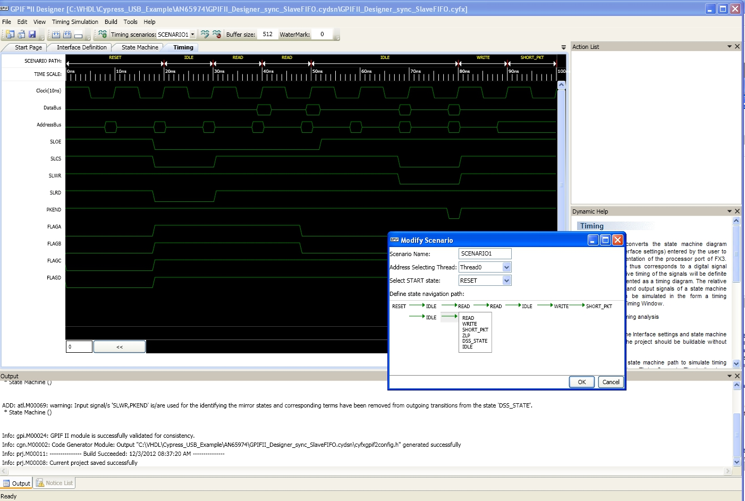
GPIF II Designer Timing
The timing tool helps to analyze the behaviour of the GPIF interface and can be used to adapt FPGA VHDL-Code

Slide 21
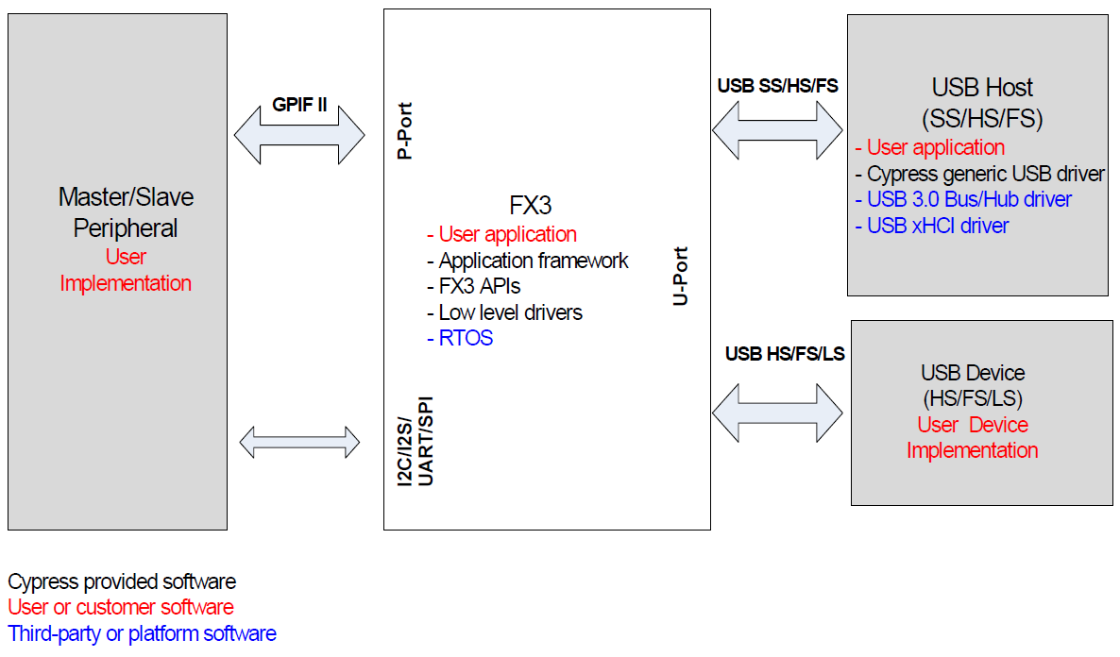
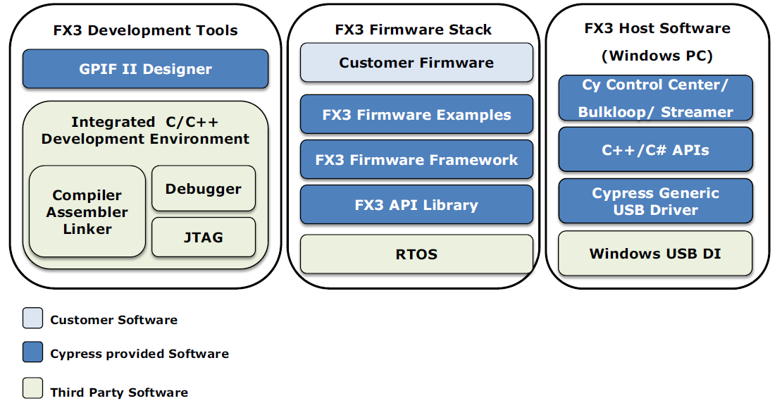
FX3 Firmware Development [1]
Cypress provides an application framework to fasten design creation for the FX3 controller
On the host side API libs are provided to use the Cypress device driver
[3]
Firmware development is done by Eclipse using ARM-GCC on Windows and Linux
Many example applications are provided to get started
[3]

Slide 22
FX3 Firmware Development [2]
A third party RTOS is running on the ARM-CPU and acesses the API libraries.
User code (if needed) can be implemented with the Eclipse IDE
[3]

Slide 23
References
[1] „AN65974 - Designing with the EZ-USB FX3 Slave FIFO Interface“, Application Note, Cypress Semiconductor, www.cypress.com
[2] „CYUSB301X EZ-USB FX3 Super Speed USB Controller“, Datasheet, Cypress Semiconductor, www.cypress.com
[3] „Cypress FX3 Programmers Manual“
Documentation, Cypress Semiconductor, www.cypress.com
[4] „AN75705 - Getting started with FX3“
Application-Note, Cypress Semiconductor, www.cypress.com
[5] „AN75432 - USB 3.0 EZ-USB FX3 Orientation”, Application Note, Cypress Semiconductor, www.cypress.com
[6] „GPIF II Designer 1.0“
Documentation, Cypress Semiconductor, www.cypress.com

Slide 24
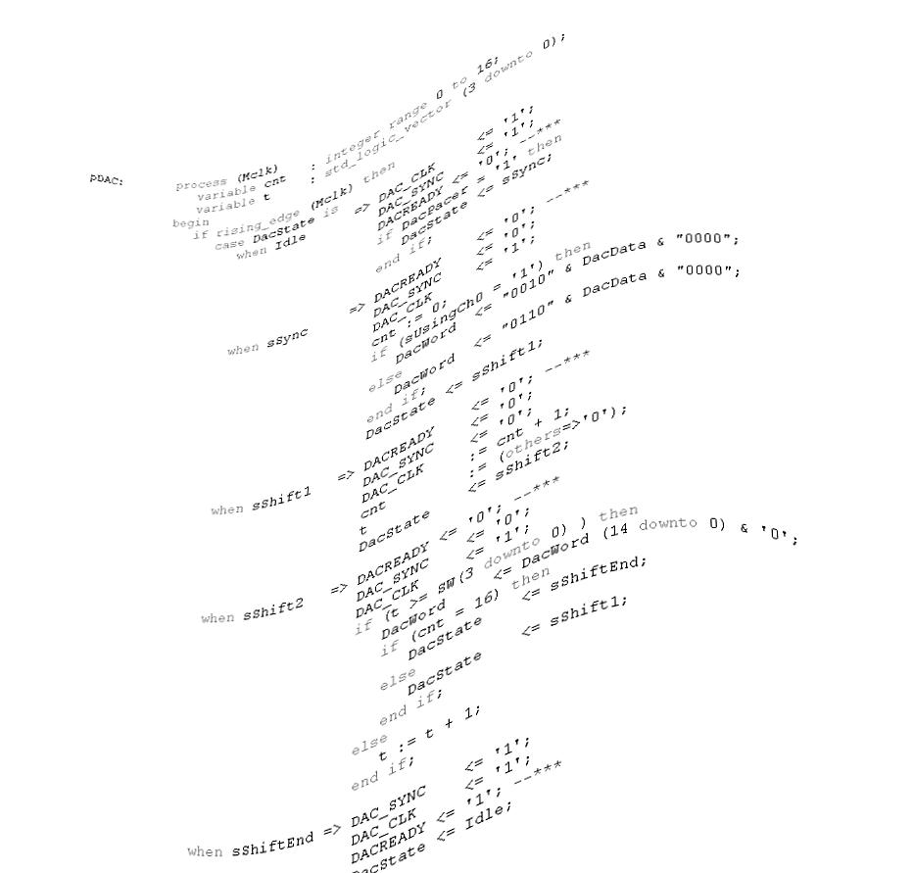
Thank you!
Matthias Streun
Heinz Loevenich
Hubert Gorke
Günter Kemmerling

