Slide 1
Results of the Auger Engineering Radio Array

Slide 2
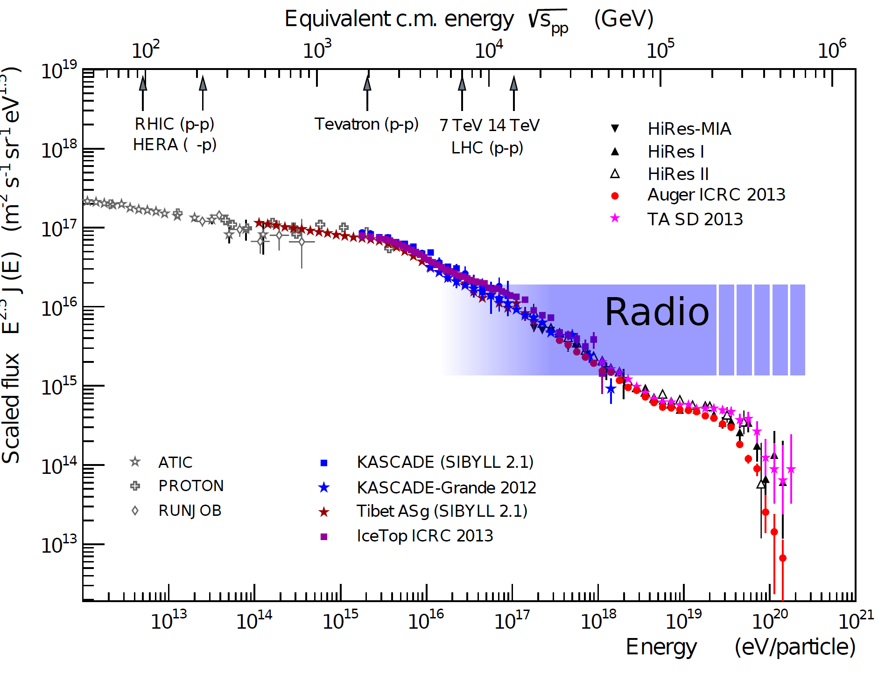
To understand the sources of cosmic rays …
we need to know their
  arrival direction
  energy
  and mass
we need large statistics
  large effective areas and high duty cycles
ideally in hybrid measurements
adapted from R. Engel

Slide 3
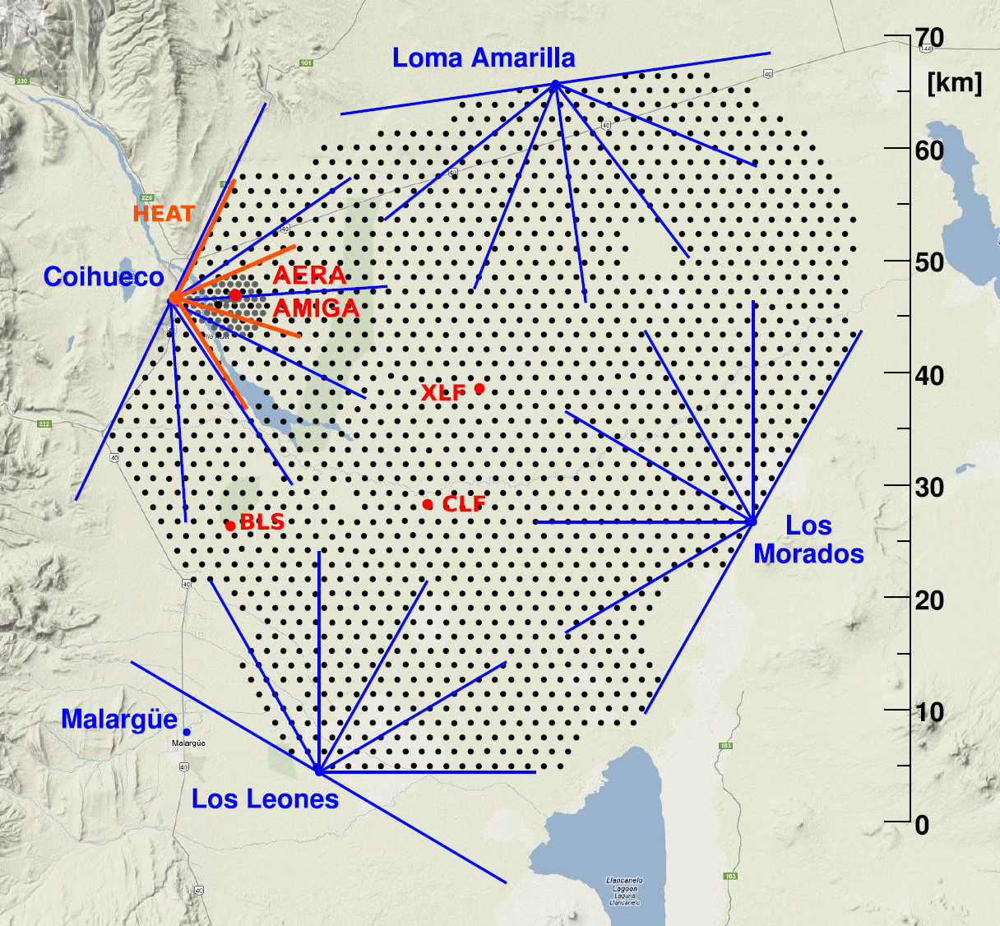
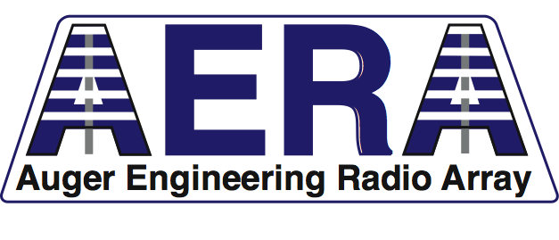
AERA in the Pierre Auger Observatory
super-hybrid cosmic ray detection

Slide 4
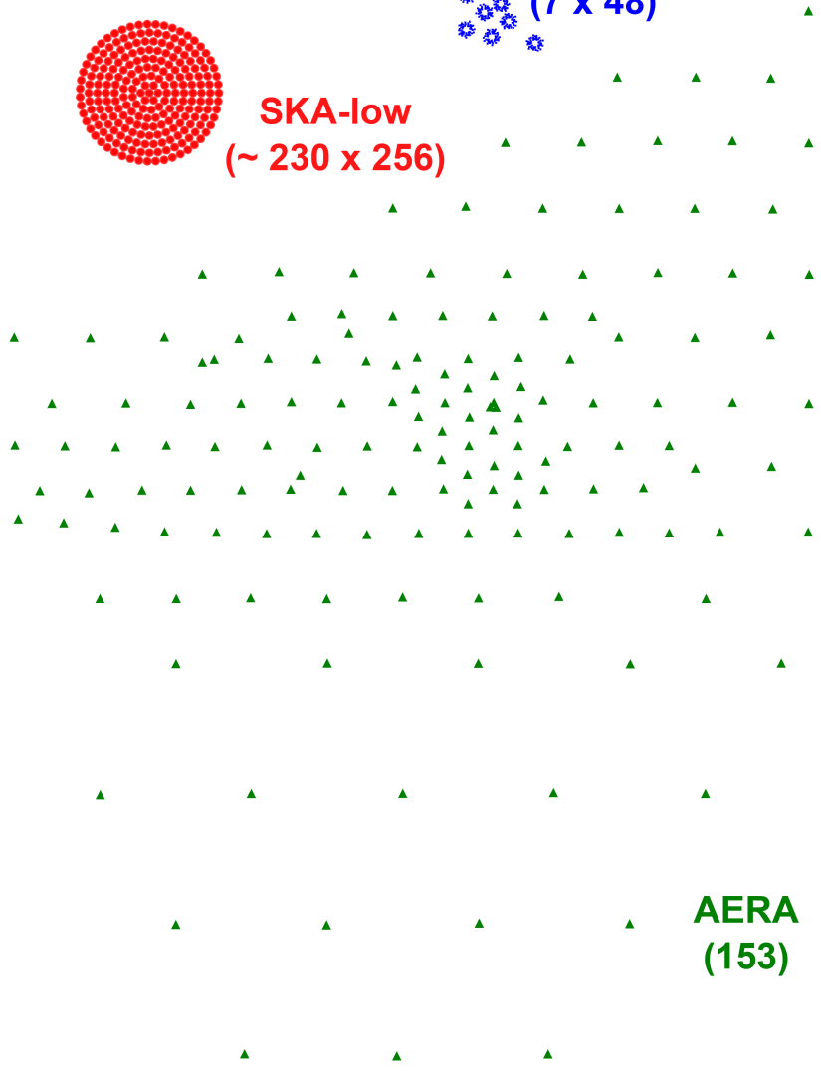


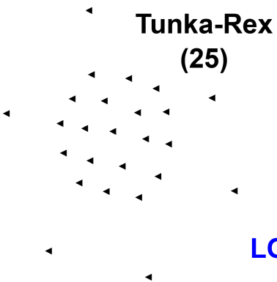
Comparison of experiments to scale
AERA is by far the largest cosmic-ray radio detector worldwide
it currently covers ~17 km²
1 km
TH, Physics Reports 620 (2016) 1

Slide 5
Autonomous detector stations

Slide 6
Radio emission physics as predicted by theory
primary effect:
geomagnetic field induces time-varying transverse currents
Kahn & Lerche (1967)
secondary effect:
time-varying net charge excess (Askaryan effect)
Askaryan (1962,1965)
„v x B“
„radial“
Diagrams by H. Schoorlemmer & K.D. de Vries

Slide 7
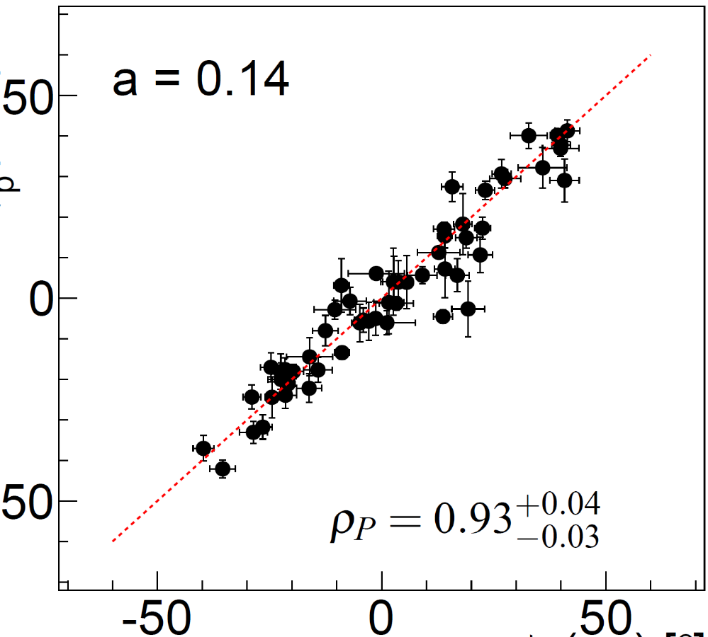
Askaryan emission shown in AERA data
pure geomagnetic polarisation
geomagnetic + 14% radial
χ²/ndf = 27
χ²/ndf = 2
pol. angle [°] measured
-
-
(2σ)
(2σ)
pol. angle [°] expected
pol. angle [°] expected
adding a 14% radial component clearly improves agreement
Pierre Auger Coll., Phys. Rev. D 89 (2014) 052002.

Slide 8
AERA energy reconstruction – radiation energy
at each antenna calculate energy fluence from time-integration of Poynting flux
then integrate energy fluence over area using 2D signal distribution model
Piere Auger Coll., Phys Rev. D 93 (2016) 122205

Slide 9
„Radiation energy“ as energy estimator
of 10¹⁸ eV, only 10⁷ eV go into radio signals
radiation energy gives a calorimetric measure of
the energy in the electromagnetic cascade
this value can be measured by any experiment, so cross-calibrate energy scales against the Auger scale
Piere Auger Coll., Phys Rev. Lett. 116 (2016) 241101

Slide 10
To come: energy scale from first principles
the radio signal can be predicted from pure electrodynamics and the well-known physics of the elcectromagnetic cascade in air showers
there is no absorption or scattering in the atmosphere
antenna arrays can be calibrated precisely
using radio signals, the energy scales of particle detector arrays
(which usually rely on uncertain hadronic interaction simulations)
can be calibrated from first principles!
see also C. Glaser et al., JCAP 09 (2016) 024

Slide 11
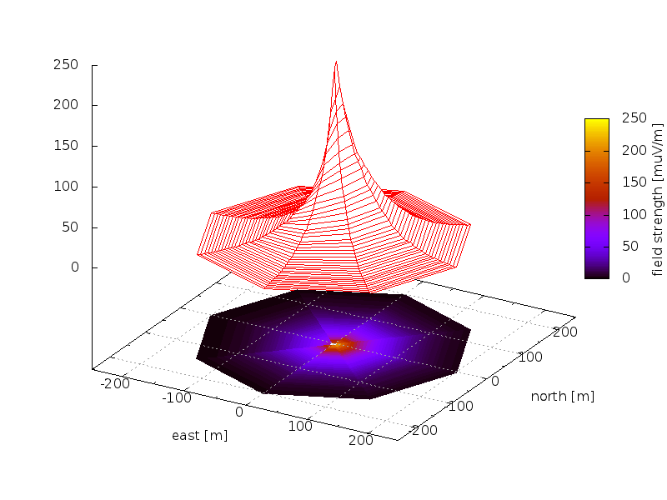
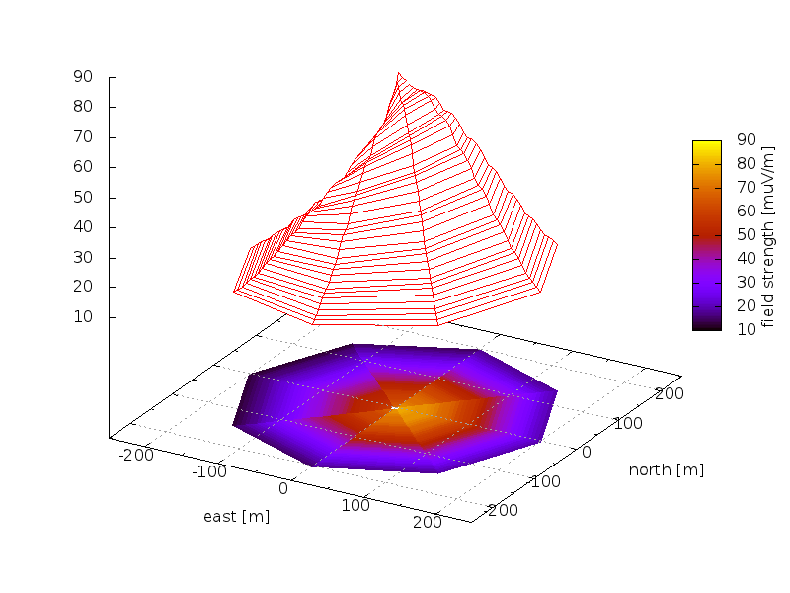
Lateral distribution as probe for composition
relativistic forward beaming of emission: geometrical distance from source to observer influences emission pattern
vertical proton shower
simulated with CoREAS
vertical iron shower
simulated with CoREAS
TH et al., ARENA2012 conference

Slide 12
Determination of Xmax with AERA
various methods being studied
  top-down comparison with simulations using CoREAS, ZHAireS, SELFAS
  2-dimensional LDF fit and extraction of Xmax-sensitive parameters
first comparison with fluorescence detector data looks promising, combined resolution of ~45 g/cm², radio alone probably better than 40 g/cm²
F. Gaté for the Pierre Auger
Collaboration, ARENA2016 conference

Slide 13
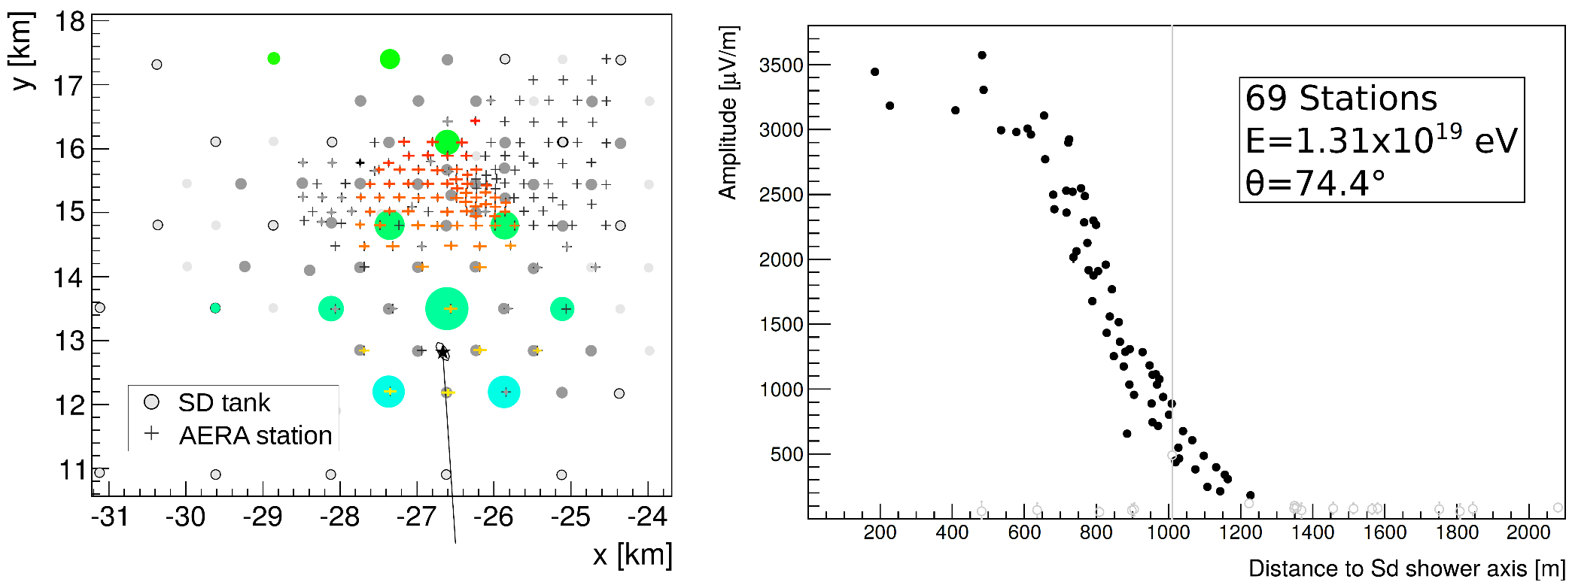
Huge showers measured by AERA
air showers up to 83° zenith angle measured
footprints with radii up to 2 km in shower plane
detection with 1.5 km antenna grid would be sufficient
particle detectors measure muons, radio antennas electromagn. comp.
O. Kambeitz for the Pierre Auger Collaboration, ARENA2016 conference

Slide 14
AERA journal publications so far
Advanced functionality for radio analysis in the Offline software framework of the Pierre Auger Observatory, NIM A 635 (2011) 92-102
Antennas for the Detection of Radio Emission Pulses from Air Showers at the Pierre Auger Observatory, JINST 7 (2012) P10011
Results of a self-triggered prototype system at the Pierre Auger Observatory for radio-detection of air showers induced by cosmic rays, JINST 7 (2012) P11023
Probing the radio emission from cosmic-ray-induced air showers by polarization measurements, Phys. Rev. D 89 (2014) 052002
Nanosecond-level time synchronization of autonomous radio detector stations for extensive air showers, JINST 11 (2016) P01018
Energy Estimation of Cosmic Rays with the Engineering Radio Array of the Pierre Auger Observatory, Phys. Rev. D 93 (2016) 122205
Measurement of the Radiation Energy in the Radio Signal of Extensive Air Showers as a Universal Estimator of Cosmic-Ray Energy,
Phys. Rev. Lett. 116 (2016) 241101

Slide 15

Conclusions
AERA is by far the world‘s largest cosmic-ray radio detector
AERA has already produced a rich scientific harvest
  development of fully autonomous radio detector stations
  precise calibration of amplitudes and timing
  experimental proof of Askaryan radiation in air showers
  measurement of the radiation energy as universal energy estimator
  first results on Xmax determination confirmed by FD data
  detection of huge radio-emission footprints in horizontal air showers
thanks a lot to HAP for supporting AERA research in many ways!

Slide 16
Backup Slides

Slide 17
Complexity of radio LDF
vertical iron shower
at LOPES frequencies
simulated with CoREAS
TH et al., ARENA2012

Slide 18
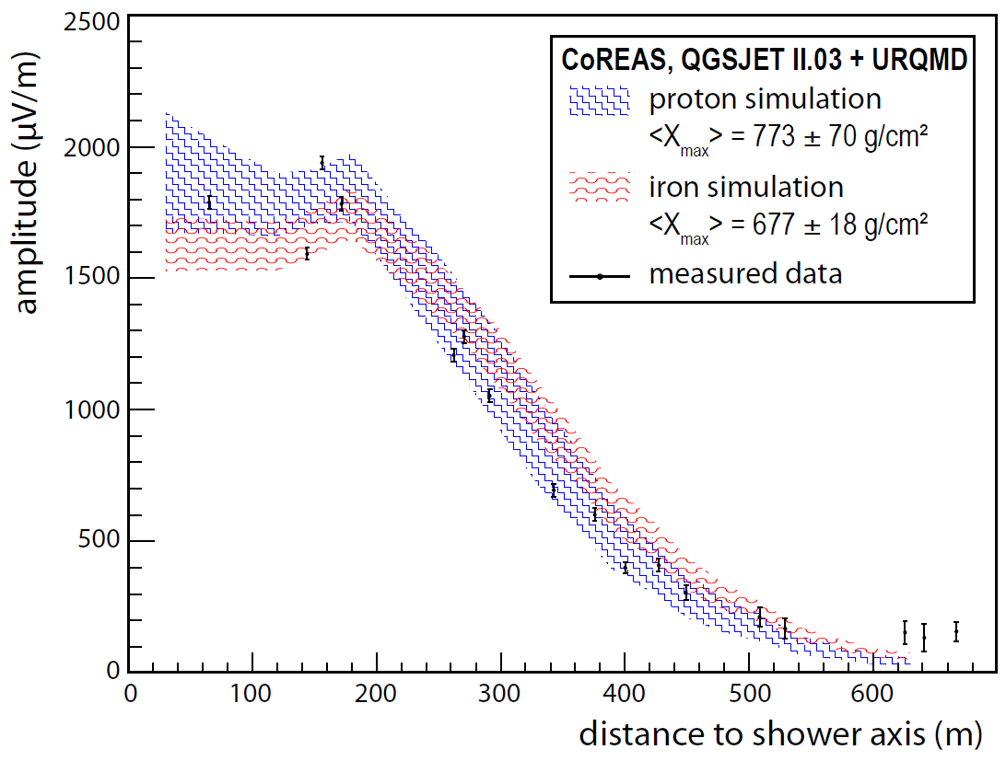
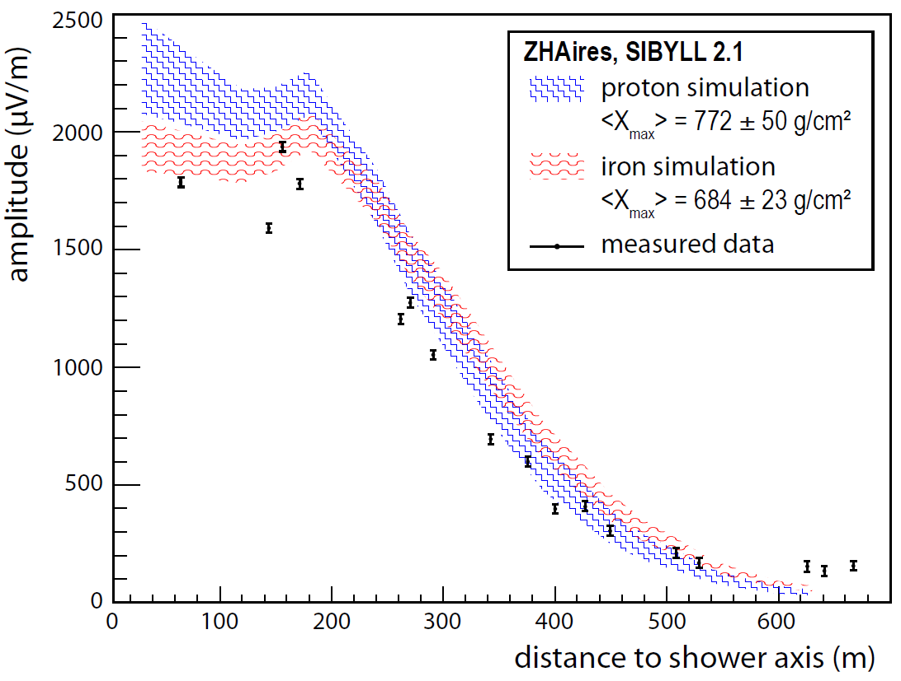
Comparison of simulations with AERA data
AERA provides detailed, well-calibrated event data
simulations can reproduce measurements
  absolute amplitude
  complex LDF
Pierre Auger Collaboration, ICRC2013, id #899

Slide 19
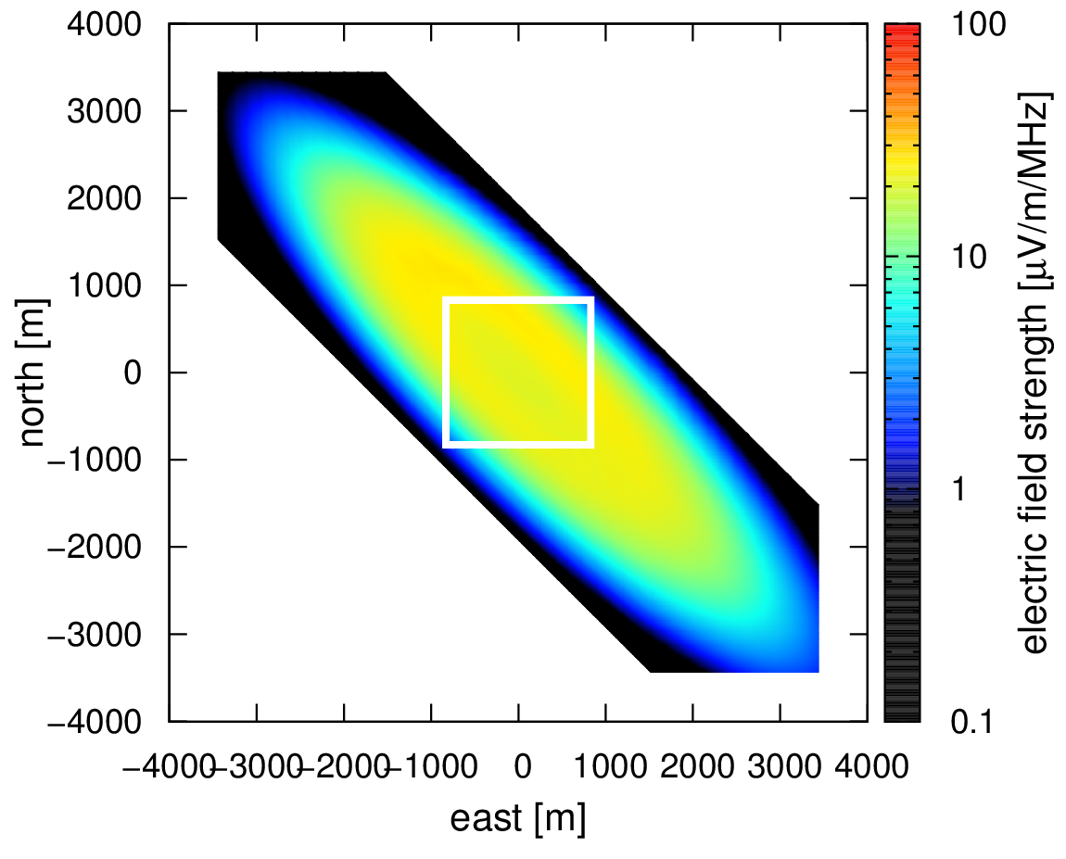

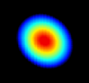
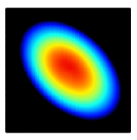
Inclined extensive air showers
large source distance leads to very large radio emission footprints
detectable with sparse arrays
integrate radio and particle detectors
vertical
30°
75°
50°
TH, A. Haungs, JPS Conf. Proc. in press, arXiv:1507.07769.

Slide 20
Experimental evidence for charge-excess
14%
CODALEMA reports core-shift ↔ east-west asymmetry ↔ charge-excess at ICRC 2011
AERA quantifies radial component to 14 ± 2%
CODALEMA Coll., Astropart. Phys. 69 (2015) 50–60.
Pierre Auger Coll., Phys. Rev. D 89 (2014) 052002.

Slide 21
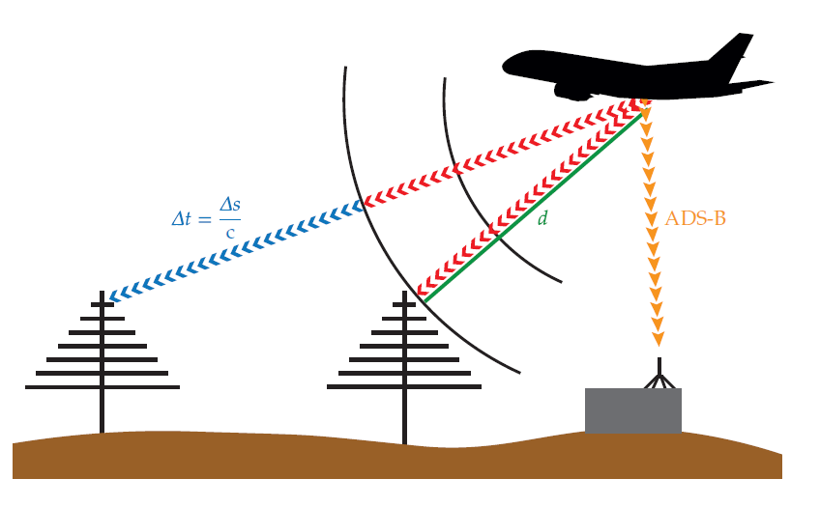
Principle of airplane timing calibration
digital data stream
at 1090 MHz
yields realtime
airplane position

Slide 22
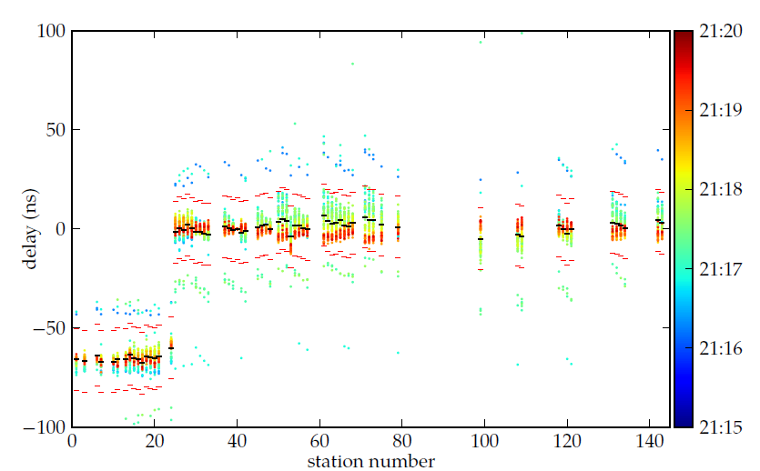
Beacon transmitter and airplane timing combined
butterfly
antennas
LPDA
antennas
timing within ~2 ns, offsets between antennas determined

