Slide 1

Nuclear physics meets sources of UHECR
HAP Workshop | Non-Thermal Universe
Anatoli Fedynitch
DESY Zeuthen

Slide 2
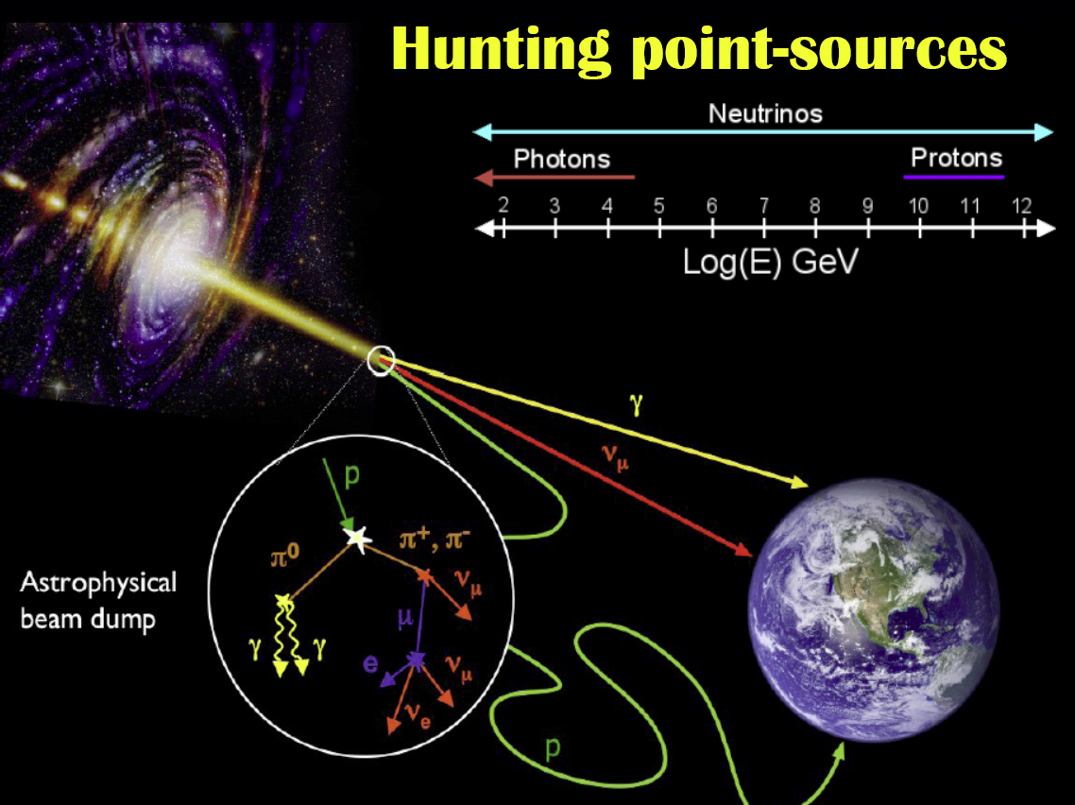
The universe in multiple messengers
... a challenge for theory
Theory
(source distribution)
Physics of astrophysical
neutrino sources = physics of
cosmic ray sources
Multi-messenger interpretations
must rely on theory (acceleration,
radiation processes, particle escape, geometry, ...)
Theory
(radiation
model)
Large astrophysical uncertainties
Theory
(infrared etc BGs)
Theory
(magn. fields, …)
W. Winter

Slide 3
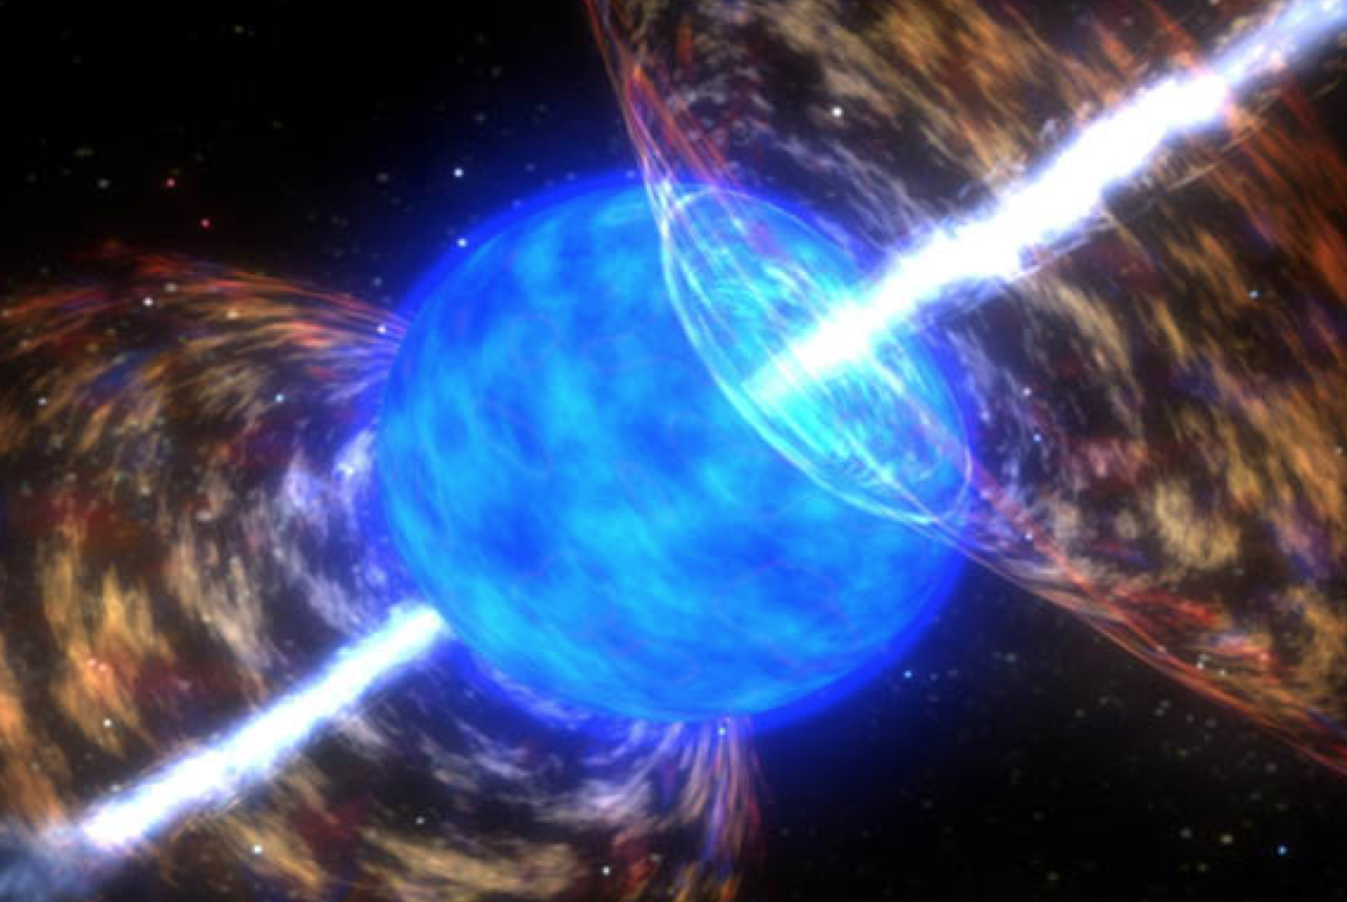
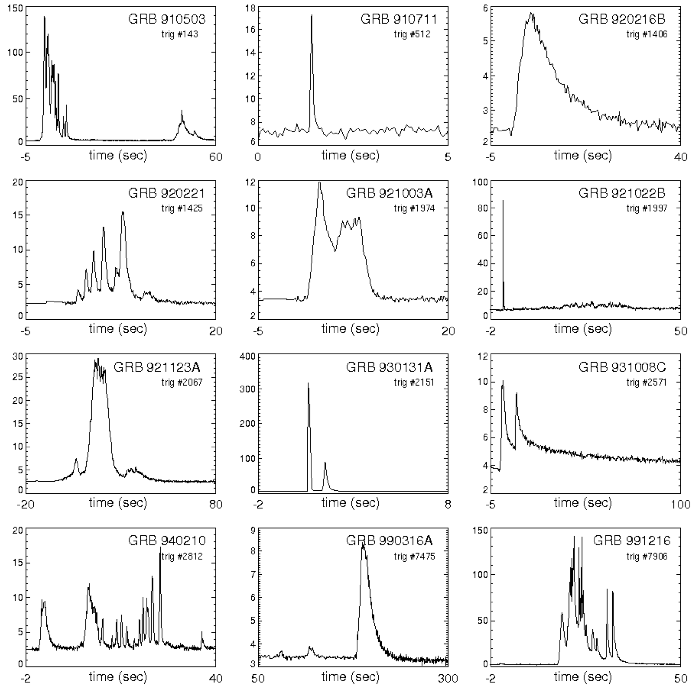
Candidate for UHECR source: Gamma-ray bursts (GRBs)
Daniel Perley
Most energetic electromagnetic
(gamma-ray) outburst class
Several populations, such as
  Long-duration bursts (~10 – 100s),
  from collapses of massive stars?
  Short-duration bursts (~ 0.1 – 1 s),
  from neutron star mergers?
Observed light curves come
in large variety
W. Winter
Source: NASA

Slide 4
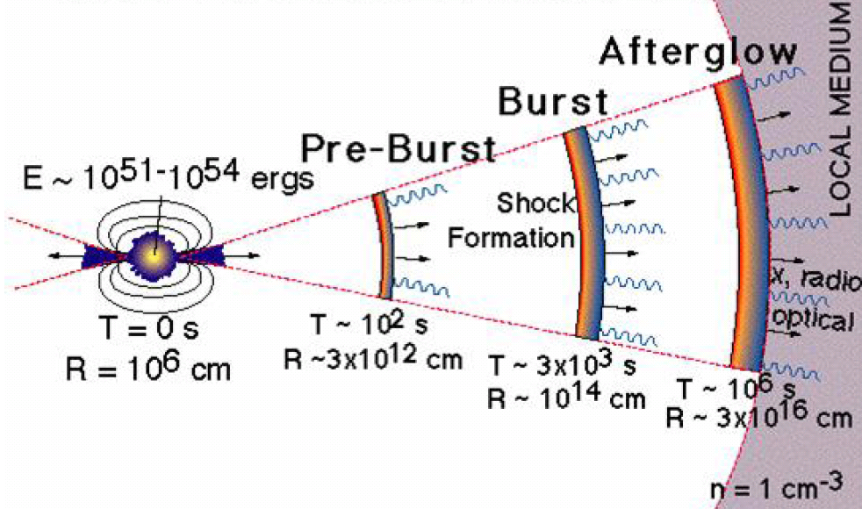
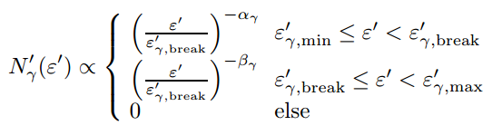
GRB - Internal shock model
(Source: SWIFT)
Γ ∼ 200−1000
Engine
“Isotropic
equivalent
energy“
Prompt phase:
collision of shells
⇨ Shocks
⇨ Particle acc.
Maximum energy of escaping UHECR depends on competition between acceleration and cooling

Slide 5
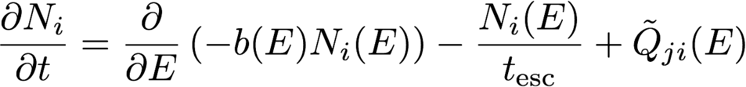

Modelling of radiation zone
Boltzmann Equations for each particle species (and energy bin)
Evolution of density for particle species i
Energy loss:
synchrotron
adiabatic
…
Escape:
dynamical timescale
interactions
decays
…
Injection from:
acceleration zone
interactions or decays
Q_{ν,out}
Radiation zone:
A_{p}, A_{γ}
Interactions
Beam of p, A, …
Q_{A’,out}
Q_{γ,out}

Slide 6
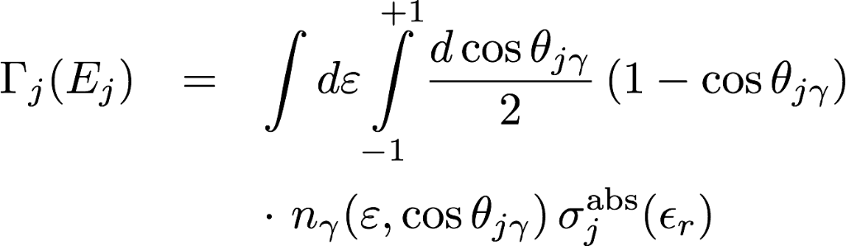
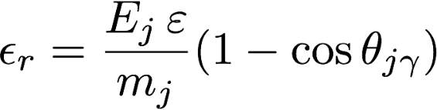
How does nuclear physics enter?
How often does a nucleus/particle in a source interact?
Photon energy in nucleus rest frame
Depends on target photon field n_{γ}
n_{γ} isotropic in shock rest frame
σ_{j}^{abs} from nuclear models or parametrizations
j = p, n, α, … ¹²C, ...⁵⁶Fe
high energy nucleus
+
“low” energy photon
=
photo-nuclear physics in MeV – GeV range
(Photon energy in nucleon rest frame)

Slide 7
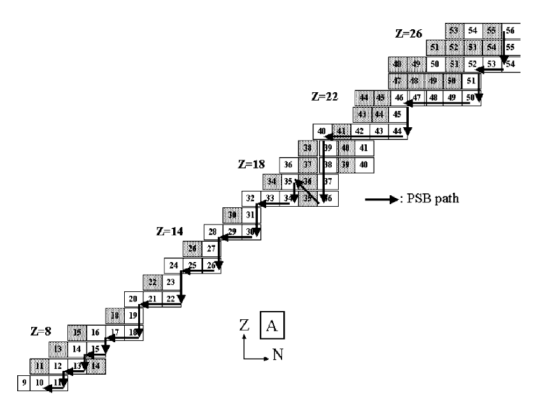
Typical astrophysical “photo-disintegration” models
Basic (propagation) calculations were based on PSB Puget et al Astrophys.J. 205 (1976) 638-654
Only one stable isotope per isobar (same A)
In each photodisintegration, one heavy nucleus is produced in the final state together with N nucleons
No competitive channels
Or more sophisticated interaction models
CRPropa 2/3
based on TALYS for A >= 12
Data and GEANT 4 for A < 12
Competitive channels + some optimization
(Photon energy in nucleon rest frame)
Khan et al, Astropart. Phys. 23 (2005) 191-201

Slide 8
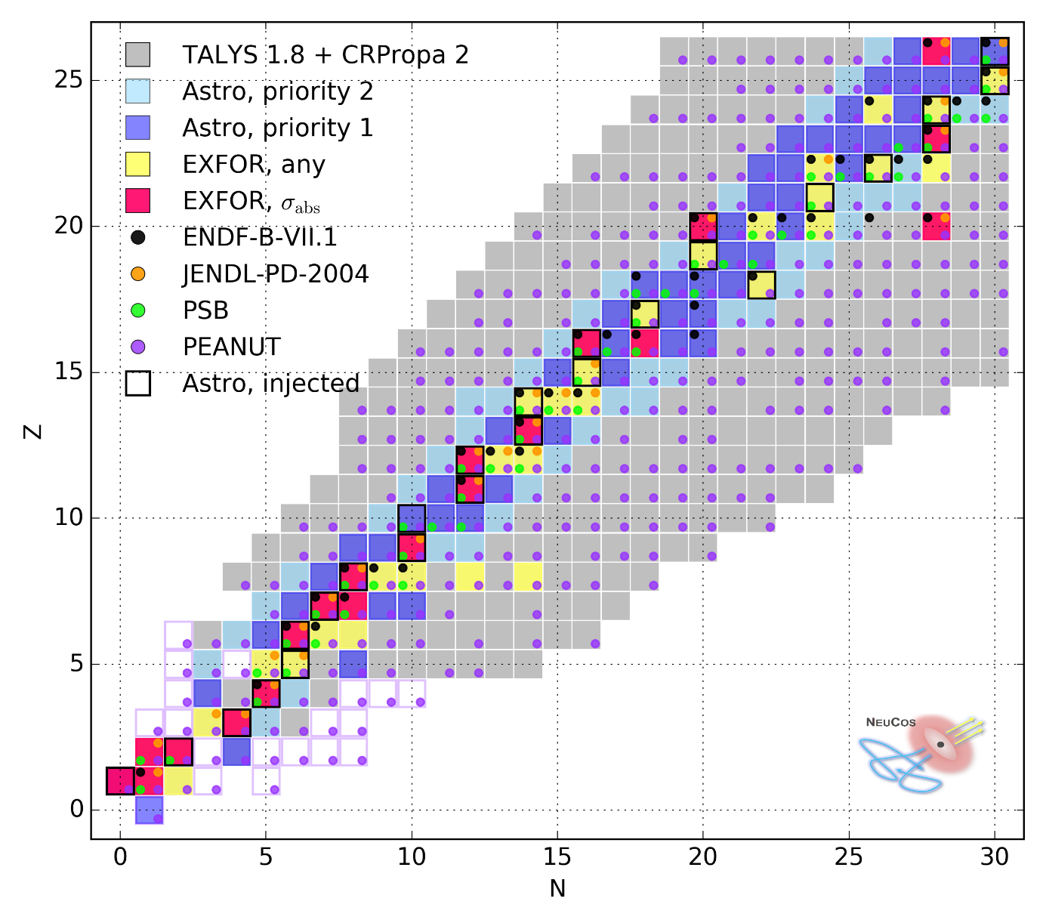
Known nuclear absorption cross sections up to mid-heavy isotopes
EXFOR database contains 14 absorption cross sections < Fe
47 measurements where at least one inclusive cross section available
Nuclear model dependent σ_{abs} possible
Located mostly on main diagonal (stable elements)
All other isotopes need model prediction!
D. Boncioli, A. Fedynitch and W. Winter
arXiv:1607.07989

Slide 9
Example 1: Calcium-40
double magic
Up to factor two differences in disintegration rates!

Slide 10
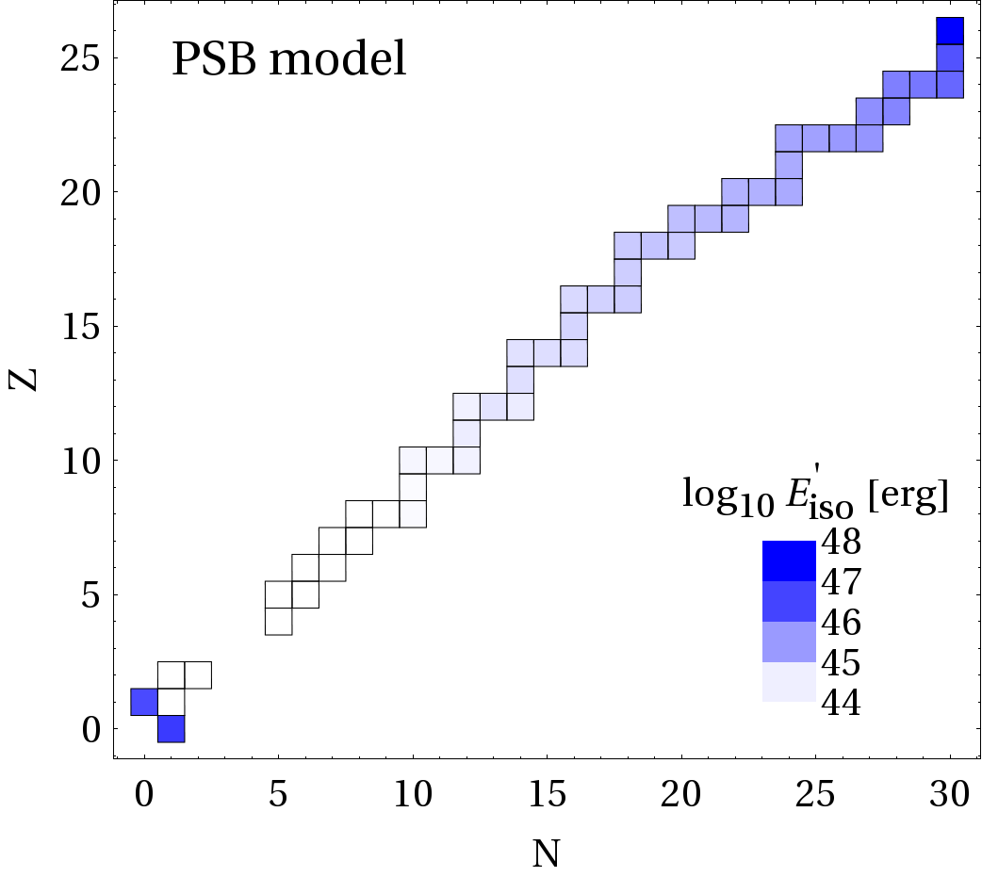
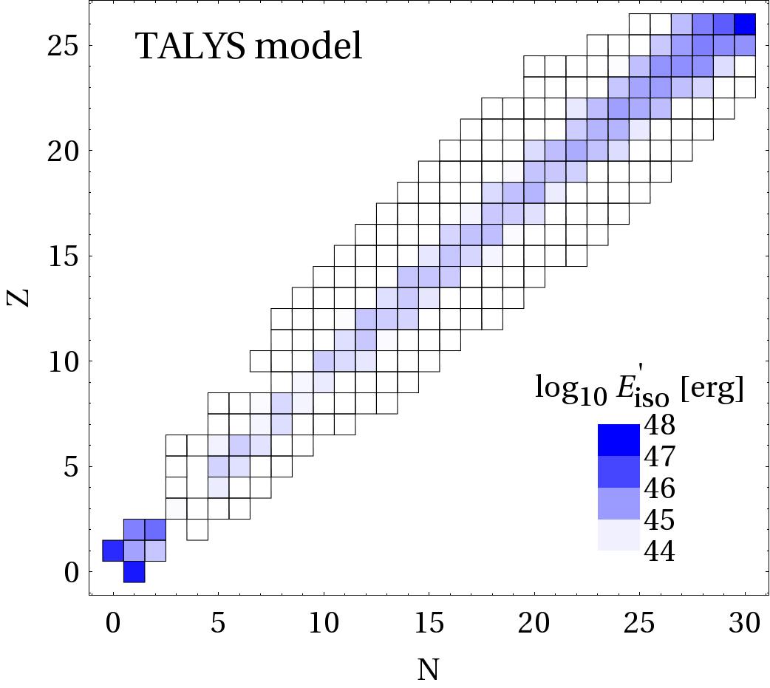
Elemental compostion in disintegration chain of GRB
Obtained by injecting only iron in a GRB
PSB disintegration chain goes not down to light elements; multi-nucleon emission and break-up weakly described

Slide 11
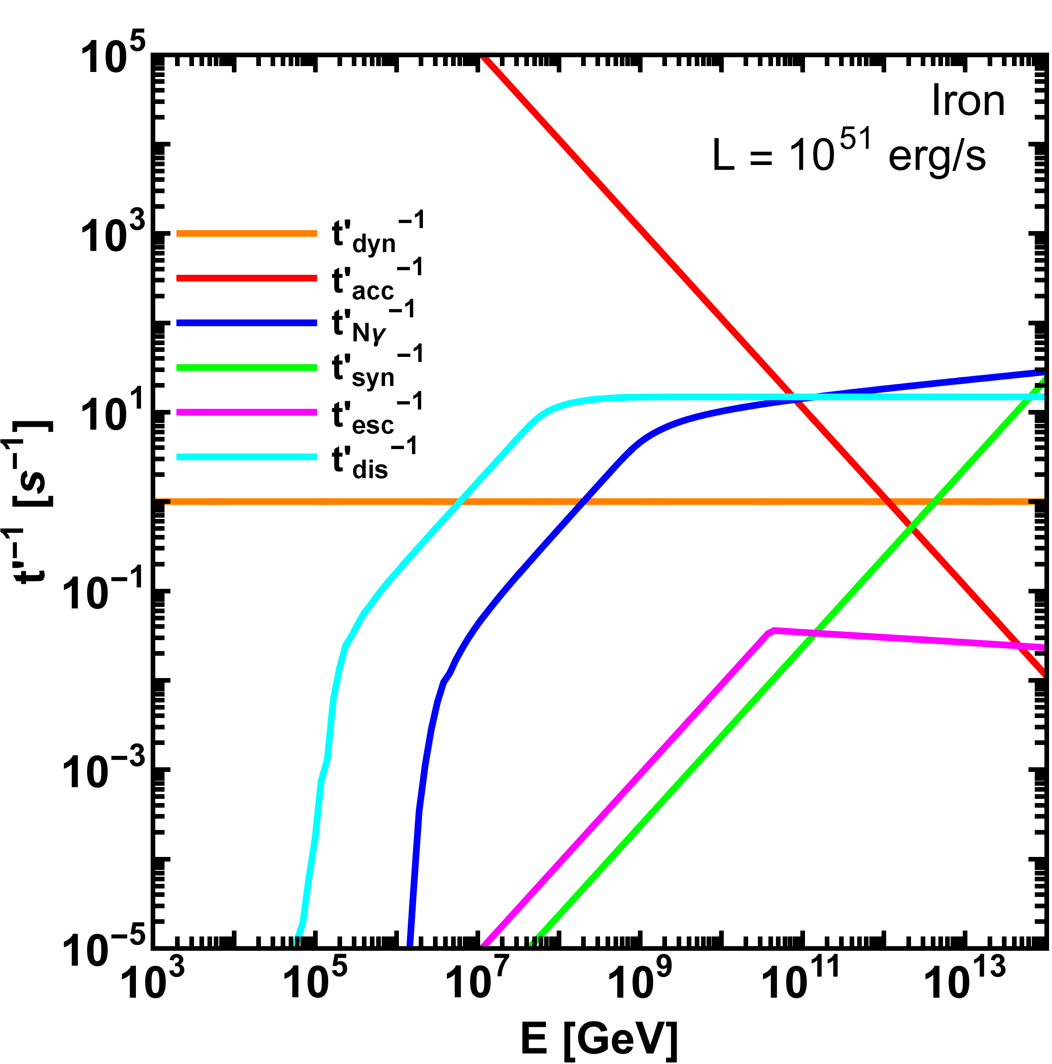
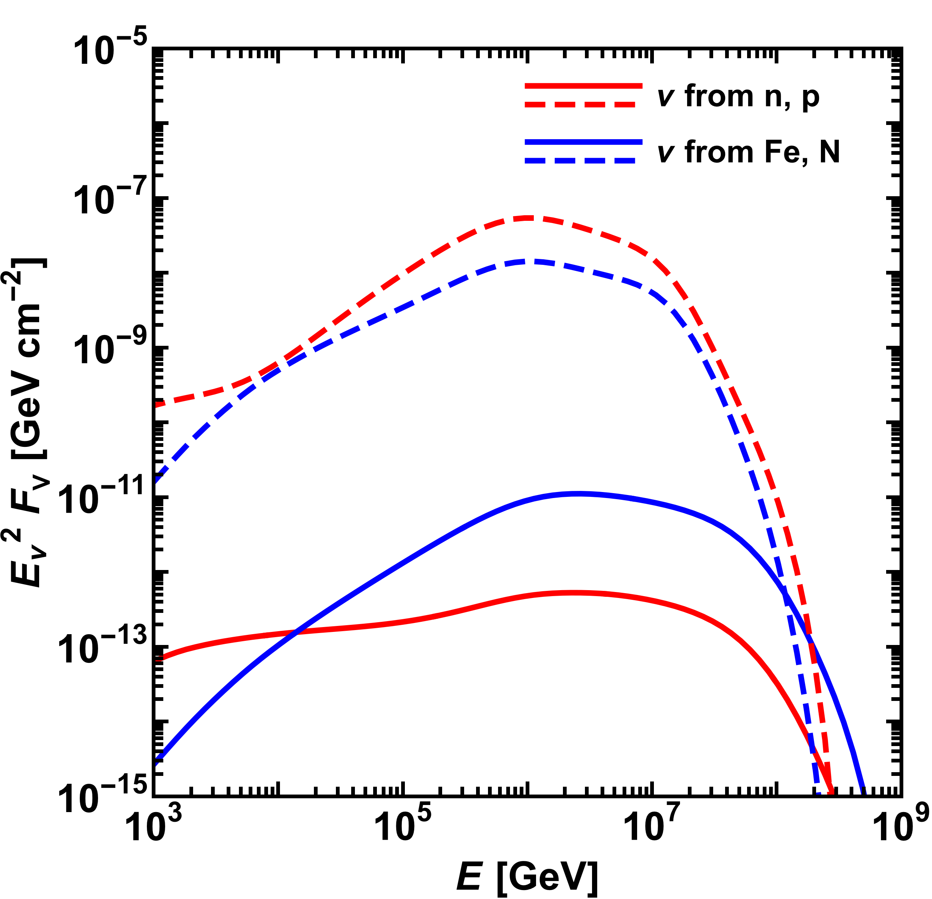
Connection between neutrinos and composition at the source
Competing process in a GRB model
Daniel Biehl, DESY Z.
L=10⁵² erg/s
L=10⁵⁰ erg/s
E_{fe,max}
Can sources of UHECR nuclei be an important source for neutrinos at the same time?

Slide 12
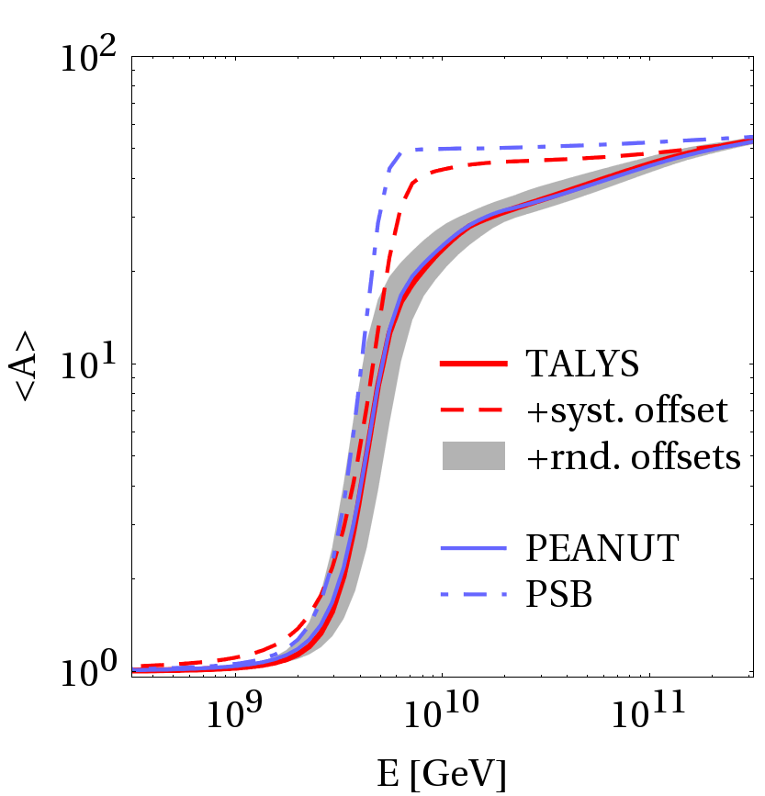
Conclusions
Composition after source
(without propagation!)
Simplified nuclear models produce over-simplified results
More realistic models predict a softer transition from light to heavier composition
Predictive power for unstable elements is serious source of uncertainty
Need for (exp.) verification of photo-nuclear σ_{abs} for unstable elements

Slide 13
Backup

Slide 14
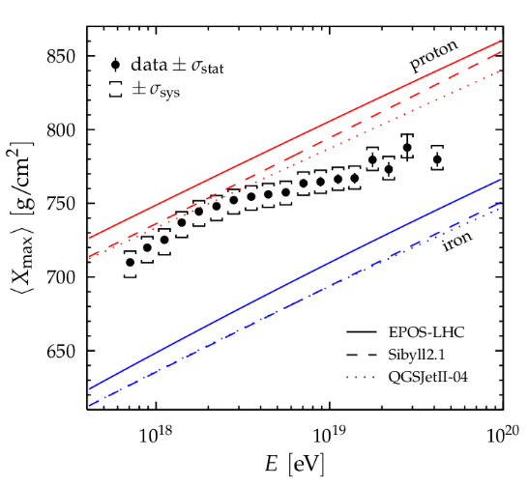
Acceleration of heavy nuclei and their role for neutrinos
Thanks to Auger we know that at highest energies are not just protons
Efficiency of acceleration and abundance of heavy nuclei is one question
Auger Collaboration, ICRC 2015
Our questions:
What are the conditions for escape of nuclei from the various source classes?
How does the presence of nuclei affect the expected flux of neutrinos and their flavors?

Slide 15

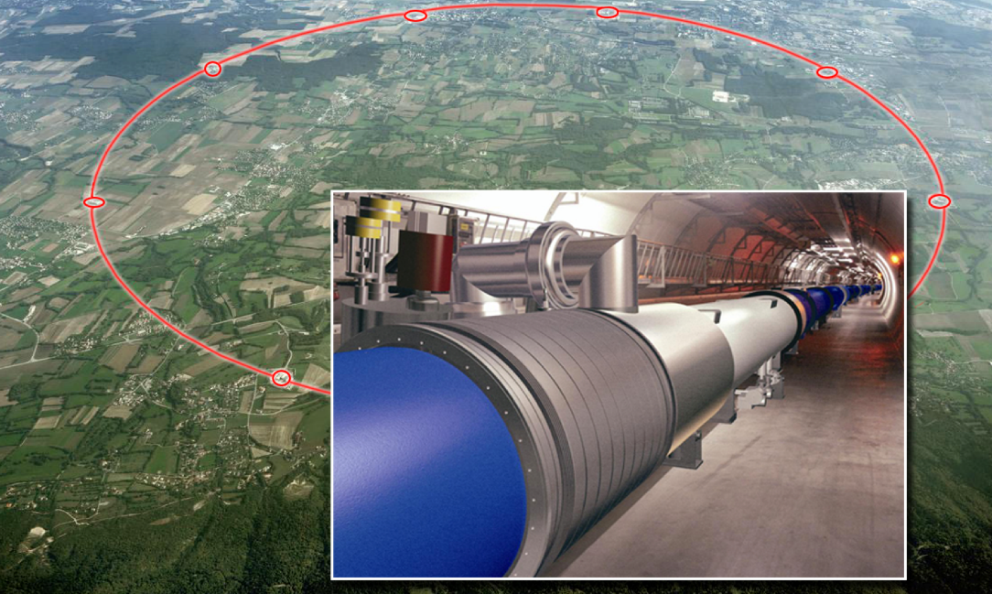
Cosmic vs. terrestrial particle accelerators
AGN, GRB
LHC
How are particles accelerated to such extreme energies?
Lorentz force = centrifugal force
E_{max} ~ q B R
E_{max} ~ 300,000,000 TeV
B ~ 1 mT – 1 T
R ~ 100,000 – 10,000,000,000 km
E_{max} ~ 13 TeV
B > 8 T
R ~ 4.3 km

Slide 16
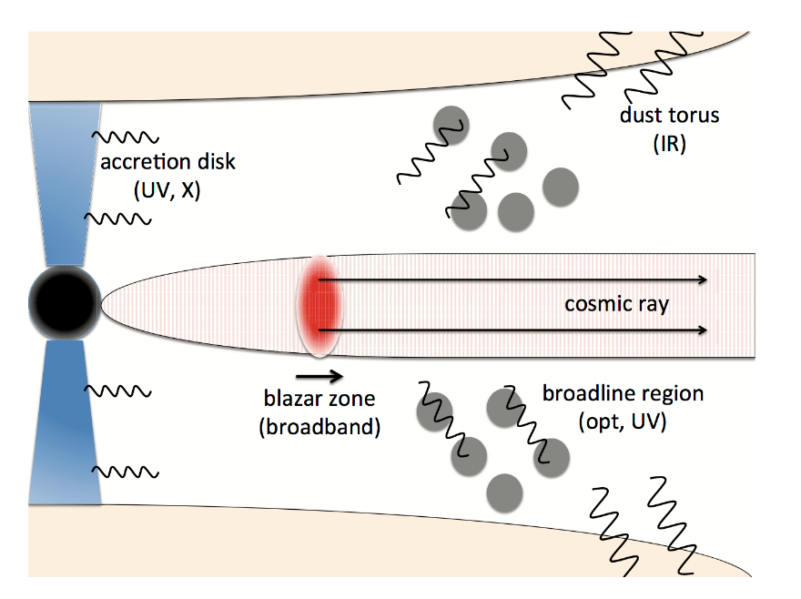
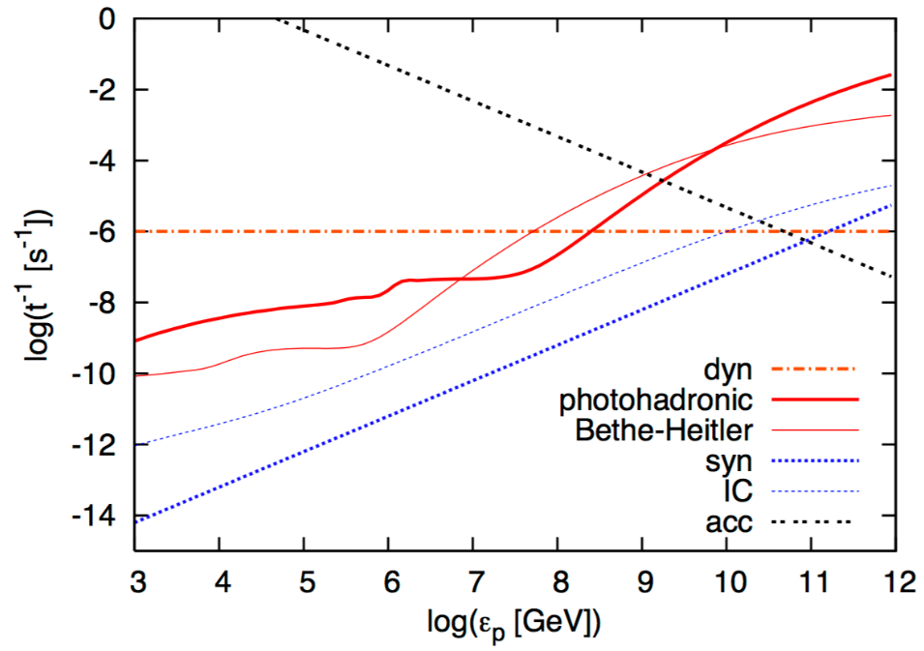
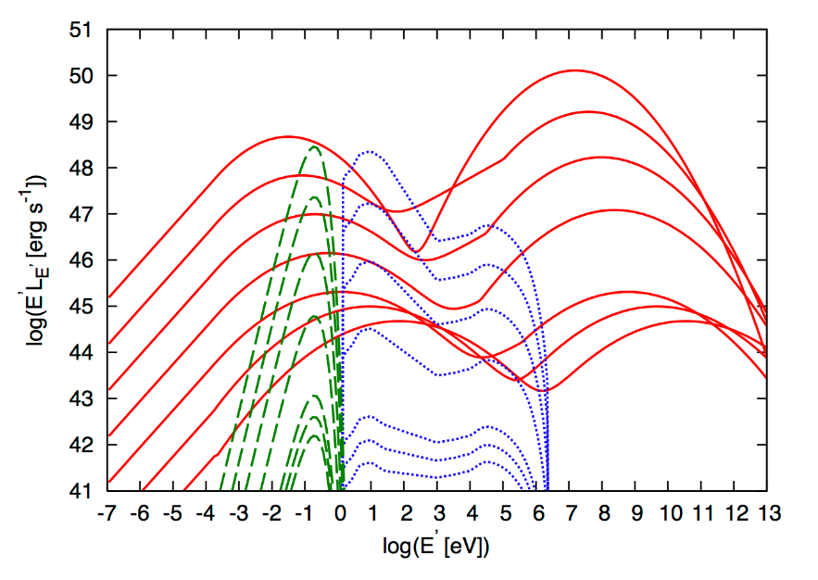
Source candidates: Active Galactic Nuclei
K. Murase et al. Phys.Rev.D 90 (2014) 023007
Target photon density
dust torus
continuum jet
Longer dynamical time scales than GRB
Other processes can limit maximum energy
accretion disc

Slide 17
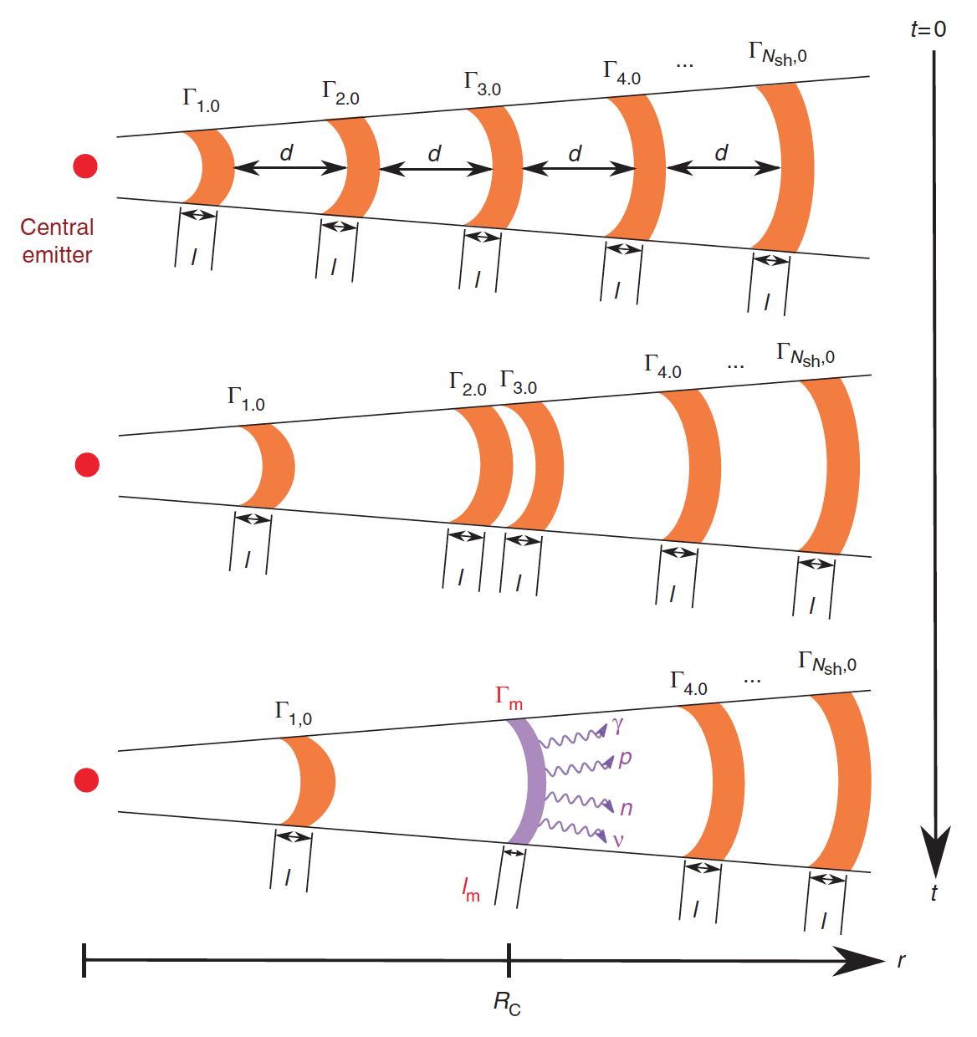
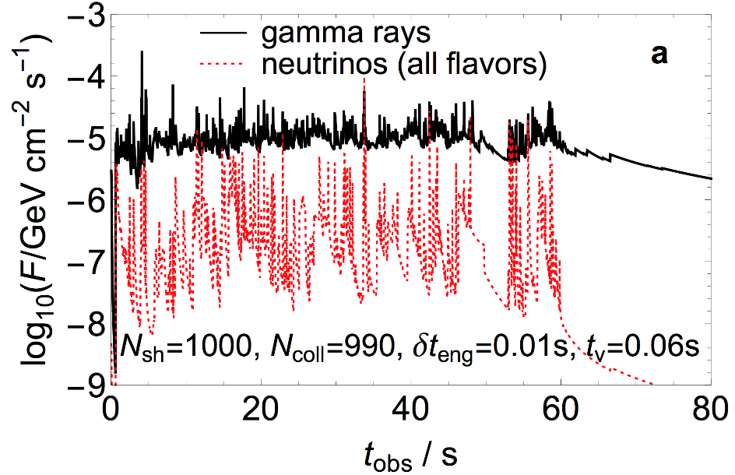
How can such a model explain the observed light curves?
Distribute shells with varying Γ
The light curves can be predicted as a function of the engine parameters
Efficient energy dissipation (conversion from kinetic to radiated E)
requires broad Γ distribution
Consequence: Collision radii are widely distributed!
From: Bustamante, Baerwald, Murase, Winter,
Nature Commun. 6, 6783 (2015)
W. Winter

Slide 18
Example 1: Calcium-40
⁴⁰Ca is double magic, ⁴⁰Ar not. No reason for cross sections to be equal!
PEANUT reproduces data where available
Cross sections in TALYS weakly depend on nuclear mass, and very weakly on element
Astrophysical box model (e.g. in Murase and Beacom, Phys Rev. D81 2010) has insufficient description

Slide 19
Example 2: Sodium-23
²³Mg is Isobar Analog State (IAS) of ²³Na: meaningful to assume similar cross sections

Slide 20
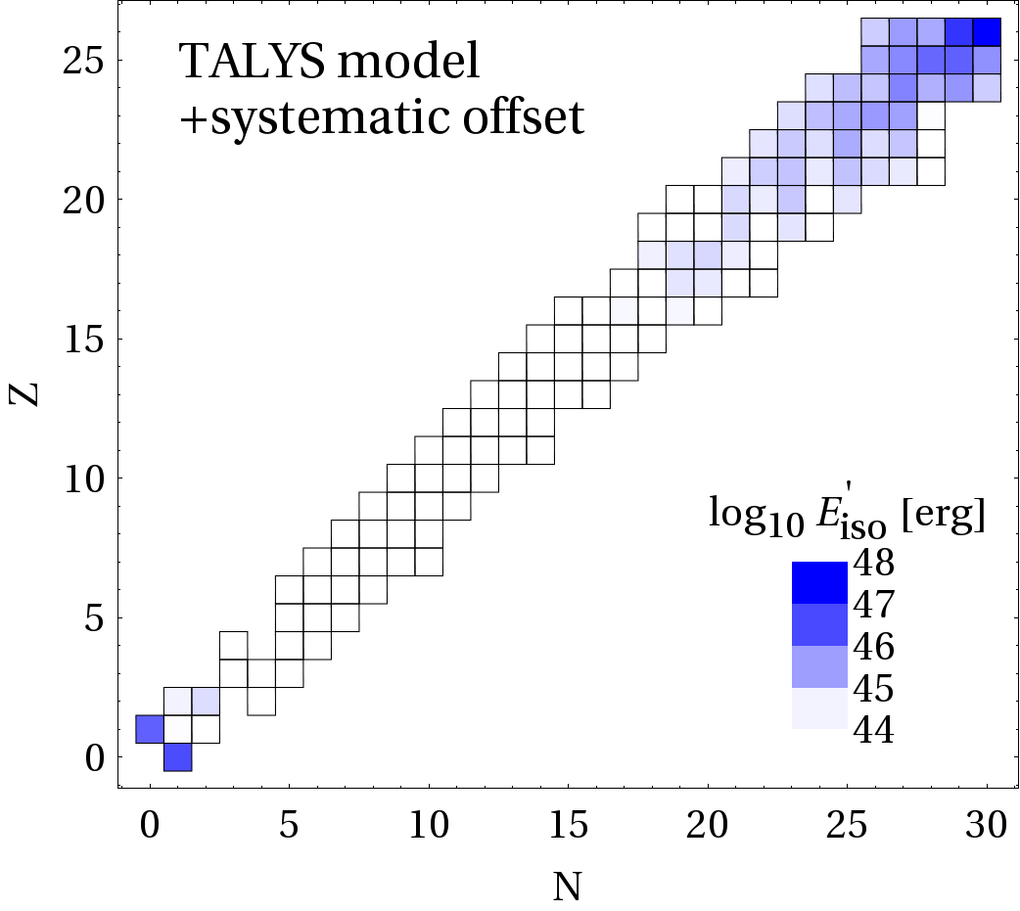
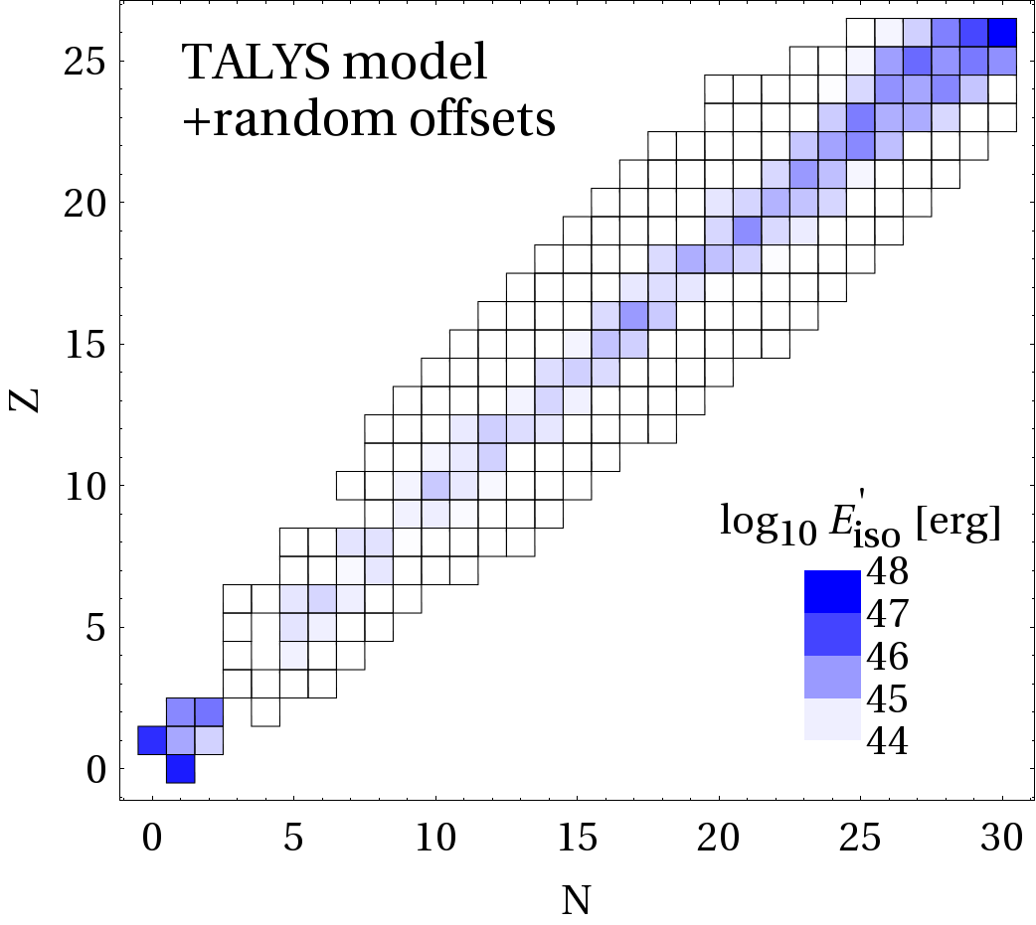
Treatment of uncertinaties
Random offsets: unmeasured cross sections are varied by factor 0…2 randomly, those with some certainty between 0.5...1.5
Systematic offset = “don’t trust unmeasured cross sections”

Slide 21

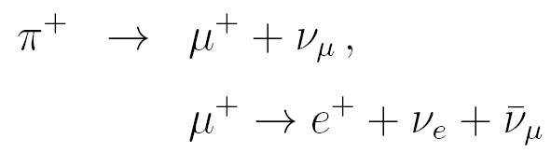
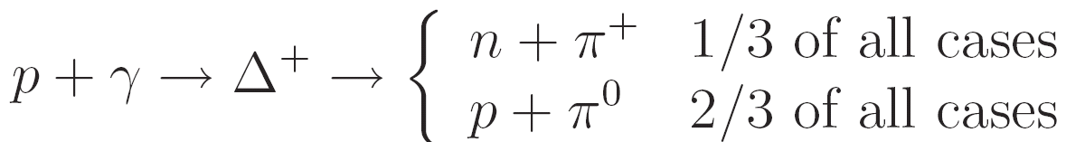
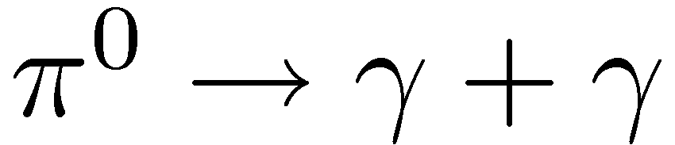
A simple toy model for the source
If neutrons can escape:
Source of cosmic rays
Neutrinos produced in
ratio (ν_{e}:ν_{μ}:ν_{τ})=(1:2:0)
Delta resonance approximation:
Cosmic messengers
High energetic gamma-rays;
typically cascade down to lower E
Additional constraints!
(Same process during propagation of cosmic rays in CMB: “cosmogenic neutrinos”)

Slide 22
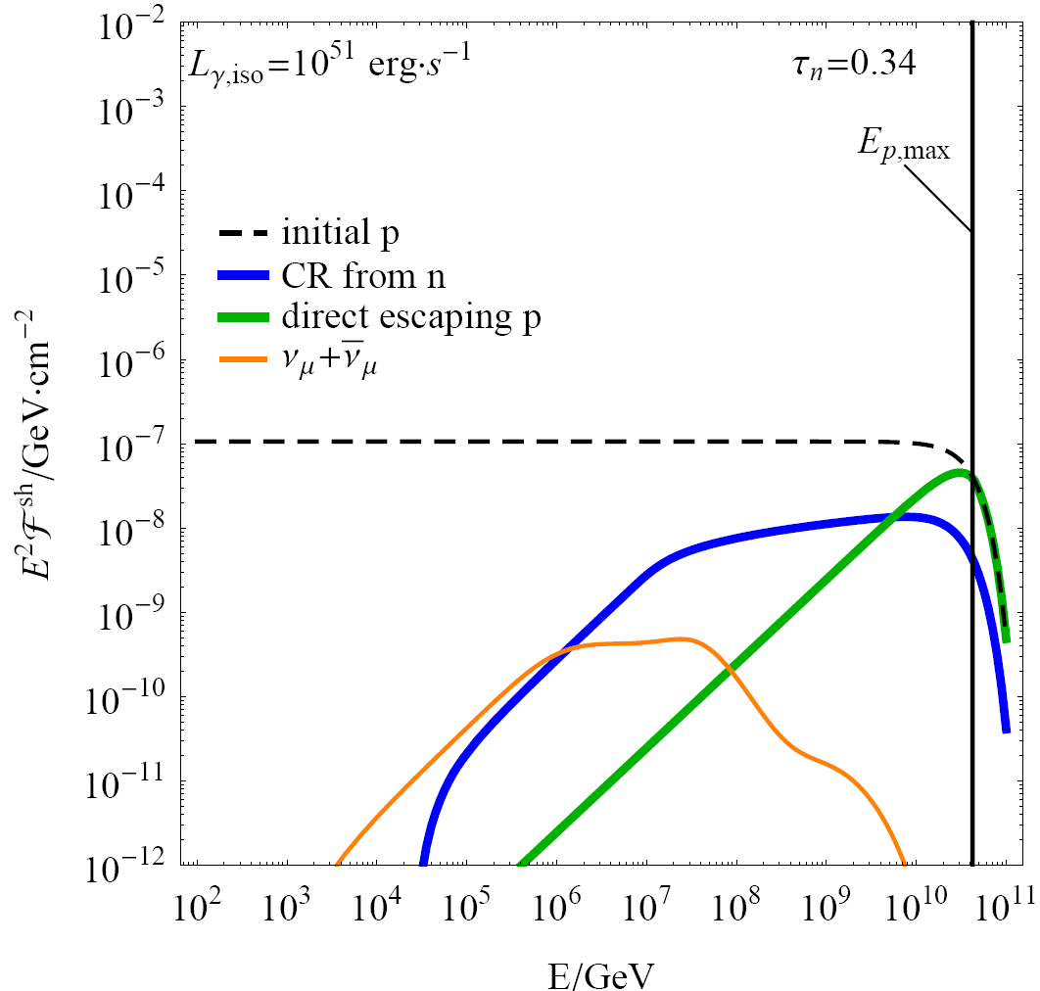
How do cosmic rays escape from the source?
Three extreme cases:
Neutron model
Neutrinos and cosmic rays (from neutrons)
produced together
(depends on pion prod. efficiency, blue curve, softer)
(pure neutron model excluded in
IceCube, Nature 484 (2012) 351)
Direct escape (aka “high pass filter”, “leakage”)
Cosmic rays can efficiently escape
if Larmor radius reaches size of shell width
(conservative scenario, green curve, hard)
(from:Baerwald, Bustamante, Winter, ApJ 768 (2013) 186;
same argument used for nuclei in Globus et al, 2014)
“All escape”: magnetic fields decay quickly
enough that charged cosmic rays can escape
(most aggressive scenario, dashed curve, ~ E⁻²)
Diffusion, …
E⁻²
hard
softer
(without prop. effects)

Slide 23
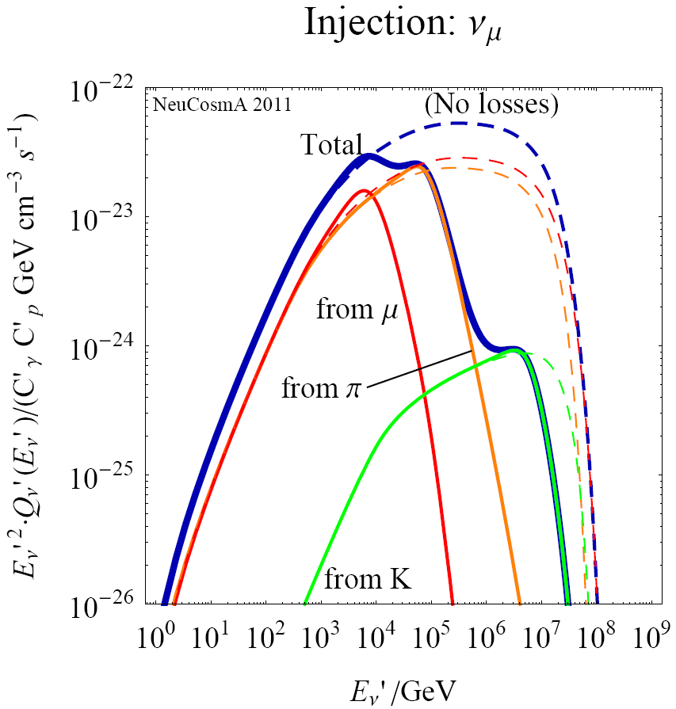
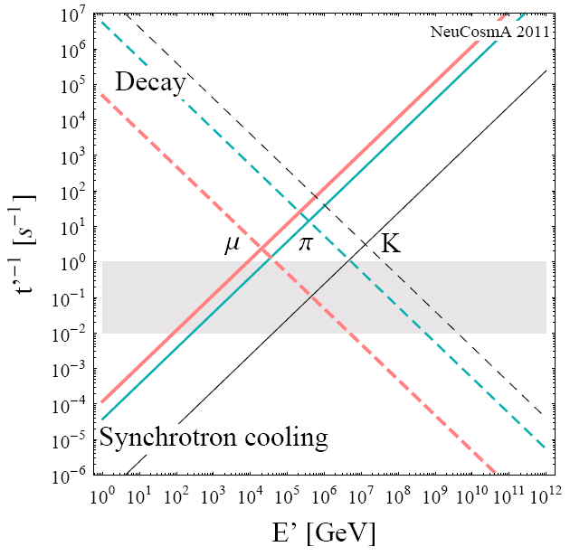
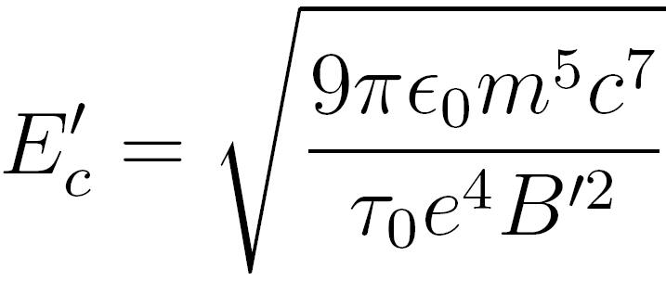
In the presence of strong B: Secondary cooling
Example: GRB
Secondary spectra (m, p, K) loss-steepend above critical energy
  E‘_{c} depends on particle physics
  only (m, t₀), and B‘
  Leads to characteristic flavor composition and shape
Decay/cooling: charged μ, π, K
(“escape”)
ν_{μ}
Adiabatic
(energy loss)
Baerwald, Hümmer, Winter, Astropart. Phys. 35 (2012) 508;
also: Kashti, Waxman, 2005; Lipari et al, 2007; ...

