Slide 1
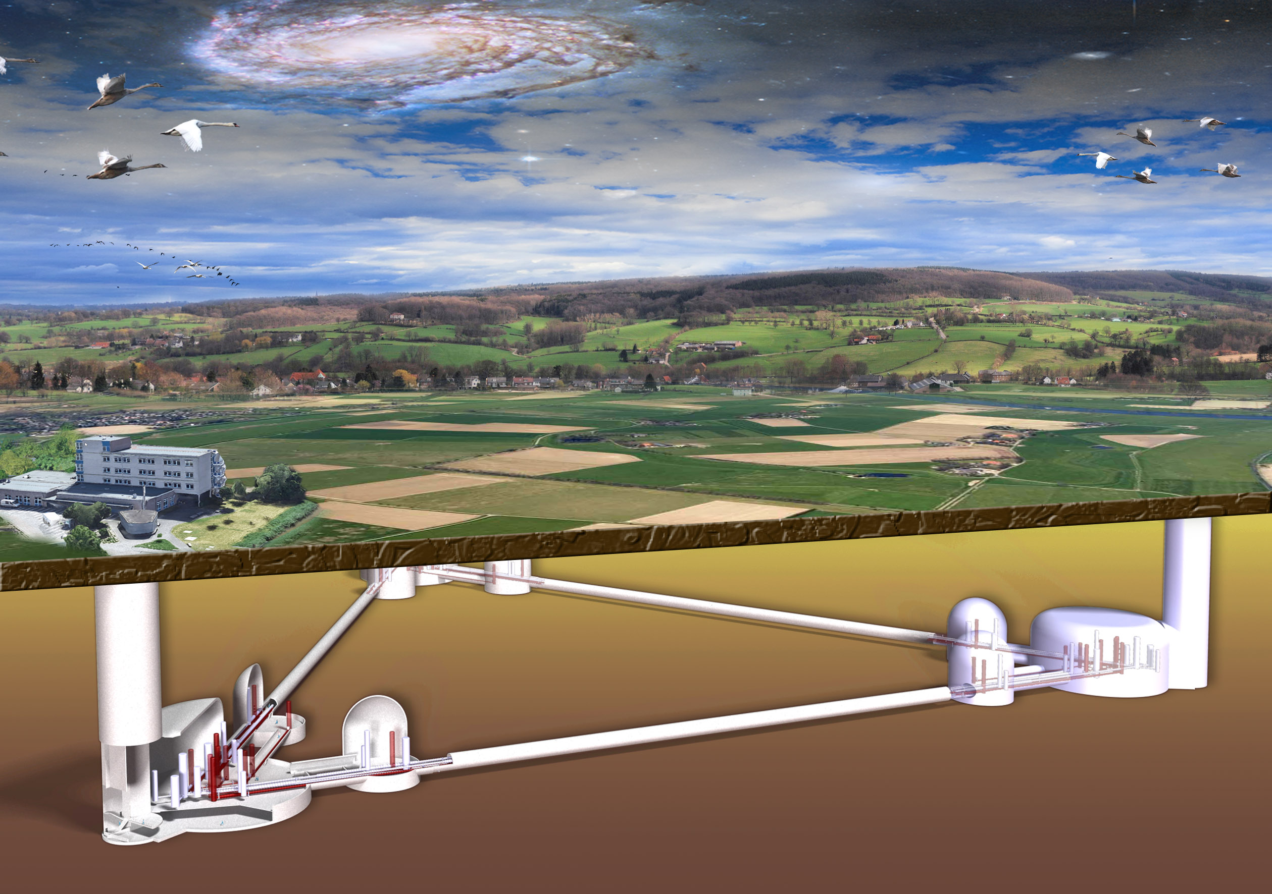
Einstein Telescope
Status

Slide 2
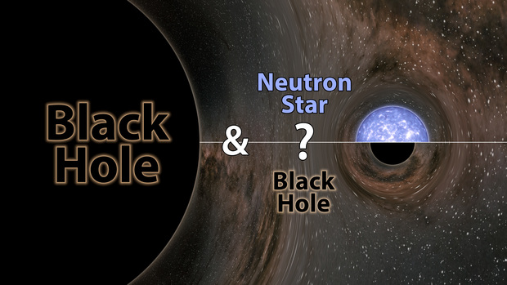
GW190814: Mystery Object in "Mass Gap"
Neutron Star?
Too heavy!
Black Hole?
Too light!
23 M⊙
2,6 M⊙

Slide 3
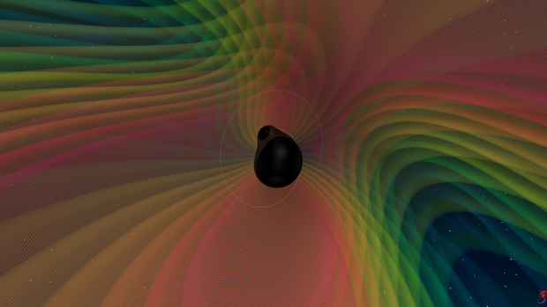

GW190412: An asymmetric collision
Asymmetric masses allow for the determination of the inclination of the orbit.
Precise prediction of the amplitude
Precise determination of the distance
${740}_{−160}^{+130} MPc≈2,4 Mrd. LJ$
29,7 M⊙
8,4 M⊙

Slide 4
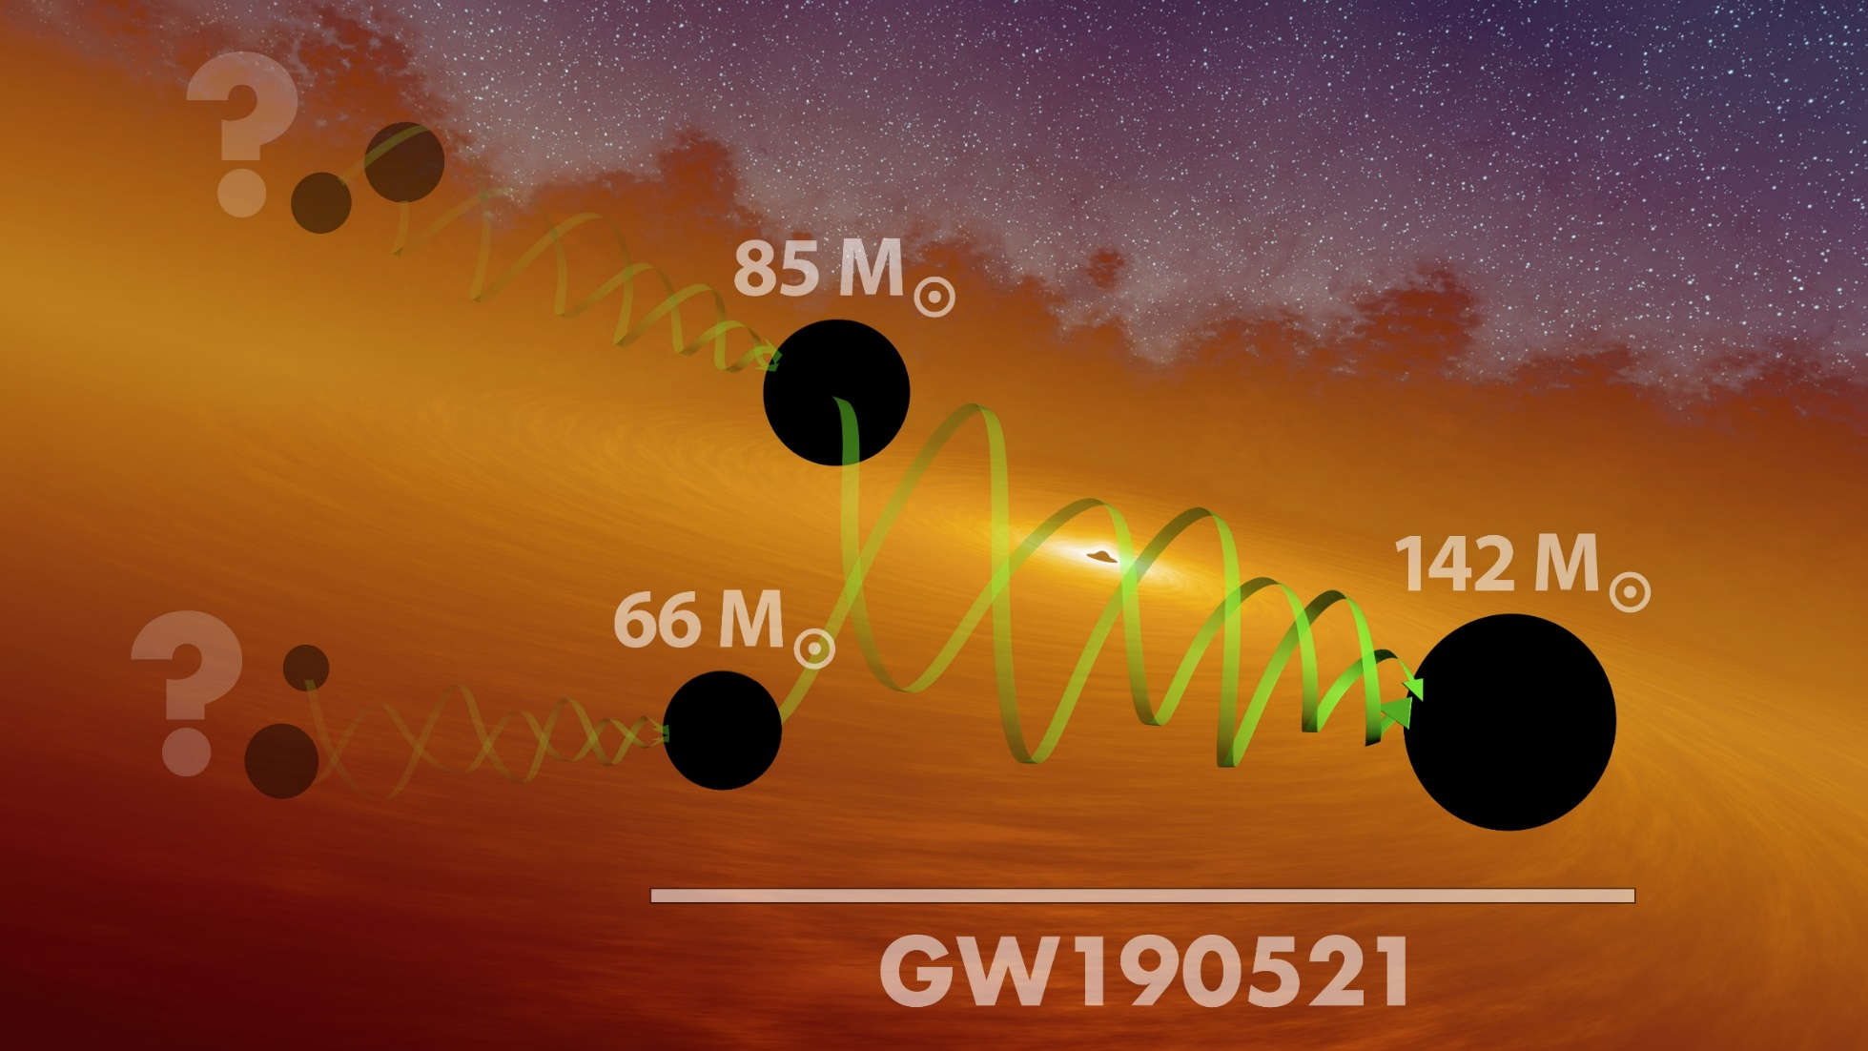
GW190521: The heaviest BH
Intermediate object towards supermassive black holes

Slide 5
Einstein Telescope
Status

Slide 6
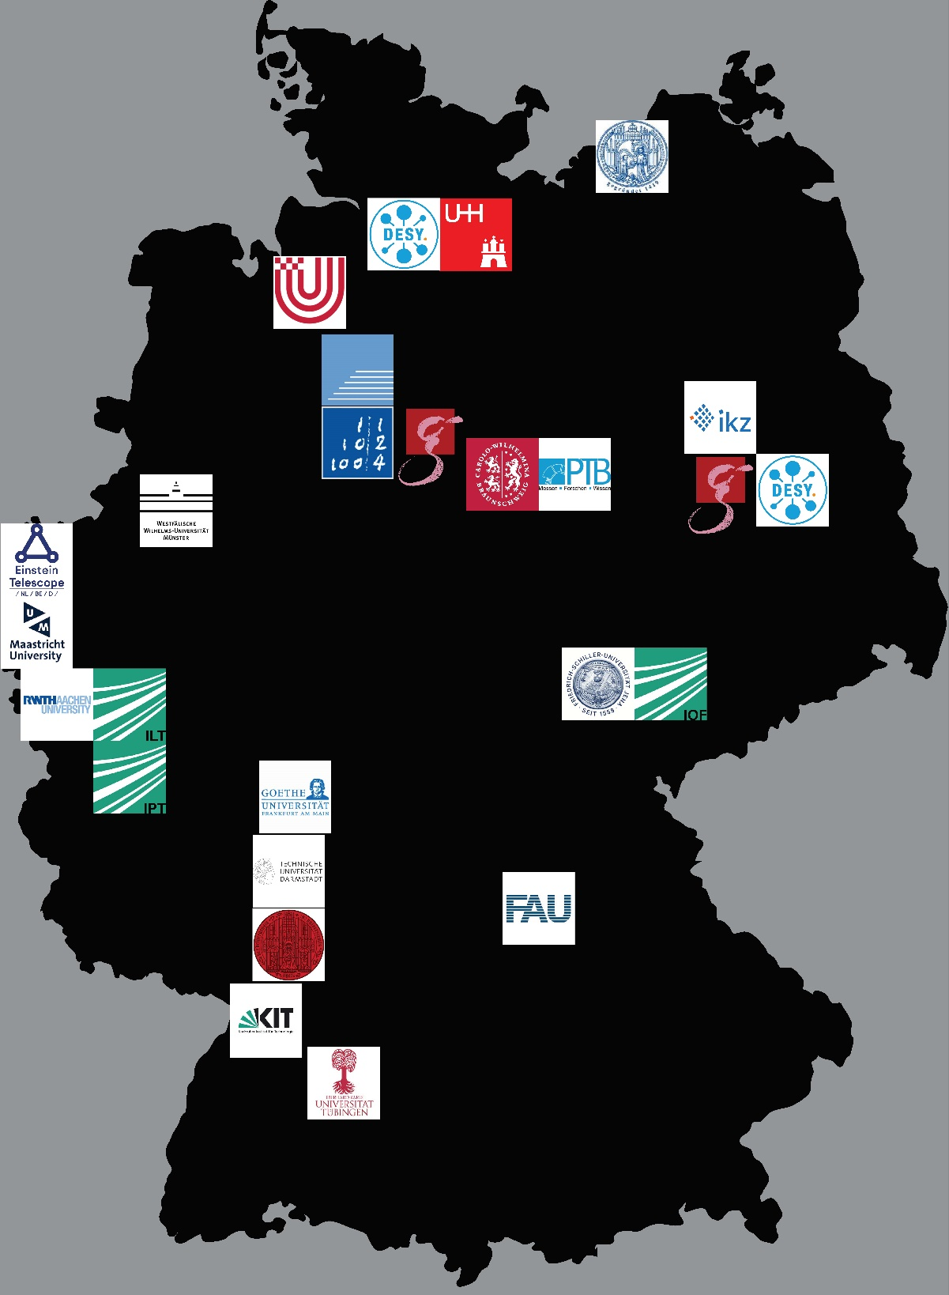

Verbundforschung
Hardware Developments
Multi-Messenger-Approach
We are thinking of a corresponding consortium
17 full & associated partners: 2.1 Mio. funding for 3 years.

Slide 7
Community Workshop
Gravitational Wave Physics
January 11th … 15th, 8:30 – 9:00
Colloquium-style presentations by experts
Binary Black Hole Systems (Sarah Caudill, Univ. Utrecht)
Multi-messenger with Binary Neutron Stars and others (N.N.)
From tests of general relativity to signs of quantum gravity (Frank Ohme, AEI Hannover)
Dark energy and cosmology (Michele Maggiore, Univ. Genève)
Towards the big bang: stochastic background of GWs (Nick van Remortel, Univ. Antwerpen)
You are cordially invited !

Slide 8

ESFRI Roadmap
European Strategy Forum für Research Infrastructures
Application submitted; decision in 2021/22
Italien: Lead-Country
Niederlande
Belgien
Spanien
Polen
40 Letter of Intents, 4 from Germany
(MPG, Unis Hannover, Hamburg, Aachen)

Slide 9
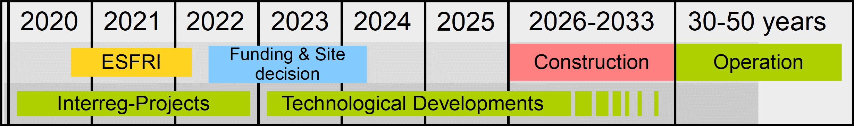
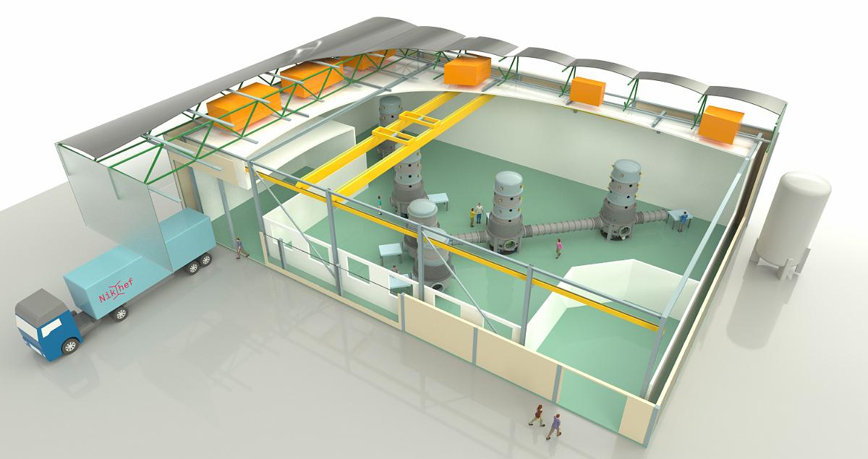
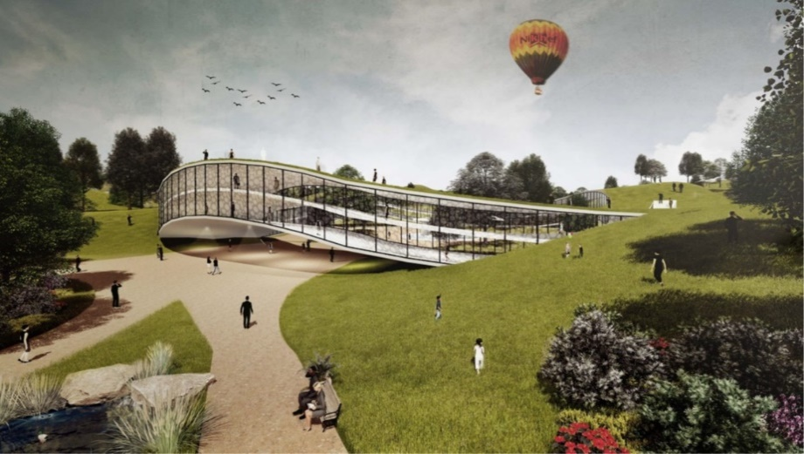
Zeitplan: Forschung & Entwicklung
interreg-Projekte (ca. 30 Mio. €)
ETPathfinder
E-Test
ET2SMEs
BMBF-Verbundforschung (2,1 Mio. €)
Third Generation Gravitational
Wave Telescope
Regionale Integration
Okönomie, Ökologie, Verkehr,
Landschaft, Tourismus, Schulen,
Wasserwirtschaft, …
Pathfinder @ Univ. Maastricht

Slide 10

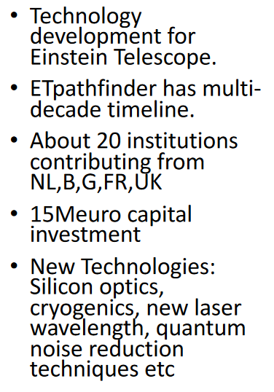
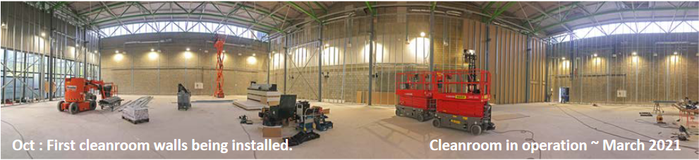
ET Pathfinder

Slide 11
ET Test
Interreg-project: Euregio Meuse-Rhine
Funding ~ 15 Mio. €
Objective:
Geological exploration of the Euregio
Construction of an instrumented test-mirror

Slide 12
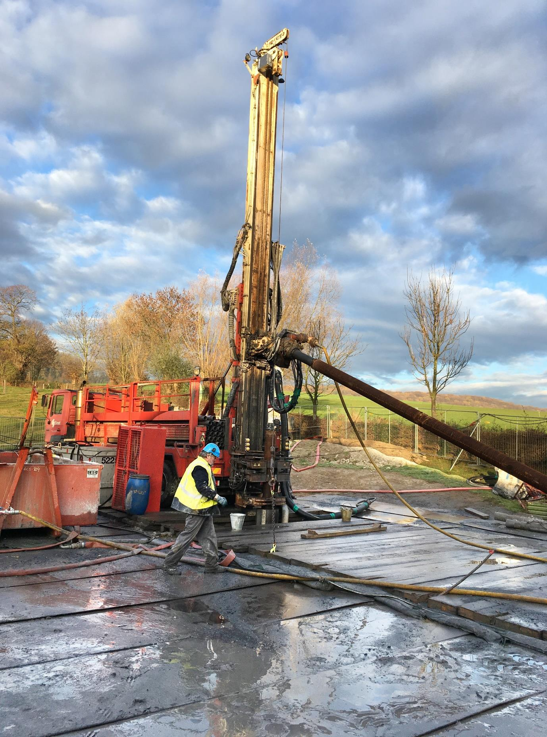
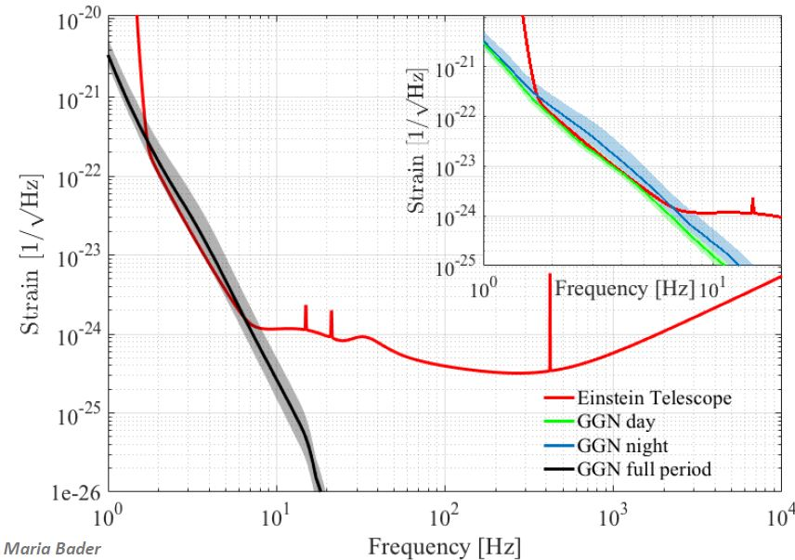
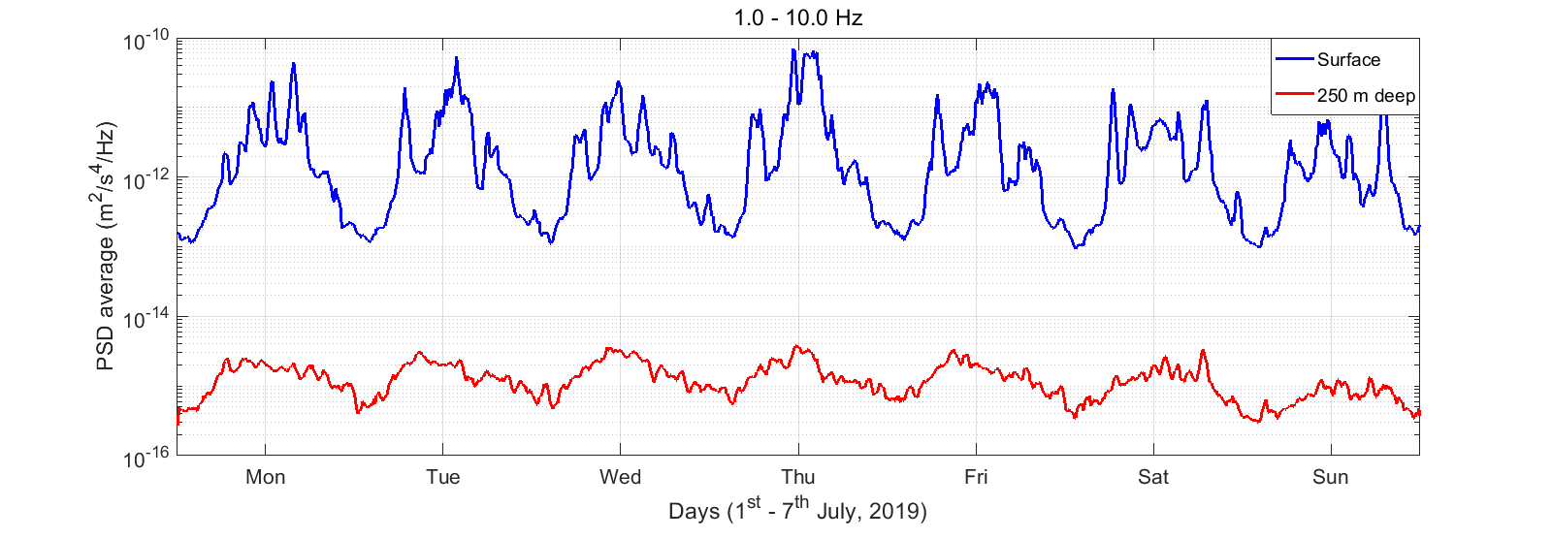
Seismic Noise
@ surface
attenuation 10,000 (day) & 200 (night)
250 m deep
Seismische Messungen bestätigen die Eignung der Euregio

Slide 13
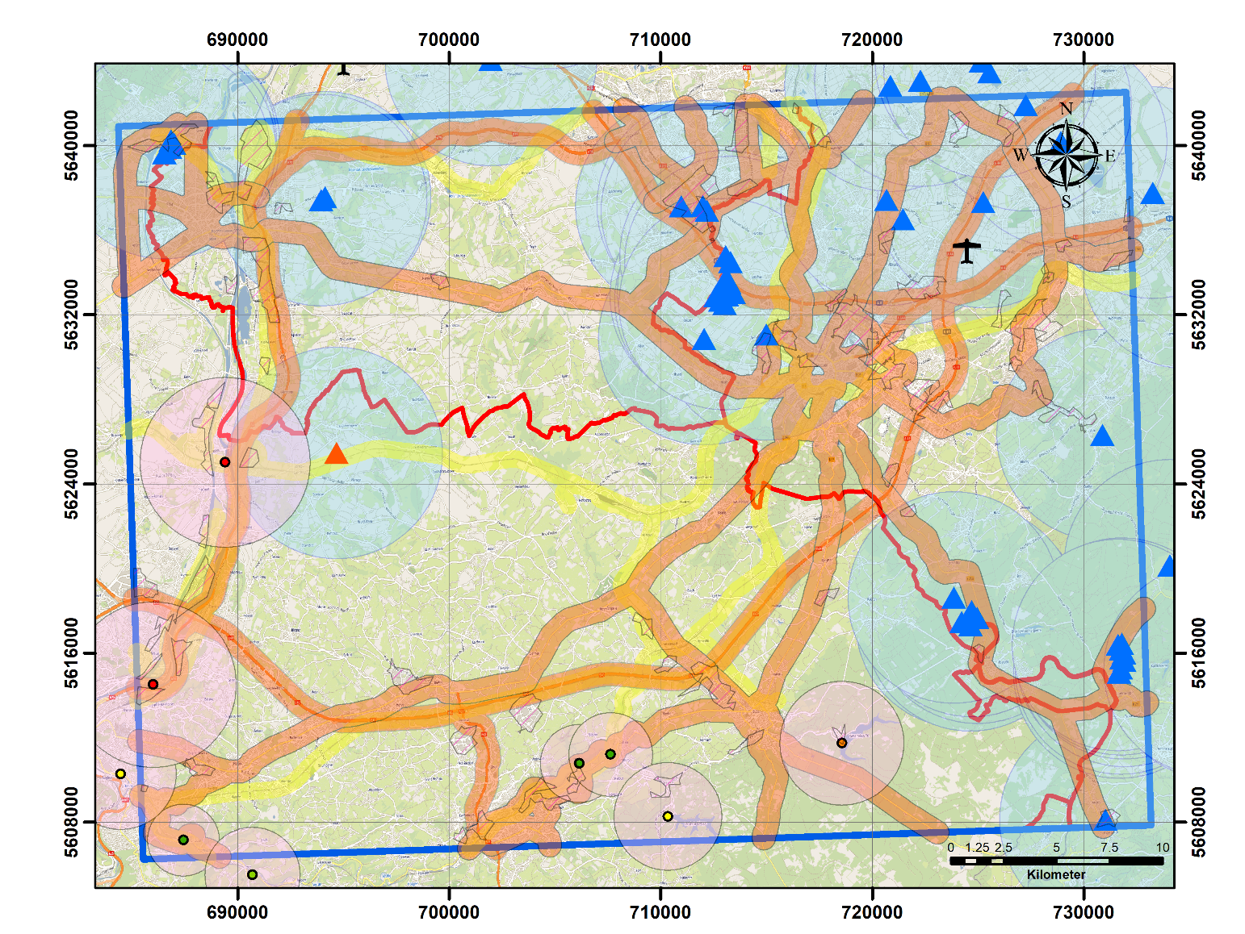
Seismic Noise
5 new boreholes from E-Test

Slide 14
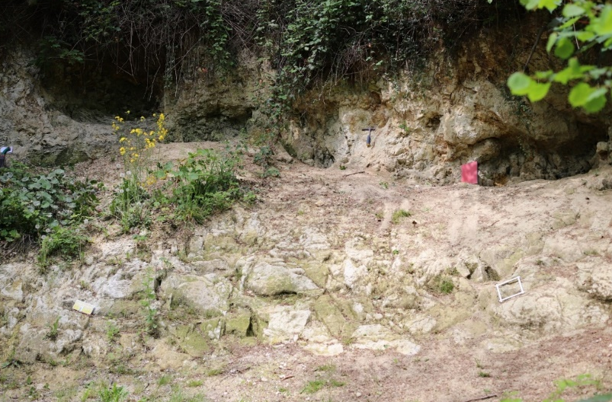
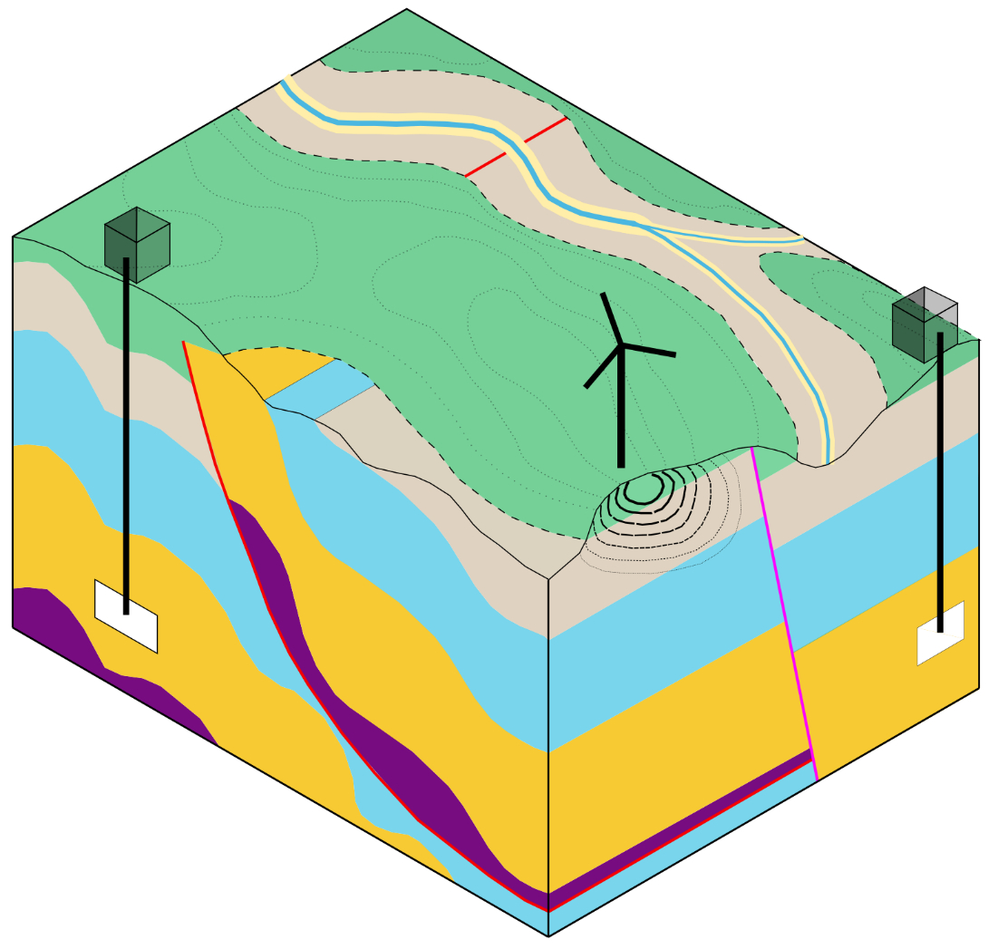
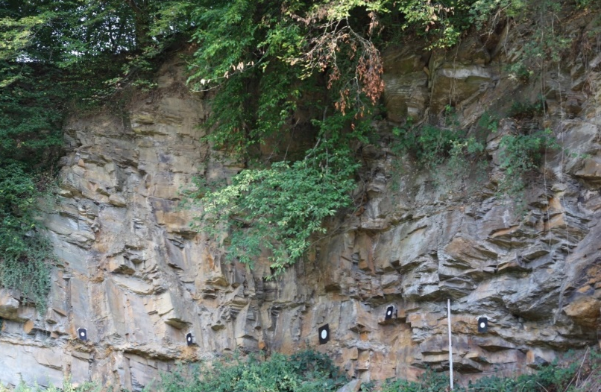
Seismic Noise
Soft rock to damp ambient noise
Surface access building
Hard rock to host ET subsurface cavern
ET subsurface cavern
Ambient noise in the subsurface

Slide 15


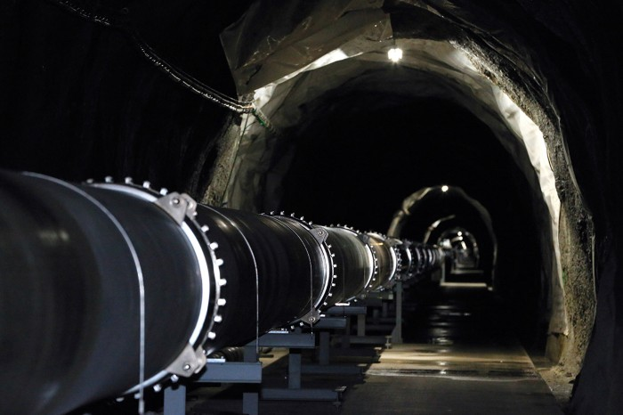
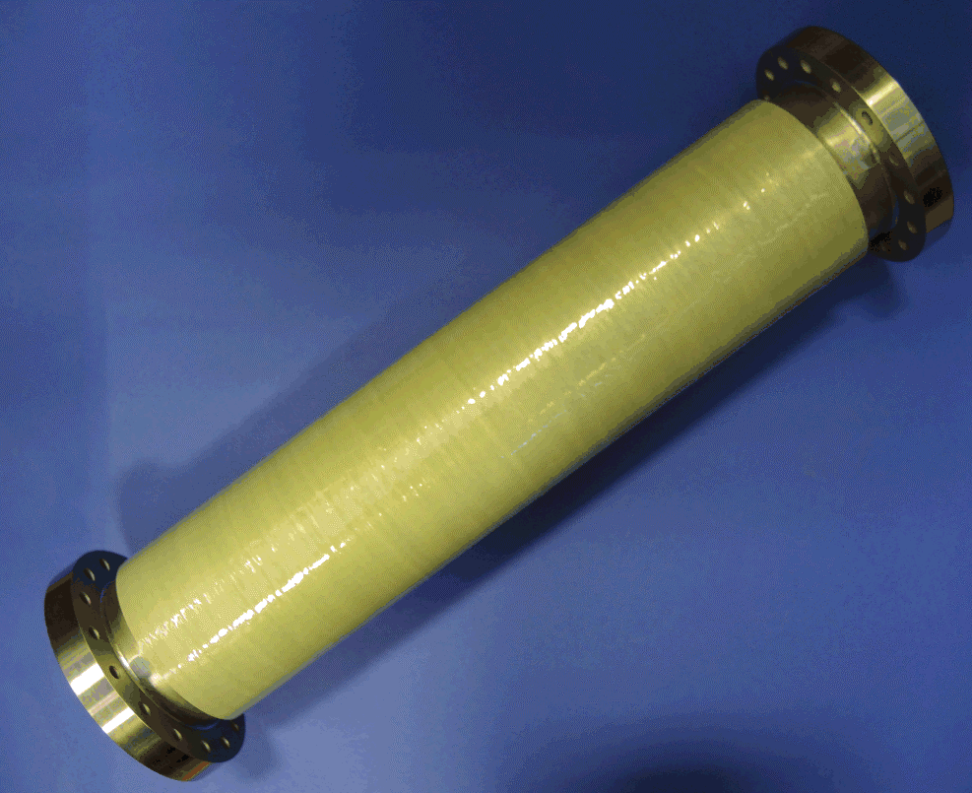
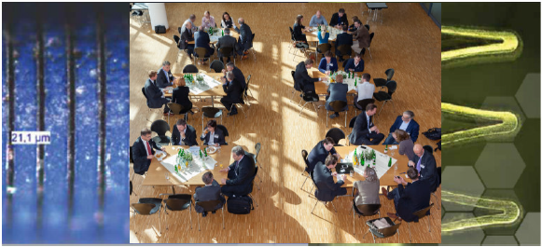

ET2SMEs
New interreg proposal: 2.3 Mio. €
Scope:
Mapping (technology catalogue)
Networking with industry
Financing & Cooperation
Sustainable structures
ET: 130 km of UHV-pipes (∅ 1m)
20 … 40 Mio. € of stainless steel
KAGRA

Slide 16
Hardware Developments
Optics & lasers
Si-mirrors, coatings
Vacuum
Cryogenic
Low-power / low-noise electronics
Precision mechanics
Sensors and actuators
Controls
Trigger (deep learning)
Collaborators welcome !

Slide 17
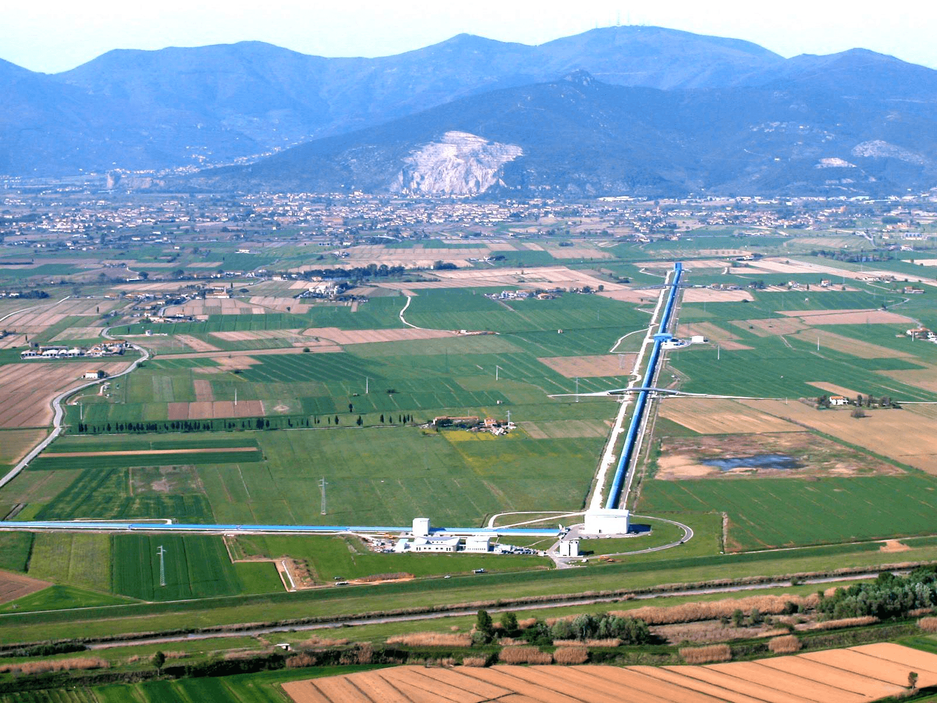
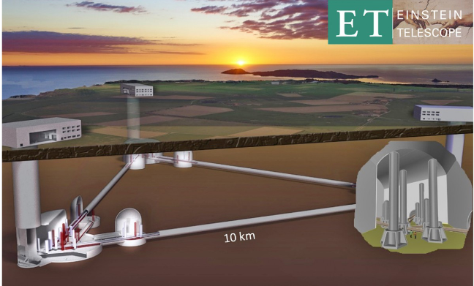
Physics with ET
Triangle
vs.
two L‘s
interferometer 1: s₁ – s₂
interferometer 2: s₂ – s₃
interferometer 3: s₃ – s₁
nullstream
Higher cost
Collaborators welcome !

Slide 18

Investitionskosten
Voll
version
Start
version
Kostenkalkulation: ESFRI Antrag 2020
Optics
Lasers
Cryogenics
Suspensions
Tunnel
Vacuum
Services
Surface
Lab
Vollversion
Plus F&E – Arbeiten: 200 Mio. €
Startversion: 2026 – 2033
Ausbau Vollversion: 2034 – 2040
1,74 Mrd. €
1,20 Mrd. €
Kostenschätzung ET Design Studie 2011: 1,07 Mrd. € (Startversion)
Tunnelkosten Euregio: Kalkulation durch Implenia AG
730 M€ inkl. 10% contingency

Slide 19
Finanzierung International
Sardinien
Euregio
Italien (600 M€)
Niederlande
(450 to 500 M€)
Vlaanderen 115 M€
Wallonia 115 M€
Germany ?
(~50 M€ HGF/MPG)
Inoffizielle Zahlen!

Slide 20
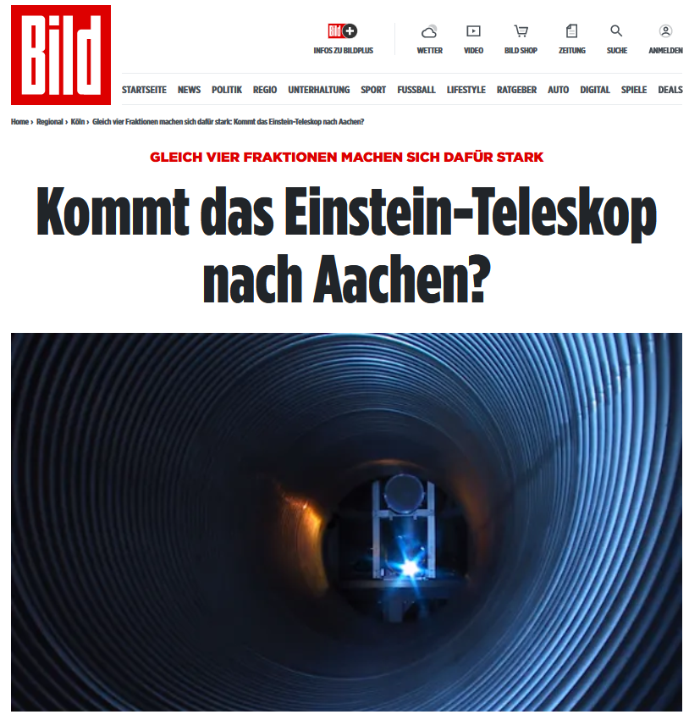
Landtag NRW
Entschließungsantrag:
Das Einstein-Teleskop – die Euregio Maas-Rhein überzeugt als
Standort des internationalen Großprojekts
Der Landtag beauftragt die Landesregierung,
International support incl. ESFRI
Coordination in the Euregio
Financial support for coordination within Euregio
Push BMBF for support:
„sich gegenüber dem Bundesministerium für Bildung und Forschung dafür einzusetzen, den geplanten Bau des Einstein-Teleskops unter eventueller Beteiligung des Landes NRW finanziell zu unterstützen.“
Unanimously approved!
https://youtube.be/ysQ9T7LQ958/ab 10:10:50

Slide 21
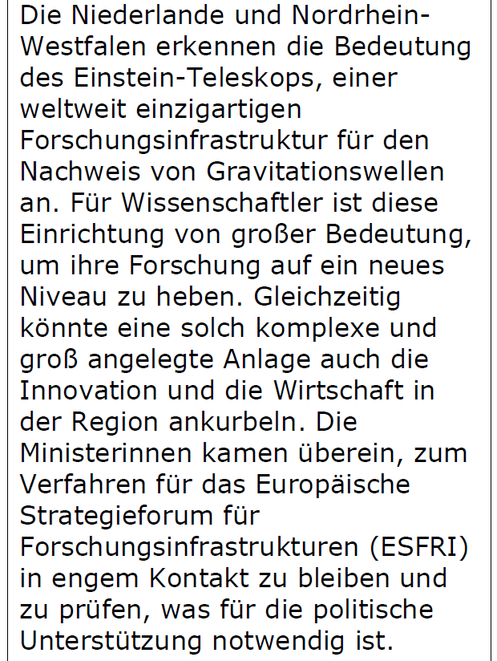

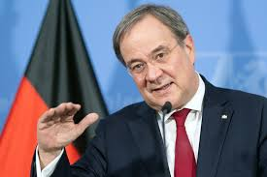
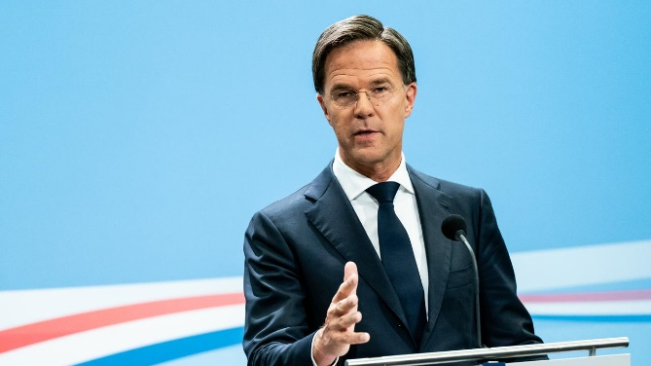
Latest News
Armin Laschet
Mark Rutte

Slide 22
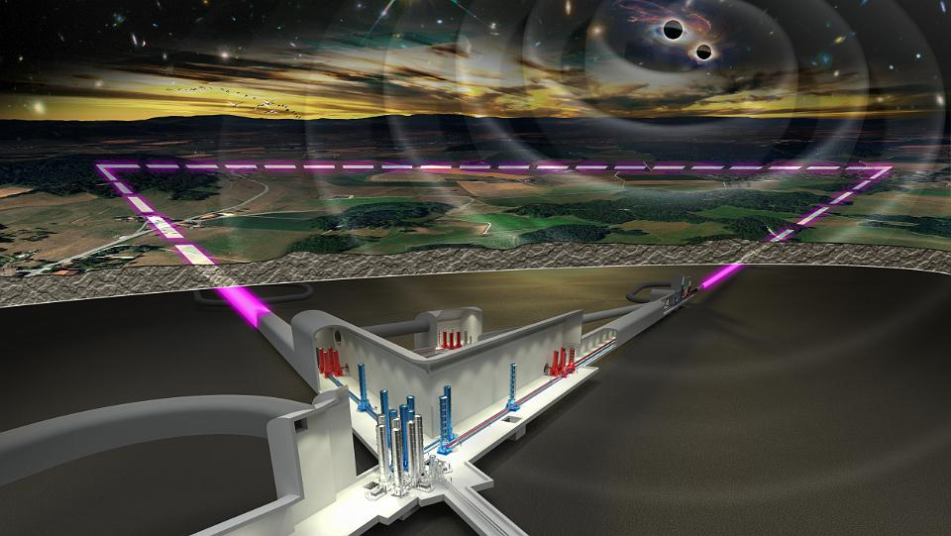

Einstein Telescope
Thanks
German coordination:
Christian Stegmann (DESY)
Harald Lück, AEI Hannover
Achim Stahl, RWTH Aachen
& Team

