Slide 1
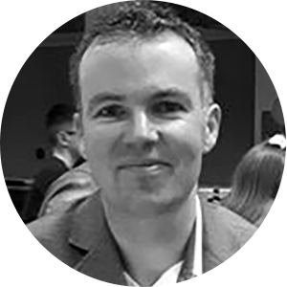
Applying Scrum to research software projects
Matt Machin
Digital Health Technical Lead
Division of Informatics, Imaging and Data Sciences
University of Manchester
matthew.machin@manchester.ac.uk

Slide 2
Applying Scrum to research software projects
Introduction to Scrum
How to apply Scrum to research software projects
What has worked well
Challenges faced
How our approach has changed

Slide 3
Introduction to Scrum
Modern Agile software development methodology
Developed in the 1990s and has evolved over time
Three main elements:
Team & roles
Events / meetings
Artifacts

Slide 4
Team and roles
Product Owner
Scrum Master
Developers
(or team members)
Responsible for requirements capture & prioritization
Owns product backlog
Carry out the work
Commit as a group to delivery
Responsible for Scrum process
Leads Scrum meetings
Coaches and supports the team

Slide 5
Events / meetings
The Sprint
Fixed length events (typically 2-4 weeks)
Focused on delivery of a specific goal
Sprint planning
Agree goal
Work items to include in sprint
Sprint review
Demonstrate sprint output
Agree changes needed
Sprint retrospective
What went well / could be improved
Daily scrum - Developers report on
What they did yesterday?
What they will do today?
What is in their way?

Slide 6
Artifacts
Product Backlog
Sprint Backlog
Ordered list of requirements
Product goal (long term)
Sprint goal (short term)
Real-time view of work within a single sprint
Owned by dev team

Slide 7
Applying Scrum to software research projects
What has worked well
Challenges faced
How our approach has changed

Slide 8
What has worked well
Effective way of planning
Good for team ownership / engagement
When applied effectively enables issues / delays to be picked up quickly
Review and retro allows for regular feedback and process improvements
Is fairly lightweight

Slide 9
Challenges faced
Commitments in grant application with fixed funding
Insufficient access / availability of research team
Customer proxy not always ideal
Dev team can lose sight of overall project goals

Slide 10
How our approach has changed
Initially had small team so single person as Scrum Master and Product Owner. This is BAD!
As team grew were able to separate these roles
Now give team better visibility and ownership of longer-term goals
Experimenting with different
estimation approaches

Slide 11
Conclusions
Can Scrum be applied to research software projects? Yes!
Carefully consider roles
Adjust approach to reflect relationship with research team
Regularly review and improve process

