Slide 1

Tb/s Optical Data Transmission
Marc Schneider, Karsten Hansen
DTS-Meeting
2020-12-16

Slide 2
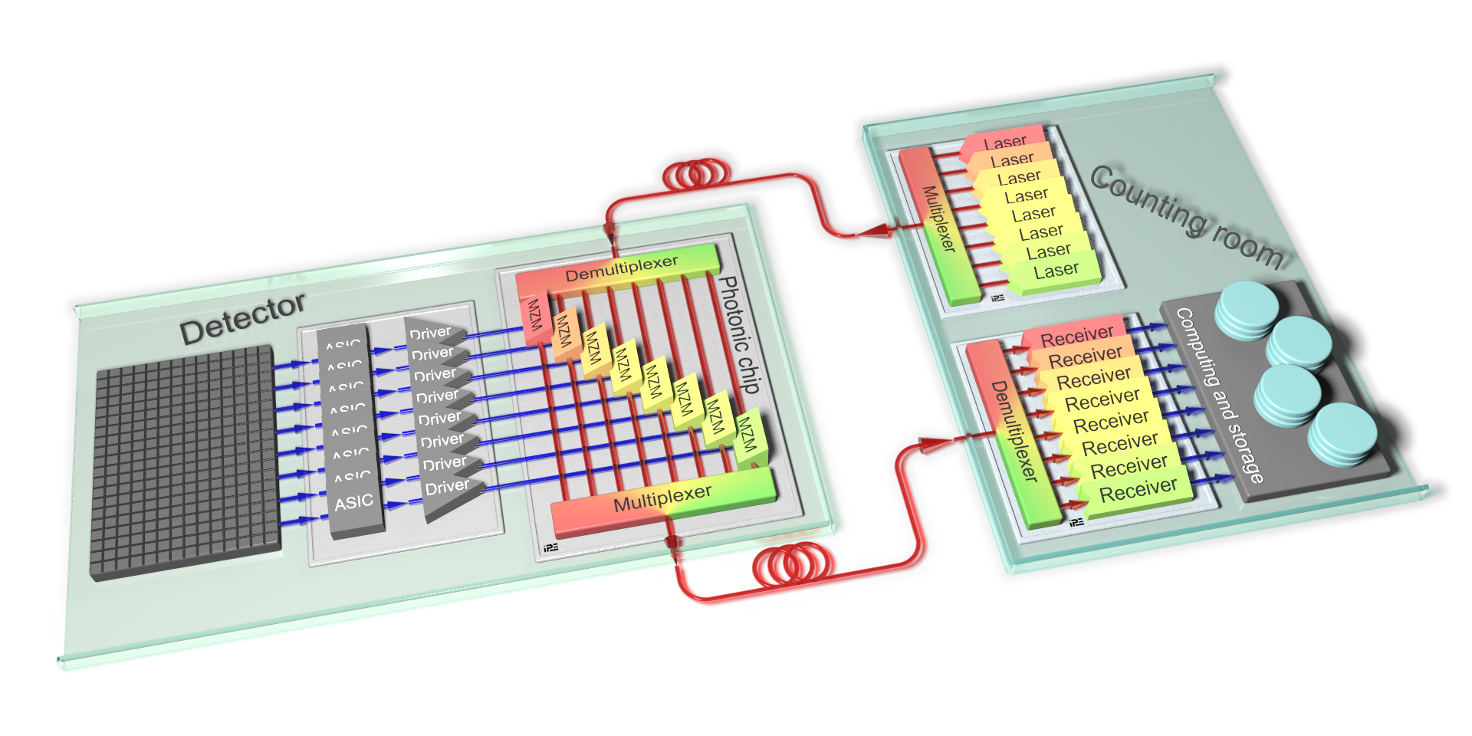

Reminder…
It’s about this:

Slide 3
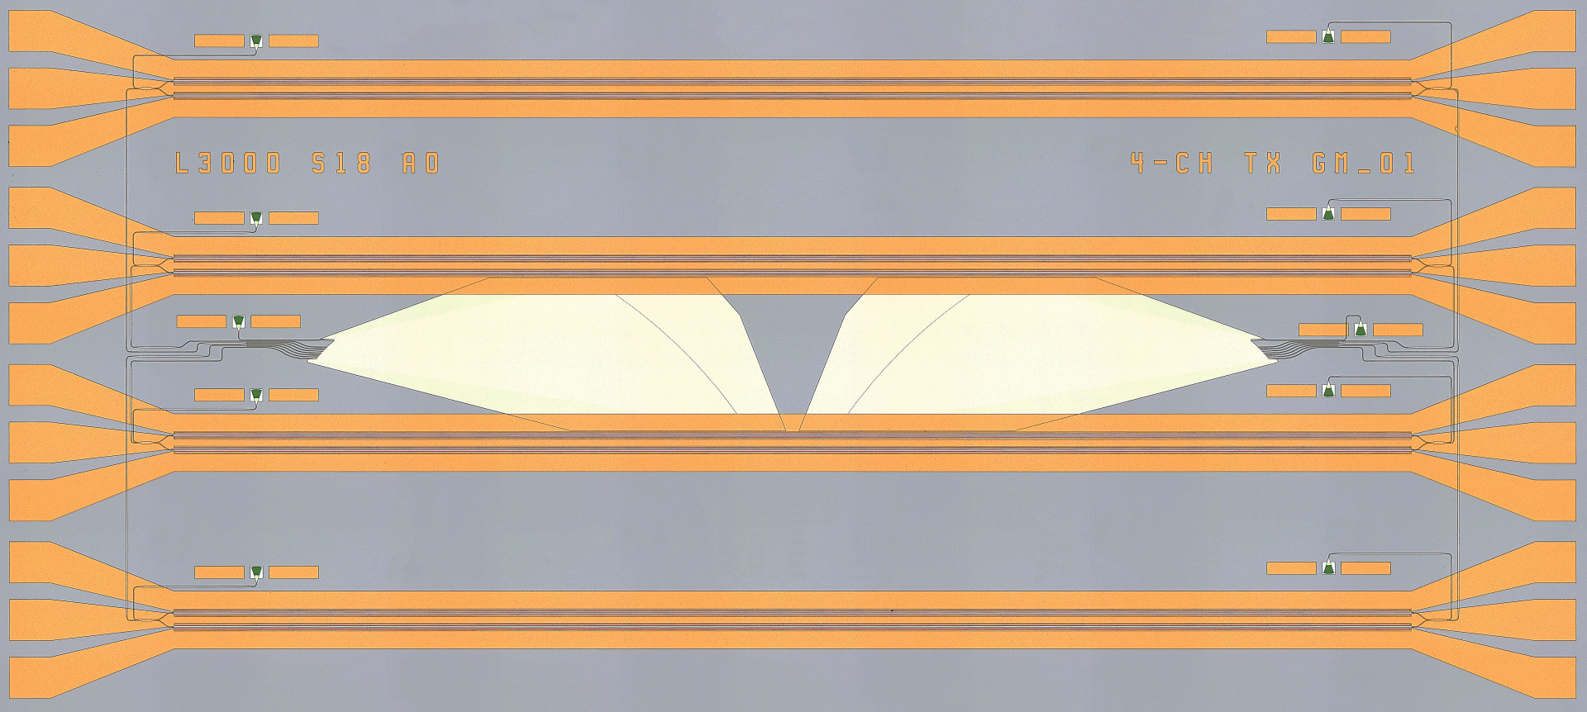
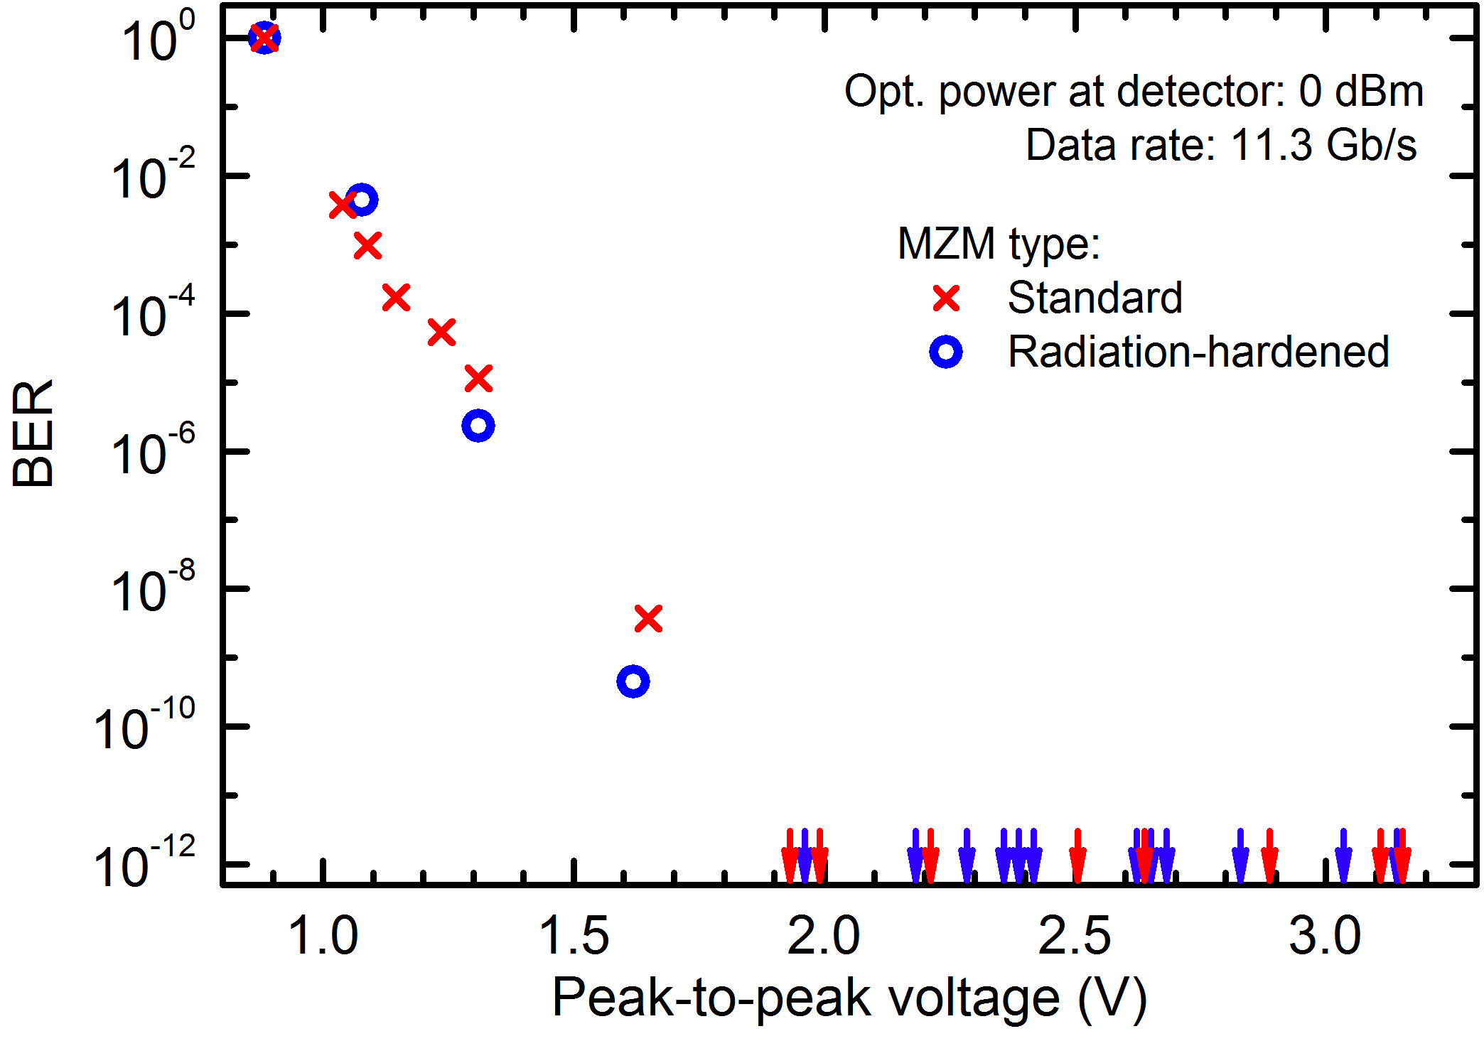
Performance of Re-Doped Chip
3.8 mm
Standard and radiation-hardened
Mach-Zehnder Modulators (MZM):
Bit error ratio < 10⁻¹² @ 11.3 Gb/s achieved
for driving amplitude ≥ 1.9 V_{PP}
1.7 mm
Integrated WDM Transmitter:
Input demultiplexer, 4 MZM, output multiplexer
System demonstrator near completion

Slide 4
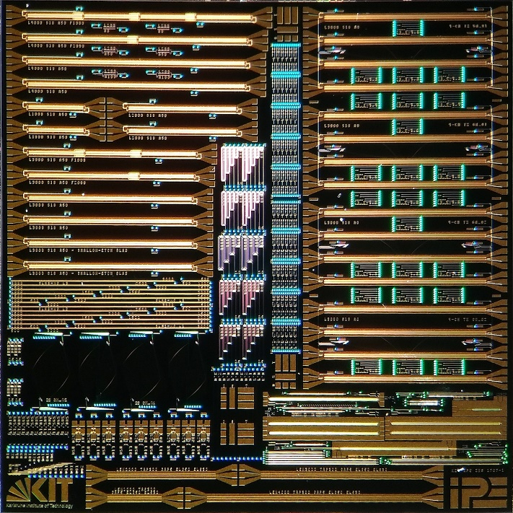
Photonic Transmitter Chips
First Chips inferior due to doping levels much too low
Re-doping of second wafer put aside after first doping with much higher doping levels didn’t solve doping problem
  Fundamental problem of IMS Chips
  Now looking for external provider
We started (just now) a new chip design
  Different fab
  Different process
  Different material
All new… ☹
9.3 × 9.3 mm²

Slide 5
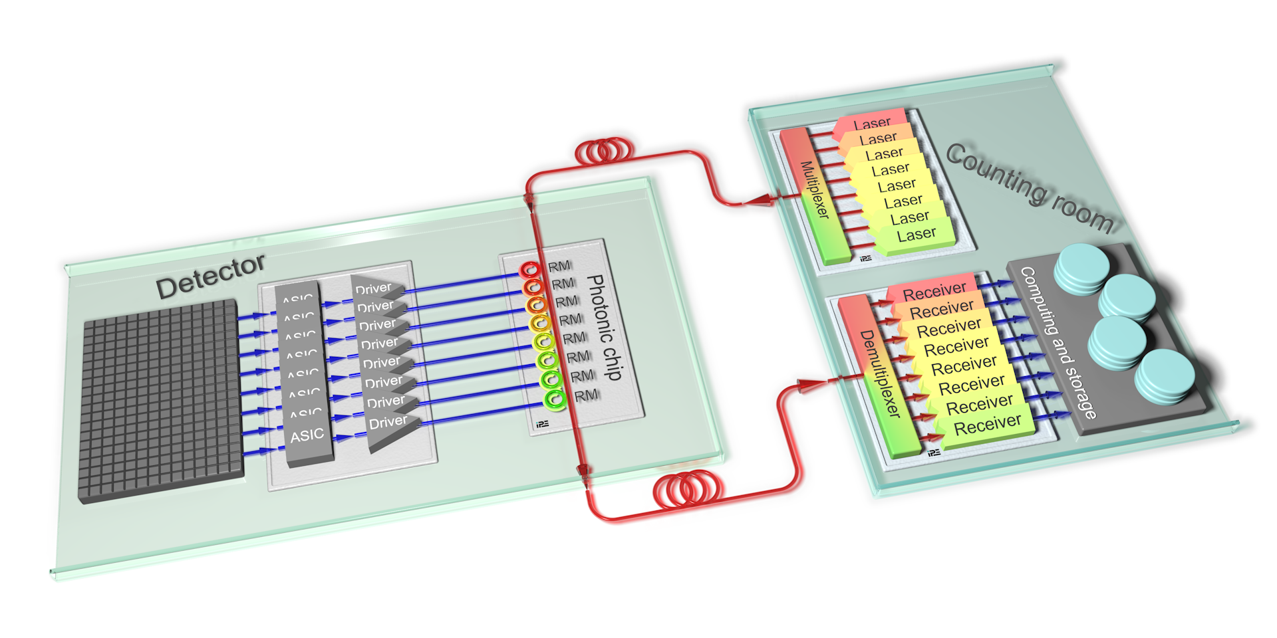
Future Developments: Ring Modulators
Small (∅ ≈ 10-20 µm)
Several different ring modulators on single bus waveguide ➔ WDM system
Receivers with same technique

Slide 6
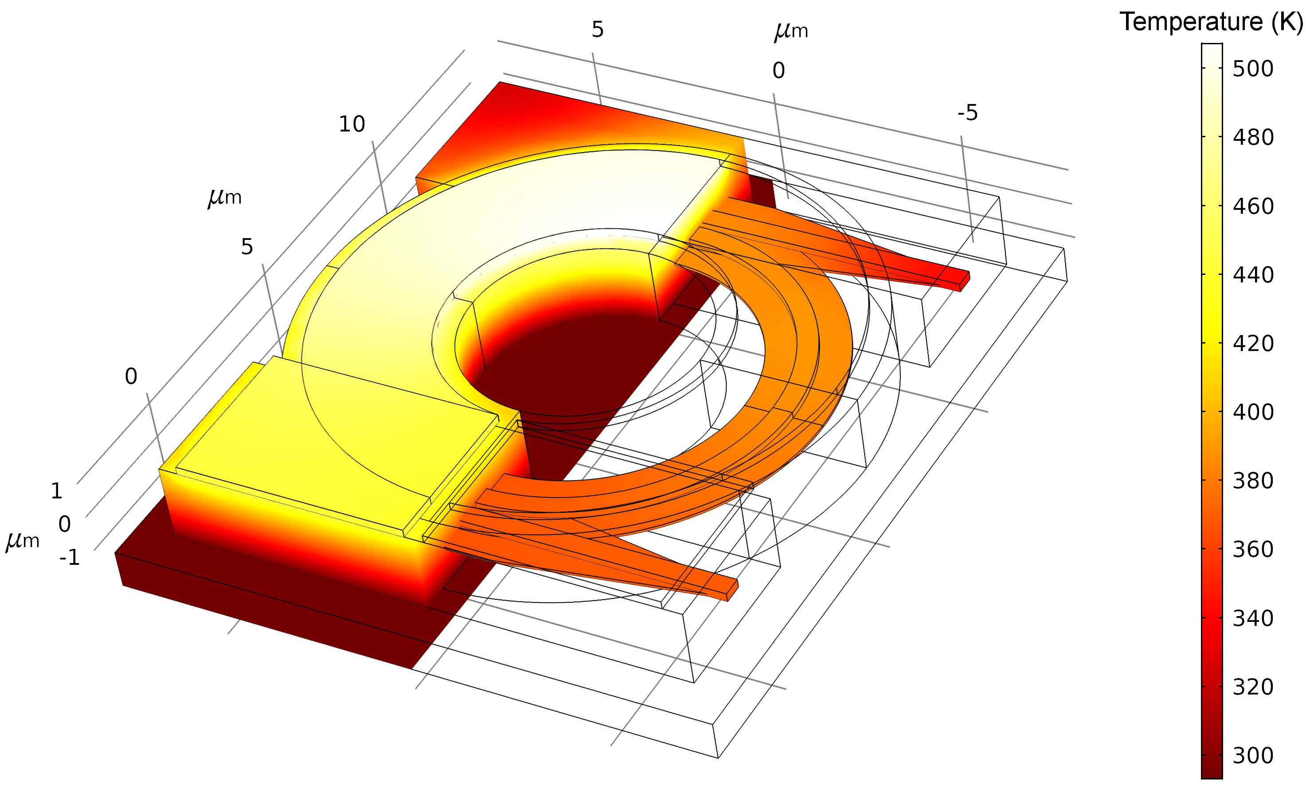
Future Developments: Ring Modulators
ATTRACT project “SiPhoSpace – Radiation-tolerant high-speed optical data transmission for space applications”, Phase 1 finished
Project partners: CERN, KIT, INFN Pisa, (Uni Bristol)
Ring modulators are sensitive to everything
  Tight temperature control required
  Wavelength tuning by temperature possible

Slide 7
Silicon Photonics
Concept

Slide 8
Silicon Photonics
Design in GF’s 90-nm CMOS
Design Phase for 1st PIC started
1st Area Requirements estimated
Next Steps: System-level Blocks (PLL, CDR, SERDES, Voltage References…)

Slide 9


Thank you!

