Slide 1
M. Schwickert, M. Caselle
Detector Technologies and Systems DTS
Beam Physics

Slide 2


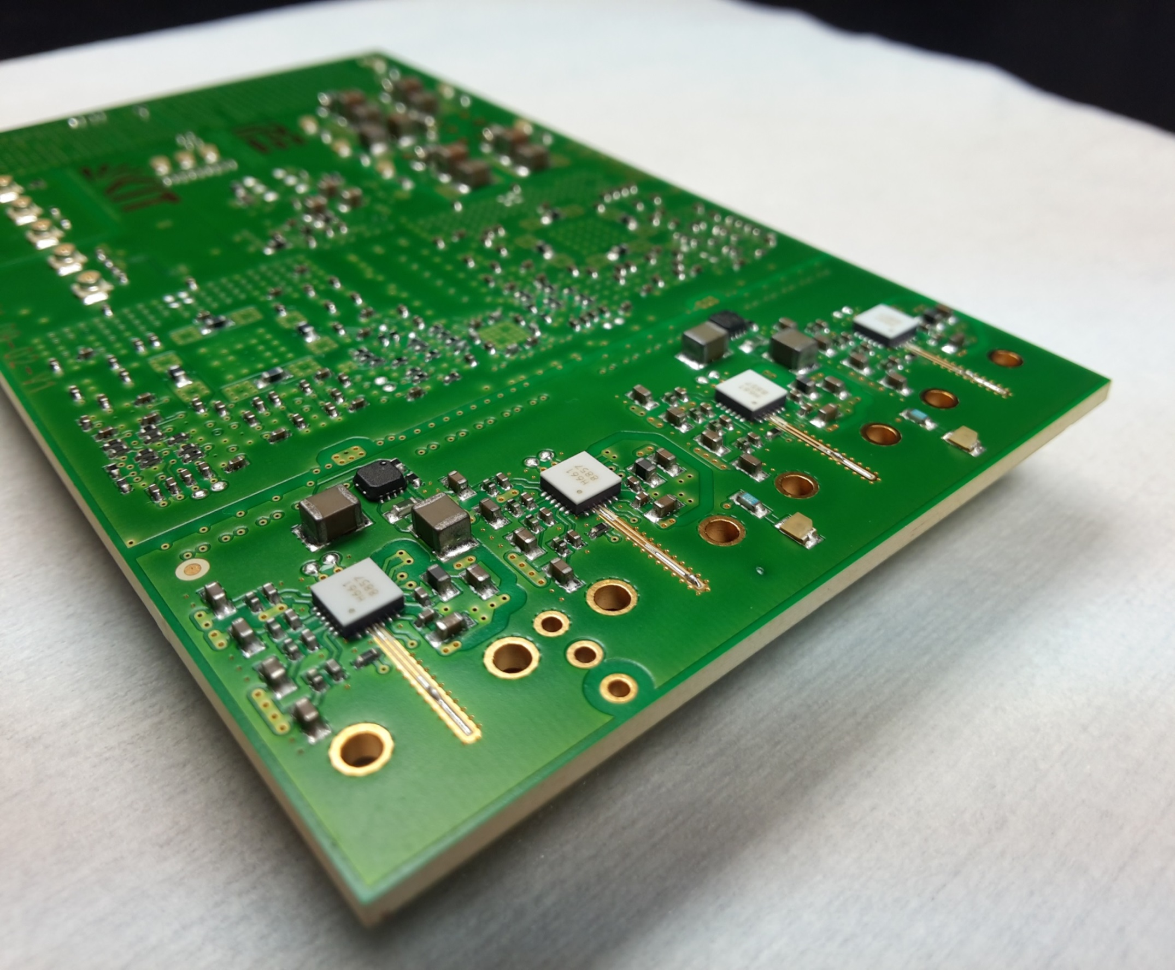
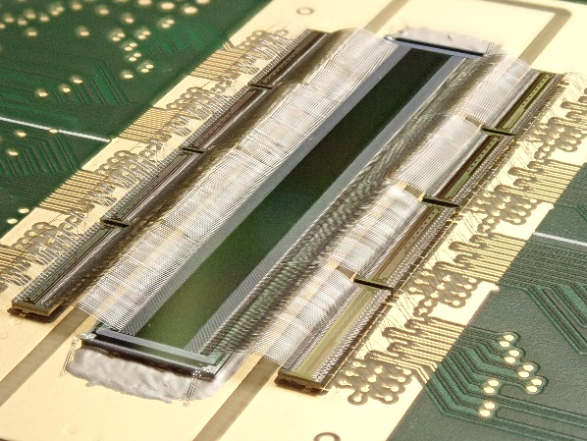
POF III: Advanced Beam Diagnostics detectors
World-leading systems: KAPTURE and KALYPSO
KAPTURE is an ultra-wideband readout electronics for ultra-fast Terahertz detectors
Local sampling frequency > 300 GS/s
Up to 1 GHz pulse repetition rate
Pulse amplitude (mV) and arrival time (ps) accuracy
KAPTURE
KALYPSO is an ultra-fast line-camera
MHz continuous frame rate & wide spectrum response
Longitudinal bunch profile with fs time resolution
Horizontal bunch profile for bunch energy spread
KAPTURE
KALYPSO
M. Caselle et al., JINST 12 C01040 (2017)
L. Rota, M. Caselle et al., NIM-A, ISSN 0168-9002 (2018)
M. Brosi et al., DOI: 10.18429/JACoW-IPAC2019-WEPTS015
S. Funkner et al., DOI: 10.1103/PhysRevAccelBeams.22.022801
Express of Interest from CERN (FCC/HL-LHC) and GSI (FAIR)

Slide 3
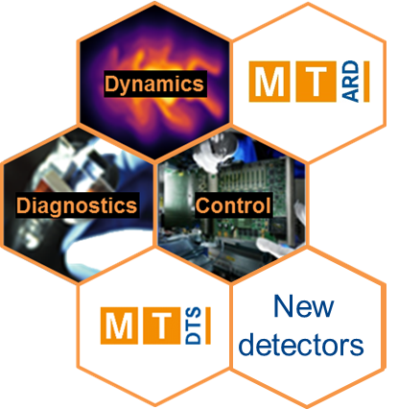
POF IV: Advanced beam control, diagnostics & dynamics
Control of extreme beams at the forefront of technology
Requirements from ARD-ST3:
6D phase space beam tomography, extreme dynamic range
Probing the femto-scale dynamics of relativistic plasmas
Advanced beam control ➔ toward Autonomous Accelerators

Slide 4
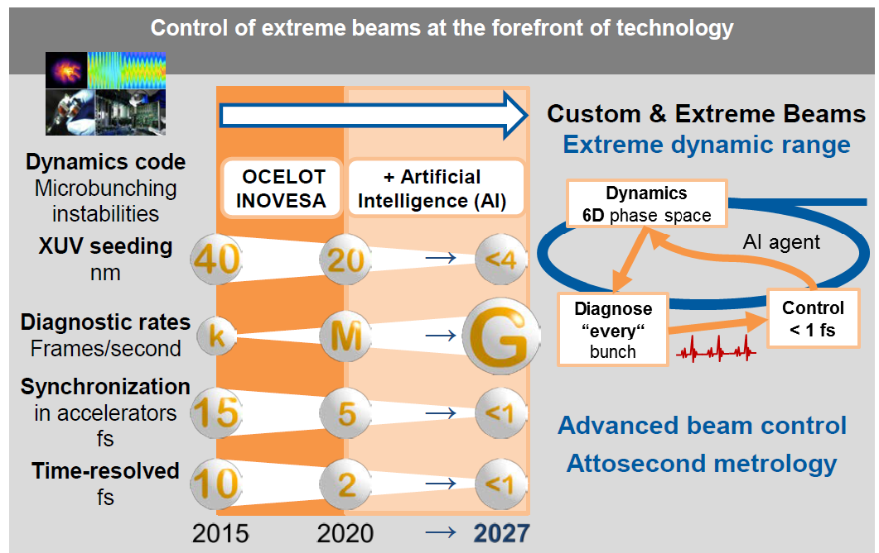
POF IV: Advanced beam control, diagnostics & dynamics
Control of extreme beams at the forefront of technology
Requirements from ARD-ST3:
6D phase space beam tomography, extreme dynamic range
Probing the femto-scale dynamics of relativistic plasmas
Advanced beam control ➔ toward Autonomous Accelerators
DTS-ST3:
New detectors for 6D beam diagnostics → THESTRAL
Probing the femto-scale dynamics → KALYPSO-LGAD
Advanced beam control system → by ML inference on FPGA
Participating institutes: KIT, DESY, HZB, HZDR, GSI
From ARD
To DTS
Andreas Jankowiak

Slide 5
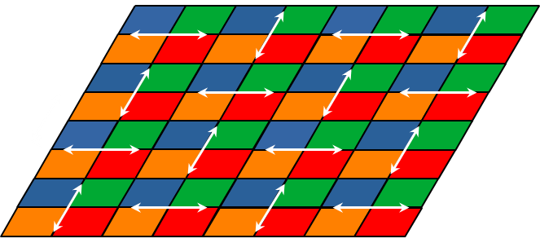


THESTRAL (TeraHErtz pixelated SpecTRAL detector) :
A large-area pixelated THz detector
THz beam
Motivation: Hugely increase sensitivity, advanced pixelated detector for THz-science
Goal: Genuine 6D THz detector system, combining: spatial, spectral, timing and polarization measurement
Milestones DTS-14:
Readout ASIC in SiGe technology by 2024,
THz detector system by 2025
All subtopics contribute
Target applications: beam physics,
THz imaging and spectroscopy, medicine, material science, THz wireless communications
PhD position in ASIC BiCMOS (2021 – 2024)
Hybrid design
TSV
THz sensor
Bump-bonding
BiCMOS readout ASIC
Detector carrier board

Slide 6
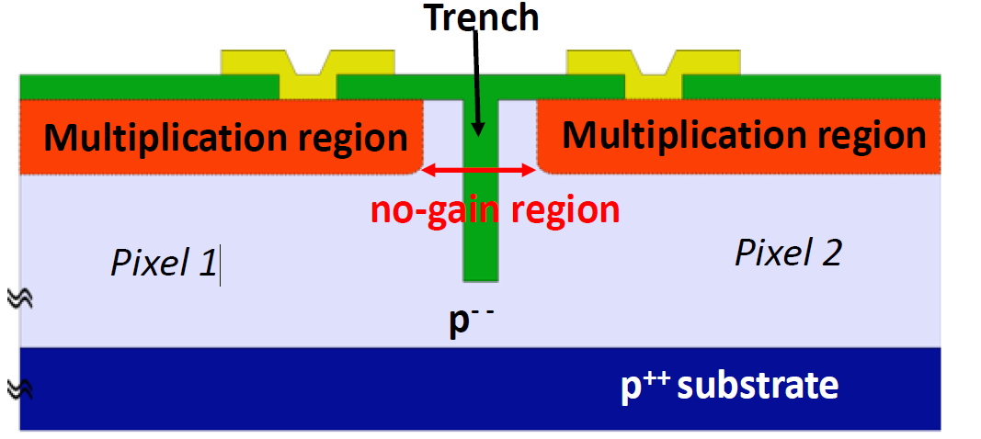
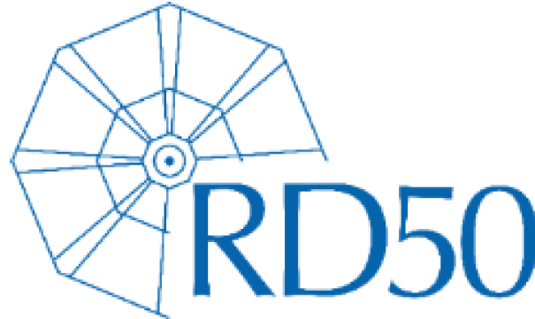
KALYPSO based on LGAD
Shot-to-shot measurements of complex beam dynamics at hundreds Mfps
Motivation: measurement of complex dynamics of the micro-bunches sub-structure in multi-bunching mode
Goal: fine-pitch LGAD sensor operating at hundreds Mfps
Milestones:
Readout ASIC by 2024
All subtopics contribute
Target applications: beam physics, medicine, material science and more
Status: trench isolated LGAD sensor submitted within RD 50 collaboration, foundry FBK
First development of microstrip LGAD sensor with channel pitch below 100 µm
Trench isolated LGAD structure
no-gain region of ~ few µm
Microstrip TI-LGAD sensors with channel pitch of 50 µm

Slide 7
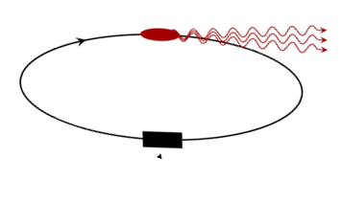
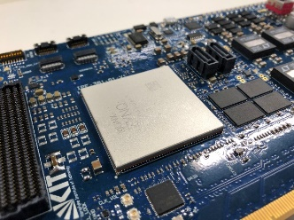

Advanced beam phase space control by AI
Machine Learning toward Autonomous Accelerators
Motivation: to stabilize the high brilliance THz beam source emitted by synchrotron accelerators
Goal: Development of a longitudinal feedback system to control the micro-bunching instability with Reinforcement Learning (RL)
Target applications: KARA, FLUTE, ARES and more …
Status: feedback control with RL on FPGA is developed within AMALEA → now is ACCLAIM
Experience in the development of fast ML inference deployed on sophisticated readout cards developed at KIT
PhD position in AI on FPGA (2021- 2024)
THz detector
KAPTURE
RF System
THz intensity (mV)
Arrival time (ps)
Feedback
action
HighFlex card
AI deployed on FPGA

Slide 8
Thank you for your attention

