Slide 1
PANDA kick-off meeting ITIV-IPE Sept. 16th (2021)
Overview of the PANDA activities/topics at IPE
Michele Caselle and Andreas Kopmann
Notes:
Good afternoon everyone. My name is Andrea Santamaria Garcia, I’m a research associate here at KIT and I will be presenting our artificial intelligence activities for accelerators.

Slide 2
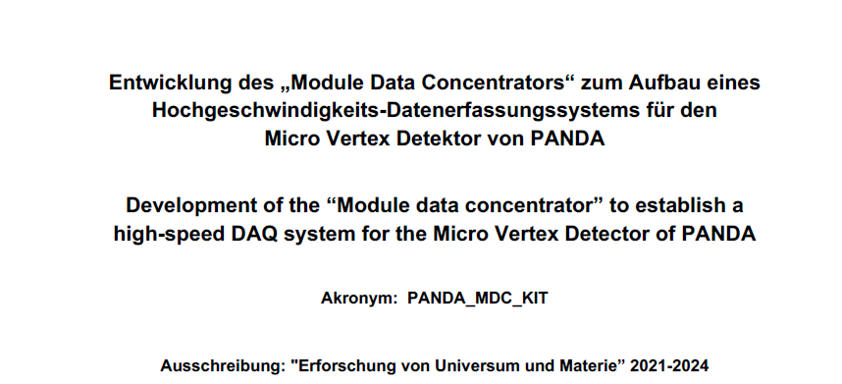

Briefly overview from 2020 to now
KIT-Expression Of Interest (M. Caselle, A. Kopmann, M. Weber), March 2020
  Hardware development of a “common readout card” for PANDA –DAQ
  Fast track-reconstruction on FPGA based on Machine Learning
Technical Design Report – PANDA Data Acquisition and Event Filtering” (M. Caselle, A Kopmann and S. Chilingaryan), August 2020 → Approved
  → reference: tdr-daqt_v2.pdf (pag. 25-28 and 40 -41)
BMBF (Acronym: PANDA_MDC_KIT) title: Development of the “Module data concentrator” to establish a high-speed DAQ system for the Micro Vertex Detector of PANDA”
December 2020
Approved
Prof. Dr.-Ing. Dr. h. c. Jürgen Becker, Dr.-Ing. Michele Caselle (Coordinator), Dr.-Ing. Andreas Kopmann, Dr.-Ing. Bähr Steffen (KIT - ITIV and IPE)

Slide 3
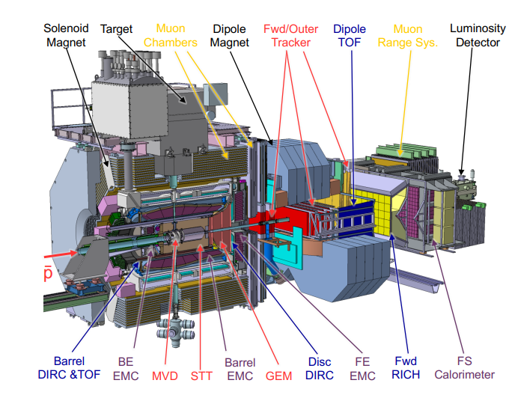
PANDA – Micro-Vertex Detector
The PANDA (antiProton ANnihilation at DArmstadt) experiment will study the strong interaction in annihilation reactions between an antiproton beam and a gas cluster jet target. The detector will comprise different sub-detectors for tracking, particle identification and calorimetry.
The Micro-Vertex Detector (MVD) as the innermost part of the tracking system will enable precise tracking and detection of primary and secondary vertices. It is equipped with both silicon pixel and strip sensors.

Slide 4
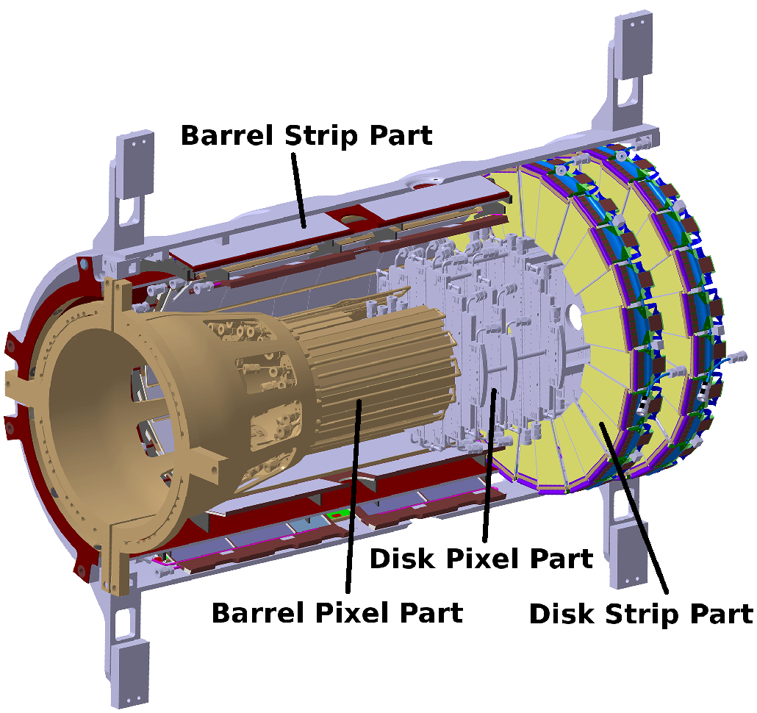
PANDA – Micro-Vertex Detector
MVD – Microvertex Detector

Slide 5
PANDA – Micro-Vertex Detector
MVD – Microvertex Detector
Microstrip detector
Barrel and Disk Strips

Slide 6
On-line data path of MVD
Local controller ASICs
Electro/optical data links
Off-detector electronics
FEE- ASICs
Compute node in the counting room (experimental area)
Sensors
Slow-control
MVD detector modules

Slide 7
On-line data path of MVD
Local controller ASICs
Electro/optical data links
Off-detector electronics
FEE- ASICs
Compute node in the counting room (experimental area)
Sensors
Slow-control
MVD detector modules
Pixel detector will be not integrated (phase 1)

Slide 8
On-line data path of MVD
Strip detector is vital for (phase 1)
Local controller ASICs
Electro/optical data links
Off-detector electronics
FEE- ASICs
Compute node in the counting room (experimental area)
Sensors
Slow-control
MVD detector modules
Pixel detector will be not integrated (phase 1)

Slide 9
On-line data path of MVD
MDC and MMB devices are missing and not covered in PANDA
Local controller ASICs
Electro/optical data links
FEE- ASICs
Compute node in the counting room (experimental area)

Slide 10


On-line data path of MVD
MDC and MMB devices are missing and not covered in PANDA
Local controller ASICs
Electro/optical data links
FEE- ASICs
Gießen
FzJü
CERN
Compute node in the counting room (experimental area)
GSI
INFN
In the BMBF we are proposing the development of both MDC and MMB, which are necessary to complete the data acquisition of the MVD
Great opportunity for ITIV and IPE to work together in the commissioning of the DAQ of the MVD
International partners: Justus-Liebig-Universität Gießen, Forschungszentrum Jülich (FzJü), GSI, CERN and INFN - TO
Slow-control
MVD detector modules

Slide 11
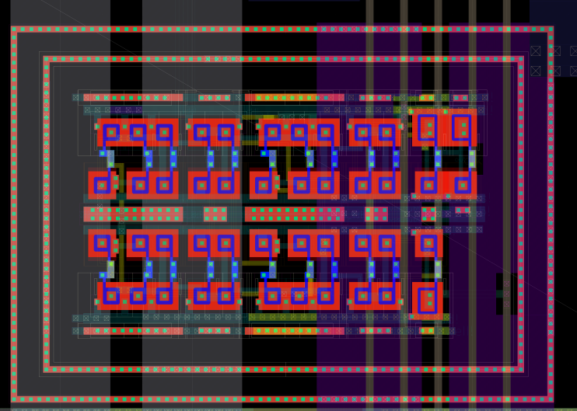
Module Data Concentrator (MDC) - ASICS
P⁺ Guardring
  Developed in UMC 110 nm with rad-hard layout
  Digital logic based on Triplicated Modular Redundancy (TRM) for Single Event Upset mitigation
  First implementation on FPGA to prove the digital behaviour
Hardening by layout:
Enclosed Layout Transistor (ELT)
P⁺ guarding
Rad-hard logic
Gotthard chip developed at KIT
PASTA
front-end ASICs
Optical link

Slide 12
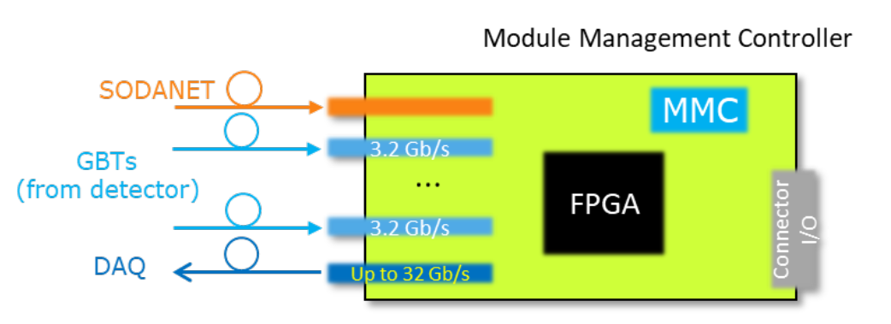
MVD Multiplexer Board (MMB) – DAQ card
  To be installed within a ATCA or µTCA creates in the counting room location: E20.201
  Must be employed during the test & characterization of the detector module during the detector production, therefore, designed to work as a “standalone” test system
  Possible form factor like AMC (Advanced Mezzanine Cards)
SODANET implemented at SoC level (ETH)
Many detector link
(i.e. 10 detector modules )
To compute node by optical link, i.e. firefly based on RoCE
  Many synergies are possible:
    Hardware development at IPE
    Firmware & SoC to be developed at ITIV

Slide 13
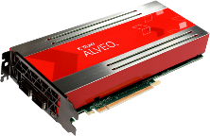

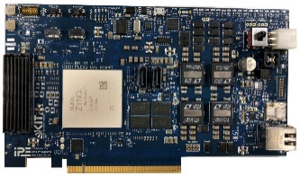
Proposed DAQ of PANDA
  More complex DAQ scheme with many sub-detectors
  On-line data path covered by off-the-shelf devices → dramatic reduction of custom electronics
  Novel heterogeneous FPGA/GPU architecture based on emerging Ethernet protocols
  High-performance ML inference on modern programmable hardware platforms
MVD Multiplexer Board (MMB)
On-line data path (by commercial devices)
Detectors
HPC
FPGA
AI
ETH
…
Ethernet fabrics
(hundreds Gb/s)
GPUs
FPGA
AI
Ethernet
Alveo
…
ETH
AI
AI
…
FPGA
AI
AI
…
ETH
HighFlex
Fast Feedback
Notes:
1000 / 3 ➔ > 300 cards to be produced & tested (installed) + 300 optical fibers (complex optical patch-panel)
31 links -> in one single optical link at 100 Gb/s , we could potentially reduce 30 cards with drastic simplifications of production & test and installation at the exp. area .

Slide 14
BMBF structure & Milestones
  WP 1 – Development of the MDC ASIC in sub-micrometer CMOS technology
  WP 2 – Development and production of an MVD Multiplexer Board and development of a test procedure and characterization of both pixel and microstrip detectors

Slide 15
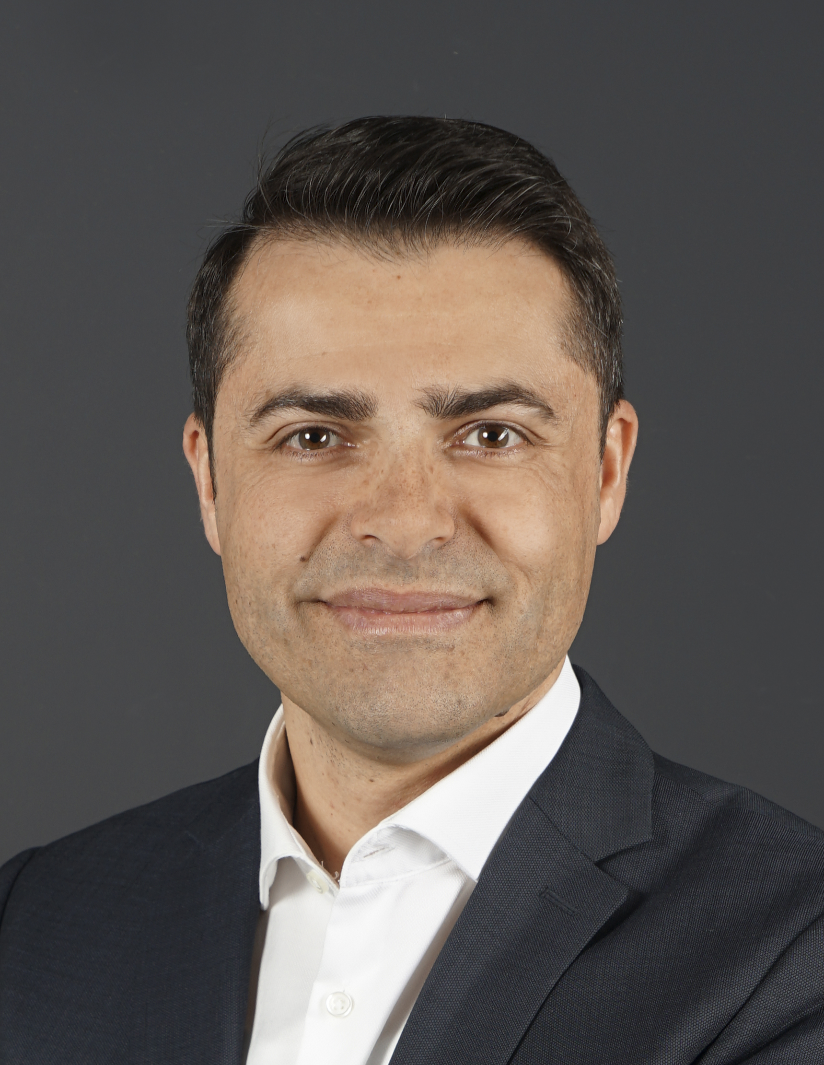
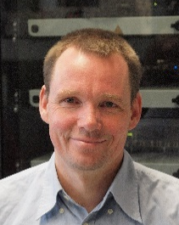


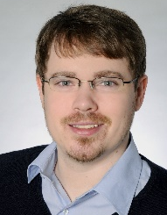

PANDA members & people
Member of PANDA (IPE):
  Staff: M. Caselle, A. Kopmann and S. Chilingaryan
PhDs (IPE):
  PhD student: T. Dritschler
  Olena Manzhura: Development of the DAQ for PANDA
  New PhD: ASIC development of the MDC for the µstrip detector
Student (IPE)
  Greta Heine (physics): fast-track reconstruction by AI (PANDA)
M. Caselle
A. Kopmann
S. Chilingaryan
PhD ?
Olena
Manzhura
T. Dritschler
Greta
Heine

Slide 16
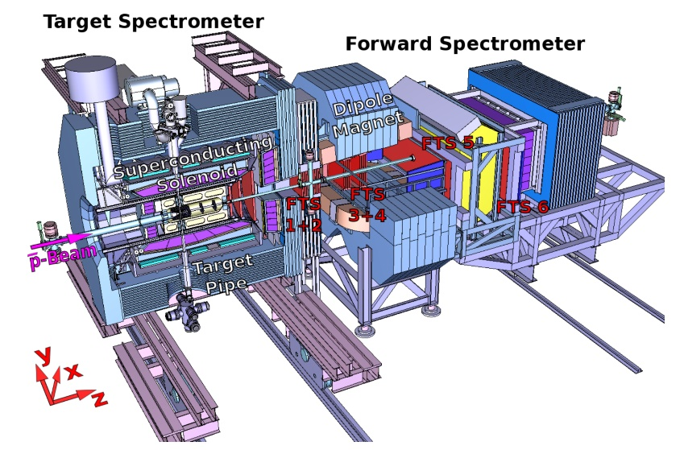
Fast tracking reconstruction
First implementation based on Unsupervised (K-means) and supervised (recurrent neural network) learning
FT5+FT6
FT₃+FT₄
FT₁+FT₂
Forward tracker detectors based on straw tube detectors
Courtesy: Waleed Esmail (Forschungszentrum Jülich) and Weijia Wang

Slide 17
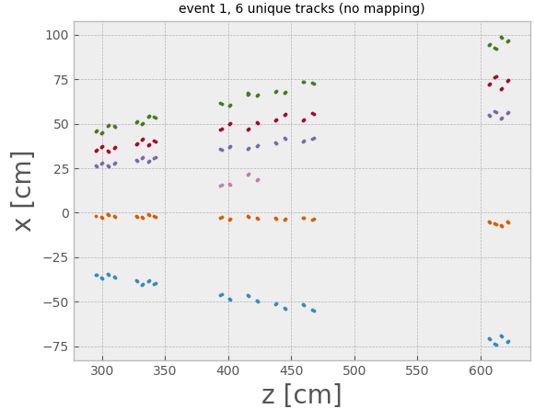
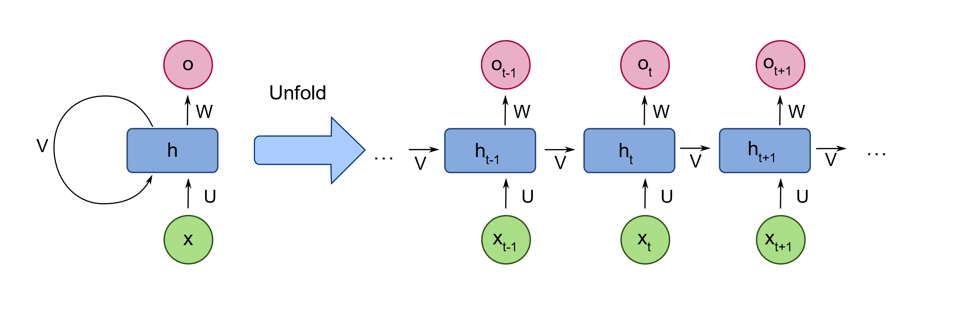
Fast tracking reconstruction
First implementation based on Unsupervised (K-means) and supervised (recurrent neural network) learning
  STEP 1: Create Track Segments by using K-means clustering algorithm
FT3+FT4
FT₁+FT₂
FT5+FT6
  STEP 2: interpolate the track segments from the different parts of the FTS to form a full track candidate, it is based on a Recurrent Neural Network (RNN)
FT5+FT6
FT₃+FT₄
FT₁+FT₂
Forward tracker detectors based on straw tube detectors
Courtesy: Waleed Esmail (Forschungszentrum Jülich) and Weijia Wang

