Slide 1
Timing and Fast Control @ ITIV
Vladimir Sidorenko

Slide 2
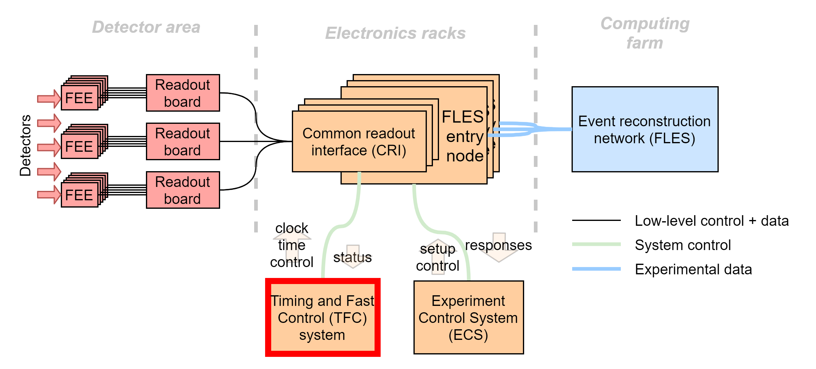
TFC - mission
(Re)synchronise data acquisition hardware with ~1 ns accuracy
Perform system-wide flow control with round trip latency <10 us
Scalable - >> 100 nodes

Slide 3
Problem structure
Bringing it all together in one architecture
Clock and timing synchronisation
Low-latency networking
Timestamp sync
Traffic prioritisation
Upstream packet switching
Phase / frequency alignment
Low latency link access
Expertise from other projects can be reused with modifications
Requires a completely original solution

Slide 4
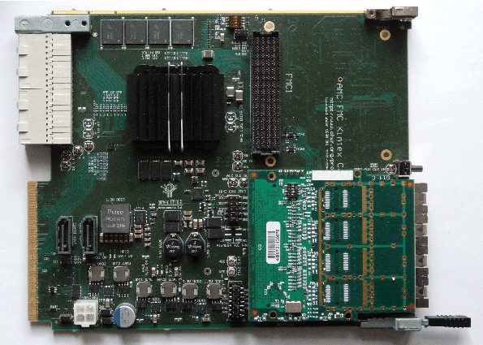
pre-TFC1
Features:
Flexible Soft-PLL with accurate all-digital phase measurement
Dual PI controller for parallel frequency and phase lock
Platform: AFCK
(Kintex-7)

Slide 5
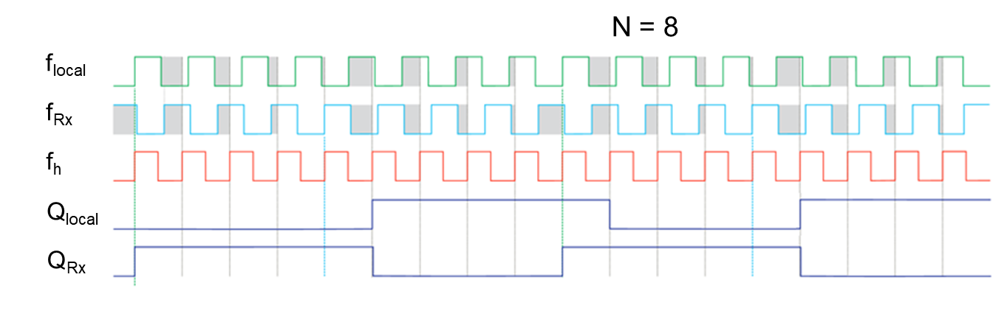
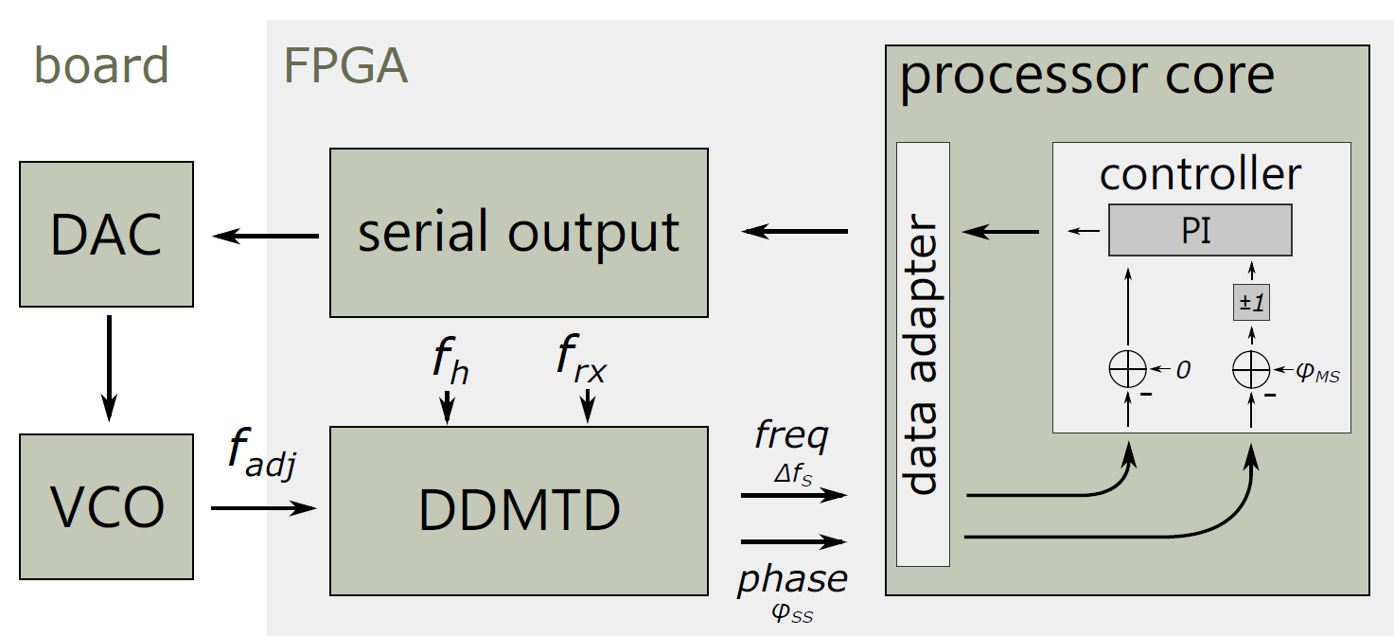
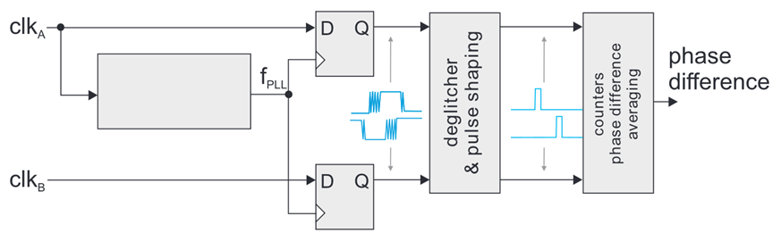
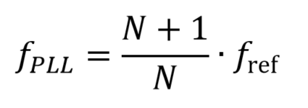
SoftPLL
Allows for easy implementation of complex control algorithms in C

Slide 6
pre-TFC2
Features:
Hard-PLL for frequency and phase alignment
Original link access unit design for prioritised link access with no dead time
Traffic prioritisation in Link Access Unit (LAU)

Slide 7
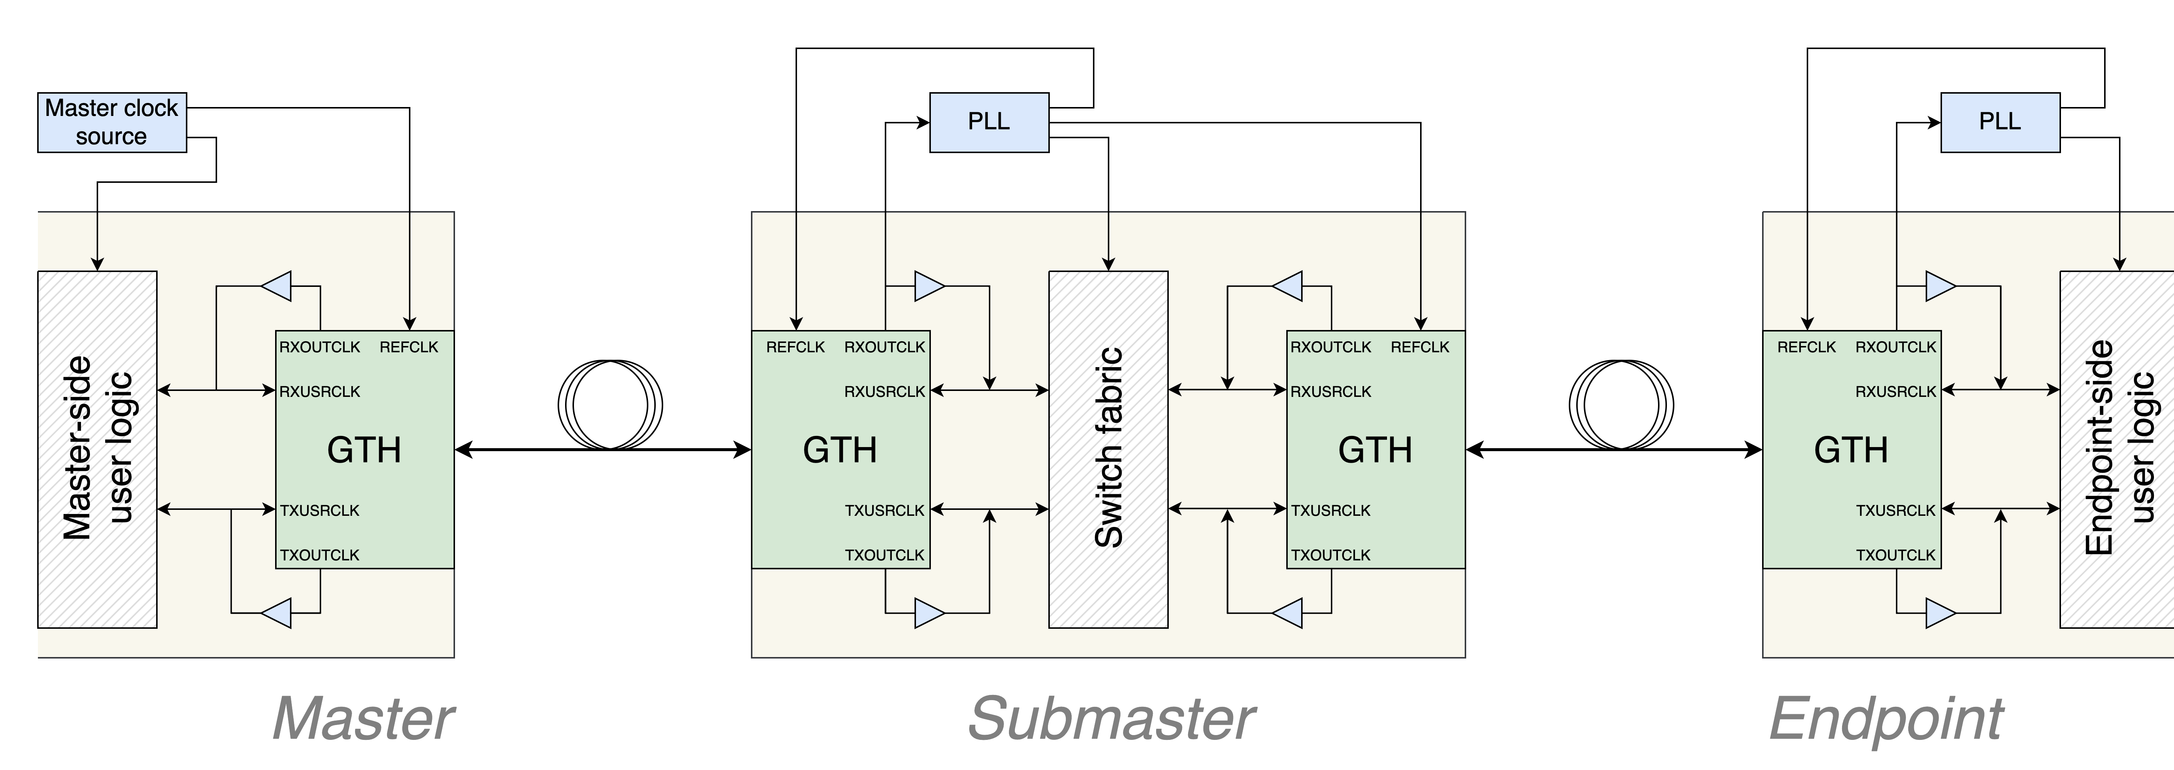
pre-TFC2
Negotiation-based timestamp synchronisation (delay-compensated)
Cascaded clock recovery

Slide 8
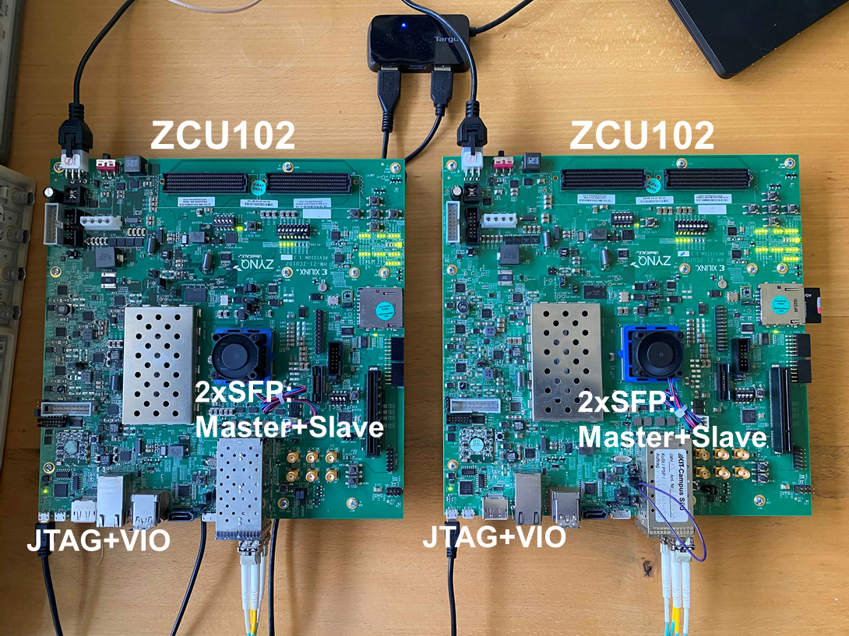
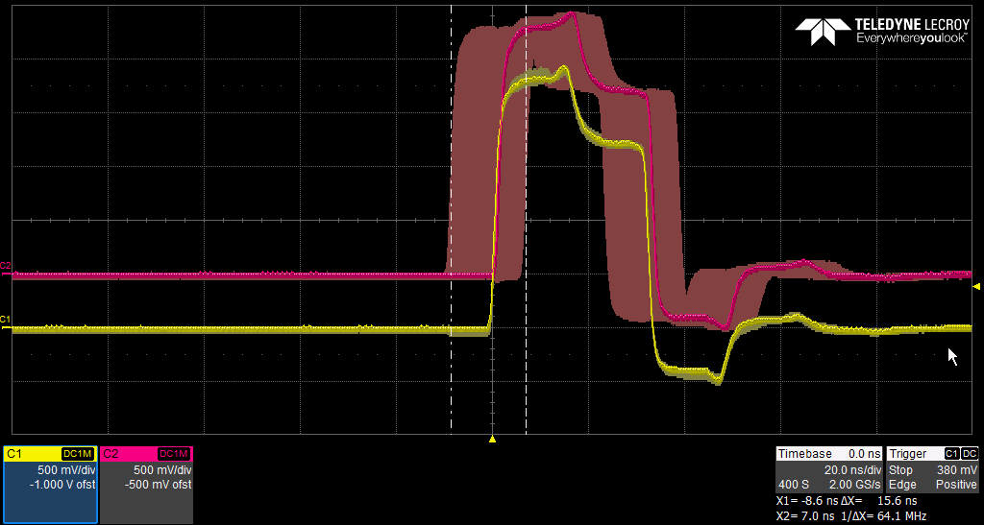
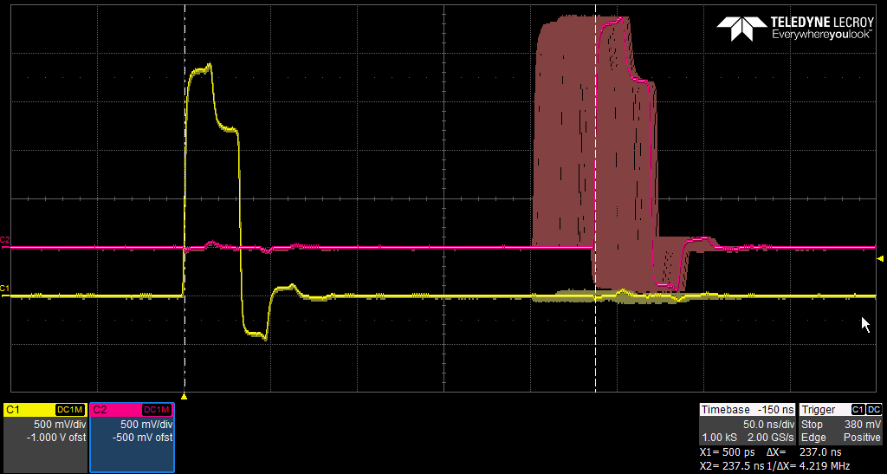
pre-TFC2
Features:
Hard-PLL for frequency and phase alignment
Original link access unit design for prioritised link access with no dead time
Prototype setup (Zynq-US)
First synchronisation and latency measurements (latency ~ 200 ns)

Slide 9
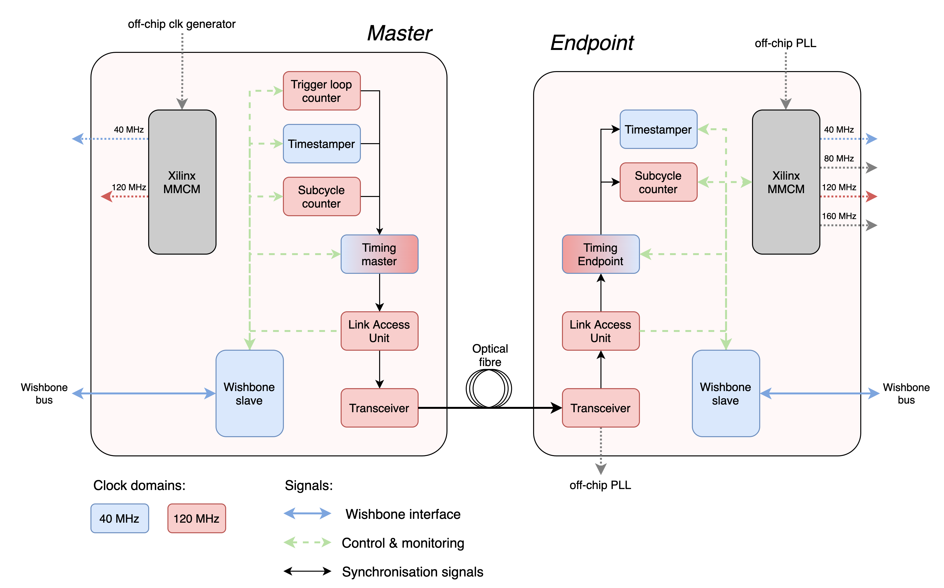
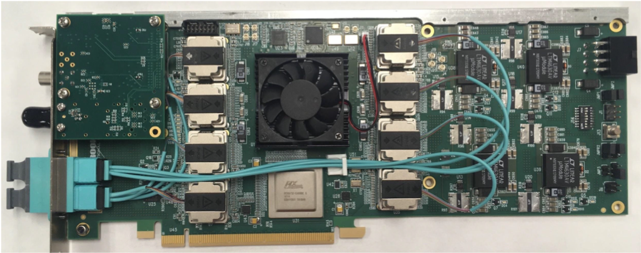
TFC1
Timestamp broadcast scheme
Cascaded clock recovery (hardware PLL)
Rx and Tx FIFOs used
Fully integrated into experimental infrastructure
Prototype firmware architecture
Platform board: BNL-712 (Kintex-US)

Slide 10
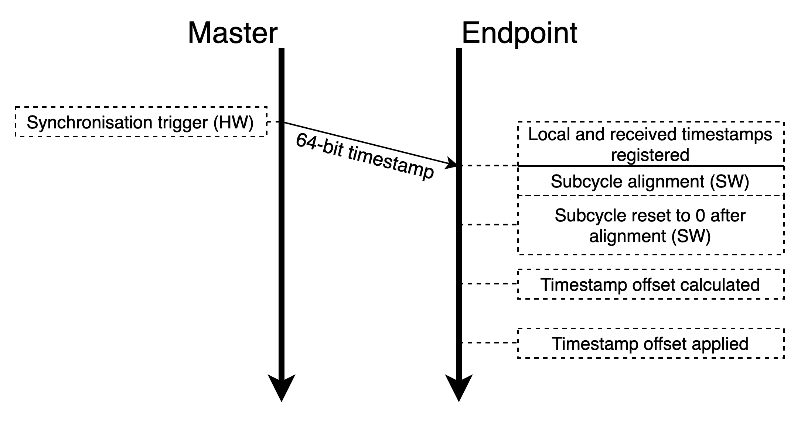
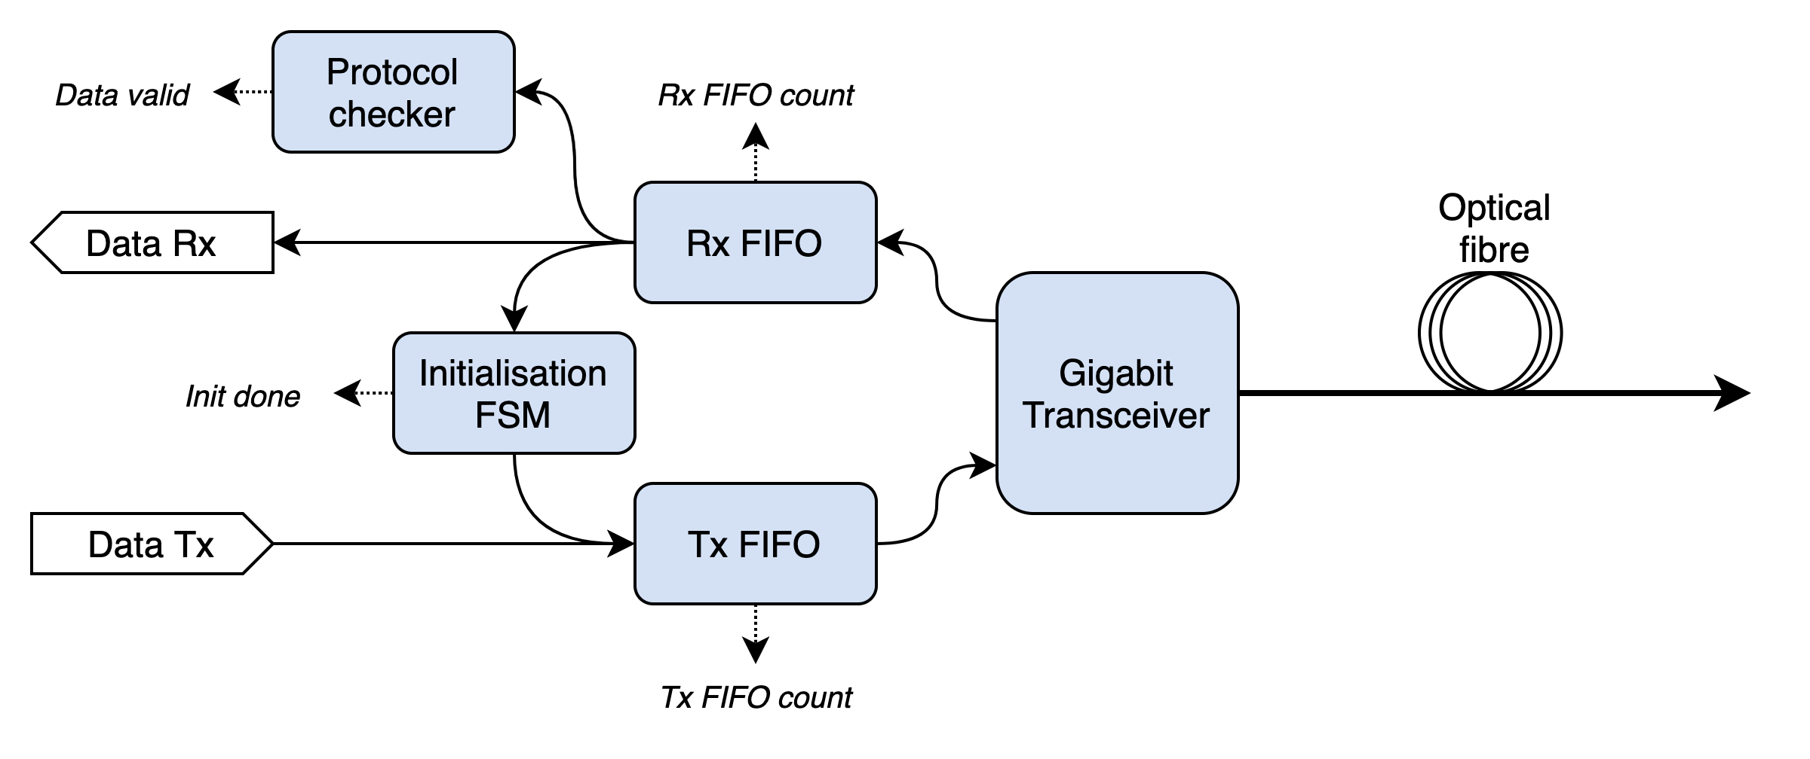
TFC1
Timestamp synchronisation
Link access unit

Slide 11
Next steps (global)
GBT transport interface for out-of-box latency optimisation and determinism
Integrate negotiation-based timestamp synchronisation
Evaluate TClink for fine phase shift tuning

Slide 12
Backup

Slide 13
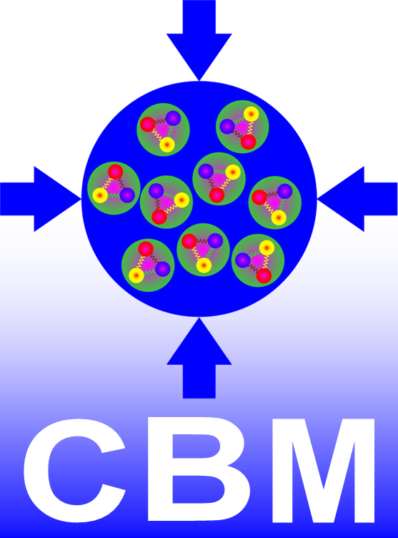
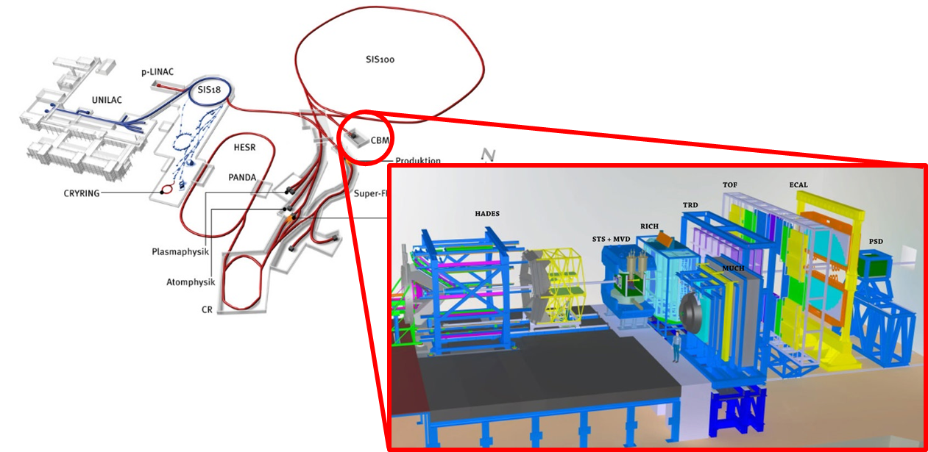
CBM Experiment @ FAIR
Pre-series and series production has started
Experiment commissioning to start in 2025
CBM full system test setup: mCBM experiment at SIS18 is ongoing at FAIR phase 0
Notes:
Add some numerical properties of the experiment
Pictures of closed roof on CBM cave
PANDA and CBM are monolythic
<FAIR Phase 0 (mCBM) ongoing now on SIS18>

Slide 14
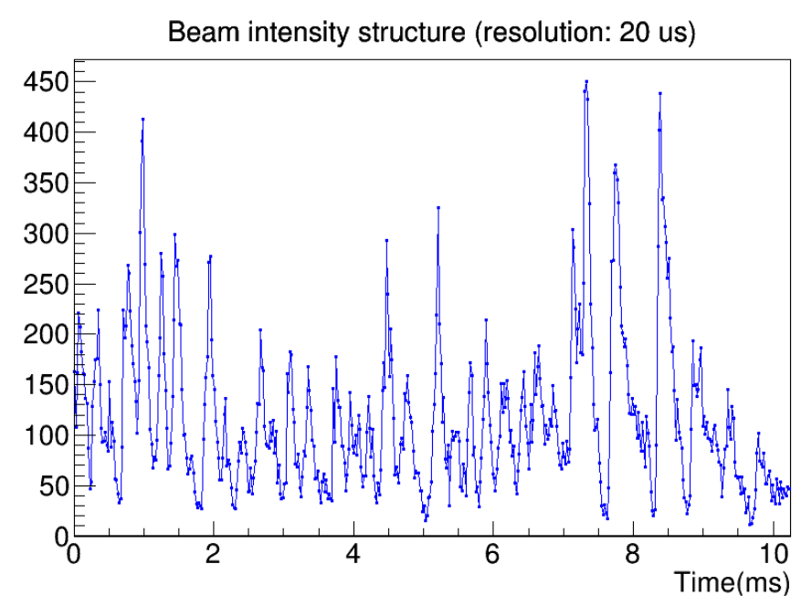

Data Acquisition System
Free-running DAQ (1 TB/s expected)
Self-triggered timestamping front-end
Occasional experimental data spikes
Throttling (study done by X. Gao):
Versatile fast control network required
Notes:
DAQ and TFC requirements
Free-running DAQ, platform boards
Long-term goal of TFC
Short-term essential requirements for the beam-time
Beam intensity plot:
HADES 2019
GBT links:
STS – 1728 links
TRD – 1152 links
TOF – 632 links
~5k links total

Slide 15
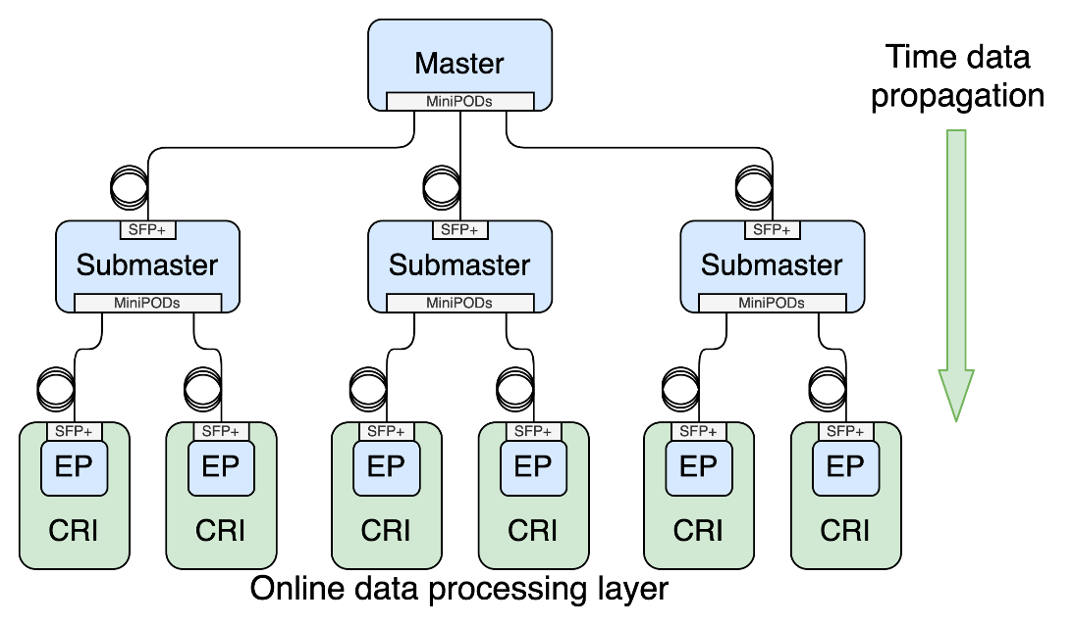
Topology

Slide 16
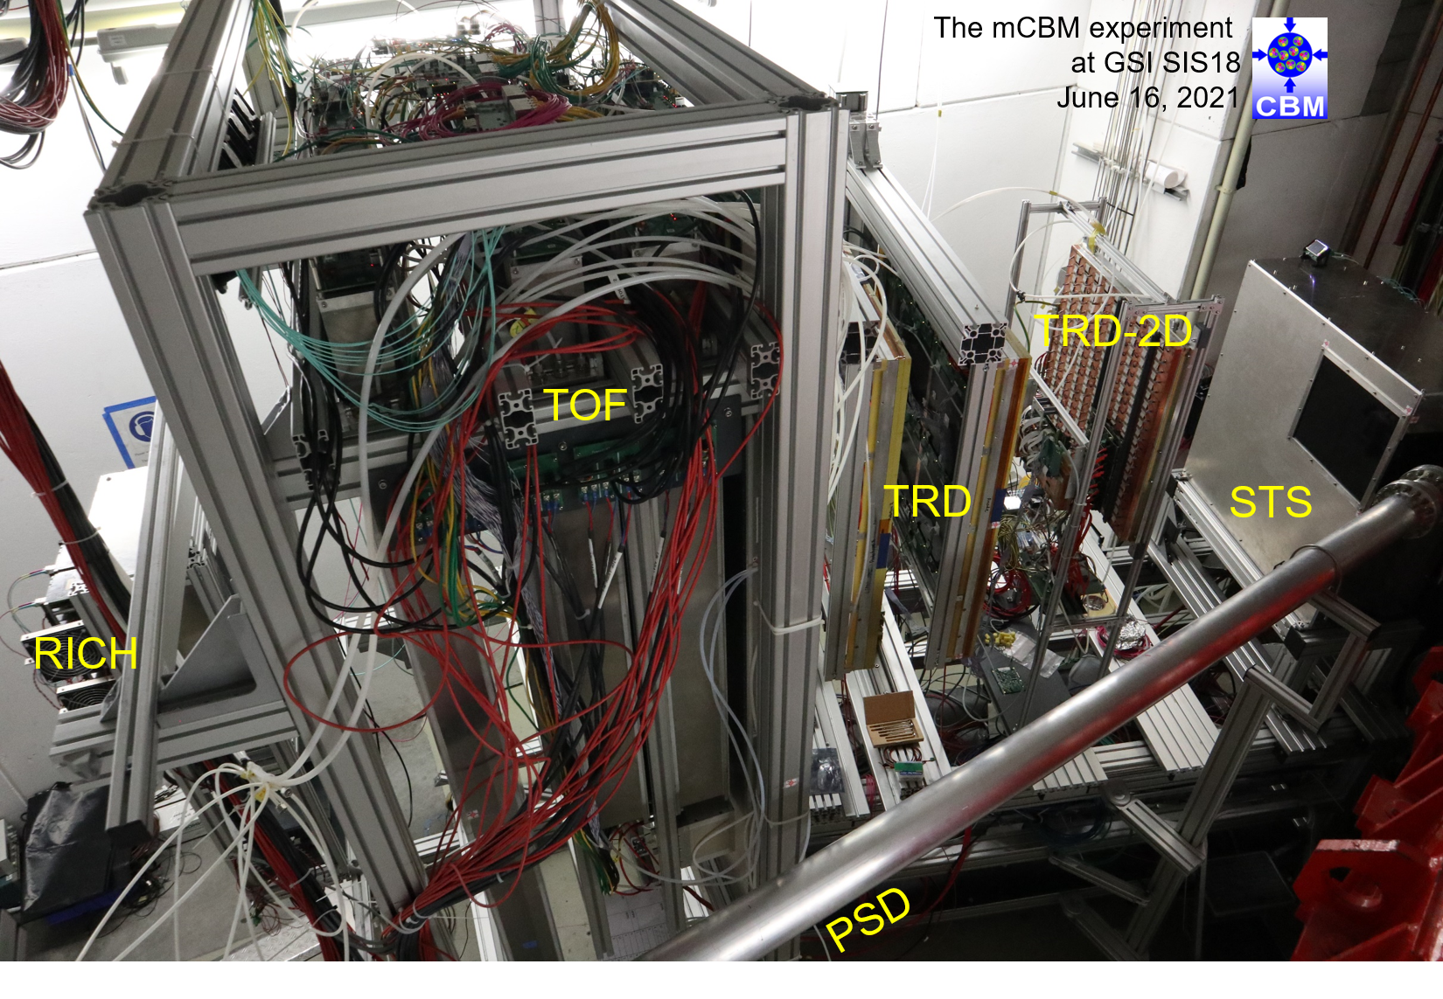
TFC1 beam test
DAQ+TFC rack

Slide 17
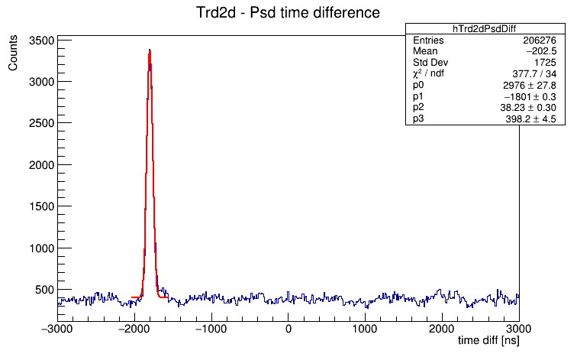
TFC1 beam test

