Slide 1
PANDA_MDC_KIT meeting (30 Sept. 2021)
Agenda
  ToASt readout chip and firmware development (Michele)
  News from Klaus Götzen <k.goetzen@gsi.de>
  Open discussion
  Conclusions and what’s next

Slide 2
PANDA-MDC-KIT Sept. 30th (2021)
ToASt readout chip and firmware development
Michele Caselle
Notes:
Good afternoon everyone. My name is Andrea Santamaria Garcia, I’m a research associate here at KIT and I will be presenting our artificial intelligence activities for accelerators.

Slide 3
Silicon Strip Detector
Readout architecture
…
Counting room
(Real-time)
Double-sided strip modules
Outside active volume
ToASt
MDC
(Module data Concentrator)
e-links
ToASt
…
ToASt
GBT
MMB
(MVD Multiplexer Board)
ToASt
MDC
(Module data Concentrator)
e-links
GBT
ToASt
…
…
ToASt
optical link
ToASt
MDC
(Module data Concentrator)
e-links
GBT
ToASt
…
MMB
(MVD Multiplexer Board)
ToASt
GBT
Sensor
ToASt
e-links
MDC
(Module data Concentrator)
…
ToASt
…
…
SODANET
ToASt
FEE- ASICs
Local controller ASICs

Slide 4

Silicon Strip Detector
Readout architecture
…
Counting room
(Real-time)
Double-sided strip modules
Outside active volume
ToASt
MDC
(Module data Concentrator)
e-links
ToASt
…
First step is the development of the MDC ASICs
ToASt
GBT
MMB
(MVD Multiplexer Board)
ToASt
MDC
(Module data Concentrator)
e-links
GBT
ToASt
…
…
ToASt
optical link
ToASt
MDC
(Module data Concentrator)
e-links
GBT
ToASt
…
MMB
(MVD Multiplexer Board)
ToASt
GBT
Sensor
ToASt
e-links
MDC
(Module data Concentrator)
…
ToASt
…
…
SODANET
ToASt
FEE- ASICs
Local controller ASICs

Slide 5
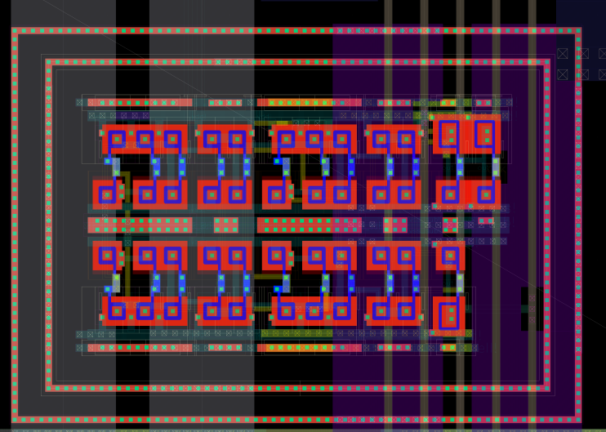
Module Data Concentrator (MDC) - ASICS
P⁺ Guardring
  Developed in UMC 110 nm with rad-hard layout
  Digital logic based on Triplicated Modular Redundancy (TRM) for Single Event Upset mitigation
  First implementation on FPGA to prove the digital behaviour
Hardening by layout:
Enclosed Layout Transistor (ELT)
P⁺ guarding
Rad-hard logic
Gotthard chip developed at KIT
PASTA
front-end ASICs
OUT

Slide 6
Silicon Strip Detector
Readout architecture
…
Counting room
(Real-time)
Double-sided strip modules
Outside active volume
ToASt
MDC
(Module data Concentrator)
e-links
ToASt
…
First step is the development of the MDC ASICs
  1) development of the MDC on FPGA
  2) qualification of the digital behaviour
  3) Appling the Triple modular redundancy (TMR) SEU logic protection by https://tmrg.web.cern.ch/tmrg/
  4) final validation of the logic behaviour
  5) migration of the netlist → CADENCE virtuoso
ToASt
GBT
MMB
(MVD Multiplexer Board)
ToASt
MDC
(Module data Concentrator)
e-links
GBT
ToASt
…
Sensor
…
ToASt
optical link
ToASt
MDC
(Module data Concentrator)
e-links
GBT
ToASt
…
MMB
(MVD Multiplexer Board)
ToASt
GBT
ToASt
e-links
…
MDC
(Module data Concentrator)
ToASt
…
…
SODANET
ToASt
FEE- ASICs
Local controller ASICs

Slide 7
ToASt – front-end chip
ASIC architecture
ToASt = Torino Amplifier for Strip Detectors
64 input channels
  Organized in 8 regions (local FIFO)
  Second level FIFO buffering for the 8 regions
Master clock: 160 MHz
Two output serial links @ 160 Mb/s
Configurations and slow-control
  Global configuration unit
  Local configuration unit
Talk: Gianni Mazza @ The PANDA DAQ Workshop (06 - 07.10)

Slide 8
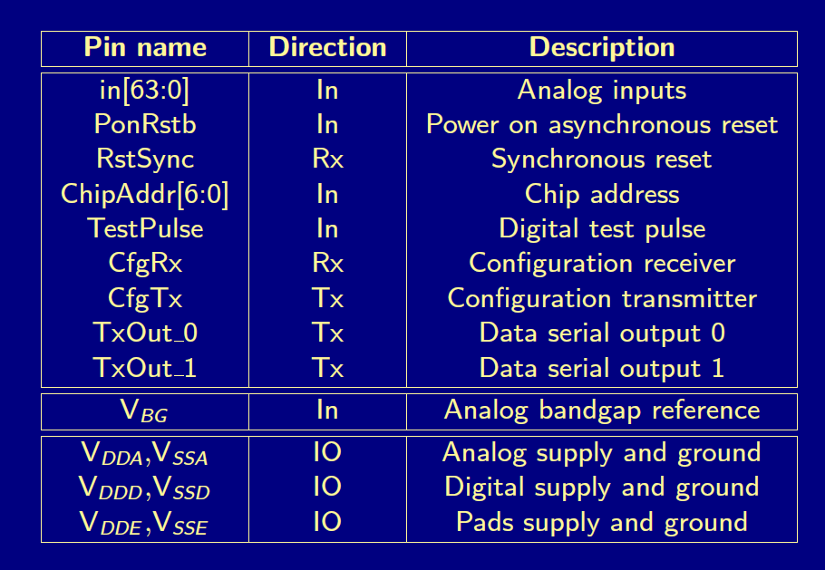
ToASt – front-end chip
ASIC architecture
We got the ToASt documentation/manual
Gianni is preparing the HDL behaviour of the ToASt
  Configuration & slow-control
  Development of the Input SERDES
  Resets and clocks distribution
Development of the firmware in pure HDL code, NO any IP-cores

Slide 9
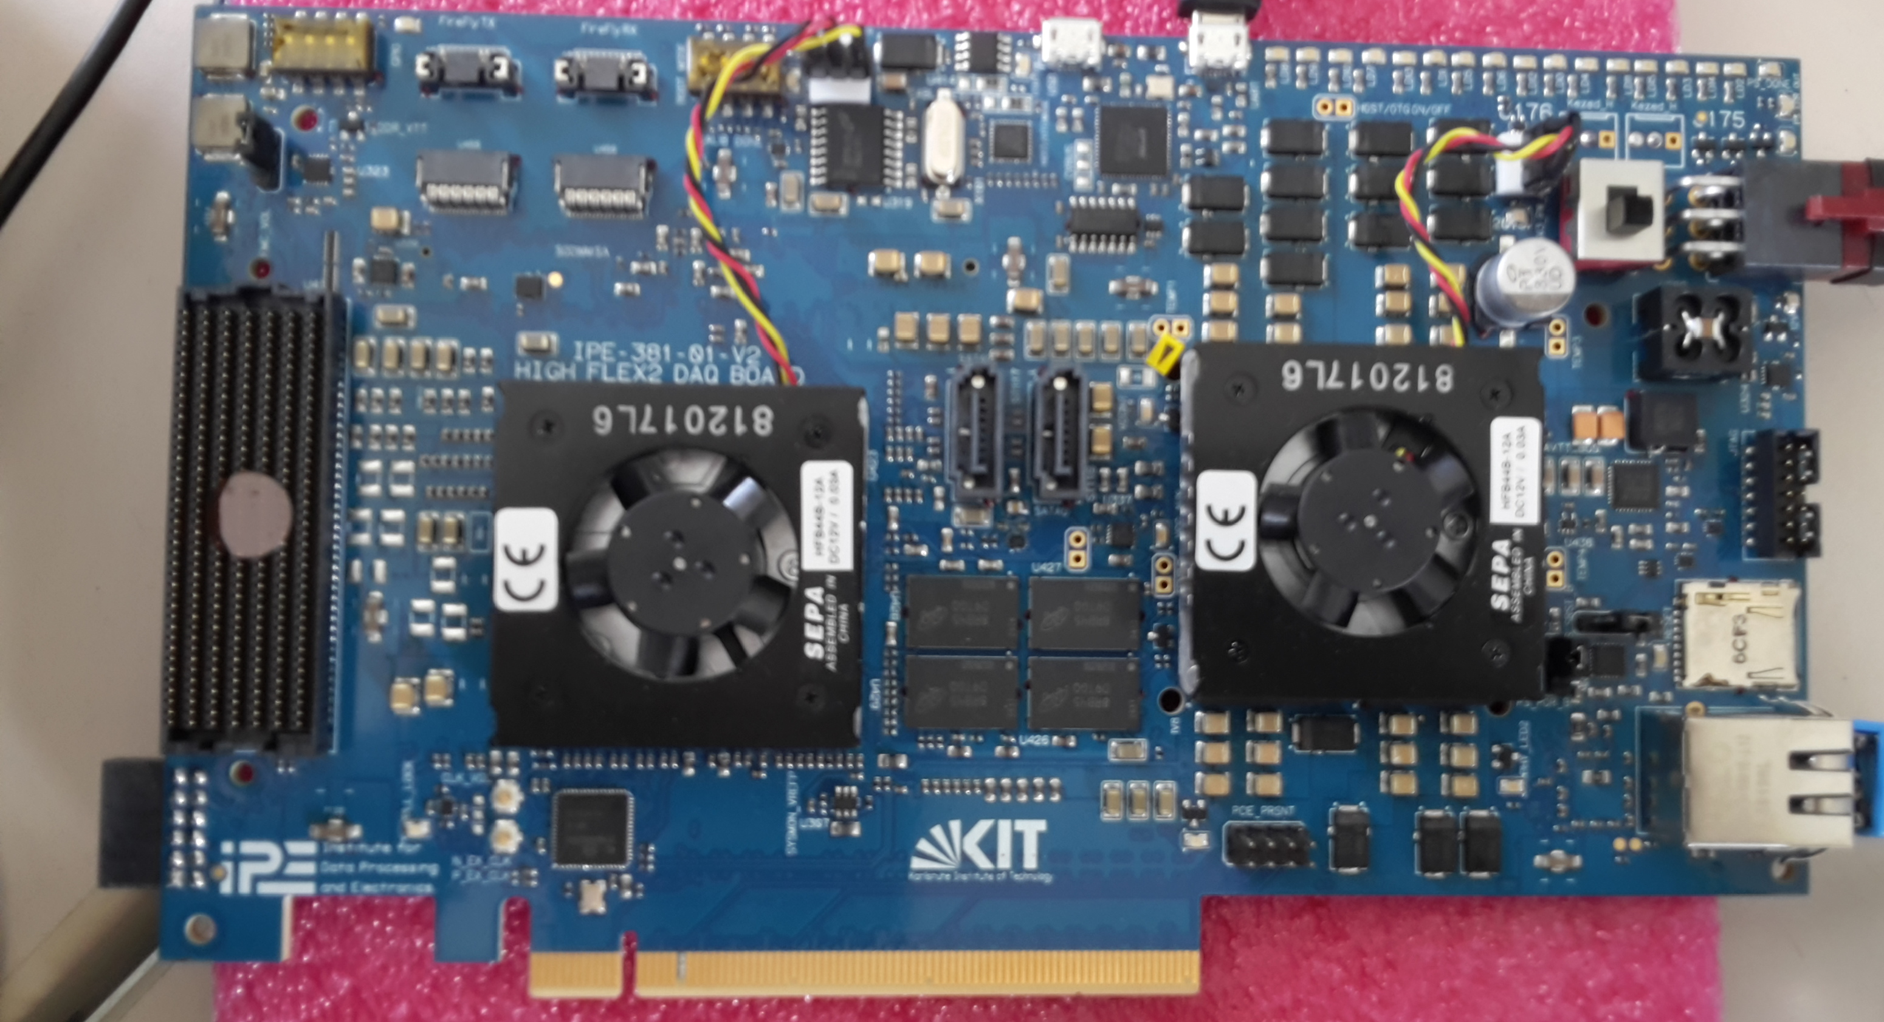
FPGA platform & test bench
FPGA platform for the MDC and the prototyping of the full readout chain
HighFlex2 vers. 2
FPGA platform selected for the beam test at COSY
US+ Zynq
12x Firefly optical connections (full-duplex)
FMC+ fully populated
PCIe gen 3 x 16 lanes
ETH, USB and UART, SDCard by PS
Possible #2 SATA (SSD)
etc…

Slide 10
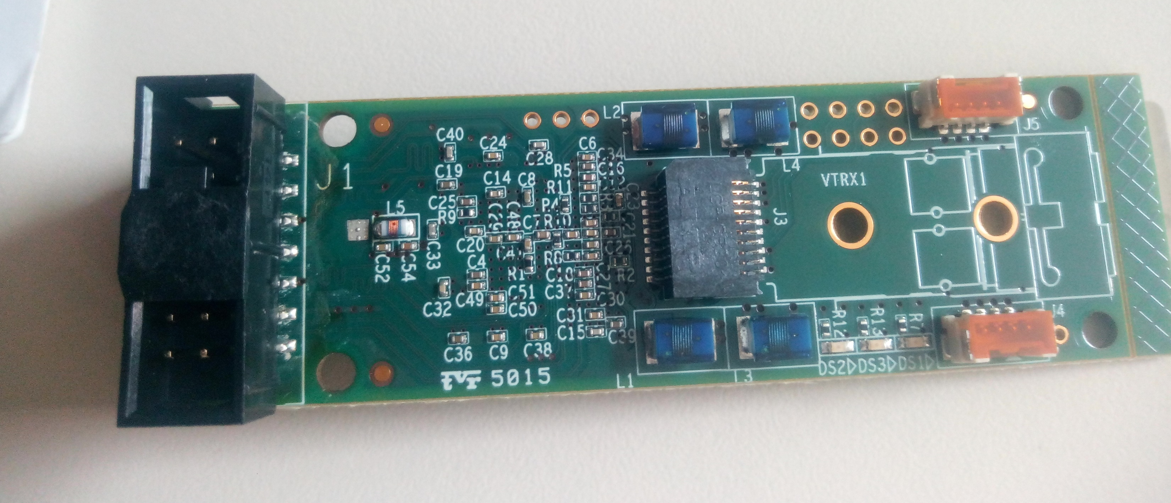
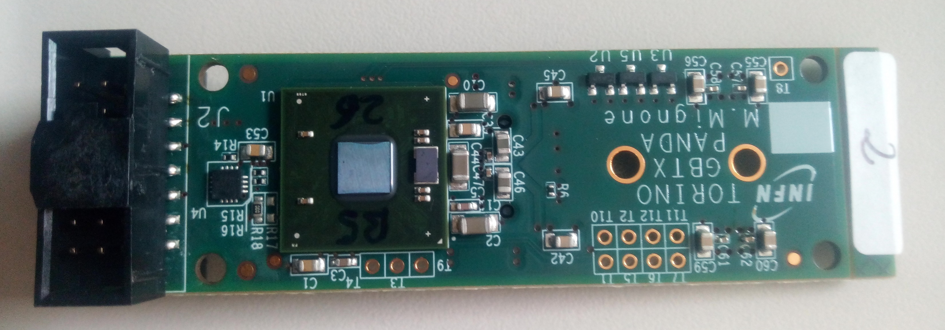
Optical communication
GPTx + Versatile link from Turin
We have also the schematic
The card will be available at IPE, soon

Slide 11

Readout chain demonstrator
Test Bench and test beam at COSY
To mimic the MMB
To mimic the MDC
e-links (320Mb/s)
ToASt
ToASt
FMC
…
GBT
ToASt
Baby module
Second HighFlex2 or Xilinx eval. based on US+ Zynq
From Turin
InfiniBand
Two possible options:
DirectGPU technology already available
RoCE (Xilinx PG332)
Server node
Server nodes equipped with commercial and powerful hardware (CPU/GPU/FPGA)

Slide 12
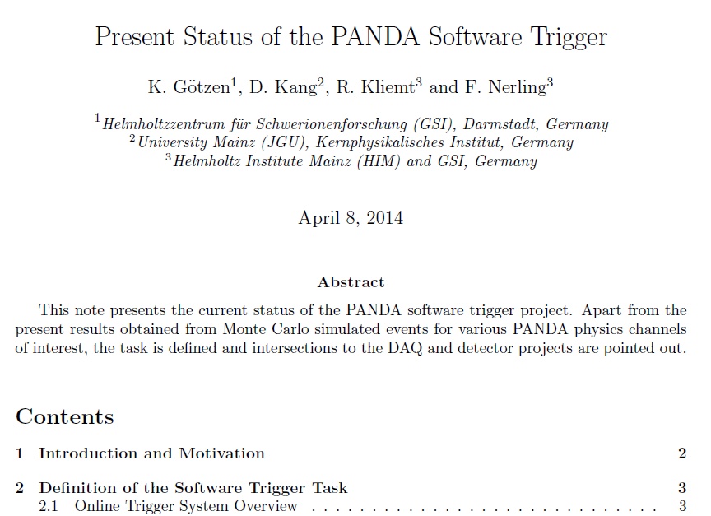
Fast-tracking and event discrimination by AI
Collaboration with software-trigger group of PANDA
Group leader: Klaus Götzen <k.goetzen@gsi.de>
  getting started here is a talk of my last comprehensive summary:
  https://sf.gsi.de/f/b834d39993804432b60a/?dl=1
  Event selection with Deep Machine Learning. He actually compared directly to our first proof-of-principle study with 10 channels (see https://panda.gsi.de/system/files/user_uploads/k.goetzen/IN-REP-2014-001.pdf)
Greta Heide has master student at IPE
  Prof. Ferber, Torben (ETP) torben.ferber@kit.edu
  Second ad. Michele

