Slide 1
INNOVEEA
Activities at HZB
Annual INNOVEEA meeting 10th Nov 2021
O. Kugeler, HZB
WP2
SRF technology

Slide 2
Sustainability goal: Efficient SRF operation in cw mode
INNOVEEA
Improve sustainability of niobium cavities for 2-K operation
Eliminate / reduce hazardous HF treatment
Reducing the RF surface resistance: e.g. nitrogen infusion
Develop systems for 4-K+ operation
conduction cooling of SRF cavities rather than LHe
proof-of-principle experiments, on samples
proof-of-principle experiments with simple cavity and some RF
use of new superconductors … development as part of collaborations, i.e. EU-ARIES, BMBF-SMART, EU-IFAST, BMBF-NOVALIS (proposed)
complimentary to in-house research (QPR)

Slide 3
Tasks
Electrodeposition of copper onto Nb (talk Alena Prudnikava)
HF free etching of Nb
Conductive cooling with Cu plated Nb (joint effort with KIT)

Slide 4
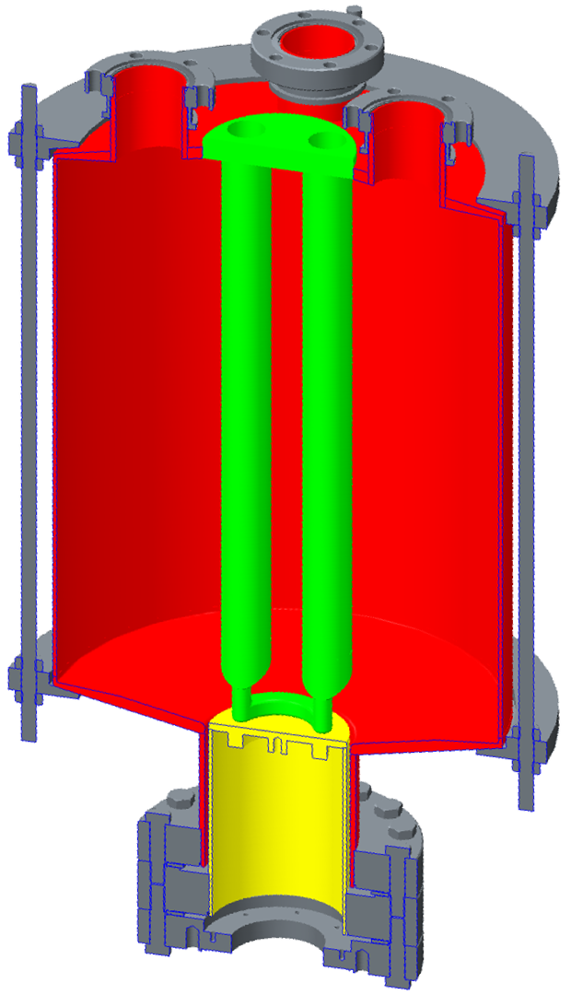
Task 2: Quadrupole Resonator (QPR)
INNOVEEA
LHe
Pumping port
Coupler ports
Tool at HZB to characterise RF performance of flat samples (415, 845, 1285 MHz)
Operated in vertical cryostat
LHe bath at 1.8 K
Coaxial structure
thermal decoupling
calorimetric measurement of surface resistance
T_{Sample} = 1.8 K … > 20 K
B_{Sample, max} $≈120 mT$ (415 MHz) ~$30 MV/m$ (TESLA)
Cavity (Nb)
4 hollow
rods (Nb)
Pole shoes
Sample
Coaxial gap
Frame
(SS, Ti)
Calorimetry chamber

Slide 5
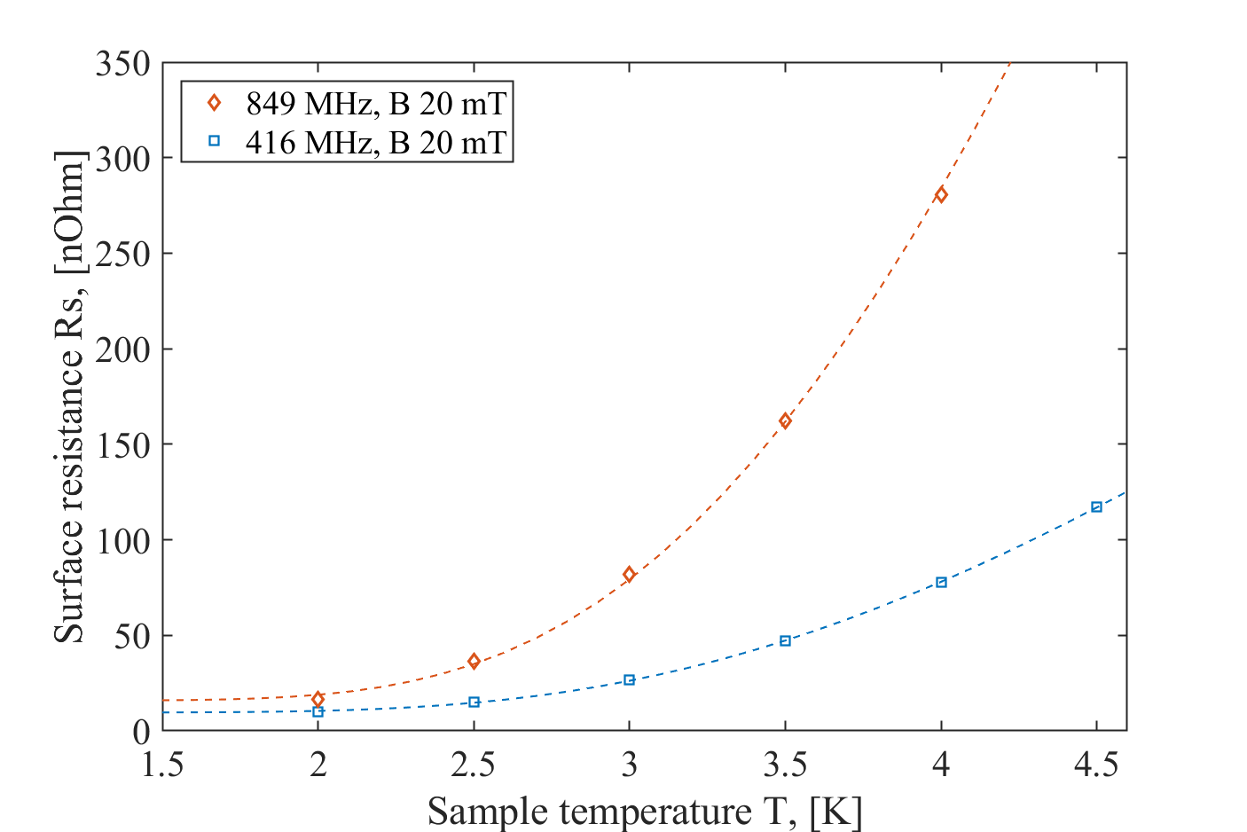
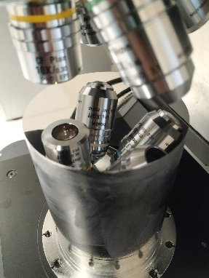
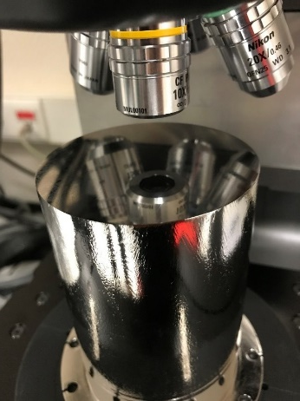
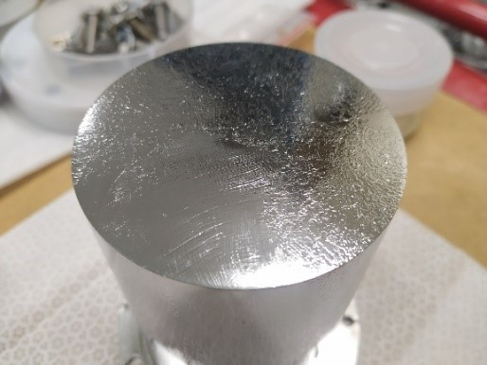
WP2: HF free etching of Nb
INNOVEEA
Investigating metallographic polishing in collaboration with CEA to evaluate possibility of omitting electrochemistry step in the cavity surface preparation recipe.
QPR sample milled from ASTM0 large grain material
S_{a} = 7 µm
Poor RF performance
Mirror polishing at IJCLab
S_{a} = 0.5 µm
After EP 150 µm + annealed at 900°C under vacuum + EP 20 µm at CEA
S_{a} = 1 µm
Great RF performance of baseline sample
(9 Ohm residual resistance at 416 MHz)
Pictures courtesy Oleksandr Hryhorenko
Omit this step and re-evaluate performance

Slide 6
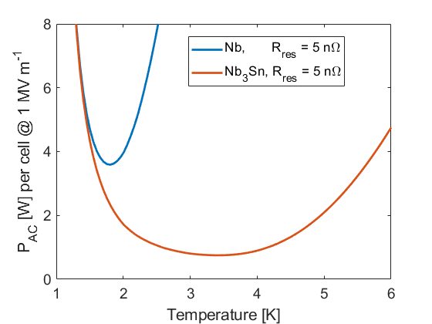
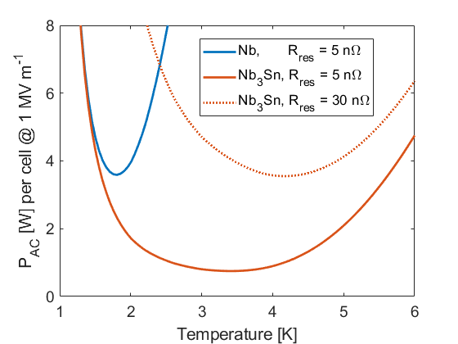
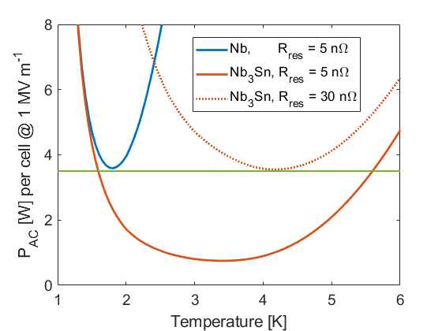
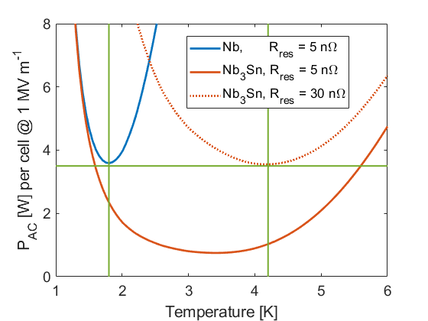
Task 3: Beyond the limits of niobium
Reducing the RF surface resistance
$$R_{S}≈\frac{A}{T}ω^{2}\exp\left(−\frac{Δ}{k_{B}T}\right)+R_{res}$$
New materials: Large sc energy gap $Δ$, large $T_{c}$
Control residual resistance $R_{res}$
Intrinsic contribution?
Cooling conditions, trapped flux
Prevent early vortex penetration
Multilayer structures
 | $$T_{c}$$ | $$Δ$$ | $$λ_{L}$$ | $$ξ_{0}$$ | R_{BCS} @ 1.8 K | R_{BCS} @ 4.2 K
Nb | 9.25 K | 1.5 meV | 39 nm | 32 nm | 3 nΩ | 763 nΩ
Nb₃Sn | 18 K | 3.4 meV | 90 nm | 7 nm | << 1 nΩ | ≤ 12 nΩ
NbTiN | 17.3 K | 2.8 meV | 150 -200 nm | 5 nm | << 1 nΩ | ≤ 60 nΩ

Slide 7
Task 3: Conduction cooling of SRF cavities
InnoveEa
Transition to cooling media:
Braze or weld connection
Transition/contact between cooling media and e.g. pipe/surface
2x thermal
contacts
Cu coating for heat transport
Nb host cavity (should be avoided if possible)
Nb₃Sn or other SRF material layer
Vacuum (Beam) +RF eigenmode
2x thermal
contacts
In worst case 4 thermal contacts/transitions, which might hinder the heat transport before reaching steady state

Slide 8
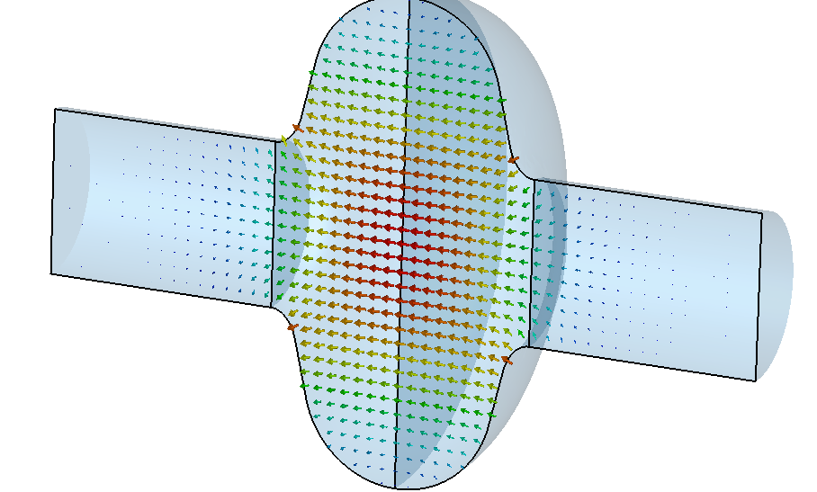
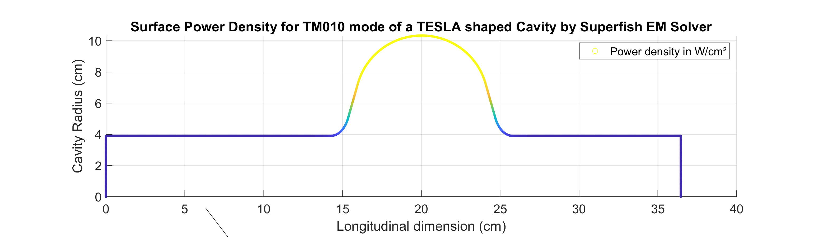
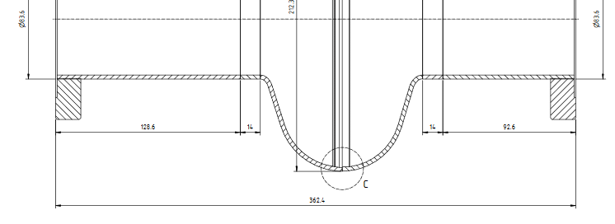
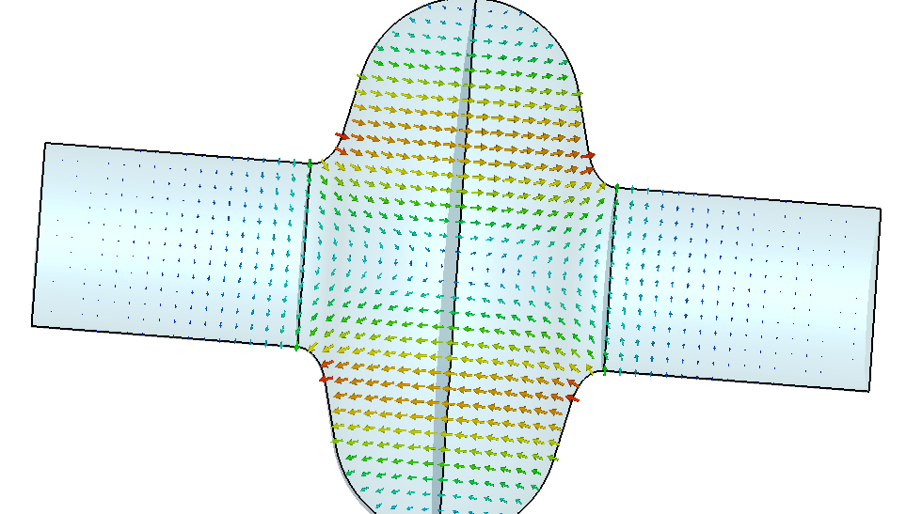
Surface RF losses in SRF Cavities
InnovEea
TM₀₁₀ E-field
TM₀₁₀ type of RF
Eigenmode with axial symmetry in
azimuthal direction: Main mode applied in particle accelerators
Power density [µW/cm²]
TM₁₁₀ E-field
µW/cm²
Parameter: Maximum field on beam axes 28 MV/m, peak surface magnetic field 60 mT Superconducting surface resistance 12.3 nΩ at 1.8 K, total dissipated power 1.1 W → Q₀=2.2e10 Stored energy in mode 3.05 Joule, but there is more about it…..

Slide 9
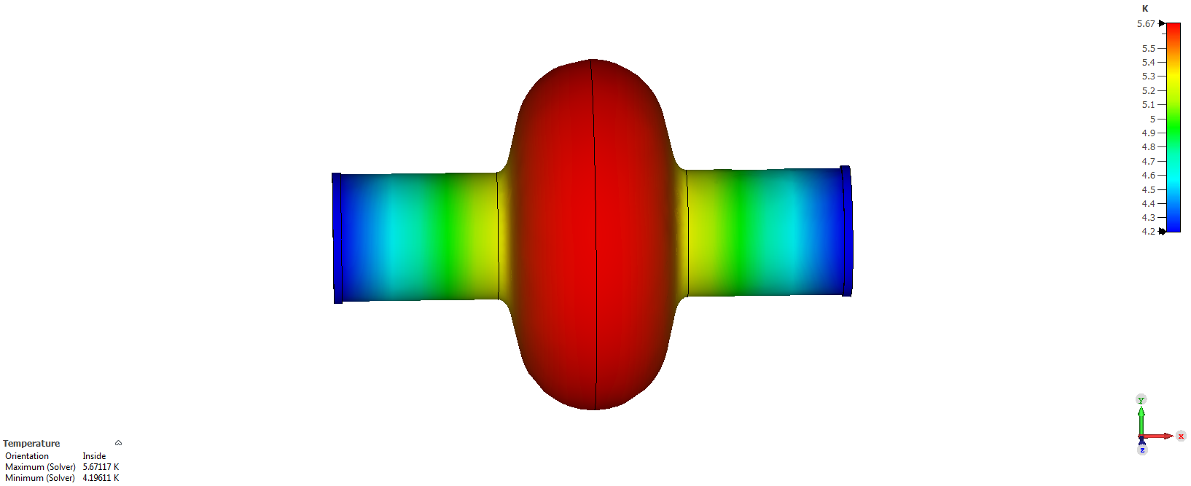
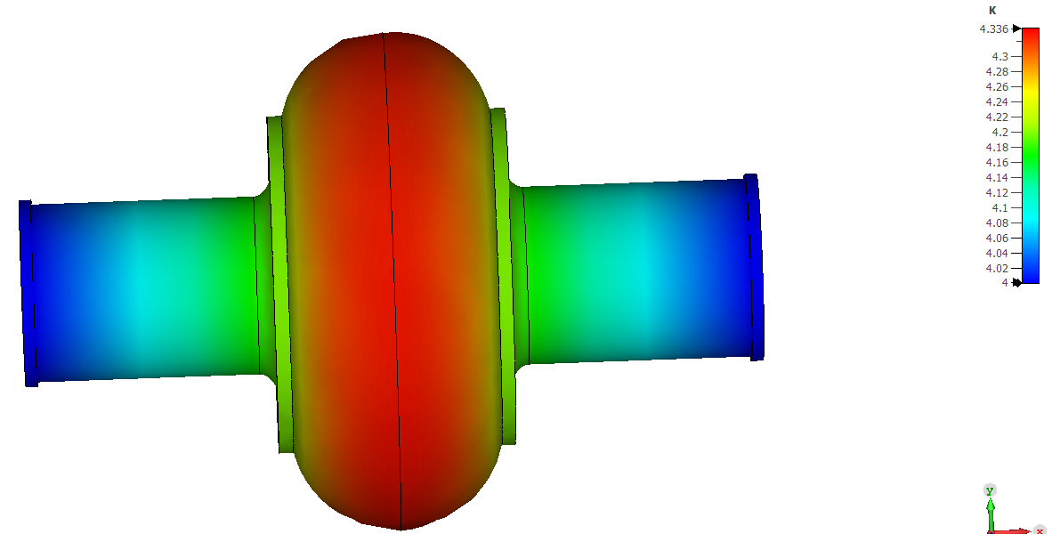
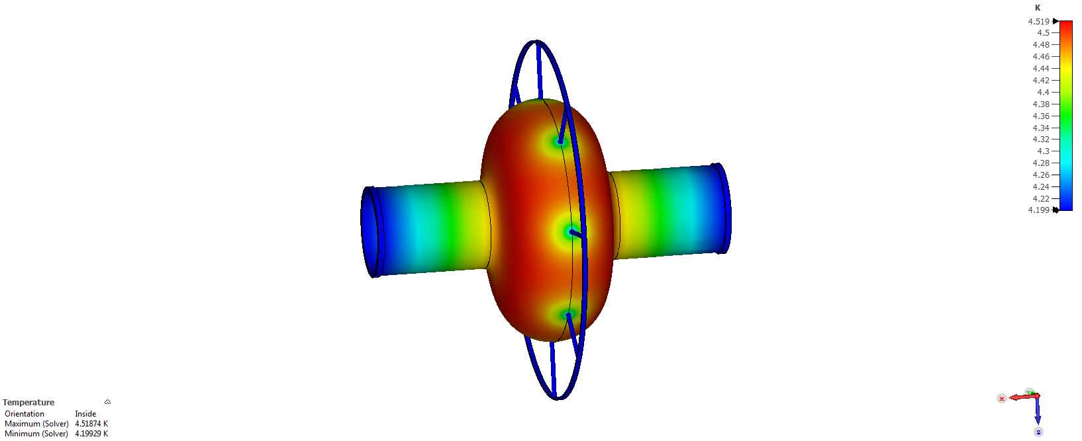
How to cool? Some ideas and basic studies
InnoveEa
1st case: Only 0.75 mm Cu thick (!) coating and beam tube end flange cooling to 4.2 K
2nd case: “End-cooling” and additional
Cooling at stiffening ring position, Cu coating (0.75mm) only between
Cooling rings
T_{max}~5.6 K
T_{max} ~ 4.3 K
→ Losses increase by factor of 3
→ Thermal runaway?
Dissipated average power total surface 4.3 W in all cases
3rd case: “End-cooling” plus some 2 mm diameter Cu connectors
to 4.3 K ring every 45 degree
Equator cooling connectors might be flexible braids later
Cu coating (0.75 mm)
→ Good enough for dynamic response?
T_{max}~4.5 K
Note: All simulations static, cooling boundaries fixed to 4 K, adiabatic boundaries to all directions, no thermal feedback
of dissipated power vs. surface resistance as a function of temperature, no assumption of thermal contact properties

Slide 10
Thank you.
INNOVEEA
Acknowledgement
Contributions from:
Oleksandr Hryhorenko, Dmitry Tikhonov, Axel Neumann, Sebastian Keckert

