Slide 1

The DWARF Network
Michael Backes
University of Namibia
Department of Physics
9th December 2016

Slide 2

The DWARF Network
Michael Backes
University of Namibia
Department of Physics
9th December 2016

Slide 3

Monitoring workshop I
20/10/2009
Place???
Date???

Slide 4
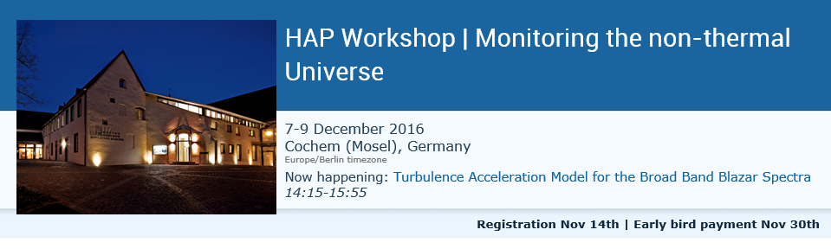
Monitoring workshop I
20/10/2009

Slide 5

Monitoring workshop II
20/10/2009

Slide 6
Monitoring workshop II
20/10/2009

Slide 7


Long-term monitoring of Blazars – the DWARF network
Blazars hosting Binary Black Holes?
Blazars as hadronic accelerators?
Monitoring with state of the art IACTs?
DWARF: A global IACT network
Michael Backes
Acknowledging support of
HELMHOLTZ Alliance for Astroparticle Physics (HAP)
Astronomische Gesellschaft (AG)
...all previous presenters, I borrowed slides from!

Slide 8
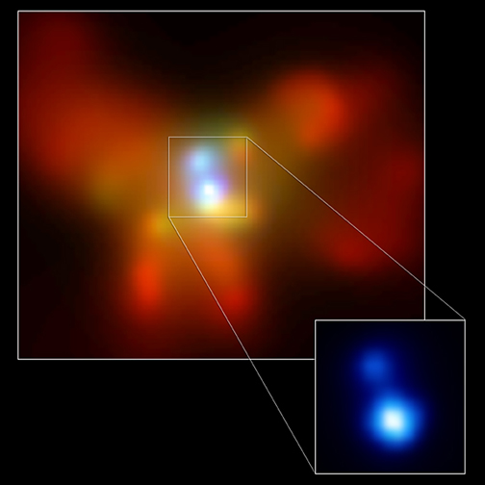
Binary BHs in AGN I: Evidences
Natural expectation of hierarchical galaxy formation [e.g. Begelman⁺80]
Discovery wide BBHs (left)
Merger kick-off by asymmetric graviatational wave emission [Komossa⁺08]
Discovery of 1 narrow BBH (7pc) [Rodriguez⁺09]
Are there close to coalescense sub-pc scale BBHs?
Chandra:
NGC 6240: z=0.024; d~1.4kpc, 2 active Nuclei [Komossa⁺03]

Slide 9
Binary BHs in AGN I: Evidences
V [km/s]
Natural expectation of hierarchical galaxy formation [e.g. Begelman⁺80]
Discovery wide BBHs (left)
Merger kick-off by asymmetric graviatational wave emission [Komossa⁺08]
Discovery of 1 narrow BBH (7pc) [Rodriguez⁺09]
Are there close to coalescense sub-pc scale BBHs?
VLBI: HI-velocity
0402+379: z=0.055; d~7pc

Slide 10
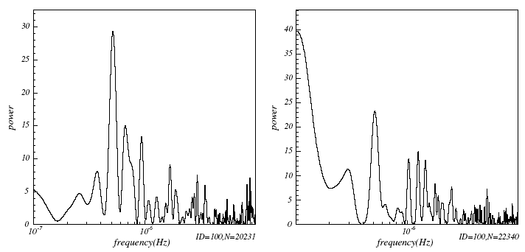
BBHs in AGN II: Blazars
Theory: quasars=narrow BBHs [Lobanov06]
Not resolvable → QPOs
OJ287: 12 yr optical [Sillanpää⁺87, Fan⁺98, Wu⁺06]
Mkn501: TeV& X-ray 23d [Kranich⁺99, Osone06] optical: 100d [Yang⁺08] ‚ ‚new’ TeV & X-Ray: 23, 36 & 72d [Röding⁺09]
Interpretation of TeV-QPO as BBH
[Rieger & Mannheim00, De Paolis⁺02, Rieger07]
Extract mass & distance
  Calculate GW templates
TeV (HEGRA)
23 days
X-ray (ASM)

Slide 11
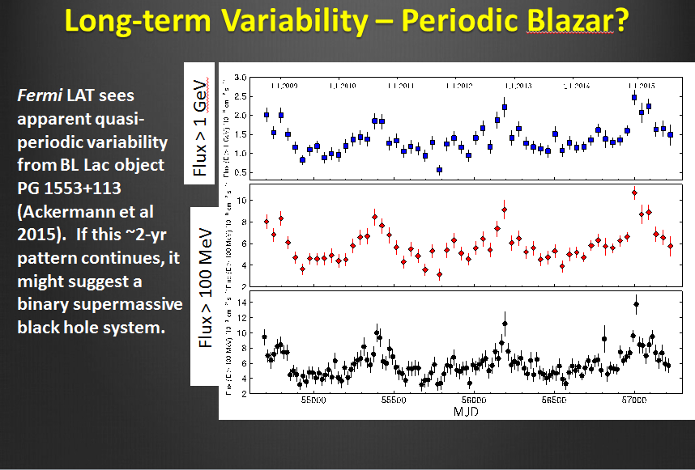
BBHs in AGN II: Blazars
borrowed from Dave Thompson: Monitoring the High Energy Sky:
The Fermi Experience, this workshop

Slide 12
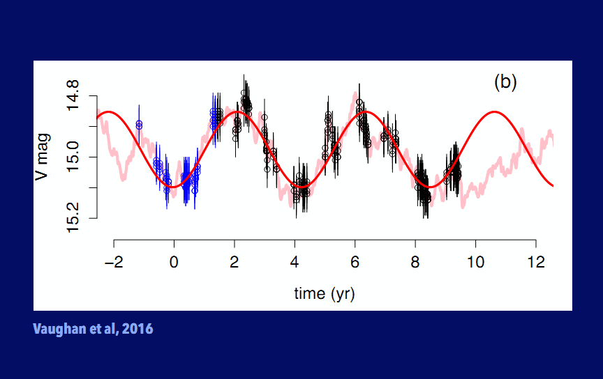
BBHs in AGN II: Blazars
borrowed from Daniela Huppenkothen: Time Series
for the Analysis Multi-wavelength future, this workshop

Slide 13
BBHs in AGN II: Blazars
Observations of several periods mandatory!
borrowed from Daniela Huppenkothen: Time Series
for the Analysis Multi-wavelength future, this workshop

Slide 14
Hadronic jets in AGN?
Orphan TeV flare in 2002 of 1ES1959+650 [Krawczynski⁺04]
„Orphan“ TeV flare in 2004 of Mkn 421 [Blazejowski⁺05]
PKS 2155-304: GeV lightcurve compatible with constant while in TeV highly variable [Aharonian⁺09]

Slide 15
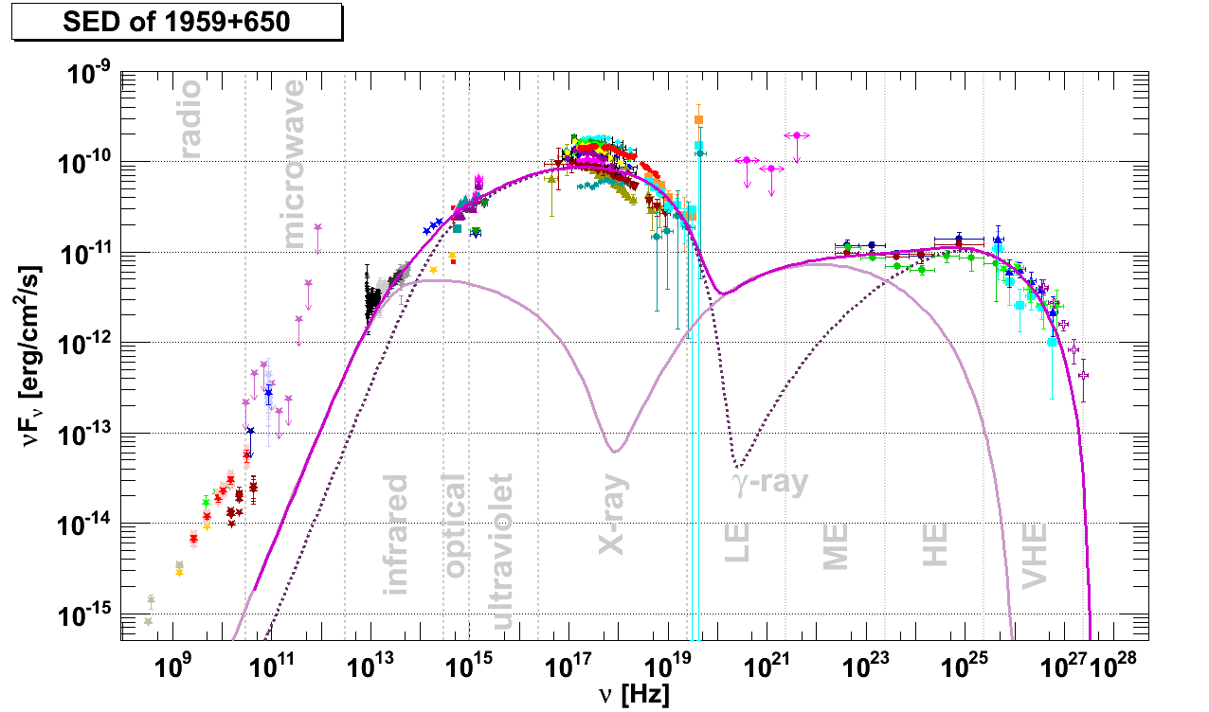
Hadronic jets in AGN?
Orphan TeV flare in 2002 of 1ES1959+650 [Krawczynski⁺04]
„Orphan“ TeV flare in 2004 of Mkn 421 [Blazejowski⁺05]
PKS 2155-304: GeV lightcurve compatible with constant while in TeV highly variable [Aharonian⁺09]
1ES1959+650: indication of different zones [Backes⁺12]
PRELIMINARY

Slide 16
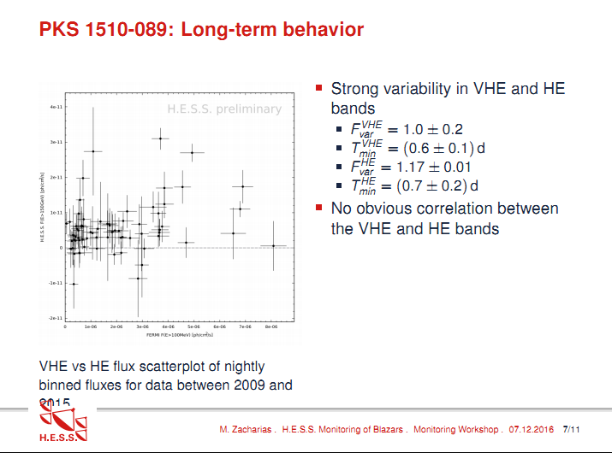
Hadronic jets in AGN?
borrowed from Michael Zacharias: Monitoring of VHE blazars
with H.E.S.S., this workshop

Slide 17
Hadronic jets in AGN?
GeV monitoring not (neccesarily) sensitive to orphan flares!
borrowed from Michael Zacharias: Monitoring of VHE blazars
with H.E.S.S., this workshop

Slide 18
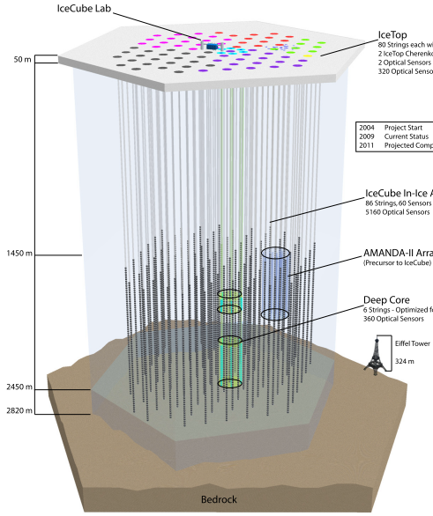
ν‘s as smoking gun for hadronic acceleration
2 ν within 66 days, 1 coincid. with orphan flare [Resconi05]
1-2 atm bg ν/yr/km³/deg² [Halzen⁺06]
2crab flare in 1h with 1ν or 1crab flare in 1d with 2ν >4σ [Godman⁺07]
Completeness of γ-data statistically crucial [Leier⁺06]

Slide 19
ν‘s as smoking gun for hadronic acceleration
2 ν within 66 days, 1 coincid. with orphan flare [Resconi05]
1-2 atm bg ν/yr/km³/deg² [Halzen⁺06]
2crab flare in 1h with 1ν or 1crab flare in 1d with 2ν >4σ [Godman⁺07]
Completeness of γ-data statistically crucial [Leier⁺06]
Fulltime observations mandatory!

Slide 20
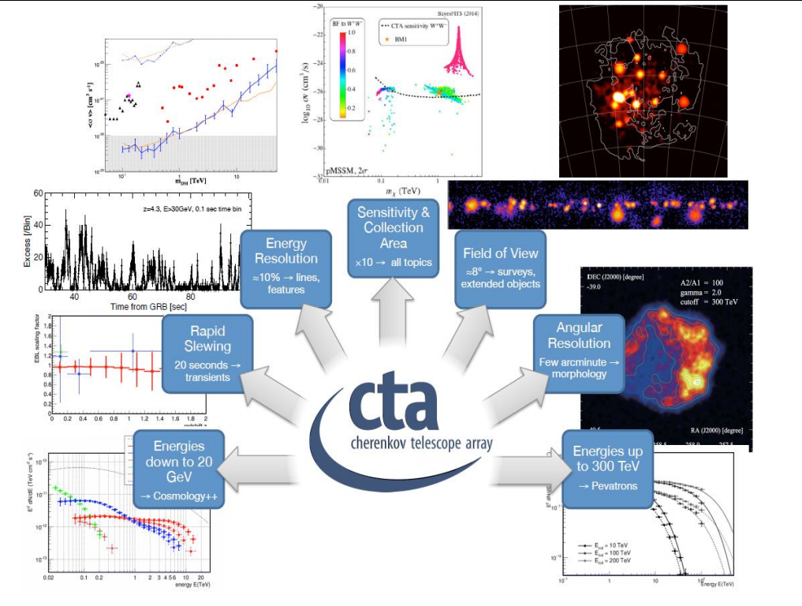
Monitoring with future IACTs?
borrowed from Elina Lindfors: CTA blazar monitoring
program and the supporting optical monitoring program, this workshop

Slide 21
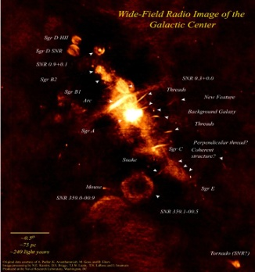
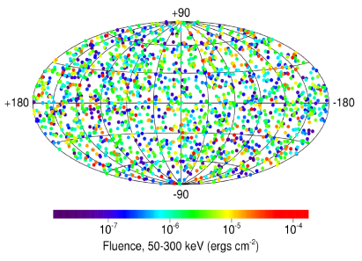
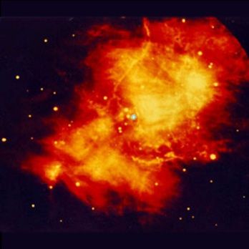
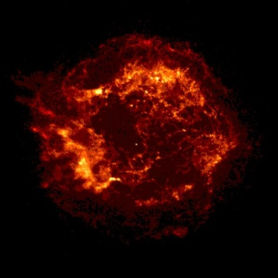
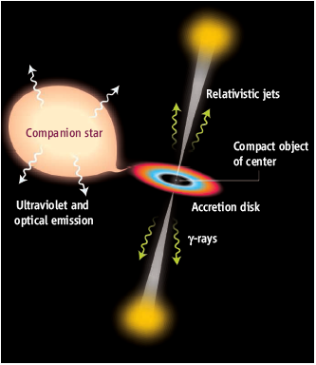
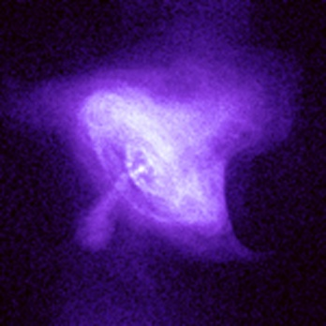
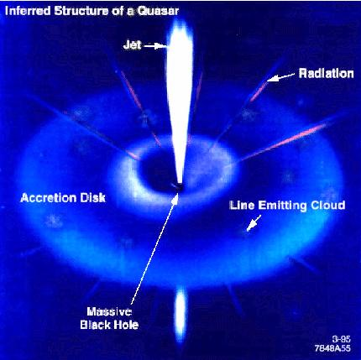
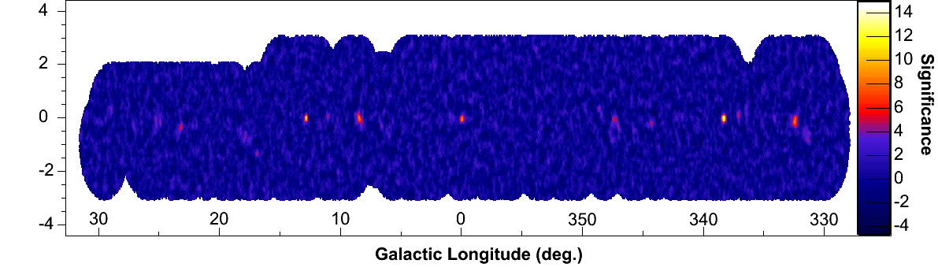
Monitoring with current IACTs?
High sensitivity with threshold energies around 100 GeV
many observation targets:
GRBs
μ-quasar
Pulsar-Wind-Nebel Supernova Reste Mikroquasare Galaxienhaufen Radiogalaxien | Pulsare Gamma-Ray-Bursts Blazare Galaktische Surveys
galactic
center
pulsar wind
nebula
shelltype
SNR
pulsar
AGN
Few tens-hundreds of hours for AGN monitoring
no cost efficient way for 24/7 monitoring

Slide 22
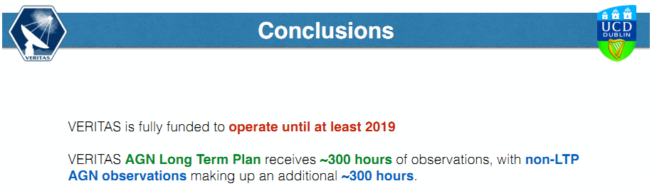
Monitoring with current IACTs?
High sensitivity with threshold energies around 100 GeV
many observation targets:
GRBs
μ-quasar
Pulsar-Wind-Nebel Supernova Reste Mikroquasare Galaxienhaufen Radiogalaxien | Pulsare Gamma-Ray-Bursts Blazare Galaktische Surveys
borrowed from Stephan O’Brien: VERITAS observations of Active Galactic Nuclei, this workshop
galactic
center
pulsar wind
nebula
shelltype
SNR
pulsar
AGN
Few tens-hundreds of hours for AGN monitoring
no cost efficient way for 24/7 monitoring

Slide 23
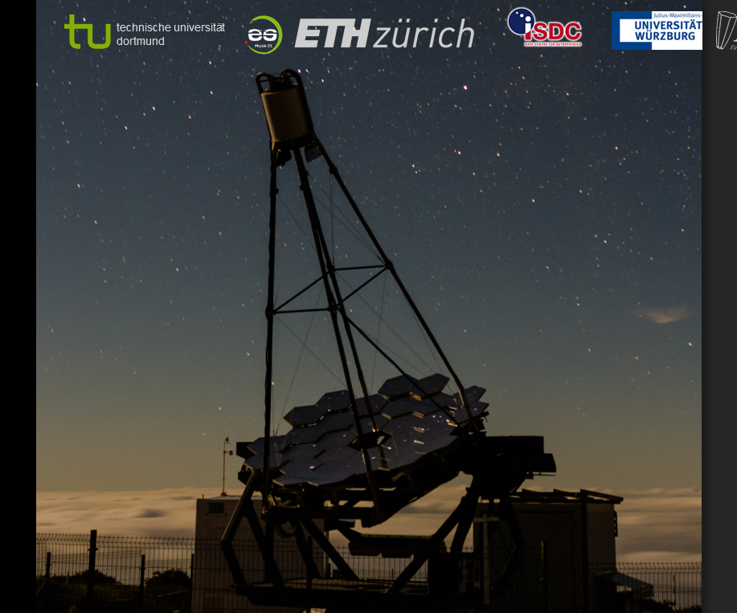

FACT telescope
borrowed from Jens Björn Buß: Blazar Monitoring with FACT,
this workshop

Slide 24
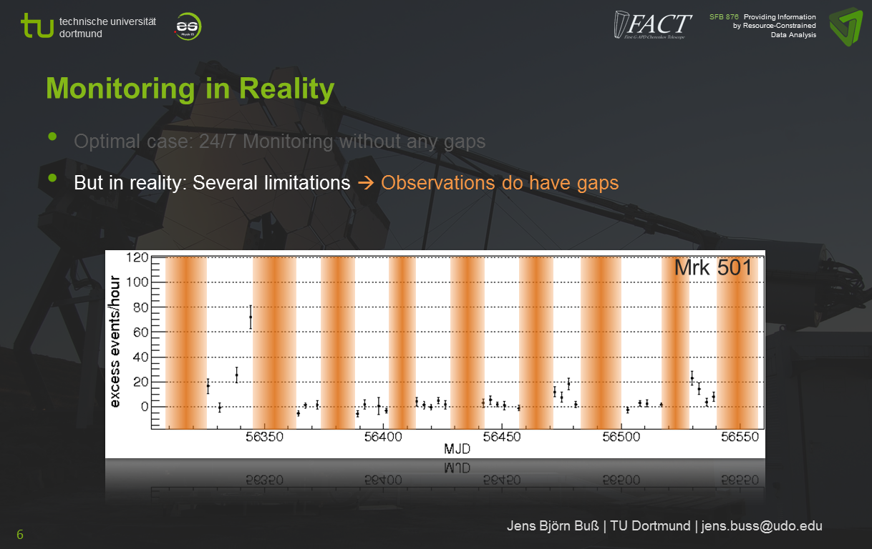
Monitoring with FACT
borrowed from Jens Björn Buß: Blazar Monitoring with FACT,
this workshop

Slide 25
Monitoring with FACT
Dedicated Worldwide Agn Research Facility (DWARF)
borrowed from Jens Björn Buß: Blazar Monitoring with FACT,
this workshop

Slide 26
DWARF – history
[Lorentz: Ideas on long-term observations with small Cherenkov telescopes, KAT Zeuthen, 2005]

Slide 27
DWARF – history
[Lorentz: Ideas on long-term observations with small Cherenkov telescopes, KAT Zeuthen, 2005]
Future extensions (…) Therefore we propose a worldwide network of (< 10) small scale Cherenkov telescopes to be build in the future allowing 24h monitoring of the bright AGNs. Such a system is so far completely unique in this energy range.
[Bretz, Backes, Rhode, Mannheim, Becker, Dorner, et al.:
Long-term VHE γ-ray monitoring of bright blazars with a dedicated Cherenkov Telescope Proc. ICRC 2007, Mérida (Mexico)]

Slide 28
DWARF – history
[Lorentz: Ideas on long-term observations with small Cherenkov telescopes, KAT Zeuthen, 2005]
Future extensions (…) Therefore we propose a worldwide network of (< 10) small scale Cherenkov telescopes to be build in the future allowing 24h monitoring of the bright AGNs. Such a system is so far completely unique in this energy range.
[Bretz, Backes, Rhode, Mannheim, Becker, Dorner, et al.:
Long-term VHE γ-ray monitoring of bright blazars with a dedicated Cherenkov Telescope Proc. ICRC 2007, Mérida (Mexico)]
[W]e intend to initiate a global network of Cherenkov telescopes, operated in a coordinated way for monitoring observations of nearby blazars – the DWARF (Dedicated Worldwide AGN Research Facility) Network.
[Backes, et al.: Long-term monitoring of blazars – the DWARF network
Proc. ICRC 2009, Lodz (Poland)]

Slide 29
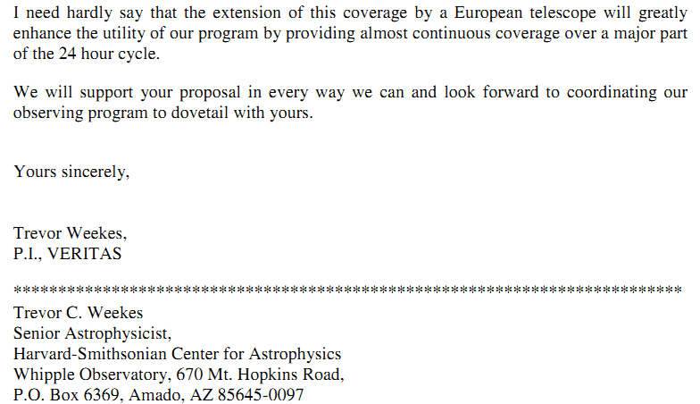
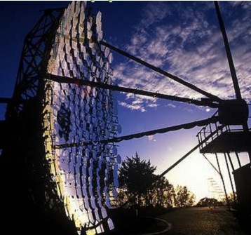
DWARF – history: Whipple

Slide 30
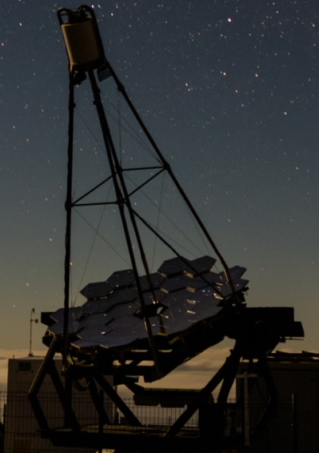
DWARF – current possible network
M@te OMEGA FACT TACTIC
form. HEGRA
La Palma (E)
2200m a.s.l.
E_{th}~700GeV
Ongoing monitoring
[Anderhub⁺13]

Slide 31
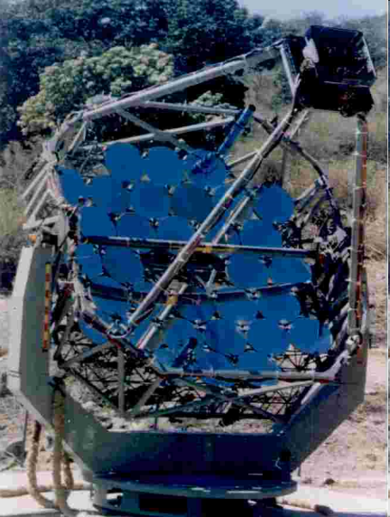
DWARF – current possible network
M@te OMEGA FACT TACTIC
form. HEGRA
La Palma (E)
2200m a.s.l.
E_{th}~700GeV
Ongoing monitoring
[Anderhub⁺13]
1 telescope
Mt. Abu (IN)
1300m a.s.l.
E_{th} ~ 1TeV
Ongoing monitoring
[Koul⁺07]
New camera

Slide 32
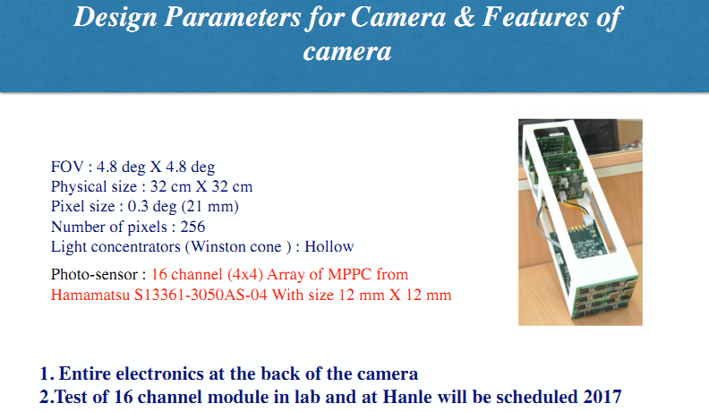
DWARF – TACTIC
M@te OMEGA FACT TACTIC
form. HEGRA
La Palma (E)
2200m a.s.l.
E_{th}~700GeV
Ongoing monitoring
[Anderhub⁺13]
1 telescope
Mt. Abu (IN)
1300m a.s.l.
E_{th} ~ 1TeV
Ongoing monitoring
[Koul⁺07]
New camera
Supplied by Amit Shukla, FACT Meeting 2016

Slide 33
DWARF – current possible network
M@te OMEGA FACT TACTIC
form. HEGRA
La Palma (E)
2200m a.s.l.
E_{th}~700GeV
Ongoing monitoring
[Anderhub⁺13]
1 telescope
Mt. Abu (IN)
1300m a.s.l.
E_{th} ~ 1TeV
Ongoing monitoring
[Koul⁺07]
New camera

Slide 34
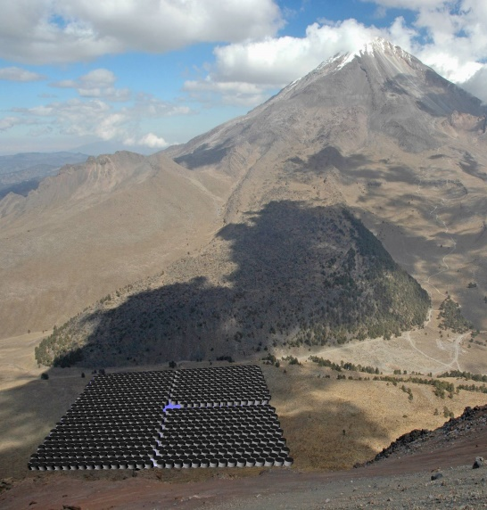
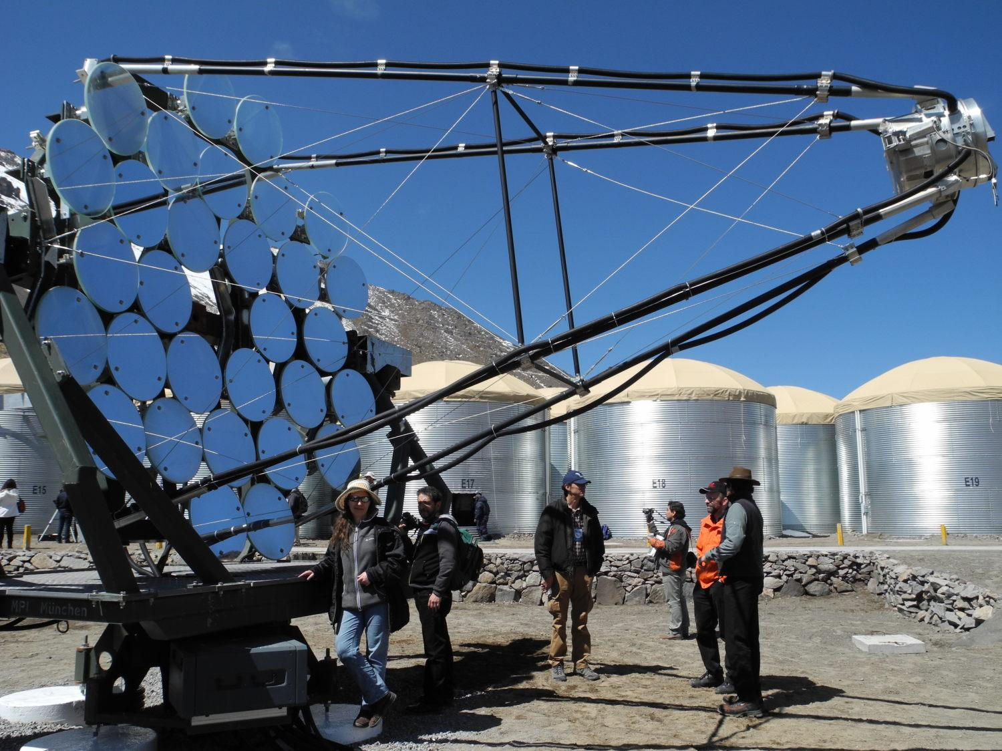
DWARF – current possible network
M@te OMEGA FACT TACTIC
1 former HEGRA
Sierra Negra
(MEX)
4100m a.s.l.
E_{th}~700GeV→???
Test bed for new GAPD camera
[Ruben⁺09]
form. HEGRA
La Palma (E)
2200m a.s.l.
E_{th}~700GeV
Ongoing monitoring
[Anderhub⁺13]
1 telescope
Mt. Abu (IN)
1300m a.s.l.
E_{th} ~ 1TeV
Ongoing monitoring
[Koul⁺07]
New camera

Slide 35
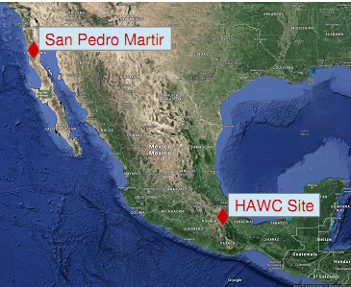
DWARF – current possible network
M@te OMEGA FACT TACTIC
1 former HEGRA
San Pedro Martir
(MEX)
2800m a.s.l.
E_{th}~700GeV→???
GAPD camera
1 former HEGRA
Sierra Negra
(MEX)
4100m a.s.l.
E_{th}~700GeV→???
Test bed for new GAPD camera
[Ruben⁺09]
form. HEGRA
La Palma (E)
2200m a.s.l.
E_{th}~700GeV
Ongoing monitoring
[Anderhub⁺13]
1 telescope
Mt. Abu (IN)
1300m a.s.l.
E_{th} ~ 1TeV
Ongoing monitoring
[Koul⁺07]
New camera

Slide 36
DWARF – current possible network
M@te OMEGA FACT TACTIC
…
more
to
come!
1 former HEGRA
San Pedro Martir
(MEX)
2800m a.s.l.
E_{th}~700GeV→???
GAPD camera
1 former HEGRA
Sierra Negra
(MEX)
4100m a.s.l.
E_{th}~700GeV→???
Test bed for new GAPD camera
[Ruben⁺09]
form. HEGRA
La Palma (E)
2200m a.s.l.
E_{th}~700GeV
Ongoing monitoring
[Anderhub⁺13]
1 telescope
Mt. Abu (IN)
1300m a.s.l.
E_{th} ~ 1TeV
Ongoing monitoring
[Koul⁺07]
New camera

Slide 37
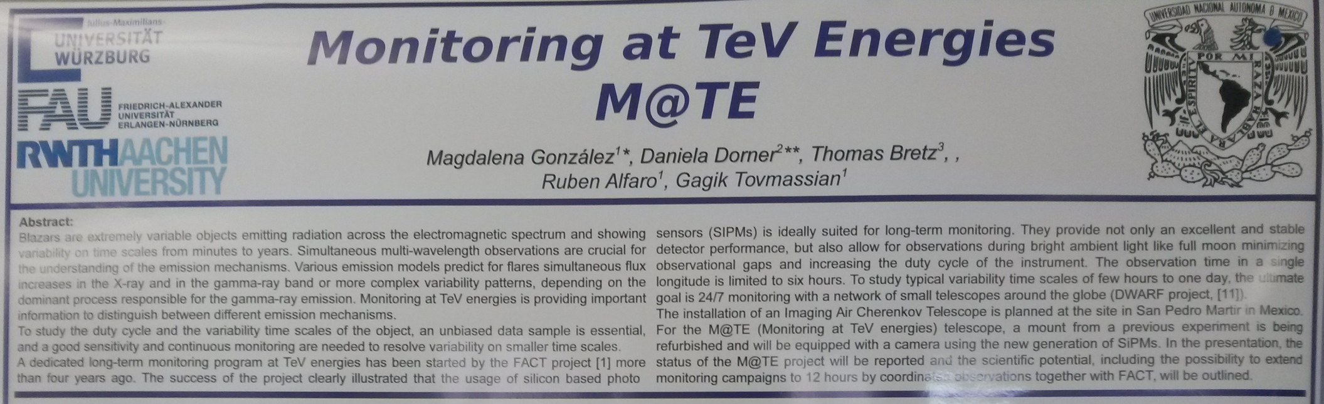
DWARF – M@te
borrowed from Magdalena González et al.: Monitoring at TeV Energies – M@te,
this workshop

Slide 38
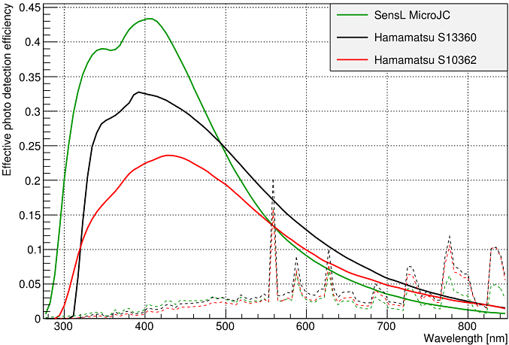
DWARF – M@te

Slide 39
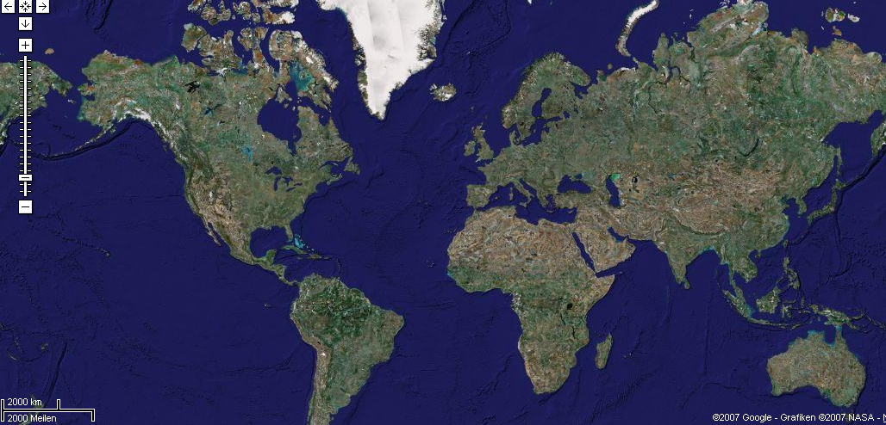
DWARF Network
TAIGA CT
VERITAS
MAGIC
CTA-N
Roman CT
M@te
FACT
OMEGA
TACTIC
Dedicated Worldwide Agn Research Facility (DWARF)
CTA-S
H.E.S.S.
Dedicated Worldwide Agn Research Facility DWARF

Slide 40
DWARF Network South
TAIGA CT
VERITAS
MAGIC
CTA-N
Roman CT
M@te
FACT
OMEGA
TACTIC
Dedicated Worldwide Agn Research Facility (DWARF)
CTA-S
H.E.S.S.
Dedicated Worldwide Agn Research Facility DWARF

Slide 41
Any questions?

Slide 42
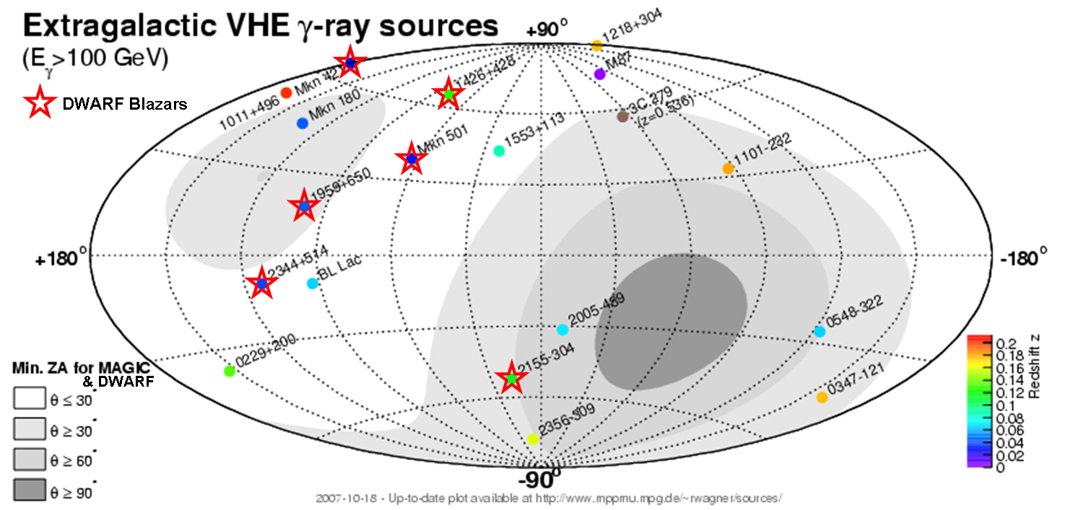
DWARF Sources
Mkn 501, Mkn 421, 1ES 1959+650, 1ES 2344+514,
H1426+428, PKS 2155-304

