Slide 1
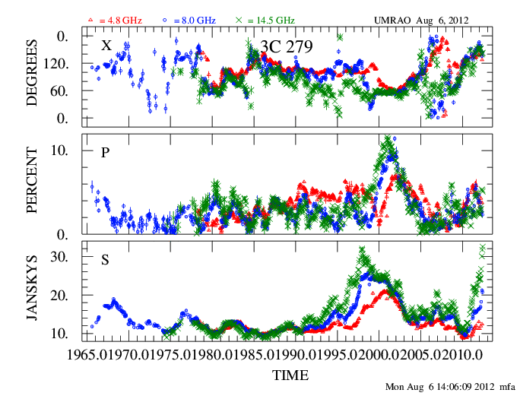
The University of Michigan Centimeter-band Blazar Monitoring Program
M.F. Aller, H.D. Aller, P.A. Hughes, & G. E. Latimer
Linear Polarization
Total flux density
First VHE detection of a FSRQ
First reported QSO variability at radio band
Two-week averaged data
Notes:
Explain three frequencies, nearly continuous activity. MAGIC DETECTION early 2006 Dent first detections 1962-1965

Slide 2
Outline
Description of the UMRAO observations & character of the radio-band variability
Radio-band variability for localization of γ-ray flaring and identification of the X-ray emission mechanism
Circular polarization variability: sign & amplitude
Multi-epoch RT modeling of the UMRAO data: jet evolution in OT 081
Primary collaborators in high energy studies : T. Hovatta, S. Jorstad & A. Marscher

Slide 3
Marscher Jet Schematic
The jet flow is relativistic: many intrinsic jet properties are not directly observed.
Notes:
Turbulent B field suggested by low degrees of LP

Slide 4
The Observations
Equatorially mounted 26-m radio telescope located in Dexter, MI
Type of Data: Flux and Polarization at 14.5, 8, & 4.8 GHz (2, 4, 6 cm)
Timespan of Data: up to 4 decades
Sampling: 2x per week to trimonthly at each frequency
Duration of a typical measurement: 30-40 minutes (CP requires longer)
Number of Sources observed in 24h run : ~24
Declination Range: +80° to -36° (southern limit for strong sources)
Limits set by the mechanical limits of the dish and pointing accuracy
Notes:
Operated under automatic computer control since approximately 1977
Cannot observe some interesting HE and VHE sources

Slide 5
Sources Monitored: Flux and Linear Polarization
Ad hoc sources (based on flaring, campaigns, requests)
UMRAO BL LAC flux-limited sample
Flux limit: S≥0.4 Jy at 8 GHz
N=41; time window≥1979
All BL at time of survey start; includes some HBLs/IBLs
Pearson Readhead sample (VLBI flux and position limited sample)
Flux limit: : S≥1.3 Jy at 5 GHz; flat & steep spectrum objects
N=62/65; time window≥1984
Distribution by Optical class: 8 BL, 29 Q, 25 G
MOJAVE (VLBI) flux-limited sample (mainly core-dominated blazars)
Flux limit: S≥1.5 Jy at 14.5 GHz (≥2 Jy for southern sources)
Original sample N=132/133 (but expanded); time window≥2002
Distribution by Optical class in MOJAVE I: 22 BL, 93 Q, 8 G, 9 U

Slide 6
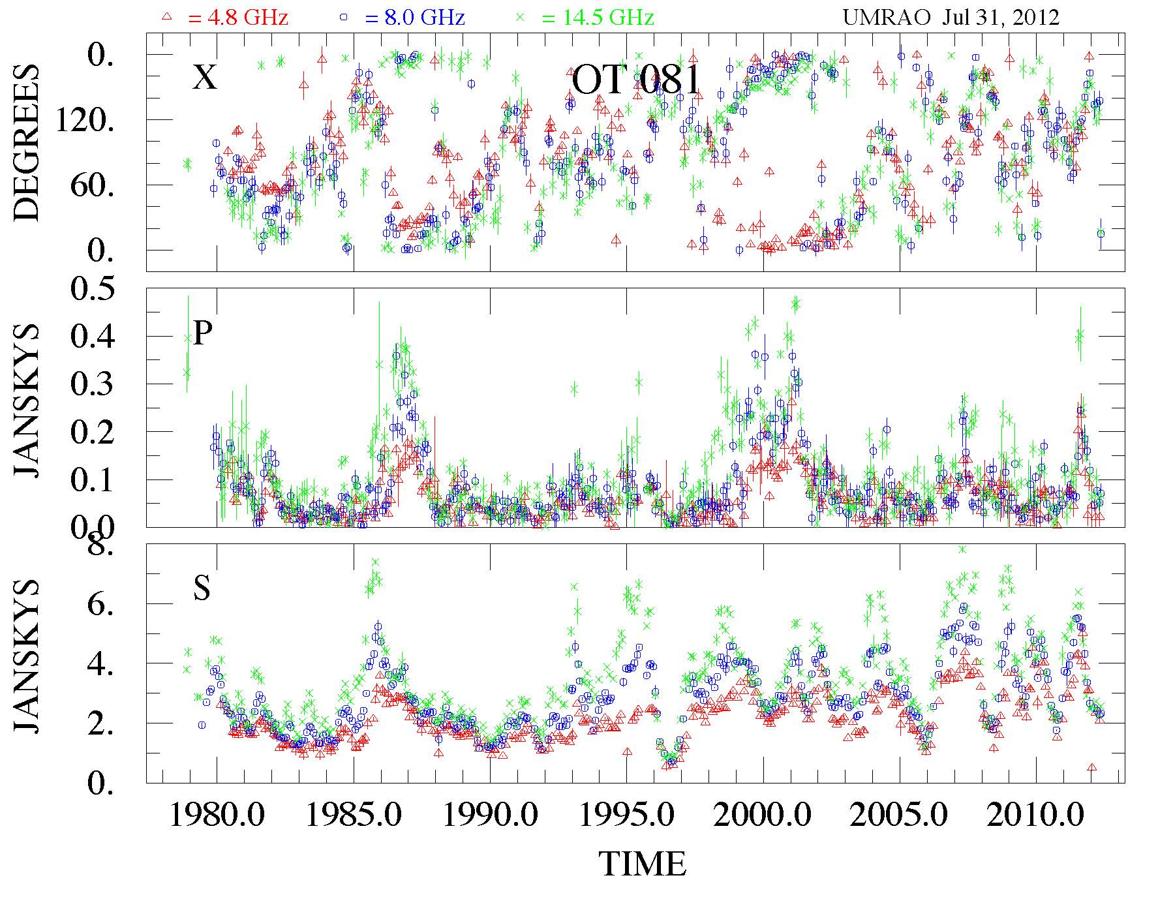
Flux and Polarization: range of parameters
EVPA: gives information on the orientation of B
Outbursts in Polarized Flux:
P% ranges from 1% to 15%.
Gives information on the degree of order of B
S: Temporally well-separated outbursts (an envelope over individual flares) lasting for months to year, continuous active, non-repeating,
Monthly-averaged, 3-frequency UMRAO Total Flux Density and Linear Polarization

Slide 7
Variability Properties from UMRAO Light Curves
Source Property Method
Time scales, noise process structure functions
Degree of variability fluctuation index, variability index
Quasi-Periodicity cross-wavelets
Periodicity Lomb-Scargle periodograms
RESULTS
Time scale for correlated activity in S: ≈2 years
Noise Process: generally shot noise except Mrk 421, Mrk 501
Evidence for time-dependent changes in characteristic behavior (SF analysis of time segments and/or visually) & quasi-periodicity
Weak evidence for periodicity in OJ 287 with P~1.6 years from LS periodograms . Quasi-periodicity from wavelets: 1.12, 1.66 years.
We require 5 cycles in periodicity analyses!
Refs: Hughes, Aller & Aller 1992; Kelly et al. 2003; Aller, Aller,& Hughes 1996
Notes:
Note that these are not orbital periods but oscillations within the flow.

Slide 8
Broadband activity is correlated (sometimes): 3C 279
GeV
X-ray
Optical P
Long time scale & low amplitude compared to HE bands
Radio
Hayashida et al. 2012 (2008 August – 2010 August)
Notes:
Variability timescales and amplitudes are diffferent: UMRAO included in 5 and 15 GHZ (plus Medecino and OVRO)

Slide 9
Time-dependent X-ray/radio behavior: 1510-089
VLBA component ejections
DCCF: 1997: X-ray lags radio by 16d
≥1998: X-ray leads by 6d and
the correlation is weaker
1997 X-ray and 14.5 GHz bursts well-correlated; timescales of the events are similar
BUT subsequent activity has lower correlation
Aller, Marscher, Marchenko-Jorstad, McHardy, & Aller 2000
Notes:
Time lags and relative amplitudes to test localization and emission mechanism.

Slide 10
Inherent Problems in Cross-Correlating Radio-band Flux Light Curves with X-ray and γ-ray Data
DATA
Unambiguous identification of the SAME event is difficult except when the light curve is dominated by a single event (e.g. 0235+164) due to continuous activity.
The variability timescales & amplitudes are different in high and low energy flares/outbursts.
FACTORS HAMPERING INTERPRETATION
Opacity produces blending of the radio flares.
Temporal changes in the jet parameters prevent a unique
signature over many outbursts.

Slide 11
Linear Polarization: a potential way to localize the optical emission site: 1510-089 (FSRQ)
2009 events:
14.5 & optical EVPAs track.
2011-2012 events:
Optical and radio EVPAs don’t track even when allowing for 180° ambiguity in the radio EVPA determination.
WHY?
Different jet location, or temporal changes in jet conditions.
2009 events
2011.5 2012 events
2008.5
2012.5
Aller et al. 2012

Slide 12
Science Goals of the CP Program (2002-2012)
From the UMRAO data directly:
Determine the range of behavior of CP: amplitude and timescale for variability in Stokes V; its relation to total flux density and linear polarization; and polarity--link between jet and central engine?
In combination with modeling & complementary VLBA program¹:
1. determine the particle distribution’s low energy cutoff from the spectral info
2. set limits on the jet’s particle composition (electron/proton or electron/positron gas?) from the amount of Faraday rotation
3. constrain the 3-D structure of the B field and the fraction of energy in an ordered component of the field from the sign and amplitude of Stokes V respectively
¹VLBA program: 6 frequency imaging in collaboration with Homan, Lister, and Wardle for a small sample of sources : analysis of 3C 279 published in Homan et al. 2009
Notes:
Mention that only one source modeled so far.

Slide 13
Circular Polarization: source selection
sample: 36 sources (positive/suspected detections, S>5Jy )
0059+581 | 3C 120 | 0736+017 | 1156+295 | 1741-038 | OX 161
DA 55 | 0420-014 | 0748+126 | 3C 273 | OT 081 | 2145+067
0235+641 | 0607-157 | OJ 287 | 3C 279 | 3C 380 | BL Lac
3C 84 | 0642+449 | 4C 39.25 | 1335-127 | OV-236 | 3C 446
NRAO 150 | 0716+714 | 1055+018 | 1510-089 | 1928+738 | CTA 102
3C 111 | 0727-115 | 1127-145 | 3C 345 | 2134+004 | 3C 454.3
Objects in yellow are detected by both Fermi and by TeV instruments. Objects in green are detected by Fermi. Objects in magenta are detected in neither the GeV or TeV bands.

Slide 14
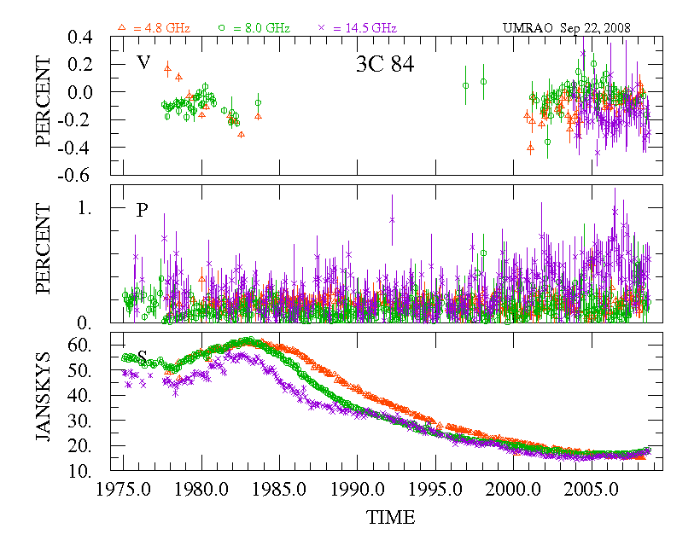
3C 84 (NGC 1275): Polarity and amplitude
RH
Weak Stokes V
LH
Fractional Circular Polarization:
Mainly negative; sign change
Fractional Linear Polarization: LOW!
No apparent correlation between P% & V%
Simple light curve with a few long-term outbursts
Monthly averages

Slide 15
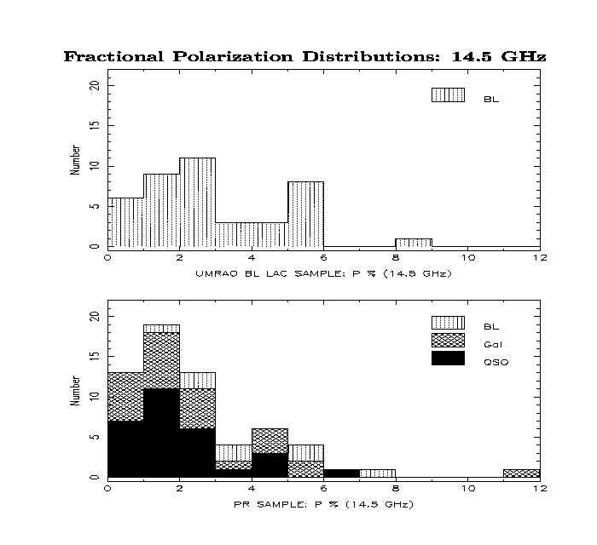
Evidence for Turbulent Magnetic Fields: Low P%
Histograms of <P> from time-averaged Q and U for two flux-limited samples
UMRAO BL Lac Sample
0<P≤9%: 41 objects observed beginning 1979
Pearson Readhead Sample
Primarily Q, G classes
0<P≤12%: 62 sample members monitored beginning1984
Notes:
Quiescent jet flow

Slide 16
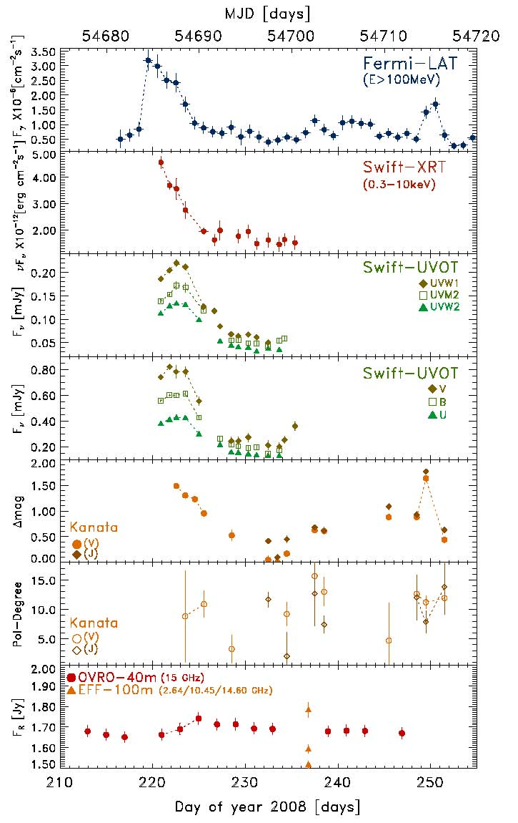
SHOCKS: Time Sampling for Identification
August 2008 event: 1502+106
Evidence for shocks during flaring from MOJAVE VLBP measurements: 1502+106
Aug 07
Jun 08
Aug 08
EVPA swing identified in VLBA data BUT time sampling insufficient to follow an event
Abdo et al. 2010
Notes:
Describe MOJAVE program

Slide 17
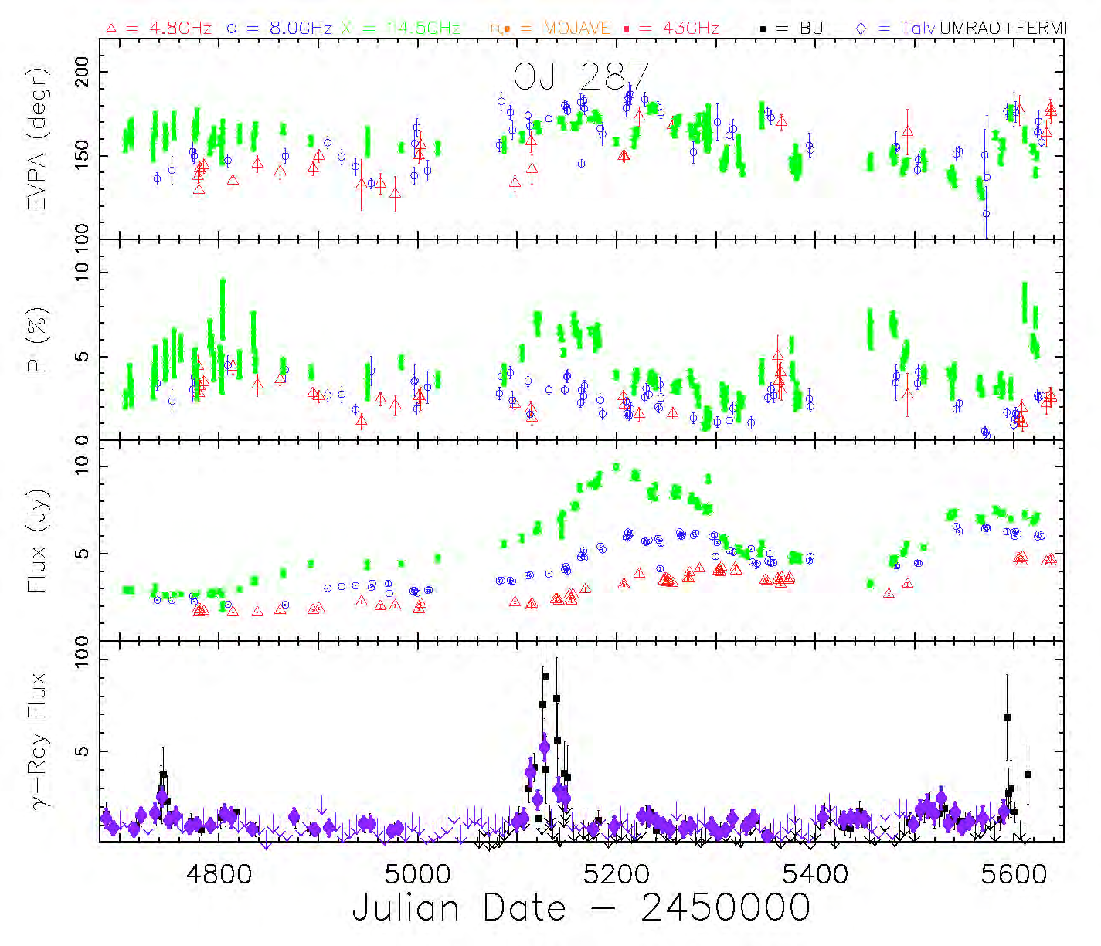
Example of Shock Signature in Linear Polarization Data
swing
increase
Fermi γ-ray:
10⁻⁷ photons/cm²/sec
Shock signature in several sources during large, contemporaneous radio & γ-ray flares
Aller et al. 2011

Slide 18
Free Parameters of Jet/Shock System & Data Constraints
MODEL PARAMETER | UMRAO DATA CONSTRAINT
Low energy cutoff (γ_{i}) EVPA Spectral behavior
Axial B field (B_{z}) EVPA and P%
Bulk Lorentz Factor (γ_{f}) P%
Viewing Angle (θ) P%
Shock obliquity (η) ΔEVPA
Shock compression (κ) ΔS and P%
Shock onset (t_{o}) Start of flare in S or P
Shock length (l) Duration of flare in S
Shock sense (F or R) Doppler Factor and β_{app}
The free jet parameters
The shock parameters
KEY POINTS
RT modeling allows for emission, absorption, intrinsic Faraday effects, mode conversion, relativistic aberration, & Doppler boosting.
2) The primary model constraint is the spectral evolution of the LP.
3) The modeling gives well-determined values for intrinsic parameters not observed directly. These include the degree of order of the B field, the shock orientation, and the viewing angle to the jet.

Slide 19
Temporal Changes in the flow: OT 081
T1985
T1996+
T2008
T2010

Slide 20
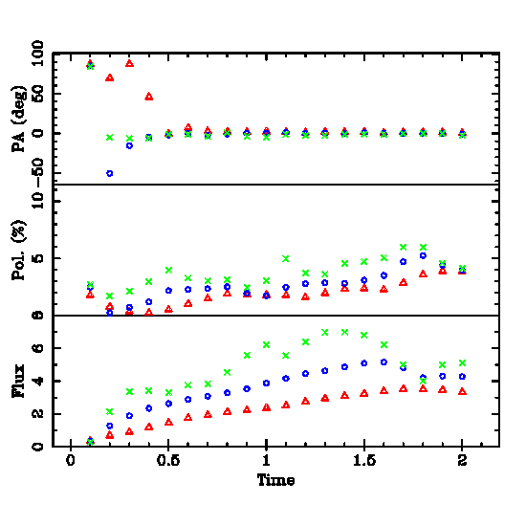
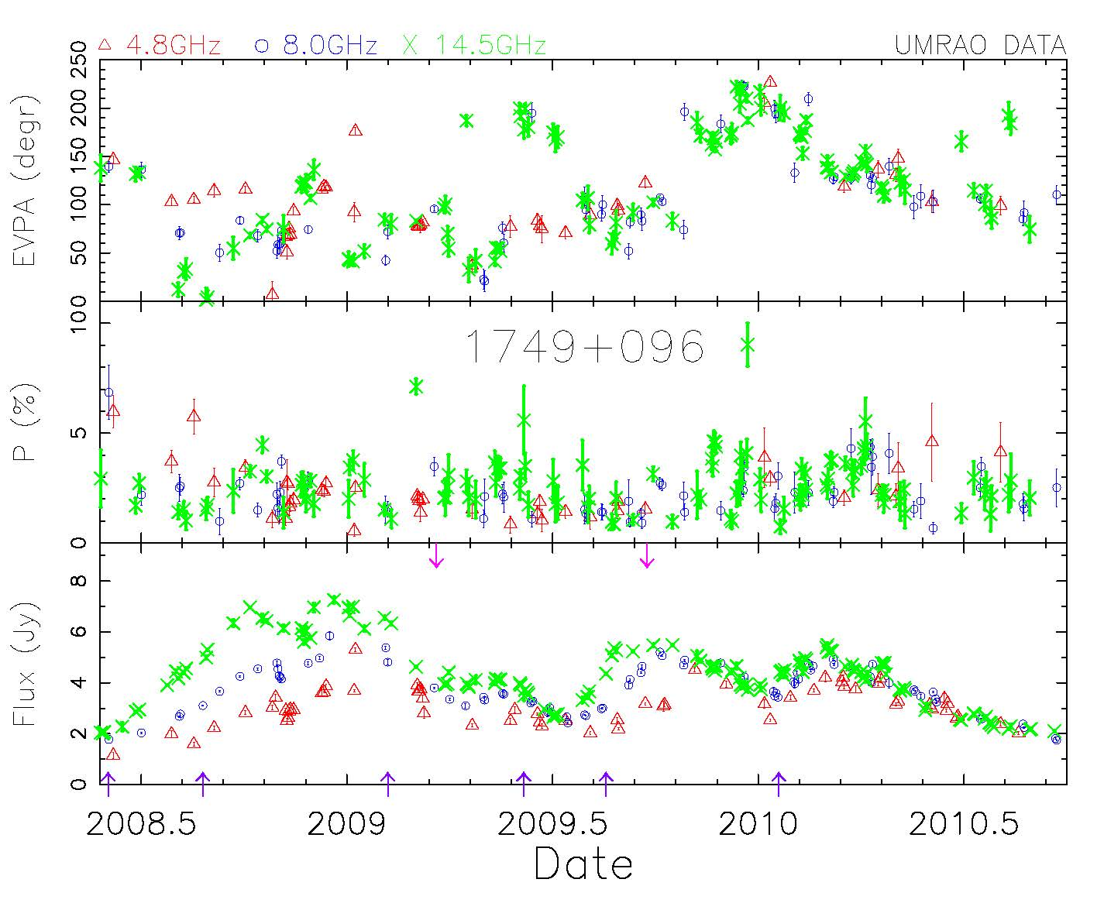
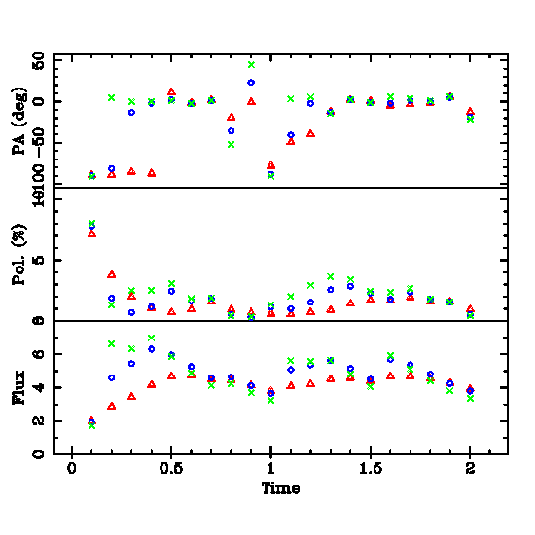
Variation in the Flow on Decadal Time Scales: OT 081
T1985: DATA
MODELS
Outburst 1985.0-1986.0: Simulation
Features reproduced
S: spectral character & max. amplitude
P: spectrum & Pmax
EVPA: near constant value during most
of modeled period; variability complex
Significant changes in the flow occurred. The variations are not self-similar; scaling does not reproduce the data.
Arrows mark shock onset
T2008: DATA
Outburst 2008.4-2010.7: Simulation
Features reproduced
S: spectral character & max. ampl.
P: generally low levels (under 5%)
EVPA: flat spectrum & complex
variation
Notes:
Arrows mark shock onsets

Slide 21
Evolution of the Flow From Modeling 4 Epochs
Parameter | T1985 | T1996 | T2008 | T2010
Low energy cutoff (γ_{i}) | 50 | 10 | 50 | 50
Axial B: % of turbulent (energy density) | 25% | 100% | 64% | 56%
Bulk Lorentz factor | 5 | 5 | 10 | 10
Viewing Angle (θ) | 1.7° | 2.3° | 1.4° | 1.1°
Shock Sense | F | F | F | F
Number of shocks | 5 | 6 | 6 | 3
Shock Compression | 0.28-0.40 | 0.20-0.30 | 0.35-0.65 | 0.30-0.40
Shock Lorentz Factor | 14.5 | 17.6 | 24.7 | 27.3
Shock β_{app} | 10.4 | 16.6 | 21.8 | 22.5
Evidence for intrinsic changes on time scales of years to decades in a BL Lac jet with extreme flow conditions, and strong and fast shocks. Detailed modeling completed for 5 γ-ray-bright blazars: 0716+714 and OT 081 are the most extreme.

Slide 22
Summary
Multi-year observations are required to sample the range of the radio band variability in flux and polarization.
Broadband flux correlations during strong flares are useful for localization & for identifying the population of radiating particles.
The linear polarization is a powerful constraint on the modeling.
Circular polarization has promise, but the measurements and calibration are difficult.
Radiative transfer modeling of multi-epoch UMRAO data identifies extreme shock/jet conditions in the OT 081 jet and intrinsic changes on timescales of decades.

