Slide 1

Polarization Variability in Leptonic and Hadronic Blazar Models
0
Markus Böttcher
North-West University
Potchefstroom
South Africa
Collaborators:
Haocheng Zhang (UNM / LANL),
Chris Diltz (Ohio University)

Slide 2
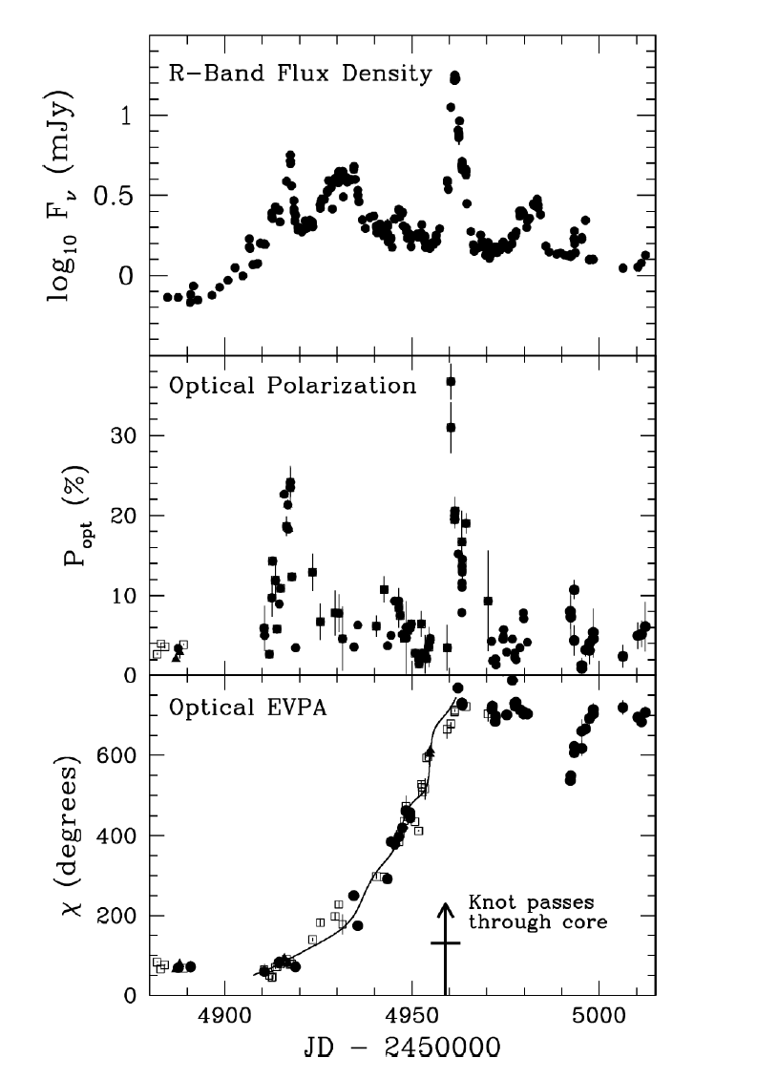
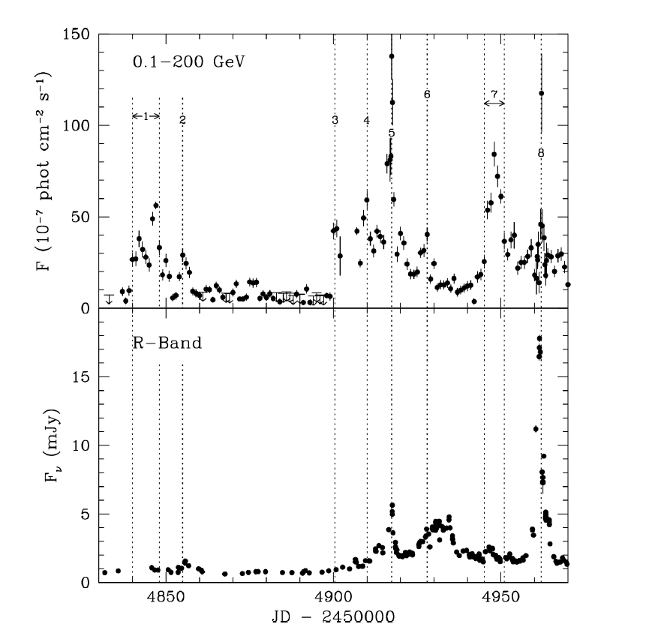
Optical Polarization Variability
Optical polarization degree and EVPA are rapidly varialble.
Sometimes Opt./γ flares correlated with rapid changes in optical polarization and multiple rotations of the polarization angle (PA)
γ-rays (Fermi)
Optical
PKS 1510-089 (Marscher et al. 2010)

Slide 3
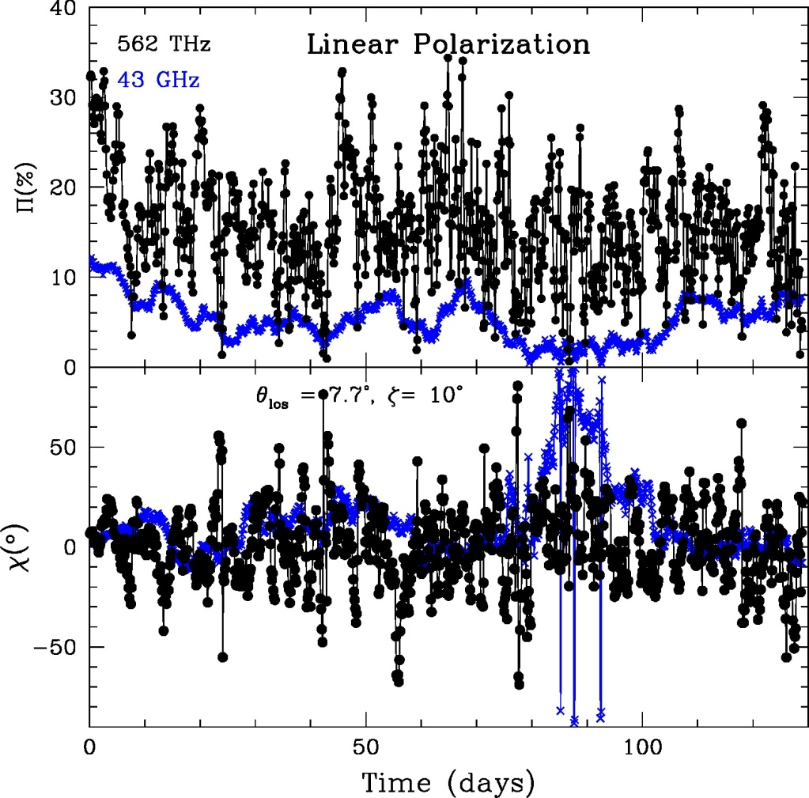
Proposed Models
Helical magnetic fields in a bent jet (e.g., Marscher et al. 2010)
Helical streamlines, guided by a helical magnetic field (Larionov et al. 2013, 2016)
Turbulent Extreme Multi-Zone
Model (Marscher 2014)
(Marscher 2014)
(Larionov et al. 2013)

Slide 4
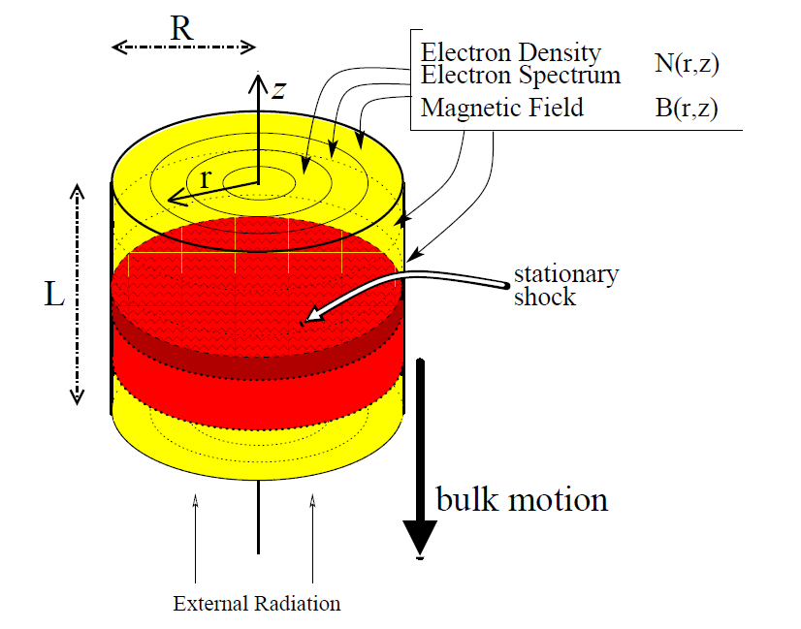
Tracing Synchrotron Polarization in the Internal Shock Model
Viewing direction in comoving frame:
θ_{obs} ~ π/2
3DPol (Zhang et al. 2014)
Solve electron dynamics and (unpolarized) radiation transfer with Monte-Carlo / Fokker-Planck scheme (Chen et al. 2011, 2012)
Time-dependent, polarization-dependent ray tracing for polarization signatures
Viewing direction in obs. Frame:
θ_{obs} ~ 1/Γ

Slide 5
Light Travel Time Effects
B
Shock propagation
LOS
B
B
(Zhang et al. 2015)
Shock positions at equal photon-arrival times at the observer

Slide 6
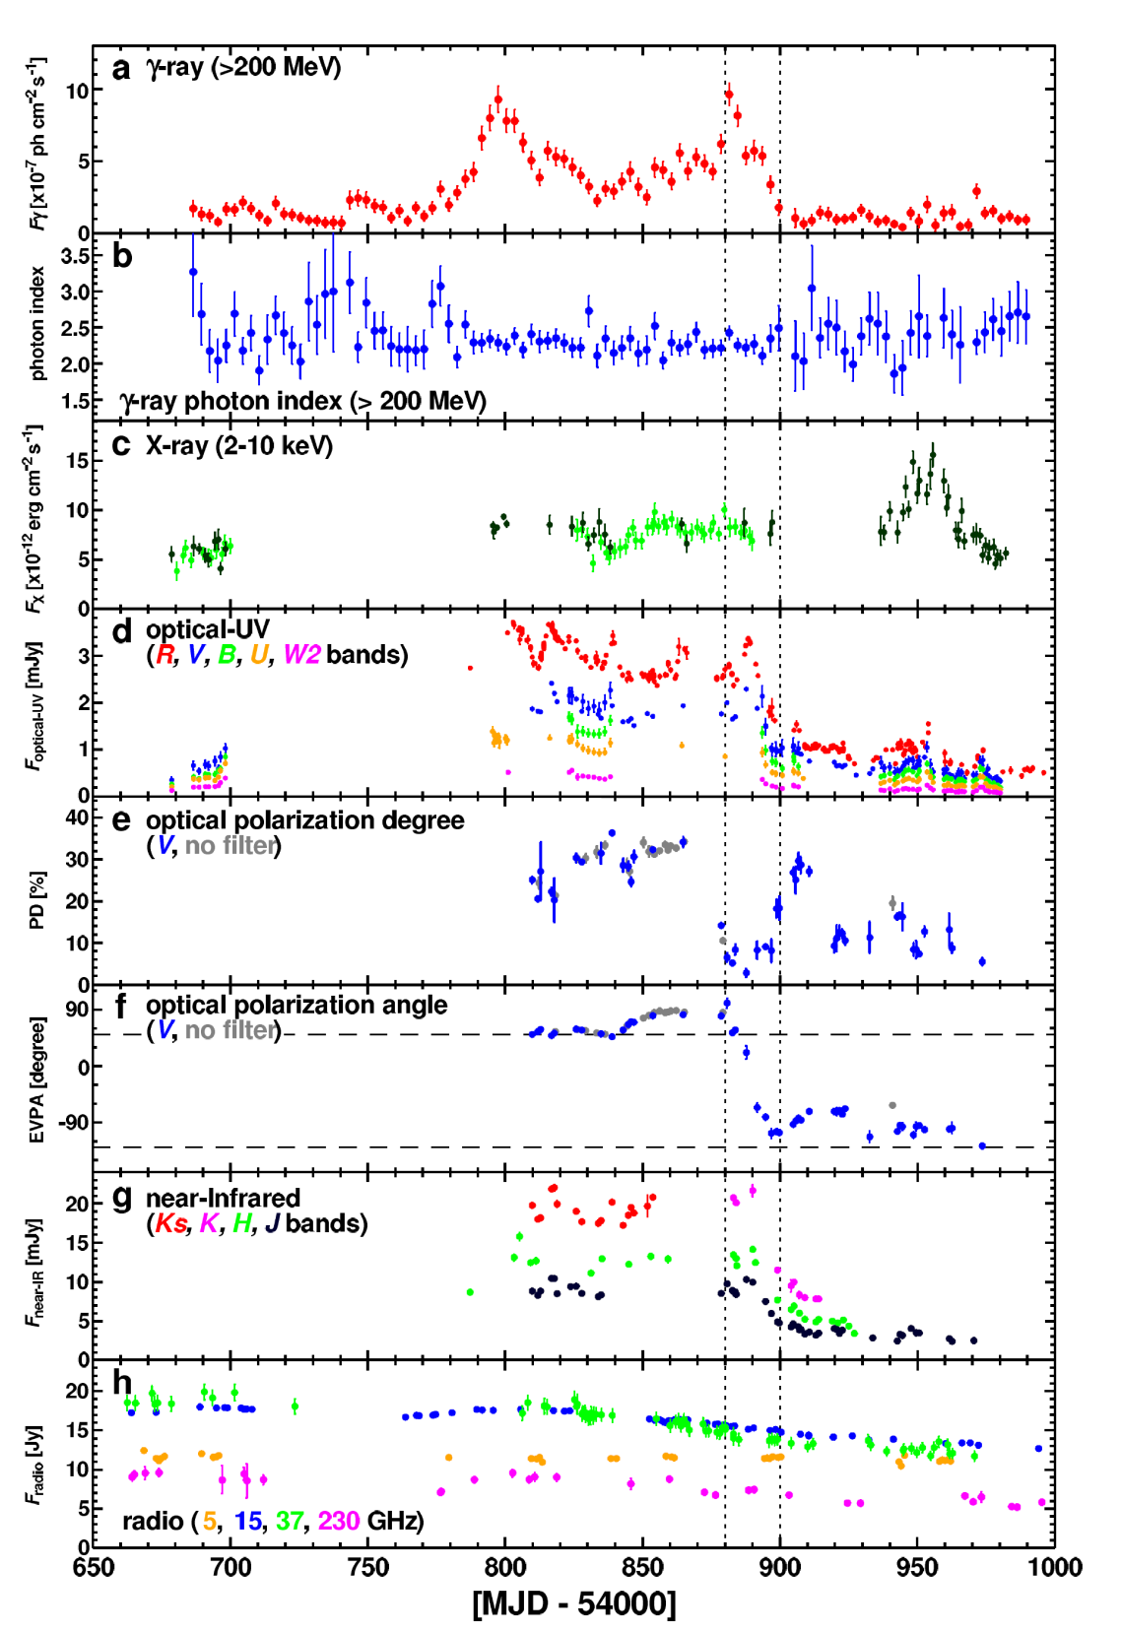
Application to the FSRQ 3C279
Simultaneous optical + γ-ray flare, correlated with a 180º polarization-angle rotation .
(Abdo et al. 2009)

Slide 7
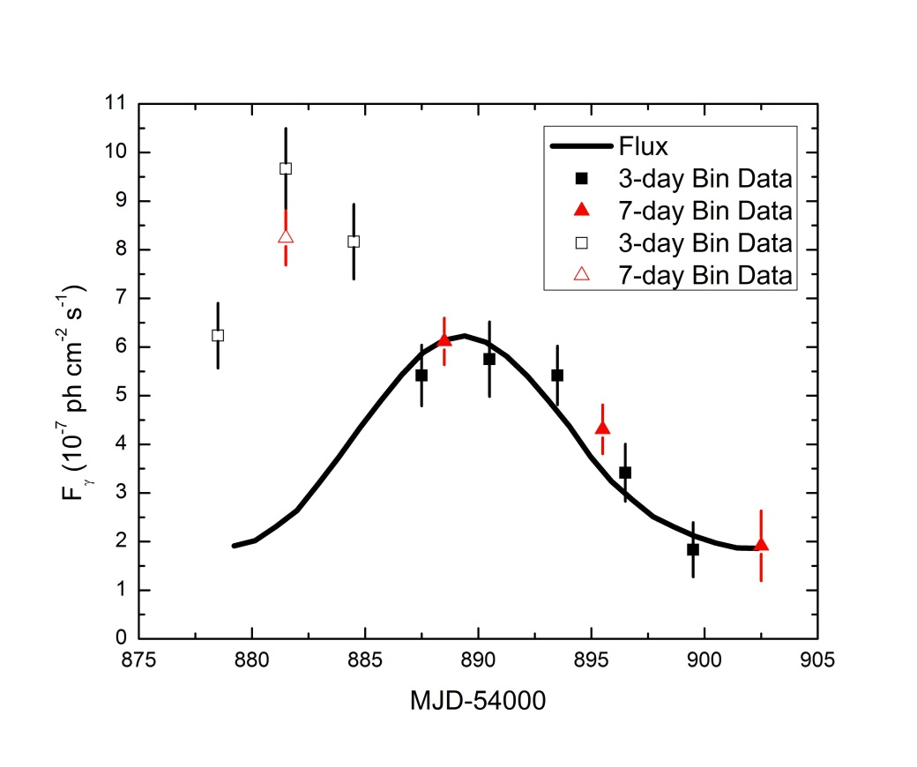
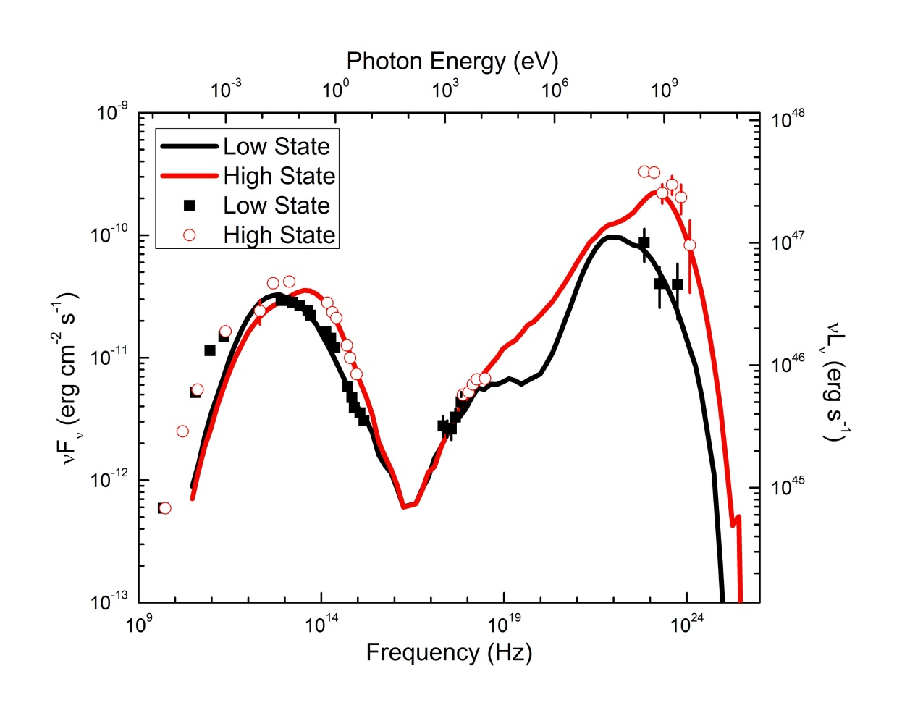
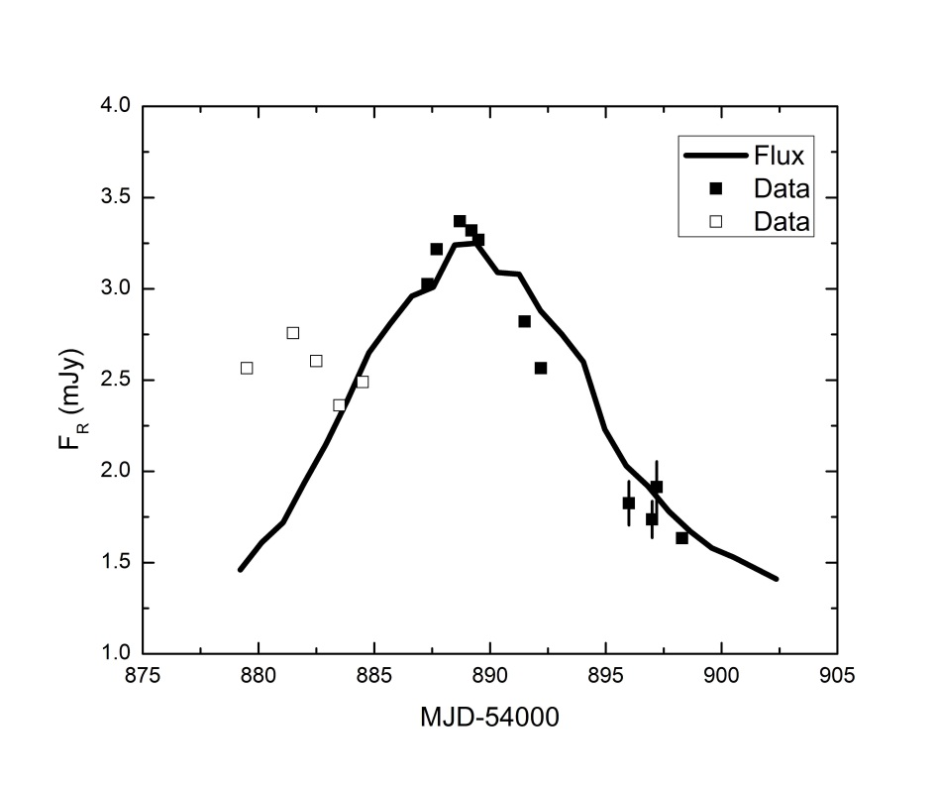
Application to 3C279
Simultaneous fit to SEDs, light curves, polarization-degree and polarization-angle swing
Fermi Lightcurve
R-Band Lightcurve
(Zhang et al. 2015)

Slide 8
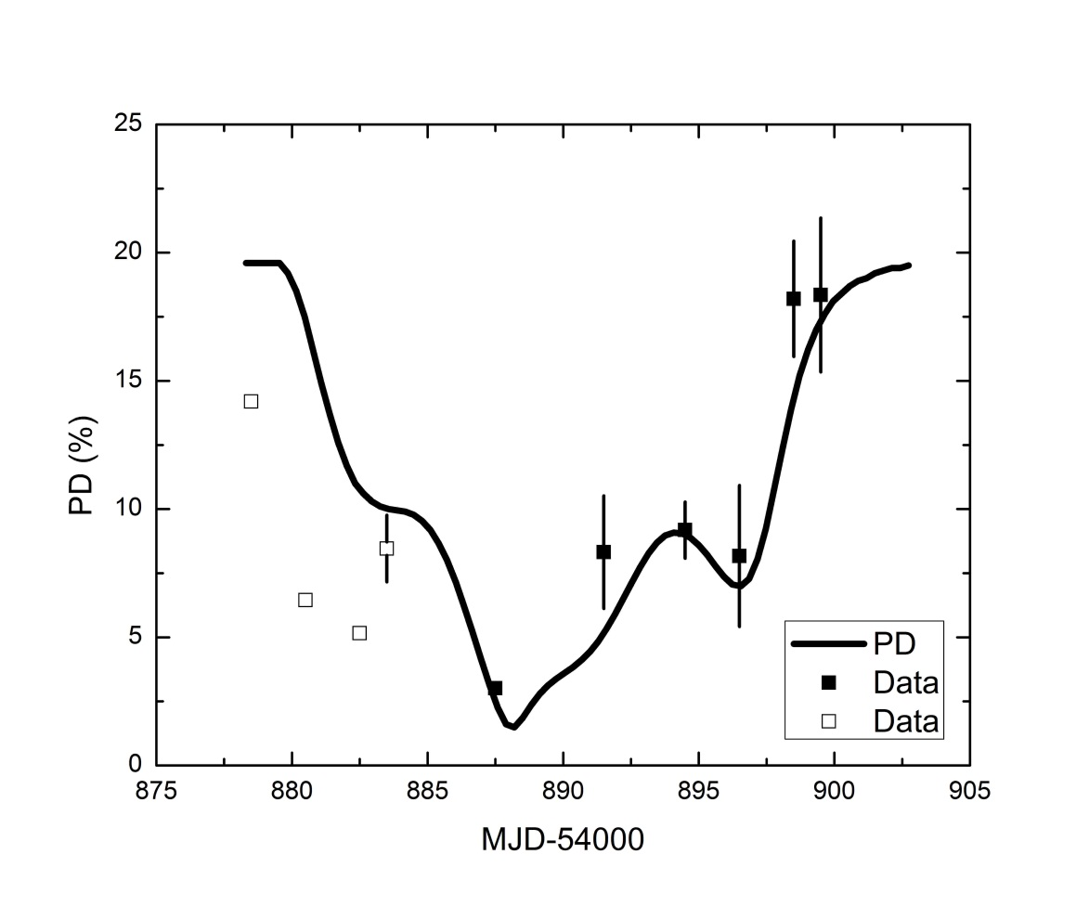
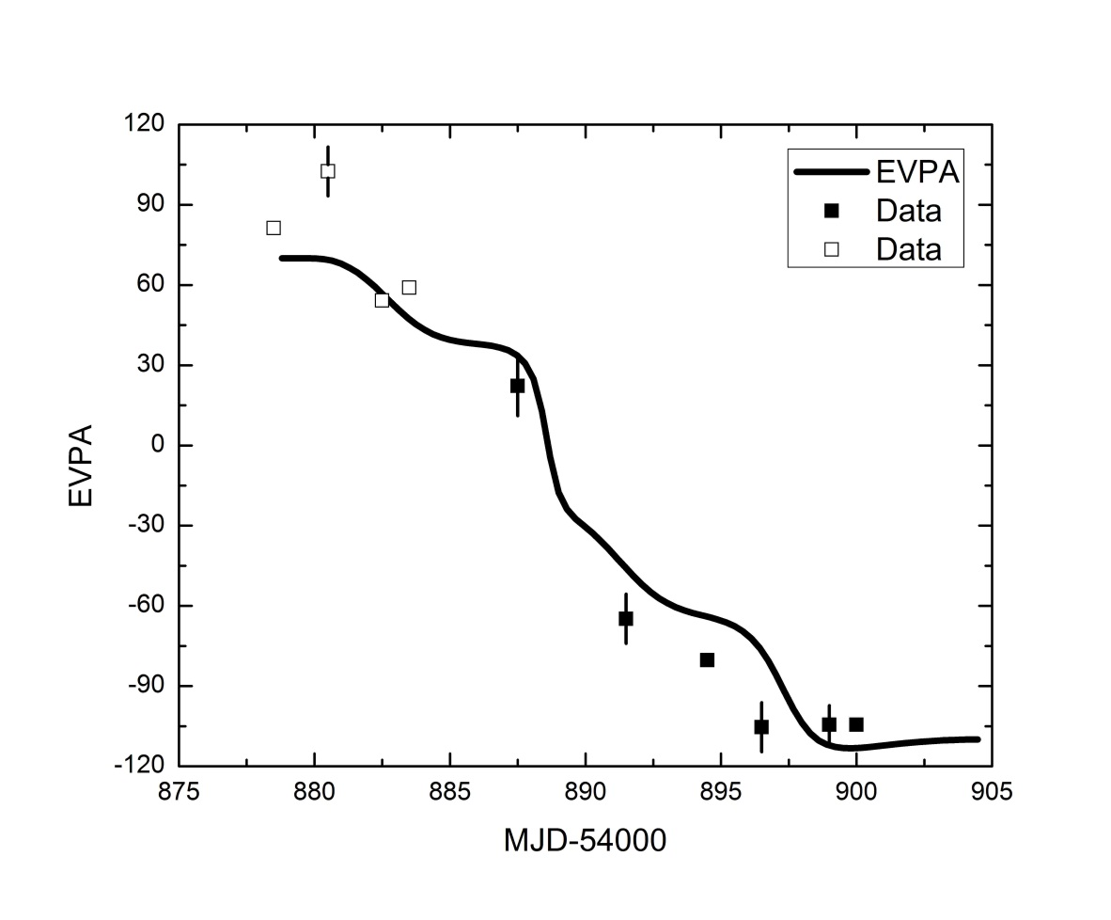
Application to 3C279
Requires particle acceleration
and reduction of magnetic field,
as expected in magnetic reconnection!
Degree of Polarization
Polarization Angle
(Zhang et al. 2015)

Slide 9
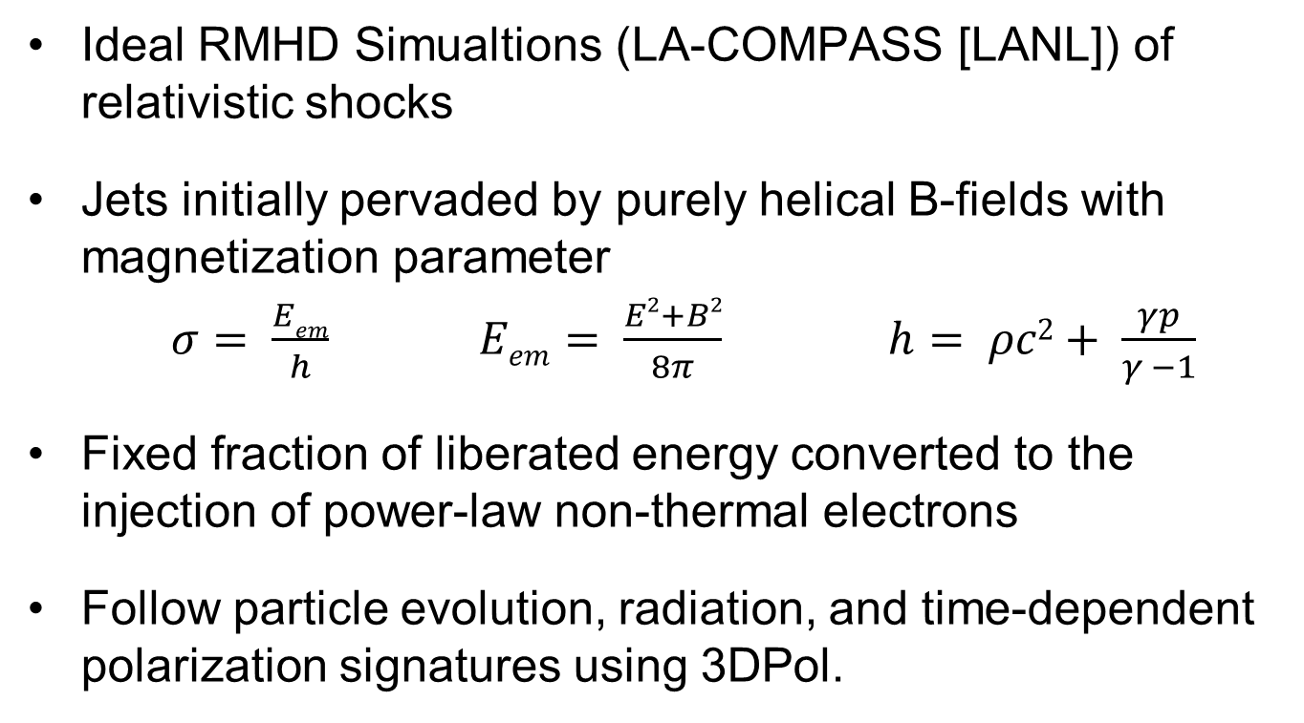
Coupling to Realistic MHD Simulations
Ideal RMHD Simualtions (LA-COMPASS [LANL]) of relativistic shocks
Jets initially pervaded by purely helical B-fields with magnetization parameter
$σ= \frac{Eem}{h}$ $Eem= \frac{E2+B2}{8π}$ $h= ρc2+ \frac{γp}{γ −1}$
Fixed fraction of liberated energy converted to the injection of power-law non-thermal electrons
Follow particle evolution, radiation, and time-dependent polarization signatures using 3DPol.
(Zhang et al. 2016a)

Slide 10
Simulation Setup
(Zhang et al. 2016a)

Slide 11
B-Field Evolution
(Zhang et al. 2016a)
High / moderate magnetization
Weak shock
velocity field strongly disturbed
B-field restored to its original topology after passage of the shock

Slide 12
B-Field Evolution
(Zhang et al. 2016)
Low magnetization
Strong shock
velocity field almost undisturbed
B-field topology significantly altered after passage of the shock

Slide 13
Polarization Signatures
PA swings with PD recovering to its pre-flare level require high / moderate magnetization (σ ≥ 1) - otherwise B-field is not restored to its original topology
Significant flares require strong shocks, i.e., moderate / high shock speed and moderate / low magnetization
(Zhang et al. 2016a)

Slide 14
The Lepto-Hadronic Version
Lepto-hadronic (p-synchrotron dominated) 3D time- and polarization-dependent internal shock model (Zhang, Diltz & Böttcher 2016b)
Model setup as for leptonic (3DPol)
model, but include injection of
ultrarelativistic protons
Electron + proton evolution with locally
isotropic Fokker-Planck equation
Fully time- and polarization-dependent
ray tracing

Slide 15
3D Lepto-Hadronic Internal Shock model
Example case: Magnetic energy dissipation (reducing B-field, additional e and p injection)
(Zhang et al. 2016b)
Snap-Shot SEDs Pol. Deg. vs. Photon Energy

Slide 16
3D Lepto-Hadronic Internal Shock model
MW Light Curves
Pol. vs. time
High-energy (p-sy) polarization signatures much more stable than low-energy (e-sy) signatures, due to slower p cooling:
No PA swings in
X-rays – γ-rays!
(Zhang et al. 2016b)

Slide 17
Summary
0
Polarization-angle swings correlated with MW flares are possible with a straight jet, pervaded by a helical B field. Fit to 3C279 event suggests magnetic energy dissipation as driver of flaring activity.
Coupling with MHD simulations → PA rotations with MW flares require moderate magnetizations (σ ~ 1) and strong (fast) shocks.
3D time- and polarization-dependent radiation transfer simulations for a proton-synchrotron dominated lepto-hadronic model: High-energy
(X-ray/gamma-ray) polarization signatures are expected to be
less variable than low-energy (e-synchrotron) ones.
PA swings in X-rays / γ-rays are unlikely if high-
energy emission has hadronic origin.

