Slide 1
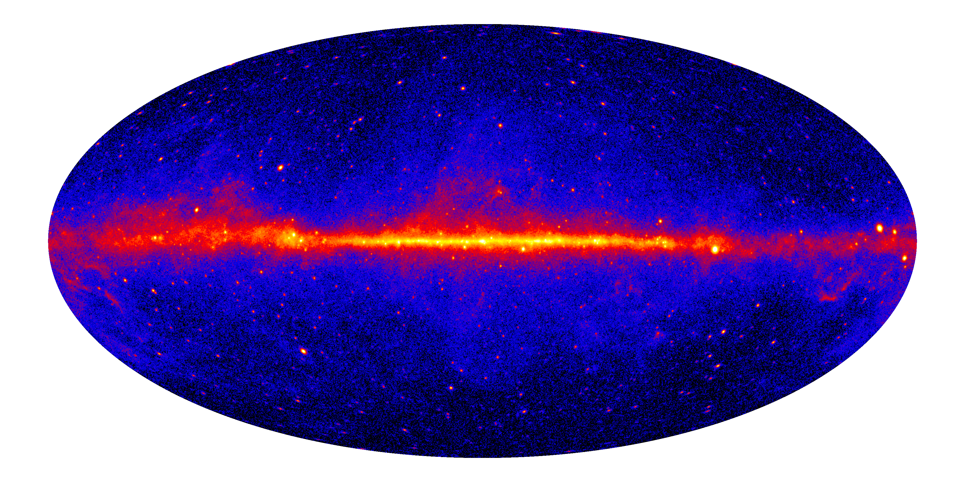
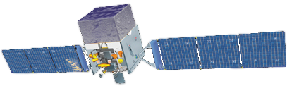
Monitoring the High-Energy Sky:
The Fermi Experience
Dave Thompson
NASA Goddard Space Flight Center
Fermi Deputy Project Scientist
HAP Workshop: Monitoring the Non-thermal Universe
Cochem, Germany
7-10 December, 2016
Notes:
Fermi is a cutting edge observatory to explore the non-thermal universe, enabling the scientific productivity of a diverse and growing user community

Slide 2
Outline
Fermi Gamma-ray Space Telescope characteristics and experience as an all-sky monitor from over 8 years in orbit.
Some examples from Fermi’s all-sky monitoring.
Optimizing the scientific return from the Fermi instruments. How we share information.
Key idea: We learn more about any astrophysical phenomenon by multiwavelength/multimessenger observations.
Notes:
Successor the the compton gamma-ray observatory, one of the great obseratories

Slide 3
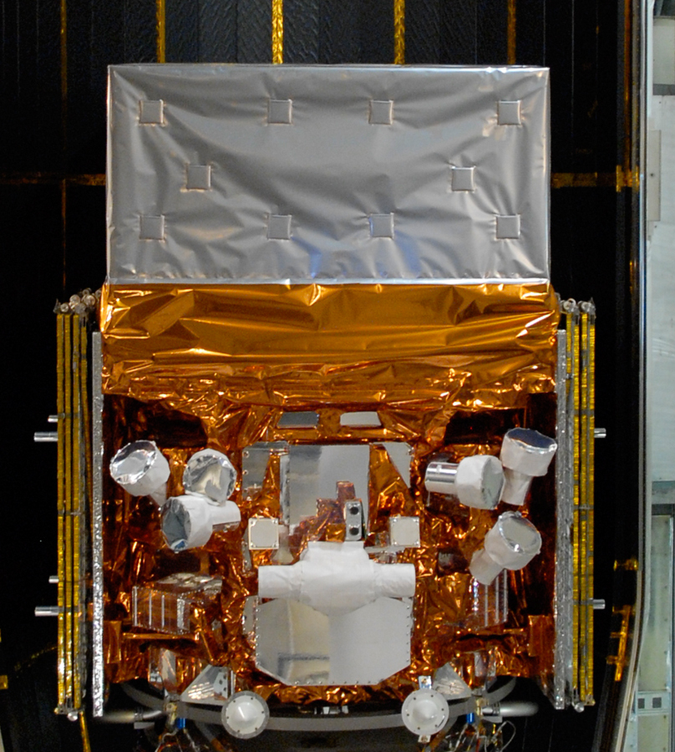
The Fermi Observatory - Characteristics
Huge fields of view
  LAT: 2.4 steradians
  GBM: whole unocculted sky at any time (9 steradians)
Very broad energy range
  Combined coverage about 8 orders of magnitude
Good timing
  Individual photons measured to 1-2 microsecond absolute
All gamma-ray data are immediately public
Large Area Telescope (LAT)
20 MeV - >500 GeV
Gamma-ray Burst Monitor (GBM)
8 keV - 30 MeV
3
Notes:
3
Gamma-ray sources are essentially all non-thermal, so likely to be multiwavelength objects, and many of them are highly variable.

Slide 4
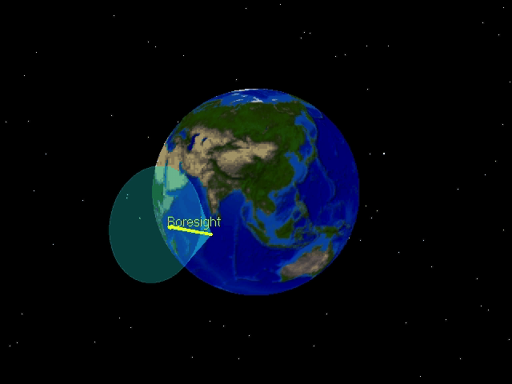
Fermi Survey Mode - Default

Slide 5
Monitoring the Gamma-ray Sky with Fermi
BENEFITS
A satellite is the only way to observe the full sky with a single instrument.
No problem with seasons or day/night (the Sun is just another source for Fermi).
No problem with weather (almost).

Slide 6
Monitoring the Gamma-ray Sky with Fermi
BENEFITS
A satellite is the only way to observe the full sky with a single instrument.
No problem with seasons or day/night (the Sun is just another source for Fermi).
No problem with weather (almost).
LIMITATIONS
The Fermi instruments are not very big. The LAT in particular is limited by photon statistics.
Data collection, transmission, and processing take some time.
Angular resolution is limited.

Slide 7
Some Examples of What the Fermi All-sky Monitoring Has Revealed

Slide 8
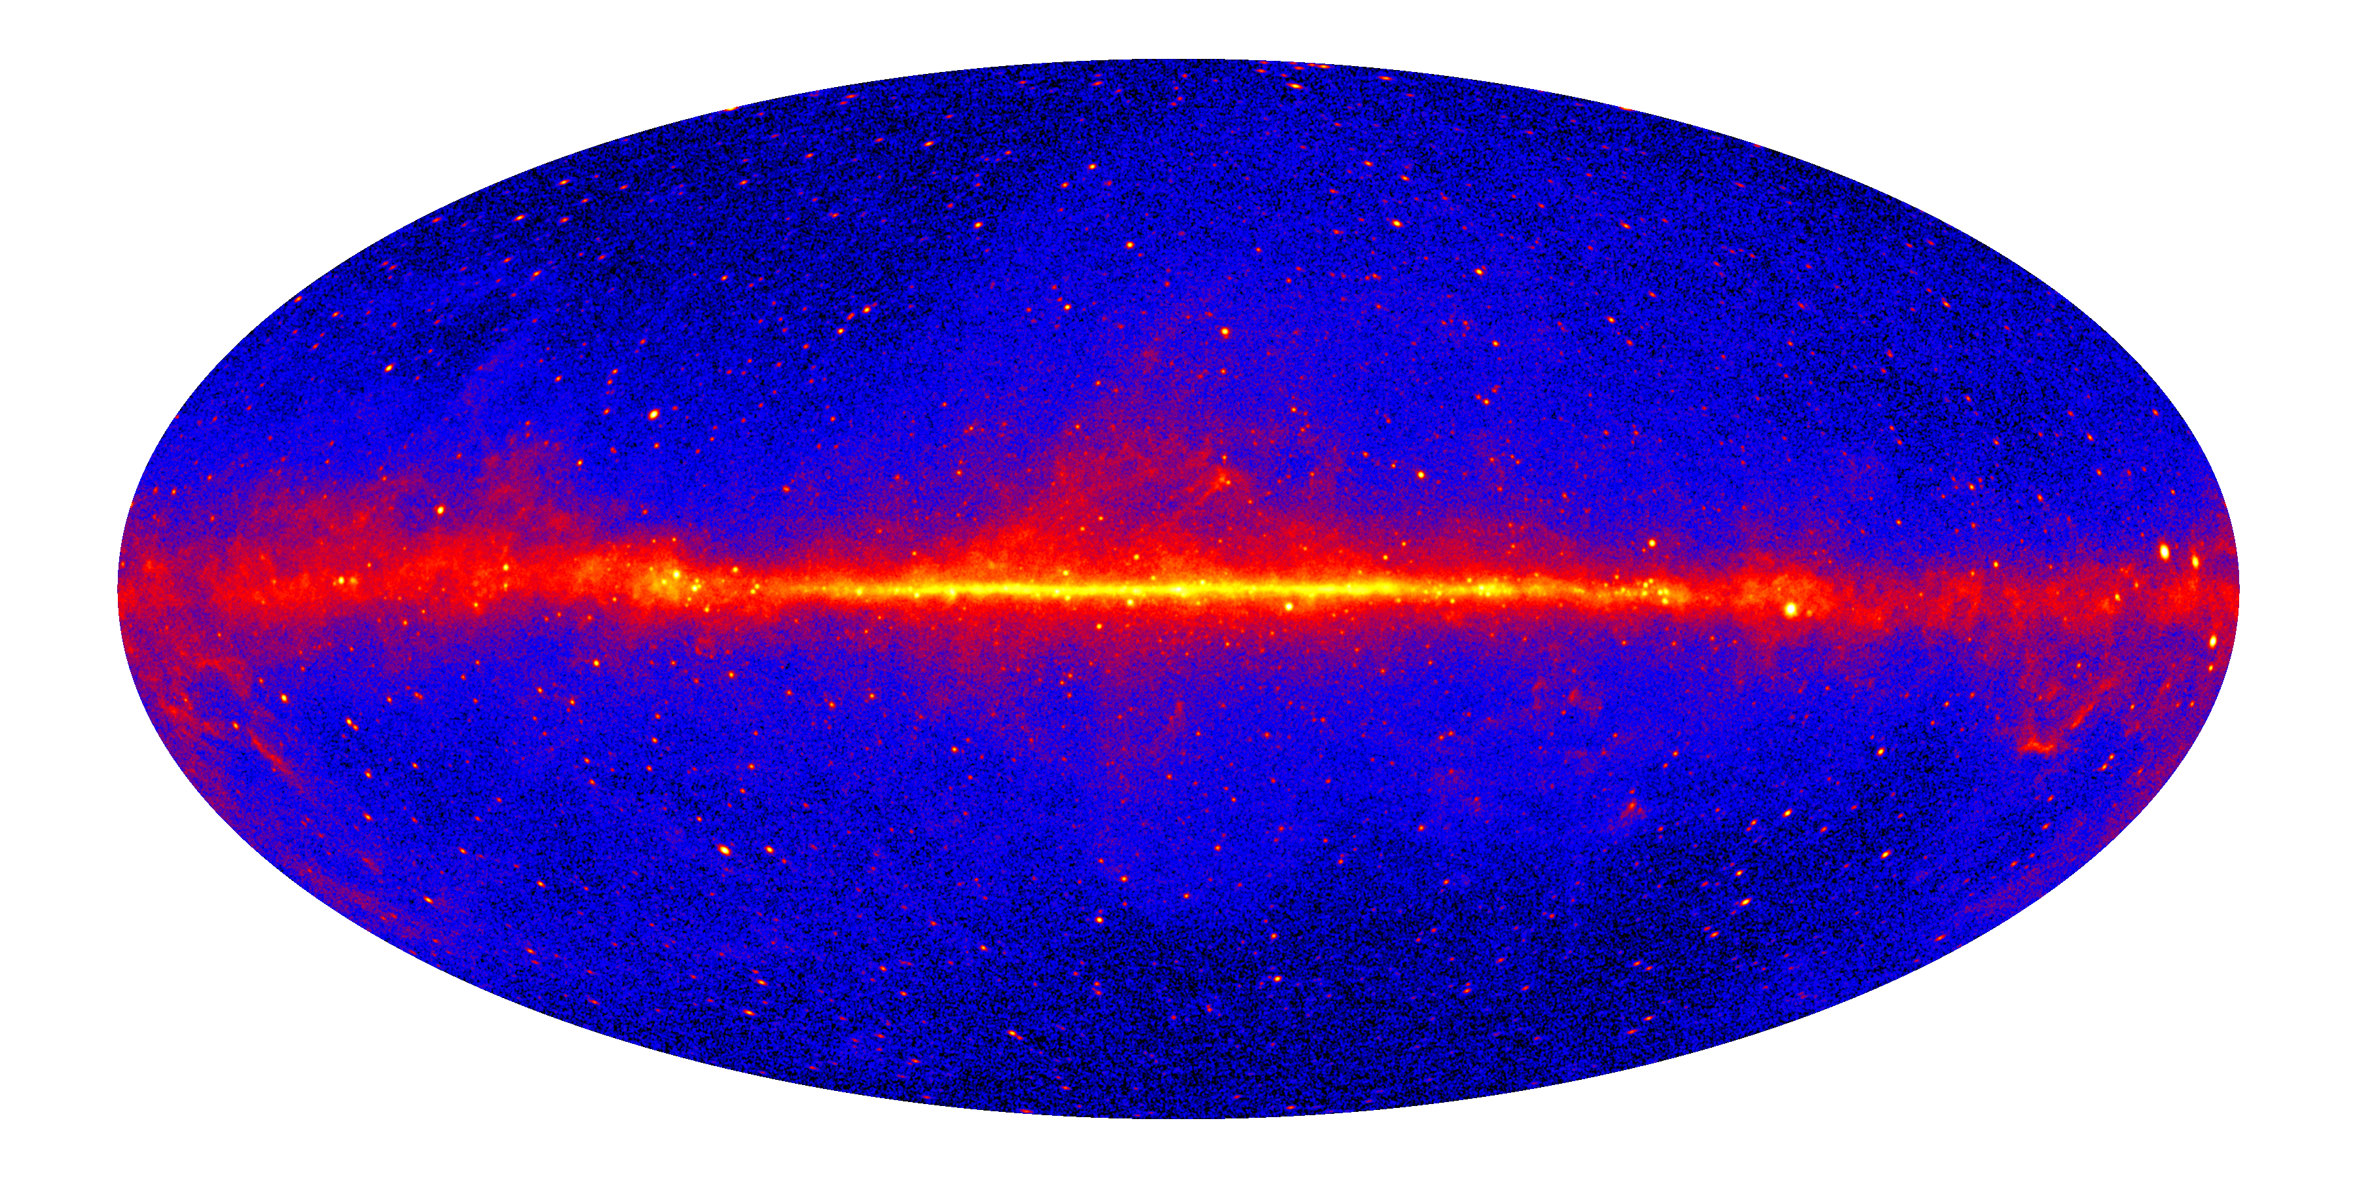
Monitoring - The Big Picture
Energy Range: E>1 GeV Duration: 8 years

Slide 9
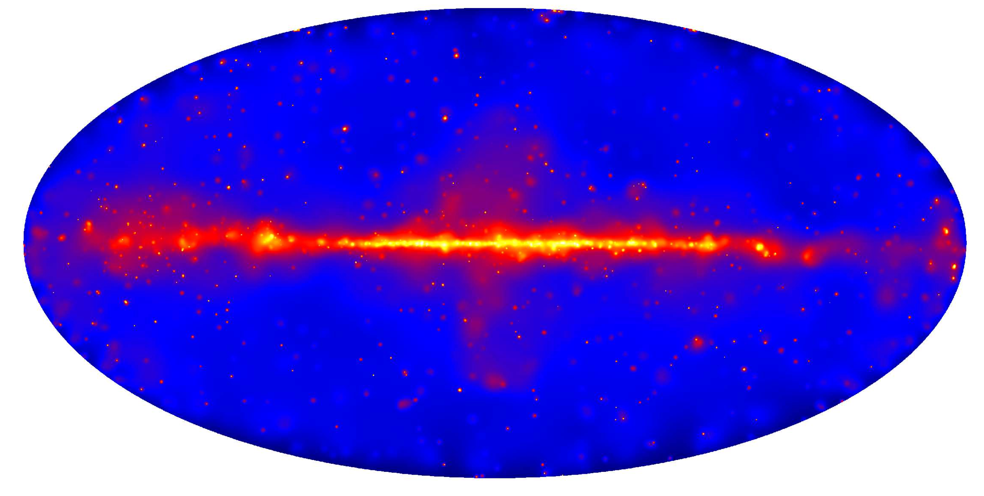
The E>50 GeV All-sky Map
Duration: 80 months

Slide 10
Monitoring – Deeper Exposures
Long exposure revealed a number of point sources in the Large Magellanic Cloud in addition to the spatially extended emission.
Energy Range: E>0.2 GeV Duration: 6 years Ackermann et al. 2016
Notes:
Background-subtracted counts map.

Slide 11
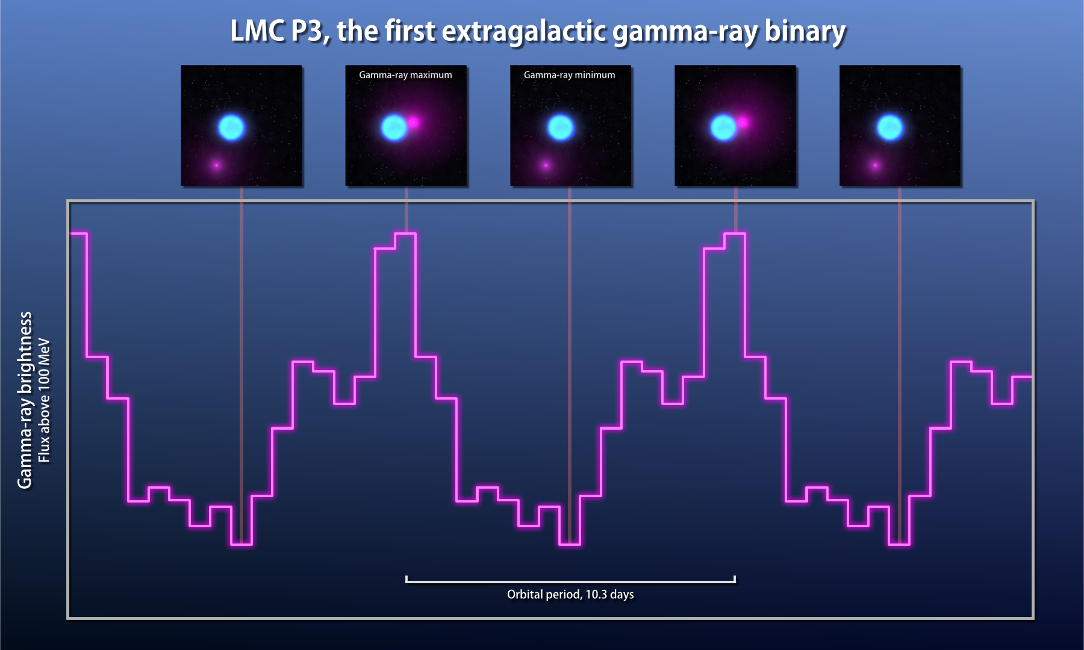
Resolving Sources in the LMC
The source at the position of PSR J0540-6919 has a pulsar-like spectrum (and is a gamma-ray pulsar), while the spectrum of the source at the position of PSR J0537-6910 looks neither like a pulsar nor a pulsar wind nebula (Ackermann et al. 2016 – two papers).
A third LMC source turned out to be a high-mass gamma-ray binary (Corbet et al. 2016)
PSR J0540-6919
PSR J0537-6910/N157B
Notes:
Spatial, statistical, and spectral gains.

Slide 12
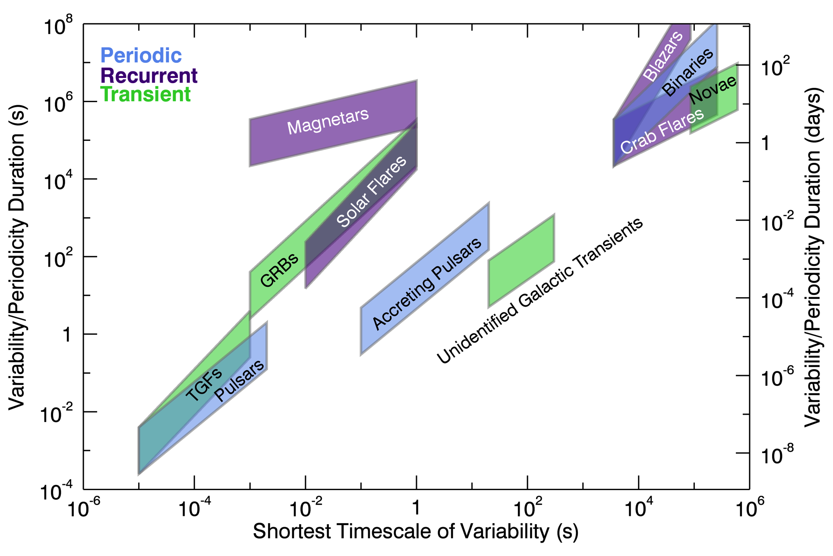
Monitoring and Time-Domain Astrophysics

Slide 13
Transients - Gravitational Wave Event GW150914
Weak signal seen by Fermi GBM
0.4 s after the LIGO trigger
False alarm probability for an event like this 0.0022
Arrival direction consistent with LIGO event, with large uncertainties
Unexpected for a black hole merger
Connaughton et al. 2016
arXiv 1602:03920
Notes:
No claim this is a real counterpart. About 5 such events per day with GBM.

Slide 14
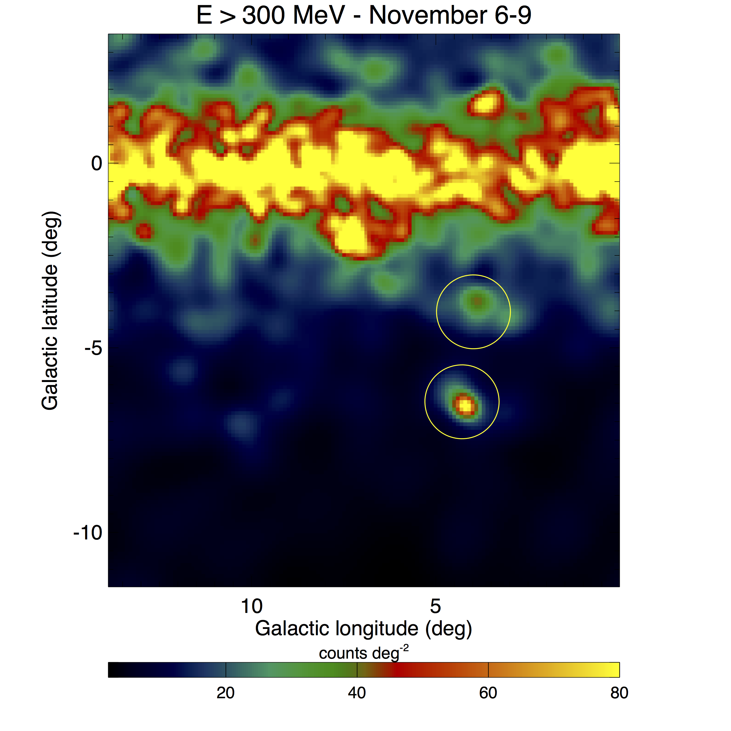
Transients - Gamma-ray Novae
Discovered in Fermi LAT monitoring data
Observable for days to weeks
Unexpected source of particle acceleration.
Typical rate is about one per year
Last month was the first time two were visible in the LAT data at the same time (ATels 9699, 9736, 9771, Li et al)
Credit: Pierre Jean
Notes:
At least one was seen by Fermi before it was seen in the optical (too close to the Sun)

Slide 15
Long-term Monitoring – PSR J2032+4127 System
2017
DISCOVERY
2014
PSR J2032+4127 is a LAT-discovered pulsar also seen in radio, recently discovered to be in orbit around a Be star, with periastron every 45-50 years (Ho et al 2016). Gamma-ray flaring activity may be expected near periastron in late 2017.
Notes:
Originally thought to be 25-year orbit with periastron in 2018.

Slide 16
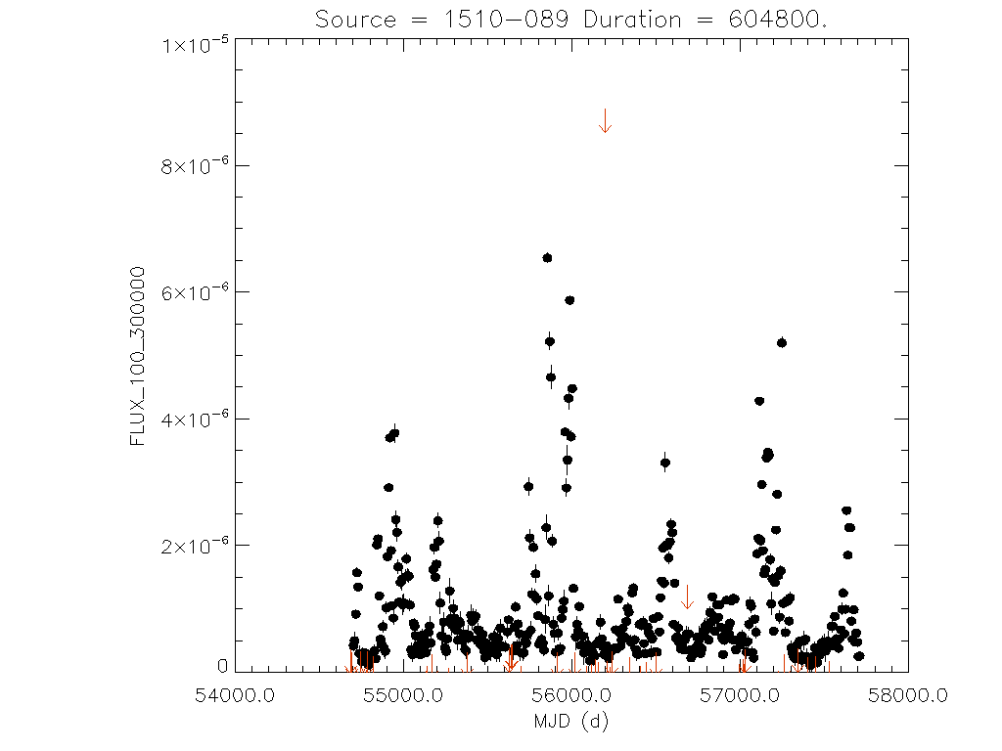
Long-Term Monitoring – 1510-089
Eight-year weekly light curve of this blazar

Slide 17
Long-term Variability – Periodic Blazar?
Fermi LAT sees apparent quasi-periodic variability from BL Lac object PG 1553+113 (Ackermann et al 2015). If this ~2-yr pattern continues, it might suggest a binary supermassive black hole system.
Flux > 1 GeV
Flux > 100 MeV

Slide 18
Optimizing the scientific return from the Fermi instruments. How we share information.

Slide 19
Optimizing the scientific return from the Fermi instruments. How we share information.
Two fairly obvious considerations:
Gamma rays by themselves cannot answer all the scientific questions. We really need multiwavelength/multimessenger partners.
Although there are monitoring programs for some sources, there are few (if any) all-sky monitoring programs like Fermi’s.

Slide 20
  Public High-Level Fermi Data Products - Examples
  Found at the Fermi Science Support Center http://fermi.gsfc.nasa.gov/ssc/
  General Catalogs – the next two catalogs (in 2017) will be
  3FHL – more than 1500 sources seen above 10 GeV
  4FGL – all Fermi LAT energies
  Specialized catalogs – pulsars, gamma-ray bursts, others
  Public automated light curves, such as the one shown earlier for 1510-089

Slide 21
  Public High-Level Fermi Data Products
  Recent Addition – Fermi All-sky Variability Analysis (FAVA)
  Found at the Fermi Science Support Center http://fermi.gsfc.nasa.gov/ssc/
  Basic idea: use the long-term Fermi LAT observations as a baseline for the “average” gamma-ray sky, then look for differences from that average.
  The FAVA map, updated weekly, shows flares.
  FAVA is also able to generate a relative gamma-ray light curve for any point on the sky.

Slide 22
  Public High-Level Fermi Data Products
  Rapid Releases
  Gamma-Ray Bursts (GRBs), inherently fast and bright, provide the fastest release of information from the Fermi instruments. On-board analysis, followed by transmission through the TDRS System and the Gamma-ray Coordinates Network (GCN), allows burst alerts to be sent within seconds of the actual burst.
  No other gamma-ray sources are bright enough to allow on-board recognition.
Notes:
Meeting after the Fermi Symposium emphasized the community interest in the fastest possible releases of information.

Slide 23
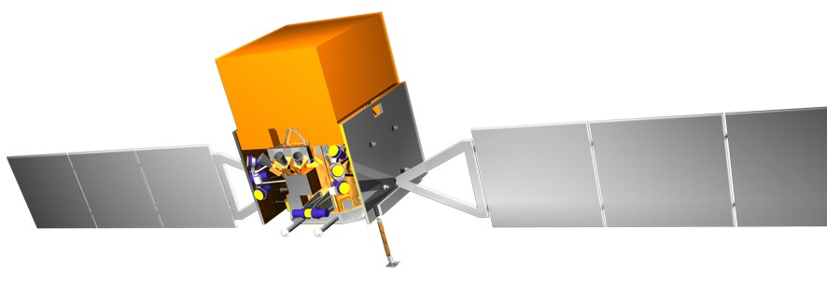
Fermi LAT Data Latency
LAT DATA PATH
T 0
T 1
T 2
T 3
T 4
T 7
T 10
T 11
T 14
Mission Operation Center
LAT Instrument Science Operations Center
Fermi Science Support Center
Fermi
White Sands Complex
GSFC
SLAC
GSFC
270m
+ 9m
+ 27m
+ 47m
+ 27m
+ 26m
+ 60m
+ 5m
+ 10m
= 481m
= 8h01m
Data sit on SSR
4.3Mbps
Nominal case, assuming no manual intervention or new calibrations.
Data ingest
Level 0 processing.
Changing downlink scheduling to reduce time that data sit on SSR
Parallelizing data transfer from White Sands provides additional saving

Slide 24
Data Latency Improvements
Significantly improved performance after Flight Operations team optimization
Still improving scripts that process the data when available at the Science Support Center

Slide 25
Sharing LAT Alerts
  Public - Astronomer’s Telegrams, GCN Notices
  http://www.astronomerstelegram.org
  http://gcn.gsfc.nasa.gov/fermi_lat_mon_trans.html
  Semi-public – gamma-ray/multiwavelength mailing list
  https://lists.nasa.gov/mailman/listinfo/gammamw
  Direct e-mails under Memoranda of Understanding
  Recent addition – information about individual
  gamma rays with energies greater than 10 GeV

Slide 26
Summary
After eight years in orbit, the Fermi Gamma-ray Space Telescope continues to monitor the high-energy sky, providing a broad range of results related to simultaneous and near-simultaneous multiwavelength and multimessenger observations. NASA has approved Fermi for at least two more years of operation.
If you have questions or comments about Fermi’s monitoring programs or data sharing, please contact me: David.J.Thompson@nasa.gov

