Slide 1
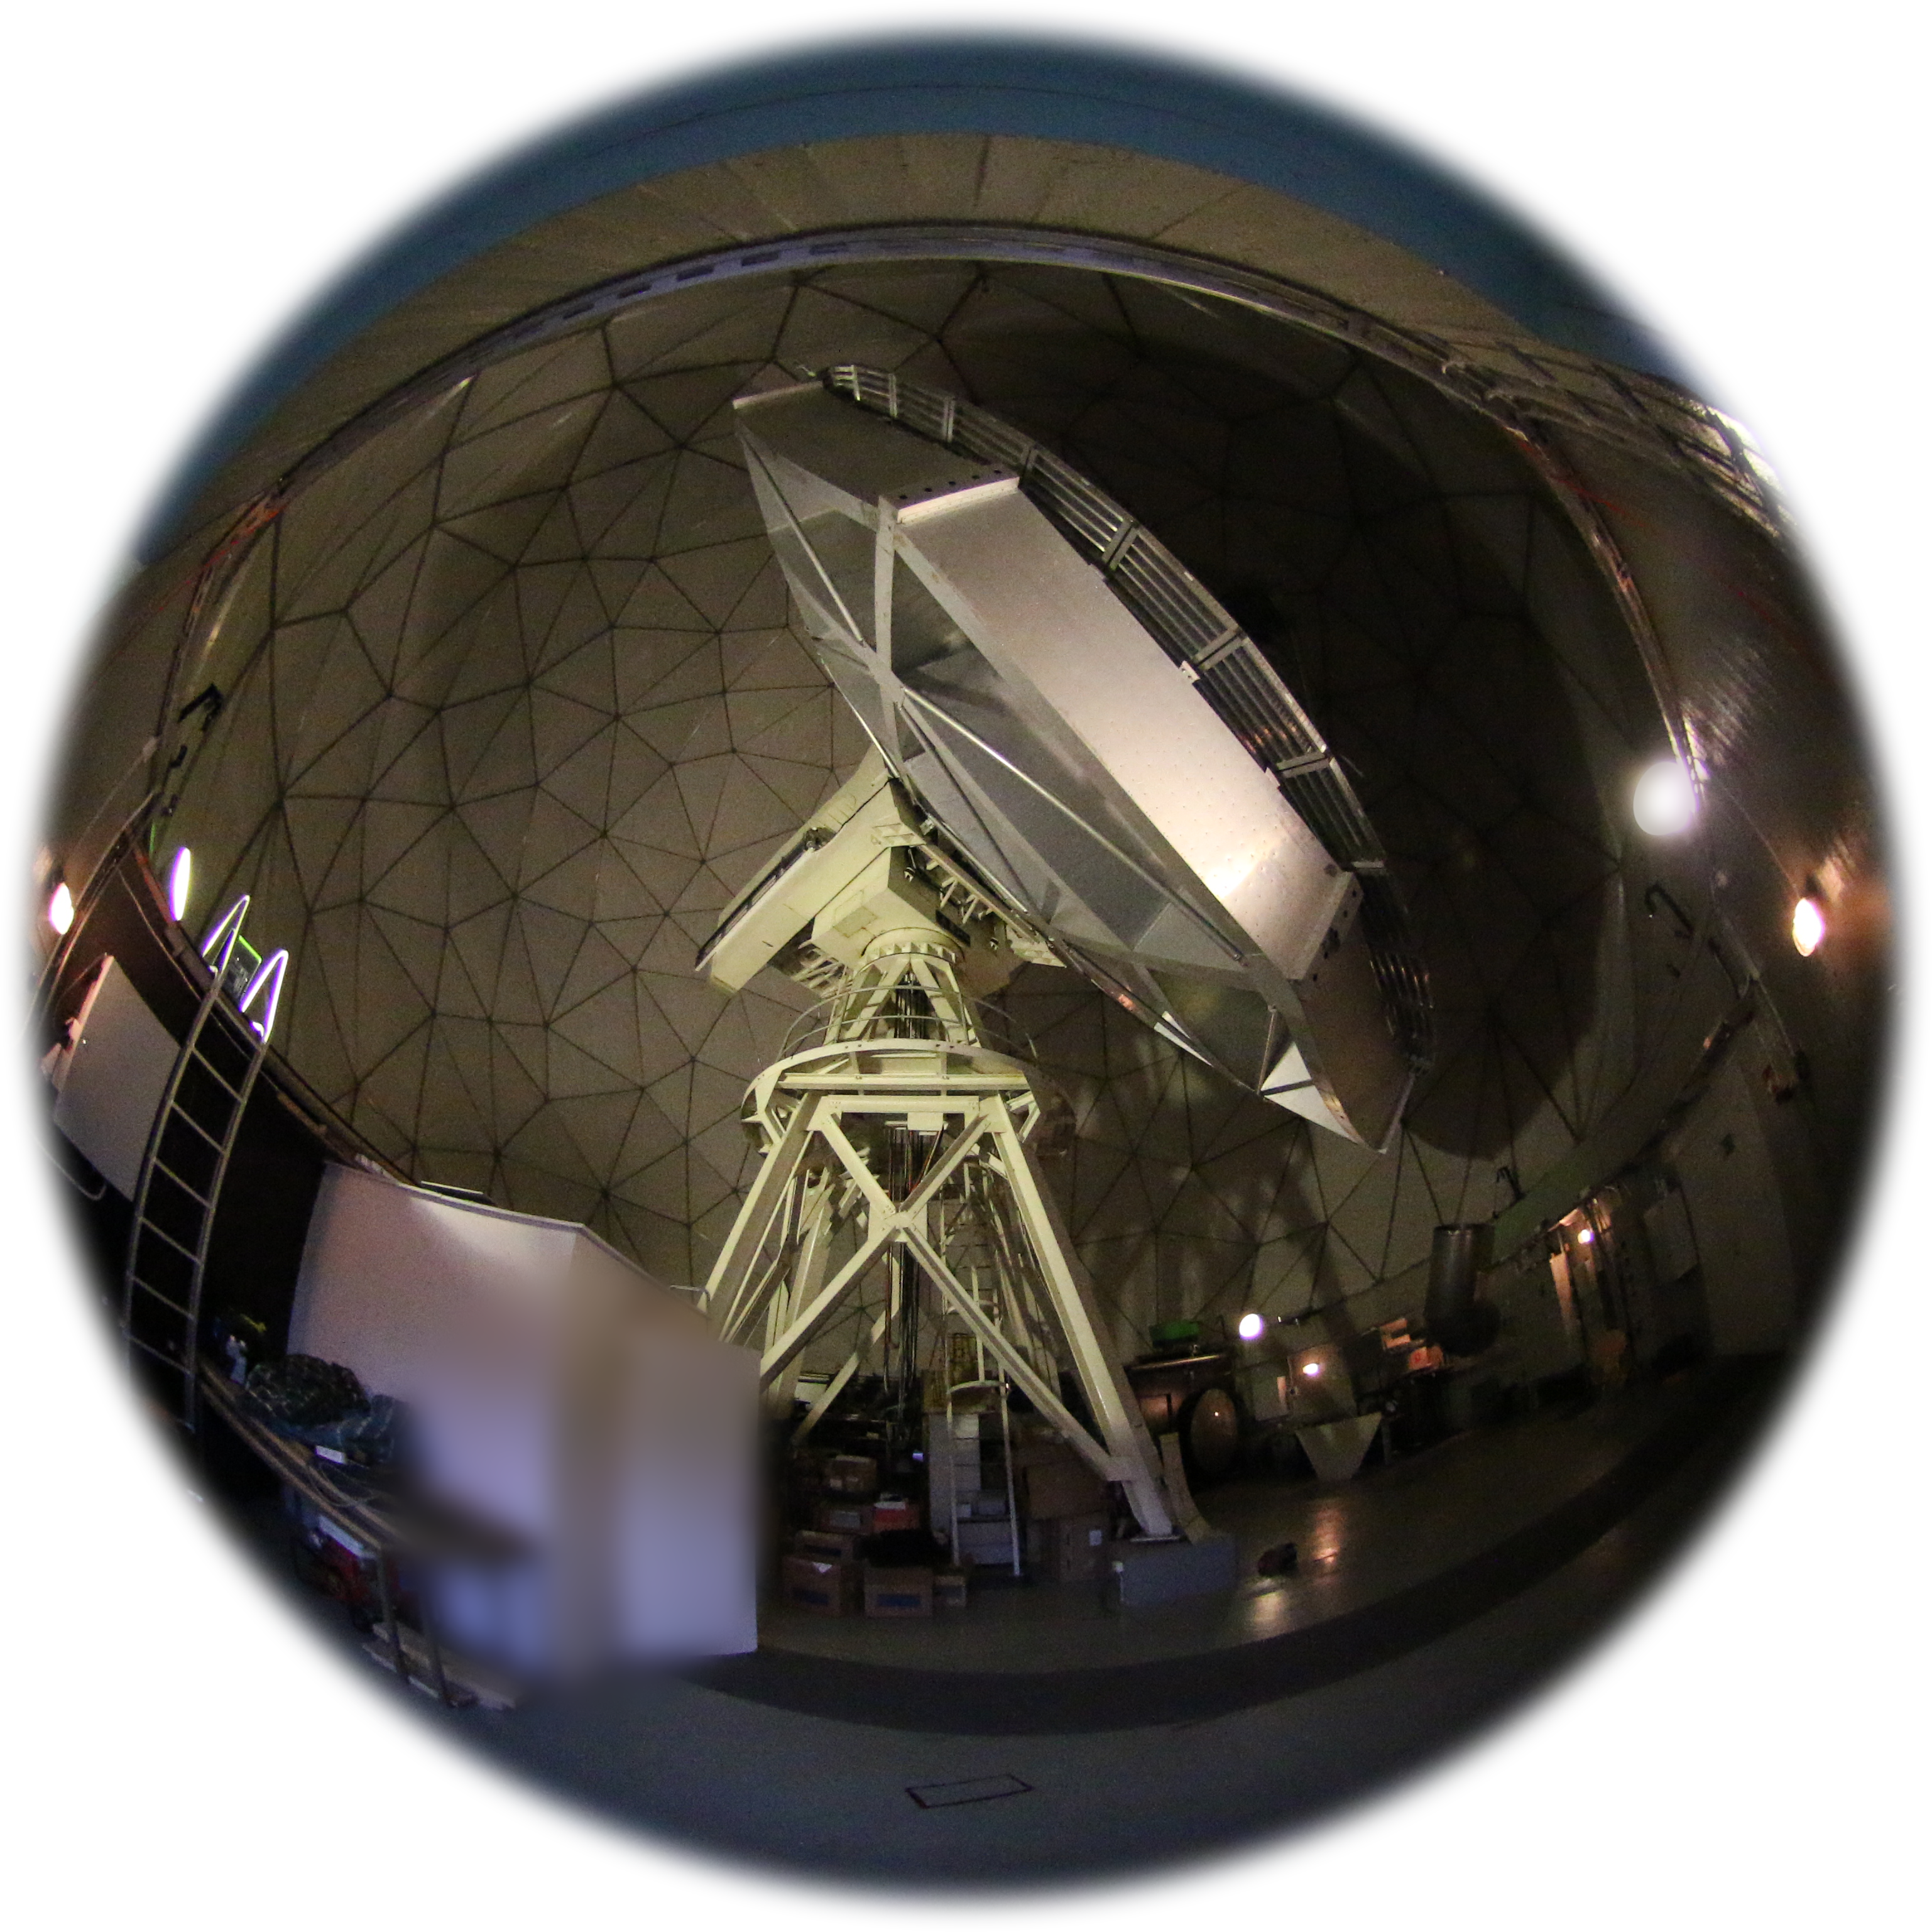
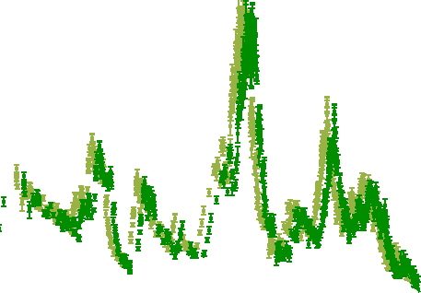
Radio monitoring at Metsähovi
Merja Tornikoski Aalto University Metsähovi Radio Observatory with: A. Lähteenmäki, J. Tammi, T. Hovatta, E. Järvelä, V. Ramakrishnan, R. J. C. Vera Rodriguez, W. Chamani, S. Enestam

Slide 2
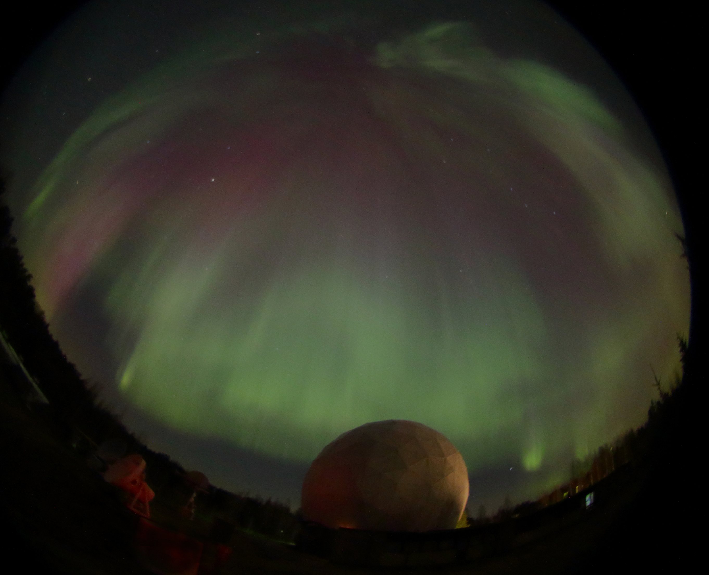
Metsähovi Strengths
We are still operational!
Plenty of observing time
70% primarily for the AGN program > 80% nighttime observations
Flexible scheduling, quick reactions

Slide 3
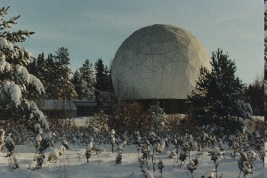
Weaknesses
Continuous pressure to “sell telescope time”, and other funding-related issues (incl. new radome, receiver update, etc.)
Still no polarization observations ☹
Limited sensitivity
Preferably observe sources >= 0.5 Jy.
Relatively long integration times →max ca. new 40 data points per 24h.
Finnish weather & high radio frequncies:
Sometimes long weather-induced gaps in the autumn (Nov/Dec).
On the other hand, winters are often excellent for observations.

Slide 4
Source lists
Full list: over 2000 sources
Have been observed at least once at 37 GHz, most of them many times.
Many multi-epoch observations during specific projects (e.g., complete BLO sample, WMAP id candidates, etc.)
High priority list: 440 sources
Observations regularly but not weekly for all of them
Long term monitoring list: ca. 100 sources
Goal: weekly observations (daily during intensive campaigns)
Long time series, 30+ years
Some “new” sources added from other lists
Dedicated samples: GPS, BLO, Planck-prelaunch, Planck simultaneous, NLSy, ...
Focus on 37 GHz observations, the core list also at 22 GHz

Slide 5
Monitoring data into science
Variability studies
Timescales, flare characteristiscs, shock models, ...
Blazar sequence
Various subsamples, effects of Doppler boosting, ...
Radio to high-energy connections
Correlations from long & dense sampling, Complete Northern sample with Planck data, ...
GPS sources and other young sources
Identification, classification, evolutionary scenarios
Narrow-line Seyfert 1 galaxies
Role of jets, place in evolutionary scenario
Masses of SMBH vs. other properties
Momentarily
hiatus, will
revisit again
Currently
working on
these (or revisiting)

Slide 6
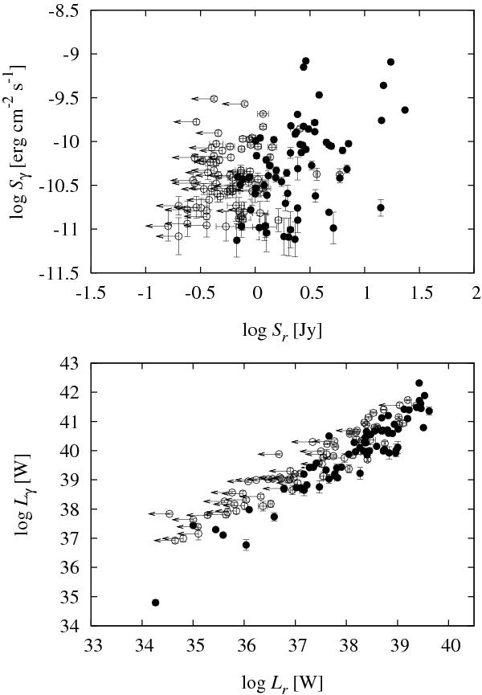
Radio vs. gamma
Initially 1FGL vs. Metsähovi 37 GHz data for 249 northern AGNs (including a complete sample of 68 with S > 1 Jy):
Significant correlation between the gamma-ray and 37 GHz flux densities for our whole sample, as well as HPQ and QSOs. For BLOs and LPQs the correlation is not significant.
Significant correlation for gamma-ray and radio luminosities.
BLOs are different gamma-ray emitters than quasars. Stronger Doppler boosting for quasars? Or inherently different emission mechanisms?
(Nieppola, Tornikoski, Valtaoja et al. A&A 535, A69, 2011)

Slide 7
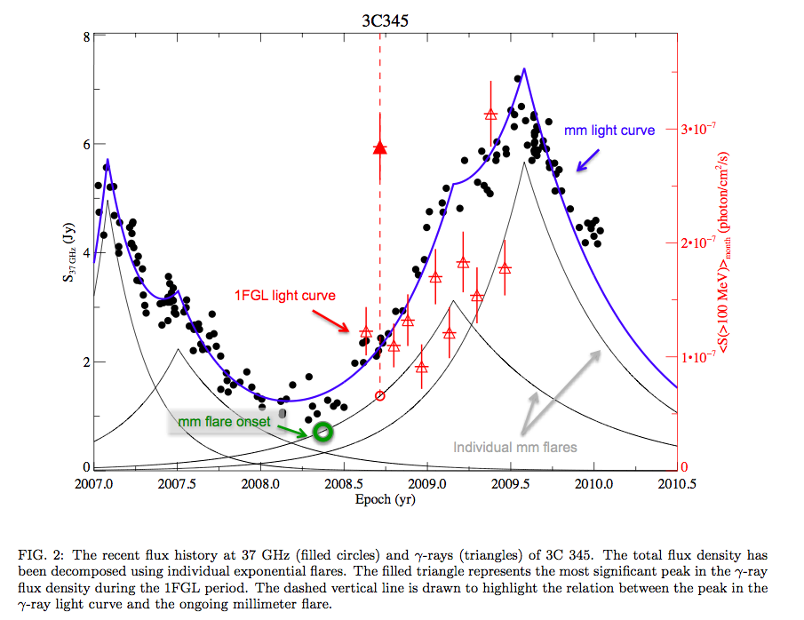
Flux curves and flares:
Positive correlation for quasars, absent for BLOs.
(León-Tavares, Valtaoja, Tornikoski et al. A&A 532, A146, 2011)

Slide 8
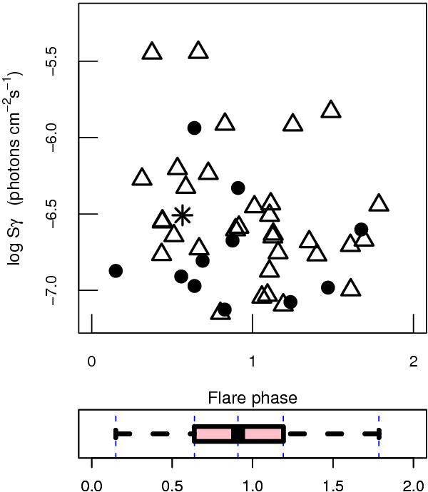
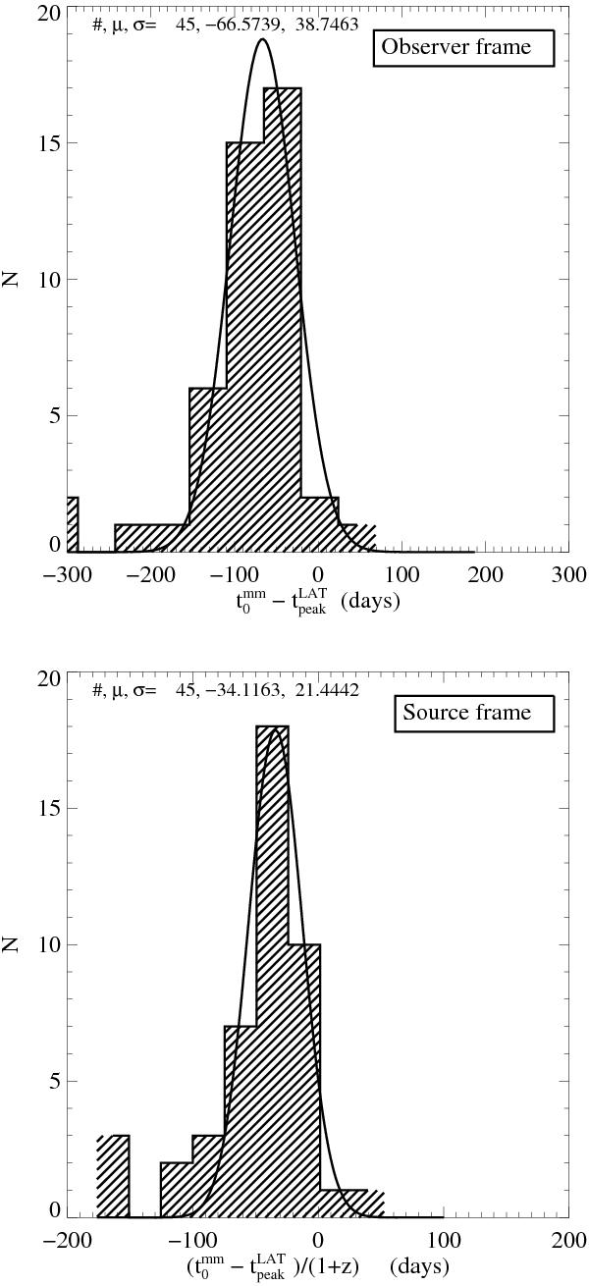
Flux curves and flares:
The brightest γ-ray events coincide with the initial stages of a mm-flare.
The mean observed delay from the beginning of a mm-flare to the peak of the γ-ray emission is about 70 days
(León-Tavares, Valtaoja, Tornikoski et al. A&A 532, A146, 2011)

Slide 9
Re-visiting radio to gamma-correlations
55 sources from our 37 GHz monitoring sample & LAT (Ramakrishnan et al. 2015)
Five years of data
26 sources with significant correlations
In most sources, γ-rays lead the radio (+20 to +690 days)
Stacked correlation is +80 d for the whole sample
Start times of activity correlate (Bayesian block analysis)
15 sources at 37 (Metsähovi) & 95 GHz (CARMA) & R & LAT (Ramakrishnan et al. 2016)
2.5 years of data
Two sources with 37 GHz vs. gamma –correlation, four with 95 GHz vs. gamma, six with R vs. gamma
Near-zero time delays with 37 vs. 95 GHz for most sources

Slide 10
(Ramakrishnan et al. 2015)

Slide 11
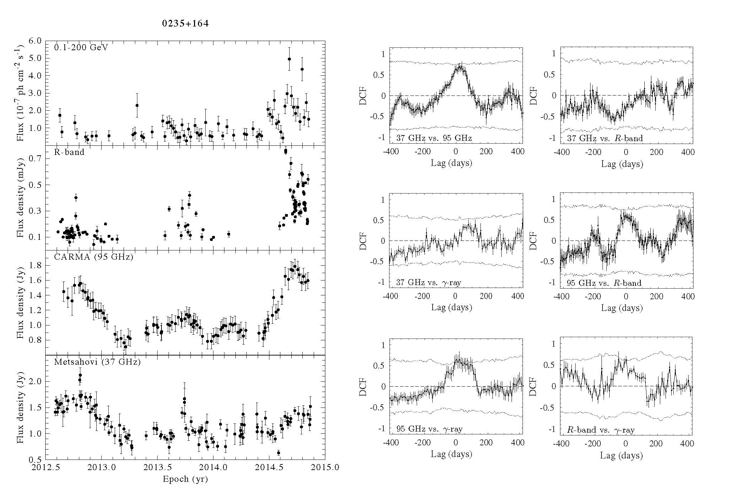
(Ramakrishnan et al. 2016)

Slide 12
But! 2.5 years vs. 5 years of data
Even in well-known flaring sources
radio flares don’t occur very frequently
Typical peak-to-peak timescale is ca. five years.
9 times out of 10 we are likely to see a source in the quiescent (51%) or intermediate (38%) state.
Long-term monitoring is essential!

Slide 13
Peaked-Spectrum Sources
Old confined sources?
Young evolving sources?
Recurrent activity?
Our interest originally:
Planck satellite’s foreground.
Identification of new extreme-peaking populations.
Our interest later:
Source evolution and other scenarios.
Contamination of the peaked-spectrum source samples.
Identification methods.
CSS: Compact Steep Spectrum source
GPS: Gigahertz Peaked Spectrum source
HFP: High Frequency Peaker

Slide 14
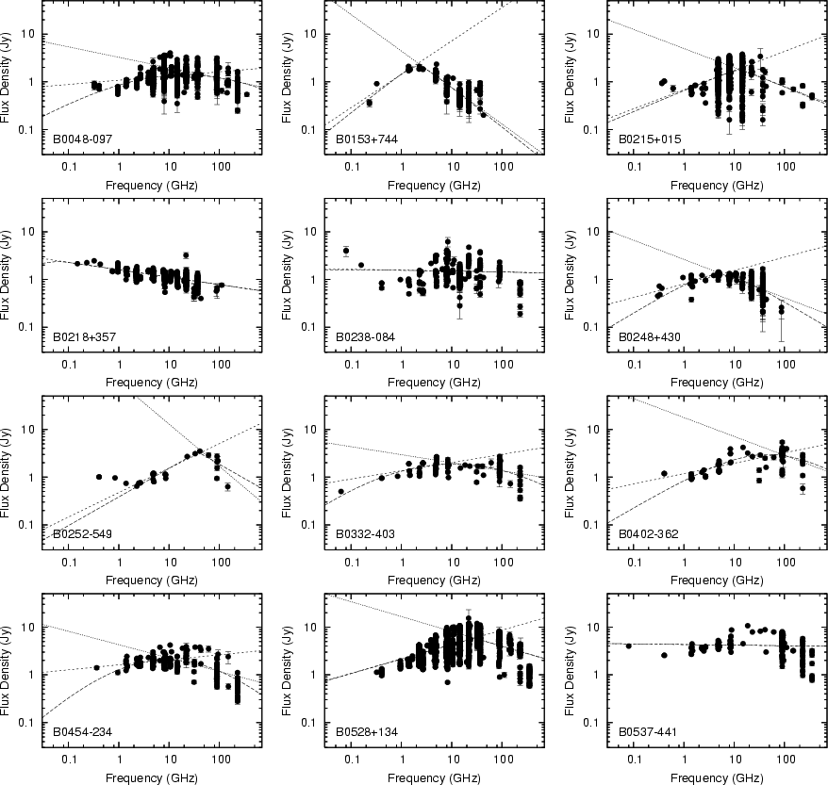
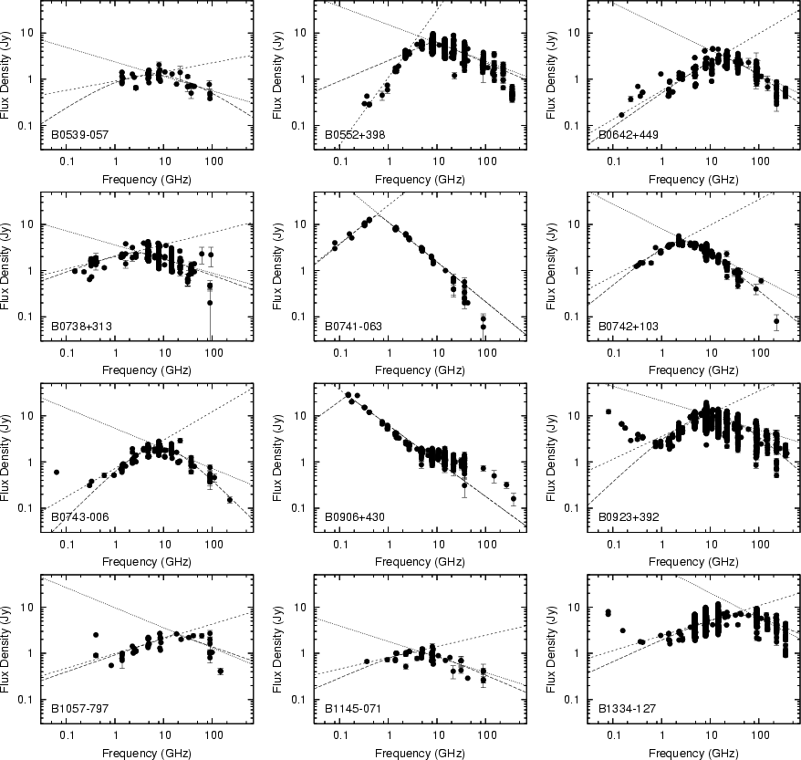
Earlier studies did not take variability into account → original GPS source samples were severely contaminated by flaring sources!
(Torniainen et al. 2005, A&A 435, 839)

Slide 15
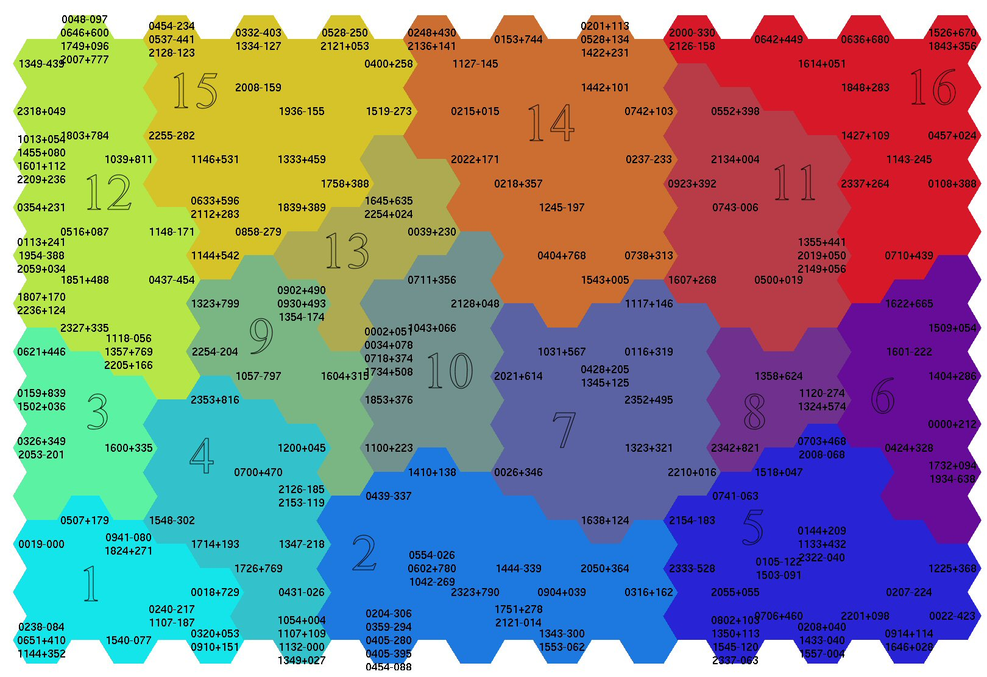
Source classification using Self-Organising Maps (Torniainen et al. 2008): Even the genuine GPS sources form several clusters → differences in addition to the quasar/galaxy –dualism.
High
variability,
very bright
Flat spectra, high pol.,
high variability
Incorrect classific,
Genuine GPS sources
Different types of young sources
Possible GPS sources, data too sparse to confirm

Slide 16
Now: Revisiting Peaked-Spectrum Sources
More sources, more parameters.
But we are still not in the realm of Big Data!
Improved methods for “intermediate-size data”: not so “sexy”, but potentially very useful in many fields of astronomy and beyond!
Experimenting with several Neural Network analysis methods and their modifications (Rafael J. C. Vera’s PhD work in progress)
Multi-dimensional scaling (MDS)
T-distributed Stochastic Neighbor Embedding (T-SNE)
And other non-linear dimensionality reduction methods

Slide 17
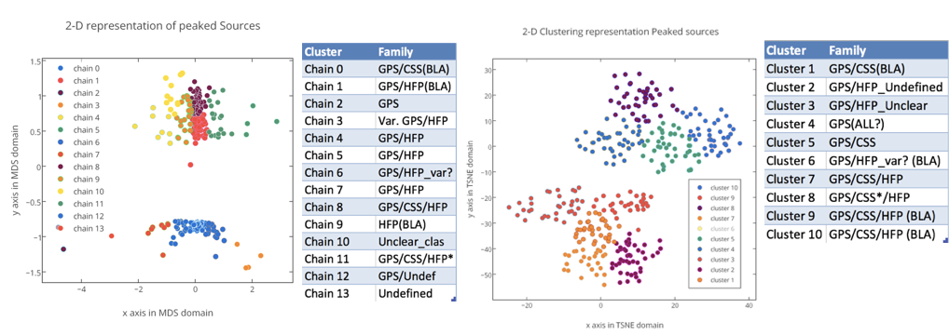
Preliminary results
Data mainly falls into two superclusters.
Some high variability GPS and CSS are grouped with blazars that were previously misclassified as GPS.
“Genuine” GPS and CSS clusters are dominating the upper supercluster of the data, meanwhile the lower supercluster is dominated by clusters with blazar contamination and highly variable sources.

Slide 18
Narrow-line Seyfert1 galaxies
A homogeneous class, or several parent populations?
Radio emission from jets or star formation processes?
Only a fraction are radio-loud.
Detection of gamma-ray emission boosted the jetted scenario.
Metsähovi NLS1 samples
160 NLS1 galaxies.
Pilot survey results submitted, ongoing for the rest.
Detections or not? Variability?
Complemented with RATAN, OVRO and Planck data.

Slide 19
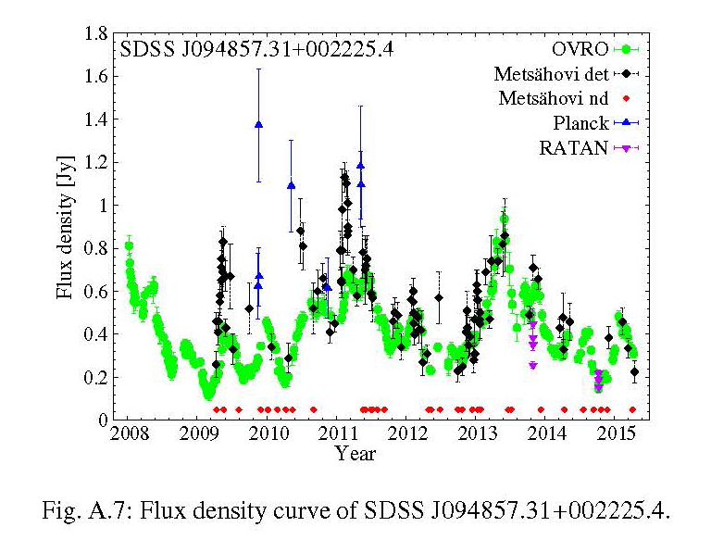
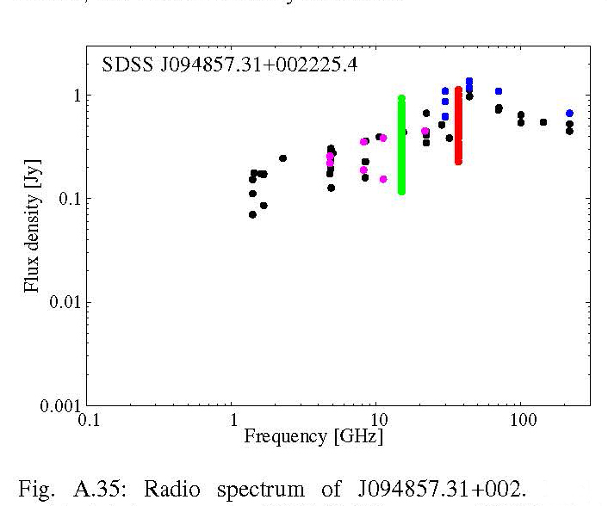
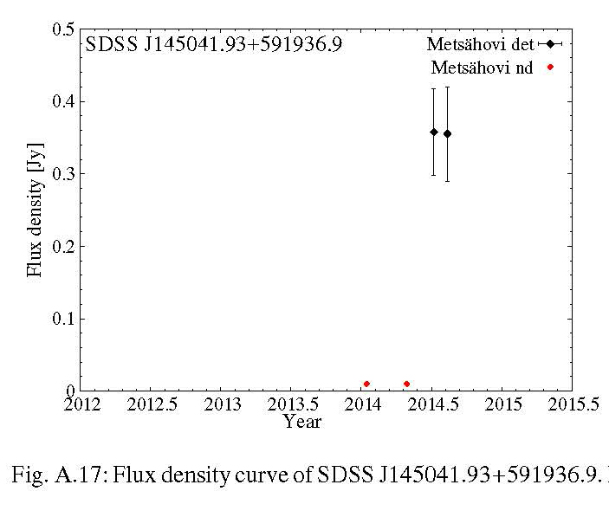
→ Larger number of jetted sources than initially assumed?
Lähteenmäki et al., A&A, submitted

Slide 20
Role of SMBH masses in AGNs
Do more massive BHs produce
faster jets? more luminous jets? faster flares? faster flare rates? brighter flares? more extreme SEDs?
Problems: Observational data are sparse and diverse!
Notes:
Blazars (active, variable, jetted AGNs): how do the various properties depend on the black hole mass?
- Do more massive BHs produce faster jets?
- Do more massive BHs produce more luminous jets?
- Correlation with the SED (spectral energy distribution) peak luminosity and(or) the peak frequency?
More generally: how is the formation of jets / type of AGN affected by the central BH.
- Mass
- Role of accretion rate (accretion rate vs. jet luminosity)
- Subtypes of AGNs to consider:
-- BLO (BL Lacertae Objects) vs. FSRQ (Flat-spectrum radio quasars)
-- HERG vs. LERG (High / Low-excitation radio galaxies)
-- LLAGN (Low-luminosity AGN) vs. other AGNs, blazars
-- GPS (Gigahertz-peaked spectrum sources)
-------
Points to consider:
- How consistent/reliable are the various methods for determing BHM,
including published data from different sources?
- Bulge magnitude vs. BHM relation.
- Non-virial BLR (Broad-line region)?
Observational data are sparse and diverse! (Jet speeds, black hole masses, accretion rates...)

Slide 21
Revisiting the SMBH masses
Work in progress (Sissi Enestam’s recently launched PhD project)
Collect representative samples of new data.
Correlation with other properties.
Comparison of masses obtained through different methods.
Effect of BLR models.
Starting with our 50 blazar sample, extending to other source types.

Slide 22
Ultimate goal: combining the various source samples and extensive sets of data
At some point: connections with our “blazar sample” and all the BLO & GPS & NLSy1 & LLAGN etc. work!
Source classification: the basic properties
Evolutionary scenarios
Blazar sequence etc.
Perfect testbed for our new classification methods, hopefully applicable to many other research problems!

Slide 23
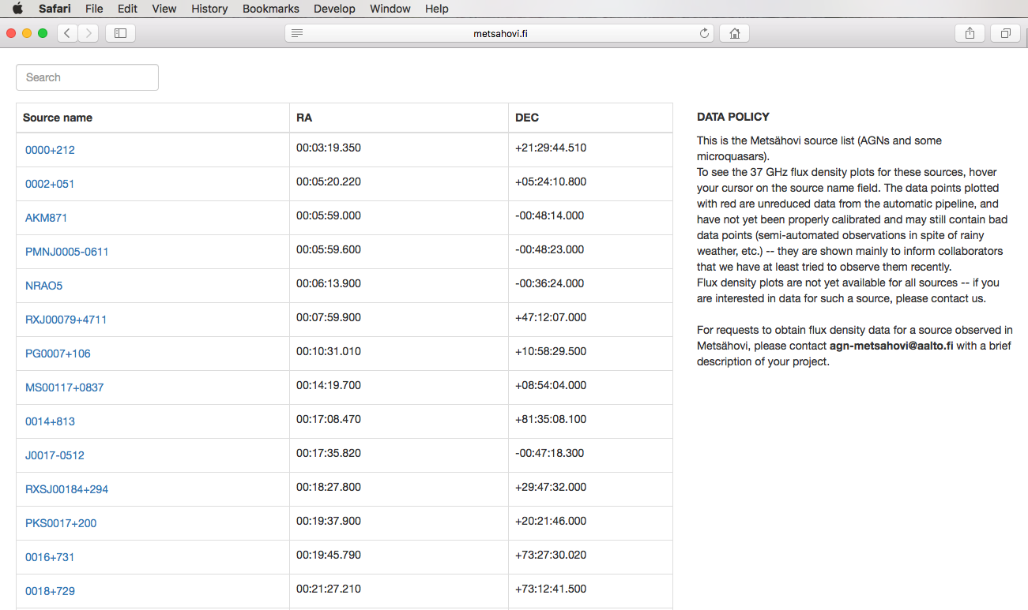
MRO flux curve database
http://www.metsahovi.fi/AGN/data/

Slide 25
Summary
Dedicated monitoring programmes with flexibility to add new source samples can open up a wealth of new research directions.
Long term monitoring is the key to understanding the various variability phenomena.
37 GHz is in many cases an optimal frequency band: near-simultaneity with 3 mm, but typically easier to obtain (sea level site, receiver technology, etc.)
New sophisticated data analysis methods can shed light to questions related to source classification and evolution, etc.

Slide 26
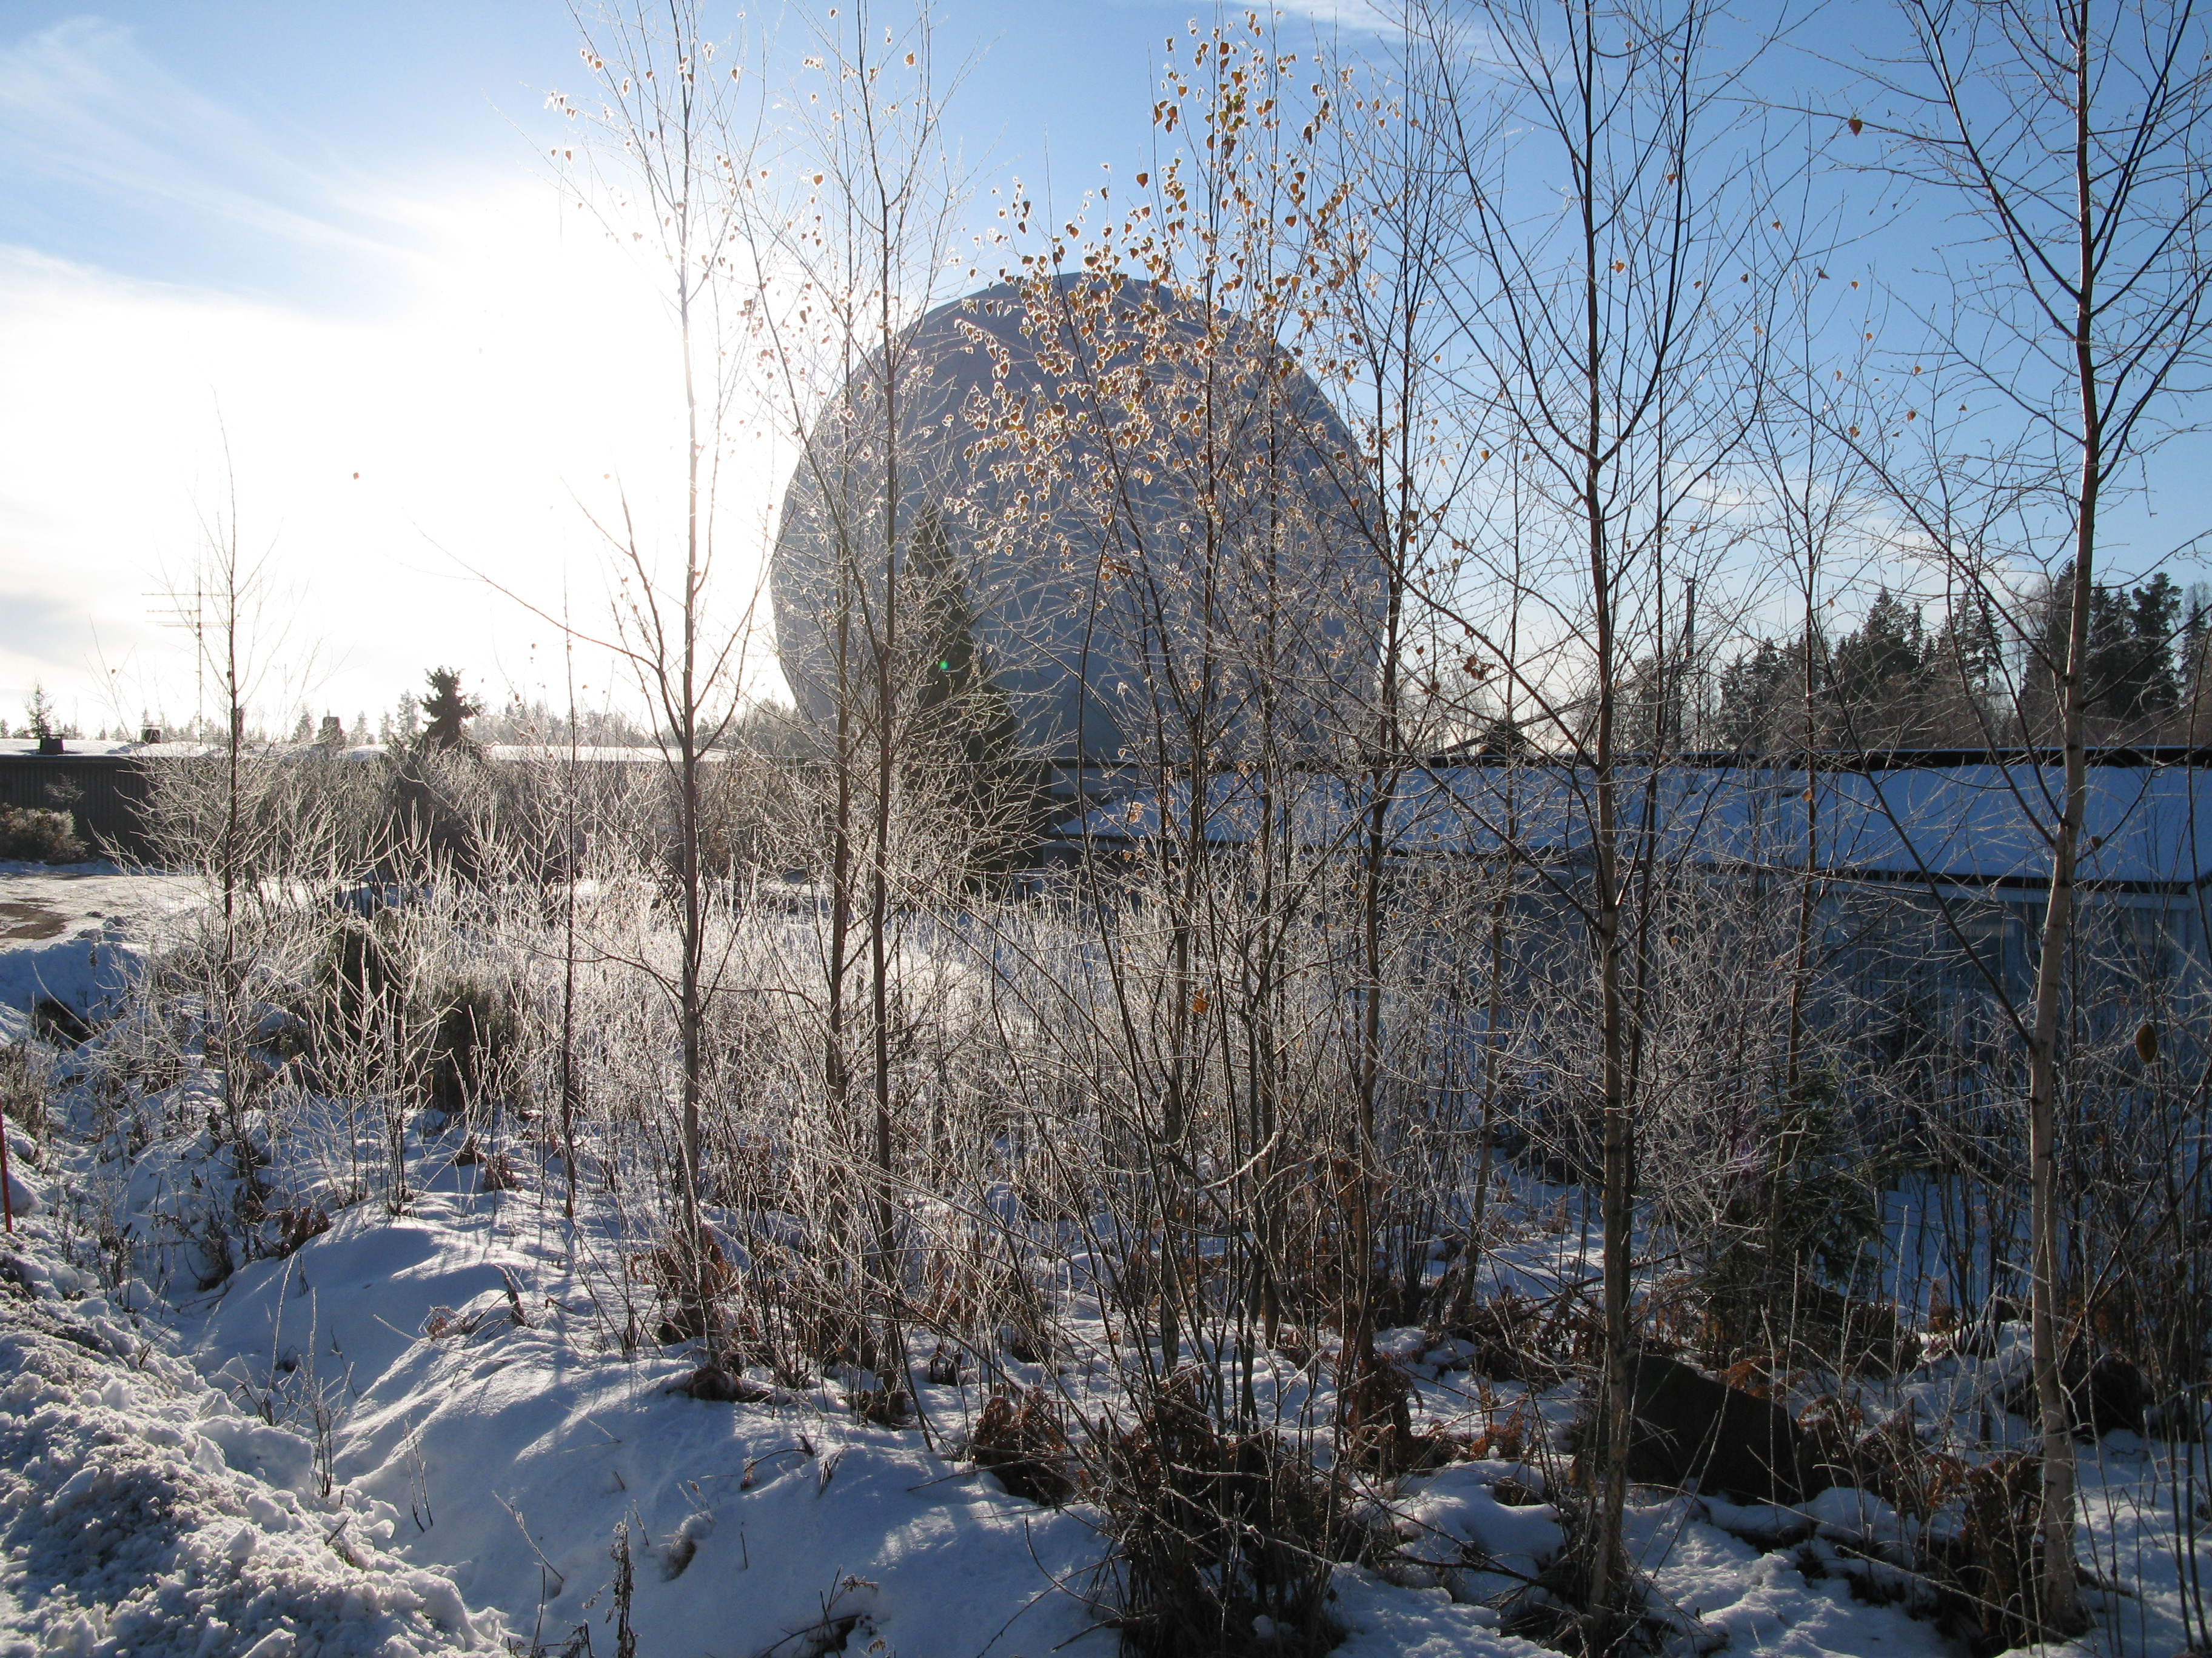
Thank you for your attention!

