Slide 1
Volker Schlott, Paul Scherrer Institut
Diagnostics Requirements for Ultra-Low Emittance Rings
I.FAST Workshop, Karlsruhe Institute of Technology (virtual) April 25th – 29th 2022

Slide 2


Acknowledgements
This presentation is based on information from many colleagues working at several light sources!
Special thanks go to…:
  … Nick Sereno, Vadim Sajaev (ANL: APS, APS-U)
  … Christoph Steier; Greg Portman (LBL: ALS, ALS-U)
  … Ake Andersson, Jonas Breulin (MAX-IV)
  … Lorraine Bobb, Chris Bloomer (DIAMOND-I and II)
  … and from PSI (SLS, SLS 2.0):
  Masamitsu Aiba, Andreas Streun, Michael Böge, Boris Keil, Cigdem Ozkan-Loch,
  Daniel Grolimund, Ana Diaz
  … and especially to Nazanin Samadi for sharing her ideas on the
  “Dispersive Crystal Diffraction Monitor”
Page 2
Notes:
2

Slide 3
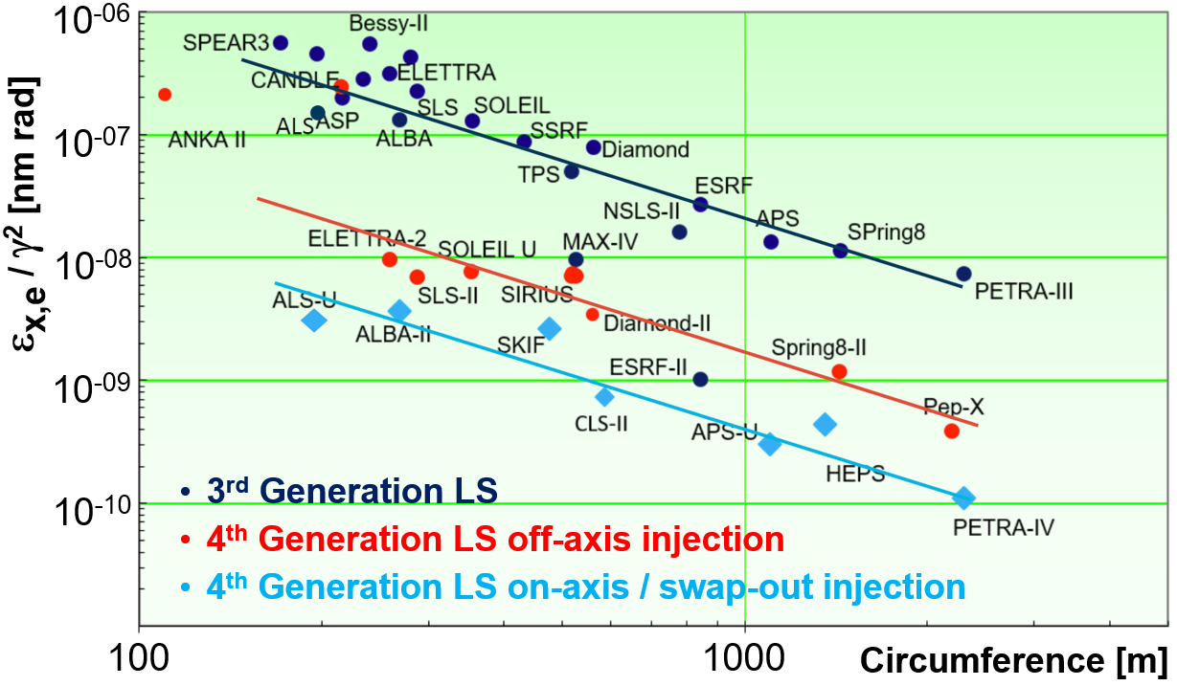
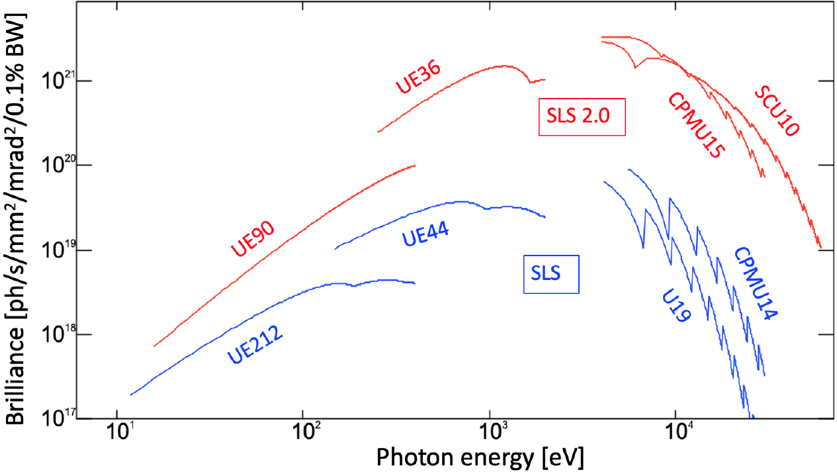
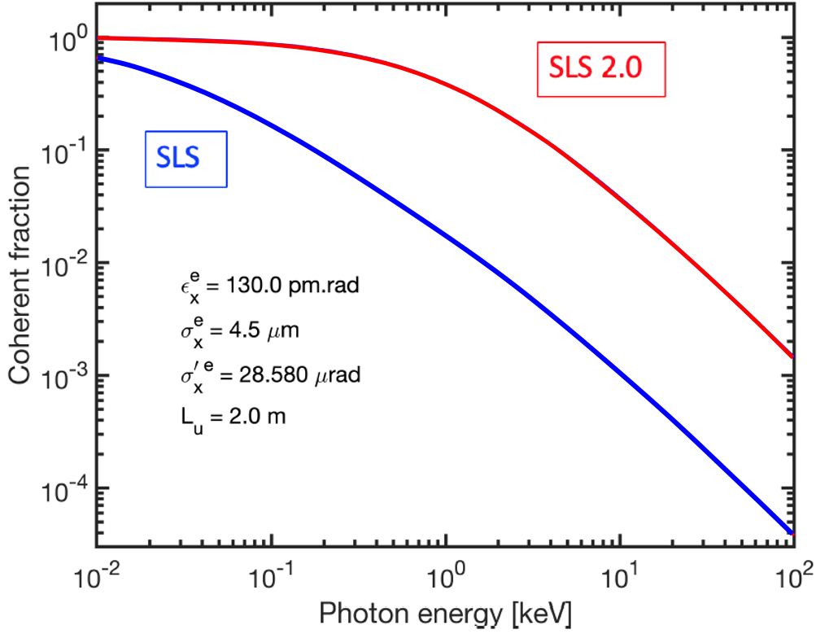
From 3rd to 4th Generation Light Sources
Technological Innovations
> 2 orders of magnitude lower horizontal emittance
NEG-coated small aperture
vacuum chambers
strong and compact PM magnets
(ultra) fast injection elements
advanced insertion devices
Storage Ring Lattice Design
MBA lattices
reverse and long. gradient bends
on-axis / swap-out injection
phase space matching of
electron and photon beams
higher brightness and more coherent photon beams
Beam Diagnostics and Beam Stability
have always been pre-requisites
for successful LS operation –
even more for 4th GLS
Page 3
Notes:
3

Slide 4
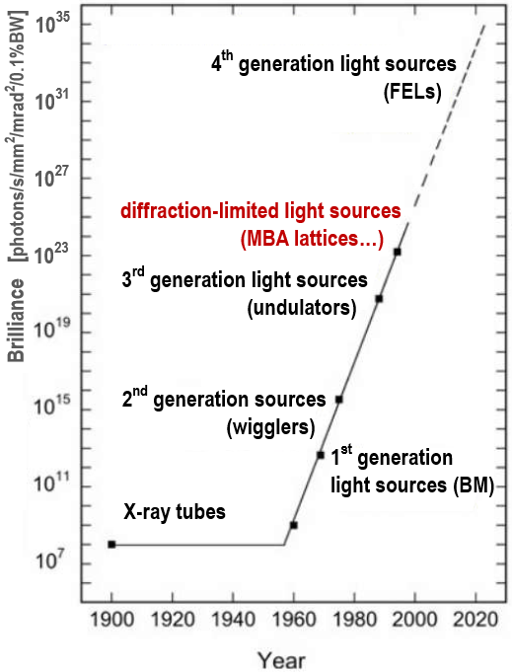
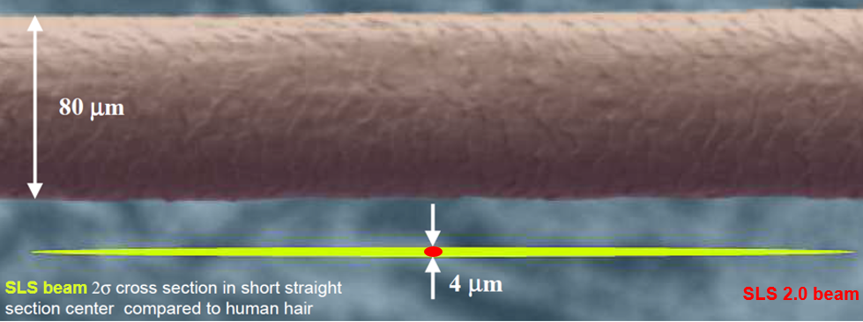
Some Introductory Remarks on Diagnostics
Light Sources and Storage Rings evolve stepwise in generation
1st GLS parasitic use of dipole sources (HEP facilities)
2nd GLS dedicated facilities (BM, wiggler)
3rd GLS optimized lattices for undulators
DLSR multi-bend achromats and optimized IDs
Diagnostic Systems are subject to a more continuous evolution…:
increasing requirements and new operation modes
(e.g. low coupling, top-up, fs-slicing…)
experience and “lessons-learned”
(e.g. calibration and drift-compensation)
technological advances
(e.g. low latency digital electronics)
ALS
ALS-U
Diagnostics requirements for ultra low emittance rings are close to those of 3GLS in the vertical plane ☺
However, Diagnostics Systems have to provide improved performance and advanced functionalities
Page 4
Notes:
4

Slide 5
Basic Requirements and Functionalities
Pre-Beam Commissioning
- lab-calibration → 5-10% calibration errors (including DAQ systems)
- initial alignment → sufficiently good to find, optimize and accumulate beam
e.g. BPM offsets ≤ 500 µm, beam line optics pre-adjusted with alignment tools (e.g. laser)
- validity checks → BPM non-linearity correction for large beam offsets and cross sums
Beam Commissioning
- full characterization of injected beam in injector and/or BR transfer line
- first turn / turn-by-turn operation modes for BPMs and BLMs (working horse diagnostics)
- profile measurements should be available after accumulation to allow optic checks
Beam Dynamics
- fast and efficient beam-based-alignment (BBA) with high resolution (µm level)
- indispensable for optics studies (orbit response matrix, coupling, LOCO, optics correction…)
User Operation
- very high reliability of all diagnostics systems
(self-calibration, self diagnosis, negligible current and filling pattern dependency)
- high resolution / sensitivity (sub-µm level) at highest possible bandwidth (kHz)
- input for any kind of beam-based feedbacks
(FOFB (local, global), top-up and filling pattern control, coupling / lifetime, injection)
- separate outputs for interlock and safety systems, provision of post-mortem (beam) data
reserve sufficient time for
diagnostics commissioning
with beam
reserve sufficient time for
diagnostics optimization
and implementation of
beam-based FBs
Page 5
Notes:
5

Slide 6
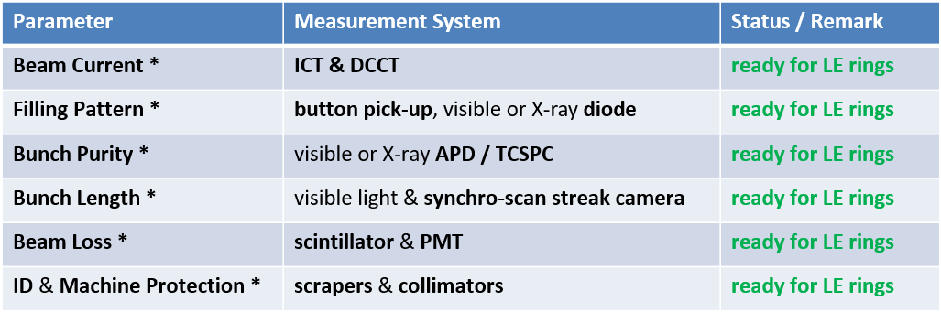
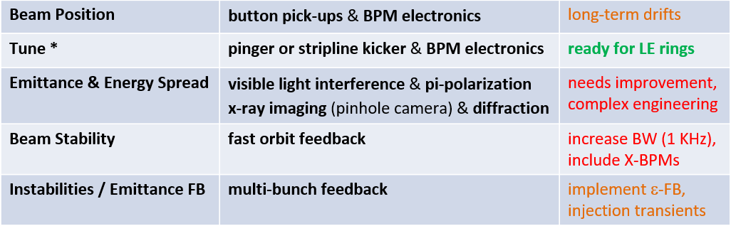
Overview of Diagnostics Systems
* These measurement systems will not be treated in detail during this presentation.
Remarks and examples may be given in additional slides or references.
Page 6
Notes:
6

Slide 7
Requirements for “Ready-to-Go” Systems
Beam Current lifetime, injection / transmission efficiency and top-up control
DCCT (commercial device, analog)
< 1 µA/√Hz (absolute calibration); up to 10 kHz BW (typ. sampling at 100 Hz)
Filling Pattern injection and top-up control, filling pattern feedback
beam pick-up, visible or X-ray diode
≤ 1 ns FW detector response time; low latency GS/s ADC (e.g. 12 bit, > 4 GS/s)
filling pattern FB via event and control system
Bunch Purity for time-resolved experiments (single bunch or hybrid modes)
visible or X-ray APD & TCSPC system (e.g. PicoHarp)
photon counting up to 10⁷ dynamics; milliseconds count rates may allow top-up control
Bunch Length bunch length / lengthening as function of bunch charge and RF settings
synchro-scan streak camera
τ ≤ 2 ps FWHM, rep.-rate: 500 (250) MHz; slow time axes at µs to ms
visible light extraction may become a challenge
Beam Loss loss detection, injection / transmission efficiency and aperture optimization
scintillator & PMT or PIN diodes / long Cerenkov fibers (LLM) & PMT
placement in transfer lines, storage ring arcs and around IDs
from single-bunch and turn-by-turn to long-term loss / radiation mapping
primary BLM use for ID protection and machine interlock
BLMs may be most sensitive system for injection monitoring & optimization (commissioning)
Page 7
Notes:
7

Slide 8
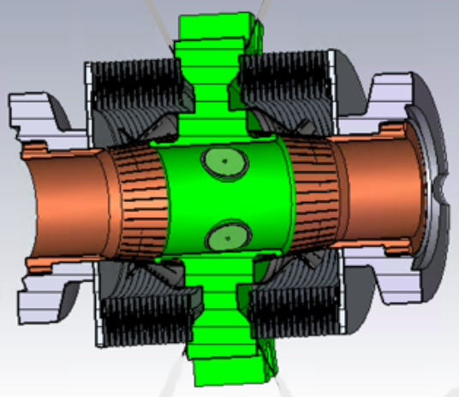
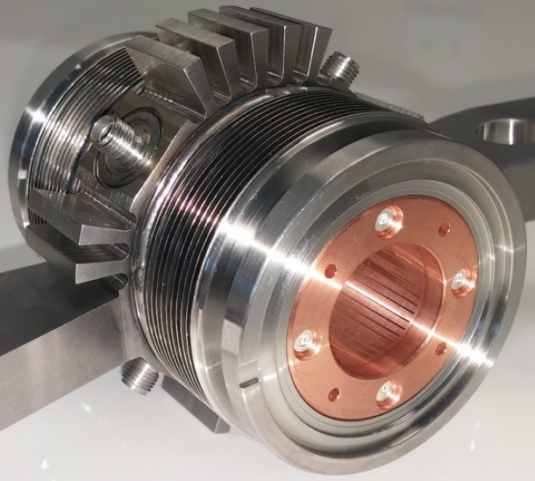
Requirements for Beam Position Monitors I
Mechanics button-type pick-up
- small diameter beam pipe (≈ 16 – 25 mm) and button feedthroughs (≈ 5 – 10 mm) - SS with Cu-coating and NEG layers
- SR shielding by diameter increase of pick-up and tapers or set-back of feedthroughs
- good impedance properties and careful feedthrough design
to prevent trapped modes and heating
- mechanical de-coupling with bellows to prevent mechanical stress
- optional monitoring of mechanical BPM pick-up position (e.g. by using dial gauges)
ALS-U BPM Pick-Up Design
SLS 2.0 BPM PU / Corrector Chamber Design
APS-U Prototype BPM Pick-Up
courtesy of S. De Santis and C. Steier
courtesy of F. Marcellini and B. Keil
courtesy of N. Sereno
Page 8
Notes:
8

Slide 9
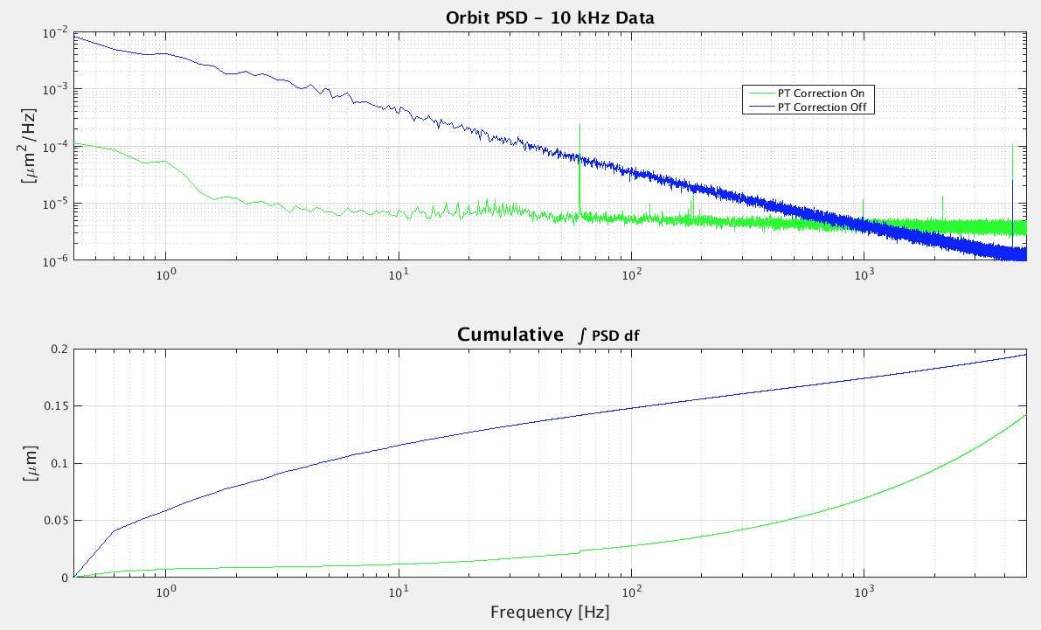
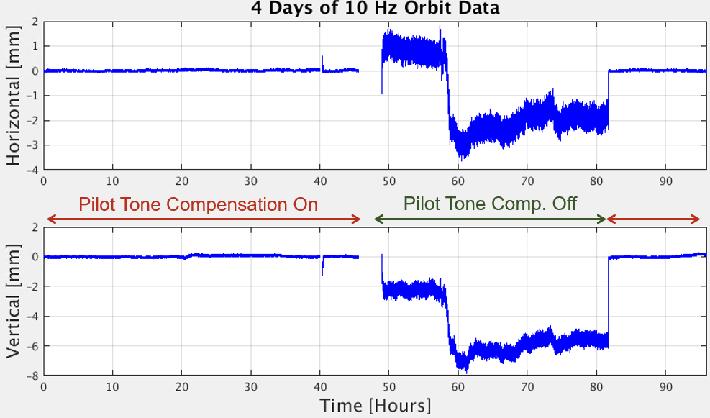
Requirements for Beam Position Monitors II
Electronics numerous in-house and some commercial developments for DLLS projects
typical specs: commissioning < 50 μm rms @ low beam currents (1 mA)
turn-by-turn < 1 μm rms (at nominal beam current)
orbit mode < 100 nm rms @ 10 kHz sampling rate
drift < 100 nm / h; < 1 μm / week
- 4-channel parallel systems
- drift compensation and calibration by channel switching (cross-bar) or pilot tone
- radiation safe placement of analog front ends in tunnel (pilot tone approach)
- use of RF cables with low temperature and humidity dependence to avoid drifts
- temperature stabilization of racks and / or temperature regulation of electronics
- digital back-ends provide parallel outputs with different BW (operation modes)
BPM requirements
are challenging
but advances in technology
and proven concepts make
improvements feasible
Improved Noise Performance and Drift Compensation by Pilot Tone Correction (ALS BPMs)
G. Portman, E. Norum, M. Chin, J. Weber (ALS-U) presented at ARIES WS on Next Generation BPM and FB Systems, Barcelona, Spain Nov. 2018
PT Correction on
PT Correction off
PT Correction on
PT Correction off
Page 9
Notes:
9

Slide 10
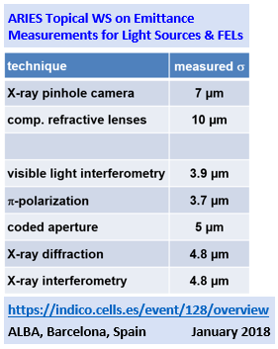
Requirements for Beam Profile Monitors
Beam Profile emittance, energy spread measurements and coupling control
typical beam sizes: σ_{h,v} ≈ 5 - 10 µm (horizontal and vertical)
smallest beam sizes: σ_{v} ≈ 1 - 5 µm
beam size changes: Δσ_{h,v} ≤ 100 nm
beam size / coupling monitoring : coupling control → FBs
coupling FBs with update rates of up to 100 Hz
mechanical constraints: limited vertical aperture (<< 10 mrad)
→ difficult out-coupling of visible light
dense lattices and small bending angles
→ large distance to first optical elements
profile monitors are very challenging!!!
“lucky ones” can use proven concepts
a few have to learn about
X-ray optics & develop new ideas
State-of-the-Art at 3GLS
imaging-based methods
- X-ray pinhole camera (> 15 keV)
- π-polarization (visible)
- coded aperture (X-rays)
interference-based methods
- double slit interferometry (visible)
- π-pol. with diffraction obstacle (visible)
Proposed Beam Profile Monitors for 4GLS
imaging-based methods
- existing methods and X-ray imaging
- Fresnel zone plates or KB mirrors (X-rays)
- compound refractive lenses (X-rays)
interference-based methods
- X-ray interferometry
- grating interferometry (X-rays)
Page 10
Notes:
10

Slide 11
Beam Profile Monitors – State-of-the-Art
X-Ray Pinhole Camera
→ see presentation from Friederike Ewald (ESRF-EBS)
π-Polarization Monitor with Diffraction Obstacle
→ see presentation from Åke Andersson (MAX-IV)
Single or Double Slit Interferometry
→ T. Naito, T. Mitsuhashi, “Very Small Beam size measurement by a Reflective Synchrotron Radiation Interferometer”
Phys. Rev. ST Acc. Beams 9, 122802, December 2006
→ M. Masaki, S. Takano, “Two-Dimensional Visible Synchrotron Light Interferomerty for Transverse Beam Profile
Measurement at the Spring-8 Storage Ring”, Journal of Synchrotron Radiation vol. 10, part 4, July 2003, 295-302
Coded Aperture
→ J.W. Flanagan et al., “X-ray Monitor based on Coded-Aperture Imaging for KEKB Upgrade and ILC Damping Ring”
Proc. EPAC 2008, Genoa, Italy, TUOCM02, 1029
Fresnel Zone Plates
→ H. Sakai et al., “Improvement of Fresnel Zone Plate Beam-Profile Monitor and Application to Ultralow Emittance
Beam Profile Measurements”, Phys. Rev. ST Acc. Beams 10, 042801, April 2007
X-Ray Diffraction
→ B. Yang, S. Lee, “Planned X-Ray Diffraction Diagnostics for APS-U Emittance Measurements”
ARIES Topical Workshop on Emittance Measurements for Light Sources and FELs, Barcelona, Spain, January 2018
“working horses”
at light sources
Page 11
Notes:
11

Slide 12
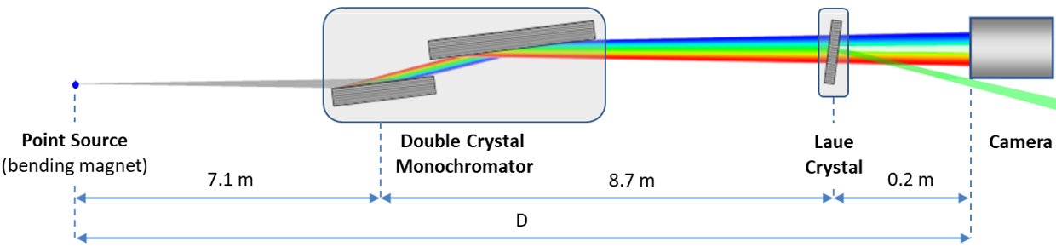
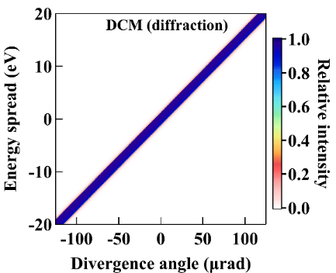
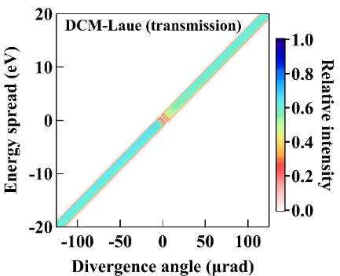
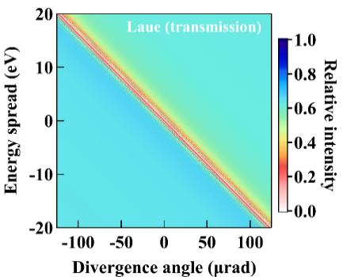
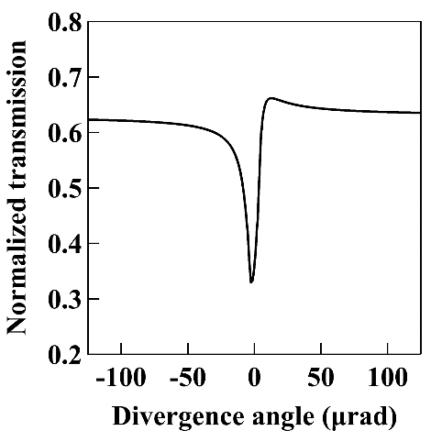
Beam Profile Monitors – New Ideas
X-Ray Beam Property Analyzer Based on Dispersive Crystal Diffraction
→ N. Samadi, X. Shi, C. O. Loch, M. Boege, J. Krempasky, D. Chapman, M. Stampanoni (2021), submitted to JSR
DCM:
e.g. cryogenically cooled
channel-cut Si (1,1,1) DCM
→ E_{ph}= 20 keV
Laue crystal:
0.35 mm Si (1,1,1)
dispersive geometry
against the DCM
Detector:
sCMOS pco.edge 5.5
2 x objective
100 μm Ce:YAG scintillator
effective pixel size=3.25 µm
Page 12
Notes:
12

Slide 13
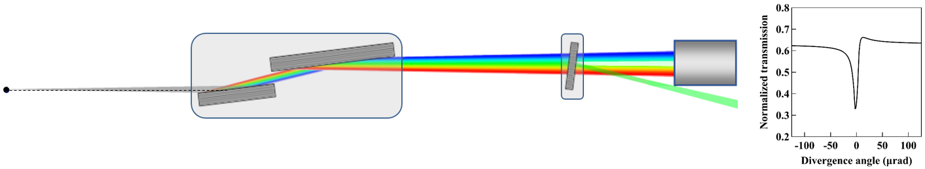
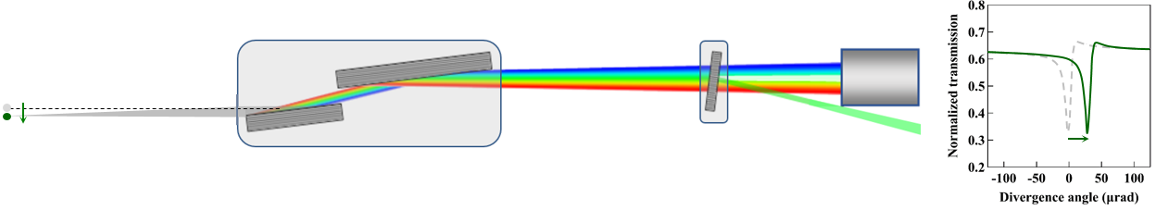
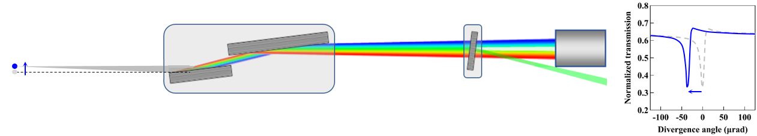
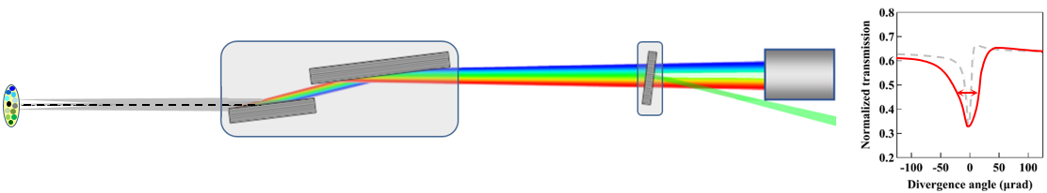
Dispersive Crystal Diffraction Monitor
Point Source at Central Position
central dip in
transmission
spectrum
BM source (~ 20 keV)
Si (111) DCM
Si (111)
Laue crystal
Point Source Downward Moved Beam
dip moves
from
central position
BM source (~ 20 keV)
Si (111) DCM
Si (111)
Laue crystal
Point Source Upward Moved Beam
dip moves
from
central position
BM source (~ 20 keV)
Si (111) DCM
Si (111)
Laue crystal
Finite Beam Size
dip widens
related to
beam size
Si (111) DCM
Si (111)
Laue crystal
BM source (~ 20 keV)
Page 13
Notes:
13

Slide 14
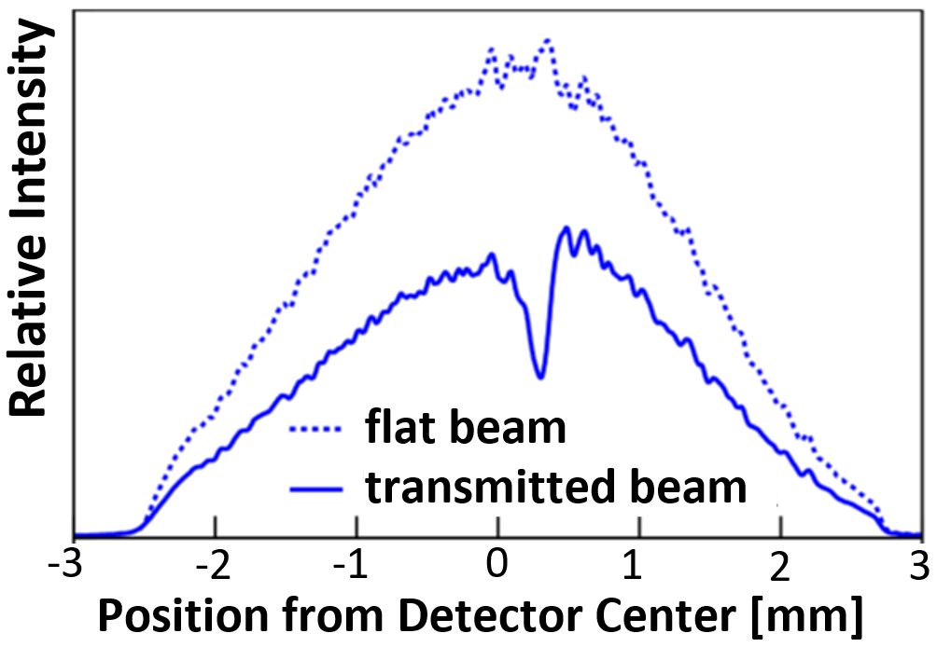
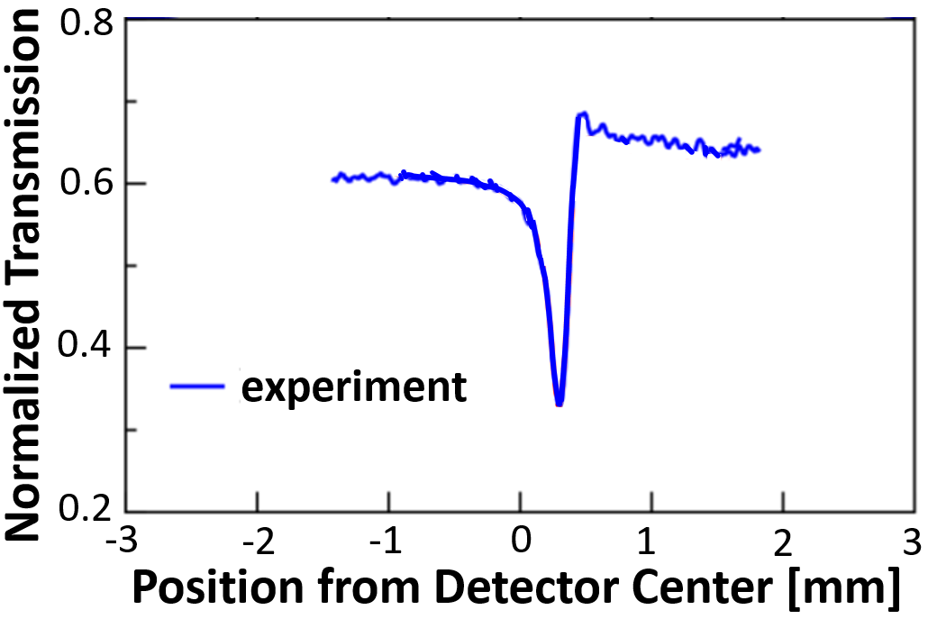
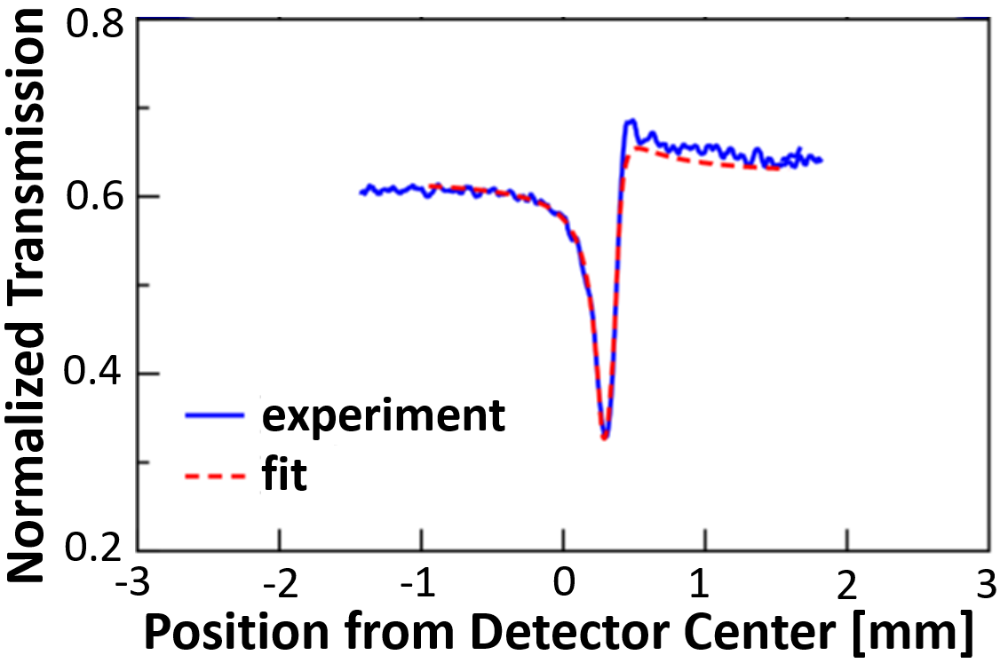
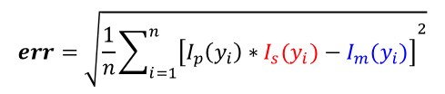
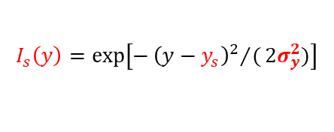
Dispersive Crystal Diffraction Monitor
Data Analysis – Extracting the Source Size from the Transmission Spectrum
1st Step: Measurement of “flat beam” (only DCM) and “transmitted beam” (DCM & Laue)
normalization
I_{m}(y) = I_{trans}(y) / I_{flat}(y)
2nd Step: Fitting process for known source profiles
Normalized transmission function I_{p} (y_{i} ) is known from “dynamical theory”
see e.g.: Zachariasen, W. H. W. Theory of X-Ray Diffraction in Crystals. (New York: John Wiley, 1945)
Gaussian beam from bending magnet:
$$I_{s}\left(y\right)=\exp\left[−{{\left(y−y_{s}\right)}^{2}}/(2σ_{y}^{2})\right]$$
Minimizing err-function by deconvolution of I_{p} (y_{i} ) and
fitting the beam size σ_{y} to the measured data I_{m} (y_{i} )
$$err=\sqrt{\frac{1}{n}{\sum_{i=1}^{n}{\left[I_{p}\left(y_{i}\right)∗I_{s}(y_{i})−I_{m}(y_{i})\right]}}^{2}}$$
Page 14
Notes:
14

Slide 15
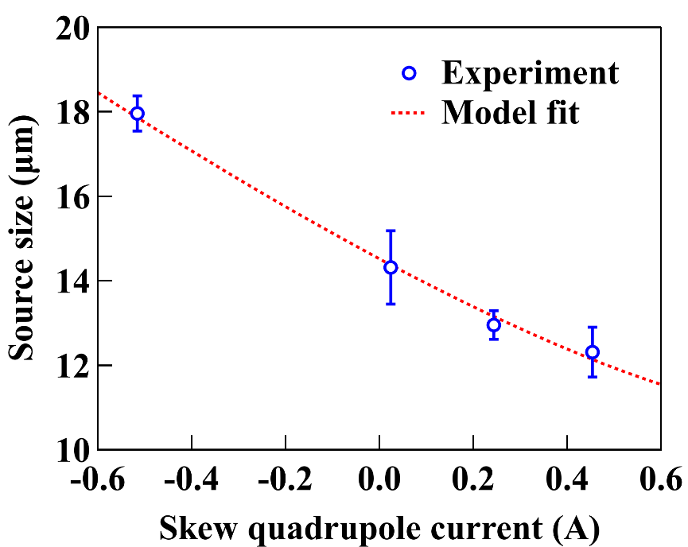
Experimental Results – SLS Measurements
variation of source size (vertical beam size) by changing the horizontal-to-vertical coupling
(changing current in skew quadrupoles)
prediction of source size by model fitting using the TRACY-2 accelerator library
excellent agreement of measured data and model fit
→ confirms that a “dispersive crystal diffraction monitor” can measure small
electron beam sizes with high sensitivity and accuracy (< 10%) ☺
needs a compact and “simple” DCM design
for diagnostics purposes
(also required for other 4GLS beam size monitors,
in preparation e.g. at SLS 2.0)
DCM / Laue can be made of polished Si crystals
(crystal quality and costs are of no major concern)
PD line arrays may speed up sampling time
(emittance FBs may profit from high update rates)
resolution can be improved for 4GLS beam
profile monitor requirements by using Si (3,3,3)
(…instead of Si (1,1,1) in SLS experiments)
Page 15
Notes:
15

Slide 16
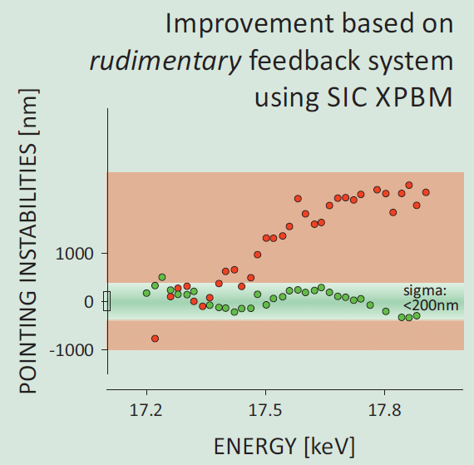
Beam Stability and Feedback Systems
Intensity: << 1 % of beam current / photon beam intensity through top-up operation
Energy Stability: < 10⁻⁴ ΔE/E with digital LLRF
Coupling: keep 10 % coupling in the vertical plane with coupling FB (beam size monitors as sensor)
Position & Angle: Fast Orbit Feedback → sub-μm stability from 0.01 to 1 kHz (a few percent of beam size)
→ drift: < 1 μm / week
1st Step
“Stability Task Force” (MAX-IV approach) implemented a
common strategy for passive stability and isolation of
vibrational and thermal sources over the whole facility
(building, accelerator and beamlines)
stability is a common effort throughout the facility
Energy Scan at SLS microXAS Beamline with XBPM FB
This approach may only work for new facilities!
Upgrading facilities – the majority of 4GLS – may put the
responsibility for electron and photon diagnostics in one hand…
2nd Step
Implement a common feedback platform open to connect
all electron and photon diagnostics systems and make use of
their improved performance
courtesy of D. Grolimund (SLS)
Page 16
Notes:
16

Slide 17
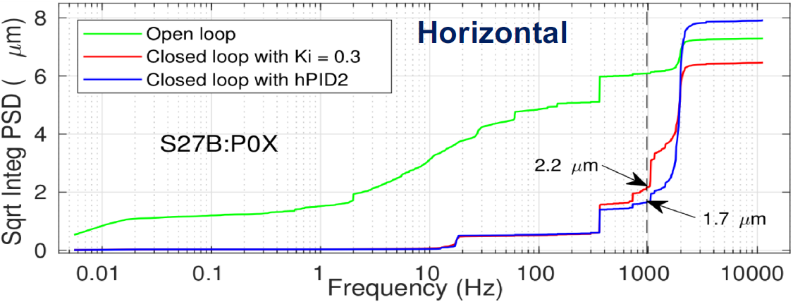
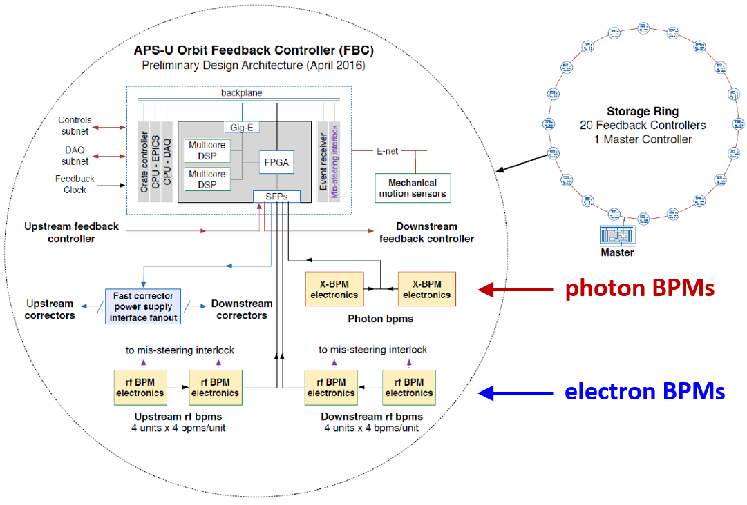
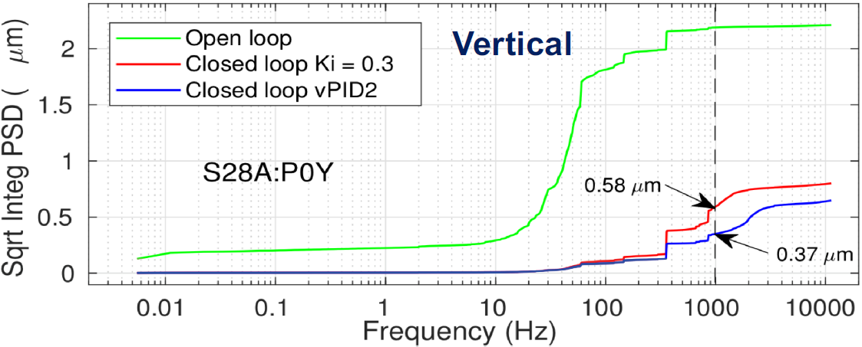
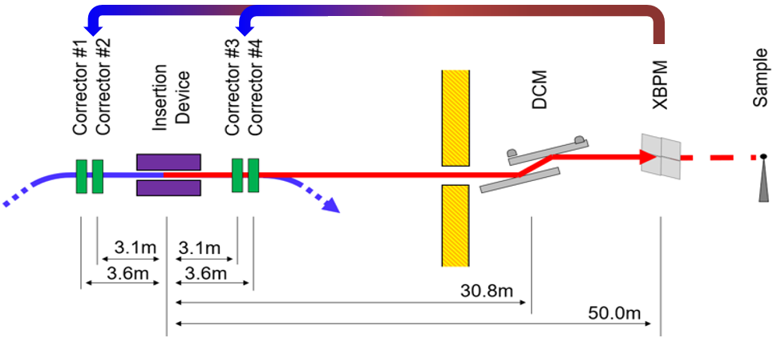
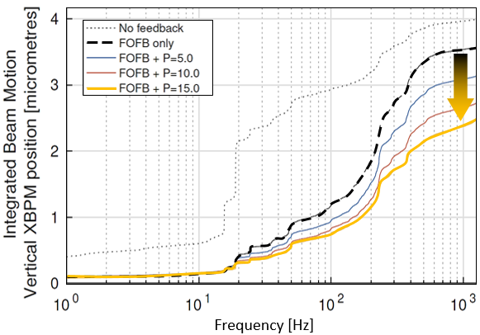
Orbit & Source Point Stabilization
Example 1: Orbit Feedback System for APS-U
N. Sereno et al. IPAC 2015 & IBIC 2016; P. Kallakuri et al. IBIC 2017, J. Carwardine et al. IBIC 2018
Example 2: Fast (1 kHz) Feedback using XBPM Reading and Electron Beam Steering at DLS
C. Bloomer, G. Rehm, A. Tipper IBIC 2019
Page 17
Notes:
17

Slide 18
Closing Remarks and Summary
Many of state-of-the-art Diagnostics Systems are “ready to go” for ultra-low emittance storage rings (4GLS) – even with sufficient performance ☺ ☺ ☺
→ BLMs can be important for commissioning and injection optimization
→ new BPM developments fulfill resolution and BW requirements
→ stringent drift requirements may be achieved by pilot tone calibration
High resolution Profile Monitors are a challenge
→ existing designs may work for some “lucky ones”
→ many have to learn from beamline scientists on X-ray imaging
→ new ideas are welcome and have already been tested successfully
→ 100 Hz to kHz update rates will allow for coupling / emittance FBs
Newly designed FB Systems are open for electron and photon diagnostics monitors and improve photon beam stabilization on the sample to closed loop BW of up to 1 kHz
I’m very excited to learn more about recent results from existing facilities and improvements of diagnostics systems for new (upgrade) projects ☺ ☺ ☺
Page 18
Notes:
18

Slide 19
Thank You
… for your patience and attention ☺ ☺ ☺
Page 19
Notes:
19

