Slide 1
Innovation Fostering in Accelerator Science and Technology
I.FAST Workshop 2022: Beam Diagnostics and Dynamics in Ultra-low Emittance Rings.
Overview of the Longitudinal bunch by bunch Feedback at DAΦNE
Giovanni Franzini
April 27th 2022
LABORATORI NAZIONALI DI FRASCATI

Slide 2
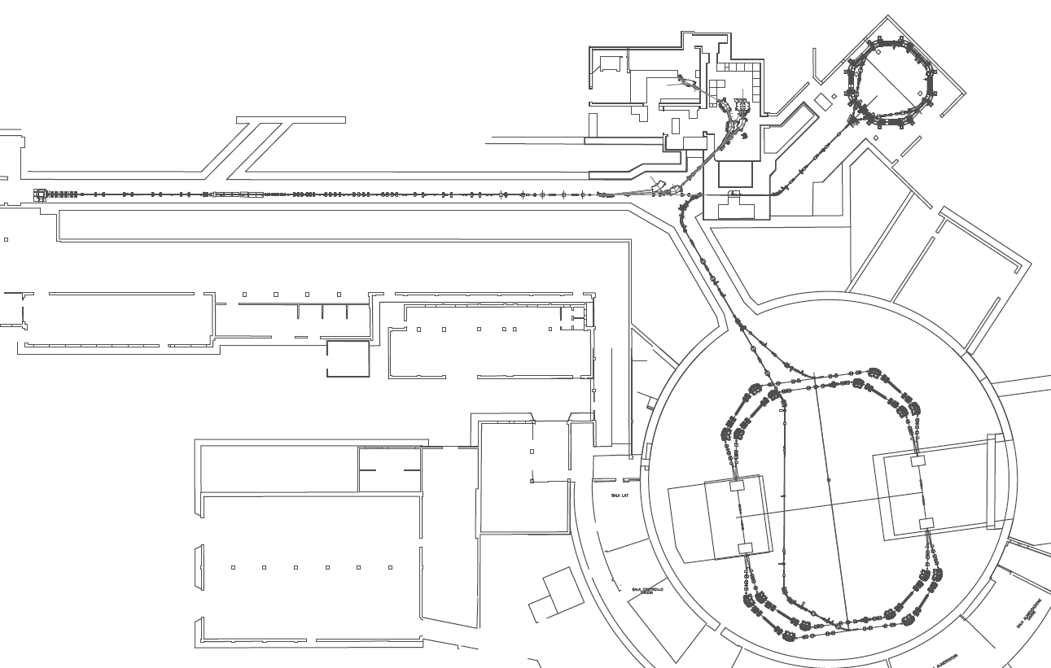
Introduction
DAΦNE is an electron-positron collider in operation at LNF for physics experiments since 1999.
It is composed of an injection system and two rings (~97 m), one per type of beam.
It operates with (usually) 100 bunches at 510 MeV, with a time interval of 2.7 ns between each other. Typical stored currents are in the range of 1 A / 2 A.
Presently DAFNE is running for the SIDDHARTA-2 apparatus. The latter is being developed in order to perform measurements of kaonic deuterium X-ray transitions to the fundamental level.
LINAC
ACCUMULATOR
e-
e+
DAΦNE
(see: DAFNE Commissioning for SIDDHARTA-2 experiment. C.Milardi et al. EPAC2021, Campinas, Brasil, 1997)

Slide 3
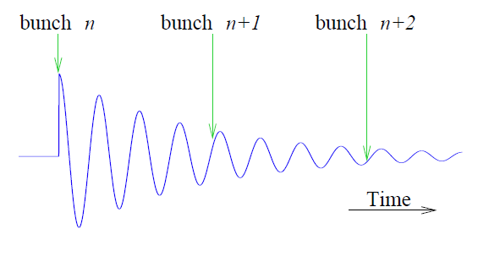
Introduction
Due to the high circulating beam-current and the presence of HOMs in the RF accelerating cavity, longitudinal and transversal coupled-bunch instabilities can severely limit the performance of the machine.
These instabilities grow exponentially with time and can lead to beam loss.
In DAΦNE main rings the combination of high current, low energy and short bunch interval enhances these instabilities.
Origin of Coupled-bunch instabilities:
Oscillatory electric fields (wakefields) excited (mostly) in the RF cavity by the bunches, which interfere with the bunches arriving in the structure afterwards.
courtesy of D.Teytelman

Slide 4
Feedback Overview
There are a total of six independent feedback systems.
Two for the longitudinal phase (e+ and e-),
two for the vertical position (e+ and e-),
two for the horizontal position (e+ and e-).
The feedback systems act on a bunch by bunch basis and in real-time. They adjusts the phase (longitudinal feedback), the horizontal and vertical position (transverse feedbacks) independently for each bunch (spaced by 2.7 ns).
In order to do so, at the passage of the n^{th} bunch, each system read the relevant property of it (phase, vertical and horizontal position), elaborates a proper correction signal and applies it to that specific bunch (after few turns).
The general architecture for longitudinal and transversal feedback systems is similar.
For this presentation, we will focus on the longitudinal feedbacks.

Slide 5
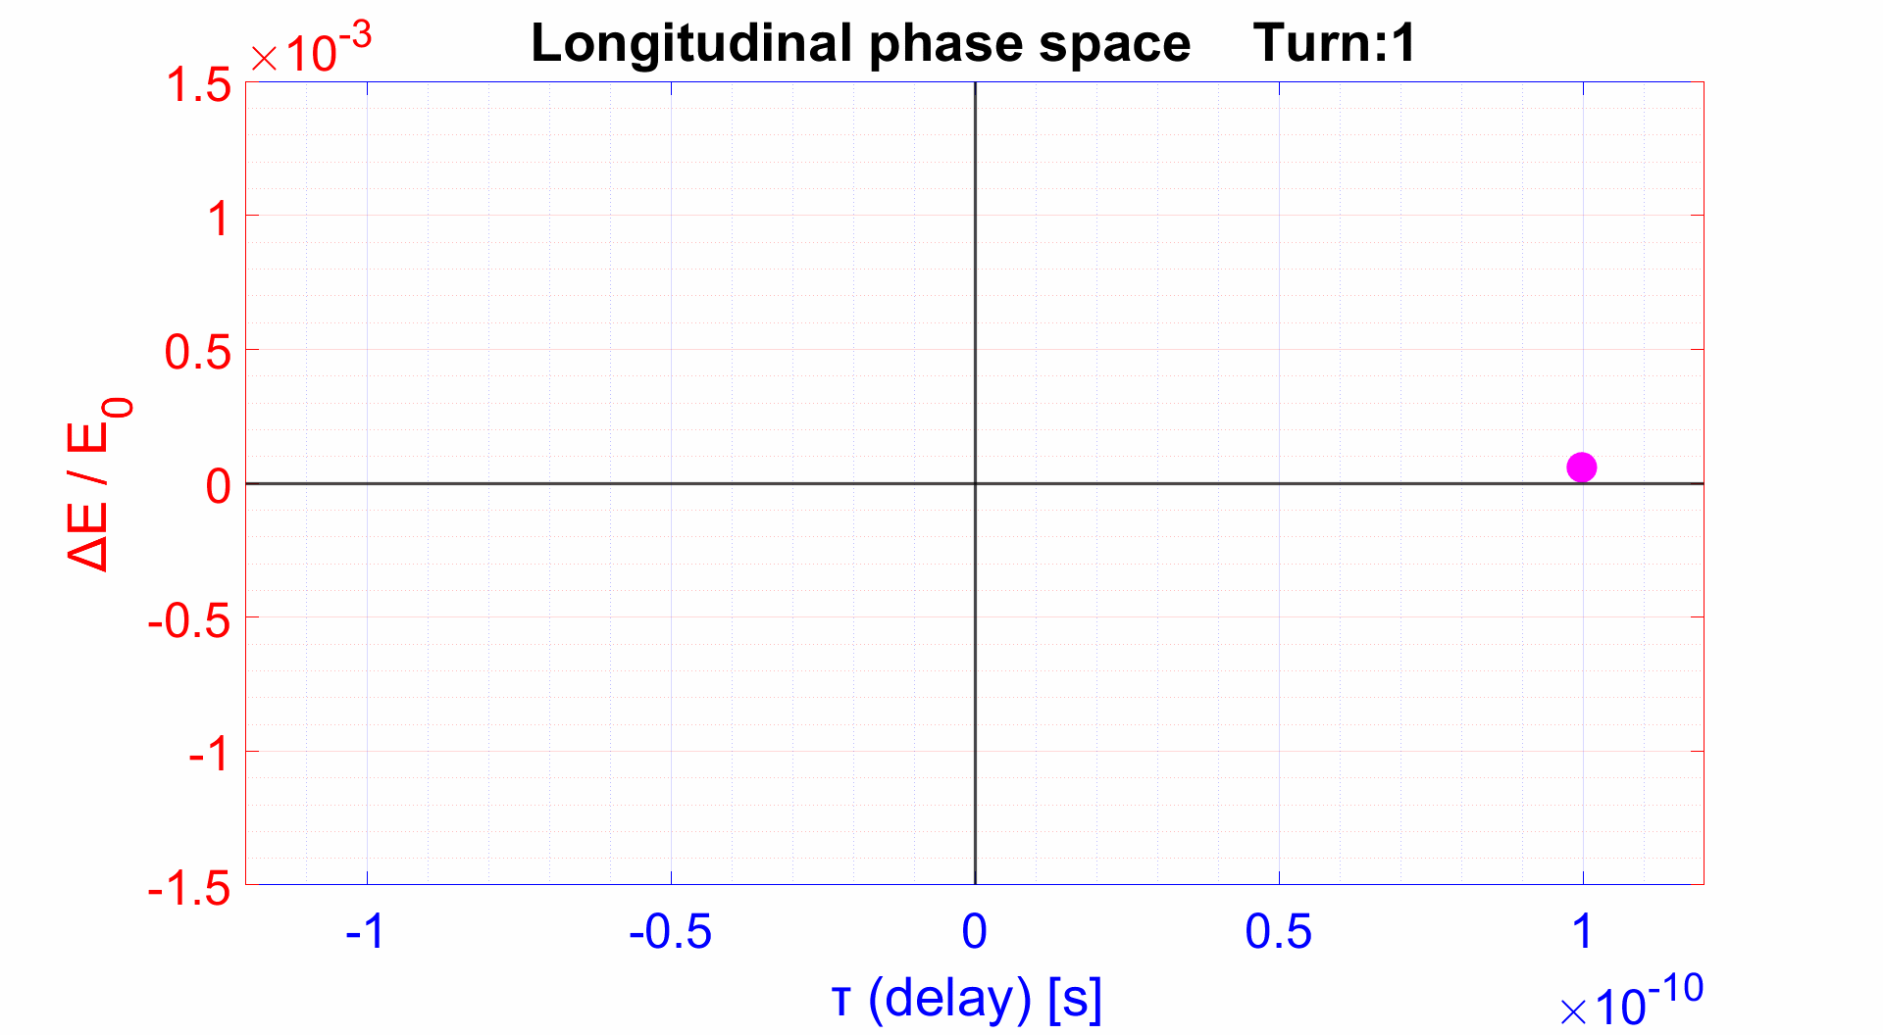
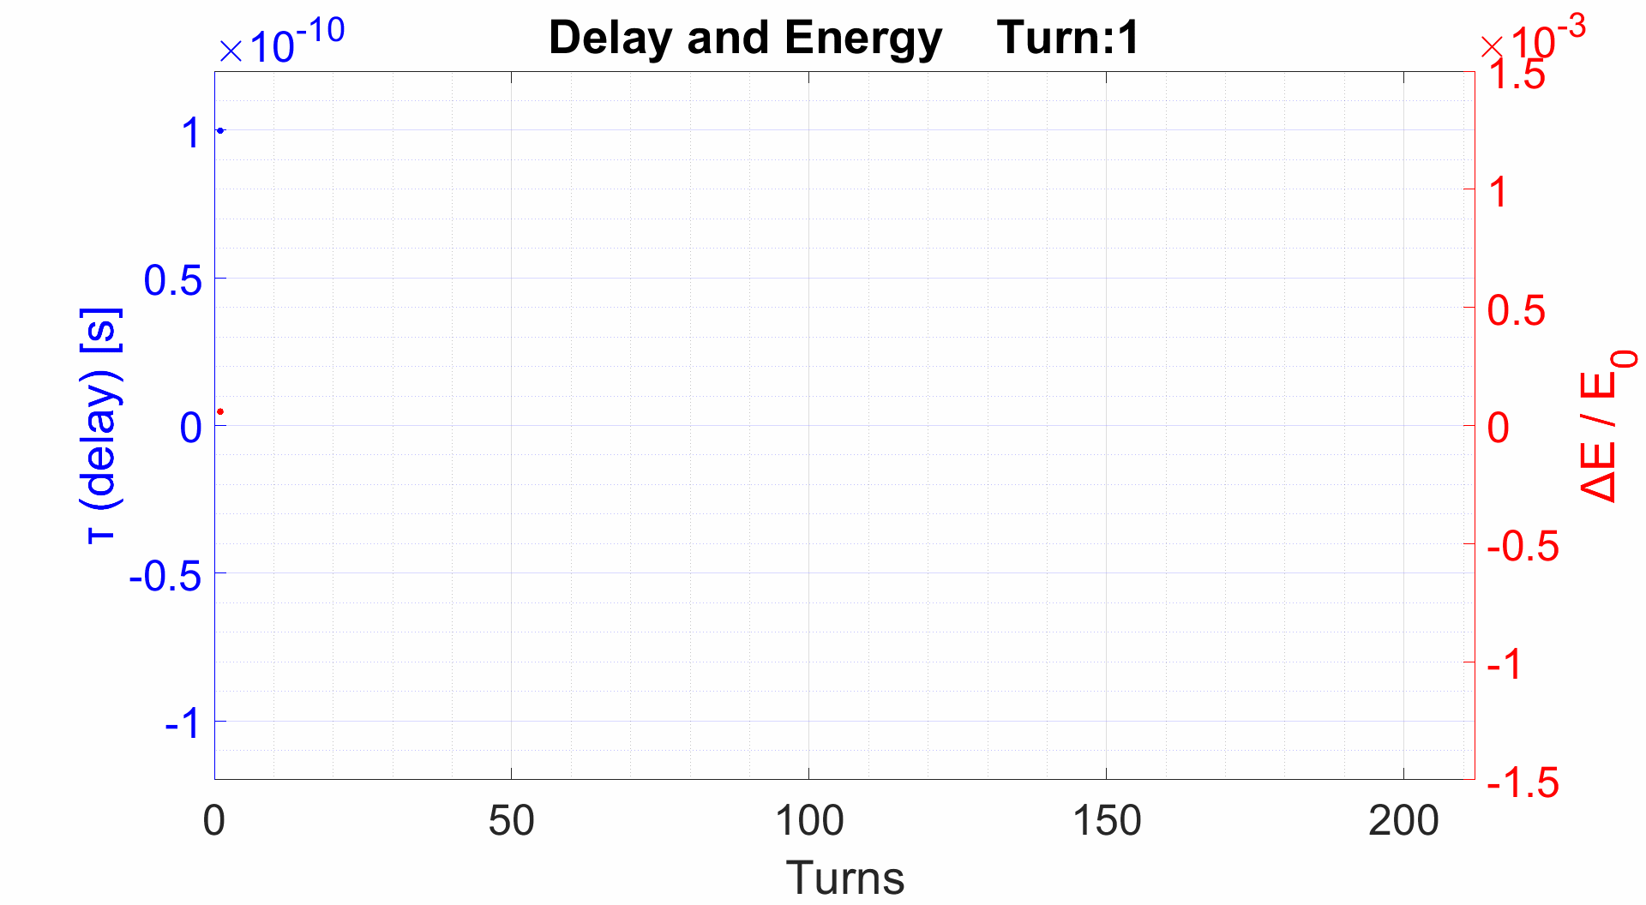
Longitudinal oscillations
Simple case:
One bunch (considered as a single macro particle) circulating at relativistic speed in a storage ring.
Absence of any kind of perturbation.
No feedback.
Only small energy oscillations.

Slide 6
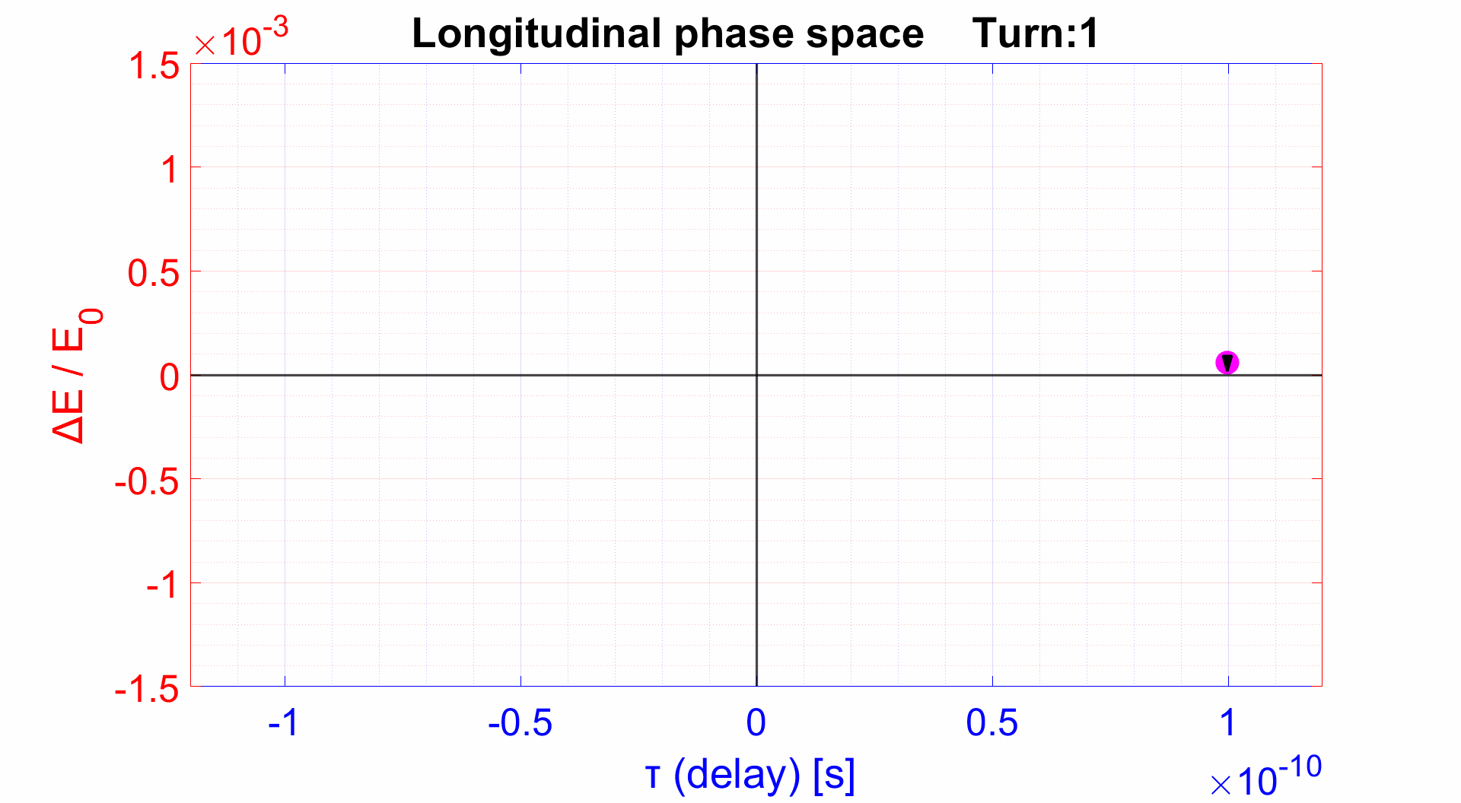
Feedback action
The action of the feedback consists in individual longitudinal kicks to each bunch and for each turn (excluding decimation tecniques).
Each turn and for each bunch:
Delay (phase) is measured.
Correction signal (longitudinal kick) is elaborated.
Longitudinal kick is applied.
Since we are measuring the delay $τ$ (phase φ), but we are going to modify the energy of the bunches, the correction signal is simply calculated as the measured delay $τ$ (phase φ), shifted by π/2 (in respect of the synchrotron oscillation frequency). Thus, we obtain and apply (after few turns) a correction signal, which is in anti-phase with the energy oscillations. This will damp the bunch oscillations.

Slide 7
Longitudinal Feedback
1
5
Beam
BPM
Kicker
2
3
4
ADC +
Digital Processing +
DAC
Front-end
Back-end
RF Amp.
The longitudinal feedback acts on the phase of the bunches. It applies a correction signal in the form of a longitudinal kick (by means of a RF cavity).
The four signals (up, down, left, right) of one BPM are summed together and sent to the front-end electronics.
The front-end electronics “transform” the SUM signal in order to get a signal which is proportional to the phase (delay) of the bunch.
The latter is then digitized and the correction signal is digitally elaborated and converted to analog (DAC).
The back-end electronics “produce” the excitation signal for the kicker, based on the DAC output.
The signal (amplified by RF amp.) is then supplied to the kicker. The latter modifies the bunch energy (by means of a longitudinal kick) with the aim of restoring the bunch synchronous phase.

Slide 8
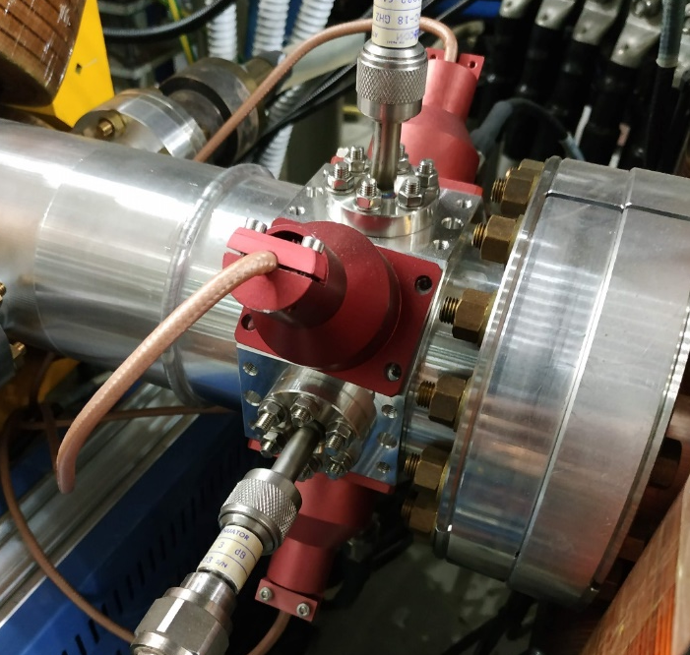
Broad-band Button BPM
BPM
Kicker
Beam
Front-end
ADC + Digital Processing DAC
Back-end
RF Amp.
Up
Ext
Int
PW Combiner
BPM
PW Combiner
To the front-end
Down
PW Combiner
The BPM used in the feedback are specifically designed for it:
Transfer Impedance is ~0.5 Ω (higher than the ordinary BPM in the same section) and sufficiently flat at the working frequencies.
Negligible effects on the beam.
(see: DAFNE broad-band button electrodes. F.Marcellini, M.Serio, A.Stella, M.Zobov. Nuclear Instruments & Methods in Physics Research, 1997)

Slide 9
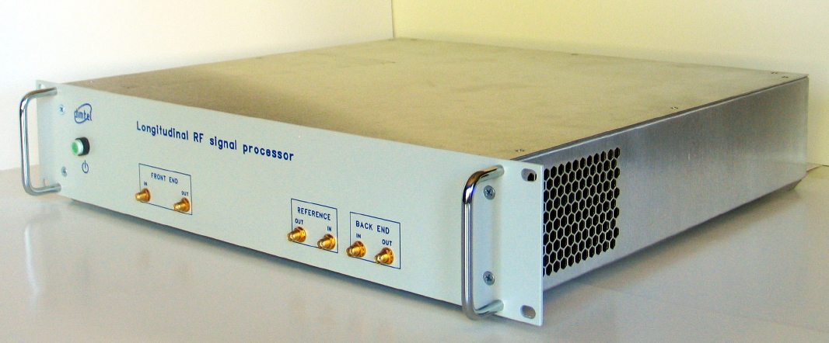
DIMTEL FBE 368L (Front-end)
Longitudinal
BPM
Kicker
Beam
Front-end
ADC + Digital Processing DAC
Back-end
RF Amp.
The Front-end main functionality is to transform the phase of the BPM signals into an amplitude signal (to be digitized later on).
Variable attenuator
Mixer
From BPM (SUM signal)
Two-cycle comb filter
Amp.
Low pass Filter
To ADC
frf
Frequency Multiplier x4
Phase shifter
Variable attenuator and phase shifters values are controllable via software.

Slide 10
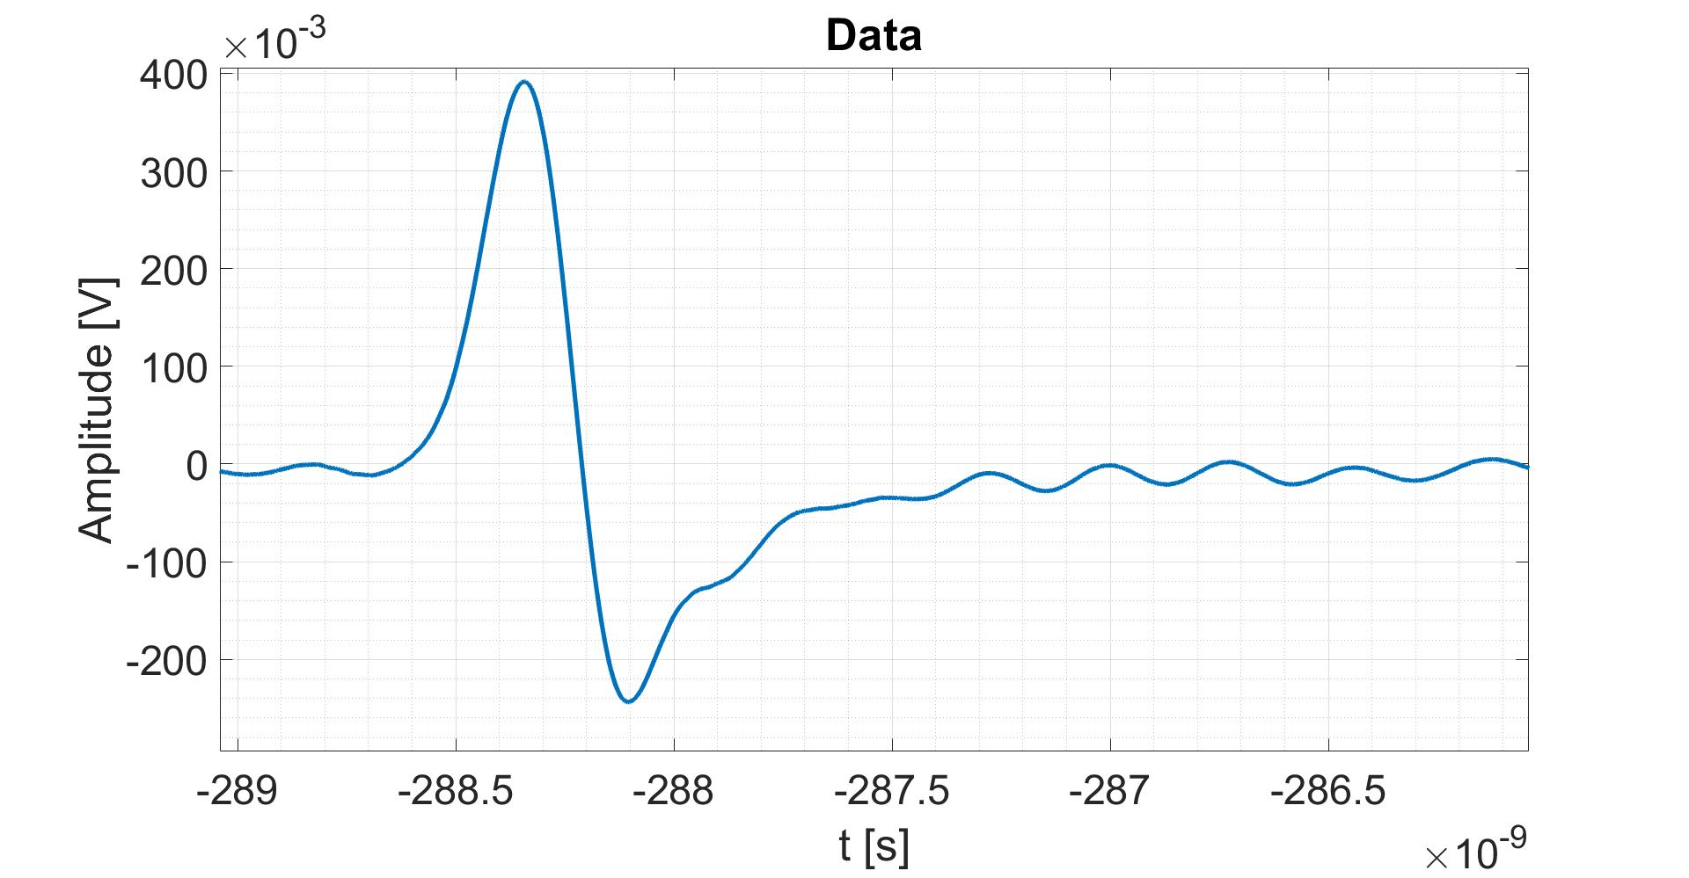
DIMTEL FBE 368L (Front-end)
Variable attenuator
Mixer
S
Two-cycle comb filter
Low pass Filter
From BPM (SUM signal)
Amp.
To ADC
frf
Frequency Multiplier x4
Phase shifter
$τ$delay ≈ ±0.1 ns
S

Slide 11
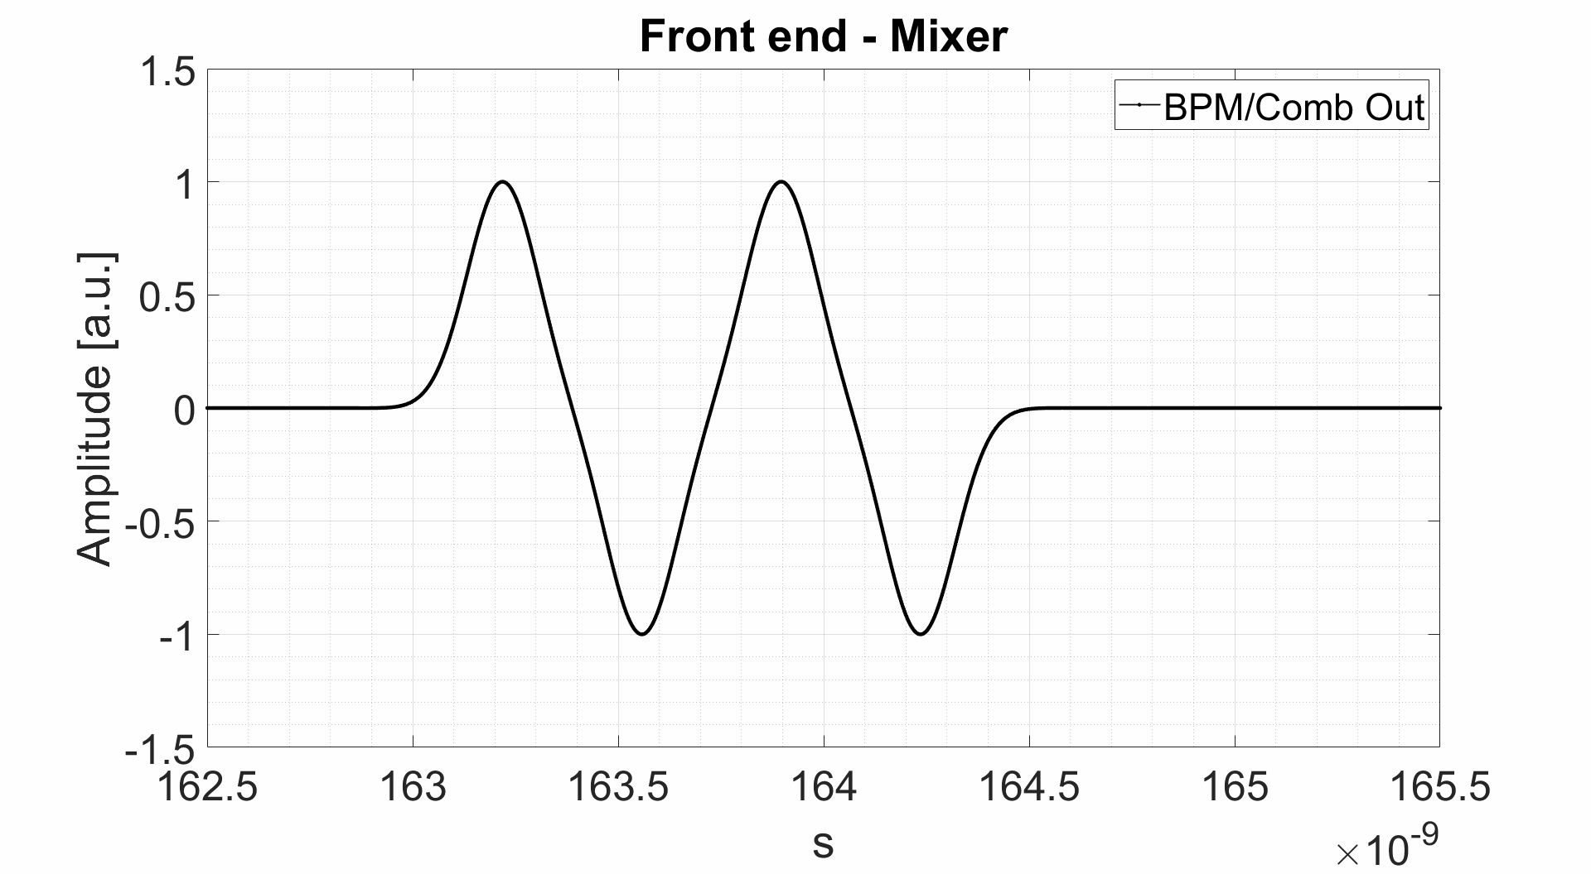
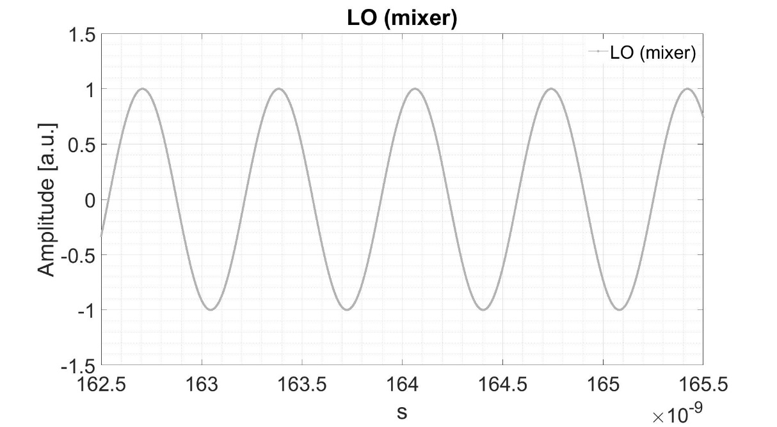
DIMTEL FBE 368L (Front-end)
Variable attenuator
Mixer
From BPM (SUM signal)
Two-cycle comb filter
Amp.
1
Low pass Filter
To ADC
2
frf
Frequency Multiplier x4
Phase shifter
$τ$delay ≈ ±0.1 ns
2
1
2
T_{rf} = 2.71ns

Slide 12
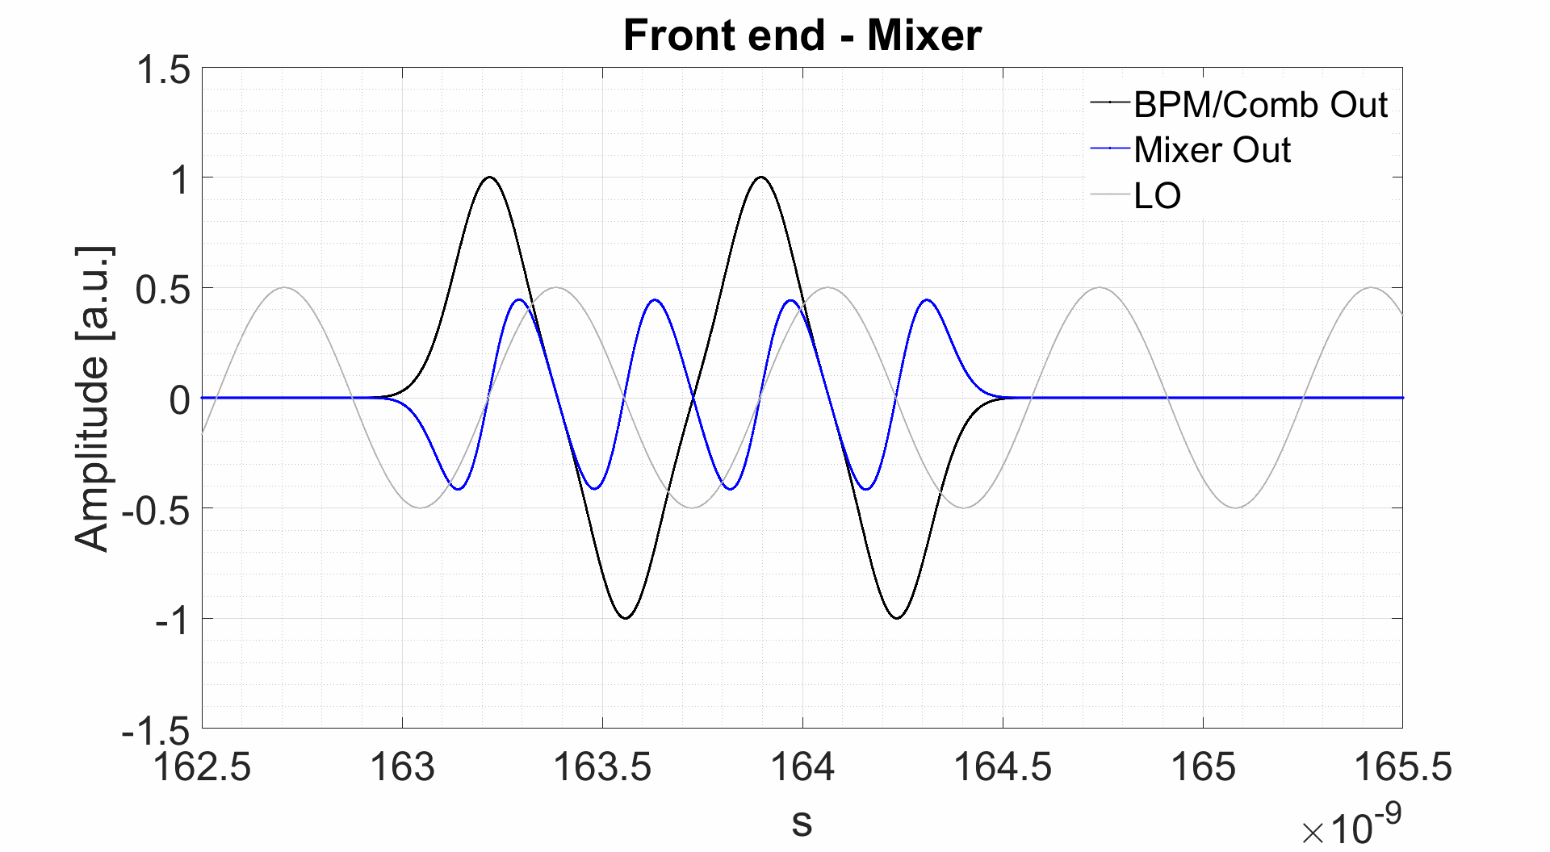
DIMTEL FBE 368L (Front-end)
Variable attenuator
Mixer
From BPM (SUM signal)
Two-cycle comb filter
Amp.
1
3
Low pass Filter
To ADC
2
frf
Frequency Multiplier x4
Phase shifter
1
2
3
T_{rf} = 2.71ns

Slide 13
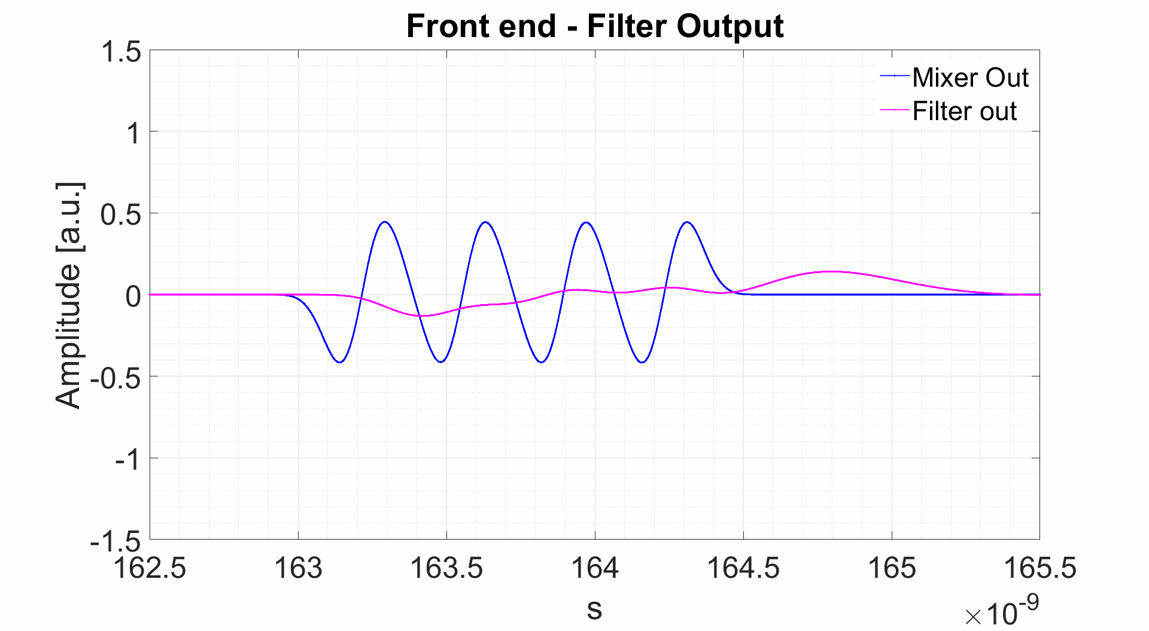
DIMTEL FBE 368L (Front-end)
Variable attenuator
Mixer
From BPM (SUM signal)
Two-cycle comb filter
Amp.
3
Low pass Filter
4
To ADC
frf
Frequency Multiplier x4
Phase shifter
Bessel 4th ord. Low Pass Filter with f_{cut}=1,1 GHz (~3·f_{rf}).
The output pulse should not last more than T_{rf} = 2.71 ns, otherwise crosstalk between bunches will appear, degrading the feedback performances.
4
3
Trf = 2.71ns

Slide 14
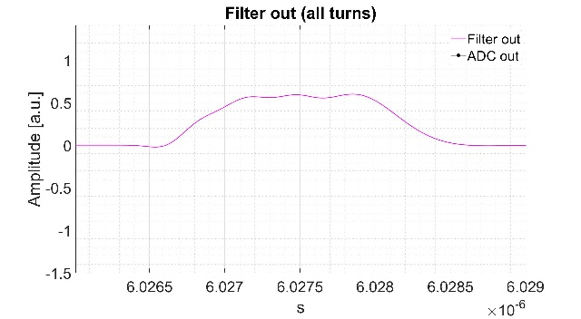
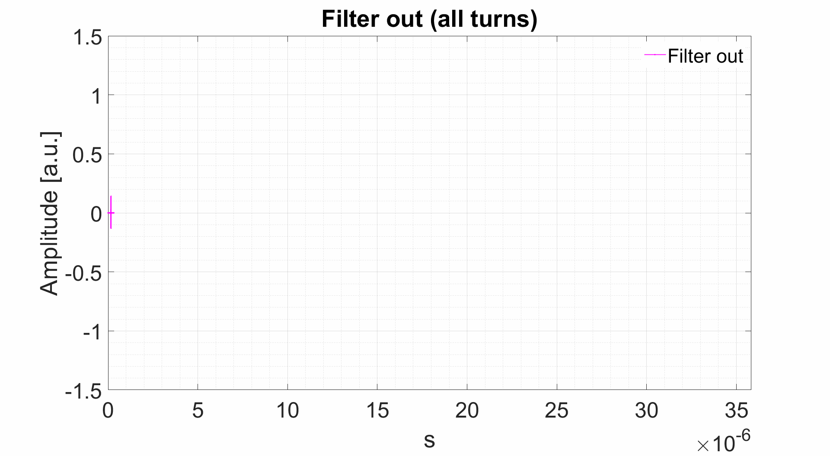
DIMTEL FBE 368L (Front-end)
Variable attenuator
Mixer
From BPM (SUM signal)
Two-cycle comb filter
Amp.
Low pass Filter
To ADC
frf
Frequency Multiplier x4
Phase shifter
Trf = 2.71ns
- One bunch for 110 machine turns.
- fsync. = 28.7 kHz
- Decimation (ADC) = 6
Tsync = 34.8 μs

Slide 15
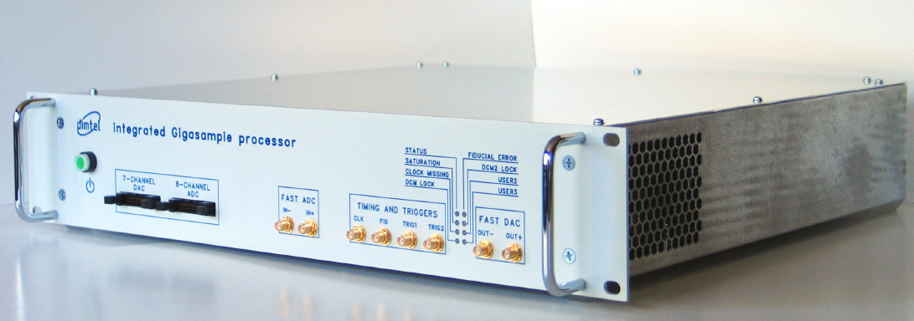
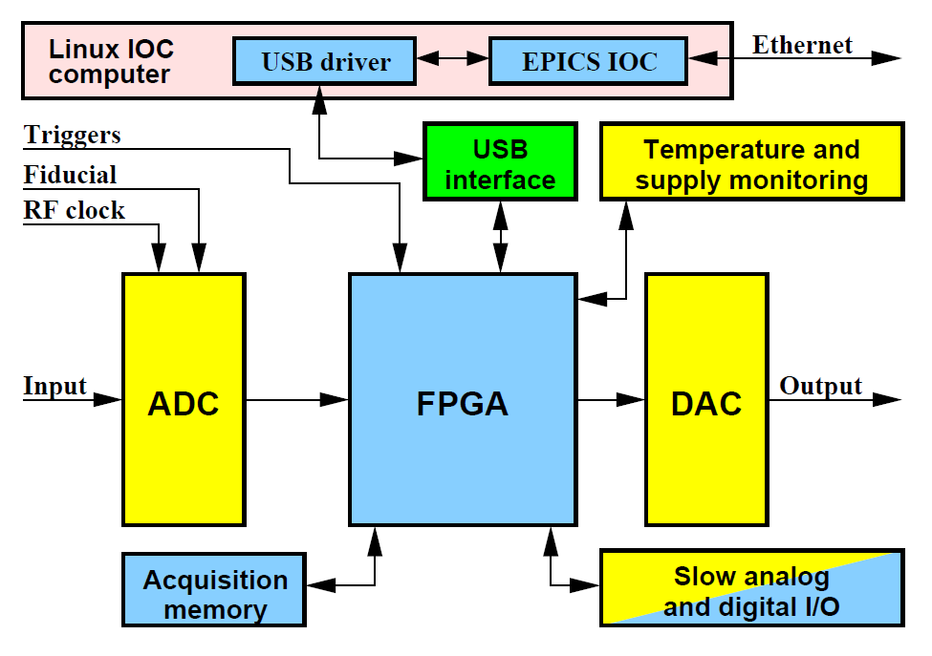
DIMTEL iGP-120F
Longitudinal
BPM
Kicker
Beam
Front-end
ADC + Digital Processing DAC
Back-end
RF Amp.
It represents the core of the system. It elaborates the correction signal, based on the phase measurements.
Block Diagram
Parameter | Value
Operating Frequency | 368 MHz
ADC resolution | 8 bits
ADC input bandwidth | 1.26 GHz
ADC input Full scale | 200 mV_{p-p}
Number of FIR taps | 16
Shift Gain (output adjustment) | 2⁰ - 2⁷
DAC resolution | 12 bits
DAC rise time (10%-90% FS) | under 250 ps
DAC fall time (90%-10% FS) | under 350 ps
DAC Full Scale | 500 mV_{p-p}
All the parameters and functionalities are controllable via software.

Slide 16
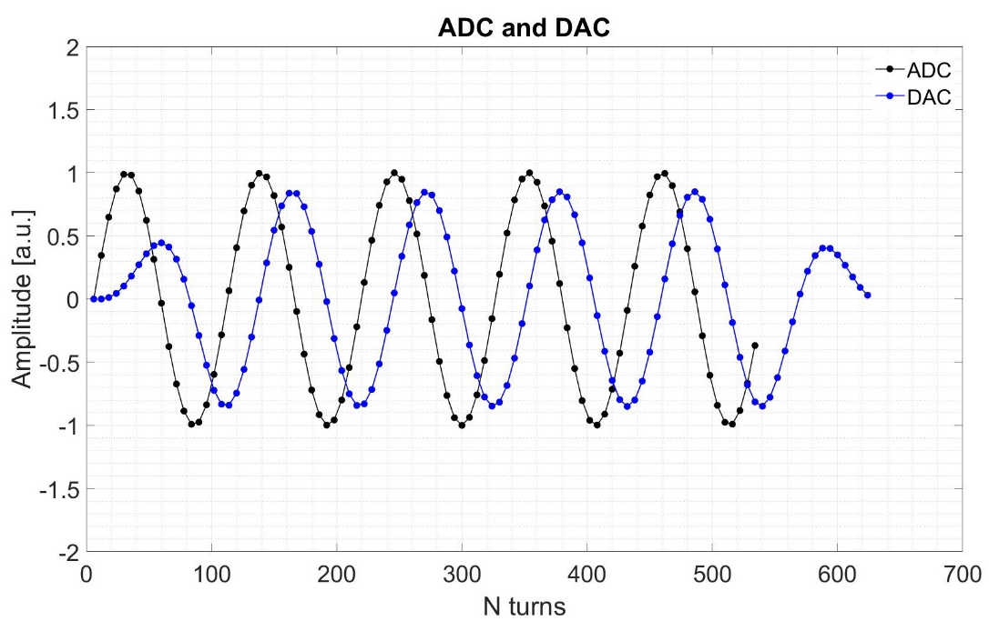
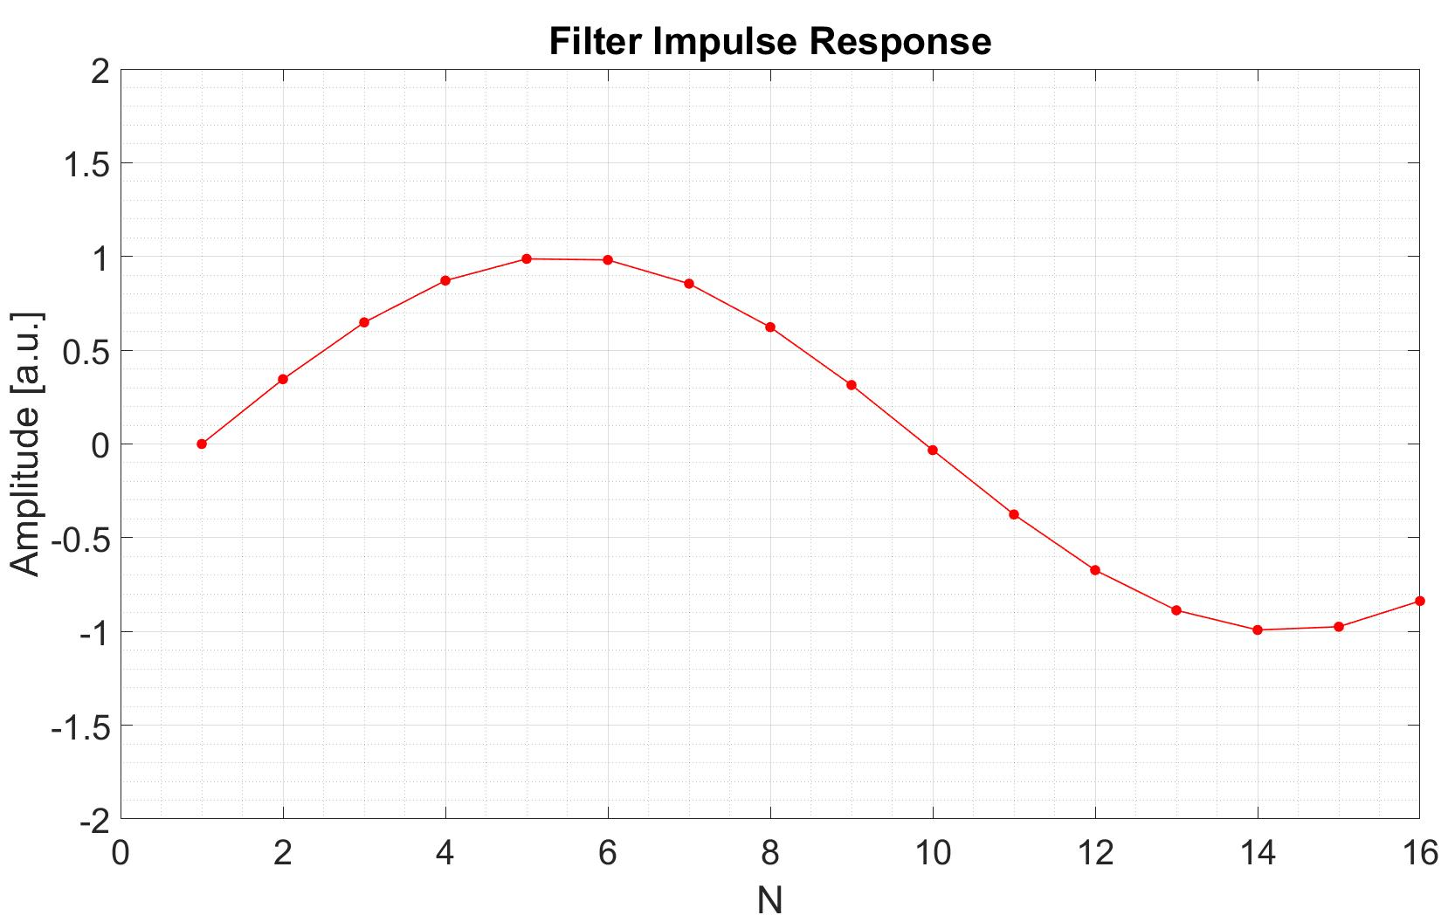
DIMTEL iGP-120F
Longitudinal
BPM
Kicker
Beam
3
1
ADC + Digital Processing DAC
2
Front-end
Back-end
RF Amp.
By means of a sinusoidal digital filters (16 taps), we obtain the correction signal for the n-th bunch. In first approximation, the filter applies a gain (user-selectable) and a phase shift of -π/2 to the digitized signal.
1
3
2

Slide 17
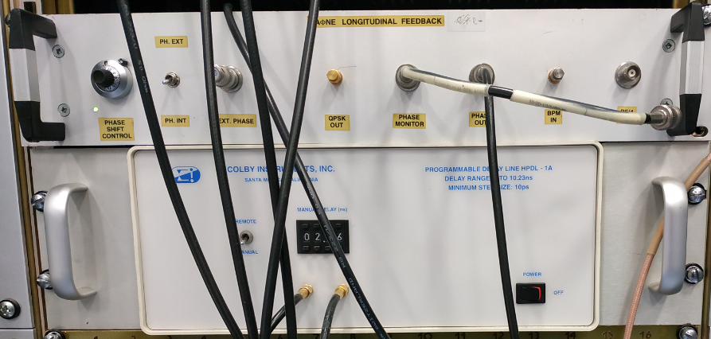
Dafne Long. Feedback (back-end)
Longitudinal
BPM
Kicker
Beam
Front-end
ADC + Digital Processing DAC
Back-end
RF Amp.
The back-end main functionalities are:
to produce an excitation signal for the Kicker, based on the output of the DAC.
To adjust the signal delay in order to synchronize the passage of the bunches with the “correction kick” (by means of a Programmable Delay Line).
Mixer
From DAC
Progr. DELAY
RF Amp
Kicker
Beam
frf
QPSK 3.25 * frf
Back-end

Slide 18
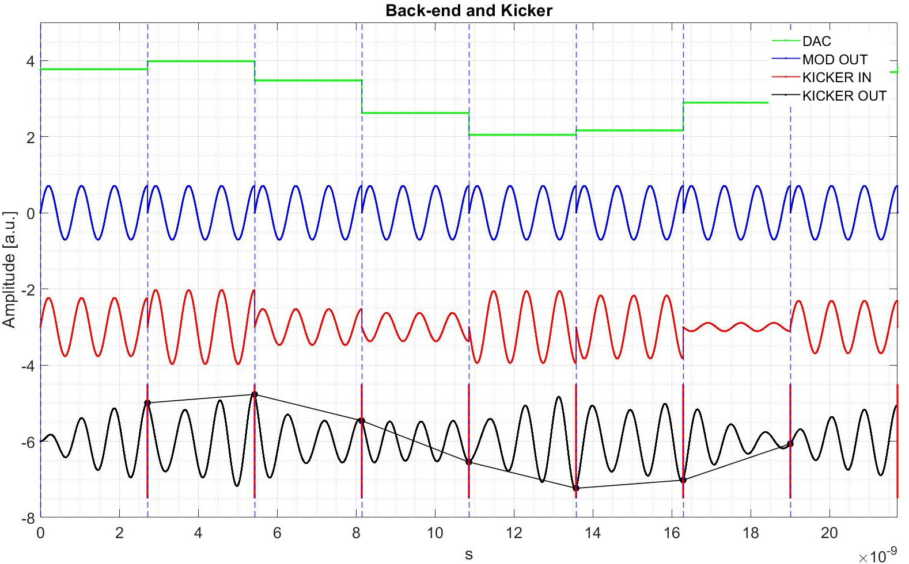
Longitudinal Feedback Back-end
1
Mixer
3
4
From DAC
Progr. DELAY
RF Amp
Kicker
Beam
2
frf
QPSK 3.25 * frf
Trf = 2.71ns
1
2
3
4

Slide 19
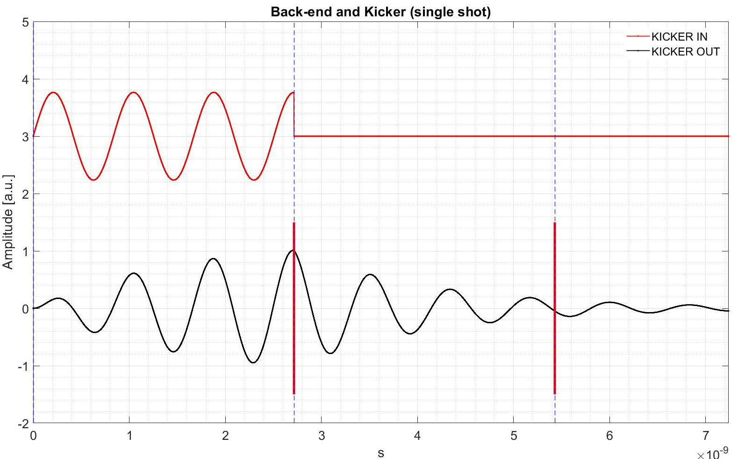
Longitudinal Feedback Back-end
Mixer
1
2
From DAC)
Progr. DELAY
RF Amp
Kicker
Beam
frf
QPSK 3.25 * frf
Trf = 2.71ns
1
2

Slide 20
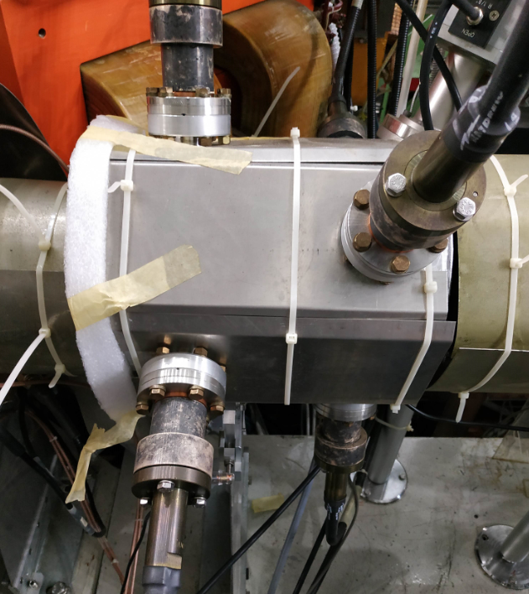
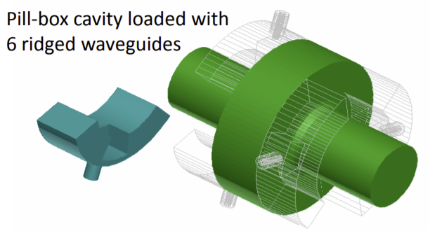
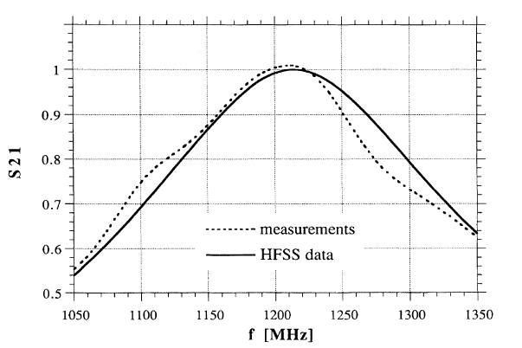
Longitudinal Feedback Kicker
Longitudinal
BPM
Kicker
Beam
Front-end
ADC + Digital Processing DAC
Back-end
RF Amp.
Transmission coefficient
Courtesy of F.Marcellini
TM010 (main mode):
Res. Frequency = 3.25 x frf (~1.2 GHz)
BW ~­220 MHz
(see: A Waveguide overloaded Cavity as Longitudinal Kicker for the DAFNE Bunch-by-bunch feedback system. R.Boni, A.Gallo, A.Ghigo, F.Marcellini, M.Serio, M.Zobov. Particle Accelerators, 1996, Vol.52, pp 95-113)

Slide 21
Instabilities measurements

Slide 22
Beam Spectrum
In order to observe beam instabilities during operations, beam spectrum is measured from the combination of signals (Vup - Vdown) + (Vleft - Vright) from one BPM. The latter is in first approximation a Dirac comb.
Instabilities will appear as side bands on every harmonic.
Longitudinal instabilities will appear as phase modulations of the beam spectrum with a frequency dependent on synchrotron tune.
Transversal instabilities will appear as amplitude modulation of the beam spectrum with a frequency dependent on the horizontal and vertical tunes.
This will measure the spectrum of all the bunches combined, but it is also possible to measure the spectrum of single bunches, by utilizing the DIMTEL signal processor used for the feedbacks.
118th harmonic of revolution frequency (118 x 3.07 MHz)
Longitudinal instability (synchrotron oscillations frequency: 28 kHz from the harmonic)
Example of beam spectrum with Positron beam (100 bunches) with Iavg = 150 mA. Long. feedback turned off.

Slide 23
Characterizing instabilities
In order to characterize beam instabilities the following method is applied (developed at SLAC):
While beam is circulating, upon some trigger, feedback is turned off.
Instabilities during this time will grow. Phase and position of each bunch is recorded.
Feedback is turned on after an adjustable time window, in order to avoid beam loss.
By performing this type of measurement, it is possible to characterize instabilities (which modes are predominant, how quick the instabilities rise) and how well the feedback (once turned on) will damp them.
An example of the measurement performed with the longitudinal feedback on positron beam (100 bunches) with Iavg = 730 mA
Mode 13 predominant

Slide 24
Conclusions
The feedback system (the longitudinal in particular) is extremely important to DAΦNE operations. Without it, bunch-coupling effects limit the maximum current stored in the rings to few hundreds of mA. By using the feedback systems it is possible to reach 1A / 2A (range of currents used currently).
The feedback system was constantly updated and maintained during the long DAΦNE operations (~22 years), by implementing new hardware, software and by reconfiguring it.
A measurement campaign is on going on the signals involved in the system (e.g. the BPM output) in order to evaluate and minimize any possible source of noise and interferences, which could degrade the system performances.

Slide 25
Thank you for your attention!

Slide 26
Spares

Slide 27
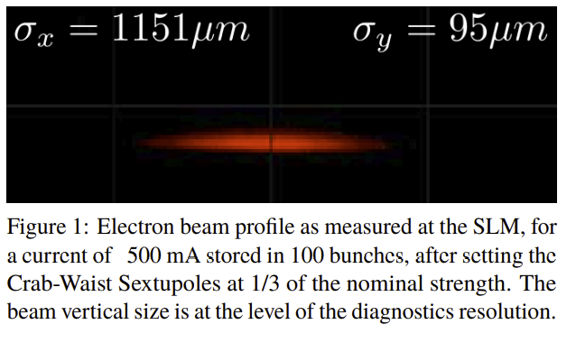
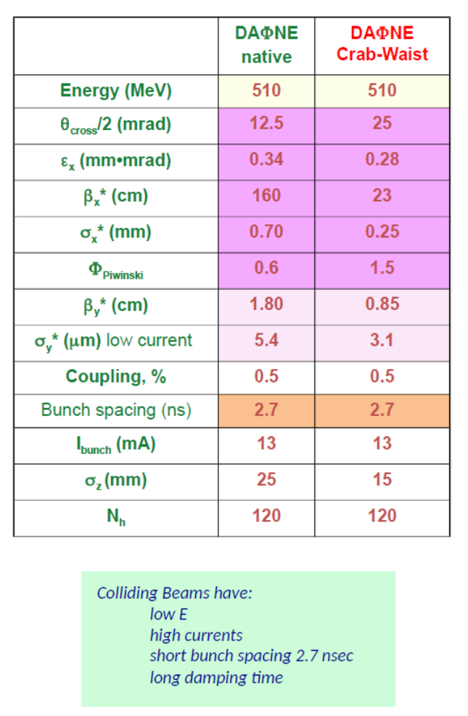
Spares

Slide 28
Longitudinal oscillations
Simple case:
One bunch (considered as a single macro particle) circulating at relativistic speed in a storage ring.
Absence of any kind of perturbation.
No feedback.
Only small energy oscillations.
The delay of a particle τ, referred to the synchronous particle is governed by the following damped harmonic oscillator equation:
$$\ddot{τ}+2d_{r}\dot{τ}+ω_{s}^{2}τ=0$$
ω_{s} is the synchrotron oscillation angular frequency.
$$ω_{s}^{2}=\frac{α_{c}e}{E_{0}T_{0}}{\dot{V}}_{rf0}$$
α_{c} is the momentum compaction factor.
E₀ is the nominal energy.
T₀ is the revolution period.
${\dot{V}}_{rf}(0)$is the derivative (in respect of time) of the voltage of the RF cavity, calculated at τ = 0 (synchronous particle)
$D$is the derivative (in respect of energy) of the energy lost by Synchrotron Radiation, calculated at Ε₀ (synchronous particle)
d_{r} is the synchrotron radiation damping rate.
$$d_{r}=\frac{D}{2T_{0}}$$
with
$$D= {\left(\frac{{dU}_{rad}}{dE}\right) }_{0}$$

Slide 29
Longitudinal oscillations
$$\ddot{τ}+2d_{r}\dot{τ}+ω_{s}^{2}τ=0$$
$$τ\left(t\right)=A∙e^{−d_{r}t}∙\cos{(ω_{s}t−Θ_{0})}$$
(for d_{r}<<ω_{s})
A and Θ₀ depend on the initial conditions.
φ$=−2πf_{RF}∙τ$
phase of the bunch (referred to the synchronous phase) could be used instead.
Similarly for ΔΕ/E₀:
$$\frac{ΔE}{E_{0}}\left(t\right)=\frac{ω_{s}}{α_{c}}∙A∙e^{−d_{r}t}∙\cos{(ω_{s}t−Θ_{0}−\frac{π}{2})}$$
Animations based on simulations of D. Quartullo for DAFNE.
Exponential decay (e^{-drt}) is not visible on this time scale. 1/d_{r}=0.0187 s (~57.000 turns)
See also: The Physics of Electron Storage Rings, M.Sands

Slide 30
Coupled bunch instabilities
To expand our simple case, we can now imagine to have multiple bunches:
coupled-bunch synchrotron (dipole) oscillations will appear and affect the longitudinal dynamics of each bunch.
Origin of Coupled-bunch instabilities:
Oscillatory electric fields (wakefields) excited (mostly) in the RF cavity by the bunches, which interefere with the bunches arriving in the structure afterwards.
$${\ddot{τ}}_{n}+2d_{r}{\dot{τ}}_{n}+ω_{s}^{2}τ_{n}=0$$
$${\ddot{τ}}_{n}+2d_{r}{\dot{τ}}_{n}+ω_{s}^{2}τ_{n}=−\frac{α_{c}e}{E_{0}T_{0}}∙V_{n}^{wk}(t)$$
courtesy of D.Teytelman
Coupled-bunch oscillations are represented by a driving force, that potentially will make the bunch oscillations unstable. The higher the circulating current, the higher the coupled-bunch oscillations.
Coupled bunch instabilities analysis will be presented by D.Quartullo in the upcoming presentation.
see : SLAC-Report-633. D.Teytelman, 2003

Slide 31
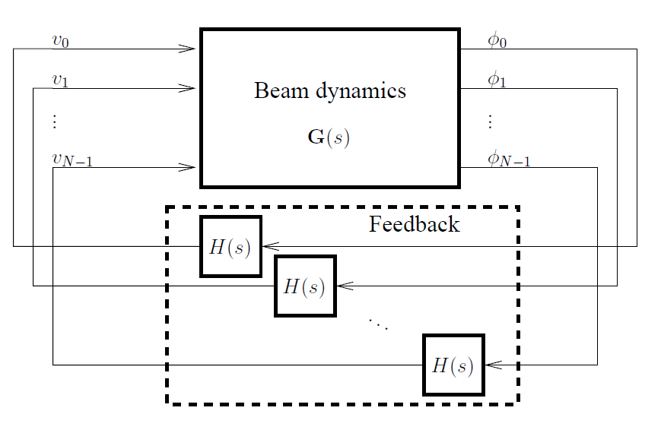
Introducing the Longitudinal Feedback
The feedback is implemented to counter the coupled-bunch instabilities.
$${\ddot{τ}}_{n}+2d_{r}{\dot{τ}}_{n}+ω_{s}^{2}τ_{n}=−\frac{α_{c}e}{E_{0}T_{0}}∙V_{n}^{wk}(t)$$
$${\ddot{τ}}_{n}+2d_{r}{\dot{τ}}_{n}+ω_{s}^{2}τ_{n}=\frac{α_{c}e}{E_{0}T_{0}}(V_{n}^{fb}(t)−V_{n}^{wk}(t))$$
The feedback acts as a driving force to stabilize the oscillations.
Eventhough the coupled-bunch instabilities create a correlation between the bunches, the DAFNE feedback system treats each bunch separately.
This is equivalent to have a separate feedback loop associated with each bunch.
courtesy of D.Teytelman

Slide 32
Mixer
Mixer
$$Y_{IN}\left(t\right)=A_{IN}\sin\left(ω_{IN}t+φ_{IN}\right)$$
$$Y_{OUT}\left(t\right)=Y_{IN}\left(t\right)∙Y_{LO}\left(t\right)$$
$$Y_{LO}\left(t\right)=A_{LO}\cos\left(ω_{LO}t+φ_{LO}\right)$$
$$Y_{OUT}\left(t\right)=\frac{1}{2}A_{LO}A_{IN}∙\left[\sin{(\left(ω_{IN}−ω_{LO}\right)t+\left(φ_{IN}−φ_{LO}\right))}+\sin{(\left(ω_{IN}+ω_{LO}\right)t+\left(φ_{IN}+φ_{LO}\right))}\right]$$
In our case: ω_{IN} = ω_{LO} = 4·ω_{RF} A_{LO} = 1 φ_{LO} = 0°
φ_{IN} is what we want to measure For small angles: sin(φ_{IN}) ≈ φ_{IN}
$$Y_{OUT}\left(t\right)=\frac{1}{2}A_{IN}∙\left[\sin\left(φ_{IN}\right)+\sin\left(\left({8·ω}_{RF}\right)t+φ_{IN}\right) \right]$$
DC component
8·ω_{RF} component (it will be filtered out)

Slide 33
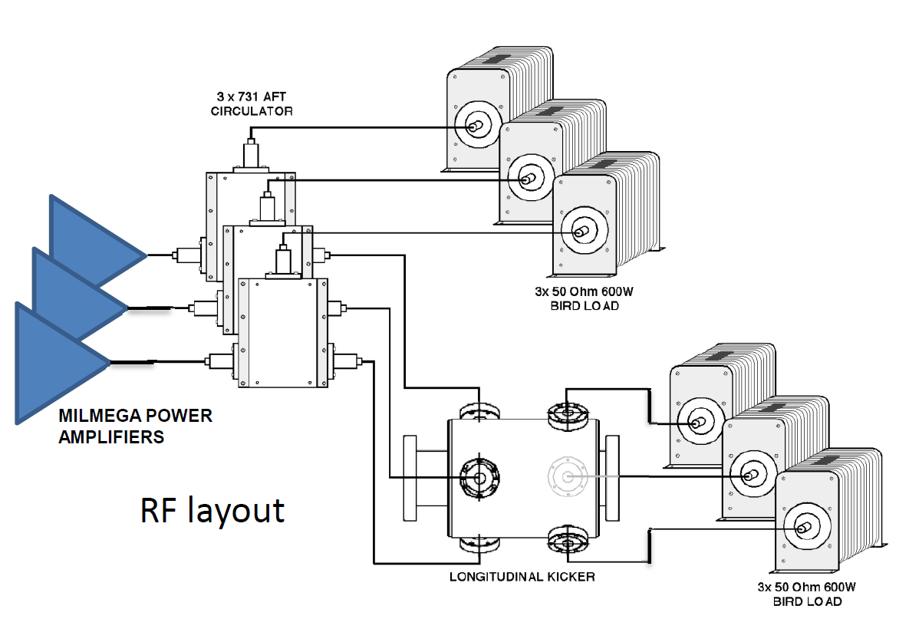
Power Amplifiers and Longitudinal Kicker
The correction signal is split in three, by means of a splitter with manually adjustable delays. The three signals are fed to the three power amplifiers. The output signals are provided to the longitudinal kickers through three ports.
Longitudinal
BPM
Kicker
Beam
Front-end
ADC + Digital Processing DAC
Back-end
RF Amp.
The longitudinal kicker is connected through Circulators to avoid that backward power (generated by reflections or bunch passage) could damage the Amplifiers.
Courtesy of D.Pellegrini

Slide 34
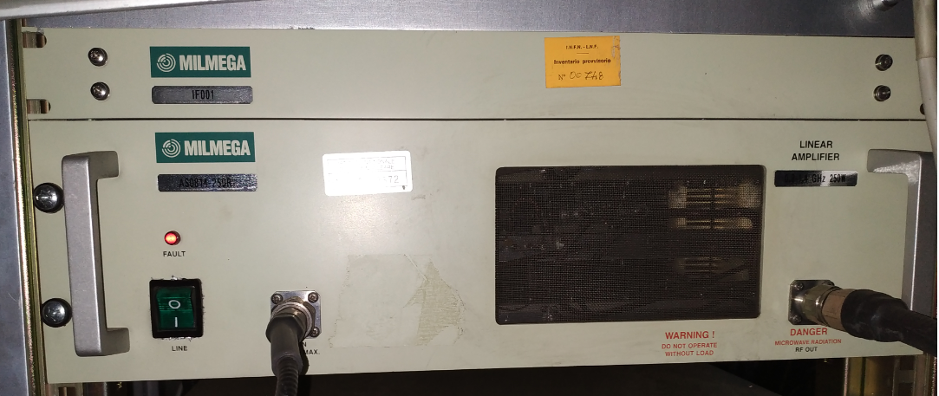
MILMEGA AS0814-250R Power Amplifier
Longitudinal
BPM
Kicker
Beam
Front-end
ADC + Digital Processing DAC
Back-end
RF Amp.
Nominal Parameter (if not specified) | Value
Operating Frequency | 0.8-1.4 GHz (fin = 1.2 GHz)
Output Power at saturation | 54 dBm
Output Power at 1dB gain compression | 53.5 dBm
Input Power for rated output | 5 dBm
Gain (measured at 1.2 GHz) | ~58 dB
Gain variation with temperature | 0.06 dB/C
Noise Figure (typical) | 10 dB
Each amplifier is associated with a control unit (MILMEGA IF001 Ctrl), interfaceable through GPIB (for basic operations and diagnostics).
A custom modification on the hardware allows to check if the amplifiers are powered on directly from the control room (see next slides).

Slide 35
Horizontal and Vertical Feedback
1
3
Beam
BPM
Kicker
2
ADC +
Digital Processing +
DAC
RF Amp.
The transverse feedbacks acts on the horizontal and vertical position of the bunches. They apply a correction signal in the form of a transverse kick (by means of stripline kickers).
The signals from the horizontal (or vertical) electrodes of one BPM are subtracted and sent to the front-end electronics. Exception: Vertical e- and e+ feedbacks use only the signal from the bottom (up for e+) electrode of the BPM (BPBES 202 and BPBPS 202).
The latter is then digitized and the correction signal is digitally elaborated and converted to analog (DAC).
The signal (amplified by RF amp.) is then supplied to the horizontal (or vertical) kicker. The latter modifies the horizontal (or vertical) momentum (by means of a transverse kick) with the aim of restoring the bunch standard orbit.
Detail of the transverse Feedbacks will be described in details in the future

Slide 36
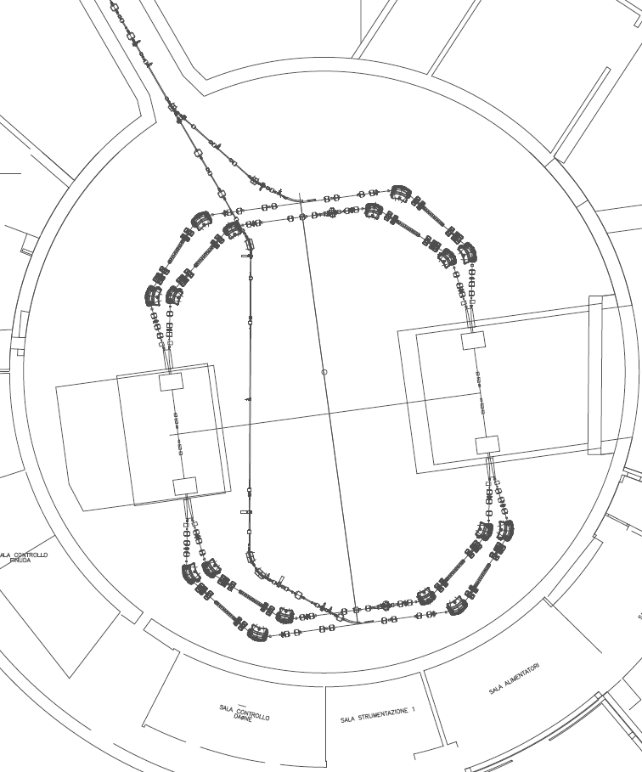
Longitudinal e- Feedback
- BPM (BPBES 108)
The signals of the four electrodes are summed together (with power combiners) and sent to the electronics.
BPM

Slide 37
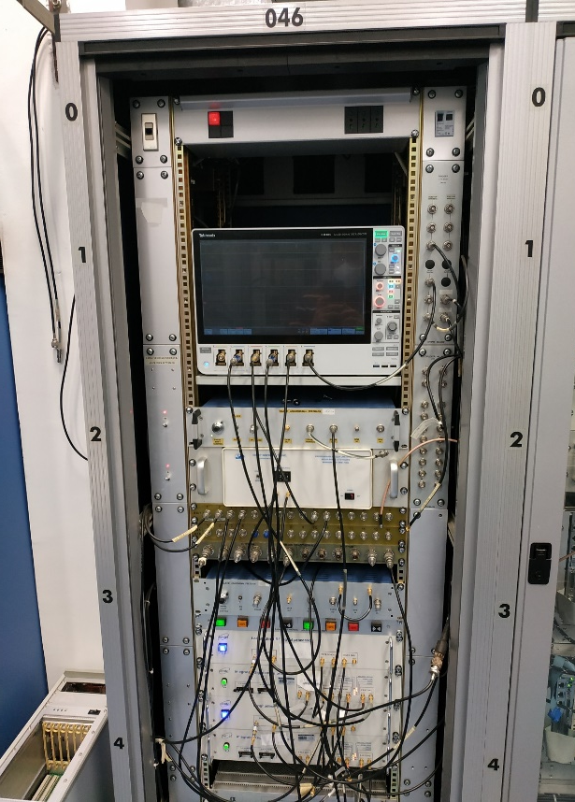
Longitudinal e- Feedback
- ELECTRONICS (instr. room – Rack 46 - multiple devices)
The analogue signal is adjusted (front-end) and digitized (ADC). The correction signal is calculated, transformed in an analogue signal (DAC), adjusted (back-end + delay unit) and sent to the RF amplifiers.
BPM
Electronics

Slide 38
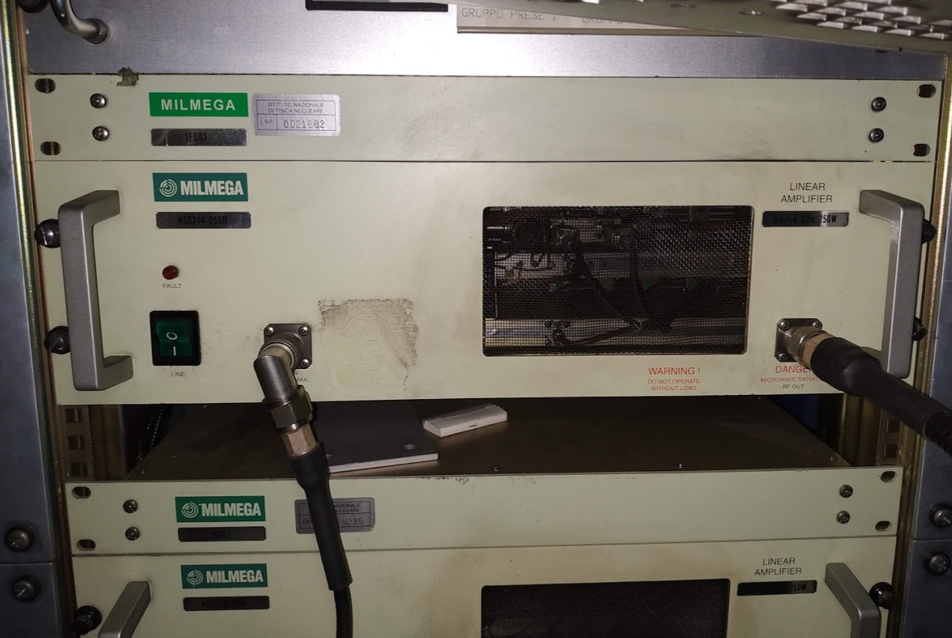
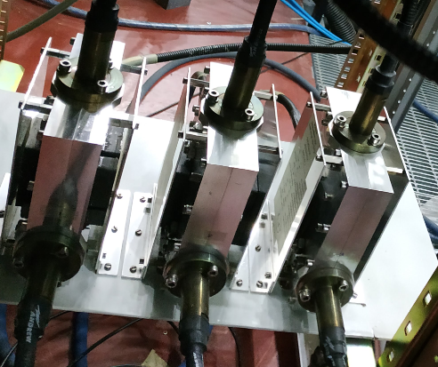
Longitudinal e- Feedback
- RF AMPLIFIERS (Rack 54 - Three units)
The correction signal is amplified and sent to the kicker (through circulators)
BPM
RF Amplifiers
Electronics

Slide 39
Longitudinal e- Feedback
- KICKER
The correction signal is applied to the bunches with a longitudinal kicker (RF resonator).
Kicker
BPM
RF Amplifiers
Electronics

Slide 40
Longitudinal e- Feedback
- BPM (BPBES 108)
The signals of the four electrodes are summed together (with power combiners) and sent to the electronics.
- ELECTRONICS (instr. room – Rack 46 - multiple devices)
The analogue signal is adjusted (front-end) and digitized (ADC). The correction signal is calculated, transformed in an analogue signal (DAC), adjusted (back-end + delay unit) and sent to the RF amplifiers.
- RF AMPLIFIERS (Rack 54 - Three units)
The correction signal is amplified and sent to the kicker (through circulators)
- KICKER
The correction signal is applied to the bunches with a longitudinal kicker (RF resonator).
Kicker
BPM
RF Amplifiers
Control
Electronics

Slide 41
Longitudinal e+ Feedback
- BPM (BPBPS 108)
The signals of the four electrodes are summed together (with power combiners) and sent to the electronics.
- ELECTRONICS (instr. room – Rack 46 - multiple devices)
The analogue signal is adjusted (front-end) and digitized (ADC). The correction signal is calculated, transformed in an analogue signal (DAC), adjusted (back-end + delay unit) and sent to the RF amplifiers.
- RF AMPLIFIERS (Rack 51 - Three units)
The correction signal is amplified and sent to the kicker (through circulators)
- KICKER
The correction signal is applied to the bunches with a longitudinal kicker (RF resonator).
RF Amplifiers
Kicker
BPM
Control
Electronics

