Slide 1

Beam dynamics on beam injection
Masamitsu Aiba, PSI
Beam Diagnostics and Dynamics
in Ultra Low Emittance Rings
Session 4, 28.04.2022

Slide 2
Contents
Introduction
Top-up injection
  Principle
  Various schemes
  Key parameters
Beam dynamics on injection
  Injector booster
  Transfer line
  Storage ring
Beam diagnostics for injection
Summary

Slide 3
Introduction
Top-up injection is essential in the lepton collider and the light source
  to maximize the performance
  to achieve high stability
Injection into ultra low emittance rings
  is challenging due to limited aperture
  drove developments of new injection schemes
  requires precise beam control/tuning and thus reliable beam diagnostics

Slide 4
Contents
Introduction
Top-up injection
  Principle
  Various schemes
  Key parameters
Beam dynamics on injection
  Injector booster
  Transfer line
  Storage ring
Beam diagnostics for injection
Summary

Slide 5
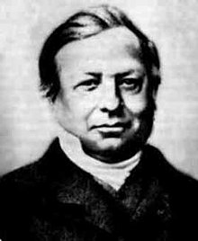
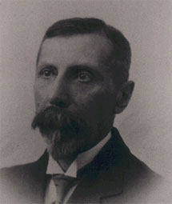

Top-up injection –Principle
Liouville’s theorem
Beam in phase space
q
?
p
J. Liouville, 1809-1882
Energy loss in B field
Storage ring aperture
At the time of injection, the injection and stored beams have to be separated
Radiation damping enables us to repeat injections
The separation is not necessarily in the hor. phase space
A.-M. Liénard, 1869-1958
* Portraits from Wikipedia

Slide 6
Various injection schemes
Beam energy
Kicker bump
Real space (x)
Conventional injection
scheme
Synchrotron phase
space injection
Multipole kicker
Off-axis injections
On-axis injections
Multipole kicker
injection
Multipole kicker
injection, off-energy
Beam
energy
and/or
RF phase
Dipole kicker
Swap-out
injection
On-axis injection
w/o dispersion
Longitudinal
injections
Angle (x’)
Review of top-up injection schemes for electron storage rings, IPAC’18
and references therein (link)

Slide 7
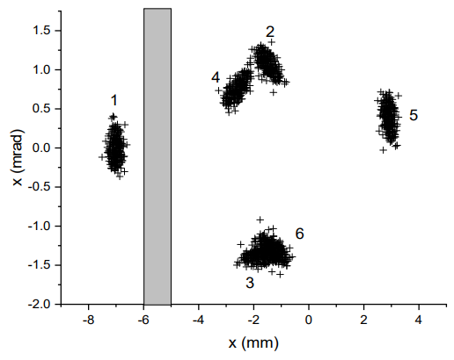


Key parameters
Septum thickness
Beam dynamics parameters
  Inj. beam emittance
  Dynamic aperture
  Bunch length
  Momentum acceptance
Injection and stored beams
(SLS2 kicker-bump injection)
In the following slides, these labels are used to indicate which parameter is relevant or to be improved (if any):
$$ε_{inj}$$
DA
$$σ_{s}$$
MA
Dynamic aperture required

Slide 8
Contents
Introduction
Top-up injection
  Principle
  Various schemes
  Key parameters
Beam dynamics on injection
  Injector booster
  Transfer line
  Storage ring
Beam diagnostics for injection
Summary

Slide 9
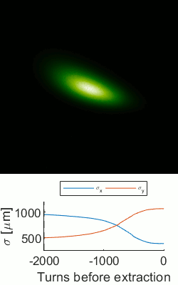




Beam dynamics in booster (1)
Emittance equalization
  Working point close to coupling resonance
Emittance exchange
  Coupling resonance crossing
Emittance exchange experiment @ SLS booster
J. Kallestrup, PhD thesis
$$ε_{inj}$$
$$ε_{inj}$$
$ε_{x}↔$ $ε_{y}$
approximately

Slide 10
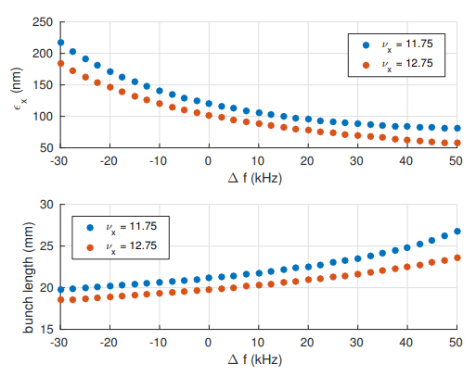
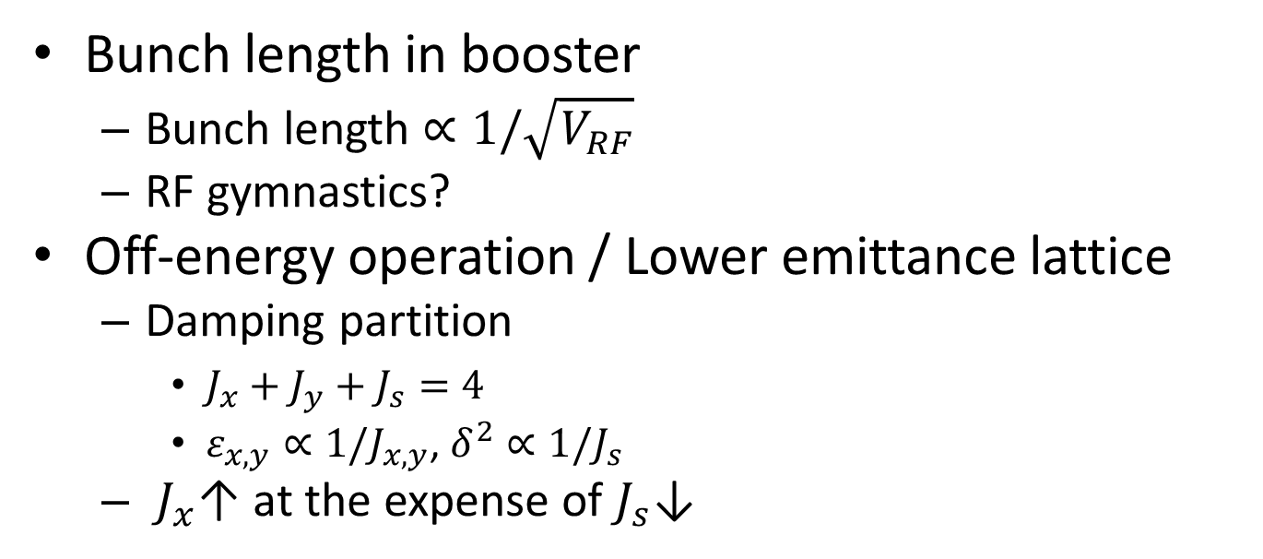


Beam dynamics in booster (2)
$$σ_{s}$$
Bunch length in booster
  Bunch length $∝1/\sqrt{V_{RF}}$
  RF gymnastics?
Off-energy operation / Lower emittance lattice
  Damping partition
    $J_{x}+J_{y}+J_{s}=4$
    $ε_{x,y}∝1/J_{x,y}$, $δ^{2}∝1/J_{s}$
  $J_{x}$↑ at the expense of $J_{s}\text{↓}$
$$ε_{inj}$$
ESRF booster, N. Carmignani et al., IPAC’18

Slide 11
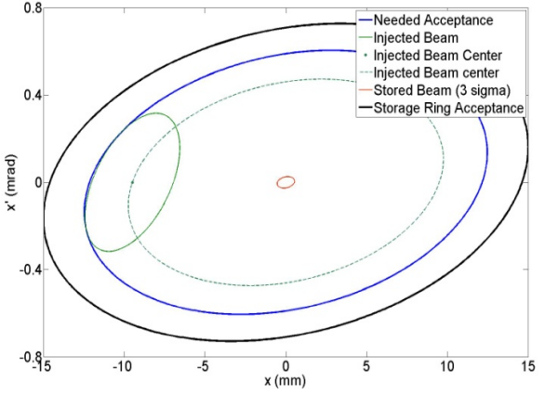
Beam dynamics in transfer line
DA
Transporting the beam from injector to storage ring
  Trivial task but a precise beam position control at the exit of injection septum required
Matching the injection beam twiss parameters
  Analysis of measurement data (quad scan) is not straightforward when the dispersion function is involved…
  Non-dispersive section, if available, makes this task much easier
DA
Optimal matching
R. P. Fliller III, IPAC’10
(Link)

Slide 12
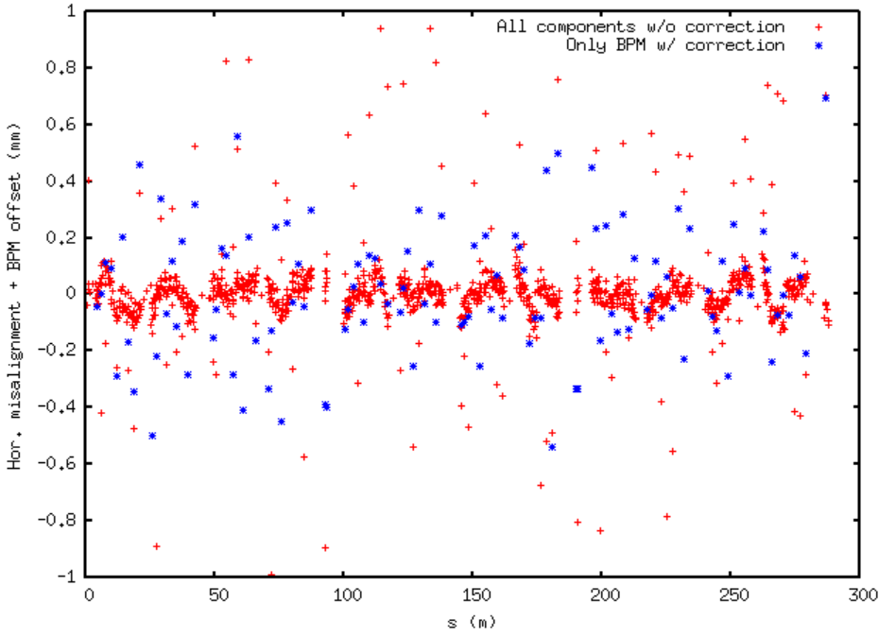
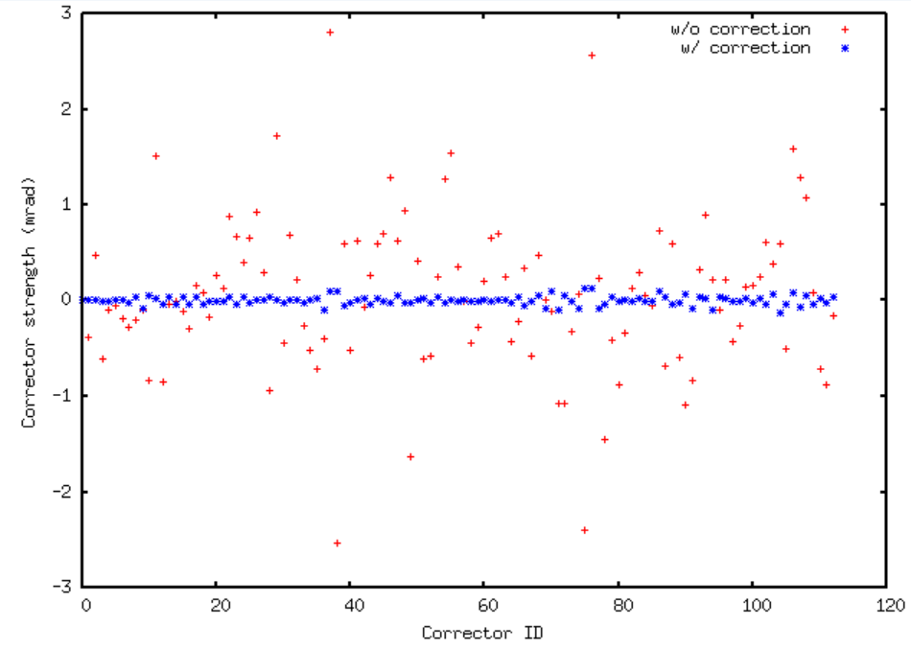
Beam dynamics in SR (1)
Corrector strengths for full trajectory correction
Before/After BPM offset correction
BPM offset correction (Before/After) in SLS2 lattice
First turn trajectory control in the commissioning
  Turn-by-turn BPM capability is indispensable
  Unfortunately BPMs have large offsets, several 100 μm…
  ‘Soft correction’ is applied normally to follow approximately the BPM centers
“Magic” to correct the BPM offsets and to enable ‘full correction’
  BPM reading = Beam position – BPM offset
  We need strong correctors, when BPM offsets are dominant, to make the beam follow the BPM centers
  By taking the BPM offsets as “another set of correction knobs” and computing the corrector strengths (SVD), large BPM offsets are identified
Corrector limit

Slide 13
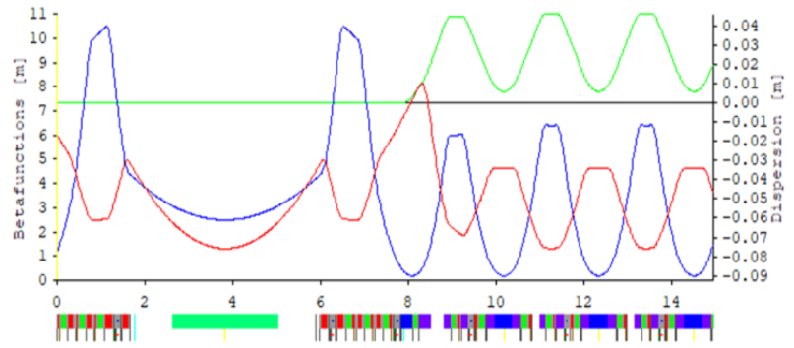
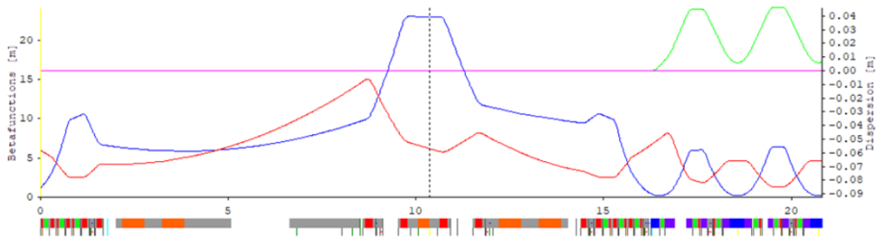
Beam dynamics in SR (2)
DA
Pseudo symmetry, A. Streun
  Phase advance between sextupoles facing to the straight is constant over all straight sections in each plane: Super-periodicity = Number of arcs for on-energy particles, significantly improving the dynamic aperture
  Beta function at the septum can be increased to enlarge the dynamic aperture there (βx=23 m in the plot below)
SLS2 short straight
SLS2 long straight (Injection straight)
Septum
μ_{x,S} = μ_{x,L}
μ_{y,S} = μ_{x,L}
μ_{x,S} / μ_{y,S}
μ_{x,L} / μ_{y,L}
Last sextupole
upstream of S.S.
First sextupole
downstream of S.S.
Last sextupole
upstream of L.S.
First sextupole
downstream of L.S.
Pseudo symmetry can be extended to off energy:
ESR workshop, P. Raimondi (Link)

Slide 14
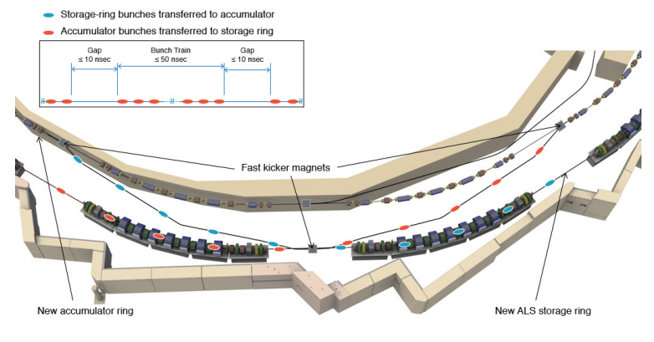
Beam dynamics in SR (3)
Round beam operation
  Longer beam lifetime due to the much-higher vertical emittance
  Drawback for the off-axis injection: a large horizontal injection beam oscillation appears in the vertical plane in a full coupled lattice
    On-axis injections are possible solutions
    Beam dynamics trick?
Swap-out injection
Plan for ALS-U
C. Steier et al., IPAC’17
(Link)

Slide 15
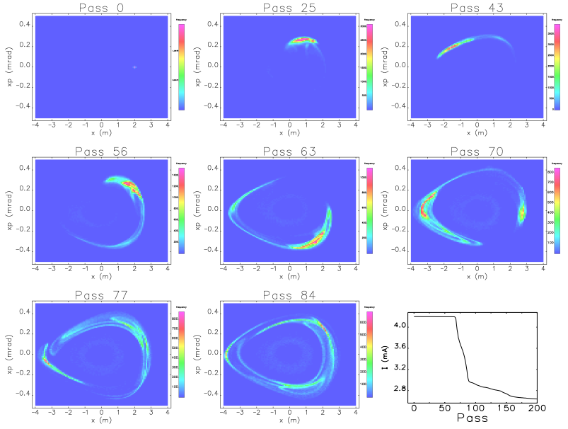
Beam dynamics in SR (4)
Collective effects
  Beam oscillation due to injection…
    in off-axis injections by design (injected beam)
    due to a misplacement of injection beam in on-axis injection
  Longitudinal phase mismatch
  These can be a cause of beam loss due to the wake field even when stability condition is met (transient effects)
  Bunch-by-bunch feedback can be a cure (if it is strong enough…)
Off-axis injection simulation for APS-U (15 nC, timing mode)
R. Lindberg, M. Borland and A. Blednykh, NA-PAC’16 (Link)

Slide 16
Beam dynamics in SR (5)
Corrections and tunings
  BPM beam based alignment
    Orbit bump + Quad variation, Quad K-modulation, etc.
  Linear optics correction
    LOCO, turn-by-turn BPM, etc.
  Nonlinear optics tuning
    Nonlinear LOCO, turn-by-turn BPM, etc.
    Empirical tuning using directly the injection efficiency and/or the beam lifetime is efficient and handy in the control room
    Injection efficiency is not fully correlated with the beam lifetime from time to time…
DA
MA

Slide 17
Contents
Introduction
Top-up injection
  Principle
  Various schemes
  Key parameters
Beam dynamics on injection
  Injector booster
  Transfer line
  Storage ring
Beam diagnostics for injection
Summary

Slide 18
Beam diagnostics for injection (1)
Booster and transfer line
  Emittance manipulations in the booster
    Characterization of the booster beam is important
    Destructive measurements are, however, available in the transfer line: no need of extraordinary diagnostics in the booster
  Precise position control at the exit of injection septum
    BPMs nearby are required
    Position feedback in the transfer line may be useful to compensate for (long-term) drifts
  Matching of injection beam optics
    Screen monitor in the transfer line is essential
    Non-dispersive section if possible

Slide 19
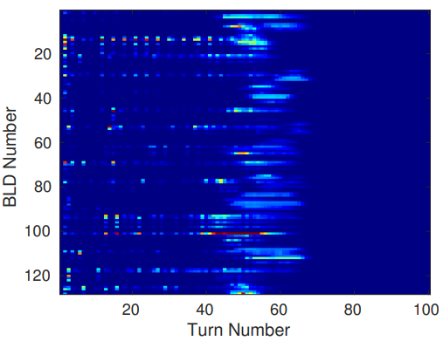
Beam diagnostics for injection (2)
Storage ring
  Commissioning (first injection and accumulation)
    BPM offsets at the beginning of the commissioning are quite large but can be corrected with the first turn beam
    Turn-by-turn BPM mode is essential to achieve beam accumulation
  Injection efficiency and lifetime maximization
    Lifetime measurement with CT is rather slow normally…
  Stored beam disturbance due to injection
    Measurement with beam size monitor, TbT BPM etc.
  Beam loss monitor may be more important in the low emittance ring
ESRF-EBS
Beam loss detector
L. Torino, K.B. Scheidt
IBIC2018 (Link)

Slide 20

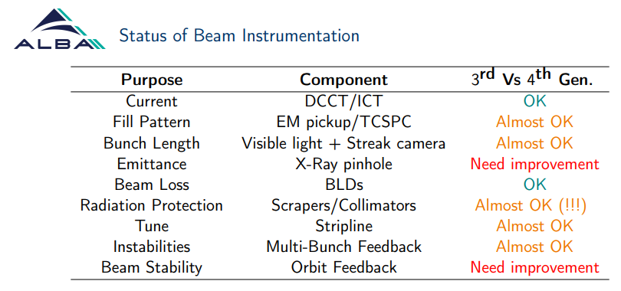
Slide borrowed from L. Torino’s presentation at ESR workshop (link)
It is noted that the table is not dedicated for the injection

Slide 21
Summary
Injection into the low emittance ring is challenging
There are many beam dynamic approaches and techniques to overcome the difficulties
Precise beam control is needed to achieve a high injection efficiency, and thus reliable beam diagnostics are essential
Question for the discussion session: can we say that the beam diagnostics available today are adequate for the injection?

