Slide 1
A public-private partnership building a multidisciplinary cloud platform for data intensive science
Karlsruhe, 30 August 2013
Bob Jones
Head of openlab
IT dept
CERN
This document produced by Members of the Helix Nebula consortium is licensed under a Creative Commons Attribution 3.0 Unported License.
Permissions beyond the scope of this license may be available at http://helix-nebula.eu/. The Helix Nebula project is co-funded by the European Community Seventh Framework Programme (FP7/2007-2013) under Grant Agreement no 312301

Slide 2
A Vision for a European e‐Infrastructure for the 21st Century
RIs currently in construction (FAIR, XFEL, ELIXIR, EPOS, ESS, SKA, ITER and upgrades to ILL and ESRF etc.), need to be convinced that e-Infrastructure will exist and continue to evolve throughout their construction and operation phases if they are to take the risk and invest in its creation & exploitation
Need an e-Infrastructure that supports the needs of the whole European research community, including the “long tail of science”, and interoperate with other regions
Cannot be a one-size-fits-all solution
Coherent set of services and tools must be available to met the specific needs of each community
Essential that European industry engage with the scientific community in building and providing such services
The user community should have a strong voice in the governance of the e-Infrastructure

Slide 3
What do we have already?
Existing European e-infrastructure long-term projects
  GEANT, EGI, PRACE
Many “pathfinder” initiatives have prototyped aspects of what will be needed in the future
  Includes much of the work in the existing e-Infrastructure projects but also projects such as EUDAT, Helix Nebula, OpenAIRE+, etc
  Thematic projects such as BioMedBridges/ CRISP/ DASISH/ ENVRI, as well as Transplant, VERCE, Genesi-DEC and many others

Slide 4
How can we create e-infrastructures that overcome fragmentation?
Fragmentation of users (big science vs. long tail)
Fragmentation of infrastructure (not integrated services)
Common platform (e-infrastructure commons) with 3 integrated areas
  International network, authorization & authentication, persistent digital identifiers
  small number of facilities to provide cloud and data services of general and widespread usage
  Software services and tools to provide value-added abilities to the research communities, in a managed repository
Need a data continuum - linking the different stages of the data lifecycle, from raw data to publication, and compute services to process this data

Slide 5
The Business of Research
Publicly funded research communities make significant investments in E-infrastructure that must be justified
  To justify these investments the e-infrastructures must show a clear impact for the research communities
  To gauge the impact, this market of end-users must be well understood by funding agencies and e-infrastructure services providers
So the user communities must have a strong voice in the governance of the e-infrastructures to ensure they remain relevant and upto-date

Slide 6
User Forum
A pan-European forum for organisations and projects that operate at an international level
Present to the policy makers and the infrastructure providers where there are common needs and opinions and where there is divergence
Independent of any supplier and engage across research domains
Supplements but does not replace existing e-infrastructure user engagement channels

Slide 7
Topics to be addressed
Strategic topics concerning e-infrastructures include, but are not limited to:
The growth of demand and expectations of infrastructure and services
The value of a proposed service or infrastructure to the community
Interoperability and Sustainability
Identifying inhibitors to use (regulatory, procurement, legal, technical)
Sharing of best practices and successful approaches
Collaboration and creation of common services
Creation of common understanding between service providers and users
“user aggregation” of needs with respect to working with industry
User Forum is not a technical body but will provide input to solution providers

Slide 8
Establish a sustainable multi-tenant cloud computing infrastructure in Europe
Initially based on the needs for the European Research Area & space agencies
Based on commercial services from multiple IT industry providers
Adhere to internationally recognised policies and quality standards
Governance structure involving all stakeholders
http://cdsweb.cern.ch/record/1374172/files/CERN-OPEN-2011-036.pdf

Slide 9































A European cloud computing partnership: big science teams up with big business
Strategic Plan
Establish a federated multi-tenant, multi-provider cloud infrastructure
Identify and adopt policies for trust, security and privacy
Create governance structure
Define funding schemes
To support the computing capacity needs for the ATLAS experiment
Setting up a new service to simplify analysis of large genomes, for a deeper insight into evolution and biodiversity
To create an Earth Observation platform, focusing on earthquake and volcano research
Adopters

Slide 10
Long Term Goal
To create a multi-tenant ‘Open Market Place for Science’, where data, scientists, funding bodies, SMEs and downstream industry meet to work towards common interests
An ecosystem to transform
data into valuable information

Slide 11
Contributors to the Ecosystem
IT Suppliers
Funding Bodies
R&D Labs
SME’s
Downstream industry
Data providers
Scientists

Slide 12
Timeline
2011
2014 …
2012-2013
Endorse the Common Strategy
Agree on the Partnership
Select flagships use cases
Define governance model
Pilot Phase
Deploy flagships,
Analysis of functionality,
performance & financial
model
Towards an open market
for Science

Slide 13
The Actors in the Helix Nebula initiative – a European Partnership
IT Providers
-commit resources
-share investments
-agree on standards
-interoperability
Scientific and Space
Organizations
-commit resources
-access to data & user
communities
NDA
SME’s
-commit resources
-link between
users and providers
- Act as catalyser
EC supports with
-policy & strategy
-through targeted
calls under FP7
EC Projects
-standard/Open source
-contributing / using HN

Slide 14
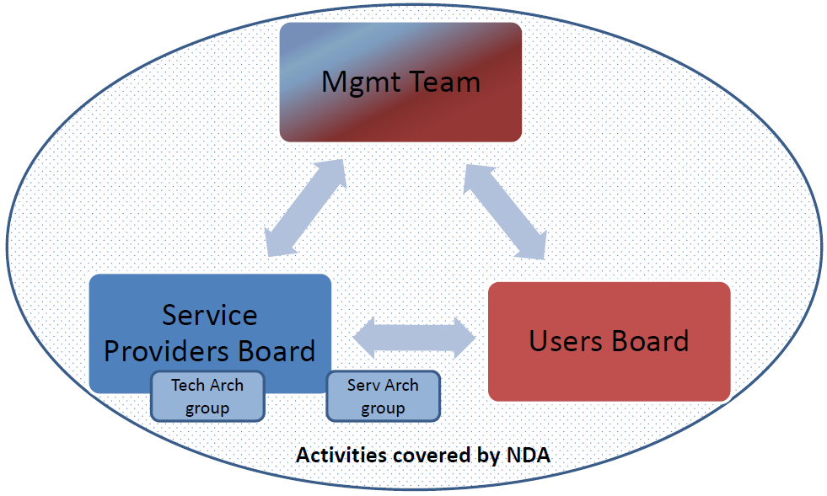
Governance Model for pilot phase
Membership rules published
# Members has increased from 20 to 34

Slide 15
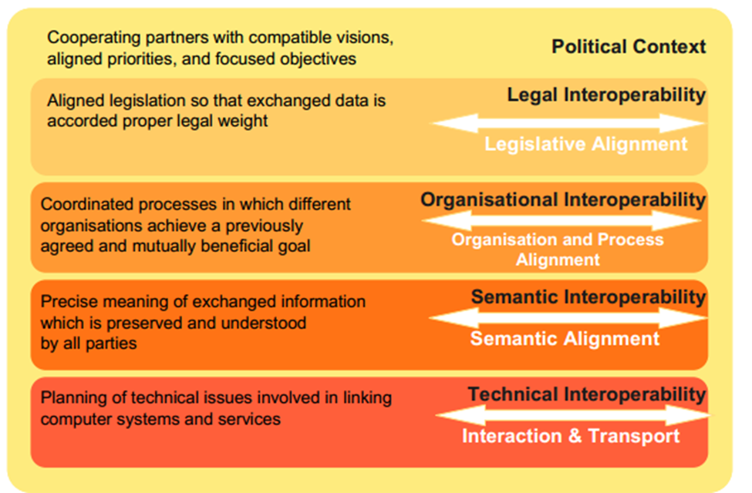
Building the hybrid cloud
How to approach interoperability
European Interoperability Framework V2
Useful not only for public-commercial hybrid model but also between public services

Slide 16
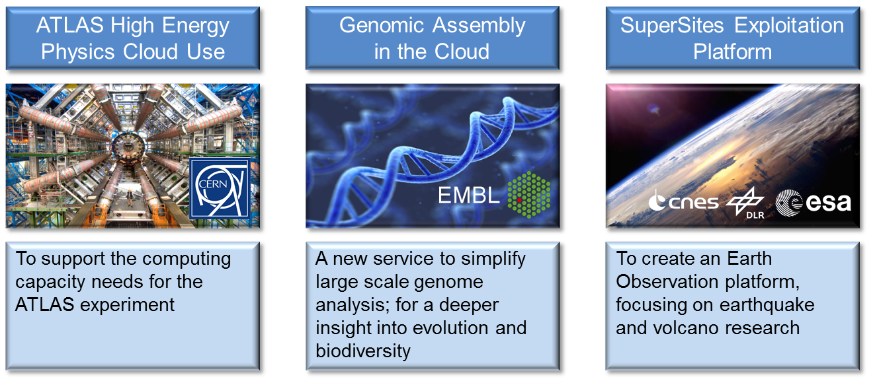
Initial Flagship Use Cases
Scientific challenges with societal impact
Sponsored by user organisations
Stretch what is possible with the cloud today

Slide 17
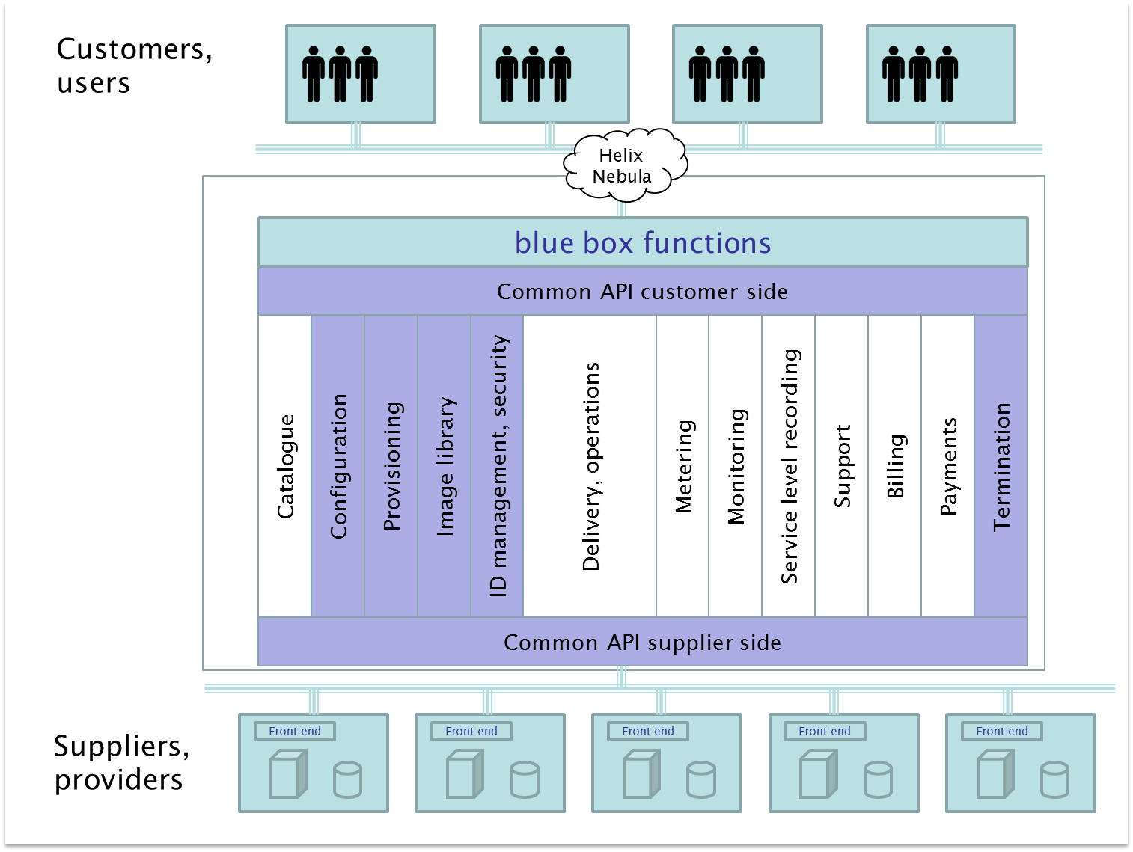
Blue Box brokerage functions
Each customer and supplier have a single connection to the Blue Box resulting in M + N relationships
- -
Notes:
Mention color coding:
- Blue are the prioritised functions

Slide 18
Building the hybrid cloud
Connecting commercial providers to the GÉANT/NRENs
DANTE offering free IP connectivity in GÉANT for research traffic during the pilot phase
NRENs have different commercial agreements (usually they apply a fee)

Slide 19
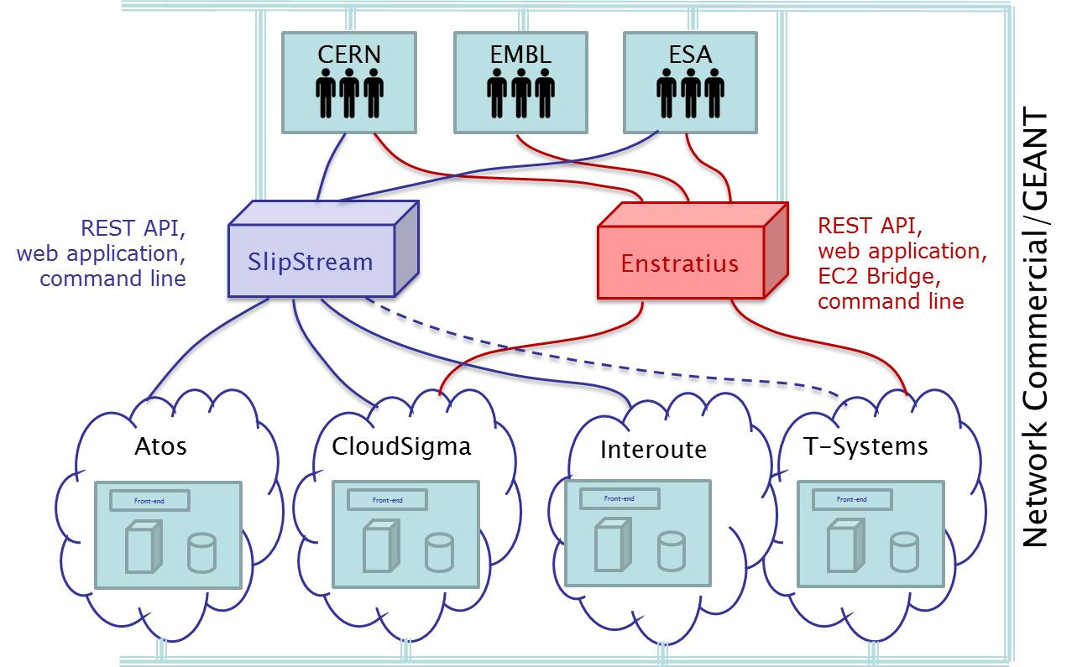
Blue Box use in pilot
Implementing two Blue Boxes in the pilot improves the evaluation by adding practical experience to the study before the pilot
- -
Notes:
It is worthwhile to try out both; a COTS product and an Open source solution

Slide 20
Procurement Challenges
User Needs
Rapid public procurement model offering
  Flexibility
  Scalability
  Lower Prices (cloud vs. in-house)
  Acceptable terms and conditions
Cloud Market Imperfections
Usage Commitment
Switching Costs
Lack of Transparency & Comparability (prices, payments, units, types)
Investment Risks

Slide 21
Building the hybrid cloud
Testing the public-commercial cloud interoperability
EGI Federated Cloud
Task Force
Launched in Sep 2011
70 members from 40 institutions and 13 countries
Pre-production test-bed:
14 resource centres actively providing resources (900 cores, 16 TB storage)
30 active users from structural biology, linguistics, ecology, space science, software engineering
http://go.egi.eu/cloud
Deploy the ESA/CNES/DLR SuperSites Exploitation Platform and CERN CMS/ATLAS flagship use cases across commercial suppliers and EGI Federated Cloud via a Blue Box broker
Use the same evaluation criteria adopted for deployment on commercial suppliers

Slide 22
Sustainability Models
Need to identify and evaluate possible sustainability models for public-private partnership
  Understand the financial implications of ‘utility computing’ for vendors and customers
  Define mechanisms for quantifying and controlling risk
  Assess the viability of standard cloud-service procurement templates across jurisdictions

Slide 23


Sustainability Model Options
Information as a Service
The trading of aggregated and analyzed data in the cloud.
Generic Cloud Computing for European Big Science
Provision of data capture and processing that elastically meet the need of big science’s growing demand.
Versioned Cloud Computing for Science & Education
Addressing the entire world of science and education through explicit versioning of prices, revenue models, SLAs, and services.
Worldwide all-in-one enterprise cloud
Platform that offers a unique resource to governments, businesses and citizens.
Collaboration & Communication Platform for Science & Education
This BM combines social networking, collaboration, data interchange, and secure communication integrated in one web frontend.
Application Crowd
a marketplace where application users can outsource or “crowdsource” domain-specific development projects to thousands of developers from around the world.
Brand Management
Establishment of a brand to utilize advertising and franchising as a revenue model.

Slide 24
Deployment Success Criteria
Agreed with both demand/supply-side
Criteria:
  Time to First Instance
    Time to port image, gain network connectivity, first instance of flagship application running
  Scaling
    Ability to scale to desired levels, time taken to scale first instance/full-scale, number of failed node deployments
  Performance
    Performance of application on suppliers’ infrastructure, network performance.
  Cost
    Actual cost against projected cost, cost per “job”
  Support
    Suitability of support provision within the federated environment
  Flagship Organisation Specific
    SLA/T&Cs analysis against the set of points outlined by the QMUL Cloud Legal Project in their recent paper "Negotiating Cloud Contracts: Looking at Clouds from Both Sides Now".

Slide 25
The Big Picture
Hybrid Cloud
Big Data Supplier #1
Big Data
#2
First Level
Processor
Big Data
#1
Value-add
Data
Potential
Revenue
Stream
Downstream
Processor
Downstream
Processor
Potential
Revenue
Stream
Potential
Revenue
Stream
Potential
Revenue
Stream
Big Data Supplier #2
Potential
Revenue
Stream
Consumer
Consumer
Consumer
Consumer

Slide 26
New flagship use cases
3 selected from 15 proposals:
  European Center for Medium Range Weather Forecasts (ECMWF)
    Weather Data Information Supersite (WDIS) with 100 years of weather data
  UNESCO (Intergovernmental Oceanographic Commission)
    Ocean and Coastal Information Supersite (OCIS)
  Port d’Informació Científica (PIC), Barcelona
    Reduce costs and improve speed of delivery, increase volume and accuracy for Neuroimaging
Expect to deploy the new flagships by end 2013

Slide 27
Working with national structures
The initial Helix Nebula flagships address the needs of international research organizations with big-science goals
We want to study how to work with national structures and funding agencies:
  Identify potential commercial suppliers and research community users in the country for whom Helix Nebula would bring advantages
  Compare the sustainability models being developed in Helix Nebula with those used on a national basis
  Understand how national engagement would impact the Helix Nebula governance model

Slide 28

A Catalyst for Change
Helix Nebula was conceived as a way of bringing coherence to a highly fragmented European IT services industry through the vision of a federated ‘science cloud’ integrated with publicly-funded scientific e-Infrastructures
Turn vision of Helix Nebula into reality: bring together a critical mass of supply-side and demand-side
We have a window of opportunity for Europe to use public and private finance to fulfil the vision of a hybrid, transformative, innovative and collaborative cloud-based infrastructure for Europe and beyond

Slide 29
Accelerating Europe
Recommendations grouped into a series of acceleration themes:
  Creating the necessary political framework to increase access to publicly funded scientific research
  Federating multiple commercial cloud service suppliers into an open platform
  Using data-intensive science to bolster the data-driven economy
  Building the hybrid cloud: putting together public and private cloud services
  Adhering to open standards that encourage uptake of a federated cloud
  Providing network access to cloud services
  Introduce a financial incentive model to encourage a rapid uptake of cloud services

Slide 30
Implementing the e-infrastructure vision
Build a hybrid model of public and commercial service suppliers into a network of Centres of Excellence
Make use of existing European e-infrastructures to jointly offer integrated services to the end-user
Centres of Excellence can be owned and operated by a mixture of commercial companies and public organisations offering a portfolio of services
  Services made available under a set of terms & conditions compliant with European jurisdiction & legislation and service definitions implementing recognised policies for trust, security and privacy notably for data protection
A management board where the Centres of Excellence operators are represented to provide strategic and financial oversight - coupled with the user forum
A pilot service (2014) initially offering a limited set of services at a prototype Centre of Excellence

Slide 31
Prototype Centre of Excellence
This Centre of Excellence will focus on data-centric services representing a platform on which more sophisticated services can be developed
Use the resources installed by CERN at the Wigner Research Centre for Physics in Budapest, Hungary
Services will be accessible via single sign-on through a fed id. mgmt system
  Multi-tenant compute environment to provision/manage networks of VMs on-demand
  ‘dropbox’ style service for secure file sharing over the internet
  Point-to-point reliable, automated file transfer service for bulk data transfers
  Open access repository for publications and supporting data allowing users to create and control their own digital libraries (see www.zenodo.org)
  Long-term archiving service
  Integrated Digital Conferencing tools allowing users to manage their conferences, workshops and meetings
  Online training material for the services

Slide 32
Sustainability of the Prototype Centre of Excellence
Based the OpenStack open source sw suite
Services not offered commercially but operated on a cost recovery basis
All stakeholders participate in the funding model which will evolve over time
CERN will
  operate the services at the Wigner data centre
  not exert any ownership or IP rights over deposited material
  cover the operating costs during the first year
  make formal agreements with partners that wish to jointly develop/use the services:
    each partner will curate their data-sets; connect their identity federations; deploy their community specific services & portals; manage the interaction with their registered users and associated support activities
    beyond this first year, each partner engages to fund the cost of the services their users consume according to a pay-per-usage model (to be jointly-developed with partners during the first year)

Slide 33
Acknowledgements
Presented material includes contributions from
  Helix Nebula consortium
  EIROforum IT working group members
  CERN IT department
All Helix Nebula public documents are held in an open access repository:
https://cds.cern.ch/search?cc=Helix+Nebula&ln=en&jrec=1
A Catalyst for Change: https://cds.cern.ch/record/1537032/files/HelixNebula-NOTE-2013-003.pdf
EIROForum E-infrastructure documents
Vision: https://cds.cern.ch/record/1550136/files/CERN-OPEN-2013-018.pdf
Implementation: https://cds.cern.ch/record/1562865/files/CERN-OPEN-2013-019.pdf
Governance: https://cds.cern.ch/record/1545615/files/CERN-OPEN-2013-017.pdf
Email lists: e-infrastructure-for-the-future@cern.ch
prototype-centre-of-excellence@cern.ch
Send message to helix-nebula-admin@cern.ch if you want to subscribe to these lists

