Slide 1
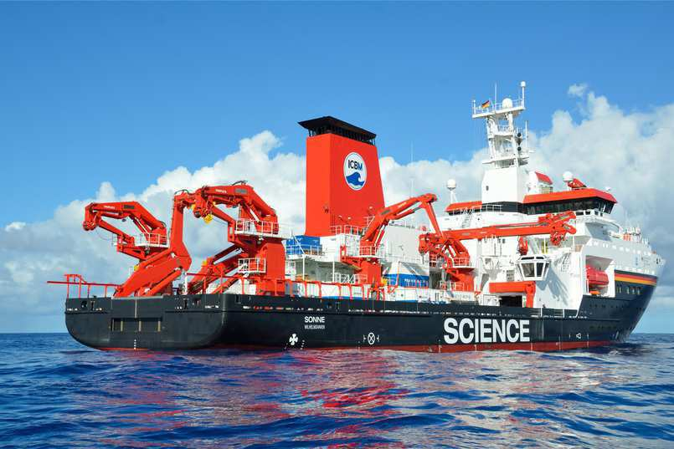
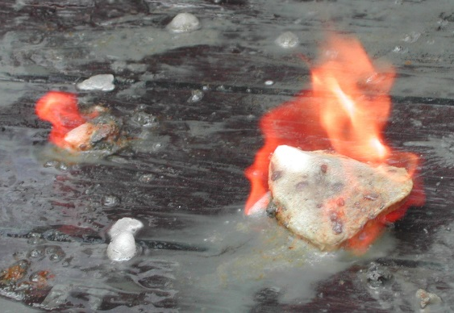
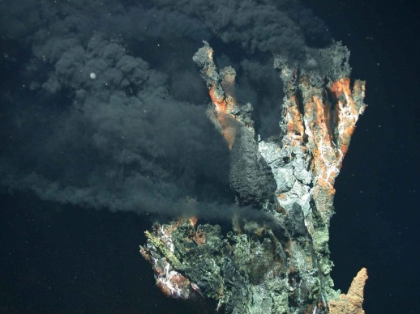
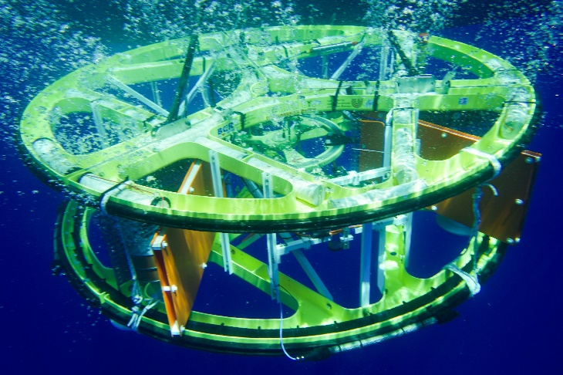
Exploration of Submarine Resources using Electromagnetic Methods
Katrin Schwalenberg¹, Hendrik Müller¹, Romina Gehrmann², Marion Jegen³, Amir Haroon³, Zahra Faghih³, Sebastian Hölz³
1 BGR - Federal Institute for Geosciences and Natural Resources, Hannover Germany
2 University of Southampton, UK, now at Dalhousie University, Canada
3 GEOMAR, Helmholtz Centre for Ocean Research Kiel, Germany

Slide 2
Outline
  Marine Electromagnetics
  Case Study 1: Submarine Gas Hydrate
  Case Study 2: Offshore Freshened Groundwater
  Case Study 3: Seafloor Massive Sulfides

Slide 3
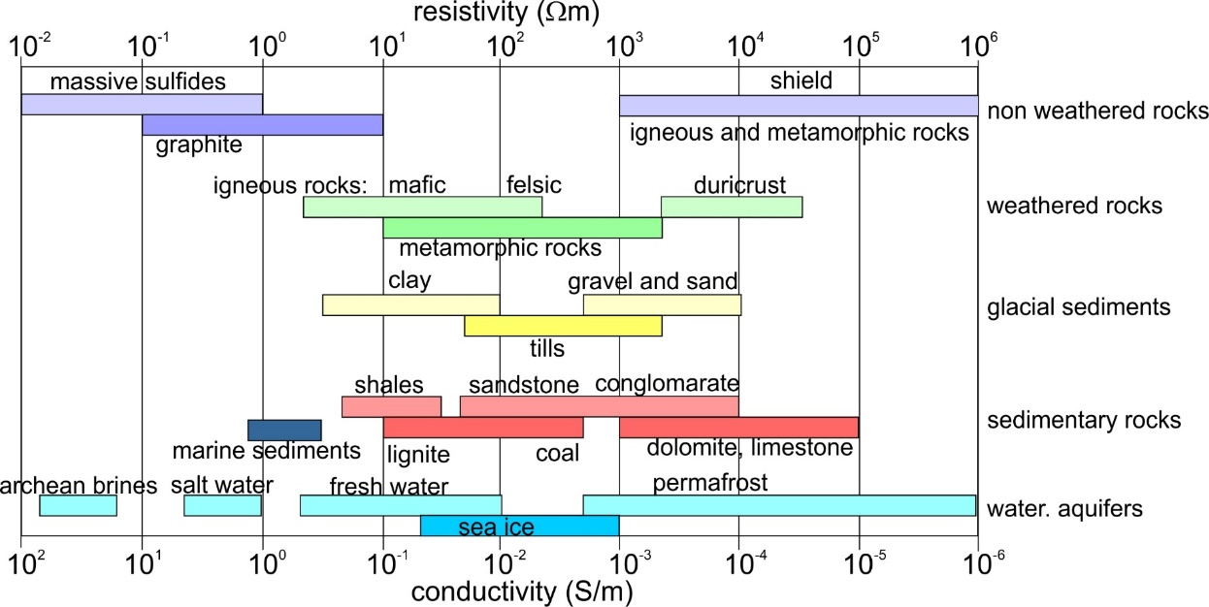
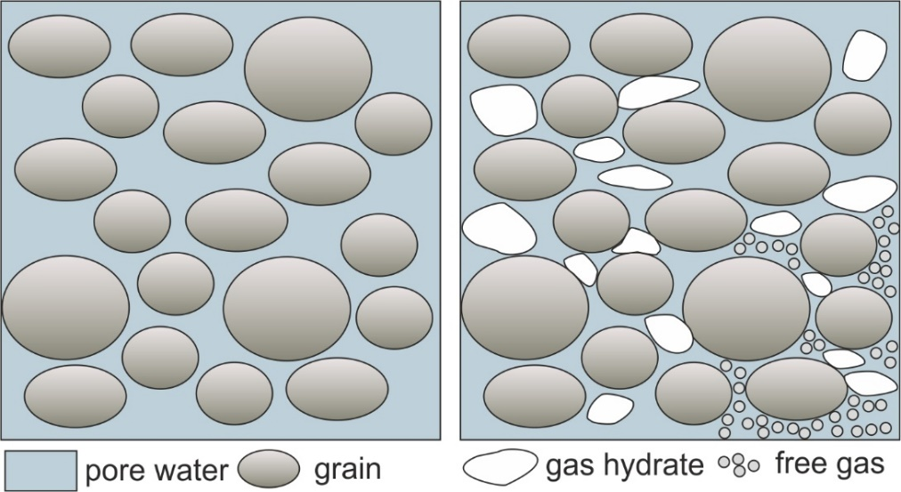
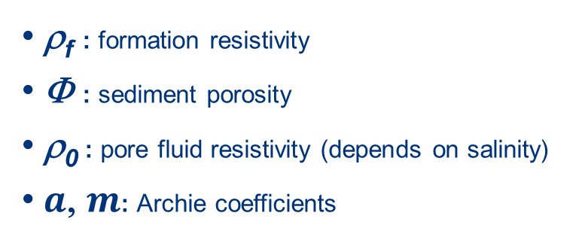
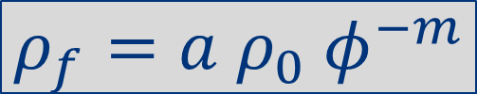
Electrical properties of naturally occuring rocks
Archie Equation (1942):
$$ρ_{f}={a ρ}_{0} φ^{−m}$$
ρ_{f} : formation resistivity
Φ : sediment porosity
ρ₀ : pore fluid resistivity (depends on salinity)
$a$, $m$: Archie coefficients
free gas,
gas hydrates

Slide 4
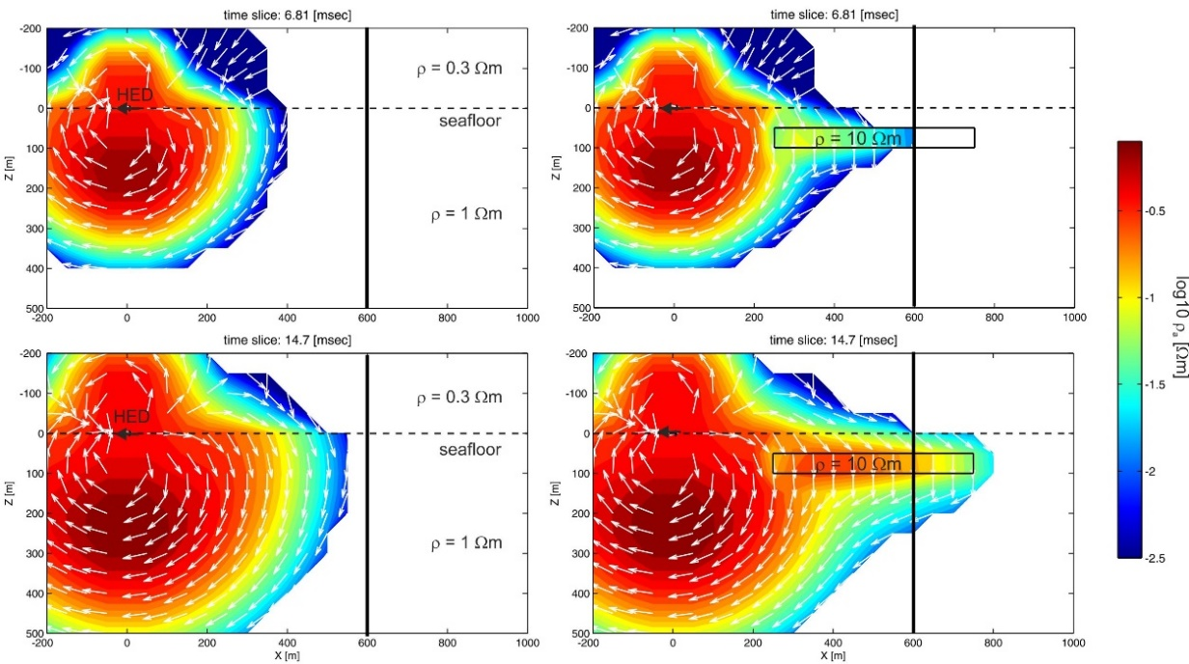
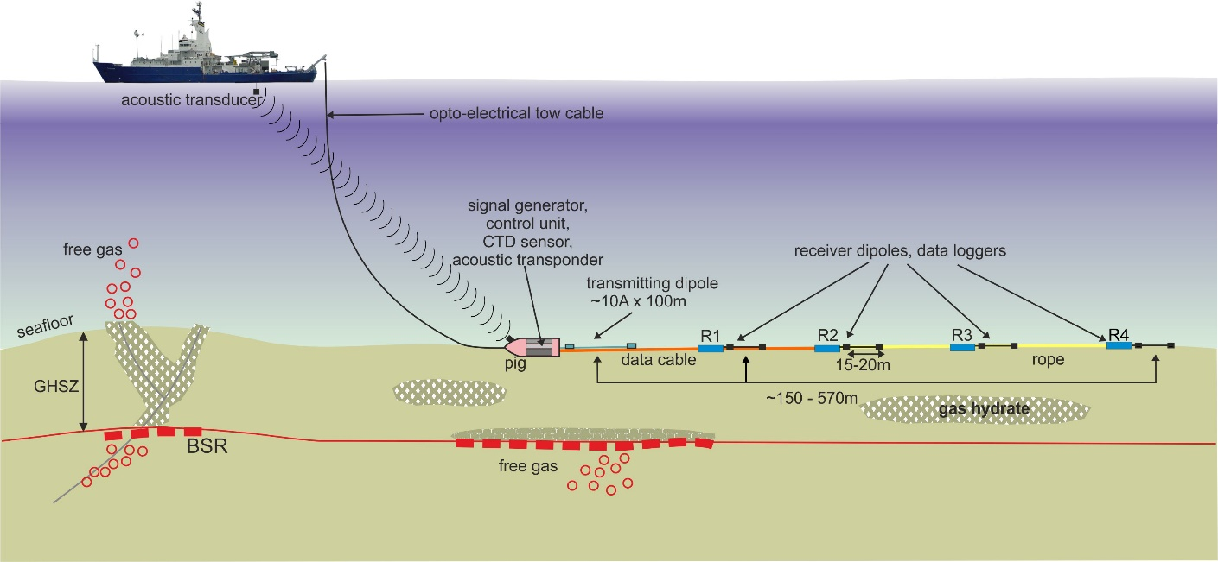
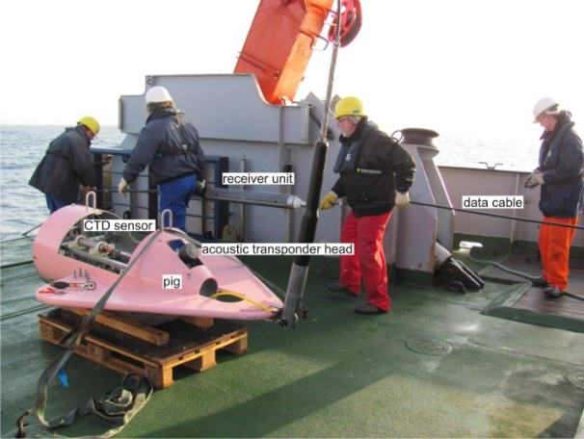
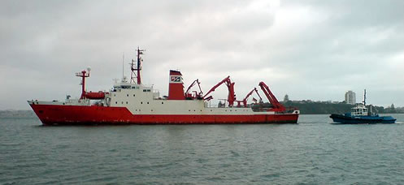
Marine Electromagnetic Principle
Electric Field propagation of a horizontal dipole at the seafloor
Seafloor-towed electric dipole-dipole system
Current Dipole: 10A x 100m
Receiving Dipoles: Offsets 150 - ~800m
Penetration Depth: Seafloor to ~ 500m below
Survey Speed: ~1knot

Slide 5
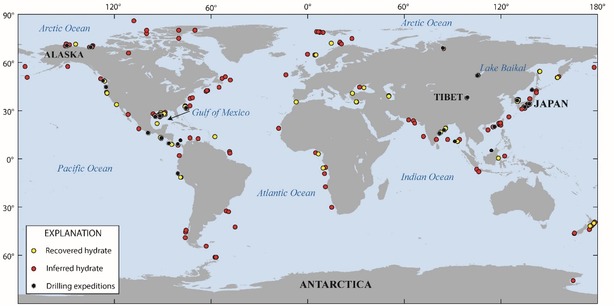
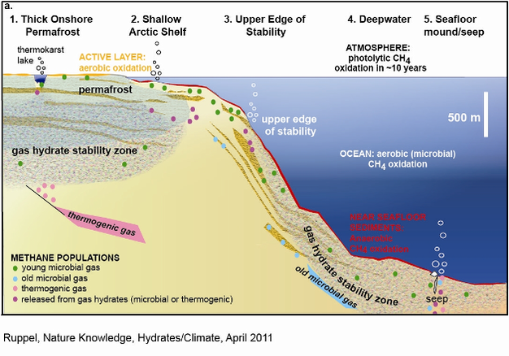
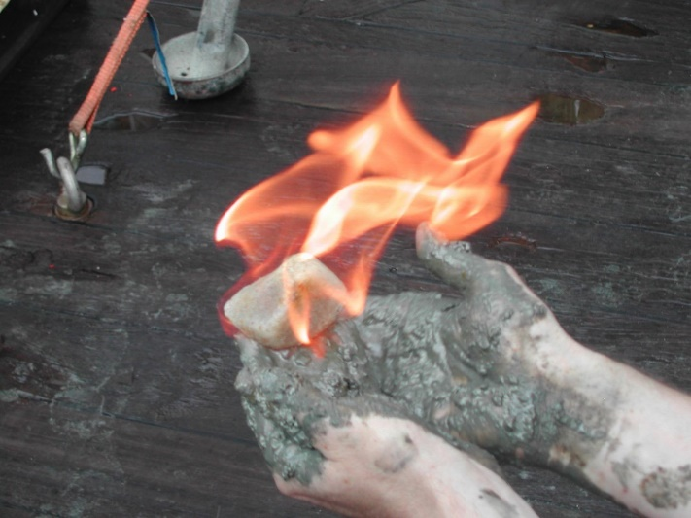
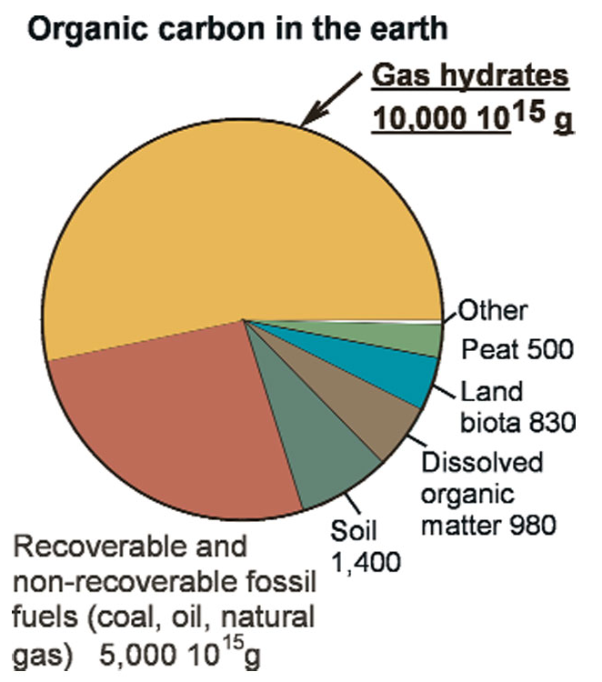
Case Study 1: Submarine Gas Hydrates
Ice-like solids, form at high pressure and low temperature from water and gas (methane)
Occurrence worldwide at continental margins, deep lakes, and permafrost grounds
Huge amounts of methane are stored in hydrate, energy potential likely exceeds conventional resources (oil, gas, coal)
Hazard at high latitudes and for offshore infrastructure
GEOMAR
CGS
Ruppel, USGS

Slide 6
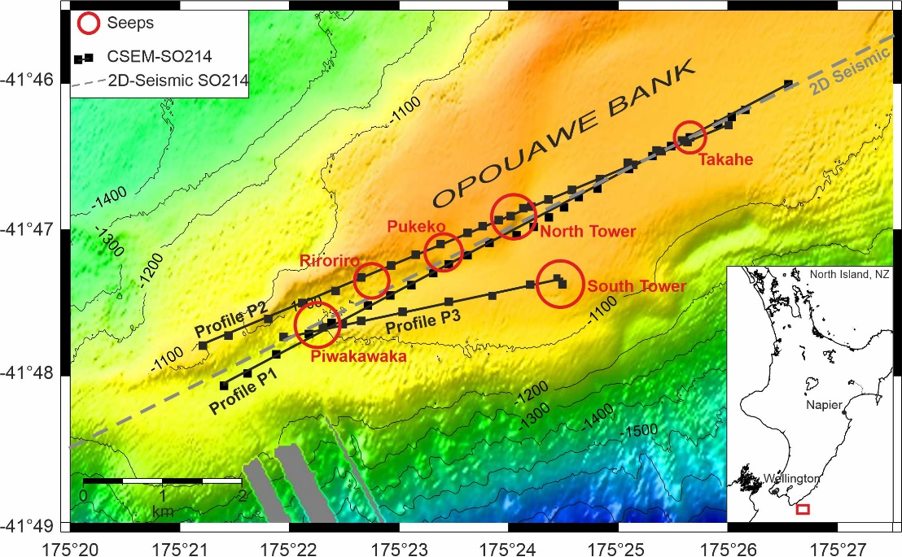
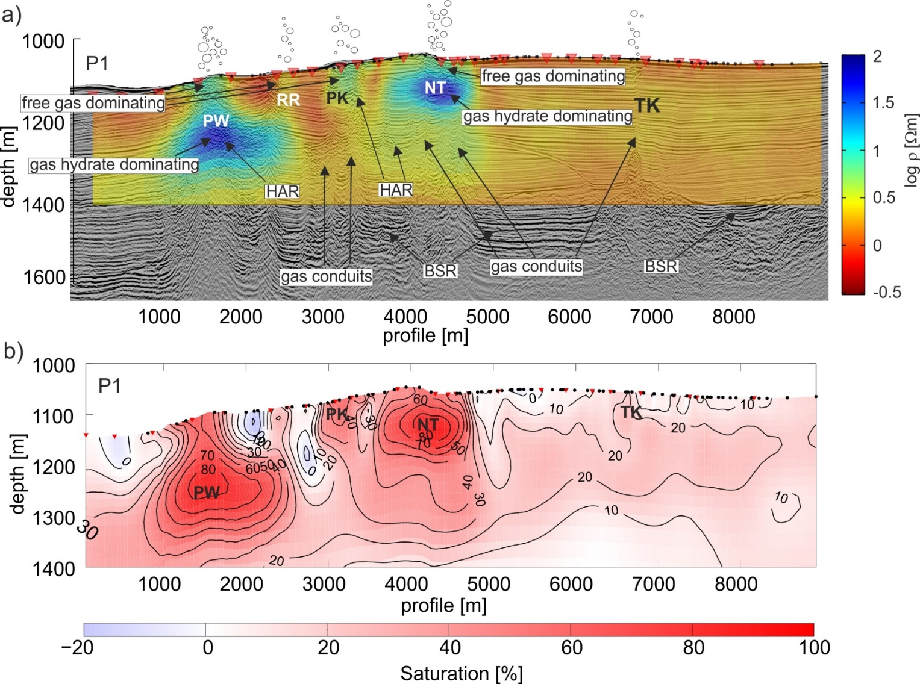
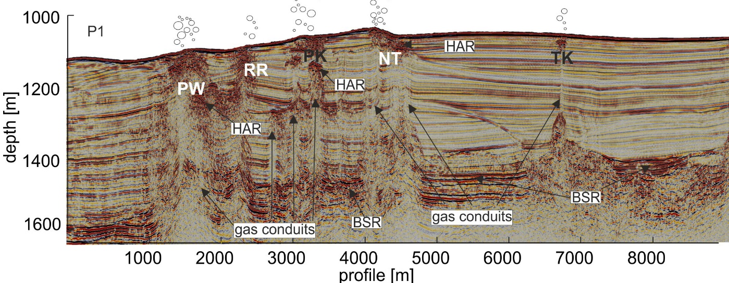
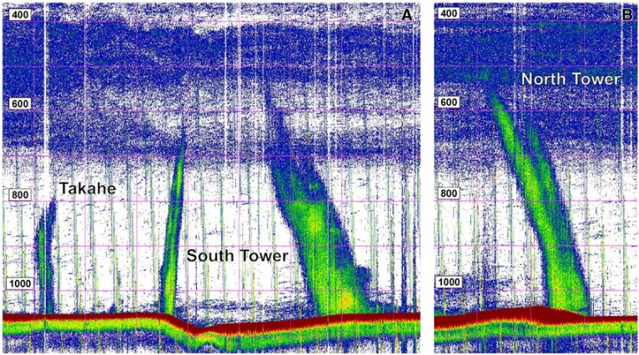
Case Study 1: Gas Hydrates, New Zealand
Seismic Section + Resistivity Model
Seismic Section
Gas Hydrate Saturation Model
Flares
Greinert et al., 2010
Schwalenberg et al., 2017

Slide 7
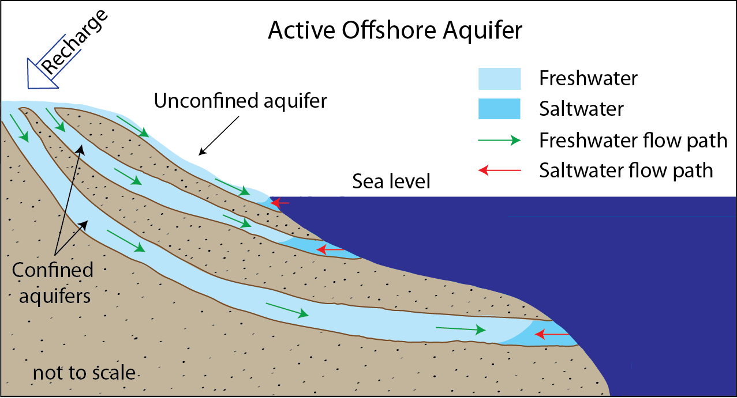
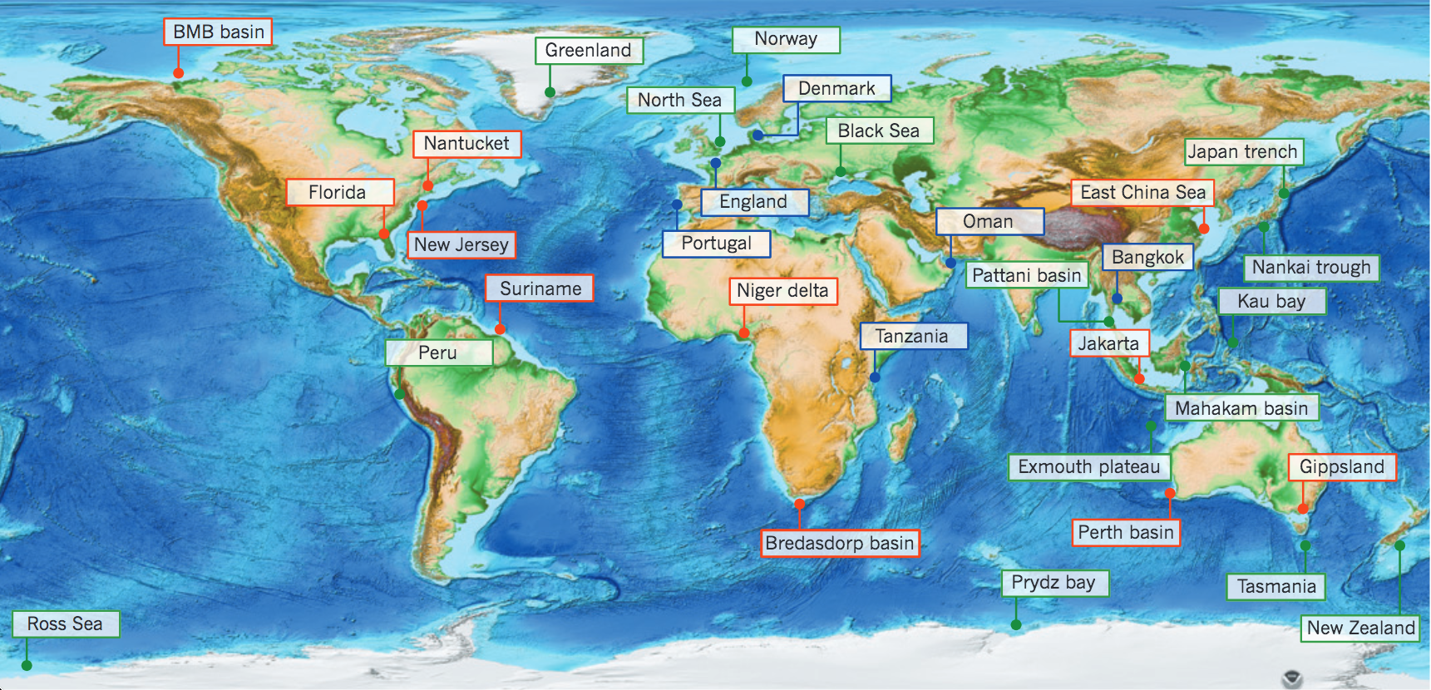
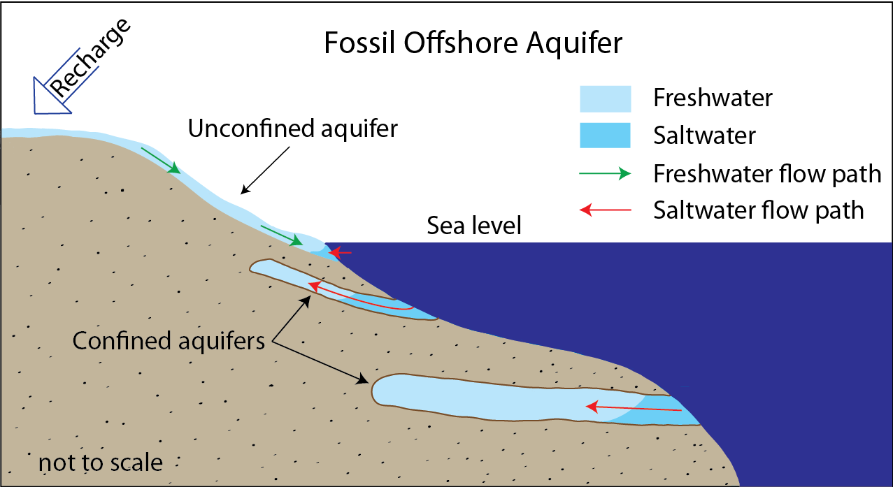
Case Study 2: Exploration of Offshore Freshened Groundwater (OFG)
Offshore Aquifers are a result of sea level (climate) change
During glaciation, sea level is low and aquifers develop on shelves
During global warming, sea levels are rising and aquifers are now offshore
Post et al., Nature, 2013
  Offshore groundwater could be a potent source of potable water
  ~ water volume of the Black Sea
GEOMAR
Notes:
LGM: 31,000 – 16,000 years ago
2 orders of magnitude of magnitude what has been extracted from continental aquiferd

Slide 8
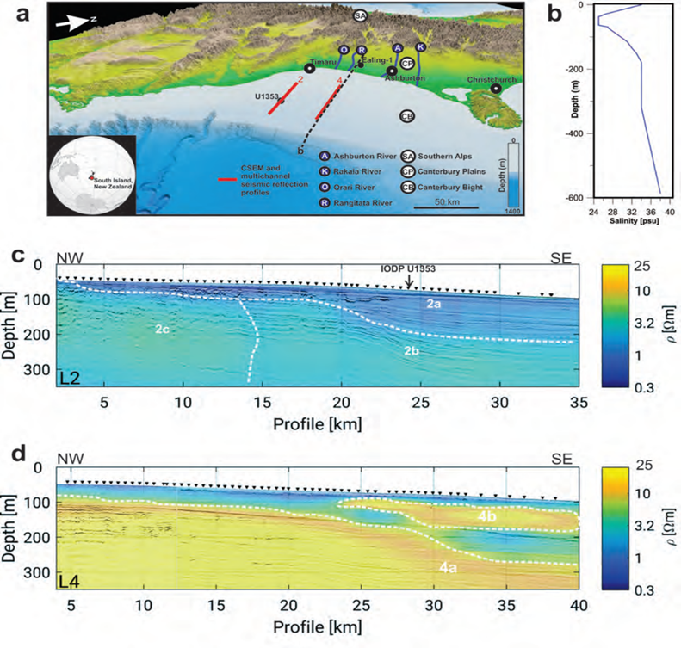
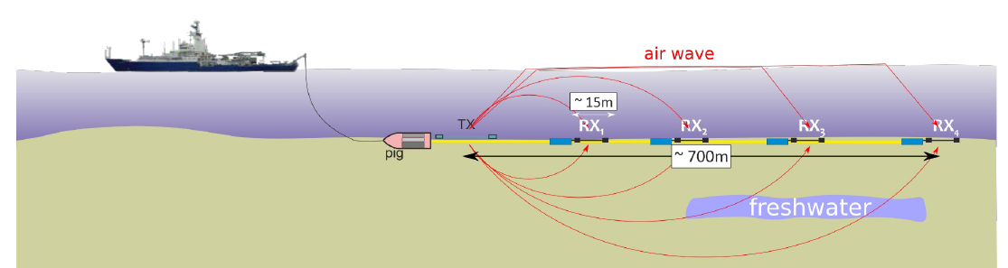

Case Study 2: OFG Study, Canterbury Bight, New Zealand
Hölz et al., 2021
  Project MARCAN, RV Tangaroa, 2017
  Salinity anomaly in borehole U1353 at 40m below seafloor
  CSEM data identified unknown offshore groundwater system
  Spatial extend and salinity distribution needs to be addressed
  Mechanisms of OFG emplacement – stratigraphically or buoyancy controlled?
Micallef et al., 2020
Notes:
Aquifers in gravel (Kies. Schotter)
Silt, sand clay layers form aquitards

Slide 9
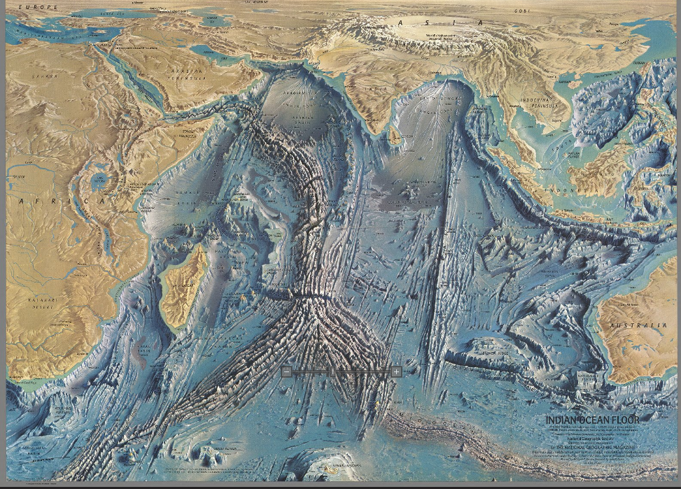

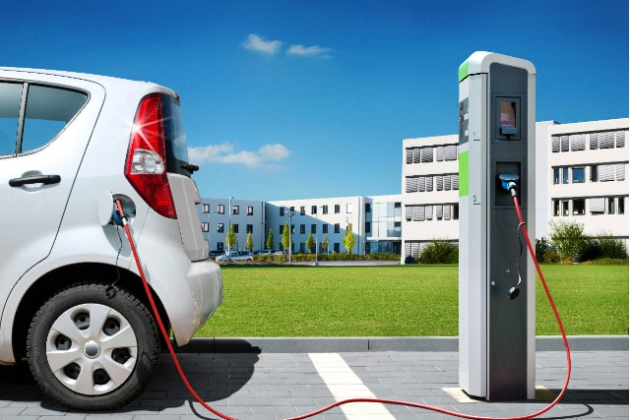

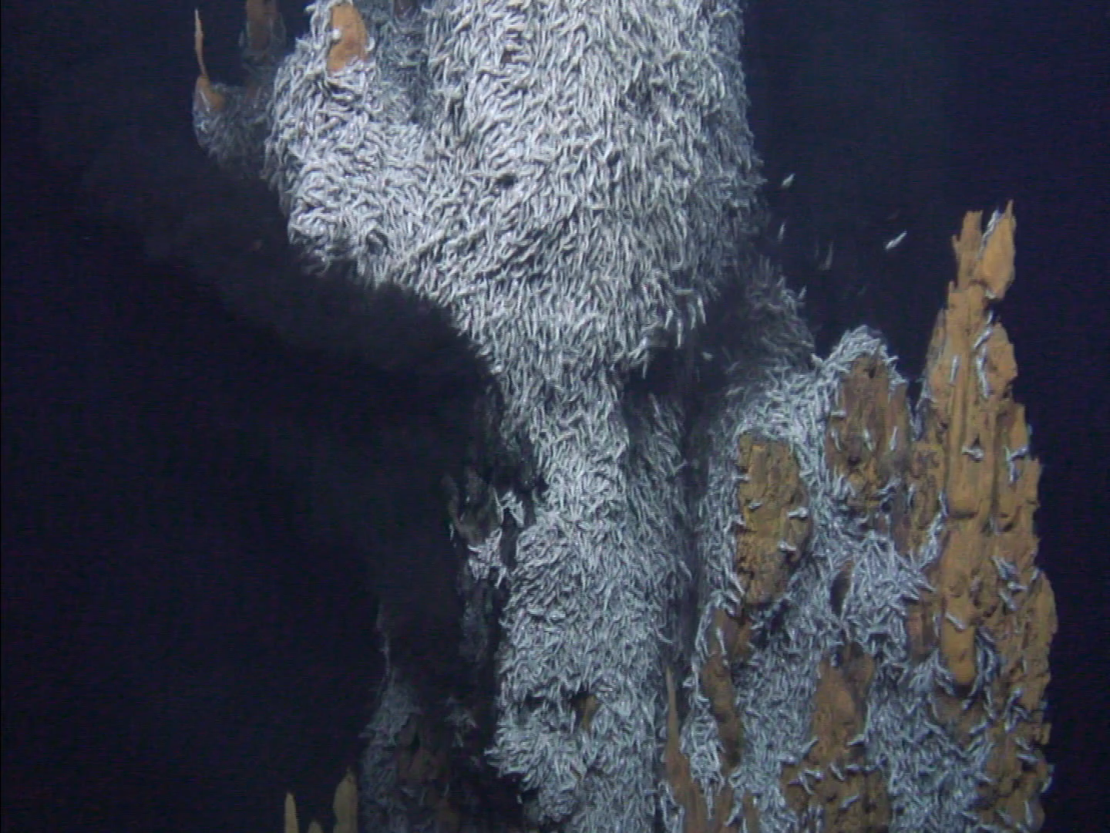
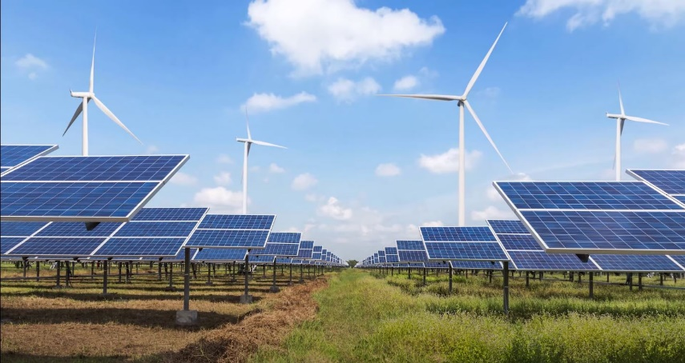
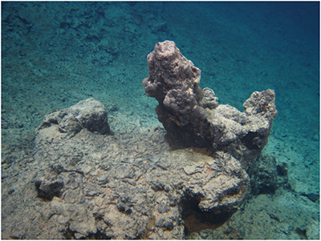
Case Study 3: Seafloor Massive Sulfide (SMS) Exploration
Seafloor Spreading Center
Active Black Smoker
Inactive Chimney
rare earth, Ag, Au, Te, Co, Pb, Zn, Cu
Notes:
Needle in a haystack problem
High grade minerals, CU, ZN, Pb, CO, TE, AU,AG, rare earth

Slide 10
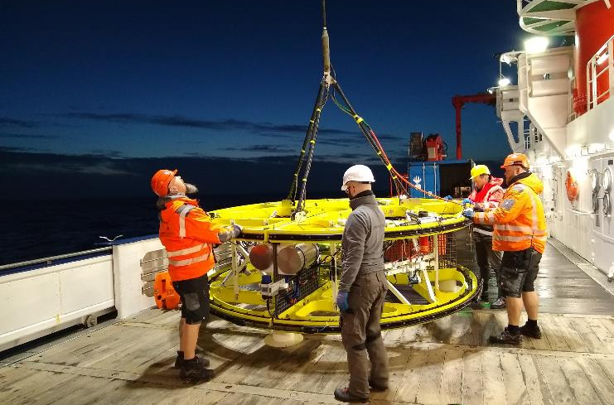
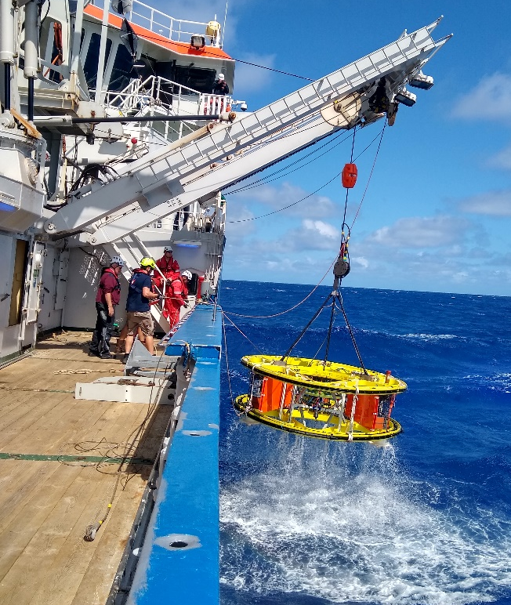
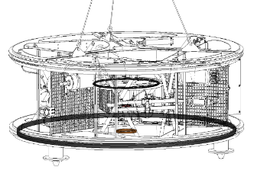
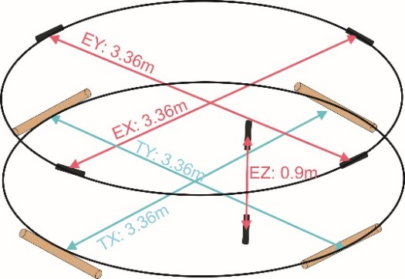
GOLDEN EYE: Deep-Sea Electromagnetic Profiler
Sensors:
CSEM Loop System: TX: Ø 3.5m, 30 A, 8 freq. 15 Hz – 9kHz, ~20m depth, conductivity, suszeptibility
Electric Dipole - Dipole System: (TX, TY, 3.6m, 10A), (RX, RY, RZ, 3.36m, 1.0m), DC, IP, SP
Broadband Mag, CTD, 4K Video (down), wide-eye (front), LED, Laser, 3 Altimeter, Sonar, USBL
Frame: modular, GFK; passive surveying by cable and ship movement, solely

Slide 11
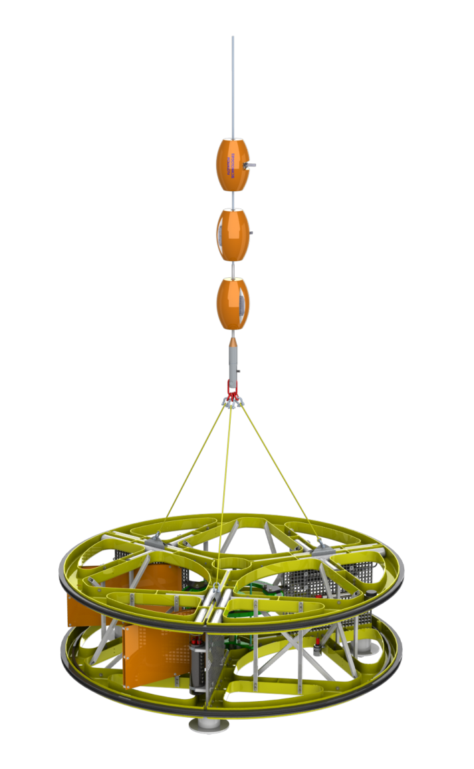
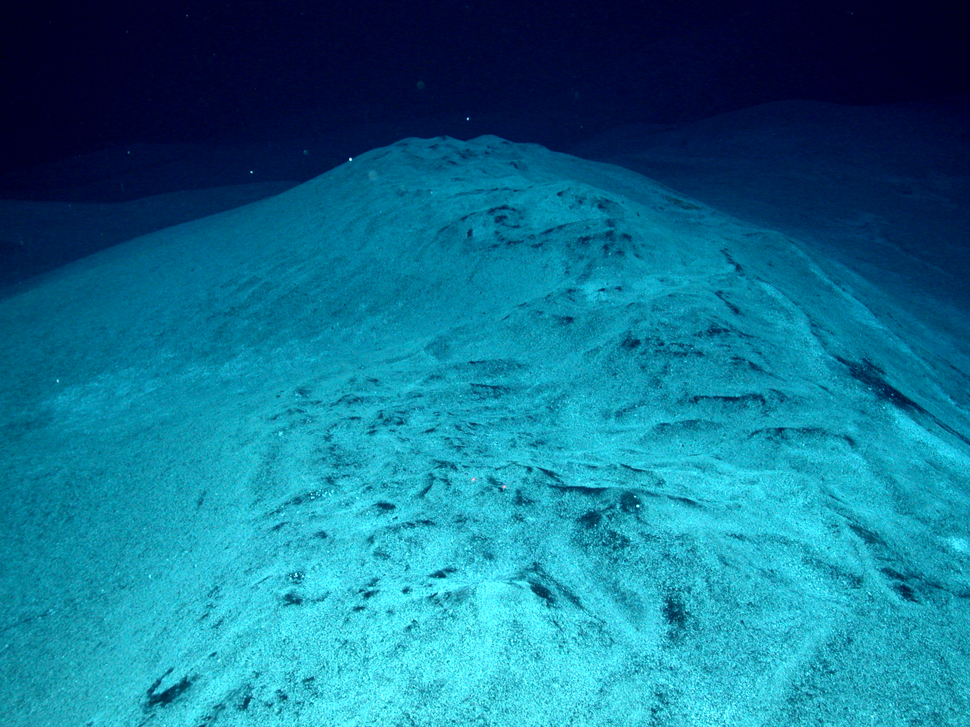
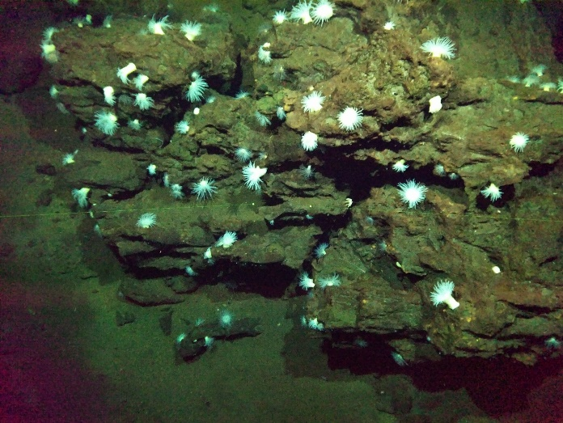
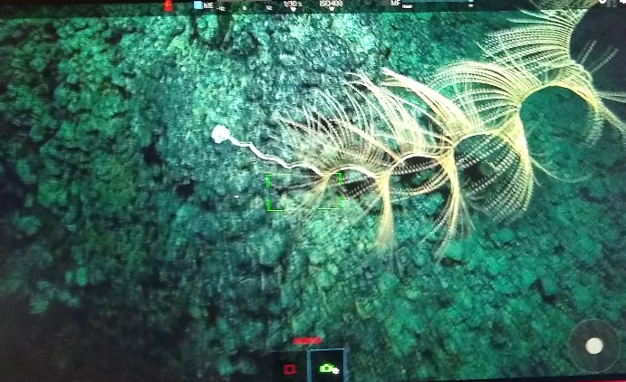
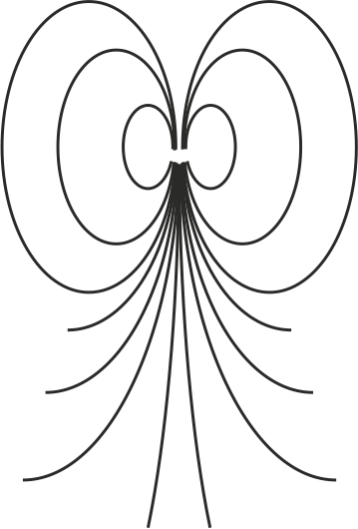
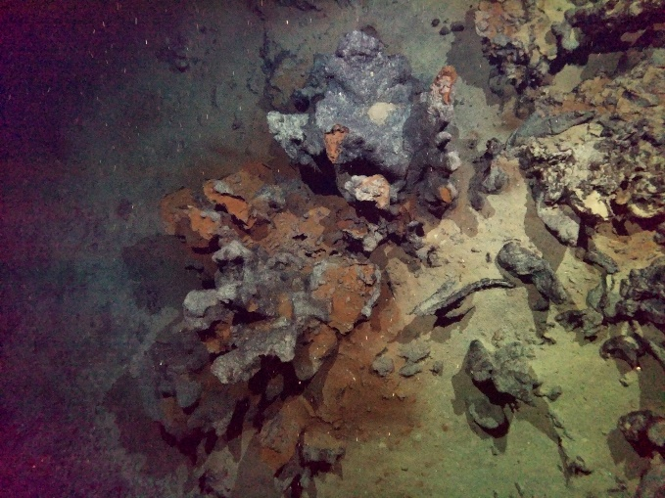
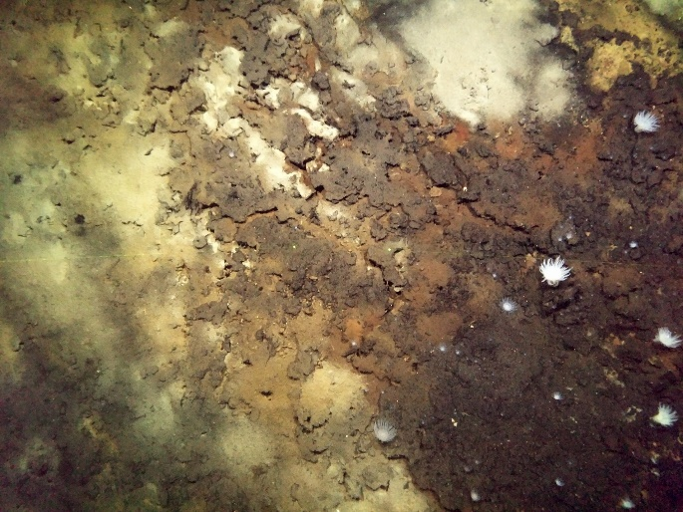
GOLDEN EYE: Electromagnetic Deep Sea Profiler
Background Image © NOAA

Slide 12
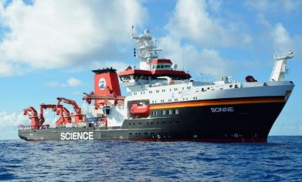
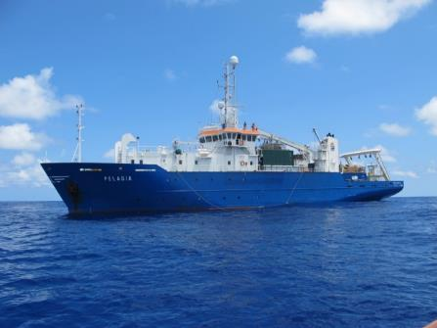
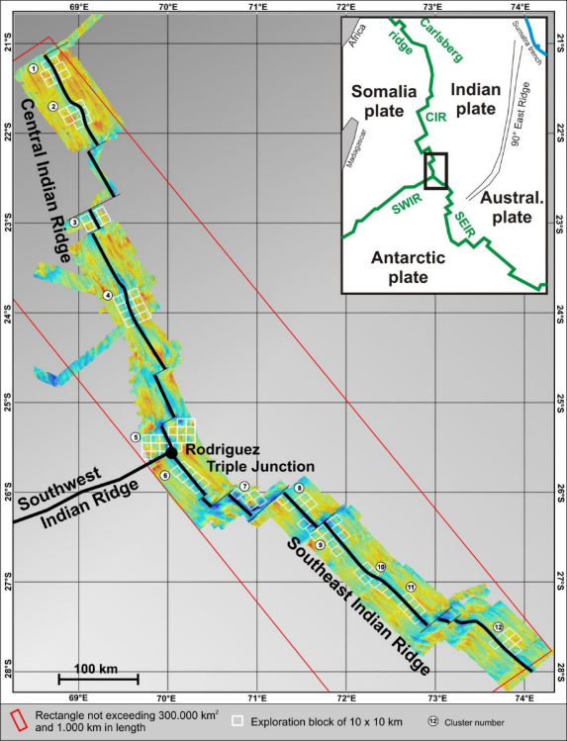

Project INDEX: SMS Exploration in German License Areas
International Seabed Authority (ISA)
Project INDEX 2015 - 2030
10.000 km², 100 blocks, 12 clusters
BGR conducts annual cruises since 2013
Identify inactive hydrothermal fields with SMS resource potential
Multi-disciplinary approach: geology, geochemistry, geophysics, petrology, biology
Environmental studies (~50% !)
Micallef et al., 2020
Notes:
11 active, 14 inactive sites
Autonomous international organization under the 1982 UN Convention on the Law of the Sea (UNCLOS).
168 member states
Regulates prospecting, exploration and exploitation of marine minerals in the international seabed area (belongs to all humankind)

Slide 13
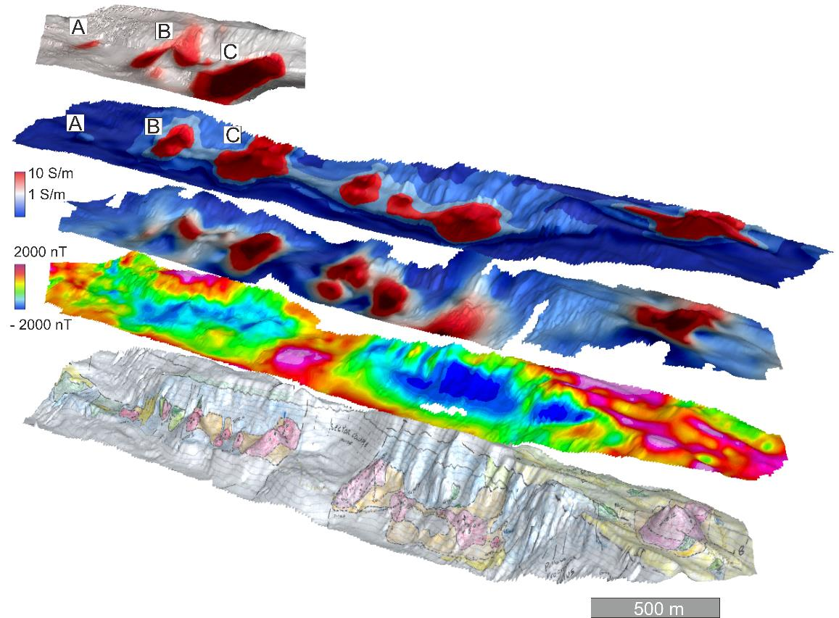
Case Study 3: INDEX, German Licence Area for SMS Exploration
Chargeability
SP (E-Field intensity)
CSEM Loop
app. cond. (5kHz)
Magnetic
Sulfides
Geology (ROV)

Slide 14
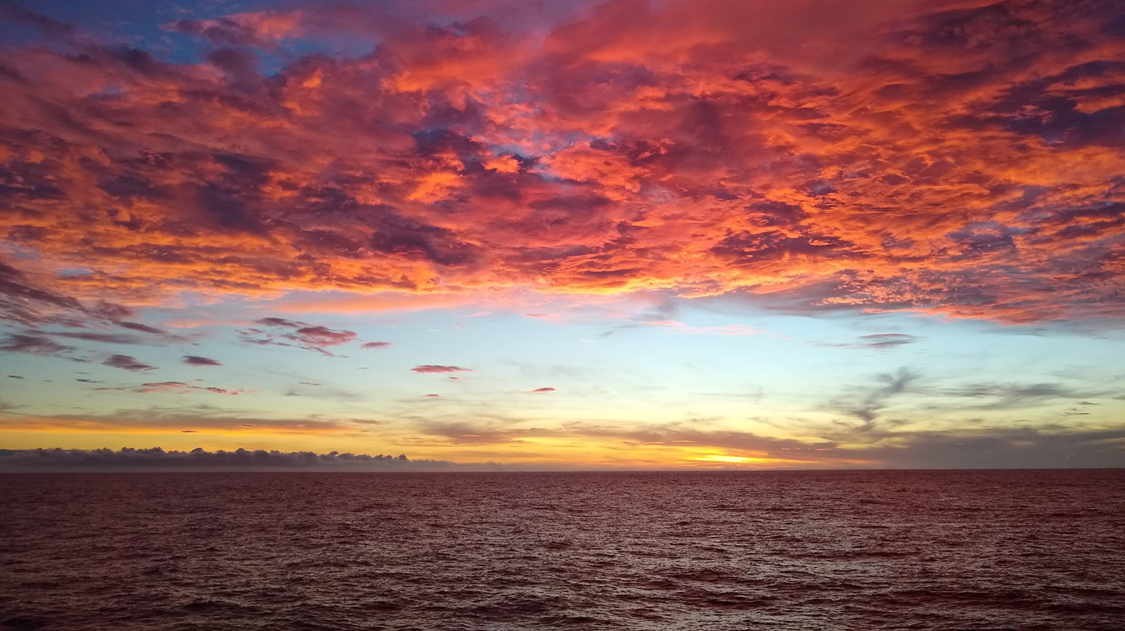



Take home messages:
Marine electromagnetics is a geophysical exploration method to derive electrical properties of the seafloor which can be related to e.g. oil, gas, gas hydrates, OFG, massive sulfides).
Instrumentation and survey configurations can be adapted to different targets and depths.
Diffuse nature of EM field propagation provides volume information which are complementary to structural information from e.g seismic methods.
Thanks for your attention
Acknowledgement:
We thank the Captains and Crews of Cruises SO214, TAN1701 and INDEX2021-1
The INDEX project is supported by funds from BMWK to BGR
MARCAN by ERC Grant 677898
NZ Gas Hydrate by BMBF Grant 03G0214B

