Slide 1
Substrate Influence on the Fano coupling of bright-dark modes in THz plasmonic n-doped Ge antennas
Institute of Leibniz Association
Elena Hardt, Carlos Alvarado Chavarin, Soenke Gruessing, Oliver Skibitzki, Thomas Voß, Davide Spirito, Bernd Witzigmann, and Giovanni Capellini
25.11.2022

Slide 2
Agenda
1
Motivation/Introduction
2
Materials
3
Wavelength: THz Gap
4
THz-TDS measurement setup
5
Substrate influence
6
Coupling Bright-Dark mode: Fano resonance
7
Conclusion

Slide 3
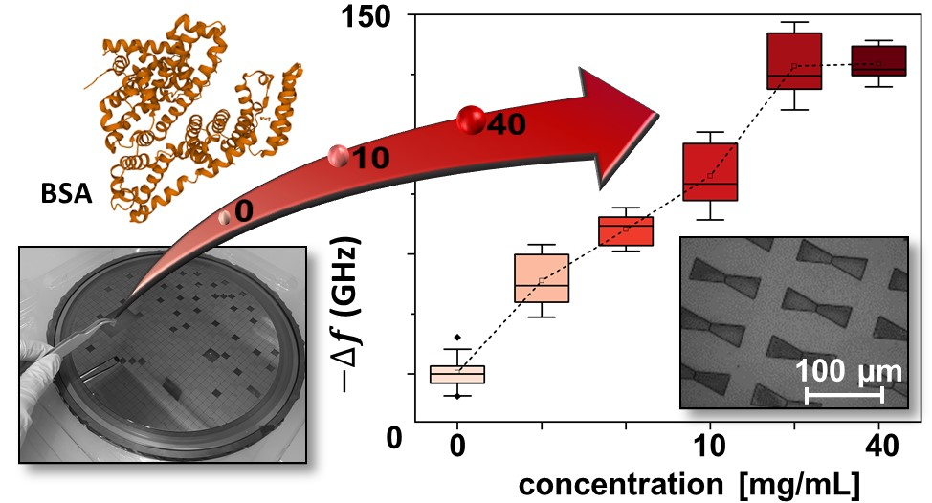
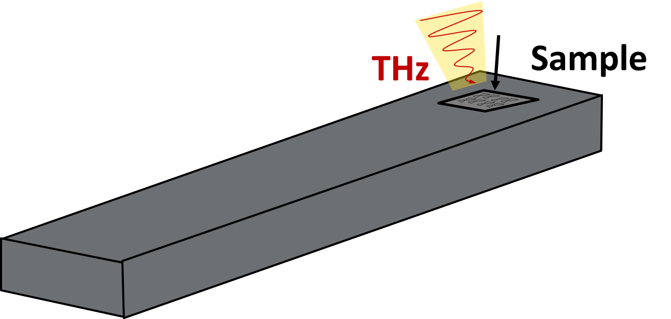
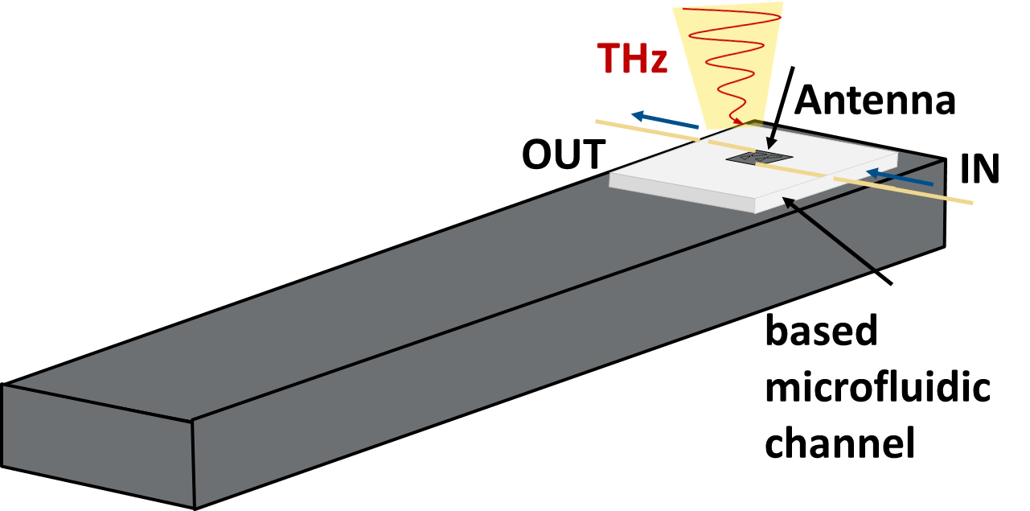

1.Motivation/Introduction
THz biosensing
microfluidic integration
lab-on-a-chip
CMOS compatible materials
biosensing platform development
blood,
plasma,
serum, etc.
E. Hardt et.al., Opt.Exp.2022, https://doi.org/10.1364/OE.469496
C. A. Chavarin et.al., Opt.Exp.2021, https://doi.org/10.1364/OE.418382
C. A. Chavarin et.al., Freq.2022, https://doi.org/10.1515/freq-2022-0078

Slide 4
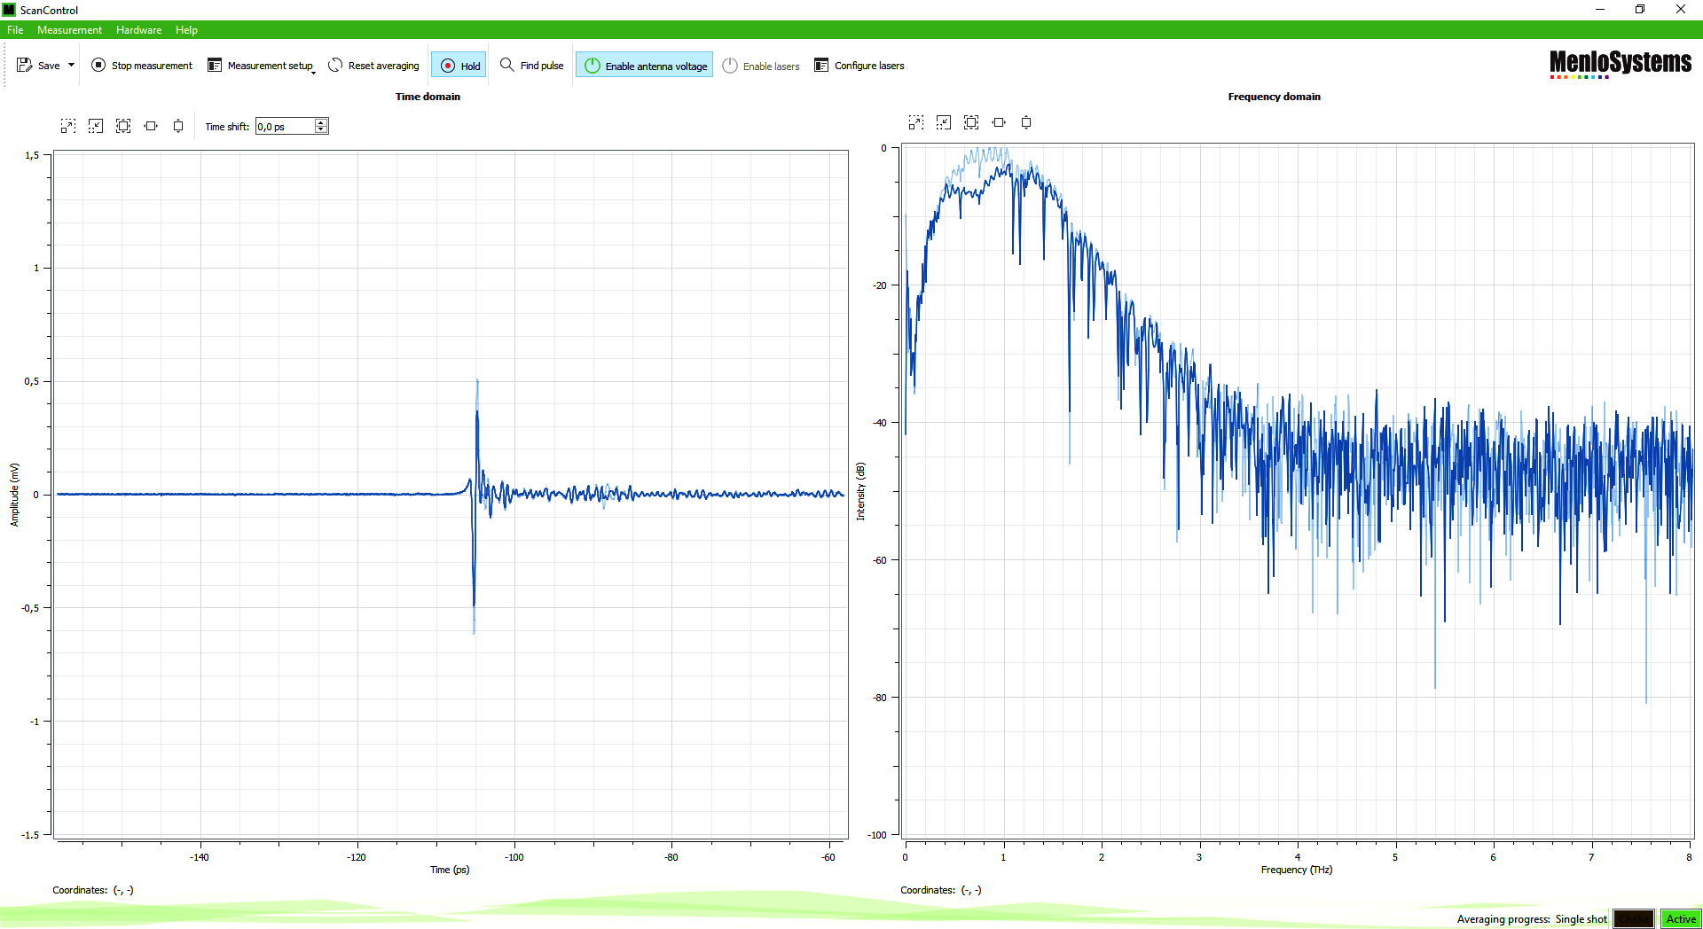
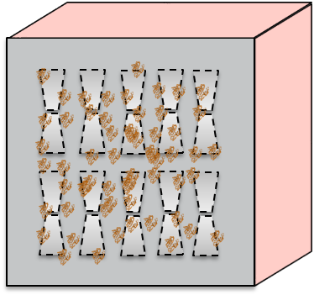
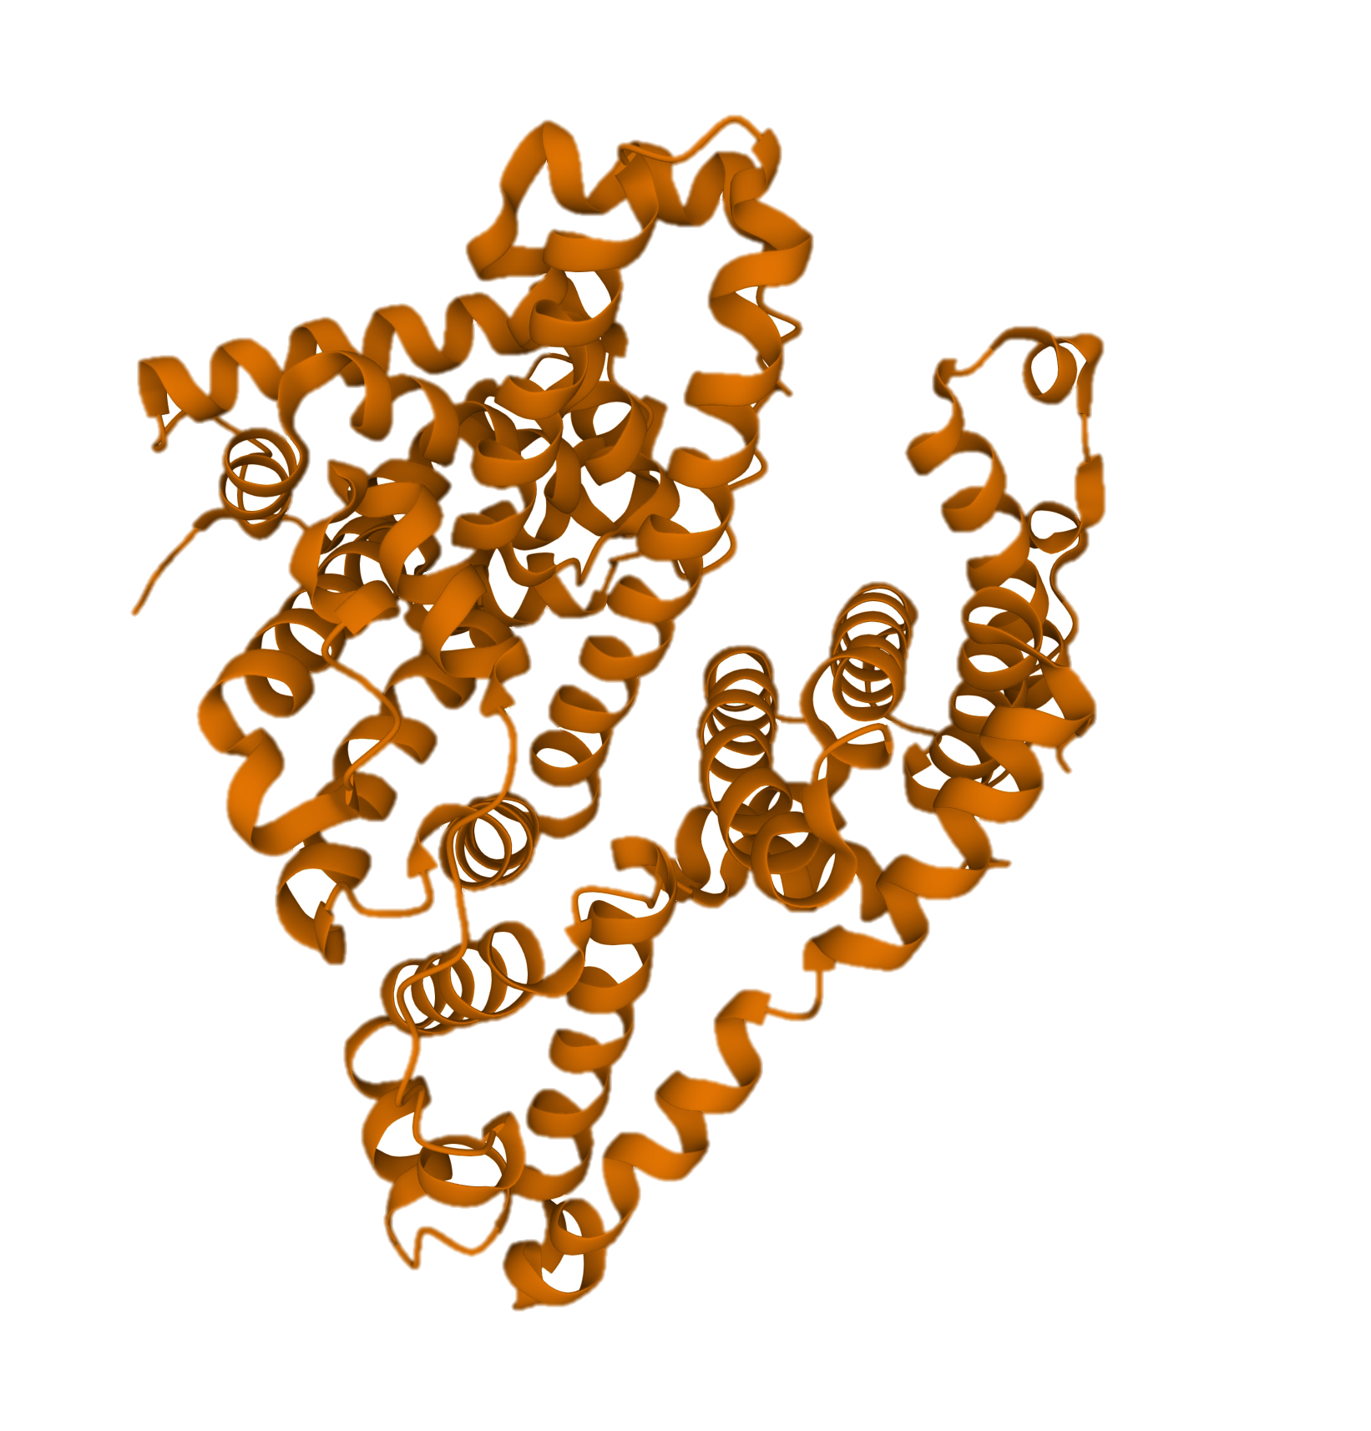
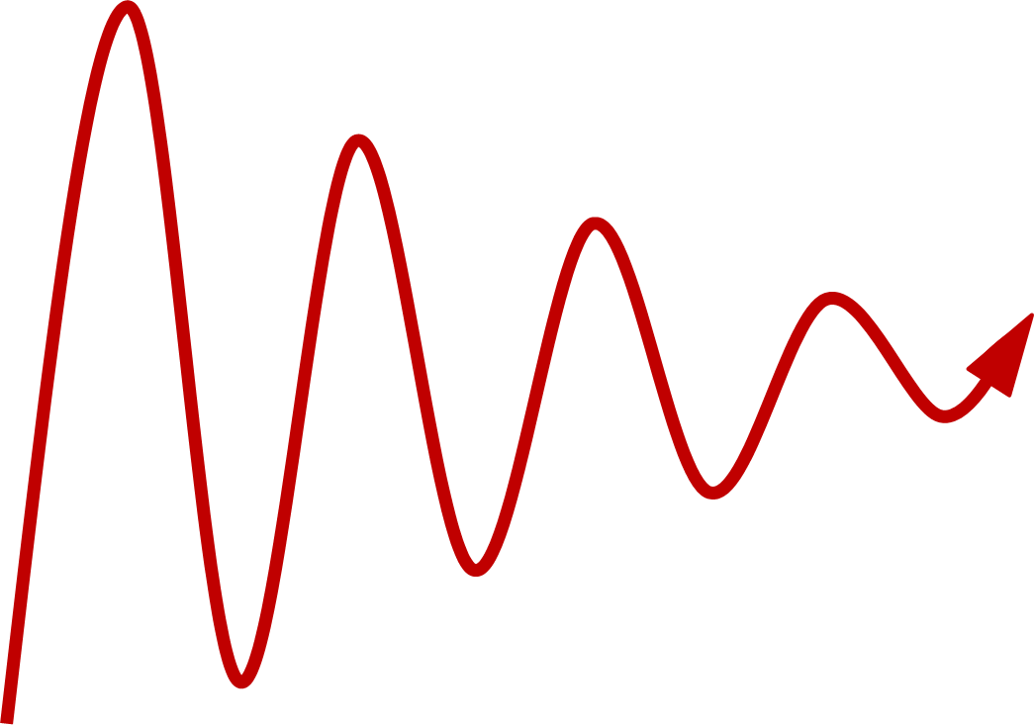
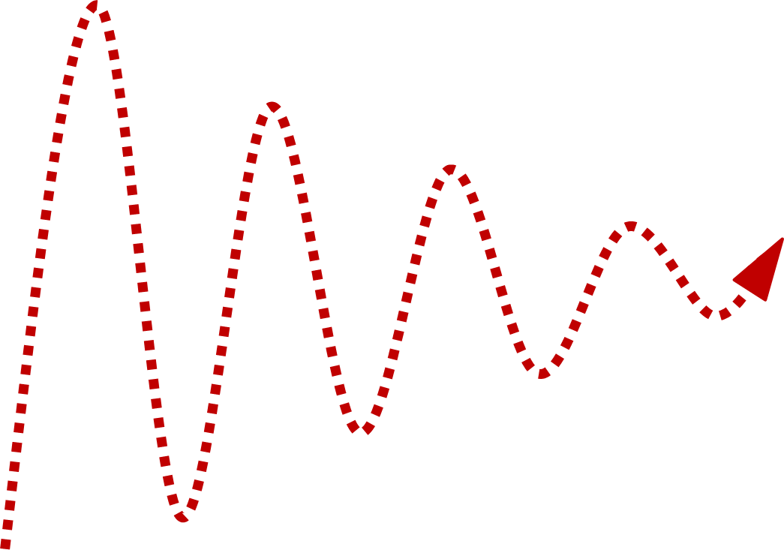
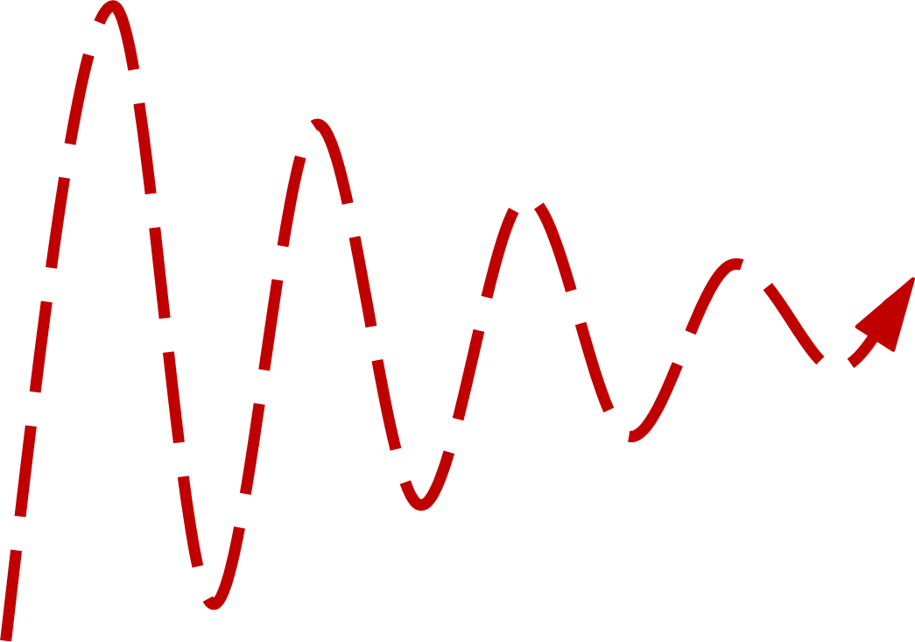
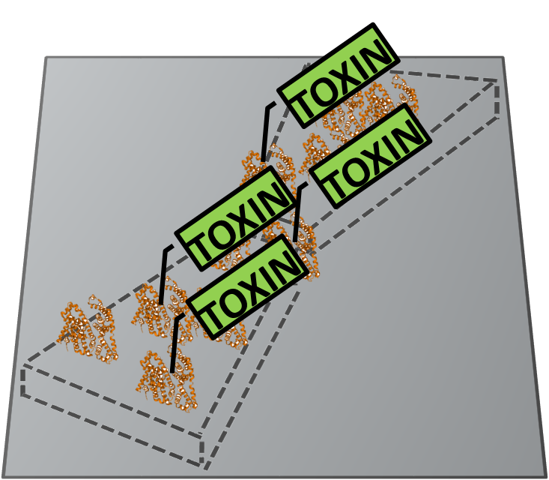
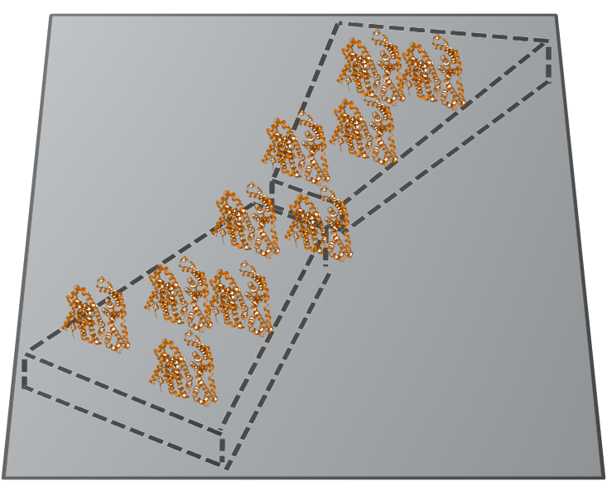
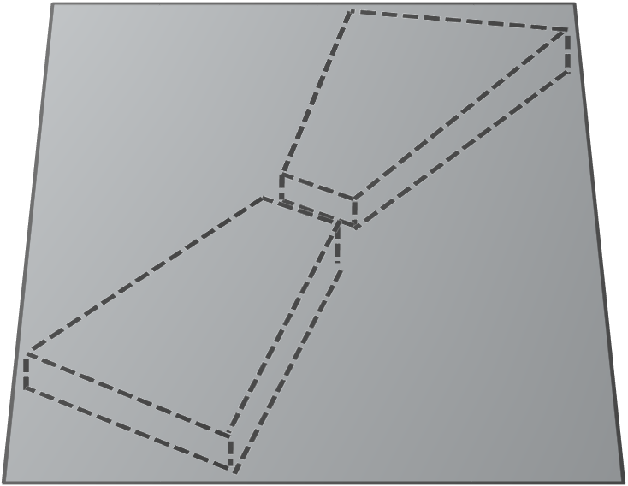
1.Motivation/Introduction
THz-TDS
Transducer
Protein
THz
Materials
Wavelength
TERASMART tool
Technique
Data analysis
Results
Optic sensor
THz spectroscopy
Label-free THz detection of biomoleculs (proteins)

Slide 5
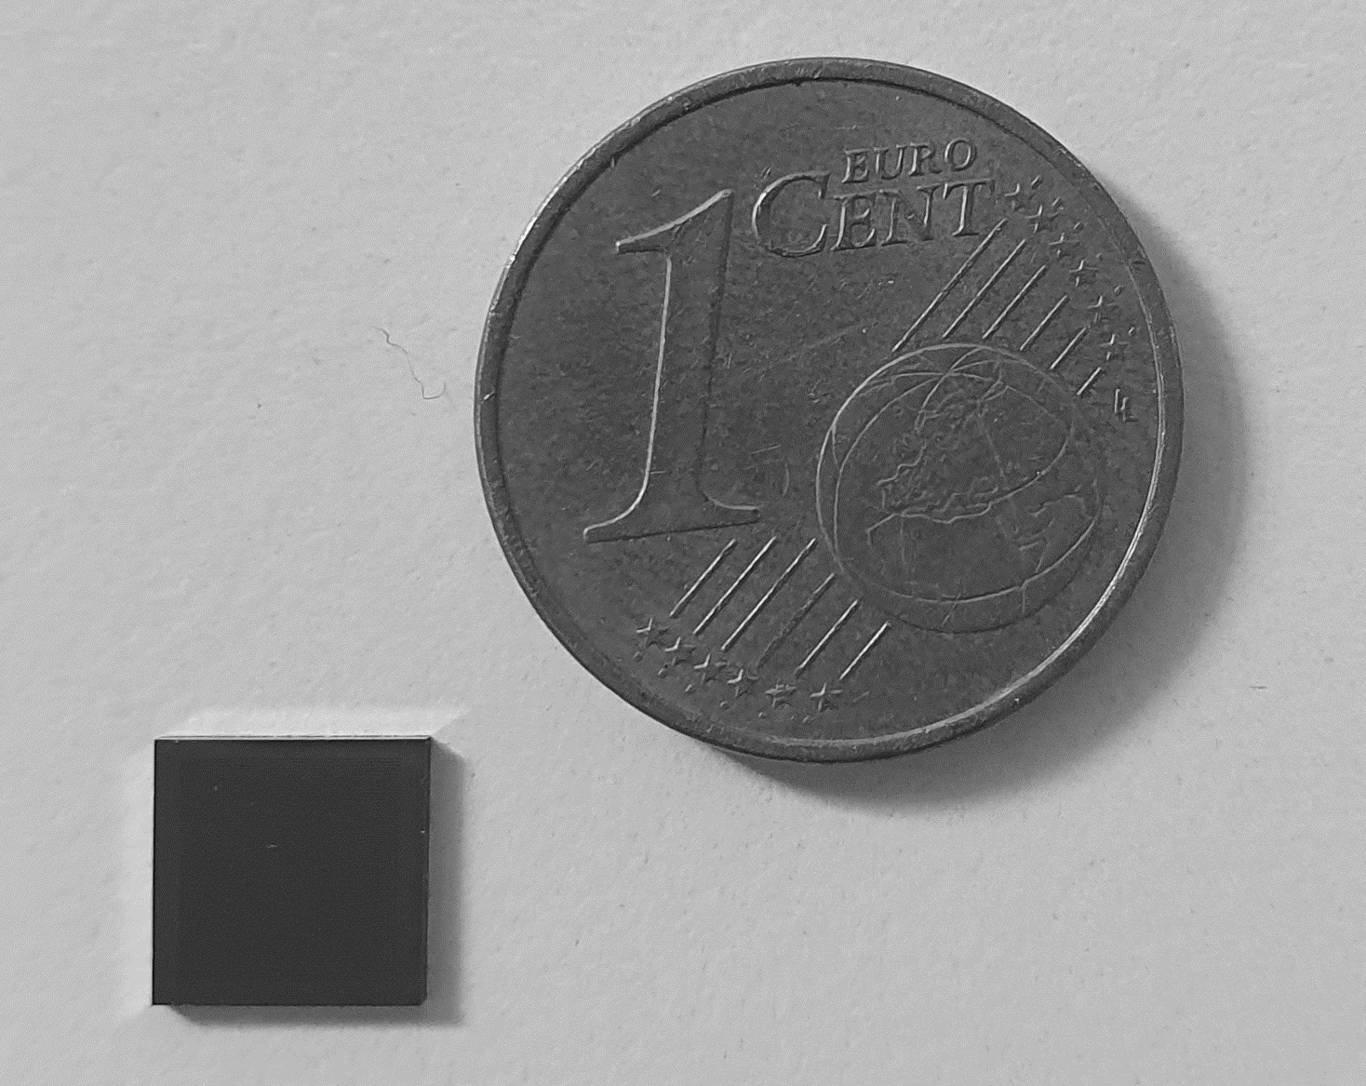
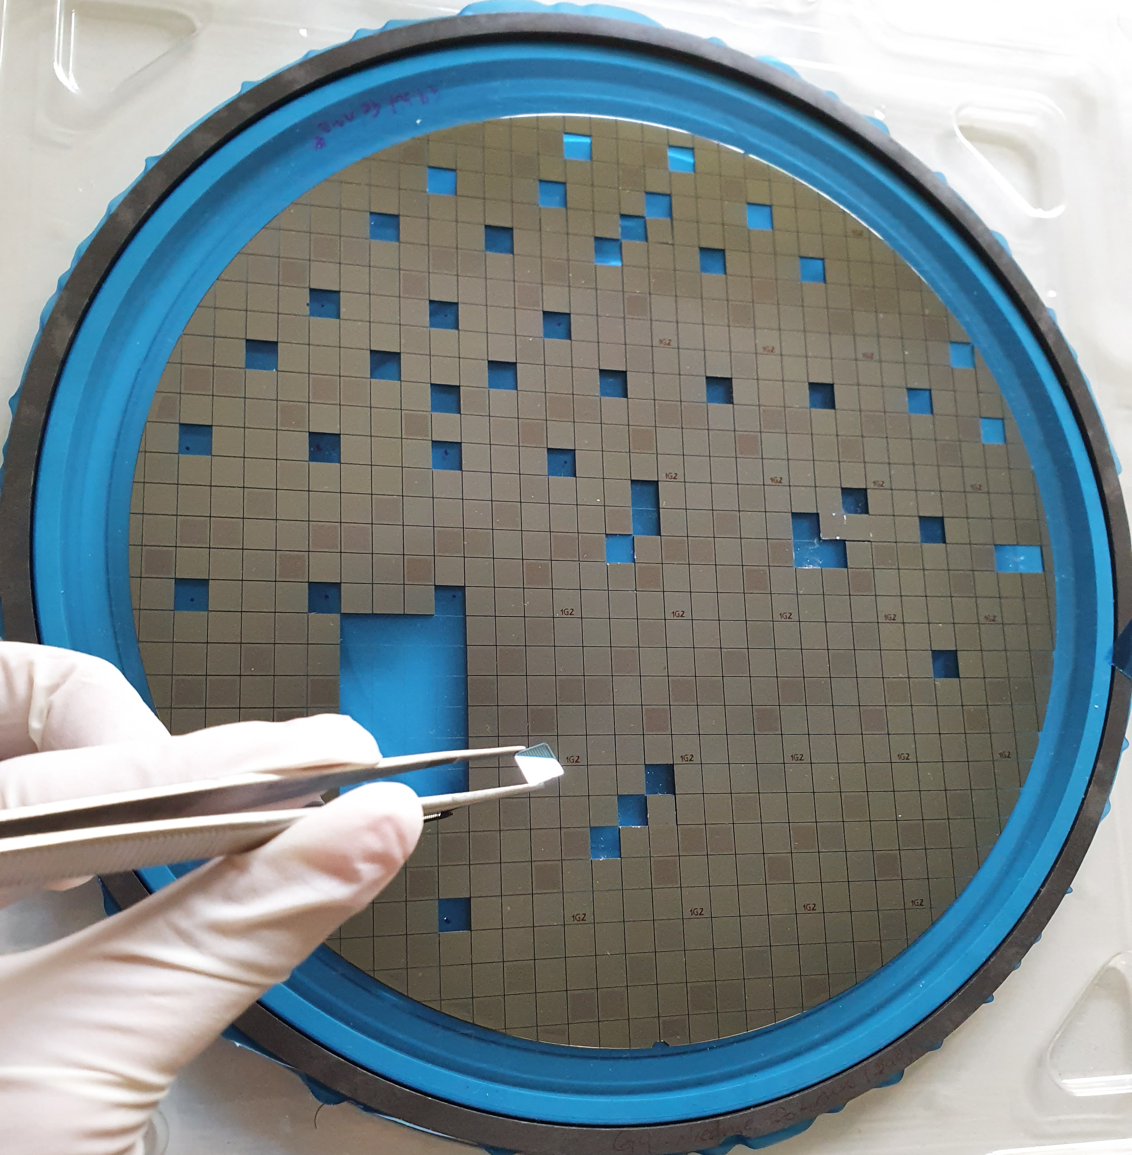
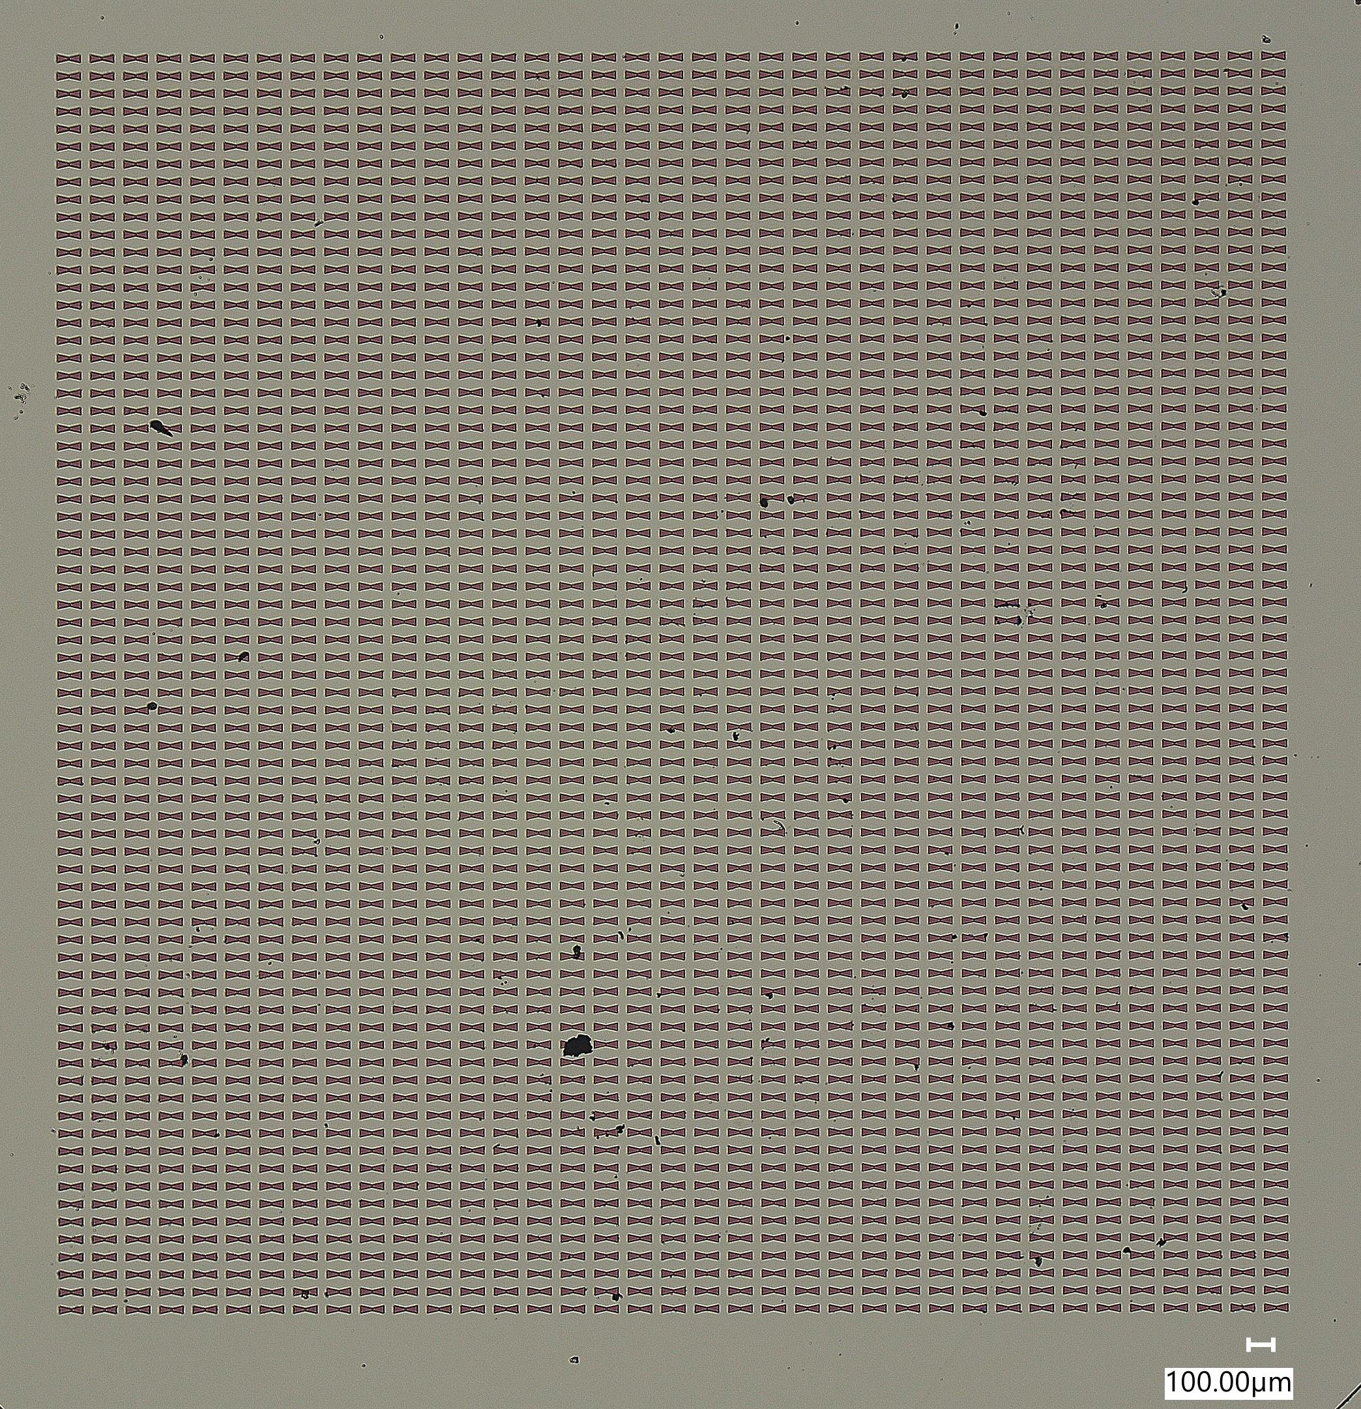
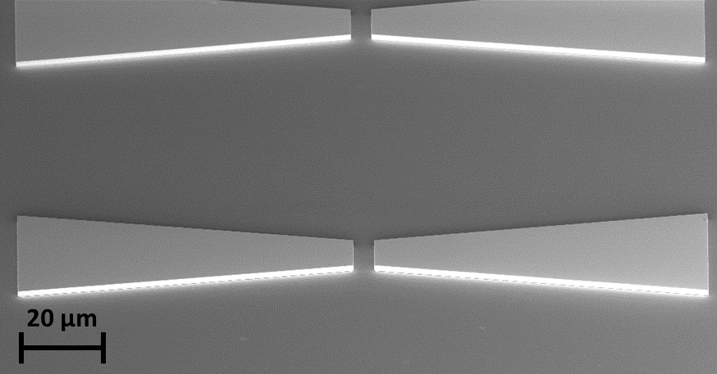
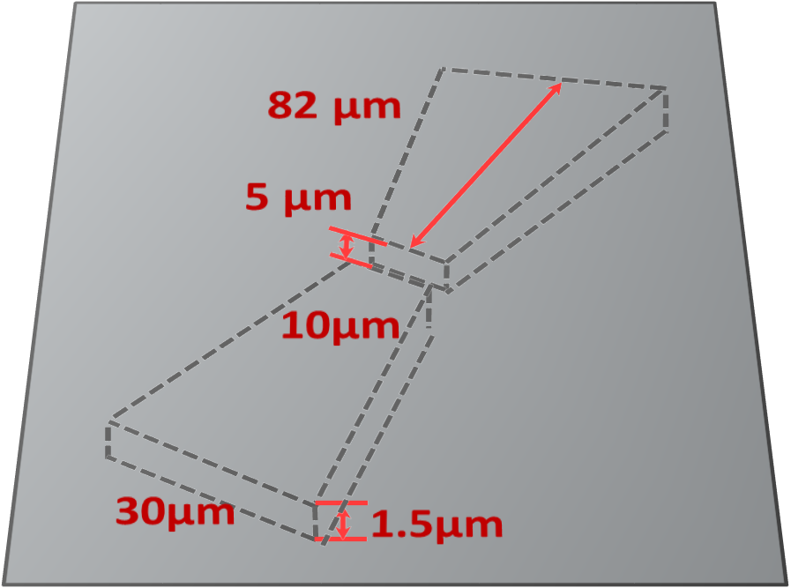
2.Materials
Si, Ge, SiO₂, Si₃N₄
using CMOS processes in an industry-standard Si foundry pilot line
=> compact, low-cost sensor system
=>mass production
Si substrate
SOI substrate
6mm
Si₃N₄
Materials
Ge
Si
1.5 µm
30-60 nm
SiO₂
2000 nm
220 nm
~730 µm
Si
bow-tie antennas

Slide 6
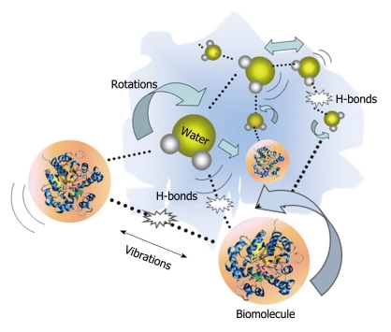
3.Wavelength: THz Gap
Enzymes and enzymes catalysis
Electronics
very sensitive to polar substances
Photonics
Membranes and Membrane proteins
intermolecular vibrations such as hydrogen bonds exhibit different spectral characteristics
DNA and RNA
Wavelength
Protein structure and dynamics
THz GAP
very low photon energy=> insufficient to cause chemical damage to molecules
Cell and tissue imaging
doi:10.4329/wjr.v3.i3.55
DOI 10.1007/s10762-009-9561-z
doi.org/10.1002/advs.202105932
100MHz
1GHz
10GHz
100GHz
10THz
100THz
1000THz
freq
radio waves
micro waves
THz range
Far IR
near IR
visible
1THz~1ps~300µm~33cm-1~4.1meV~47.6°K

Slide 7
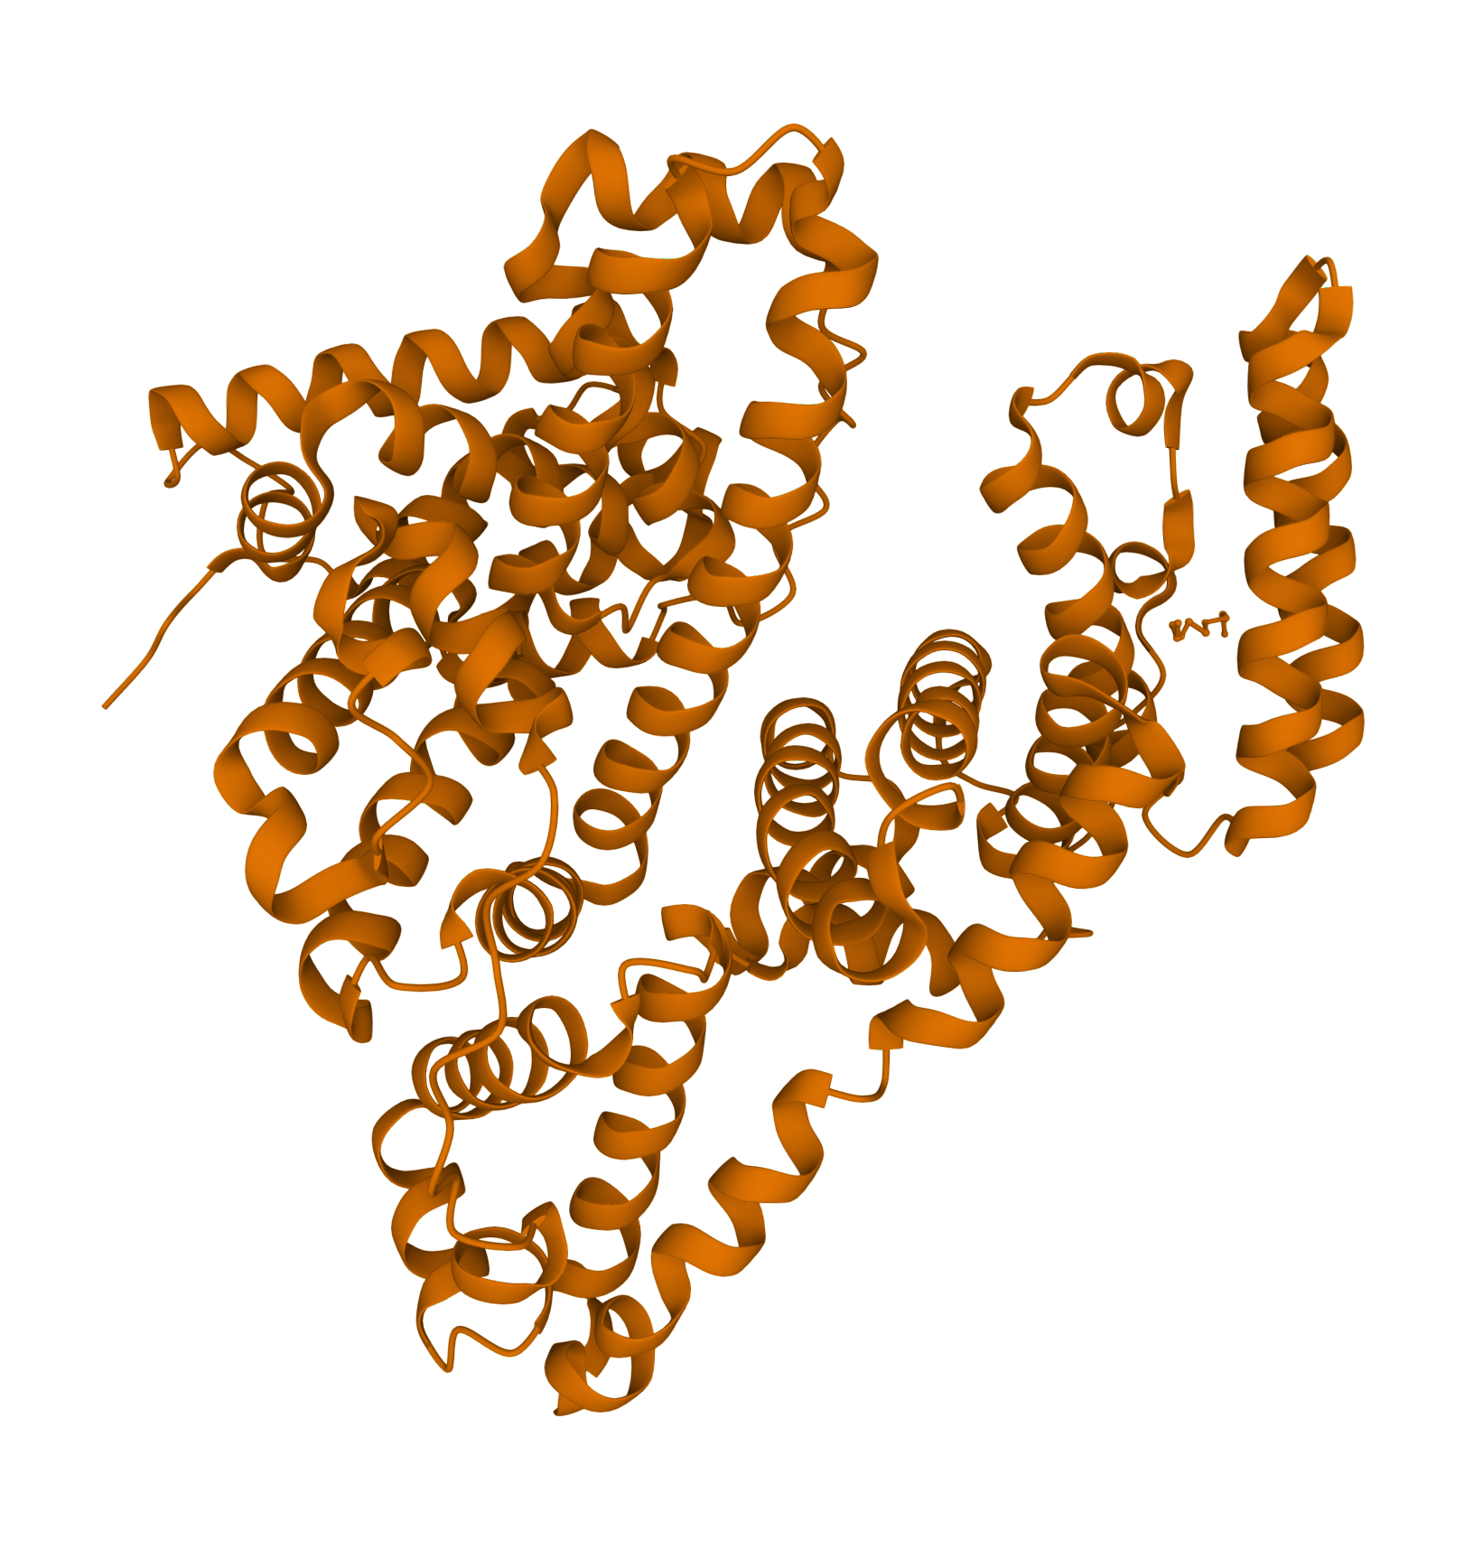
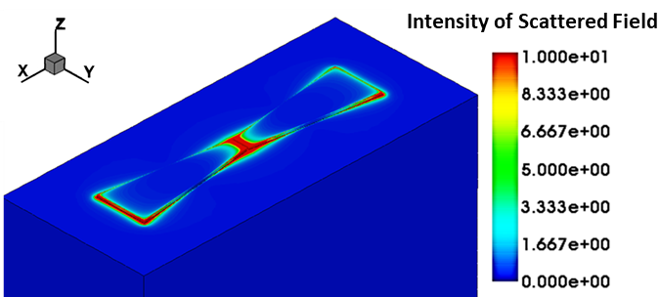
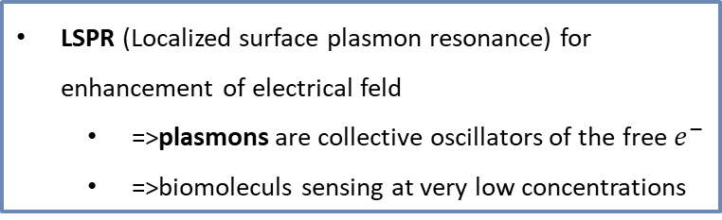

3.Wavelength: THz Gap
THz range 0.1-2.5 THz
(Optical Wavelength ~120-3000µm)
THz plasmonic resonators
LSPR (Localized surface plasmon resonance) for enhancement of electrical feld
  =>plasmons are collective oscillators of the free $e^{−}$
  =>biomoleculs sensing at very low concentrations
Biomoleculs (~nm)
HIV-1 Virus ~120nm
Protein ~5nm
DNA ~2nm
$$E_{ON}$$
Elena Hardt et.al., Opt.Exp.2022, https://doi.org/10.1364/OE.469496

Slide 8
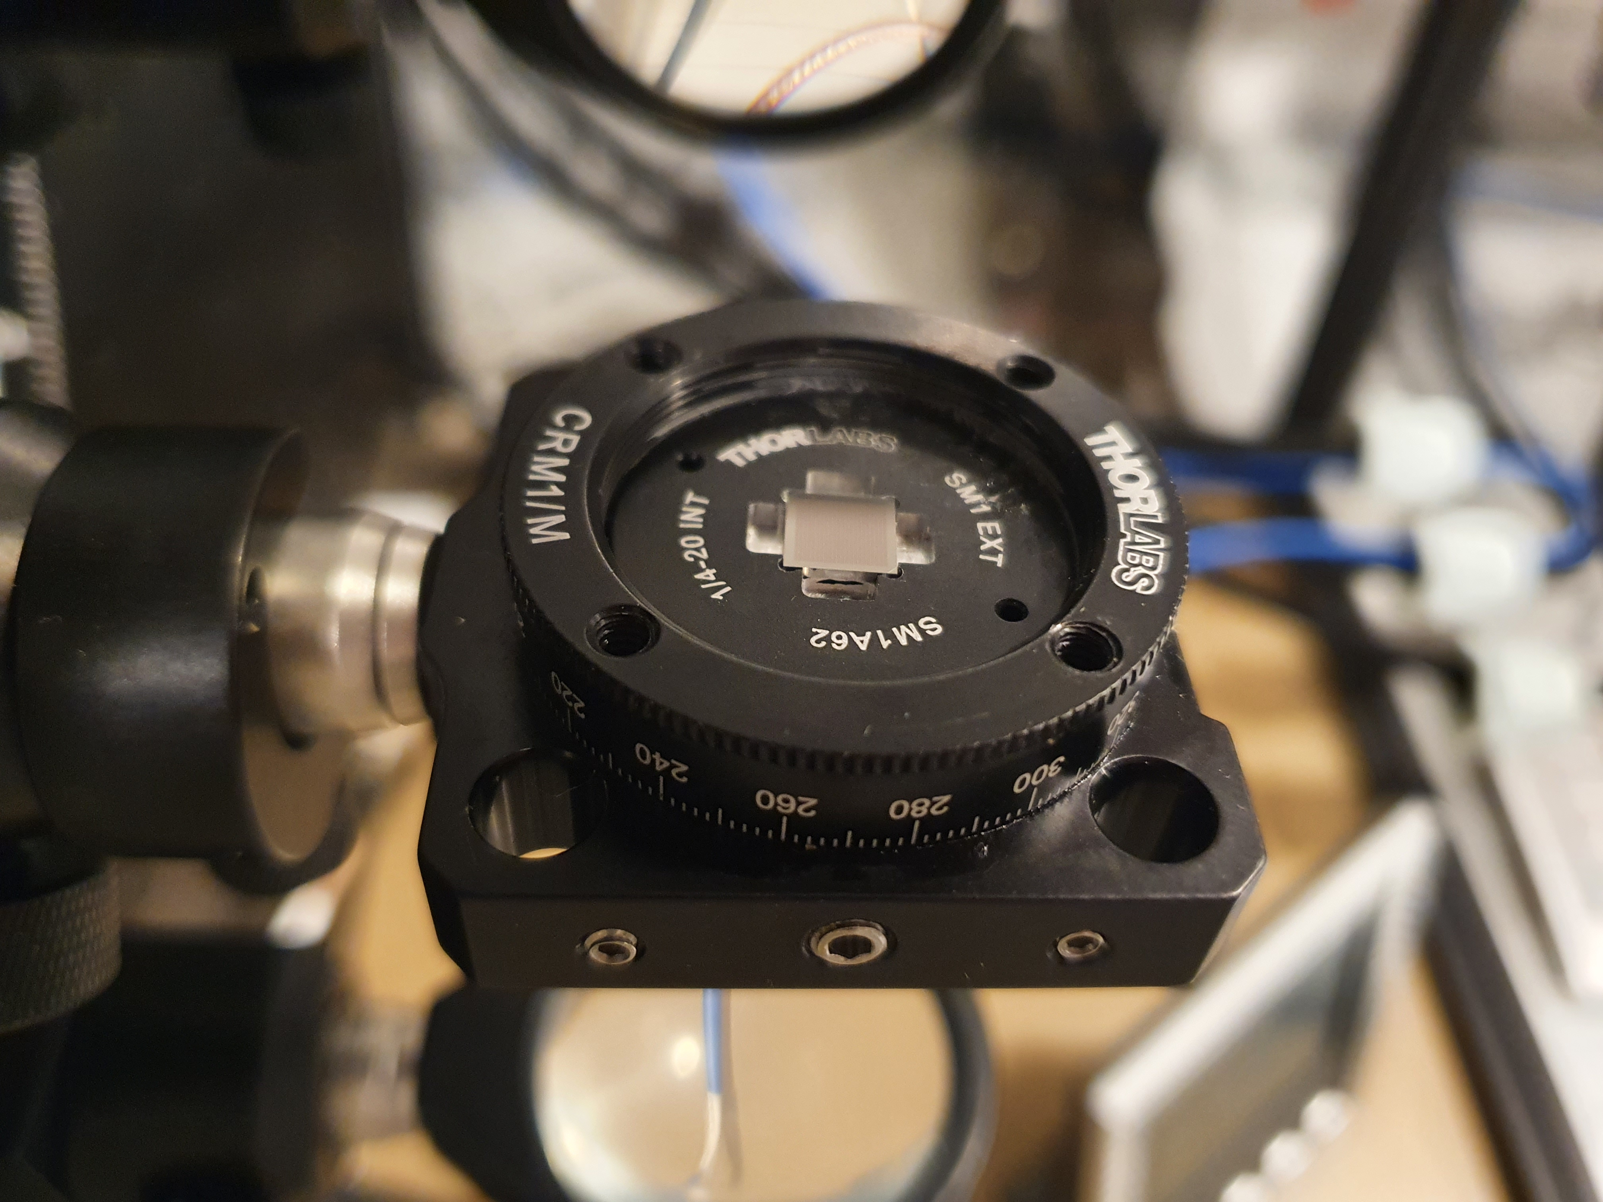
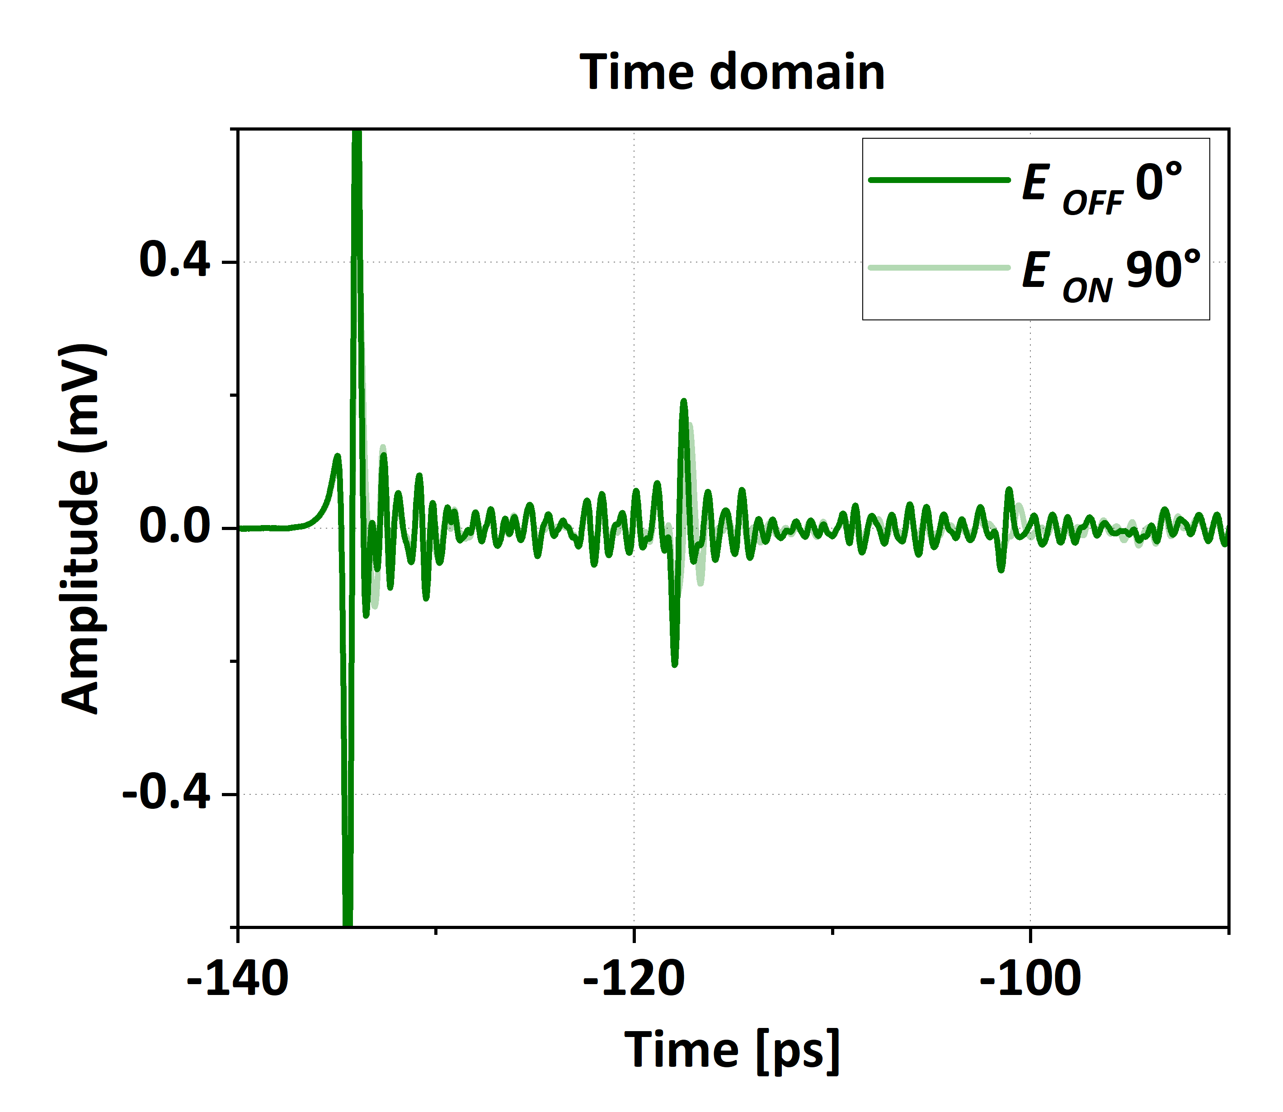
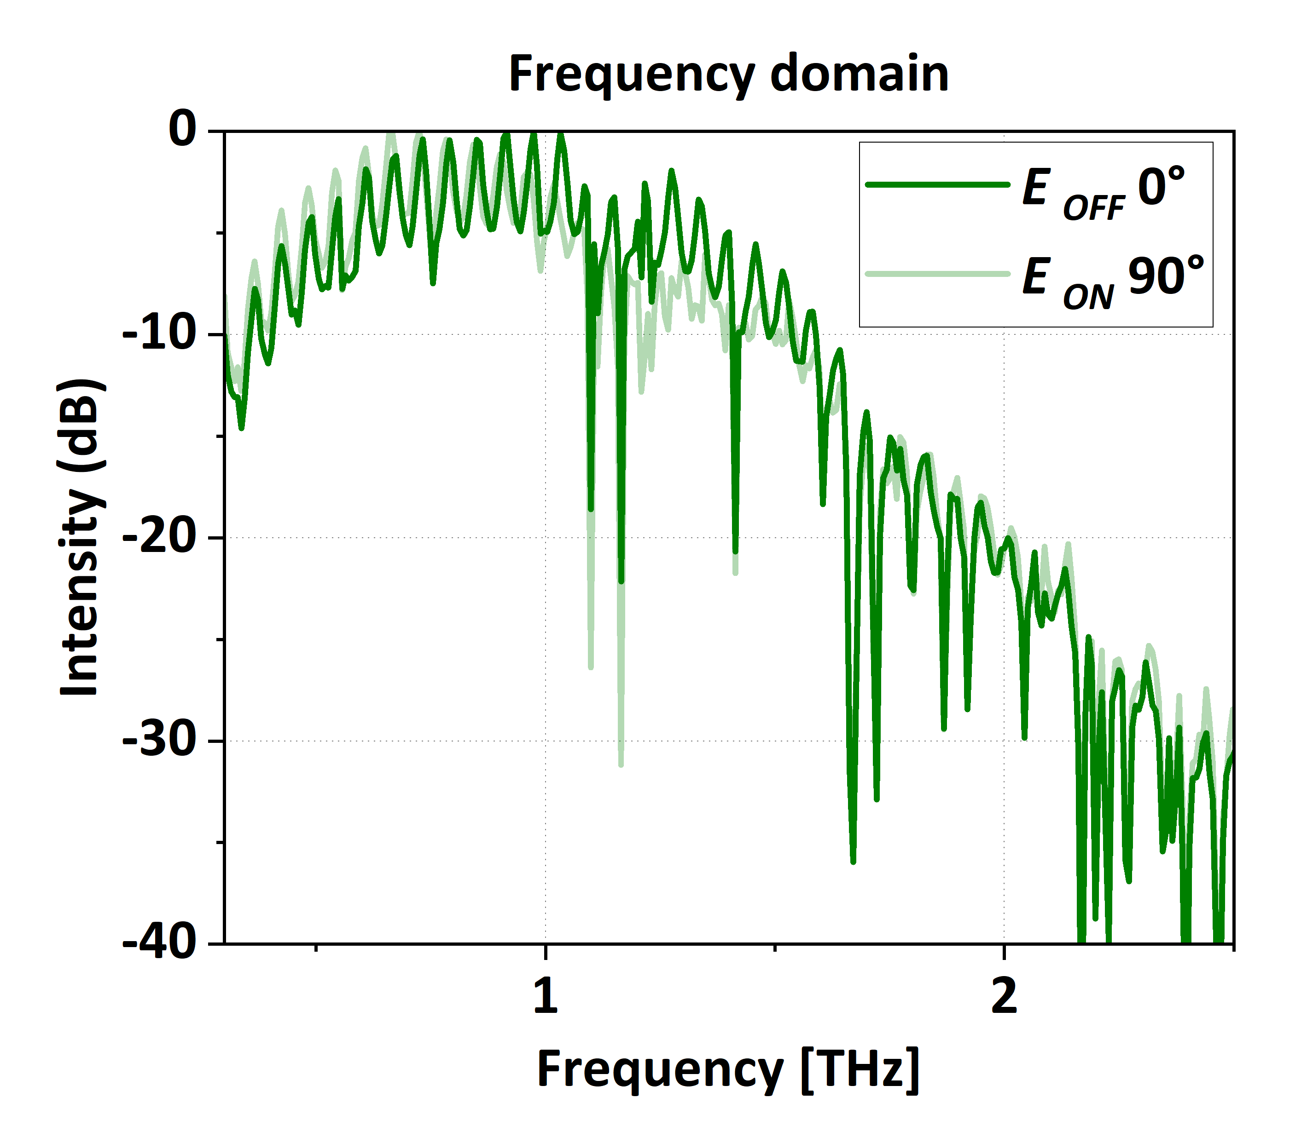







4.THz-TDS measurement setup
y
$$FFT$$
Bias
$$0°$$
$$E_{OFF}$$
Emitter
$$90°$$
Technique
fs-laser
$$E_{ON}$$
x
Sample
PC
$$E_{ON}$$
Detector
A/D
Transmission mode
Linearly polarized light
Amplifier

Slide 9
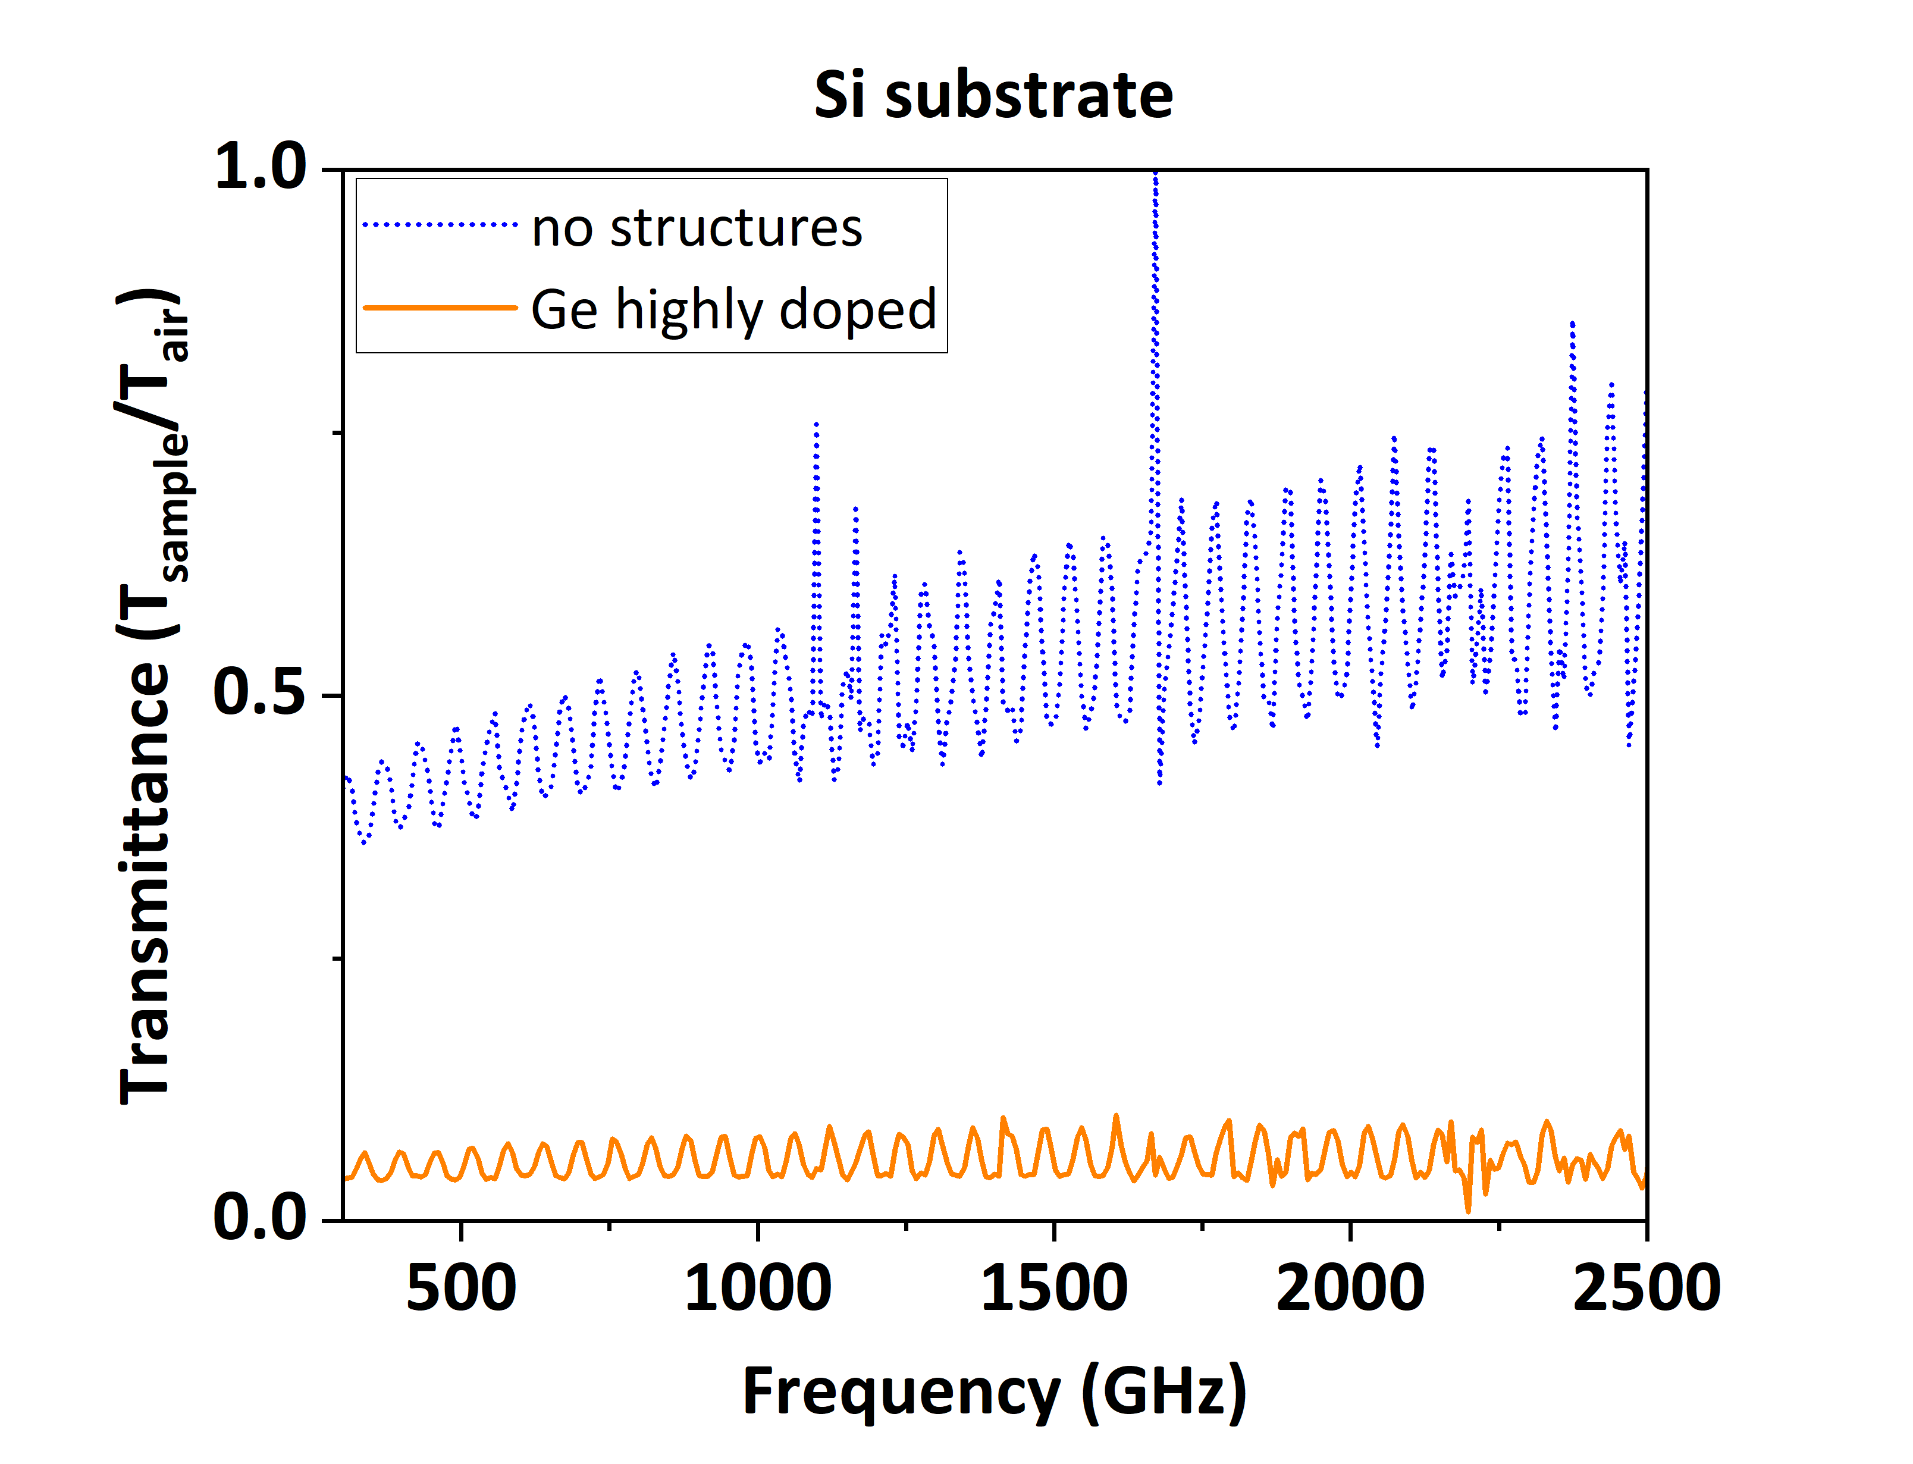
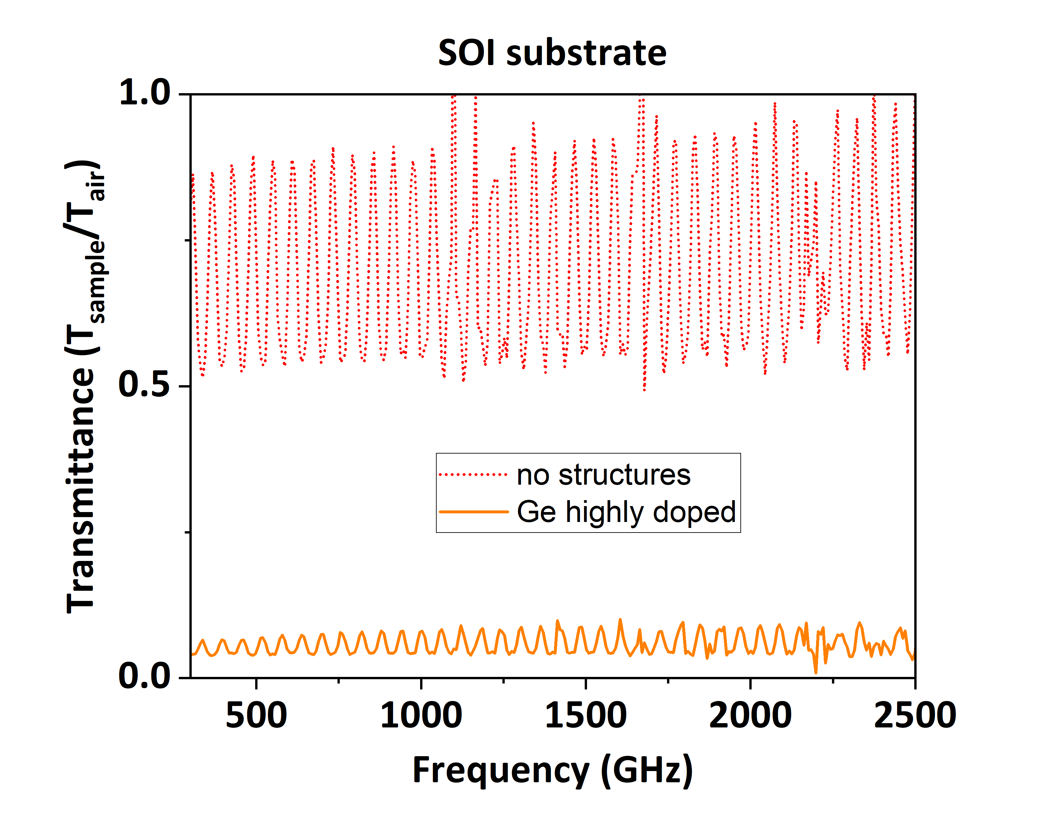
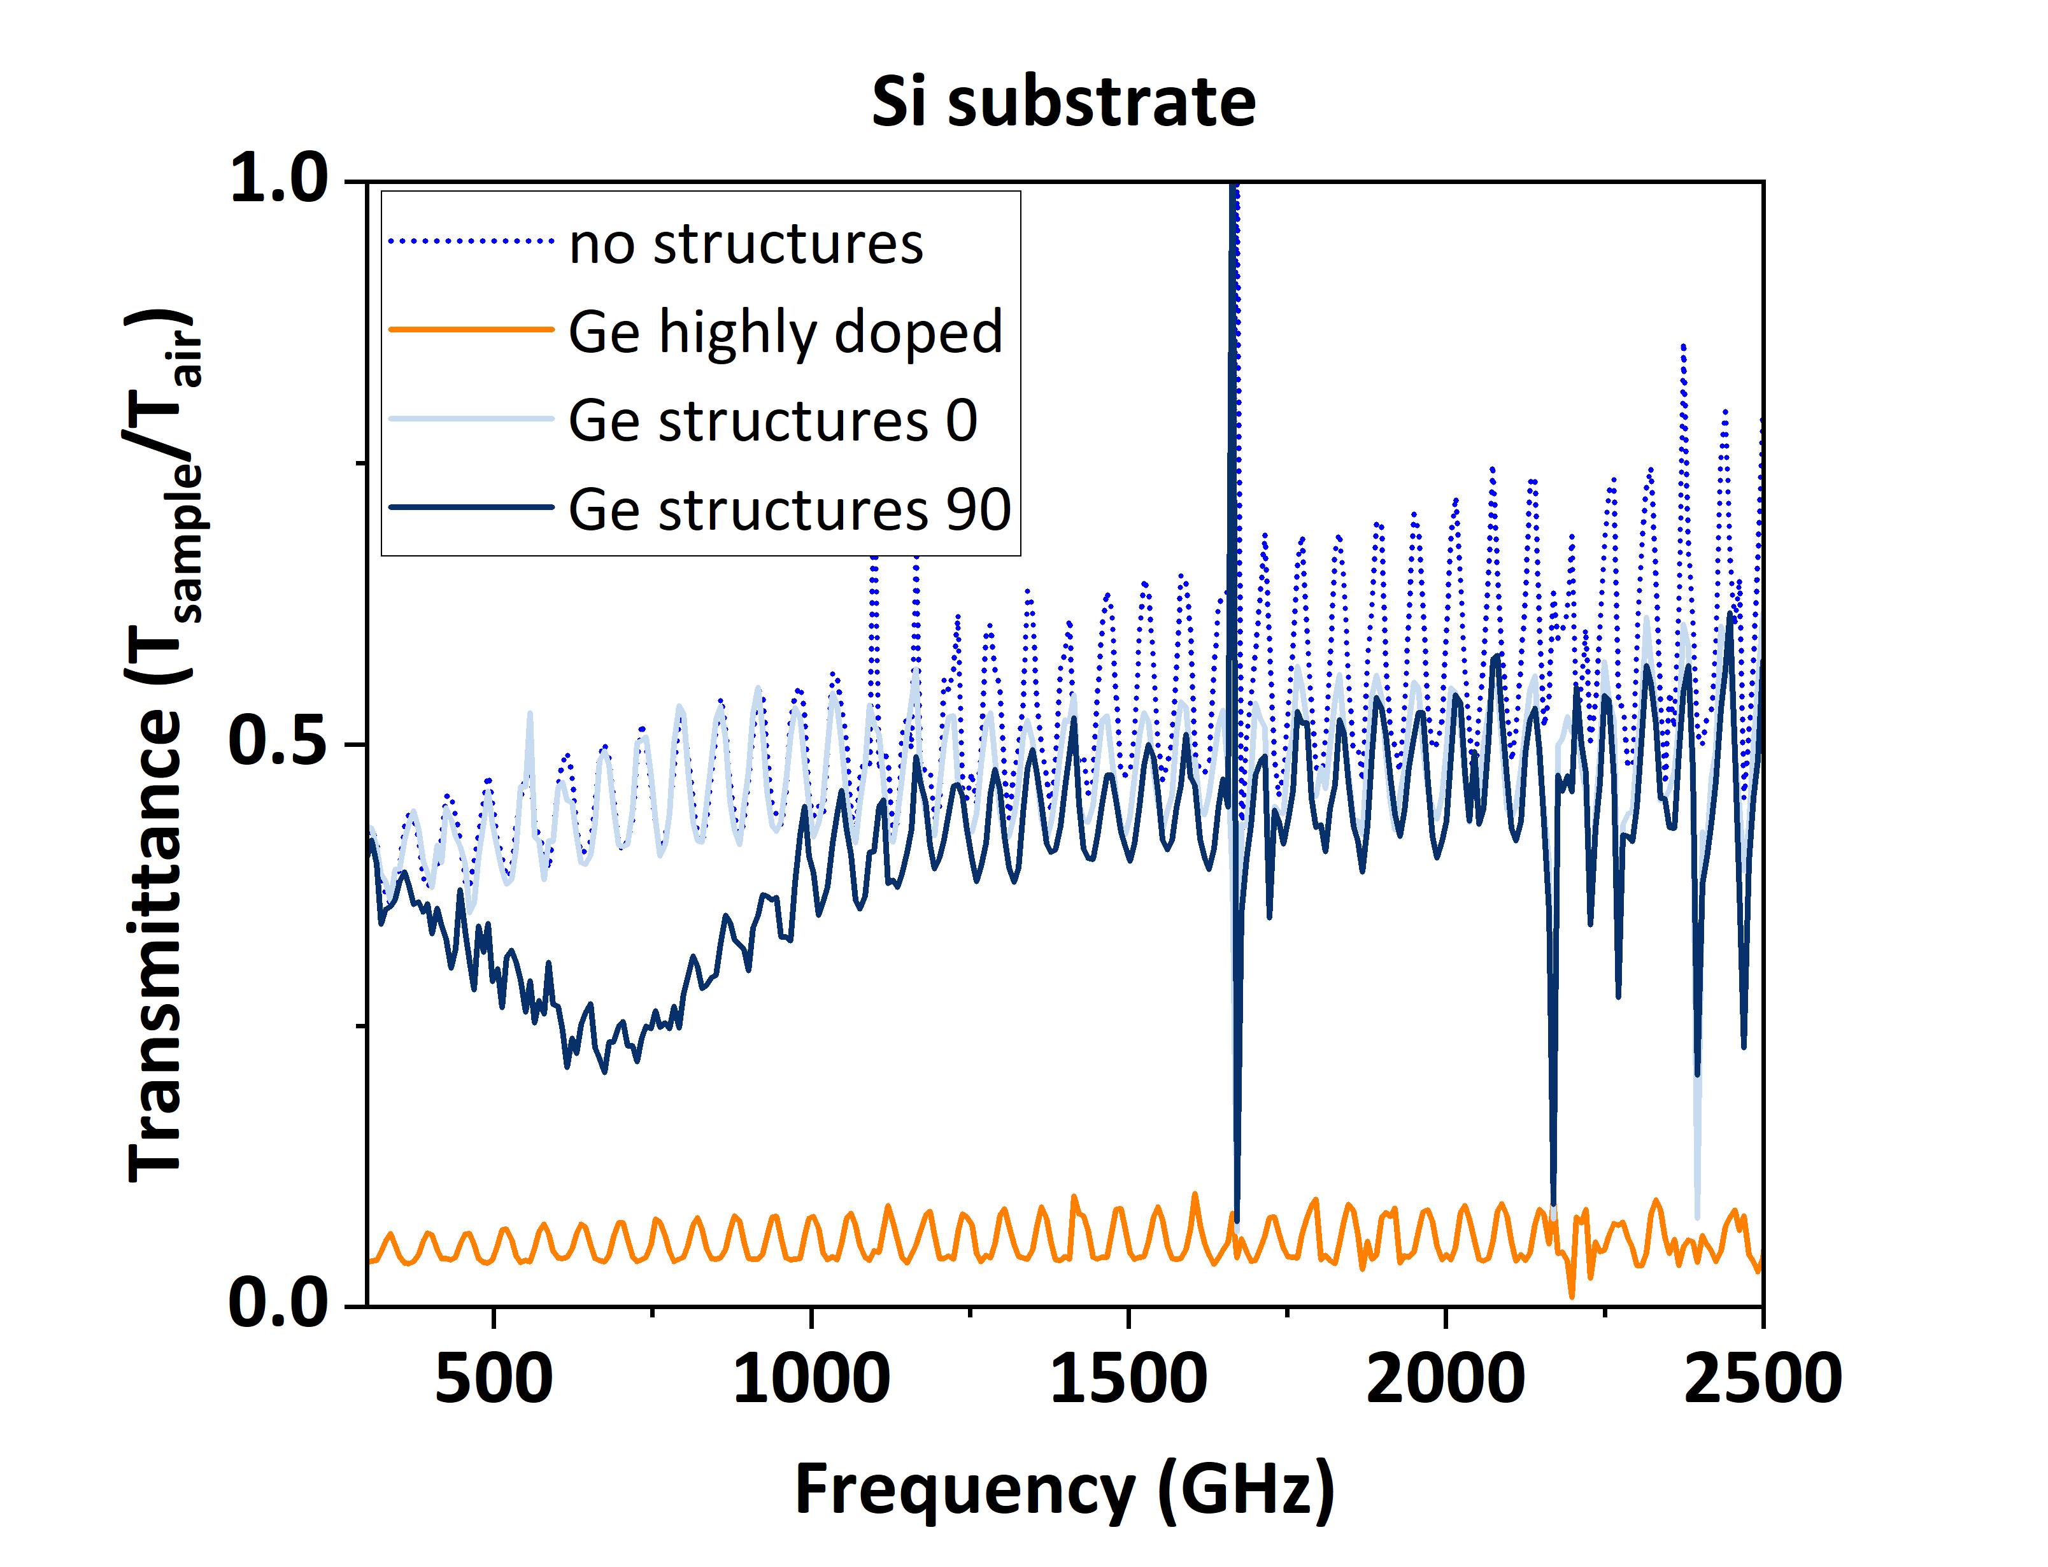
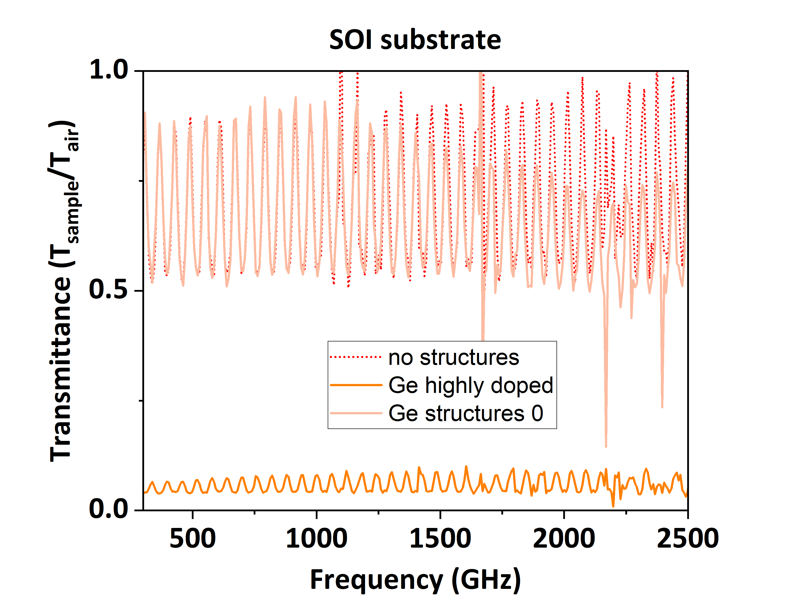
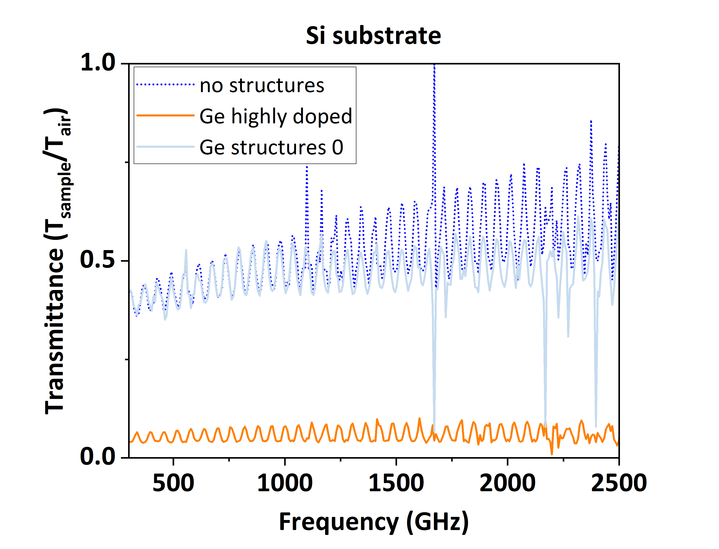
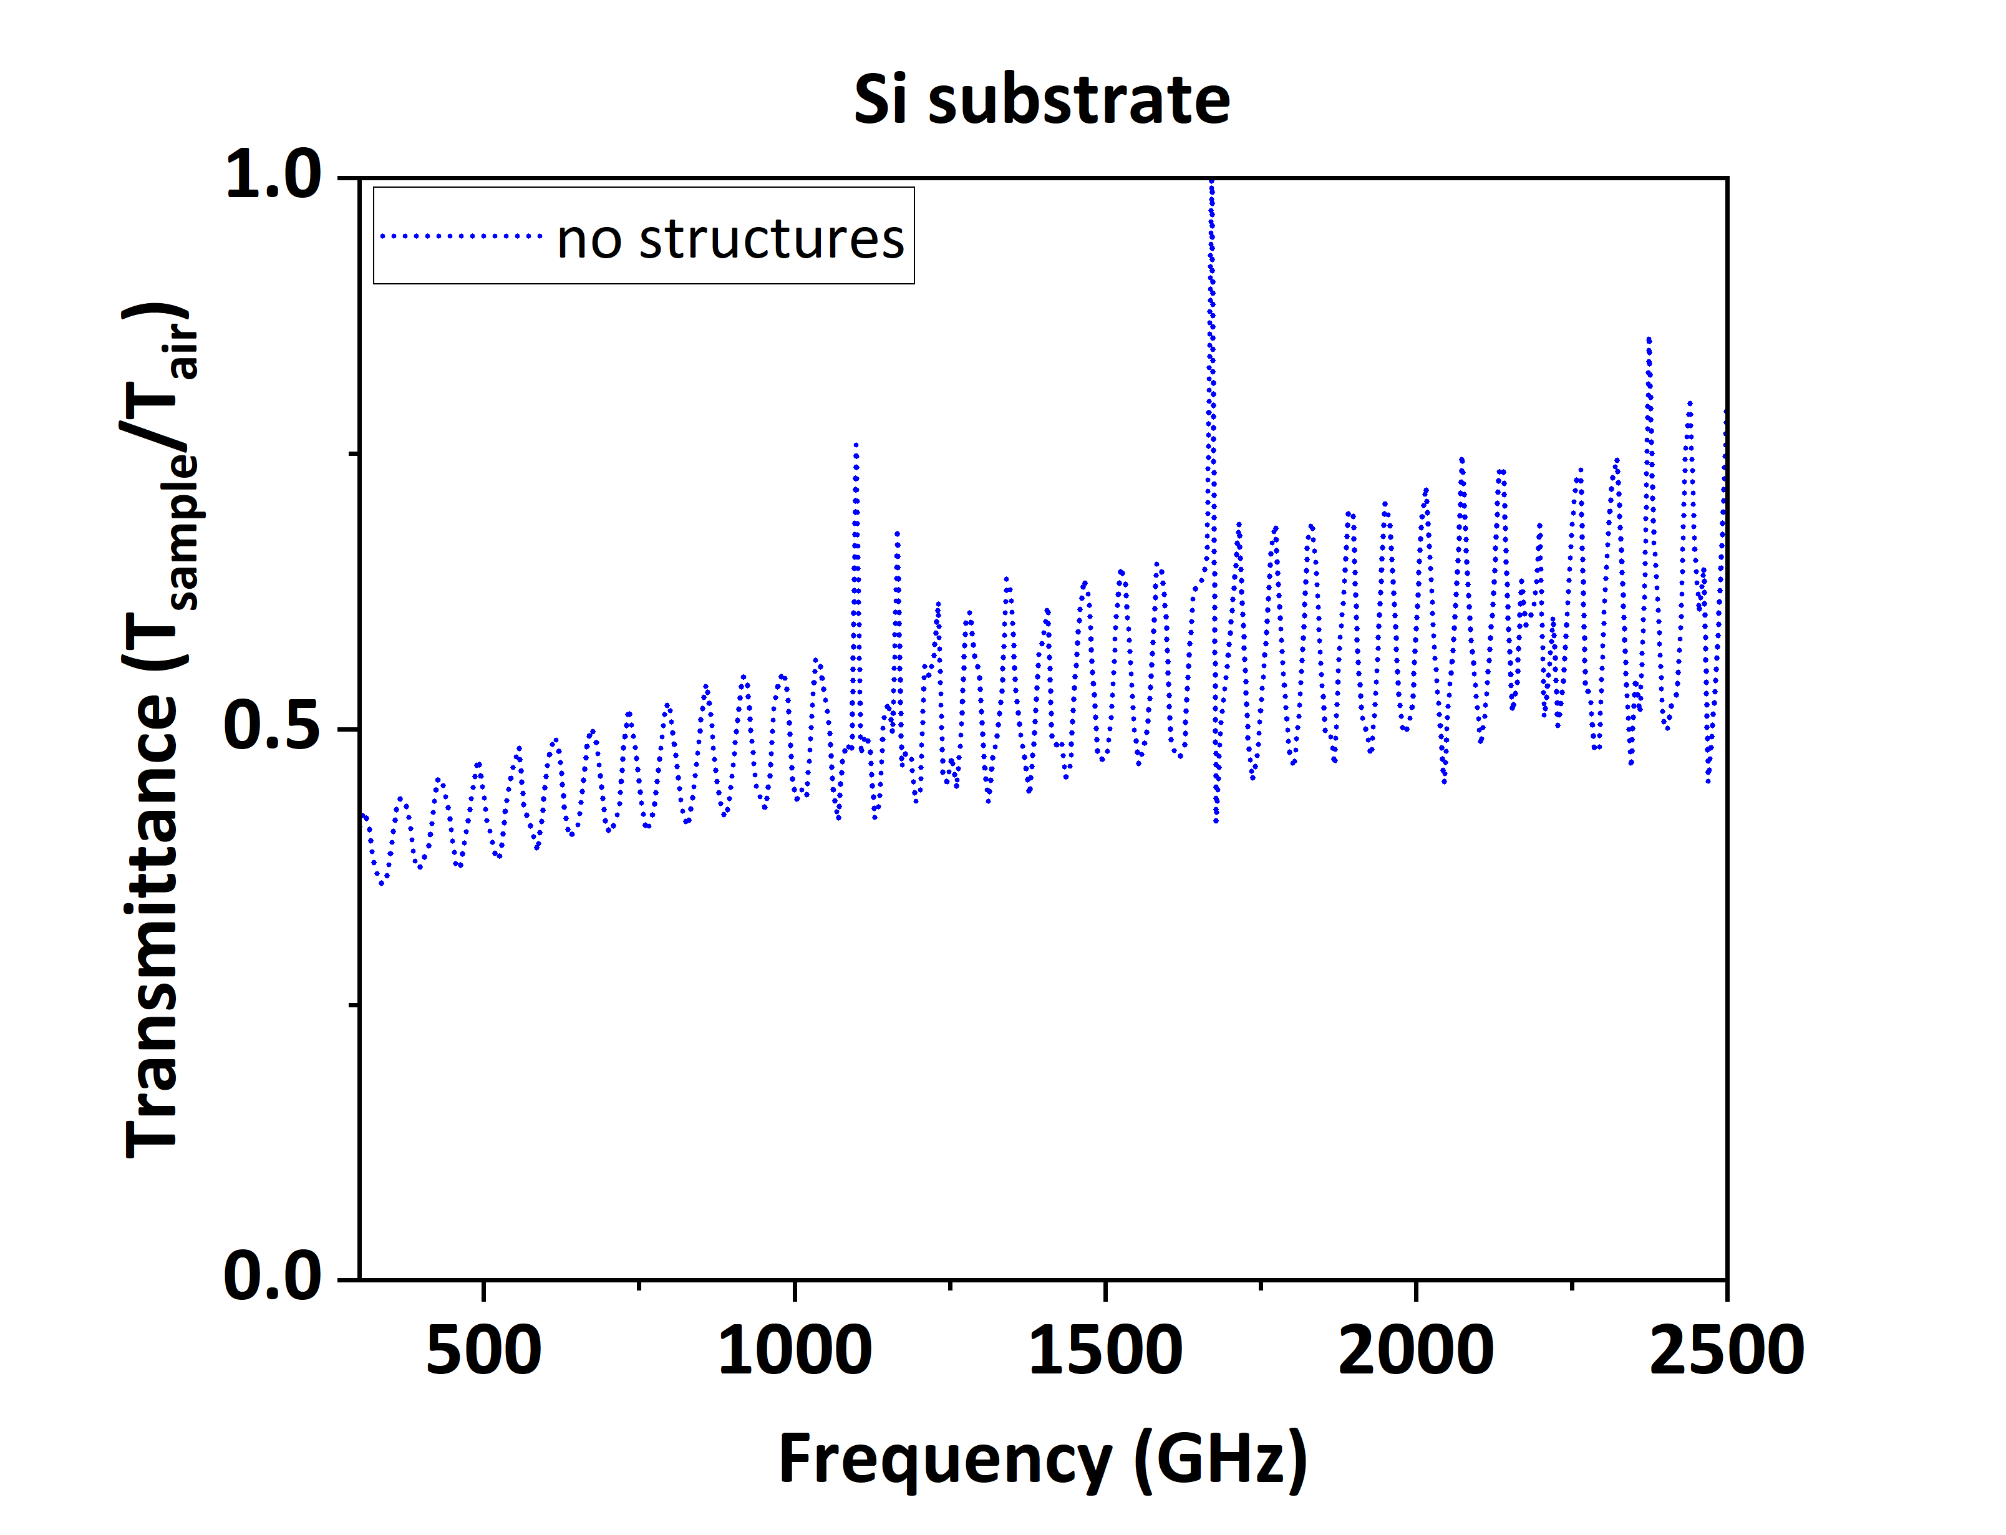
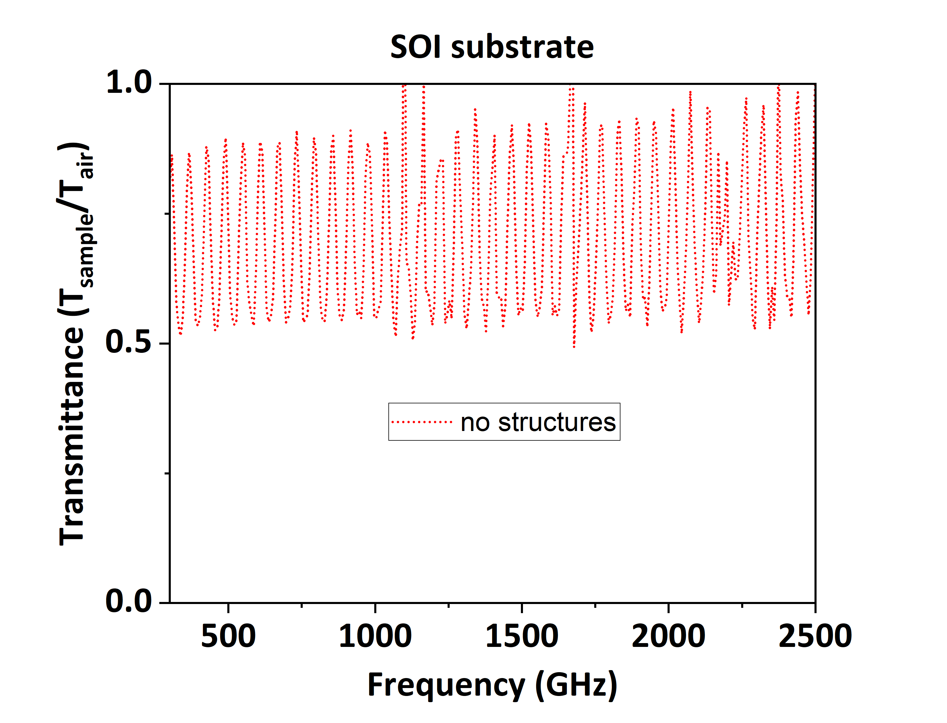
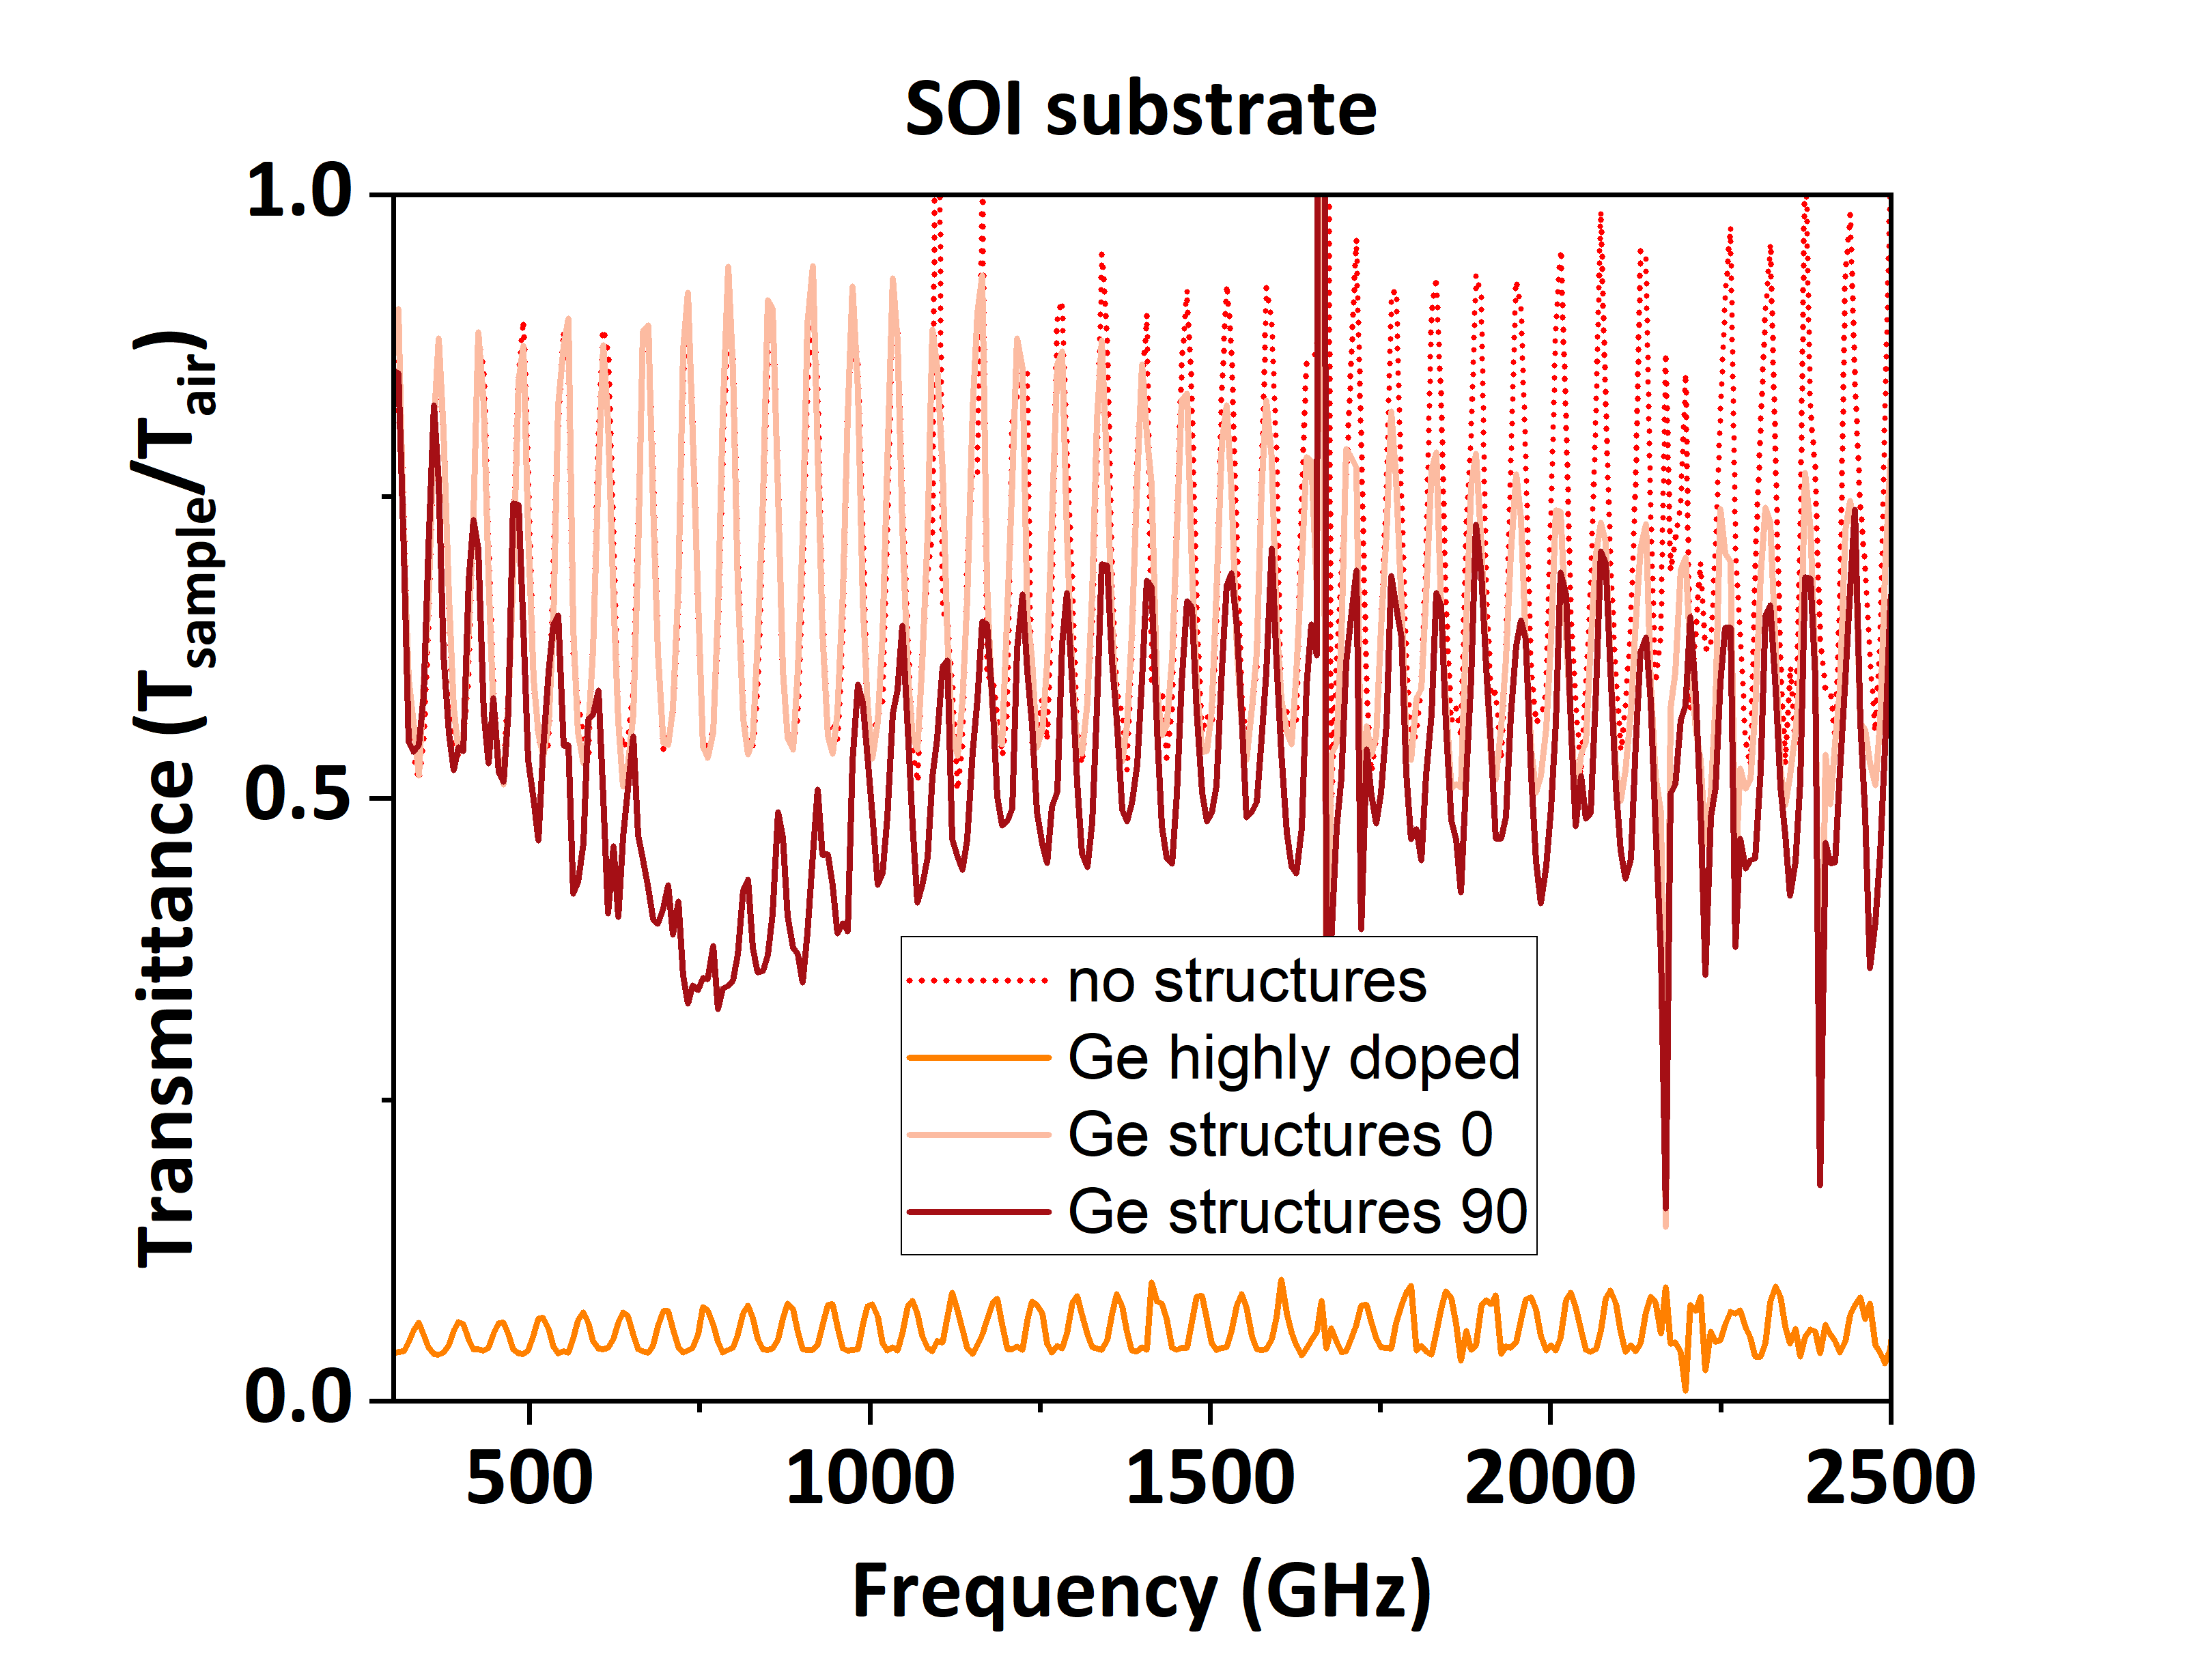






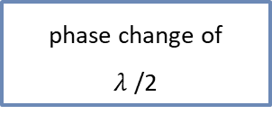




5.Substrate influence: Material
air
$$α$$
$$n_{air}$$
Fabry- Perot
air
Si₃N₄
Si₃N₄
amplitude of incident
>
reflected
>
transmitted
Si₃N₄
$$n_{Si}$$
Si
incident
reflected
phase change of
$λ$ /2
SiO₂
$$θ$$
~d=730 µm
Si
transmitted
Si
air
Ge
n-doped (10¹⁹ cm⁻³ )
$$0°$$
y
$$E_{OFF}$$
$$90°$$
x
$$E_{ON}$$
Si
air
air
Si₃N₄
Si₃N₄
Ge
n-doped (10¹⁹ cm⁻³ )
Ge
Si
SiO₂
Si
Si

Slide 10
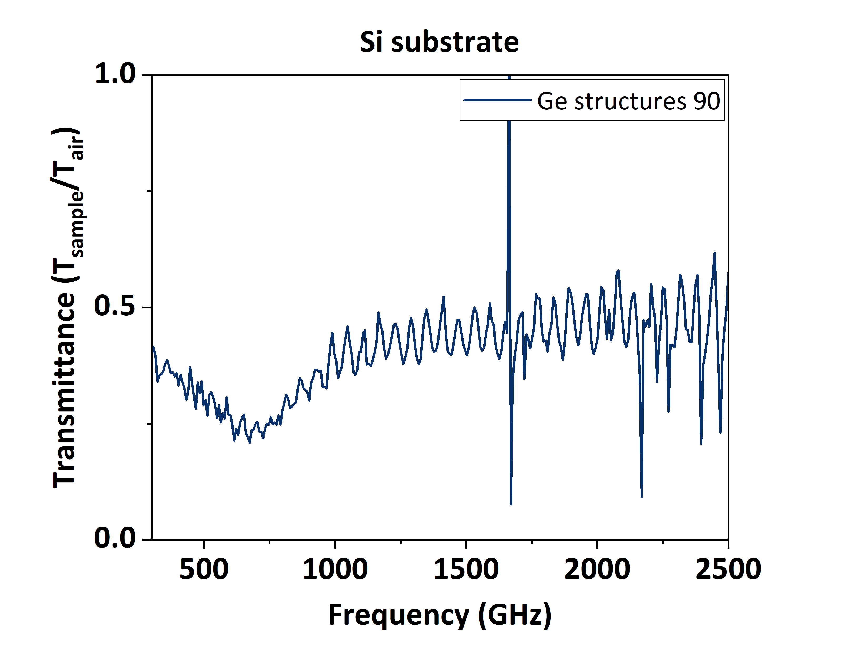
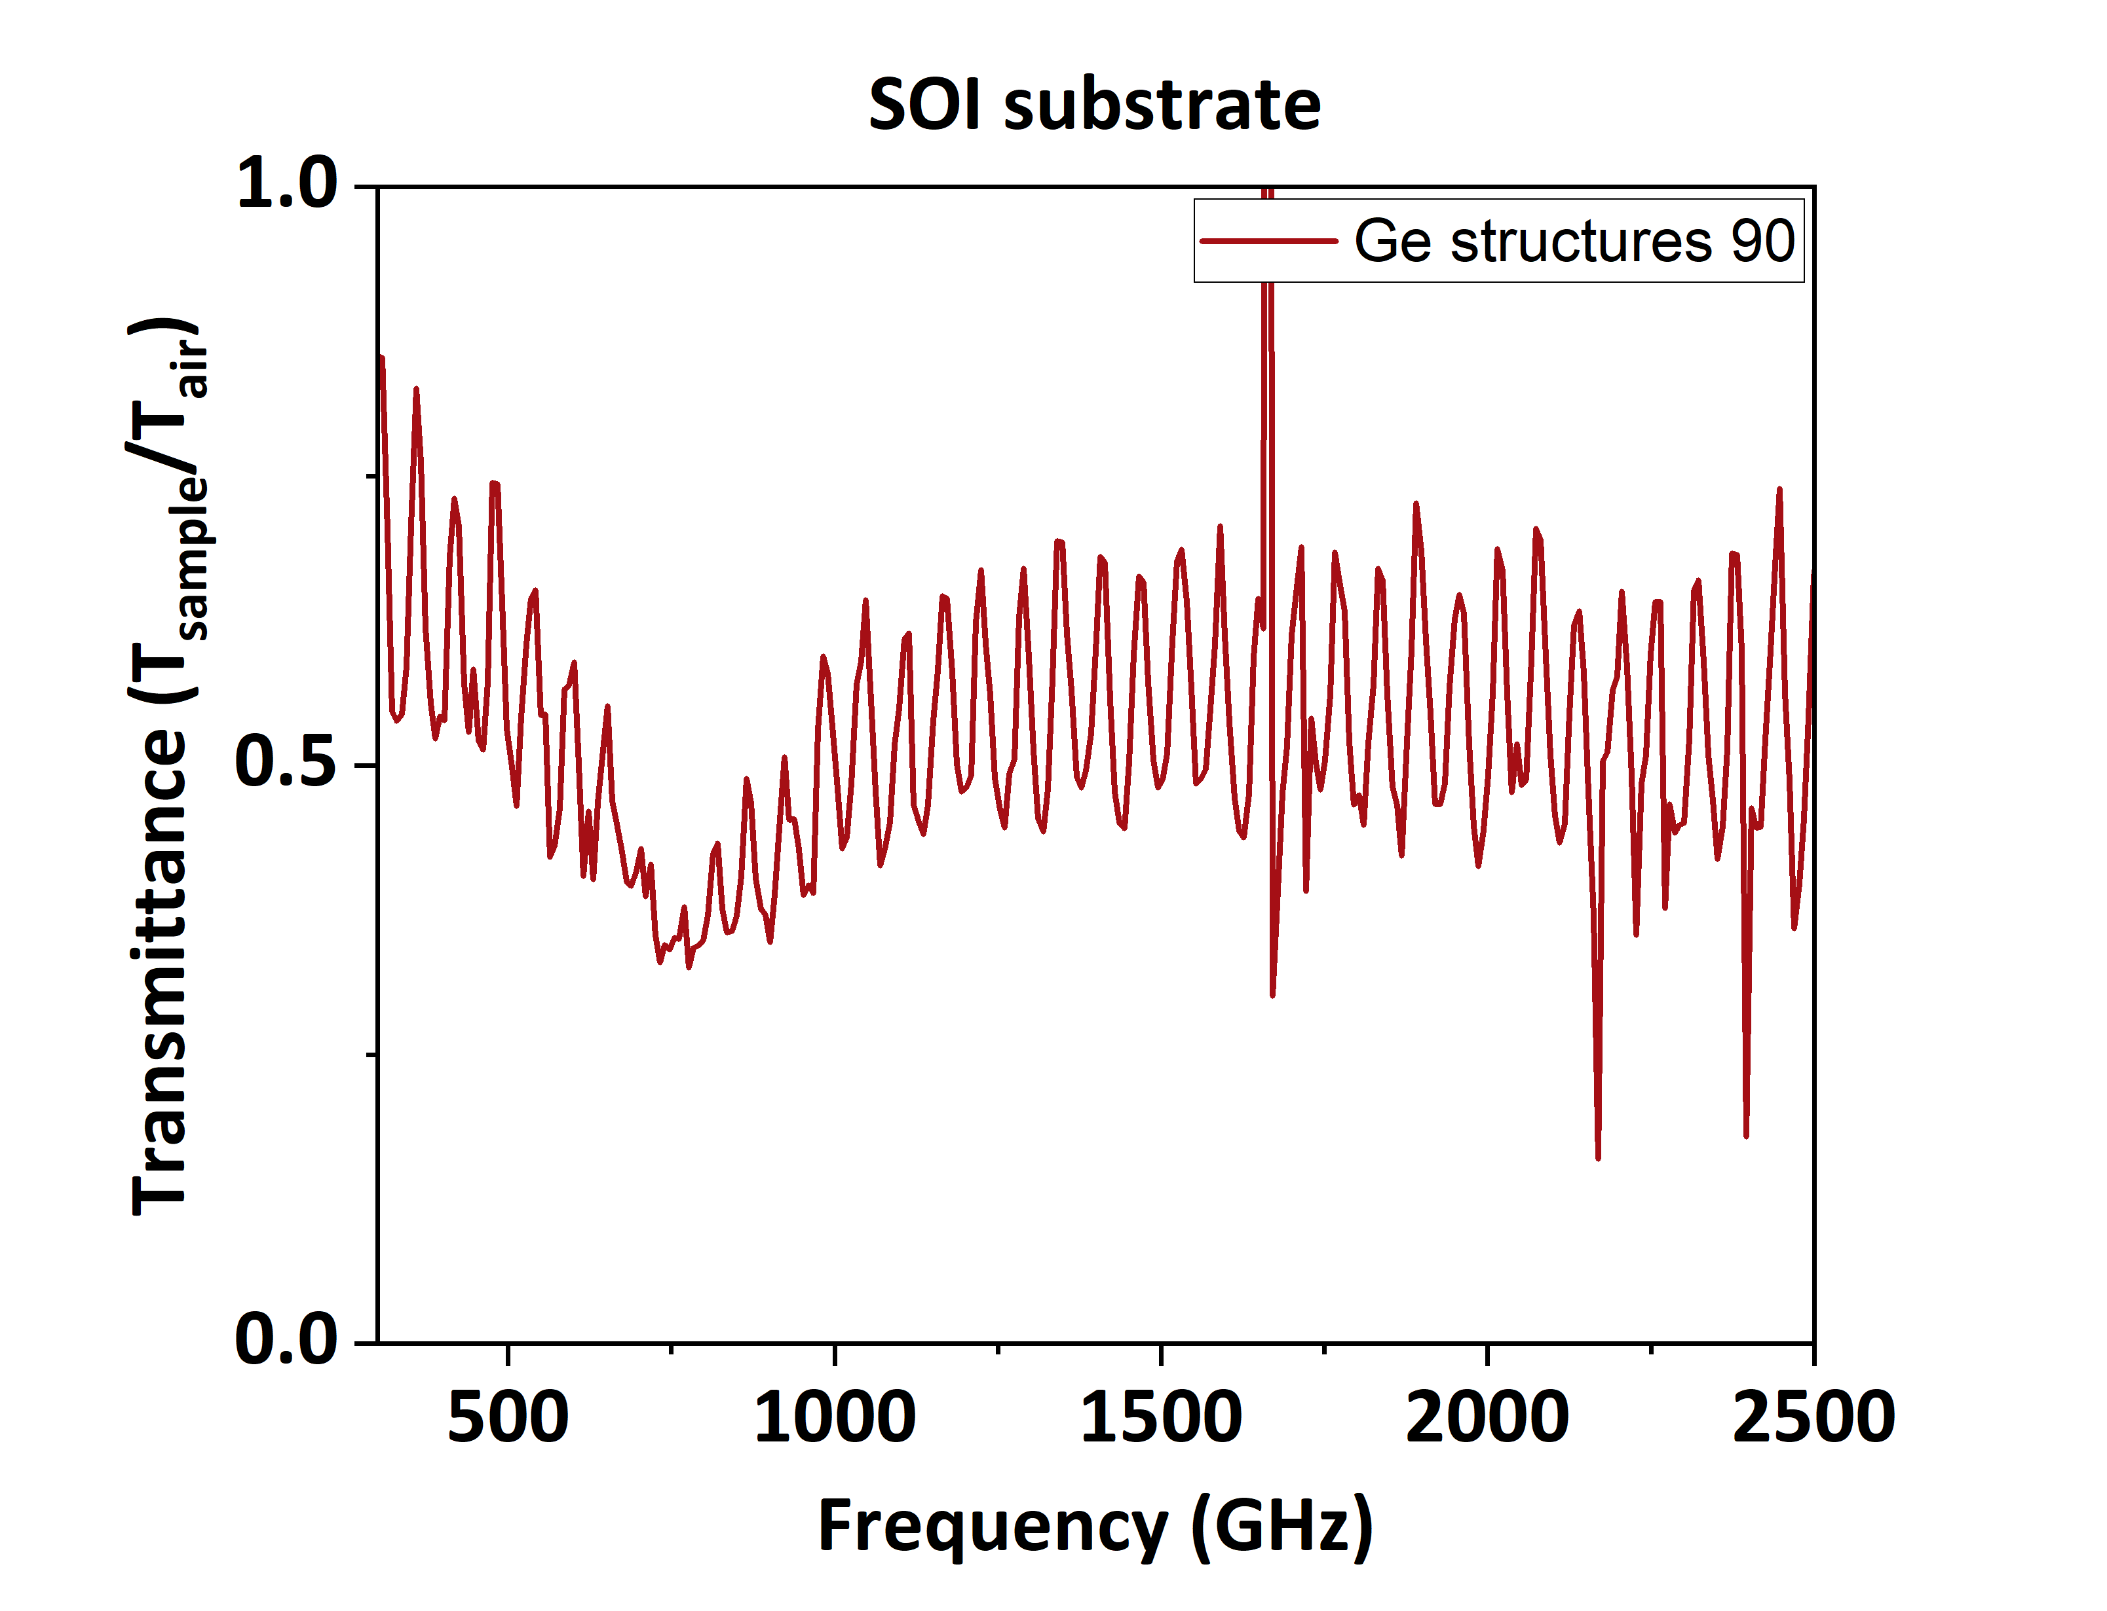
5.Substrate influence: Material
$$E_{ON}$$
$$E_{ON}$$
air
air
Si₃N₄
Si₃N₄
Ge
n-doped (10¹⁹ cm⁻³ )
Ge
Si
SiO₂
Si
Si
Plasmonic resonance
Bright mode

Slide 11
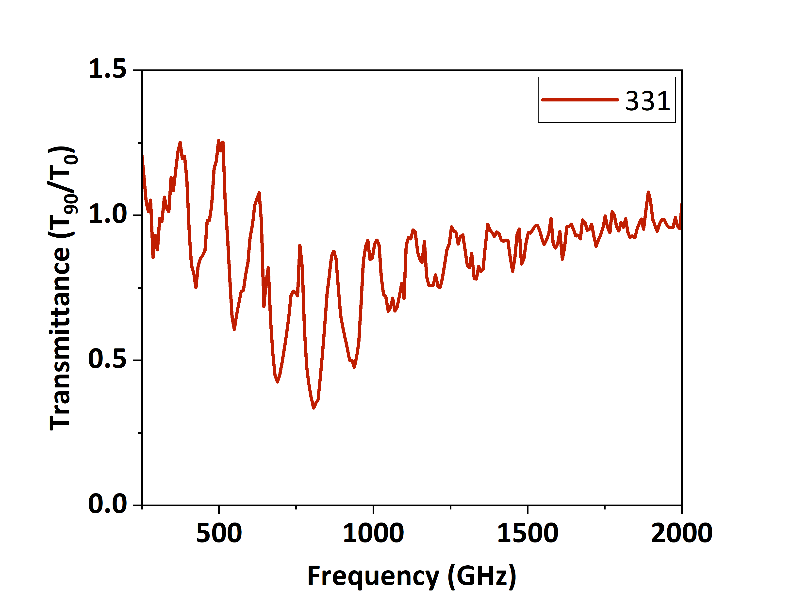
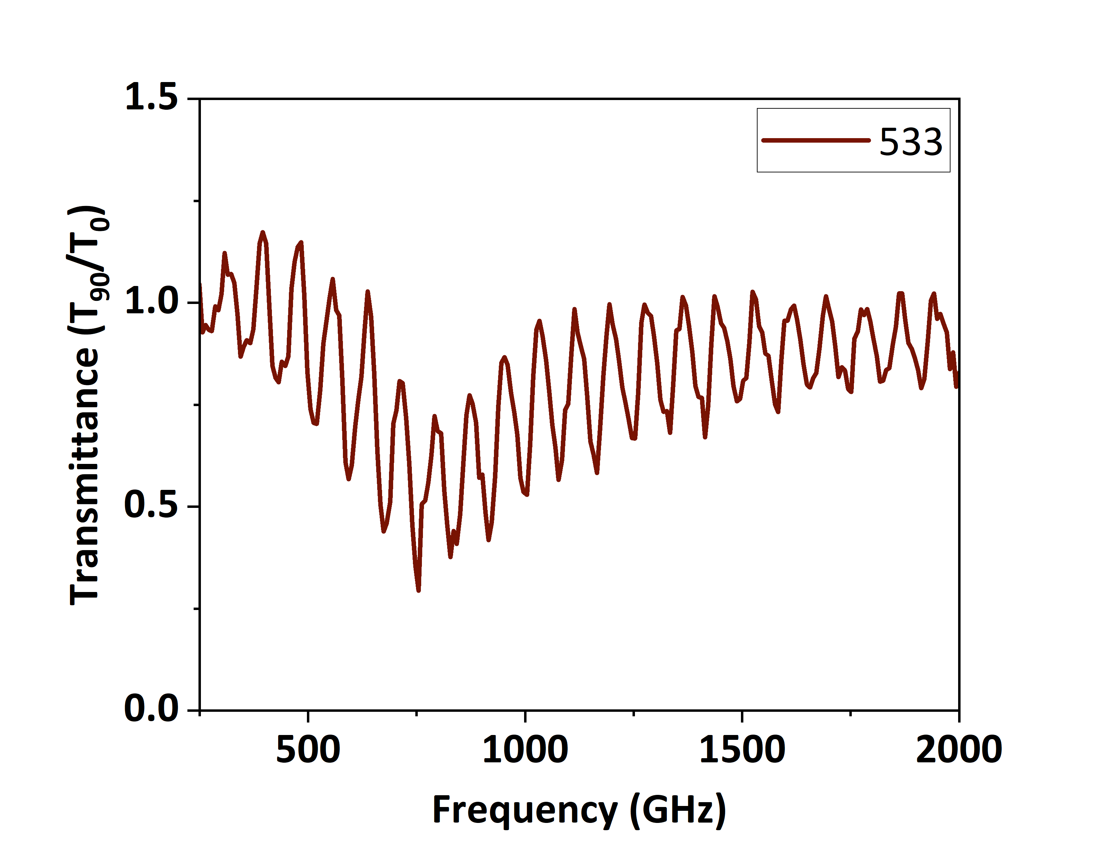
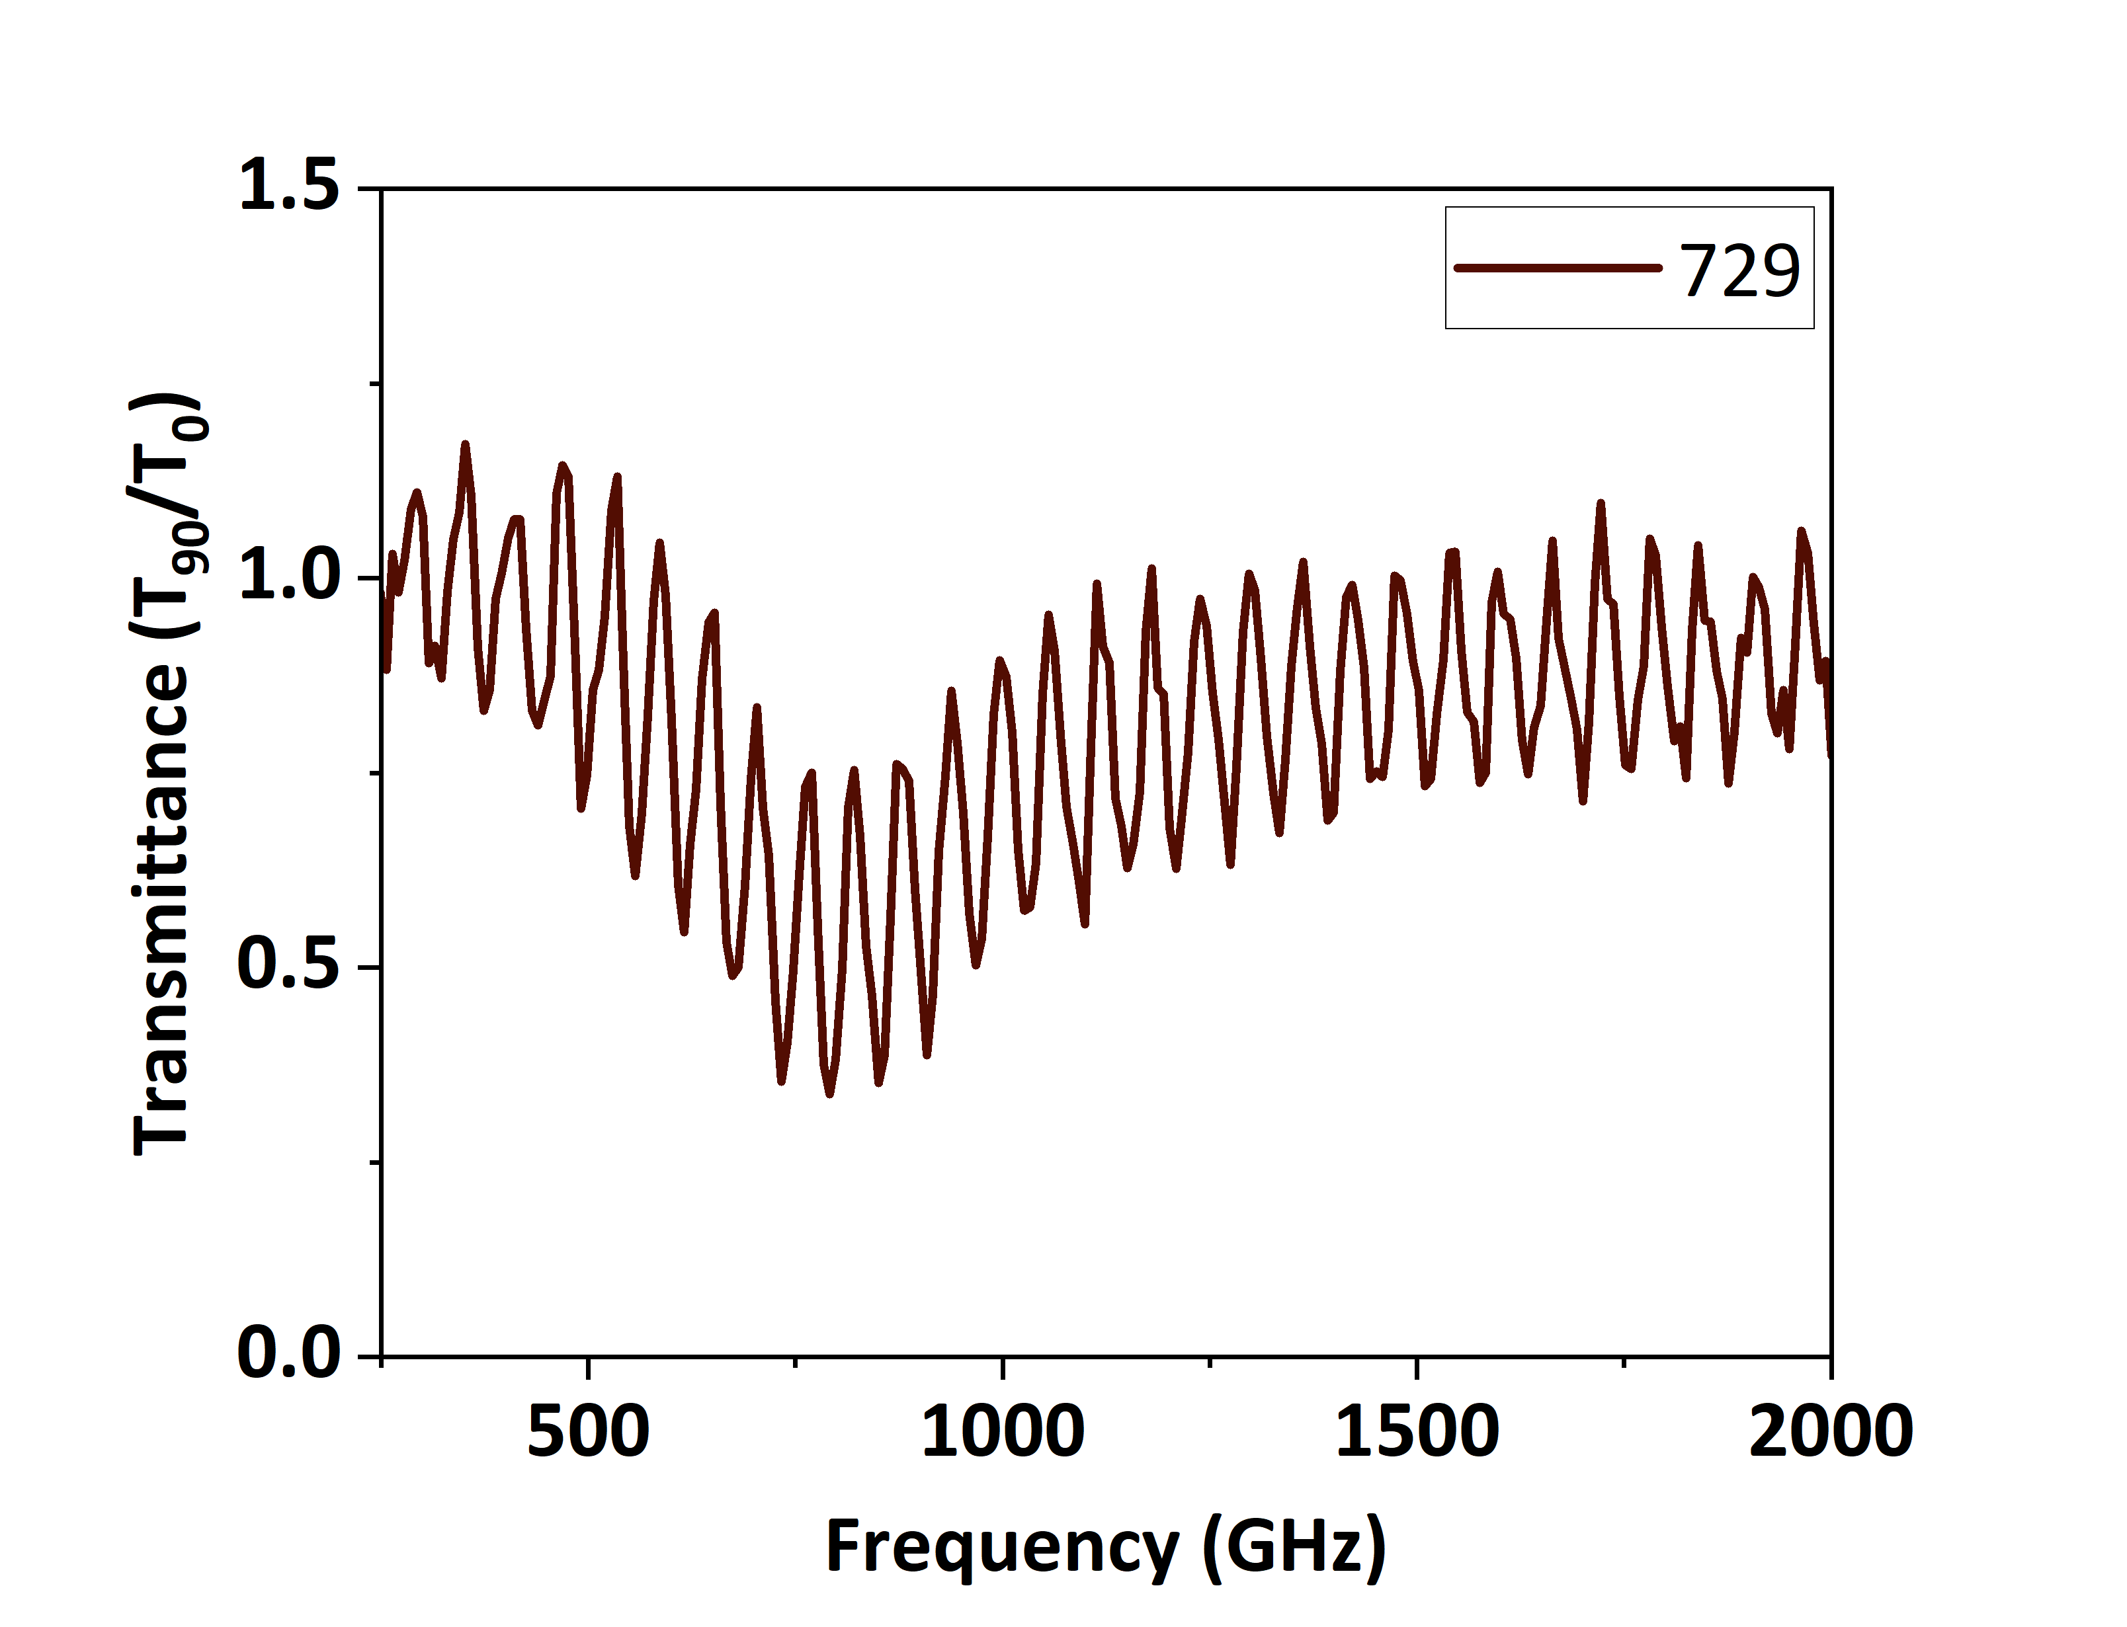
5.Substrate influence: Thickness
331 µm
533 µm
Oscillations
Not clear from which thickness we have Fano resonance
729 µm
Si

Slide 12
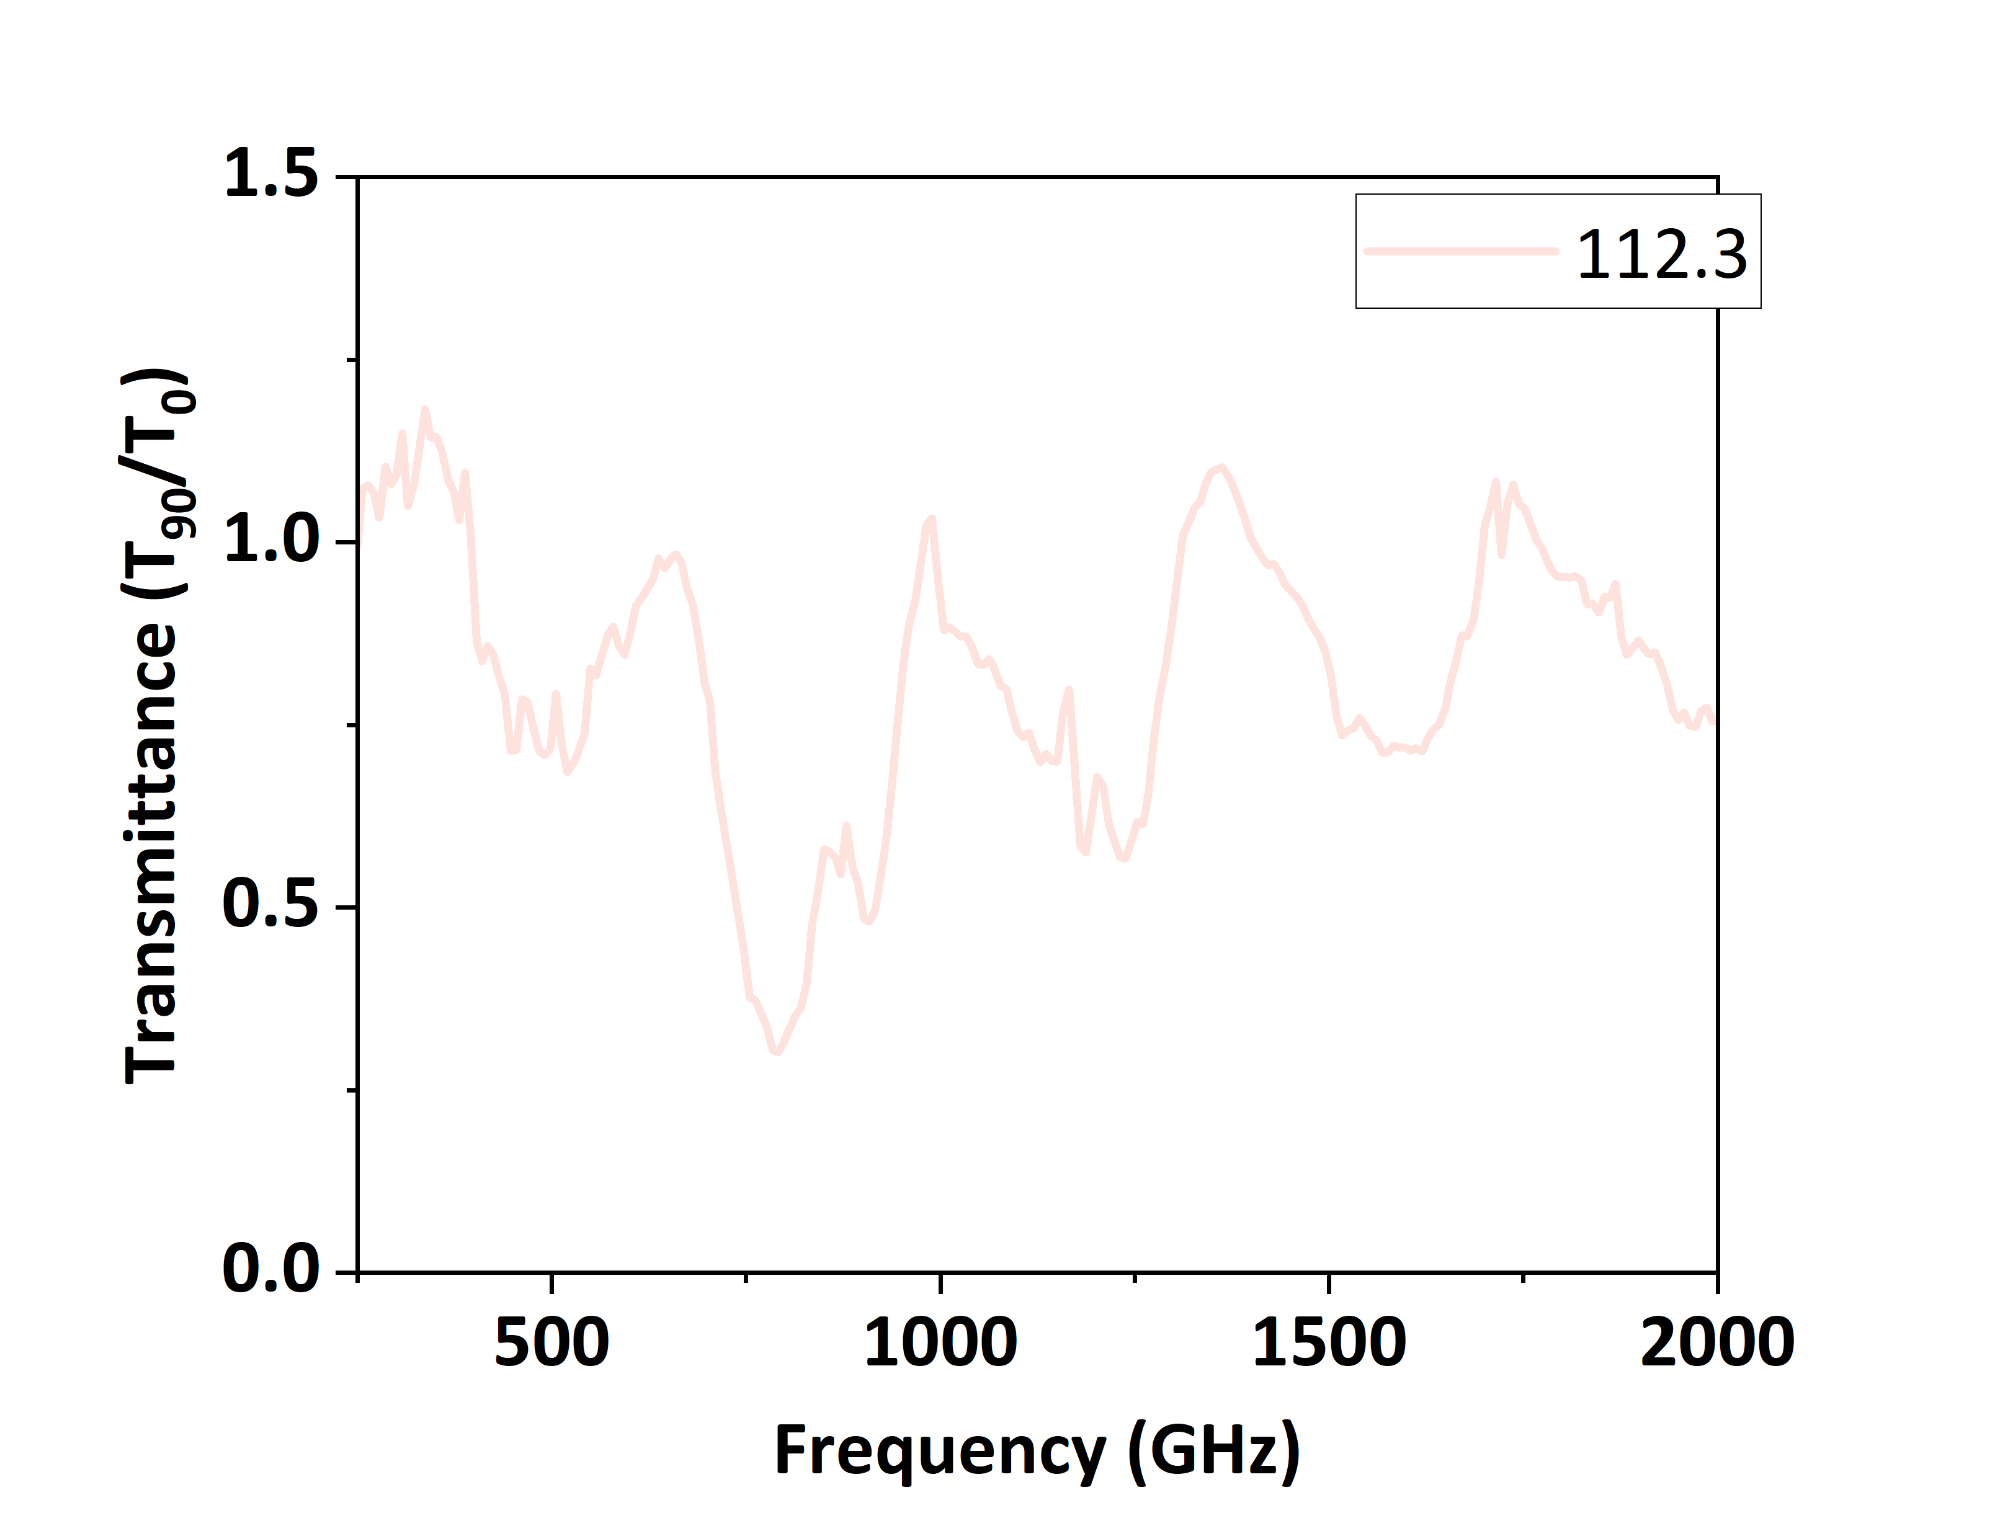
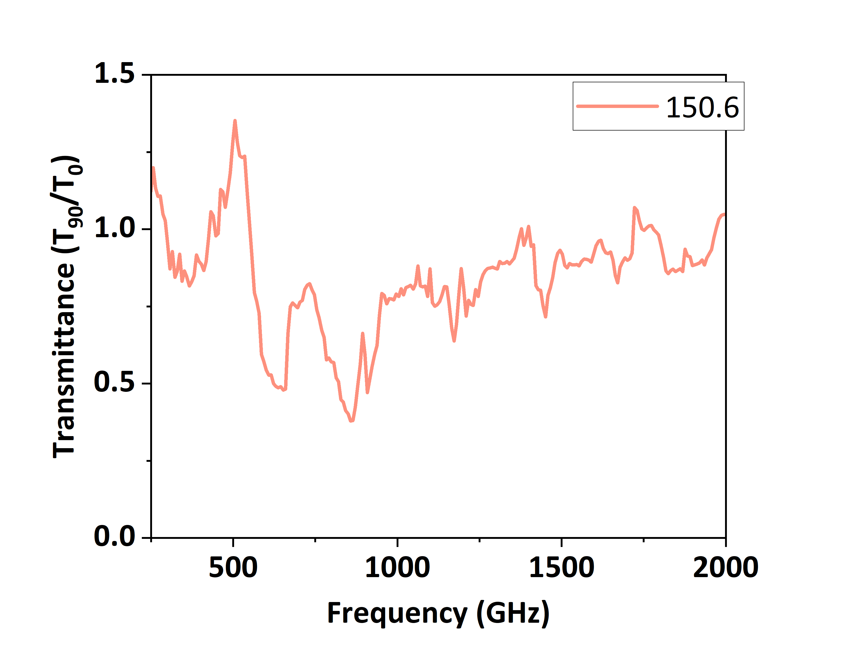
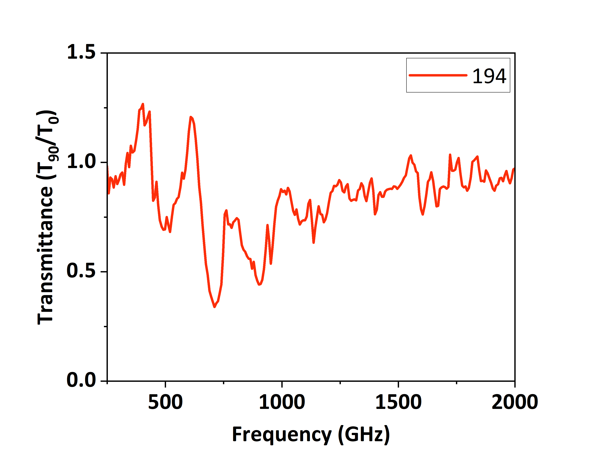
5.Substrate influence: Thickness
331 µm
112.3 µm
150.6 µm
533 µm
194 µm
Si
729 µm
Fano resonance?
Si

Slide 13
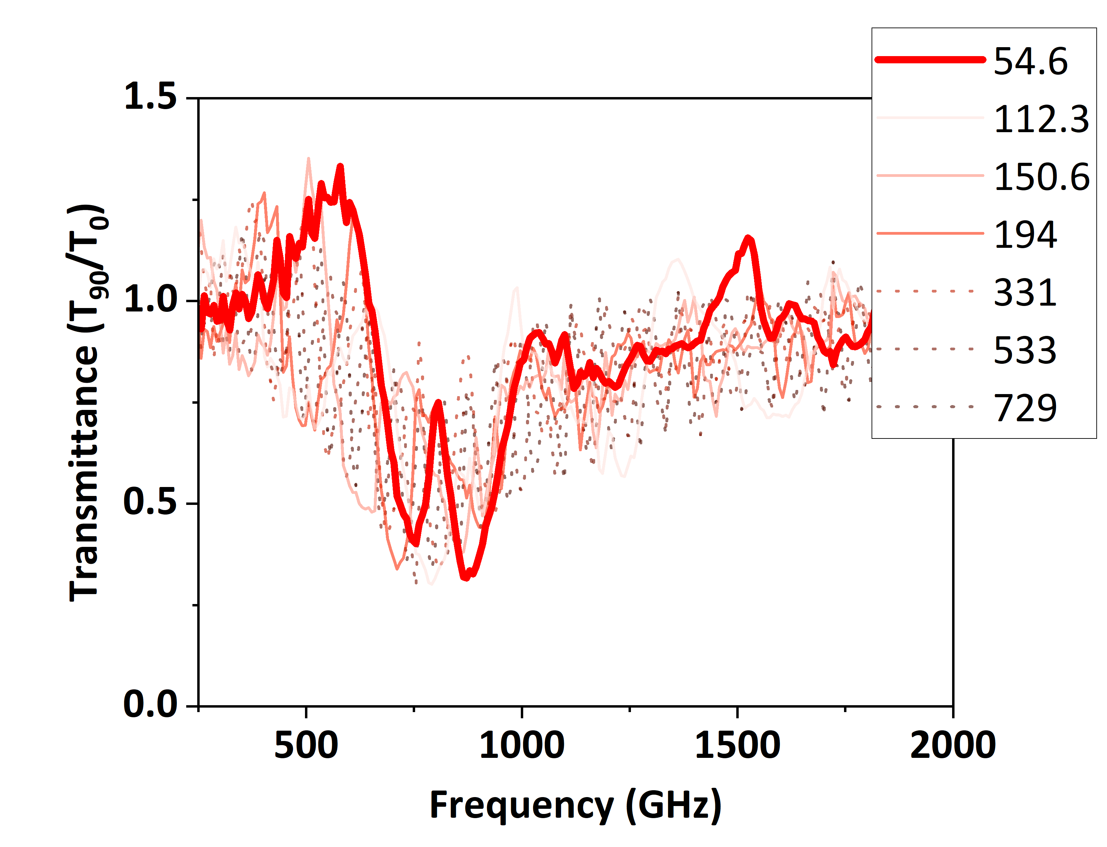
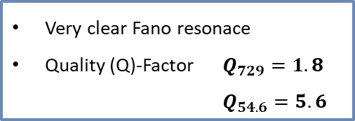
6.Coupling Bright-Dark mode: Fano resonance
331 µm
112.3 µm
150.6 µm
533 µm
54.6 µm
Very clear Fano resonace
Quality (Q)-Factor $Q_{729}=1.8$
$Q_{54.6}=5.6$
194 µm
Si
729 µm
Si

Slide 14
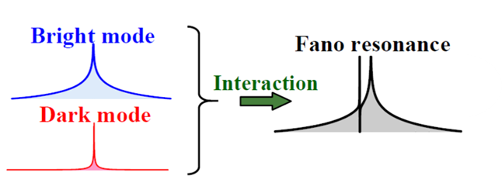
6.Coupling Bright-Dark mode: Fano resonance
Fanocoupling
729 µm
54.6 µm
Si
43.3,
55.3,
65.4 µm
Fanoresonace
Fano resonance
Fanocoupling effect
1. Bright mode: Plasmonic resonance in Ge antennas
2. Dark mode: Substrate resonance only possible due interaction with the bright mode
Plasmonic resonance
Substrate resonance
Mikhail F. Limonov, Advances in Optics and Photonics, https://doi.org/10.1364/AOP.420731

Slide 15
7.Conclusions
high n-doped Ge antennas=> Plasmonic resonance in THz light
decrease of substrate=> Fano coupling effect
Fanoresonance=> an improvement of the antenna quality factor (Q-factor) by Fano coupling of bright and dark modes

Slide 16
Elena, Hardt
249
681
hardt@ihp-microelectronics.com

Slide 17
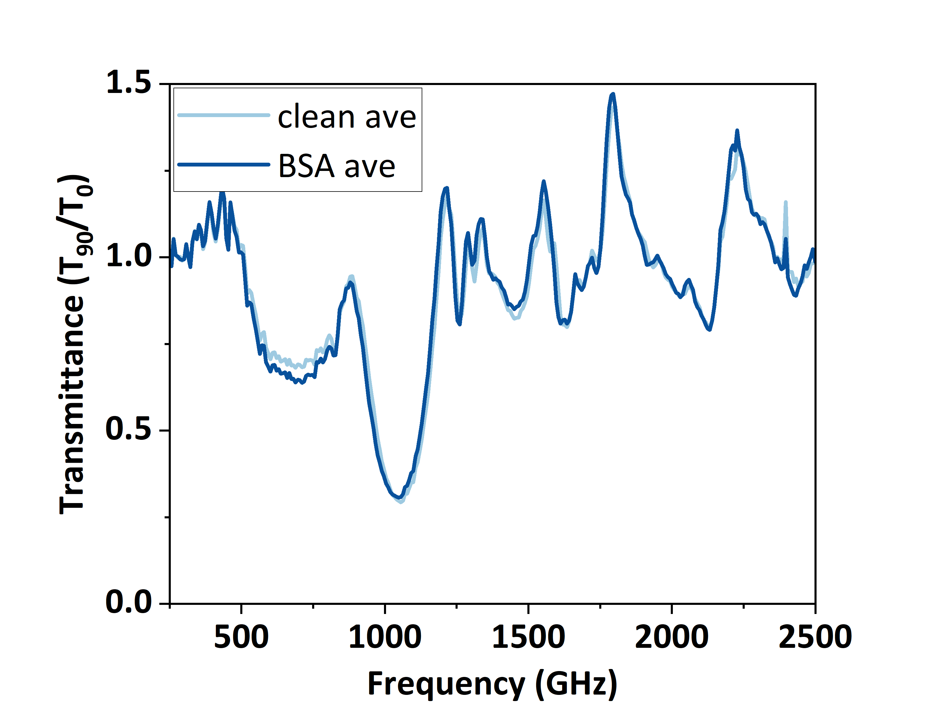
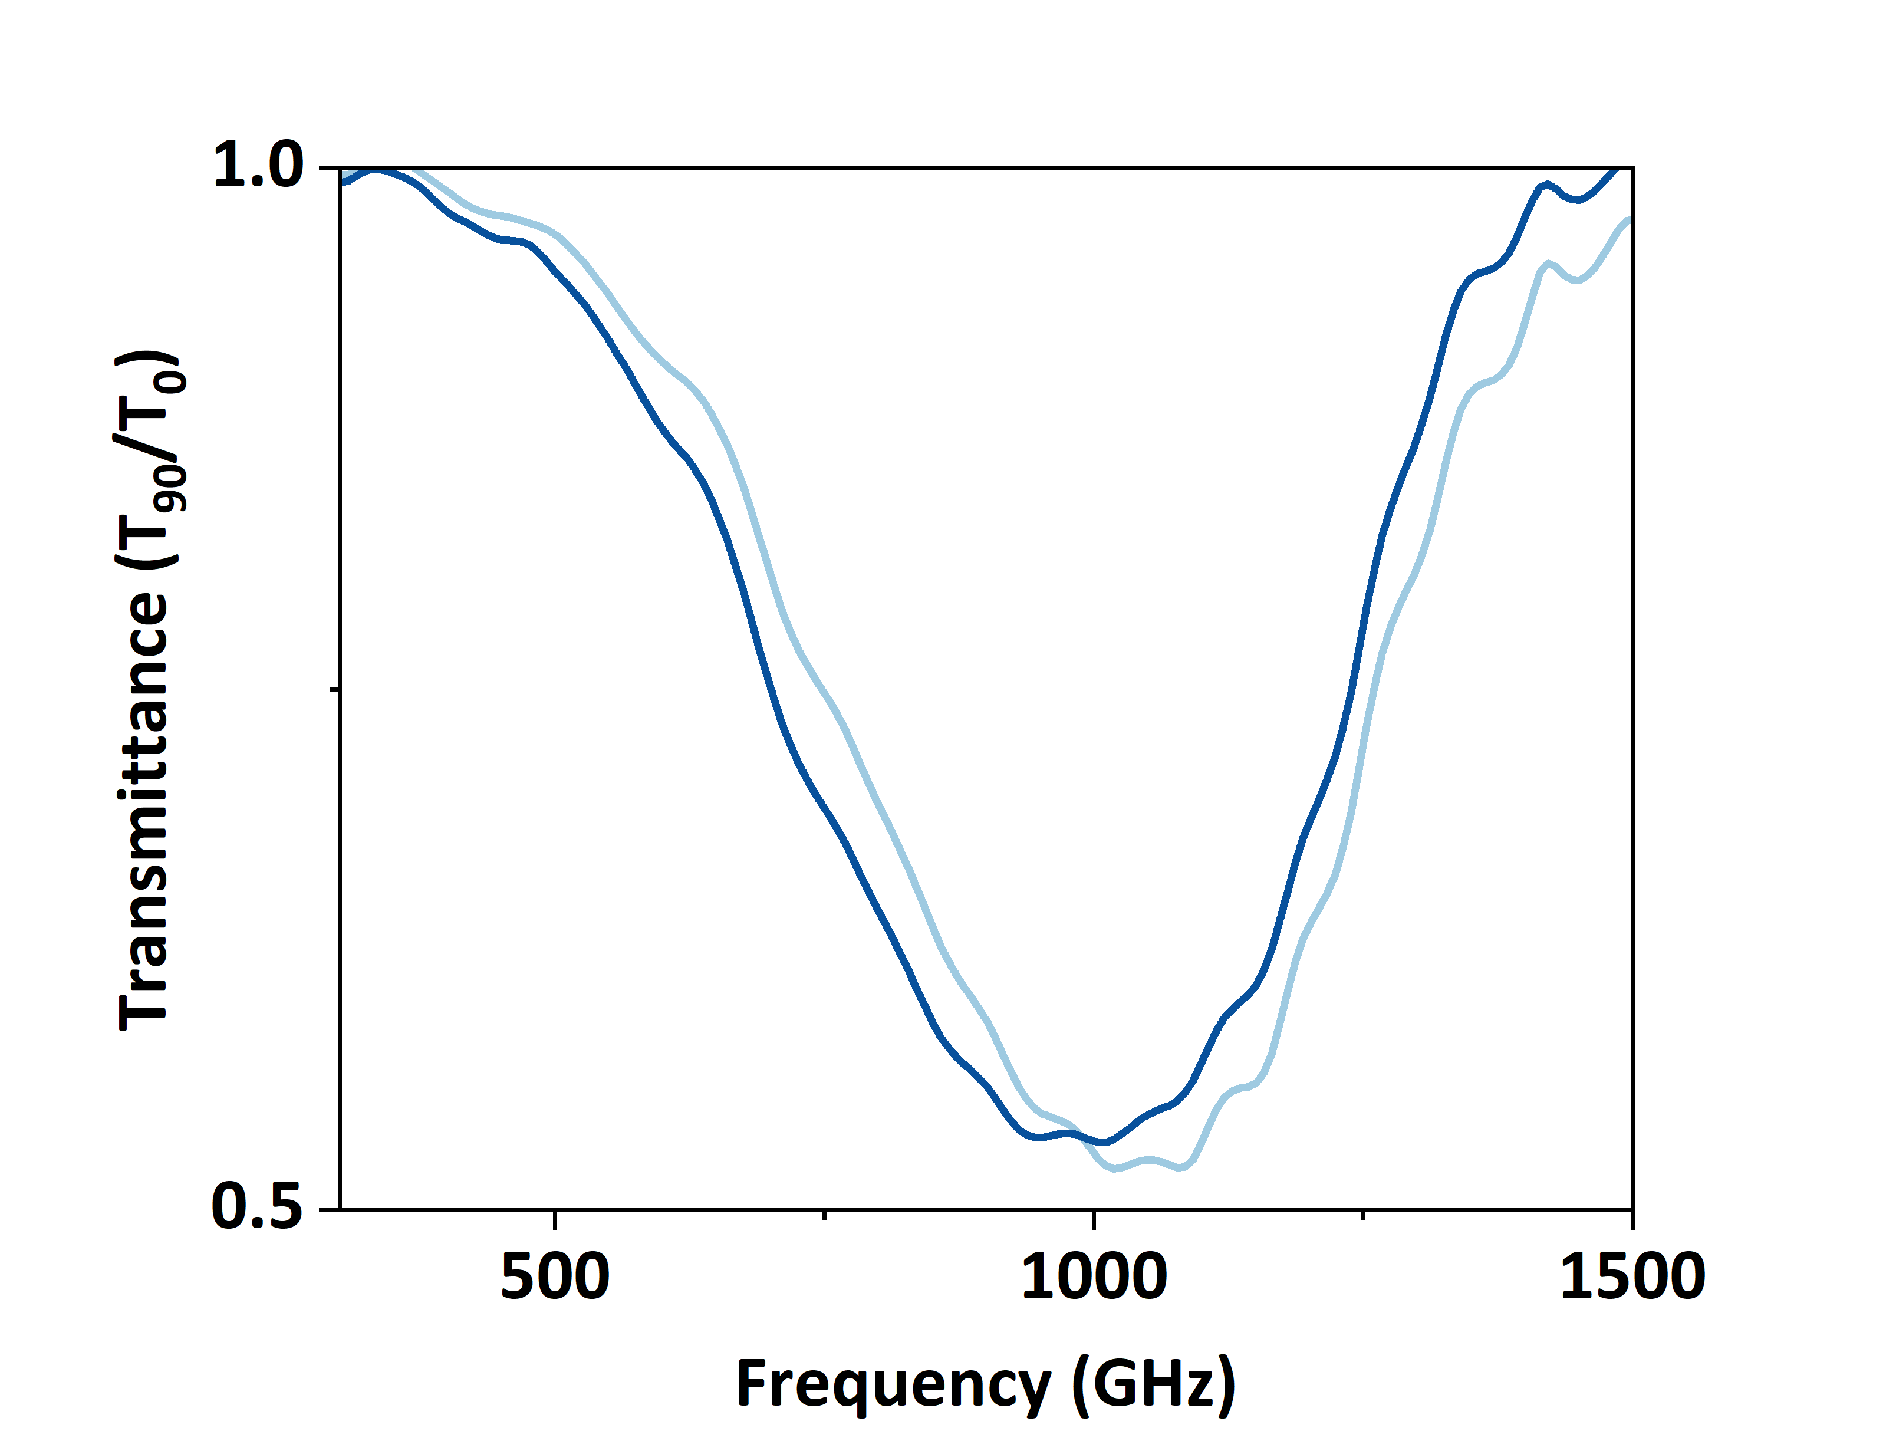
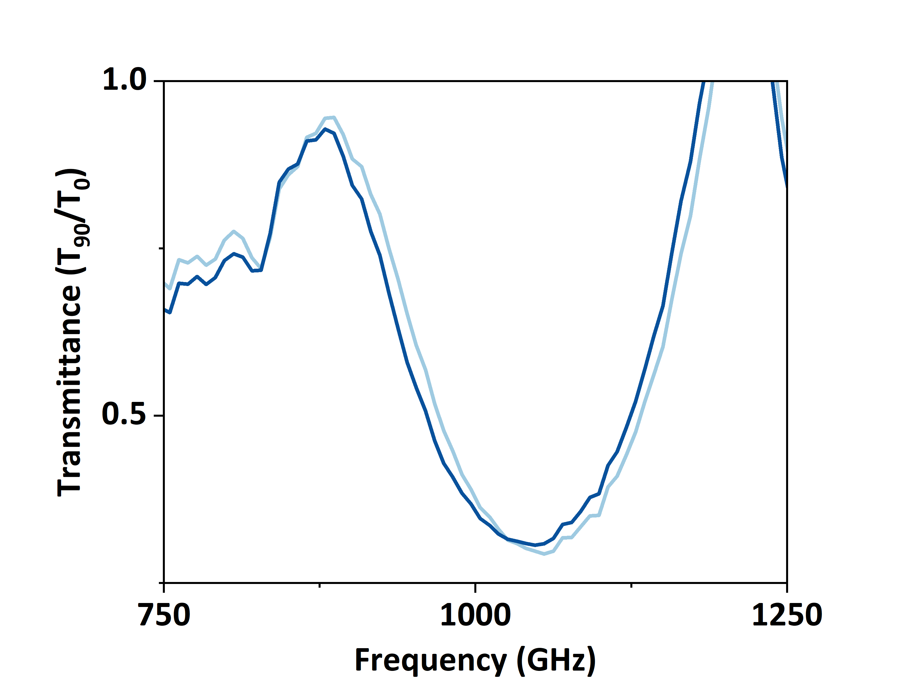
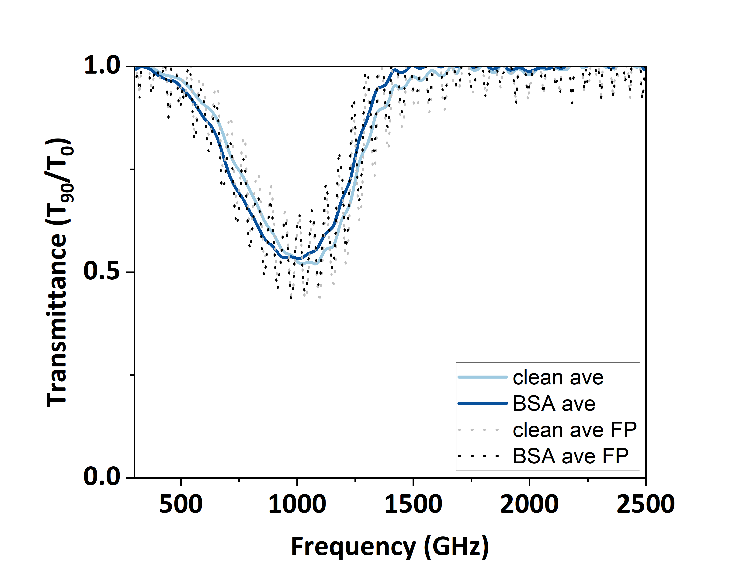
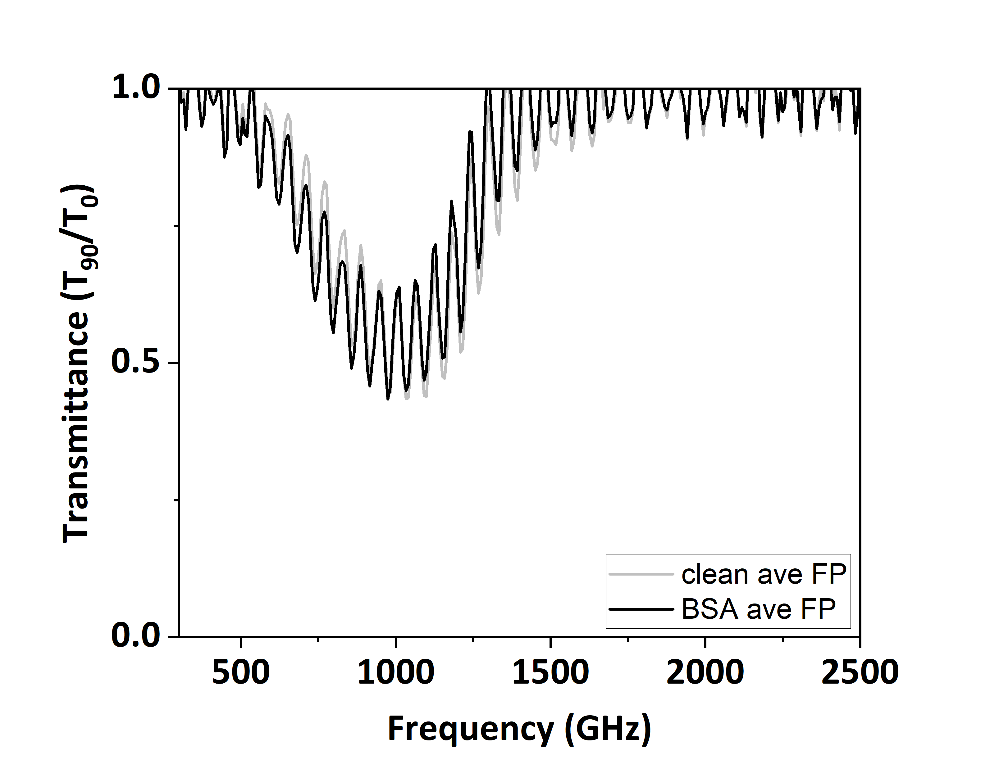
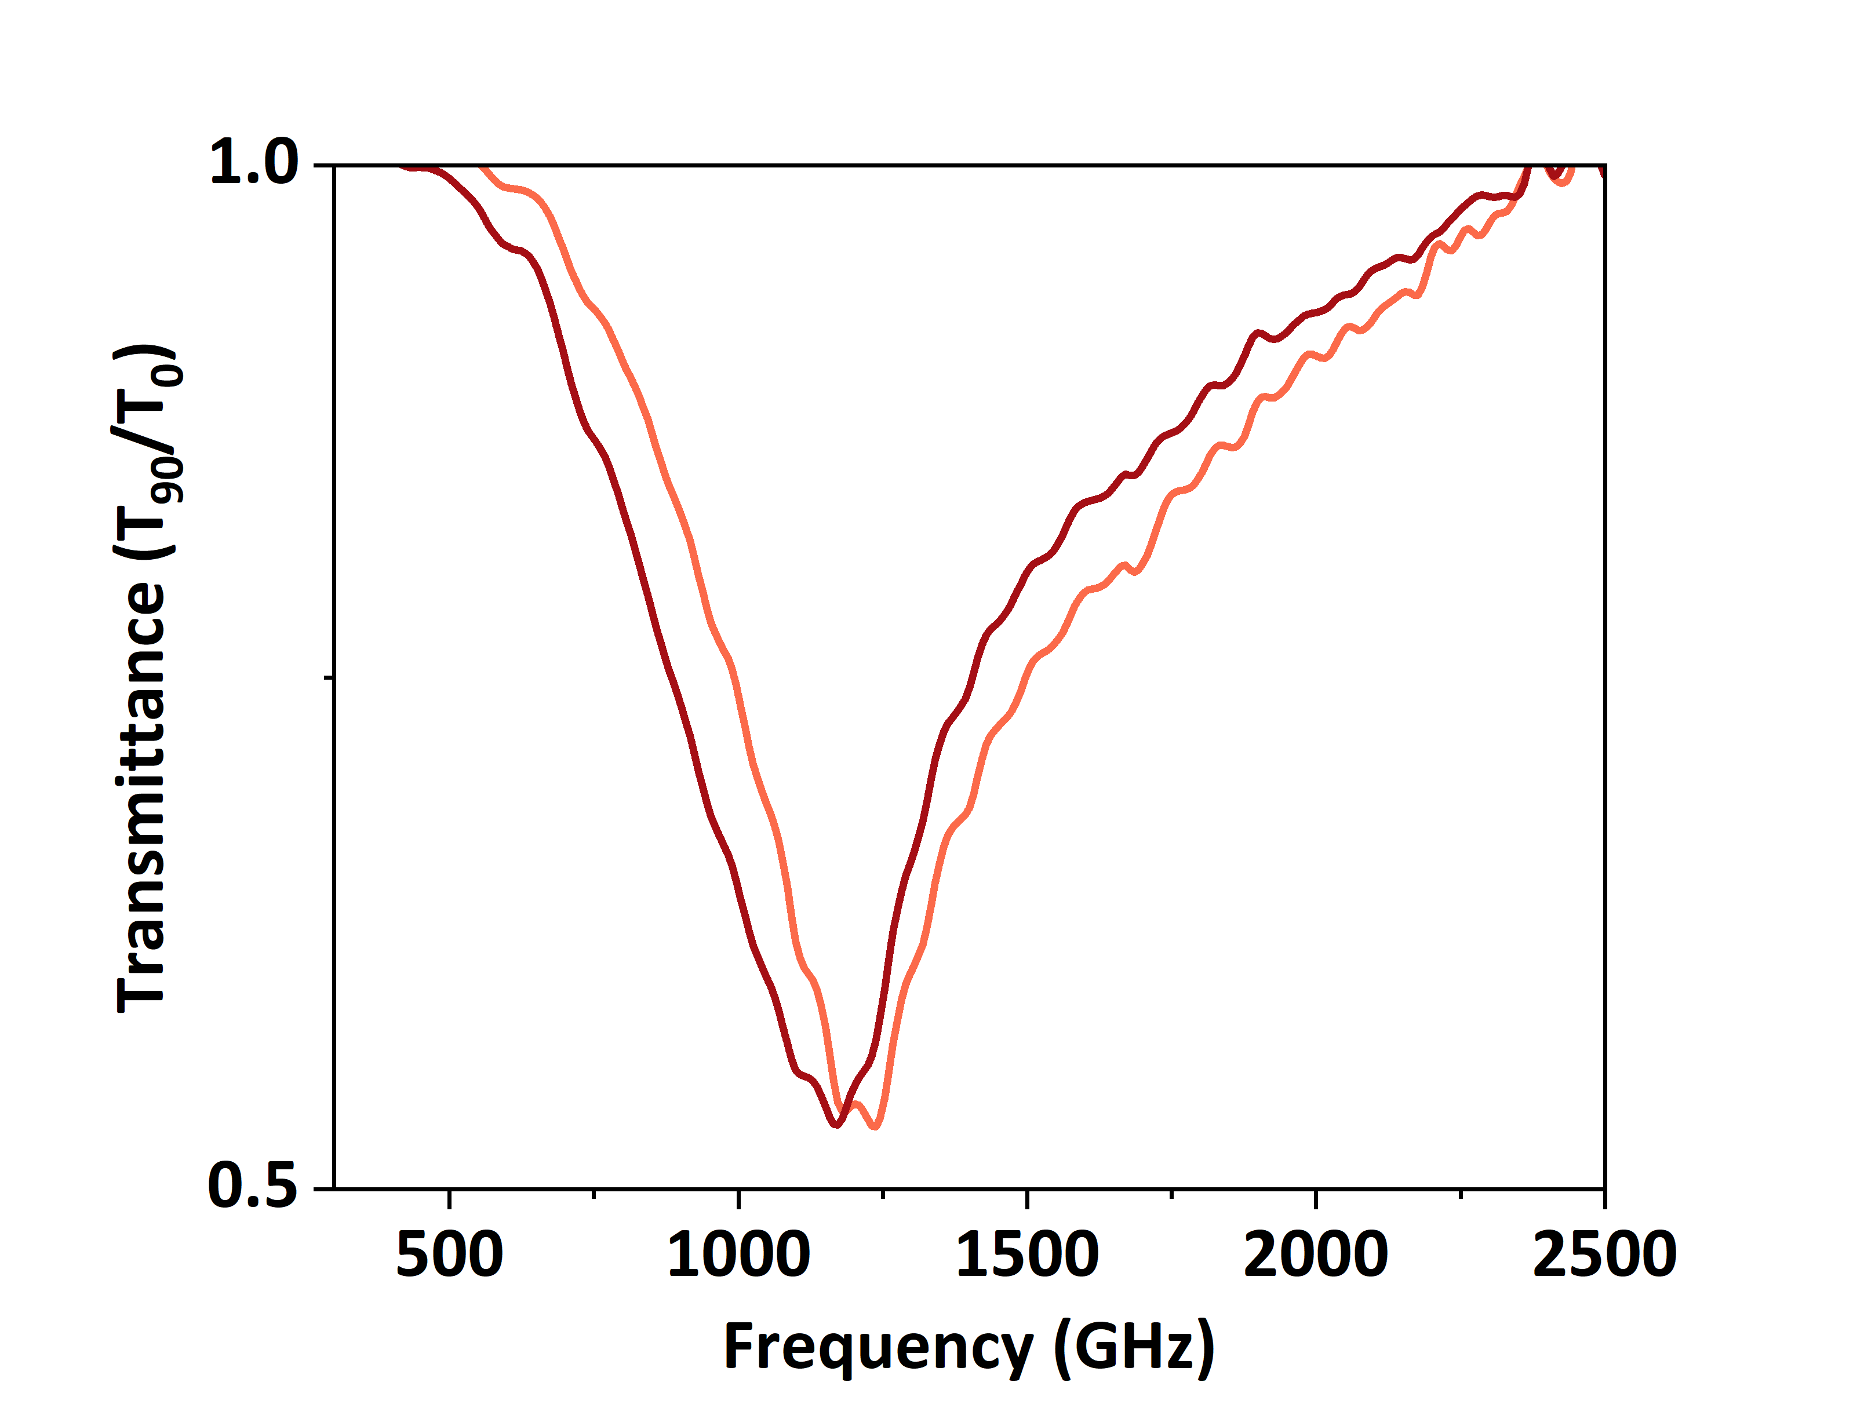








BSA detection c = 10mg/mL
Substrate thickness ~730 µm
Substrate thickness ~75 µm
air
BSA
Si substrate
$$Q_{Si}=1.6$$
$$−∆f=46 GHz$$
$$Q_{Si}=2.1$$
$$−∆f=10 GHz$$
+BSA
air
BSA
SOI substrate
The absorption coefficient(α):
$$Q_{SOI}=2$$
$$−∆f =88 GHz$$
$$Q_{SOI}=2.6$$
$$−∆f =27 GHz$$

Slide 18
Sample fabrication
Cleaning
Epitaxy Layer
high doped Ge
CVD
PE CVD
Exposure
Dry etching, removal of mask,
photoresist and silicon dioxide
PE CVD
Ge
1.5 µm
Si₃N₄
30 nm
SiO₂
210 nm
* Maske
Si₃N₄
30 nm
* Photoresist
Si substrate

