Slide 1
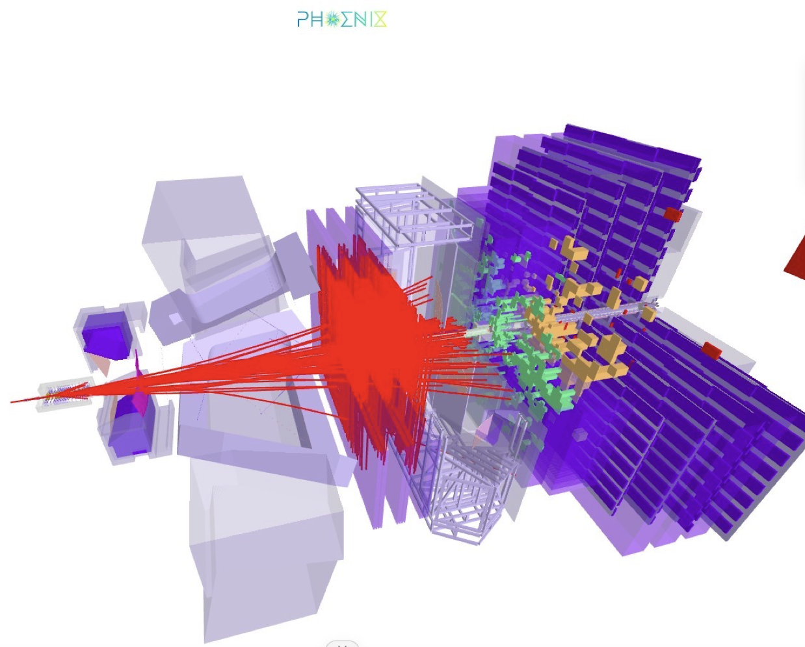
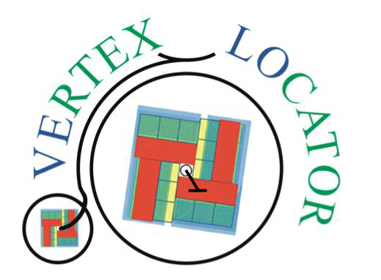
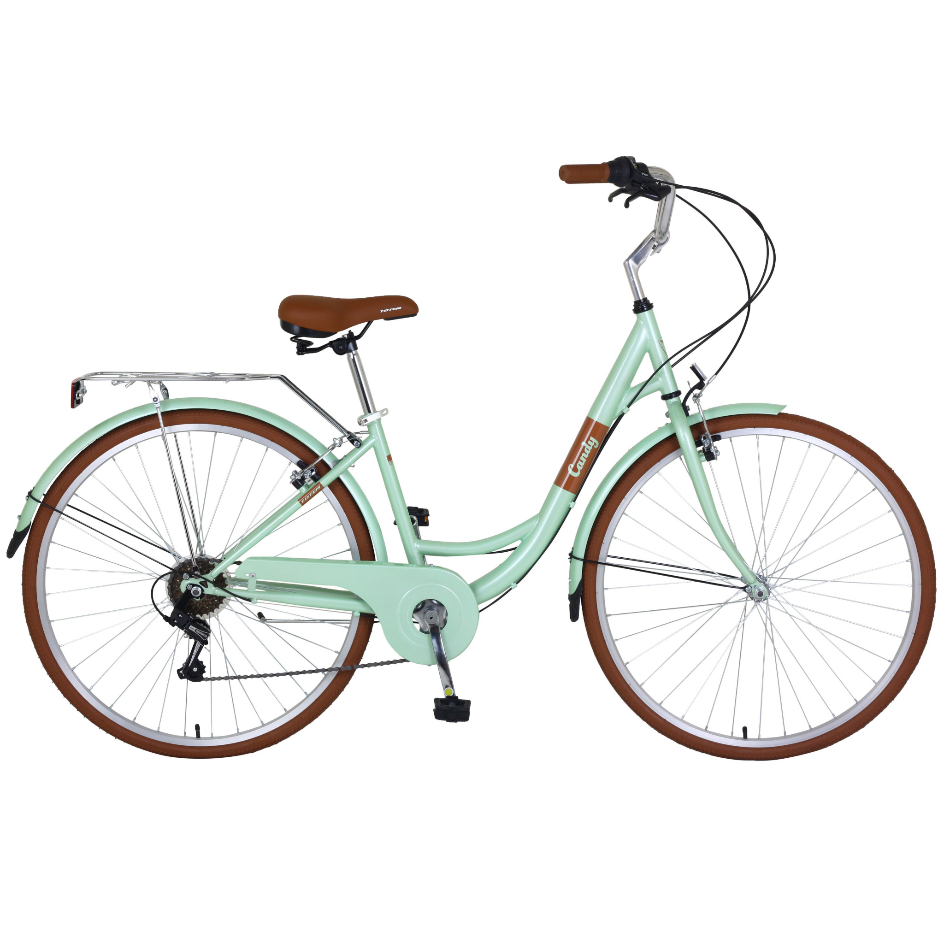
The VErtex LOcator
at the LHCb Experiment
German Conference of Women in Physics
Tamaki Holly McGrath
on behalf of the VELO Group at LHCb
27th Nov 2022

Slide 2
The Standard Model
The Standard Model is the model that currently best describes elementary particles and their interactions
So far has been very successful as it has passed many precision tests
Some big questions remain……
Why is there more matter than anti-matter?
What is dark matter?
Where do neutrinos get their mass from?
Notes:
Blinding strat:

Slide 3
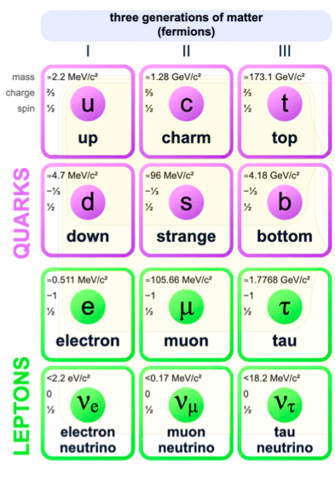
Flavour in the Standard Model
Difference in quarks and leptons referred to as “flavour”
Quarks combine to form hadrons
Flavour physics experiments such as LHCb aim to test the limits of the Standard Model through the analysis of “heavy” flavour hadron decays
Consist of b- and c-quarks
Probes the existence of undiscovered particles contributing to the decay by measuring deviations from SM predictions
Notes:
Quarks don’t exist on their own, form
Say: their decays depend on their quark content and their interaction with the forces
BSM ->

Slide 4
What is the LHCb Experiment?

Slide 5
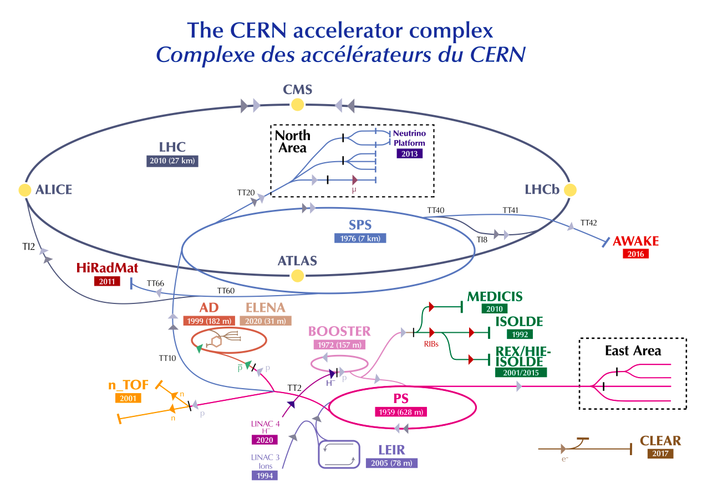
The Large Hadron Collider
Protons collided at the four main experiments on the LHC ring:
LHCb, ATLAS, CMS, ALICE
Since 2010, there have been 2 “Runs” of data taking
Run I at collision energies 7 and 8 TeV
Run II at 13 TeV
We have entered Run III this July with collision energies of an unprecedented 13.6 TeV!

Slide 6
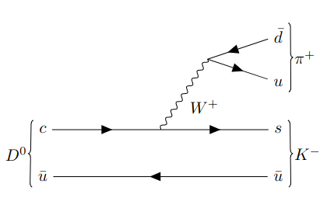
Studying Flavour Experimentally
Say we want to study the decay:
What information do we need?
Notes:
To be able to identify
Used for CP violation studies in charm decays (CPV is one of the sakharov conditions for why we mostly see matter in the universe)

Slide 7
Studying Flavour Experimentally
We need to know…
What particles are leaving tracks (pions? kaons? protons?)
Notes:
To be able to identify
Used for CP violation studies in charm decays (CPV is one of the sakharov conditions for why we mostly see matter in the universe)

Slide 8
Studying Flavour Experimentally
We need to know…
What particles are leaving tracks (pions? kaons? protons?)
The momentum and energy of the decay products to deduce which particle has produced them
Notes:
To be able to identify
Used for CP violation studies in charm decays (CPV is one of the sakharov conditions for why we mostly see matter in the universe)

Slide 9
Studying Flavour Experimentally
We need to know…
What particles are leaving tracks (pions? kaons? protons?)
The momentum and energy of the decay products to deduce which particle has produced them
The primary vertex (PV) position where the D⁰ is produced
Notes:
To be able to identify
Used for CP violation studies in charm decays (CPV is one of the sakharov conditions for why we mostly see matter in the universe)

Slide 10
Studying Flavour Experimentally
We need to know…
What particles are leaving tracks (pions? kaons? protons?)
The momentum and energy of the decay products to deduce which particle has produced them
The primary vertex (PV) position where the D⁰ is produced
The secondary vertex position where the D⁰ has decayed since heavy flavour hadrons typically travel a few cm
Notes:
To be able to identify
Used for CP violation studies in charm decays (CPV is one of the sakharov conditions for why we mostly see matter in the universe)

Slide 11
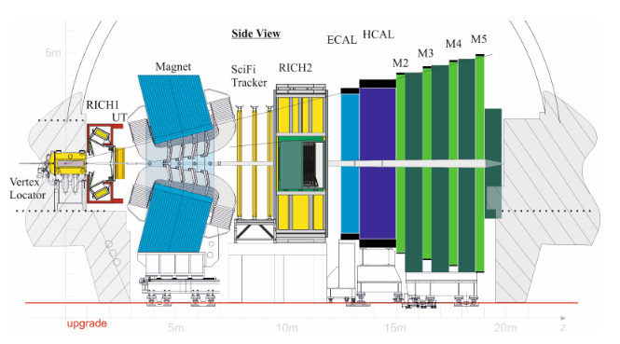
The LHCb Experiment
“Large Hadron Collider Beauty” experiment
Several features are specialised for studying b- and c- hadron decays:
Sub-detectors stacked in the forward region
Ring imaging Cherenkov detectors, calorimeters and muon detectors for particle ID
The trackers measure hits from charged particles before and after the magnet so that we know their trajectories and momenta
Notes:
Give a brief run down

Slide 12
The LHCb Experiment
“Large Hadron Collider Beauty” experiment
Several features are specialised for studying b- and c- hadron decays:
Sub-detectors stacked in the forward region
Ring imaging Cherenkov detectors, calorimeters and muon detectors for particle ID
The trackers measure hits from charged particles before and after the magnet so that we know their trajectories and momenta
Notes:
Give a brief run down

Slide 13
The LHCb Experiment
“Large Hadron Collider Beauty” experiment
Several features are specialised for studying b- and c- hadron decays:
Sub-detectors stacked in the forward region
Ring imaging Cherenkov detectors, calorimeters and muon detectors for particle ID
The trackers measure hits from charged particles before and after the magnet so that we know their trajectories and momenta
Notes:
Cherenkov detectors detect cherenkov radiation emitted in a cone when a charged particle travels faster than the spped of light in that medium -> angle depends on the velocity of the particle + momentum information

Slide 14
The LHCb Experiment
“Large Hadron Collider Beauty” experiment
Several features are specialised for studying b- and c- hadron decays:
Sub-detectors stacked in the forward region
Ring imaging Cherenkov detectors, calorimeters and muon detectors for particle ID
The trackers measure hits from charged particles before and after the magnet so that we know their trajectories and momenta
Notes:
Give a brief run down

Slide 15
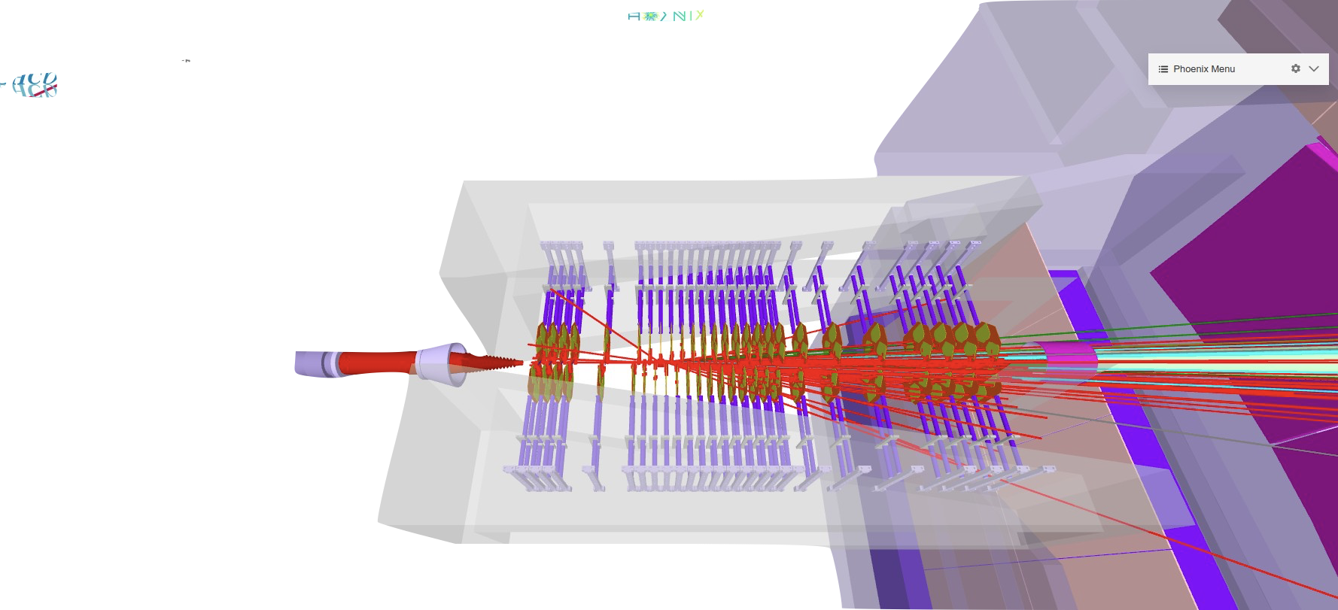
What is the VErtex LOcator?

Slide 16
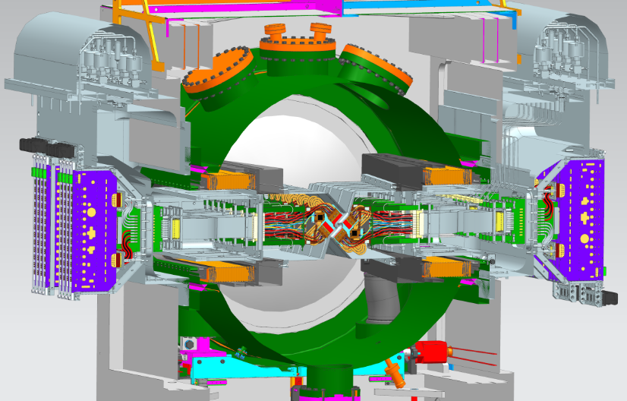
The VELO
Beam
The tracker closest to the interaction region where the protons collide
Tasked with crucial measurements such as the primary vertex, secondary vertex, and the closest distance between a track and the PV

Slide 17
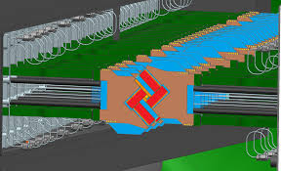
The VELO
NEW!
52 L-shaped modules arranged in pairs with 26 rows surrounding the beam
Silicon pixel detector developed for the upgrade for faster readout rate
Microchannel cooling system directly beneath the sensors with biphase CO₂ as coolant

Slide 18
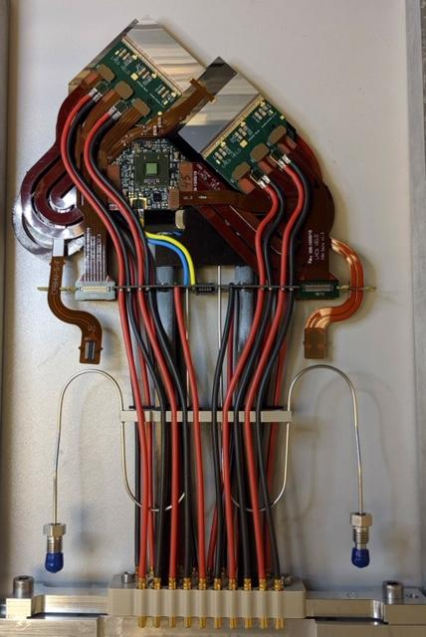
The VELO
NEW!
52 L-shaped modules arranged in pairs with 26 rows surrounding the beam
Silicon pixel detector developed for the upgrade for faster readout rate
Microchannel cooling system directly beneath the sensors with biphase CO₂ as coolant

Slide 19
The VELO
NEW!
52 L-shaped modules arranged in pairs with 26 rows surrounding the beam
Silicon pixel detector developed for the upgrade for faster readout rate
Microchannel cooling system directly beneath the sensors with biphase CO₂ as coolant
Notes:
Directly underneath sensors in substrate

Slide 20
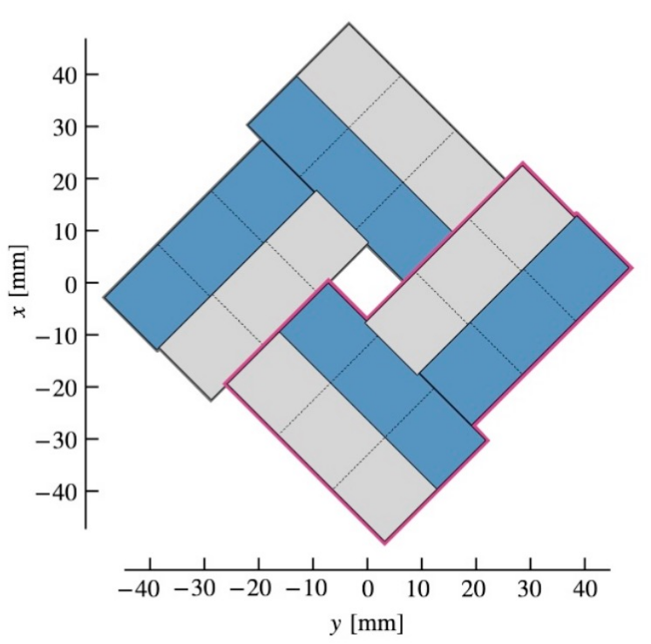
Geometry
C side
Chip
Sensor
Module
1 m
A side

Slide 21
How the VELO Tracks Charged Particles

Slide 22
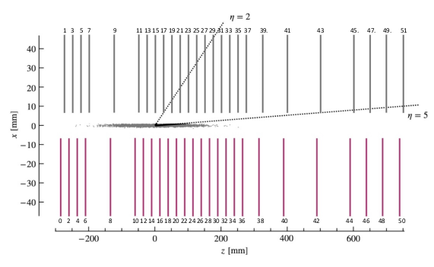
How the VELO Tracks Charged Particles
?
Notes:
simplified

Slide 23
How the VELO Tracks Charged Particles
?
Clusters: a collection of pixels registering a hit in the sensor from a traversing particle
Notes:
simplified

Slide 24
How the VELO Tracks Charged Particles
?
Clusters: a collection of pixels registering a hit in the sensor from a traversing particle
Tracks: trajectory of particles reconstructed from clusters in at least 3 sensors
Notes:
simplified

Slide 25
How the VELO Tracks Charged Particles
?
Clusters: a collection of pixels registering a hit in the sensor from a traversing particle
Tracks: trajectory of particles reconstructed from clusters in at least 3 sensors
Vertices: position calculated from groups of tracks suspected to be from the same decay
Notes:
PV position calculated from the sets of tracks in the event
Measurement of the impact parameter lets us know whether a vertex is a secondary vertex
Secondary vertex determined from the track coordinates and the PV position

Slide 26
Looking Towards Run III

Slide 27
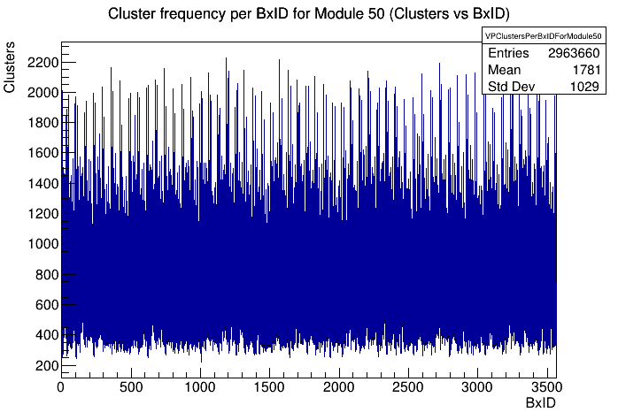
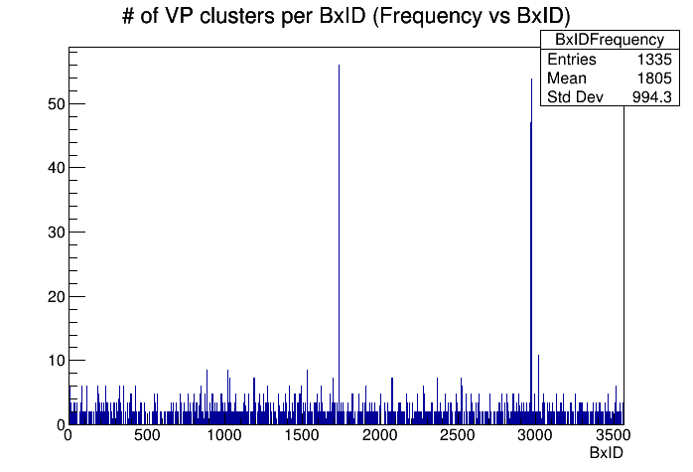
First Look
VELO fully installed in May 2022 and now in the commissioning stage!
First glimpse of data!
LHCb Unofficial

Slide 28
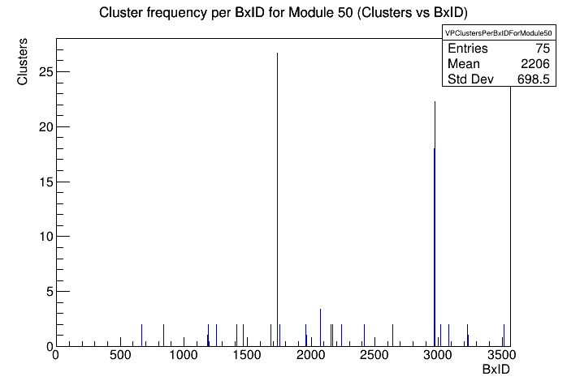
First Look
VELO fully installed in May 2022 and now in the commissioning stage!
Then we cleaned it up a bit…
LHCb Unofficial

Slide 29
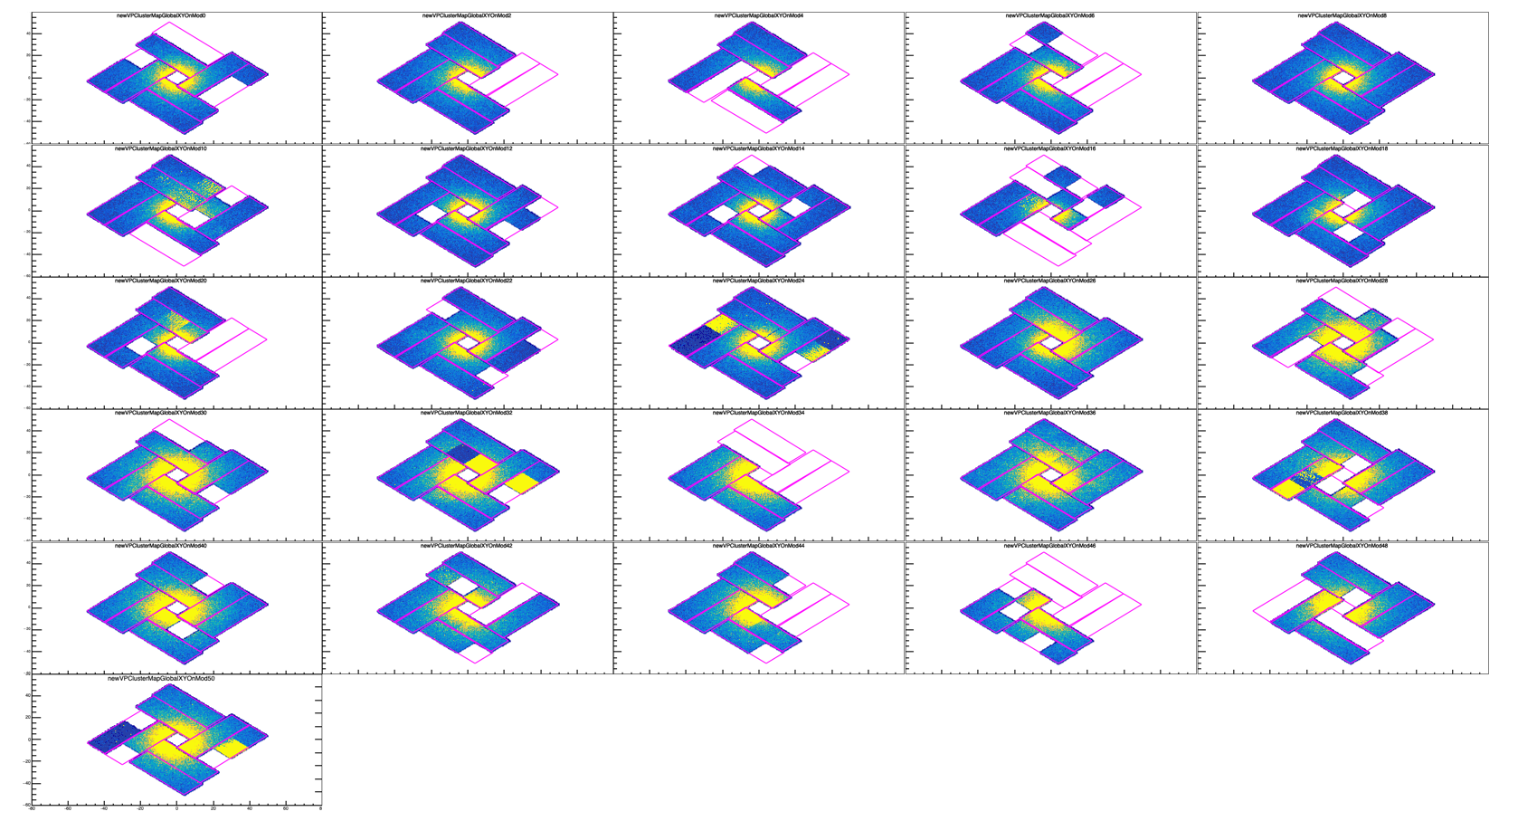
Monitoring for Commissioning
Data quality checks
At some point in the Velo’s life…
LHCb VELO unofficial
Clusters
Vertices

Slide 30
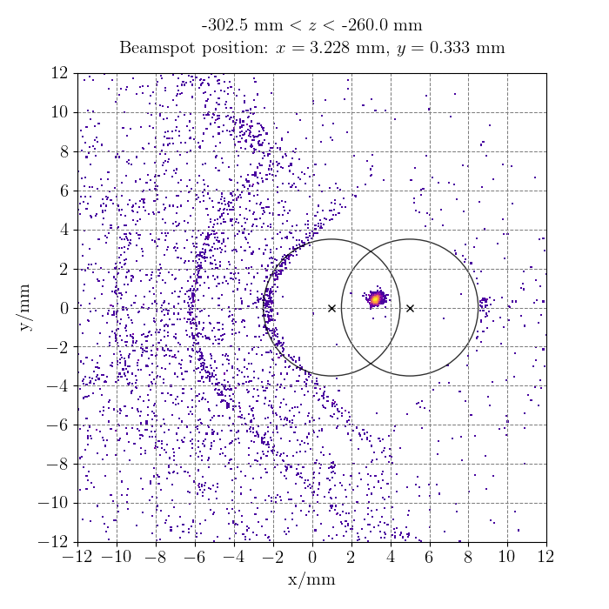
Monitoring for Commissioning
Data quality checks
Vertices

Slide 31
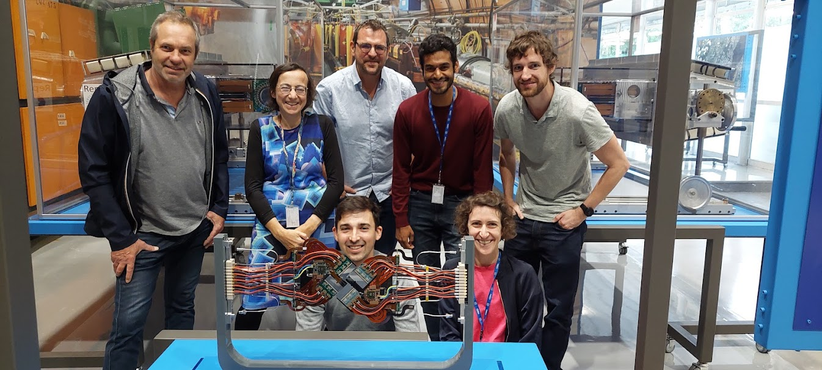
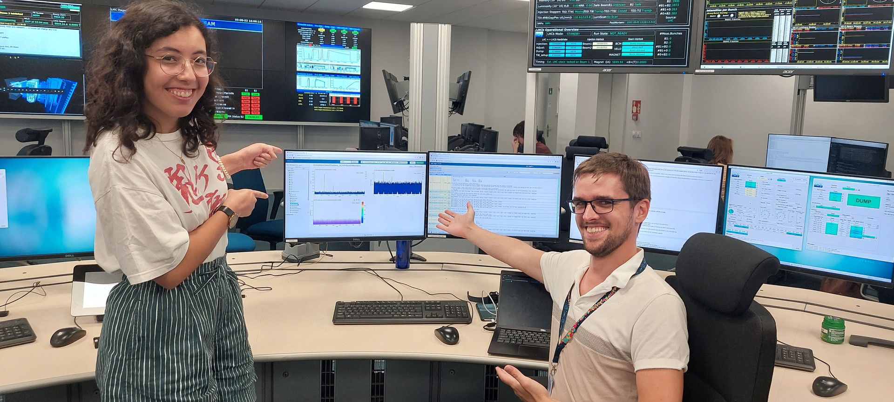
Summary
The Vertex Locator is a crucial sub-detector for the physics program of the LHCb detector
The detector is currently in its commissioning phase with monitoring a big part of this
The VELO project is a huge team effort and is the result of hard work from people from various institutions around the world

Slide 32
Thank You!

Slide 33
Monitoring for Commissioning
Calibration

