Slide 1
Nonleptonic B decays
Hai-Yang Cheng
Academia Sinica, Taipei
Status & Prospects of Nonleptonic B Meson Decays
Siegen, Germany
June 1, 2022

Slide 2
Resonant B → 3P decays proceed through scalar (S), vector (V) and tensor (T) resonances
Outline:
Quasi-2-body decays B → S + P & B → T + P in QCDF
Resonant 3-body B decays
Finite width effects
CP violation in 3-body B decays

Slide 3
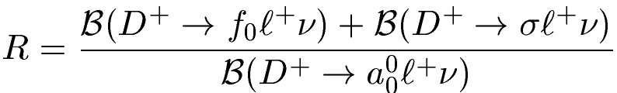
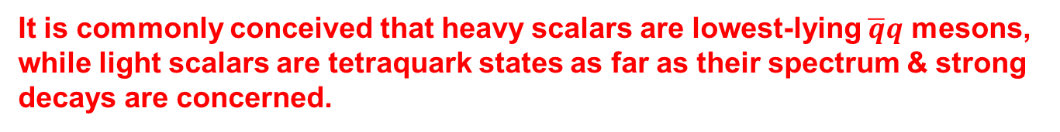
B→ S (P,V)
HYC, Chua, Yang (2006)
Scalar mesons (J^{PC}= 0⁺⁺): two nonets observed
light nonet (< 1 GeV): σ/f₀ (500), f₀(980), κ/K*₀ (700), a₀(980),
heavy nonet (> 1 GeV): f₀(1370), f₀(1500), f₀(1710), K*₀(1430), a₀(1450)
It is commonly conceived that heavy scalars are lowest-lying $\overline{q}q$ mesons, while light scalars are tetraquark states as far as their spectrum & strong decays are concerned.
Will the energetic light scalar meson such as f₀(980) produced in B decays be dominated by 4-quark configuration?
In charm sector
Wang, Lu (’10)
R=1.0±0.3 in $q\overline{q}$ scheme and 3.0±0.9 in tetraquark scenario under SU(3)
BESIII ⇒ R > 2.7 at 90% c.l. ⇒ light scalar produced in charm decays has adequate time to form a tetraquark state.

Slide 4
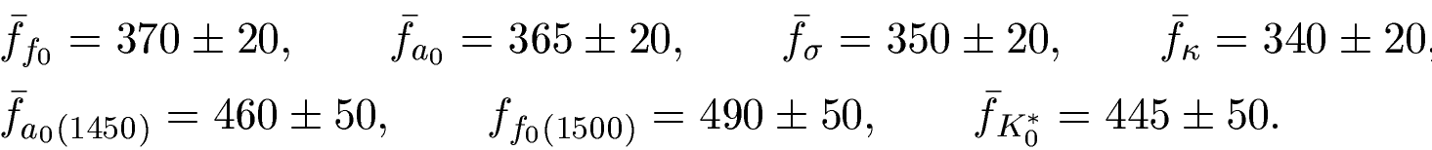


For neutral $σ, { f}_{0}, a_{0}^{0}, f_{S}=0$ due to C invariance
At μ= 1 GeV,
HYC, Chua, Yang (’06)
Typical scalar decay constant ${\overline{f}}_{S}$ is above 300 MeV!
${\overline{f}}_{\overline{S}}={\overline{f}}_{S}$, $f_{\overline{S}}={−f}_{S}$
LCDAs
$$Φ_{S}={\overline{f}}_{S}\left(μ\right)6x\left(1−x\right)[B_{0}\left(μ\right)+∑{ B}_{m}\left(μ\right)C_{m}^{3/2}\left(μ\right)\left(2x−1\right)]$$
For neutral scalars f₀, a₀⁰, σ, B₀=0 and only odd C’s contribute
⇒ $Φ_{S}\left(x\right)=−Φ_{S}(1−x)$
In general, B₀(μ)=[m₁(μ)-m₂(μ)]/m_{S} ⇒ B₀ is either zero or small, contrary to pseudoscalar case where B₀=1.
4

Slide 5
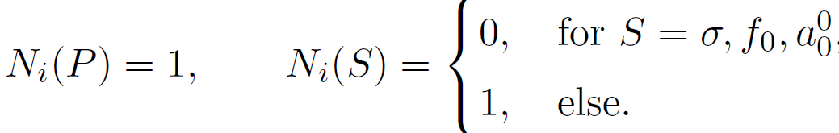
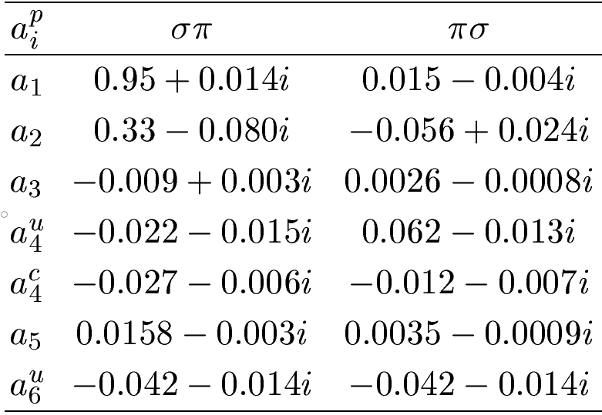
Flavor operators:
$M_{2}$ emitted meson, $M_{1}$ shares same spectator quark with B
In naïve factorization, $B^{−}→σπ^{− }$receives factorizable color-allowed π emission, but not color-suppressed σ emission ⇒ $a_{2}\left(πσ\right)=0$
In general, $a_{i}\left(SP\right)≠a_{i}(PS)$ especially for $a_{1} and a_{2}$

Slide 6



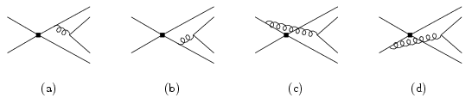
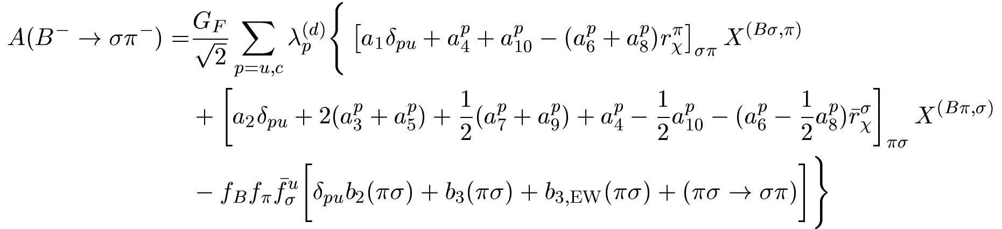

Apply QCD factorization to B →SP
HYC, Chua, Yang (’06)
vertex & penguin
spectator int.
annihilation
In naïve factorization, $B^{−}→σπ^{− }$receives color-allowed π emission but not color-suppressed σ emission

Slide 7
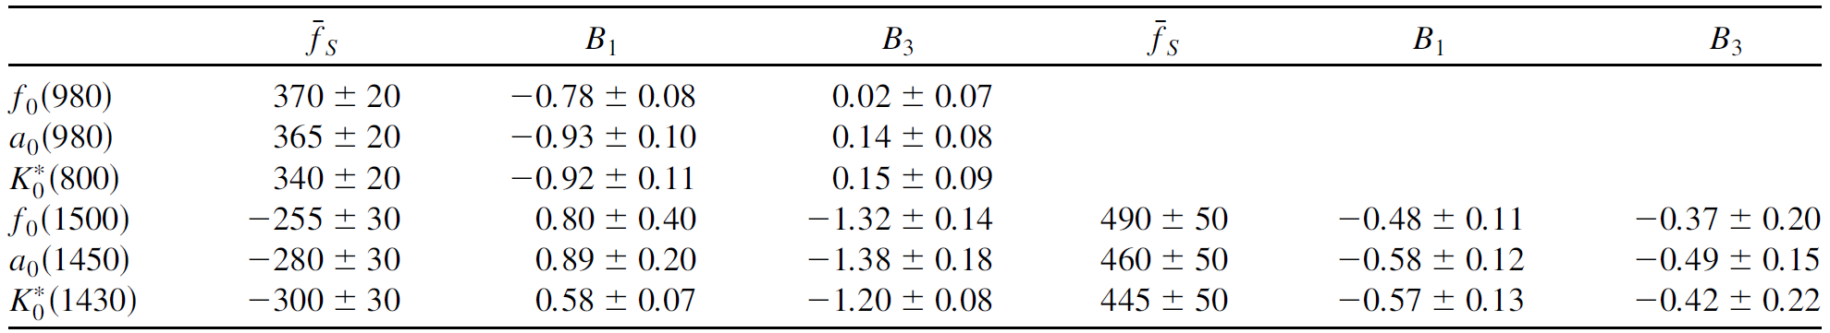
In practice, it is difficult to make quantitative predictions on $B→SP$ based on tetraquark picture for light scalars.
We consider two scenarios for treating a₀(1450) & K*₀(1450) in sum rules:
Scenario 1: κ, a₀(980), f₀(980) lowest lying qq states,
K*₀(1430), a₀(1450), f₀(1500) first radially excited states
⇒ 2-quark states for all scalars
Scenario 2: K*₀(1430), a₀(1450), f₀(1500) lowest lying qq states
first excited states lie between 2.0 ∼ 2.3 GeV
⇒ 4-quark states for light scalars & 2-quark ones for others
Scenario 1
Scenario 2

Slide 8
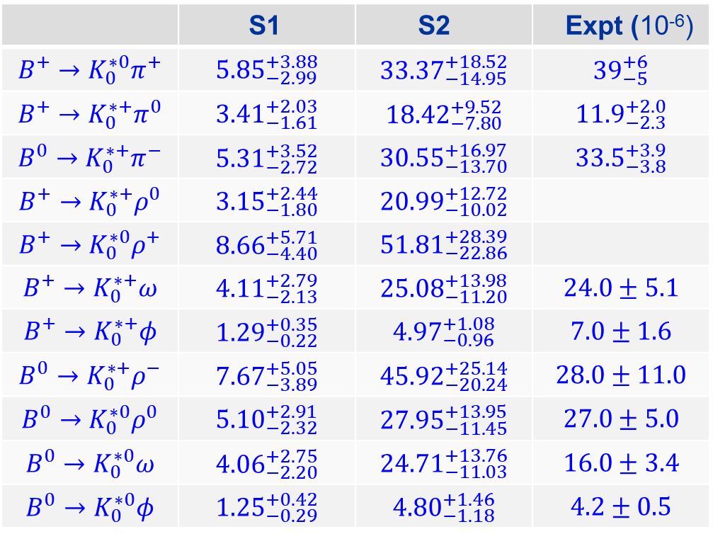
B→ K₀*(1430)(π , ρ, ω, φ) in QCDF
 | S1 | S2 | Expt (10⁻⁶)
$$B^{+}→K_{0}^{∗0}π^{+}$$ | $${5.85}_{−2.99}^{+3.88}$$ | $${33.37}_{−14.95}^{+18.52}$$ | $${39}_{−5}^{+6}$$
$$B^{+}→K_{0}^{∗+}π^{0}$$ | $${3.41}_{−1.61}^{+2.03}$$ | $${18.42}_{−7.80}^{+9.52}$$ | $${11.9}_{−2.3}^{+2.0}$$
$$B^{0}→K_{0}^{∗+}π^{−}$$ | $${5.31}_{−2.72}^{+3.52}$$ | $${30.55}_{−13.70}^{+16.97}$$ | $${33.5}_{−3.8}^{+3.9}$$
$$B^{+}→K_{0}^{∗+}ρ^{0}$$ | $${3.15}_{−1.80}^{+2.44}$$ | $${20.99}_{−10.02}^{+12.72}$$
$$B^{+}→K_{0}^{∗0}ρ^{+}$$ | $${8.66}_{−4.40}^{+5.71}$$ | $${51.81}_{−22.86}^{+28.39}$$
$$B^{+}→K_{0}^{∗+}ω$$ | $${4.11}_{−2.13}^{+2.79}$$ | $${25.08}_{−11.20}^{+13.98}$$ | $$24.0±5.1$$
$$B^{+}→K_{0}^{∗+}φ$$ | $${1.29}_{−0.22}^{+0.35}$$ | $${4.97}_{−0.96}^{+1.08}$$ | $$7.0±1.6$$
$$B^{0}→K_{0}^{∗+}ρ^{−}$$ | $${7.67}_{−3.89}^{+5.05}$$ | $${45.92}_{−20.24}^{+25.14}$$ | $$28.0±11.0$$
$$B^{0}→K_{0}^{∗0}ρ^{0}$$ | $${5.10}_{−2.32}^{+2.91}$$ | $${27.95}_{−11.45}^{+13.95}$$ | $$27.0±5.0$$
$$B^{0}→K_{0}^{∗0}ω$$ | $${4.06}_{−2.20}^{+2.75}$$ | $${24.71}_{−11.03}^{+13.76}$$ | $$16.0±3.4$$
$$B^{0}→K_{0}^{∗0}φ$$ | $${1.25}_{−0.29}^{+0.42}$$ | $${4.80}_{−1.18}^{+1.46}$$ | $$4.2±0.5$$
Chang, Chen, Zhao, Zhang (’22)
Scenario 1 for K₀*(1430) is ruled out
⇒ K₀*(1430) is a lowest lying qq state
⇒ light scalars are most likely 4-quark states

Slide 9
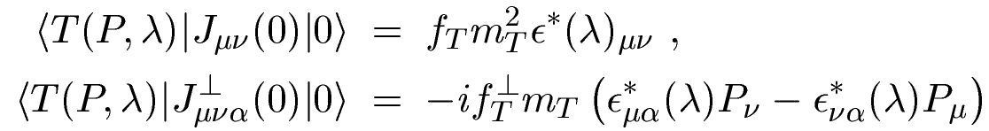
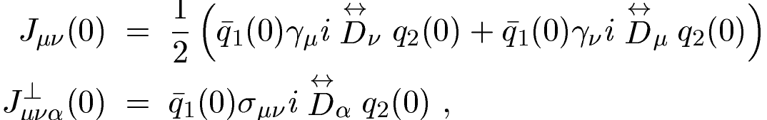
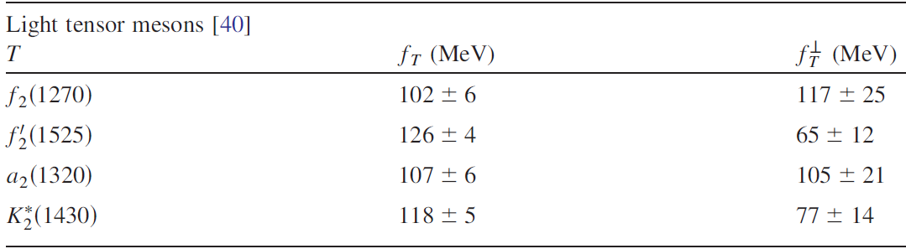
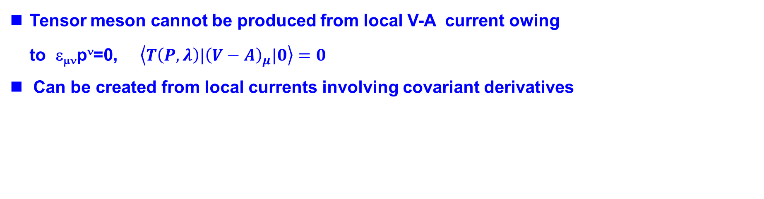
B→ T (P,V)
J^{P}=2⁺ tensor mesons: f₂(1270), f’₂(1525), K₂*(1430), a₂(1320)
Tensor meson cannot be produced from local V-A current owing to ε_{μν}p^{ν}=0, $\left\langle T\left(P,λ\right)|{\left(V−A\right)}_{μ}|0\right\rangle =0$
Can be created from local currents involving covariant derivatives
with
HYC, Koike, Yang (’10)

Slide 10
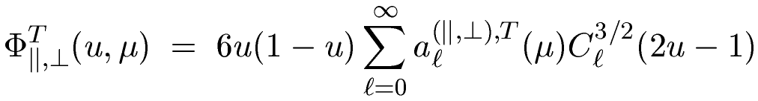

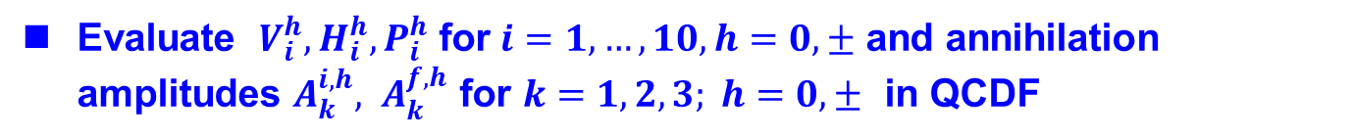
Study of B → TP, TV in QCDF
HYC, Yang (’11)
LCDAs: twist-2: Φ∥,Φ⊥, twist-3: g_{v}, g_{a}, h_{t}, h_{s,} twist-4: g₃, h₃
HYC, Koike, Yang (’10)
Due to even G-parity, these LCDAs are anti-symmetric under the replacement u→1-u in SU(3) limit
Twist-3 LCDAs g_{v}, g_{a}, h_{t}, h_{s} are related to twist-2 ones by Wandzura-Wilczek relations
Need to know longitudinal & transverse helicity projection operators for tensor mesons
Evaluate $V_{i}^{h}, H_{i}^{h}, P_{i}^{h}$ for$i=1,…,10, h=0,±$ and annihilation amplitudes $A_{k}^{i,h}, A_{k}^{f,h}$ for $k=1,2,3; h=0, ±$ in QCDF

Slide 11
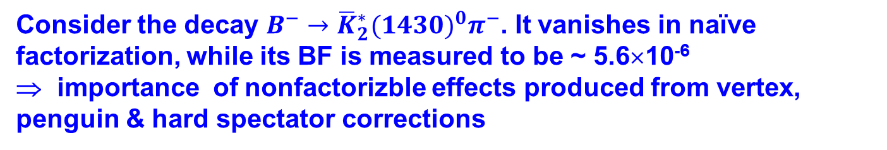
Consider the decay $B^{−}→{\overline{K}}_{2}^{∗}{(1430)}^{0}π^{−}$. It vanishes in naïve factorization, while its BF is measured to be ~ 5.6×10⁻⁶
⇒ importance of nonfactorizble effects produced from vertex, penguin & hard spectator corrections
$$A∝\left(δ_{pu}β_{2}+α_{4}^{ }−\frac{α_{4,EW}}{2}+β_{3}+β_{3,EW}\right)X^{(Bπ,K_{2}^{∗})}$$
$$X^{(BP,T)}=\sqrt{6 }f_{T}\frac{m_{T}^{2}}{m_{B}p_{c}}F_{1}^{BP}\left(m_{T}^{2}\right)ε^{∗μν}\left(0\right) {(p_{B})}_{μ}{(p_{B})}_{ν}$$
$$X^{(BT,P)}=2 f_{P}\frac{m_{T}}{m_{B}}A_{0}^{BT}\left(m_{P}^{2}\right)ε^{∗μν}\left(0\right) {(p_{B})}_{μ}{(p_{B})}_{ν}$$
In B rest frame
$$X^{(BP,T)}=2f_{T}m_{B}p_{c}F_{1}^{BP}\left(m_{T}^{2}\right)$$
$$X^{(BT,P)}=2 \sqrt{2/3}f_{P}\frac{m_{B}}{m_{T}}{p_{c}^{2}A}_{0}^{BT}\left(m_{P}^{2}\right)$$

Slide 12
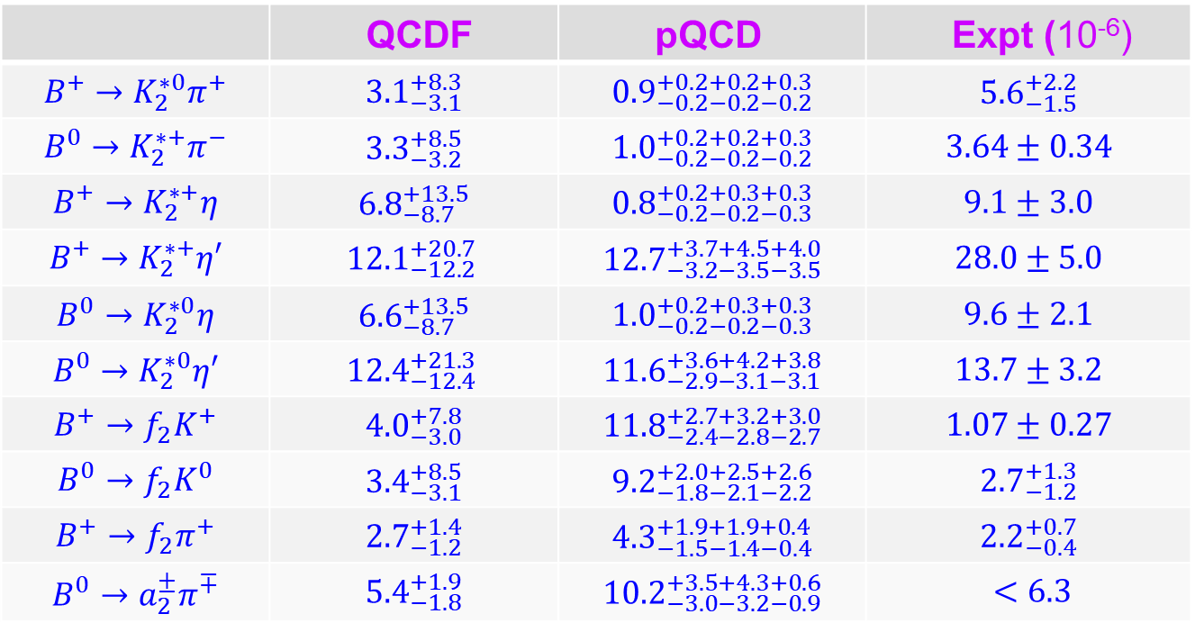
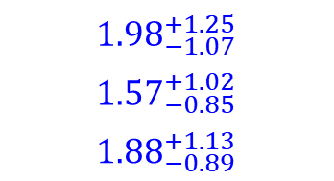
QCDF: HYC, Yang (’11)
pQCD: Zou, Yu, Lu (’12).
pQCD: Li, Ma, Rui, Wang, Xiao (’18)
 | QCDF | pQCD | Expt (10⁻⁶)
$$B^{+}→K_{2}^{∗0}π^{+}$$ | $${3.1}_{−3.1}^{+8.3}$$ | $${0.9}_{−0.2−0.2−0.2}^{+0.2+0.2+0.3}$$ | $${5.6}_{−1.5}^{+2.2}$$
$$B^{0}→K_{2}^{∗+}π^{−}$$ | $${3.3}_{−3.2}^{+8.5}$$ | $${1.0}_{−0.2−0.2−0.2}^{+0.2+0.2+0.3}$$ | $$3.64±0.34$$
$$B^{+}→K_{2}^{∗+}η$$ | $${6.8}_{−8.7 }^{+13.5}$$ | $${0.8}_{−0.2−0.2−0.3}^{+0.2+0.3+0.3}$$ | $$9.1±3.0$$
$$B^{+}→K_{2}^{∗+}η′$$ | $${12.1}_{−12.2 }^{+20.7}$$ | $${12.7}_{−3.2−3.5−3.5}^{+3.7+4.5+4.0}$$ | $$28.0±5.0$$
$$B^{0}→K_{2}^{∗0}η$$ | $${6.6}_{−8.7 }^{+13.5}$$ | $${1.0}_{−0.2−0.2−0.3}^{+0.2+0.3+0.3}$$ | $$9.6±2.1$$
$$B^{0}→K_{2}^{∗0}η′$$ | $${12.4}_{−12.4 }^{+21.3}$$ | $${11.6}_{−2.9−3.1−3.1}^{+3.6+4.2+3.8}$$ | $$13.7±3.2$$
$$B^{+}→f_{2}K^{+}$$ | $${4.0}_{−3.0}^{+7.8}$$ | $${11.8}_{−2.4−2.8−2.7}^{+2.7+3.2+3.0}$$ | $$1.07±0.27$$
$$B^{0}→f_{2}K^{0}$$ | $${3.4}_{−3.1}^{+8.5}$$ | $${9.2}_{−1.8−2.1−2.2}^{+2.0+2.5+2.6}$$ | $${2.7}_{−1.2}^{+1.3}$$
$$B^{+}→f_{2}π^{+}$$ | $${2.7}_{−1.2}^{+1.4}$$ | $${4.3}_{−1.5−1.4−0.4}^{+1.9+1.9+0.4}$$ | $${2.2}_{−0.4}^{+0.7}$$
$$B^{0}→a_{2}^{±}π^{∓}$$ | $${5.4}_{−1.8}^{+1.9}$$ | $${10.2}_{−3.0−3.2−0.9}^{+3.5+4.3+0.6}$$ | $$<6.3$$
$${1.98}_{−1.07}^{+1.25}$$
$${1.57}_{−0.85}^{+1.02}$$
$${1.88}_{−0.89}^{+1.13}$$
QCDF gives a better agreement with experiment

Slide 13
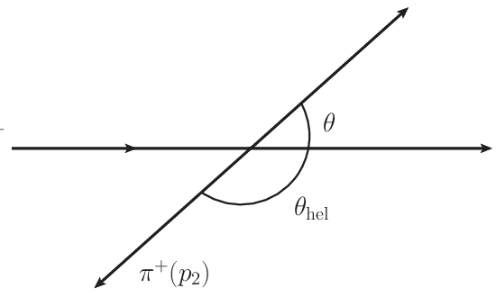
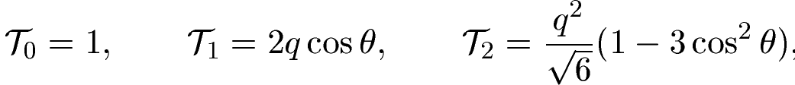
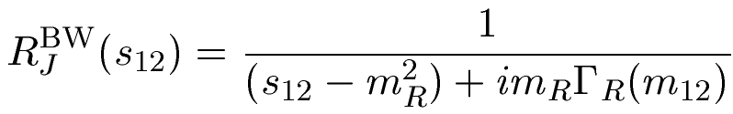

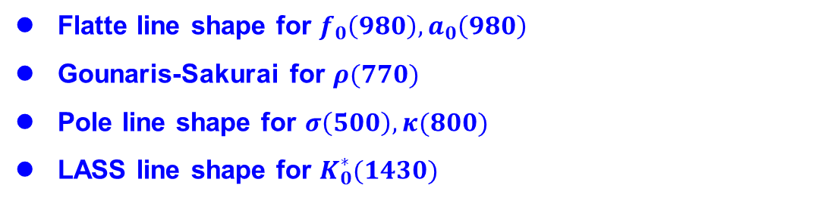


Resonant 3-body B decays
Consider resonant 3-body B decay $B→RP_{3}→P_{1}P_{2}P_{3}$ in isobar model
weak & strong decays
line shape
angular dependence
Dalitz plot analysis: $M\left(s_{12,}s_{12}\right)$ is assumed to be a constant fit to the data
Angular distribution governed by Legendre polynomial $P_{J}(cosθ)$
$$P_{1}(p_{1})$$
B
$$P_{3}(p_{3})$$
θ: angle measured in resonance rest frame
$$P_{2}(p_{2})$$
Line shape: relativistic Breit-Wigner parameterizatiom
Flatte line shape for $f_{0}\left(980\right), a_{0}\left(980\right)$
Gounaris-Sakurai for $ρ(770)$
Pole line shape for $σ\left(500\right), κ(800)$
LASS line shape for $K_{0}^{∗}(1430)$

Slide 14
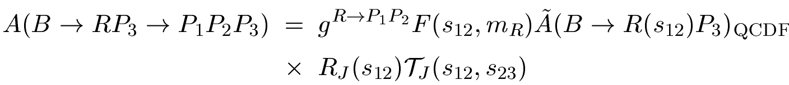
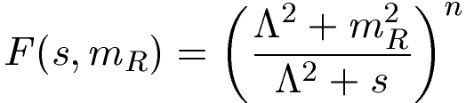

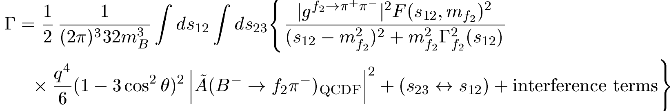
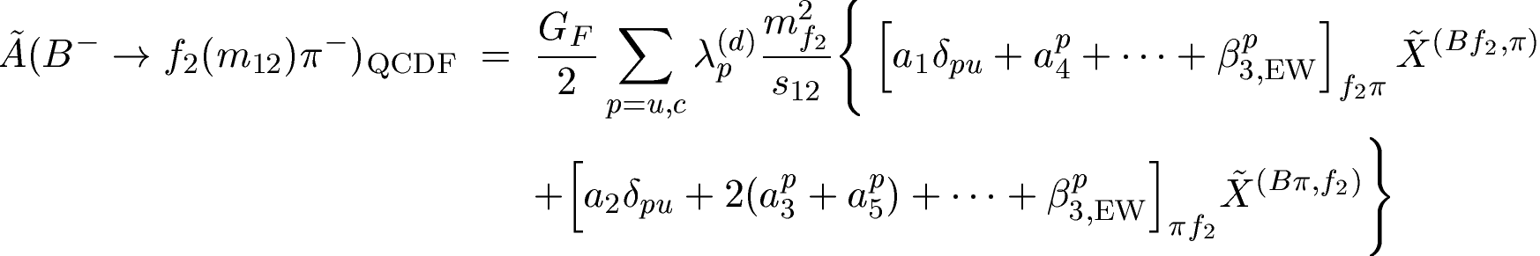
When resonance is off shell, form factor $F(s, m_{R})$ is introduced for the strong coupling of $R\left(m_{12}\right)→P_{1}P_{2}$ when $m_{12}$ is away from $m_{R}$
Take $B^{−}→f_{2}π^{−}→π^{+}π^{−}π^{−}$ as an example
with

Slide 15
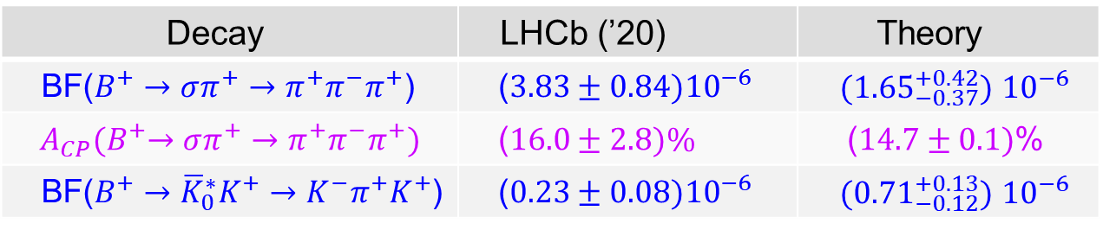
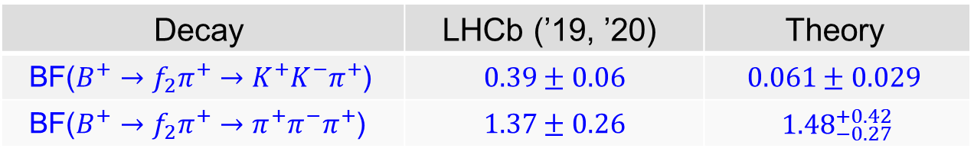

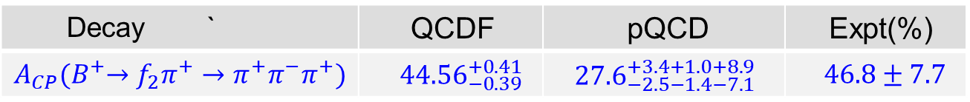

Decay | LHCb (’19, ’20) | Theory
BF($B^{+}→f_{2}π^{+}→K^{+}K^{−}π^{+}$) | $$0.39±0.06$$ | $$0.061±0.029$$
BF($B^{+}→f_{2}π^{+}→π^{+}π^{−}π^{+}$) | $$1.37±0.26$$ | $${1.48}_{−0.27}^{+0.42}$$
$${(10}^{−6})$$
$f_{2}(1270)$ contribution to $B^{+}→K^{+}K^{−}π^{+}$ is likely overestimated by LHCb by a factor of 6! Needs to be clarified in Run II
$$\frac{Γ(f_{2}→K^{+}K^{−})}{Γ(f_{2}→π^{+}π^{−})}≈\frac{1}{25}$$
A large CP asymmetry of order 45% (20σ effect) observed in $B^{+}→f_{2}π^{+}→π^{+}π^{−}π^{+}$ by LHCb using the isobar model
Decay ` | QCDF | pQCD | Expt(%)
$$A_{CP}{(B}^{+}→f_{2}π^{+}→π^{+}π^{−}π^{+})$$ | ${ 44.56}_{−0.39 }^{+0.41}$ | ${27.6}_{−2.5−1.4−7.1}^{+3.4+1.0+8.9}$ | $$46.8±7.7$$
For scalar resonances
Decay | LHCb (’20) | Theory
BF($B^{+}→σπ^{+}→π^{+}π^{−}π^{+}$) | ($3.83±0.84){10}^{−6}$ | ${ (1.65}_{−0.37}^{+0.42})$ ${10}^{−6}$
$$A_{CP}{(B}^{+}→σπ^{+}→π^{+}π^{−}π^{+})$$ | ($16.0±2.8)\%$ | ($14.7±0.1)$%
BF($B^{+}→{\overline{K}}_{0}^{∗}K^{+}→K^{−}π^{+}K^{+}$) | ($0.23±0.08){10}^{−6}$ | ${ (0.71}_{−0.12}^{+0.13})$ ${10}^{−6}$

Slide 16

Finite-width effects in 3-body B decays
HYC, Chiang, Chua (’21)
BF of quasi-two-body decays are usually extracted by assuming the factorization relation
This relation is valid only in narrow width approximation (NWA)
assuming $Γ(B→RP_{3})$ & $B\left(R→P_{1}P_{2}\right)$ are not affected by NWA
How to extract BF($B→RP_{3})$ from measured $Γ\left(B→RP_{3}→P_{1}P_{2}P_{3}\right)?$
Let $η_{R}=1+δ,$ it is expected $δ∼O(\frac{Γ_{R}}{m_{R}})$
Deviation of $η_{R}$ from unity measures the degree of departure from NWA when width is finite

Slide 17
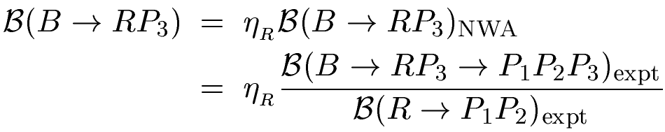
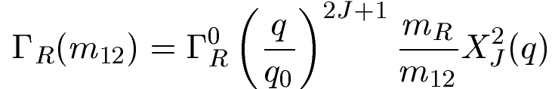

$η_{R}$ is calculable theoretically. It depends on resonance line shape & the approach for describing nonleptonic weak decays
We also consider the Dalitz plot parameterization adopted by many experimental groups (EXPP)
$X_{J}$: Blatt-Weisskopf barrier factor

Slide 18
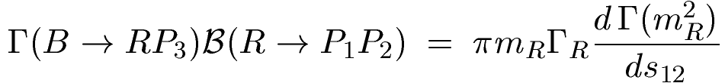
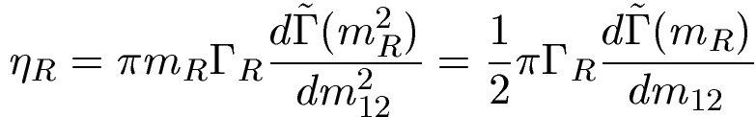
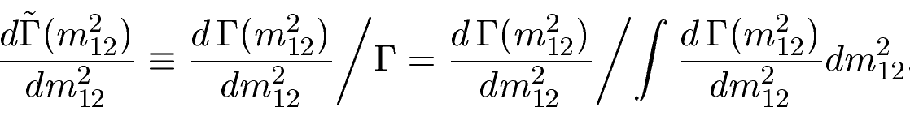
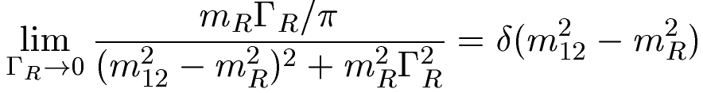
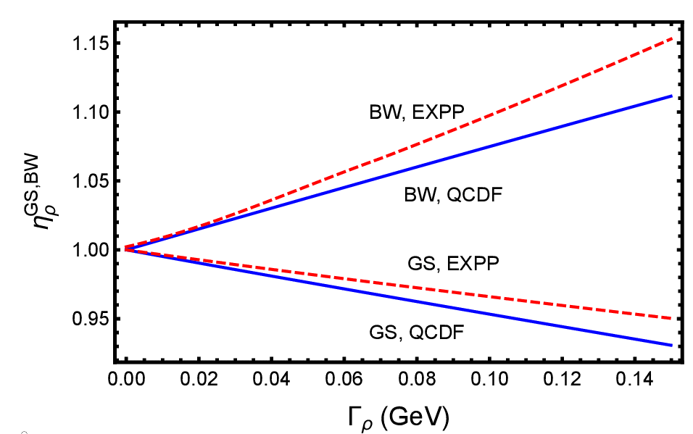

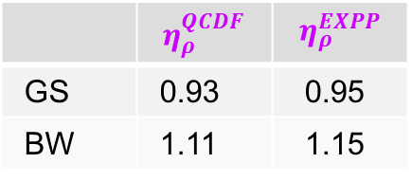




$η_{R}$ can be expressed in terms of normalized differential rate at resonance
⇒
$$s_{12}=m_{12}^{2}$$
with
⇒ $η_{R}→1$ in zero width limit
$$B^{+}→ρπ^{+}→π^{+}π^{−}π^{+}$$
$Γ_{ρ}=149.1±0.8$ MeV
Consider GS & BW line shapes for ρ in QCDF & EXPP schemes
 | $$η_{ρ}^{QCDF}$$ | $$η_{ρ}^{EXPP}$$
GS | 0.93 | 0.95
BW | 1.11 | 1.15

Slide 19
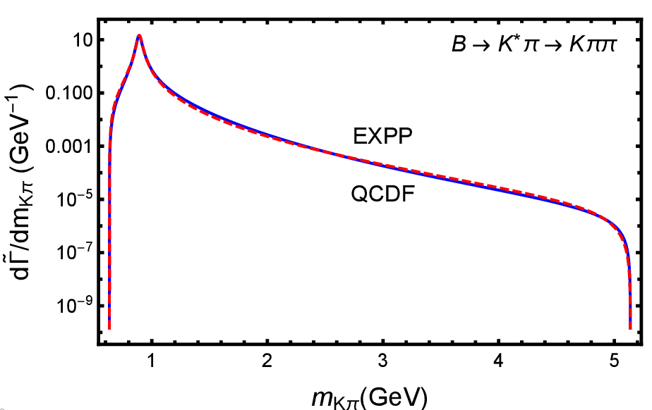
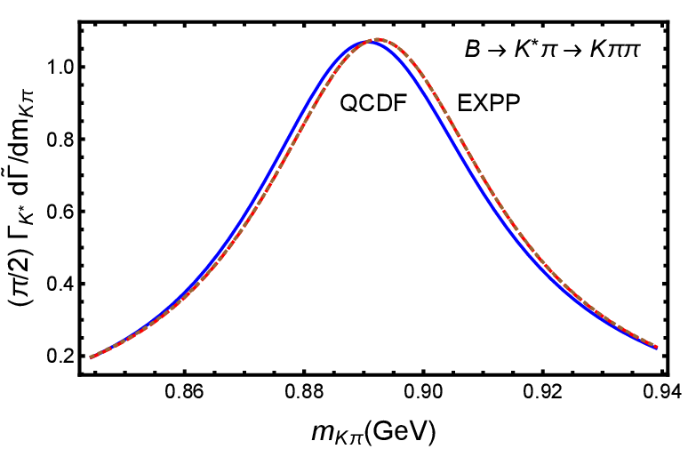
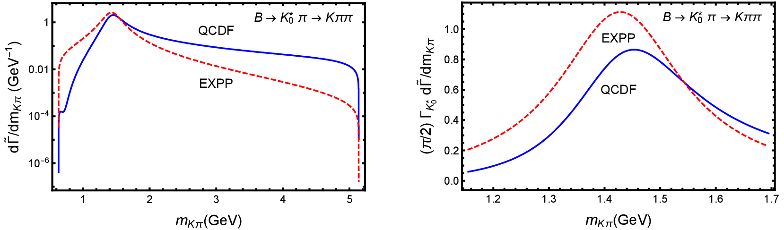
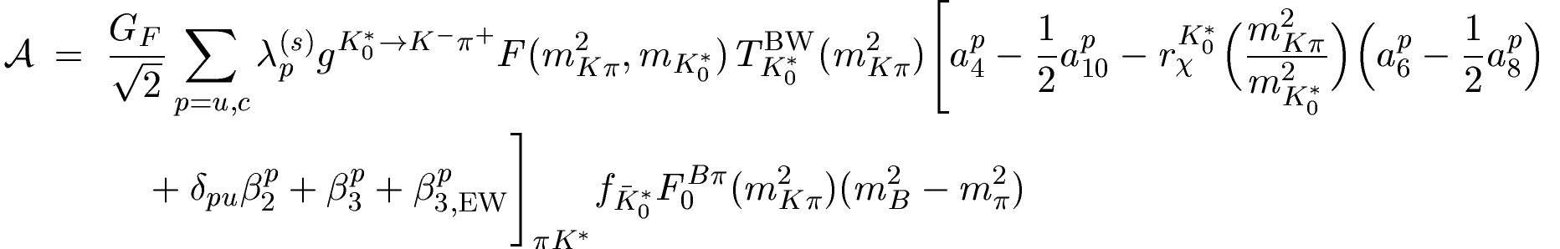
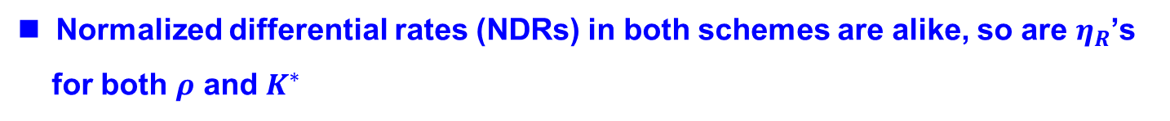
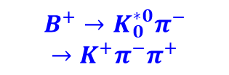

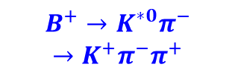
Normalized differential rates (NDRs) in both schemes are alike, so are $η_{R}$’s
for both $ρ$ and $K^{∗}$
$$B^{+}→K^{∗0}π^{−}$$
$$→K^{+}π^{−}π^{+}$$
Large enhancement of QCDF differential rate at large $m_{Kπ}$ distribution
$$B^{+}→K_{0}^{∗0}π^{−}$$
$$→K^{+}π^{−}π^{+}$$
$Γ_{K_{0}^{∗}}=270±80$ MeV
$η_{K_{0}^{∗}(1430)}^{QCDF}=0.83±0.04$ $η_{K_{0}^{∗}(1430)}^{EXPP}=1.11±0.03$

Slide 20
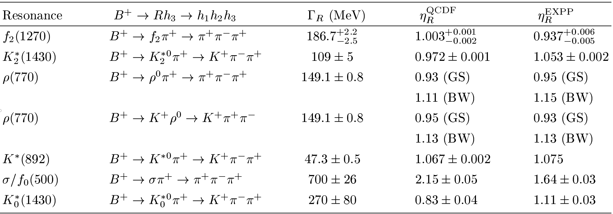
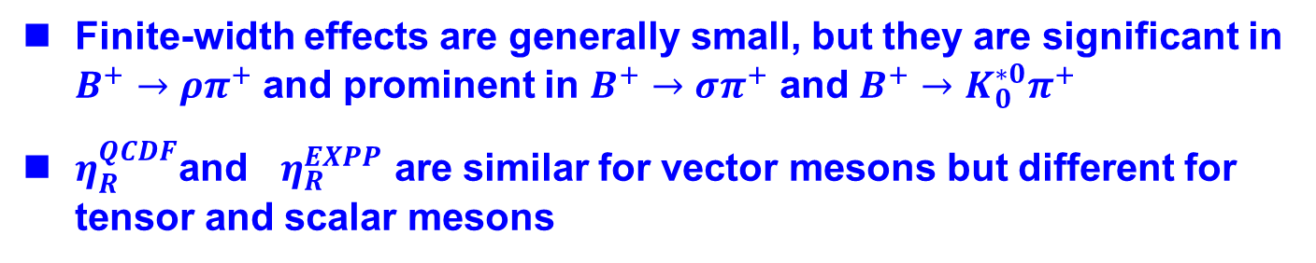
Finite-width effects on BF($B→RP)$ (I)
Finite-width effects are generally small, but they are significant in $B^{+}→ρπ^{+}$ and prominent in $B^{+}→σπ^{+}$ and $B^{+}→K_{0}^{∗0}π^{+}$
$η_{R}^{QCDF}$and $η_{R}^{EXPP}$ are similar for vector mesons but different for tensor and scalar mesons

Slide 21
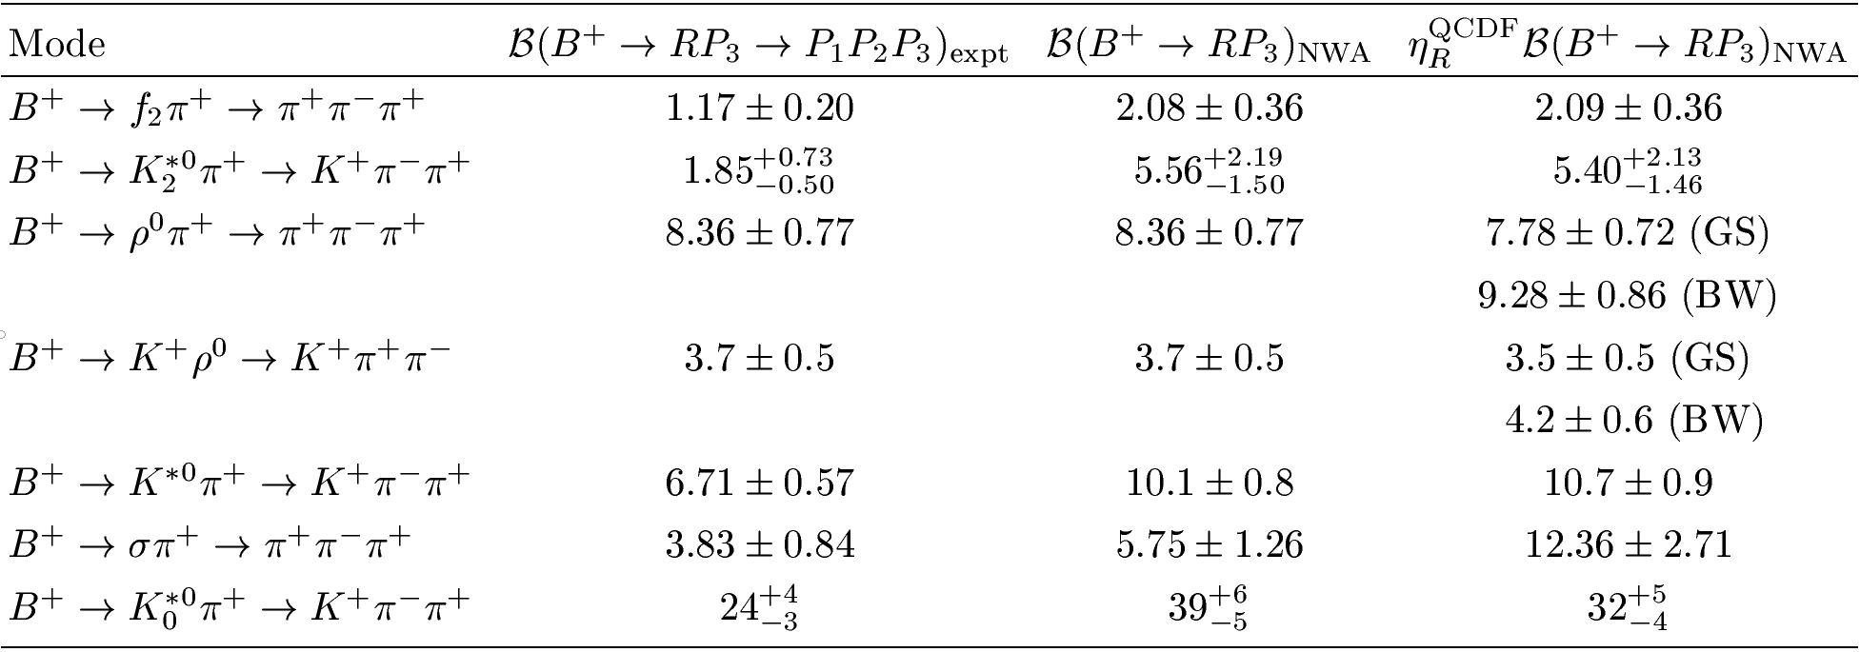
Finite-width effects on BF($B→RP)$ (II)
$BF{\left(B^{+}→ρπ^{+}\right)}_{PDG }=\left(8.3±1.2\right){10}^{−6}$ → $(7.7±1.1){10}^{−6 }$ for $η_{ρ}^{QCDF}=0.93$
$BF{\left(B^{+}→σπ^{+}\right)}_{NWA }=\left(5.8±1.3\right){10}^{−6}$ → $\left(12.4±2.7\right){10}^{−6 }$for $η_{σ}^{QCDF}=2.15$
$BF{\left(B^{+}→K_{0}^{∗0}π^{+}\right)}_{PDG }=\left({39}_{−5}^{+6}\right){10}^{−6}$ → $({32}_{−4}^{+5}){10}^{−6 }$ for ${ η}_{K_{0}^{∗}}^{QCDF}=0.83$

Slide 22
CP violation in 3-body B decays

Slide 23
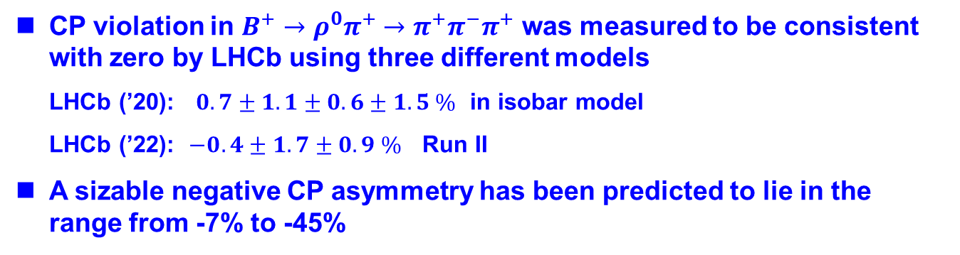
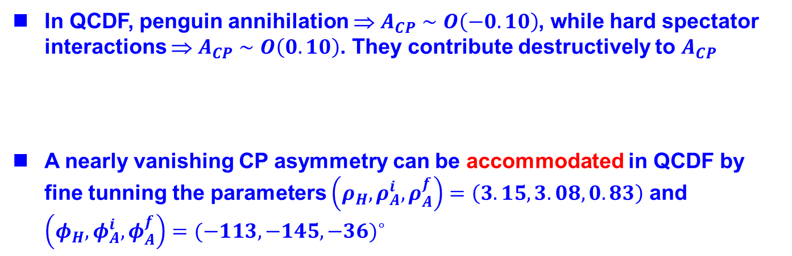
CP violation in $B^{+}→ρπ^{+}$
CP violation in $B^{+}→ρ^{0}π^{+}→π^{+}π^{−}π^{+}$ was measured to be consistent with zero by LHCb using three different models
LHCb (’20): $0.7±1.1±0.6±1.5 \%$ in isobar model
LHCb (’22): $−0.4±1.7±0.9 \%$ Run II
A sizable negative CP asymmetry has been predicted to lie in the range from -7% to -45%
In QCDF, penguin annihilation ⇒ $A_{CP}∼O\left(−0.10\right)$, while hard spectator interactions ⇒ $A_{CP}∼O\left(0.10\right)$. They contribute destructively to $A_{CP}$
A nearly vanishing CP asymmetry can be accommodated in QCDF by fine tunning the parameters $\left(ρ_{H}, ρ_{A}^{i }, ρ_{A}^{f}\right)=\left(3.15,3.08,0.83\right)$ and $\left(φ_{H},φ_{A}^{i},φ_{A}^{f}\right)=(−113,−145,−36)^{∘}$
HYC (’20)
23
The puzzle of $A_{CP}\left(B^{+}→ρπ^{+}\right)≈0$ still remains an enigma!

Slide 24
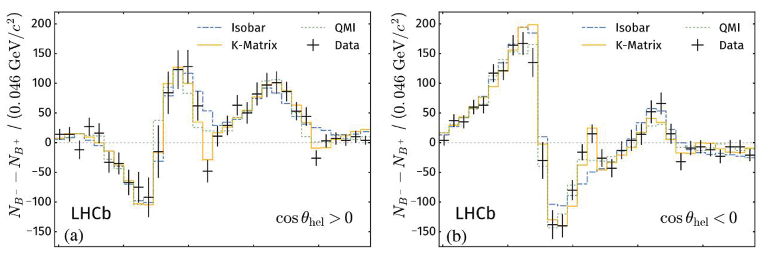










$$π^{+}(p_{1})$$
B+
$$π^{+}(p_{3})$$
cos$θ<0$
cos$θ>0$
$$π^{−}(p_{2})$$
Significant CP violation is seen in the data separated by the sign of cosθ.
CP asymmetry near the ρ resonance is proportional to $\left(m_{12}^{2}−m_{ρ}^{2}\right)cosθ.$
⇒ It gives a nearly vanishing $A_{CP}\left(B^{+}→ρπ^{+}\right)$ when integrating over θ
Well described by the interference between ρ & σ & nonresonant bkg
⇒ 1st evidence of CP violation mediated by interference between
resonances with significance exceeding 25σ (LHCb 2019)
cos$θ>0$
Interference pattern is well reproduced
cos$θ<0$

Slide 25





CP violation from final-state rescattering
In LHCb analysis of $B^{−}→h^{−}π^{+}π^{−}, h^{−}K^{+}K^{−}$, rescattering of $π^{+}π^{−}↔K^{+}K^{−}$ dominates CP asymmetry in mass region between 1 and 1.5 GeV
Almost all the observed CP asymmetry, O(-66%), in $B^{−}→π^{−}K^{+}K^{−}$ is seen in the rescattering amplitude
Wolfenstein, Suzuki (’99)
⇒
S-wave amplitudes

Slide 26





S-wave $π^{+}π^{−}→K^{+}K^{−}$ rescattering amplitude
Strong coupling is determined up to a strong phase ambiguity,
A large CP asymmetry of -66% can be accommodated at $φ_{σ}≈134^{∘}$
BF(rescattering) is calculated in (i) $A=S^{1/2}A_{0} \&$(ii) $A=SA_{0}.$ BF is about four times larger in (ii)
 | BF (expt) | BF (theory) | $${ A}_{CP}(expt)(\%)$$ | $A_{CP}$ (theory)
Rescattering to $$B^{−}→π^{−}K^{+}K^{−}$$ | $0.85±0.10$ | $$\left(i\right) {0.40}_{−0.10}^{+0.12}$$ $$\left(ii\right) {1.70}_{−0.36}^{+0.42}$$ | $−66.4±4.2$ | Fit
The correct description of $ππ↔K\overline{K}$ rescattering is given by (i). We suggest that LHCb should adapt (i) to analyze rescattering.

Slide 27

Conclusions
QCDF treatment of B→ SM & B→ TM is reviewed. Color-suppressed tensor or neutral scalar emission is prohibited in naïve factorization, but can proceed via vertex & hard spectator interactions
Resonant 3-body B decays via S, V & T resonances are analyzed
Finite-width effects are generally small, but they are significant in $B^{+}→ρπ^{+}$ & prominent in $B^{+}→σπ^{+}$ and $B^{+}→K_{0}^{∗0}π^{+}$
The puzzle with $A_{CP}\left(B^{+}→ρπ^{+}\right)≈0$ needs to be resolved
CP asymmetry has been seen in $ρ(770)$ region for positive & negative-angle cosines. It is well described by interference between $ρ$ & $σ$
Large CP asymmetry in rescattering region of $B^{+}→π^{+}K^{+}K^{−}$ can be accommodated by adjusting the relative phase between $σ$ & NR

