Slide 1
MMB

Slide 2
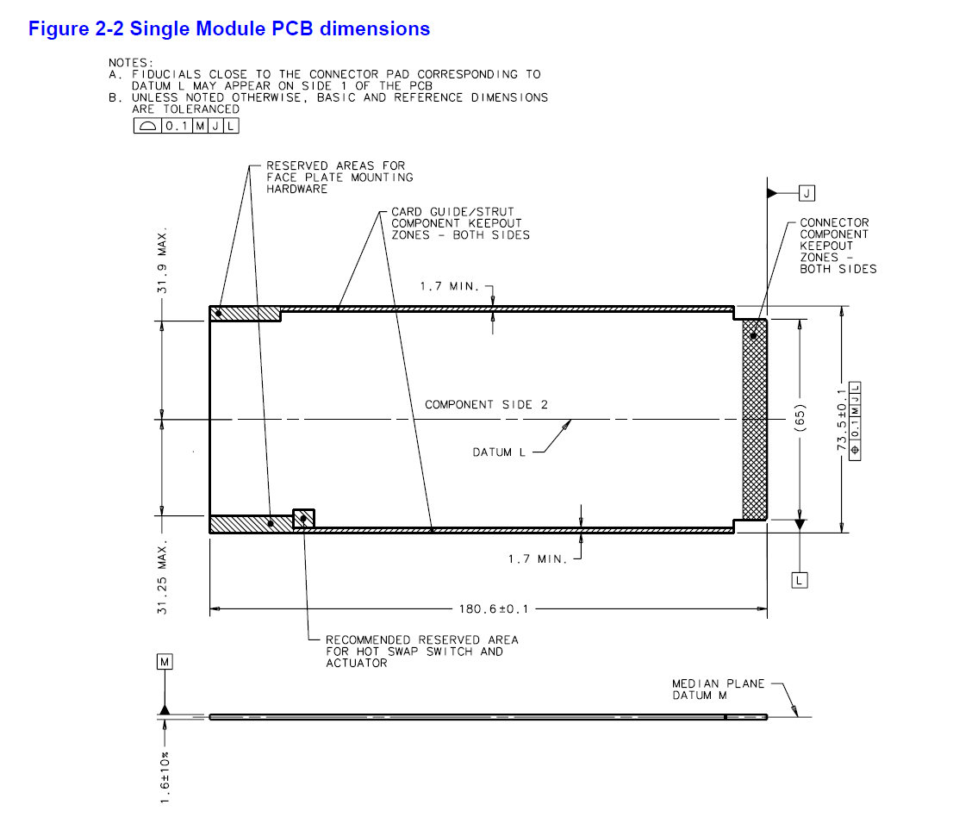

Slide 3
Component Side 1
Keepout area
Recommended area for hot-swap switch
FireFly
SODIMM
ZYNQ
US+
FireFly
FireFly
FireFly
FireFly
PLL
LTM46
44
LTM4620
LTM4620
LTM4620
LTM4620
MMC

Slide 4
Component Side 2
Keepout area
FireFly
SODIMM
ZYNQ
US+
FireFly
FireFly
FireFly
FireFly
PLL
LTM46
44
LTM4620
LTM4620
LTM4620
LTM4620
MMC

Slide 6
ZYNQ UltraScale+ XCZU11EG-1FFVC1760
11
C
1760

Slide 7
Recommended Operating Conditions (PS)
(DS925, p. 4)
Symbol | Description | Min (V) | Typ (V) | Max (V)
VCC_PSINTFP | PS full-power domain supply voltage | 0.808 | 0.850 | 0.892
VCC_PSINTLP | PS low-power domain supply voltage | 0.808 | 0.850 | 0.892
VCC_PSAUX | PS auxiliary supply voltage | 1.710 | 1.800 | 1.890
VCC_PSINTFP_DDR | PS DDR controller and PHY supply voltage | 0.808 | 0.850 | 0.892
VCC_PSADC | PS SYSMON ADC supply voltage relative to GND_PSADC | 1.710 | 1.800 | 1.890
VCC_PSPLL | PS PLL supply voltage | 1.164 | 1.200 | 1.236
VPS_MGTRAVCC | PS-GTR supply voltage | 0.825 | 0.850 | 0.875
VPS_MGTRAVTT | PS-GTR termination voltage | 1.746 | 1.800 | 1.854
VCCO_PSDDR | PS DDR I/O supply voltage | 1.06 | - | 1.575
VCC_PSDDR_PLL | PS DDR PLL supply voltage | 1.710 | 1.800 | 1.890
VCCO_PSIO | PS I/O supply | 1.710 | - | 3.465
VPSIN | PS I/O input voltage | –0.200 | - | VCCO_PSIO + 0.200
 | PS DDR I/O input voltage | –0.200 | - | VCCO_PSDDR + 0.200
VCC_PSBATT | PS battery-backed RAM and battery-backed real-time clock (RTC) supply voltage | 1.200 | - | 1.500

Slide 8
Recommended Operating Conditions (PL)
(DS925)
Symbol | Description | Min (V) | Typ (V) | Max (V)
VCCINT | PL internal supply voltage | 0.825 | 0.850 | 0.876
VCCINT_IO | PL internal supply voltage for the I/O banks | 0.825 | 0.850 | 0.876
VCCBRAM | Block RAM supply voltage | 0.825 | 0.850 | 0.876
VCCAUX | Auxiliary supply voltage | 1.746 | 1.800 | 1.854
VCCO | Supply voltage for HD I/O banks | 1.140 | - | 3.400
 | Supply voltage for HP I/O banks | 0.950 | - | 1.900
VCCAUX_IO | Auxiliary I/O supply voltage | 1.746 | 1.800 | 1.854
VIN | I/O input voltage | –0.200 | - | VCCO + 0.200
VMGTAVCC | Analog supply voltage for the GTH or GTY transceiver | 0.873 | 0.900 | 0.927
VMGTAVTT | Analog supply voltage for the GTH or GTY transmitter and receiver termination circuits | 1.06 | - | 1.575
VMGTVCCAUX | Auxiliary analog QPLL voltage supply for the transceivers | 1.746 | 1.800 | 1.854
VMGTAVTTRCAL | Analog supply voltage for the resistor calibration circuit of the GTH or GTY transceiver column | 1.164 | 1.200 | 1.236
VCCADC | PS DDR I/O input voltage | 1.746 | 1.800 | 1.854
VREFP | PL System Monitor externally supplied reference voltage relative to GNDADC | 1.200 | 1.250 | 1.300

Slide 9
Quiescent Supply Current (VCCINT = 0.85V)
VCCINT rail would typically require most amount of current
Maximum current draw for VCCINT for XCZU11EG-1FFVC1760: 70 A
(DS925, p. 11 - 15)
(UG583, p. 33)
Symbol | Description | I (mA)
ICCINTQ | Quiescent VCCINT supply current | 1699
ICCINT_IOQ | Quiescent VCCINT_IO supply current | 115
ICCOQ | Quiescent VCCO supply current | 1
ICCAUXQ | Quiescent VCCAUX supply current | 255
ICCAUX_IOQ | Quiescent VCCAUX_IO supply current | 56
ICCBRAMQ | Quiescent VCCBRAM supply current | 22
 |  | 2.148

Slide 10
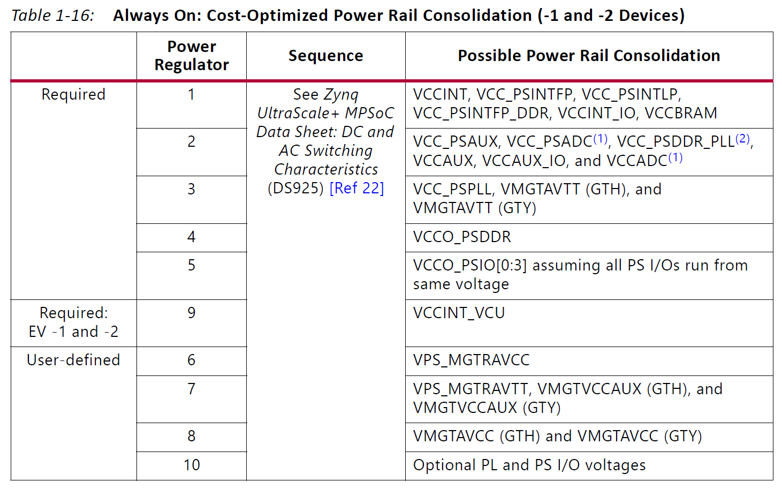
Power Supply Consolidation

Slide 11
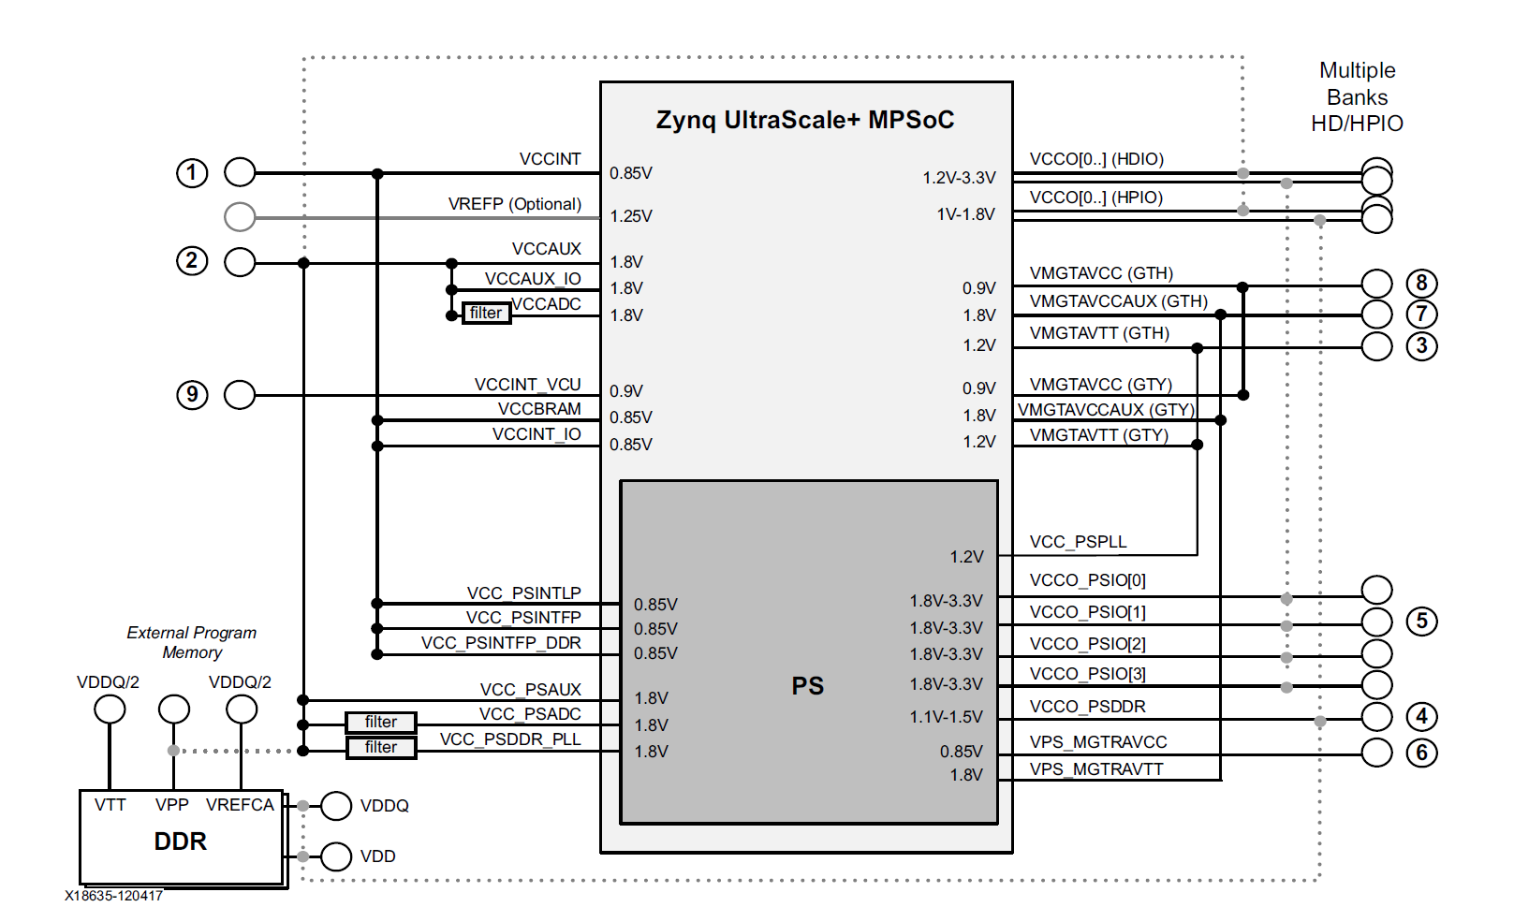
(UG583, p. 29)

Slide 12
FireFly Power (1)

Slide 13
FireFly Power (2)

Slide 14
PLL Power (1)

Slide 15
PLL Power (2)

Slide 16
Power Supplies (1)
LTM4620 (two outputs):
Input: 4.5 .. 16 V
Output: 0.6 .. 2.5 V
Current: 13 A/Output; 26 A when combined outputs
LTM4644 (four outputs):
Input: 4 .. 14 V; with external bias: 2.375 .. 14 V
Output: 0.6 .. 5.5 V
Current: 4 A/Output; up to 16 A when combined outputs

Slide 17
Power Supplies (2)
LTM4650 (two outputs, used in HighFlex2):
Input: 4.5 .. 15 V
Output: 0.6 .. 1.8 V
Current: 25 A/Output; 50 A when combined outputs
MAX8686:
Input: 4.5 .. 20 V
Output: 0.7 .. 5.5 V
Current: 25 A per phase

Slide 18
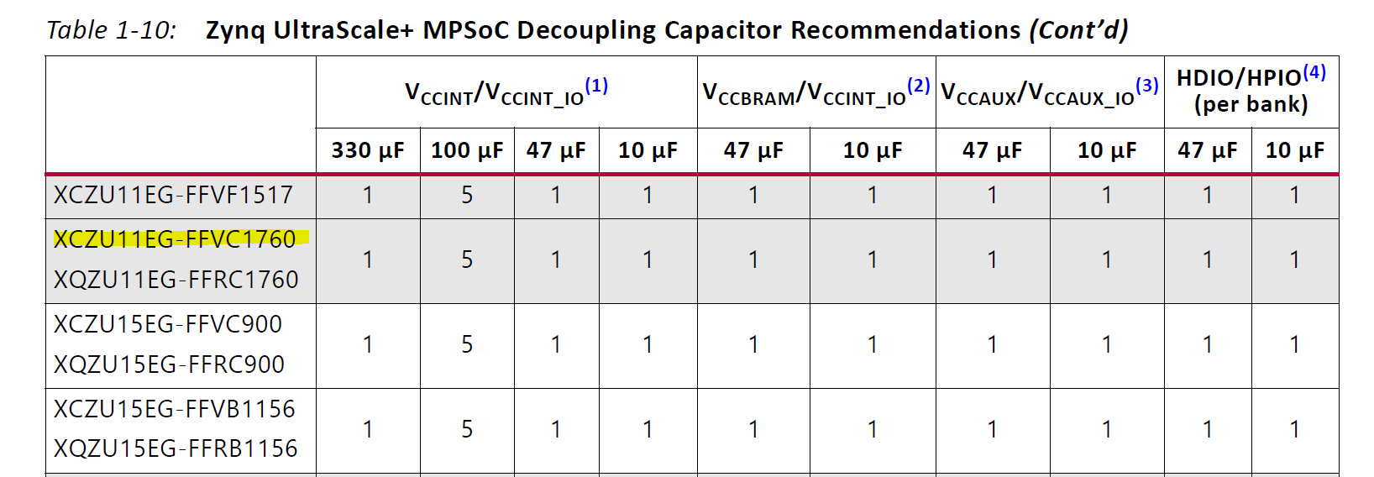
(UG583, p. 20)

Slide 19
