Slide 1
Micro Channel Cooling for ultra light silicon detectors.
M. Deveaux

Slide 2
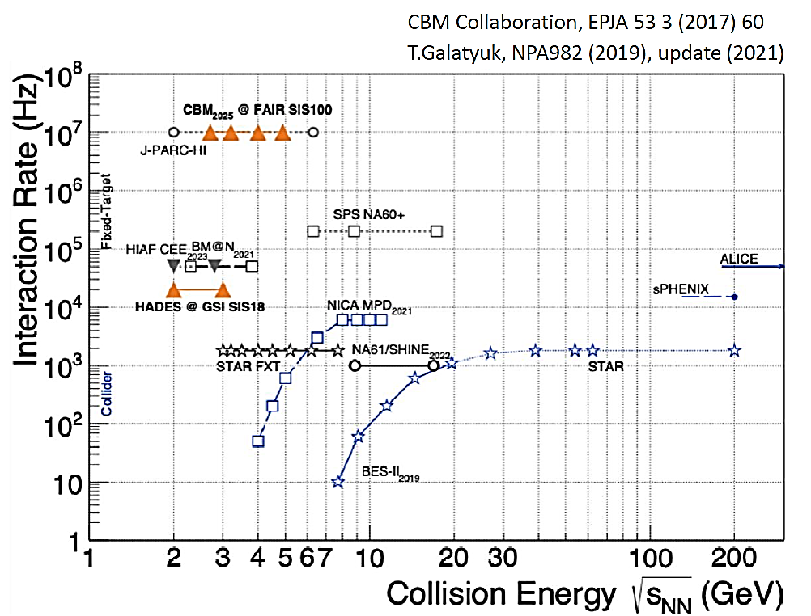
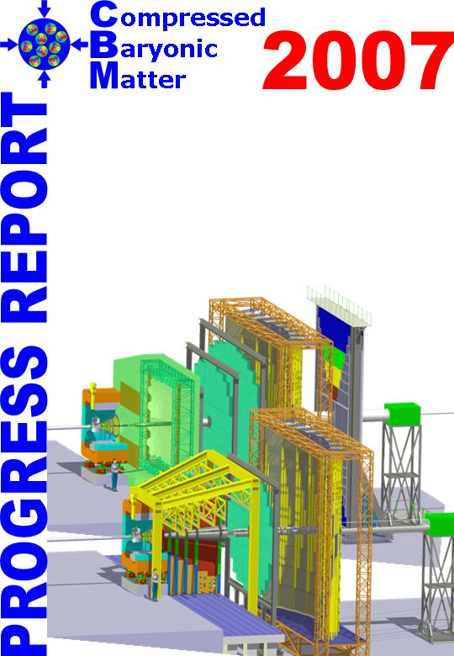
Purpose of the concept
Our project: The CBM experiment
A heavy ion fixed target experiment
Location: GSI/FAIR – Darmstadt
8 subdetector systems (2x silicon)
>400 scientists, 57 institutes
CBM is designed to become the fastest
heavy ion experiment buildt so far:
10 MHz Au+Au collisions.

Slide 3
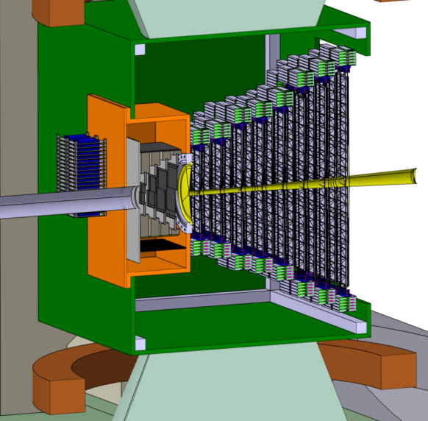
Weak point: MVD
The CBM-MVD
CBM is designed to become the fastest
heavy ion experiment buildt so far:
10 MHz Au+Au collisions.
The MVD is at present limited to 100 kHz.
On the long run: Room for improvement
Sensors have to be operated in vacuum.
Accelerating them needs adding power.
Adding power adds material for cooling.
=> Optimizing requires

Slide 4
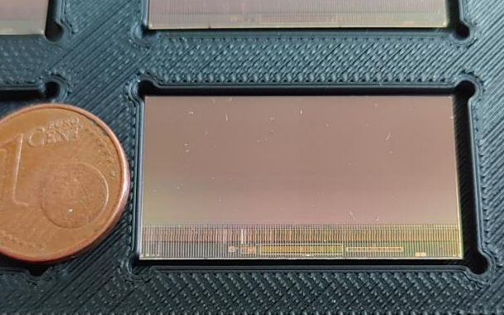




CMOS Monolithic Active Pixel Sensors
Use CMOS Monolithic Active Pixel Sensors (MIMOSIS-1):
5µm/5µs resolution
27x30 µm² pixel pitch
50µm thick
20 MHz/cm² (80 MHz/cm² peak).
Power dissipation:
In synergy with:
50 – 100 mW/cm²
MIMOSIS-1, 60µm thick
MIMOSIS-1
Team:
PICSEL Group IPHC Strasbourg
AG Stroth, Goethe University
Detektorlabor, GSI
Sensors have dead area.
Needs two layers of silicon

Slide 5
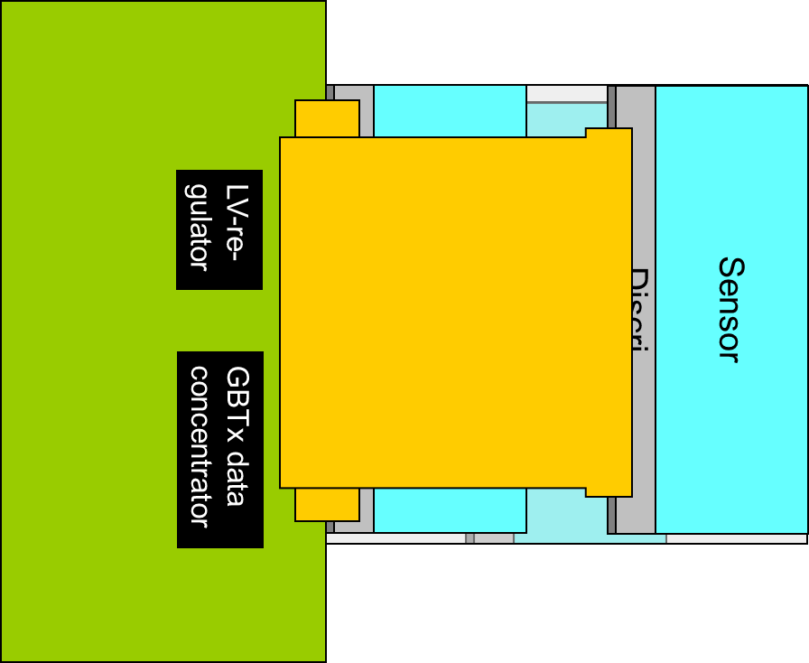
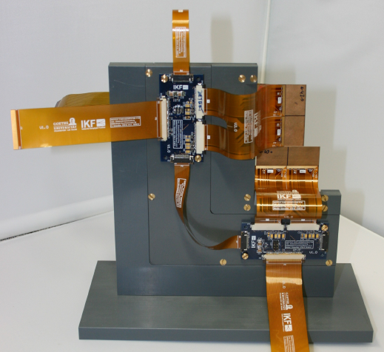
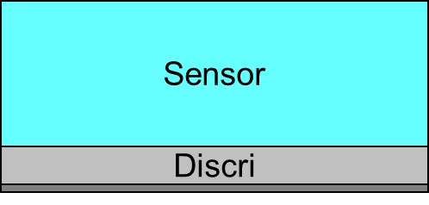
Integration concept of the MVD
Sensor
Discri
Sensor
Discri
MVD Prototype (mock up)
LV-re-
gulator
GBTx data
concentrator
M. Deveaux
17

Slide 6
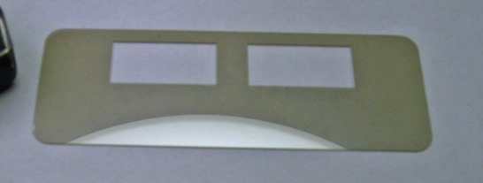
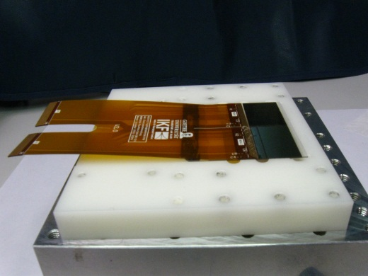
Cooling options so far
Sensors on CVD-Diamond:
+ Highly heat conductive
+ Very stiff
+ “Easy” to handle
- High price
Sensors on TPG-graphite:
+ Highly heat conductive
+ Cheap
o Needs wrapping
- Difficult to handle
- Mechanically fragile

Slide 7

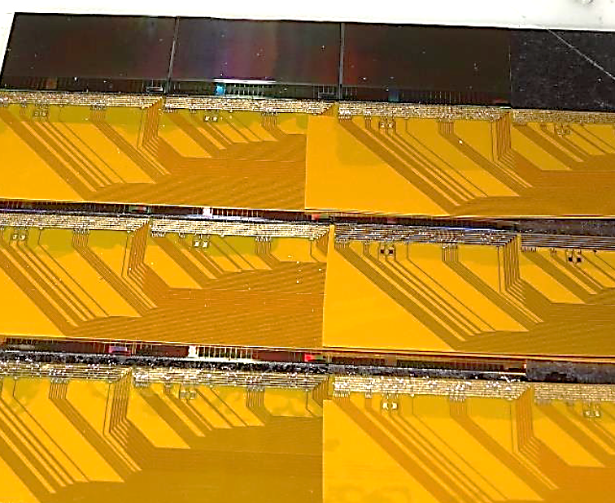
Detector integration: state of the art
PRESTO:
Prototype of a quarter station incl. sensors (MIMOSA-26),
cables, support etc.
In synergy with:
Sensor (3x)
Discri
Cable (2x)
Sensor
Discri
Cable (2x)
Sensor
Discri
Cable (2x)
Material budget is dominated by:
Cables
Cooling
=> Need to increase efficiency of both

Slide 8



What is the challenge?
Gen. 3
MIMOSIS-1
Data stream: >20 Gbps internal, 2.4 Gbps external
ALPIDE
MIMOSA-26
FSBB
Gen. 2
MIMOSTAR-3
Gen. 1
MIMOSA-5
Video (DVD)
Year
A further acceleration of sensors would require higher data streams:
~ 2 Tbps internal, 240 Gbps external (already compressed, corresponds to computer RAM).
Needs cables and cooling in vacuum.

Slide 9
What could be done?
Hold sensors with cooling support
Integrate cables
into support
Bond sensors to
support
Sensor
0.05X₀
Use highly
doped Si as additional ground plate
Metal 2
Bonding pad
SiO₂
Metal 1
CO₂ Channel
~ 0.2 X₀
Si
Sensor
0.05X₀
Evacuate heat with micro-channels (e.g. liquid CO₂)

Slide 10
Open scientific questions
Design rules,
thickness of metall layers (thicker=better)
thickness of isolators (5V, 100V?)
HF-properties of traces
Feasibility of Bonding
Sensor
0.05X₀
Metal 2
Bonding pad
SiO₂
Metal 1
CO₂ Channel
~ 0.2 X₀
Si
Sensor
0.05X₀
Design of the
inlet
Design of micro channels Handling of (liquid CO₂)
Operation and test

Slide 11
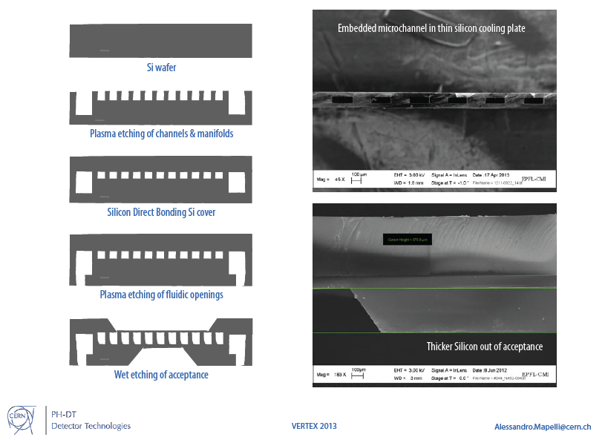
Anodic wafer bonding
Creation of micro – channels (simple example):
Put lithography mask.
Edge e.g. (111) wafers with KOH (Potassiom Hydroxide)
Result: Open channels
Rather triangular if KOH is used.
Well structured if plasma etching is used.

Slide 12
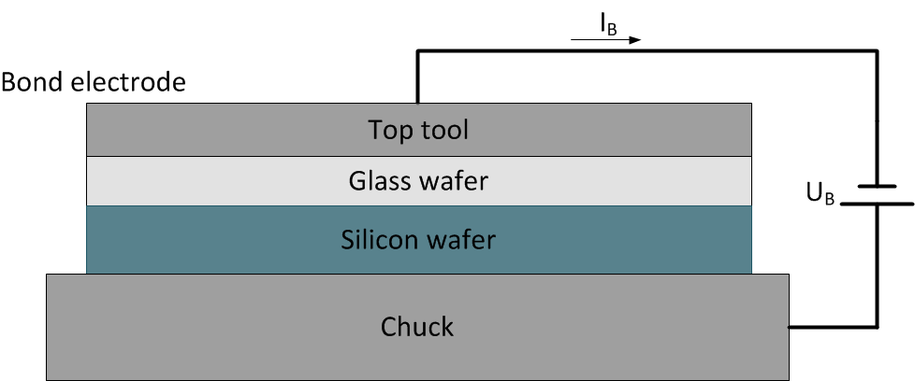
Anodic wafer bonding
Connect to wafers (e.g. Si + Glass).
Needs high voltage: ~ 1 kV
Needs high temperature: >400°C
Needs pressure
Structured objects should be bonded in vacuum
=> Wafers bond by electro-chemical reaction.
Outcome:
Double wafer with buried channels.
Possibly still too thick for the application
No inlets yet.
Important note:
Conditions not compatible with the use of structured wafers => Can't use sensor wafers.

Slide 13
Thinning and opening of inlets
Channels still closed, need inlets/outlets.
Inlets added by etching.
Reduce thickness by etching.

Slide 14
Connect tube adapters
Placing the tube adapter in a reliable way is an art of its own.
Tube adapter
So far: State of the art. Processes were validated at CERN.

Slide 15
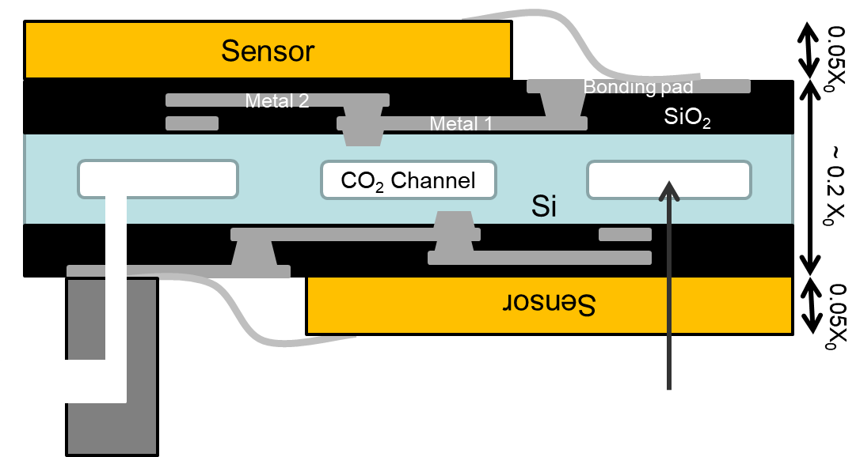
Add traces and sensors
Cu-traces
Add traces with lithographic methods.
Challenge: Need relatively thick Cu-layers to reach reasonably low R
Add and bond sensors
Add sensors by glueing and wire bonding.
Challenge:
Need to place sensors at both sides
=> Complicated holding structures needed.

Slide 16
What was learned from a first attempt
Starting from 2013 – Attempt do to something together with CiS.
Idea: Build device based on lithography for silicon strip detectors.
Discontinued do to missing funding and insufficient human ressources.
Lessons learned:
Wafer size is limited (4", 6"?) => Difficult to build sizeable devices.
Transporting power though lithographic traces is difficult (ohmic losses)
  Restrict to data (?).
This is complex, need experience in
  Sensor operation.
  Sensor integration (bonding etc.).
  CO₂ – cooling systems.
  Fluid dynamics (design of cooling channels).
  Connecting micro channels to macroscopic channels.

Slide 17
Summary and conclusion
High performance pixel sensor systems need highest data transport capability.
Sizeable power for data transport.
Highly efficient and ultra-light cooling systems.
Ultra light cabling.
Idea:
Integrate cooling micro channels and micro cables into one silicon device.
Status:
First attempt done together with CiS failed due to missing ressources.

