Slide 1
ttH production in the Higgs characterisation model at NLO in QCD with full off-shell effects
Based on arXiv:2205.09983
Jonathan Hermann, RWTH Aachen University
In collaboration with Daniel Stremmer, RWTH Aachen University
and Małgorzata Worek, RWTH Aachen University
Young Scientists Meeting of the CRC TRR 257 • 10.06.2022

Slide 2
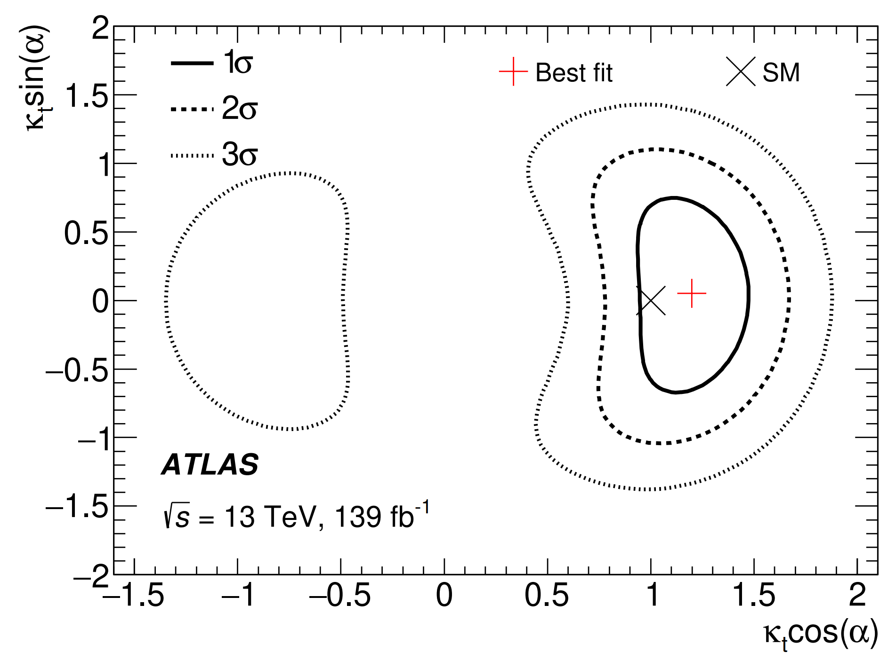
Introduction
CP-odd
ttH production:
Observed for the first time in 2018, ATLAS ‘18, CMS’18
Allows for direct probe of Yukawa interaction
Top is heaviest SM particle → strongest Yukawa coupling
Measurement of CP-odd component would indicate new physics
ATLAS ‘20

Slide 3
Introduction
CP-odd
SM-like interpretation:
Still freedom in the CP-state of the Higgs boson
SM prediction: Higgs is CP-even
CP-odd state excluded with 3.9
iiiiiiiiiiiiiiiiiiiii excluded at 95% CL if CP-even and CP-odd couplings are equal
ATLAS ‘20
BSM interpretations:
Extended Higgs sector
2HDM
…
ATLAS ‘20
Notes:
Tau Leptons allow for exclusion of alpha > 36 degrees

Slide 4
Introduction
Main Goal:
Provide state-of-the-art predictions for ttH production with possible mixing between CP-even (SM) and CP-odd Higgs states at NLO in QCD including full off-shell effects
using HELAC-NLO
Questions:
Which observables are sensitive to the CP-state?
How are the different CP-states affected by NLO QCD corrections?
How are the different CP-states affected by off-shell effects?

Slide 5
Theory status
SM Higgs boson (stable tops):
ttH @ NLO in QCD+EW with NNLL soft gluon resummation Broggio et al. ‘19, Kulesza, et al. ‘20
SM Higgs boson (with top quark decays):
ttH @ NLO in QCD with full off-shell effects Denner, Feger ‘15
ttH @ NLO in QCD+EW with full off-shell effects Denner, Lang, Pellen, Uccirati ‘17
ttH @ NLO in QCD with full off-shell effects + Higgs decays in NWA Stremmer, Worek ‘22
Higgs boson with CP-odd admixture:
ttX @ NLO in QCD with LO decays Artoisenet et al. ‘13, Demartin et al. ‘14
HC_NLO_X0 model Artoisenet et al. ‘13, Maltoni et al. ‘14, Demartin et al. ‘14

Slide 6
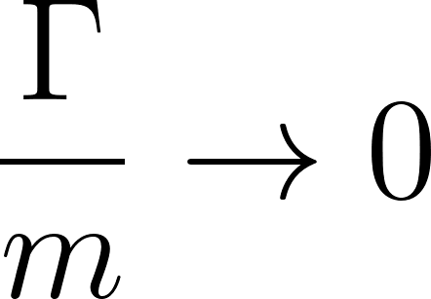
Off-shell effects
Process:
Double resonant
Single resonant
Non resonant
NWA
Off-shell
Full off-shell = DR + SR + NR + interference + Breit-Wigner
NWA = DR with on-shell masses

Slide 7
The Higgs characterisation framework (HCF)
Top-Yukawa coupling
Top-quark fields
SM:
Higgs boson field
Mixing angle
HCF:
Additional couplings
Artoisenet et al. ‘13
Maltoni et al. ‘14
Demartin et al. ‘14
Recover SM for gggggggg and

Slide 8
The Higgs characterisation framework (HCF)
Mixing angle
HCF:
CP-even
CP-odd
Three reference points:
CP-even:
CP-odd:
CP-mixed:

Slide 9
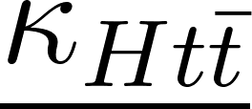
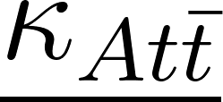
Parameter choices
Choose iiiiiiiiiiiiiiiii to recover SM results for
Choose iiiiiiiiiiiiiiii ito have the same coupling as for CP-even part
Choose iiiiiiiiiiiiiiiiiiiii to be consistent with gluon-gluon fusion (ggF) measurements (ATLAS ‘21)
Additional coupling

Slide 10
Parameter choices
Choose iiiiiiiiiiiiiiiii to recover SM results for
Choose iiiiiiiiiiiiiiii ito have the same coupling as for CP-even part
Choose iiiiiiiiiiiiiiiiiiiii to be consistent with gluon-gluon fusion (ggF) measurements (ATLAS ‘21)
Choose iiiiiiiiiiiiiiiiiiiii to be consistent with vector-boson fusion (VBF) measurements (CMS ‘19)
Choose iiiiiiiiiiiiiiiiiiiiiiiiiiiim to avoid coupling of pseudoscalar particle to vector bosons (e.g. 2HDM)

Slide 11
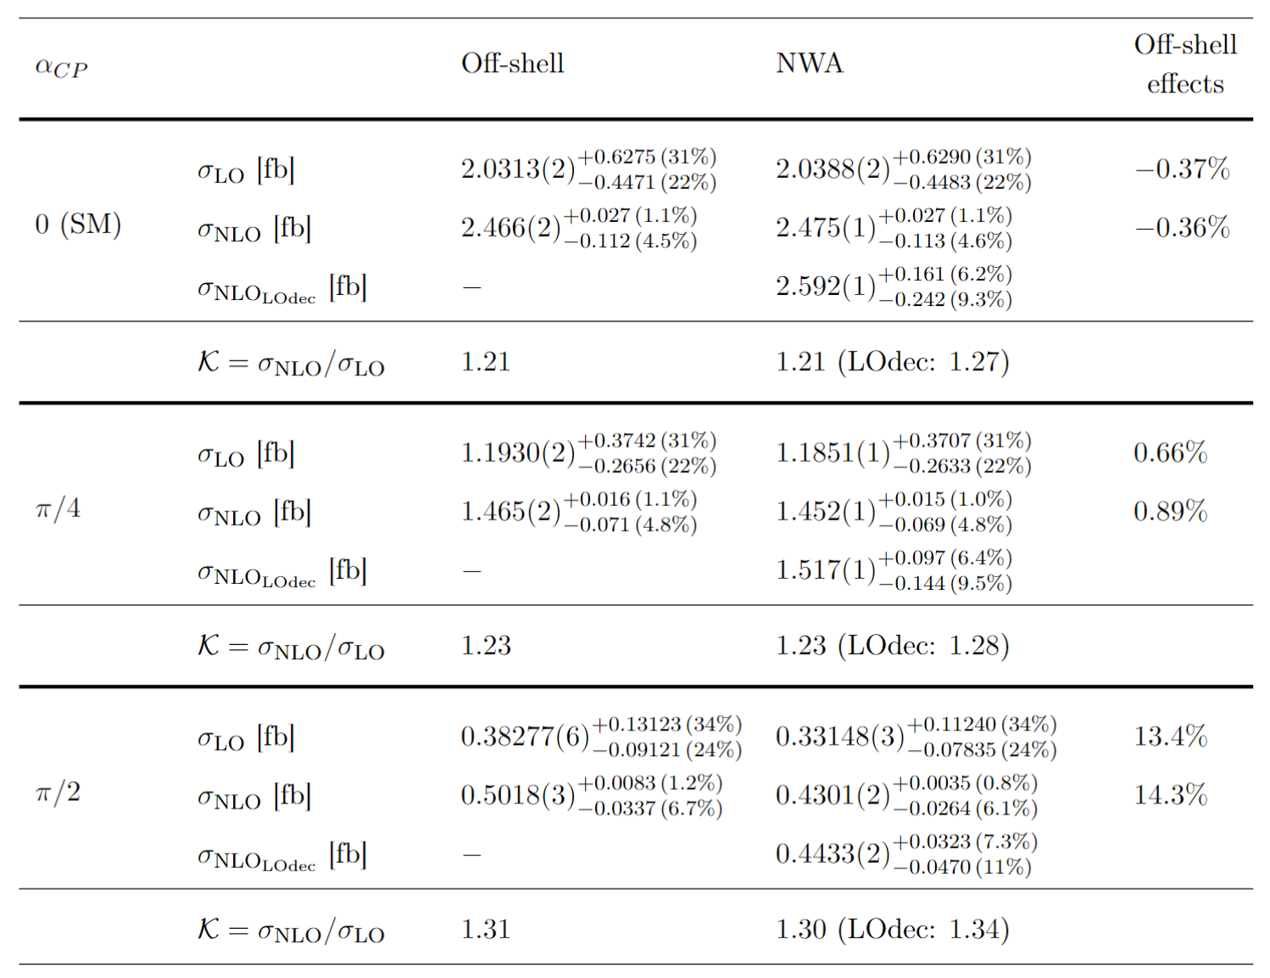
Integrated fiducial cross-sections (NLO)
NLO corrections:
21% - 31%
Increase with the mixing angle
NLO with LO decays overestimates NLO results by a few percent
Off-shell effects:
Small for CP-even and CP-mixed Higgs boson
Large effects for CP-odd Higgs boson
Notes:
Results are different from Daniel’s since we used different inputs
NLO corrections within LO uncertainties

Slide 12
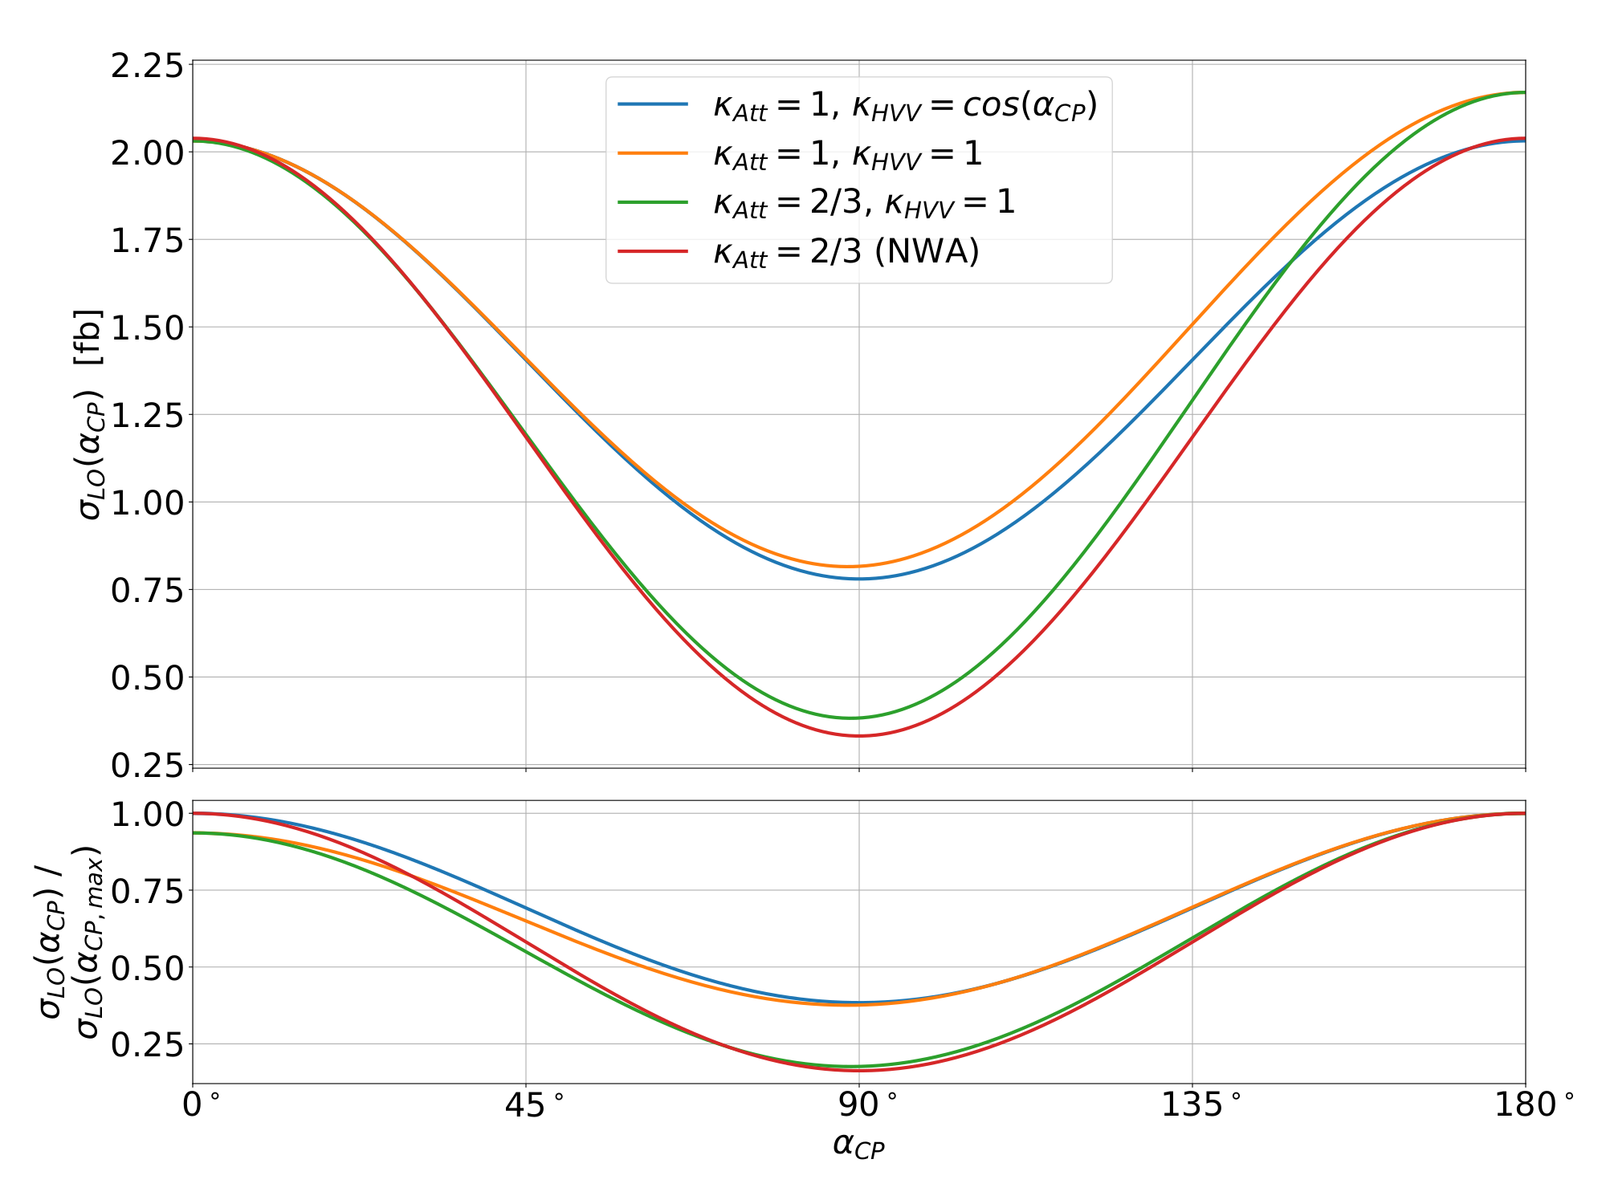
Integrated fiducial cross-sections (LO)
NWA is symmetric
Full result is only symmetric for
iiiiiiii only influences the size of the CP-odd contribution
Off-shell contributions break symmetry

Slide 13
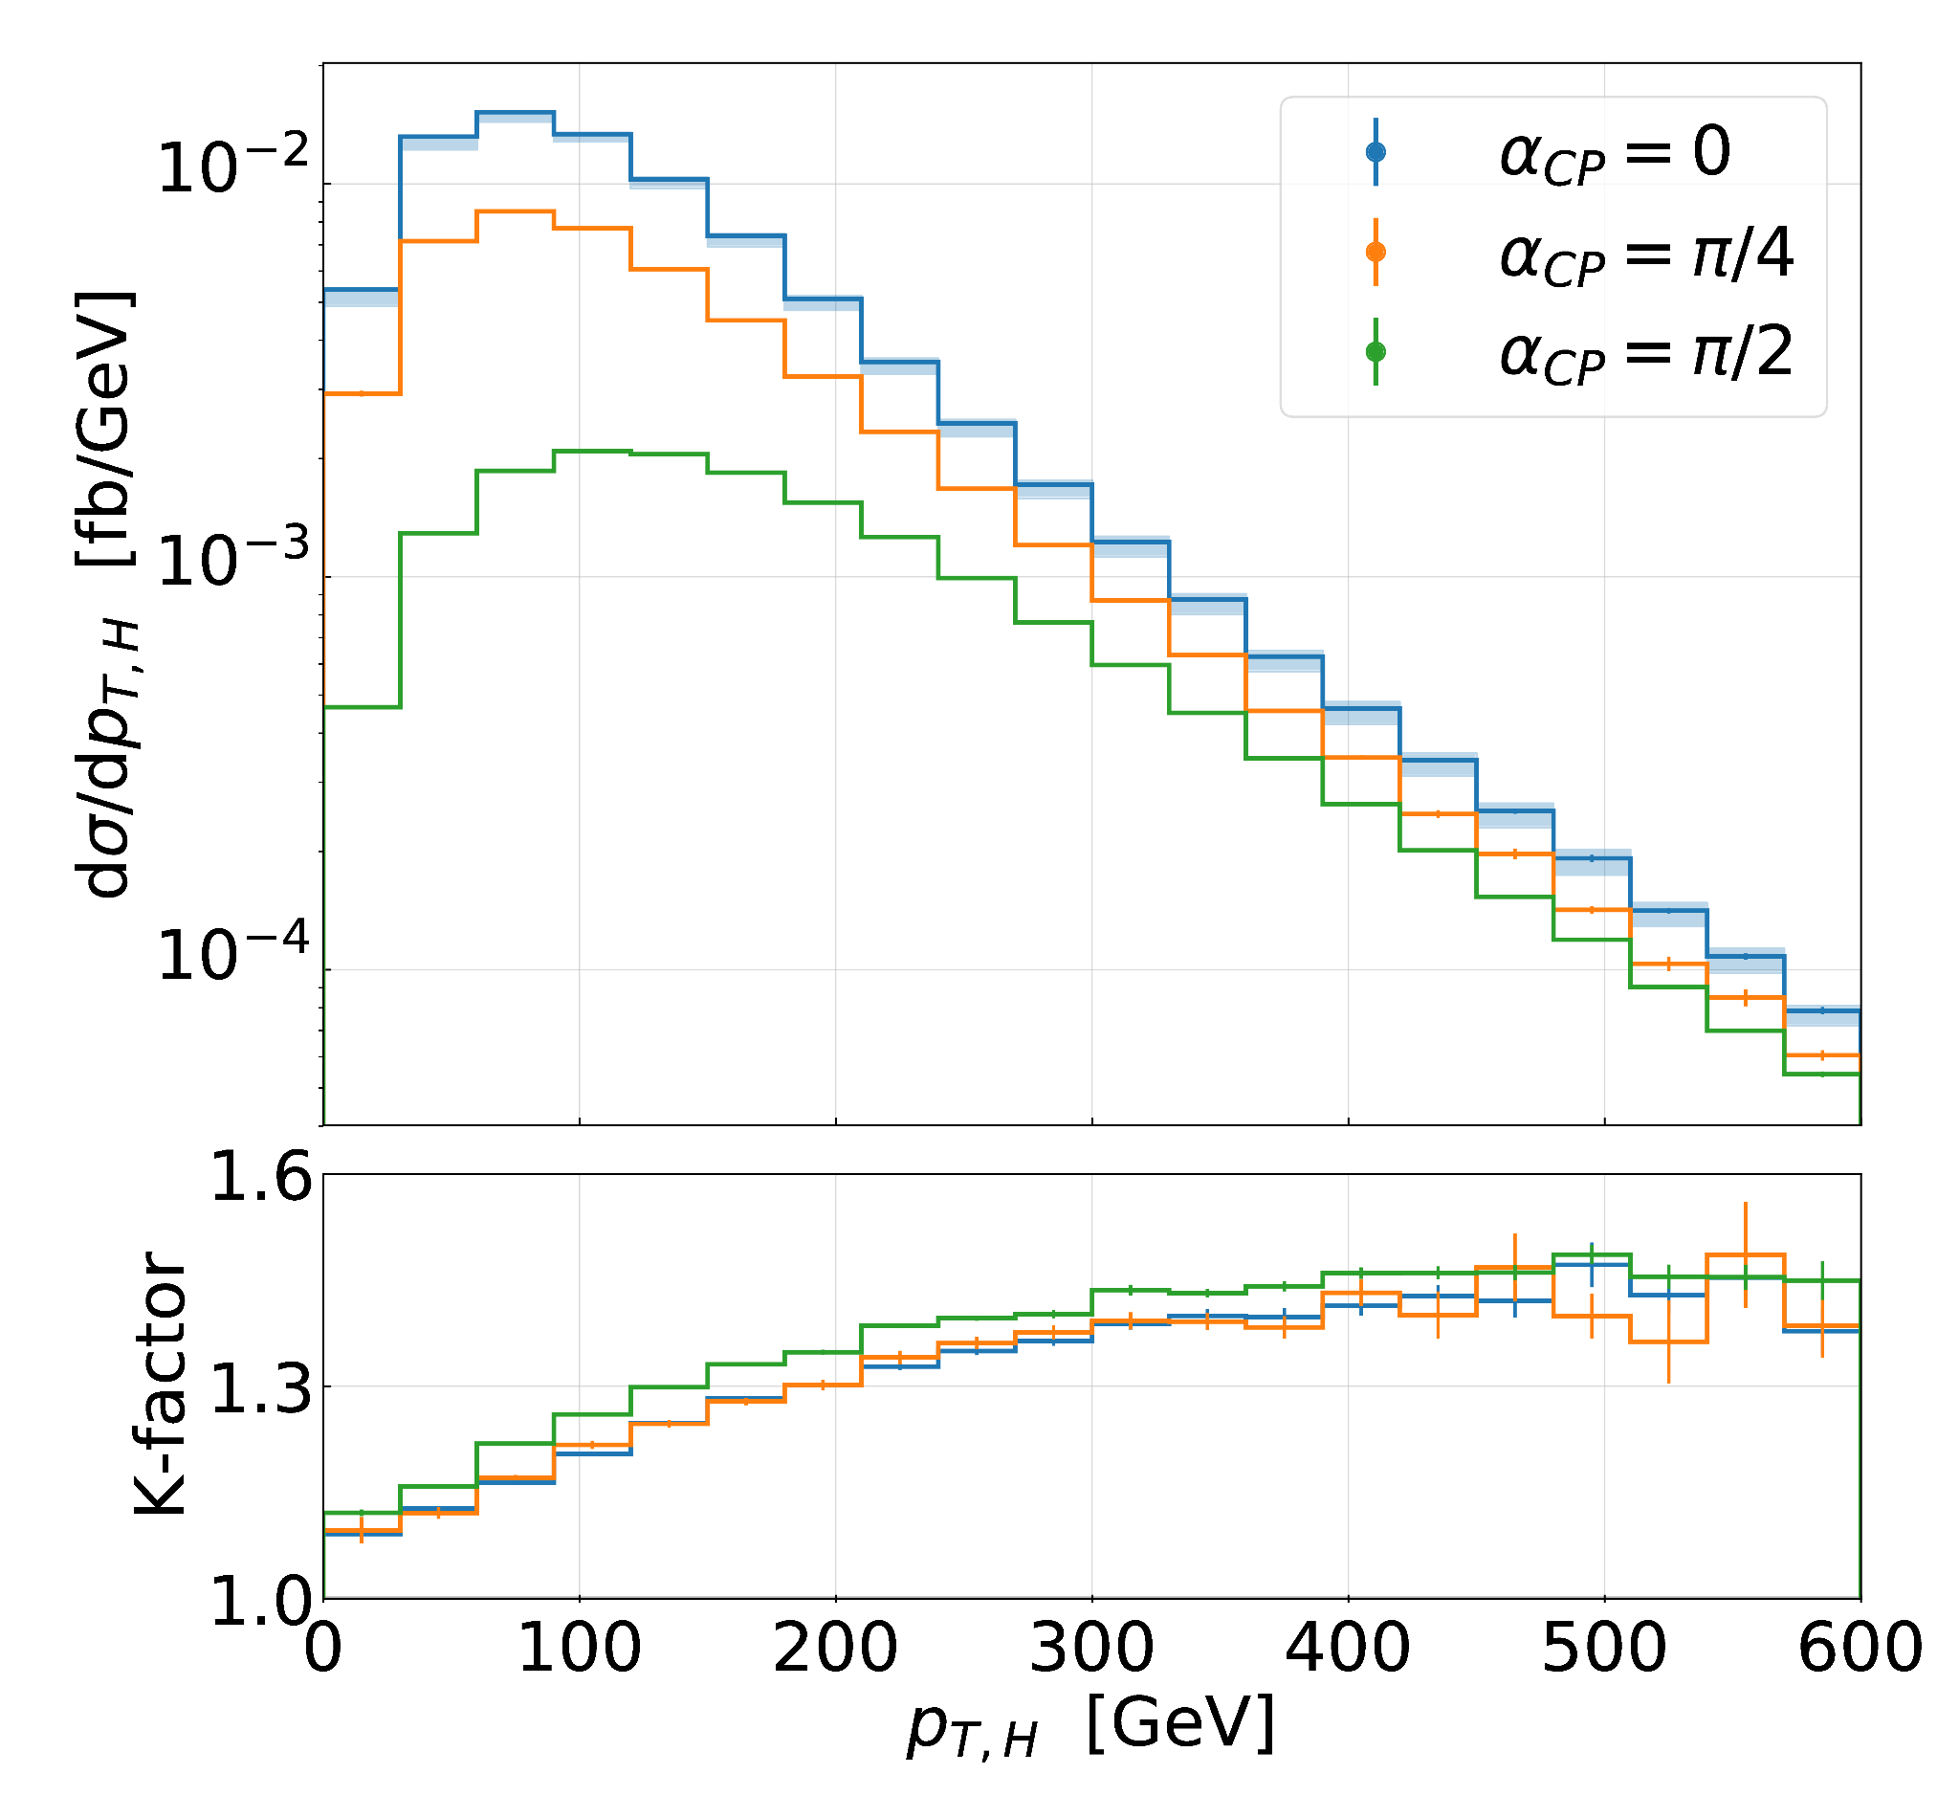
Differential distributions - NLO corrections
General behaviour:
Larger corrections in distribution tails
Corrections largest for CP-odd case
Shape of K-factor similar between different CP-states
Harder Higgs radiation in CP-odd case
Notes:
Results here are for full off-shell

Slide 14
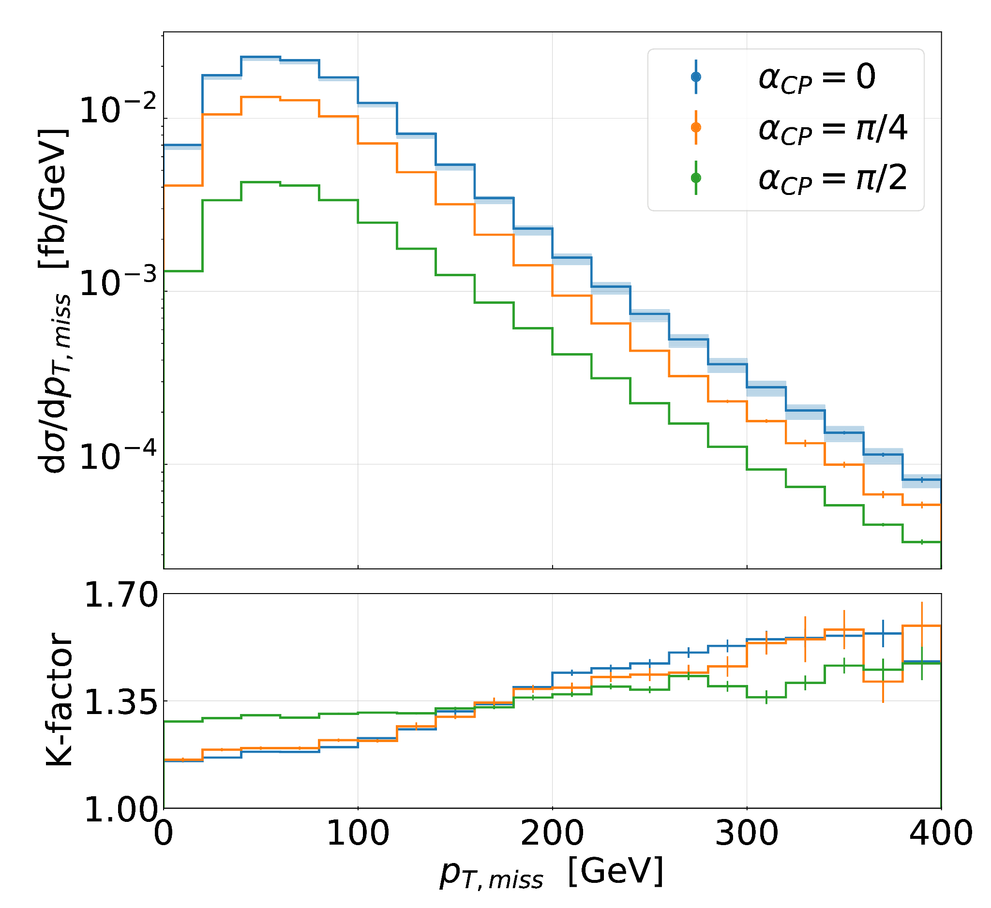
Differential distributions - NLO corrections
Observables with top-quark decay products:
Corrections largest for CP-odd case only for small transverse momenta
For large momenta, CP-odd case receives smallest corrections -> smaller shape distortions
Harder Higgs radiation in CP-odd case suppresses K-factor
CP-even and CP-mixed very similar

Slide 15
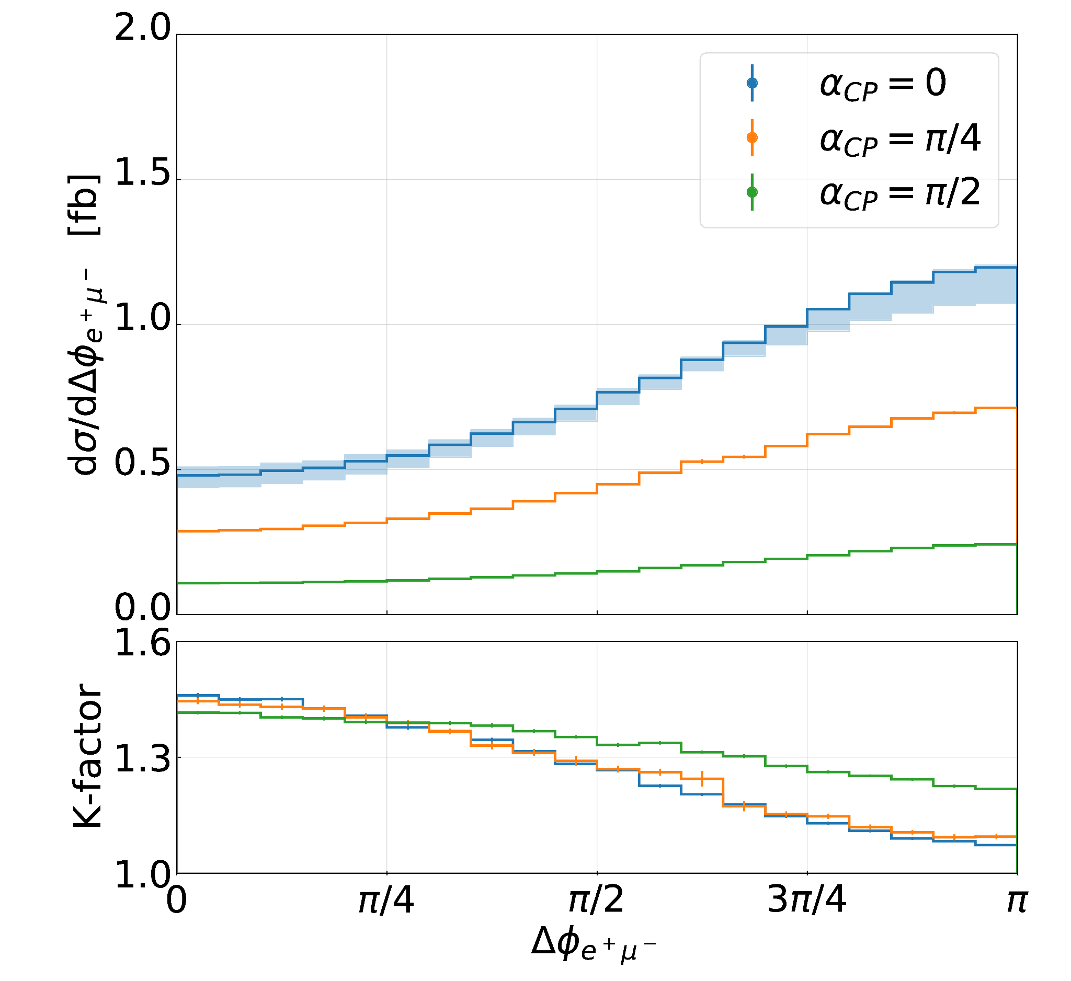
Differential distributions - NLO corrections
Observables with top-quark decay products:
Corrections largest for CP-odd case only for large opening angles
For small opening angles, CP-odd case receives smallest corrections -> smaller shape distortions
Harder Higgs radiation in CP-odd case suppresses K-factor
CP-even and CP-mixed very similar

Slide 16
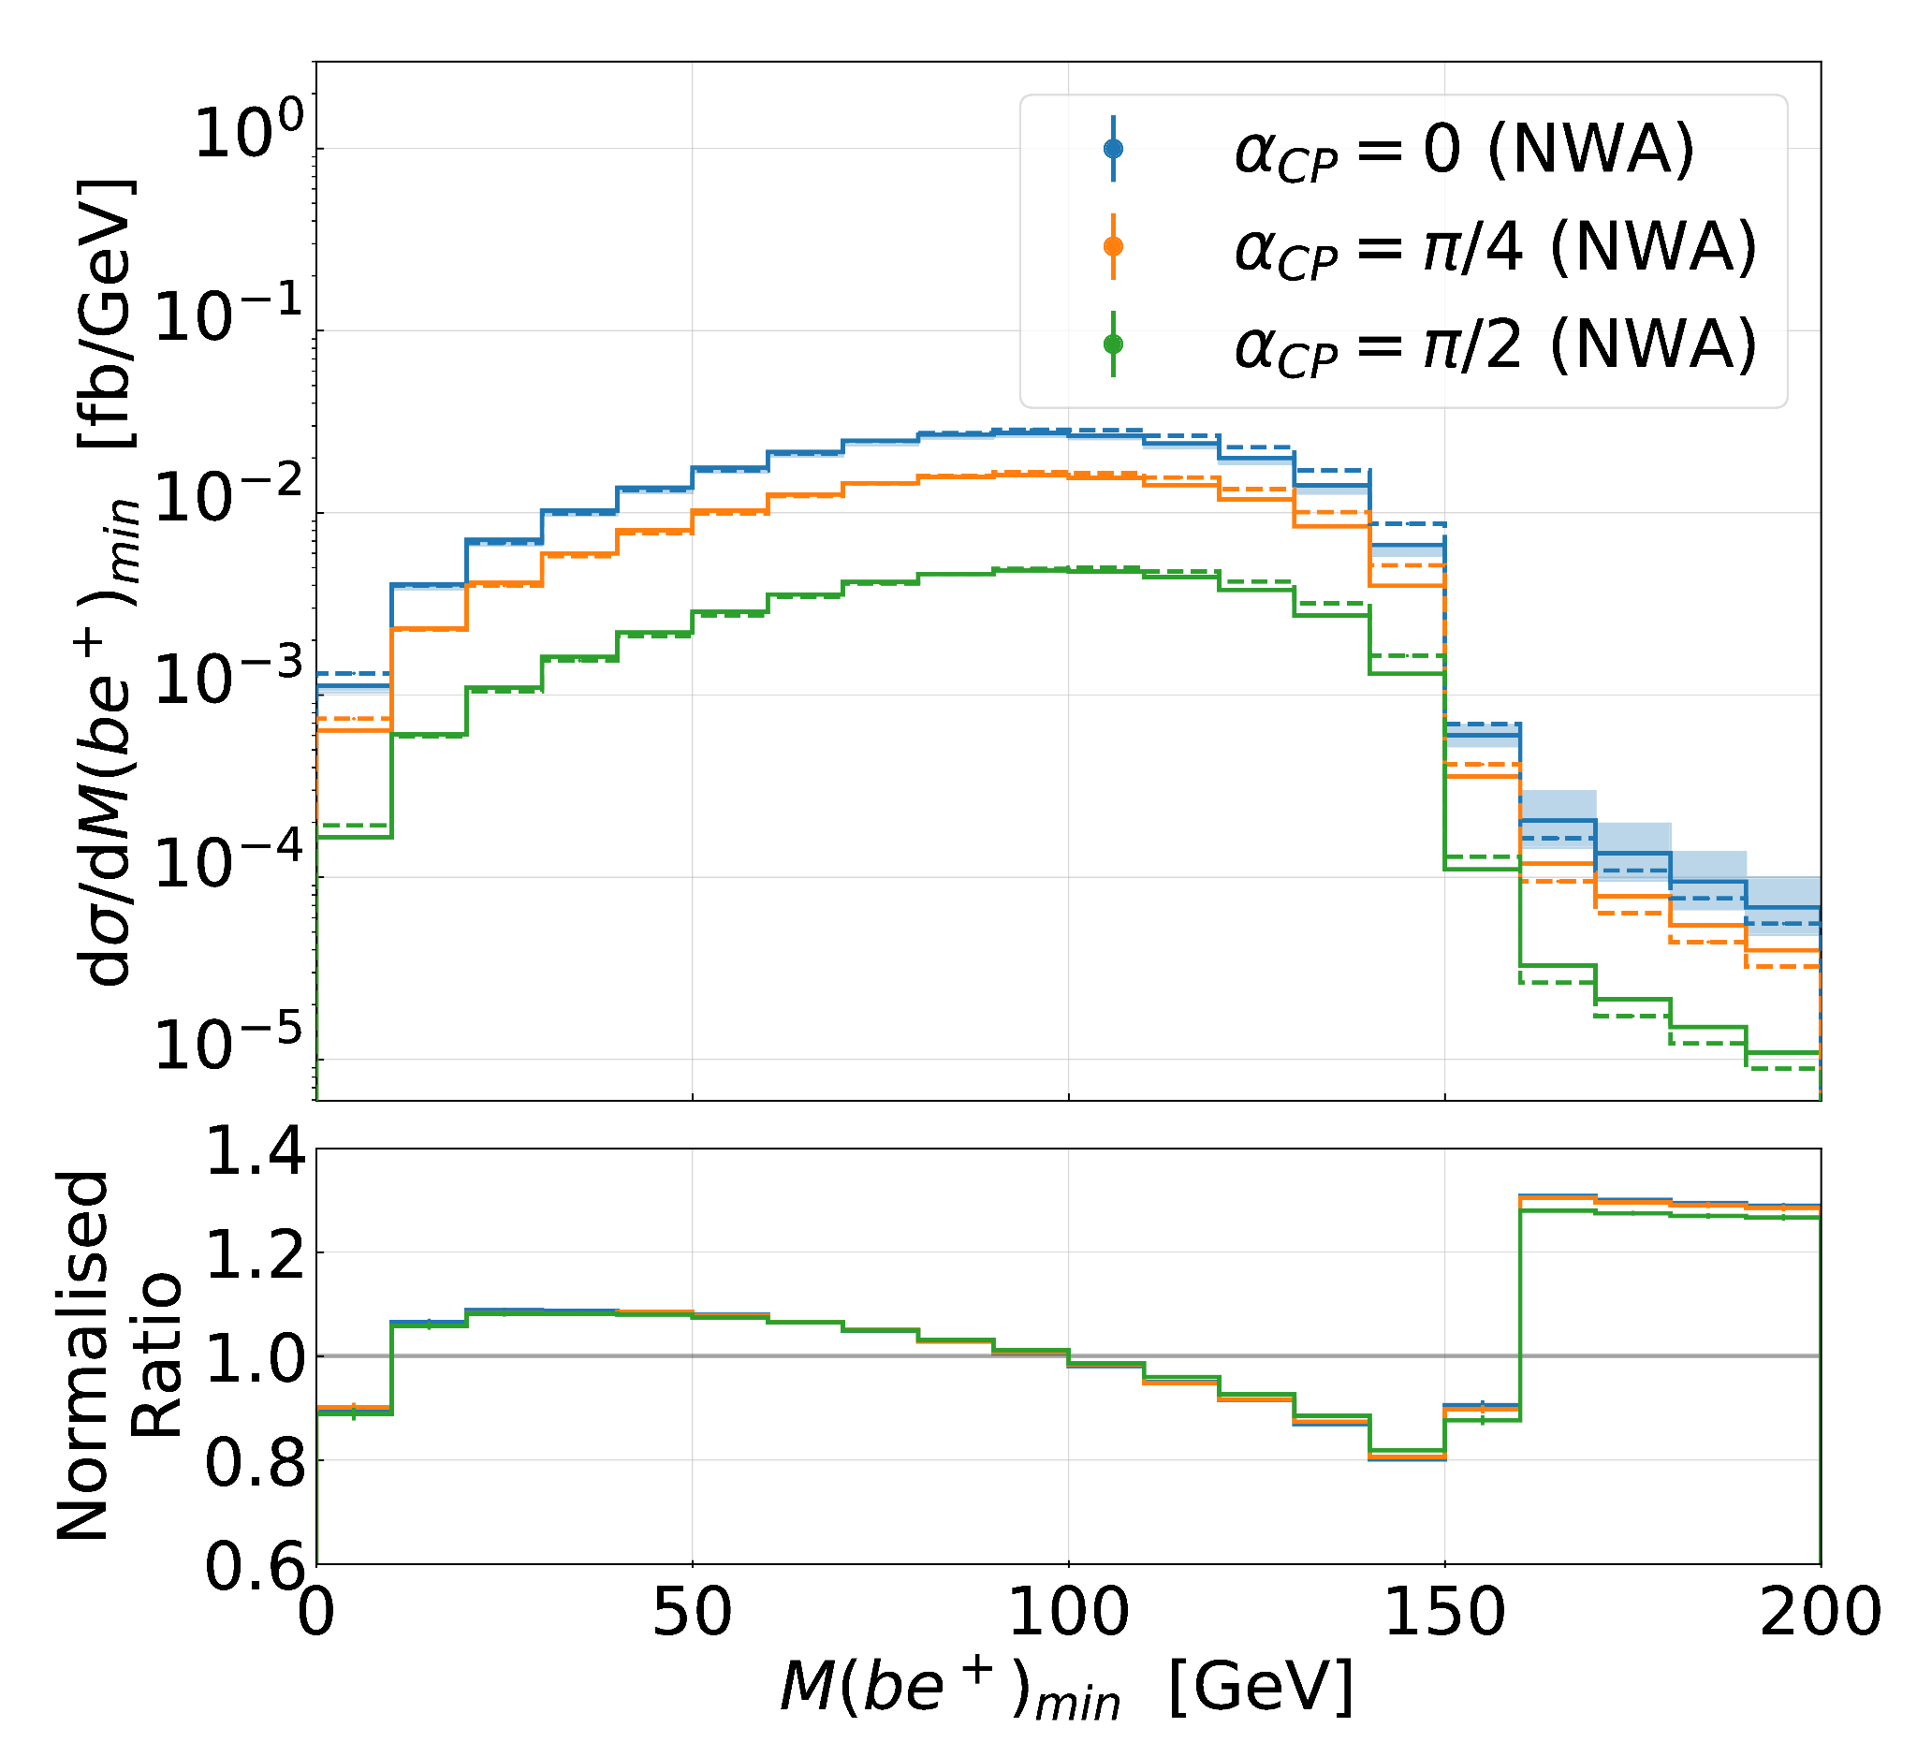
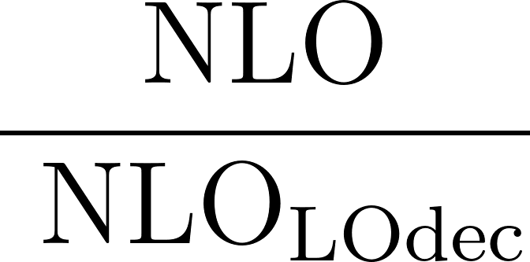
Differential distributions - NLO corrections
NLO corrections to top-quark decays:
Almost no difference between the CP-states
Significant shape distortions
(both normalised)

Slide 17
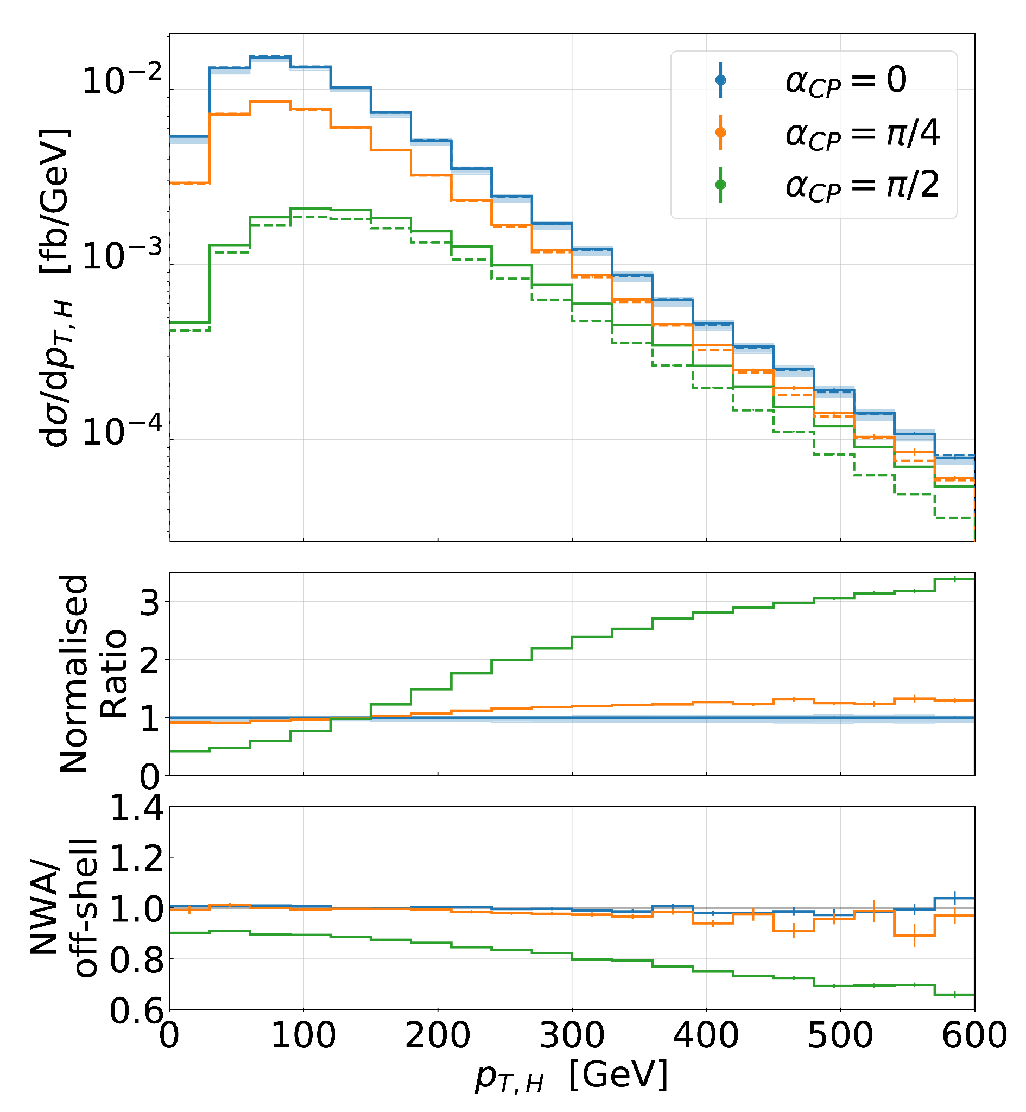
Differential distributions
Shape comparison:
CP-even and CP-mixed similar, small difference in tails
Tails much more pronounced in CP-odd case
Off-shell
NWA
Off-shell effects:
Large effects on size and shape for CP-odd Higgs boson
Only small effects for CP-even and CP-mixed

Slide 18
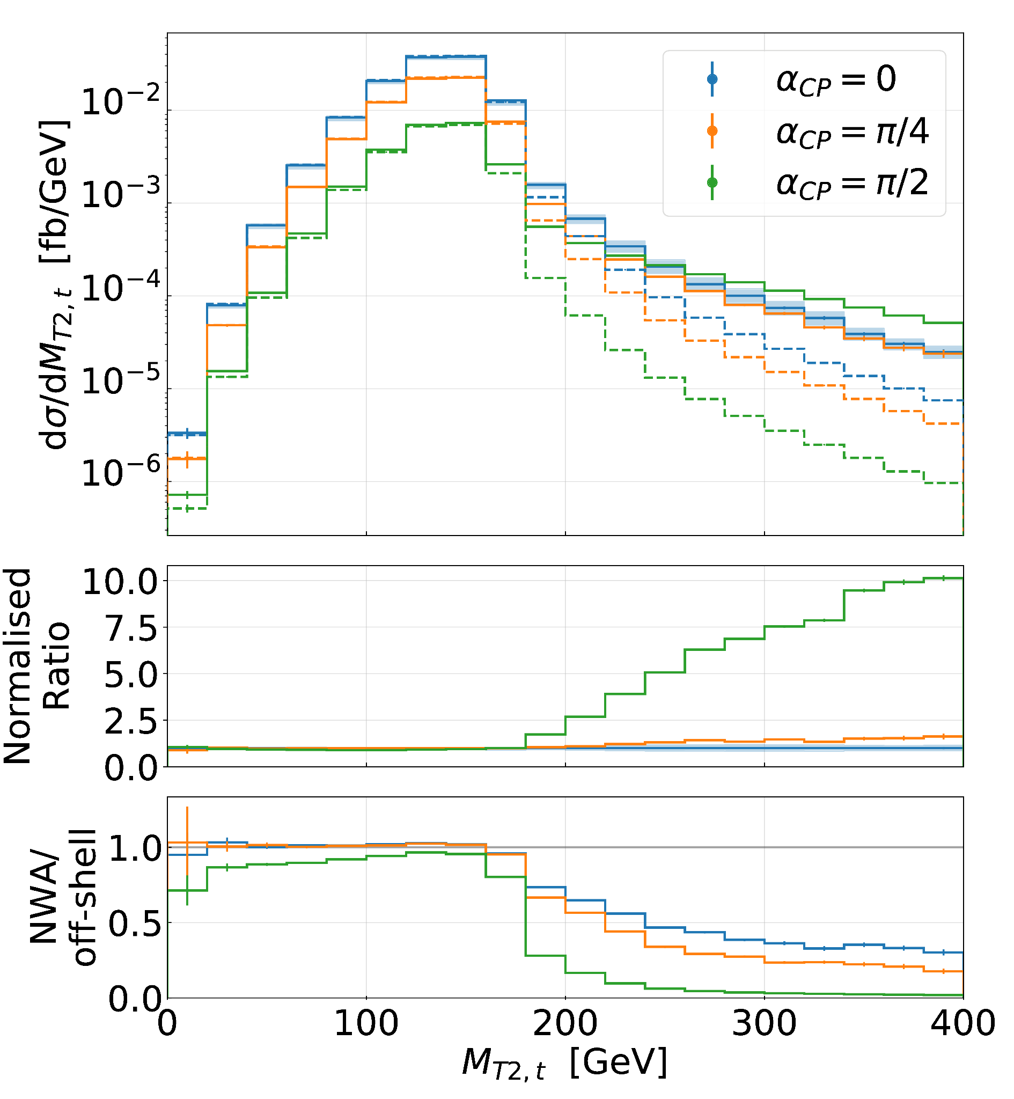
Differential distributions
Shape comparison:
CP-even and CP-mixed similar, large difference in tails
In the tails, the CP-odd cross-section is actually the largest
Off-shell effects:
Large effects for all CP-states above kinematic edge, largest for CP-odd
Notes:
Harder radiation in PS case softens the kinematic edge

Slide 19
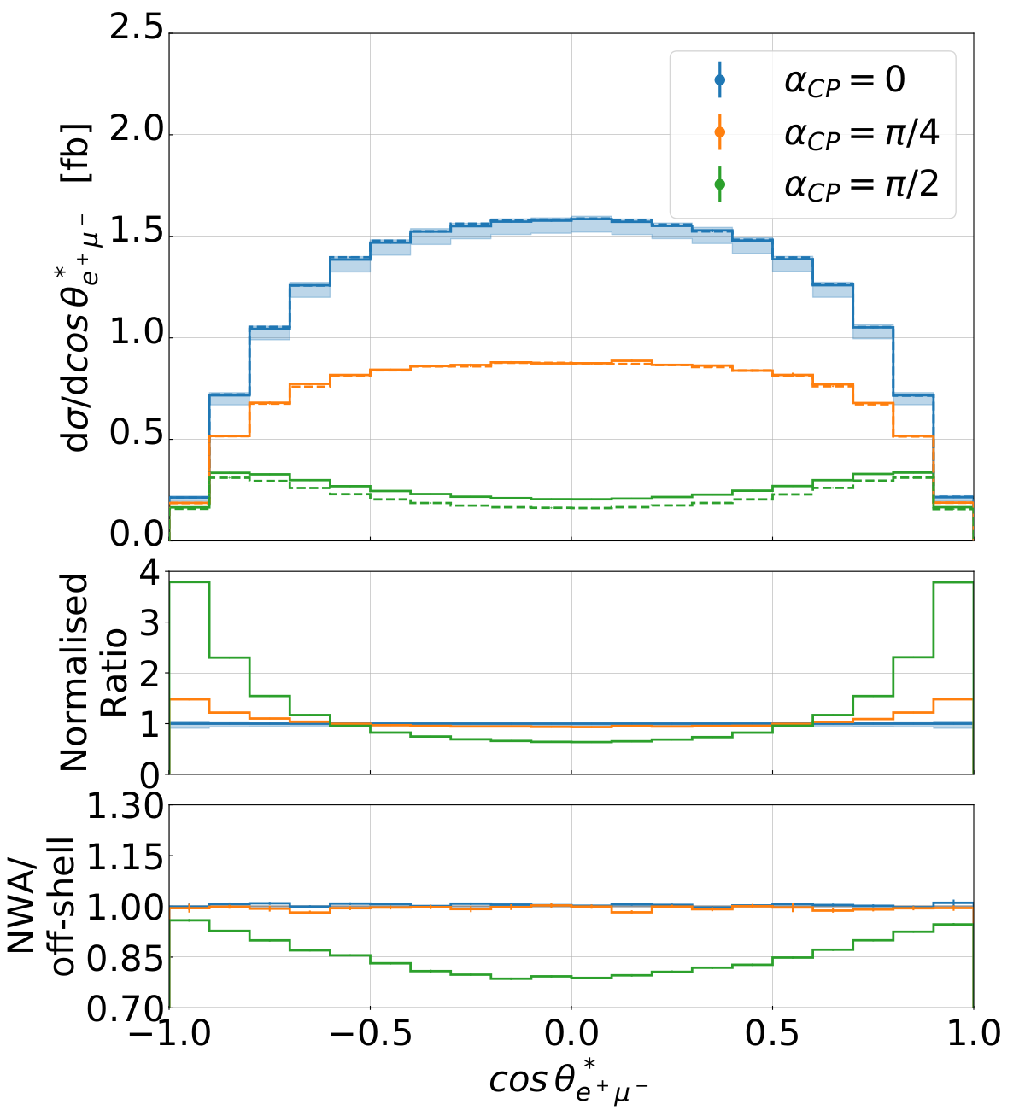
Differential distributions
Shape comparison:
CP-even and CP-mixed similar, small differences around 1 and -1
Significant differences for CP-odd case
Off-shell effects:
Significant effects on size and shape for CP-odd Higgs boson
Only small effects for CP-even and CP-mixed
Notes:
Harder radiation in PS case softens the kinematic edge

Slide 20
Conclusions
Which observables are sensitive to the CP-state?
Integrated fiducial cross-section (total rate)
Observables with kinematic edges (iiiiiiiiiiiiiiiiiiiiii)
Observables involving decay products of both top quarks (iiiiiiiiiiiiiiiiii iiiiiiiii)
How are the different CP-states affected by NLO QCD corrections?
Larger overall corrections for CP-odd Higgs boson but smaller shape distortions
CP-mixed very similar to CP-even (SM) case
How are the different CP-states affected by off-shell effects?
Large corrections in CP-odd case even for integrated cross-section
Off-shell effects break symmetry of integrated cross-section
Particularly large effects in distribution tails and above kinematic edges

Slide 21
Thank you for your attention!

Slide 22
Backup

Slide 23
Outline
Introduction
The Higgs characterisation framework
Off-shell effects
Integrated fiducial cross-sections
Differential fiducial cross-section distributions
Conclusions

Slide 24
Inputs
PDF:
Parameters:

Slide 25
Inputs
Cuts:
Jet-clustering:
Scale choice:
Scale variation:

Slide 26
Integrated fiducial cross-sections (NLO)
Expanded NWA:
CP-even: 2.418 fb (-2.3 %)
CP-mixed: 1.417 fb (-2.4 %)
CP-odd: 0.416 fb (-3.2 %)
Notes:
Results are different from Daniel’s since we used different inputs
NLO corrections within LO uncertainties

Slide 27
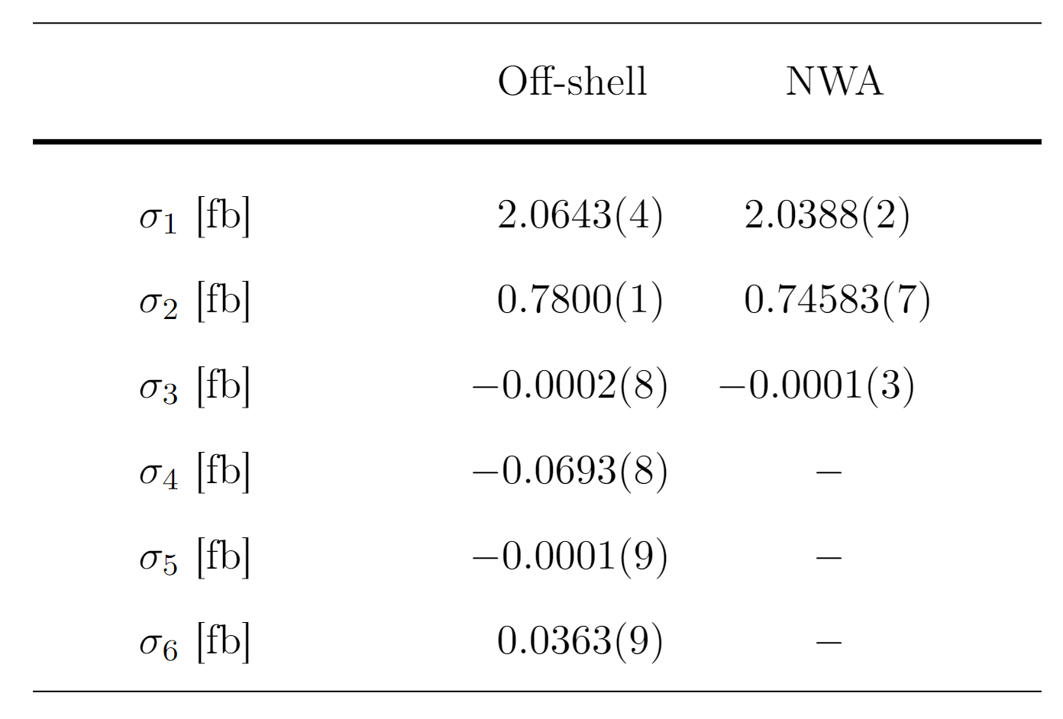
Integrated fiducial cross-sections (LO)
Interpolation formula:
No interference between diagrams with CP-even and CP-odd Yukawa interactions
No interference between diagrams with HVV and CP-odd Yukawa interactions
No HVV couplings in NWA

Slide 28
Integrated fiducial cross-sections (LO)
Interpolation formula (without vanishing terms):
First two terms are symmetric in
Last term is either constant (iiiiiiiiiiiiii iii) or symmetric (iiiiiiiiiiiiiiiiiiiiiiiiiiii) with respect to
Interference between diagrams with HVV and CP-even Yukawa interactions breaks the symmetry

Slide 29
Integrated fiducial cross-sections (NLO)
Interpolation formula (without vanishing terms):
Problem: The virtual contributions do not factorise in this manner
→ Interpolation much more complicated
Example diagram?

Slide 30
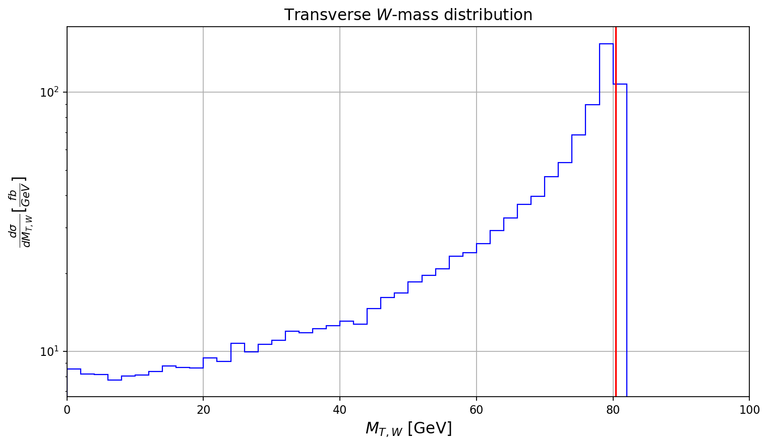
The ‘stransverse’ mass - idea
Reconstruct the W mass:
Transverse mass:
reconstruct mass of particle with partly invisible final state
beam axis (z)
Only know the momenta in transverse plane
Define mass & momenta in transverse plane
where
Notes:
plot with two resonant t and W
plot with transverse mass m_T_W -> reconstruct m_W
mT2 to reconstruct mass for two intermediate particles
definitions for mT2_W, m_T2_t (as extension)

Slide 31
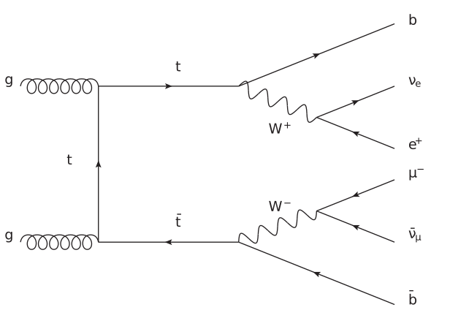
The ‘stransverse’ mass - idea & definition
‘Stransverse’ mass:
generalization for two particles with partly invisible final state
Only know the sum of the momenta in transverse plane
Minimize over all missing momentum combinations
Notes:
plot with two resonant t and W
plot with transverse mass m_T_W -> reconstruct m_W
mT2 to reconstruct mass for two intermediate particles
definitions for mT2_W, m_T2_t (as extension)

Slide 32
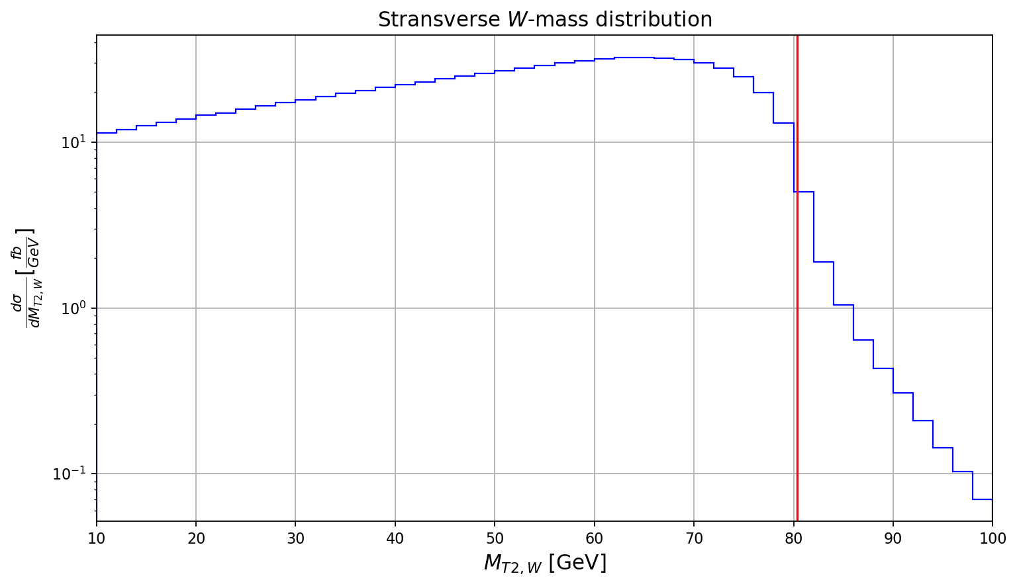
The ‘stransverse’ mass - distribution
Not a ‘hard’ cut-off but drop-off is clearly visible
Notes:
plot with two resonant t and W
plot with transverse mass m_T_W -> reconstruct m_W
mT2 to reconstruct mass for two intermediate particles
definitions for mT2_W, m_T2_t (as extension)

Slide 33
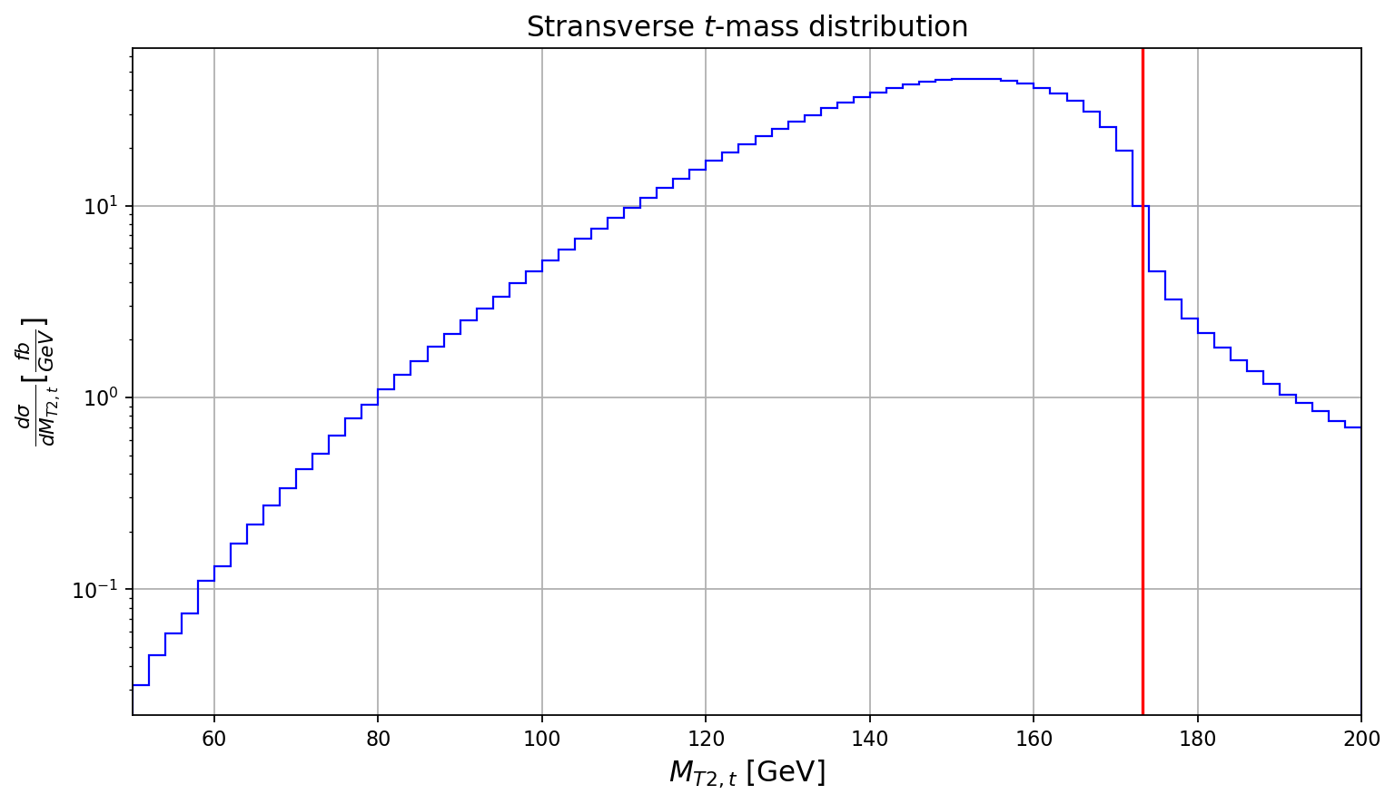
The ‘stransverse’ mass - distribution
We can do the same for the top quarks:
Use b-jet + lepton instead of lepton as visible, massive ‘particle’
Problem: which jet is associated with which lepton?
take minimum of invariant b-jet + lepton mass combinations
minimize the sum of the two invariant masses to avoid combining one lepton with both b-jets
Notes:
plot with two resonant t and W
plot with transverse mass m_T_W -> reconstruct m_W
mT2 to reconstruct mass for two intermediate particles
definitions for mT2_W, m_T2_t (as extension)

Slide 34
The ‘stransverse’ mass - definition
where
Lepton + b-jet combinations chosen such that
is minimal
Notes:
plot with two resonant t and W
plot with transverse mass m_T_W -> reconstruct m_W
mT2 to reconstruct mass for two intermediate particles
definitions for mT2_W, m_T2_t (as extension)

