Slide 1

Overview of in-ice radio simulations for neutrino detection
Christian Glaser

Slide 2
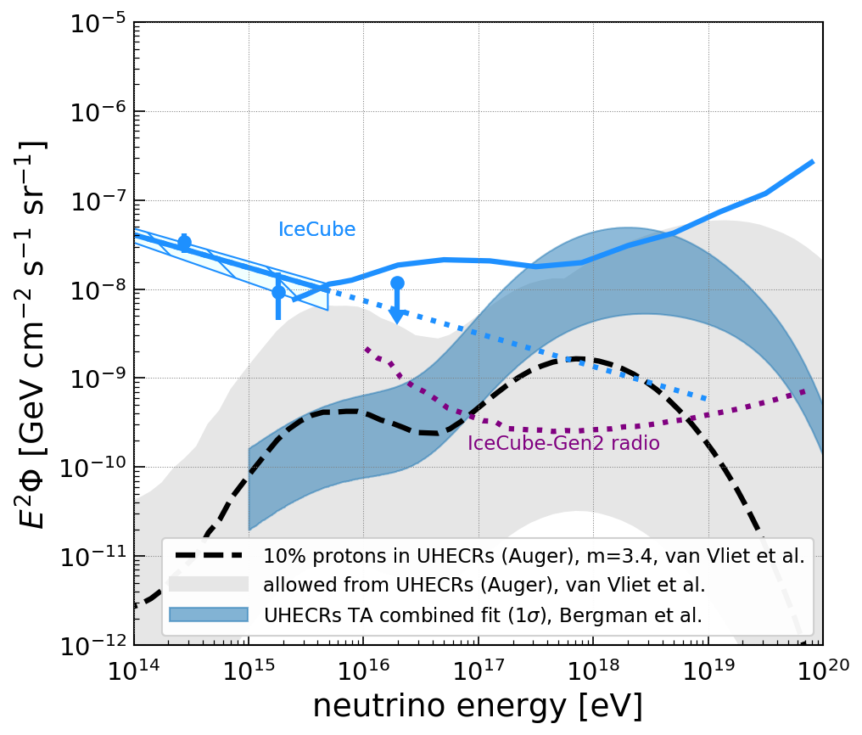
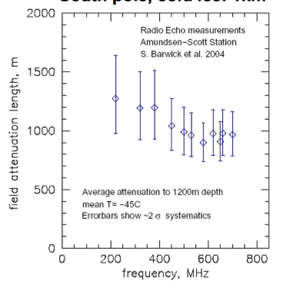

Going to ultra-high energies
neutrino spectrum
Low interaction cross section of neutrinos
Very low neutrino flux
Very large volumes needed for reasonable rates
Solution: radio technique
  Large volumes at no cost: Antarctic ice
  Ice transparent to radio waves (L ~ 1km)
  A single radio station has 1km³ effective volume (comparable to IceCube)
=
optical
radio
Notes:
The properties that make a neutrino a great messenger particle also make it very challenging to detect neutrinos on Earth. Their low interaction cross section and the very low neutrino flux require the instrumentation of large volumes to detect neutrinos with reasonable rates. This plot shows the neutrino flux as a function of their energy. The y-axis is multiplied by the energy squared. Hence, a horizontal line actually means that the flux drops by two orders of magnitude if the energy is increased by a factor of 10x. On the left side we see the astrophysical neutrino flux measured by the IceCube neutrino detector, an optical detector at the South Pole. However, its sensitivity is limited by its size to about 1e7 GeV (=1e16 eV). The upper energies are largely unexplored, but this is the energy region connected to ultra-high energy cosmic rays and thus the region where we can study the most violent phenomena in our universe.
The solution to explore the high energy region is the radio technique. The two main advantages are that we get large volumes for essentially no costs by using the Antarctic ice, and that the ice is transparent to radio waves. The attenuation length is larger than 1km. Hence, a single radio station already observes an effective volume of one cubic kilometer. That mean that a single radio detector station is as sensitive as the complete IceCube detector.

Slide 3
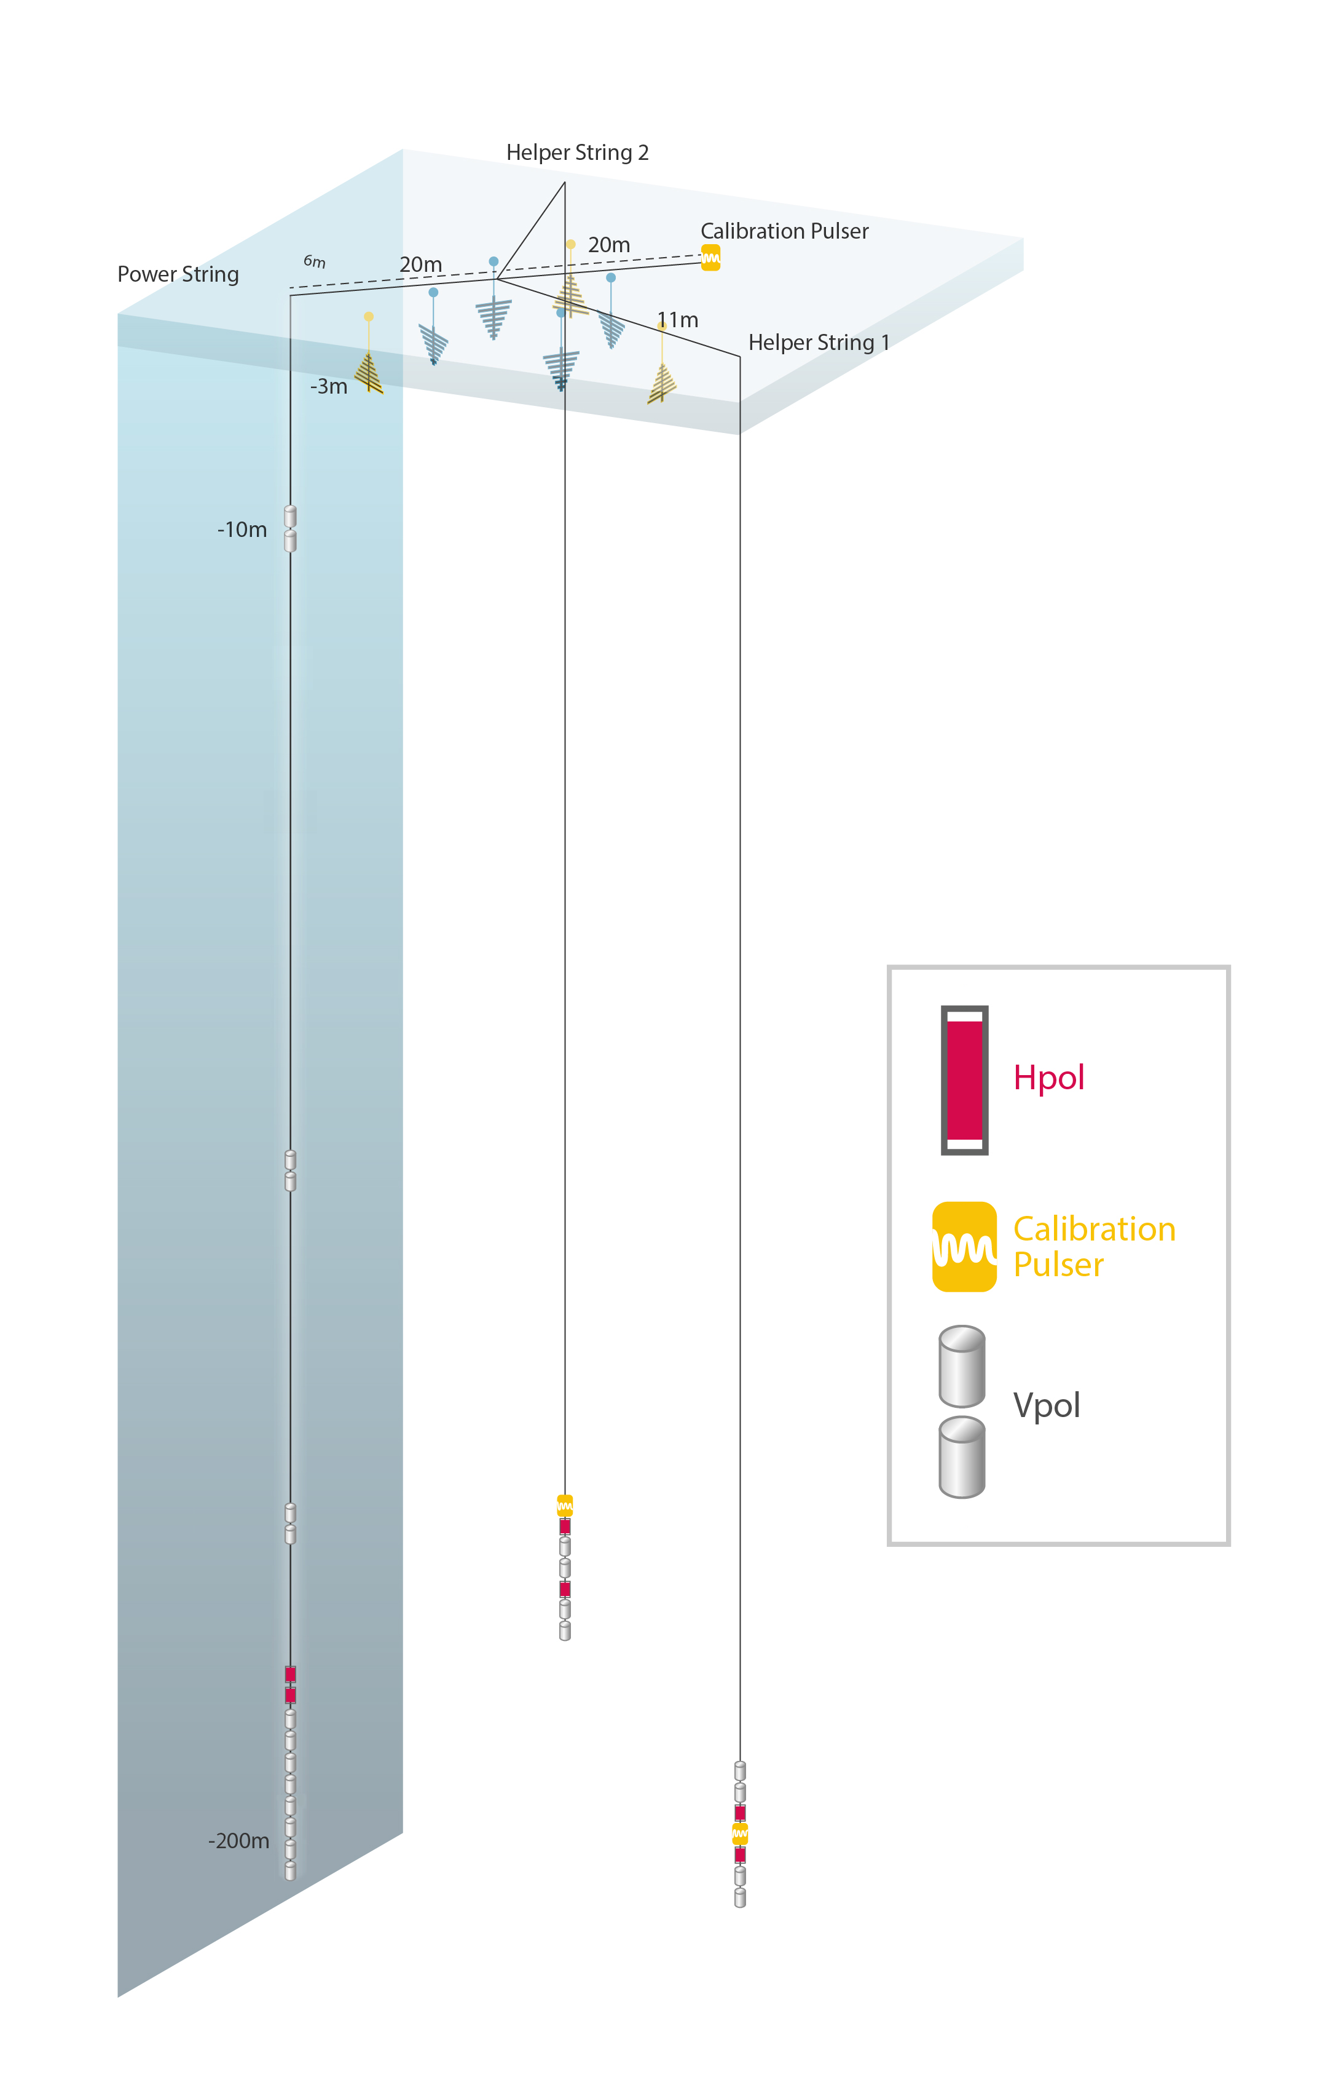
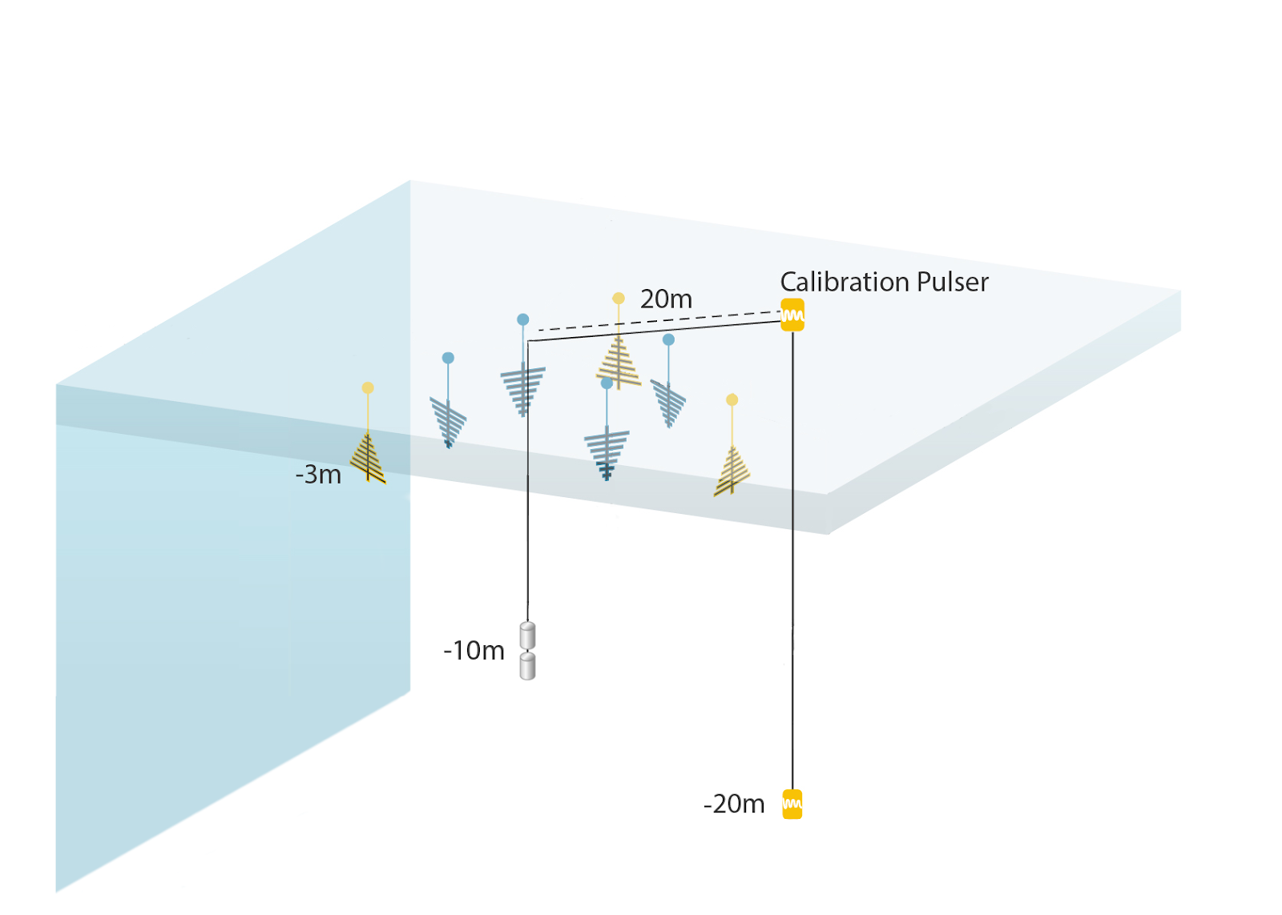
Experimental Landscape
ARIANNA test bed
12 shallow stations at Moore’s Bay + South Pole
ARA
5x 200m deep stations at South Pole
Radio technology developed and verified; hardware proven reliable
RNO-G
35 detector stations in Greenland
first deployment summer 2021
past
IceCube-Gen2
300+ detector stations at South Pole
hybrid array of deep and shallow stations
now
future
S. Hallmann et al., PoS(ICRC2021)1183

Slide 4
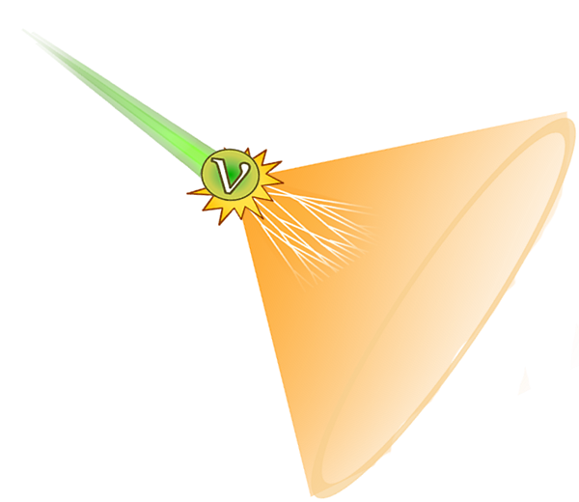
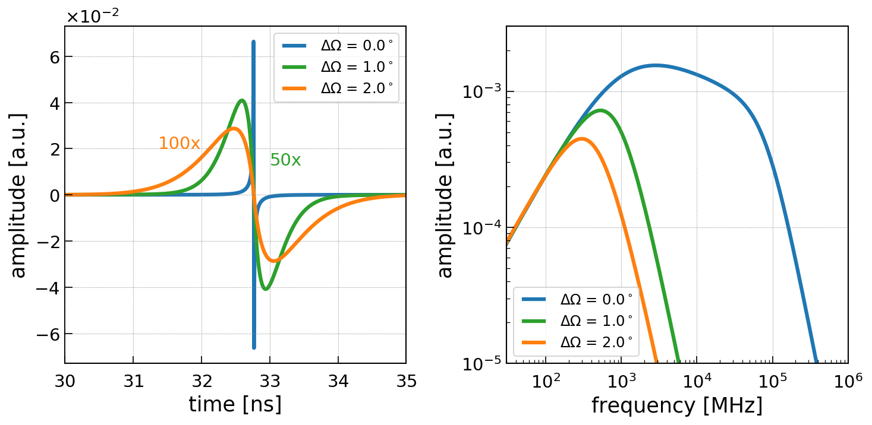
Radio Emission of Particle Showers
Askaryan effect: Negative charge excess in the shower front
Notes:
So where does the radio emission come from. When a neutrino interacts in the ice, due to its enormous energy it creates a large cascade of secondary particles. This particle shower has a negative charge excess in the shower front that changes in time which produces a short radio pulse. This is called the Askaryan effect. This plot shows how a typical neutrino radio pulse looks like. The pulse is very short. Depending on the angle under which the shower is observed, it ranges from a less than a nano second to a few nano seconds. This corresponds to frequencies of roughly 100MHz to 1GHz. Hence, we can observe neutrinos by installing antennas close to the ice surface.

Slide 5
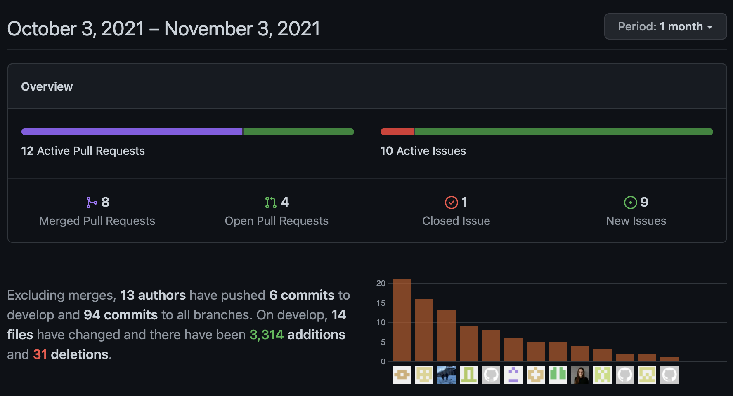
NuRadioMC Overview
C. Glaser et al., EPJ-C 79: 464 (2019)
C. Glaser et al., EPC-C 80, 77 (2020)
D. Garcia et al, Rev. D 102 083011 (2020)
From neutrino interaction to detector output
Modular python code (C++ modules for time critical operations)
Open source: github.com/nu-radio/NuRadioMC
Community wide effort, started in 2018, now 20+ contributors
More flexible, faster, more precise modelling of physics

Slide 6
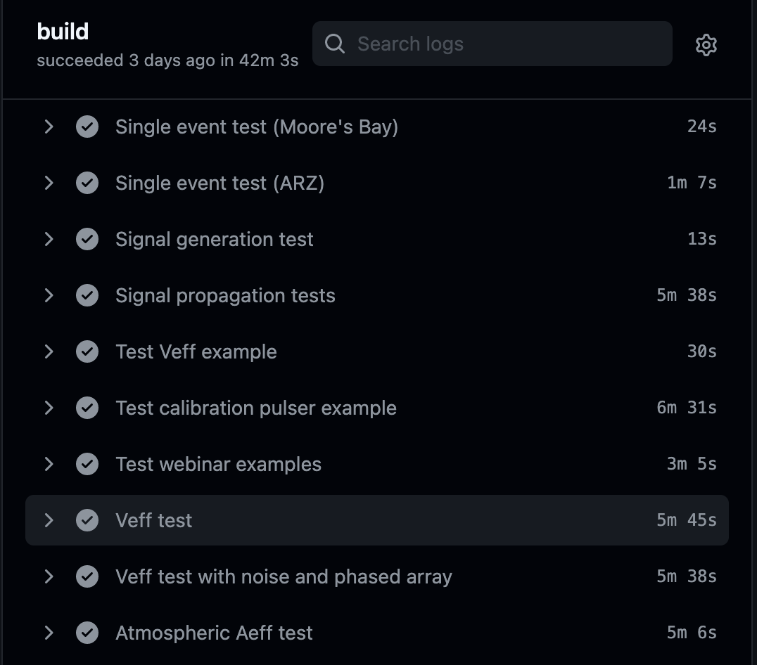
NuRadioMC Overview
C. Glaser et al., EPJ-C 79: 464 (2019)
C. Glaser et al., EPC-C 80, 77 (2020)
D. Garcia et al, Rev. D 102 083011 (2020)
From neutrino interaction to detector output
Modular python code (C++ modules for time critical operations)
Open source: github.com/nu-radio/NuRadioMC
Community wide effort, started in 2018, now 20+ contributors
More flexible, faster, more precise modelling of physics
Accuracy:
  Extensive comparison with existing codes:
  agreement within 10% for the same physics settings
  automatic testing of relevant components
  review of every code addition

Slide 7
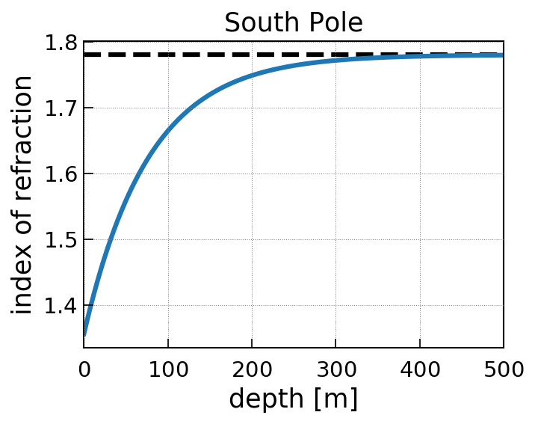
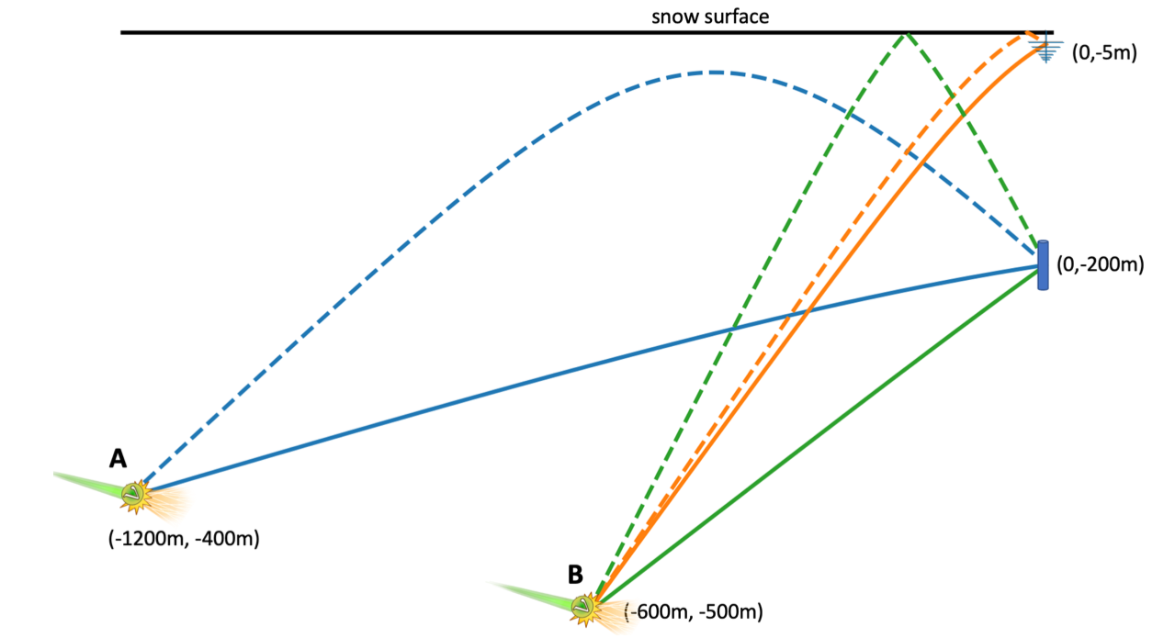
Signal Propagation
shadow zone

Slide 8
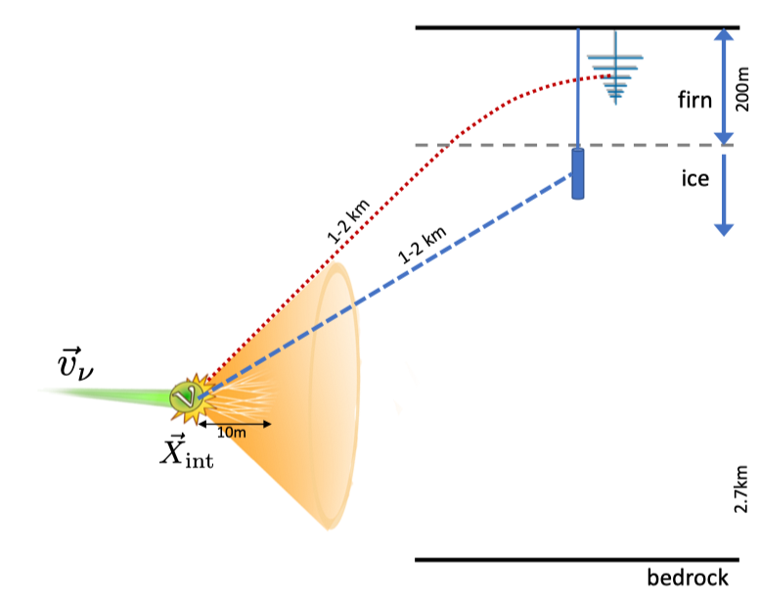
Overview: Radio detection of neutrinos
Neutrino interaction
Askaryan emission
Signal
Propagation
Detection

Slide 9
Overview: Radio detection of neutrinos
CORSIKA 8
Neutrino interaction
Askaryan emission
Signal
Propagation
Detection

Slide 10
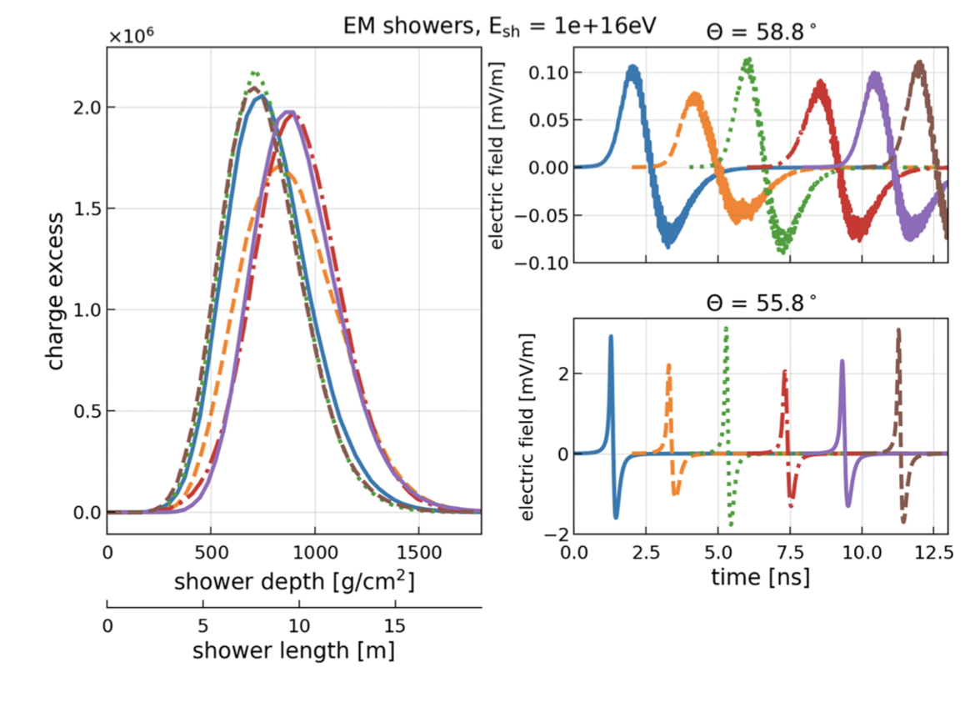
Current state-of-the-art in calculating radio emission
Microscopic shower simulations in homogeneous ice (using ZHAireS)
Semi-analytic formalism to calculate emission for arbitrary charge-excess profiles
  Agrees within 3% with full MC simulation
Alvarez-Muñiz et al., Phys. Rev. D 101, 083005

Slide 11
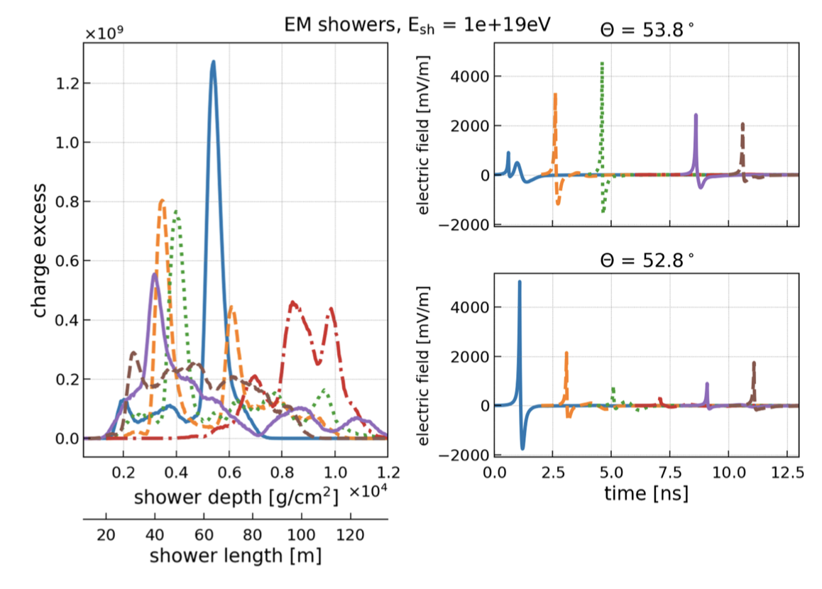
Current state-of-the-art in calculating radio emission
Microscopic shower simulations in homogeneous ice (using ZHAireS)
Semi-analytic formalism to calculate emission for arbitrary charge-excess profiles
  Agrees within 3% with full MC simulation
  Precise calculation of LPM showers
Full end-to-end (from neutrino interaction to detector) simulation codes exist
  e.g. NuRadioMC
So far: Calculations assumed medium with constant index of refraction
Alvarez-Muñiz et al., Phys. Rev. D 101, 083005
C. Glaser et al., Eur. Phys. J. C (2020) 80:77
Goal 1: Microscopic simulation in inhomogeneous medium

Slide 12
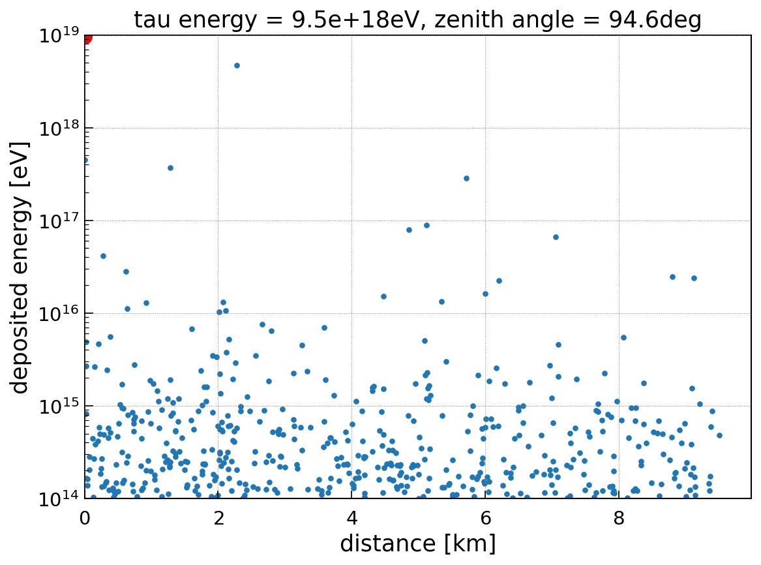
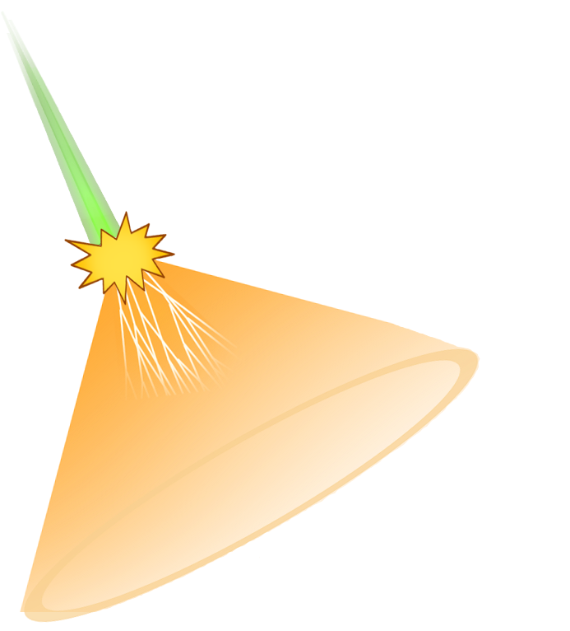
Energy losses of high-energy muon/tau
D. Garcia et al, Rev. D 102 083011 (2020)
1 EeV tau propagating through ice
Simulated using PROPOSAL
Stochastic energy losses > 10¹⁴ eV shown
many low energy showers might interfere constructively
tau
Notes:
Now begins the interesting part of the talk where we simulate the propagation of leptons through the ice. Here we show a 1EeV muon propagating inclined through the ice. We used the PROPOSAL code to calculate the energy losses. In this plot we show all stochastic energy lossed > 1e14eV. All of these dots will initiate a particle cascade that will generate radio emission. We see that 6 particularly high energy deposits that are similar in energy than the initial shower. So instead of just having a large shower from the initial interaction, we get several large showers along the muon trajectory.
In addition, we often get many lower energy showers in close vicinity that might interfere constructively. In our previous publication we ignored this effect, but here we study it in detail.

Slide 13
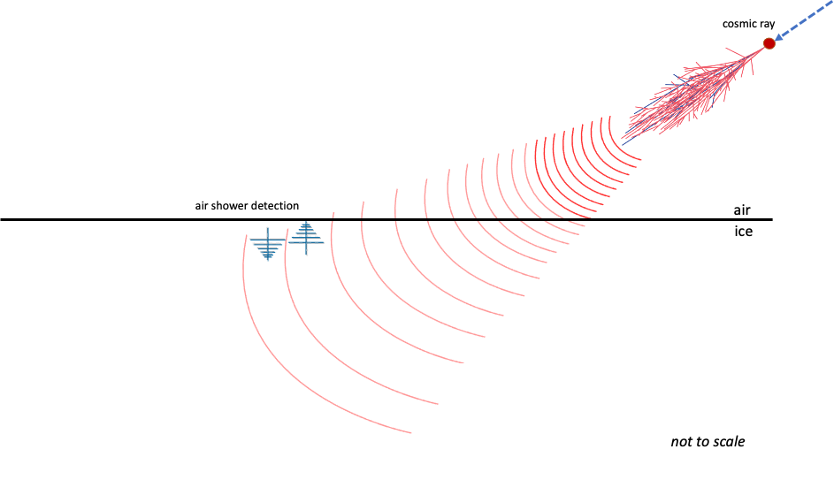
Additional Geometries
Air shower radio emission

Slide 14

Additional Geometries
Air shower radio emission
-> see Uzairs talk

Slide 15
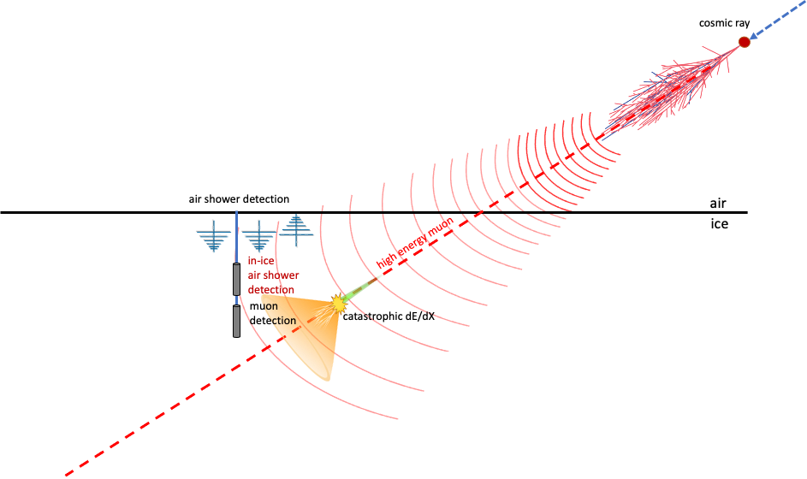
Additional Geometries
Air shower radio emission
High-energy muons
  signature similar to neutrino signal but mostly low energy

Slide 16
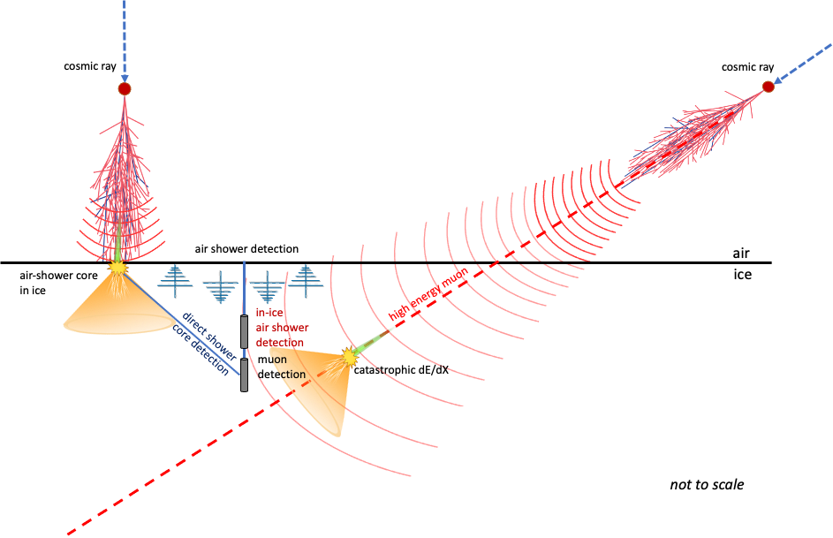
Additional Geometries
Air shower radio emission
High-energy muons
Shower cores
-> see Simons talk

Slide 17
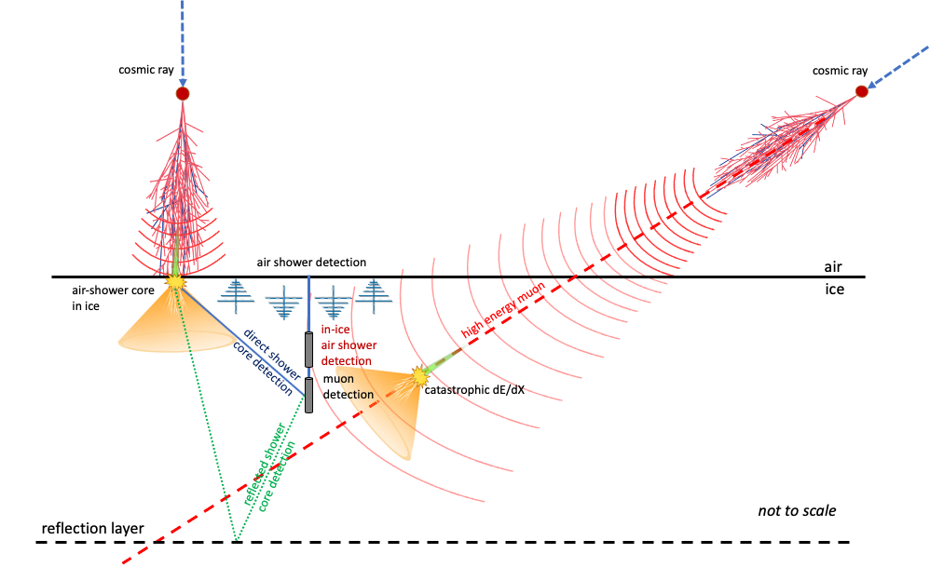
Additional Geometries
Air shower radio emission
High-energy muons
Shower cores

Slide 18
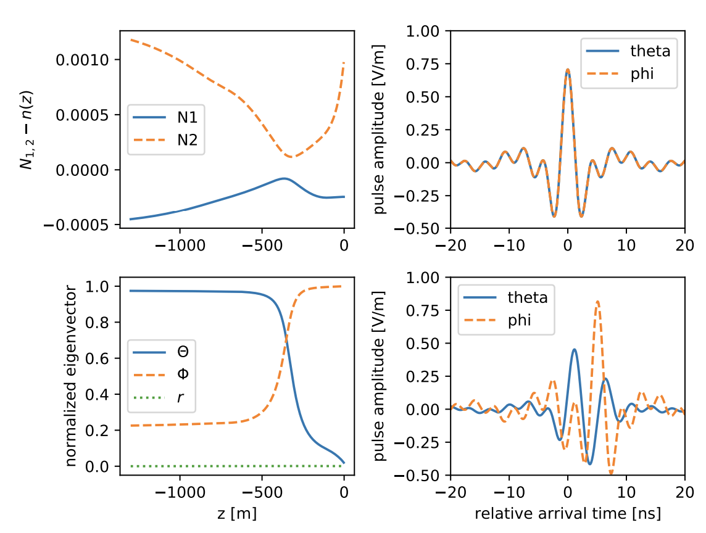
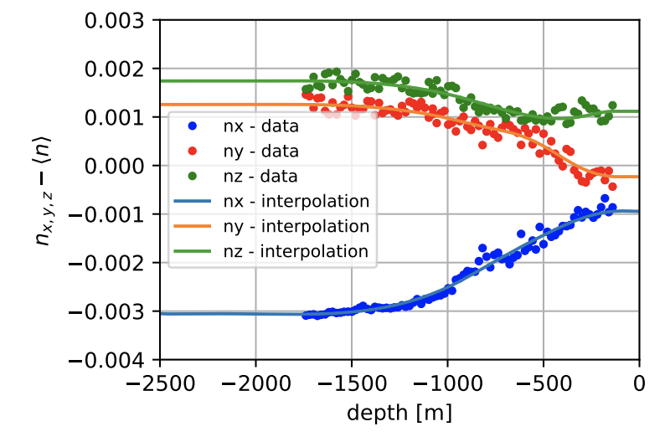
Additional Propagation Effects: Birefringence
N. Heyer, C. Glaser arXiv:2205.06169
Index–of-refraction different for different signal polarizations
Complex interference after propagation
-> propagation time between shower track and receiver not sufficient
any ideas how to model this effect time efficient?

Slide 19
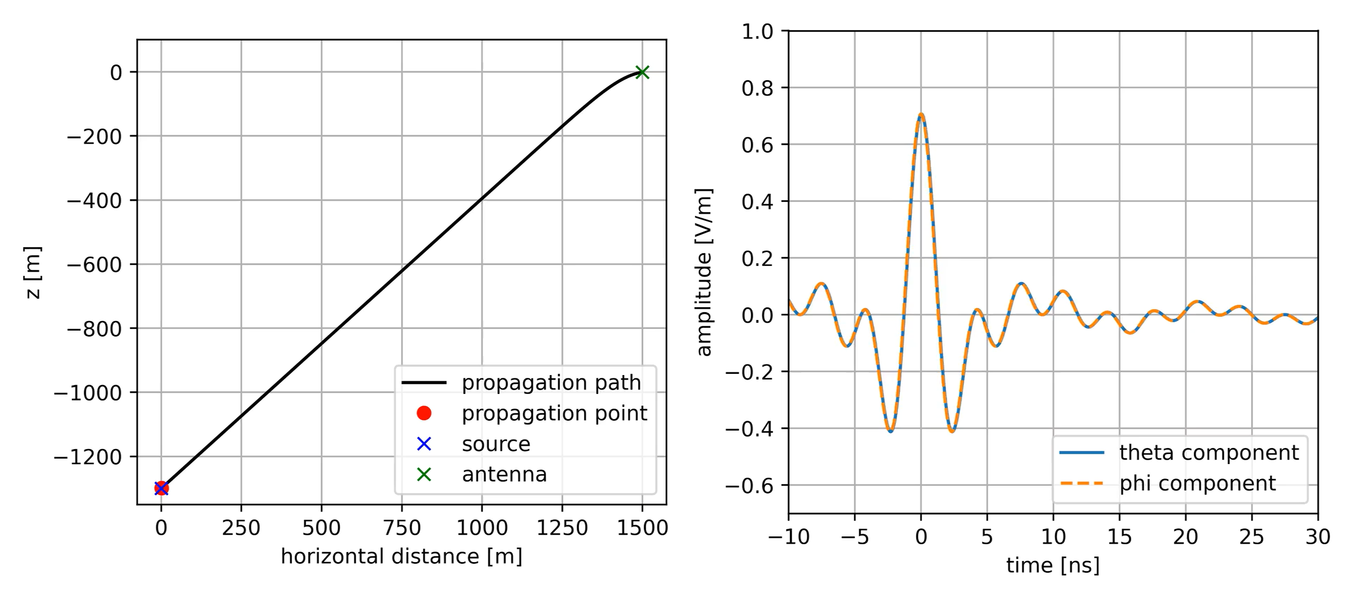
N. Heyer, C. Glaser arXiv:2205.06169
Pulse Propagation (⊥)
19

Slide 20
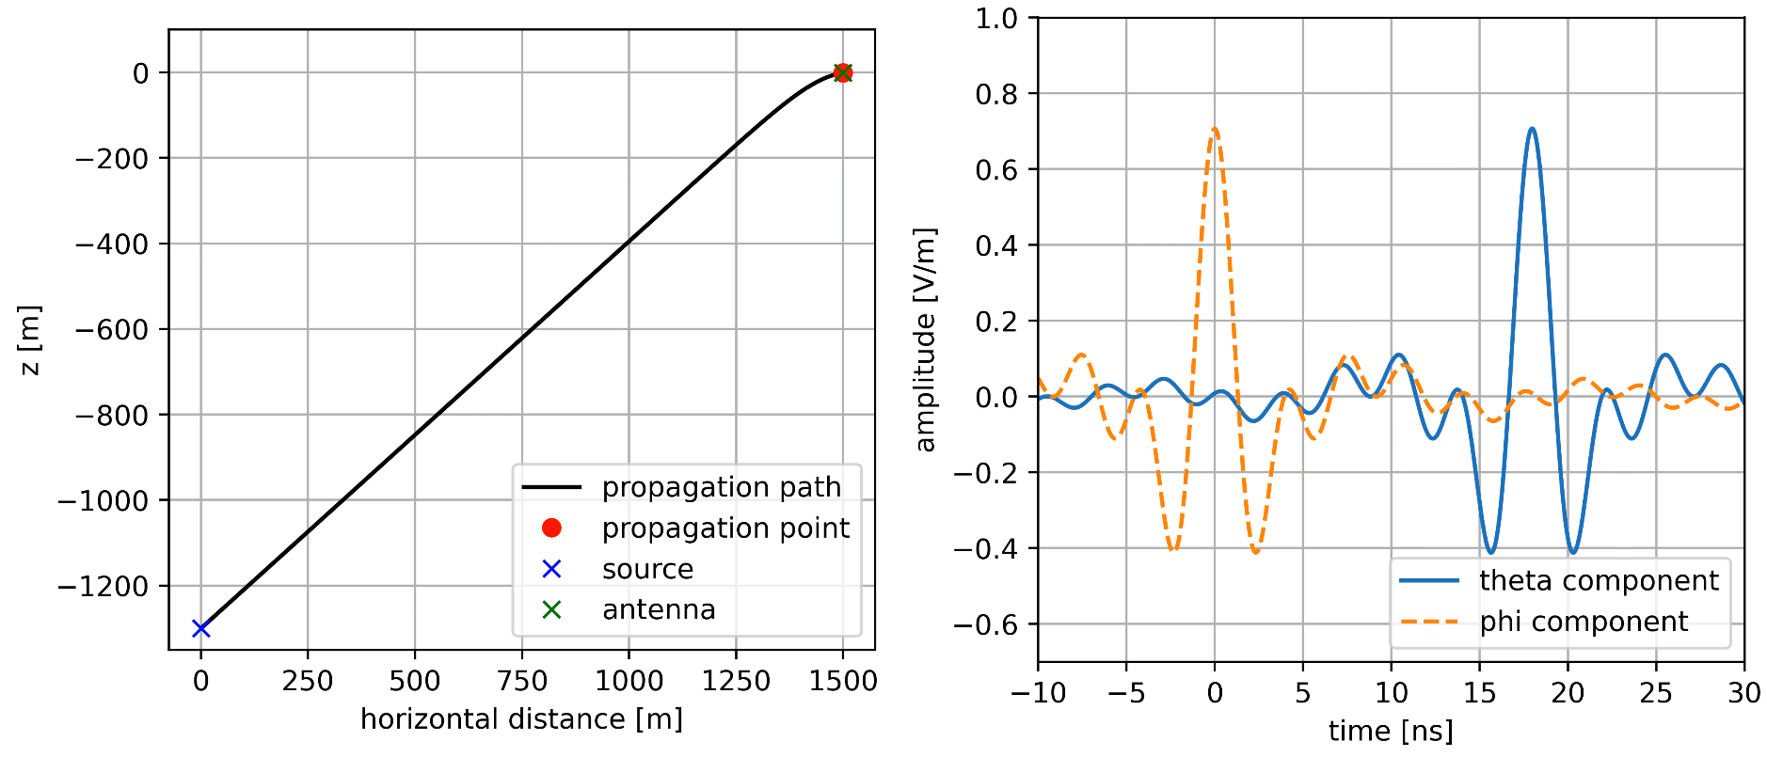
N. Heyer, C. Glaser arXiv:2205.06169
Pulse Propagation (⊥, final state)
20

Slide 21
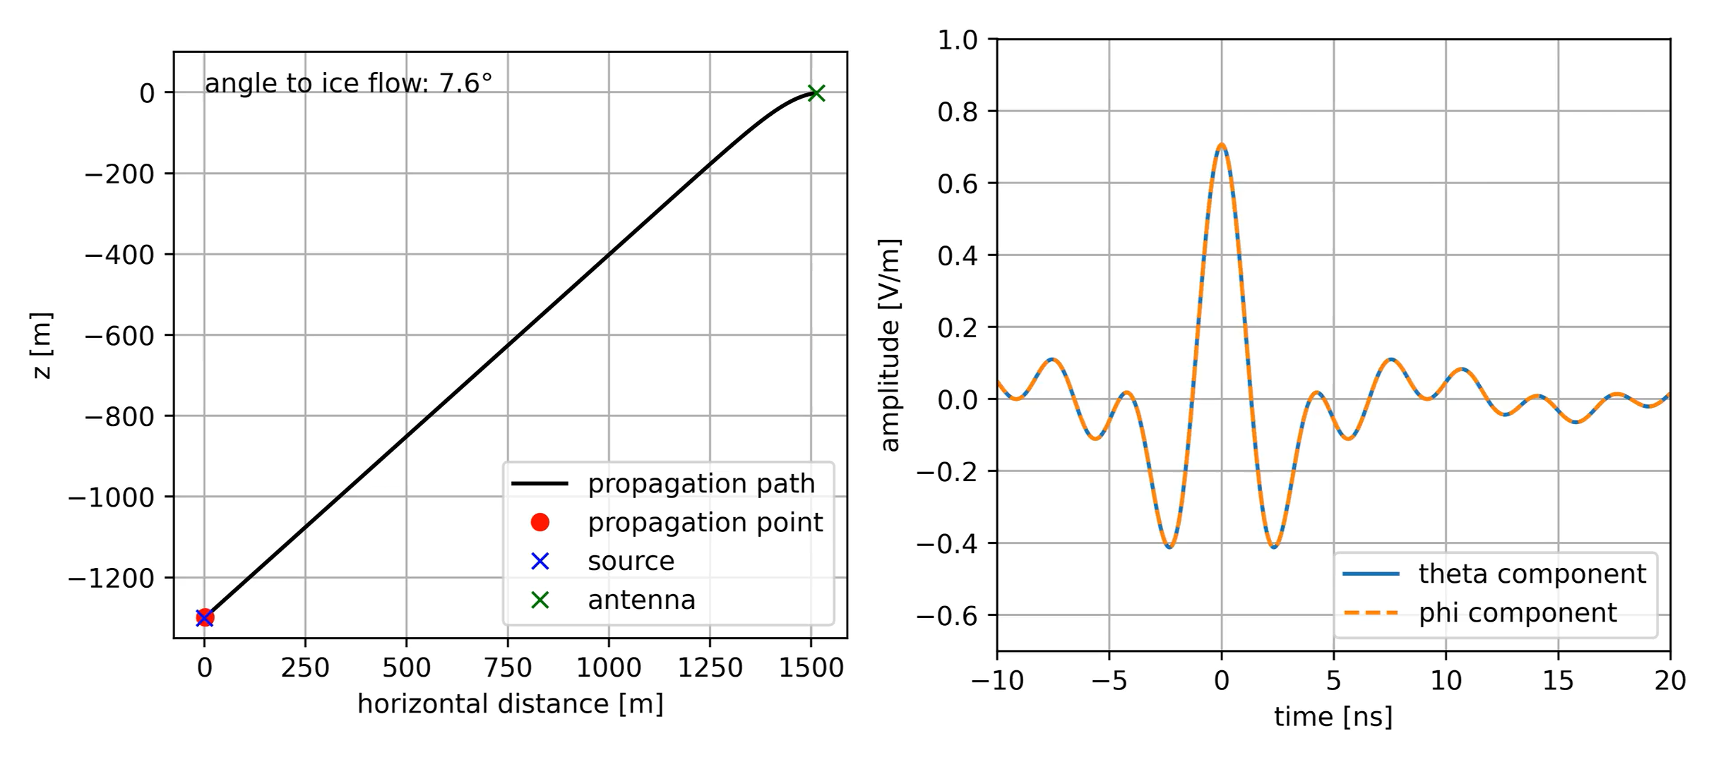
N. Heyer, C. Glaser arXiv:2205.06169
Pulse Propagation (∡)
21

Slide 22
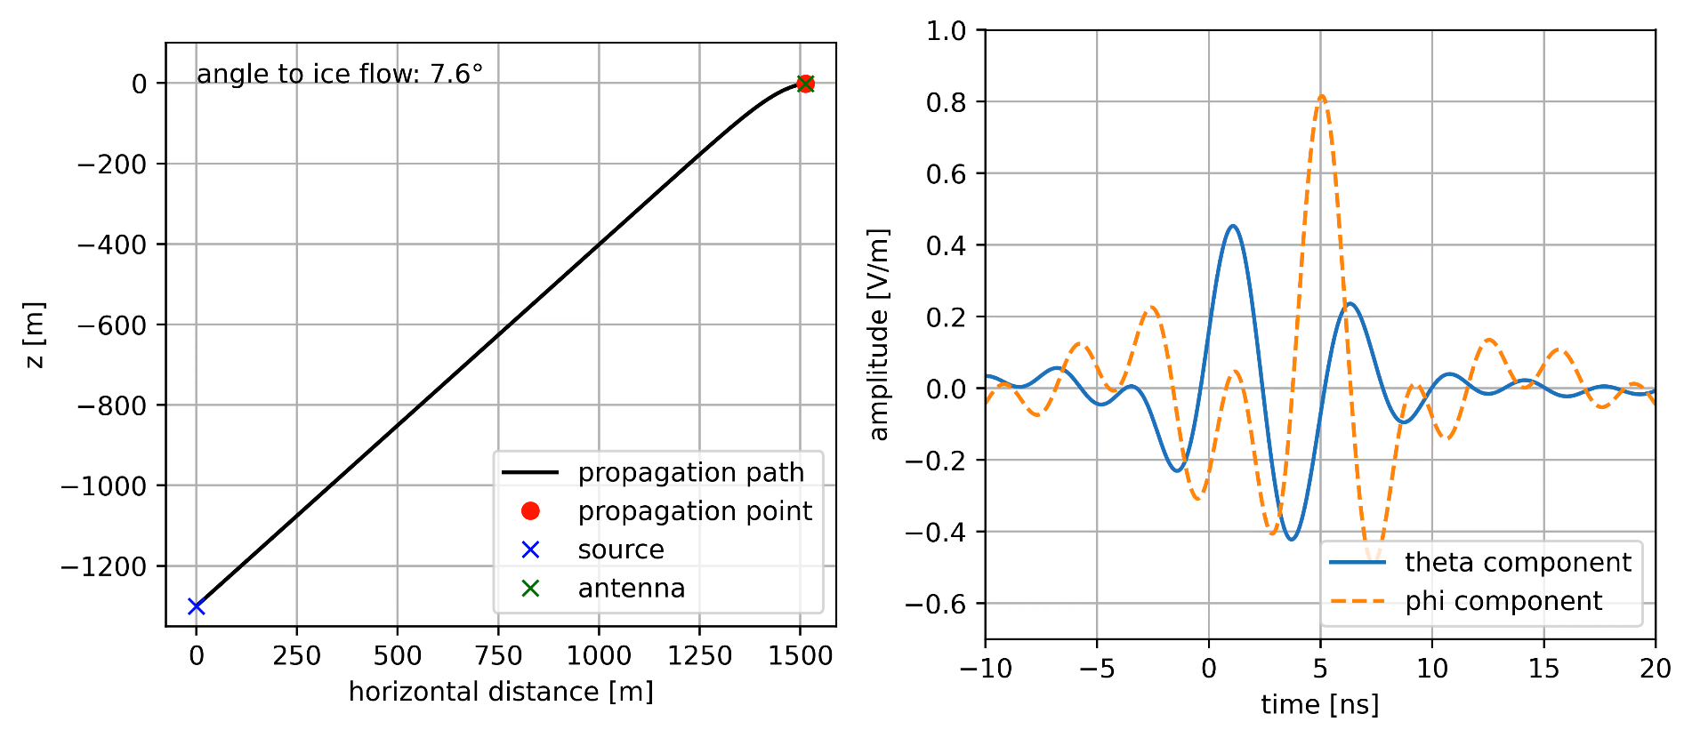
N. Heyer, C. Glaser arXiv:2205.06169
Pulse Propagation (∡, final state)
22

Slide 23
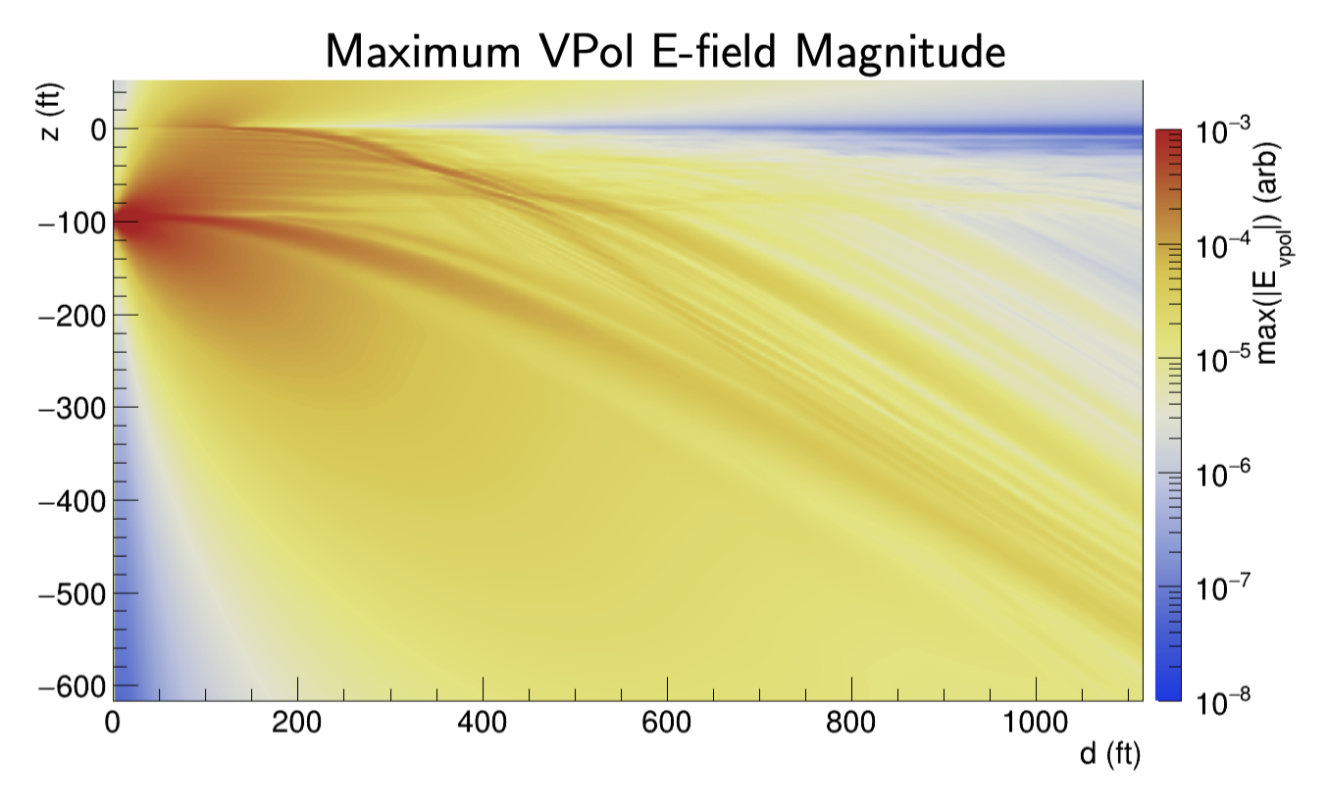
Additional Propagation Effects: Everything
Complex ice properties can lead to propagation effects beyond ray tracing
Solvable via Finite-diﬀerence time-domain (FDTD)
  solves Maxwell’s equation with discretized space / time
  BUT very time consuming (100k core hours for single geometry)
  feasible once for every antenna position/depth
    use reciprocity approach
see e.g. C. Deaconu arXiv:1805.12576

Slide 24
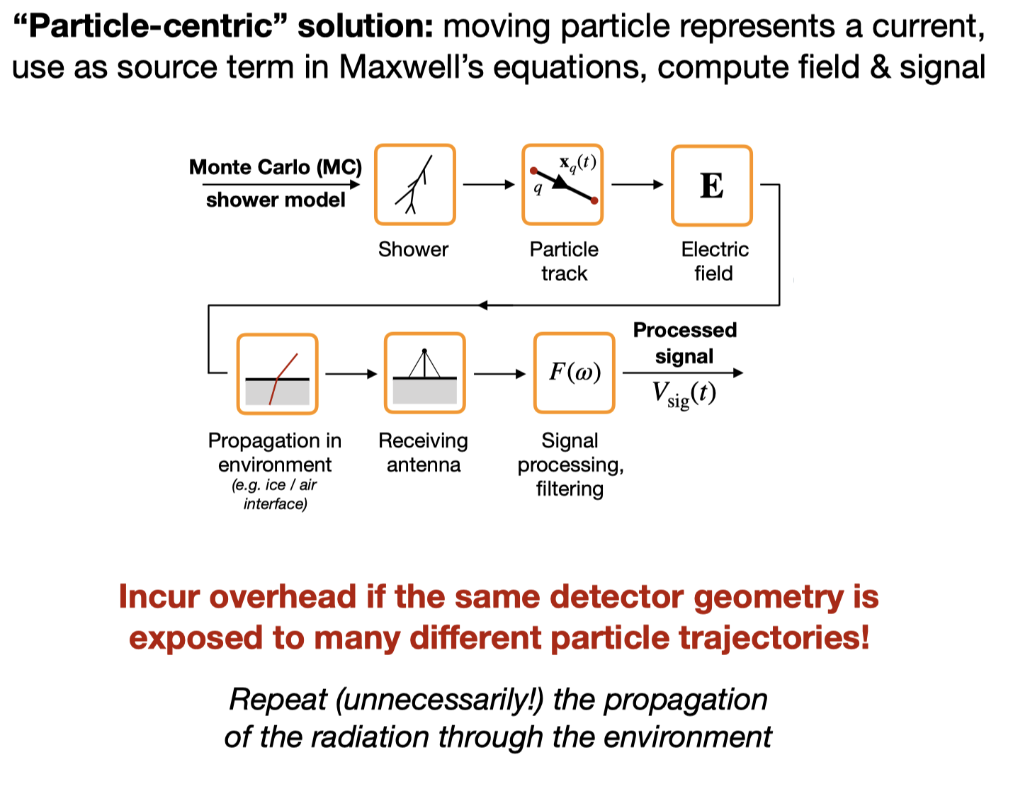
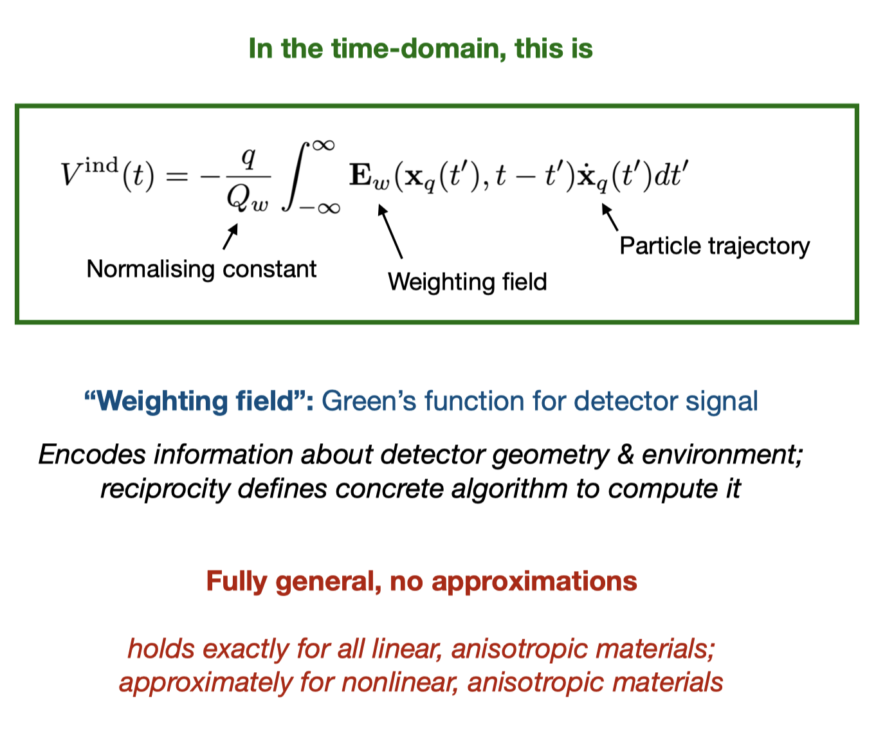
Calculation of Propagation Effects via Reciprocity
current approach
using reciprocity
only calculated once per medium and antenna
slides by Philipp Windischhofer
more info: W. Riegler, P. Windischhofer, NIM-A 980 164471 (2020)

Slide 25
Summary: Simulation of InIce Radio Emission
What we already have:
  microscopic simulation of radio emission in dense homogeneous media
  End-to-end MC code (NuRadioMC) for fast simulation
What we need:
  Simulation in inhomogeneous media (first step n(z) gradient)
    can be solved by adding ray tracing to radio module
  Complex geometries (transition of boundaries)
  Second-order propagation effects, e.g. birefringence
    propagation time between shower track and receiver is not sufficient
    can potentially be solved using an reciprocity approach

Slide 26
Backup

Slide 27
Hard requirements
from ARENA2018 brain storming meeting
Support of dense media such as ice, water, lunar regolith, ...
  Do we need to implement additional interactions that are only relevant for dense media? E.g. tau propagation, dE/dX for muons, LPM effect?
  Does the medium need to couple back to simulation parameters such as low-energy cutoffs?
Support of arbitrary medium configurations, including transitions from air to dense media or dense media to vacuum (at least medium properties as a function of height, better arbitrary 3D medium configurations)
Medium model including refractive index profile, and possibility to do ray-tracing on the basis of this in both air and dense media
  Additional properties needed? Humidity? Temperature?
Direct interface to the tracking of each particle in the shower simulation with bi-directional communication
  E.g. readjust step size in particle tracking
  E.g. readjust thinning level of important/unimportant particles or even throw away particles that are not relevant for radio emission
  E.g. modify particle properties due to atmospheric electric fields
Simple interface to inject arbitrary particles (including their energy, momentum) and possibly specify their interactions to start a shower (“the world’s dumbest event generator”)
Global coordinate system that supports curvature of Earth (anyway planned, adaption from Offline)

Slide 28
Very useful features
from ARENA2018 brain storming meeting
Inspect particle cascade at arbitrary observation planes, e.g. to calculate drift velocities on the fly, ...
In general a very flexible adjustment of thinning
  First interactions are very important -> low thinning
  Medium energy interactions are less important -> high thinning
  Low energy interactions are important to correctly model coherence -> low thinning
Possibility to simulate air showers induced by upgoing neutrinos (from the Earth, mountains, …)

Slide 29
Wishlist
from ARENA2018 brain storming meeting
Retain information on particles at rest -> ionization in medium (relevant for RADAR reflections, low-frequency radio emission)
Simulate ‘very’ low energy particles (keV scale) and interaction with atmospheric electric fields relevant for thunderstorm studies - in general allow interfacing of additional interaction models for particles/energy ranges not treated by existing models
Simulate particle oscillation (e.g. neutrino oscillation or strong oscillations such as K-short -> K-long). I.e., in general provide the possibility to change the type of the particle during propagation; this could be implemented in form of a propagation modules.
Save state of simulation at any stage (e.g. a specific height/atmospheric depth). Then be able to resume simulation with e.g. modified density profile or just with different random seeds

Slide 30
Implementation of Radio Modules
from ARENA2018 brain storming meeting
Radio part should be modular in itself, i.e. decouple
  Emission calculation (e.g. ZHS vs. endpoints)
  Signal propagation
    Straight lines (for air showers/constant density)
    Ray tracing
    Full FDTD propagation?
  Receive module
    Add emission from all particle tracks (as right now in CoREAS)
    Keep track of incoming direction of signal -> efield in angular bins
    On-the-fly convolving with directional antenna response

