Slide 1


EMF (ElectroMagneticFluka) and muon and neutrinos in Fluka
Alfredo Ferrari, Paola R. Sala
for the FLUKA Collaboration

Slide 2
Electron/photon and atomic interactions:
Interactions of leptons/photons
  Photon interactions
    Photoelectric
    Compton
    Rayleigh
    Pair production
    Photonuclear
    Photomuon production
  Electron/positron interactions
    Bremsstrahlung
    Scattering on electrons
    Electronuclear
  Muon interactions
    Bremsstrahlung
    Pair production
    Nuclear interactions
Ionization energy losses
  Continuous
  dE/dx fluctuations
  Delta-ray production
Transport
  Multiple scattering
  Single scattering
These are common to all charged particles, although traditionally associated with EM

Slide 3
EMF ElectroMagneticFluka
Energy range: 1 keV (100 eV for γ )- 10²¹eV
Cross sections: NEW γ cross section tabulations from EPICS 2017
Photoelectric: fluorescence, angular distribution, Auger, polarization
Compton and Rayleigh: atomic bonds, polarization
e⁺e⁻ pair production: correlated angular and energy distribution... Also for μ
Photo-μ pair production
Photo/Electronuclear interactions; also for μ
Bremsstrahlung : LPM, correlated energy and angular distribution... Also for μ
Bhabha and Møller scattering, delta-ray spin dependent (with Mott) for heavier particles
Positron annihilation at rest and in flight, with polarization
μ⁻ capture at rest
Energy losses: restricted, density effects, higher order corr., fluctuations
Multiple scattering, or single scattering on option
Optical photon: (Cherenkov/scintillation) production and transport

Slide 4
(Unrestricted) dE/dx for heavy particles:
∼ln β⁴γ⁴ relativistic rise
Spin 0:
Spin 1/2:
Valid for m>>m_{e,} the formulation for electron/positrons is similar, except for “energetic” collisions with atomic electrons where the proper Møller and Bhabha formalism
n_{e} : target electron density (ρN_{Av}Z/P_{A});
z : √z²_{eff} “effective” charge of the projectile
I : mean excitation energy, material-dependent;
δ : density correction;
C : shell correction, important at low energies;
T_{max} : maximum energy transfer to an electron;
Higher order corrections implemented in FLUKA
L₁ : Barkas correction (z³) → difference
particles-antiparticles;
L₂ : Bloch (z⁴) correction;
G : Mott corrections
  Mott corrections (maybe the only code)!
    … for the average dE/dx …
    … for the “Landau” fluctuations…
    … for the δ ray production cross section and spectrum

Slide 5
Ionization fluctuations, e⁺/e⁻ and charged hadrons
The Landau distribution contains approximations and limitations that prevent its use in MC’s.
The Vavilov distribution overcomes some (not all) of the Landau limitations, but is difficult to compute if the step length or the energy are not known a priori.
The FLUKA approach:
Based on general statistical properties of the cumulants of a distribution (in this case a Poisson distribution convoluted with dσ/dE);
Integrals can be calculated analytically and exactly a priori (min. CPU time);
Works for whichever δ ray threshold
Applicable to any kind of charged particle, taking into account the proper spin (or Møller/Bhabha) dependent cross section for δ ray production, and Mott corrections for ions;
The first 6-moments of the energy loss distribution are reproduced:

Slide 6
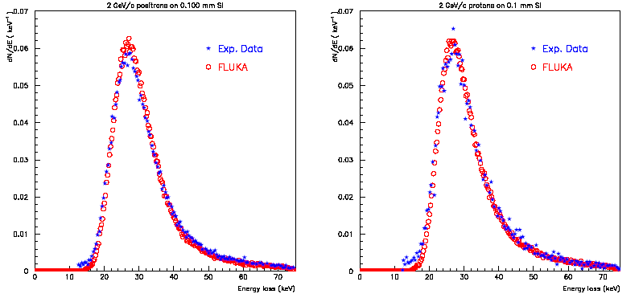
Ionization fluctuations – cont.
Experimental ¹ and calculated energy loss distributions for 2 GeV/c positrons (left) and protons (right) traversing 100μm of Si
¹J.Bak et al. NPB288, 681 (1987)

Slide 7
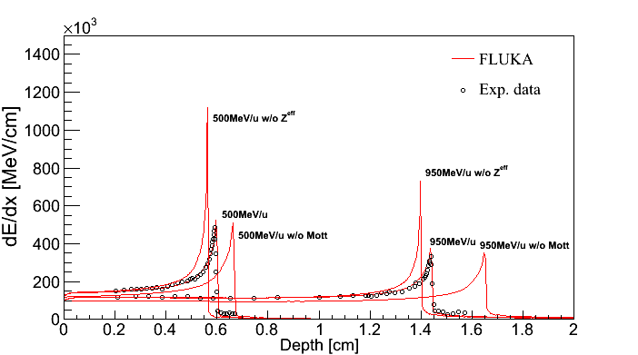
Heavy ion stopping power
Ionization energy losses
Up-to-date effective charge parameterizations
Energy loss straggling according to:
  “normal” first Born approximation
  Charge exchange effects (dominant at low energies, ad-hoc model developed for FLUKA)
  Mott cross section
  Nuclear form factors (high energies)
  Direct e+/e- production
Depth-dose distribution of ²³⁸U beam in steel (exp data GSI).

Slide 8
The FLUKA Multiple Coulomb Scattering (MCS)
Based on the Molière theory used strictly within its limits of validity
Accurate path length correction (PLC), not the average value but sampled from a distribution, giving a complete independence from step size
Correct lateral displacement even near a boundary
Correlations:
PLC ⇔ lateral deflection
lateral displacement ⇔ longitudinal displacement
scattering angle ⇔ longitudinal displacement
Optionally higher order spin-relativistic corrections and effect of nucleus finite size (form factors)
Special geometry tracking near boundaries, with automatic control of the step size
On user request, single scattering automatically replaces multiple scattering for steps close to a boundary or too short to satisfy Moliere theory. A full Single Scattering option is also available (very CPU expensive).
Combined effect of MCS and magnetic fields
The same algorithm is used for charged hadrons and muons, in that case with the addition of the Fano correction
NIM B 71, 1992, 412-426
Notes:
8

Slide 9
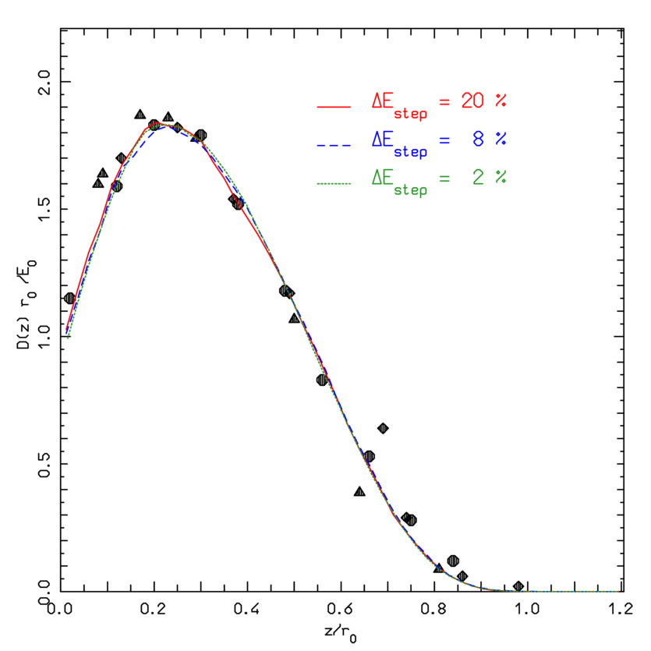
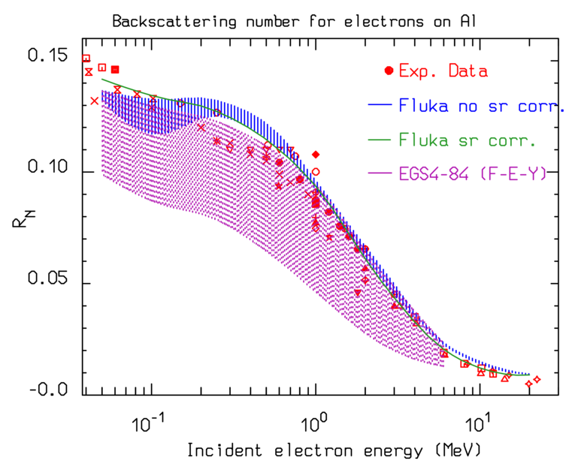
Stability vs step length (less CPU!)
NIM B 71, 1992, 412-426
Calculated and experimental depth-dose profiles, for 0.5 MeV e⁻ on Al, with three different step sizes (2%, 8%, 20% ΔE/step)
Symbols: experimental data
r₀ is the csda range
Number reflection R_{N} for e⁻ on Al foils of saturation thickness. Red symbols: exp data. Green line: FLUKA with sr corr. Blue dashed: FLUKA with 5-20% ΔE. Purple dotted: EGS4 with the original FEY PLC correction (steps 1-20% ΔE)

Slide 10
Low energy electron scattering: an example
Transmitted (forward) and backscattered (backward) electron angular distributions for 1.75 MeV electrons on a 0.364 g/cm² thick Copper foil.
Measured (dots) and simulated (histos) data

Slide 11
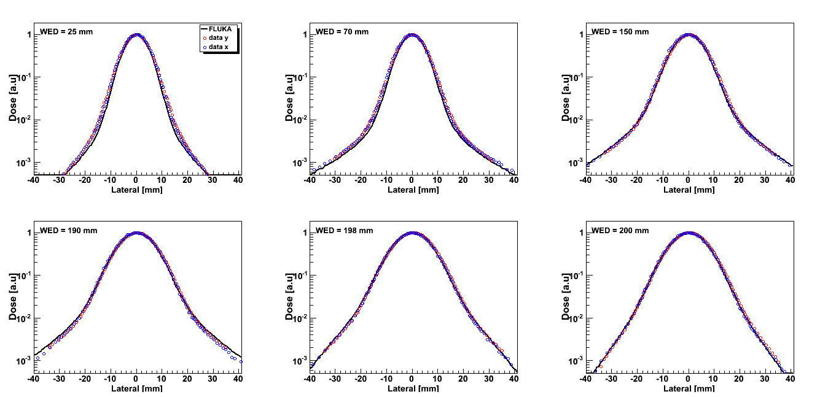
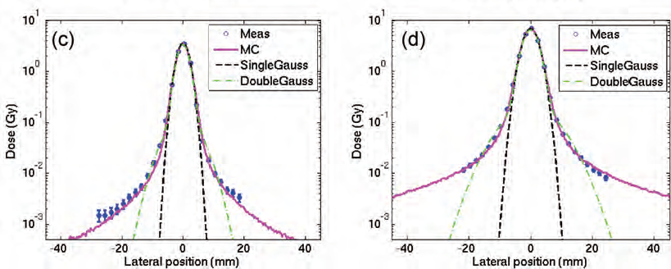
MCS for hadrons and ions : Lateral-depth dose distributions
Entrance channel
Near to Bragg peak
p @ 173.12 MeV/u
At CNAO
FLUKA multiple coulomb scattering
NIM B71,412
(1992); also for ions
¹²C @ 299.94 MeV/u
At HIT
K. Parodi et al JRR 54, i91–i96
(2013),

Slide 12
Bremsstrahlung and Pair Production:
Pair production:
  Angular and energy distribution of e⁺,e⁻ described correctly (no “fixed angle” or similar approximation)
  No approximations near threshold
  Extended to 10²¹ eV taking into account the LPM (Landau-Pomeranchuk-Migdal) effect
  Differences between emitted e⁺ and e⁻ at threshold accounted for
Bremsstrahlung:
  Energy-differential cross sections based on the Seltzer and Berger database, which goes into the DBMO analytical high-energy theory (with Coulomb corrections, and the Elwert correction) at energies above 50 MeV
  LPM effect and soft photon suppression (Ter-Mikaelyan) polarization effect
  Detailed photon angular distribution fully correlated with energy
  Differences between e⁺/e⁻ bremsstrahlung taken into account

Slide 13
Bremsstrahlung: benchmarks
60⁰
20.9 MeV
0⁰
120⁰
12 MeV
2 MeV electrons on Iron, bremsstrahlung photon spectra, measured (dots) and simulated (histos) at three different angles
12 and 20.9 MeV electrons on a W-Au-Al target,
bremsstrahlung photon spectra in the forward direction. Measured (dots) and simulated (histos)

Slide 14
Bremsstrahlung: benchmark III Esposito et al., LNF 93-072
ADONE storage ring
1.5 GeV e⁻
Bremss. on the residual gas in the straight sections
Measured with TLD’s matrices at different distances from the straight Section
Here: dose vs. horizontal position at different vertical positions , d=218cm

Slide 15
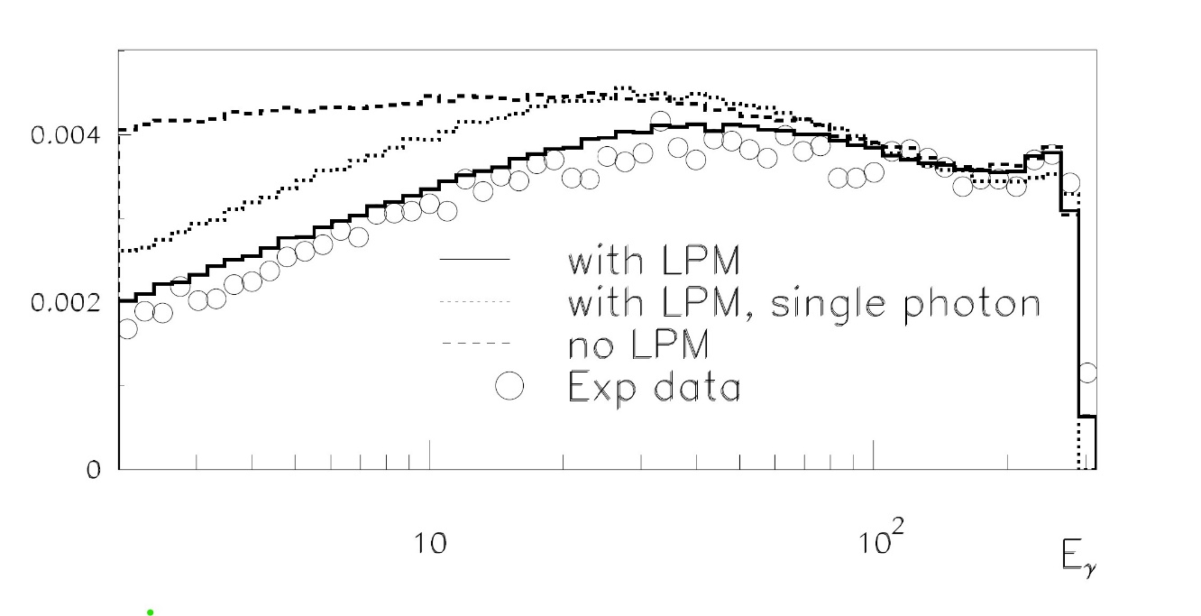
Landau-Pomeranchuk-Migdal benchmark
Bremsstrahlung spectrum, dNγ /dlog(Eγ), for 287 GeV electrons on 0.128 mm Ir (~4.36% X₀). The vertical scale is normalized to the number of incoming electrons.
Data from Phys.Rev. D 69,032001 (2004)
Simulations (lines) with FLUKA
The full and dashed lines include the effect of pile-up (multiple superimposed photon detection ),
with and without LPM.
The dotted line is the single photon spectrum (no pile-up) including LPM
LPM: interference among scattering centres within the photon “formation zone”.
scales ~ E² /X₀ - also for pair production

Slide 16
Pair production: examples and asymmetry
γ on Pb
Eγ= 3.0 m_{e}c²
Eγ=10000 m_{e}c²
Eγ= 4000 m_{e}c²
Eγ= 2.7 m_{e}c²
Eγ= 2.4 m_{e}c²
Eγ= 1000 m_{e}c²
Eγ= 400m_{e}c²
Eγ= 2.2 m_{e}c²
u₊
u₊
1/Z²dσ_{pair}/du₊ (u₊ =E(e+)/Eγ) for different incoming photon energies (in units of m_{e}c²)

Slide 17
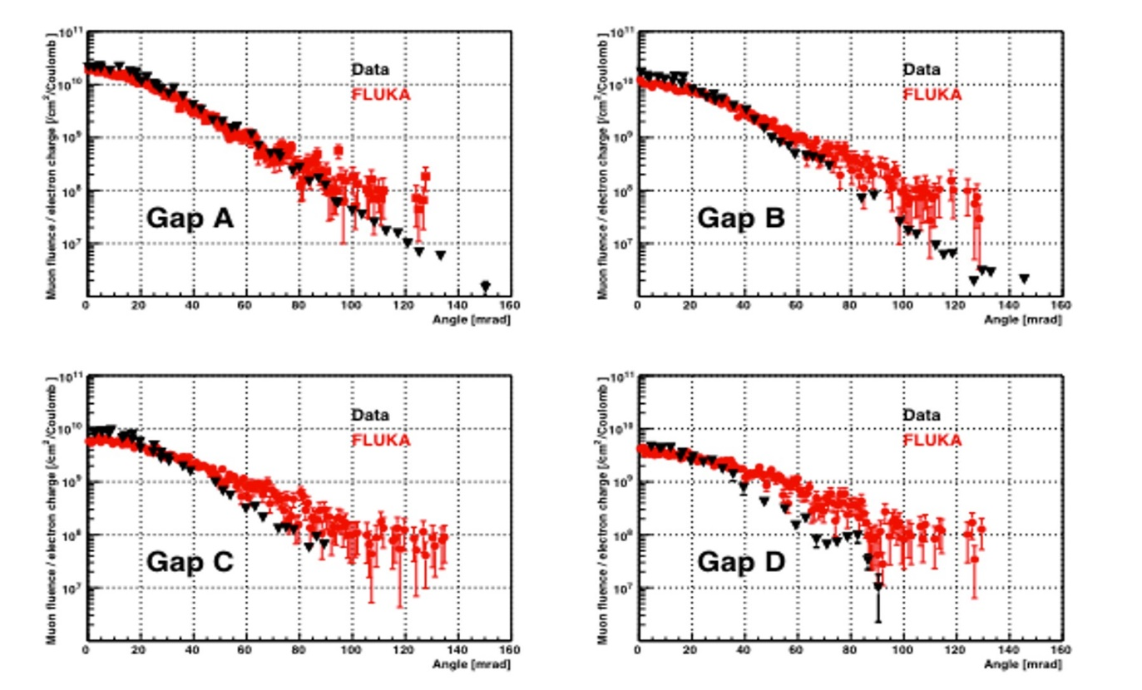
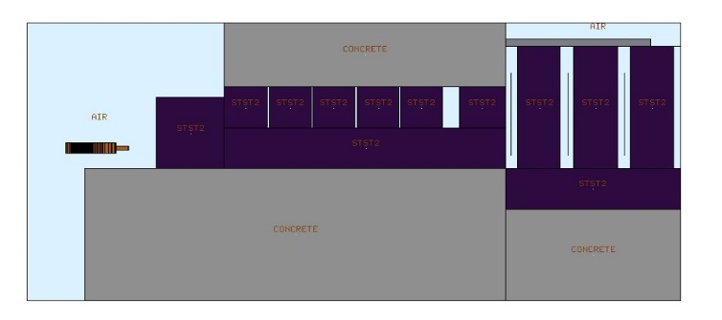
Photomuon production
For photon energies above ~2*105 MeV/c² : muon-+ pair production, forward peaked.
Relative importance wrt e-e+ pair prod.: (m_{e}/m_{μ})² → ~1/40000
Ref: Y.S. Tsai, Rev. Mod. Phys. 46 4 815-851 (1974)+ ERRATUM
Muon fluence from 18 GeV e⁻ on
Cu+H₂ O target followed by
Fe shield
Measured in A,B,C,D air gaps
Vs angle in vertical plane
Data: Nelson et al, NIM 120,413 (1974)
MC: NEA/NSC/R(2015)3

Slide 18
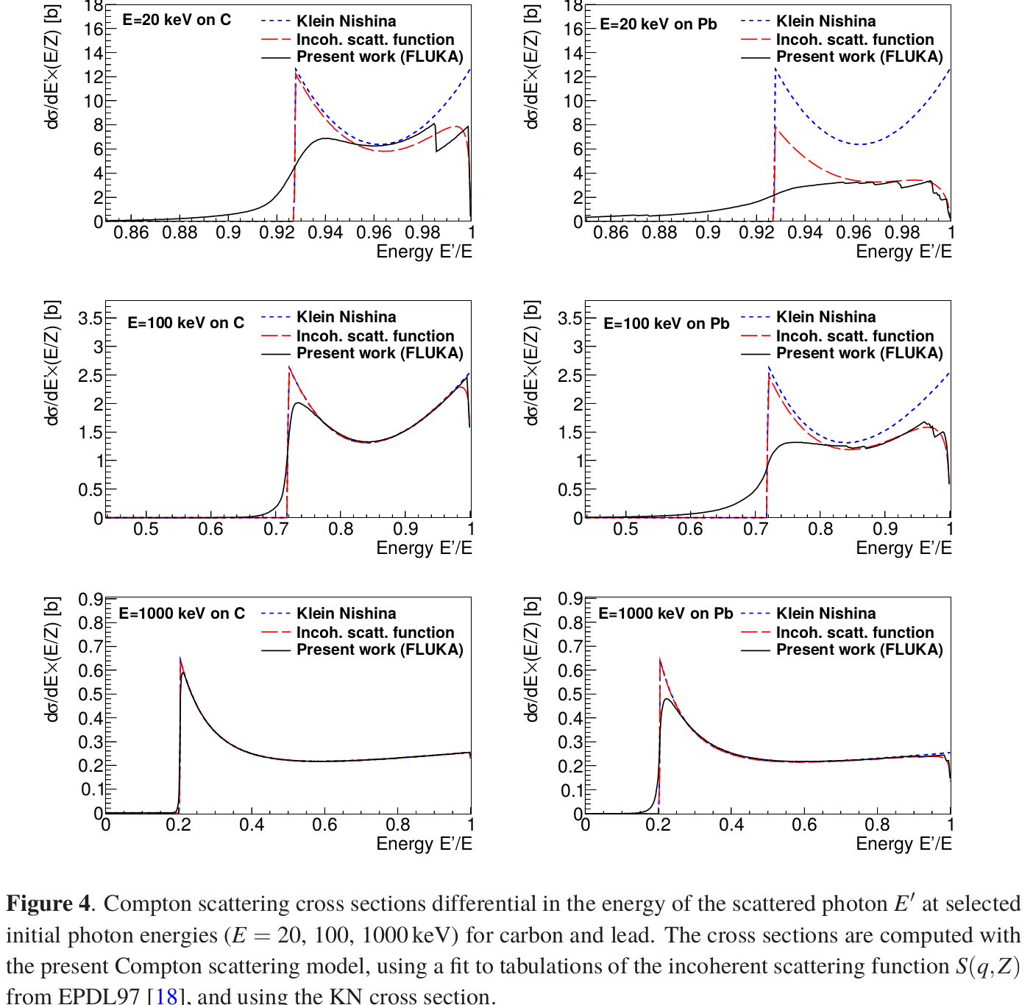
Compton scattering
FLUKA: accounting for atomic shell binding energies and e⁻ orbital motion. Also for positron annihilation
KN: free e⁻ at rest
Incoh. scatt. function: binding via form factor
Ref: T. Boehlen et al., J Instrum 7 P07018 (2012)

Slide 19
Muon and (anti)neutrino physics in FLUKA

Slide 20
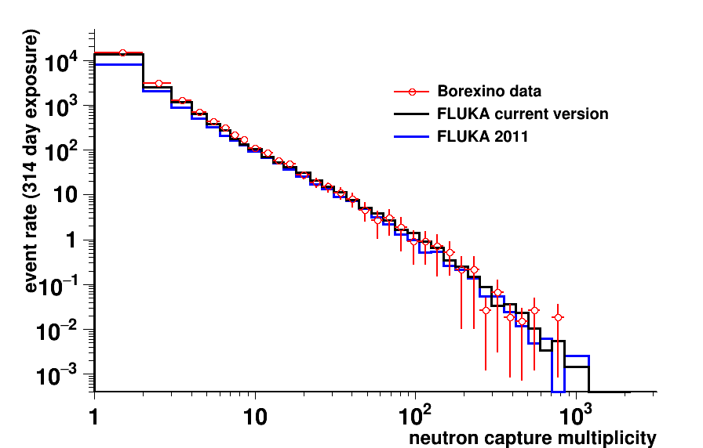
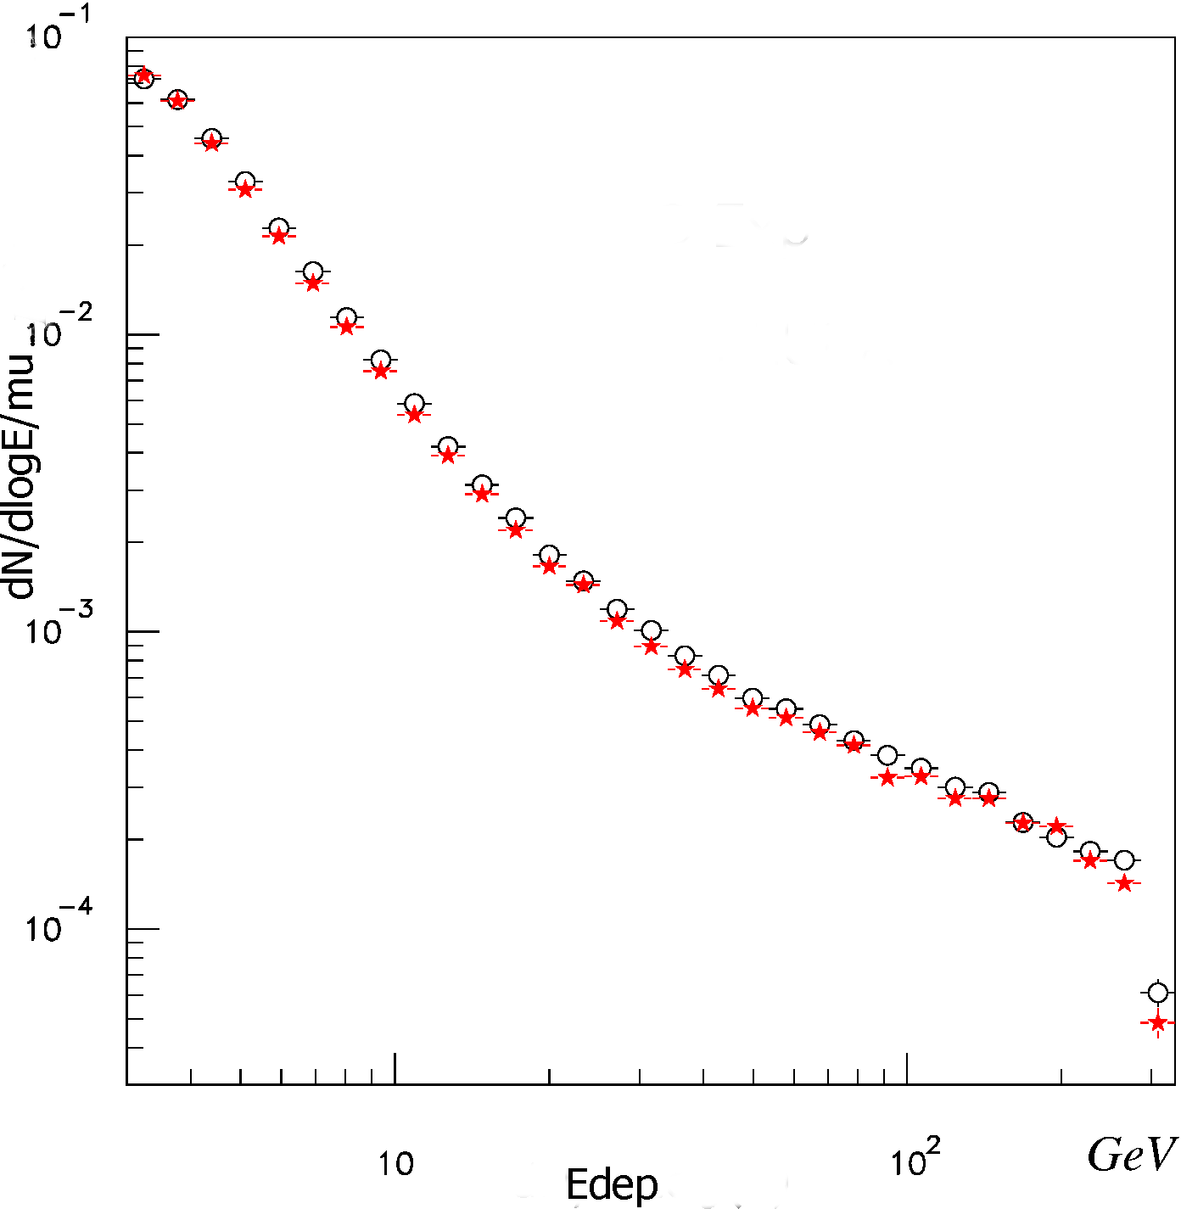
Muons in FLUKA
Induced neutron multiplicity @ Borexino, <E_{µ} > = 283 GeV
Ionization energy losses
Multiple Coulomb scattering
Decay, accounting for polarization
(Virtual) Photonuclear interactions
Pair Production
Bremsstrahlung
*A.Empl et al, APCPC,1672,090001
Evt/day
Borexino: 67±1
Fluka: 62±1
Fluka2011: 42±1
★ FLUKA
𝚘 Exp. Data
Energy loss spectrum, from 300 GeV muons, in the ATLAS Tile calorimeter prototype (Fe+Sci), for E_{loss} > 3GeV
(see next slides)

Slide 21
ATLAS combined calorimeter test beam
Layout of the experimental set-up (NIM A387,333(1997), NIM A449,461 (2000))
Test beams in 1994 and 1997, electrons, muons, and positive pions
preshower (LAr-Pb)
LAr/Pb
Fe-Scint

Slide 22
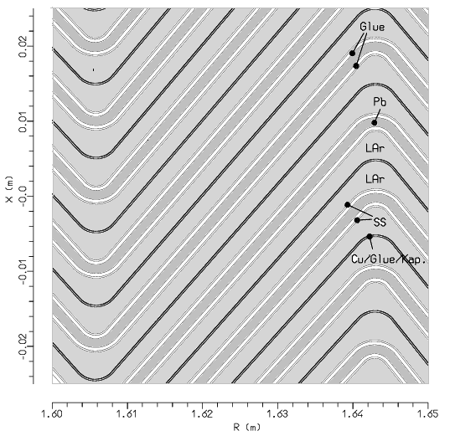
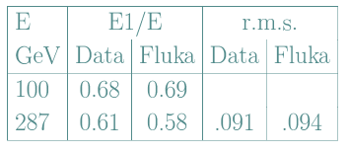
The EM calo (from standalone test beams)
response vs. electron impact position
Detail of the FLUKA geometry and
deposited energy
287 GeV
electron
beam
Stars : fluka
Dots: expt. (RD3 collab.)
impact position
Energy resolution 10-100 GeV:
Longitudinal Development

Slide 23
300 GeV μ in ATLAS combined calo
Calibration in electron scale, electronic noise added
Pb+LAr
Fe+Scint.
Proceedings. of Calor96 (Frascati)

Slide 24
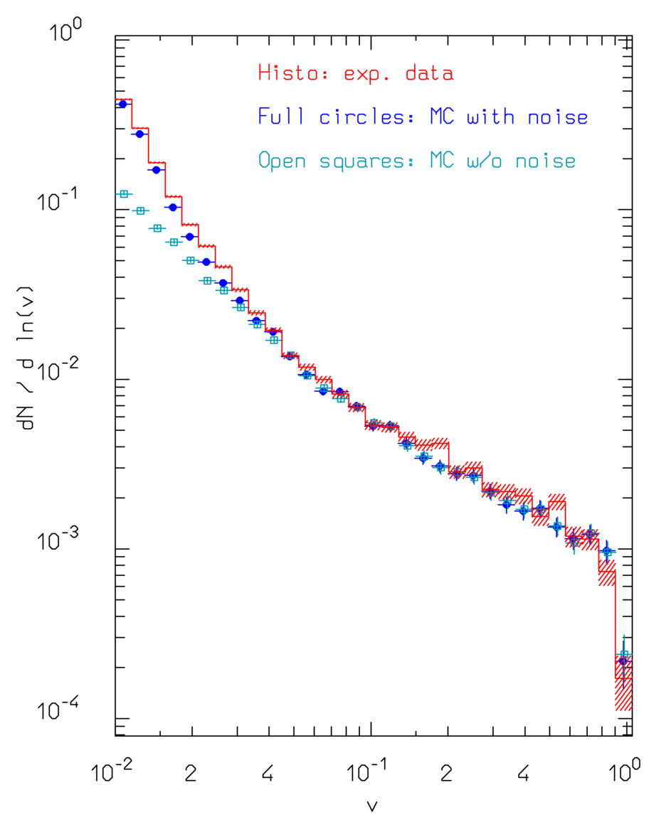
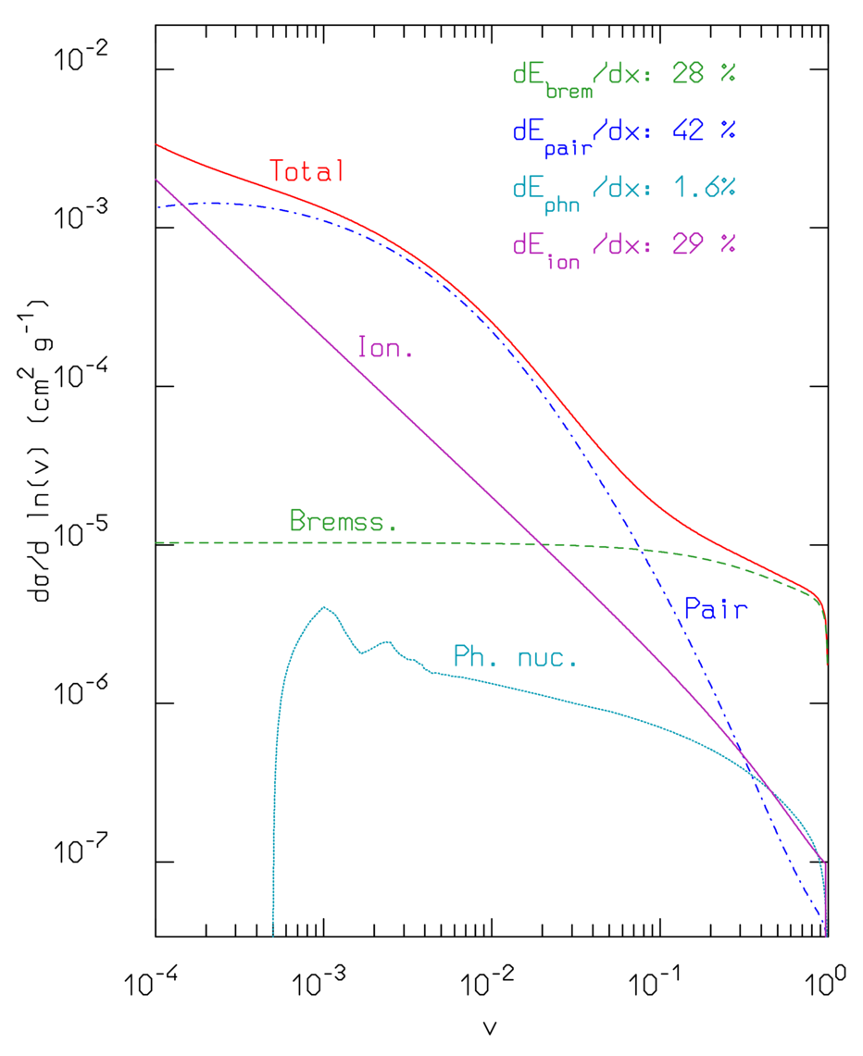
300 GeV muon losses in the ATLAS accordion (Pb-LAr) calorimeter
Muon energy losses spectra
(v⋅dN/dv)
in the LAr-Pb accordion prototype calorimeter
Soft γ*A
introduced in 2013

Slide 25
(Anti)Neutrinos in FLUKA:
Acta Phys.Polon. B40 (2009) 2491-2505
CERN-Proceedings-2010-001 pp.387-394.
νN QuasiElastic (from ~0.1 GeV upward):
νN Resonance production
νN Deep Inelastic Scattering
νN interactions embedded in PEANUT for νA (Initial State and Final State effects)
Fermi/GT absorption of few-MeV (solar) neutrinos on ⁴⁰Ar
Used for all ICARUS simulations/publications
FLUKA can currently manage (anti)ν-A interations from ~0.1 GeV up to 1000 TeV
Isoscalar ν_{µ} -Nucleon total CC cross section
Fluka (lines) with two pdf options vs Experimental data

Slide 26
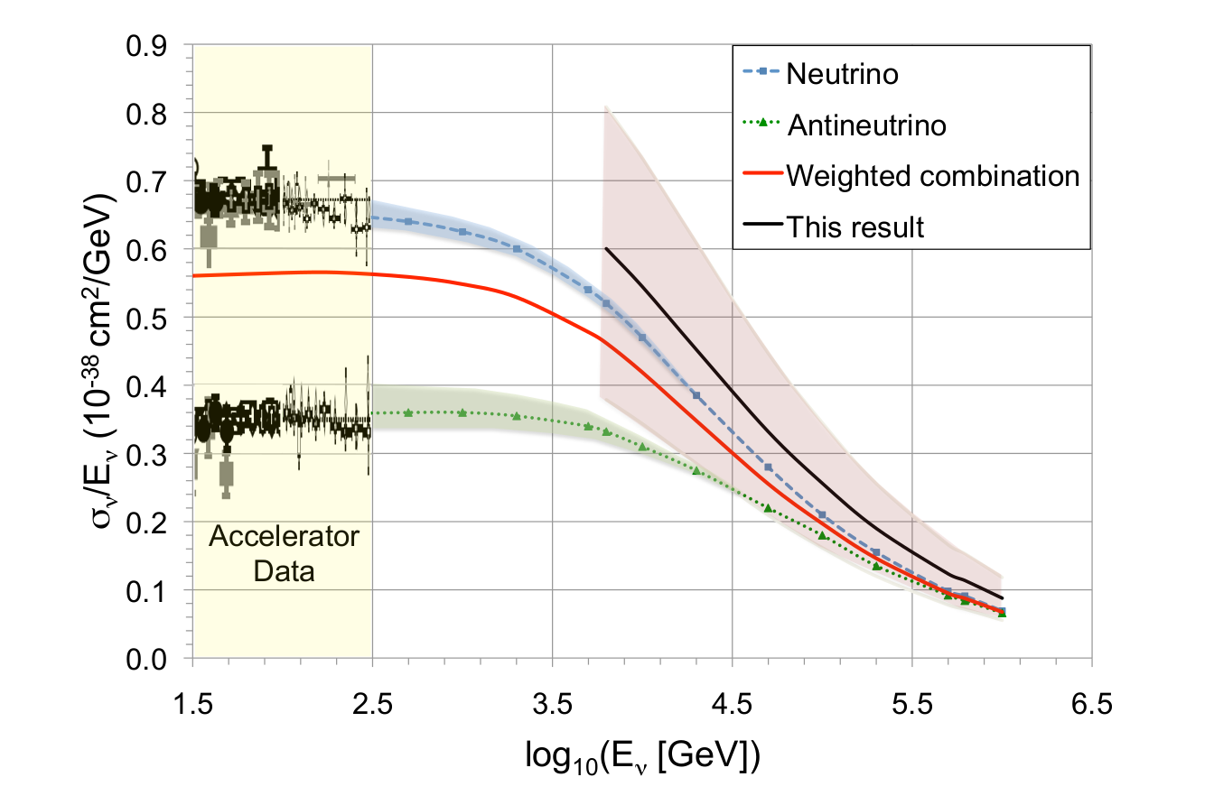
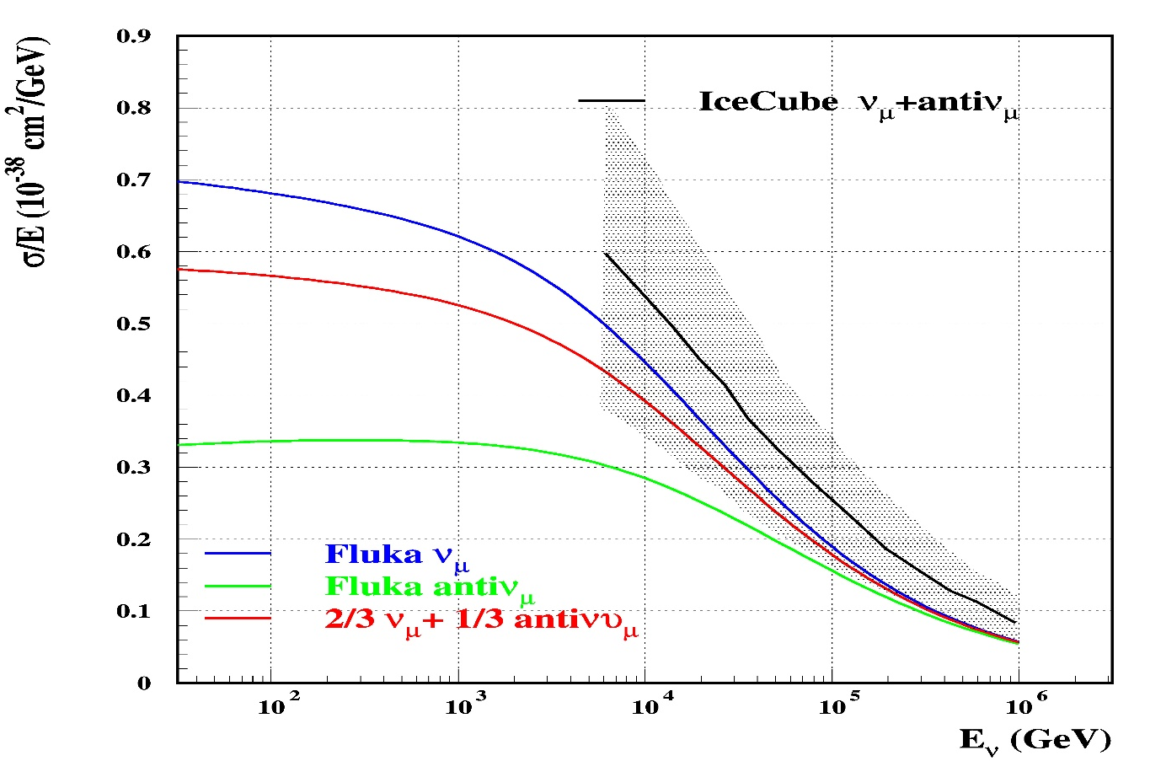
(anti)ν cross sections at higher energies:
IceCube cross section data (arXiv:1711.08119 , Nature 51,596 (2017))
Muon neutrino and antineutrino, “weighted combination” (?)
Blue and green: “standard theoretical predictions”
FLUKA results

Slide 27
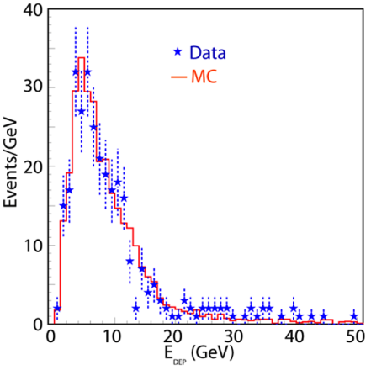
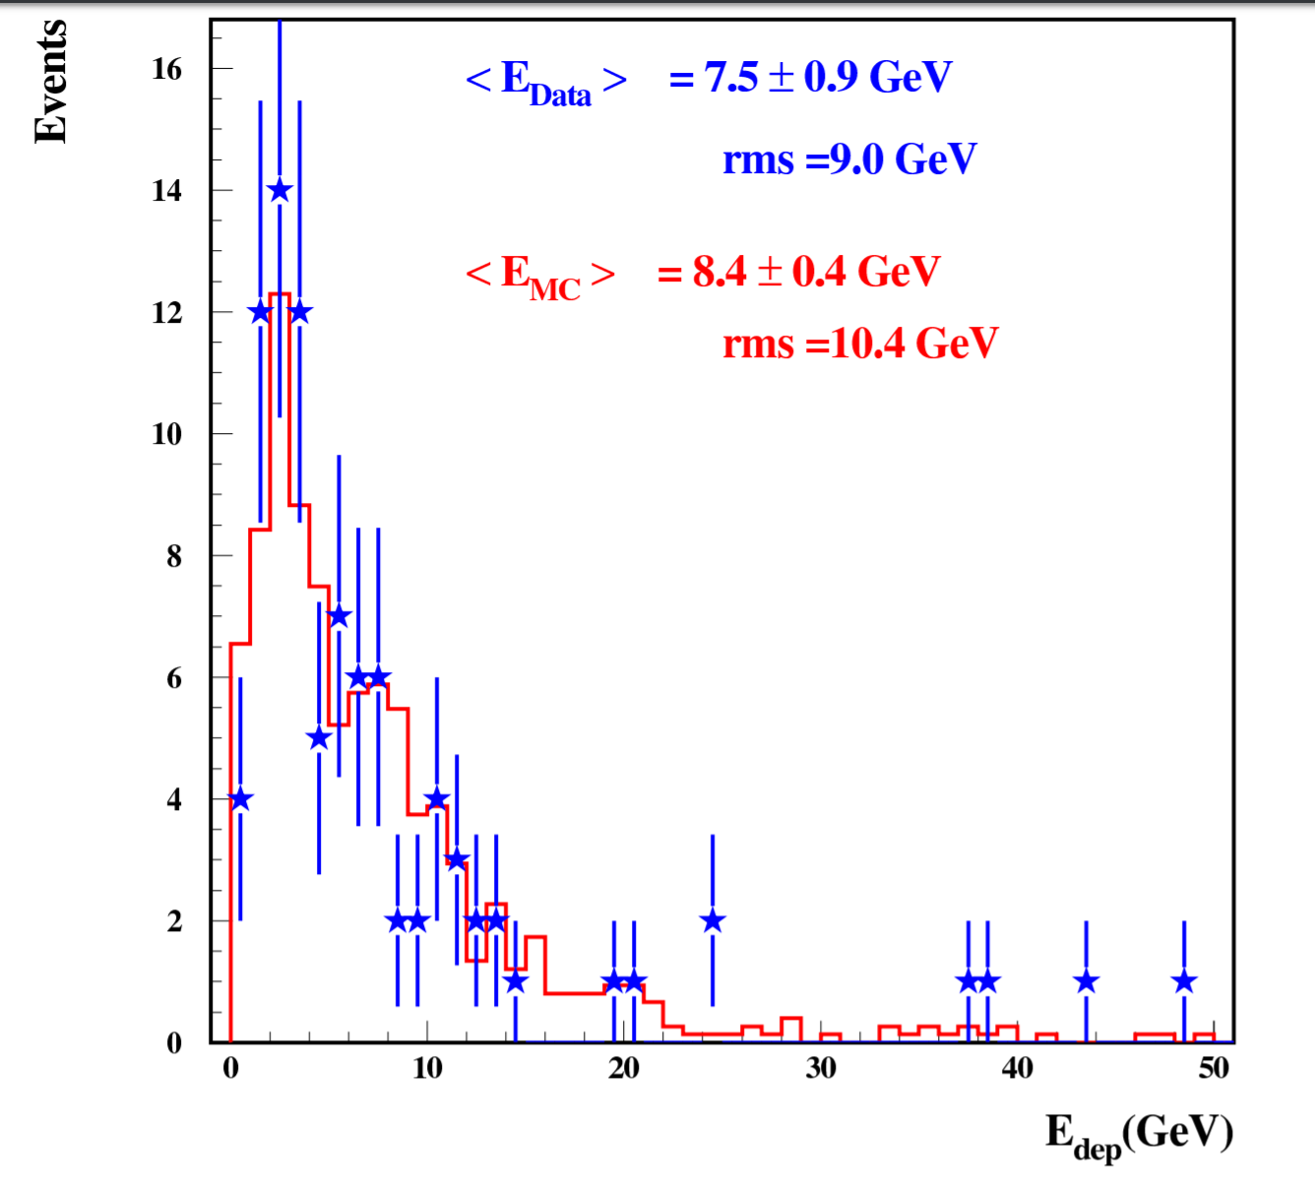
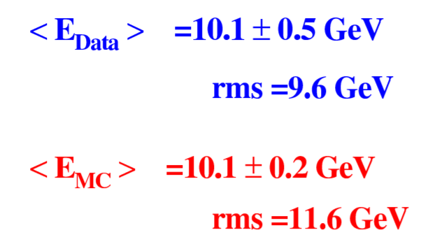
Reaction products: CNGS/ICARUS data (≈20 GeV <E_{ν}>)
Distribution of total deposited energy in the T600 detector
← Left:
ν_{µ} CC events
Right:→
ν NC events
Same reconstruction in MC and Data
Neutrino fluxes from FLUKA CNGS simulations
Absolute agreement on neutrino rates within 6%
Eur. Phys. J. C (2013) 73:2345
Phys. Lett. B (2014)

Slide 28
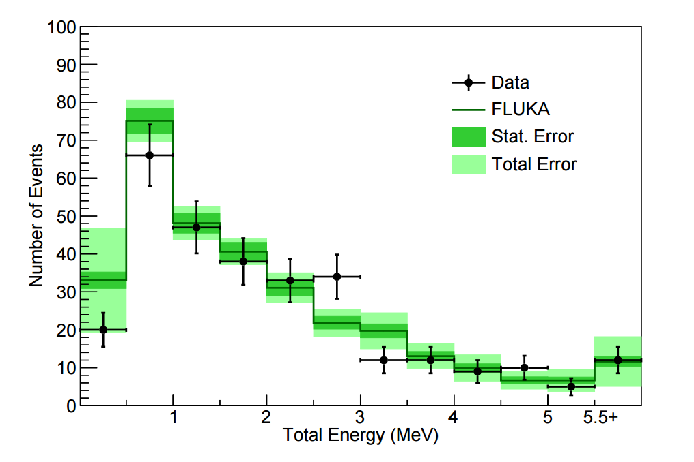
Application: neutrinos+neutrons
Detector: ARGONEUT operated in the NuMi beam, in front of the Minos near detector. Small LAr chamber
One of the measurements: de-excitation gamma-rays from neutrino interactions
Background to this search: mainly photons from unseen neutrons generated in the neutrino interaction
Simulations with FLUKA, internal neutrino generator + fully correlated pointwise low-energy neutron σ’s for Ar
Total reconstructed γ energy in an event for neutrino data and FLUKA MC events. Events with no reconstructed energy are not included
Phys. Rev. D 99, 012002 – Published 7 January 2019

Slide 29
Real and virtual photons

Slide 30
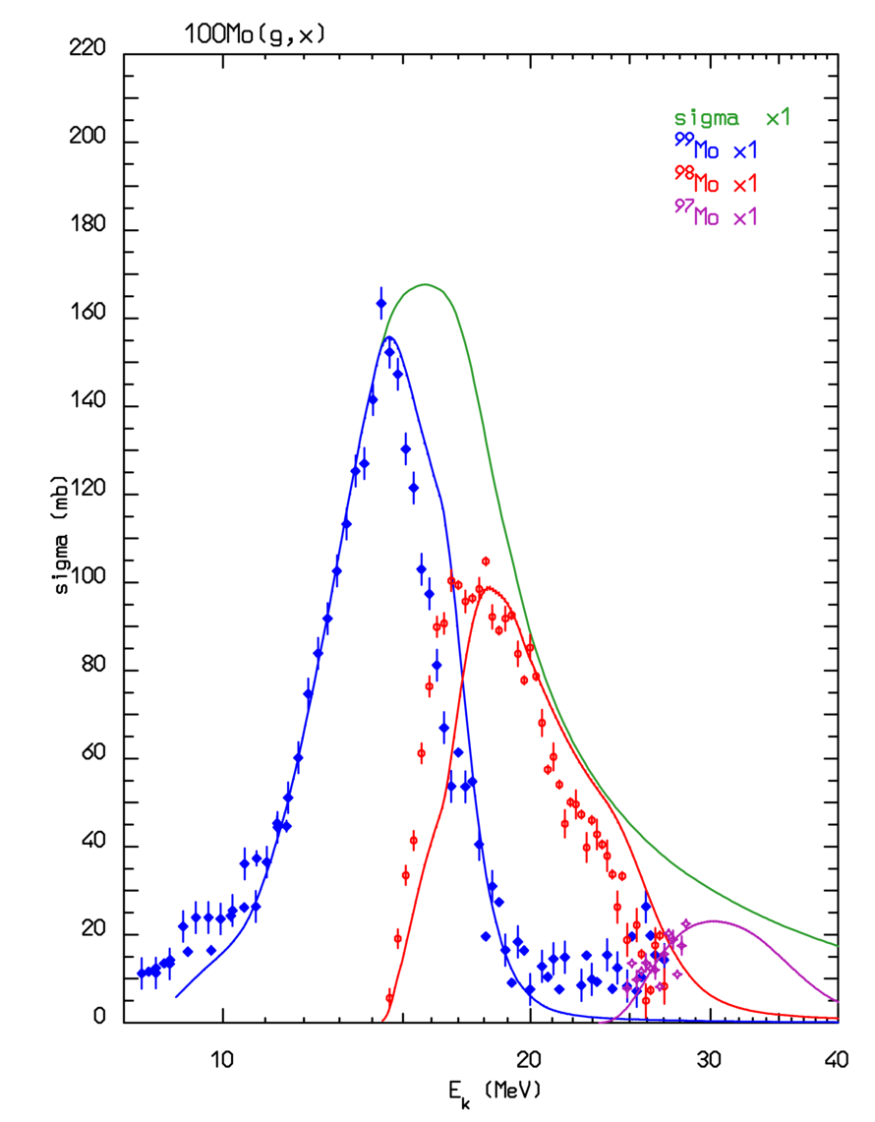
Real and Virtual Photonuclear Interactions
Photonuclear reactions
Giant Dipole Resonance interaction (special database)
Quasi-Deuteron effect
Delta Resonance energy region
Vector Meson Dominance at high energies
INC, preequilibrium and evaporation via the PEANUT model
Virtual photon reactions
Muon photonuclear interactions
Electronuclear interactions
Electromagnetic dissociation
¹⁰⁰Mo(γ,n)⁹⁹Mo, ¹⁰⁰Mo(γ,2n)⁹⁸Mo, ¹⁰⁰Mo(γ,3n)⁹⁷Mo
(lines Fluka, symbols exp.data)
With help from P.Degtiarenko and G.Kharashvili
Notes:
In not many other existing transport codes photonuclear reactions are simulated over the whole energy range

Slide 31
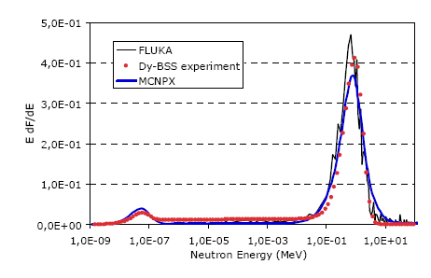
Photo-neutron production n@BTF
G. Mazzitelli et al., presented at IPAC 2010 ; courtesy of Lina Quintieri
Beam from the DAPHNE linac, 750 MeV electrons on a W target, 6 cm length, 3.5 cm radius
Experimental and calculated neutron spectra at 150 cm from the target at 90° wrt beam direction

Slide 32
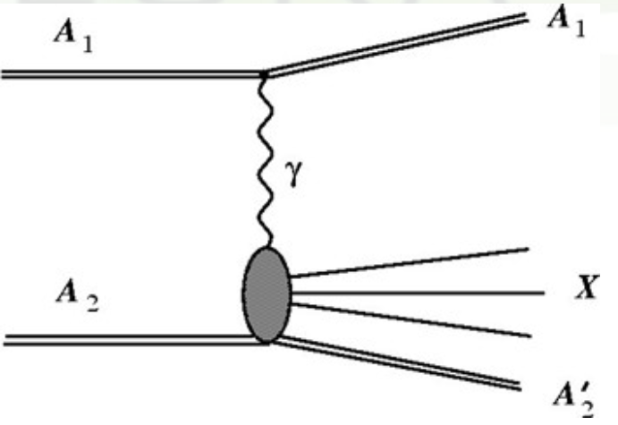
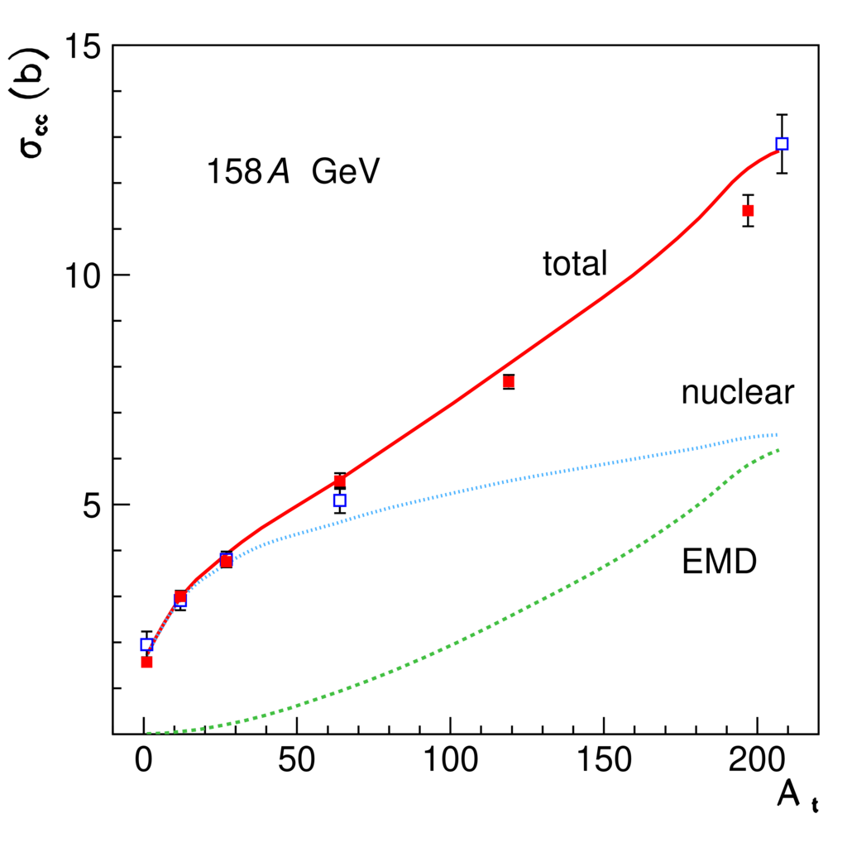
ElectroMagnetic Dissociation
Very peripheral collisions
Break-up of one of the colliding nuclei in the electromagnetic field of the other nucleus
… nuclear and, mostly, ElectroMagneticDissociation collisions on LHC machine elements or at IP’s produce a variety of (excited), possibly radioactive, fragments in flight
Pb ions on various targets
Symbols: exp. data
PRC71 02495
PRC70 014902
NPA707 513
NPA662 207
Lines: Fluka
Ref. for FLUKA model
PRSTAB17 021006
Alice:
√s_{nn}=2.8 TeV
PRL109
252302
(2012)
Total charge changing cross section as a function of target atomic mass
Total EMD, 1 n, 2 n, and nuclear cross sections as a function of the effective γ factor

Slide 33
Thanks for your patience!

