Slide 1
CPU-Runtimes of EM-showers
Jannik Augscheller

Slide 2
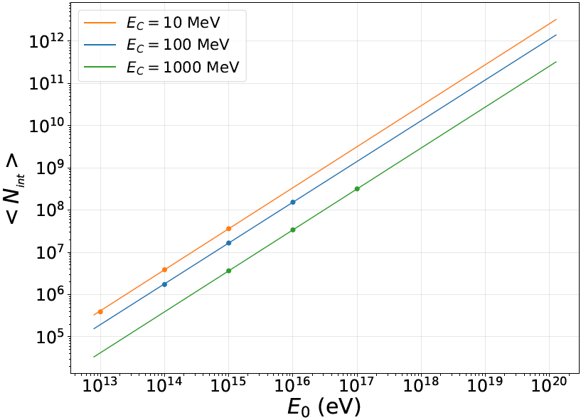
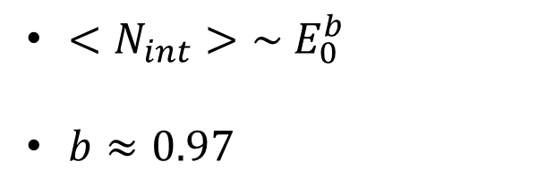
Relation between number of interactions and initial energy
$<N_{int}>\sim E_{0}^{b}$
$b≈0.97$

Slide 3
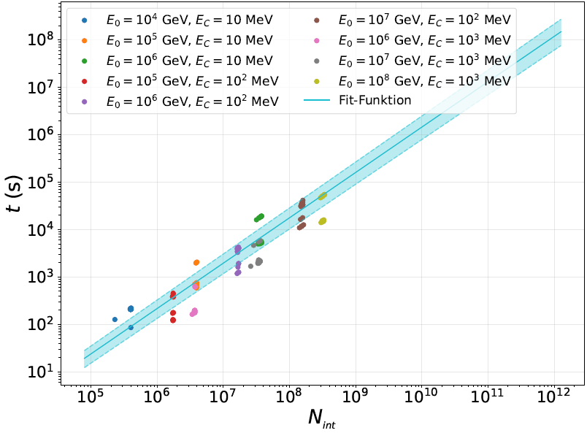
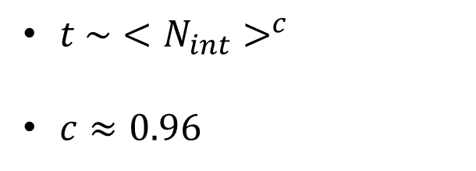
Relation between CPU-time and number of interactions
$t \sim {<N_{int}>}^{c}$
$c≈0.96$

Slide 4
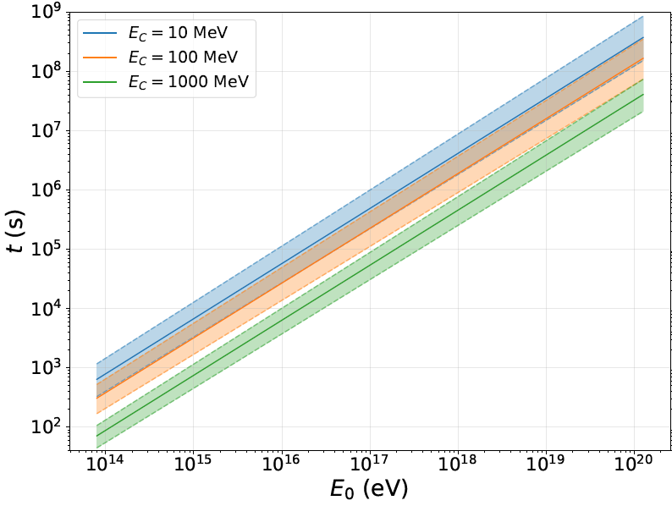
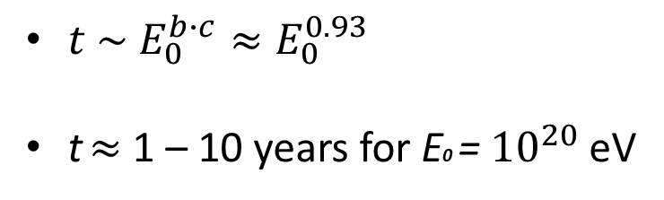
Relation between CPU-time and initial energy for different Ec
$t \sim E_{0}^{b∙c}≈E_{0}^{0.93}$
t $≈$ 1 – 10 years for E0 = ${10}^{20}$ eV

