Slide 1
Pattern Recognition in KM3NeT: A multi-dimensional challenge
João Coelho
for the KM3NeT Collaboration
21 February 2017

Slide 2
KM3NeT Collaboration
www.km3net.org
>200 scientists
>40 Institutions
9 Countries
ORCA Site:
40km from Toulon
ARCA Site

Slide 3
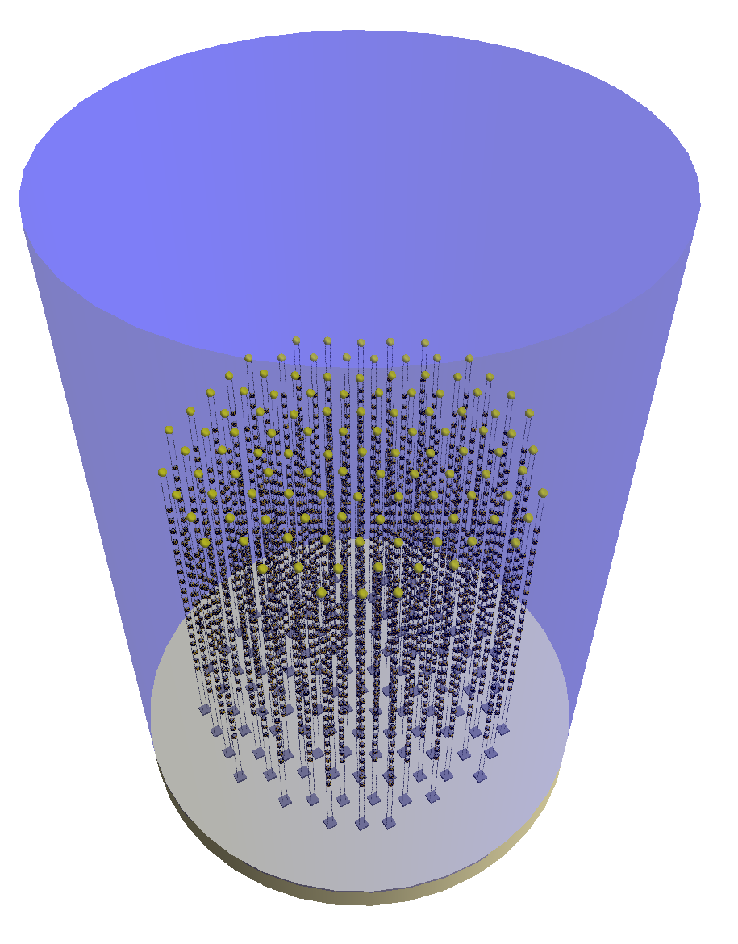
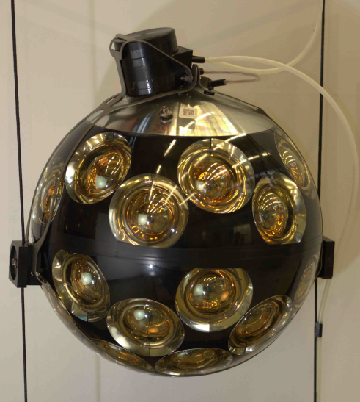
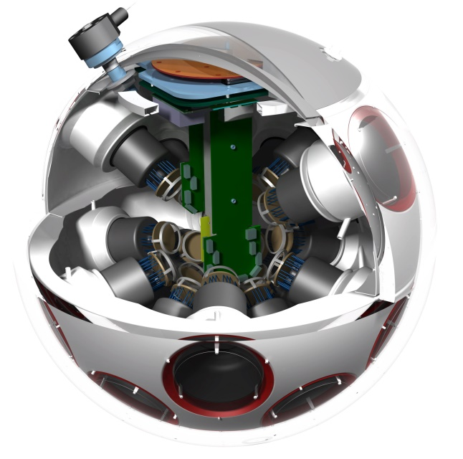
The ORCA Detector
~6 Mt instrumented
115 strings
18 DOMs / str
31 PMTs / DOM
Total: 64k PMTs
20 m
43 cm
9 m
~200 m
Optimized for MH sensitivity
~210 m

Slide 4
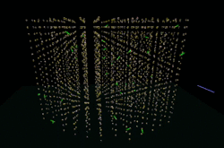
The ORCA Detector
~6 Mt instrumented
115 strings
18 DOMs / str
31 PMTs / DOM
Total: 64k PMTs
20 m
43 cm
9 m
~200 m
Optimized for MH sensitivity
~210 m

Slide 5
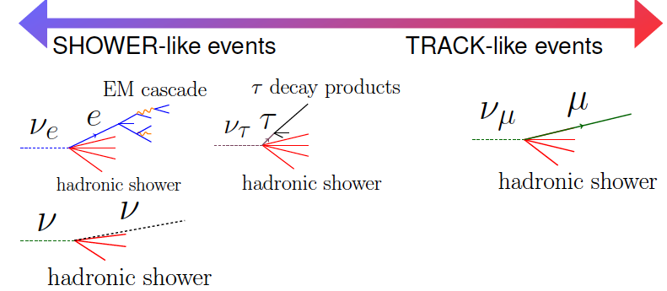
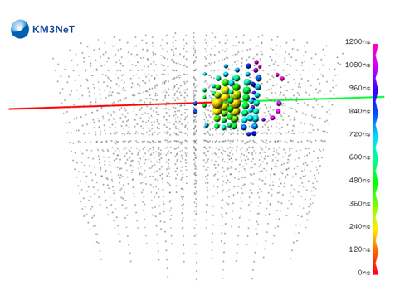
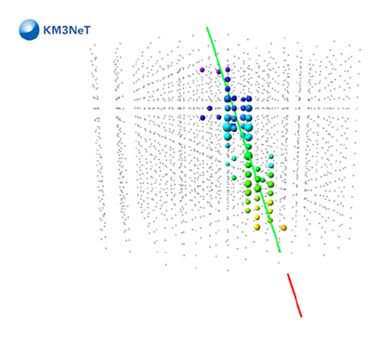
Measuring Neutrinos
Track-like
Shower-like

Slide 6
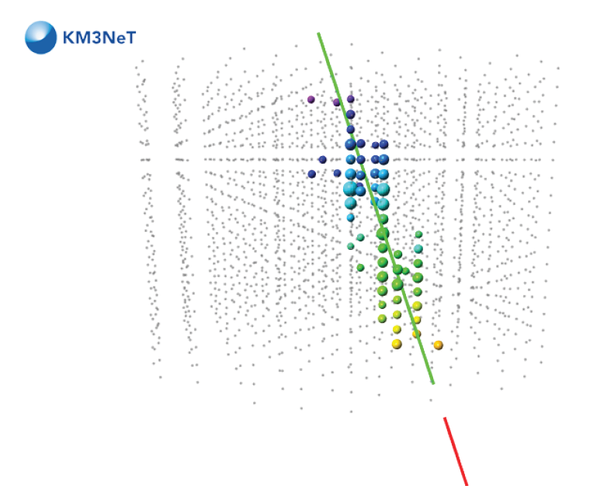
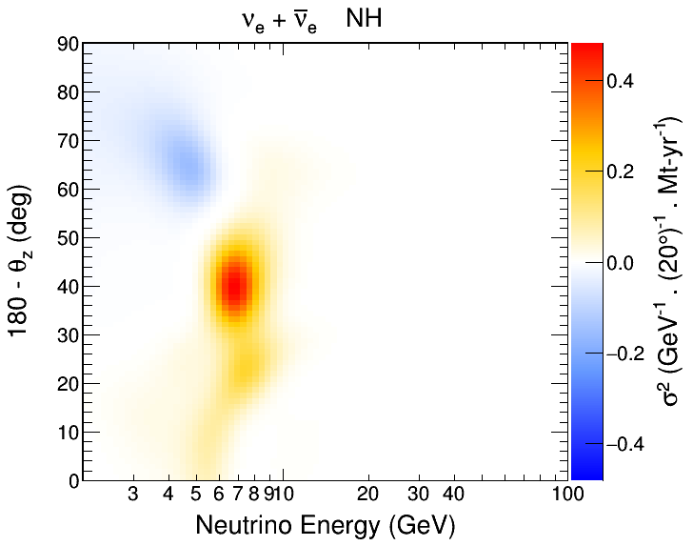
Motivation
KM3NeT detectors form 3D images (6D maybe?)
Our goal is to extract physics from these images
Can we train a neural network to do the job for us?
θ_{z}
ν flav.
E_{ν}

Slide 7
Inspired by:
Convolutional Neural Network work developed by NOvA
Paper: arXiv:1604.01444
The following slides were taken from talks below
CHEP 2016

Slide 9
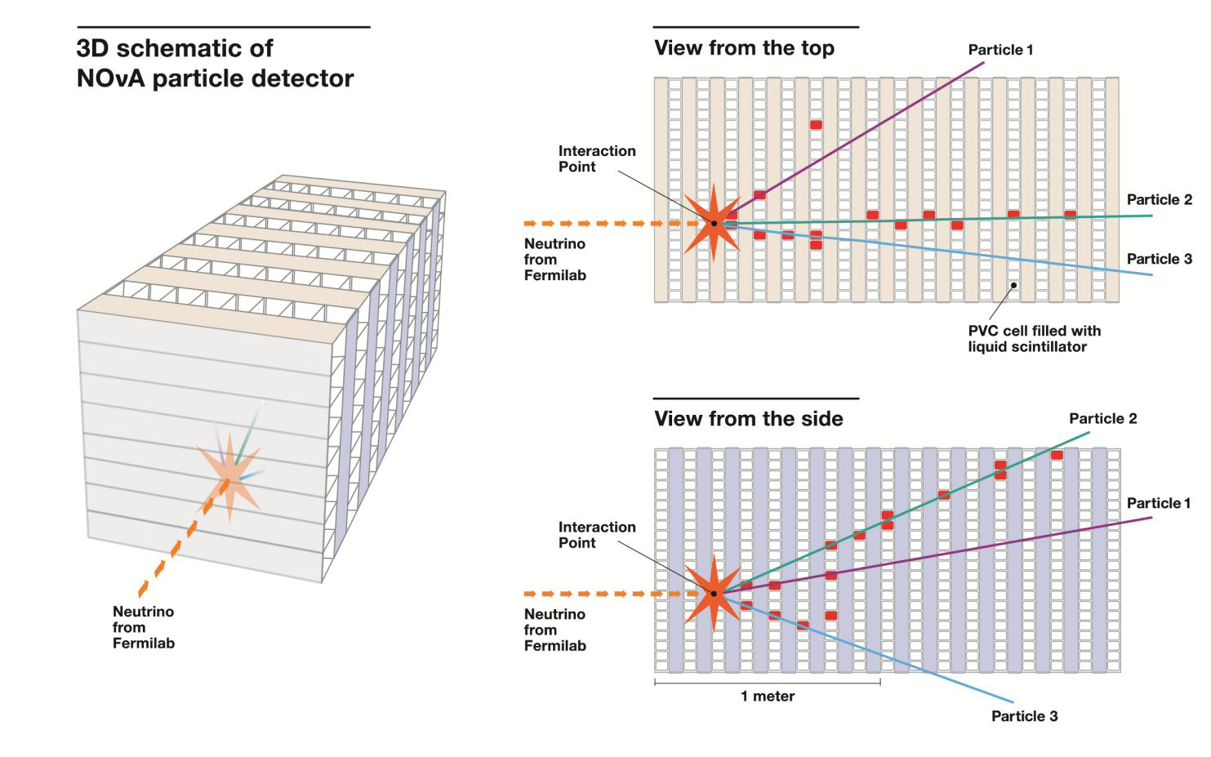
NOvA

Slide 13
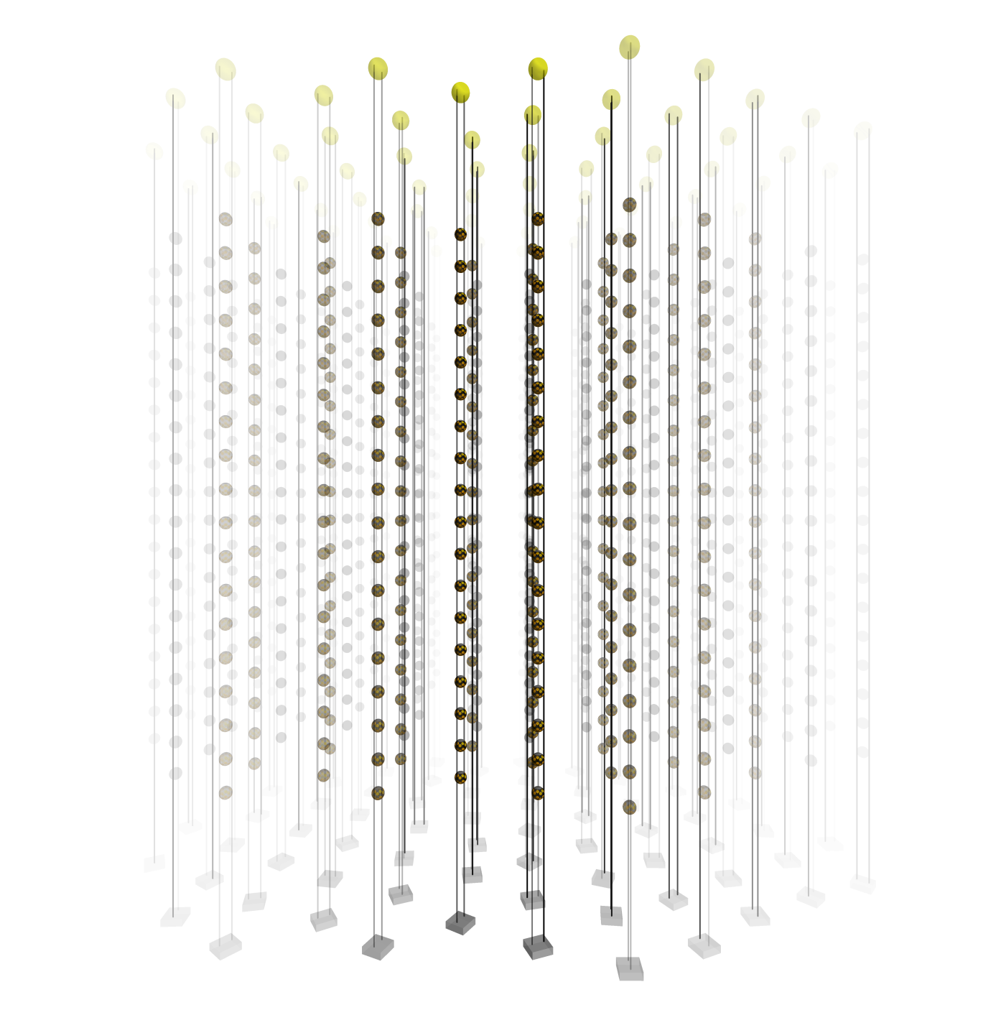
What about ORCA?

Slide 14
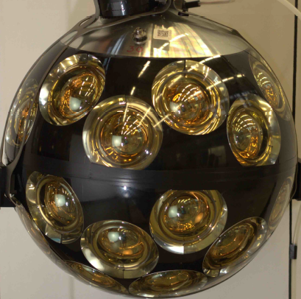
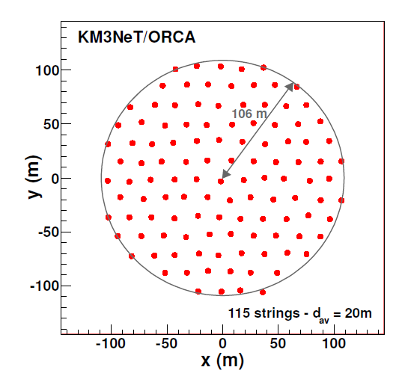
Our Detector
Cylindrical volume with hexagonal string symmetry
Extra dimensions from PMT orientation and hit time
A 2-point model: Light production and detection points
3 well-defined axes
X2
Detection point
Y
6 PMT Layers
X1
Production point

Slide 15
Detection Point
No need for true detection, just encode time and direction infor-mation
Extrapolate light back in the direction of the PMT for a time t_{hit} - t₀ (event start time)
Ignores particle that produced the light
Detection point (t_{hit})
Estimated production point (t₀)
c_{w} × (t_{hit} - t₀)
Particle start point (t₀)

Slide 16
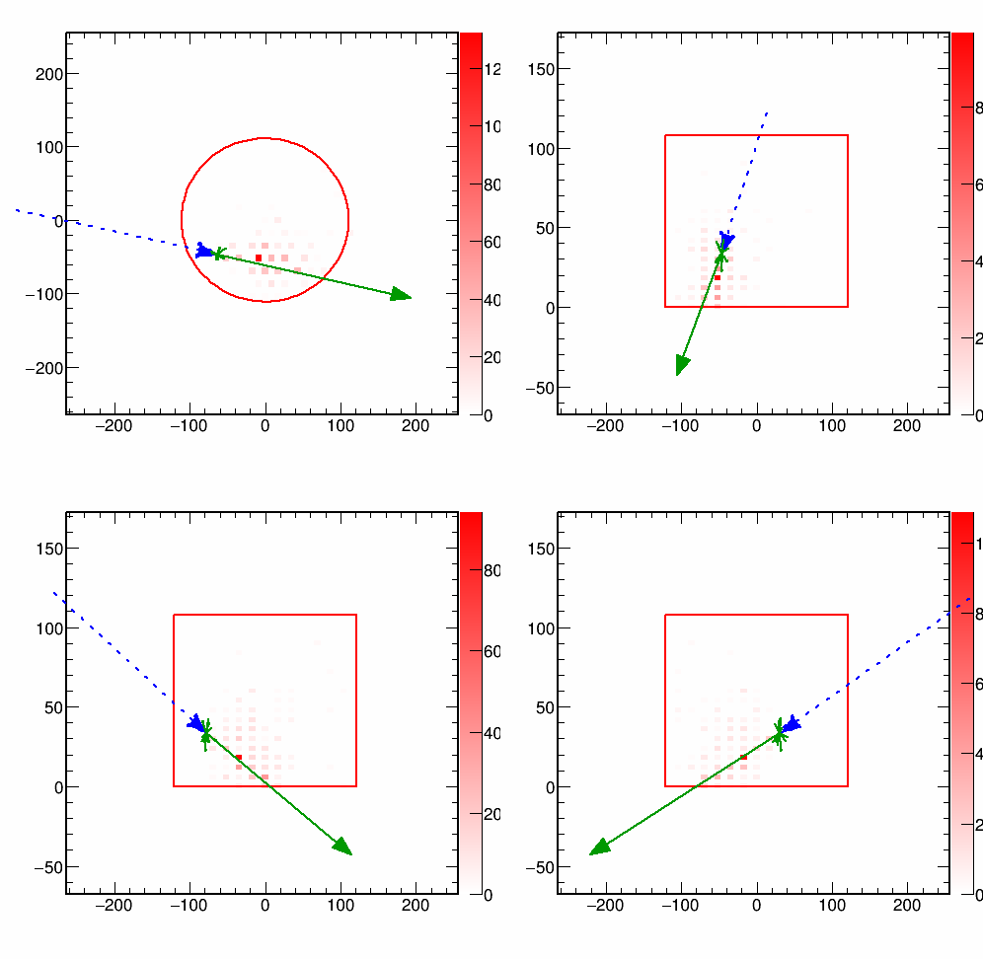
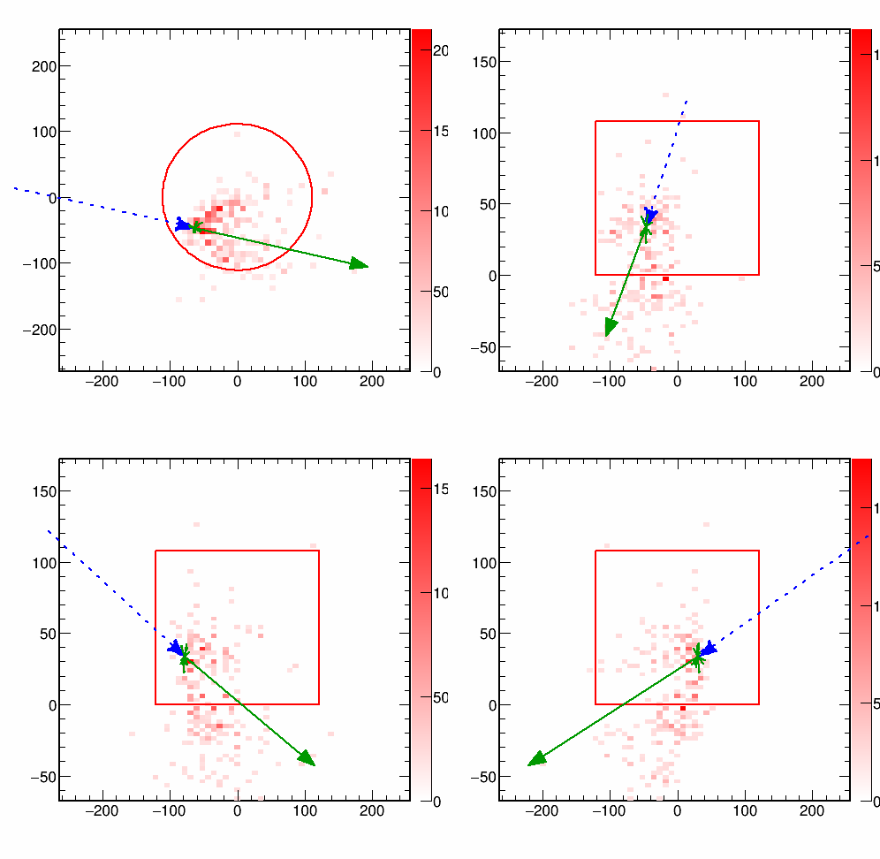
Image Inputs
Define four (x2) views (2D projections of the detector)
Plot charge in detection and “production” positions
Detection point
Estimated production point
X-Y
Y-Z
A ‘V’ shape
X1-Z
X2-Z
Maybe a ring?

Slide 17
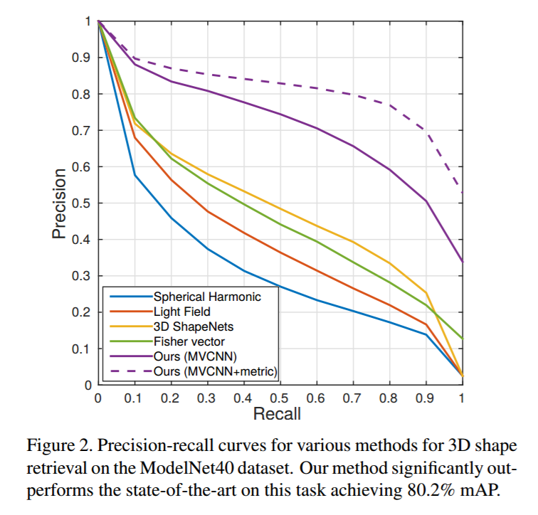
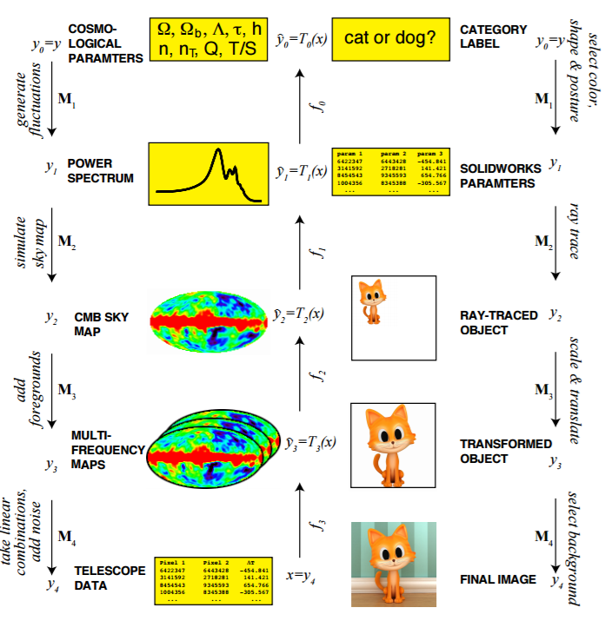
Why Projections?
Symmetry, locality, ... -> neural nets are good with images and drawings
Hierarchical data -> deep neural network more efficient
Multi-view 2D images can outperform networks with truly 3D shape inputs

Slide 18
What’s next?
Deep learning is being successfully implemented in HEP
Can we use it to reconstruct and/or classify KM3NeT events?
We have an initial concept, based on the NOvA experience
NOvA used the Caffe framework, but should we?
Challenging 6D input space. Is the best solution projections?
Are Convolutional NNs a good approach?
Other sugestions?

Slide 19
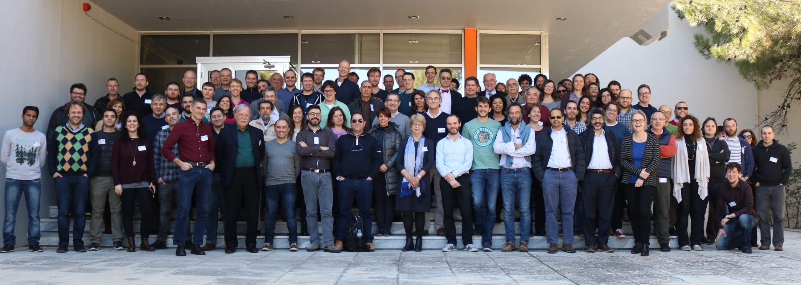
Thank you!

Slide 20
Backup Slides

Slide 21
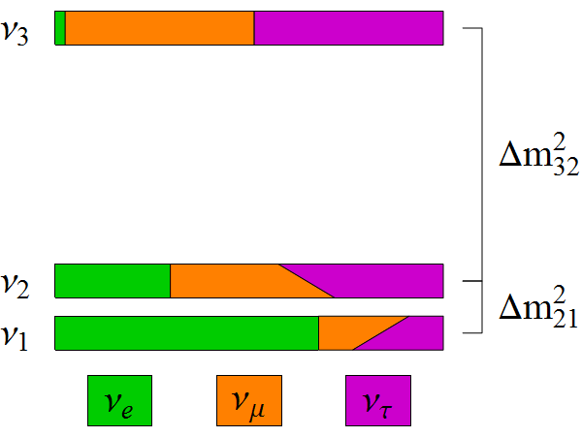
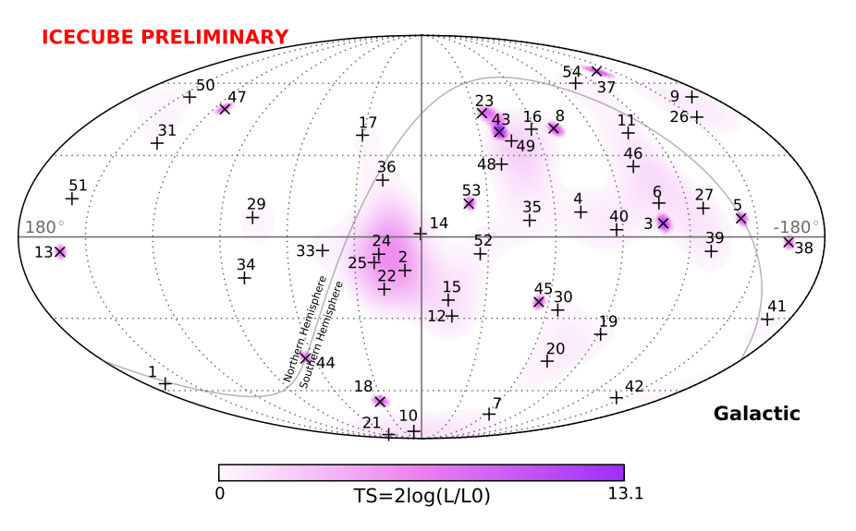
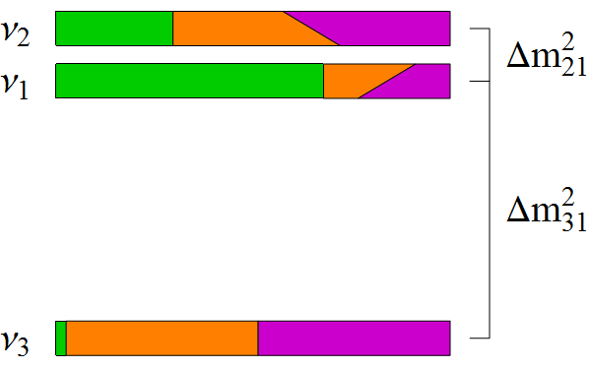
Objectives
ORCA: Determine the Neutrino Mass Hierarchy (NMH)
ARCA: Discover/Observe high-energy neutrino sources in the universe
m²
Normal Hierarchy
Δm²₃₂ > 0
m²
Inverted Hierarchy
Δm²₃₂ < 0

Slide 22
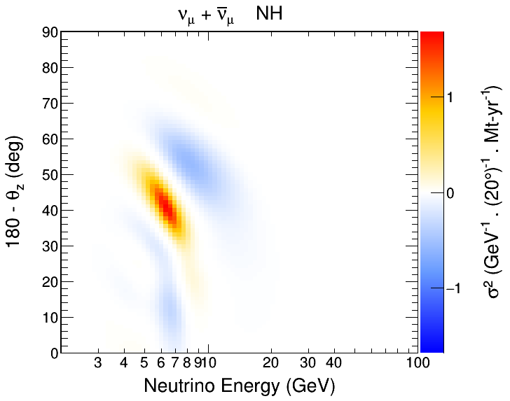
The Challenge
θ_{Z}
Measure neutrino direction and energy
Search for oscillation patterns from matter effects
Sensitive to difference in patterns between NH and IH
Requires large statistics and good energy and direction res.

Slide 23
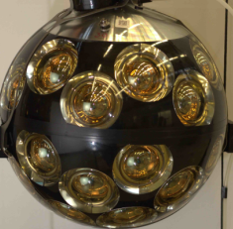
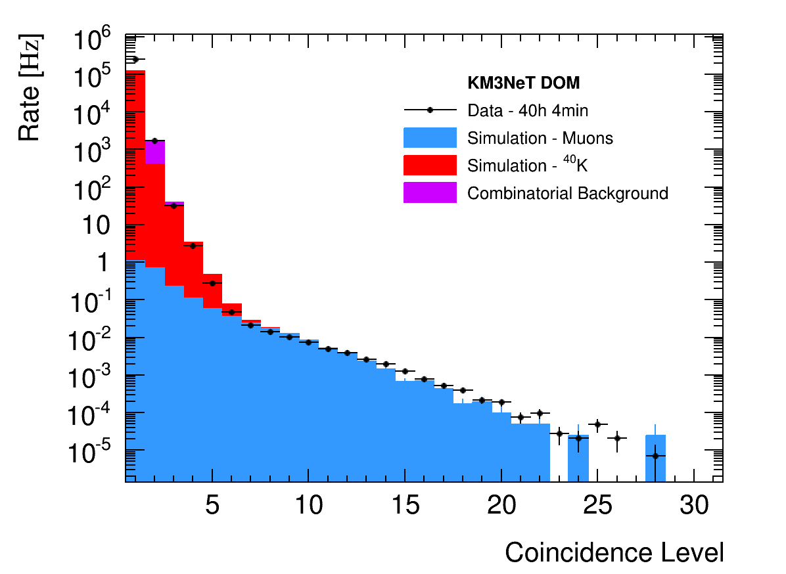
Trigger
Optical background mostly from ⁴⁰K decays in the water
Measured: 8 kHz uncorr., 340 Hz level-two coinc. / PMT [Eur. Phys. J. C 74, 3056 (2014)]
Look for coincidences in time and PMT direction to reduce trigger rate.
Causality further restricts space and time correlations for extra power.
Final trigger rate ~59 Hz, with 70% of events containing a cosmic ray muon.
β
⁴⁰K
⁴⁰Ca
⁴⁰Ca
β
⁴⁰K
⁴⁰K
⁴⁰K
β
⁴⁰Ca

Slide 24
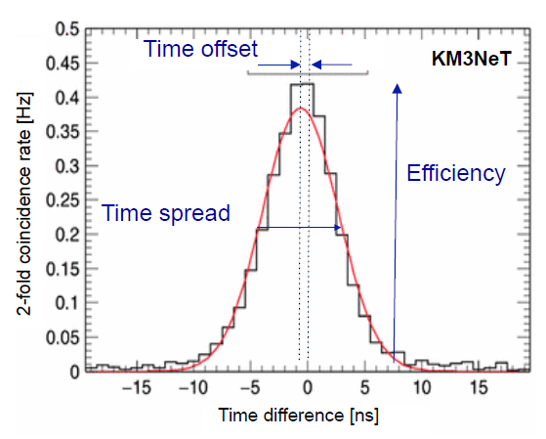
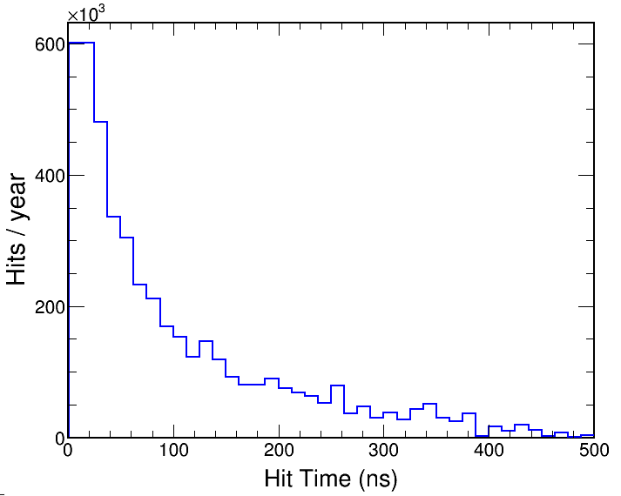
Optical Noise
Optical background in full detector ~500 MHz.
Neutrino events ~40 hits in a ~500 ns window
Expect 250 noise hits (~14% purity)
Trigger approach ~5 ns time residuals
Calibrated using 2-fold coincidences
Can achieve ~3 noise hits per trigger (>90% purity)
ν_{μ}-CC
ν_{μ}-CC

Slide 25
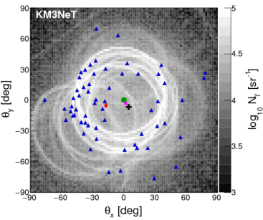
Limitations
Hadronic showers can generate multiple cherenkov rings, but reconstructing them is limited by photon statistics
Without hadronic info, reconstruction is limited by intrinsic kinematics
Extracting some information on particle multiplicity would be a significant achievement for a deep learning technique

Slide 26
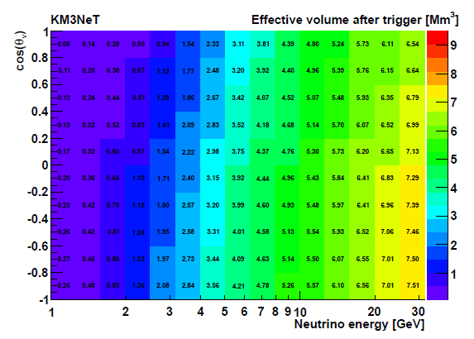
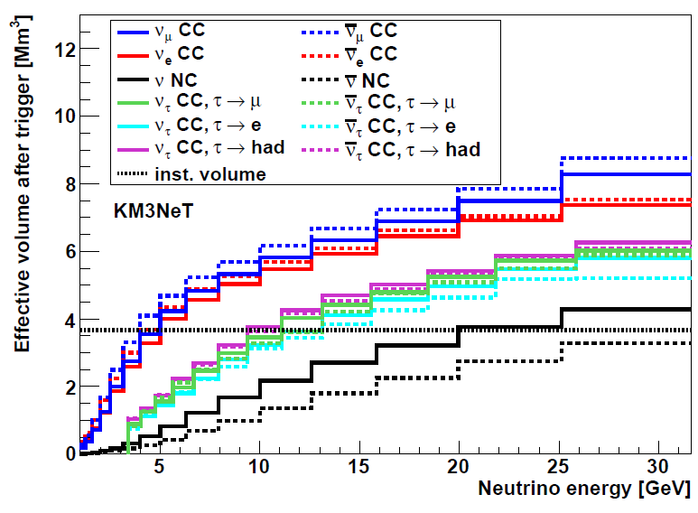
Trigger Performance
Input a conservative noise rate of 10 kHz uncorr. (500Hz level-two coinc.)
Achieve a total triggered rate of 59 Hz
About 70% of events contain a muon (41 Hz)
High efficiency for ν_{μ} and ν_{e} above 4 GeV
Slightly more efficient for up-going neutrinos (Larger PMT coverage)
Neutrino Rate:
~ 1 ν / 10 min
ν_{e}-CC

Slide 27
Reconstruction
Start with a track or shower hypothesis
Use causality to perform a robust hit selection
Find vertex and direction that best match hit pattern
Estimate track range for computing track energy (0.24 GeV / m)
Estimate Shower energy and direction from hit distribution after initial fit to the vertex position and time
Track Hypothesis
Shower Hypothesis
θ_{C}

Slide 28
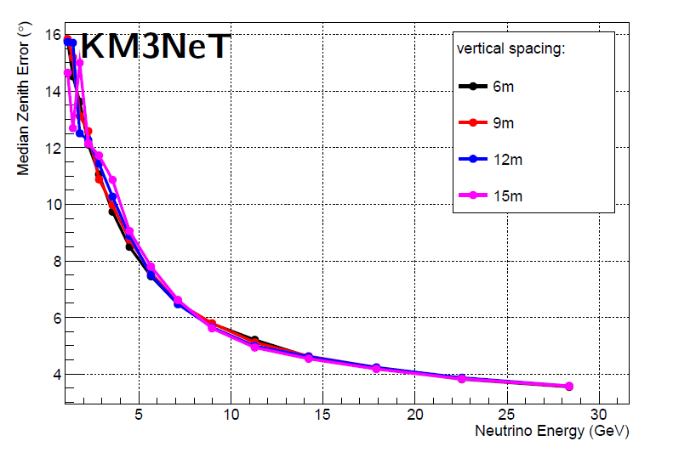
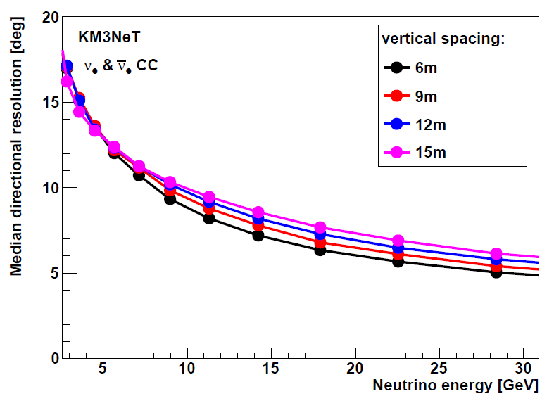
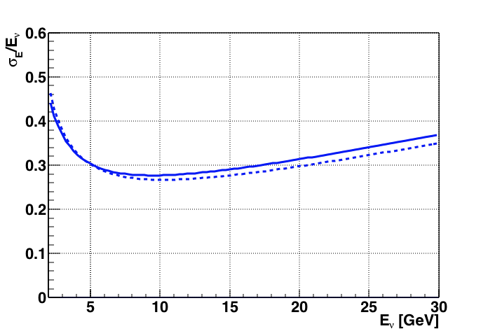
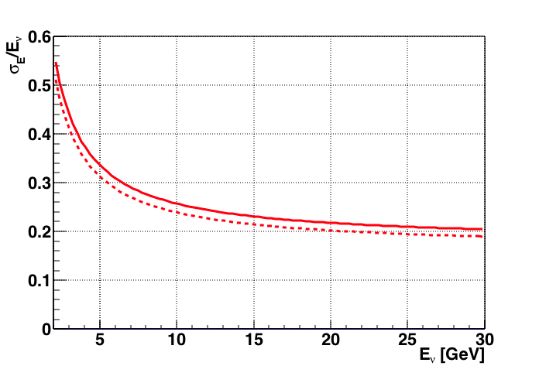
Reco Performance
Energy resolution: ~25% (Close to limit arXiv:1612.05621)
Angular resolution: Better than 10 degrees at relevant energies
ν_{μ}-CC
ν_{e}-CC
θ Res.
θ Res.
ν_{μ}-CC
ν_{e}-CC
E Res.
E Res.

Slide 29
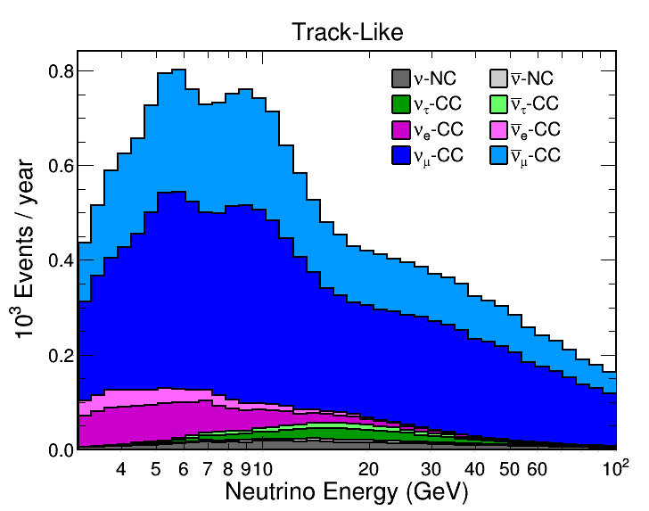
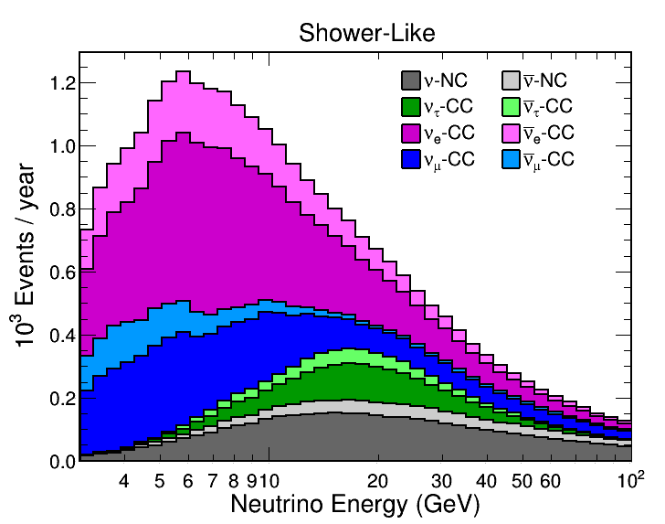
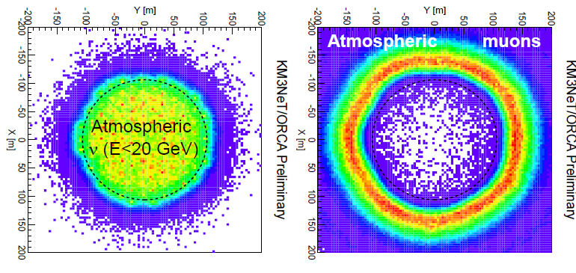
Event Selection
Events are classified through a Random Decision Forest (RDF)
At 10 GeV:
90% of ν_{e}-CC are shower-like
70% of ν_{μ}-CC are track-like
Most atmospheric muons are removed by containment cuts

Slide 33
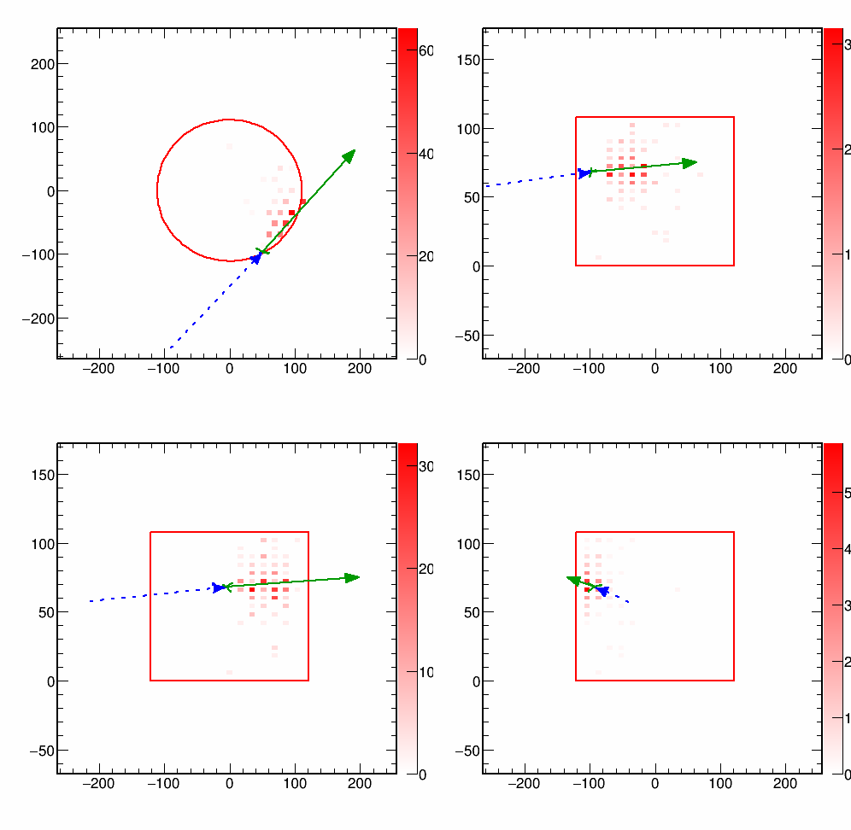
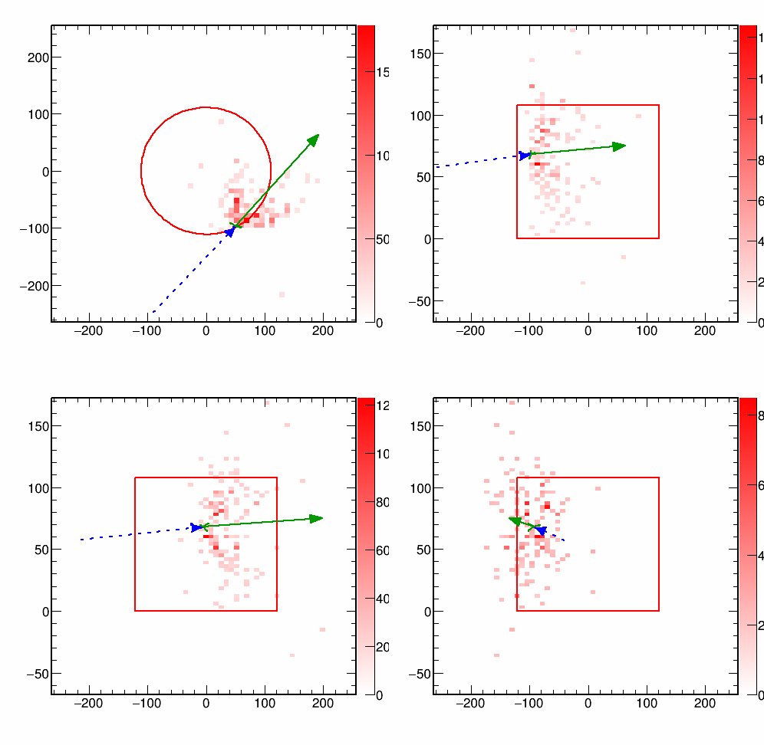
OrcaNet Inputs
Define four views (2D projections of the detector)
Plot charge in detection and “production” positions
Detection point
Estimated production point
X-Y
Y-Z
A ‘V’ shape
outside detector
X1-Z
X2-Z

Slide 34
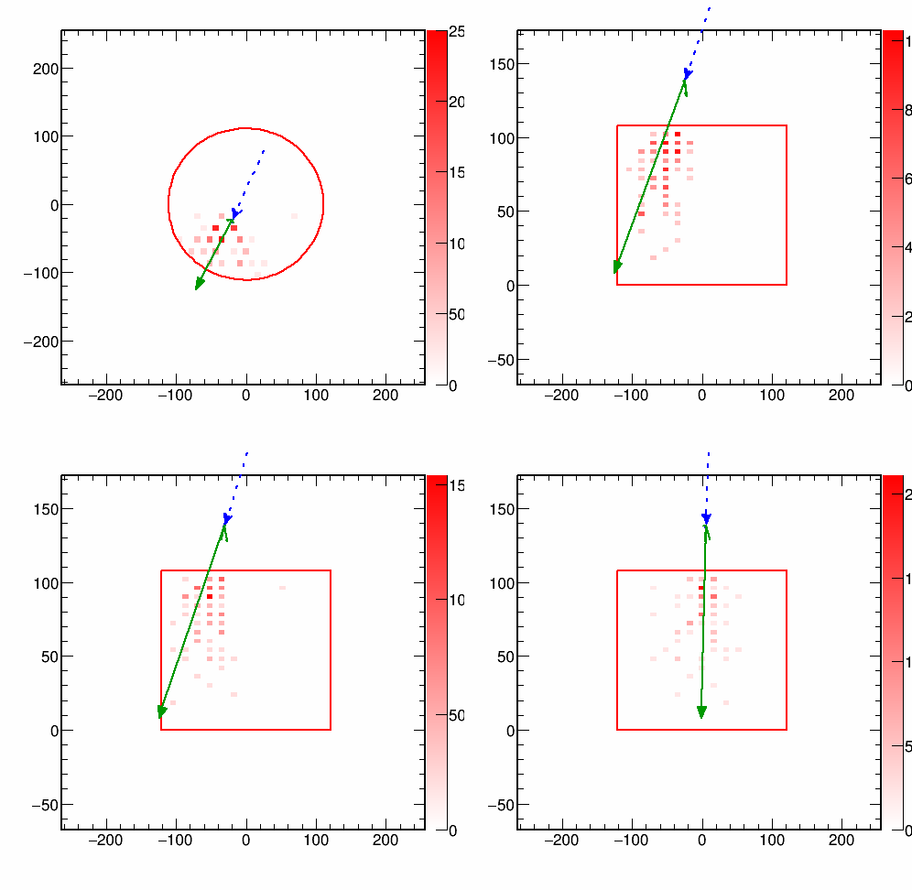
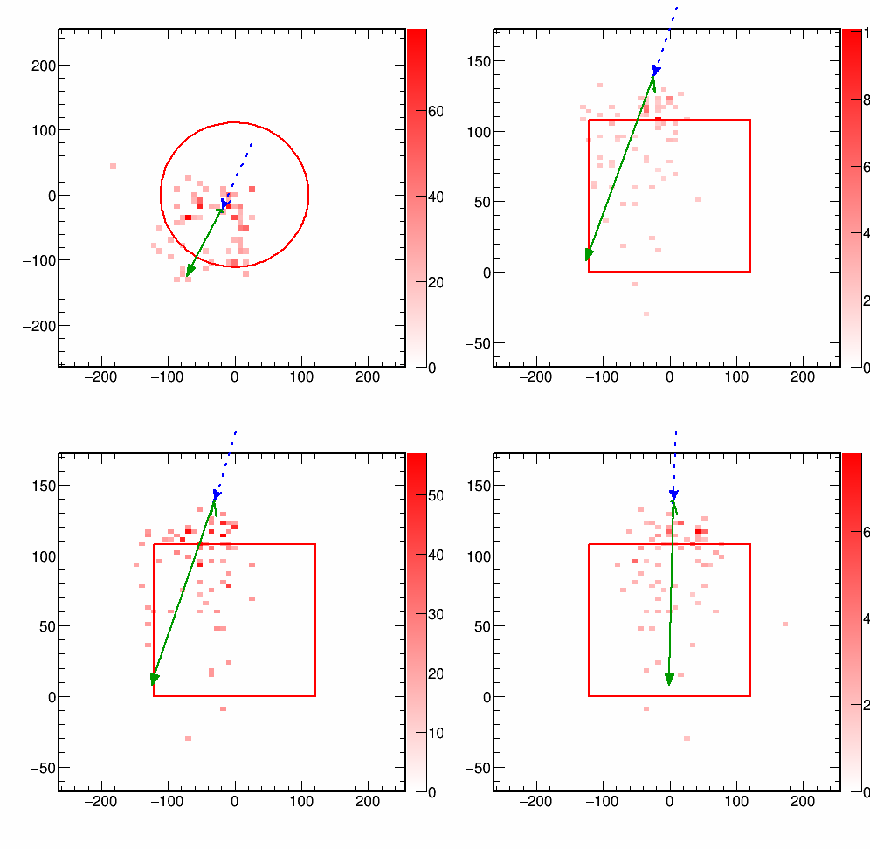
OrcaNet Inputs
Define four views (2D projections of the detector)
Plot charge in detection and “production” positions
Detection point
Estimated production point
X-Y
Y-Z
A ring?
X1-Z
X2-Z

Slide 35
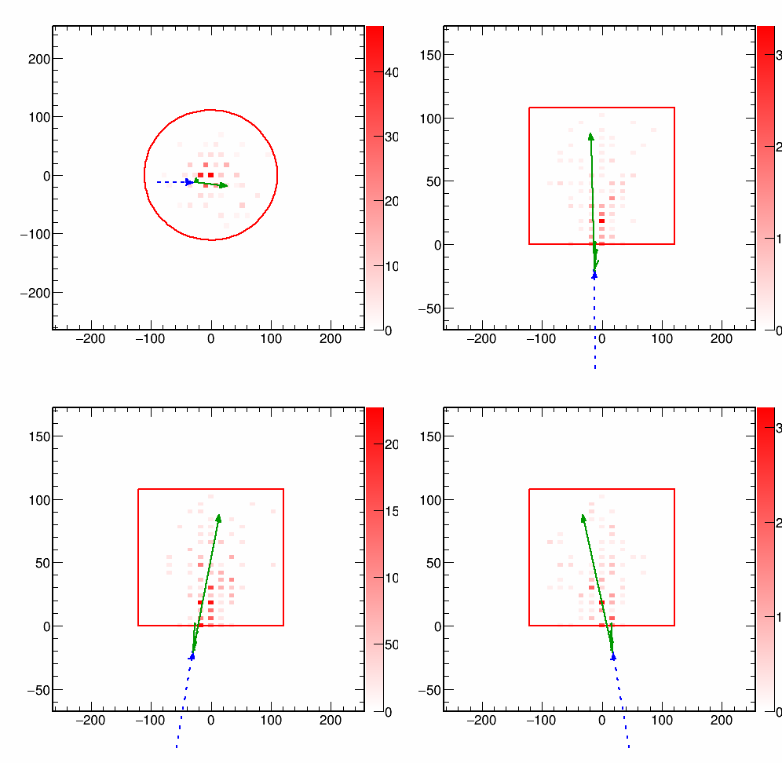
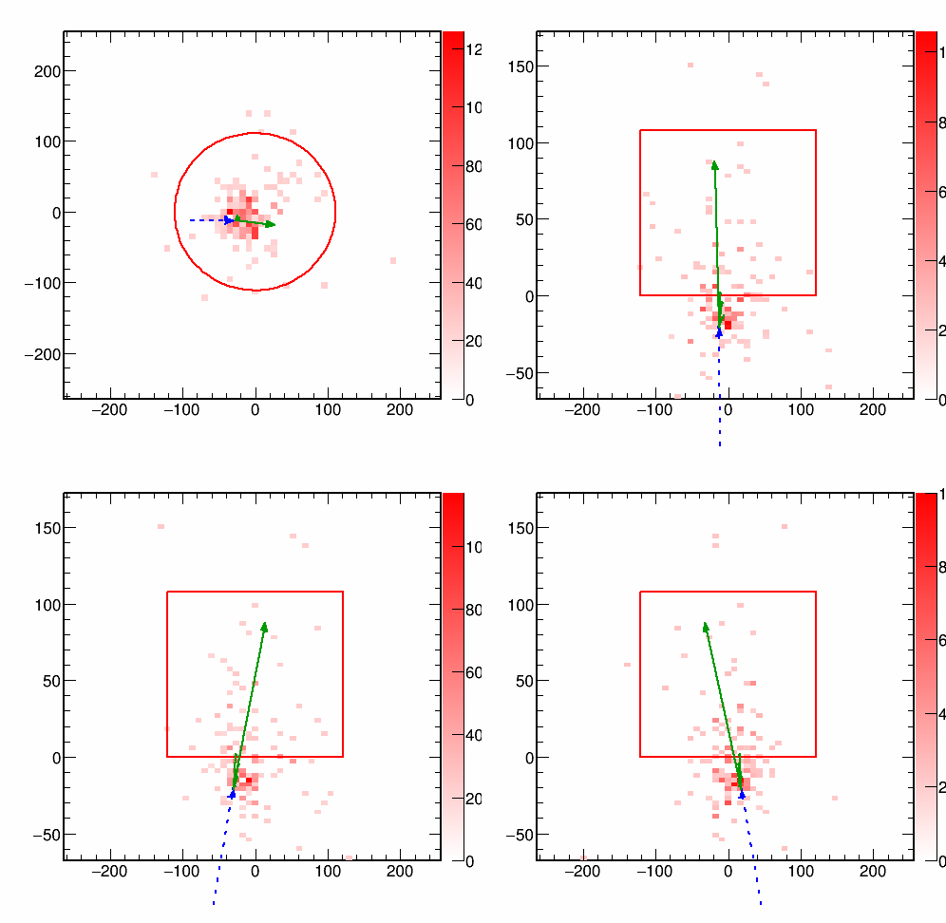
OrcaNet Inputs
Define four views (2D projections of the detector)
Plot charge in detection and “production” positions
Detection point
Estimated production point
X-Y
Y-Z
X1-Z
X2-Z
Good vertex?

Slide 36
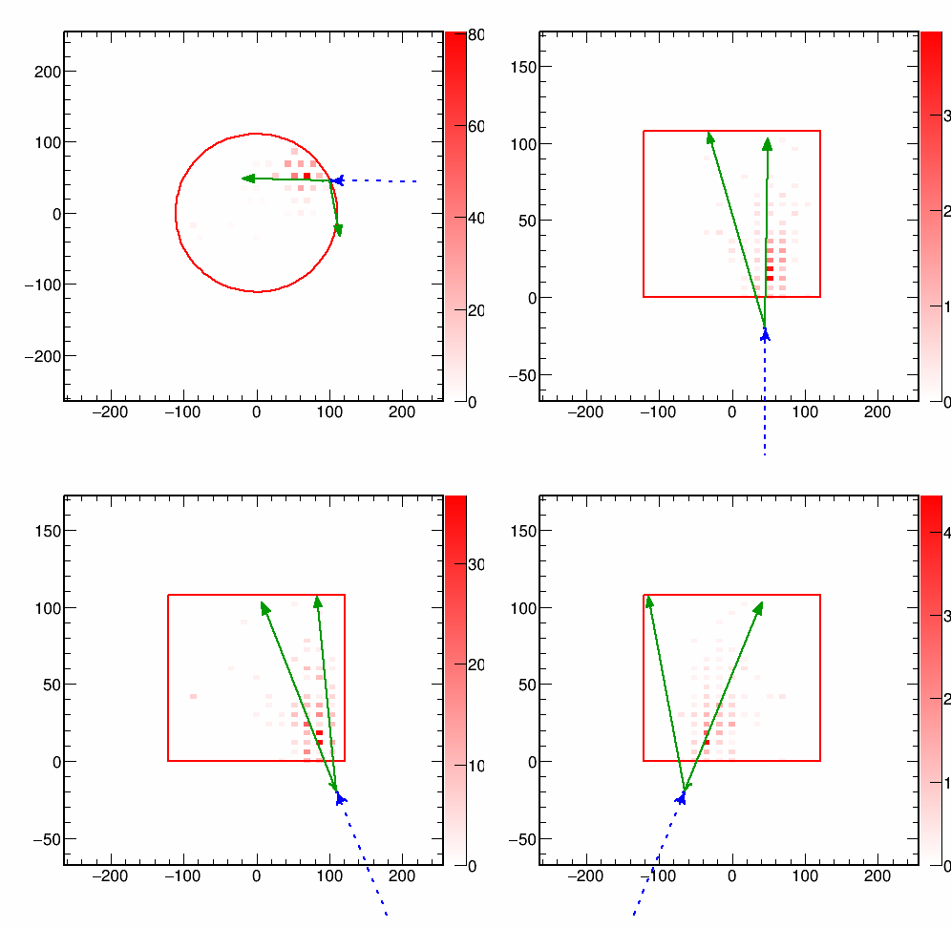
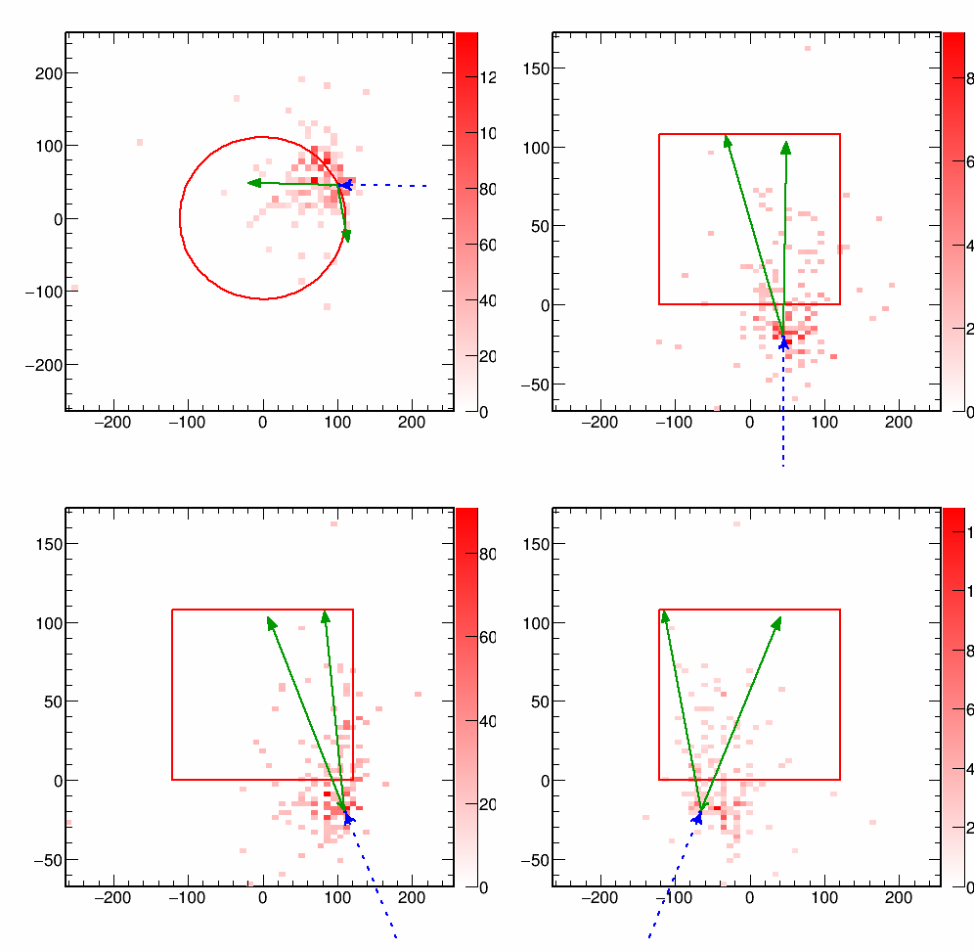
OrcaNet Inputs
Define four views (2D projections of the detector)
Plot charge in detection and “production” positions
Detection point
Estimated production point
X-Y
Y-Z
X1-Z
X2-Z
Multiple Tracks?

Slide 37
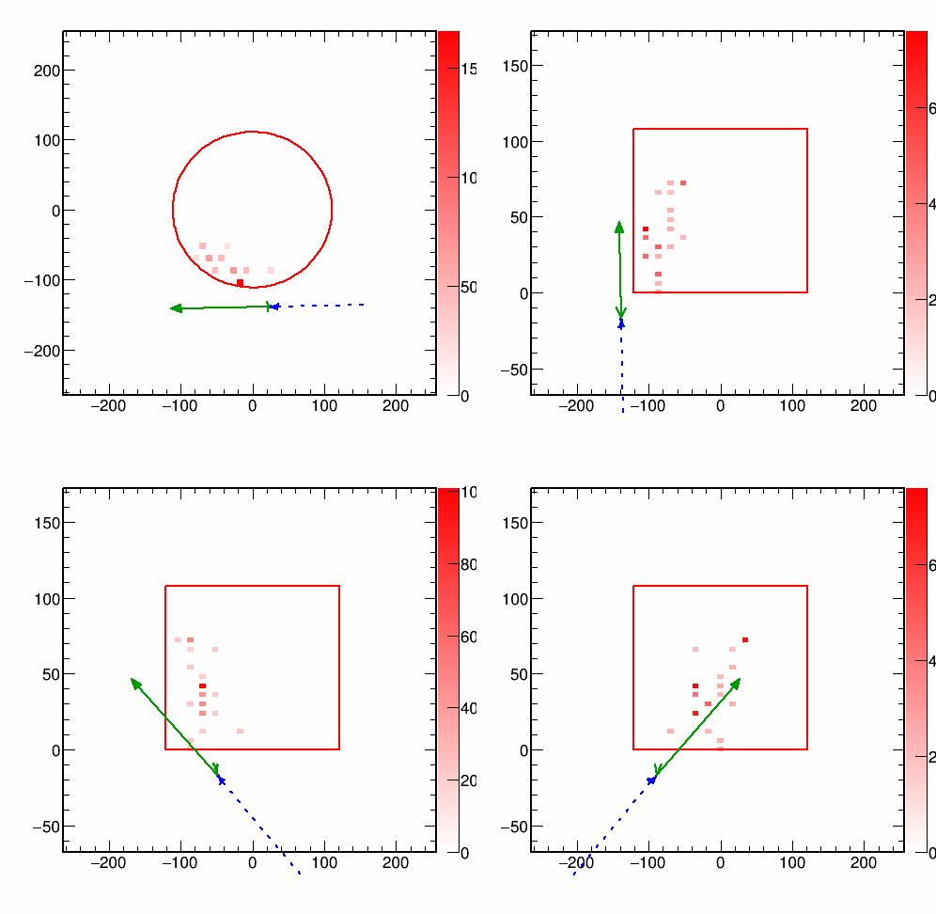
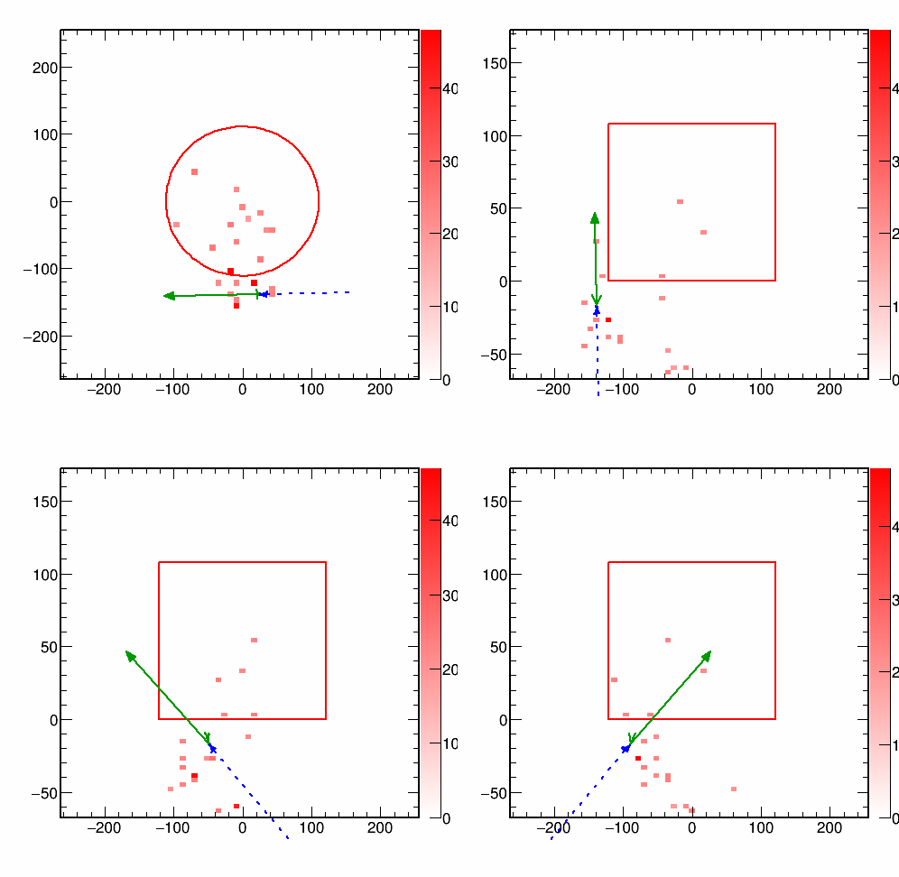
OrcaNet Inputs
Define four views (2D projections of the detector)
Plot charge in detection and “production” positions
Detection point
Estimated production point
X-Y
Y-Z
Too Little Data?
X1-Z
X2-Z

Slide 38
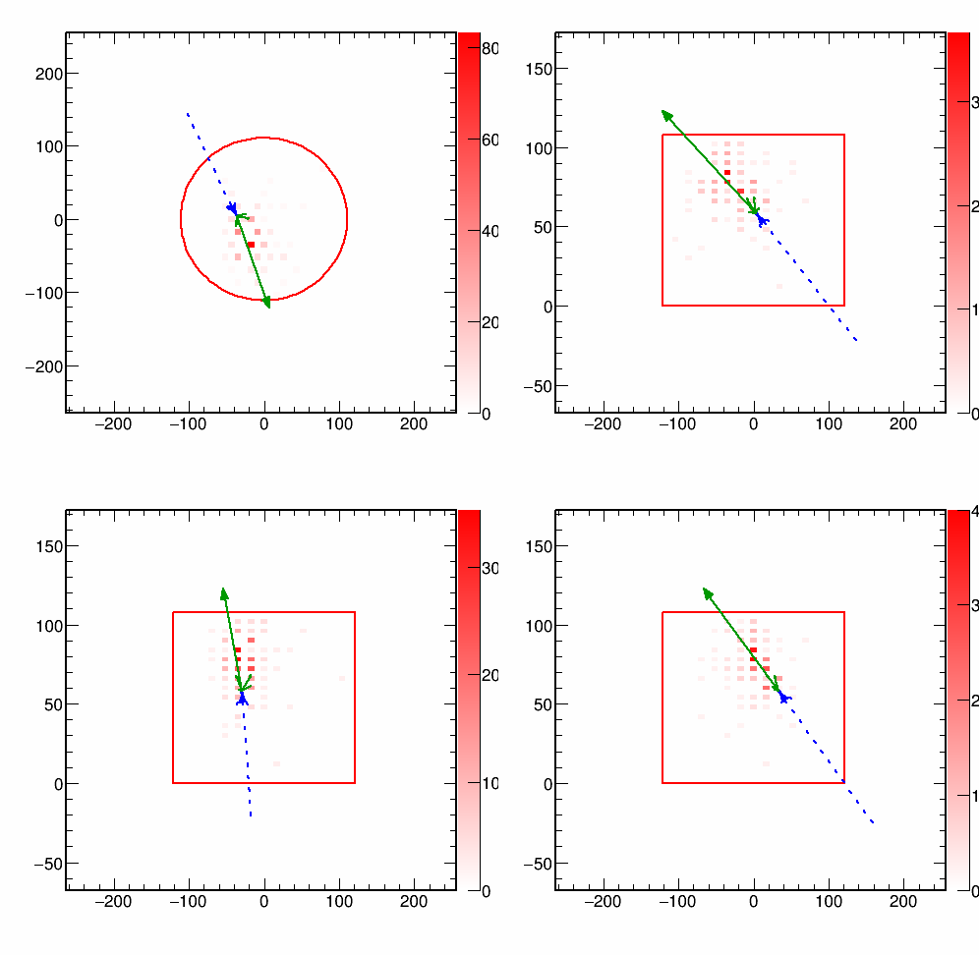
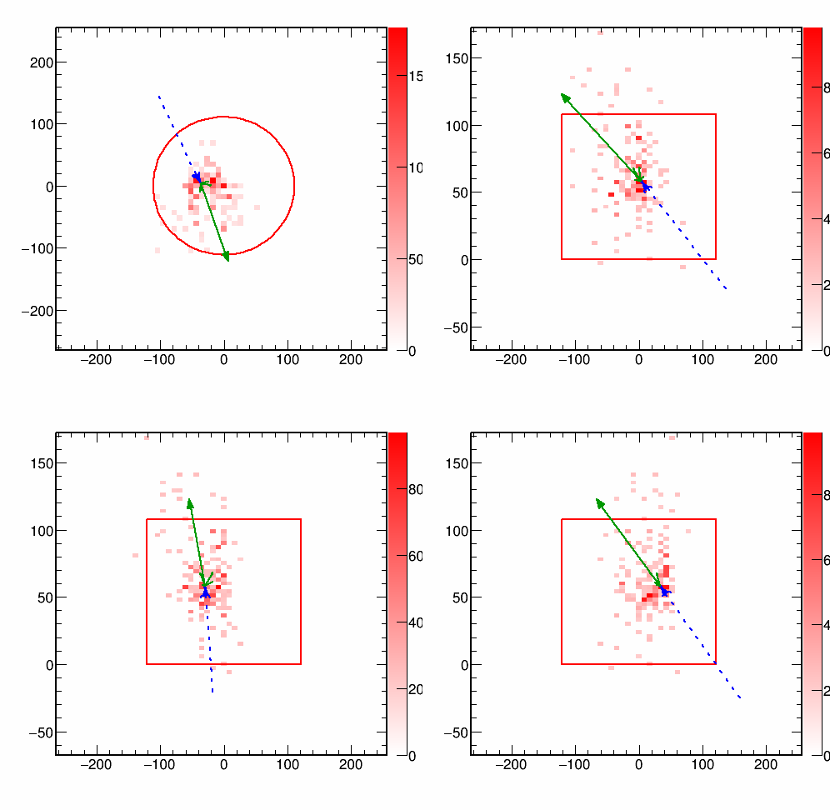
OrcaNet Inputs
Define four views (2D projections of the detector)
Plot charge in detection and “production” positions
Detection point
Estimated production point
X-Y
Y-Z
X1-Z
X2-Z

Slide 39
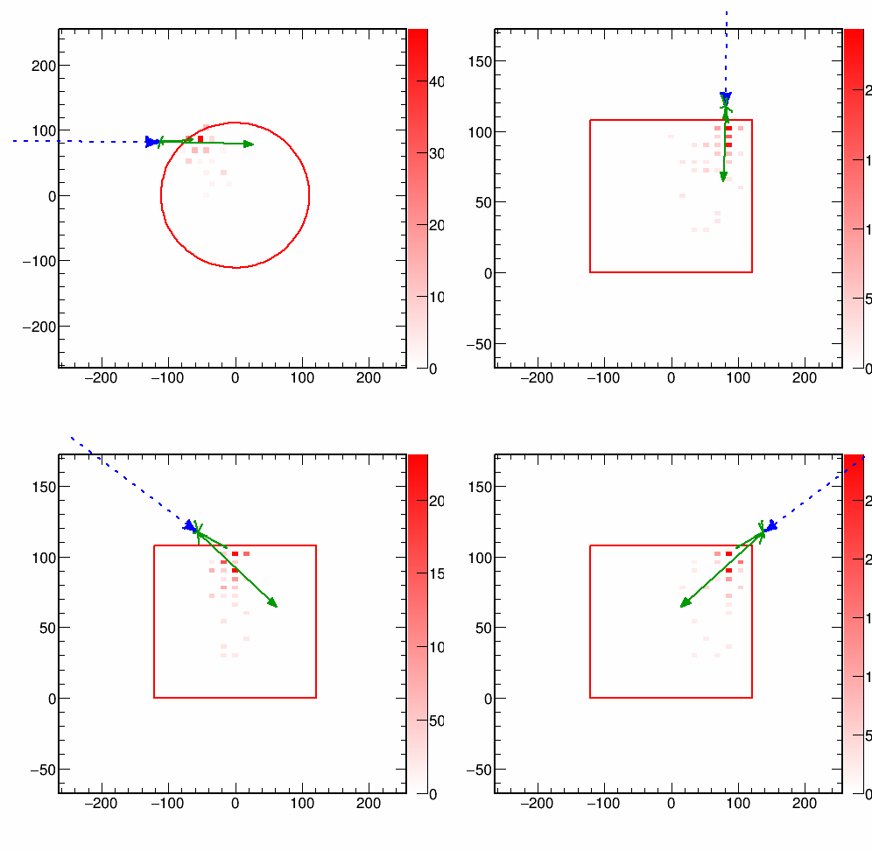
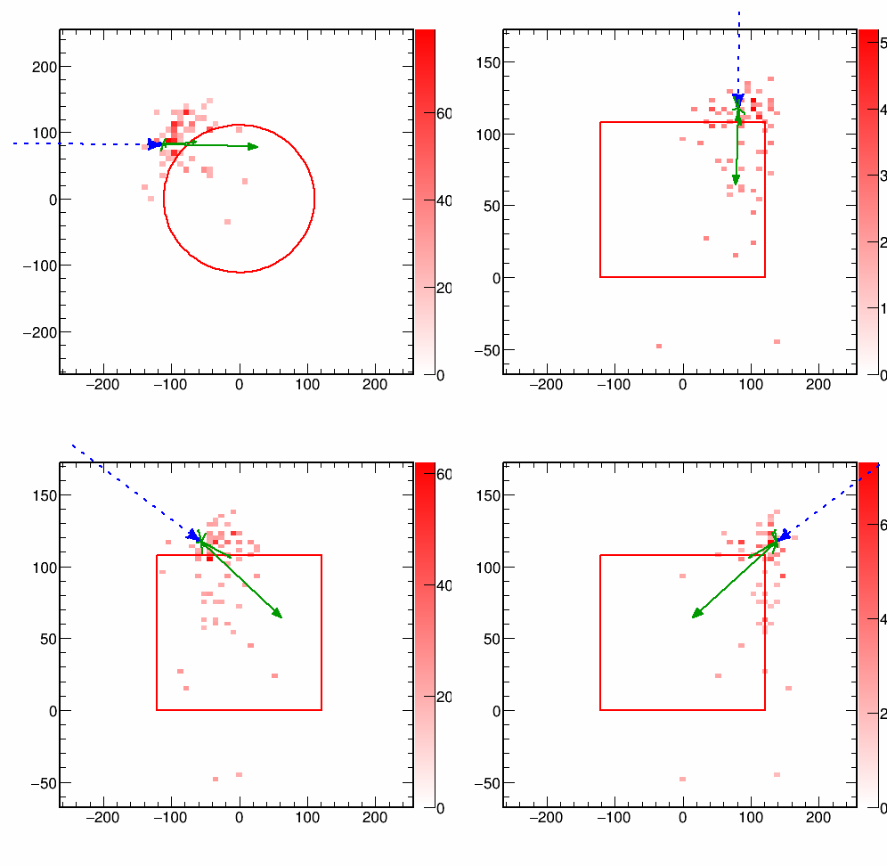
OrcaNet Inputs
Define four views (2D projections of the detector)
Plot charge in detection and “production” positions
Detection point
Estimated production point
X-Y
Y-Z
X1-Z
X2-Z

