Slide 1
Research Data (Management) in Environmental Sciences
Characteristics, Status and Challenges
Prof. Dr. Lars Bernard - Karlsruhe 8/2017
Notes:
- Titel:
Research Data and Management in Environmental Sciences - Characteristics,
Status and Challenges
- Abstract
Research in environmental sciences is widely 'digitized' and a plethora of
approaches and initiatives for environmental (research) data management and
infrastructures established. However, still a number of issues hinder
seamless data integration for environmental researchers and reproducible
research is far from being reality.
This contribution will give an overview on the current status, list some
promising approaches as well as current r&d challenges.

Slide 2
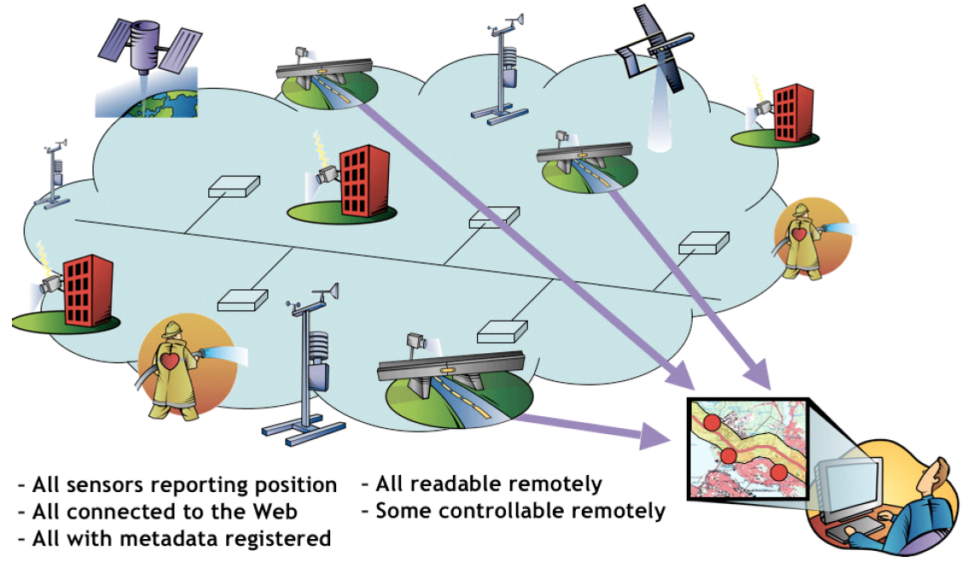

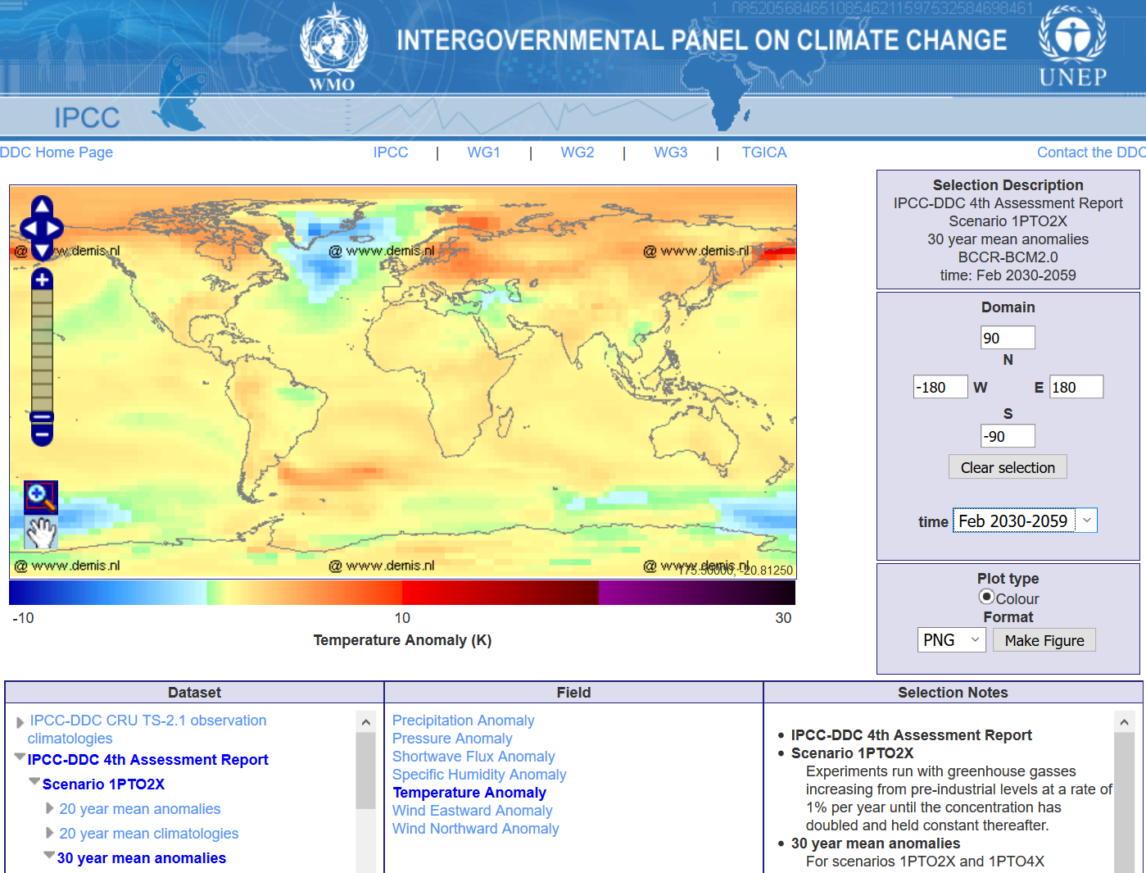
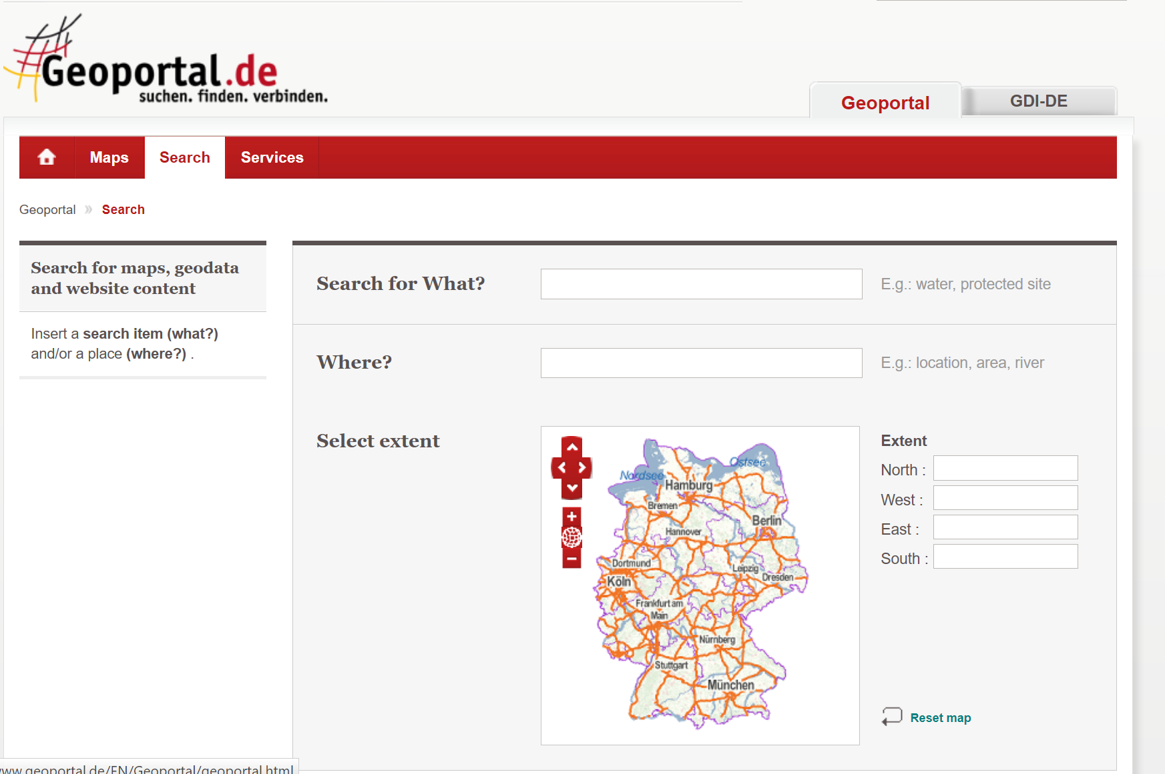
Research in Environmental Sciences
Happens often digital …
from observations over
analysis towards
simulation and synthesis.
Masses of big (open) data…
(rarely big data analytics)
http://www.opengeospatial.org
http://www.ipcc-data.org/maps
http://www.geoportal.de

Slide 3
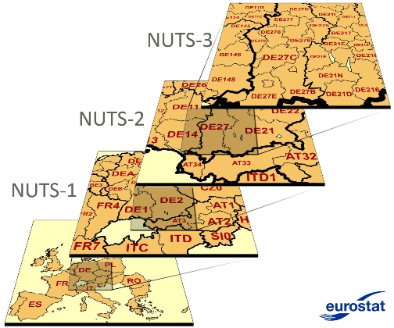
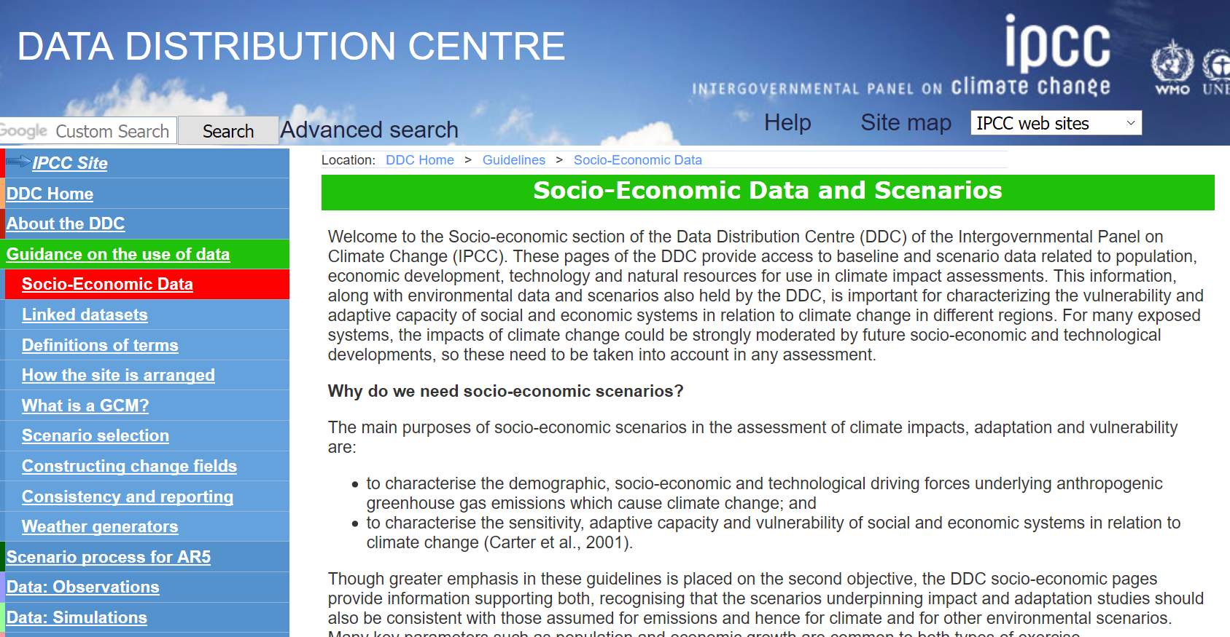
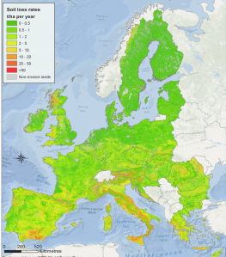
Research in Environmental Sciences
Happens mostly across disciplines
(e.g. climatology - social sciences
- regional planning/law)
Geodata often acts as the
common starting point or reference
(e.g. topography, socio-economics,
scenarios…)
http://sedac.ipcc-data.org/ddc/
EUROPEAN SOIL DATA CENTRE

Slide 4
Research Data in Environmental Sciences
Consider a simplified research workflow:
Discover environmental data or geodata
as input to your research
– how/where to find appropriate, consistent data?
… research …
Publish environmental research results
(research data in a strict sense)
– how/where best to provide ?

Slide 5

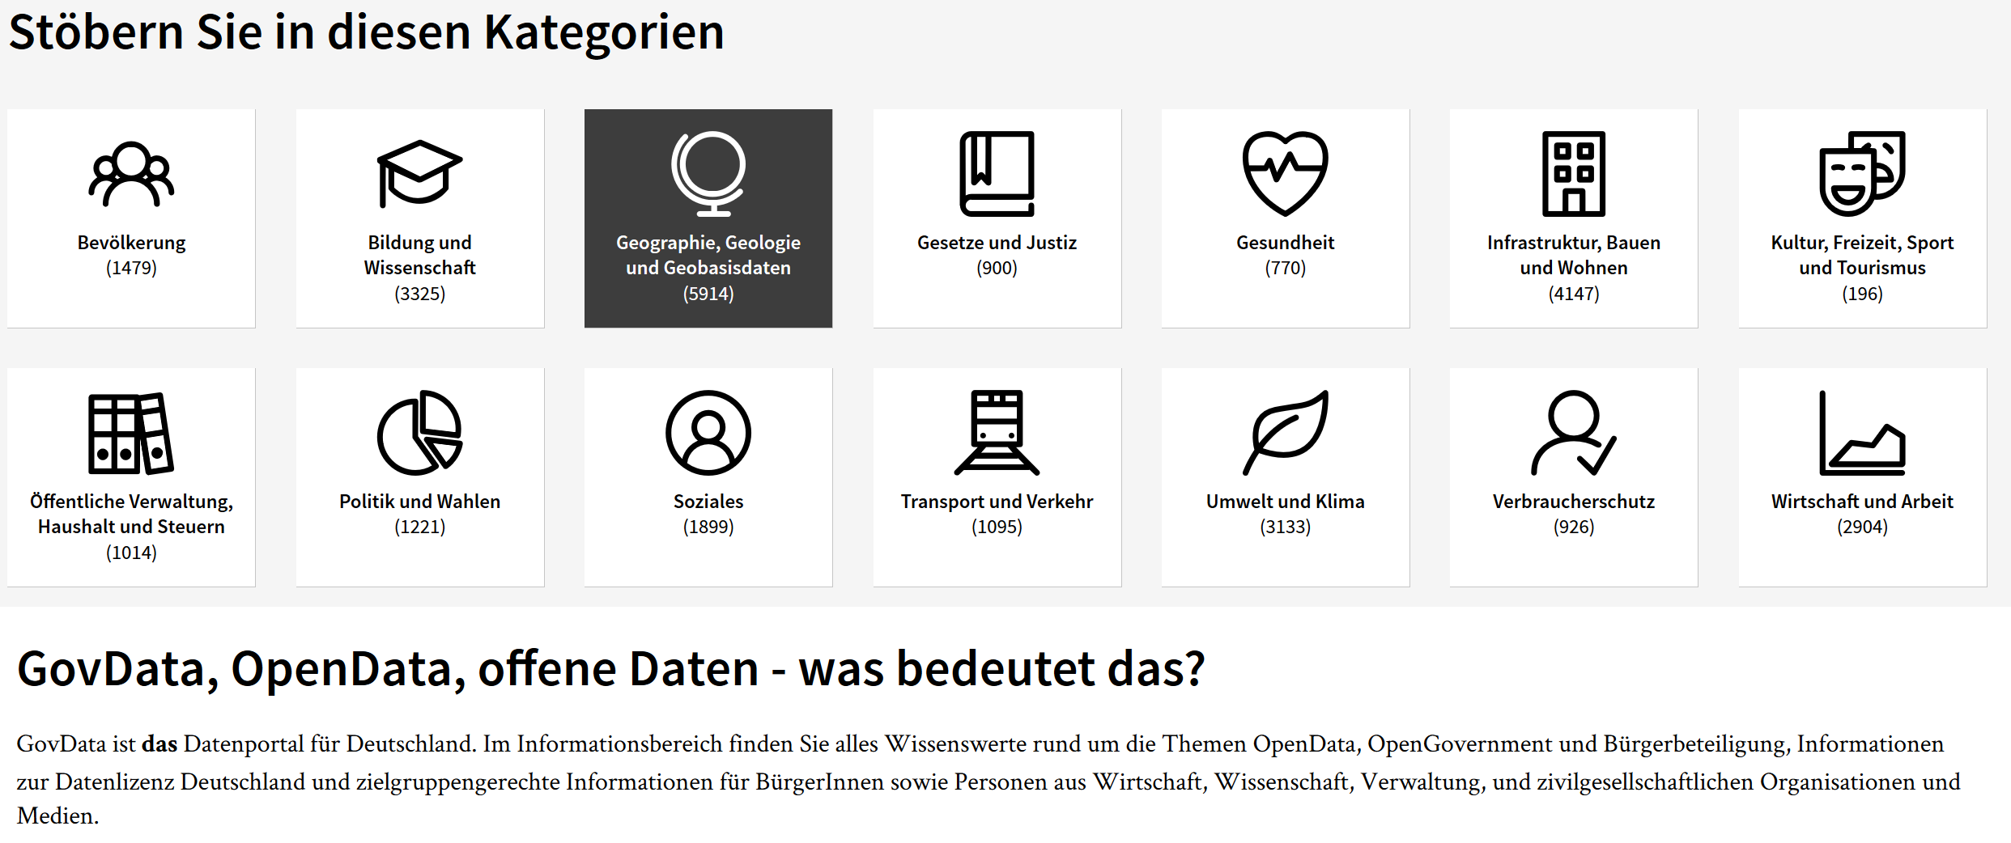
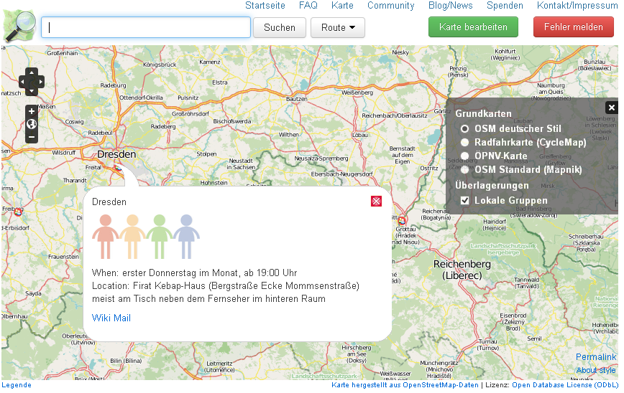
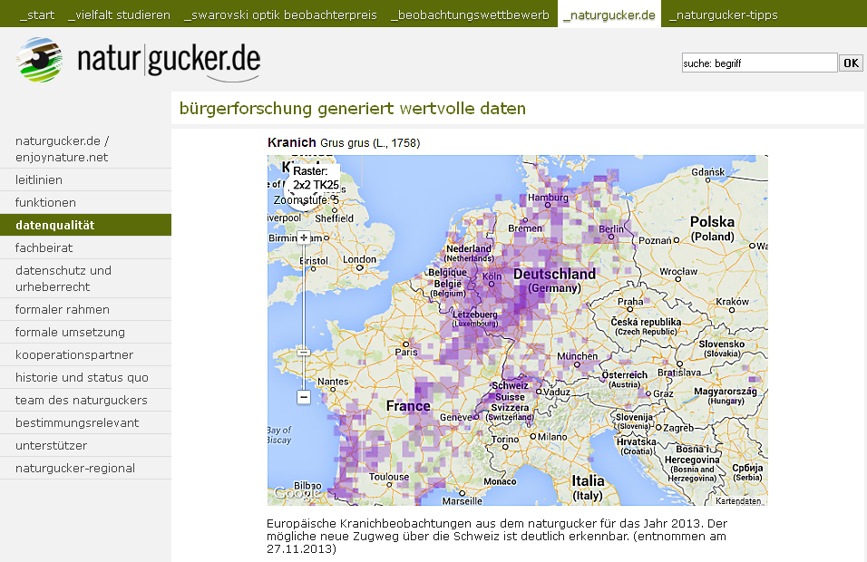
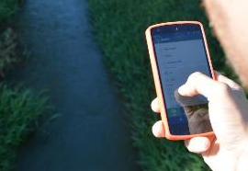
Environmental Data for Research
Heterogeneous...
Several Providers
(administration, commercial,
volunteered/crowd sourcing, scientific…)
Different data qualities,
semantics, scales, coverages,…
Different (data) cultures
within sub-disciplines and organizations
www.govdata.de
www.openstreetmap.org
/www.naturgucker.info

Slide 6
Environmental Data for Research
A lack common reference data sets
for environmental sciences ?!?
  As spatio-temporal reference for
  interdisciplinary environmental
  research
  As basis to reproducibility
  Developing common qualification
  mechanism ?
  Several Nuclei (INSPIRE, UNGIM,
  EU Data Centres, SRTM, Copernicus,…)
  Which Scales, topics, degree of coherency?
  Approaches for ad-hoc Data Fusion ?!!?

Slide 7

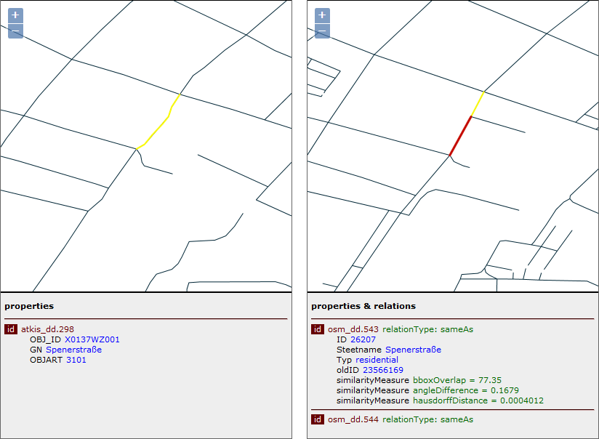
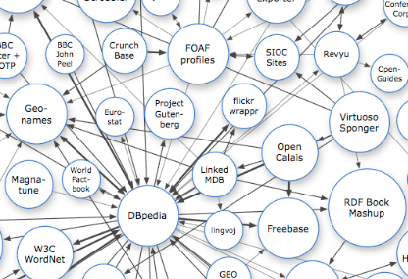
Ad-Hoc Data Fusion…our approach
Using Linked Data Approaches to describe fusion paths between features in different geodata sets
Fusion service (WPS)
Client
3
Source Data
(WFS)
1
SPARQL
Triple Store
(Linked Data)
4
2
Semantic Web
Wiemann, Bernard (2016)

Slide 8
Ad-Hoc Data Fusion…our approach
Wiemann, Bernard (2016)

Slide 9
Ad-Hoc Data Fusion…our approach
Example: Deriving homologues Objects
in OSM and ATKIS Data (e.g. for enrichment)
OSM
(WFS)
Fusion
Service
(WPS)
Define confidence measures for the fusion:
+0.1, if the bounding boxes intersect or the distance is less than 50 m;
+0.2, if the angle difference is less than π/10;
+0.1, if the minimal geographic distance is less than 50 m;
+0.1, if the length difference is less than 20 m;
+0.15, if the Hausdorff distance is less than 50 m;
+0.15, if the topology relation is not disjoint;
+0.2, if the Damerau-Levenshtein distance between the road names is less than 4.
Client
3
ATKIS
(WFS)
1
Triple Store
(Linked Data)
SPARQL
2
4
687 Features | confidence >= 0.4 | confidence >= 0.8
Features with relation | 670 | 360
sameAs [1:1] relation | 11 | 296
Multiple [m:n] relation | 470 | 25
Precision | ~0.4 | ~0.9
Recall | ~0.9 | ~0.6
Semantic Web
Wiemann, Bernard (2016)
Notes:
Precision = (true positives / positves),
Recall = (true positives / real positives)

Slide 10
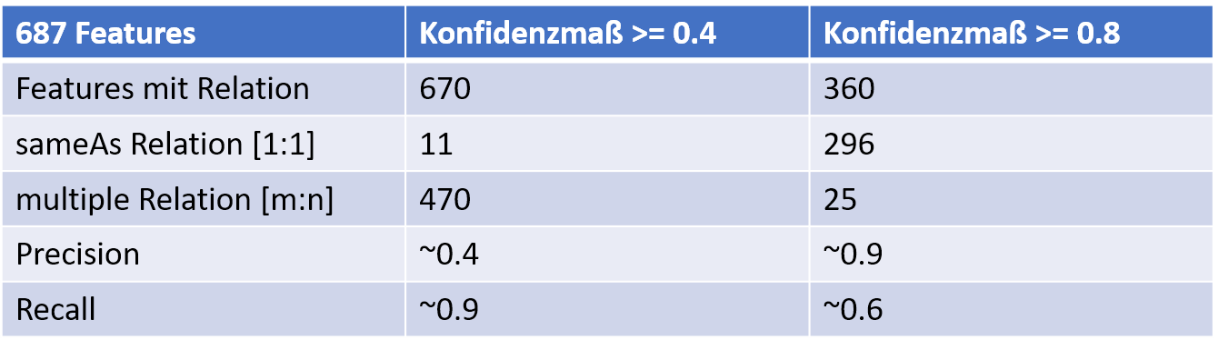
Ad-Hoc Data Fusion…our approach
Example: Deriving homologues Objects
in OSM and ATKIS Data (e.g. for enrichment)
  Advantages
  Relation descriptions as Linked Data can also be used in the non GI World (Semantic Web).
  Linked Data tools (SPARQL) support analyzing
  relations and relation measures…
  Relations can be managed independently from the Geodata (sources) to derive differences, changes etc. (thus not requiring access to the source data)…
  Supports user controlled ad-hoc data fusions,
  once relations are derived
  Next Steps:
  A DFG Roundtable on New Geodata Models (1/2018)
OSM
(WFS)
Fusion
Service
(WPS)
Define confidence measures for the fusion:
+0.1, if the bounding boxes intersect or the distance is less than 50 m;
+0.2, if the angle difference is less than π/10;
+0.1, if the minimal geographic distance is less than 50 m;
+0.1, if the length difference is less than 20 m;
+0.15, if the Hausdorff distance is less than 50 m;
+0.15, if the topology relation is not disjoint;
+0.2, if the Damerau-Levenshtein distance between the road names is less than 4.
Client
3
ATKIS
(WFS)
1
Triple Store
(Linked Data)
SPARQL
2
4
Semantic Web
Wiemann, Bernard (2016)
Notes:
DFG-Rundgespräch "Neue Wege in der verteilten Geodatenmodellierung, ad hoc Geodatenintegration u. -analyse„ –
25.-26.01 2018

Slide 11
Research Data in Environmental Sciences
Consider a simplified research workflow:
Discover environmental Data
as input to your research
– how/where to find appropriate, consistent data?
… research …
Publish environmental research results
(research data in a strict sense)
– how/where best to provide ?

Slide 12


Environmental Research Data Management…
Several research data initiatives (further) emerged…e.g.
www.rd-alliance.org
www.bfe-inf.org
www.rfii.de
Notes:
The Belmont Forum is an international partnership that mobilizes funding of environmental change research and accelerates its delivery to remove critical barriers to sustainability.

Slide 13
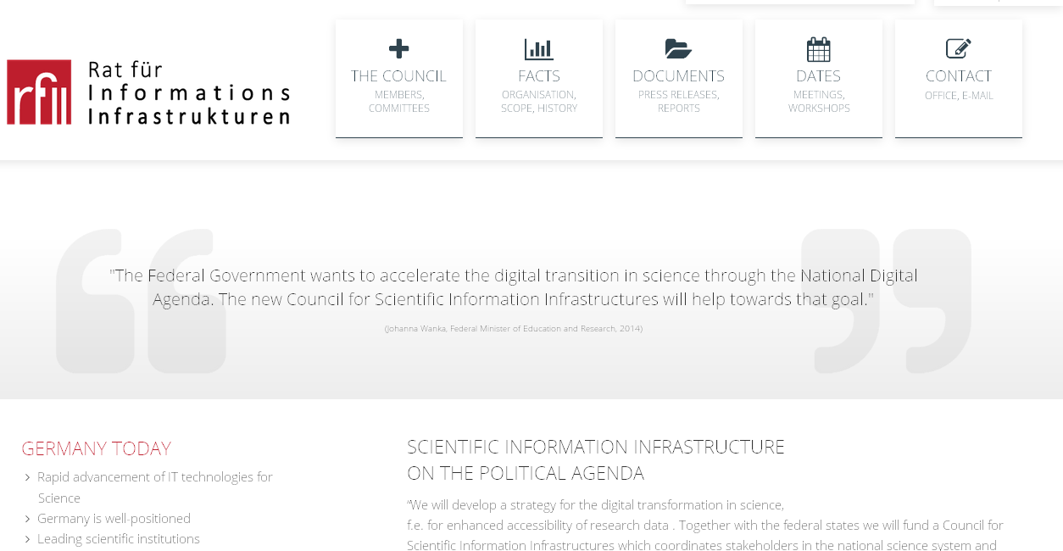
Side Note on German Council on
Research Information Infrastructures
http://www.rfii.de/
Established 2014 by the German Joint Science Conference
  Started as a temporary measure
  24 Members (science/policy/society) and
  a head office in Göttingen
Notes:
8 scientific users, 8 information providers, 4 policy, 4 public life

Slide 14
Side Note on German Council on
Research Information Infrastructures
http://www.rfii.de/
Recommendations and Roadmap towards a
German Research Data Infrastructure:
  Establish sustainable research data infrastructure offerings (get away from project based solutions) !
  Driven by the scientific users !
  Have of consortia to develop nodes/services of the
  German Research Data Infrastructure
  Consortia = scientific users of a domain + data/computing centers + libraries…
  Stepwise, iterative process, linked to/in international developments
  Accommodating the different digital cultures…
Recommended reading:
RfII Recommendations 2016: Performance through Diversity http://www.rfii.de/

Slide 15

Environmental Research Data Management…
(Several) best practices/standards on interfaces,
on data quality and data citations exist…e.g.
www.opengeospatial.org
www.langzeitarchivierung.de
certificates.theodi.org
www.datacite.org

Slide 16

Environmental Research Data Management…
(Several) Scientific data publishing software systems and supporting tools exist or emerge…e.g.
ckan.org
www.r-project.org
www.docker.com
Notes:
Ckan

Slide 17
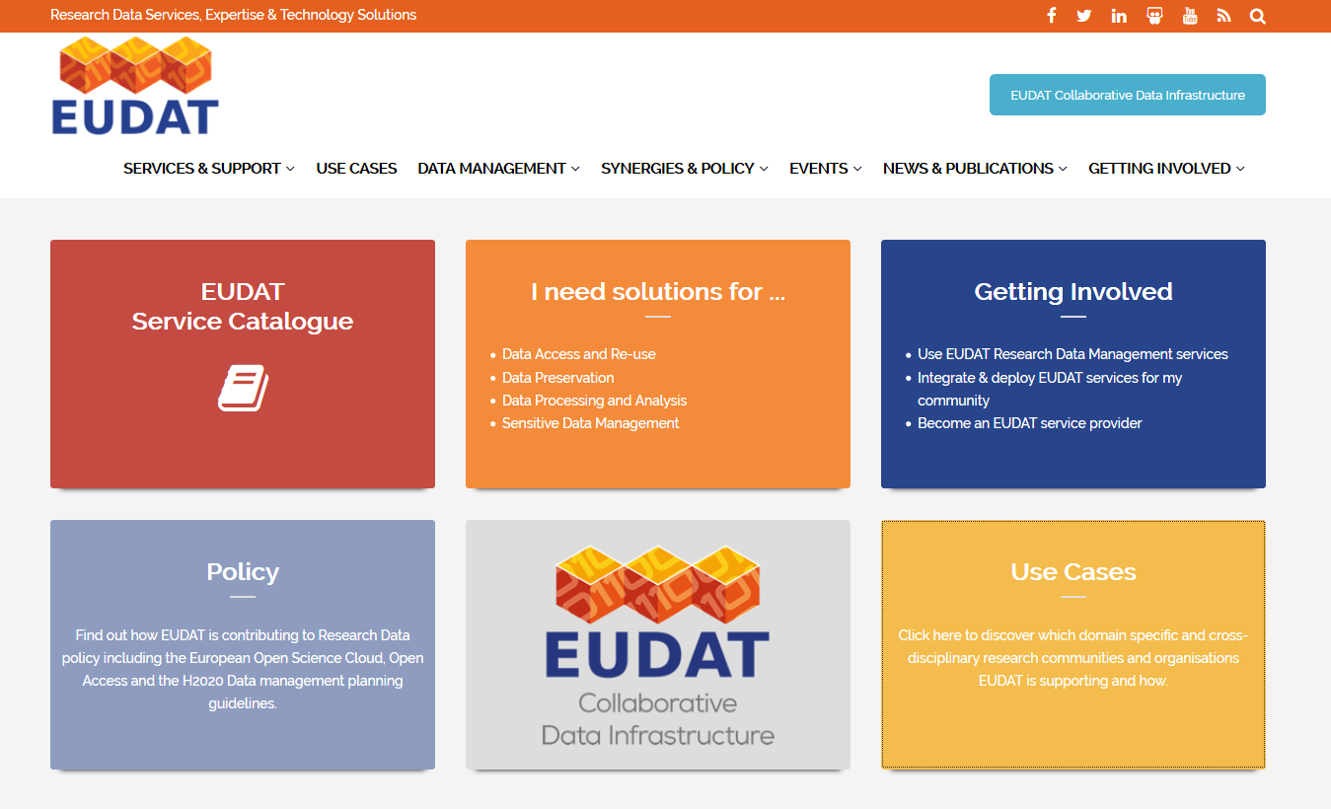
Environmental Research Data Management…
(Generic) research data exchange publishing platforms exist or emerge…e.g.
eudat.eu

Slide 18
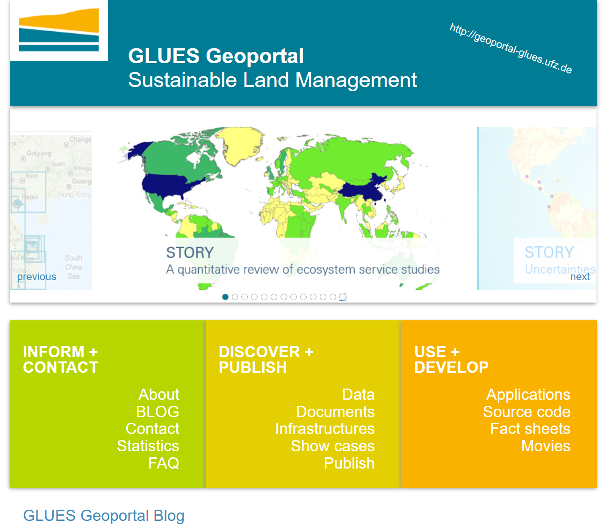
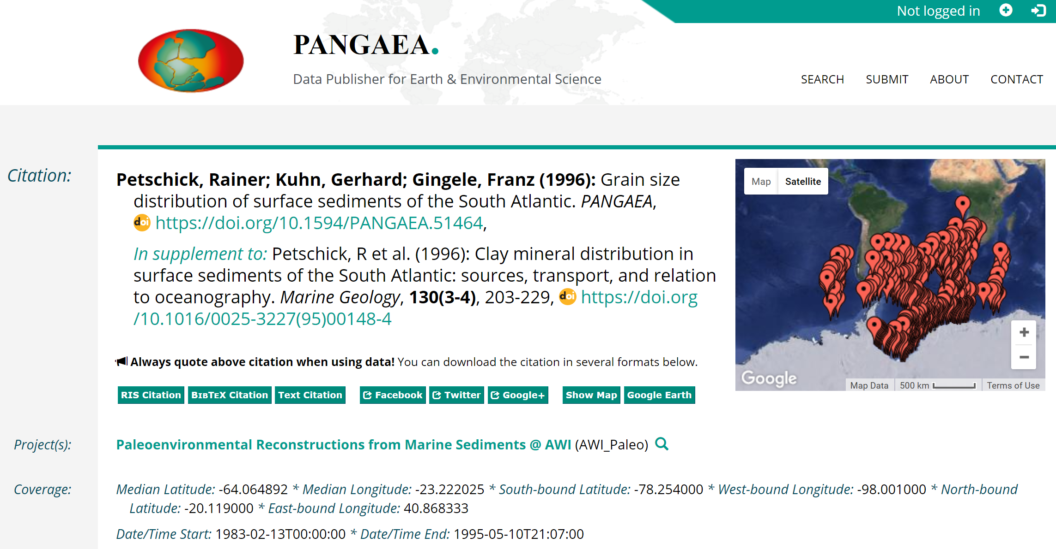
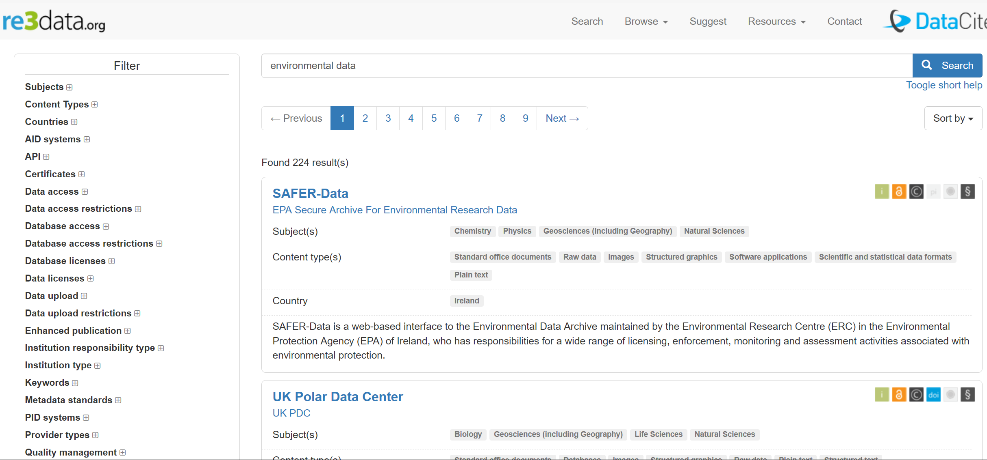
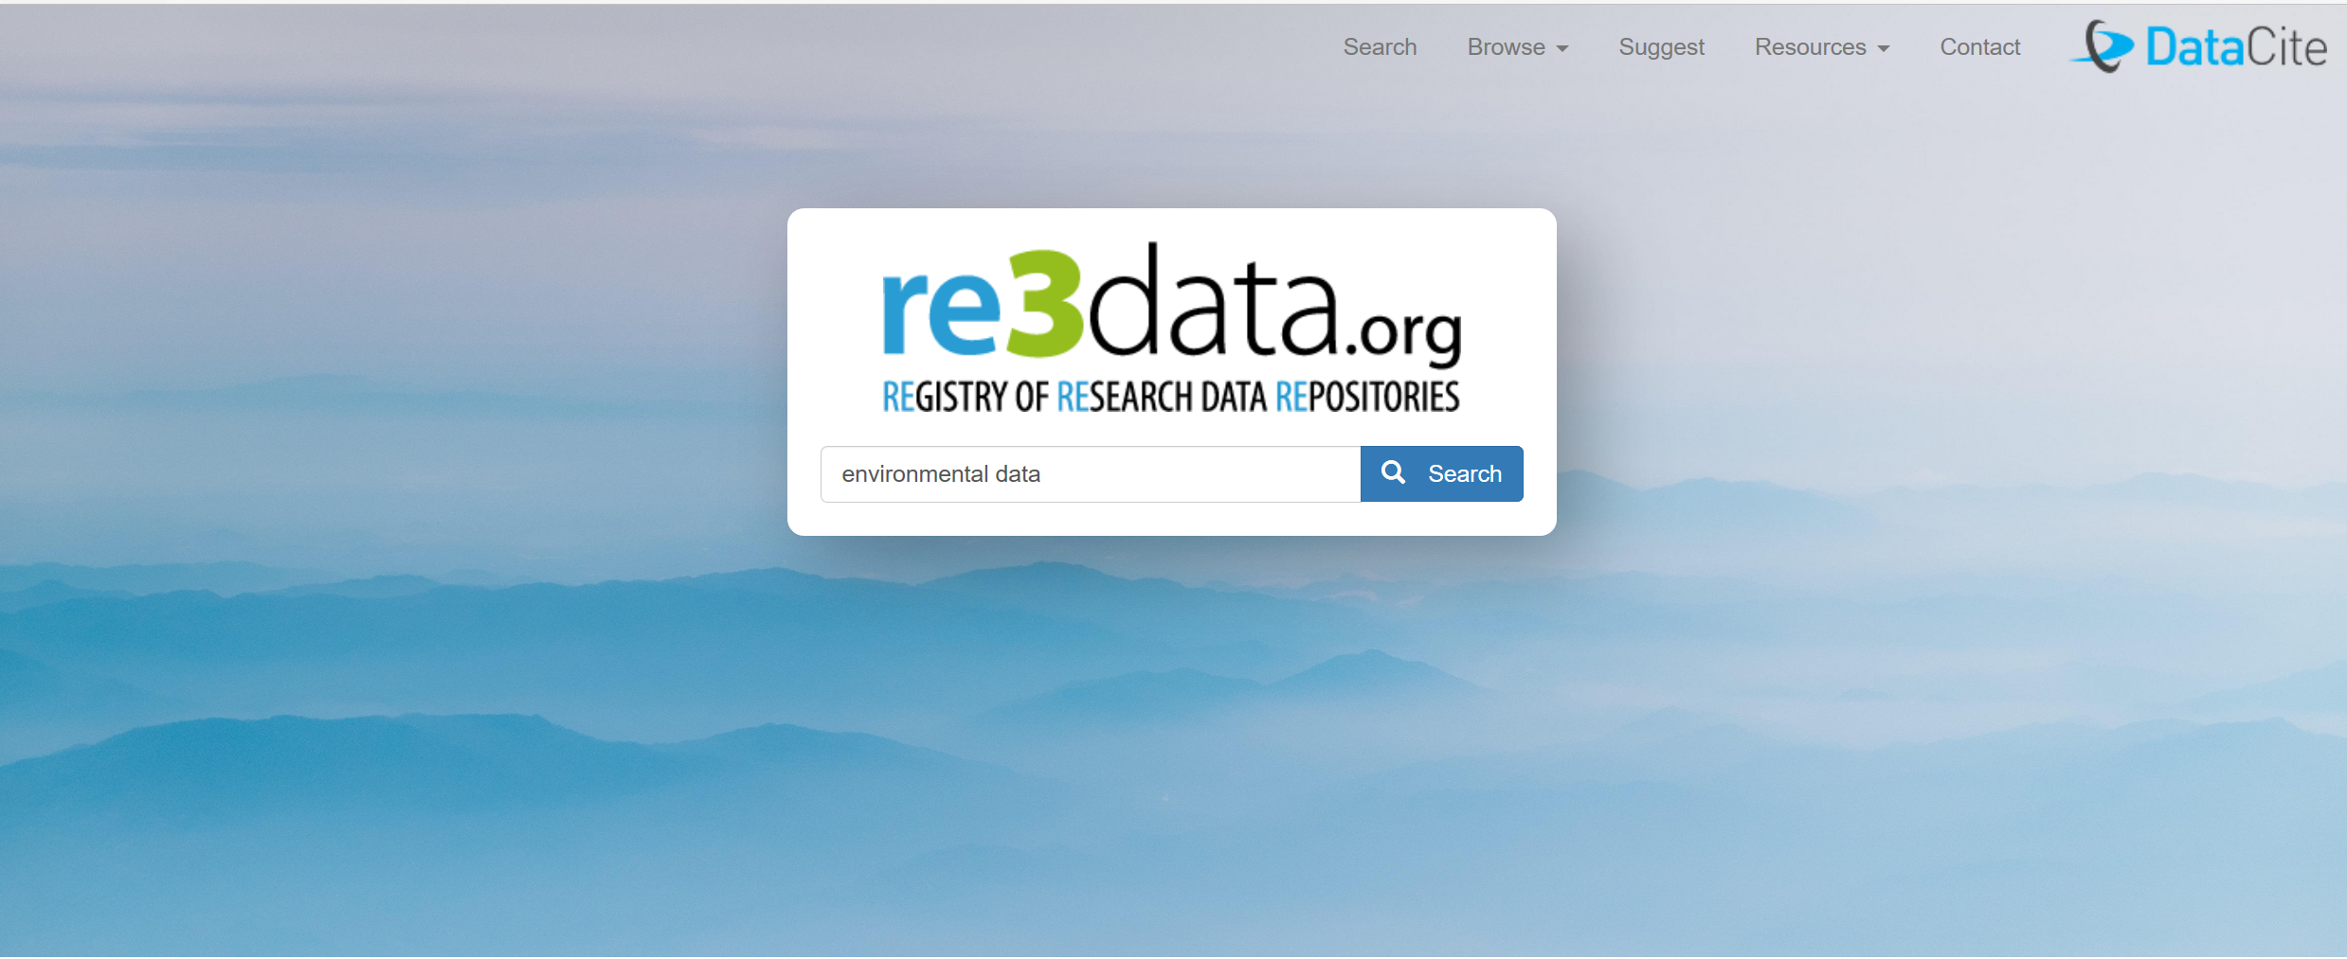
Environmental Research Data Management…
(Generic) research data exchange publishing platforms exist or emerge…e.g.
http://www.re3data.org/
http://doi.pangaea.de/10.1594/PANGAEA.51464
http://geoportal-glues.ufz.de/index.php

Slide 19
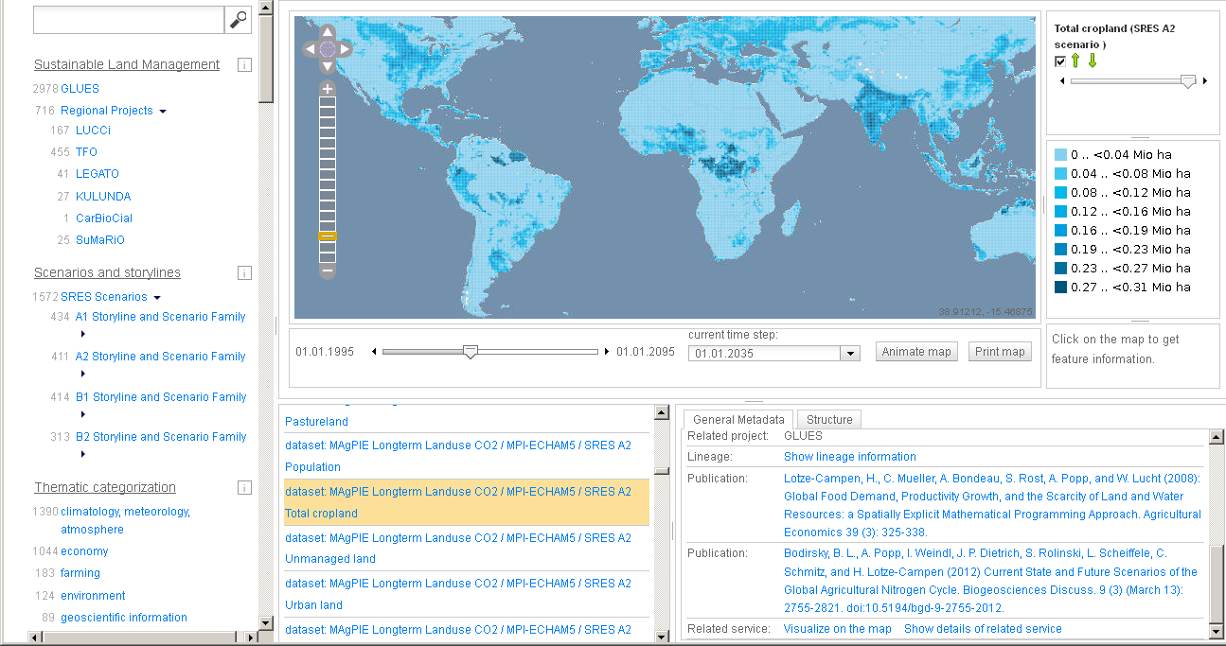
Environmental Research Data Management…our approach
Supporting researchers in data publishing & exploration
Application: http://geoportal-glues.ufz.de/index.php
Source Code: https://github.com/GeoinformationSystems
Henzen et al. (2013)

Slide 20
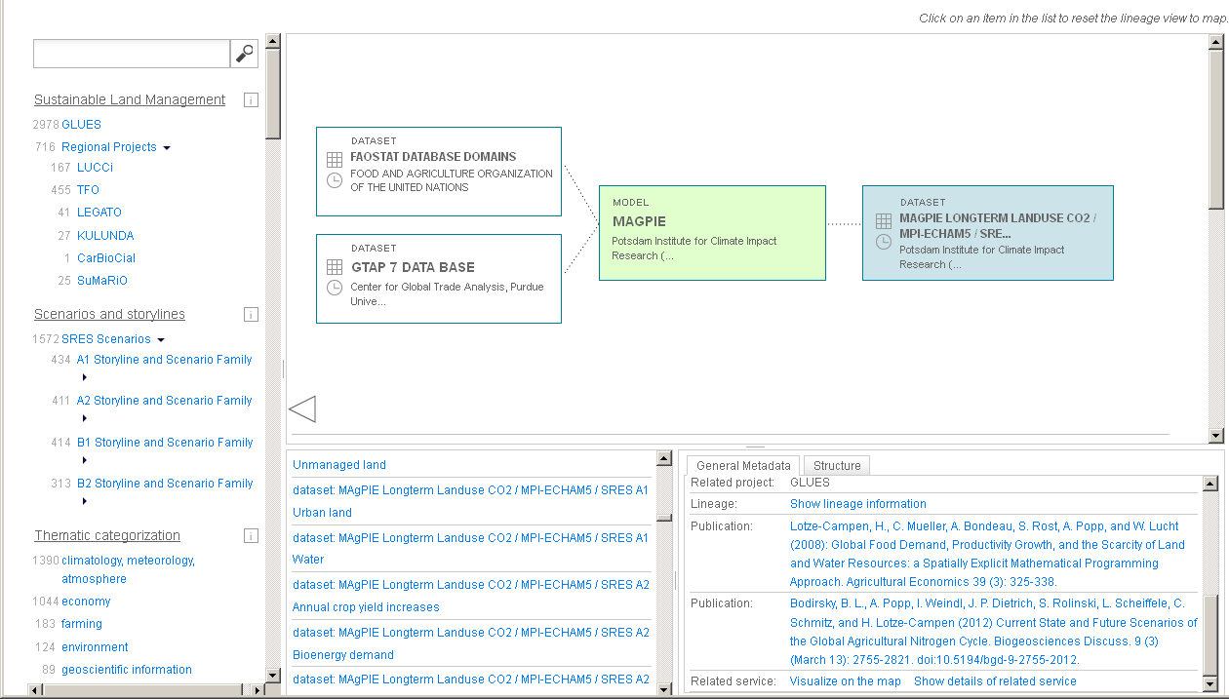
Environmental Research Data Management…our approach
Supporting researchers in data publishing & exploration
(Describe Provenance Using ISO 19115 Metadata)
Application: http://geoportal-glues.ufz.de/index.php
Source Code: https://github.com/GeoinformationSystems
Henzen et al. (2013)

Slide 21
Environmental Research Data Management…
Own experiences and gut feeling for
environmental research data:
  Too spatial/special solutions
  Still too many tedious metadata tasks
  Lack of data management plans
  Lack of research data qualification
  mechanisms
  Lack of support for the whole research workflow (data publication is mostly done once - at the end…)
  Not the solution in place….

Slide 22

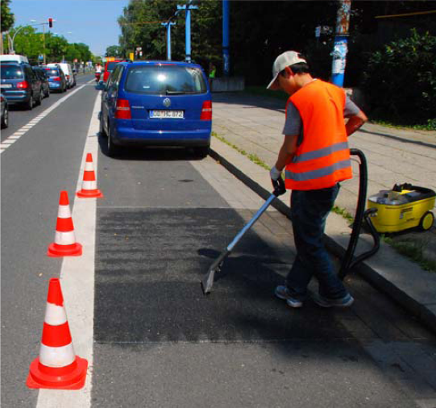
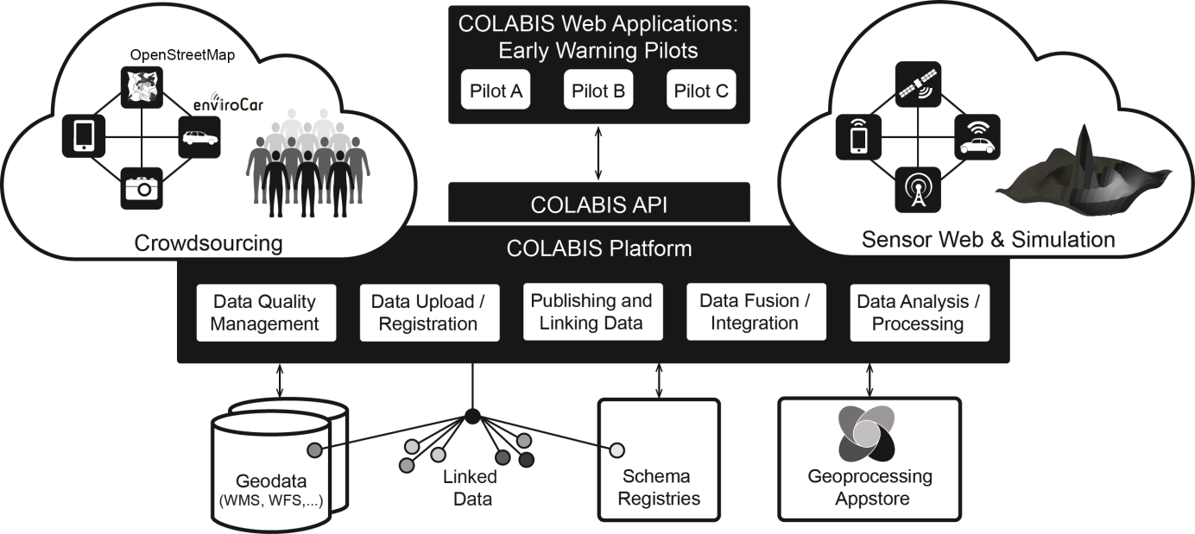
Case Study COLABIS
better monitor, model and predict urban wastewater quantities/qualities to support urban water management
Different research disciplines, workflows, institutions,…
How best to tackle related research data management – today?
Notes:
Discharge: approx. 3-4 time per year for a duration of approx. 30 minutes.

Slide 23
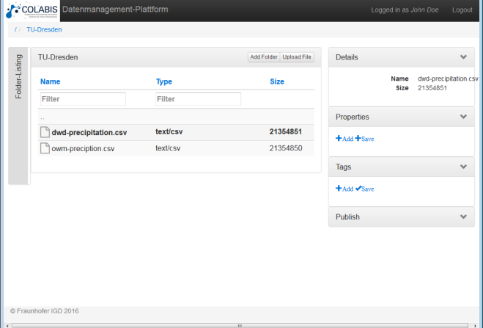
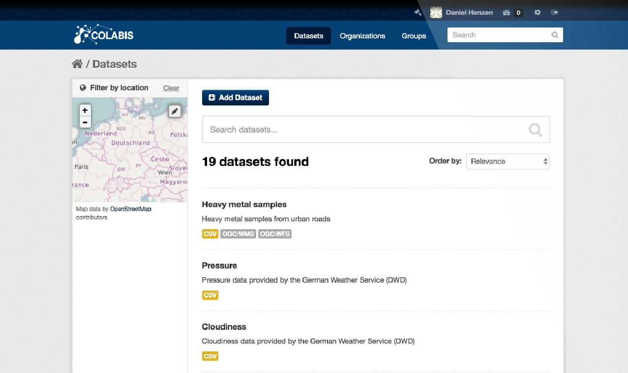
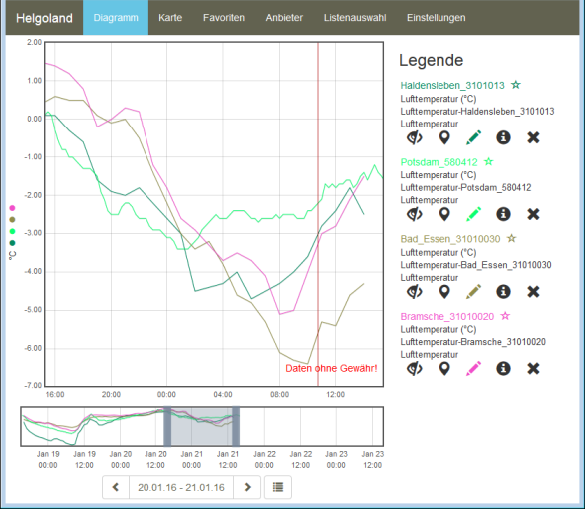
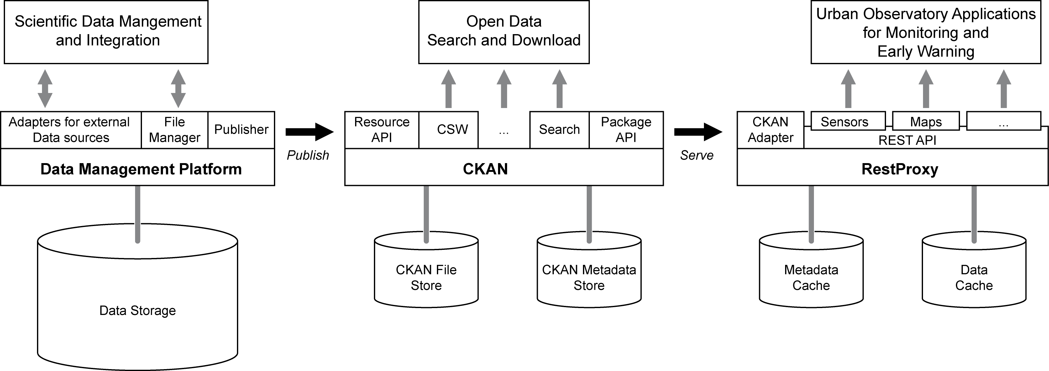

Environmental Research Data Management…our approach
Closing the metadata gap – getting on the researchers‘ desk
qualification
qualification
Researchers‘
environment
Research
Data Sharing
Data/Service Publications
Application: https://colabis.de/
Source Code: https://github.com/GeoinformationSystems
Henzen et al. (2016)

Slide 24
Environmental Research Data Management…our approach
Closing the metadata gap – getting on the researchers‘ desk
Provide support for the whole research data management & publication process
Support semantic enrichment, transformation, qualification & publishing
Try and read more: https://colabis.de/
Almost all tools from shelf
→ not (yet?) really seamless…
Issues still occur with bandwidths,
different data and user policies…
qualification
qualification
Researchers‘
environment
Research
Data Sharing
Data/Service Publications
https://colabis.de/
Application: https://colabis.de/
Source Code: https://github.com/GeoinformationSystems

Slide 25
Conclusions Research Data Management in Environmental Sciences
Several approaches emerge(d)
Still (?!?) data integration and (meta-) data curation tasks
are too tedious
  Lack of common reference data sets…
  (Still) lack of data annotation/metadata automation…
  Lack of common data qualification/peer review mechanisms…
Consolidation required (e.g. via RfII)
Did not touch on: Archiving, sharing models/tools and reproducible research, capacity building...

Slide 26
Thank You -
Your questions please !
Bernard, L.; Mäs, S.; Müller, M.; Henzen, C.; Brauner, J. (2014): Scientific Geodata Infrastructures: Challenges, Approaches and Directions. International Journal of Digital Earth 7(7): 613-633. http://dx.doi.org/10.1080/17538947.2013.781244
Henzen, C.; Mäs, S.; Bernard, L. (2013): Provenance Information In Geodata Infrastructures. Geographic Information Science at the Heart of Europe. Eds.: Vandenbroucke, D.; Bucher, B.; Crompvoets, J. Heidelberg, Springer: 131-151. http://dx.doi.org/10.1007/978-3-319-00615-4_8
Henzen, D.; Mueller, M.; Jirka, S.; Senner, I.; Kaeseberg, T.; Zhang, J.; Bernard, L. and Krebs, P. (2016): A Scientific Data Management Infrastructure for Environmental Monitoring and Modelling. Proceedings of the International Environmental Modeling & Software Society Conference 2016, Toulouse, France. http://scholarsarchive.byu.edu/iemssconference/2016/Stream-A/23/
Wiemann, S. ; Bernard, L. (2016): Spatial data fusion in Spatial Data Infrastructures using Linked Data. International Journal of Geographical Information Science, 30 (4). pp. 613-636. (http://dx.doi.org/10.1080/13658816.2015.1084420)
Lars Bernard
lars.bernard@tu-dresden.de

