Slide 1
Beeswax: An optimized tool to enhance the performance of HIVE
Presented By
Dr. Mohamed Khafagy

Slide 2
Outlines
Why Beeswax
What is Beeswax
Beeswax Modules
HOME
iHOME
QRMapper
JOMR
JOUM
MOTH

Slide 3
Why Beeswax
Support running advanced SQL query
2
Enhance the performance of JOIN queries
4
Multi-Query
Multi-Session
1
3
Reuse Intermediate Results in Multi-session
Support Data Sharing for
Multi-User

Slide 4
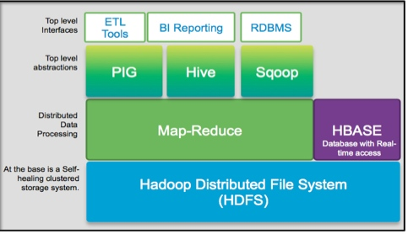
Beeswax and HIVE

Slide 5
Notes:
Why naming it beeswax ? It is on top of Hive
the wax secreted by bees to make honeycombs and used to make wood polishes and candles

Slide 6
Beeswax Evaluation
Star Schema Benchmark SSB
based on TPC-H benchmark to measure performance
Billion tuples / ~2TBs
Customer
Supplier
Line Order
Part
Date

Slide 7
Beeswax Modules
Reuse Intermediate Results in Multi-session
HOME
iHOME
QR
Mapper
MOTH
Support Advanced Query
Exploit Data Sharing
JOMR
JOUM
Enhance the Performance of JOIN Queries
Notes:
HOME
Reuse intermediate results in one and multi-session
Improve Hadoop performance by storing previous results
Reuse intermediate results in one and multi-session
iHOME
Improve HOME system
Minimize storage by storing index of previous results
Improve Hadoop performance considering JOIN queries
Reuse intermediate results in one and multi-session
QRMapper
QRMapper improves performance of HiveQL
QRMapper support interoperability of Hive for advanced query
QRMapper increase compatibility of Hive for different Big Data analysts requests
JOMR
Optimize Multi-JOIN query in Map-Reduce Jobs
Change JOIN order of tables in multi-JOIN query
Save intermediate results costs
JOUM
Improve performance of Big Data analysis and processing
Generate optimized pipeline for Hive JOIN query execution
Optimize Hive temporary storage size
MOTH
Exploit sharing among multi-query for multi-user
Improve performance by eliminating redundant computing

Slide 8
Beeswax Architecture
Beeswax Meta data and Index
QRMapper
JOMR
ReWrite Query
HOME
iHOME
JOUM
SQL Query Parser
MOTH
Results
Execute Optimized Query(s)
Input Query(s)
Query(s) Results
Notes:
Beeswax has 4 optimization levels or Beeswax has a multi-phase query optimization
1- First, the SQL query is parsed then HOME and iHOME check if the query is matched with other stored queries using beeswax metadata and index. If the query can reuse previous results so HOME and iHOME system retrieve the desired results to the end user/ users.
Otherwise, the query(s) is optimized by passing it through the rest optimization phases.
2- the second optimization phase is translation phase which use QRMapper translator. The QRMapper translator generates the optimized translation for query if the input query is non- supported in Hive. It converts the complex queries into simple queries can run into Hive.
3- Third Optimization phase is JOIN optimization. The JOIN queries can be optimized in two perspectives 1- from table order perspective by (JOMR) 2) from materialized JOINed results in order to avoid long shuffling time by JOUM.
4- The fourth optimization phase is multi-query optimization which exploit sharing according queries. The queries are passed to MOTH to find the sharing among multi-query in ordered to exploit sharing to avoid redundant computation.
The rewriter query rewrite query according the multi-phase optimization in Beeswax. The optimized query(s) is executed and the final results are submitted to the end user(s).

Slide 9
Beeswax Modules
iHOME
HOME
QR
Mapper
MOTH
JOUM
JOMR

Slide 10
HiveQL Optimization in Multi-Session Environment (HOME)
Beeswax Modules
First Module

Slide 11
HOME System
HOME Main Goals
Reuse intermediate results in multi-session by storing previous results
HOME
Pervious Results
Notes:
Group

Slide 12
HOME Cases
1
Exists Query
2
Subset of Results
3
ORDER BY Clause
4
GROUP BY Clause
5
HAVING Clause
6
WHERE Clause
7
JOIN Clause
Notes:
Main feature of HOME system
reuse the intermediate results in one and multi-session
improve Hadoop performance by storing data for previous results
HOME system cases
Case 1:Exists Query
Input HiveQL statement equals to stored HiveQL statement in Results File
Case 2:Subset of columns
Columns of input HiveQL statement subset of stored HiveQL statement in Results File
Case 3:ORDER BY clause
Columns of ORDER BY in the input HiveQL statement is the same in the stored HiveQL statement in Results File
Case 4:GROUP BY clauses
Columns of GROUP BY in the input HiveQL statement is the same in the stored HiveQL statement in Results File
Case 5:HAVING clauses
Columns of GROUP BY & HAVING condition in the input HiveQL statement is the same in the stored HiveQL statement in Results File
Case 6:WHERE clauses
Contains three cases (Add , Same ,and Different) WHERE condition
Case 7:JOIN Statements
Contains three cases (Add , Same ,and Different) JOIN

Slide 13
HOME System Architecture
HOME Repository
JOIN Query Extractor
HOME Query Optimizer
HOME Cases Indicator
HOME Metafile
Storage
Tables Names
Query in HOME Metafile
Case 1
Existed Query
Yes
Case 2
Subset of Columns
Columns Names
No
Case 3
ORDER BY Clauses
Query Parser
WHERE Conditions
Save in HOME Metafile
Indicated Case
Case 4
GROUP BY Clauses
ORDER BY Columns
Execute Input HiveQL
Query Rewriter
Case 5
HAVING Clauses
Input HiveQL
GROUP BY Columns
Case 6
WHERE Clauses Existed-Condition
Store Results
Execute Optimized Query on Pervious Results
Case 7
WHERE Clauses Sub-Condition
HAVING Conditions
JOIN Conditions
Case 8
WHERE Clauses
New-Condition
Output Results

Slide 14
Home Evaluation
Improvement wrt Hive | Case Name |  | Case Number
100% | Exists Query |  | 1
32% | Subset of Results |  | 2
70% | ORDER BY Clause |  | 3
89% | GROUP BY Clause |  | 4
89% | HAVING Clause |  | 5
38% | Add Condition | WHERE Clause | 6
36% | Same Condition
27% | Different Condition
81% | Add Condition | JOIN Clause | 7
89% | Same Condition
88% | Different Condition

Slide 15
Beeswax Modules Second Module
iHOME
HOME
QR
Mapper
MOTH
JOUM
JOMR

Slide 16
indexing HiveQL Optimization For JOIN Over Multi-Session Environment (iHOME)
Beeswax Modules
Second Module

Slide 17
iHOME System
HOME Drawback
Wasting in Storage Space
Data Repetition
iHOME overcome drawback
by storing index of previous results instead of restoring it
HOME
iHOME
Pervious Results
Index of Pervious Results

Slide 18
iHOME Evaluation
Improvement wrt Hive | Case Name |  | Case Number
89% | Exists Query |  | 1
87% | Subset of Columns |  | 2
86% | ORDER BY Clause |  | 3
88% | GROUP BY Clause |  | 4
80% | HAVING Clause |  | 5
81% | Add Condition | JOIN Clause | 7
82% | Same Condition
88% | Different Condition

Slide 19
Beeswax Modules Third Module
iHOME
HOME
QR
Mapper
MOTH
JOUM
JOMR

Slide 20
Why QRMapper –cont..
Existed SQL-on-Hadoop Translators
Did not support advanced/complex SQL Query
UNION, MINUS, INTERSECT, ….
Inefficient compared to hand-optimized MapReduce programs
Auto-generated jobs for queries
Long jobs- execution time overheads
Unnecessary jobs -waste cluster resources
Non-optimized jobs - affect HPC performance
Notes:
The non-optimized jobs cause wasteful HPC

Slide 21
QRMapper Translator Objectives
1
Improve performance of HiveQL
2
Support compatibility of Hive for advanced query

Slide 22
QRMapper Translator Cases
Case 1: UNION Query
Case 2: MINUS Query
Case 3: INTERSECT Query
Case 4: Sub Query
HAVING clause
WHERE clauses
EXISTS – NOT EXISTS
ALL– ANY
IN– NOT IN
Notes:
We will start to explain each case of them what QRMapper will do in each case
Animation updates each line separated

Slide 23
QRMapper Translator High-level Design
Parser
QRMapper Translator
Complex SQL Query
Query Results
Complex SQL Query
Query Results
Simple Query
Complex SQL Query
Query Results
Hive
Complex SQL Query
Query Results
HDFS

Slide 24
QRMapper Evaluation
SQL Clauses | QRMapper | Existed SQL-on-Hadoop Translators
 |  | Hive | Ysmart | S2mart | QMapper
SELECT,LOAD INSERT from query | √ | √ | √ | √ | √
Expressions in WHERE and HAVING | √ | √ | √ | √ | √
GROUP BY, ORDER BY, SORTBY | √ | √ | √ | √ | √
Sub-queries in FROM clause | √ | X | X | X | √
Sub-queries in WHERE clause ( IN, NOT IN) | √ | X | X | X | X
(EXISTS)/(NOT EXISTS) | √ | X | X | X | √
Sub-queries in HAVING clause | √ | X | X | X | X
Intra Query Relation ships | X | X | √ | √ | X
GROUP BY, ORDER BY | √ | √ | X | X | X
UNION | √ | X | √ | √ | X
LEFT,RIGHT and FULL INNER/OUTER JOIN | √ | X | √ | √ | √
CROSS JOIN, LEFT SEMI JOIN | √ | X | X | X | √
INTERSECT, EXCEPT, UNION | √ | X | X | X | √
DISTINCT | X | X | X | X | X

Slide 25
Beeswax Modules Fourth Module
iHOME
HOME
QR
Mapper
MOTH
JOUM
JOMR

Slide 26
JOIN Order In Map-Reduce (JOMR)
Beeswax Modules Fourth Module

Slide 27
JOMR Main Goals
1
Optimize Multi-JOIN query in Map-Reduce Jobs
2
Change JOIN order of tables in multi-JOIN query
Save intermediate results costs

Slide 28
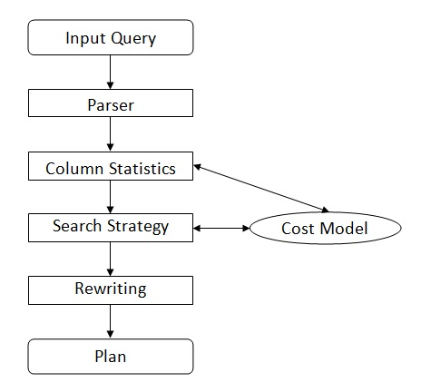
JOMR Case Study (cont..)
Return to Search Strategy
Find the best execution plan
N
C
L
O

Slide 29
JOMR Case Study (cont..)
Query Rewriting
Original query
customer orders lineitem nation
Optimized query
customer nation orders lineitem

Slide 30
JOMR Evaluation
Improvement for JOINed 6 tables =60%
Improvement for JOINed 2 tables =20%
Notes:
Increment rate
when use three JOINed tables we found that JOMR enhanced the performance by around 20% but when we used six tables the performance by around 60% .

Slide 31
Beeswax Modules Fifth Module
iHOME
HOME
QR
Mapper
MOTH
JOUM
JOMR

Slide 32
JOIN Once Use Many (JOUM)
Beeswax Modules Fifth Module
GridKa School 2017
8/28/2017

Slide 33
JOUM Main Goals
1
Generate optimized pipeline for Hive JOIN query execution
2
Optimize Hive temporary storage size
GridKa School 2017
8/28/2017
Notes:
The same as JOMR slide

Slide 34
JOUM Indexed Materialized Table
JOUM JOIN Pipeline
Query Result
Query Result
Filling-In UDF
Filling-In UDF
Reduce
Reduce
Reduce
No
Shuffle
Reduce
Reduce
Reduce
No
Shuffle
MAP
MAP
MAP
MAP
MAP
MAP
L
O
L
O
L
O
L
O
L
O
L
O
Load into Hive
Load into Hive
materialized Table
Indexing
Index Materialized Table
Materialized Table Builder
Materialized Indexed Table Builder
W
X
Y
Z
W
X
Y
Z
8/28/2017
Notes:
Keys Table: contains all records, which at least contains one new dimension record that appears for the first time.
-Facts Table: contains only keys and properties attributes from all tables and only records, which their key attributes, values stored before in keys table so by using index attribute we can access their Keys records in Key Table

Slide 35
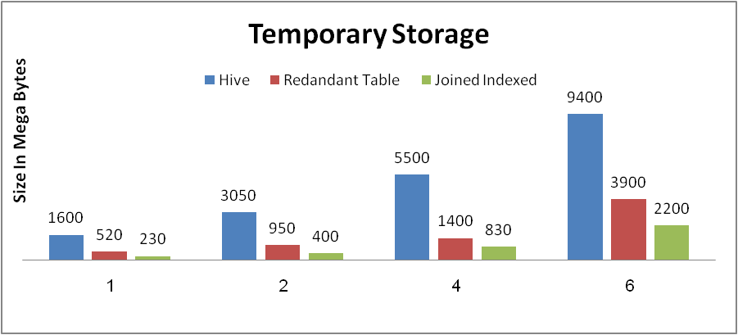
JOUM Experimental Results Evaluation the Temporary Storage
Redundant: 34.1%
Joined Indexed: 16.4%
Records Number In Million
JOUM temporary storage required for running TPC-H Query #1
GridKa School 2017
8/28/2017

Slide 36
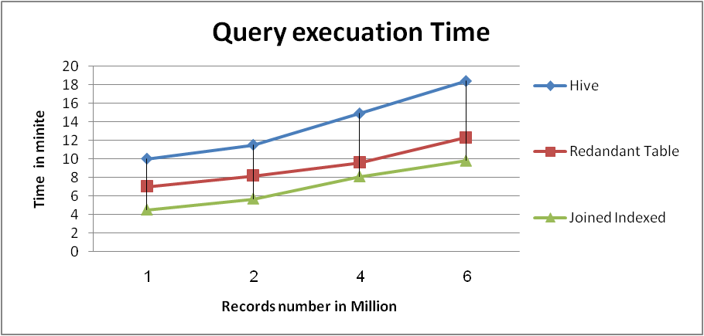
JOUM Experimental Results Evaluation Execution time
Redundant: 58%
Joined Indexed: 71%
TPC-H Query #1 JOUM execution time by number of records Query #1.

Slide 37
Beeswax Modules Sixth Module
iHOME
HOME
QR
Mapper
MOTH
JOUM
JOMR
GridKa School 2017
8/28/2017

Slide 38
Multi-Query Optimizer using Tuple Size and Histogram (MOTH)
Beeswax Modules Sixth Module
GridKa School 2017
8/28/2017

Slide 39
Big Data Multi-Query Optimization I/O
Output
Optimized Multi-Query Plan
Input
Multi-Query
Q4
Exploiting
Sharing
Q1
Q2
Q3
Q2
Q6
Q7
Q4
Q5
Q6
Q1
Q5
Materialization and Grouping Techniques
Non-Concurrent and Concurrent Execution
Notes:
Plan shows the concurrency degree ( dependent and independent queries )of multi-query execution
Pure independent (no sharing) in parallel .

Slide 40
Fine-grained vs. coarse-grained
Regular grain size
Equal Sharing
Irregular grain size
Non-equal Sharing
Notes:
Beside sharing queries, there are more investigations of data granularity
Exploiting of balanced sharing data
Equal or overlapped
MRShare
Overlapped
Relaxed MRShare
Typical shared data sizes

Slide 41
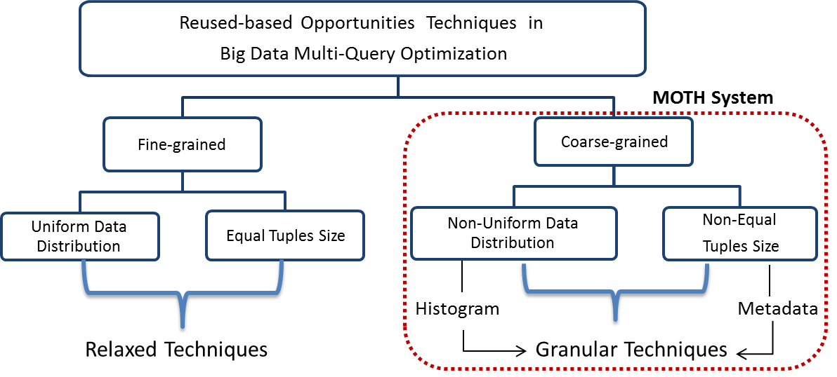
The reused-based opportunities techniques in Big Data multi-query optimization

Slide 42
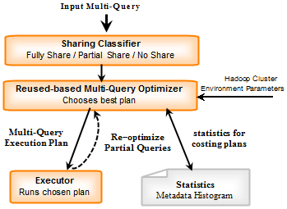
High-level abstraction of the MOTH system

Slide 43
Beeswax Modules
Reuse Intermediate Results in Multi-session
HOME
iHOME
QR
Mapper
MOTH
Support Advanced Query
Exploit Data Sharing
JOMR
JOUM
Enhance the Performance of JOIN Queries
GridKa School 2017
8/28/2017
Notes:
HOME
Reuse intermediate results in one and multi-session
Improve Hadoop performance by storing previous results
Reuse intermediate results in one and multi-session
iHOME
Improve HOME system
Minimize storage by storing index of previous results
Improve Hadoop performance considering JOIN queries
Reuse intermediate results in one and multi-session
QRMapper
QRMapper improves performance of HiveQL
QRMapper support interoperability of Hive for advanced query
QRMapper increase compatibility of Hive for different Big Data analysts requests
JOMR
Optimize Multi-JOIN query in Map-Reduce Jobs
Change JOIN order of tables in multi-JOIN query
Save intermediate results costs
JOUM
Improve performance of Big Data analysis and processing
Generate optimized pipeline for Hive JOIN query execution
Optimize Hive temporary storage size
MOTH
Exploit sharing among multi-query for multi-user
Improve performance by eliminating redundant computing

Slide 44
Beeswax Extendibility
Complete and concrete Beeswax tool
can be extended to other
Big Data analysis systems
Platform-Independent Tool
Deployed on Cloud
Big Data Analysis-as-Service
(BDAaS)
Flink
Time
Cost
GridKa School 2017
8/28/2017
Notes:
As a proof-of-concept we built beeswax as an extension on Hive on top of Hadoop (popular big data analysis system)
Easy portable across different Hadoop versions
When we talk about big data analysis, we talk about time
When big data is analyzed on cloud we talk about resources
Resources are cost
Cost is money $$$$$$$$$$$$$$$$$$$$$$$$
So we need optimized tool for big data analysis

Slide 45
Thank You

