Slide 1
From Particles to Orbits: Astrodynamics at the European Space Agency
Waldemar Martens
28/10/2022

Slide 2
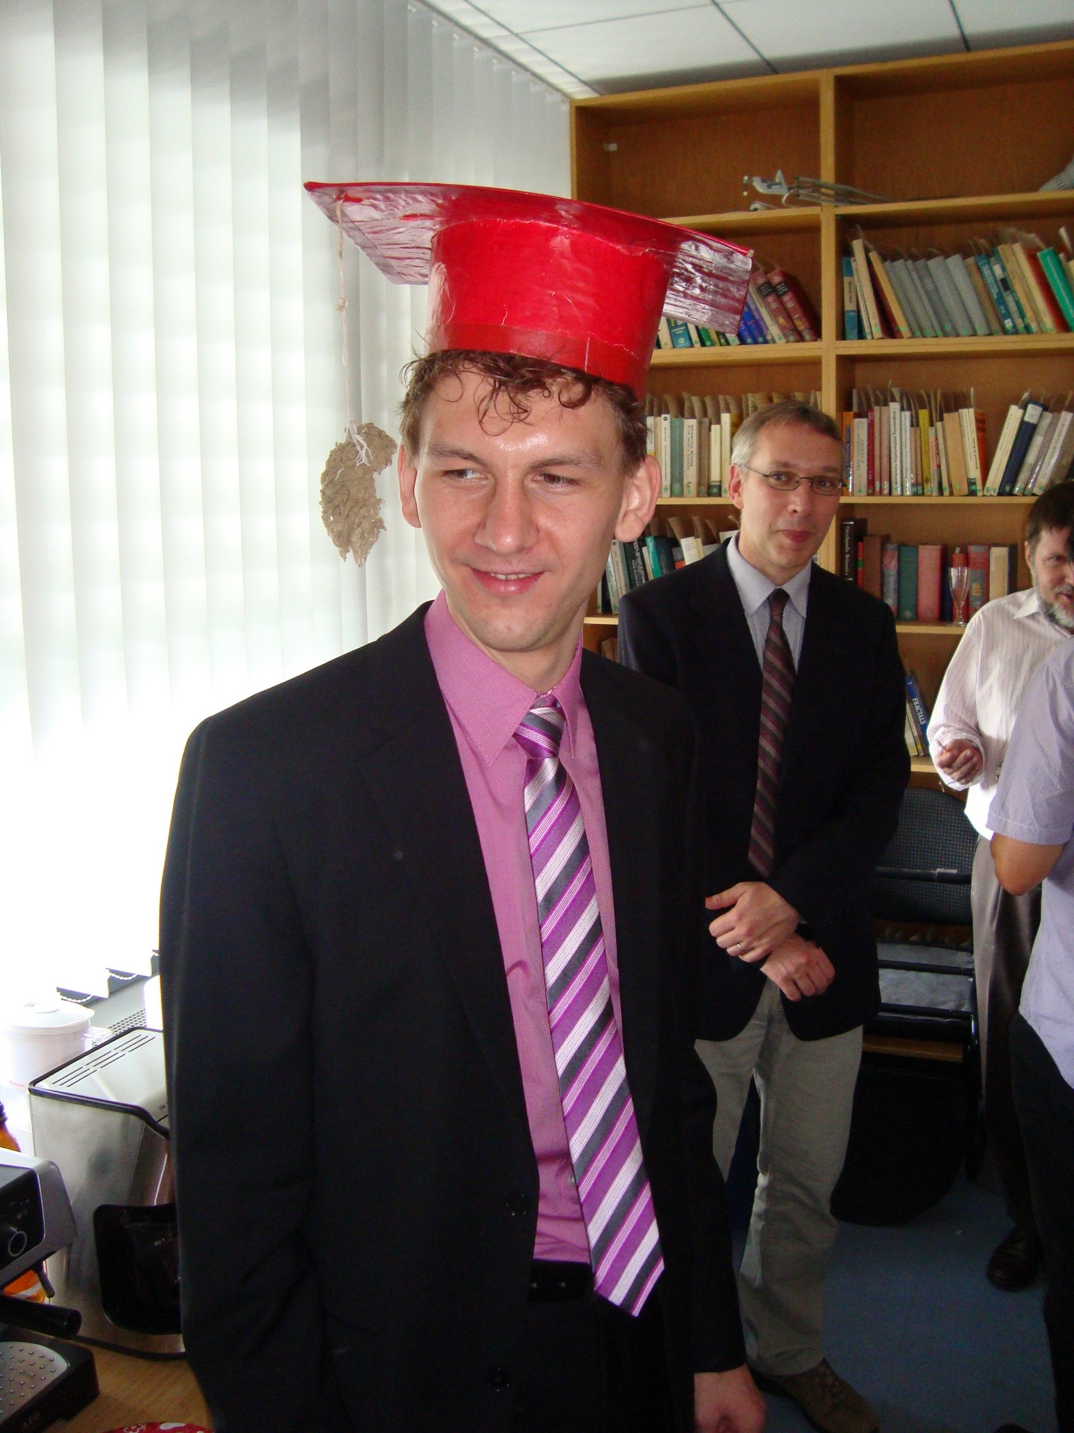
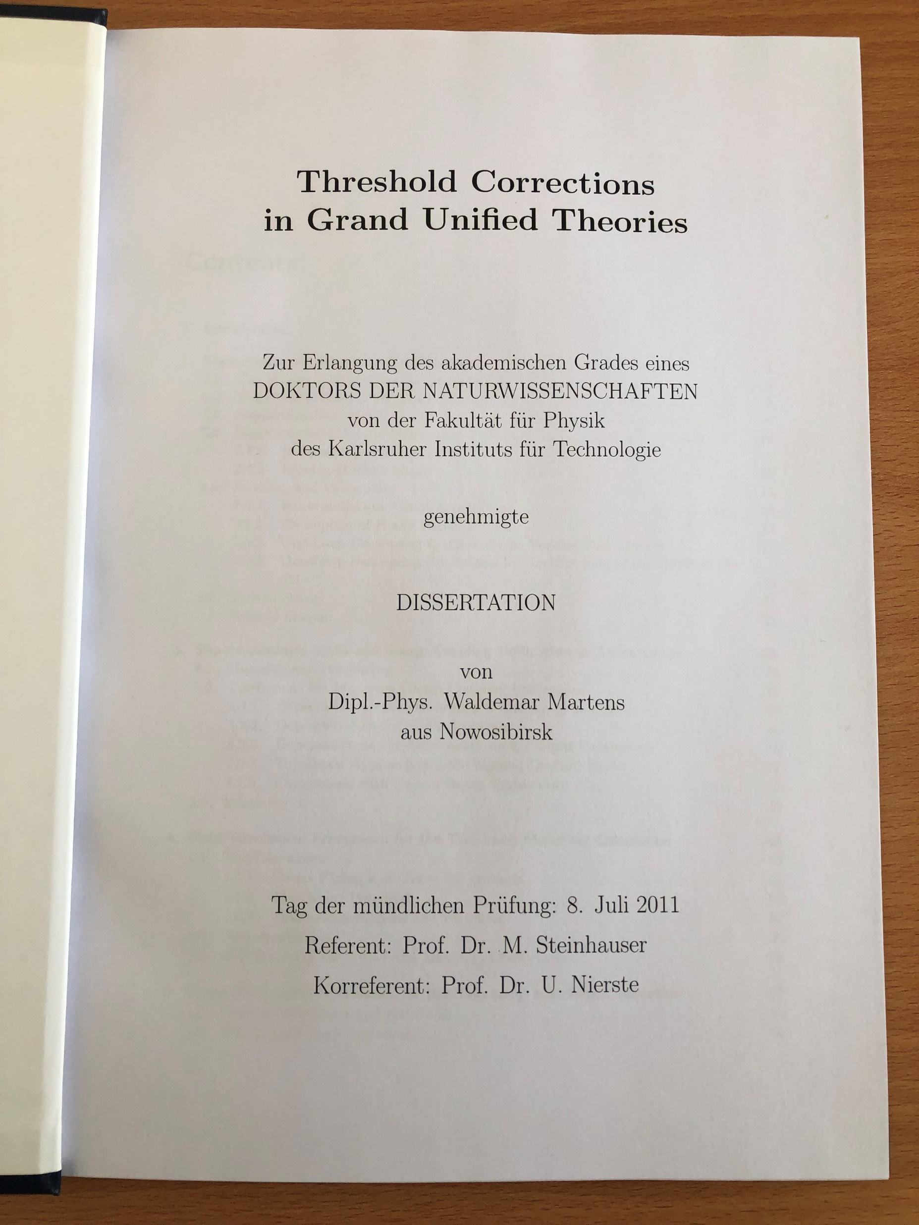

Slide 4
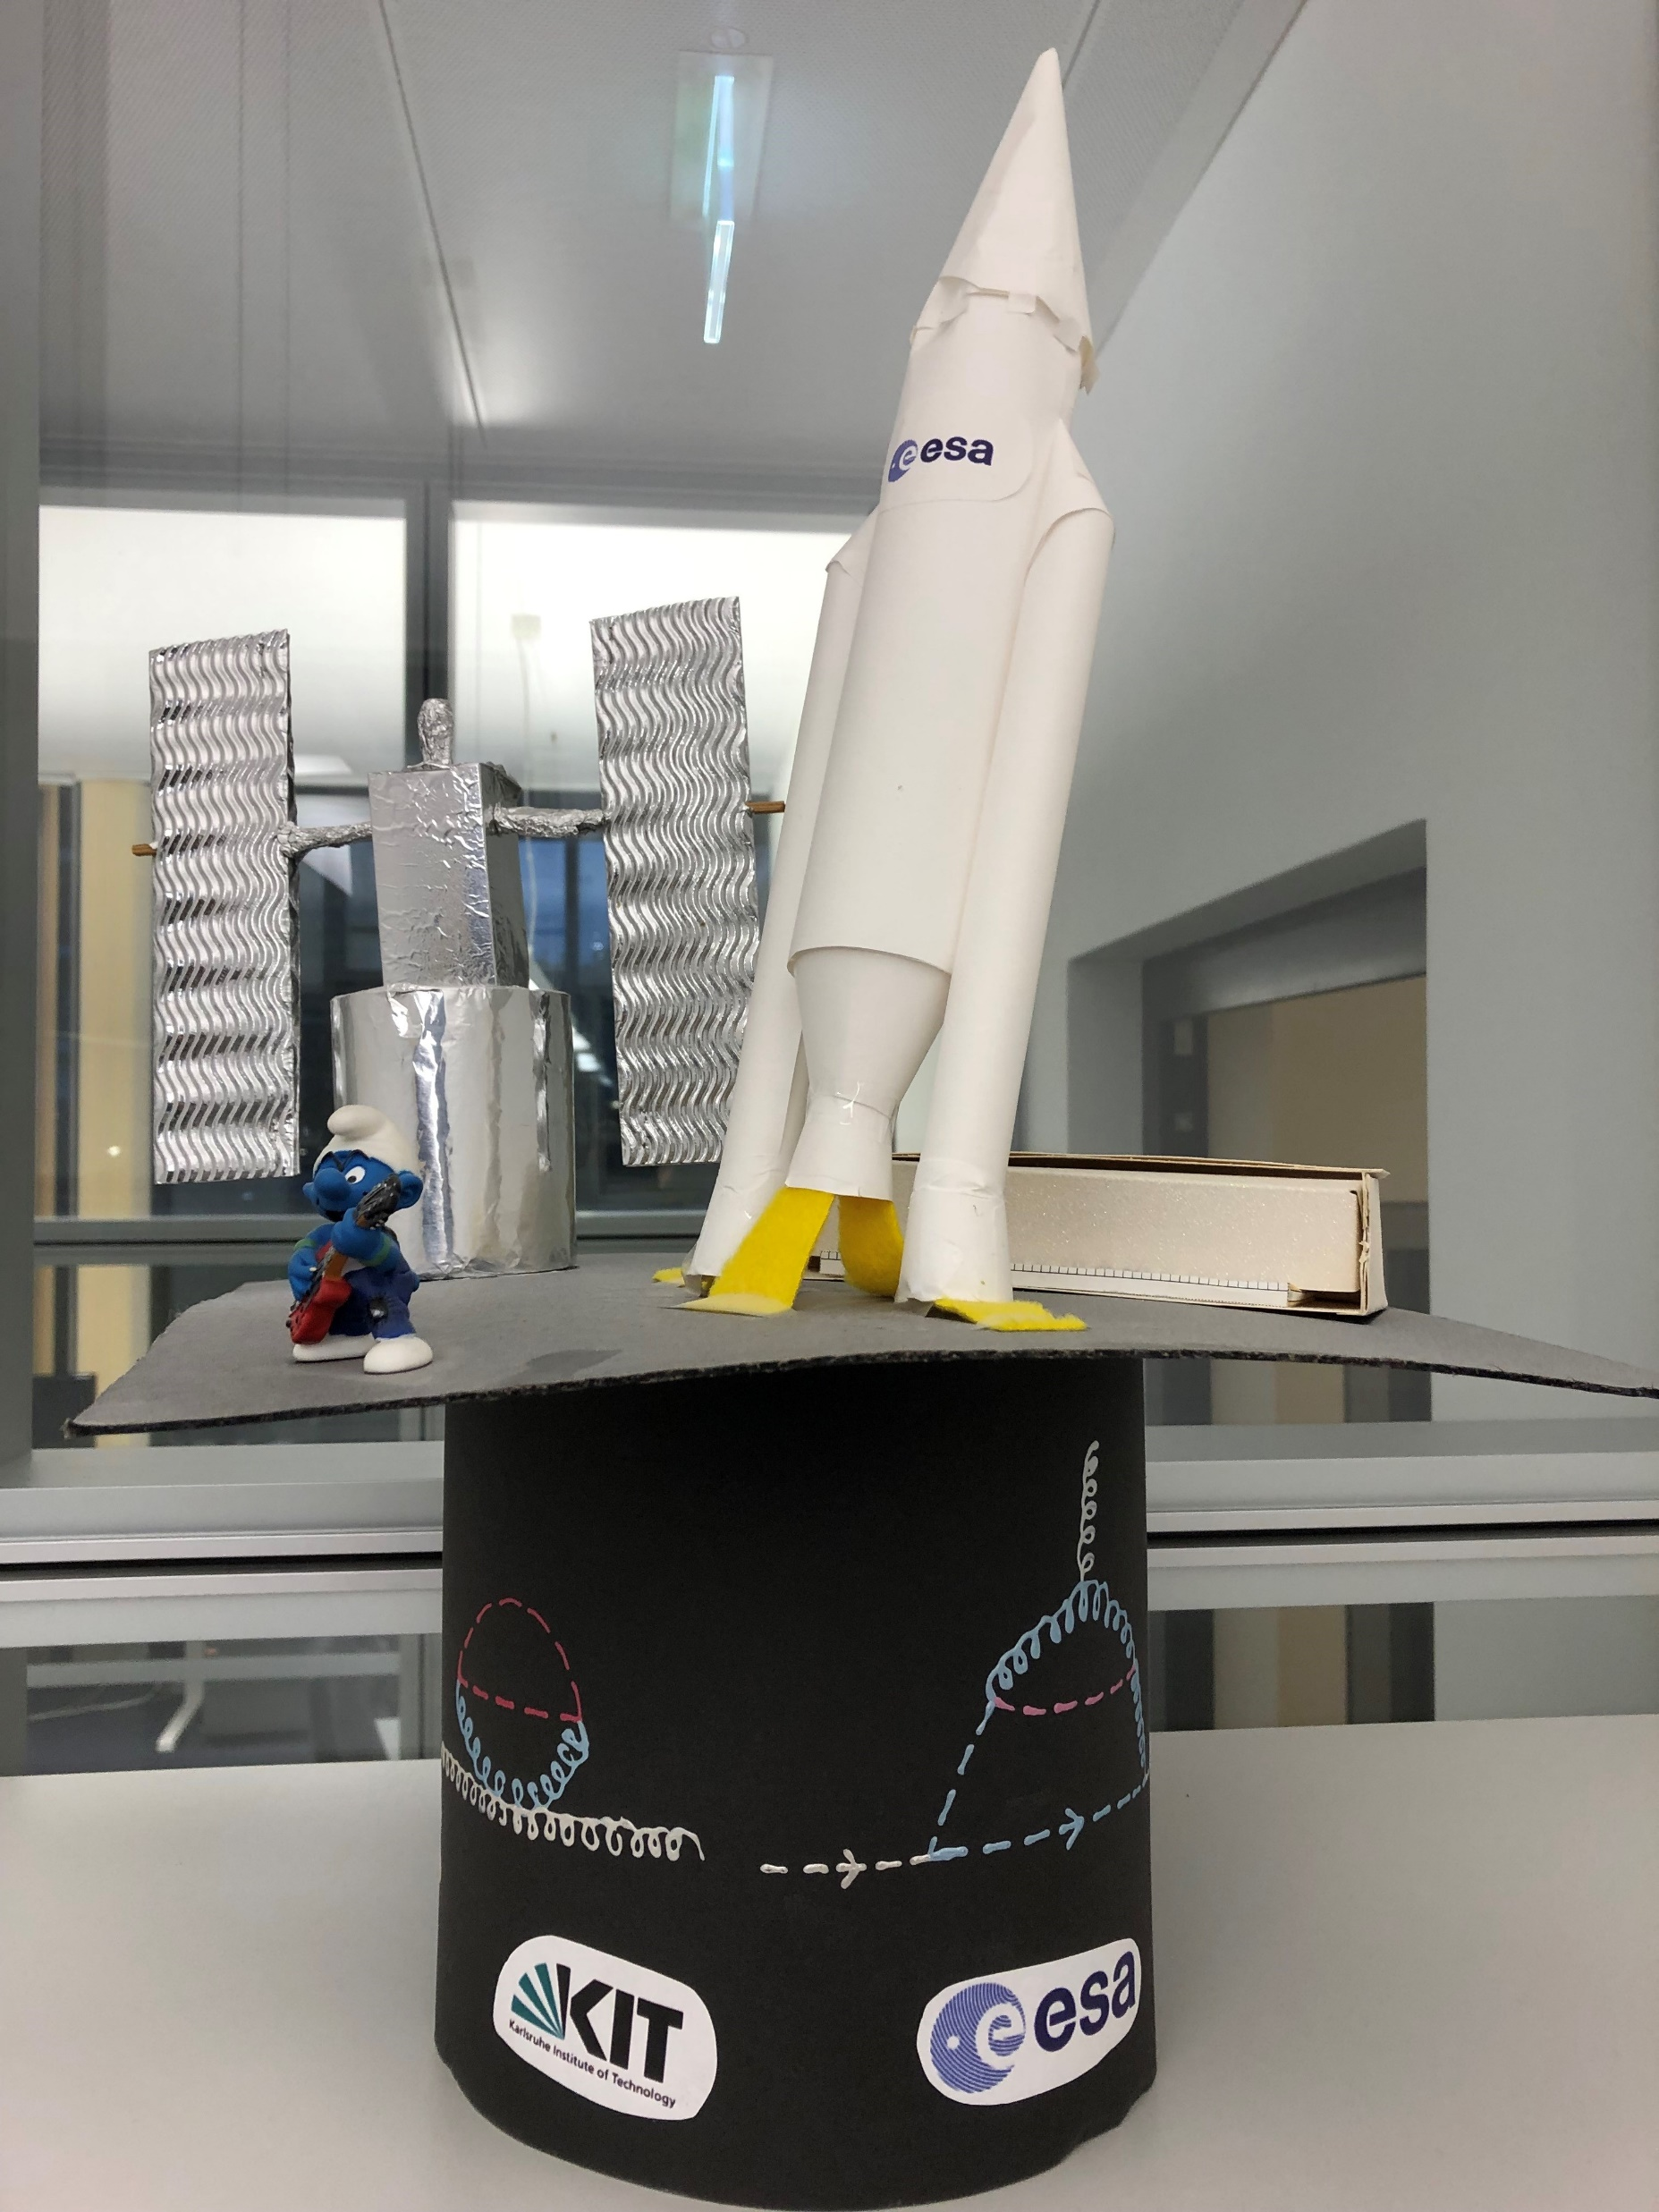
2011
2022

Slide 5
We Are ESA
EUROPE’S GATEWAY TO SPACE
WHAT
22 Member States, 5000 employees
WHY
Exploration and use of space for exclusively peaceful purposes
WHERE
HQ in Paris, 7 sites across Europe and a spaceport in French Guiana
HOW MUCH
€6.49 billion = €12 per European per year
Notes:
ESA: European counterpart to NASA
Additional Notes
Who: Austria, Belgium, the Czech Republic, Denmark, Estonia, Finland, France, Germany, Greece, Hungary, Ireland, Italy, Luxembourg, the Netherlands, Norway, Poland, Portugal, Romania, Spain, Sweden, Switzerland and the United Kingdom. Slovenia, Latvia and Lithuania are Associate Members. Bulgaria, Croatia, Cyprus, Malta and Slovakia have cooperation agreements with ESA. Canada takes part in some ESA programmes under a Cooperation Agreement.
ESA and the EU are two different organisations but they work together with the same goal: to benefit European citizens. They work together on projects that represent about 20% of ESA’s budget.
Employees: 2300 permanent staff; the rest are provided by European industry to work on site as local contracted experts.
When: The idea for an independent European space organisation developed in the 1960s. Two existing organisations, ESRO for space research and ELDO for launchers, were merged in May 1975 to form ESA.
Where: choose which Establishments to highlight, covering all will make the presentation longer than 5’.
How much: 85% of ESA’s budget is spent on contracts to industry in ESA Member States. Citizens of Europe can enjoy the results, for just €12 per year.
Pie charts by programme and MS: http://www.esa.int/About_Us/Welcome_to_ESA/Funding

Slide 6
Taking Control
ESOC
Control Room
Notes:
Additional Notes
Over to Germany, in Darmstadt. Once a launcher has done its job and a new satellite is released safely in orbit, teams in the main control room of ESA’s European Space Operations Centre take control.
Every mission is supported by a Flight Control Team as well as specialists in ground stations, flight dynamics and software and systems. They oversee as many as 24 missions in a single year, 24 hours per day, year round.

Slide 7
Finding Your Way Towards Other Planets
Notes:
JUICE baseline trajectory animation: https://www.youtube.com/watch?v=Fw17N3rdN7s
JUICE 2022 option: https://www.youtube.com/watch?v=uMyaIphWp1A

Slide 8
JUICE: Fly me to Jupiter
Notes:
JUICE: Jupiter Icy Moon Explorer
JUICE baseline trajectory animation: https://www.youtube.com/watch?v=Fw17N3rdN7s
JUICE 2022 option: https://www.youtube.com/watch?v=uMyaIphWp1A

Slide 9
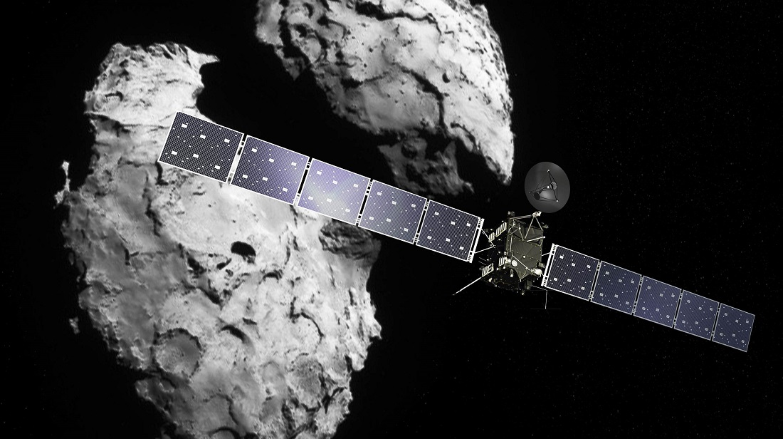
Rosetta: The First Spacecraft to Orbit a Comet
6 August 2014: ESA’s Rosetta is first spacecraft to rendezvous with a comet
12 November 2014: its Philae probe made the first soft-landing on a comet and returned data from the surface
Notes:
Additional Notes
ESA has flown amazing space missions, voyaging to the edge of human knowledge.
After more than 10 years, looping around the Sun five times and clocking up 6.4 billion km, ESA’s Rosetta spacecraft became the first to rendezvous with a comet.
It later became the first to deploy a lander – Philae – to the comet’s surface and was the first to follow a comet as it orbited around the Sun, watching it become more and more active.
Scientists are still unravelling the wealth of data it has provided.
ESA has pioneered many other firsts in science, like Ulysses, first spacecraft to fly over the Sun’s poles and Planck, detecting the Universe’s first light and looking back to the dawn of time.
Today, BepiColombo is on its way to Mercury, the first European-led mission to the Solar System’s innermost planet.
More missions are now under preparation that will help us understand gravitational waves and the nature of dark matter.
Overview of Science missions: https://www.esa.int/spaceinimages/Images/2019/02/ESA_s_fleet_of_Solar_System_explorers

Slide 10
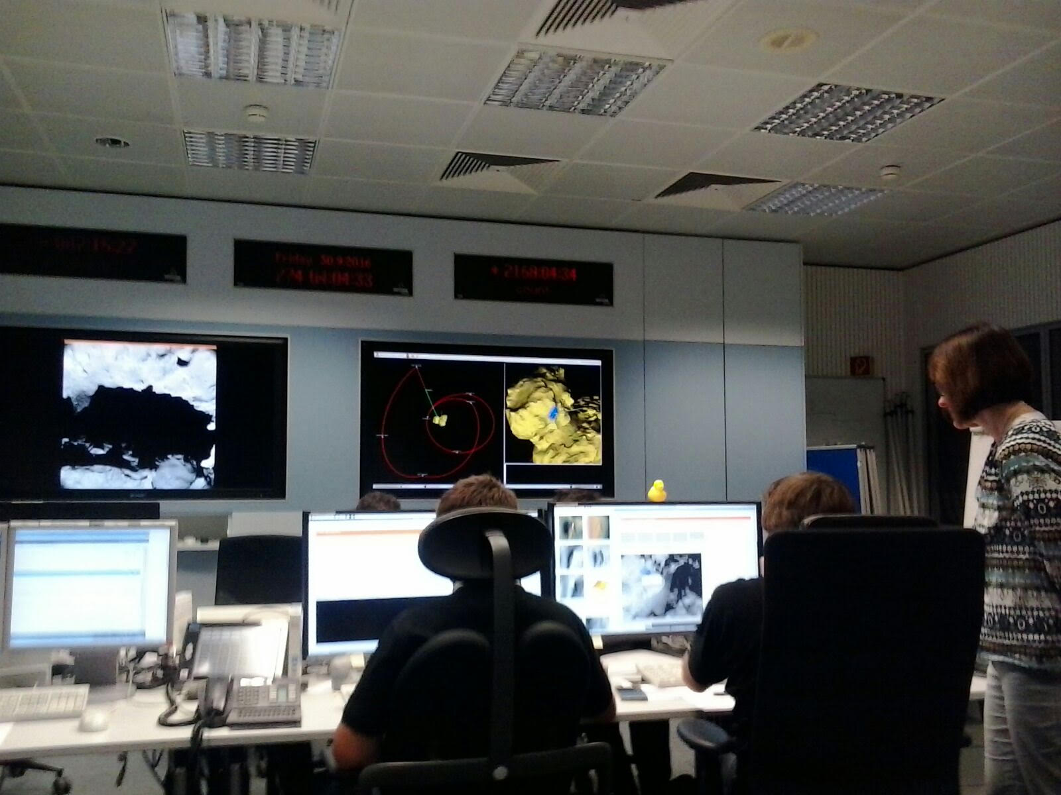
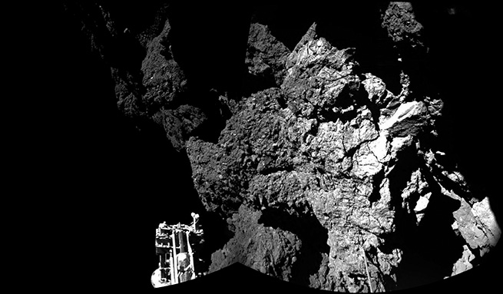
Rosetta: End-of-Mission
30 September 2017: ESA’s Rosetta end-of-mission by controlled impact on the comet’s surface

Slide 11
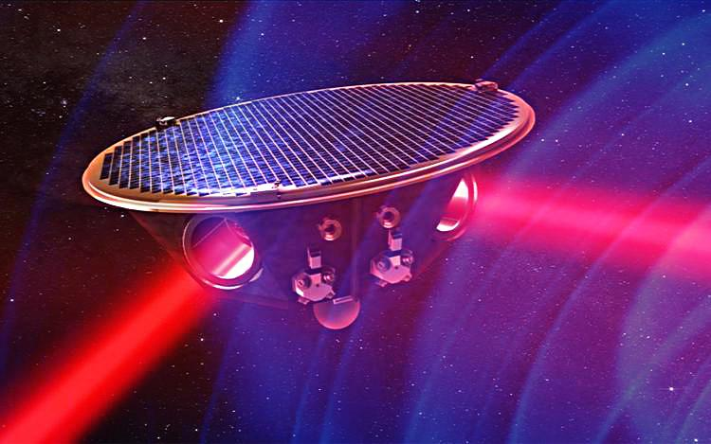
Laser Interferometer Space Antenna (LISA)
Measure gravitational waves at much higher sensitivity and lower frequencies than what is possible from ground.
Planned launch 2034
Notes:
LISA movie: https://youtu.be/h_ApNry_jN0

Slide 12
LISA Sensitivity
Ground-based detectors are sensitive at frequencies of 100 - 1000 Hz
LISA will be sensitive to super-massive black hole binary mergers
Possibly discover a primordial gravitational wave background
Notes:
LIGO/VIRGO binary: ~36 and 20 stellar mass black holes

Slide 13
THANK YOU!

