Slide 1
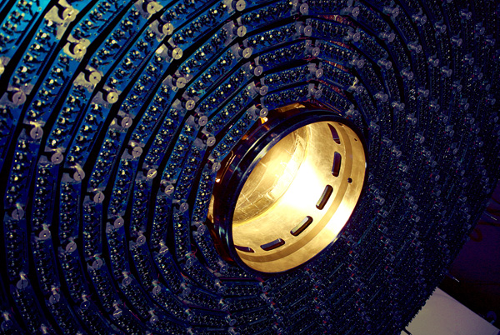
Detector Technology and Systems Platform Berlin Workshop Report from Administration
Christiane Buchwald

Slide 2
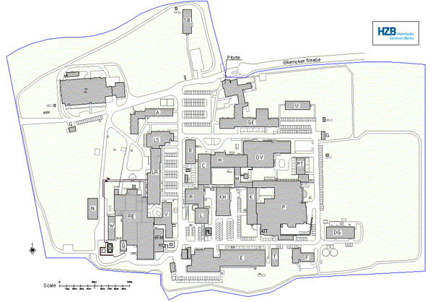
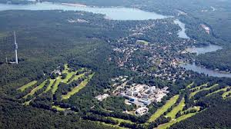
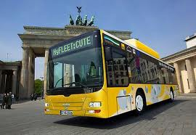
Organisation - Transfer
Monday, 13th May: Transfer HZB to S-Wannsee 20:30
Tuesday, 14th May: Transfer S-Wannsee to HZB 8:30
Tuesday, 14th May: Transfer HZB to Ratskeller Babelsberg: 19:15
Tuesday, 14th May: Transfer Ratskeller Babelsberg to S-Wannsee 21:45 (via Hotel Mercure Potsdam, Hotel Forsthaus and Hotel Petit)
Wednesday, 15th May: Transfer S-Wannsee to HZB 8:30
Wednesday, 15th May: Transfer HZB to S-Wannsee 13:45

Slide 3
Organisation Parallel Sessions (Pillars)
Monday, 13th May 16:00 - 19:00
Pillar I in room PT104
Pillar II in room LR204
Pillar III in room LS206
RECEPTION: „Cafe Jahn“ (room H 200)

Slide 4
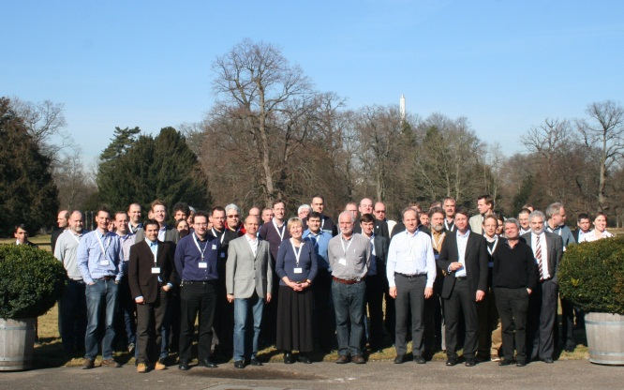
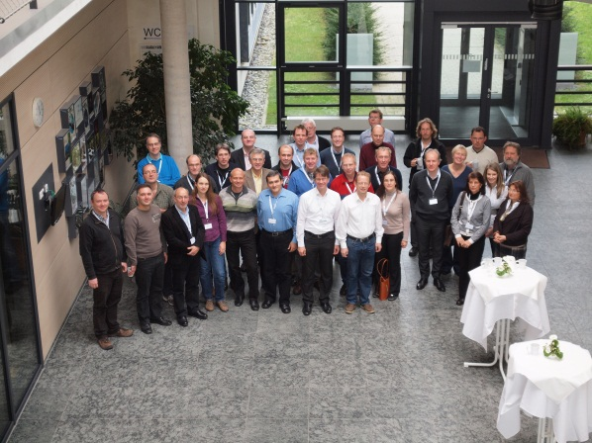
Regular meetings
Meeting venue in rotation with Karlsruhe
Next meeting in Karlsruhe in spring 2014 (depending on date of POF III Evaluation)
Generally two collaboration meetings a year February 2012 November 2012 May 2013

Slide 5
Focus of this meeting
Status and plans till 2014
First Meeting of Advisory Board
Collaboration matters
Vote of Collaboration Board Chair
Use of the Common Fund
Next HGF funding period POF III
Scientific content of proposal
Organisational matters
Submission of proposal: 1st November 2013

Slide 6
Status of Collaboration Agreement
Agreement signed by:
Helmholtz Centers:
DESY
GSI (including HIM and HIJ)
HZB
HZDR
HZG
Jülich
KIT
Universities (so far)
Aachen
Bonn
Dresden
Florenz

Slide 7
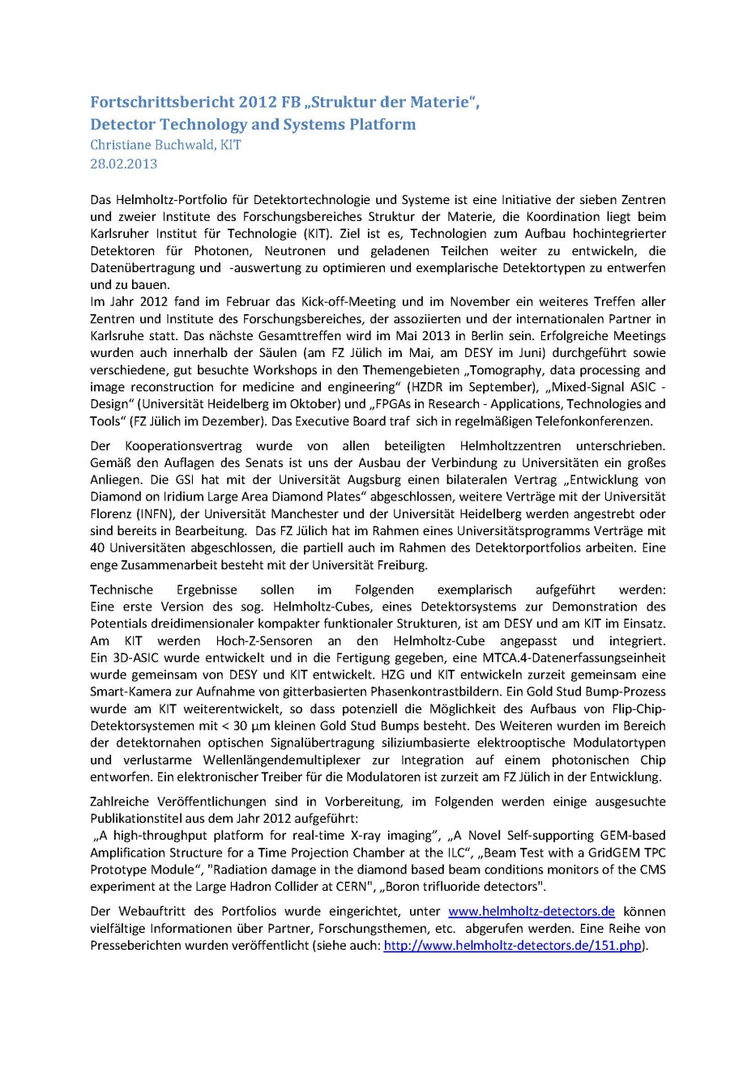
Progress Report
Deadline: February 28th 2013
Just a formality
For coming reports:
Publications
Details from workpackages
Job offers

Slide 8
PR Activities
Web pages
Wiki
Standard templates
Flyer
Emblem

Slide 9
Web pages: http://www.helmholtz-detectors.de/
Main structure
Introduction / news
Research topics
Ordered by work packages
Partners
Contact / organization
Please help to keep the web pages up-to-date
Topics for news
Press releases
Work package progress!
E.g. Milestones, publications, ...

Slide 10
Web pages: http://www.helmholtz-detectors.de/
Main structure
Introduction / news
Research topics
Ordered by work packages
Partners
Contact / organization
Please help to keep the web pages up-to-date
Topics for news
Press releases
Work package progress !
E.g. Milestones, publications, ...
Pillars +
work
packages

Slide 11
Web pages: http://www.helmholtz-detectors.de/
Main structure
Introduction / news
Research topics
Ordered by work packages
Partners
Contact / organization
Please help to keep the web pages up-to-date
Topics for news
Press releases
Work package progress!
E.g. Milestones, publications, ...
Contact
List of work packages

Slide 12
Web pages: http://www.helmholtz-detectors.de/
Main structure
Introduction / news
Research topics
Ordered by work packages
Partners
Contact / organization
Please help to keep the web pages up-to-date
Topics for news
Press releases
Work package progress!
E.g. Milestones, publications, ...
List of
Work
packages
in the pillar

Slide 13
Web pages: http://www.helmholtz-detectors.de/
Main structure
Introduction / news
Research topics
Ordered by work packages
Partners
Contact / organization
Please help to keep the web pages up-to-date
Topics for news
Press releases
Work package progress!
E.g. Milestones, publications, ...
Task allocation, milestones, publications

Slide 14
Web pages: http://www.helmholtz-detectors.de/
Main structure
Introduction / news
Research topics
Ordered by work packages
Partners
Contact / organization
Please help to keep the web pages up-to-date
Topics for news
Press releases
Work package progress!
E.g. Milestones, publications, ...
Institutes, departments?
Contact persons?

Slide 15
Web pages: http://www.helmholtz-detectors.de/
Main structure
Introduction / news
Research topics
Ordered by work packages
Partners
Contact / organization
Please help to keep the web pages up-to-date
Topics for news
Press releases
Work package progress !
E.g. Milestones, publications, ...
List of press releases +
Articles about the portfolio

Slide 16
Wiki pages: http://wiki.helmholtz-detectors.de/
„Internal web pages“
Links to all resources
Members of work packages
Documents, minutes
Project database
Please use the wiki pages
Avoid sending documents by mail
Work packages description
Conference list?
Only for detector internal use!

Slide 17
Wiki pages: http://wiki.helmholtz-detectors.de/
„Internal web pages“
Links to all resources
Members of work packages
Documents, minutes
Project database
Please use the wiki pages
Avoid sending documents by mail
Work packages description
Conference list?
Read-only account:
detector / hgf-cube

Slide 18
Wiki pages: http://wiki.helmholtz-detectors.de/
„Internal web pages“
Links to all resources
Members of work packages
Documents, minutes
Project database
Please use the wiki pages
Avoid sending documents by mail
Work packages description
Conference list?
List of links

Slide 19
Wiki pages: http://wiki.helmholtz-detectors.de/
„Internal web pages“
Links to all resources
Members of work packages
Documents, minutes
Project database
Please use the wiki pages
Avoid sending documents by mail
Work packages description
Conference list?
Information on pillars, work packages, …

Slide 20
Wiki pages: http://wiki.helmholtz-detectors.de/
„Internal web pages“
Links to all resources
Members of work packages
Documents, minutes
Project database
Please use the wiki pages
Avoid sending documents by mail
Work packages description
Conference list?
Create account:
Vorname Nachname
Active after Email confirmation

Slide 21
Wiki pages: http://wiki.helmholtz-detectors.de/
„Internal web pages“
Links to all resources
Members of work packages
Documents, minutes
Project database
Please use the wiki pages
Avoid sending documents by mail
Work packages description
Conference list?
Email notification on page update
(activate on edit page tab)

Slide 22
Standard templates
Presentation
Standard text for job advertisement:
„The 'Detector Technology and Systems Platform' is formed by a consortium of the Helmholtz Centers and Institutes DESY, FZJ, GSI, HIJ, HIM, HZB, HZDR, HZG, KIT complemented by various national and international partner institutions and universities.
The interdisciplinary platform will provide access to modern detector technologies and enable the development of the next generation of cutting-edge detectors for fundamental and applied science as well as for society.“
„Die "Plattform für Detektortechnologie und -systeme" ist eine gemeinsame Initiative der Helmholtz-Zentren und -Institute DESY, FZJ, GSI, HIJ, HIM, HZB, HZDR, HZG, KIT ergänzt durch nationale und internationale Forschungseinrichtungen und Universitäten.
Die interdisziplinäre Plattform wird den Zugang zu den Detektortechnologien der Zukunft sichern und die Entwicklung von Hochleistungsdetektoren für Forschung und Gesellschaft ermöglichen.“

Slide 23
Flyer

Slide 24
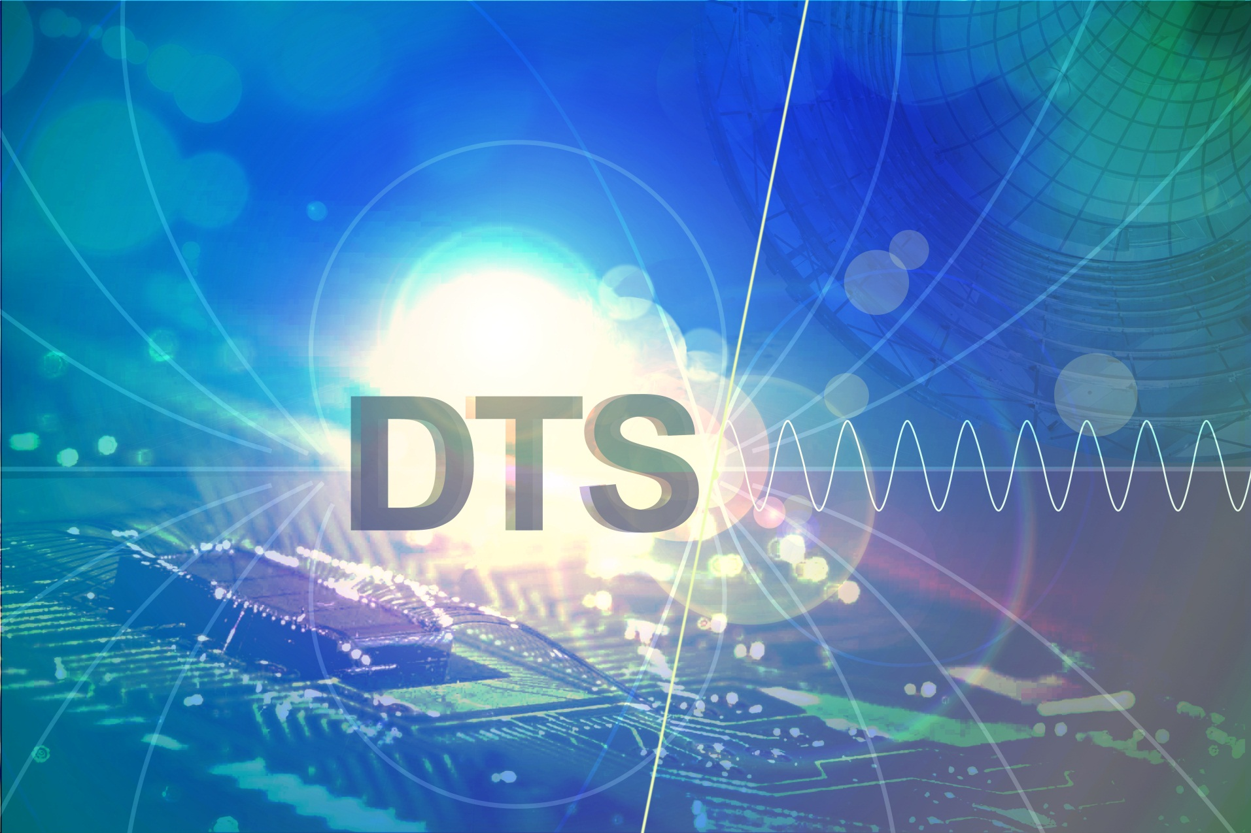
Emblem

Slide 25
Thank you!

Slide 26
Collaboration Agreement
Boards
Work Results
Property Rights
Confidentiality
Liability
Common Fund
In effect retroactively on January 1st, 2012

