Slide 1
Ultra-Fast Data Transfer and Analysis
Intelligent Programmable Electronics Tobias Stockmanns (FZJ)
Ultra-fast Optical Communications Marc Schneider (KIT)
Fastest Data Processing with Highly Parallel Architectures Felix Beckmann (HZG)

Slide 2
WP6 – Intelligent programmable electronics
Activities:
Regular EVO meetings every month with increasing number of participants
Common wiki page to improve contact between groups
Database with ongoing or finished projects
Common developments:
µTCA-based DAQ system (DESY/KIT/FZJ)
UDP plus (in preparation)

Slide 3
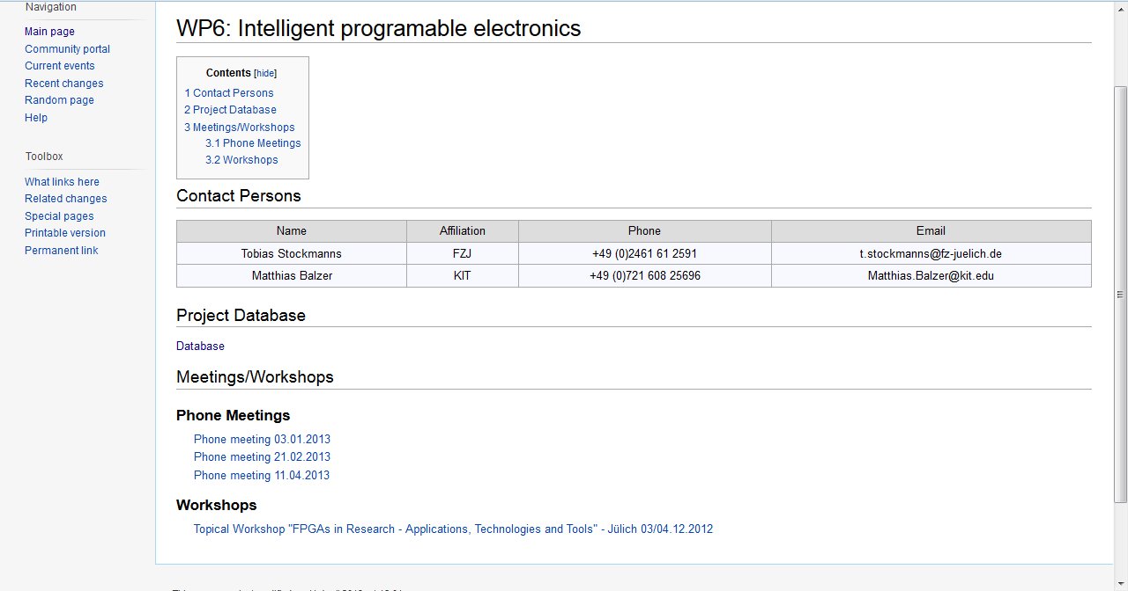
Wiki page

Slide 4
Workshops
First topical workshop in Jülich:
„FPGAs in Research – Applications, Technologies and Tools“
~ 40 participants
Second topical workshop in Karlsruhe:
„Fast Data Transmission for Detector Systems“
September 2013

Slide 5
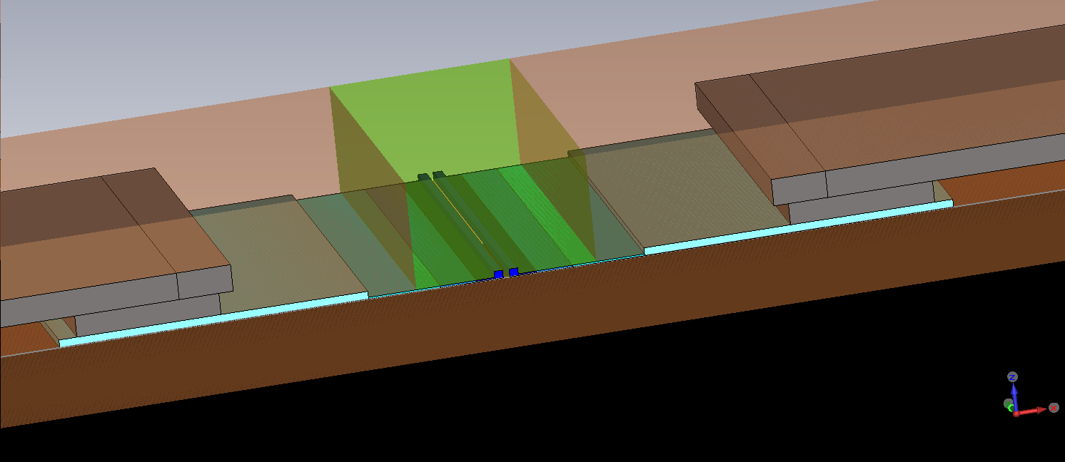
WP7 - Work on Optical Data Transmission
Design and simulation of SOH-modulators (Silicon-Organic-Hybrid) for fabrication on a multi project wafer at OpSIS foundry.
Simulation model
electrooptical active polymer
metal contact
metal contact
SiO₂
active zone
Si

Slide 6
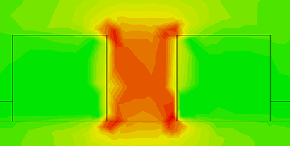
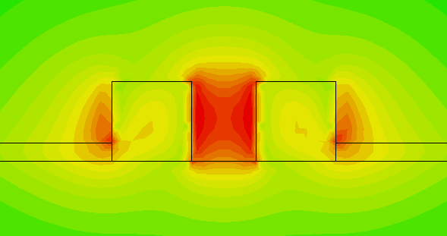
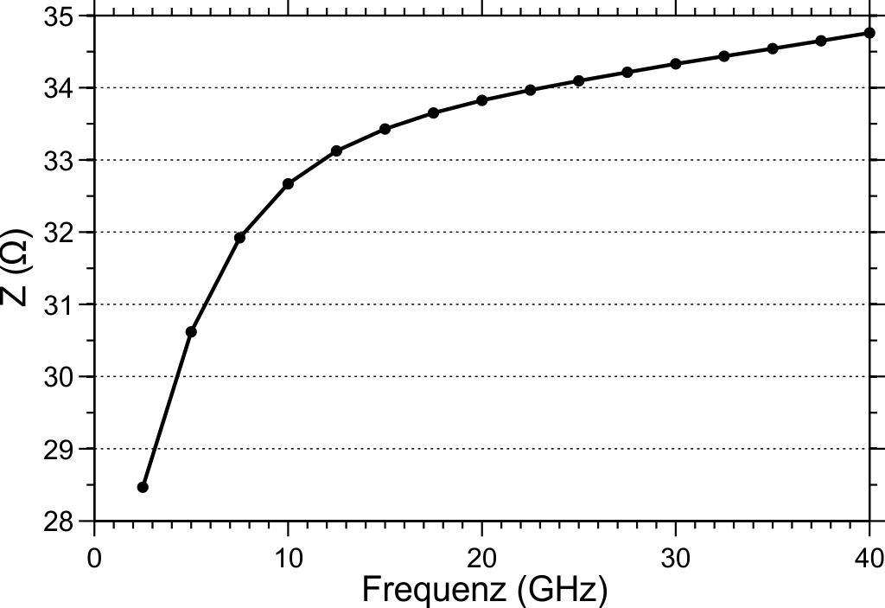
Work on Optical Data Transmission
Electrical field simulation: The electrical field is well concentrated in the slot of the slot waveguide
⇒ Good utilization of the electrooptic polymer
Simulation of the electrical impedance:
Design goal: 33 Ω
Optical field simulation

Slide 7
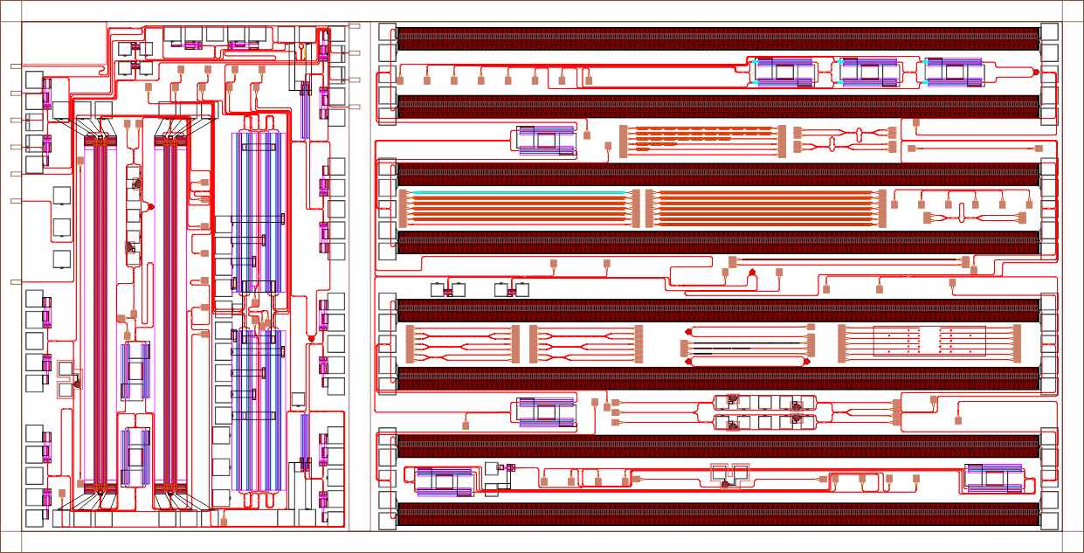
Work on Optical Data Transmission
Final design and composition for wafer production.
single modulator
SOH modulators
pn-modulators
In production, available: end of June

Slide 8
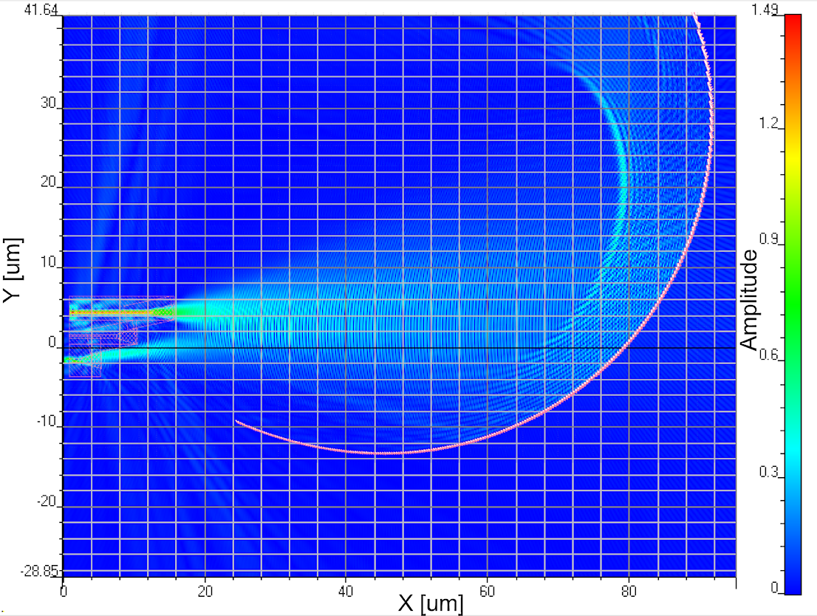
Work on Optical Data Transmission
Work for another production run at IMS Stuttgart:
Collection and matching of design rules
Modulator design
Further simulations on echelle gratings (wavelength division multiplexers) for this run
Echelle grating as wavelength (de)multiplexer

Slide 9
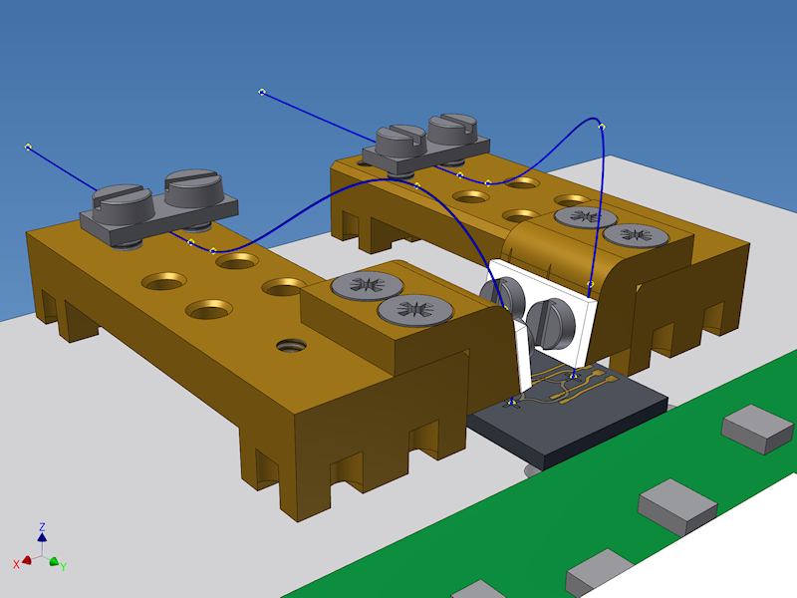
Work on Optical Data Transmission
Redesign of fiber-chip-coupling:
- Composed part with shifted fiber clamps
- Similar parts for both mountig positions
30 mm
11 mm

Slide 10
WP8 – Fastest Data Processing with Highly Parallel Architectures
Activities:
Setup of the electronics department
Started a project for a phase-contrast detector

