Slide 1
Status report Pillar-1: Technology

Slide 2
The “Helmholtz-Cube”
Vertically Integrated Detector Technology
Replace standard sensor with: 3D and edgeless sensors, as well as High-Z
Replace standard bump-bonds with new interconnect techniques
Replace standard ASIC and wire bonds with thinned ASICs and TSV as well as ball-grid arrays
Replace standard ASIC with 3D-ASICs
Develop new high speed IO’s
Employ innovative materials

Slide 3
After F2F meeting of ASIC designers:
  Decided to merge WP1 (3D-ASIC) and WP2 (2D-ASIC)
  Decided to (try to) use one future Technology (65 nm; TSMC)
  Decided to develop a common chip (proposal is on wiki)
  Decided to set-up a HGF repository for designs or design blocks
First Helmholtz cube finished:
  Few silicon sensor systems produced and tested
  1st CdTe version produced by FMF (KIT).
  1st GaAs version under assembly by FMF (KIT)

Slide 4
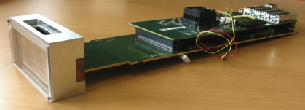
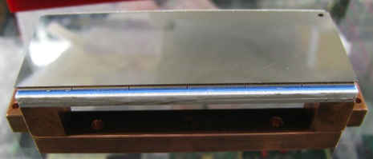
First version of the Helmholtz-Cube ready!
6 by 2 chips (1536 by 512 pixels)
  Large Si sensor from 6” wafer
    300µm Si sensor here
  2 x “Hexa” high-Z sensors
Ceramic circuit board (LTCC)
  14 layer board
  Good match to germanium CTE
  Cooling through thermal vias
500-pin connector on board
  Full parallel readout (8 LVDS data outputs per chip)
  ~150 LVDS pairs total
6 x 2 Medipix3 chips
LTCC board
Notes:
Approximately 200 output, 100 other signals, over 100 ground pins (improving LVDS), then other things like power
More about edge area could be added
Maybe additional slide? Wire bonding issues? Could be helpful, but not critical – non-uniform layout of pads – useful to mention, perhaps show.
(More about ceramic?)

Slide 5
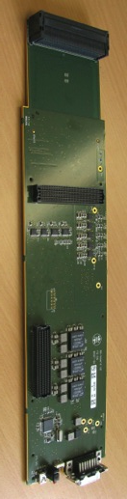
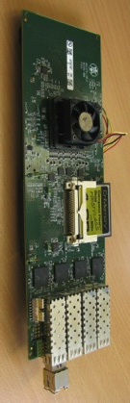
High-speed readout system
Connector to det. head
Previously developed prototype system (USB2 readout only)
High-speed readout with common DESY mezzanine card
  Virtex-5 FPGA with PowerPC
  4 * 10 Gigabit Ethernet links
  DDR2 RAM (8GB)
“Signal distribution” board connects to det. head
  Space for vacuum barrier with germanium detector
Currently working on high-speed readout firmware
Space for barrier
FPGA
Vregs, ADC/DAC
10GBE links
Power / trigger in
Notes:
Need to add photos of course
Prototype system used for tests
Readout
Discuss plans – lightweight – single link, RAM for burst mode.

Slide 6

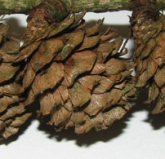
Test results with Si module
First full Si module assembled (300µm thick sensor from Canberra)
  Solder bonding at IZM
  All 12 chips successfully bonded and functional
  Small no. of bad pixels on chips and bad bumps on test module
Flat-field corrected image, Mo X-ray tube, 40kV
Notes:
Quantification

Slide 7
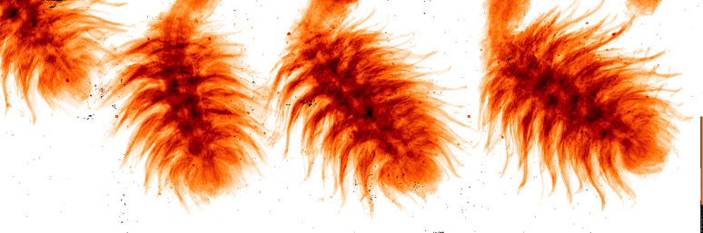
Test results with Si module
First full Si module assembled (300µm thick sensor from Canberra)
  Solder bonding at IZM
  All 12 chips successfully bonded and functional
  Small no. of bad pixels on chips and bad bumps on test module
Flat-field corrected image, Mo X-ray tube, 40kV
One system delivered to KIT for hybridization with CdTe
Notes:
Quantification

Slide 8
High-Z development (M. Fiederle / KIT-FMF)
Processing of High-Z semiconductors: CdTe and GaAs
Development of monolithic sensors with 165 / 110 / 55 µm pixels
Active area 28 x 43 mm² => maximum size of available material
Tasks:
  Wafer level: metallization, passivation, UBM, bump deposition, dicing
  Sensor level: flip-chip bonding, assembling, wire bonding
Photon Counting Chip: Medipix3 – Version 3RX (latest):
  Full functionality: Single Pixel Mode SPM, Charge Summing Mode CPM,
  Color Mode with Super Pixels 110 µm => 8 (eight) energy tresholds
First assemblies: CdTe 3RX 55 µm and CdTe 3RX 110 µm
Notes:
German-Russian partnership – mention ANKA

Slide 9
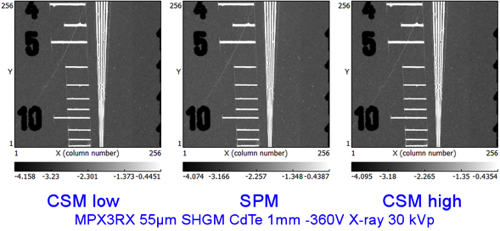
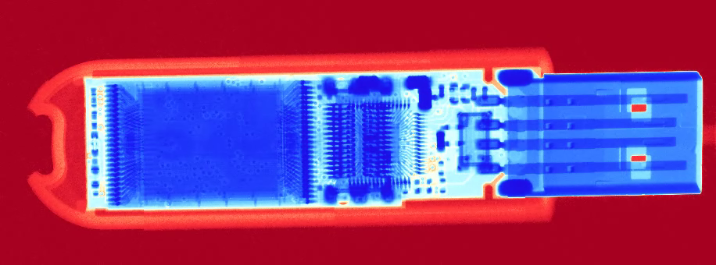
High-Z development (M. Fiederle / KIT-FMF)
X-ray images with CdTe 55 µm 3RX: lowest energy < 3keV
X-ray images with CdTe 110 µm 3RX:
Notes:
German-Russian partnership – mention ANKA

Slide 10
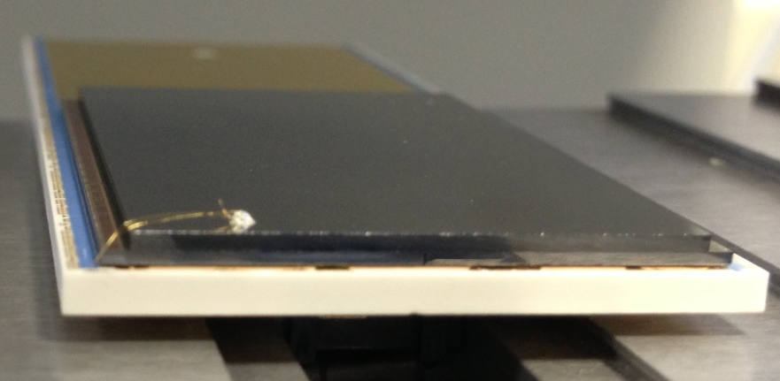
High-Z development (M. Fiederle / KIT-FMF)
CdTe Hexa 28x43 mm² with Medipix 3RX
Assembling on HGF-Cube boards:
  One hexa in the first step
  Adjustment of back-side contact (gold wire glued to CdTe)
  Tests in the next two weeks
  First Cube with one Hexa in April 2013
Notes:
German-Russian partnership – mention ANKA

Slide 11
High-Z development (M. Fiederle / KIT-FMF)
CdTe Hexa 28x43 mm² with Medipix 3RX:
First image with Helmholtz Cube:
  Single Pixel Mode (measurements D. Pennicard DESY)
Notes:
German-Russian partnership – mention ANKA

Slide 12
High-Z development (M. Fiederle / KIT-FMF)
CdTe Hexa 28x43 mm² with Medipix 3RX:
First image with Helmholtz Cube:
  Charge Summing Mode (measurements D. Pennicard DESY)
Notes:
German-Russian partnership – mention ANKA

Slide 13
High-Z development (M. Fiederle / KIT-FMF)
Production of further CdTe Hexas for the
Helmholtz Cubes
Pixels sizes: 55 µm
Medipix3RX
Complete Lamda system with fast read-out interface
Proposal for Common fund (in preparation)
Notes:
German-Russian partnership – mention ANKA

