Slide 1

`Cross disciplinary applications`
Annual Meeting and Workshop
Detector technology and systems platform
HMI Berlin
May 13th – May 15th
Radiation Physics, HZDR
Fine Fiedler

Slide 2
DTSP – Detektor Technology and Systems Platform
Ultrafast data
transfer and
reconstruction
Intelligent programmable
hardware
Near detector
optical signal
transmission
Fastest data
processing with
highly parallel
architectures
Technologies for
assembling highly
integrated detectors
3D ASICs
Mixed-signal ASICs
3D / high-Z sensors
Packaging and interconnection technologies
Innovative detector structure materials
Detector types
Fast photon and
X-ray detectors
Diamond detectors
Detectors for
thermal neutrons
Compact gas detectors
Cross disciplinary application

Slide 3
Cross disciplinary application
This topic will look for specific application fields outside “Matter”
Visibility of the technological competencies
Search for interdisciplinary cross-program opportunities

Slide 4
Cross disciplinary application
This topic will look for specific application fields outside “Matter”
Visibility of the technological competencies
Search for interdisciplinary cross-program opportunities

Slide 5
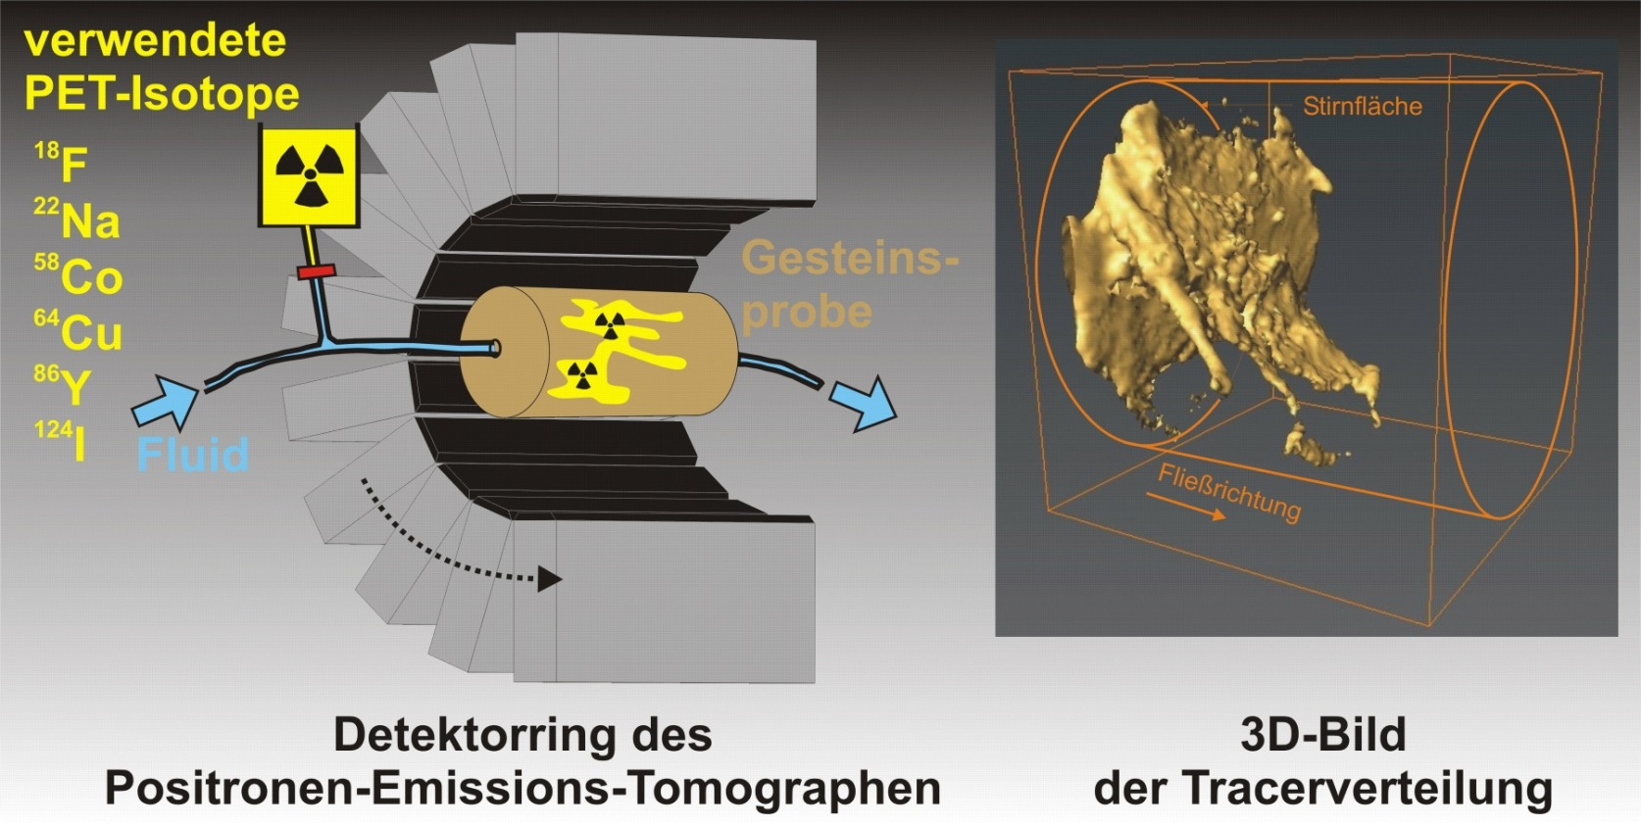
Research
We study fluid transport processes by means of radiotracer applications at laboratory scale.
We aim at further deepen our understanding of fluid dynamics and solute transport in complex media. This media might be geological media (rocks, soils and sediments), model systems (e.g. pebble beds, porous media) or technical units (any kind of opaque, porous matter). Fluids are water, gas with/without dissolved solutes and (nano-)particles/colloids.
The array of required methods includes:
* the production of radionuclides,
* the development of radiotracer substances,
* studies of elementary processes in equilibrium and kinetic systems, in batch and columns,
* (3D+t) visualization of transport processes by means of the GeoPET-method,
* the development of conceptual models, and
* simulation & parameterization of transport processes by means of numerical modelling.
Cross disciplinary application - ENERGY
Reactive Transport - GeoPET
Focused on the investigation of (reactive) transport processes in heterogeneous geological material by means of radiotracer
We are focusing on the investigation of (reactive) transport processes in heterogeneous geological material by means of radiotracer applications. Our activities address two themes in the research field Energy:
Long-lived radionuclides in permanent disposal sites (Nuclear Safety Research) and
Particle-mediated transport in geosystems (Energy efficiency, materials and resources).
https://www.hzdr.de/db/Cms?pOid=36313&pNid=2058
Contact: Dr. Johanna Lippmann-Pipke, j.lippmann-pipke@hzdr.de

Slide 6
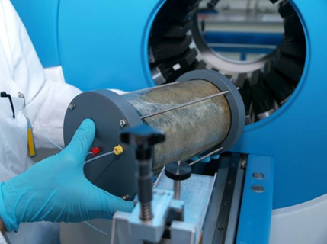
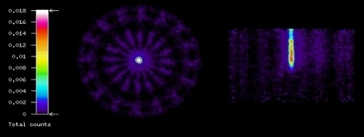
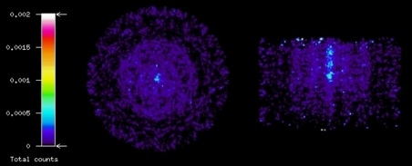
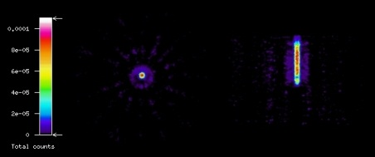
Cross disciplinary application - ENERGY
Reactive Transport - GeoPET
Monte Carlo Simulation results for a ClearPET:
Cylindrical clay phantom (∅ 10cm, ρ ~ 2.6 g/cm³), 5 MBq ¹⁸F
total
scattered
unscattered
GeoPET-Measurement
Simulated scatter
Corrected singal
Energy window
➔ The scattered fraction could be reduced most effectively from GeoPET-measurement by means of a simple energy filter
https://www.hzdr.de/db/Cms?pOid=36313&pNid=2058
Contact: Dr. Johanna Lippmann-Pipke, j.lippmann-pipke@hzdr.de
-
=
=

Slide 7
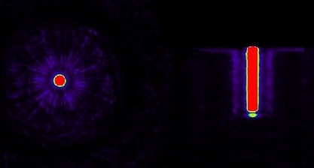
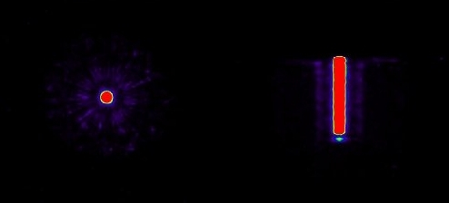
Cross disciplinary application - ENERGY
Reactive Transport - GeoPET
Monte Carlo Simulation results for a ClearPET:
Cylindrical clay phantom (∅ 10cm, ρ ~ 2.6 g/cm³), 5 MBq ¹⁸F
total
scattered
unscattered
GeoPET-Measurement
(simulated data)
Reconstructed image
Energy filter (450-600) keV
Energy window
➔ The scattered fraction could be reduced most effectively from GeoPET-measurement by means of a simple energy filter
Zakhnini, A., Kulenkampff, J., Sauerzapf., S., Pietrzyk, U., Lippmann-Pipke, J. (2013): Computers and Geosciences, in press
-
=
=

Slide 8
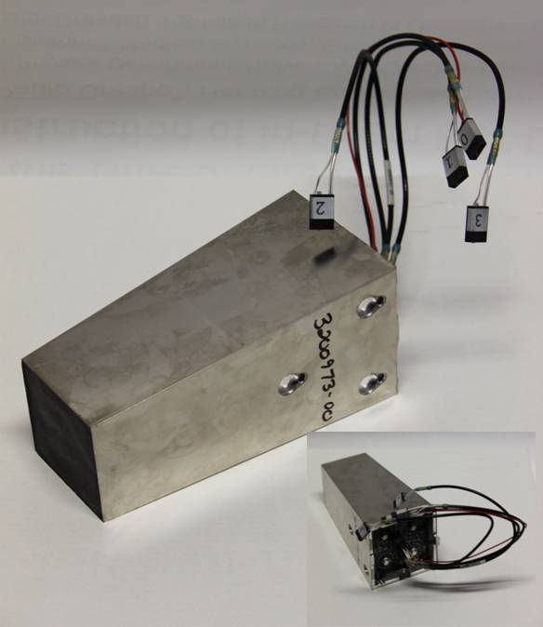
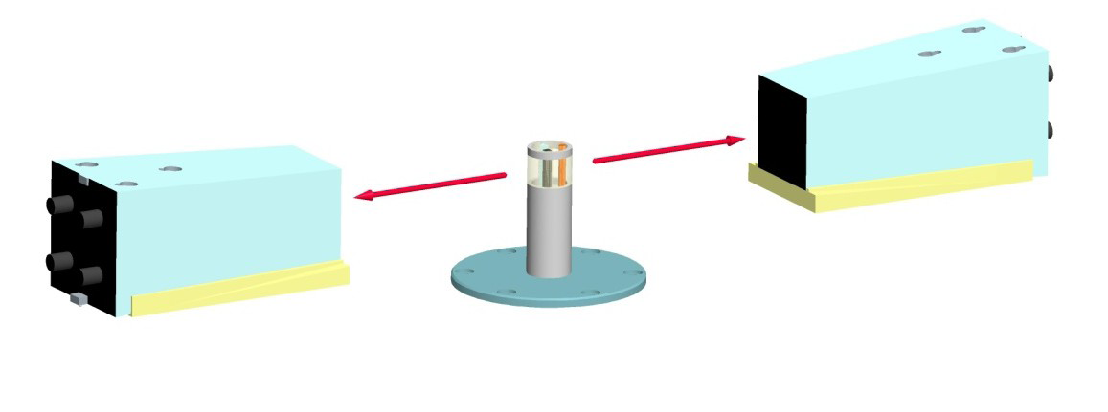
  Cross disciplinary application –
  Non-destructive material analysis with positron life time spectroscopy
Bremsstrahlung beam
511 keV
511 keV
Siemens’ LSO-based commercial 13x13 PET pixel detector
F. Fiedler, F. Fritz, M. Kempe, S. Schöne, T. Steudtner, A. Wagner

Slide 9
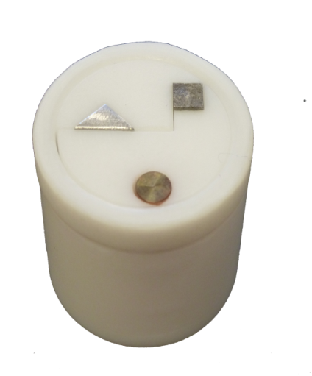
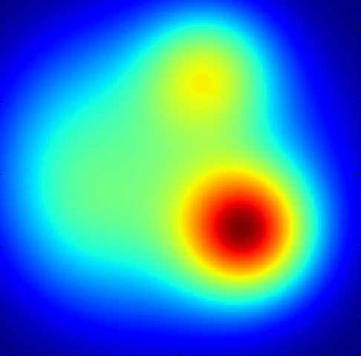
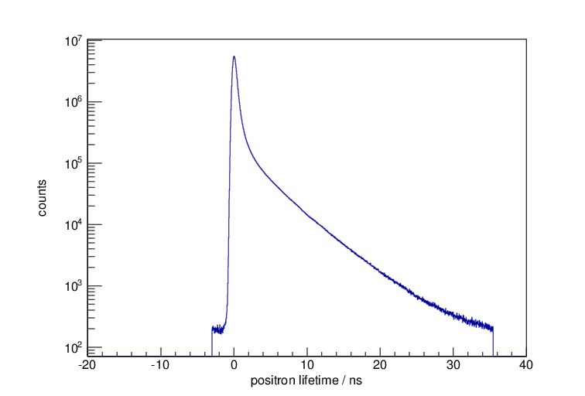
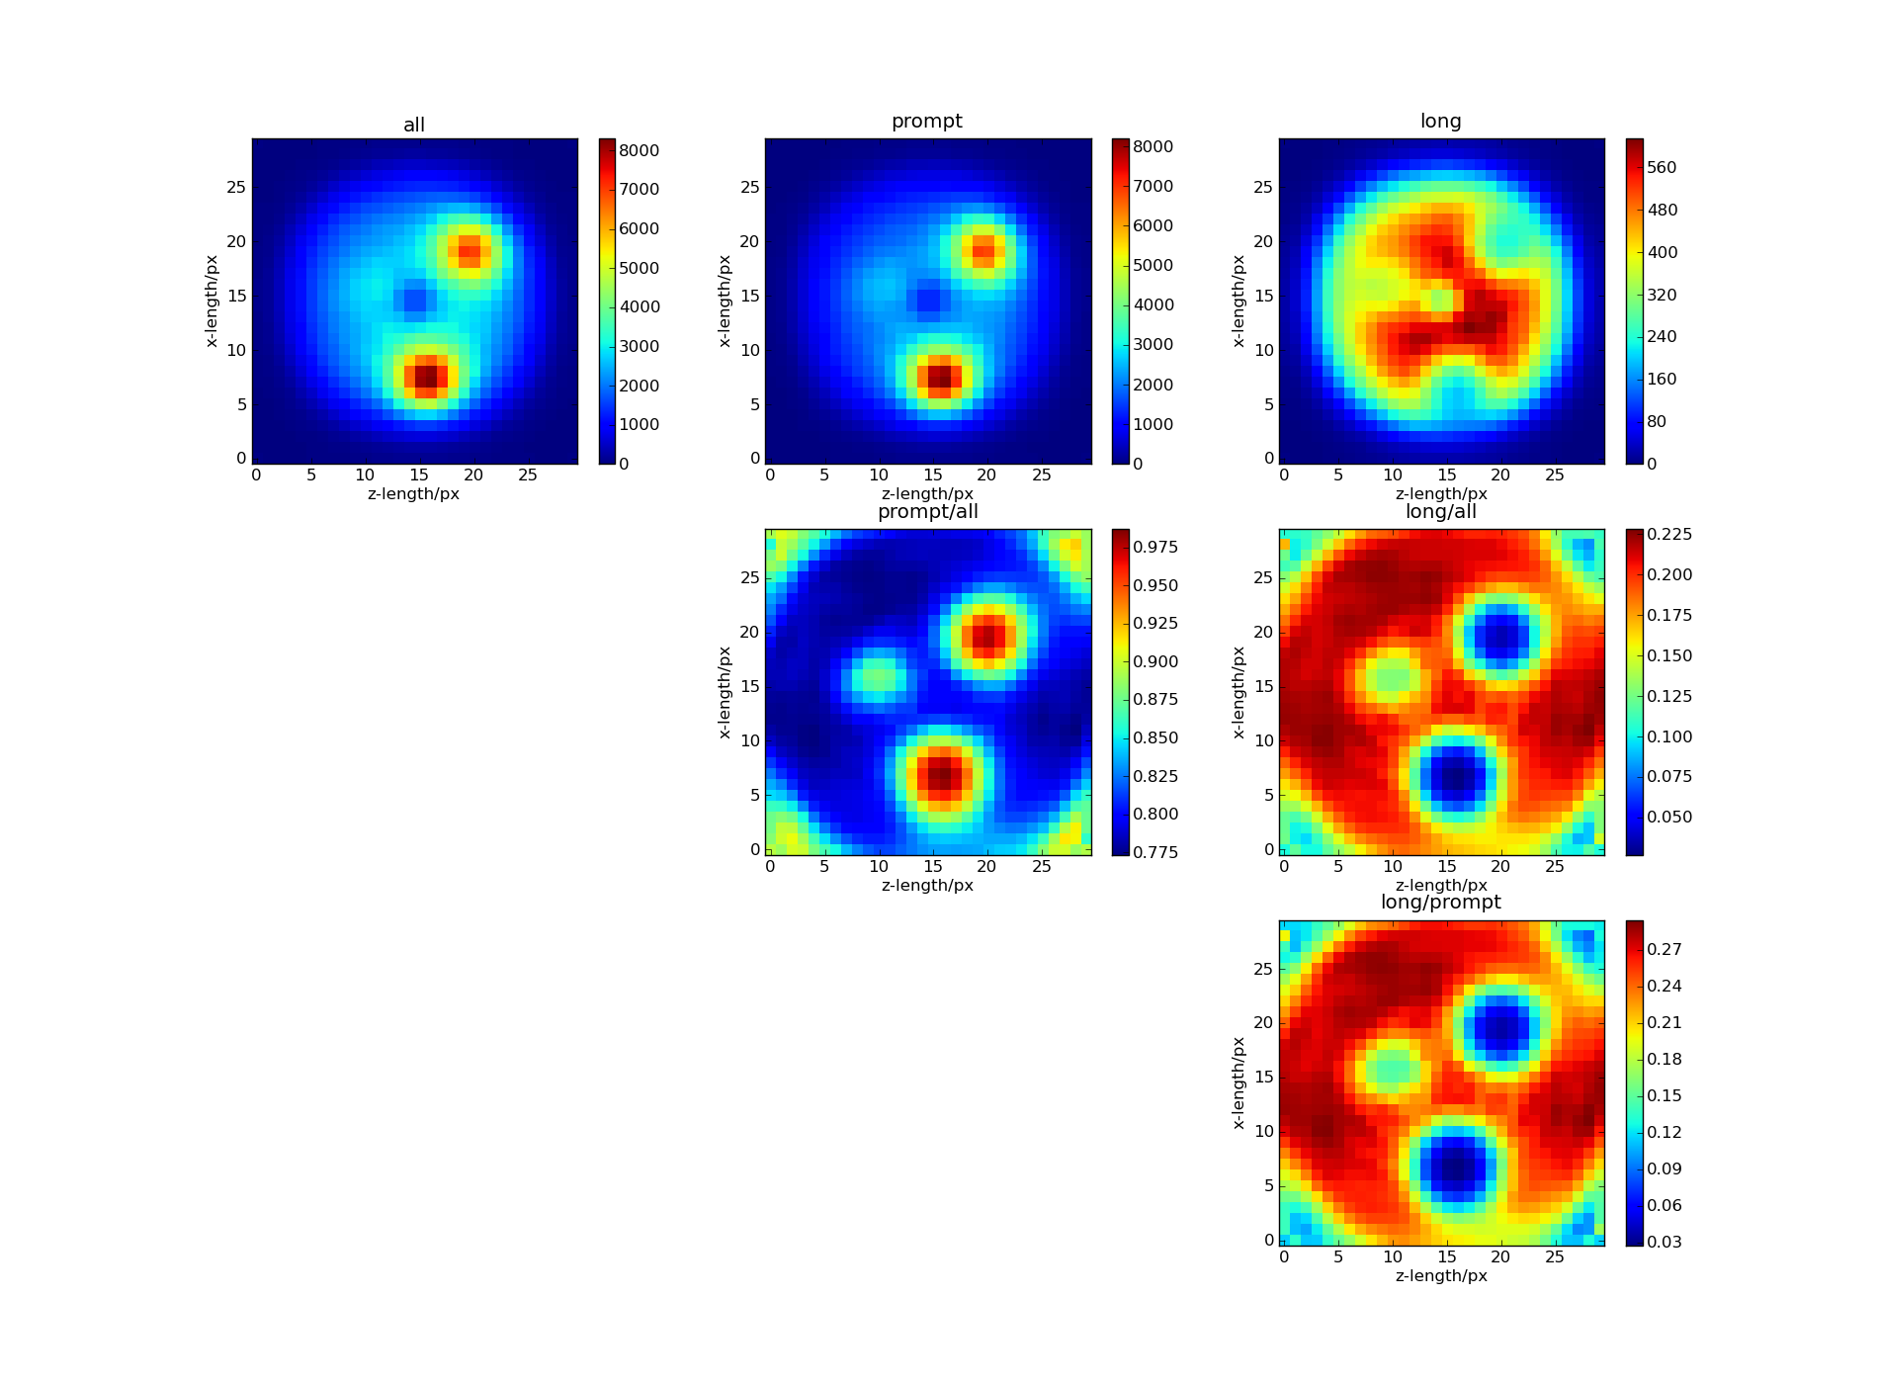
  Cross disciplinary application –
  Non-destructive material analysis with positron life time spectroscopy
Aluminium
Probability for pair creation
κ_{paar} ~ Z ρ log E_{γ}
What we expect from simulation
Steel
Copper
Teflon
 | Teflon | Aluminium | Copper | Steel
τ_{s} | ~ 300 ps 0.6-1.1 ns 1.7-4.1 ns | ~ 166 ps | ~ 122 ps | ~ 107 ps
Prompt / all
short
long
F. Fiedler, F. Fritz, M. Kempe, S. Schöne, T. Steudtner, A. Wagner

Slide 10
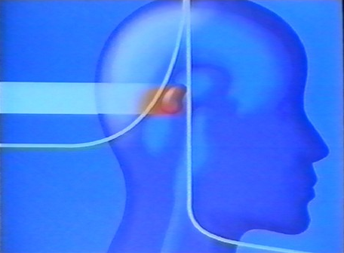
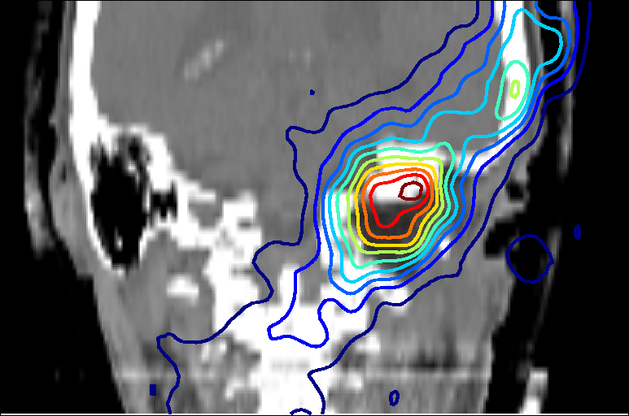
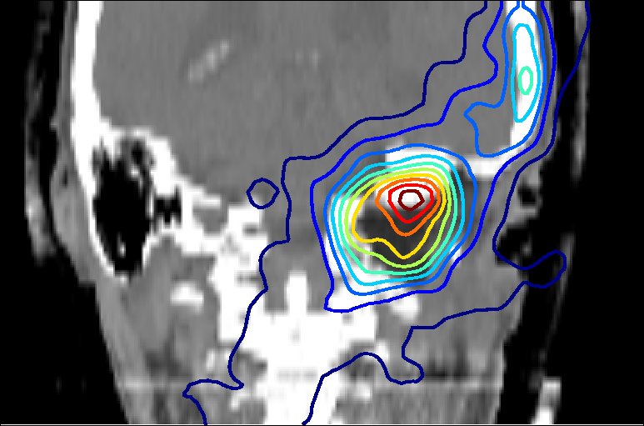
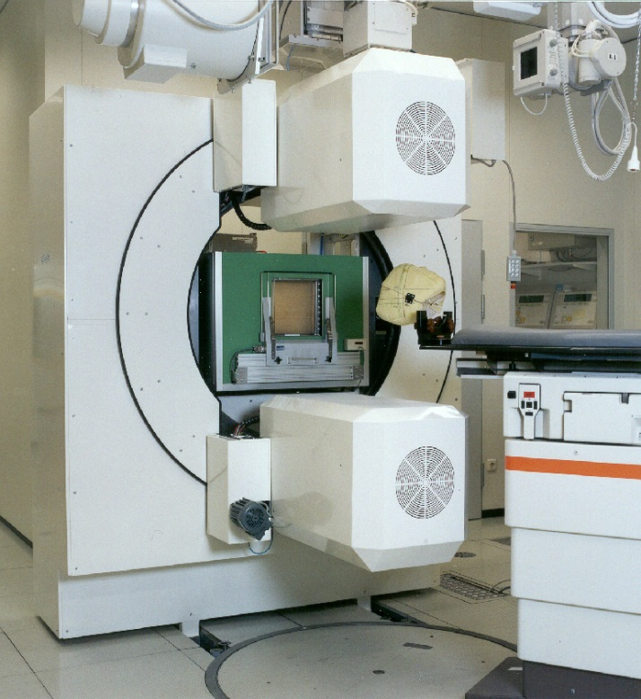
  Cross disciplinary application – HEALTH
  In-vivo dose monitoring by means of PT PET
Prediction Measurement
Tumortherapy with protons and ions
Courtesy: Cern
Efficient detectors for good counting statistics while dose is limited
In-beam PET scanner at
¹²C-therapy unit at GSI

Slide 11

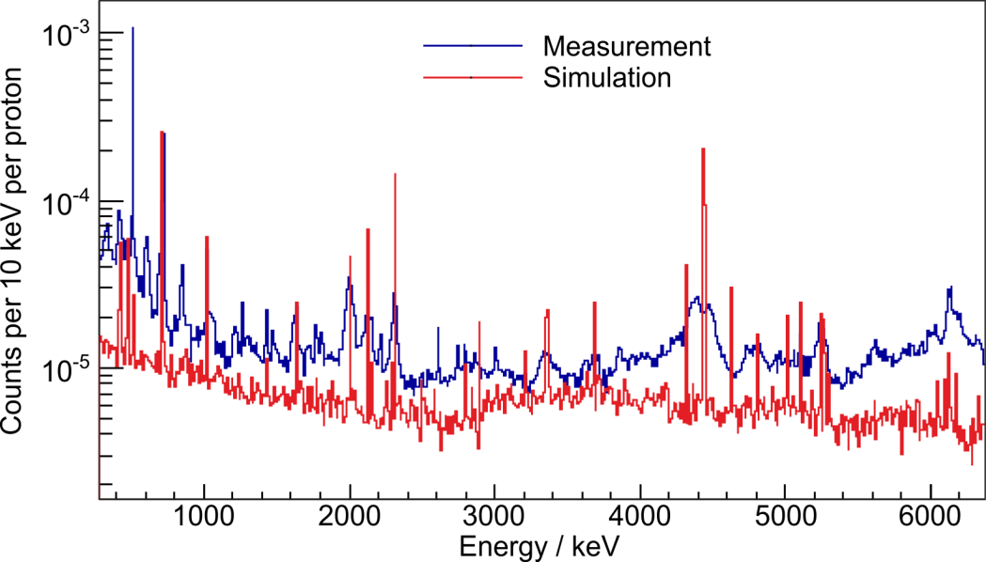
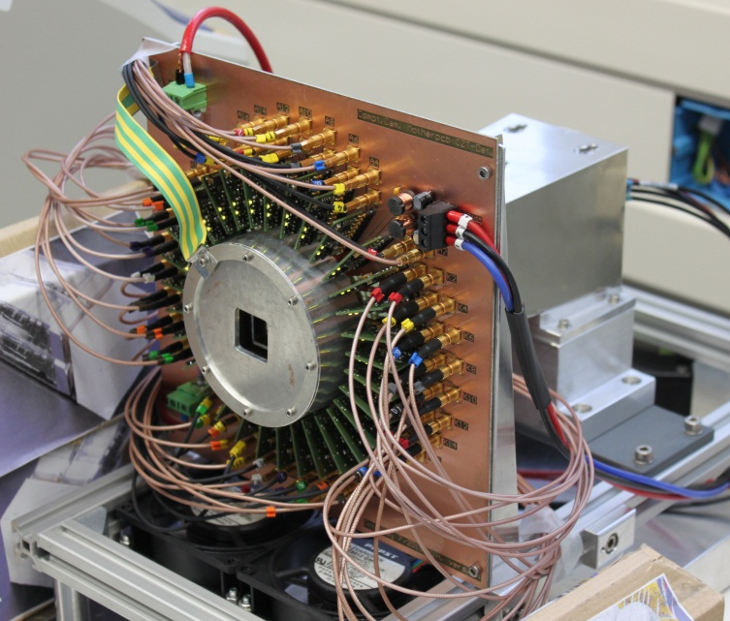


Cross disciplinary application - HEALTH
Prompt gamma imaging
LSO detector
CZT detector
Prototype of a Compton camera
Prompt gamma imaging
Coherent development and combination of various sub-domains for an application with common benefit
All sub-domains are technological challenging
No real cutting edge detector development, however
Novelty: Systemic solution-focused development, all components need special and highly skilled support

Slide 12


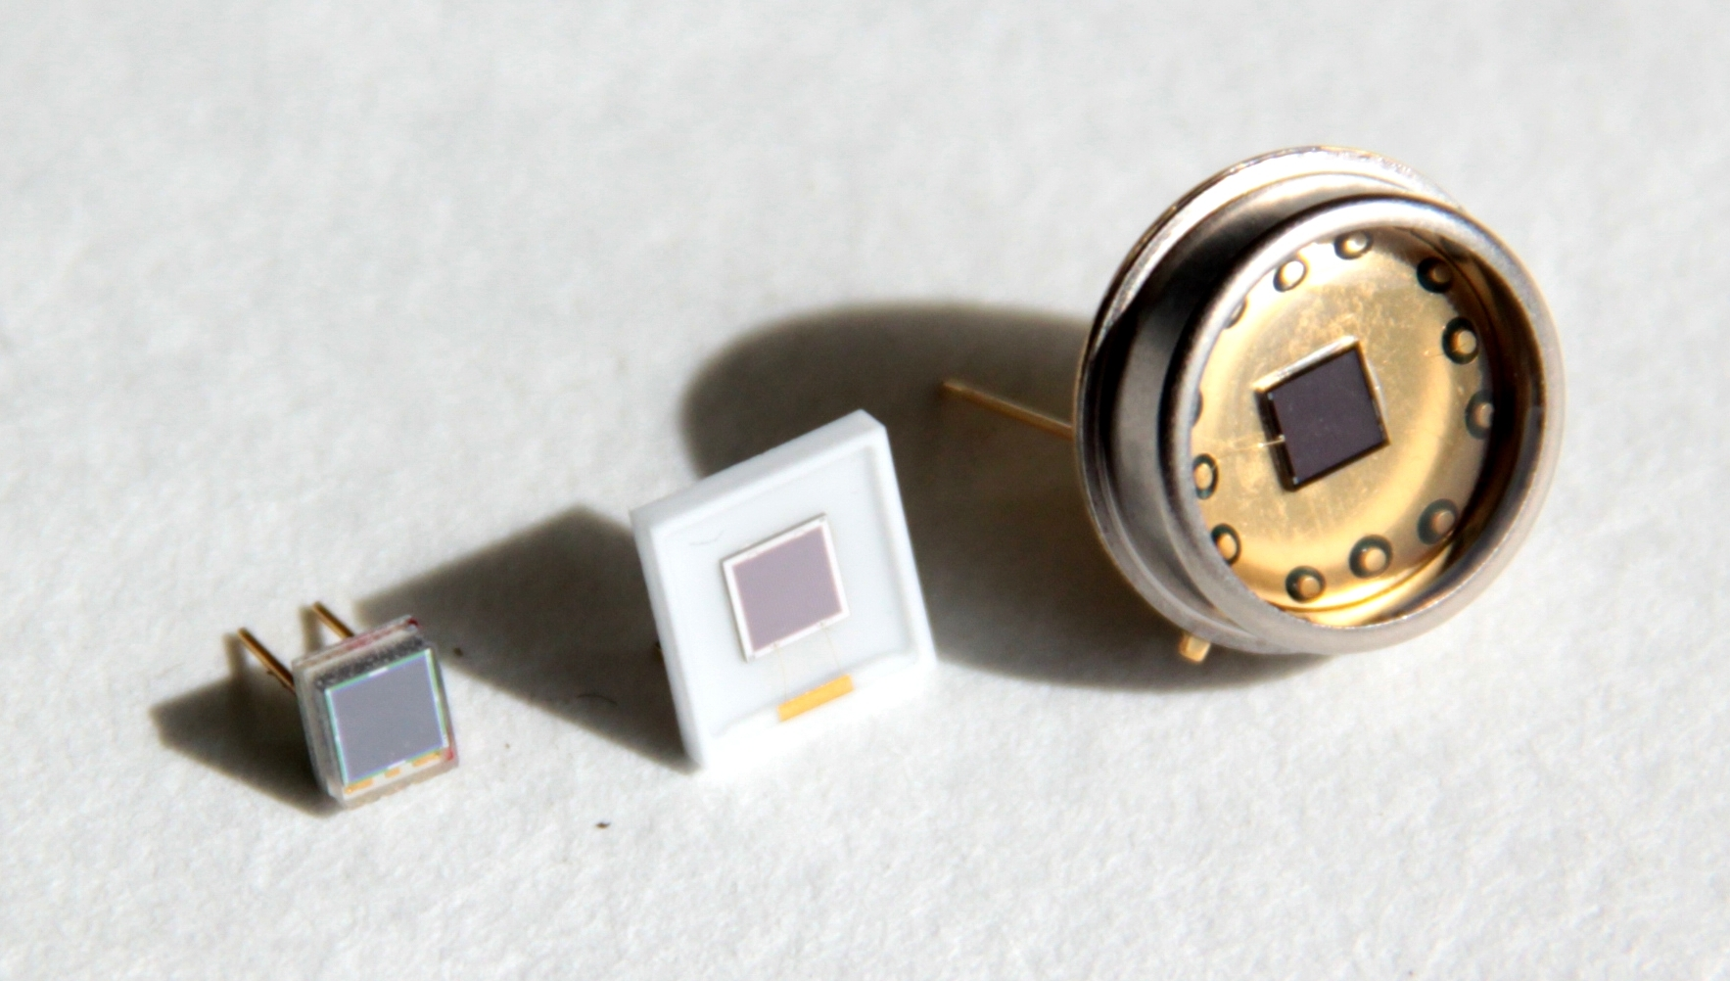



Cross disciplinary application - ENERGY
Alternatives to photomultiplier tubes in fundamental research
Close contact with industrial research
Pilot SiPM models for qualification experiments
By courtesy of KETEK and Excelitas
Cooperation for optimization of SiPMs regarding our field fo application
KETEK PM3360
Excelitas 3x3 SiPM
(APD package)
AdvanSiD ASD-SiPM3S-M
Courtesy: Tobias Kögler, Andreas Wagner

Slide 13
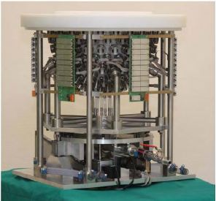
  Cross disciplinary application – HEALTH
Ultrasound Computer Tomography @ KIT
3D USCT II
Imaging of early stage breast cancer
Imaging without radiation exposure
Fast data aquisition (6 s – 2 min)
FPGA based computation applied for signal processing
20 GByte of raw data are acquired per breast volume
Computing power of the FPGAs will further accelerate the data pre-processing and reconstruction
courtesy: N. Ruiter
Nicole V. Ruiter et al., Proc. SPIE 7968, 796805 (2011); doi:10.1117/12.877520

Slide 14
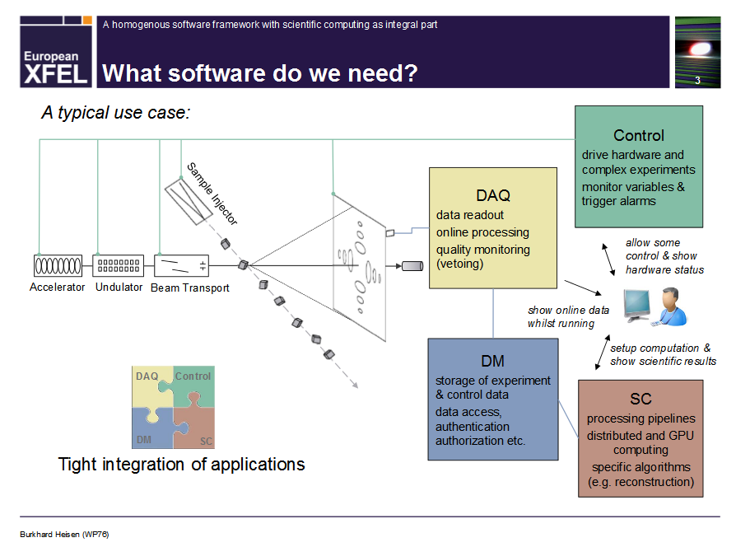
Cross disciplinary application - MATTER
Fast reconstruction for XFEL using GPU:
Courtesy: Burkhard Heisen for WP76 European XFEL GmbH User-Meeting 25 January 2012

Slide 15
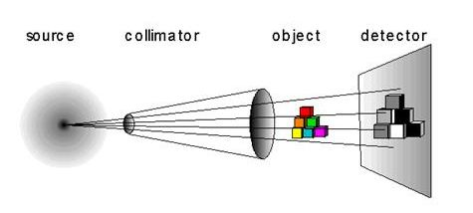
Cross disciplinary application
Detectors for neutron radiography
Complementary method to gain additional information about waste content
Fast neutrons
courtesy: J. Kettler
Standard Detector technology:
  - Integrating detectors, e.g. Scintillators coupled to CCD or Image plates
  New approaches:
    - Event based detectors, e.g. Scintillators with wavelength-shifting fibers readout by PMTs
    - Better neutron/gamma discrimination
Profits/demands :
Fast readout and data transfer systems for high event rates
Online preprocessing of data for image correction and reconstruction
courtesy: G. Kemmerling

Slide 16




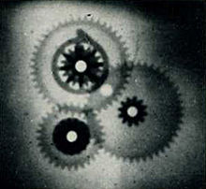
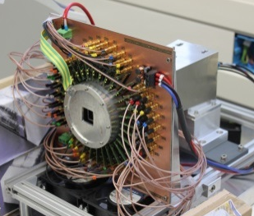
Cross disciplinary application - Activities
GeoPET
detectors for 511 keV γ-rays –
good energy resolution
3D USCT
FPGA, big data, GPU reconstruction
XFEL
FPGA, big data, GPU reconstruction
EPET
detectors for 511 keV γ-rays –
good energy and time
resolution
Neutron radiography
Event based detectors
PT PET
detectors for 511 keV γ-rays –
High efficiency
Prompt gamma imaging
Systemic solution
SiPM
Contact to industry

Slide 17
Cross disciplinary application
This topic will look for specific application fields outside “Matter”
Visibility of the technological competencies
Search for interdisciplinary cross-program opportunities

Slide 18
Cross disciplinary application
On-line monitoring for machine tools
The X-rays and gamma irradiation is used in the
• Nondestructive testing for quality control
• Process control of process parameters as a continuous measurement method
It is used for fault detection of components inside, particularly at welds of metal sheets, pipes and tanks.
To date, relevant sectors:
• pipeline and plant construction – e.g. inspection of welds
• Power plant and boiler – Verification of material homogeneity
• Semi-finished products and component manufacturing - for example in foundries
• Pipeline - regular inspection intervals
• Automotive and vehicle construction - testing of mechanical components
• Aviation - Testing of mechanical components (esp. composite materials such as rotor blades ..)
• Electronics - Inline inspection of parts and circuit boards
Industry highly involved, maybe there is room for improvement with new detectors like HGF cube

Slide 19
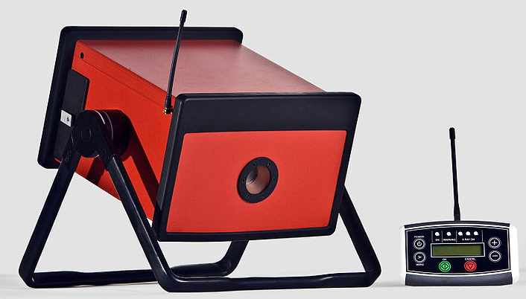
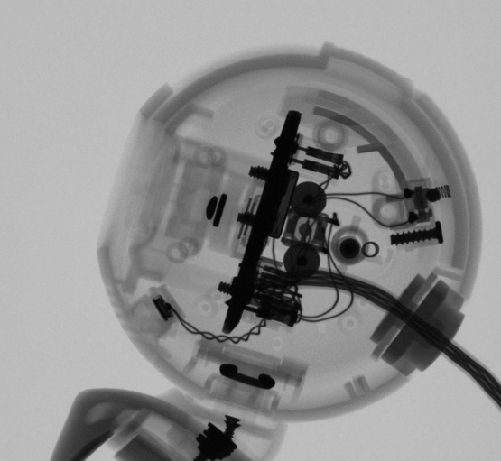

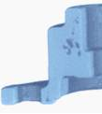
Cross disciplinary application
On-line monitoring for machine tools
The X-rays and gamma irradiation is used in the
• Nondestructive testing for quality control
• Process control of process parameters as a continuous measurement method
It is used for fault detection of components inside, particularly at welds of metal sheets, pipes and tanks.
The previous use is limited due to various parameters
• screening of metals or other dense materials => max. material thickness
• Resolution and contrast in fiber composites
Workshop
Industry meets science
?
Portable X-ray scanner
Industry highly involved, maybe there is room for improvement with new detectors like HGF cube

Slide 20
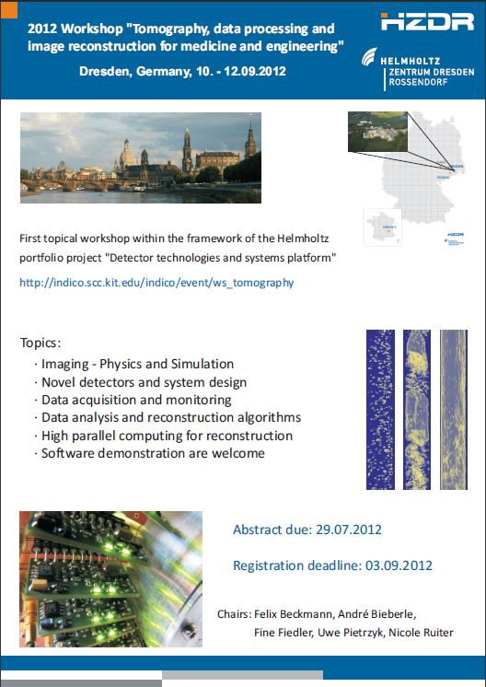
Cross disciplinary application

Slide 21
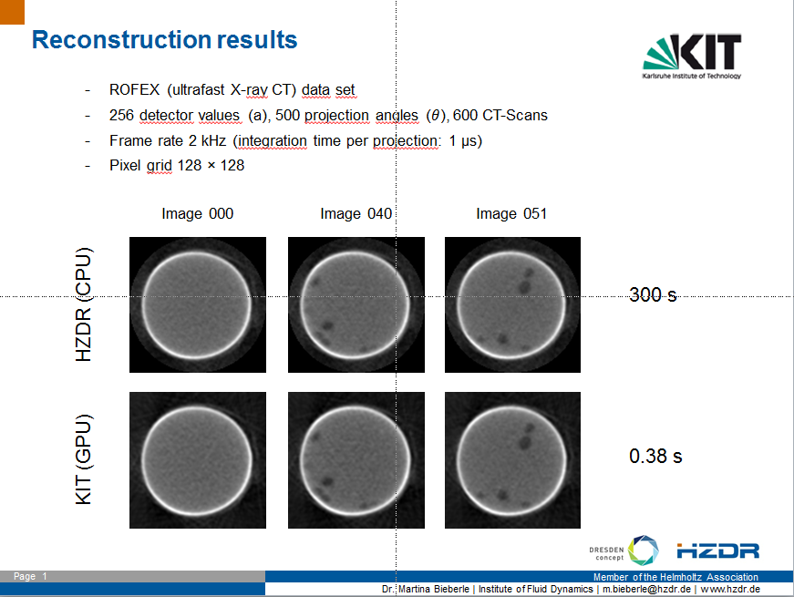

Slide 22
Common Application (HZDR, KIT) for further funding by DFG in progress

Slide 23
DTSP Workshops and more
10.-12. 9. 2012 @HZDR
Tomography, data processing and image reconstruction for medicine and engineering
10.-11. 10. 2012 @ Heidelberg (Ch. Schmidt)
ASCI Developers Meeting
3.-4. 12. 2012 @ Jülich (Stockmanns)
September 2013 @ KIT (Balzer)
“Fast data transmission for detector systems”
23.-25.5. 2013 @ Bad Honef - 532. Wilhelm und Else Heraeus-Seminar
“Development of High-resolution Pixel Detectors and their Use in Science and Society”
Idea:
Workshop close to industrial needs, identify application areas

Slide 24
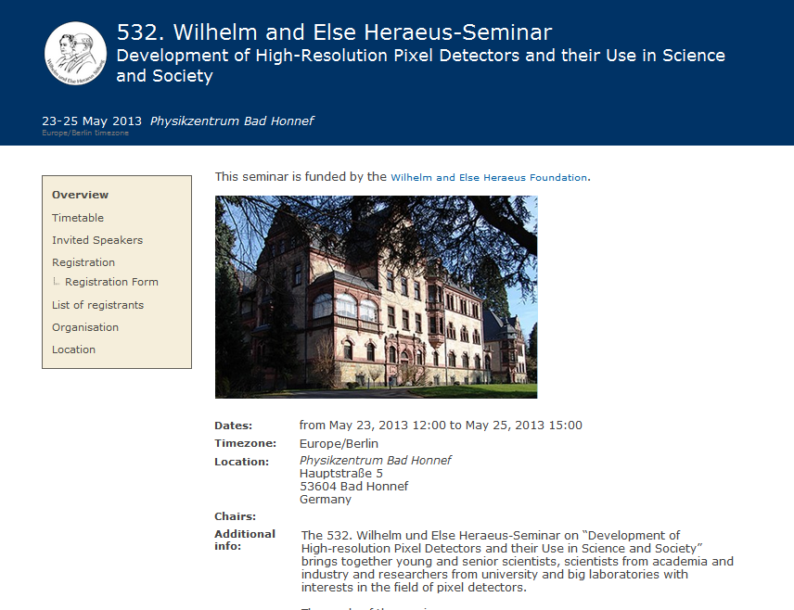
  Cross disciplinary application

Slide 25
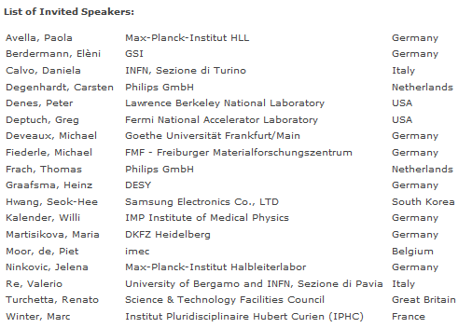
  Cross disciplinary application

Slide 26
Cross disciplinary application
This topic will look for specific application fields outside “Matter”
Visibility of the technological competencies
Search for interdisciplinary cross-program opportunities

Slide 27
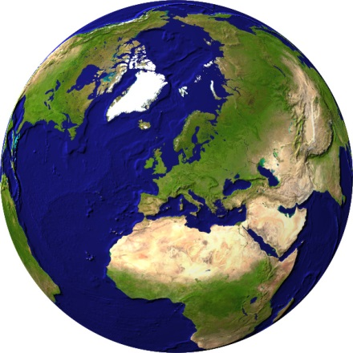

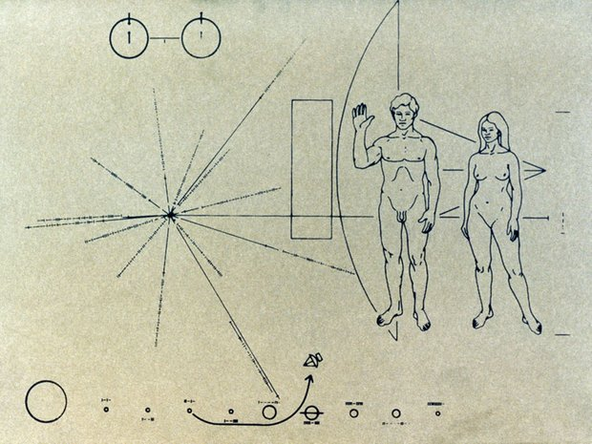
How can people learn about us
Detector Technology and Systems Platform
- DTSP
Ultrafast data
transfer and
reconstruction
Intelligent programmable
hardware
Near detector
optical signal
transmission
Fastest data
processing with
highly parallel
architectures
Technologies for
assembling highly
integrated detectors
3D ASICs
Mixed-signal ASICs
3D / high-Z sensors
Packaging and interconnection technologies
Innovative detector structure materials
Detector types
Fast photon and
X-ray detectors
Diamond detectors
Detectors for
thermal neutrons
Compact gas detectors

Slide 28
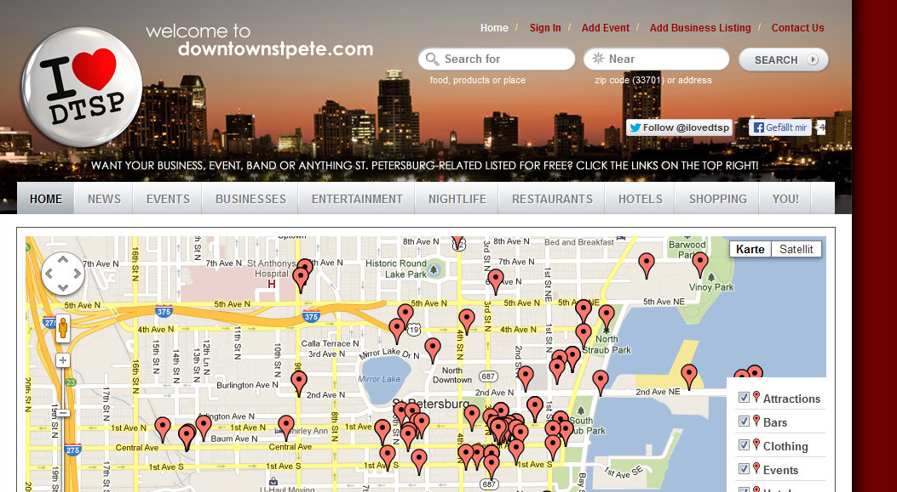
DTSP – what is the content…
Detector Technology and Systems Platform
- DTSP

Slide 29
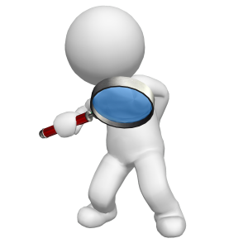
How can people learn about us
Wiki
Webpages
Leaflets
Talks
Posters
Emblem
…

Slide 30
How can people learn about us
Wiki
Webpages
Leaflets
Talks
Posters
Emblem
…

Slide 31

DTSP - Leaflet
Target group Scientists
Financial supporter
Decision makers
Language German
English
Message About us, who we are, where we go
Collection of information
Advertisement
….
Welche Zielgruppe wollen wir mit den Leaflets erreichen? - Wissenschaftler in- und ausländischer Forschungsinstitute, Universitäten - Falls wir hier noch die Zuwendungsgeber und Entscheidungsträger erreichen wollen, müssen wir es zusätzlich noch auf Deutsch machen Welche Botschaft wollen wir vermitteln? - uns als Portfolio und Zusammenschluss der Zentren gibt es, wir bearbeiten folgende Themen (3.5 Säulen), Motivation unserer Arbeit wie im Antrag Sprache -Englisch Auflage - keine Vorstellung, ist aber für das Angebot was wir einholen wichtig. Wer wird die Kosten tragen?

Slide 32
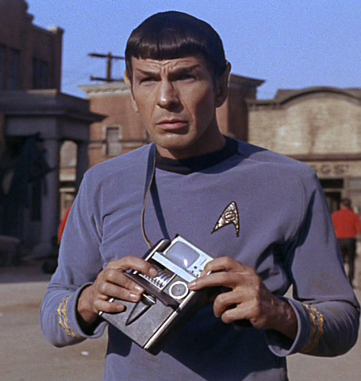
DTSP - Leaflet
Scientists
Target group Scientists
Financial supporter
Decision makers
Language German
English
Message About us, who we are, where we go
Collection of information
Advertisement
….
Welche Zielgruppe wollen wir mit den Leaflets erreichen? - Wissenschaftler in- und ausländischer Forschungsinstitute, Universitäten - Falls wir hier noch die Zuwendungsgeber und Entscheidungsträger erreichen wollen, müssen wir es zusätzlich noch auf Deutsch machen Welche Botschaft wollen wir vermitteln? - uns als Portfolio und Zusammenschluss der Zentren gibt es, wir bearbeiten folgende Themen (3.5 Säulen), Motivation unserer Arbeit wie im Antrag Sprache -Englisch Auflage - keine Vorstellung, ist aber für das Angebot was wir einholen wichtig. Wer wird die Kosten tragen?
http://www.themarysue.com

Slide 33
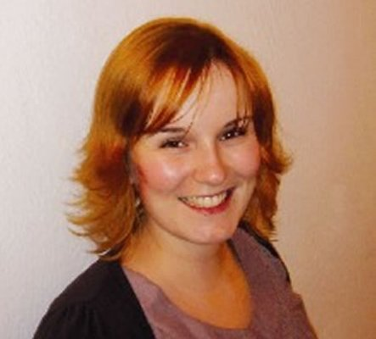
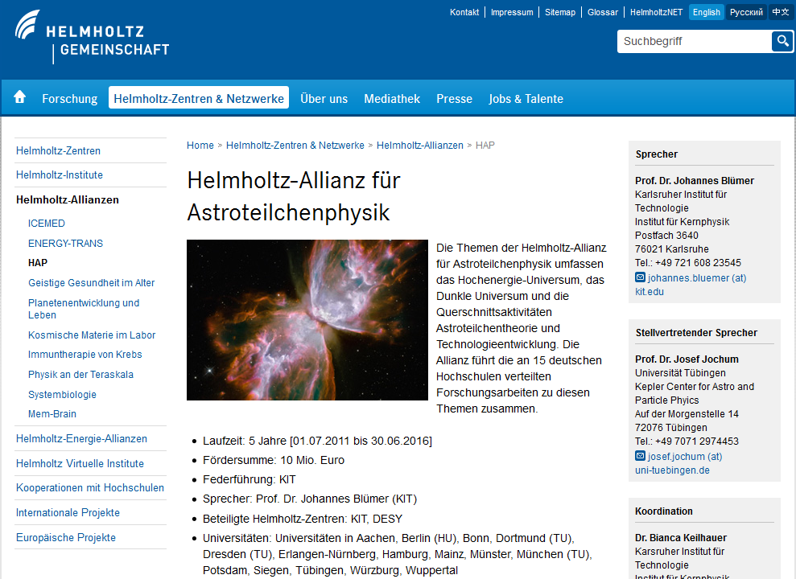
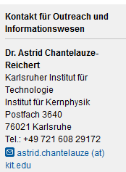
DTSP – Leaflet

Slide 34
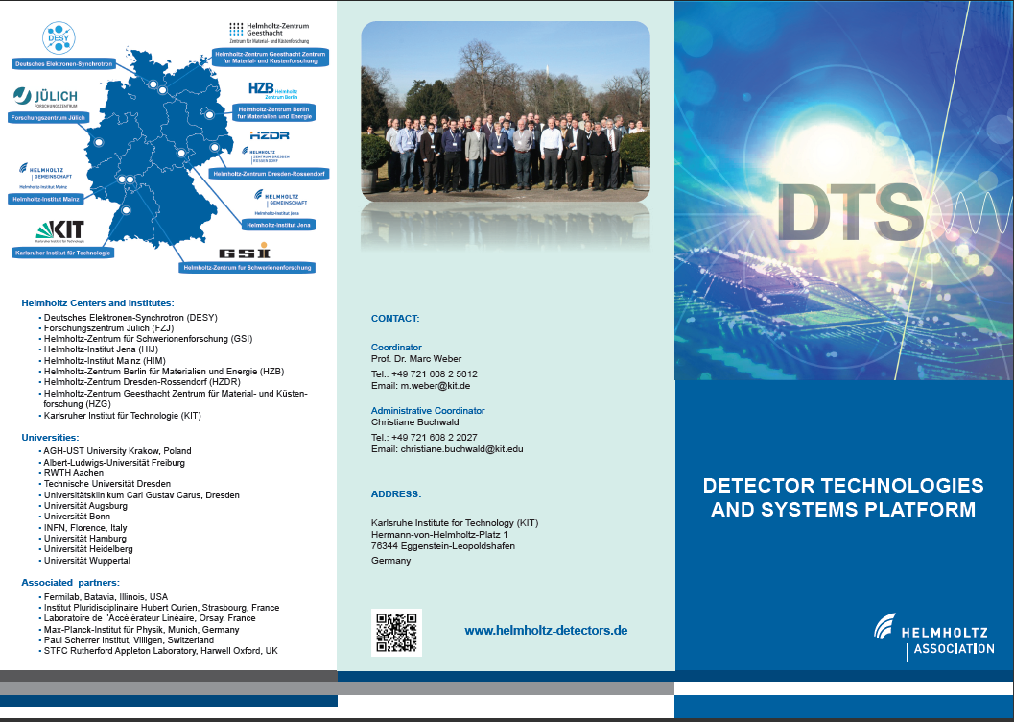
DTSP – Leaflet
…coming soon

Slide 35
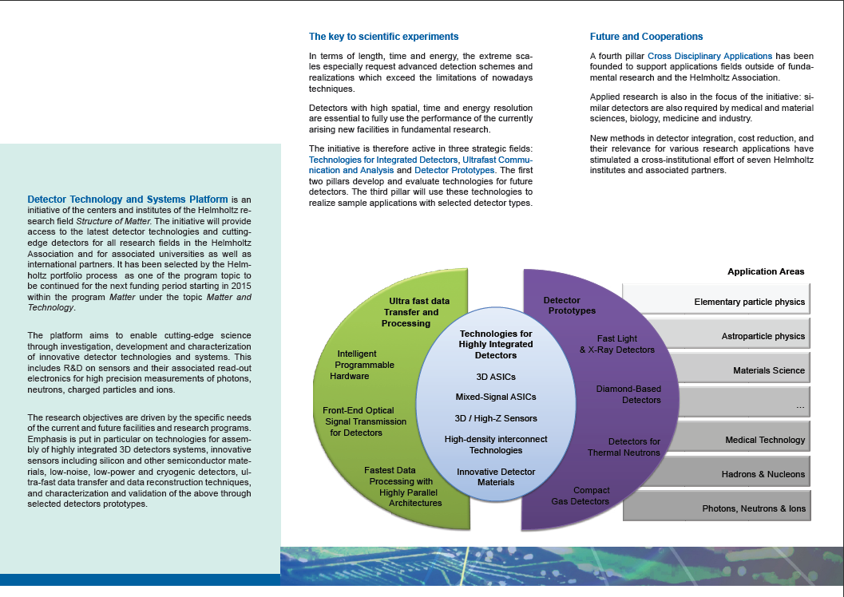
DTSP – Leaflet
Photo: Detector

Slide 36


Cross disciplinary application - Leaflet
Target group Scientists
Financial supporter
Decision makers
Language German
English
Message About us, who we are, where we go
Collection of information
Advertisement
….
Welche Zielgruppe wollen wir mit den Leaflets erreichen? - Wissenschaftler in- und ausländischer Forschungsinstitute, Universitäten - Falls wir hier noch die Zuwendungsgeber und Entscheidungsträger erreichen wollen, müssen wir es zusätzlich noch auf Deutsch machen Welche Botschaft wollen wir vermitteln? - uns als Portfolio und Zusammenschluss der Zentren gibt es, wir bearbeiten folgende Themen (3.5 Säulen), Motivation unserer Arbeit wie im Antrag Sprache -Englisch Auflage - keine Vorstellung, ist aber für das Angebot was wir einholen wichtig. Wer wird die Kosten tragen?

Slide 37

Cross disciplinary application - Leaflet

Slide 38
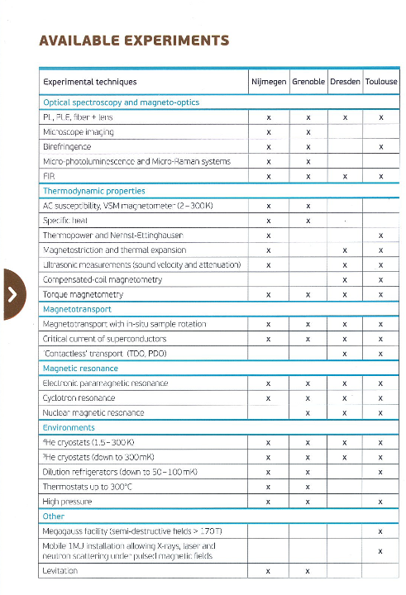
Cross disciplinary application - Leaflet
List of institutions / labs for detector tests

Slide 39
Die Strahlungsquelle ELBE besteht aus einer 250 keV-thermionischen DC Electronenkanone, die einen mit 13 MHz gepulsten Elektronenstrahl liefert, und einem daran anschließende zweistufigen supraleitenden Linearbeschleunigern. An jede der beiden Beschleunigungseinheiten kann eine Spannung von 20 MeV angelegt werden, so dass insgesamt eine Energie von 40 MeV auf den Elektronenstrahl übertragen werden kann. Der gemittelte Strahlstrom beträgt maximal 1 mA, die Strahlemittanz liegt typischerweise unter 10 pi mm mrad.
Bemerkenswert ist die wohldefinierte Zeitstruktur des Elektronenstrahls von ELBE. Diese kann in weiten Bereichen vom Experimentator vorgegeben werden. Drei verschiedene Pulsmodi stehen zur Verfügung:
Im Mikropuls-Betrieb beträgt die Pulsdauer 1ps bis 5 ps, die Wiederholfrequenz ist ein ganzzahliges Vielfaches von 13 MHz, wobei der Faktor zwischen 1 und 7 gewählt werden kann.
Im Makropuls-Betrieb werden die Mikropulse zusätzlich mit einer Frequenz zwischen 1 Hz und 25 Hz amplitudenmodulierte, die Makropulslänge kann 0.1ms bis 40ms betragen.
Der Singlepuls-Betrieb gleicht dem Makropulsbetrieb. Statt der Pulsdauer wird jedoch die Anzahl der Mikropulse innerhalb eines Makropulses spezifiziert (1 bis 4096). Die Mikropulsfrequenz beträgt 13 MHz, der Abstand sukzessiver Makropulse kann 1 ms bis mehrere Minuten betragen. Die Gesamtzahl von Makropulsen kann ebenfalls gewünscht werden.
Einen Eindruck von der Vielschichtigkeit der Forschung an ELBE gewinnt man aus den Listen der Publikationen, die aus Experimenten an ELBE in neuester Zeit entstanden.
Der Elektronenstrahl von ELBE generiert verschiedene Arten von Sekundärstrahlung, die an den jeweiligen Experimentierplätzen zur Verfügung stehen, siehe Lageplan.
In den optischen Labors steht Freie-Elektronen Laserstrahlung im Wellenlängenbereich 5-250 µm zur Verfügung, siehe FELBE Seiten für weitere Informationen. Einzigartig ist Möglichkeit, den Laserstrahl auch in das benachbarte Hochfeldmagnetlabor zu leiten und dort magnetooptische Experimente durchzuführen.
Cross disciplinary application – Leaflet - The Next Generation
Dresden ELBE e⁻, γ
Micro pulse mode (1-5 ps), (26, 13, 7.5, …) MHz, I ≤ 1 mA, E ≤ 40 MeV,
Macro pulse mode, 1 – 25 Hz, pulse duration 0.1 – 40 ms,
Single pulse mode (e⁻)
Biannual beamtime application, evaluation by SAC

Slide 40
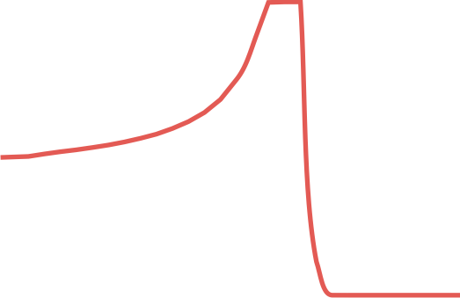
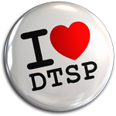
Cross disciplinary application
This topic will look for specific application fields outside “Matter”
Visibility of the technological competencies
Search for interdisciplinary cross-program opportunities
Thank you

Slide 41


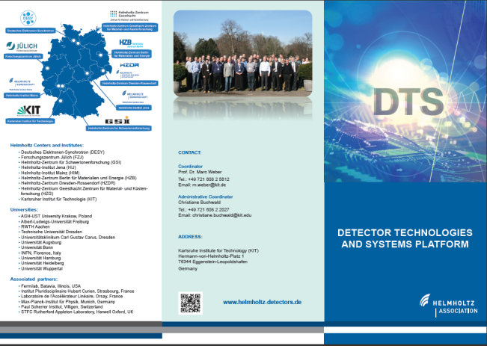
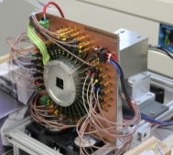
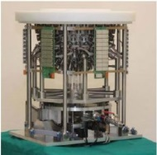
Cross disciplinary application
This topic will look for specific application fields outside “Matter”
Visibility of the technological competencies
Search for interdisciplinary cross-program opportunities
Thank you

Slide 42
Cross disciplinary application - ENERGY
GeoPET
Reactive Transport - GeoPET
Monte Carlo Simulation results for a ClearPET:
Cylindrical clay phantom (∅ 10cm, ρ ~ 2.6 g/cm³), 5 MBq ¹⁸F
total
scattered
unscattered
Energy window
Left: Energy spectra of the total coincidences (red), unscattered true coincidences (blue), scattered true coincidences (green)
Right: Energy spectra of the scattered trues, classified by order of scattering.
➔ The scattered fraction could be reduced most effectively from GeoPET-measurement das by means of a simple energy filter
https://www.hzdr.de/db/Cms?pOid=36313&pNid=2058
Contact: Dr. Johanna Lippmann-Pipke, j.lippmann-pipke@hzdr.de

Slide 43
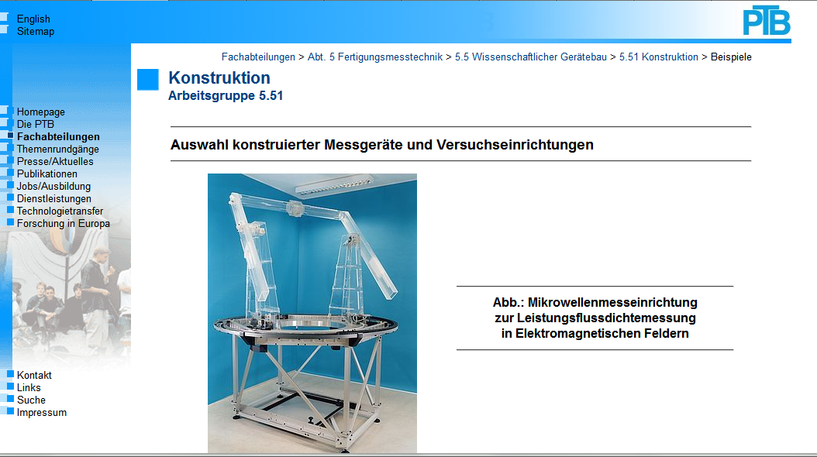
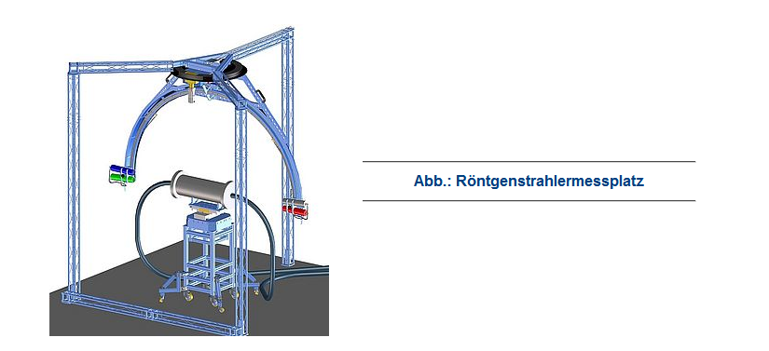

Cross disciplinary application
On-line monitoring for machine tools
Workshop
Industry meets science
?
Industry highly envolved, maybe there is room for improvement with new detectors like HGF cube

