Slide 1
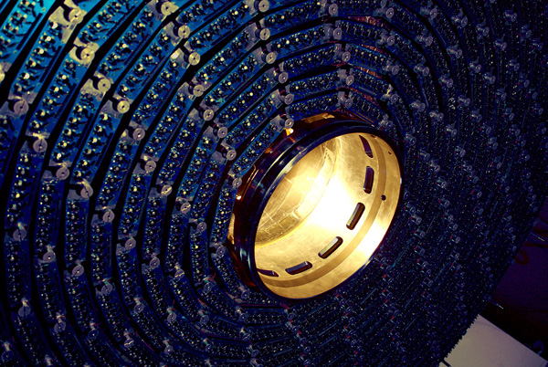
Detector Technology and Systems Platform
Advisory Board Meeting
Marc Weber

Slide 2
Welcome
and
thank you for serving on the
advisory board!

Slide 3
Members of Advisory Board
Wladek Dabrowski (AGH Krakau)
Christophe De La Taille (IN2P3)
Lutz Feld (RWTH Aachen)
Marcus French (STFC)
Richard Hall-Wilton (ESS)
Roland Horisberger (PSI)
Hans-Günter Moser (MPP München)
Eric Ramberg (FNAL)

Slide 4
General charge of the Advisory Board of the HGF - “Detector Technologies and Systems Platform”
To advise the platform on strategical matters - in particular on how to best position ourselves for the next large-scale instrumentation projects of “Matter”
To help identify promising future technology directions
To suggest opportunities for industrial, medical and societal spin-offs
To comment on Research and Development priorities and specific project opportunities
Karlsruhe, April 26th, 2013

Slide 5
Suggestions for this meeting
Getting organized
Vote a chair
Decide on frequency of AB meetings (eg. at any collaboration meeting)
Give first impressions on the emerging funding proposal
More importantly, suggest a practical mode of providing us feed-back before mid June 2013 (presention of concept to HGF senate)

